Slide 1
CSCE 689: Special Topics in Modern Algorithms for Data Science
Lecture 9
Samson Zhou

Slide 2
The Streaming Model
Scenario: We are given a massive dataset that arrives in a continuous stream, which we would like to analyze – but we do not have enough space to store all the items

Slide 3
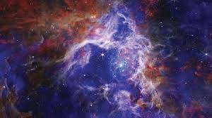
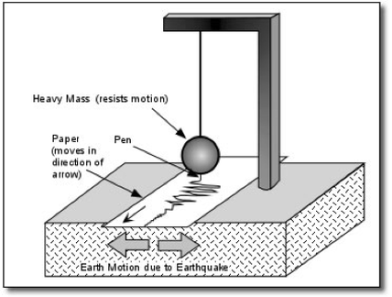
The Streaming Model
Scientific observations: images from telescopes (Event Horizon Telescope collected 1 petabyte, i.e., 1024 terabytes, of data from a five-day observing campaign), readings from seismometer arrays monitoring and predicting earthquake activity

Slide 4

The Streaming Model
Internet of Things (IoT): home automation (security cameras, smart devices), medical care (health monitoring devices, pacemakers), traffic cameras and travel time sensors (smart cities), electrical grid monitoring

Slide 5
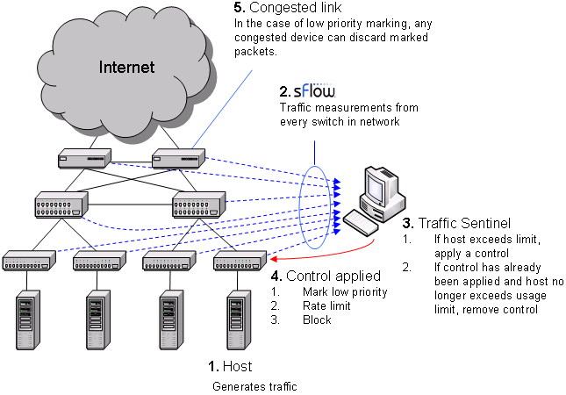

The Streaming Model
Financial markets
Traffic network monitoring

Slide 6
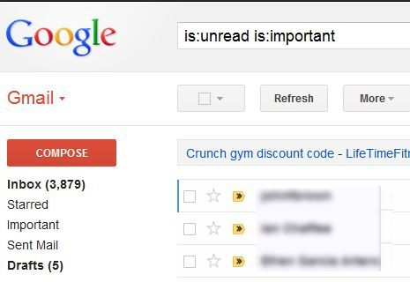
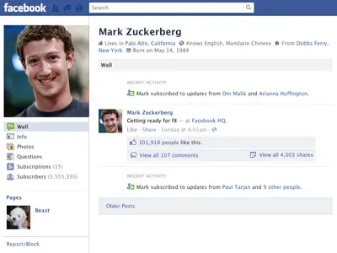

330 billion daily e-mails
3 billion monthly active users
8.5 billion daily Google searches

Slide 7
The Streaming Model
Scenario: We are given a massive dataset that arrives in a continuous stream, which we would like to analyze – but we do not have enough space to store all the items
Typically the data must be compressed on-the-fly
Store a data structure from which we can still learn useful information

Slide 8

The Streaming Model
Input: Elements of an underlying data set $S$, which arrive sequentially
Output: Evaluation (or approximation) of a given function
Goal: Use space sublinear in the size $m$of the input $S$
1 0 1 1 1 0 0 1

Slide 9
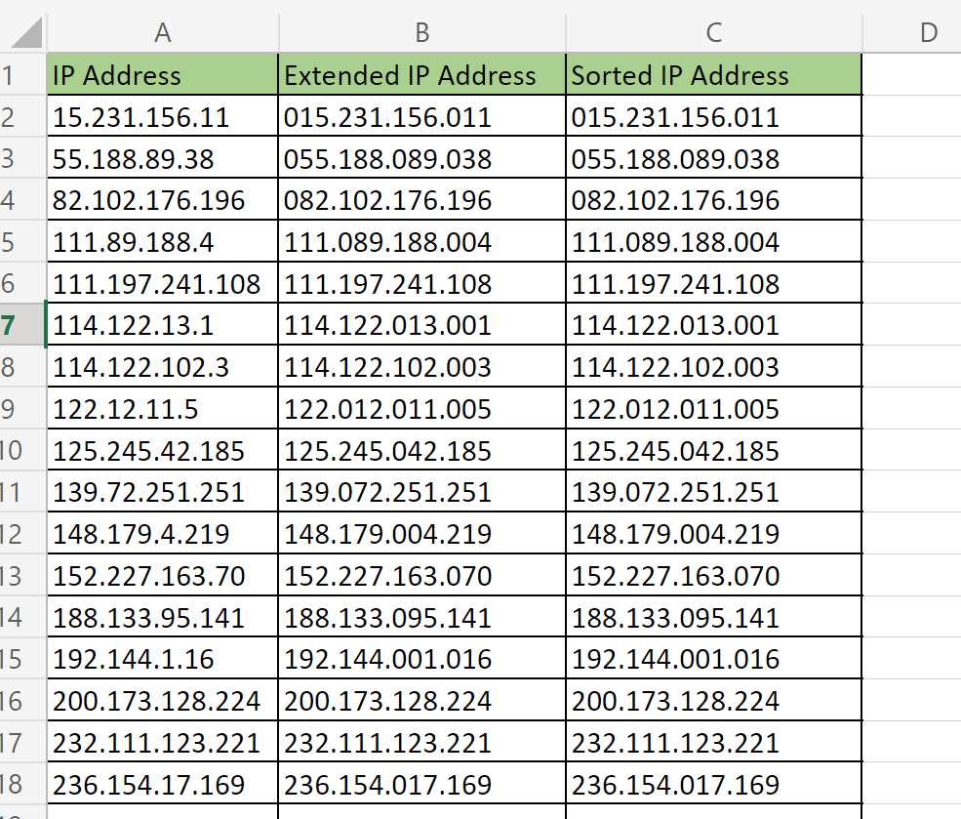

Slide 10
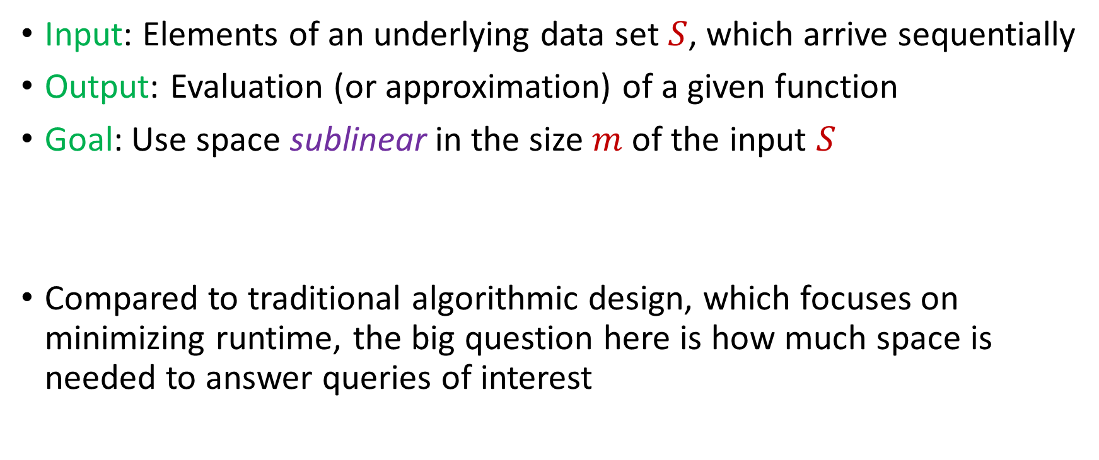
The Streaming Model
Input: Elements of an underlying data set $S$, which arrive sequentially
Output: Evaluation (or approximation) of a given function
Goal: Use space sublinear in the size $m$of the input $S$
Compared to traditional algorithmic design, which focuses on minimizing runtime, the big question here is how much space is needed to answer queries of interest

Slide 11
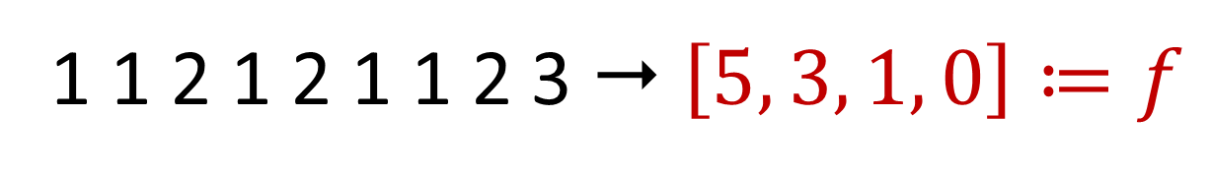

Frequency Vector
Given a set $S$ of $m$ elements from $[n]$, let $f_{i}$ be the frequency of element $i$. (How often it appears)
1 1 2 1 2 1 1 2 3  $\left[5, 3, 1, 0\right]≔f$

Slide 12
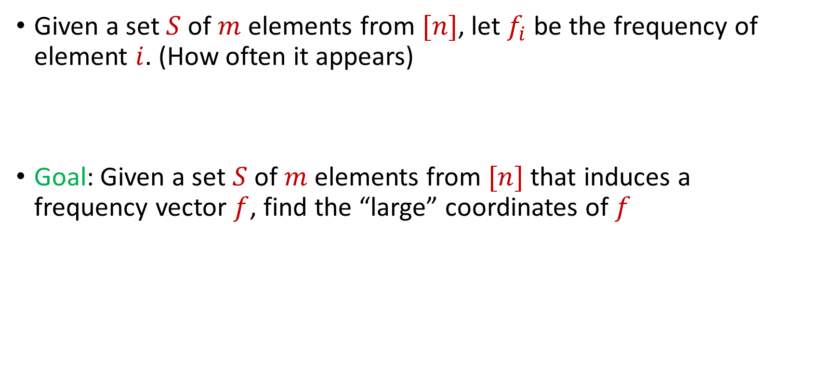
Frequent Items
Given a set $S$ of $m$ elements from $[n]$, let $f_{i}$ be the frequency of element $i$. (How often it appears)
Goal: Given a set $S$ of $m$ elements from $[n]$ that induces a frequency vector $f$, find the “large” coordinates of $f$
$f_{1}$ | $f_{2}$ | $f_{3}$ | $f_{4}$ | $f_{5}$ | $f_{6}$ | $f_{7}$
10 | 0 | 1 | 1 | 2 | 0 | 9

Slide 13
Frequent Items
Data mining: Finding top products/viral objects, e.g., Google searches, Amazon products, YouTube videos, etc.
Traffic network monitoring: Finding IP addresses with high volume traffic, e.g., detecting distributed denial of service (DDoS) attacks, network anomalies)
Database design: Finding iceberg queries, i.e., items in a database with high volume of queries
Want fast response and running list of frequent items, i.e., cannot process entire database for each query/update

Slide 14
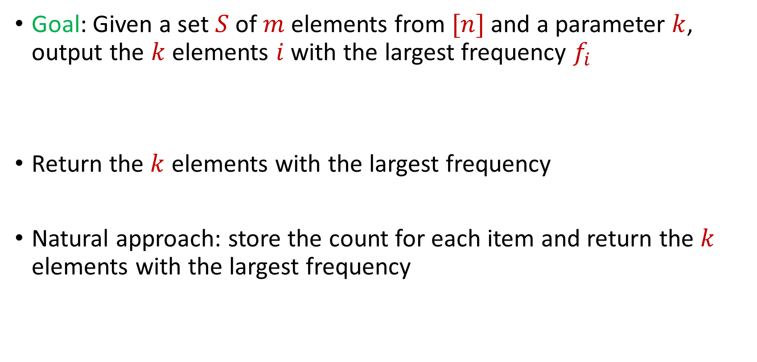
Frequent Items
Goal: Given a set $S$ of $m$ elements from $[n]$ and a parameter $k$, output the $k$ elements $i$ with the largest frequency $f_{i}$
Return the $k$ elements with the largest frequency
Natural approach: store the count for each item and return the $k$ elements with the largest frequency
$f_{1}$ | $f_{2}$ | $f_{3}$ | $f_{4}$ | $f_{5}$ | $f_{6}$ | $f_{7}$
10 | 0 | 1 | 1 | 2 | 0 | 9

Slide 15
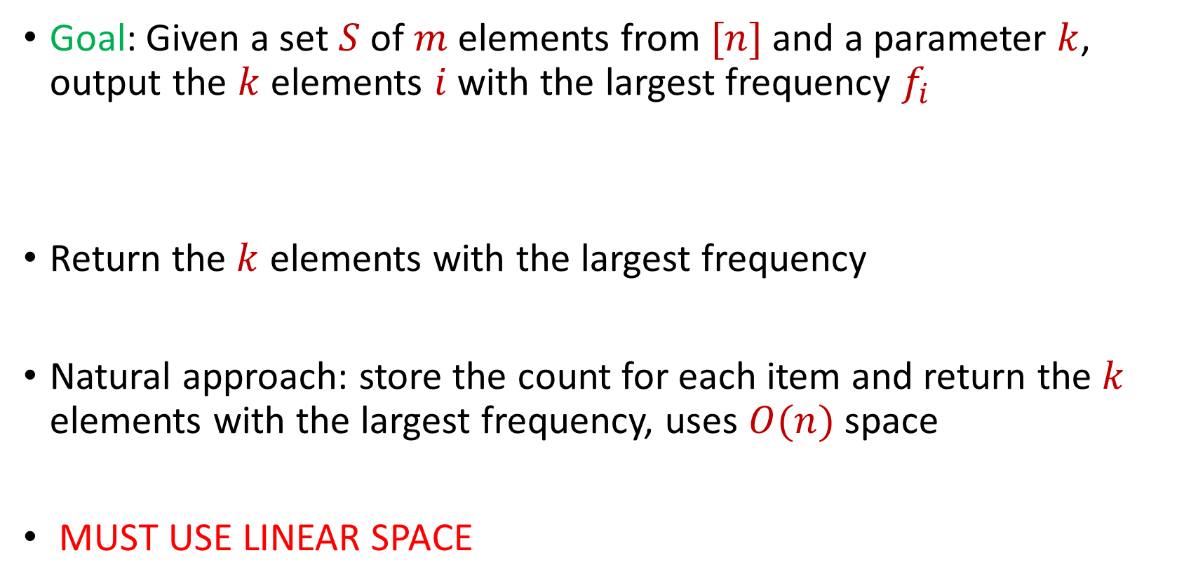
Frequent Items
Goal: Given a set $S$ of $m$ elements from $[n]$ and a parameter $k$, output the $k$ elements $i$ with the largest frequency $f_{i}$
Return the $k$ elements with the largest frequency
Natural approach: store the count for each item and return the $k$ elements with the largest frequency, uses $O(n)$ space
MUST USE LINEAR SPACE
$f_{1}$ | $f_{2}$ | $f_{3}$ | $f_{4}$ | $f_{5}$ | $f_{6}$ | $f_{7}$
10 | 0 | 1 | 1 | 2 | 0 | 9

Slide 16
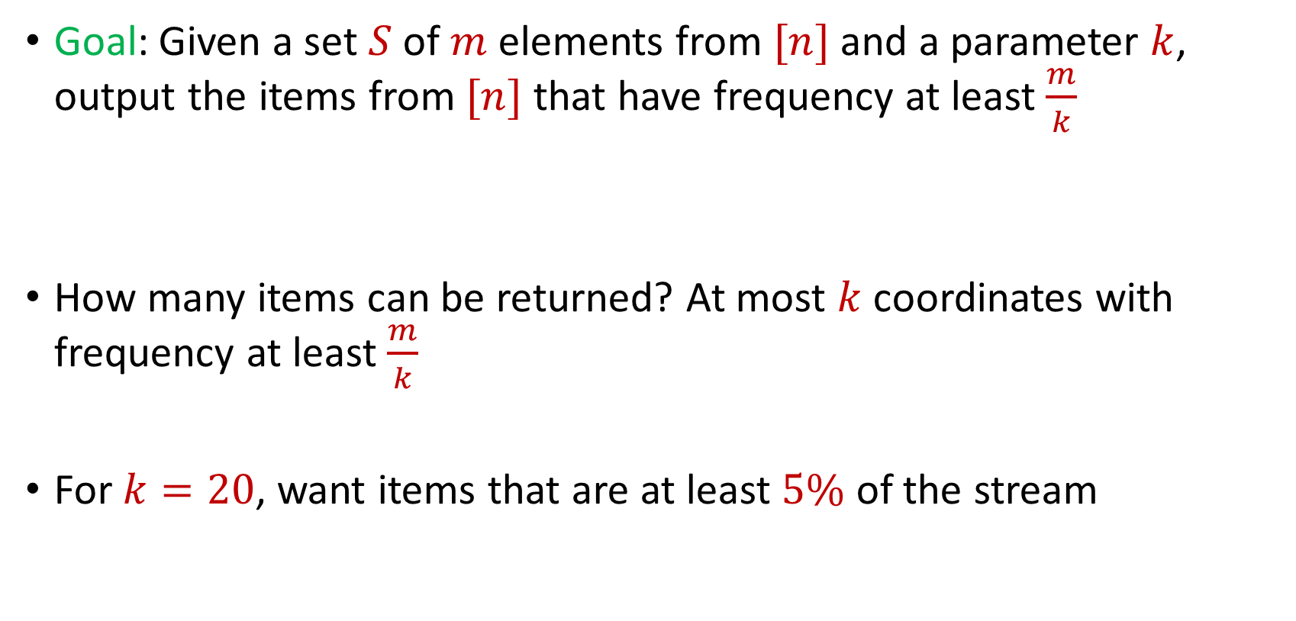
Frequent Items
Goal: Given a set $S$ of $m$ elements from $[n]$ and a parameter $k$, output the items from $[n]$ that have frequency at least $\frac{m}{k}$
How many items can be returned? At most $k$ coordinates with frequency at least $\frac{m}{k}$
For $k=20$, want items that are at least $5\%$ of the stream
$f_{1}$ | $f_{2}$ | $f_{3}$ | $f_{4}$ | $f_{5}$ | $f_{6}$ | $f_{7}$
10 | 0 | 1 | 1 | 2 | 0 | 9

Slide 17
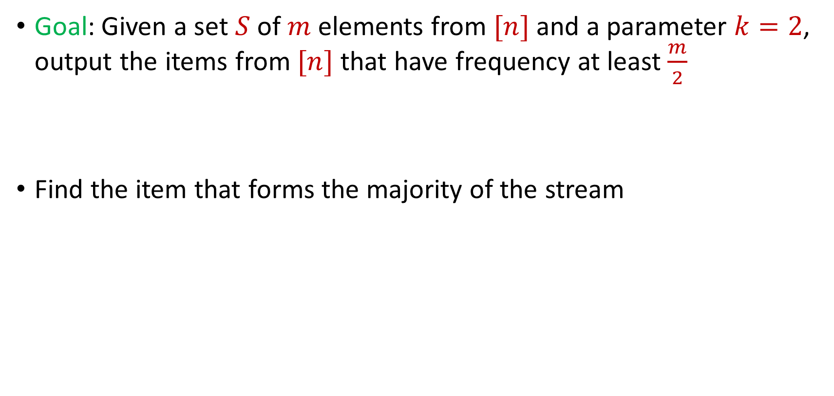
Frequent Items
Goal: Given a set $S$ of $m$ elements from $[n]$ and a parameter $k=2$, output the items from $[n]$ that have frequency at least $\frac{m}{2}$
Find the item that forms the majority of the stream

Slide 18

$$1$$

Slide 19
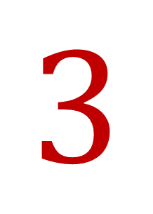
$$3$$

Slide 20
$$3$$

Slide 21
$$1$$

Slide 22
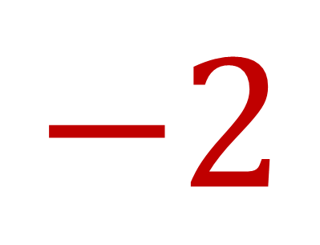
$$−2$$

Slide 23
$$1$$

Slide 24
$$1$$

Slide 25

$$7$$

Slide 26
$$1$$

Slide 27
$$1$$

Slide 28
$$3$$

Slide 29
$$3$$

Slide 30
$$1$$

Slide 31
$$1$$

Slide 32
$$3$$

Slide 33
$$3$$

Slide 34
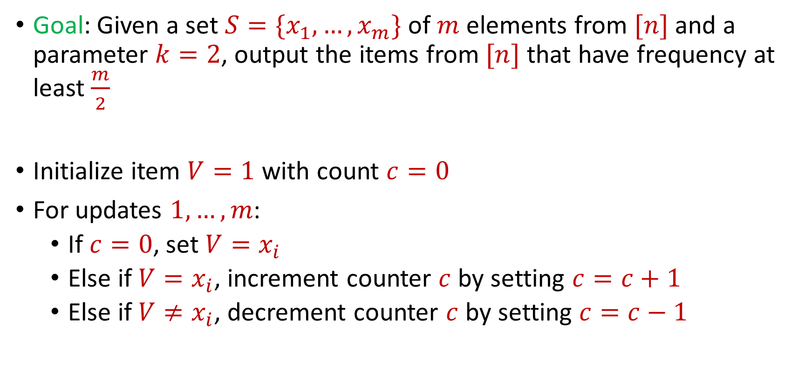
Majority
Goal: Given a set $S=\{x_{1},…, x_{m}\}$ of $m$ elements from $[n]$ and a parameter $k=2$, output the items from $[n]$ that have frequency at least $\frac{m}{2}$
Initialize item $V=1$ with count $c=0$
For updates $1,…,m$:
If $c=0$, set $V=x_{i}$
Else if $V=x_{i}$, increment counter $c$ by setting $c=c+1$
Else if $V≠x_{i}$, decrement counter $c$ by setting $c=c−1$

Slide 35
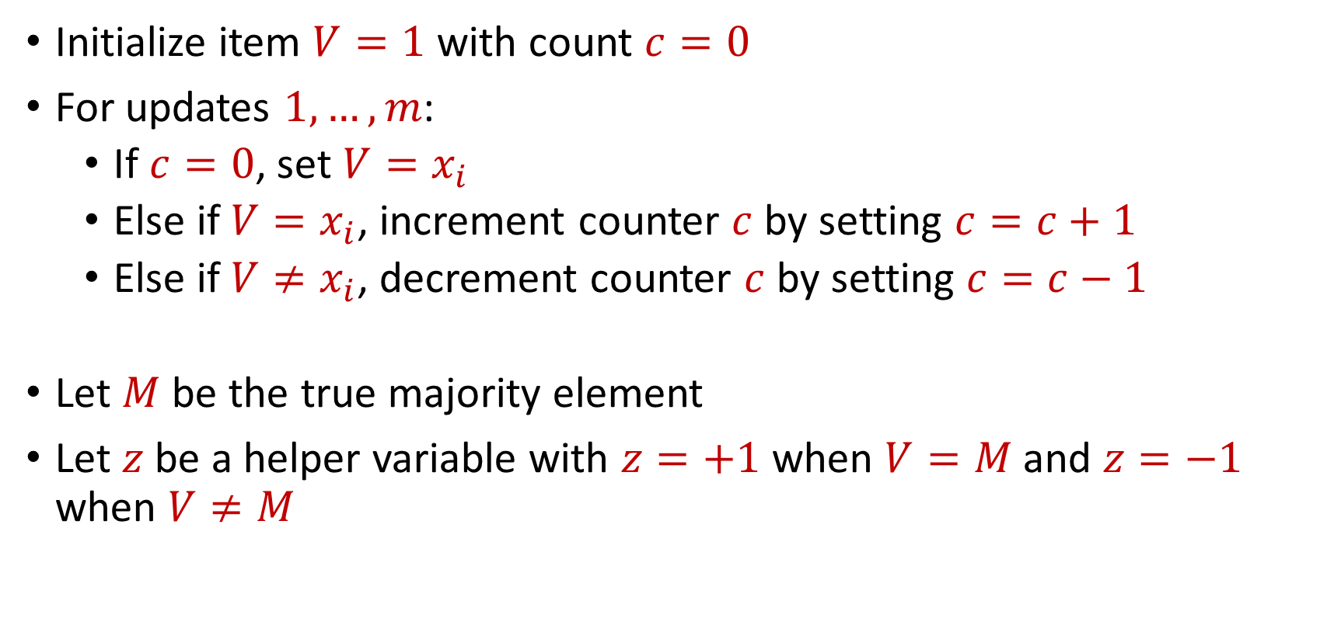
Majority
Initialize item $V=1$ with count $c=0$
For updates $1,…,m$:
If $c=0$, set $V=x_{i}$
Else if $V=x_{i}$, increment counter $c$ by setting $c=c+1$
Else if $V≠x_{i}$, decrement counter $c$ by setting $c=c−1$
Let $M$ be the true majority element
Let $z$be a helper variable with $z=+1$ when $V=M$ and $z=−1$ when $V≠M$

Slide 36
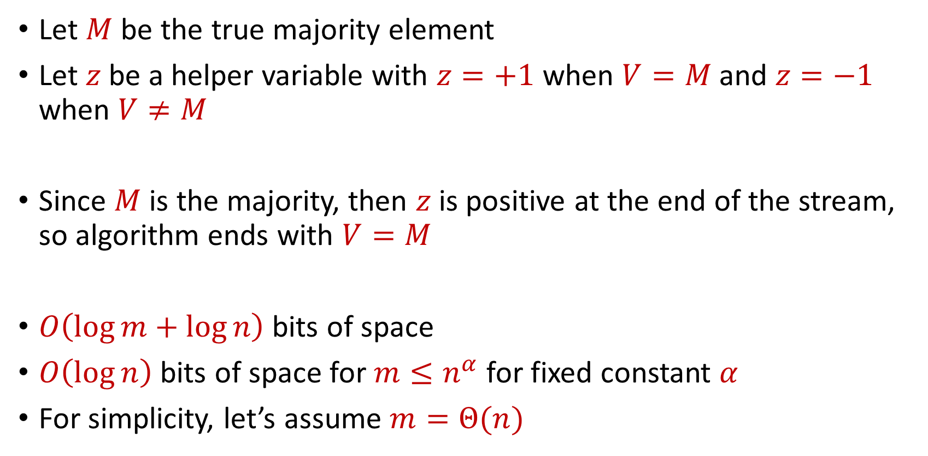
Majority
Let $M$ be the true majority element
Let $z$be a helper variable with $z=+1$ when $V=M$ and $z=−1$ when $V≠M$
Since $M$ is the majority, then $z$ is positive at the end of the stream, so algorithm ends with $V=M$
$O\left(\log{m}+\log{n}\right)$ bits of space
$O\left(\log{n}\right)$ bits of space for $m≤n^{α}$ for fixed constant $α$
For simplicity, let’s assume $m=Θ(n)$

Slide 37

Frequent Items
Goal: Given a set $S$ of $m$ elements from $[n]$ and a parameter $k$, output the items from $[n]$ that have frequency at least $\frac{m}{k}$

Slide 38
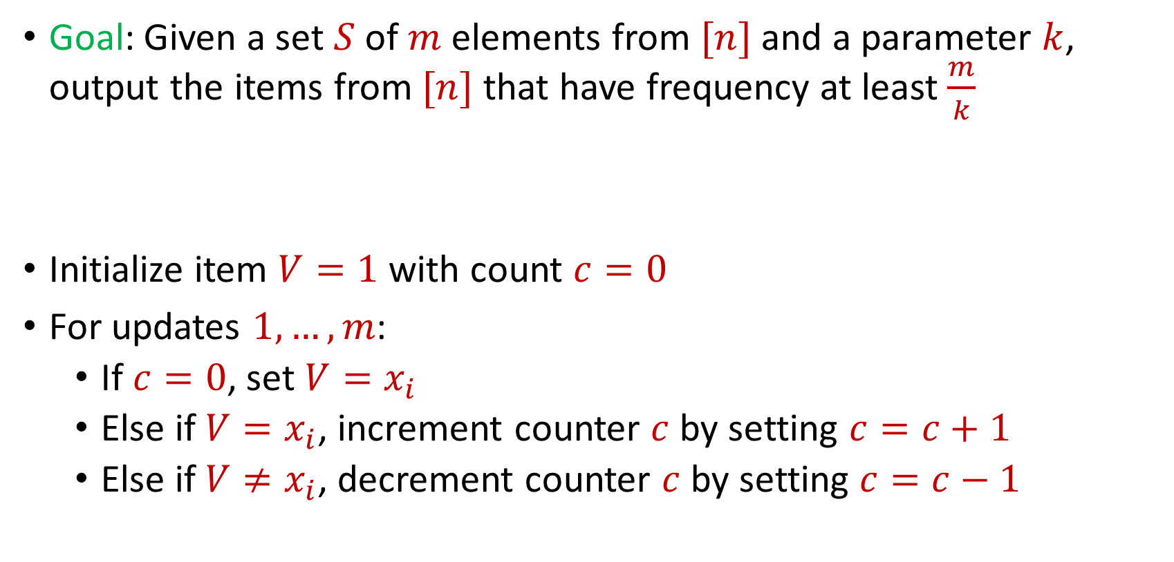
Frequent Items
Goal: Given a set $S$ of $m$ elements from $[n]$ and a parameter $k$, output the items from $[n]$ that have frequency at least $\frac{m}{k}$
Initialize item $V=1$ with count $c=0$
For updates $1,…,m$:
If $c=0$, set $V=x_{i}$
Else if $V=x_{i}$, increment counter $c$ by setting $c=c+1$
Else if $V≠x_{i}$, decrement counter $c$ by setting $c=c−1$

Slide 39
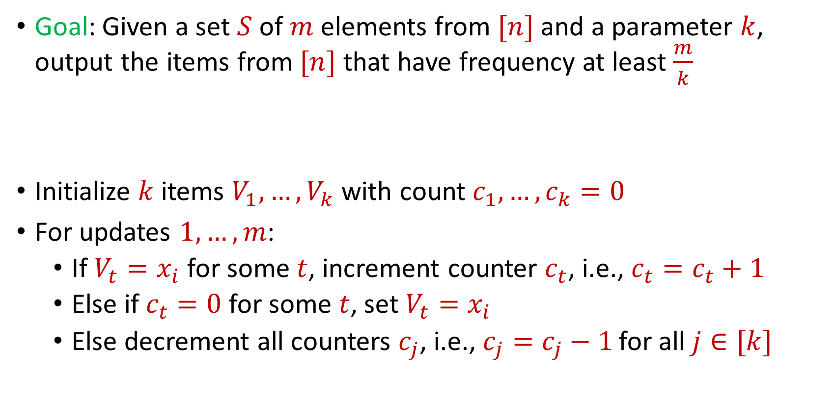
Misra Gries
Goal: Given a set $S$ of $m$ elements from $[n]$ and a parameter $k$, output the items from $[n]$ that have frequency at least $\frac{m}{k}$
Initialize $k$ items $V_{1},…,V_{k}$ with count $c_{1},…,c_{k}=0$
For updates $1,…,m$:
If $V_{t}=x_{i}$ for some $t$, increment counter $c_{t}$, i.e., $c_{t}=c_{t}+1$
Else if $c_{t}=0$ for some $t$, set $V_{t}=x_{i}$
Else decrement all counters $c_{j}$, i.e., $c_{j}=c_{j}−1$ for all $j∈[k]$

Slide 40

Misra Gries
$n=7$, $k=3$
$V_{1}= ⊥$, $c_{1}=0$
$V_{2}= ⊥$, $c_{2}=0$
$V_{3}= ⊥$, $c_{3}=0$
$f_{1}$ | $f_{2}$ | $f_{3}$ | $f_{4}$ | $f_{5}$ | $f_{6}$ | $f_{7}$
0 | 0 | 0 | 0 | 0 | 0 | 0

Slide 41


Misra Gries
$$3$$
$V_{1}= ⊥$, $c_{1}=0$
$V_{2}= ⊥$, $c_{2}=0$
$V_{3}= ⊥$, $c_{3}=0$
$f_{1}$ | $f_{2}$ | $f_{3}$ | $f_{4}$ | $f_{5}$ | $f_{6}$ | $f_{7}$
0 | 0 | 0 | 0 | 0 | 0 | 0

Slide 42

Misra Gries
$$3$$
$V_{1}=3$, $c_{1}=1$
$V_{2}= ⊥$, $c_{2}=0$
$V_{3}= ⊥$, $c_{3}=0$
$f_{1}$ | $f_{2}$ | $f_{3}$ | $f_{4}$ | $f_{5}$ | $f_{6}$ | $f_{7}$
0 | 0 | 1 | 0 | 0 | 0 | 0

Slide 43

Misra Gries
$$1$$
$V_{1}=3$, $c_{1}=1$
$V_{2}= ⊥$, $c_{2}=0$
$V_{3}= ⊥$, $c_{3}=0$
$f_{1}$ | $f_{2}$ | $f_{3}$ | $f_{4}$ | $f_{5}$ | $f_{6}$ | $f_{7}$
0 | 0 | 1 | 0 | 0 | 0 | 0

Slide 44

Misra Gries
$$1$$
$V_{1}=3$, $c_{1}=1$
$V_{2}=1$, $c_{2}=1$
$V_{3}= ⊥$, $c_{3}=0$
$f_{1}$ | $f_{2}$ | $f_{3}$ | $f_{4}$ | $f_{5}$ | $f_{6}$ | $f_{7}$
1 | 0 | 1 | 0 | 0 | 0 | 0

Slide 45

Misra Gries
$$2$$
$V_{1}=3$, $c_{1}=1$
$V_{2}=1$, $c_{2}=1$
$V_{3}= ⊥$, $c_{3}=0$
$f_{1}$ | $f_{2}$ | $f_{3}$ | $f_{4}$ | $f_{5}$ | $f_{6}$ | $f_{7}$
1 | 0 | 1 | 0 | 0 | 0 | 0

Slide 46

Misra Gries
$$2$$
$V_{1}=3$, $c_{1}=1$
$V_{2}=1$, $c_{2}=1$
$V_{3}=2$, $c_{3}=1$
$f_{1}$ | $f_{2}$ | $f_{3}$ | $f_{4}$ | $f_{5}$ | $f_{6}$ | $f_{7}$
1 | 1 | 1 | 0 | 0 | 0 | 0

Slide 47
Misra Gries
$$1$$
$V_{1}=3$, $c_{1}=1$
$V_{2}=1$, $c_{2}=1$
$V_{3}=2$, $c_{3}=1$
$f_{1}$ | $f_{2}$ | $f_{3}$ | $f_{4}$ | $f_{5}$ | $f_{6}$ | $f_{7}$
1 | 1 | 1 | 0 | 0 | 0 | 0

Slide 48

Misra Gries
$$1$$
$V_{1}=3$, $c_{1}=1$
$V_{2}=1$, $c_{2}=2$
$V_{3}=2$, $c_{3}=1$
$f_{1}$ | $f_{2}$ | $f_{3}$ | $f_{4}$ | $f_{5}$ | $f_{6}$ | $f_{7}$
2 | 1 | 1 | 0 | 0 | 0 | 0

Slide 49

Misra Gries
$$4$$
$V_{1}=3$, $c_{1}=1$
$V_{2}=1$, $c_{2}=2$
$V_{3}=2$, $c_{3}=1$
$f_{1}$ | $f_{2}$ | $f_{3}$ | $f_{4}$ | $f_{5}$ | $f_{6}$ | $f_{7}$
2 | 1 | 1 | 0 | 0 | 0 | 0

Slide 50

Misra Gries
$$4$$
$V_{1}=3$, $c_{1}=0$
$V_{2}=1$, $c_{2}=1$
$V_{3}=2$, $c_{3}=0$
$f_{1}$ | $f_{2}$ | $f_{3}$ | $f_{4}$ | $f_{5}$ | $f_{6}$ | $f_{7}$
2 | 1 | 1 | 1 | 0 | 0 | 0

Slide 51
Misra Gries
$$2$$
$V_{1}=3$, $c_{1}=0$
$V_{2}=1$, $c_{2}=1$
$V_{3}=2$, $c_{3}=0$
$f_{1}$ | $f_{2}$ | $f_{3}$ | $f_{4}$ | $f_{5}$ | $f_{6}$ | $f_{7}$
2 | 1 | 1 | 1 | 0 | 0 | 0

Slide 52

Misra Gries
$$2$$
$V_{1}=3$, $c_{1}=0$
$V_{2}=1$, $c_{2}=1$
$V_{3}=2$, $c_{3}=1$
$f_{1}$ | $f_{2}$ | $f_{3}$ | $f_{4}$ | $f_{5}$ | $f_{6}$ | $f_{7}$
2 | 2 | 1 | 1 | 0 | 0 | 0

Slide 53
Misra Gries
$$1$$
$V_{1}=3$, $c_{1}=0$
$V_{2}=1$, $c_{2}=1$
$V_{3}=2$, $c_{3}=1$
$f_{1}$ | $f_{2}$ | $f_{3}$ | $f_{4}$ | $f_{5}$ | $f_{6}$ | $f_{7}$
2 | 2 | 1 | 1 | 0 | 0 | 0

Slide 54

Misra Gries
$$1$$
$V_{1}=3$, $c_{1}=0$
$V_{2}=1$, $c_{2}=2$
$V_{3}=2$, $c_{3}=1$
$f_{1}$ | $f_{2}$ | $f_{3}$ | $f_{4}$ | $f_{5}$ | $f_{6}$ | $f_{7}$
3 | 2 | 1 | 1 | 0 | 0 | 0

Slide 55

Misra Gries
$$5$$
$V_{1}=3$, $c_{1}=0$
$V_{2}=1$, $c_{2}=2$
$V_{3}=2$, $c_{3}=1$
$f_{1}$ | $f_{2}$ | $f_{3}$ | $f_{4}$ | $f_{5}$ | $f_{6}$ | $f_{7}$
3 | 2 | 1 | 1 | 0 | 0 | 0

Slide 56

Misra Gries
$$5$$
$V_{1}=5$, $c_{1}=1$
$V_{2}=1$, $c_{2}=2$
$V_{3}=2$, $c_{3}=1$
$f_{1}$ | $f_{2}$ | $f_{3}$ | $f_{4}$ | $f_{5}$ | $f_{6}$ | $f_{7}$
3 | 2 | 1 | 1 | 1 | 0 | 0

Slide 57
Misra Gries
$$1$$
$V_{1}=5$, $c_{1}=1$
$V_{2}=1$, $c_{2}=2$
$V_{3}=2$, $c_{3}=1$
$f_{1}$ | $f_{2}$ | $f_{3}$ | $f_{4}$ | $f_{5}$ | $f_{6}$ | $f_{7}$
3 | 2 | 1 | 1 | 1 | 0 | 0

Slide 58

Misra Gries
$$1$$
$V_{1}=5$, $c_{1}=1$
$V_{2}=1$, $c_{2}=3$
$V_{3}=2$, $c_{3}=1$
$f_{1}$ | $f_{2}$ | $f_{3}$ | $f_{4}$ | $f_{5}$ | $f_{6}$ | $f_{7}$
4 | 2 | 1 | 1 | 1 | 0 | 0

Slide 59
Misra Gries
$$4$$
$V_{1}=5$, $c_{1}=1$
$V_{2}=1$, $c_{2}=3$
$V_{3}=2$, $c_{3}=1$
$f_{1}$ | $f_{2}$ | $f_{3}$ | $f_{4}$ | $f_{5}$ | $f_{6}$ | $f_{7}$
4 | 2 | 1 | 1 | 1 | 0 | 0

Slide 60

Misra Gries
$$4$$
$V_{1}=5$, $c_{1}=0$
$V_{2}=1$, $c_{2}=2$
$V_{3}=2$, $c_{3}=0$
$f_{1}$ | $f_{2}$ | $f_{3}$ | $f_{4}$ | $f_{5}$ | $f_{6}$ | $f_{7}$
4 | 2 | 1 | 2 | 1 | 0 | 0

Slide 61
Misra Gries
$$3$$
$V_{1}=5$, $c_{1}=0$
$V_{2}=1$, $c_{2}=2$
$V_{3}=2$, $c_{3}=0$
$f_{1}$ | $f_{2}$ | $f_{3}$ | $f_{4}$ | $f_{5}$ | $f_{6}$ | $f_{7}$
4 | 2 | 1 | 2 | 1 | 0 | 0

Slide 62

Misra Gries
$$3$$
$V_{1}=5$, $c_{1}=0$
$V_{2}=1$, $c_{2}=2$
$V_{3}=3$, $c_{3}=0$
$f_{1}$ | $f_{2}$ | $f_{3}$ | $f_{4}$ | $f_{5}$ | $f_{6}$ | $f_{7}$
4 | 2 | 2 | 2 | 1 | 0 | 0

Slide 63
Misra Gries
$$1$$
$V_{1}=5$, $c_{1}=0$
$V_{2}=1$, $c_{2}=2$
$V_{3}=3$, $c_{3}=0$
$f_{1}$ | $f_{2}$ | $f_{3}$ | $f_{4}$ | $f_{5}$ | $f_{6}$ | $f_{7}$
4 | 2 | 2 | 2 | 1 | 0 | 0

Slide 64

Misra Gries
$$1$$
$V_{1}=5$, $c_{1}=0$
$V_{2}=1$, $c_{2}=3$
$V_{3}=3$, $c_{3}=0$
$f_{1}$ | $f_{2}$ | $f_{3}$ | $f_{4}$ | $f_{5}$ | $f_{6}$ | $f_{7}$
5 | 2 | 2 | 2 | 1 | 0 | 0

Slide 65
Misra Gries
$$3$$
$V_{1}=5$, $c_{1}=0$
$V_{2}=1$, $c_{2}=3$
$V_{3}=3$, $c_{3}=0$
$f_{1}$ | $f_{2}$ | $f_{3}$ | $f_{4}$ | $f_{5}$ | $f_{6}$ | $f_{7}$
5 | 2 | 2 | 2 | 1 | 0 | 0

Slide 66

Misra Gries
$$3$$
$V_{1}=5$, $c_{1}=0$
$V_{2}=1$, $c_{2}=3$
$V_{3}=3$, $c_{3}=1$
$f_{1}$ | $f_{2}$ | $f_{3}$ | $f_{4}$ | $f_{5}$ | $f_{6}$ | $f_{7}$
5 | 2 | 3 | 2 | 1 | 0 | 0

Slide 67
Misra Gries
$$1$$
$V_{1}=5$, $c_{1}=0$
$V_{2}=1$, $c_{2}=3$
$V_{3}=3$, $c_{3}=1$
$f_{1}$ | $f_{2}$ | $f_{3}$ | $f_{4}$ | $f_{5}$ | $f_{6}$ | $f_{7}$
5 | 2 | 3 | 2 | 1 | 0 | 0

Slide 68

Misra Gries
$$1$$
$V_{1}=5$, $c_{1}=0$
$V_{2}=1$, $c_{2}=4$
$V_{3}=3$, $c_{3}=1$
$f_{1}$ | $f_{2}$ | $f_{3}$ | $f_{4}$ | $f_{5}$ | $f_{6}$ | $f_{7}$
6 | 2 | 3 | 2 | 1 | 0 | 0

Slide 69
Misra Gries
$$3$$
$V_{1}=5$, $c_{1}=0$
$V_{2}=1$, $c_{2}=4$
$V_{3}=3$, $c_{3}=1$
$f_{1}$ | $f_{2}$ | $f_{3}$ | $f_{4}$ | $f_{5}$ | $f_{6}$ | $f_{7}$
6 | 2 | 3 | 2 | 1 | 0 | 0

Slide 70

Misra Gries
$$3$$
$V_{1}=5$, $c_{1}=0$
$V_{2}=1$, $c_{2}=4$
$V_{3}=3$, $c_{3}=2$
$f_{1}$ | $f_{2}$ | $f_{3}$ | $f_{4}$ | $f_{5}$ | $f_{6}$ | $f_{7}$
6 | 2 | 4 | 2 | 1 | 0 | 0

Slide 71
Misra Gries
$$3$$
$V_{1}=5$, $c_{1}=0$
$V_{2}=1$, $c_{2}=4$
$V_{3}=3$, $c_{3}=2$
$f_{1}$ | $f_{2}$ | $f_{3}$ | $f_{4}$ | $f_{5}$ | $f_{6}$ | $f_{7}$
6 | 2 | 4 | 2 | 1 | 0 | 0

Slide 72

Misra Gries
$$3$$
$V_{1}=5$, $c_{1}=0$
$V_{2}=1$, $c_{2}=4$
$V_{3}=3$, $c_{3}=3$
$f_{1}$ | $f_{2}$ | $f_{3}$ | $f_{4}$ | $f_{5}$ | $f_{6}$ | $f_{7}$
6 | 2 | 5 | 2 | 1 | 0 | 0

Slide 73

Misra Gries
$$6$$
$V_{1}=5$, $c_{1}=0$
$V_{2}=1$, $c_{2}=4$
$V_{3}=3$, $c_{3}=3$
$f_{1}$ | $f_{2}$ | $f_{3}$ | $f_{4}$ | $f_{5}$ | $f_{6}$ | $f_{7}$
6 | 2 | 5 | 2 | 1 | 0 | 0

Slide 74

Misra Gries
$$6$$
$V_{1}=6$, $c_{1}=1$
$V_{2}=1$, $c_{2}=4$
$V_{3}=3$, $c_{3}=3$
$f_{1}$ | $f_{2}$ | $f_{3}$ | $f_{4}$ | $f_{5}$ | $f_{6}$ | $f_{7}$
6 | 2 | 5 | 2 | 1 | 1 | 0

Slide 75

Misra Gries
$$6$$
$V_{1}=6$, $c_{1}=1$
$V_{2}=1$, $c_{2}=4$
$V_{3}=3$, $c_{3}=3$
Report $1$, $3$, and $6$ as frequent items
$f_{1}$ | $f_{2}$ | $f_{3}$ | $f_{4}$ | $f_{5}$ | $f_{6}$ | $f_{7}$
6 | 2 | 5 | 2 | 1 | 1 | 0

Slide 76
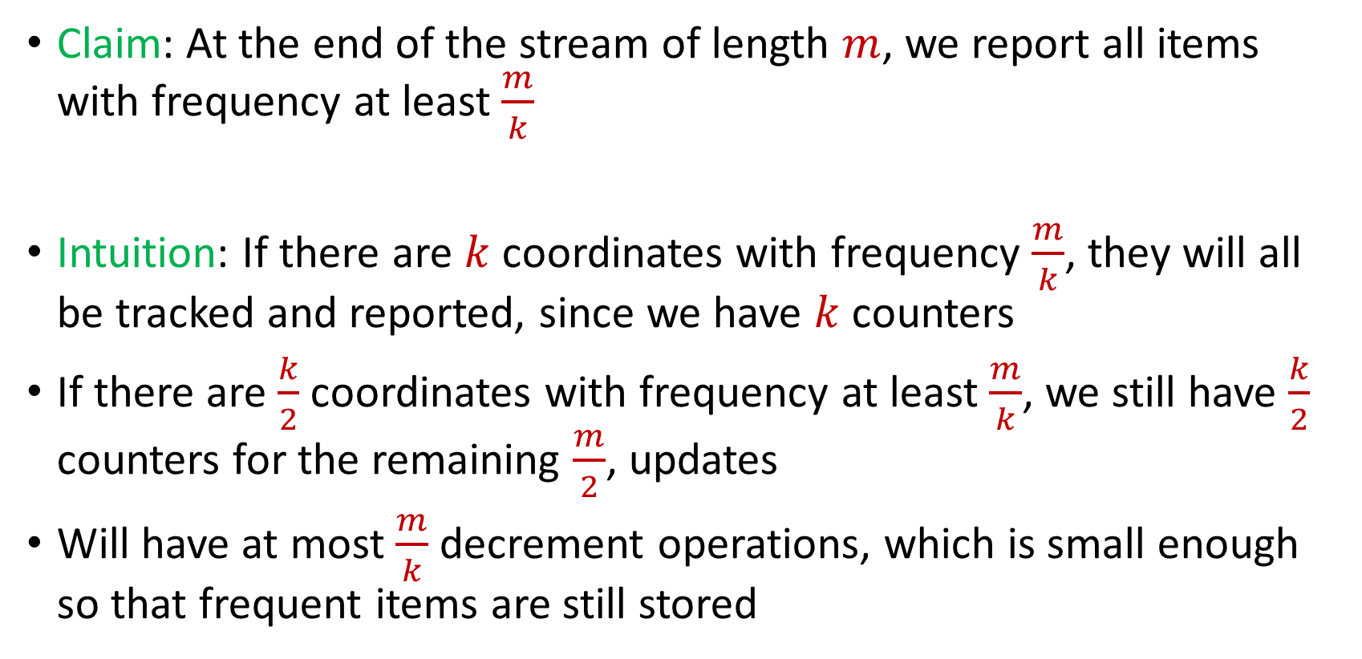
Misra Gries
Claim: At the end of the stream of length $m$, we report all items with frequency at least $\frac{m}{k}$
Intuition: If there are $k$ coordinates with frequency $\frac{m}{k}$, they will all be tracked and reported, since we have $k$counters
If there are $\frac{k}{2}$ coordinates with frequency at least $\frac{m}{k}$, we still have $\frac{k}{2}$ counters for the remaining $\frac{m}{2}$, updates
Will have at most $\frac{m}{k}$ decrement operations, which is small enough so that frequent items are still stored

Slide 77
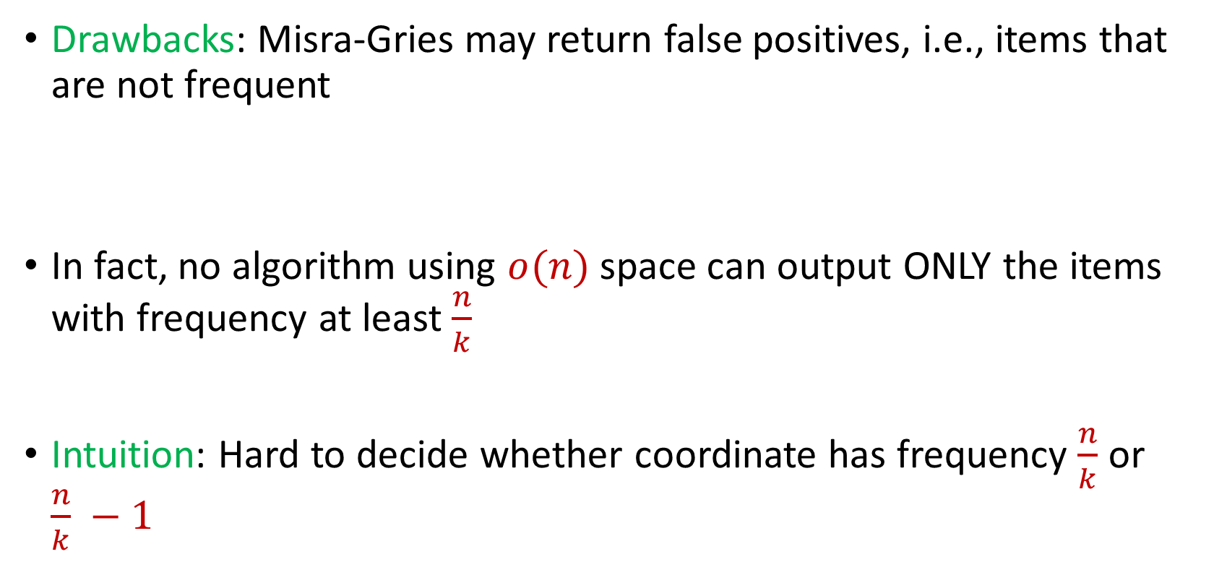
Misra Gries
Drawbacks: Misra-Gries may return false positives, i.e., items that are not frequent
In fact, no algorithm using $o(n)$ space can output ONLY the items with frequency at least $\frac{n}{k}$
Intuition: Hard to decide whether coordinate has frequency $\frac{n}{k}$ or $\frac{n}{k} −1$

Slide 78

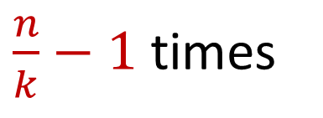
Misra Gries
Intuition: Hard to decide whether coordinate has frequency $\frac{n}{k}$ or $\frac{n}{k} −1$
$x_{1}=2$, $x_{2}=5$, $x_{3}=4$, $x_{4}=7$, $x_{5}=1$, $x_{6}=9$, …
$x_{n−\frac{n}{k}+1}=α$, $x_{n−\frac{n}{k}+2}=α$,…, $x_{n}=α$
$\frac{n}{k}−1$ times

Slide 79
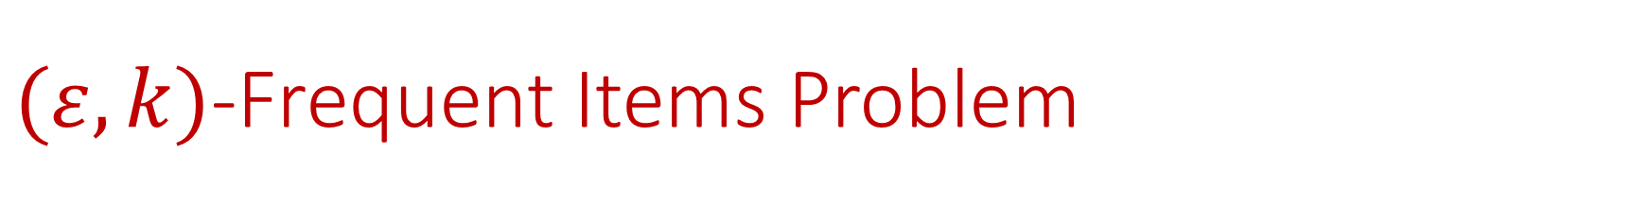

$(ε,k)$-Frequent Items Problem
Goal: Given a set $S$ of $m$ elements from $[n]$, an accuracy parameter $ε∈(0, 1)$, and a parameter $k$, output a list that includes:
The items from $[n]$ that have frequency at least $\frac{m}{k}$
No items with frequency less than $\left(1−ε\right)\frac{m}{k}$

Slide 80


Misra Gries for $(ε,k)$-Frequent Items Problem
Initialize $k$ items $V_{1},…,V_{k}$ with count $c_{1},…,c_{k}=0$
For updates $1,…,m$:
If $V_{t}=x_{i}$ for some $t$, increment counter $c_{t}$, i.e., $c_{t}=c_{t}+1$
Else if $c_{t}=0$ for some $t$, set $V_{t}=x_{i}$
Else decrement all counters $c_{j}$, i.e., $c_{j}=c_{j}−1$ for all $j∈[k]$

Slide 81
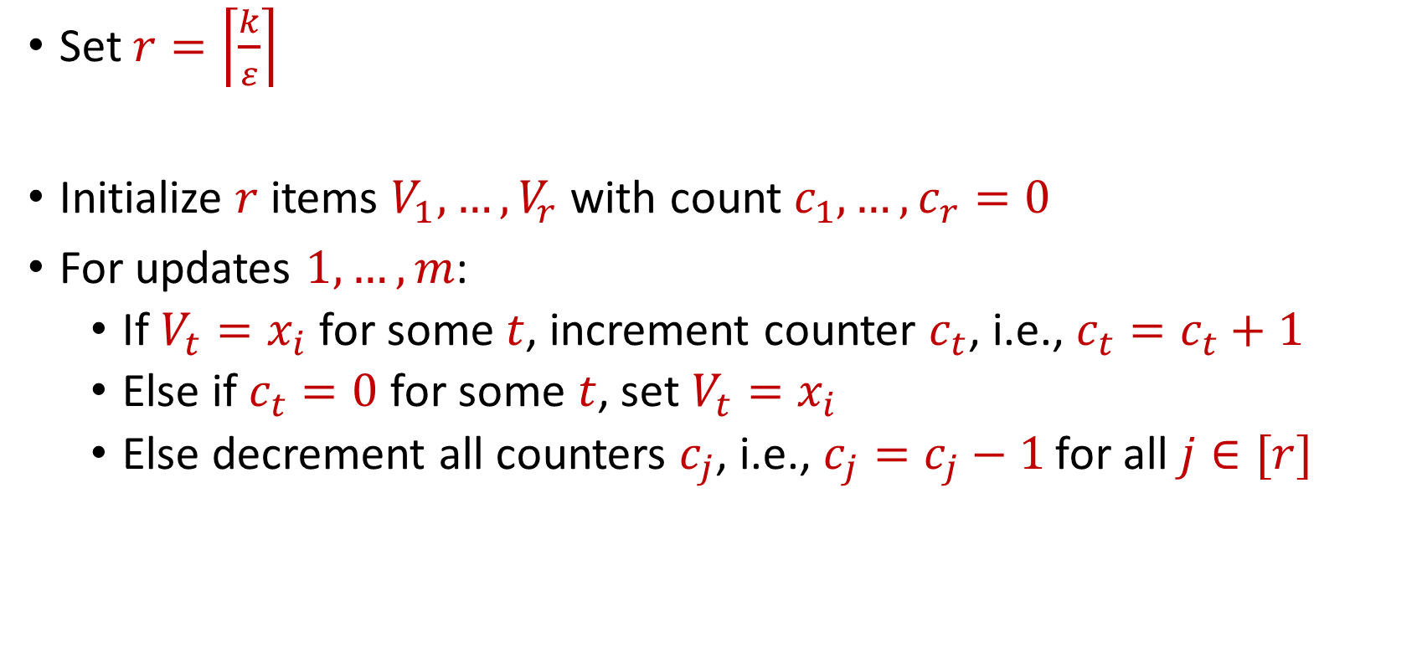
Misra Gries for $(ε,k)$-Frequent Items Problem
Set $r=\left\lceil \frac{k}{ε}\right\rceil$
Initialize $r$ items $V_{1},…,V_{r}$ with count $c_{1},…,c_{r}=0$
For updates $1,…,m$:
If $V_{t}=x_{i}$ for some $t$, increment counter $c_{t}$, i.e., $c_{t}=c_{t}+1$
Else if $c_{t}=0$ for some $t$, set $V_{t}=x_{i}$
Else decrement all counters $c_{j}$, i.e., $c_{j}=c_{j}−1$ for all $j∈[r]$

Slide 82


Misra Gries for $(ε,k)$-Frequent Items Problem
Claim: For all estimated frequencies $\hat{f_{i}}$ by Misra-Gries, we have
Intuition: Have a lot of counters, so relatively few decrements
$$f_{i}−\frac{εm}{k}≤\hat{f_{i}}≤f_{i}$$

Slide 83
$(ε,k)$-Frequent Items Problem
Goal: Given a set $S$ of $m$ elements from $[n]$, an accuracy parameter $ε∈(0, 1)$, and a parameter $k$, output a list that includes:
The items from $[n]$ that have frequency at least $\frac{m}{k}$
No items with frequency less than $\left(1−ε\right)\frac{m}{k}$

Slide 84
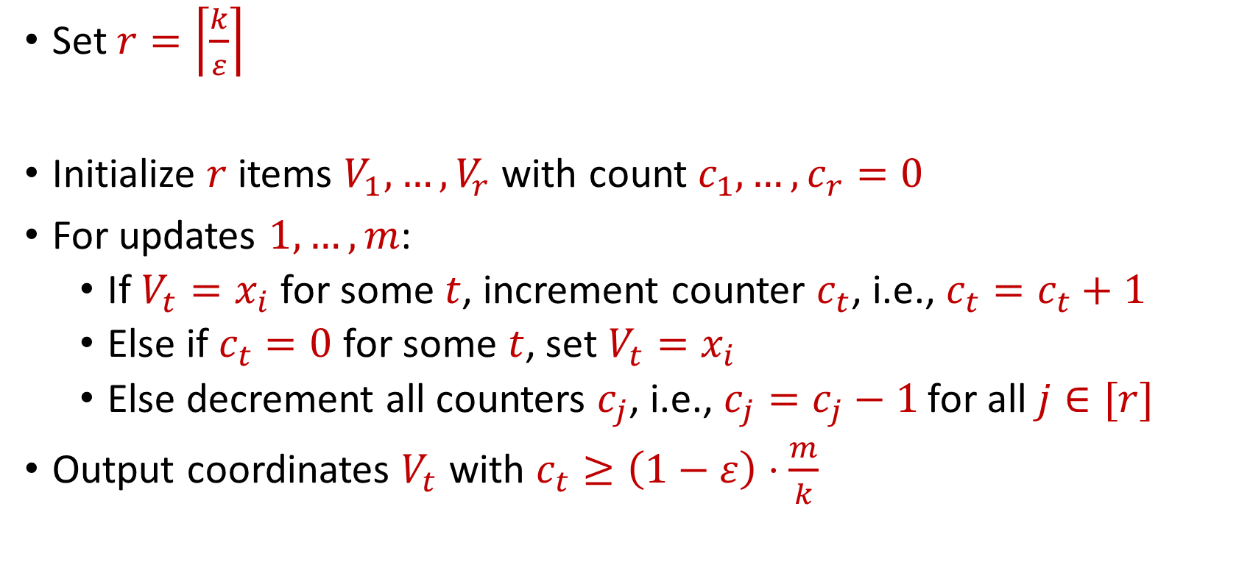
Misra Gries for $(ε,k)$-Frequent Items Problem
Set $r=\left\lceil \frac{k}{ε}\right\rceil$
Initialize $r$ items $V_{1},…,V_{r}$ with count $c_{1},…,c_{r}=0$
For updates $1,…,m$:
If $V_{t}=x_{i}$ for some $t$, increment counter $c_{t}$, i.e., $c_{t}=c_{t}+1$
Else if $c_{t}=0$ for some $t$, set $V_{t}=x_{i}$
Else decrement all counters $c_{j}$, i.e., $c_{j}=c_{j}−1$ for all $j∈[r]$
Output coordinates $V_{t}$ with $c_{t}≥\left(1−ε\right)⋅\frac{m}{k}$

Slide 85
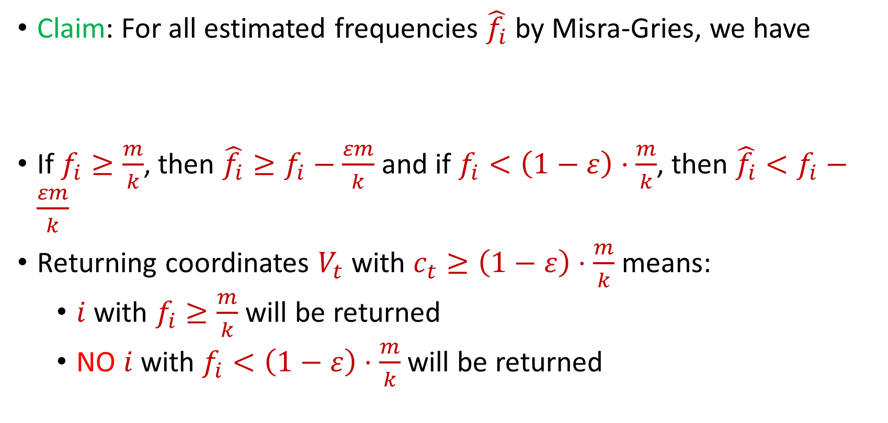
Misra Gries for $(ε,k)$-Frequent Items Problem
Claim: For all estimated frequencies $\hat{f_{i}}$ by Misra-Gries, we have
If $f_{i}≥\frac{m}{k}$, then ${\hat{f_{i}}≥f}_{i}−\frac{εm}{k}$ and if $f_{i}<\left(1−ε\right)⋅\frac{m}{k}$, then ${\hat{f_{i}}<f}_{i}−\frac{εm}{k}$
Returning coordinates $V_{t}$ with $c_{t}≥\left(1−ε\right)⋅\frac{m}{k}$ means:
$i$ with $f_{i}≥\frac{m}{k}$ will be returned
NO $i$ with $f_{i}<\left(1−ε\right)⋅\frac{m}{k}$will be returned
$$f_{i}−\frac{εm}{k}≤\hat{f_{i}}≤f_{i}$$

Slide 86
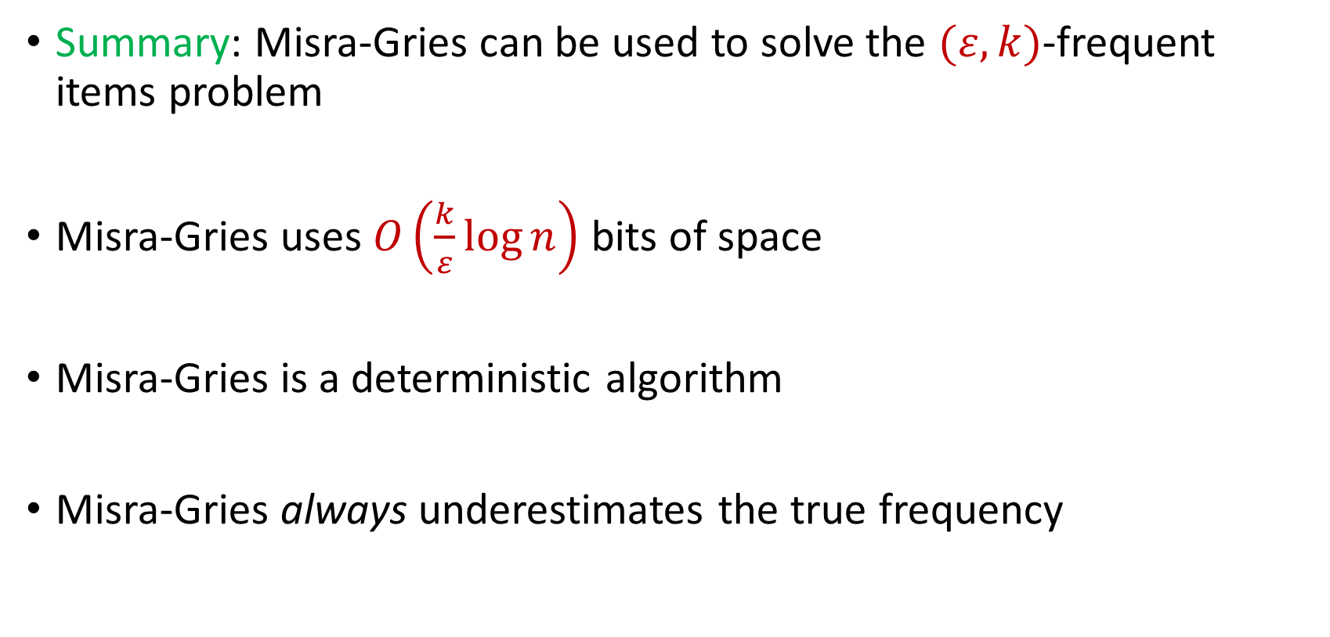
Misra Gries for $(ε,k)$-Frequent Items Problem
Summary: Misra-Gries can be used to solve the $(ε,k)$-frequent items problem
Misra-Gries uses $O\left(\frac{k}{ε}\log{n}\right)$ bits of space
Misra-Gries is a deterministic algorithm
Misra-Gries always underestimates the true frequency

Slide 87

CountMin
Another algorithm for the $(ε,k)$-frequent items problem
Can be easily parallelized across multiple servers

Slide 88
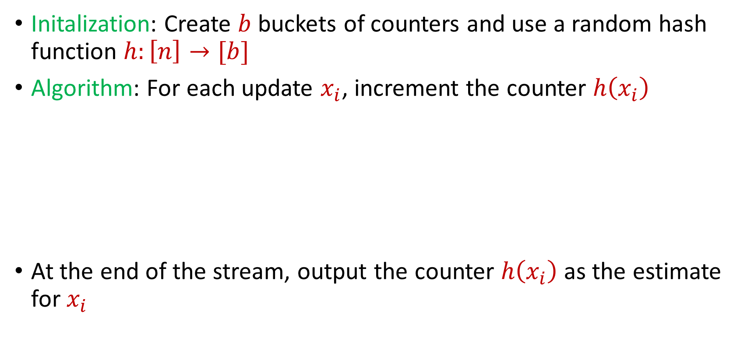
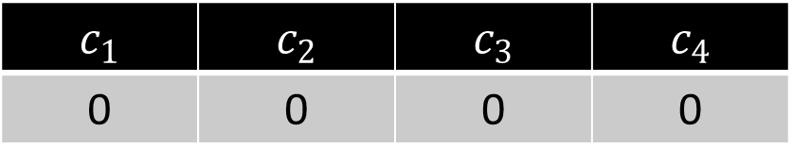
CountMin
Initalization: Create $b$ buckets of counters and use a random hash function $h:\left[n\right]→[b]$
Algorithm: For each update $x_{i}$, increment the counter $h\left(x_{i}\right)$
At the end of the stream, output the counter $h\left(x_{i}\right)$ as the estimate for $x_{i}$
$c_{1}$ | $c_{2}$ | $c_{3}$ | $c_{4}$
0 | 0 | 0 | 0

Slide 89
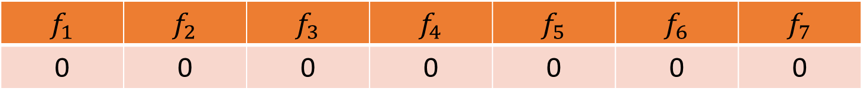


CountMin
$f_{1}$ | $f_{2}$ | $f_{3}$ | $f_{4}$ | $f_{5}$ | $f_{6}$ | $f_{7}$
0 | 0 | 0 | 0 | 0 | 0 | 0
$$1$$
$c_{1}$ | $c_{2}$ | $c_{3}$ | $c_{4}$
0 | 0 | 0 | 0

Slide 90
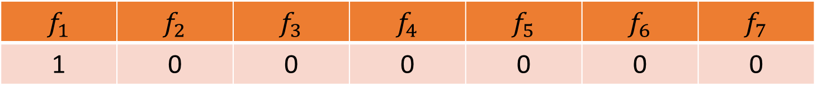

CountMin
$f_{1}$ | $f_{2}$ | $f_{3}$ | $f_{4}$ | $f_{5}$ | $f_{6}$ | $f_{7}$
1 | 0 | 0 | 0 | 0 | 0 | 0
$$1$$
$$h\left(x\right)=3x+2 (mod 4)$$
$c_{1}$ | $c_{2}$ | $c_{3}$ | $c_{4}$
0 | 0 | 0 | 0

Slide 91
CountMin
$f_{1}$ | $f_{2}$ | $f_{3}$ | $f_{4}$ | $f_{5}$ | $f_{6}$ | $f_{7}$
1 | 0 | 0 | 0 | 0 | 0 | 0
$$1$$
$$h\left(x\right)=3x+2 (mod 4)$$
$c_{1}$ | $c_{2}$ | $c_{3}$ | $c_{4}$
0 | 0 | 0 | 0

Slide 92
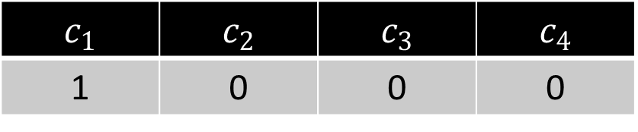
CountMin
$f_{1}$ | $f_{2}$ | $f_{3}$ | $f_{4}$ | $f_{5}$ | $f_{6}$ | $f_{7}$
1 | 0 | 0 | 0 | 0 | 0 | 0
$$1$$
$$h\left(x\right)=3x+2 (mod 4)$$
$c_{1}$ | $c_{2}$ | $c_{3}$ | $c_{4}$
1 | 0 | 0 | 0

Slide 93
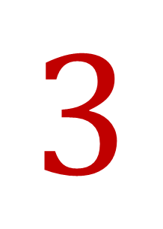
CountMin
$f_{1}$ | $f_{2}$ | $f_{3}$ | $f_{4}$ | $f_{5}$ | $f_{6}$ | $f_{7}$
1 | 0 | 0 | 0 | 0 | 0 | 0
$$3$$
$$h\left(x\right)=3x+2 (mod 4)$$
$c_{1}$ | $c_{2}$ | $c_{3}$ | $c_{4}$
1 | 0 | 0 | 0

Slide 94
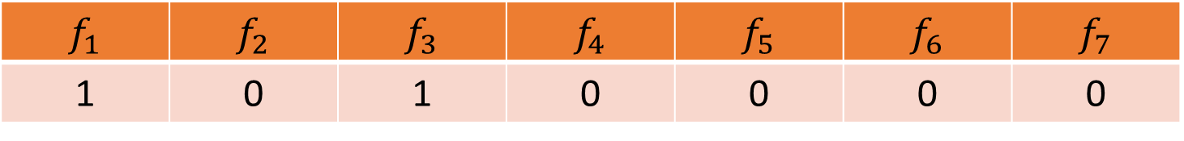

CountMin
$f_{1}$ | $f_{2}$ | $f_{3}$ | $f_{4}$ | $f_{5}$ | $f_{6}$ | $f_{7}$
1 | 0 | 1 | 0 | 0 | 0 | 0
$$3$$
$$h\left(x\right)=3x+2 (mod 4)$$
$c_{1}$ | $c_{2}$ | $c_{3}$ | $c_{4}$
1 | 0 | 1 | 0

Slide 95

CountMin
$f_{1}$ | $f_{2}$ | $f_{3}$ | $f_{4}$ | $f_{5}$ | $f_{6}$ | $f_{7}$
1 | 0 | 1 | 0 | 0 | 0 | 0
$$2$$
$$h\left(x\right)=3x+2 (mod 4)$$
$c_{1}$ | $c_{2}$ | $c_{3}$ | $c_{4}$
1 | 0 | 1 | 0

Slide 96


CountMin
$f_{1}$ | $f_{2}$ | $f_{3}$ | $f_{4}$ | $f_{5}$ | $f_{6}$ | $f_{7}$
1 | 1 | 1 | 0 | 0 | 0 | 0
$$2$$
$$h\left(x\right)=3x+2 (mod 4)$$
$c_{1}$ | $c_{2}$ | $c_{3}$ | $c_{4}$
1 | 0 | 1 | 1

Slide 97
CountMin
$f_{1}$ | $f_{2}$ | $f_{3}$ | $f_{4}$ | $f_{5}$ | $f_{6}$ | $f_{7}$
1 | 1 | 1 | 0 | 0 | 0 | 0
$$1$$
$$h\left(x\right)=3x+2 (mod 4)$$
$c_{1}$ | $c_{2}$ | $c_{3}$ | $c_{4}$
1 | 0 | 1 | 1

Slide 98


CountMin
$f_{1}$ | $f_{2}$ | $f_{3}$ | $f_{4}$ | $f_{5}$ | $f_{6}$ | $f_{7}$
2 | 1 | 1 | 0 | 0 | 0 | 0
$$1$$
$$h\left(x\right)=3x+2 (mod 4)$$
$c_{1}$ | $c_{2}$ | $c_{3}$ | $c_{4}$
2 | 0 | 1 | 1

Slide 99

CountMin
$f_{1}$ | $f_{2}$ | $f_{3}$ | $f_{4}$ | $f_{5}$ | $f_{6}$ | $f_{7}$
2 | 1 | 1 | 0 | 0 | 0 | 0
$$5$$
$$h\left(x\right)=3x+2 (mod 4)$$
$c_{1}$ | $c_{2}$ | $c_{3}$ | $c_{4}$
1 | 0 | 1 | 1

Slide 100


CountMin
$f_{1}$ | $f_{2}$ | $f_{3}$ | $f_{4}$ | $f_{5}$ | $f_{6}$ | $f_{7}$
2 | 1 | 1 | 0 | 1 | 0 | 0
$$5$$
$$h\left(x\right)=3x+2 (mod 4)$$
$c_{1}$ | $c_{2}$ | $c_{3}$ | $c_{4}$
3 | 0 | 1 | 1

Slide 101

CountMin
$f_{1}$ | $f_{2}$ | $f_{3}$ | $f_{4}$ | $f_{5}$ | $f_{6}$ | $f_{7}$
2 | 1 | 1 | 0 | 1 | 0 | 0
What is the estimation for $f_{4}$?
What about $f_{3}$?
What about $f_{5}$? What about $f_{1}$?
$$h\left(x\right)=3x+2 (mod 4)$$
$c_{1}$ | $c_{2}$ | $c_{3}$ | $c_{4}$
3 | 0 | 1 | 1

Slide 102

CountMin
Given a set $S$ of $m$ elements from $[n]$, let $\hat{f_{i}}$ be the estimated frequency for $f_{i}$

Slide 103


Heavy-Hitters (Frequent Items)
Given a set $S$ of $m$ elements from $[n]$, let $f_{i}$ be the frequency of element $i$. (How often it appears)
Let $L_{2}$ be the norm of the frequency vector:
Goal: Given a set $S$ of $m$ elements from $[n]$ and a threshold $ε$, output the elements $i$ such that $f_{i}>$ $ε L_{2}$...and no elements $j$ such that $f_{j}<$ $\frac{ε}{16} L_{2}$
Motivation: DDoS prevention, iceberg queries
$$L_{2}=\sqrt{f_{1}^{2}+f_{2}^{2}+…+f_{n}^{2}}$$

Slide 104



Frequency Moments ($L_{p}$ Norm)
Given a set $S$ of $m$ elements from $[n]$, let $f_{i}$ be the frequency of element $i$. (How often it appears)
Let $F_{p}$ be the frequency moment of the vector:
Goal: Given a set $S$ of $m$ elements from $[n]$ and an accuracy parameter $ε$, output a $(1+ε)$-approximation to $F_{p}$
Motivation: Entropy estimation, linear regression
$F_{p}=$ $f_{1}^{p}+f_{2}^{p}+…+f_{n}^{p}$

Slide 105


Distinct Elements ($F_{0}$ Estimation)
Given a set $S$ of $m$ elements from $[n]$, let $f_{i}$ be the frequency of element $i$. (How often it appears)
Let $F_{0}$ be the frequency moment of the vector:
Goal: Given a set $S$ of $m$ elements from $[n]$ and an accuracy parameter $ε$, output a $(1+ε)$-approximation to $F_{0}$
Motivation: Traffic monitoring
$F_{0}=$ $|\{i :f_{i}≠0\}|$

