Slide 1

Efficient Coreset Constructions via Sensitivity Sampling
Vladimir Braverman (John Hopkins University)
Dan Feldman (University of Haifa)
Harry Lang (MIT)
Adiel Statman (University of Haifa)
Samson Zhou (Carnegie Mellon University)

Slide 2



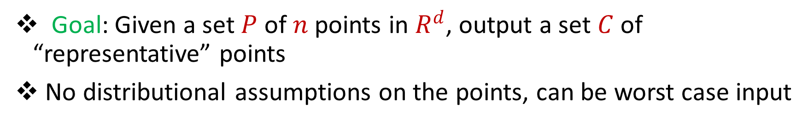



Model
Goal: Given a set $P$ of $n$points in $R^{d}$, output a set $C$ of “representative” points
No distributional assumptions on the points, can be worst case input
$$P_{1}$$
$$P_{5}$$
$$P_{2}$$
$$P_{4}$$
$$P_{3}$$
$$P_{6}$$

Slide 3
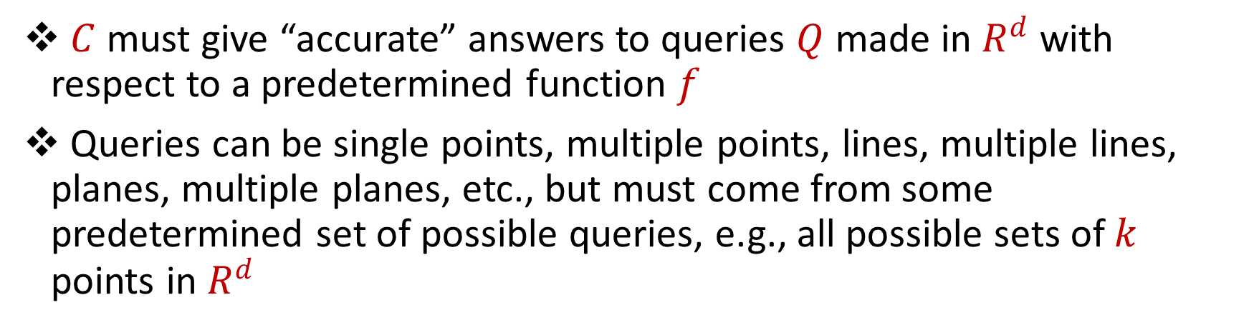
Model
$C$ must give “accurate” answers to queries $Q$ made in $R^{d}$ with respect to a predetermined function $f$
Queries can be single points, multiple points, lines, multiple lines, planes, multiple planes, etc., but must come from some predetermined set of possible queries, e.g., all possible sets of $k$ points in $R^{d}$
$$P_{1}$$
$$P_{5}$$
$$P_{2}$$
$$P_{4}$$
$$P_{3}$$
$$P_{6}$$

Slide 4







Model
$$P_{1}$$
$$P_{5}$$
$$P_{2}$$
$$P_{4}$$
$$P_{3}$$
$$P_{6}$$
$$Q$$

Slide 5
Model
$$P_{1}$$
$$P_{5}$$
$$P_{2}$$
$$P_{4}$$
$$P_{3}$$
$$P_{6}$$
$$Q$$

Slide 6

Coresets
Coreset: Returns an $ε$-approximation on a query space
$$P_{1}$$
$$P_{5}$$
$$P_{2}$$
$$P_{4}$$
$$P_{3}$$
$$P_{6}$$

Slide 7












Coresets
$$P_{1}$$
$$P_{1}$$
$$P_{5}$$
$$P_{5}$$
$$P_{2}$$
$$P_{2}$$
$$P_{4}$$
$$P_{4}$$
$$P_{3}$$
$$P_{3}$$
$$P_{6}$$
$$P_{6}$$

Slide 8
Coresets
$$P_{1}$$
$$P_{1}$$
$$P_{5}$$
$$P_{5}$$
$$P_{2}$$
$$P_{2}$$
$$P_{4}$$
$$P_{4}$$
$$P_{3}$$
$$P_{3}$$
$$P_{6}$$
$$P_{6}$$

Slide 9
Coresets
$$P_{1}$$
$$P_{5}$$
$$P_{2}$$
$$P_{4}$$
$$P_{3}$$
$$P_{6}$$
$$C$$

Slide 10
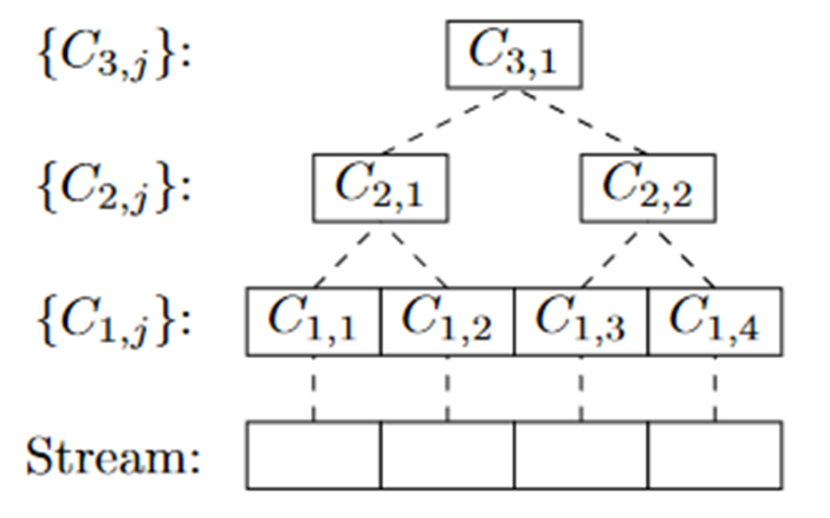
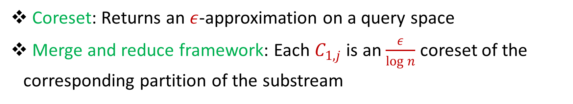
Coresets
Coreset: Returns an $ε$-approximation on a query space
Merge and reduce framework: Each $C_{1,j}$ is an $\frac{ε}{\log{n}}$ coreset of the corresponding partition of the substream

Slide 11
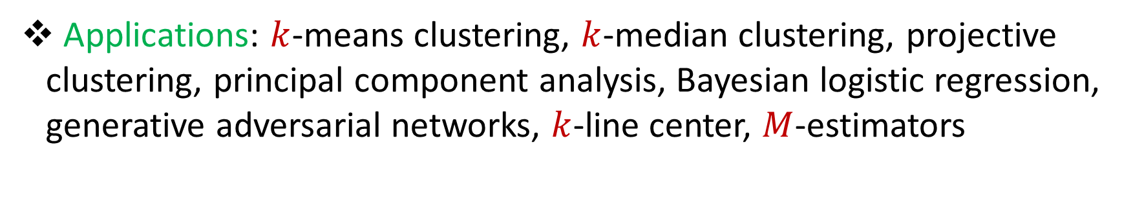
Coresets
Applications: $k$-means clustering, $k$-median clustering, projective clustering, principal component analysis, Bayesian logistic regression, generative adversarial networks, $k$-line center, $M$-estimators

Slide 12
Motivation
Runtime: Faster algorithms downstream
Space: Space used to store the data is decreased
Communication: Size/number of messages passed between multiple parties is decreased
Dimensionality Reduction: Each point in the coreset can be further optimized by dimensionality reduction techniques if applicable, e.g., Johnson-Lindenstrauss transformation

Slide 13
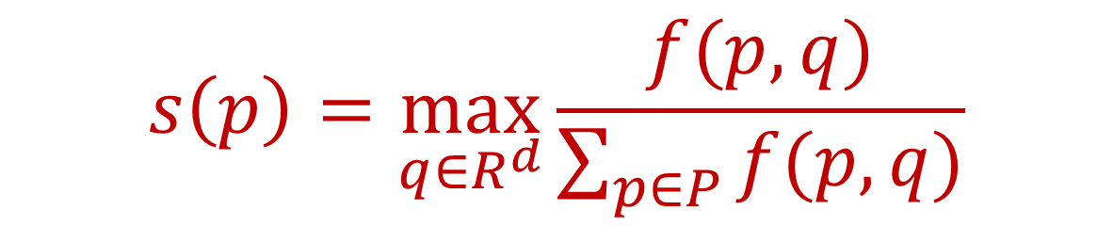
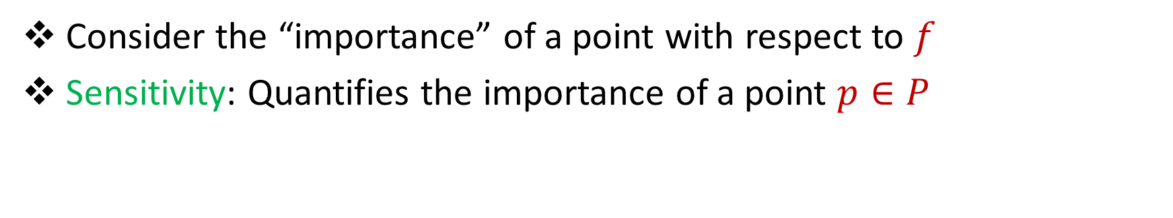
Sensitivity
Consider the “importance” of a point with respect to $f$
Sensitivity: Quantifies the importance of a point $p∈P$
$$s\left(p\right)=\max_{q∈R^{d}}{\frac{f(p,q)}{\sum_{p∈P}{f(p,q)}}}$$

Slide 14
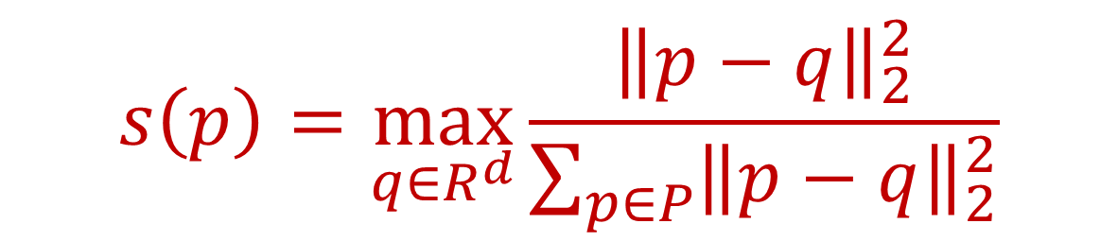
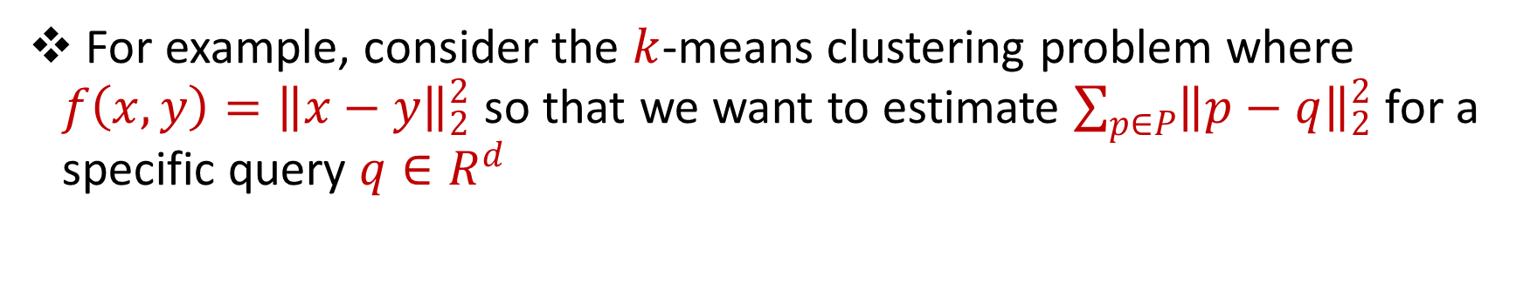
Sensitivity
For example, consider the $k$-means clustering problem where $f\left(x,y\right)={\left\|x−y\right\|}_{2}^{2}$ so that we want to estimate $\sum_{p∈P}{{\left\|p−q\right\|}_{2}^{2}}$ for a specific query ${q∈R}^{d}$
$$s\left(p\right)=\max_{q∈R^{d}}{\frac{{\left\|p−q\right\|}_{2}^{2}}{\sum_{p∈P}{{\left\|p−q\right\|}_{2}^{2}}}}$$

Slide 15
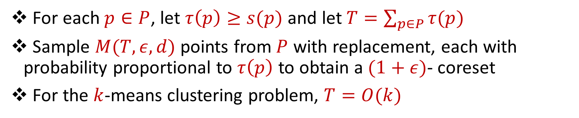
Sensitivity Sampling
For each $p∈P$, let $τ\left(p\right)≥s(p)$ and let $T=\sum_{p∈P}{τ(p)}$
Sample $M(T,ε, d)$ points from $P$ with replacement, each with probability proportional to $τ\left(p\right)$ to obtain a $(1+ε)$- coreset
For the $k$-means clustering problem, $T=O(k)$

Slide 16
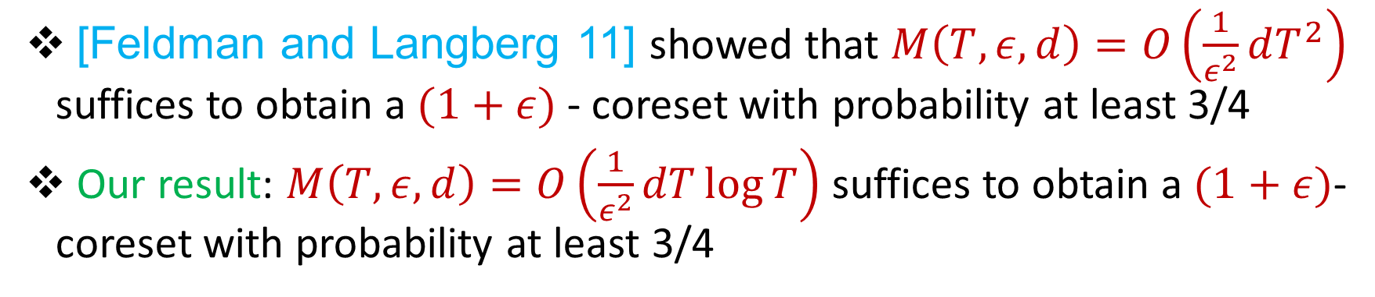
Results and Related Work
[Feldman and Langberg 11] showed that $M\left(T,ε, d\right)=O\left(\frac{1}{ε^{2}}dT^{2}\right)$ suffices to obtain a $(1+ε)$ - coreset with probability at least 3/4
Our result: $M\left(T,ε, d\right)=O\left(\frac{1}{ε^{2}}dT\log{T}\right)$ suffices to obtain a $(1+ε)$- coreset with probability at least 3/4

Slide 17
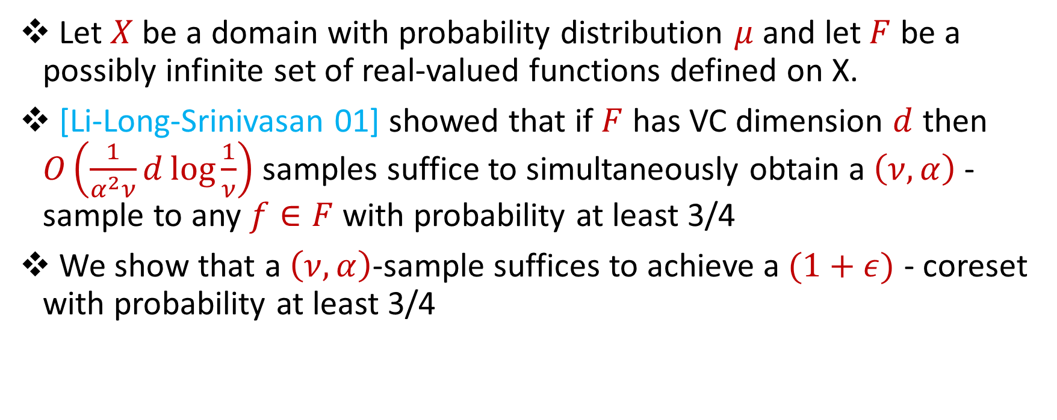
Intuition from Learning
Let $X$ be a domain with probability distribution $μ$ and let $F$ be a possibly infinite set of real-valued functions defined on X.
[Li-Long-Srinivasan 01] showed that if $F$ has VC dimension $d$ then $O\left(\frac{1}{α^{2}ν}d\log{\frac{1}{ν}}\right)$ samples suffice to simultaneously obtain a $\left(ν,α\right)$ -sample to any $f∈F$ with probability at least 3/4
We show that a $\left(ν,α\right)$-sample suffices to achieve a $(1+ε)$ - coreset with probability at least 3/4

Slide 18
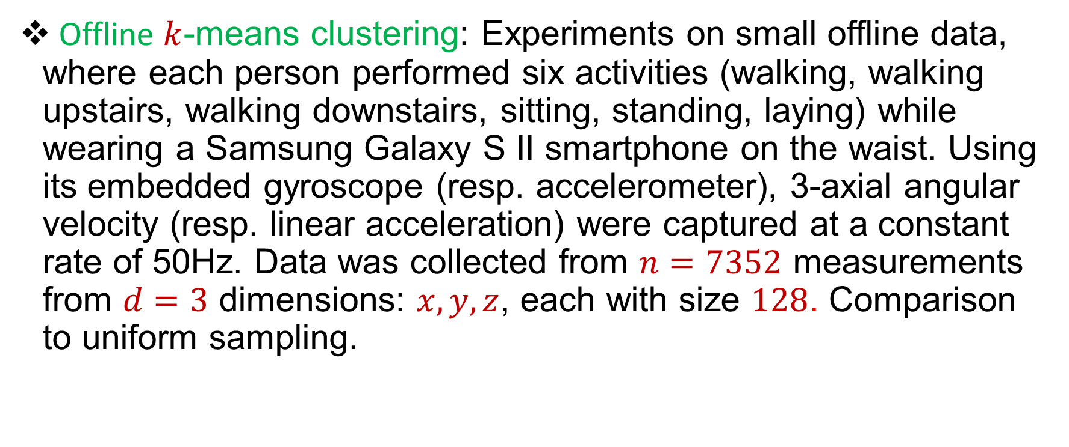
Empirical Evaluations
Offline $k$-means clustering: Experiments on small offline data, where each person performed six activities (walking, walking upstairs, walking downstairs, sitting, standing, laying) while wearing a Samsung Galaxy S II smartphone on the waist. Using its embedded gyroscope (resp. accelerometer), 3-axial angular velocity (resp. linear acceleration) were captured at a constant rate of 50Hz. Data was collected from $n=7352$ measurements from $d=3$ dimensions: $x,y,z$, each with size $128$. Comparison to uniform sampling.

Slide 19
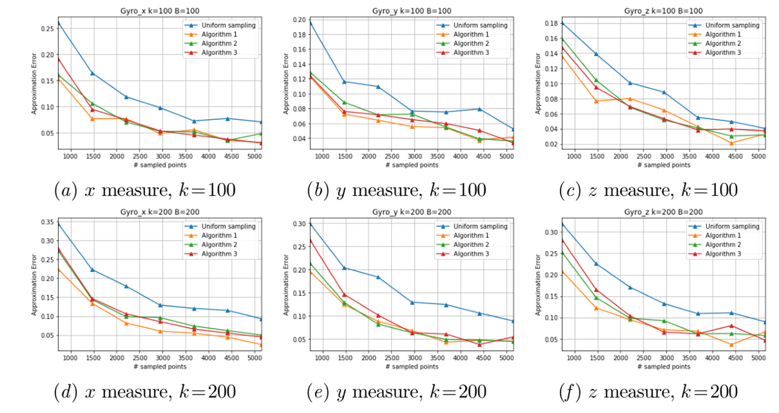

Slide 20

Empirical Evaluations
Streaming $k$-means clustering: Standard dictionary of the $d=100,000$ most common words in Wikipedia and how often they appeared across $n=4624611$ articles, so that each cell $(i,j)$ represents how often word $j$ appears in article $i$. Comparison to uniform sampling.

Slide 21
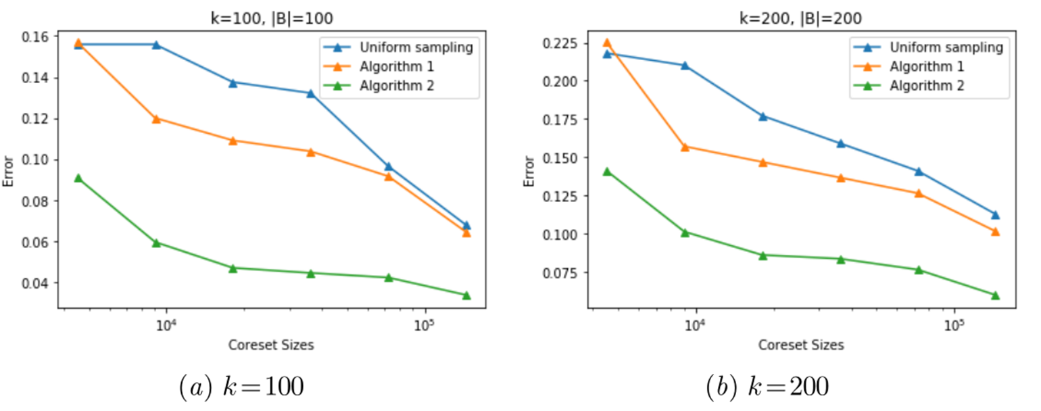

Slide 22


