Slide 1




Nearly Optimal Distinct Elements and Heavy Hitters on Sliding Windows
VLADIMIR BRAVERMAN
ELENA GRIGORESCU
HARRY LANG
DAVID P. WOODRUFF
SAMSON ZHOU

Slide 2
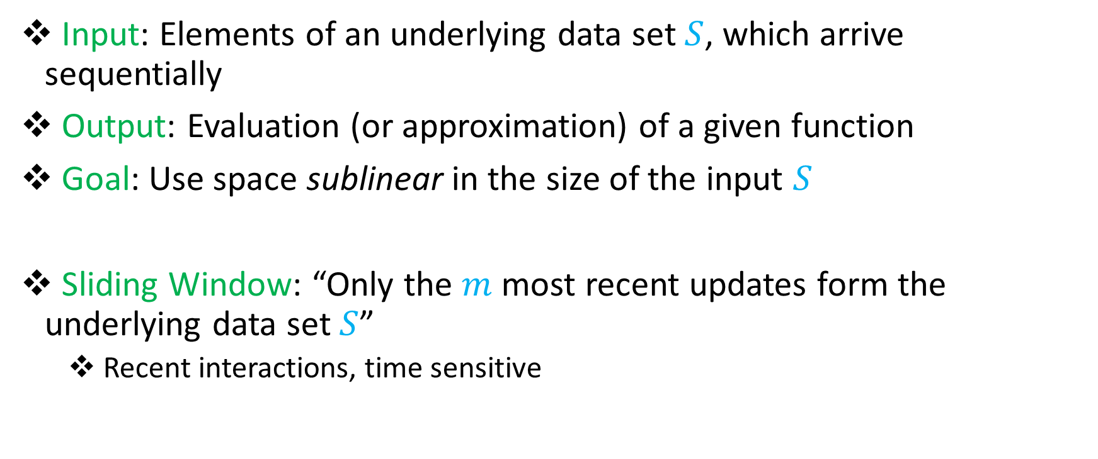
Streaming / Sliding Window Model
Input: Elements of an underlying data set $S$, which arrive sequentially
Output: Evaluation (or approximation) of a given function
Goal: Use space sublinear in the size of the input $S$
Sliding Window: “Only the $m$ most recent updates form the underlying data set $S$”
Recent interactions, time sensitive

Slide 3
Heavy-Hitters
Given a set $S$ of $m$ elements from $[n]$, let $f_{i}$ be the frequency of element $i$. (How often it appears)
Let $L_{2}$ be the norm of the frequency vector:
Goal: Given a set $S$ of $m$ elements from $[n]$ and a parameter $ε$, output the elements $i$ such that $f_{i}>$ $ε L_{2}$...and no elements $j$ such that $f_{j}<$ $\frac{ε}{16} L_{2}$.
$$L_{2}=\sqrt{f_{1}^{2}+f_{2}^{2}+…+f_{n}^{2}}$$

Slide 4
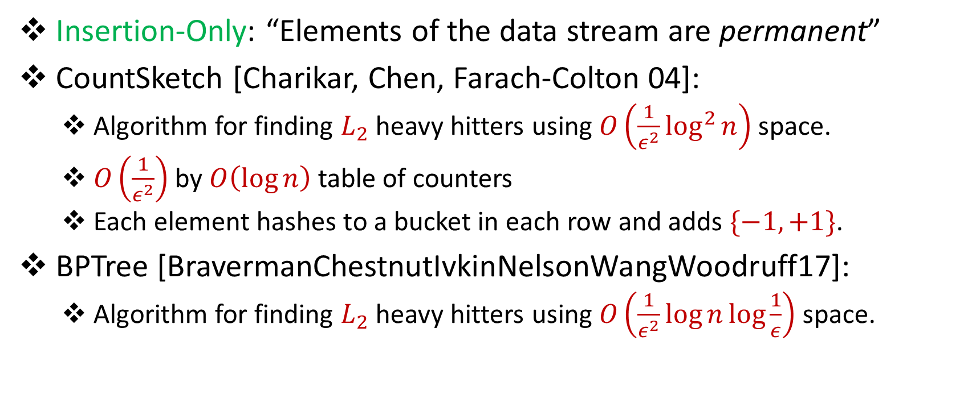
Heavy-Hitters in the Insertion-Only Model
Insertion-Only: “Elements of the data stream are permanent”
CountSketch [Charikar, Chen, Farach-Colton 04]:
Algorithm for finding $L_{2}$ heavy hitters using $O\left(\frac{1}{ε^{2}}\log^{2}{n}\right)$ space.
$O\left(\frac{1}{ε^{2}}\right)$ by $O\left(\log{n}\right)$ table of counters
Each element hashes to a bucket in each row and adds $\{−1, +1\}$.
BPTree [BravermanChestnutIvkinNelsonWangWoodruff17]:
Algorithm for finding $L_{2}$ heavy hitters using $O\left(\frac{1}{ε^{2}}\log{n\log{\frac{1}{ε}}}\right)$ space.

Slide 5

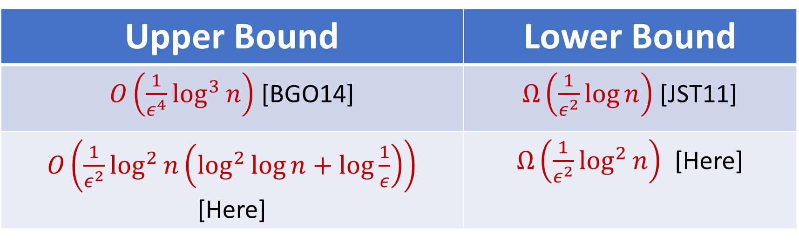
Heavy-Hitters in the Sliding Window Model
Upper Bound | Lower Bound
$O\left(\frac{1}{ε^{4}}\log^{3}{n}\right)$ [BGO14] | $Ω\left(\frac{1}{ε^{2}}\log{n}\right)$ [JST11]
$O\left(\frac{1}{ε^{2}}\log^{2}{n}\left(\log^{2}{\log{n+\log{\frac{1}{ε}}}}\right)\right)$ [Here] | $Ω\left(\frac{1}{ε^{2}}\log^{2}{n}\right)$ [Here]
Optimal up to $\log{\log{n,\log{\frac{1}{ϵ}}}}$ factors

Slide 6
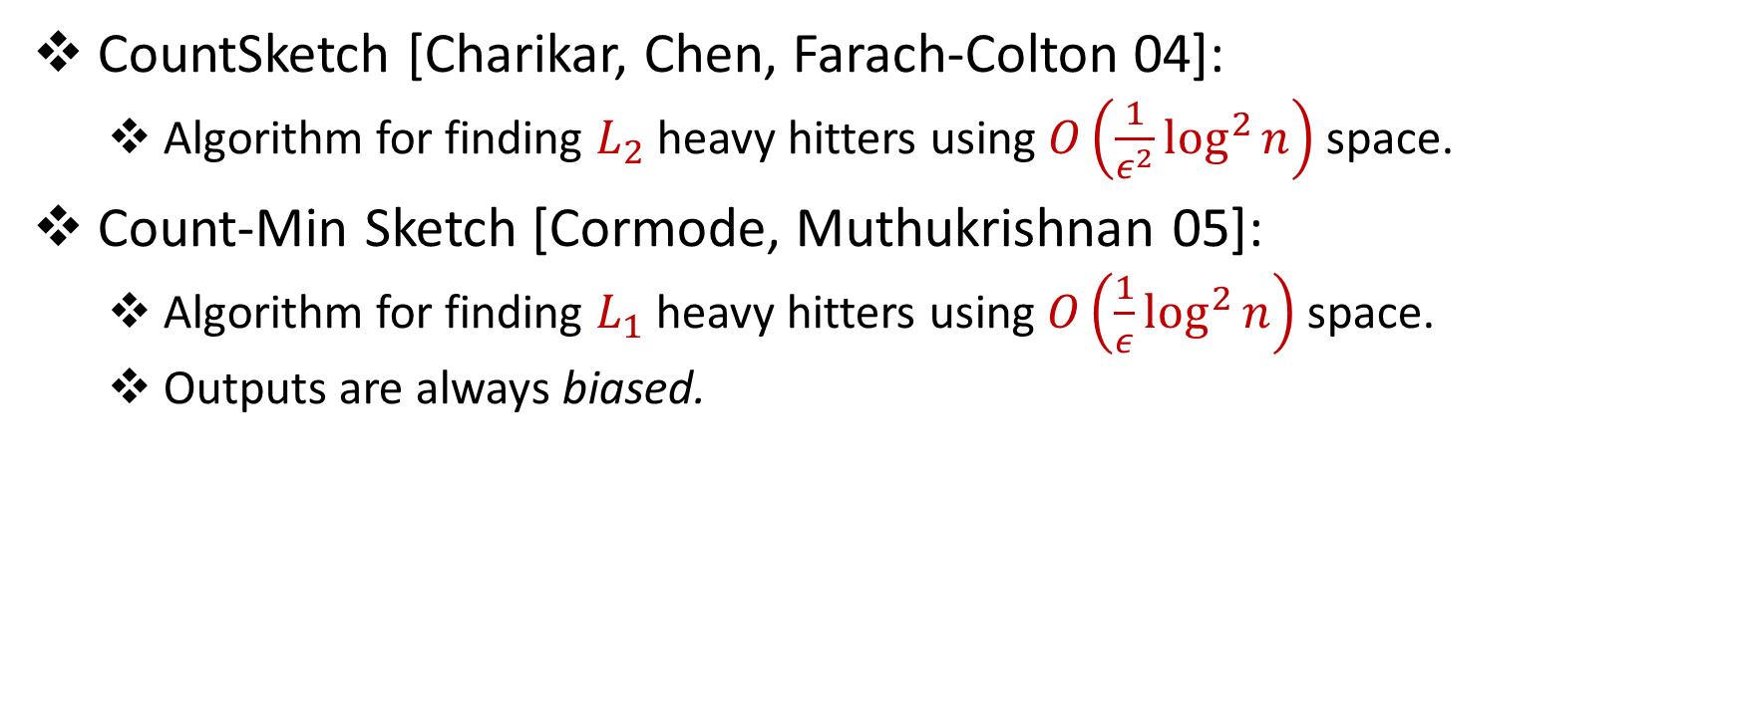

The $ε$ Matters!
CountSketch [Charikar, Chen, Farach-Colton 04]:
Algorithm for finding $L_{2}$ heavy hitters using $O\left(\frac{1}{ε^{2}}\log^{2}{n}\right)$ space.
Count-Min Sketch [Cormode, Muthukrishnan 05]:
Algorithm for finding $L_{1}$ heavy hitters using $O\left(\frac{1}{ε}\log^{2}{n}\right)$ space.
Outputs are always biased.

Slide 7
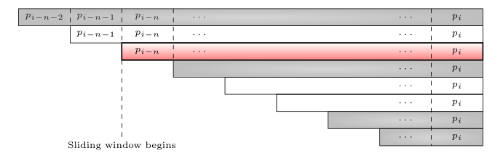
Technical Ingredient: Smooth Histogram
Data structure for converting insertion-only streaming algorithms to sliding window algorithms for smooth functions [Braverman, Ostrovsky 07]

Slide 8
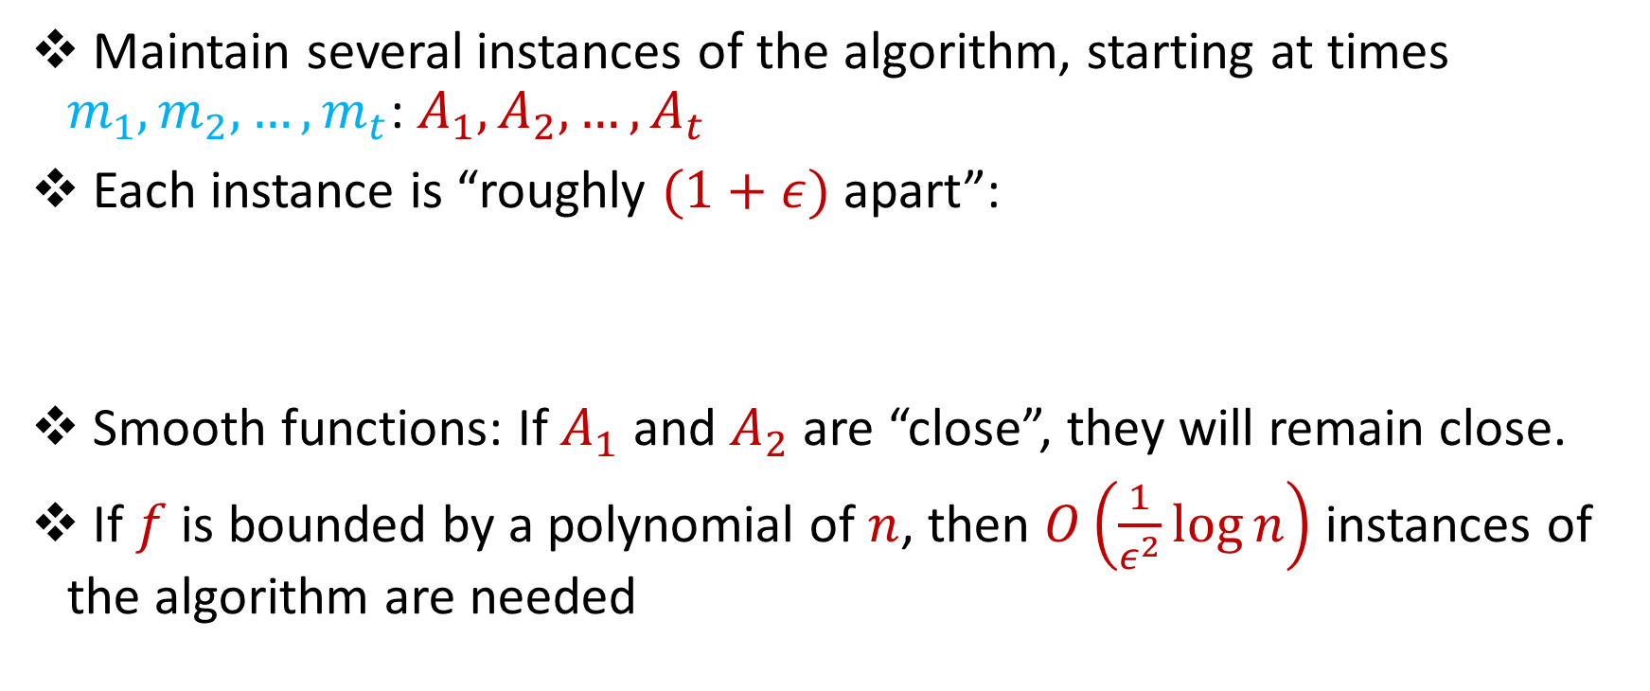
Smooth Histogram
Maintain several instances of the algorithm, starting at times $m_{1},m_{2},…, m_{t}$: $A_{1},A_{2},…, A_{t}$
Each instance is “roughly $(1+ε)$ apart”:
Smooth functions: If $A_{1}$ and $A_{2}$ are “close”, they will remain close.
If $f$ is bounded by a polynomial of $n$, then $O\left(\frac{1}{ε^{2}}\log{n}\right)$ instances of the algorithm are needed
$$f(A_{t})≤\left(1+ε\right){f(A}_{t−1})≤{\left(1+ε\right)}^{2}f(A_{t−2})≤…$$

Slide 9
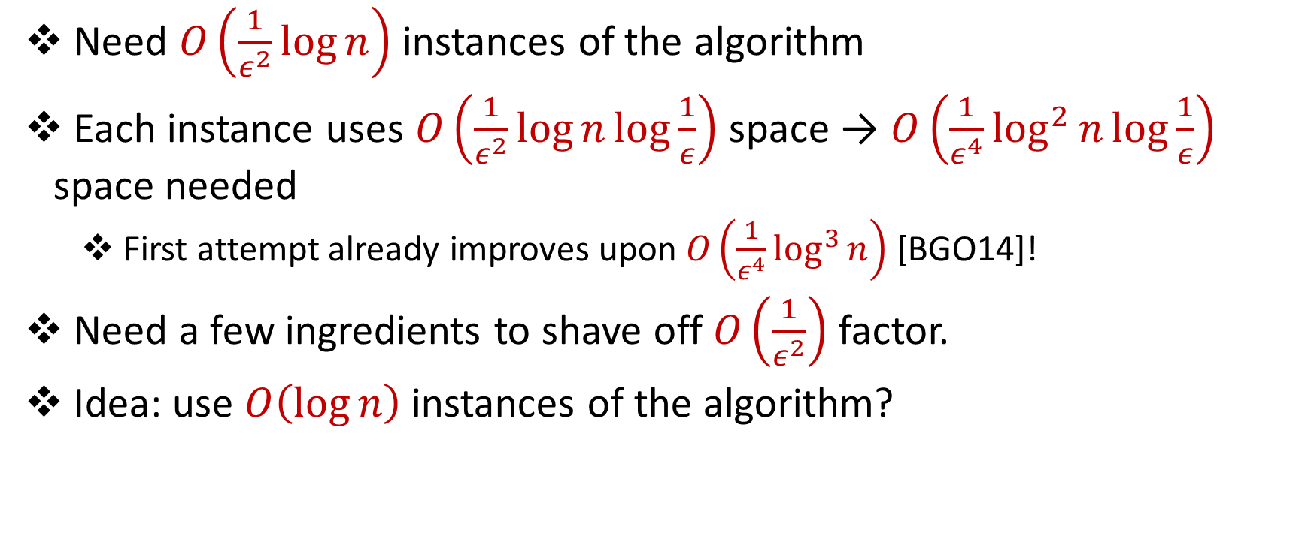
Review
Need $O\left(\frac{1}{ε^{2}}\log{n}\right)$ instances of the algorithm
Each instance uses $O\left(\frac{1}{ε^{2}}\log{n\log{\frac{1}{ε}}}\right)$ space → $O\left(\frac{1}{ε^{4}}\log^{2}{n\log{\frac{1}{ε}}}\right)$ space needed
First attempt already improves upon $O\left(\frac{1}{ε^{4}}\log^{3}{n}\right)$ [BGO14]!
Need a few ingredients to shave off $O\left(\frac{1}{ε^{2}}\right)$ factor.
Idea: use $O\left(\log{n}\right)$ instances of the algorithm?

Slide 10
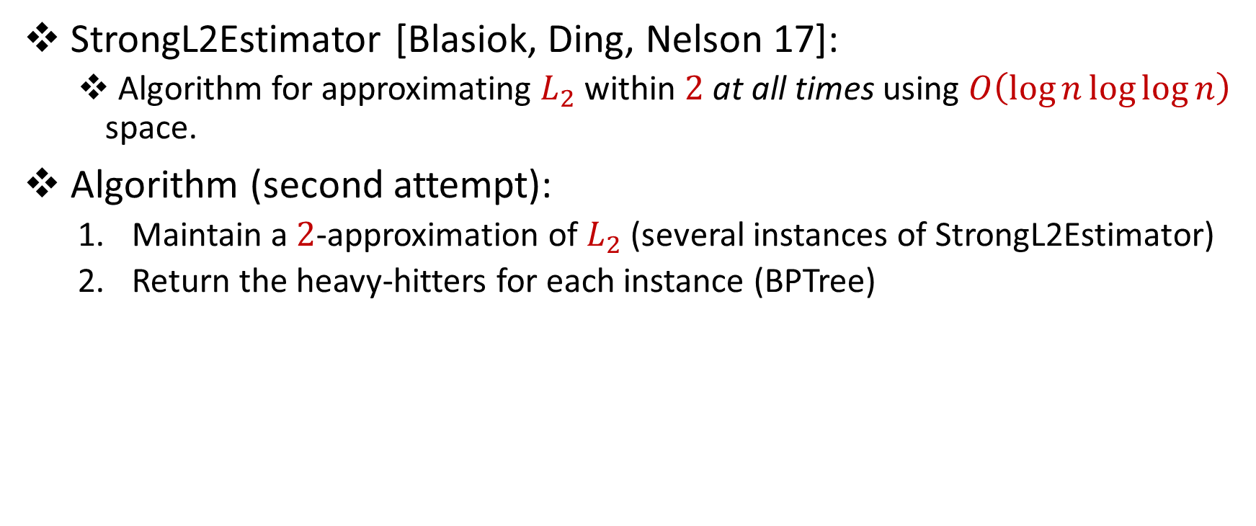
Heavy-Hitters in the Sliding Window Model
StrongL2Estimator [Blasiok, Ding, Nelson 17]:
Algorithm for approximating $L_{2}$ within $2$at all times using $O\left(\log{n\log{\log{n}}}\right)$ space.
Algorithm (second attempt):
Maintain a $2$-approximation of $L_{2}$ (several instances of StrongL2Estimator)
Return the heavy-hitters for each instance (BPTree)

Slide 11

Heavy-Hitters in the Sliding Window Model
Algorithm (second attempt):
Maintain a $2$-approximation of $L_{2}$ (several instances of StrongL2Estimator)
Return the heavy-hitters for each instance (BPTree)
False positives!

Slide 12
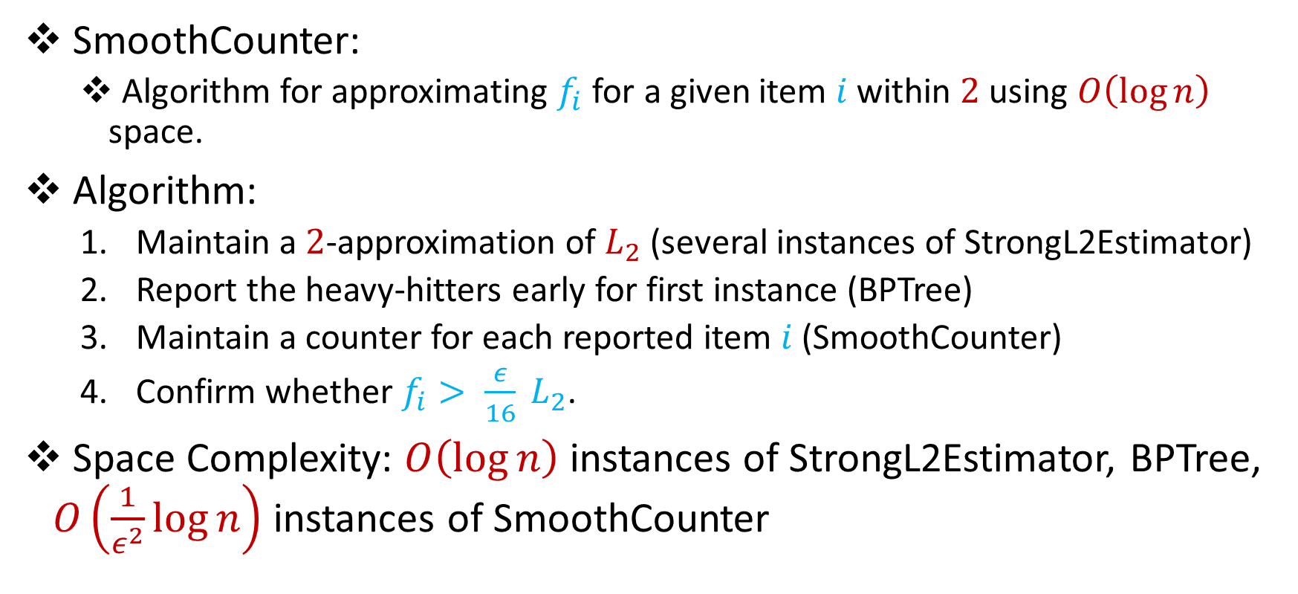
Heavy-Hitters in the Sliding Window Model
SmoothCounter:
Algorithm for approximating $f_{i}$ for a given item $i$ within $2$ using $O\left(\log{n}\right)$ space.
Algorithm:
Maintain a $2$-approximation of $L_{2}$ (several instances of StrongL2Estimator)
Report the heavy-hitters early for first instance (BPTree)
Maintain a counter for each reported item $i$ (SmoothCounter)
Confirm whether $f_{i}> \frac{ε}{16} L_{2}$.
Space Complexity: $O\left(\log{n}\right)$ instances of StrongL2Estimator, BPTree, $O\left(\frac{1}{ε^{2}}\log{n}\right)$ instances of SmoothCounter

Slide 13
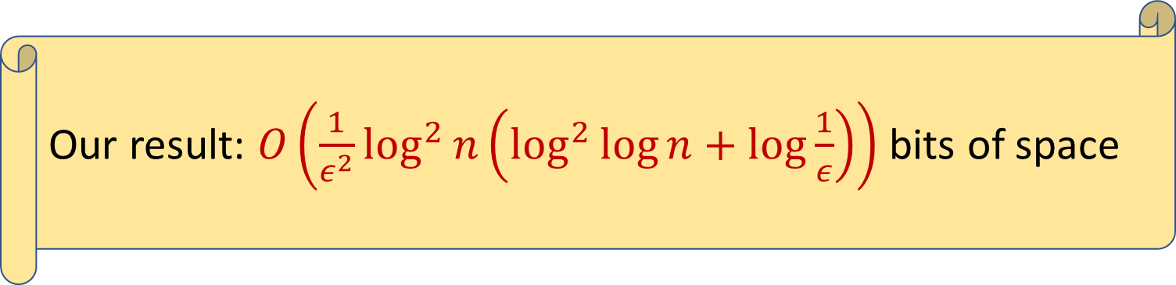

Heavy-Hitters in the Sliding Window Model
SmoothCounter:
Algorithm for approximating $f_{i}$ for a given item $i$ within $2$ using $O\left(\log{n}\right)$ space.
Algorithm:
Maintain a $2$-approximation of $L_{2}$ (StrongL2Estimator)
Report the heavy-hitters early for first instance (BPTree)
Maintain a counter for each reported item $i$ (SmoothCounter)
Confirm whether $f_{i}> \frac{ε}{16} L_{2}$.
Space Complexity: $O\left(\log{n}\right)$ instances of StrongL2Estimator, BPTree, $O\left(\frac{1}{ε^{2}}\log{n}\right)$ instances of SmoothCounter
Our result: $O\left(\frac{1}{ε^{2}}\log^{2}{n}\left(\log^{2}{\log{n+\log{\frac{1}{ε}}}}\right)\right)$ bits of space

Slide 14
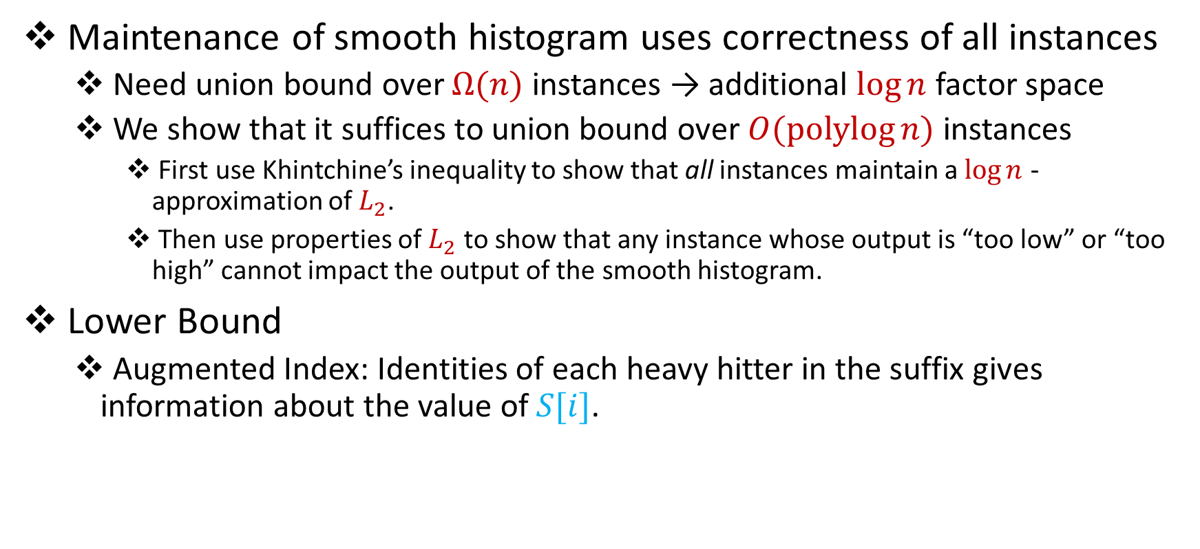
Technical Caveats
Maintenance of smooth histogram uses correctness of all instances
Need union bound over $Ω(n)$ instances → additional $\log{n}$ factor space
We show that it suffices to union bound over $O(polylog{n)}$ instances
First use Khintchine’s inequality to show that all instances maintain a $\log{n}$ - approximation of $L_{2}$.
Then use properties of $L_{2}$ to show that any instance whose output is “too low” or “too high” cannot impact the output of the smooth histogram.
Lower Bound
Augmented Index: Identities of each heavy hitter in the suffix gives information about the value of $S[i]$.

Slide 15
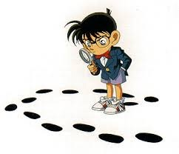
Questions?

Slide 16
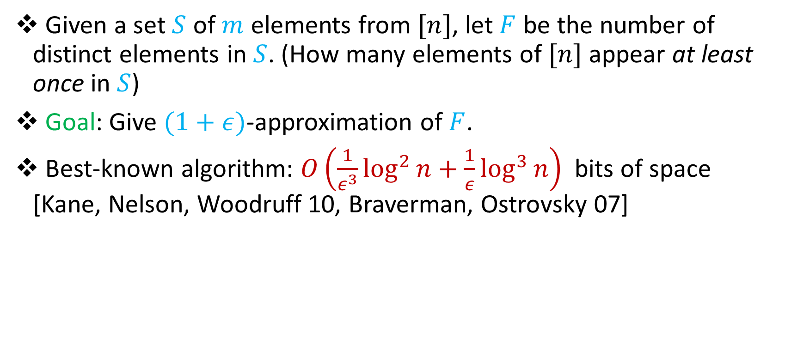
Distinct Elements ($L_{0}$ Norm)
Given a set $S$ of $m$ elements from $[n]$, let $F$ be the number of distinct elements in $S$. (How many elements of $[n]$ appear at least once in $S$)
Goal: Give $(1+ε)$-approximation of $F$.
Best-known algorithm: $O\left(\frac{1}{ε^{3}}\log^{2}{n}+\frac{1}{ε}\log^{3}{n}\right)$ bits of space [Kane, Nelson, Woodruff 10, Braverman, Ostrovsky 07]
Our result: $O\left(\frac{1}{ε^{2}}\log{n}\left(\log{\log{n\log{\frac{1}{ε}}}}\right)+\frac{1}{ε}\log^{2}{n}\right)$ bits of space

Slide 17
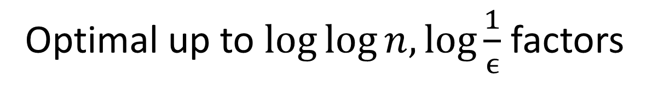
Distinct Elements
Upper Bound | Lower Bound
$O\left(\frac{1}{ε^{3}}\log^{2}{n}+\frac{1}{ε}\log^{3}{n}\right)$[KNW10, BO07] | $Ω\left(\frac{1}{ε^{2}}+\log{n}\right)$ [AMS99, IW03]
$O\left(\frac{1}{ε^{2}}\log{n}\left(\log{\log{n\log{\frac{1}{ε}}}}\right)+\frac{1}{ε}\log^{2}{n}\right)$ [Here] | $Ω\left(\frac{1}{ε^{2}}\log{n}+\frac{1}{ε}\log^{2}{n}\right)$ [Here]
Optimal up to $\log{\log{n,\log{\frac{1}{ϵ}}}}$ factors

Slide 18

Distinct Elements
$$n$$

Slide 19
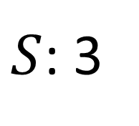
Distinct Elements
$$n$$
$S$: 3

Slide 20
Distinct Elements
 |  | 1
$$n$$
$S$: 3

Slide 21
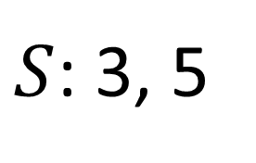
Distinct Elements
 |  | 1
$$n$$
$S$: 3, 5

Slide 22
Distinct Elements
 |  | 1 |  | 1
$$n$$
$S$: 3, 5

Slide 23
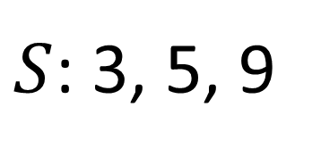
Distinct Elements
 |  | 1 |  | 1
$$n$$
$S$: 3, 5, 9

Slide 24
Distinct Elements
 |  | 1 |  | 1 |  |  |  | 1
$$n$$
$S$: 3, 5, 9

Slide 25
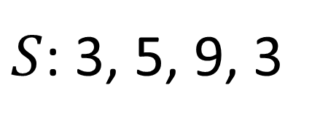
Distinct Elements
 |  | 1 |  | 1 |  |  |  | 1
$$n$$
$S$: 3, 5, 9, 3

Slide 26
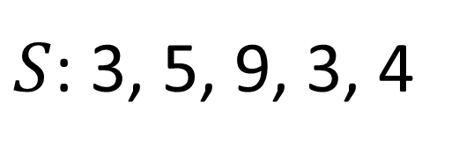
Distinct Elements
 |  | 1 | 1 | 1 |  |  |  | 1
$$n$$
$S$: 3, 5, 9, 3, 4

Slide 27
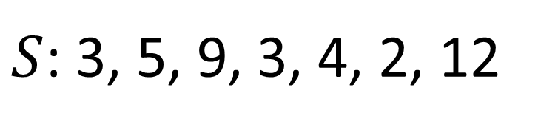
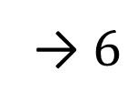
Distinct Elements
 | 1 | 1 | 1 | 1 |  |  |  | 1 |  |  | 1
→ $6$
$$n$$
$S$: 3, 5, 9, 3, 4, 2, 12

Slide 28
Distinct Elements
 | 1 | 1 | 1 | 1 |  |  |  | 1 |  |  | 1
$$n$$
$S$: 3, 5, 9, 3, 4, 2, 12

Slide 29

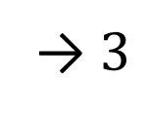
Distinct Elements
 | 1 | 1 | 1 | 1 |  |  |  | 1 |  |  | 1
$$\frac{n}{2}$$
1 | 1 |  |  |  | 1
→ $3$
$S$: 3, 5, 9, 3, 4, 2, 12

Slide 30
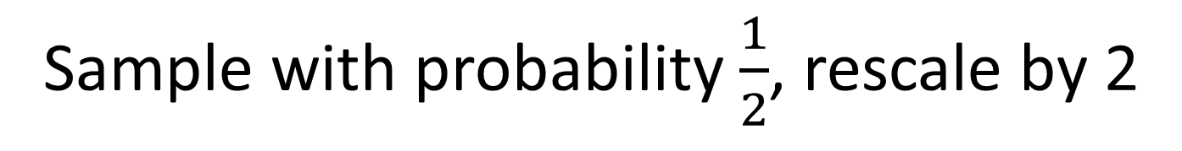
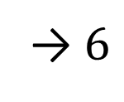
Distinct Elements
 | 1 | 1 | 1 | 1 |  |  |  | 1 |  |  | 1
$$\frac{n}{2}$$
1 | 1 |  |  |  | 1
→ $6$
Sample with probability $\frac{1}{2}$, rescale by 2

Slide 31
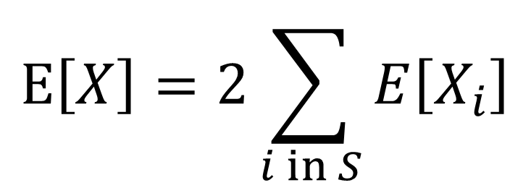
Distinct Elements
 | 1 | 1 | 1 | 1 |  |  |  | 1 |  |  | 1
$$\frac{n}{2}$$
1 | 1 |  |  |  | 1
$$E\left[X\right]=2\sum_{i in S}{E\left[X_{i}\right]}$$

Slide 32
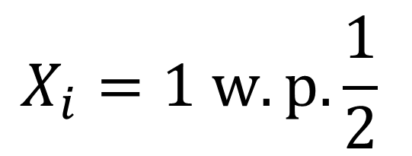
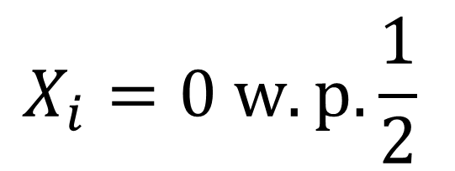
Distinct Elements
 | 1 | 1 | 1 | 1 |  |  |  | 1 |  |  | 1
$$\frac{n}{2}$$
1 | 1 |  |  |  | 1
$$X_{i}=0 w.p.\frac{1}{2}$$
$$E\left[X\right]=2\sum_{i in S}{E\left[X_{i}\right]}$$
$$X_{i}=1 w.p.\frac{1}{2}$$

Slide 33
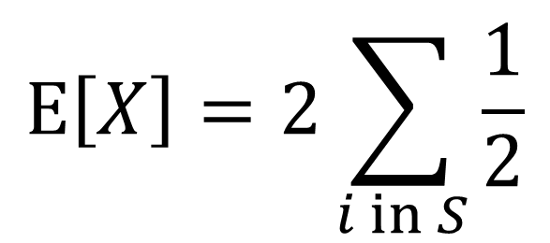
Distinct Elements
 | 1 | 1 | 1 | 1 |  |  |  | 1 |  |  | 1
$$\frac{n}{2}$$
1 | 1 |  |  |  | 1
$$X_{i}=0 w.p.\frac{1}{2}$$
$$E\left[X\right]=2\sum_{i in S}{\frac{1}{2}}$$
$$X_{i}=1 w.p.\frac{1}{2}$$

Slide 34
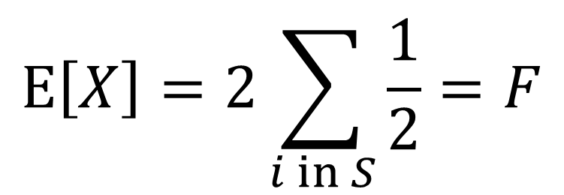
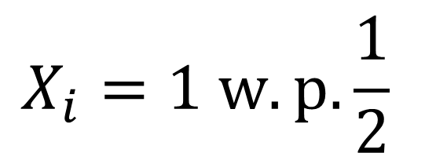
Distinct Elements
 | 1 | 1 | 1 | 1 |  |  |  | 1 |  |  | 1
$$\frac{n}{2}$$
1 | 1 |  |  |  | 1
$$X_{i}=0 w.p.\frac{1}{2}$$
$$E\left[X\right]=2\sum_{i in S}{\frac{1}{2}}=F$$
$$X_{i}=1 w.p.\frac{1}{2}$$

Slide 35
Distinct Elements
 | 1 | 1 | 1 | 1 |  |  |  | 1 |  |  | 1
1 | 1 |  |  |  | 1

Slide 36
Distinct Elements
 | 1 | 1 | 1 | 1 |  |  |  | 1 |  |  | 1
1 | 1 |  |  |  | 1
1 |  | 1

Slide 37
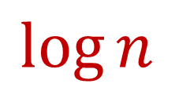
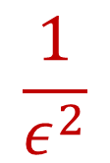
Distinct Elements
$$\log{n}$$
$$\frac{1}{ε^{2}}$$

Slide 38
Distinct Elements
 | 1
 | 1
$$\log{n}$$
$$\frac{1}{ε^{2}}$$

Slide 39
Distinct Elements
 | 1 | 1
 | 1
$$\log{n}$$
$$\frac{1}{ε^{2}}$$

Slide 40
Distinct Elements
 | 1 | 1 | 1
 | 1 |  | 1
 |  |  | 1
 |  |  | 1
 |  |  | 1
 |  |  | 1
$$\log{n}$$
$$\frac{1}{ε^{2}}$$

Slide 41
Distinct Elements
1 | 1 | 1 | 1
 | 1 |  | 1
 |  |  | 1
 |  |  | 1
 |  |  | 1
 |  |  | 1
$$\log{n}$$
$$\frac{1}{ε^{2}}$$

Slide 42
Distinct Elements
1 | 1 | 1 | 1 | 1
 | 1 |  | 1
 |  |  | 1
 |  |  | 1
 |  |  | 1
 |  |  | 1
$$\log{n}$$
$$\frac{1}{ε^{2}}$$

Slide 43
Distinct Elements
1 | 1 | 1 | 1 | 1
 | 1 |  | 1
 | 1 |  | 1
 |  |  | 1
 |  |  | 1
 |  |  | 1
$$\log{n}$$
$$\frac{1}{ε^{2}}$$

Slide 44
Distinct Elements
1 | 1 | 1 | 1 | 1 | 1
 | 1 |  | 1
 | 1 |  | 1
 |  |  | 1
 |  |  | 1
 |  |  | 1
$$\log{n}$$
$$\frac{1}{ε^{2}}$$

Slide 45

Distinct Elements
1 | 1 | 1 | 1 | 1 | 1
 | 1 |  | 1 | 1
 | 1 |  | 1
 |  |  | 1
 |  |  | 1
 |  |  | 1
$$\log{n}$$
$$\frac{1}{ε^{2}}$$

Slide 46
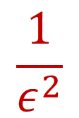
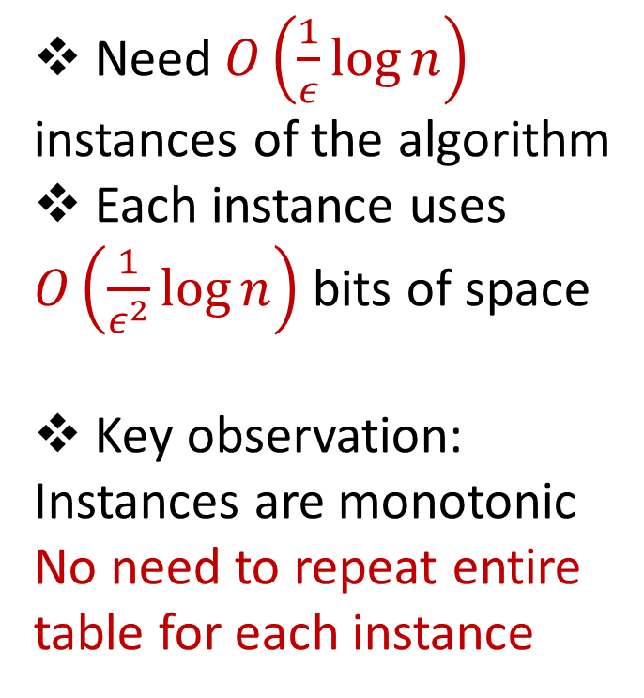

Distinct Elements on Sliding Windows
Need$O\left(\frac{1}{ε}\log{n}\right)$ instances of the algorithm
Each instance uses $O\left(\frac{1}{ε^{2}}\log{n}\right)$ bits of space
Key observation:
Instances are monotonic
No need to repeat entire table for each instance
1 | 1 | 1 | 1 | 1 | 1
 | 1 |  | 1 | 1
 | 1 |  | 1
 |  |  | 1
 |  |  | 1
 |  |  | 1
$$\log{n}$$
$$\frac{1}{ε^{2}}$$

Slide 47
Distinct Elements on Sliding Windows
1 | 1 | 1 | 1
 | 1 |  | 1
 |  |  | 1
 |  |  | 1
 |  |  | 1
 |  |  | 1
1 | 1 | 1 | 1 | 1 | 1
 | 1 |  | 1 | 1
 | 1 |  | 1
 |  |  | 1
 |  |  | 1
 |  |  | 1

Slide 48
Distinct Elements on Sliding Windows
1 | 1 | 1 | 1
 | 1 |  | 1
 |  |  | 1
 |  |  | 1
 |  |  | 1
 |  |  | 1
1 | 1 | 1 | 1 | 1 | 1
 | 1 |  | 1 | 1
 | 1 |  | 1
 |  |  | 1
 |  |  | 1
 |  |  | 1
Each cell stores the ID of the first time it is nonzero

Slide 49
Distinct Elements on Sliding Windows
1 | 1 | 1 | 1
 | 1 |  | 1
 |  |  | 1
 |  |  | 1
 |  |  | 1
 |  |  | 1
1 | 1 | 1 | 1 | 1 | 1
 | 1 |  | 1 | 1
 | 1 |  | 1
 |  |  | 1
 |  |  | 1
 |  |  | 1

Slide 50
Distinct Elements on Sliding Windows
1 | 1 | 1 | 1
 | 1 |  | 1
 |  |  | 1
 |  |  | 1
 |  |  | 1
 |  |  | 1
1 | 1 | 1 | 1 | 1 | 1
 | 1 |  | 1 | 1
 | 1 |  | 1
 |  |  | 1
 |  |  | 1
 |  |  | 1
1 | 1 | 1 | 1 | 2 | 2
 | 1 |  | 1 | 2
 | 2 |  | 1
 |  |  | 1
 |  |  | 1
 |  |  | 1

Slide 51
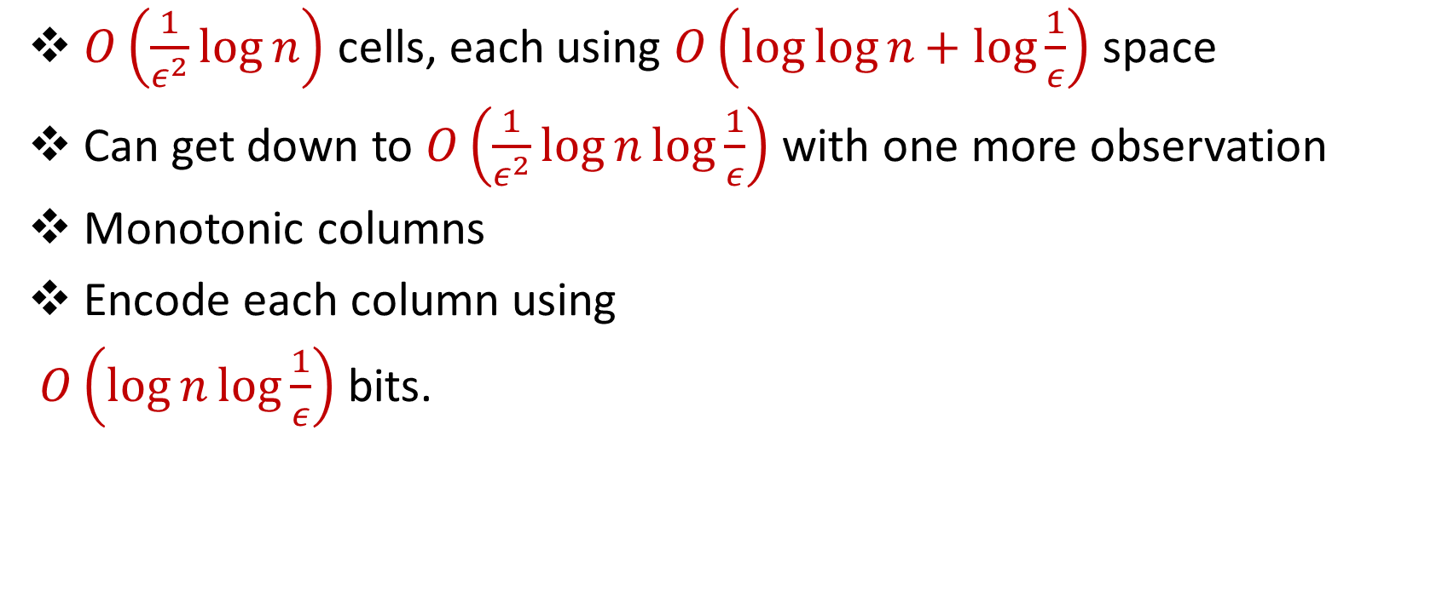
Distinct Elements on Sliding Windows
$O\left(\frac{1}{ε^{2}}\log{n}\right)$ cells, each using $O\left(\log{\log{n+ log{\frac{1}{ε}}}}\right)$ space
Can get down to $O\left(\frac{1}{ε^{2}}\log{n}\log{\frac{1}{ε}}\right)$ with one more observation
Monotonic columns
Encode each column using
$O\left(\log{n}\log{\frac{1}{ε}}\right)$ bits.
1 | 1 | 1 | 1 | 2 | 2
3 | 1 | 3 | 1 | 2 | 3
4 | 2 | 3 | 1 | 3 | 4
4 | 3 | 3 | 1
4 |  | 4 | 1
 |  |  | 1
 |  |  | 4

Slide 52
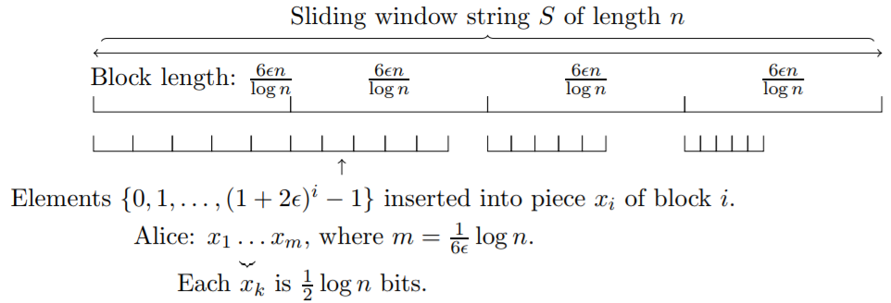

Technical Caveats
Maintenance of smooth histogram uses correctness of all instances
$Ω\left(\frac{1}{ε^{2}}\log{n}\right)$ Lower Bound
IndexGreater problem: Alice is given $S$, Bob is given $i,j$ and must decide whether $S\left[i\right]≤j$.

Slide 53


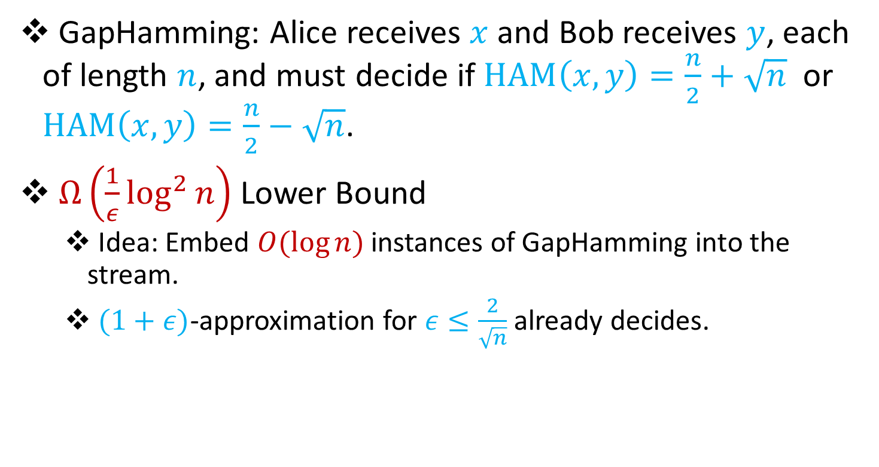
Technical Caveats
GapHamming: Alice receives $x$ and Bob receives $y$, each of length $n$, and must decide if $HAM\left(x,y\right)=\frac{n}{2}+\sqrt{n}$ or $HAM\left(x,y\right)=\frac{n}{2}−\sqrt{n}$.
$Ω\left(\frac{1}{ε}\log^{2}{n}\right)$ Lower Bound
Idea: Embed $O(log{n)}$ instances of GapHamming into the stream.
$(1+ε)$-approximation for $ε≤\frac{2}{\sqrt{n}}$ already decides.

Slide 54

Questions?

