Slide 1


Periodicity in Data Streams with Wildcards
Funda Ergun,
Elena Grigorescu,
Erfan Sadeqi Azer,
Samson Zhou
(Talk by Tatiana Kuznetsova)

Slide 2
Periodicity
A portion of a string that repeats
ABCDABCDABCDABCD
ABCDABCDABCDABCD
Finding repetitive structure
Applications:
Bioinformatics
Natural language processing
Knuth-Morris-Pratt algorithm

Slide 3
Periodicity
Alternate definition: prefix is the same as suffix
If $S$ has length $n$, and $S\left[1:n−p\right]=S\left[p+1:n\right]$, then we say $S$ has period $p$.
ABCDABCDABCDABCD
ABCDABCDABCD
ABCDABCDABCD
ABCDABCDABCDABCD

Slide 4
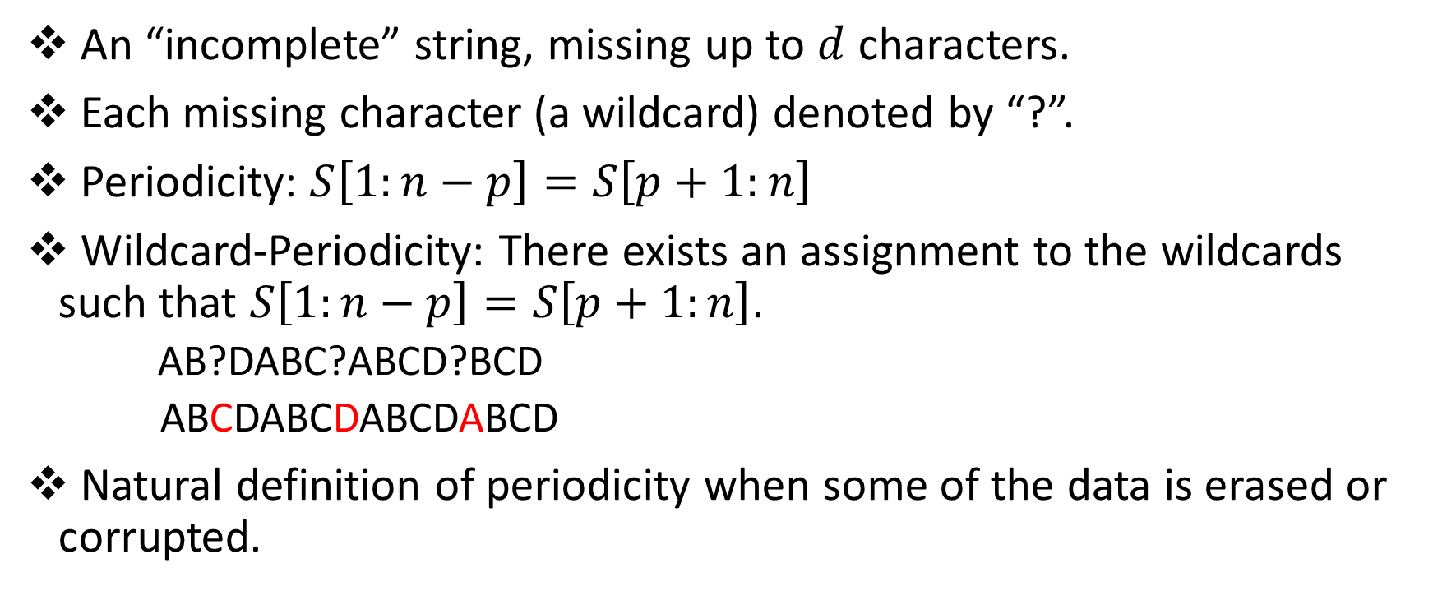
Wildcard-Periodicity
An “incomplete” string, missing up to $d$ characters.
Each missing character (a wildcard) denoted by “?”.
Periodicity: $S\left[1:n−p\right]=S\left[p+1:n\right]$
Wildcard-Periodicity: There exists an assignment to the wildcards such that $S\left[1:n−p\right]=S\left[p+1:n\right]$.
AB?DABC?ABCD?BCD
ABCDABCDABCDABCD
Natural definition of periodicity when some of the data is erased or corrupted.
Wildcard-period: 4

Slide 5

Streaming Model
String of length $n$ arrives one symbol at a time
Use $o(n)$ space, ideally $O(polylog n)$
abaacabaccbabbbcbabbccababbccb
abaacabaccbabbbcbabbccababbccb
abaacabaccbabbbcbabbccababbccb

Slide 6
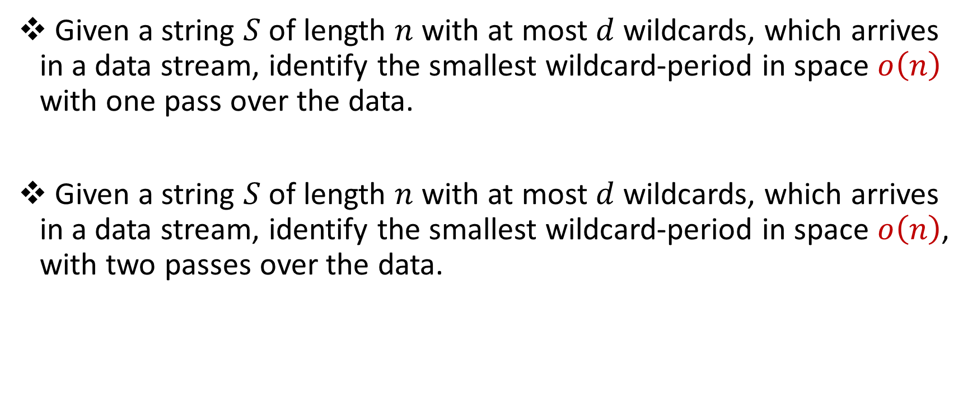
Wildcard-Periodicity Problem
Given a string $S$ of length $n$ with at most $d$ wildcards, which arrives in a data stream, identify the smallest wildcard-period in space $o\left(n\right)$ with one pass over the data.
Given a string $S$ of length $n$ with at most $d$ wildcards, which arrives in a data stream, identify the smallest wildcard-period in space $o\left(n\right)$, with two passes over the data.

Slide 7
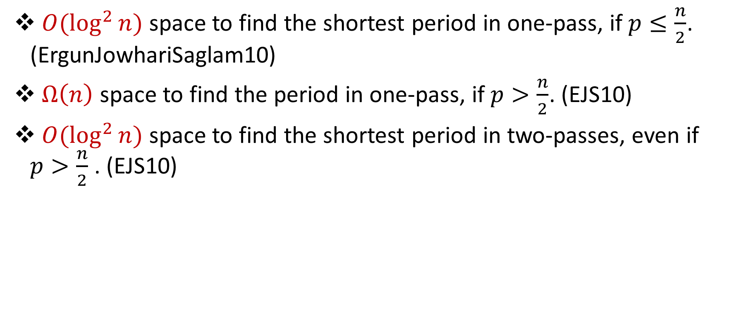
Related Work (Exact Periodicity)
$O(\log^{2}{n)}$ space to find the shortest period in one-pass, if $p≤\frac{n}{2}$. (ErgunJowhariSaglam10)
$Ω\left(n\right)$ space to find the period in one-pass, if $p>\frac{n}{2}$. (EJS10)
$O(\log^{2}{n)}$ space to find the shortest period in two-passes, even if $p>\frac{n}{2}$. (EJS10)

Slide 8

Naïve Approach 1 (Exact Periodicity)
Make a guess for each of the $d$ wildcard characters.
$O(Σ^{d})$ post-processing time.

Slide 9
Hamming Distance
Given strings $X, Y,$ the Hamming distance between $X$and $Y$ is defined as the positions $i$ at which $X_{i}≠Y_{i}$.
$S$ = HAMMING
$T$ = FALLING
$HAM(S,T)=3$

Slide 10
$k$-Periodicity
A string that is “almost” periodic, robust to $k$ changes.
Periodicity: $S\left[1:n−p\right]=S\left[p+1:n\right]$
$k$-Periodicity: $HAM\left(S\left[1:n−p\right],S\left[p+1,n\right]\right)≤k.$
ABCDABCDABCEABCE
ABCDABCDABCEABCE
ABCDABCDABCE
ABCDABCEABCE
ABCDABCDABCEABCE
Long term periodic changes, but also encompasses “natural” definition.
1-period: 4

Slide 11
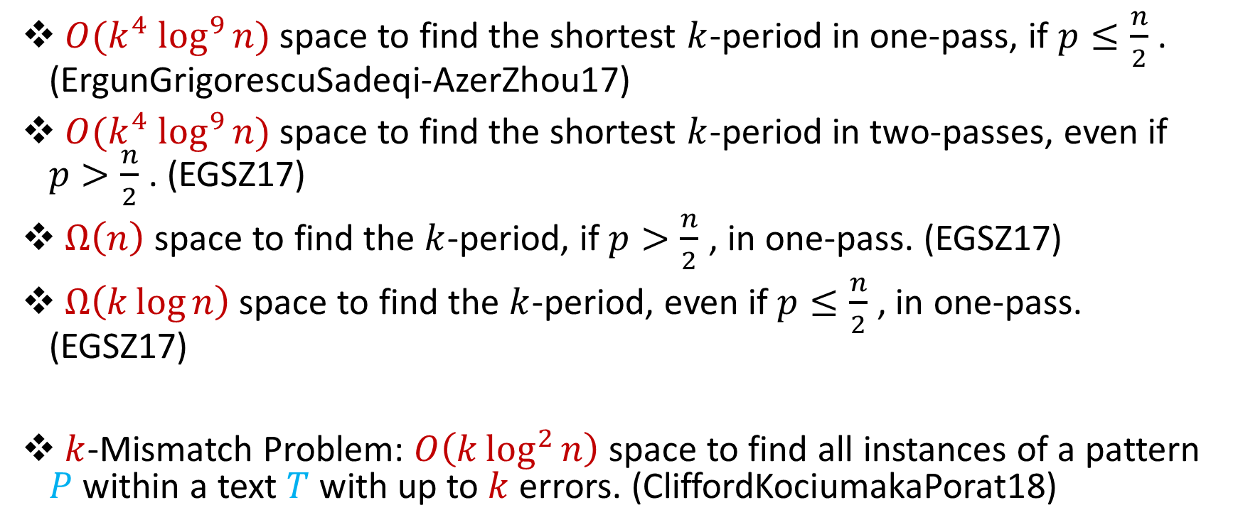

Related Work ($k$-Periodicity)
$O({k^{4} log}^{9}{n)}$ space to find the shortest $k$-period in one-pass, if $p≤\frac{n}{2}$ . (ErgunGrigorescuSadeqi-AzerZhou17)
$O({k^{4} log}^{9}{n)}$ space to find the shortest $k$-period in two-passes, even if $p>\frac{n}{2}$ . (EGSZ17)
$Ω\left(n\right)$ space to find the $k$-period, if $p>\frac{n}{2}$ , in one-pass. (EGSZ17)
$Ω\left(k\log{n}\right)$ space to find the $k$-period, even if $p≤\frac{n}{2}$ , in one-pass. (EGSZ17)
$k$-Mismatch Problem: $O\left(k\log^{2}{n}\right)$ space to find all instances of a pattern $P$ within a text $T$ with up to $k$ errors. (CliffordKociumakaPorat18)

Slide 12


Naïve Approach 2 ($k$-Periodicity)
Treat each of the $d$ wildcard characters as a “mismatch”.
$O({d^{4} log}^{9}{n)}$ space.

Slide 13
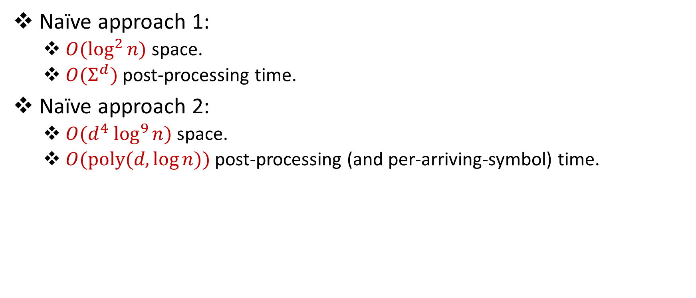
Naïve Approach (Summary)
Naïve approach 1:
$O(\log^{2}{n)}$ space.
$O(Σ^{d})$ post-processing time.
Naïve approach 2:
$O({d^{4} log}^{9}{n)}$ space.
$O(poly(d,{\log{n}))}$ post-processing (and per-arriving-symbol) time.

Slide 14
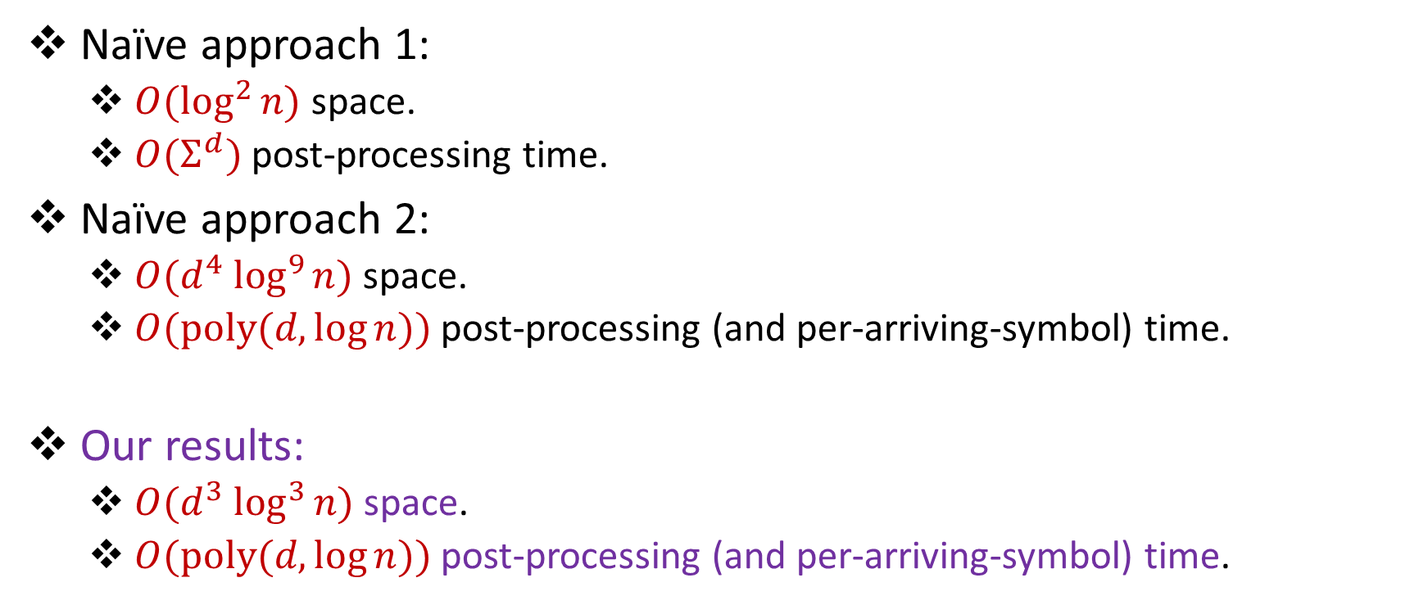
Our Results
Naïve approach 1:
$O(\log^{2}{n)}$ space.
$O(Σ^{d})$ post-processing time.
Naïve approach 2:
$O({d^{4} log}^{9}{n)}$ space.
$O(poly(d,{\log{n}))}$ post-processing (and per-arriving-symbol) time.
Our results:
$O({d^{3} log}^{3}{n)}$ space.
$O(poly(d,{\log{n}))}$ post-processing (and per-arriving-symbol) time.

Slide 15
Intuition
A period $p$ satisfies $S\left[1:n−p\right]=S\left[p+1,n\right]$ .
If $p≤\frac{n}{2}$ , then $S\left[1:\frac{n}{2}\right]=S\left[p+1,p+\frac{n}{2}\right]$ .
ABCDABCDABCDABCD
ABCDABCDABCDABCD
ABCDABCDABCDABCD
ABCDABCDABCDABCD
If $p>\frac{n}{2}$ , then for some $m$, $S\left[1:2^{m}\right]=S\left[p+1,p+2^{m}\right]$ .

Slide 16
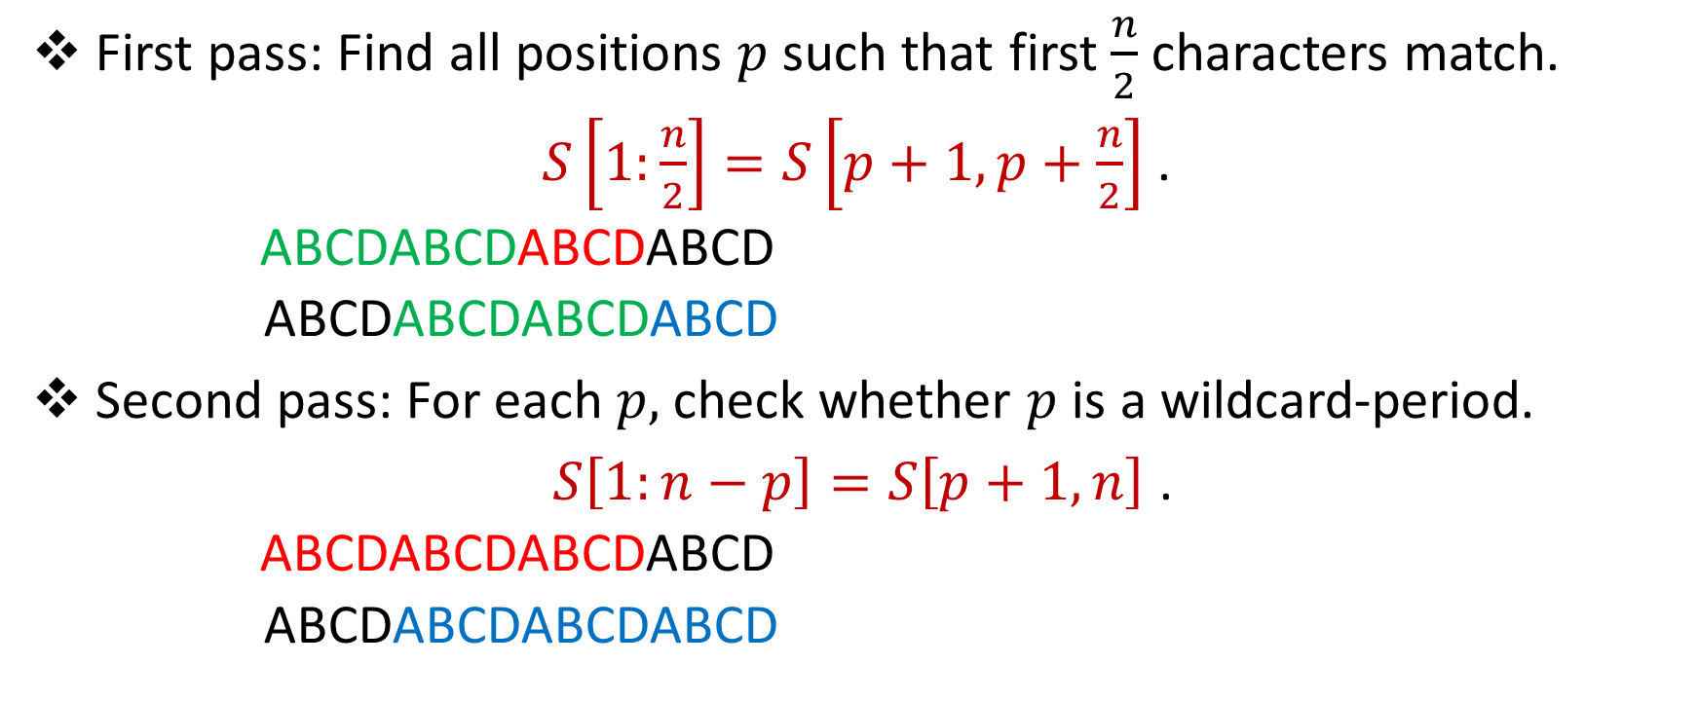
More Intuition
First pass: Find all positions $p$such that first $\frac{n}{2}$ characters match.
$S\left[1:\frac{n}{2}\right]=S\left[p+1,p+\frac{n}{2}\right]$ .
ABCDABCDABCDABCD
ABCDABCDABCDABCD
Second pass: For each $p,$ check whether $p$ is a wildcard-period.
$S\left[1:n−p\right]=S\left[p+1,n\right]$ .
ABCDABCDABCDABCD
ABCDABCDABCDABCD

Slide 17


Review
First pass: Find candidates $p$
Second pass: Check candidates $p$

Slide 18
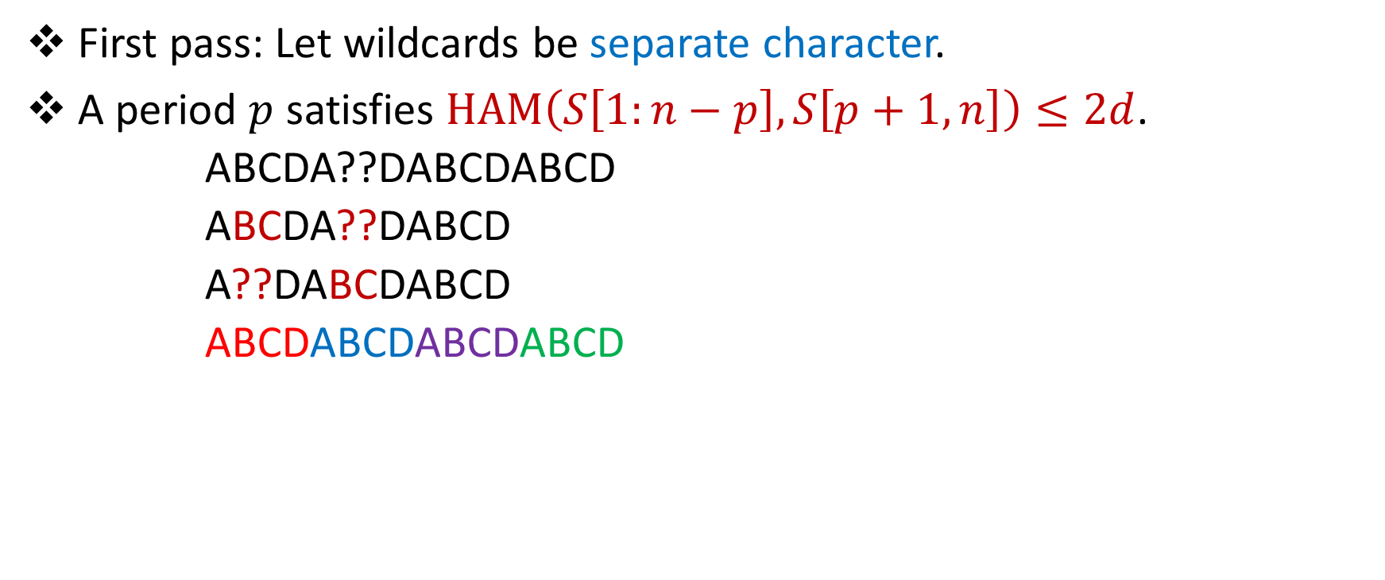
Wildcard Periodicity
First pass: Let wildcards be separate character.
A period $p$ satisfies $HAM\left(S\left[1:n−p\right],S\left[p+1,n\right]\right)≤2d$.
ABCDA??DABCDABCD
ABCDA??DABCD
A??DABCDABCD
ABCDABCDABCDABCD

Slide 19
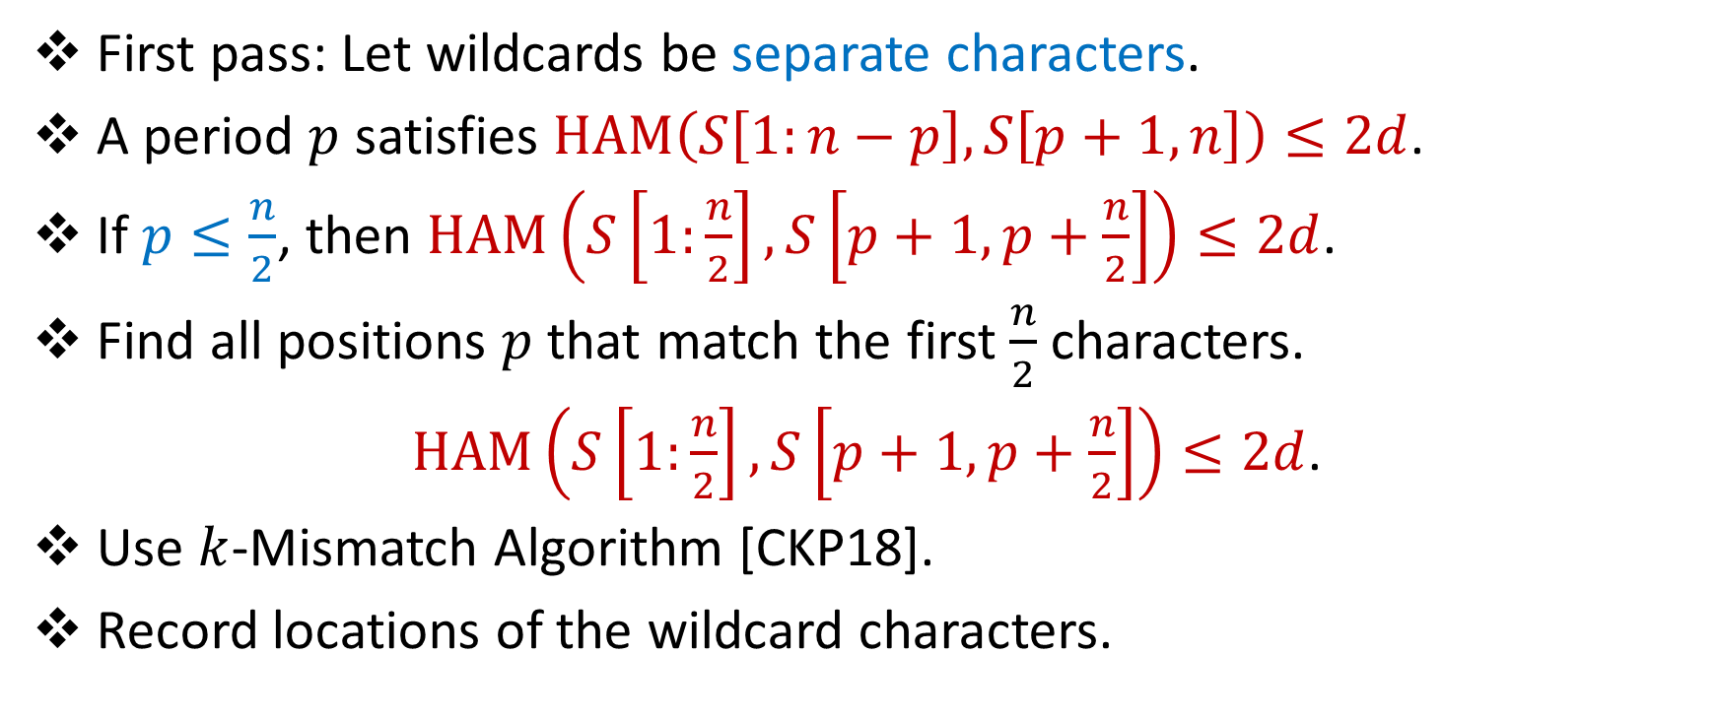
Overall Idea (First Pass)
First pass: Let wildcards be separate characters.
A period $p$ satisfies $HAM\left(S\left[1:n−p\right],S\left[p+1,n\right]\right)≤2d$.
If $p≤\frac{n}{2}$, then $HAM\left(S\left[1:\frac{n}{2}\right],S\left[p+1,p+\frac{n}{2}\right]\right)≤2d$.
Find all positions $p$ that match the first $\frac{n}{2}$ characters.
$HAM\left(S\left[1:\frac{n}{2}\right],S\left[p+1,p+\frac{n}{2}\right]\right)≤2d$.
Use $k$-Mismatch Algorithm [CKP18].
Record locations of the wildcard characters.

Slide 20

Overall Idea (Second Pass)
Second pass: For each $p,$ check whether $p$ is a wildcard-period.
Does there exist an assignment to the wildcards such that
$S\left[1:n−p\right]=S\left[p+1,n\right]$?

Slide 21
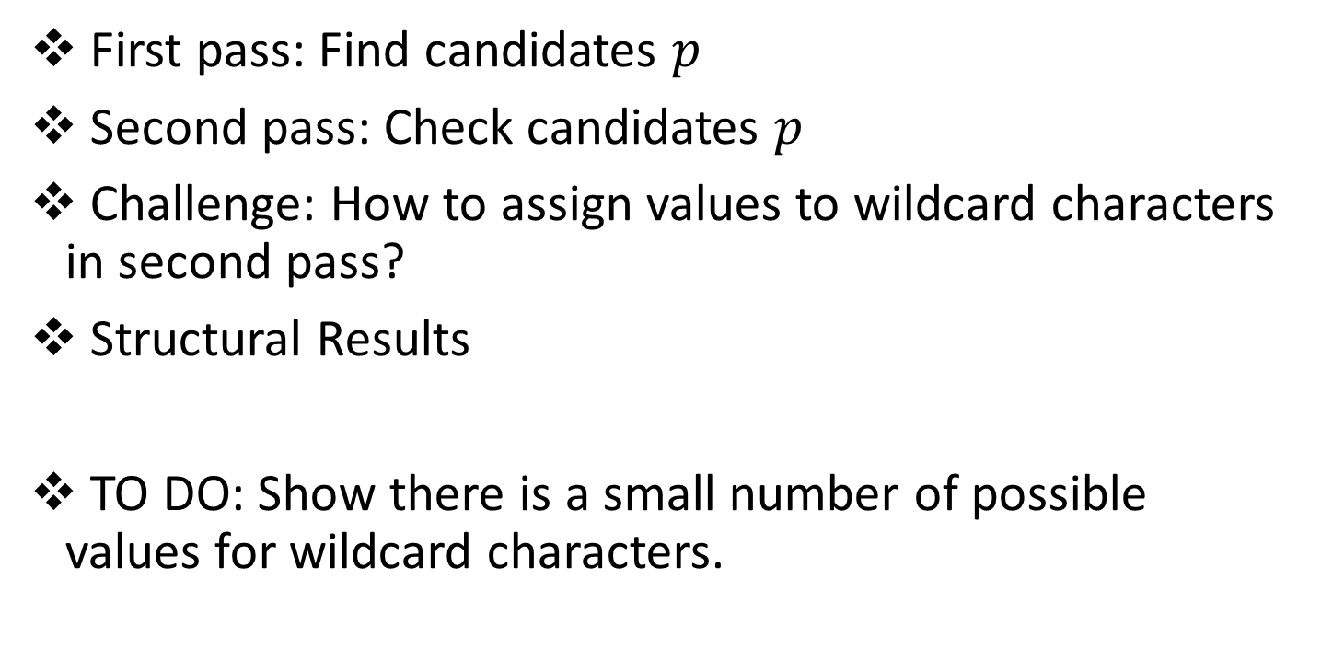
Review
First pass: Find candidates $p$
Second pass: Check candidates $p$
Challenge: How to assign values to wildcard characters in second pass?
Structural Results
TO DO: Show there is a small number of possible values for wildcard characters.

Slide 22


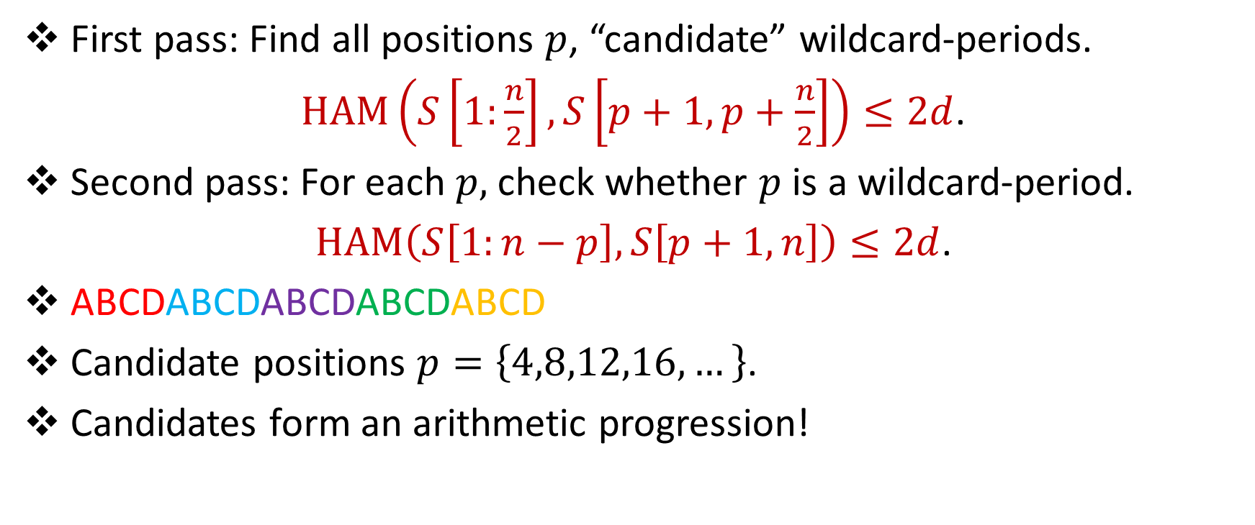
First Pass to Second Pass?
First pass: Find all positions $p$, “candidate” wildcard-periods.
$HAM\left(S\left[1:\frac{n}{2}\right],S\left[p+1,p+\frac{n}{2}\right]\right)≤2d$.
Second pass: For each $p,$ check whether $p$ is a wildcard-period.
$HAM\left(S\left[1:n−p\right],S\left[p+1,n\right]\right)≤2d$.
ABCDABCDABCDABCDABCD
Candidate positions $p=\left\{4,8,12,16,…\right\}$.
Candidates form an arithmetic progression!

Slide 23
First Pass to Second Pass?
If $p$ and $q$ are periods, then $d=gcd(p,q)$ is a period.
Does not work for $k$-periodicity!
AAAABA, $k=1$
$p=2$: AAAABA, AAAABA
AAAA
AABA
$p=3$: AAAABA, AAAABA
AAA
ABA
$p=1$: AAAABA, AAAABA
AAAAB
AAABA
1 mismatch
1 mismatch
2 mismatches!

Slide 24


Structural Results from $k$-Periodicity
Candidates actually form $O(k\log{n})$ arithmetic progressions [EGSZ17]
Each arithmetic progression can be checked by building $O(k^{2}\log{n})$ fingerprints. [EGSZ17]

Slide 25

Karp-Rabin Fingerprints
Given base $B$and a prime $P$, define $φ\left(S\right)=\sum_{i=1}^{n}{B^{i}S\left[i\right] \left(mod P\right)}$
If $S=T$, then $φ\left(S\right)=φ\left(T\right)$
If $S≠T$, then $φ\left(S\right)≠φ\left(T\right)$ w.h.p. (Schwartz-Zippel)

Slide 26

Structural Result
After first pass: $O(d\log{n})$ arithmetic progressions, locations of wildcards
Let $w_{1},w_{2},…, w_{d}$ be the locations of the wildcards.
Let $A_{i}=\{a_{1}, a_{2},{…a}_{j}\}$ be one of the arithmetic progressions.

Slide 27


Structural Result
Consider the $d$ sequences:
Recall: Each arithmetic progression can be checked by building $O(d^{2}\log{n})$ fingerprints. [EGSZ17]
Theorem: At most $O(d^{2}\log{n})$ fingerprints needed for assignments of wildcards for each arithmetic progression!
$$S\left[w_{1}+a_{1}\right],S\left[w_{1}+a_{2}\right],…,S\left[w_{1}+a_{j}\right],$$
$$S\left[w_{2}+a_{1}\right],S\left[w_{2}+a_{2}\right],…,S\left[w_{2}+a_{j}\right],$$
$$…$$
$$S\left[w_{d}+a_{1}\right],S\left[w_{d}+a_{2}\right],…,S\left[w_{d}+a_{j}\right].$$

Slide 28
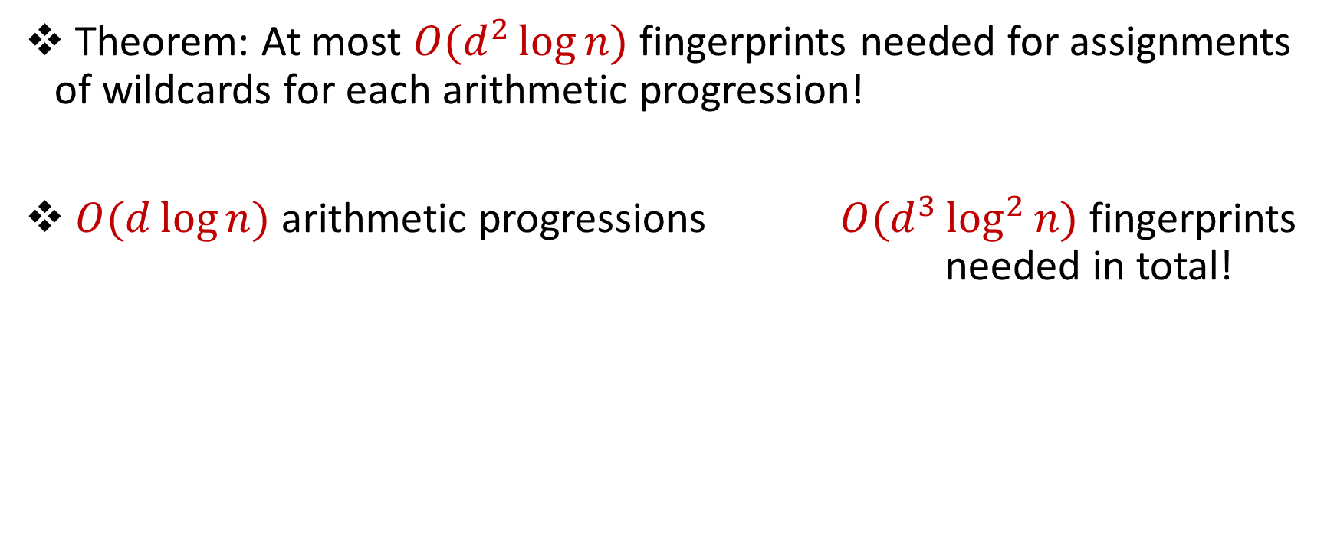
Structural Result
Theorem: At most $O(d^{2}\log{n})$ fingerprints needed for assignments of wildcards for each arithmetic progression!
$O(d\log{n})$ arithmetic progressions $O(d^{3}\log^{2}{n})$ fingerprints needed in total!

Slide 29

Review
First pass: Find candidates $p$
Second pass: Check candidates $p$
Challenge: How to assign values to wildcard characters in second pass? candidates between passes?
Structural Results
Theorem: At most $O(d^{3}\log^{2}{n})$ fingerprints needed for assignments of wildcards.

Slide 30


Questions?

Slide 31
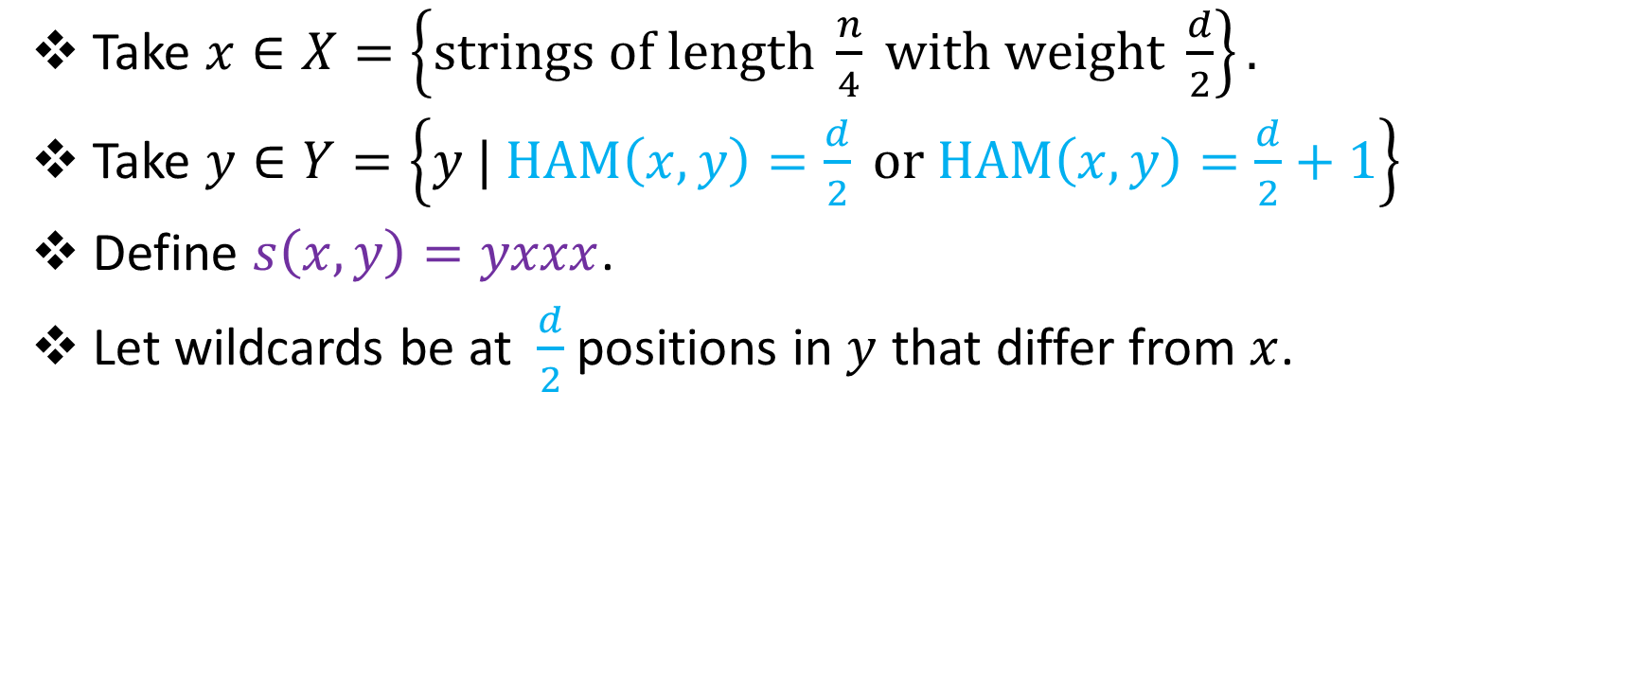
Lower Bounds
Take $x∈X=\left\{strings of length \frac{n}{4} with weight \frac{d}{2}\right\}.$
Take $y∈Y=\left\{y | HAM\left(x,y\right)=\frac{d}{2} or HAM\left(x,y\right)=\frac{d}{2}+1\right\}$
Define $s\left(x,y\right)=yxxx$.
Let wildcards be at $\frac{d}{2}$positions in $y$ that differ from $x$.

Slide 32
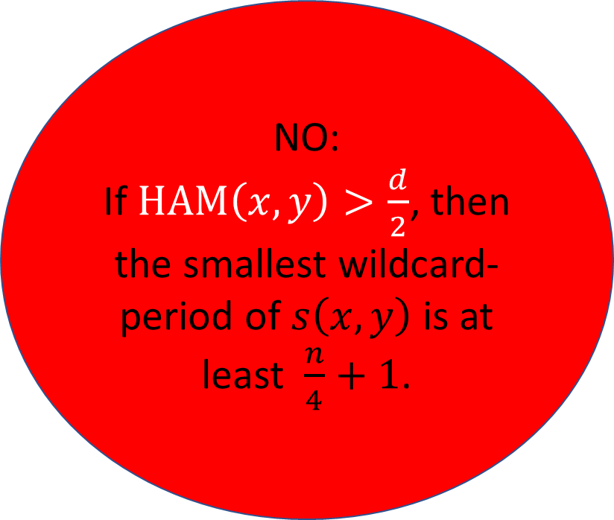
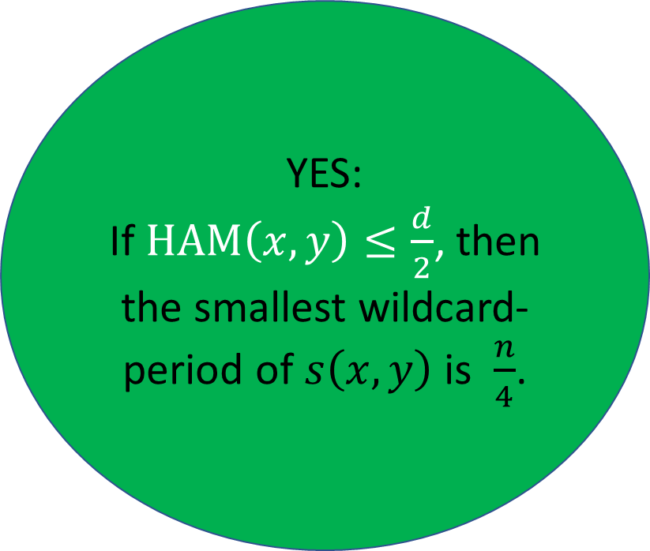
Lower Bounds
YES:
If $HAM\left(x,y\right)≤\frac{d}{2}$, then the smallest wildcard-period of $s\left(x,y\right)$ is $\frac{n}{4}$.
NO:
If $HAM\left(x,y\right)>\frac{d}{2}$, then the smallest wildcard-period of $s\left(x,y\right)$ is at least $\frac{n}{4}+1$.

Slide 33

Lower Bounds
Just need to show cannot differentiate whether $HAM\left(x,y\right)≤\frac{d}{2}$ or $HAM\left(x,y\right)>\frac{d}{2}$ in $o(d\log{n)}$ space!

Slide 34


Lower Bounds
Save $x$ in $\frac{d\log{n}}{6}$ bits.
Since $x∈X=\left\{strings of length \frac{n}{4} with weight \frac{d}{2}\right\}$, there are $\frac{|X|}{4}$ pairs $(x,x^{′})$ which are mapped to the same configuration.

Slide 35
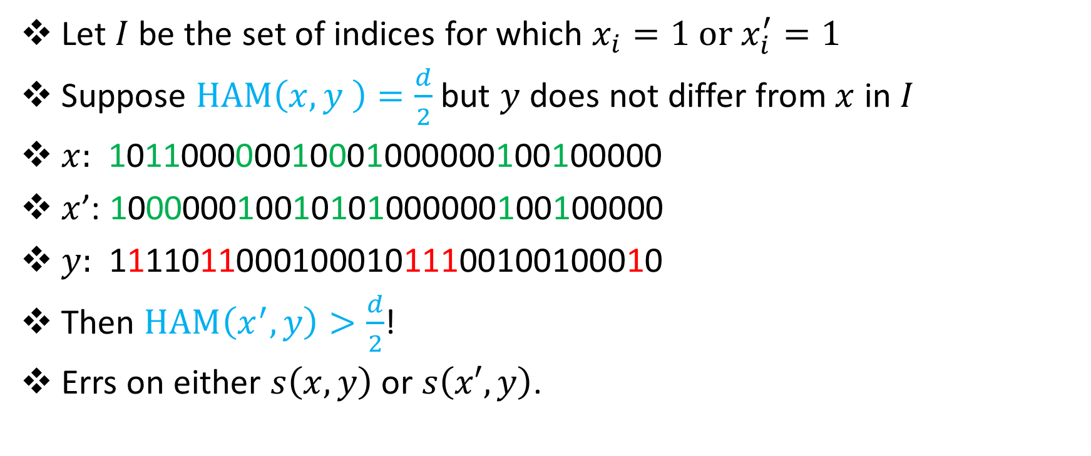
Lower Bounds
Let $I$ be the set of indices for which $x_{i}=1 or x_{i}^{′}=1$
Suppose $HAM\left(x,y \right)=\frac{d}{2}$ but $y$ does not differ from $x$ in $I$
$x:$ 101100000010001000000100100000
$x$’: 100000010010101000000100100000
$y:$ 111101100010001011100100100010
Then $HAM\left(x^{′},y\right)>\frac{d}{2}$!
Errs on either $s\left(x,y\right)$ or $s\left(x′,y\right)$.
???

Slide 36
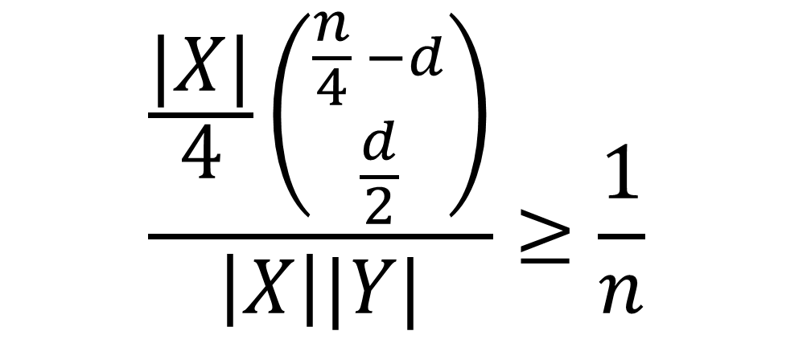
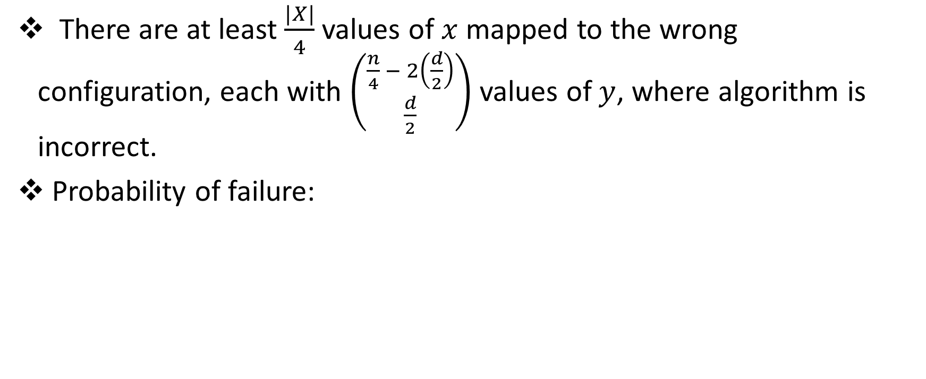
Lower Bounds
There are at least $\frac{|X|}{4}$ values of $x$ mapped to the wrong configuration, each with $\left({\frac{n}{4} − 2\left(\frac{d}{2}\right) \atop \frac{d}{2}}\right)$ values of $y$, where algorithm is incorrect.
Probability of failure:
$$\frac{\frac{|X|}{4}\left({\frac{n}{4} −d \atop \frac{d}{2}}\right)}{\left|X\right||Y|}≥\frac{1}{n}$$

Slide 37
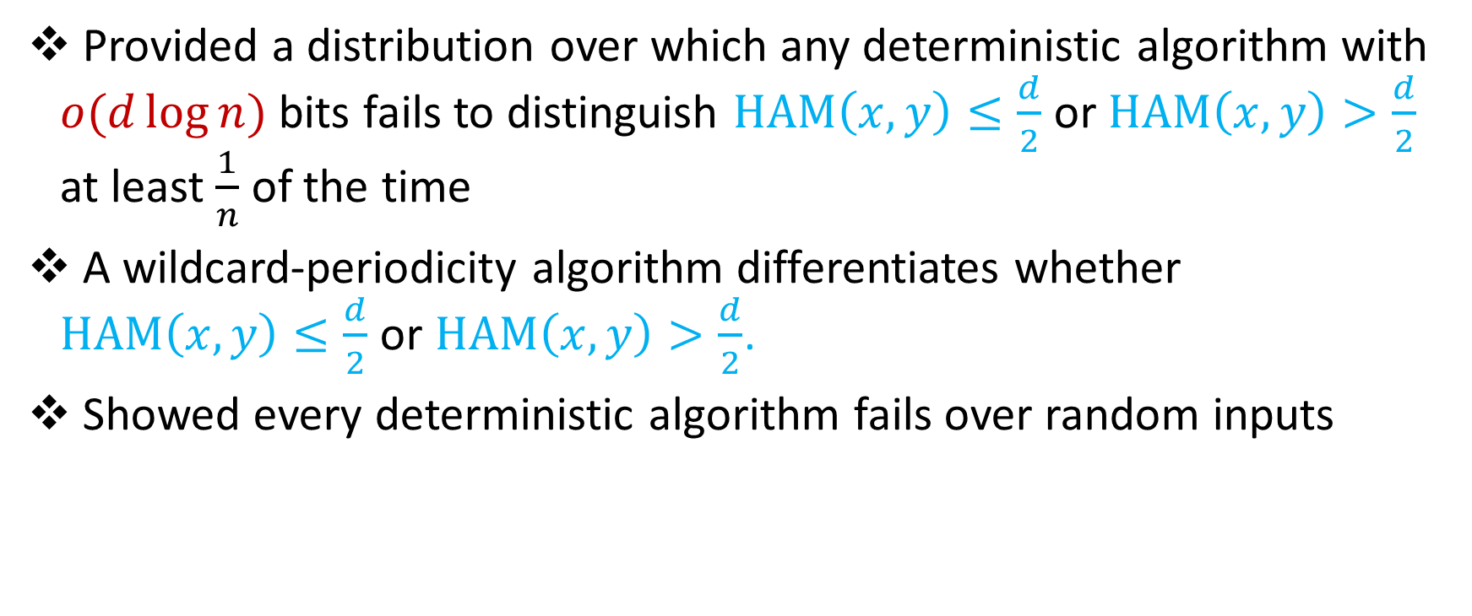
In review
Provided a distribution over which any deterministic algorithm with $o(d\log{n)}$ bits fails to distinguish $HAM\left(x,y\right)≤\frac{d}{2}$ or $HAM\left(x,y\right)>\frac{d}{2}$ at least $\frac{1}{n}$ of the time
A wildcard-periodicity algorithm differentiates whether $HAM\left(x,y\right)≤\frac{d}{2}$ or $HAM\left(x,y\right)>\frac{d}{2}$.
Showed every deterministic algorithm fails over random inputs

Slide 38
Larger Values and One-Pass Algorithm
If $p>\frac{n}{2}$ , then for some $m$, $S\left[1:2^{m}\right]=S\left[p+1,p+2^{m}\right]$ .
Run $O(\log{n)}$ instances in parallel.

Slide 39
Properties of Karp-Rabin Fingerprints
$φ\left(S[1:y]\right)=φ\left(S[1:x]\right)+B^{x}φ\left(S[x:y]\right)$ (sliding)
Define $φ^{R}\left(S\right)=\sum_{i=1}^{n}{B^{−i}S\left[i\right] \left(mod P\right)}$
$φ\left(S^{R}[1:x]\right)=B^{x+1}φ^{R}\left(S[1:x]\right)$ (reversal)
$φ^{R}\left(S[1:y]\right)=φ^{R}\left(S[1:x]\right)+B^{−x}φ^{R}\left(S[x:y]\right)$

