Slide 1

Points

Slide 2
Points

Slide 3

Query

Slide 4
Query

Slide 5
Query

Slide 6
Sample Points

Slide 7
x1
x2
x5
x4
x9
x1
x5
Reweight
x1

Slide 8
Query

Slide 9
Query

Slide 10
Query

Slide 11
Query

Slide 12
Query

Slide 13
Query

Slide 14
Reweight

Slide 15
Algorithm doesn’t know “best” samples
x1
x2
x5
x4
x9
x1
x5
Reweight
x1

Slide 16
Algorithm doesn’t know “best” samples
x1
x2
x5
x4
x9
x1
x5
Coreset
x1

Slide 17
Algorithm doesn’t know “best” samples
x1
x2
x5
x4
x9
x1
x5
Query Independent!
x1

Slide 18
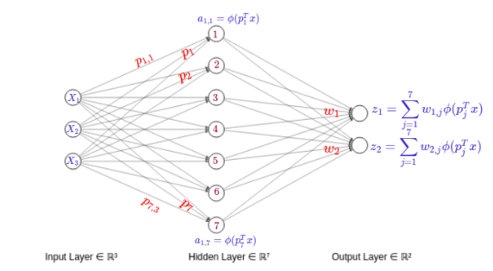
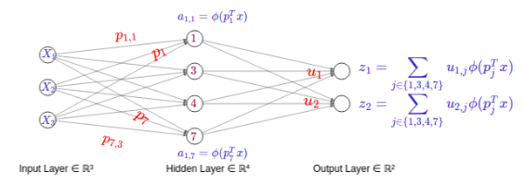
→
Coresets for Neural Networks

Slide 19
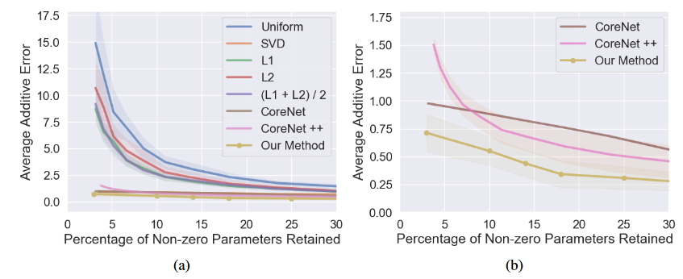
Average accuracy of various algorithms on LeNet-200-105 on MNIST dataset across different sparsity rates. (a) shows the results of all tested methods. (b) zooms in on the three top methods. Our method, which constructs neural coresets in a layer-by-layer fashion, outperforms other coreset-based algorithms

Slide 20
Okay so running time improves…
What about accuracy?
Average accuracy of various algorithms on LeNet-200-105 on MNIST dataset across different sparsity rates. (a) shows the results of all tested methods. (b) zooms in on the three top methods. Our method, which constructs neural coresets in a layer-by-layer fashion, outperforms other coreset-based algorithms

Slide 21
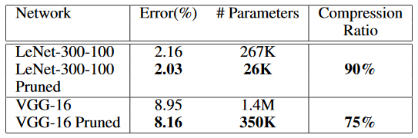
Empirical evaluations of our coresets on existing architectures for MNIST and CIFAR-10. Note the improvement of accuracy in both cases, despite the compression ratio

Slide 22
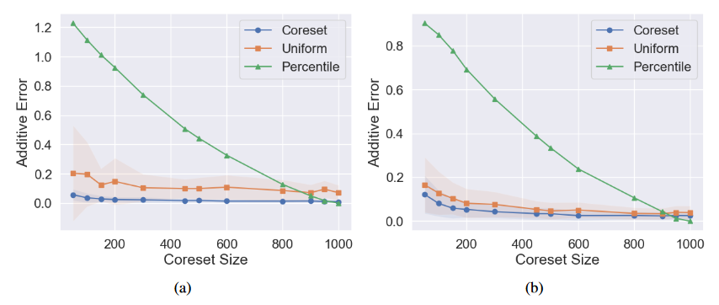
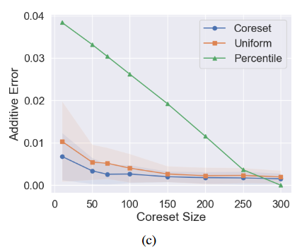
Approximation error of a single neuron on MNIST dataset across different coreset sizes. The weights of the points in (a) are drawn from the Gaussian distribution, in (b) from the Uniform distribution and in (c) we used the trained weights from LeNet-300-100. Our coreset outperforms other reduction methods.

Slide 23
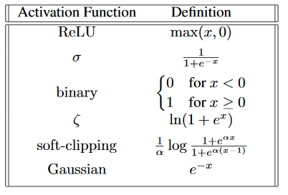
A coreset for a set of points P with weights w and a function f is a set of points Q with weights u such that f(P,w)≈f(Q,u).
Theorem: No coreset for multiplicative error.
Idea: There exists a set of points and a function such that all points are important, depending on the query.
Theorem: Coresets for many popular activation functions for additive error.
Idea: Sample points based on their sensitivity, a measure of importance
Examples of functions with O(1/ε²) size coreset:

Slide 24
Query

