Slide 1




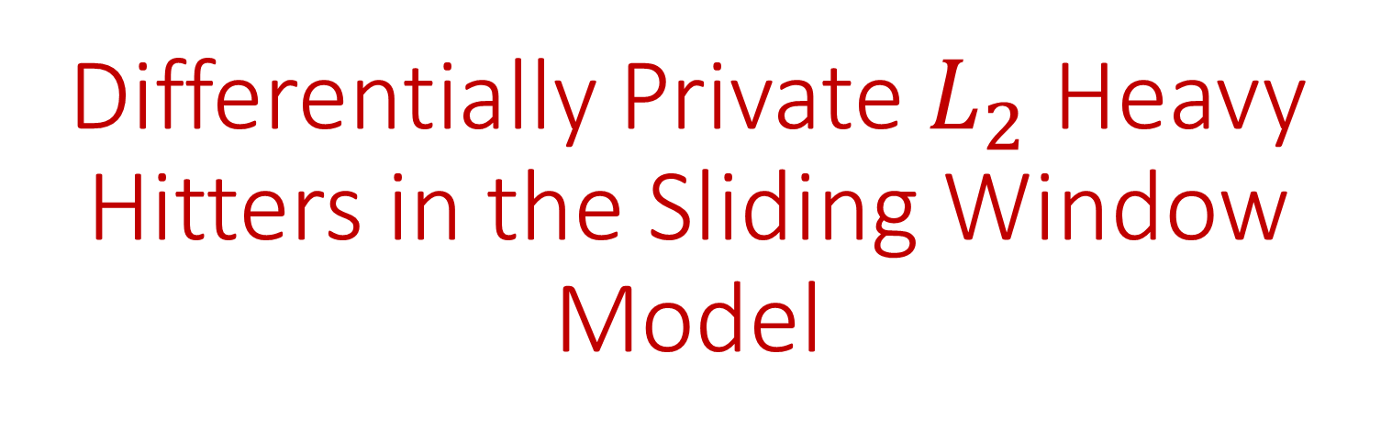
Differentially Private $L_{2}$Heavy Hitters in the Sliding Window Model
Jeremiah Blocki
Seunghoon Lee
Tamalika Mukherjee
Samson Zhou

Slide 2
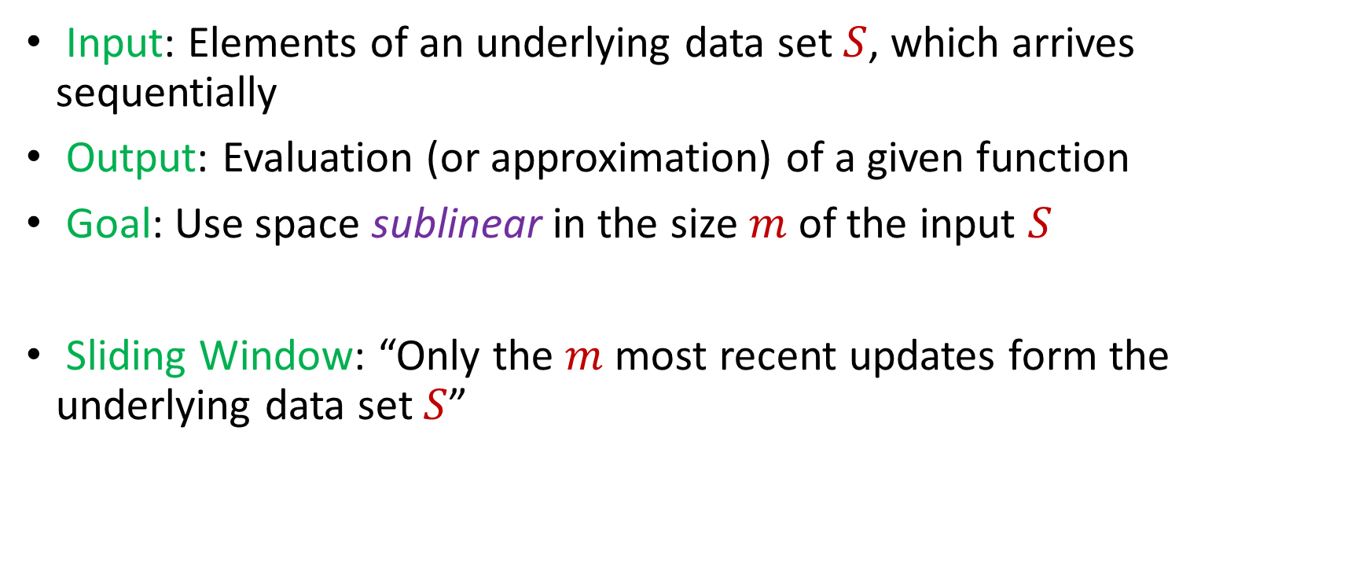
Sliding Window Model
Input: Elements of an underlying data set $S$, which arrives sequentially
Output: Evaluation (or approximation) of a given function
Goal: Use space sublinear in the size $m$of the input $S$
Sliding Window: “Only the $m$ most recent updates form the underlying data set $S$”
1 0 1 1 1 0 0 1
Notes:
Let’s start by breaking down each of the terms in the title. To understand the sliding window model, we first have to understand the streaming model of computation, in which elements of an underlying data set S, arrive sequentially and the goal is to evaluate or approximate some given function on this dataset, using space sublinear in S. In the sliding window model, only the W most recent updates form the underlying data set

Slide 3
Sliding Window Model
Input: Elements of an underlying data set $S$, which arrives sequentially
Output: Evaluation (or approximation) of a given function
Goal: Use space sublinear in the size $m$of the input $S$
Sliding Window: “Only the $m$ most recent updates form the underlying data set $S$”
1 0 1 1 1 0 0 1 1

Slide 4
Sliding Window Model
Input: Elements of an underlying data set $S$, which arrives sequentially
Output: Evaluation (or approximation) of a given function
Goal: Use space sublinear in the size $m$of the input $S$
Sliding Window: “Only the $m$ most recent updates form the underlying data set $S$”
1 0 1 1 1 0 0 1 1 0

Slide 5

Sliding Window Model
Input: Elements of an underlying data set $S$, which arrives sequentially
Output: Evaluation (or approximation) of a given function
Goal: Use space sublinear in the size $m$of the input $S$
Sliding Window: “Only the $m$ most recent updates form the underlying data set $S$”
Emphasizes recent interactions, appropriate for time sensitive settings
1 0 1 1 1 0 0 1 1 0 1
Notes:
The sliding window model emphasizes recent data and thus is appropriate for settings that are time sensitive.

Slide 6
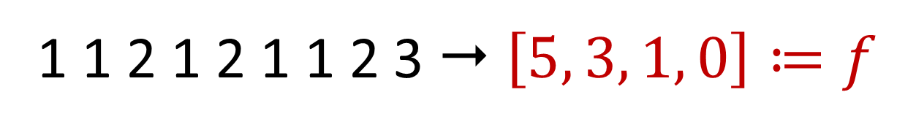

Frequency Vector
Given a set $S$ of $m$ elements from $[n]$, let $f_{i}$ be the frequency of element $i$. (How often it appears)
1 1 2 1 2 1 1 2 3  $\left[5, 3, 1, 0\right]≔f$

Slide 7
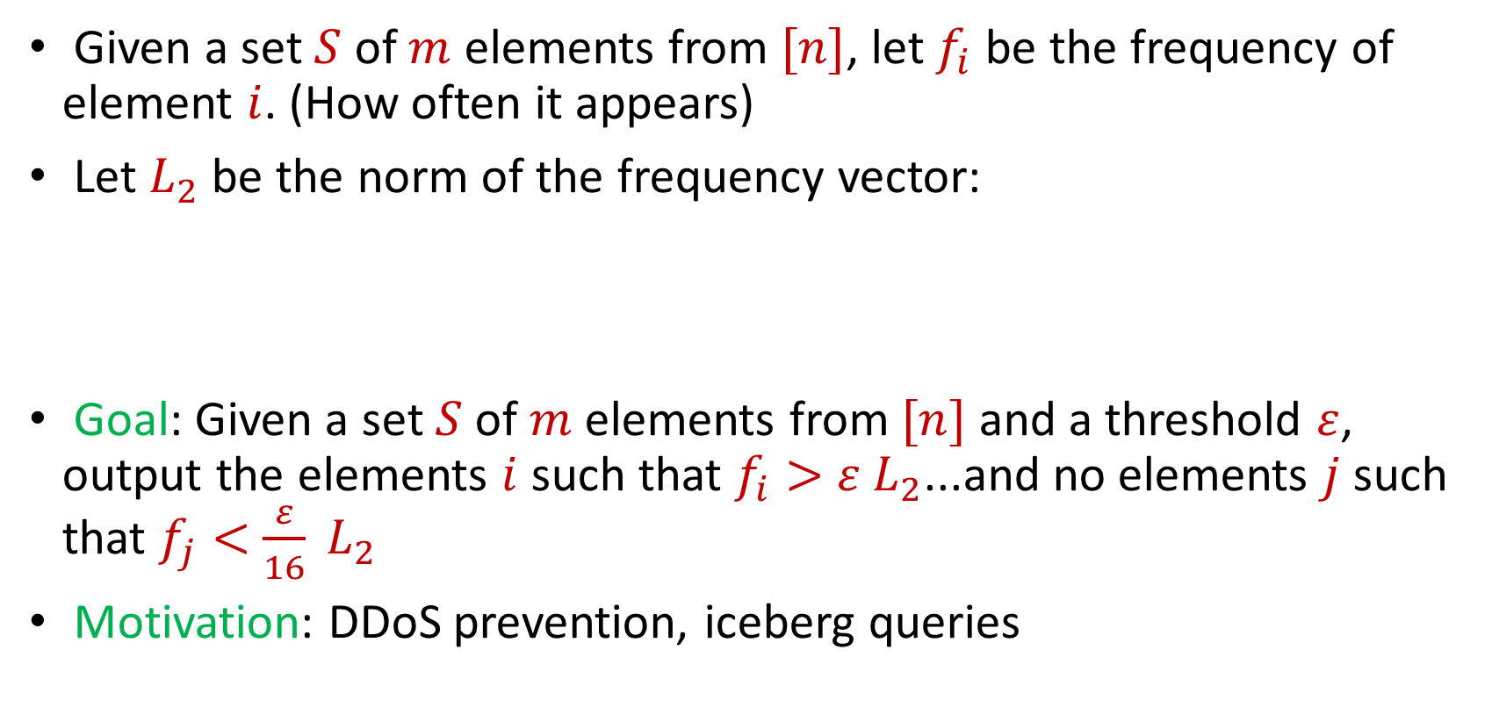
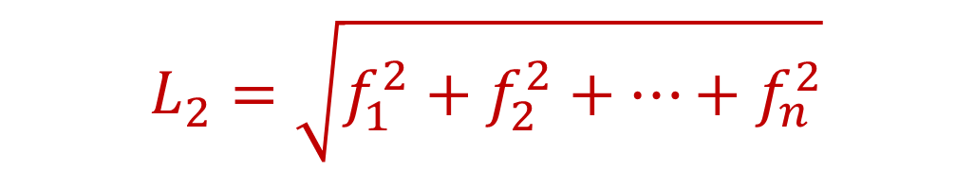
Heavy-Hitters (Frequent Items)
Given a set $S$ of $m$ elements from $[n]$, let $f_{i}$ be the frequency of element $i$. (How often it appears)
Let $L_{2}$ be the norm of the frequency vector:
Goal: Given a set $S$ of $m$ elements from $[n]$ and a threshold $ε$, output the elements $i$ such that $f_{i}>$ $ε L_{2}$...and no elements $j$ such that $f_{j}<$ $\frac{ε}{16} L_{2}$
Motivation: DDoS prevention, iceberg queries
$$L_{2}=\sqrt{f_{1}^{2}+f_{2}^{2}+…+f_{n}^{2}}$$

Slide 8





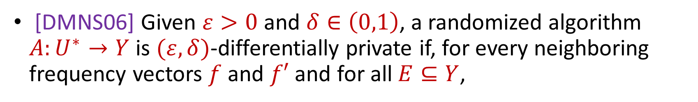
Differential Privacy (DP)
[DMNS06] Given $ε>0$and $δ∈\left(0,1\right)$, a randomized algorithm $A:U^{∗}→Y$ is $(ε,δ)$-differentially private if, for every neighboring frequency vectors $f$ and $f′$ and for all $E⊆Y$,
$$Pr\left[A\left(f\right)∈E\right]≤e^{ε}Pr\left[A\left(f^{′}\right)∈E\right]+δ$$
$$A\left( \right)≈A\left( \right)$$
Notes:
[DworkMcSherryNissimSmith06]

Slide 9
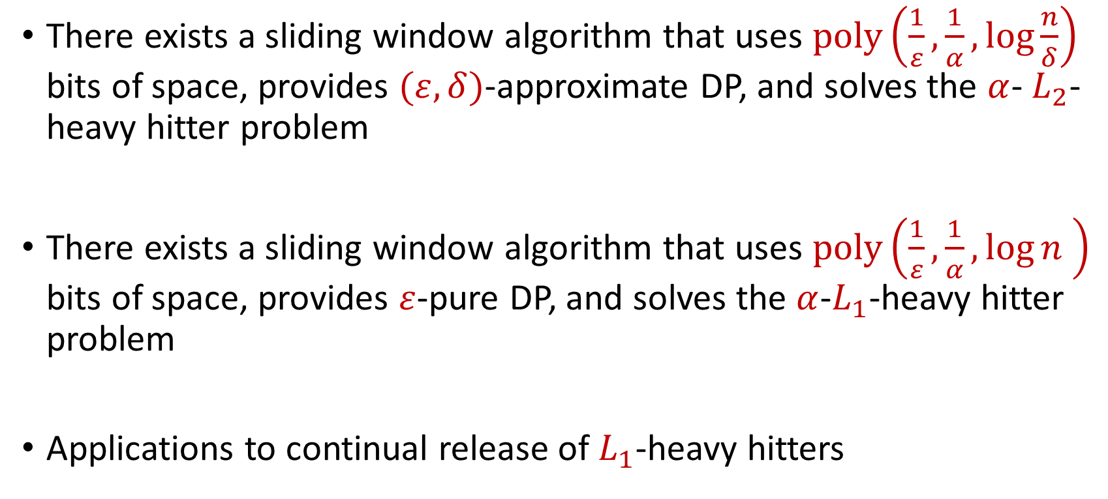
Our Results
There exists a sliding window algorithm that uses $poly\left(\frac{1}{ε},\frac{1}{α},\log{\frac{n}{δ}}\right)$ bits of space, provides $(ε,δ)$-approximate DP, and solves the $α$- $L_{2}$-heavy hitter problem
There exists a sliding window algorithm that uses $poly\left(\frac{1}{ε},\frac{1}{α},\log{n} \right)$ bits of space, provides $ε$-pure DP, and solves the $α$-$L_{1}$-heavy hitter problem
Applications to continual release of $L_{1}$-heavy hitters

