Slide 1

Learning a Latent Simplex in Input-Sparsity Time
Ainesh Bakshi (Carnegie Mellon University)
Chiranjib Bhattacharyya (Indian Institute of Science)
Ravi Kannan (Microsoft Research India)
David P. Woodruff (Carnegie Mellon University)
Samson Zhou (Carnegie Mellon University)

Slide 2


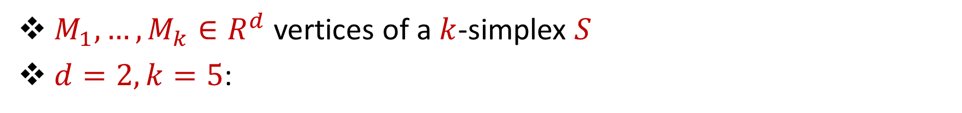



Latent Simplex Model
$M_{1},…, M_{k}∈R^{d}$ vertices of a $k$-simplex $S$
$d=2, k=5$:
$$M_{1}$$
$$M_{5}$$
$$M_{2}$$
$$M_{4}$$
$$M_{3}$$

Slide 3



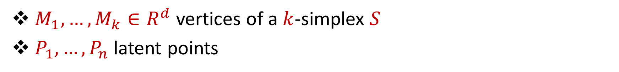






Latent Simplex Model
$M_{1},…, M_{k}∈R^{d}$ vertices of a $k$-simplex $S$
$P_{1},…, P_{n}$ latent points
$$M_{1}$$
$$P_{5}$$
$$M_{5}$$
$$P_{3}$$
$$P_{10}$$
$$M_{2}$$
$$P_{1}$$
$$P_{4}$$
$$P_{2}$$
$$P_{6}$$
$$P_{8}$$
$$P_{7}$$
$$M_{4}$$
$$M_{3}$$

Slide 4




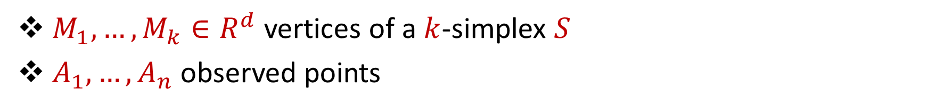






Latent Simplex Model
$M_{1},…, M_{k}∈R^{d}$ vertices of a $k$-simplex $S$
$A_{1},…, A_{n}$ observed points
$$M_{1}$$
$$A_{5}$$
$$M_{5}$$
$$A_{3}$$
$$A_{10}$$
$$M_{2}$$
$$A_{4}$$
$$A_{1}$$
$$A_{2}$$
$$A_{6}$$
$$A_{9}$$
$$A_{7}$$
$$A_{8}$$
$$M_{4}$$
$$M_{3}$$

Slide 5
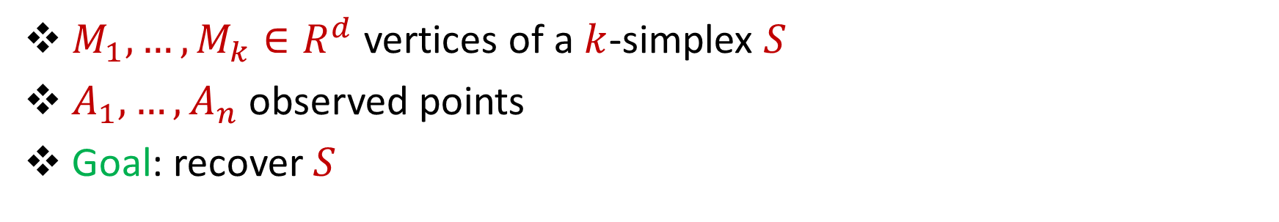
Latent Simplex Model
$M_{1},…, M_{k}∈R^{d}$ vertices of a $k$-simplex $S$
$A_{1},…, A_{n}$ observed points
Goal: recover $S$
$$M_{1}$$
$$A_{5}$$
$$M_{5}$$
$$A_{3}$$
$$A_{10}$$
$$M_{2}$$
$$A_{4}$$
$$A_{1}$$
$$A_{2}$$
$$A_{6}$$
$$A_{9}$$
$$A_{7}$$
$$A_{8}$$
$$M_{4}$$
$$M_{3}$$

Slide 6
Applications/Motivations
Topic models: identify abstract topics in a collection of documents by discovering latent semantic structure
Mixed membership block stochastic model: recover communities in a network by observing frequencies of communication between nodes
Adversarial clustering: learn the centers of clusters whose mixture forms a set of latent points that may be perturbed adversarially but with bounded norm

Slide 7
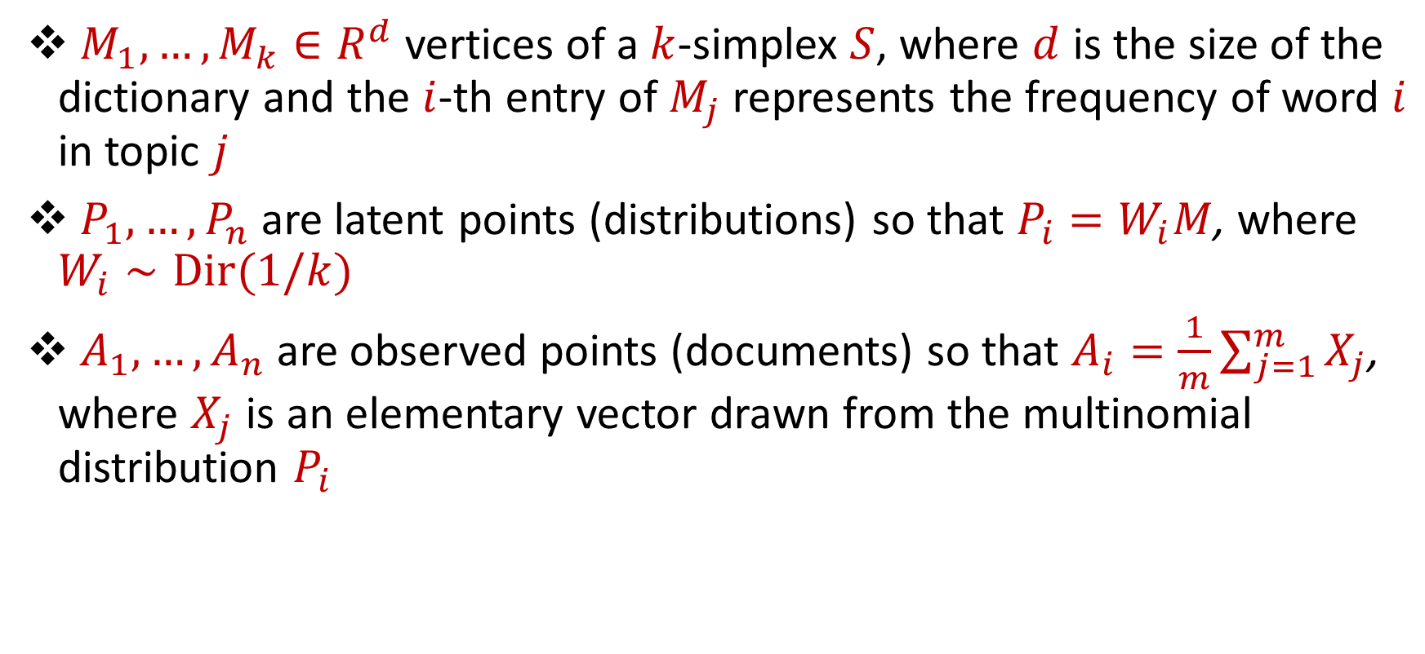
Topic Model (Latent Dirichlet Allocation)
$M_{1},…, M_{k}∈R^{d}$ vertices of a $k$-simplex $S$, where $d$ is the size of the dictionary and the $i$-th entry of $M_{j}$ represents the frequency of word $i$ in topic $j$
$P_{1},…, P_{n}$ are latent points (distributions) so that $P_{i}=W_{i}M$, where $W_{i}∼Dir(1/k)$
$A_{1},…, A_{n}$ are observed points (documents) so that $A_{i}=\frac{1}{m}\sum_{j=1}^{m}{X_{j}}$, where $X_{j}$ is an elementary vector drawn from the multinomial distribution $P_{i}$

Slide 8
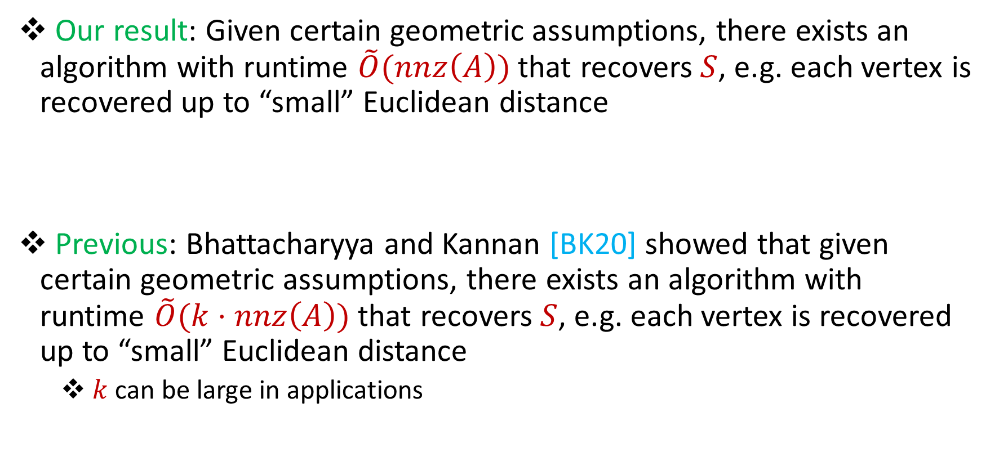
Results and Related Work
Our result: Given certain geometric assumptions, there exists an algorithm with runtime $\tilde{O}(nnz\left(A\right))$ that recovers $S$, e.g. each vertex is recovered up to “small” Euclidean distance
Previous: Bhattacharyya and Kannan [BK20] showed that given certain geometric assumptions, there exists an algorithm with runtime $\tilde{O}(k⋅nnz\left(A\right))$ that recovers $S$, e.g. each vertex is recovered up to “small” Euclidean distance
$k$ can be large in applications

Slide 9




Assumptions (1)
[Well-Separateness] Each simplex vertex has non-trivial mass in the orthogonal complement of the span of the remaining vectors
Also assumed by [BK20]
$$M_{1}$$
$$M_{2}$$
$$M_{3}$$
$$M_{4}$$

Slide 10
Assumptions (2)
[Proximate Latent Points] There exists a significant fraction of points near each simplex vertex
Also assumed by [BK20]
$$M_{1}$$
$$M_{5}$$
$$M_{2}$$
$$M_{4}$$
$$M_{3}$$

Slide 11


Assumptions (3)
[Spectrally Bounded Perturbation] Total mass of perturbation should not be too large
Also assumed by [BK20]
$$M_{1}$$
$$M_{2}$$

Slide 12

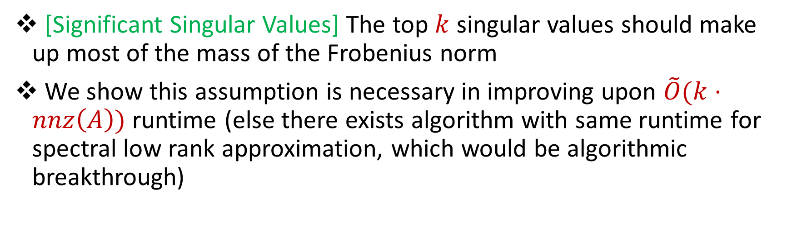

Assumptions (4)
[Significant Singular Values] The top $k$ singular values should make up most of the mass of the Frobenius norm
We show this assumption is necessary in improving upon $\tilde{O}(k⋅nnz\left(A\right))$ runtime (else there exists algorithm with same runtime for spectral low rank approximation, which would be algorithmic breakthrough)
$$M_{1}$$
$$M_{2}$$

Slide 13
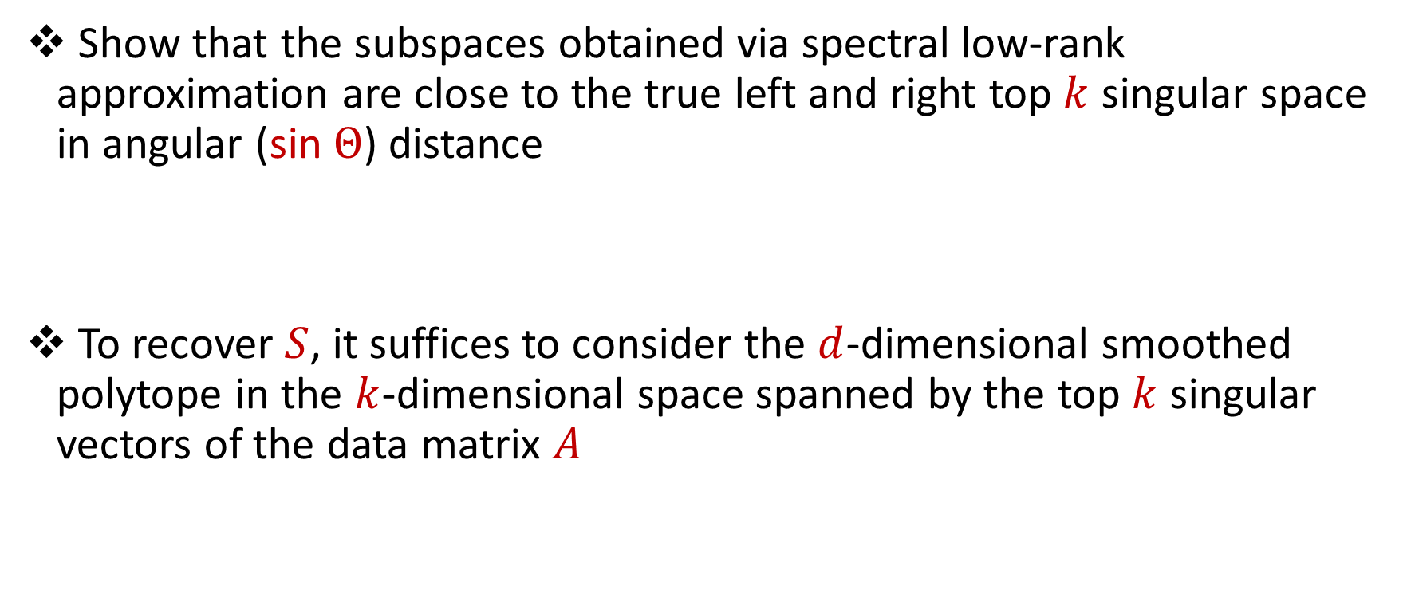
Technical Contribution
Show that the subspaces obtained via spectral low-rank approximation are close to the true left and right top $k$ singular space in angular (sin $Θ$) distance
To recover $S$, it suffices to consider the $d$-dimensional smoothed polytope in the $k$-dimensional space spanned by the top $k$ singular vectors of the data matrix $A$

Slide 14
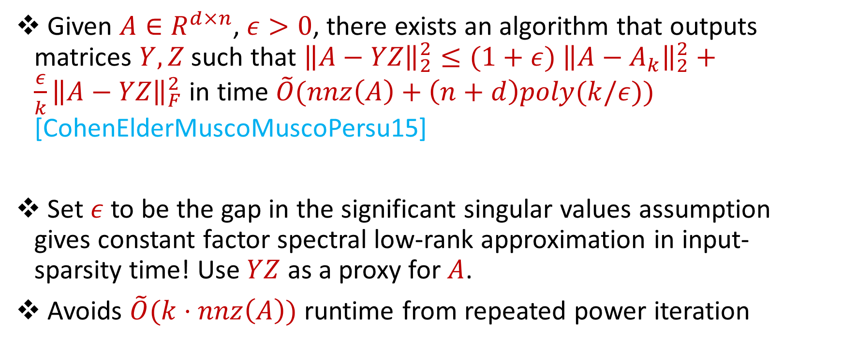
Input-Sparsity Spectral-Frobenius LRA
Given $A∈R^{d×n}$, $ε>0$, there exists an algorithm that outputs matrices $Y,Z$ such that ${\left\|A−YZ\right\|}_{2}^{2}≤(1+ε)$ ${\left\|A−A_{k}\right\|}_{2}^{2}+\frac{ε}{k}{\left\|A−YZ\right\|}_{F}^{2}$ in time $\tilde{O}(nnz\left(A\right)+\left(n+d\right)poly(k/ε))$ [CohenElderMuscoMuscoPersu15]
Set $ε$ to be the gap in the significant singular values assumption gives constant factor spectral low-rank approximation in input-sparsity time! Use $YZ$ as a proxy for $A$.
Avoids $\tilde{O}(k⋅nnz\left(A\right))$ runtime from repeated power iteration

Slide 15
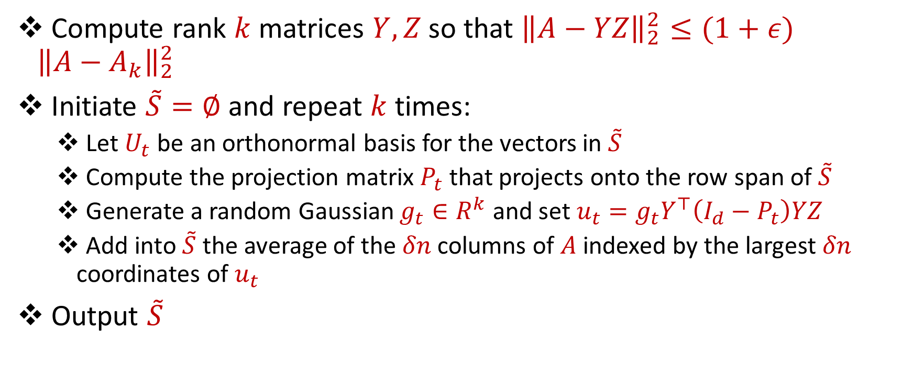
Our Algorithm
Compute rank $k$matrices $Y,Z$ so that ${\left\|A−YZ\right\|}_{2}^{2}≤(1+ε)$ ${\left\|A−A_{k}\right\|}_{2}^{2}$
Initiate $\tilde{S}=∅$ and repeat $k$ times:
Let $U_{t}$ be an orthonormal basis for the vectors in $\tilde{S}$
Compute the projection matrix $P_{t}$ that projects onto the row span of $\tilde{S}$
Generate a random Gaussian $g_{t}∈R^{k}$ and set $u_{t}=g_{t}Y^{⊤}\left(I_{d}−P_{t}\right)YZ$
Add into $\tilde{S}$ the average of the $δn$ columns of $A$ indexed by the largest $δn$ coordinates of $u_{t}$
Output $\tilde{S}$

Slide 16
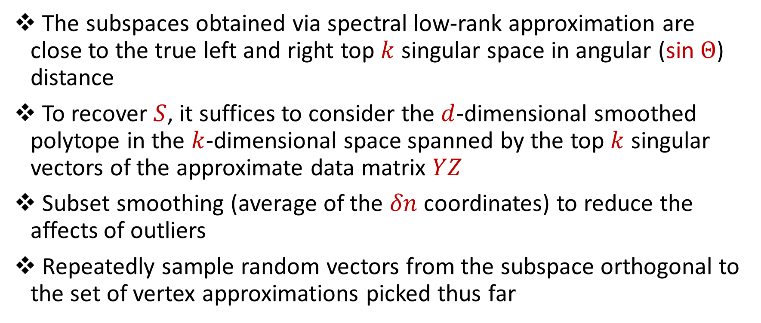
Intuition
The subspaces obtained via spectral low-rank approximation are close to the true left and right top $k$ singular space in angular (sin $Θ$) distance
To recover $S$, it suffices to consider the $d$-dimensional smoothed polytope in the $k$-dimensional space spanned by the top $k$ singular vectors of the approximate data matrix $YZ$
Subset smoothing (average of the $δn$ coordinates) to reduce the affects of outliers
Repeatedly sample random vectors from the subspace orthogonal to the set of vertex approximations picked thus far

Slide 17


