Slide 1
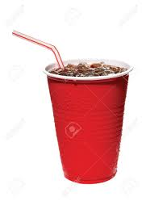

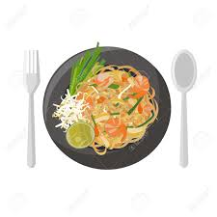
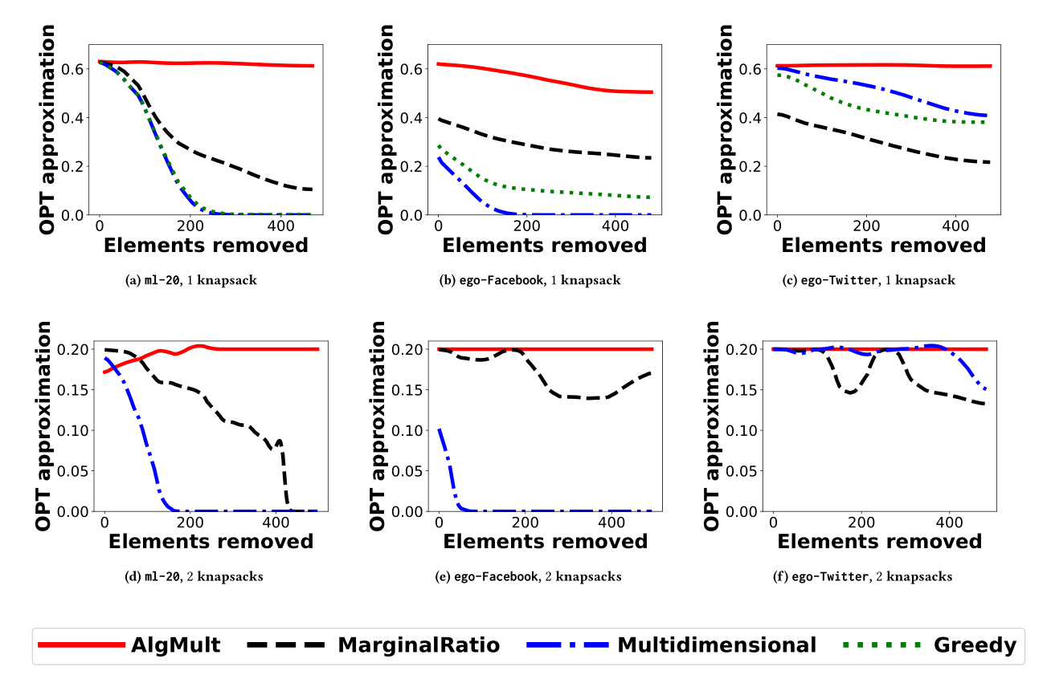



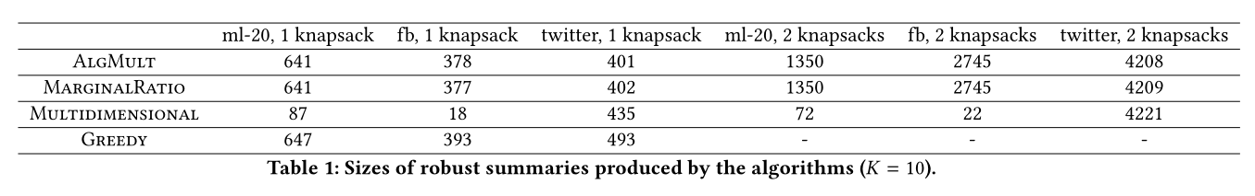





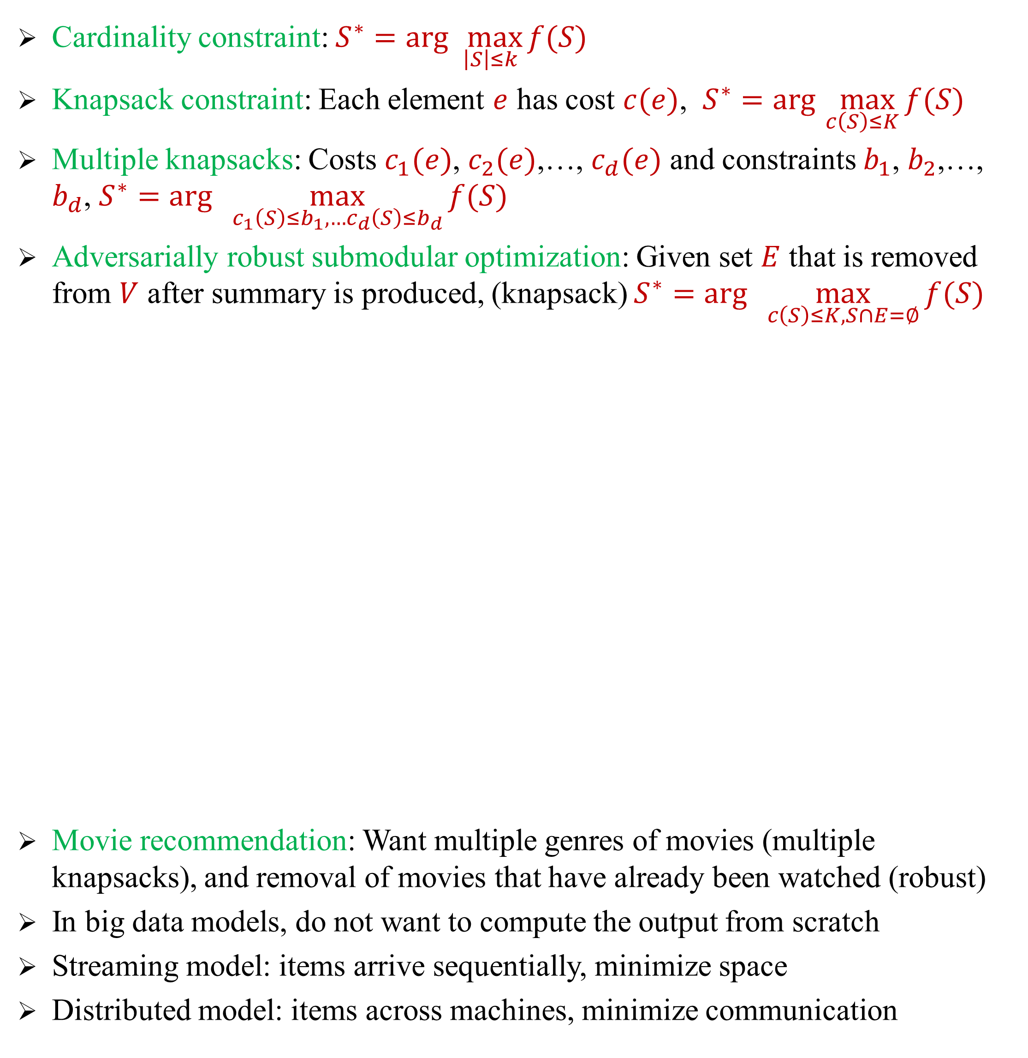


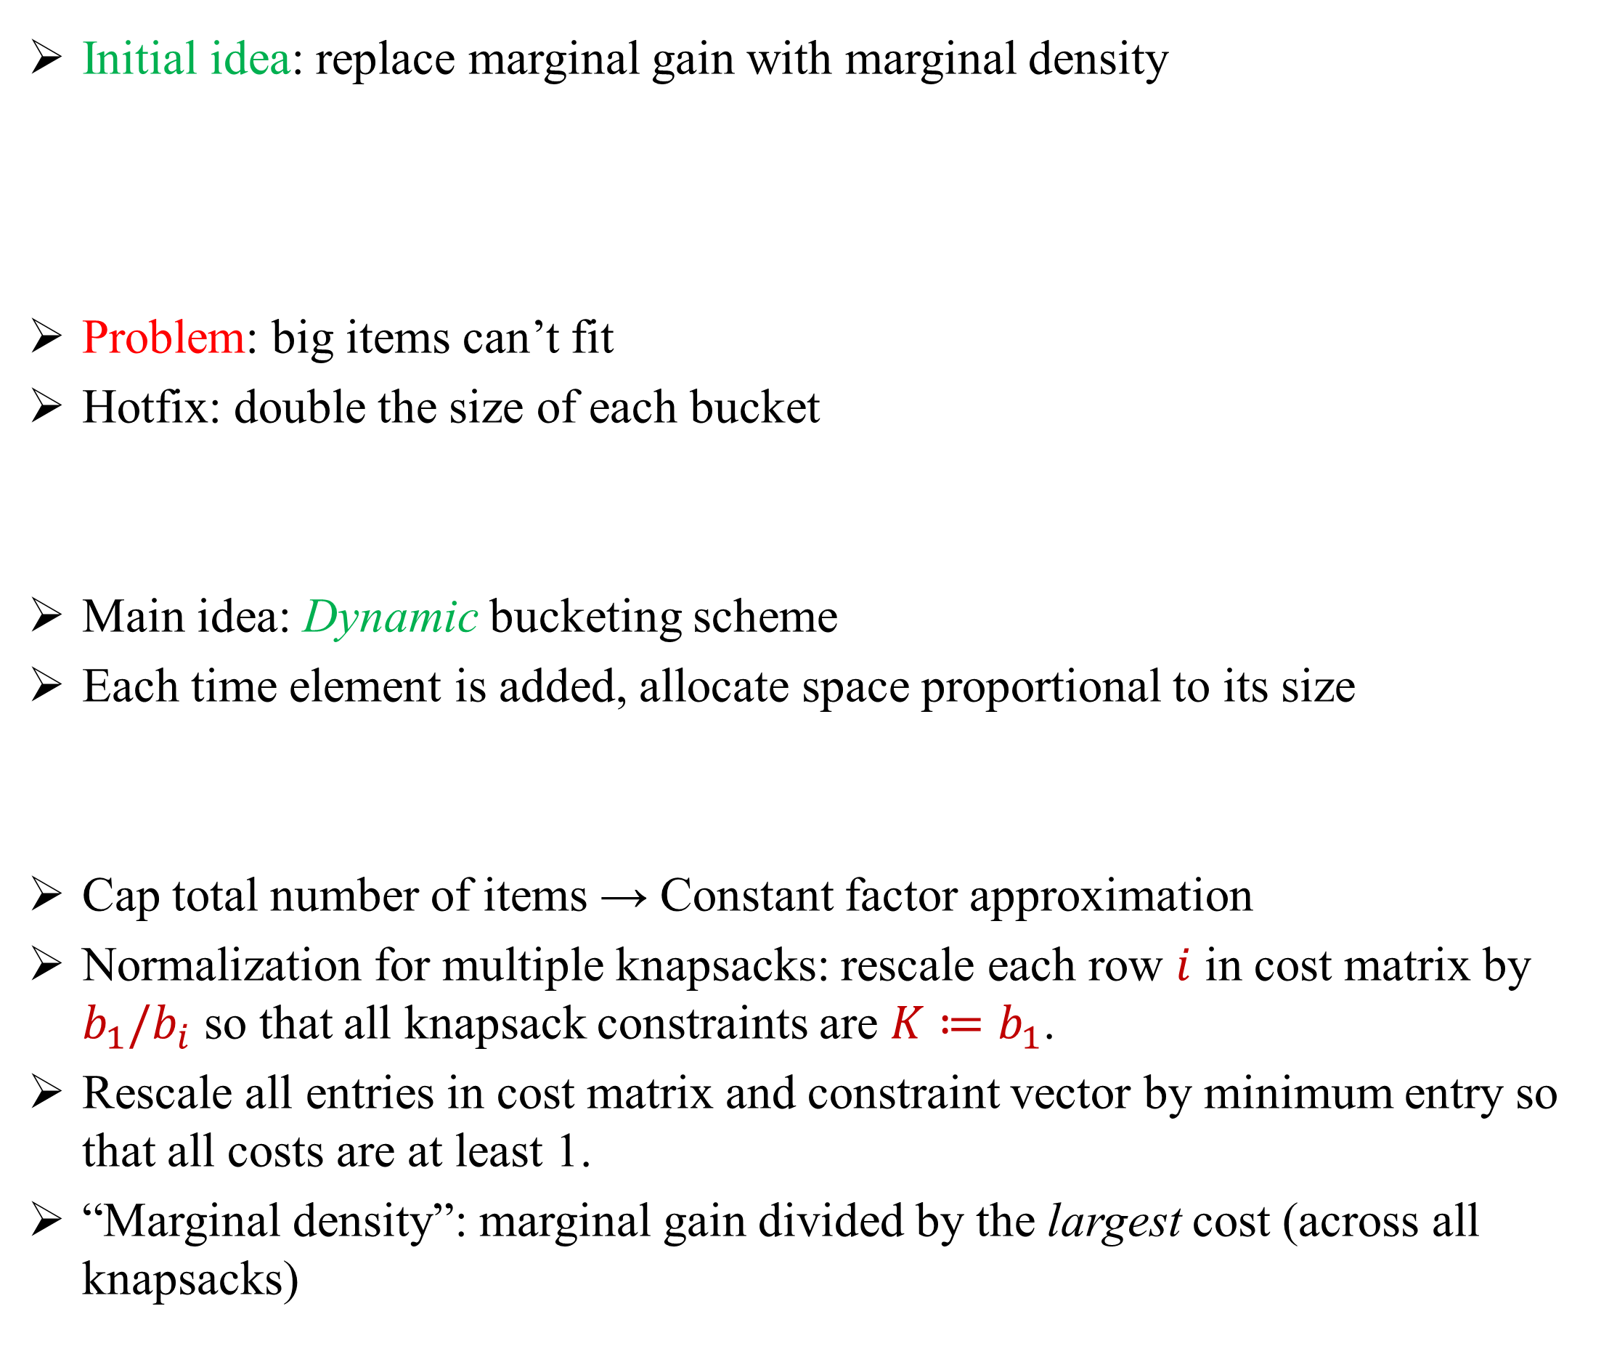




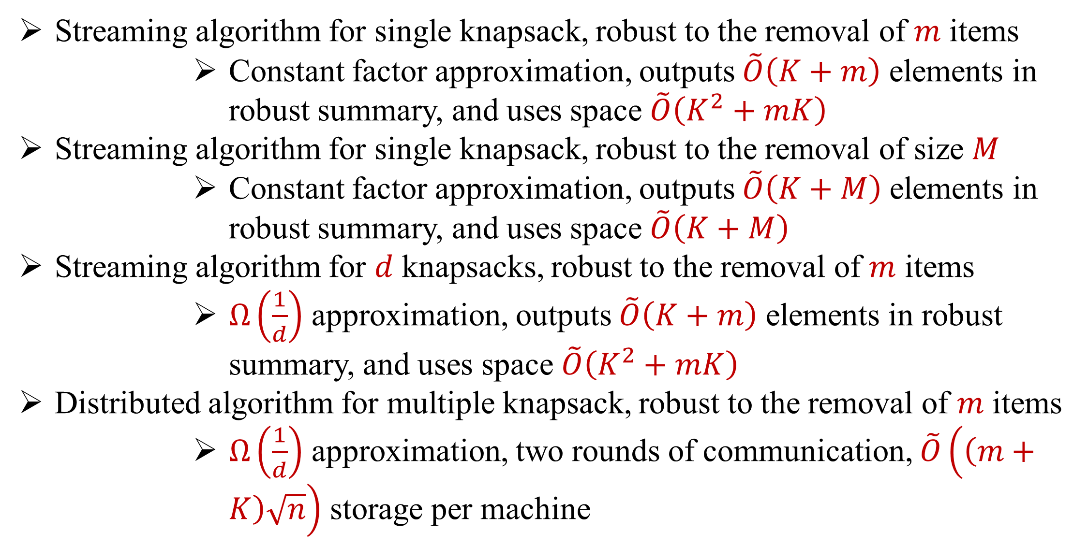
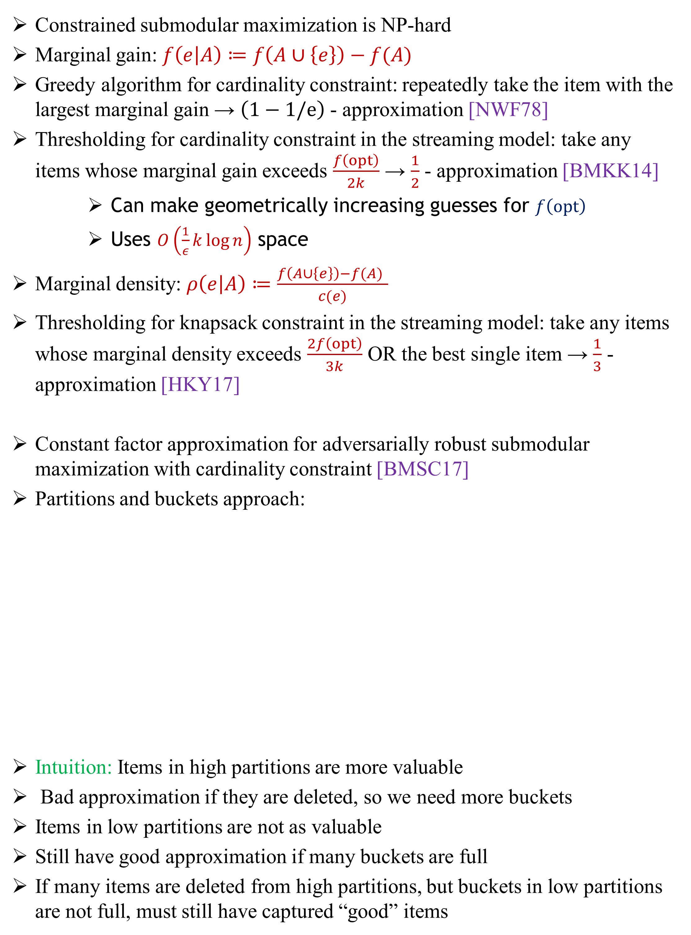







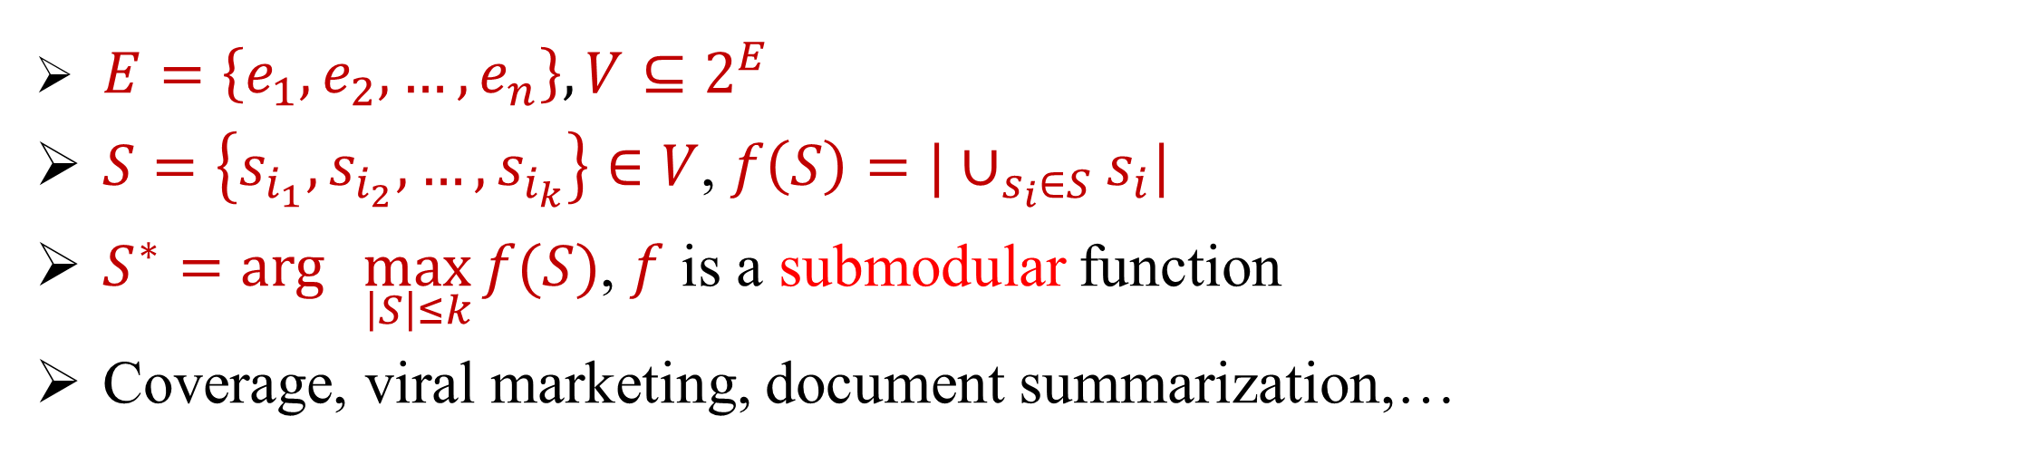

Adversarially Robust Submodular Maximization under Knapsack Constraints
Dmitrii Avdiukhin¹, Slobodan Mitrović ², Grigory Yaroslavtsev¹, Samson Zhou¹
¹Indiana University, ²MIT
SUBMODULAR FUNCTIONS
BACKGROUND
KNAPSACK ROBUSTNESS
Ground Set $V$ (items, sets, vertices)
Set function $f:2^{V}→ℝ$ with diminishing returns property
$∀ A⊆B⊆V, e∉B$, $f\left(A∪\left\{e\right\}\right)−f\left(A\right)≥f\left(B∪\left\{e\right\}\right)−f(B)$
Oracle access to $f:$ Given a subset $S⊆V$, returns $f(S)$
Constrained submodular maximization is NP-hard
Marginal gain: $f\left(e | A\right)≔f\left(A∪\left\{e\right\}\right)−f(A)$
Greedy algorithm for cardinality constraint: repeatedly take the item with the largest marginal gain → $\left(1−1/e\right)$ - approximation [NWF78]
Thresholding for cardinality constraint in the streaming model: take any items whose marginal gain exceeds $\frac{f\left(opt\right)}{2k}$ → $\frac{1}{2}$ - approximation [BMKK14]
Can make geometrically increasing guesses for $f\left(opt\right)$
Uses $O\left(\frac{1}{ε}k\log{n}\right)$ space
Marginal density: $ρ\left(e | A\right)≔\frac{f\left(A∪\left\{e\right\}\right)−f(A) }{c(e)}$
Thresholding for knapsack constraint in the streaming model: take any items whose marginal density exceeds $\frac{2f\left(opt\right)}{3k}$ OR the best single item → $\frac{1}{3}$ - approximation [HKY17]
Constant factor approximation for adversarially robust submodular maximization with cardinality constraint [BMSC17]
Partitions and buckets approach:
Intuition: Items in high partitions are more valuable
Bad approximation if they are deleted, so we need more buckets
Items in low partitions are not as valuable
Still have good approximation if many buckets are full
If many items are deleted from high partitions, but buckets in low partitions are not full, must still have captured “good” items
Initial idea: replace marginal gain with marginal density
Problem: big items can’t fit
Hotfix: double the size of each bucket
Main idea: Dynamic bucketing scheme
Each time element is added, allocate space proportional to its size
Cap total number of items → Constant factor approximation
Normalization for multiple knapsacks: rescale each row $i$ in cost matrix by $b_{1}/b_{i}$ so that all knapsack constraints are $K≔b_{1}$.
Rescale all entries in cost matrix and constraint vector by minimum entry so that all costs are at least 1.
“Marginal density”: marginal gain divided by the largest cost (across all knapsacks)
Remains good approximation
$$A$$
$$B$$
Problem: number of buckets is based on the threshold, not size
Bad approximation!
$$f\left(A∪\left\{e\right\}\right)−f(A)$$
$$≥$$
$$f\left(B∪\left\{e\right\}\right)−f(B)$$
APPLICATIONS
$E=\left\{e_{1},e_{2},…,e_{n}\right\}, {V⊆2}^{E}$
$S=\left\{s_{i_{1}},s_{i_{2}},…,s_{i_{k}}\right\}∈V$, $f\left(S\right)=|∪_{s_{i}∈S}s_{i}|$
$S^{∗}=arg\max_{ \left|S\right|≤k}{f(S)}$, $f$ is a submodular function
Coverage, viral marketing, document summarization,…
$S_{3}$
$S_{6}$
$S_{1}$
$S_{2}$
$S_{4}$
$S_{5}$
CONSTRAINED SUBMODULAR OPTIMIZATION
Partition 3
$$τ$$
Social network graphs from Facebook (4K vertices, 81K edges) and Twitter (88K vertices, 1.8M edges) collected by the Stanford Network Analysis Project (SNAP), MovieLens (27K movies, 200K ratings)
Baselines: Offline Greedy, “Robustified” versions of streaming algorithms
Cardinality constraint: $S^{∗}=arg\max_{ \left|S\right|≤k}{f(S)}$
Knapsack constraint: Each element $e$ has cost $c(e)$, $S^{∗}=arg\max_{ c\left(S\right)≤K}{f(S)}$
Multiple knapsacks: Costs $c_{1}(e)$, $c_{2}(e)$,…, $c_{d}(e)$ and constraints $b_{1}$, $b_{2}$,…, $b_{d}$, $S^{∗}=arg\max_{ c_{1}\left(S\right)≤b_{1},…c_{d}\left(S\right)≤b_{d}}{f(S)}$
Adversarially robust submodular optimization: Given set $E$ that is removed from $V$ after summary is produced, (knapsack) $S^{∗}=arg\max_{ c\left(S\right)≤K, S∩E=∅}{f(S)}$
Movie recommendation: Want multiple genres of movies (multiple knapsacks), and removal of movies that have already been watched (robust)
In big data models, do not want to compute the output from scratch
Streaming model: items arrive sequentially, minimize space
Distributed model: items across machines, minimize communication
$$τ/2$$
EXPERIMENTS
Partition 2
Partition 1
$$τ/4$$
Partition 0
$$τ/8$$
RESULTS
Streaming algorithm for single knapsack, robust to the removal of $m$ items
Constant factor approximation, outputs $\tilde{O}\left(K+m\right)$ elements in robust summary, and uses space $\tilde{O}\left(K^{2}+mK\right)$
Streaming algorithm for single knapsack, robust to the removal of size $M$
Constant factor approximation, outputs $\tilde{O}\left(K+M\right)$ elements in robust summary, and uses space $\tilde{O}\left(K+M\right)$
Streaming algorithm for $d$ knapsacks, robust to the removal of $m$ items
$Ω\left(\frac{1}{d}\right)$ approximation, outputs $\tilde{O}\left(K+m\right)$ elements in robust summary, and uses space $\tilde{O}\left(K^{2}+mK\right)$
Distributed algorithm for multiple knapsack, robust to the removal of $m$ items
$Ω\left(\frac{1}{d}\right)$ approximation, two rounds of communication, $\tilde{O}\left(\left(m+K\right)\sqrt{n}\right)$ storage per machine
REFERENCES
[AMYZ19] Dmitrii Avdiukhin, Slobodan Mitrović, Grigory Yaroslavtsev, Samson Zhou. Adversarially Robust Submodular Maximization under Knapsack Constraints. KDD 2019
[BMKK14] Ashwinkumar Badanidiyuru, Baharan Mirzasoleiman, Amin Karbasi, and Andreas Krause. Streaming submodular maximization: Massive data summarization on the fly. KDD 2014.
[HKY17] Chien-Chung Huang, Naonori Kakimura, and Yuichi Yoshida. Streaming algorithms for maximizing monotone submodular functions under a knapsack constraint. APPROX 2017
[BMSC17] Ilija Bogunovic, Slobodan Mitrović, Jonathan Scarlett, and Volkan Cevher. Robust submodular maximization: A non-uniform partitioning approach. ICML 2017
[NWF78] George L. Nemhauser, Laurence A. Wolsey, and Marshall L. Fisher. An analysis of approximations for maximizing submodular set functions - I.Math. Program. 14(1):265–294, 1978

