Slide 1
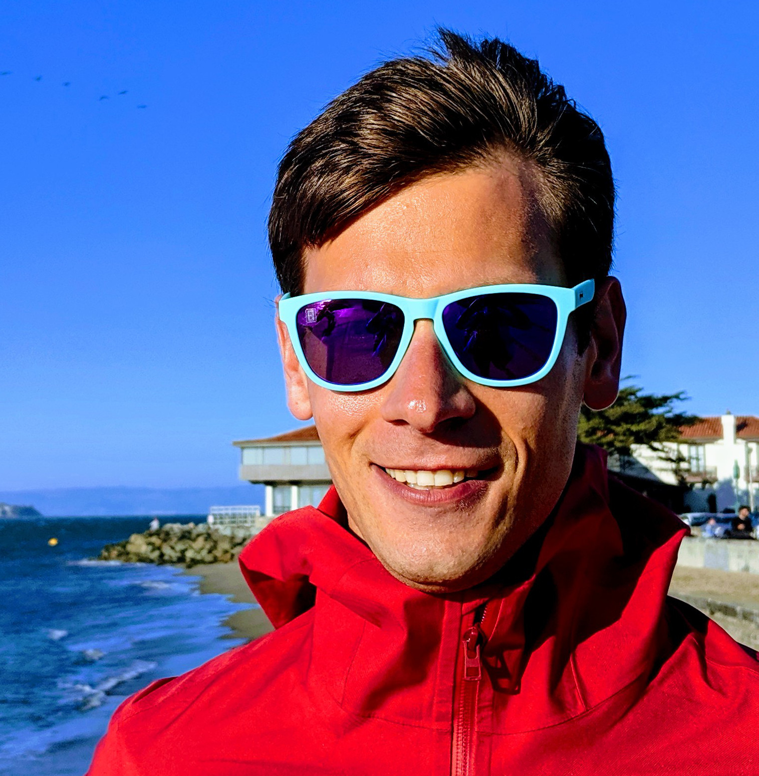
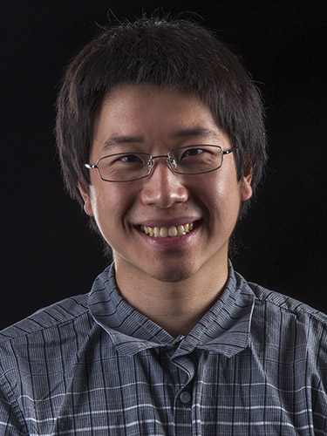



Approximate $𝔽_{2}$-Sketching of Valuation Functions
GRIGORY YAROSLAVTSEV
SAMSON ZHOU

Slide 2


Slide 3






$$x_{1}$$
$$x_{2}$$
$$x_{3}$$
$$x_{4}$$
$$x_{5}$$
$$x_{6}$$

Slide 4
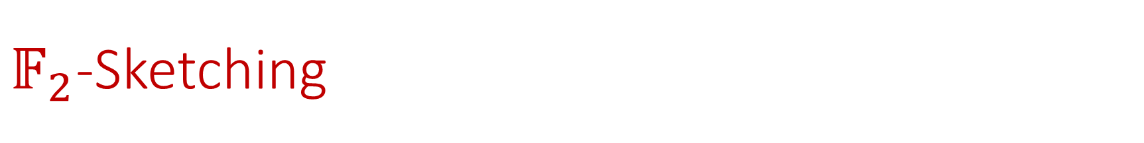
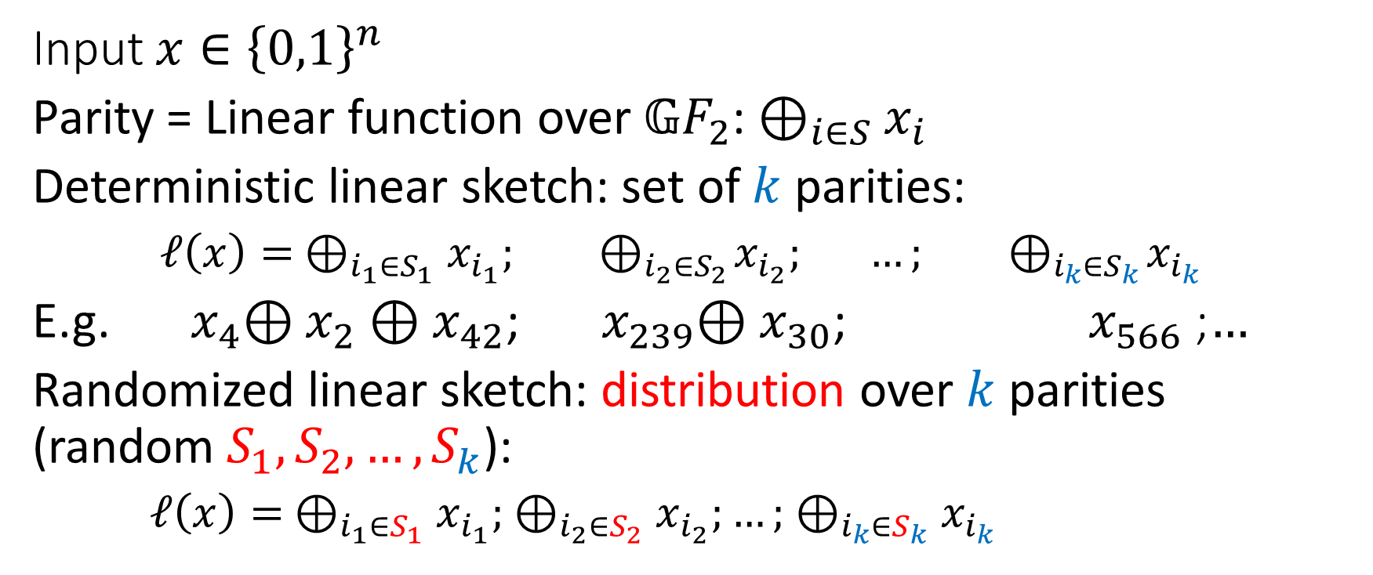
$𝔽_{2}$-Sketching
Input $x∈{\left\{0,1\right\}}^{n}$
Parity = Linear function over 𝔾$F_{2}$: $⊕_{i∈S}x_{i}$
Deterministic linear sketch: set of $k$ parities:
$ℓ\left(x\right)= ⊕_{i_{1}∈S_{1}}x_{i_{1}}; { ⊕}_{i_{2}∈S_{2}}x_{i_{2}}; …; { ⊕}_{i_{k}∈S_{k}}x_{i_{k}}$
E.g. ${ x}_{4}⊕x_{2}⊕x_{42}$; ${ x}_{239}⊕x_{30}$; ${ x}_{566}$ ;$…$
Randomized linear sketch: distribution over $k$ parities (random $S_{1}, S_{2}, …,S_{k}$):
$ℓ\left(x\right)= ⊕_{i_{1}∈S_{1}}x_{i_{1}}; ⊕_{i_{2}∈S_{2}}x_{i_{2}};…; ⊕_{i_{k}∈S_{k}}x_{i_{k}}$

Slide 5

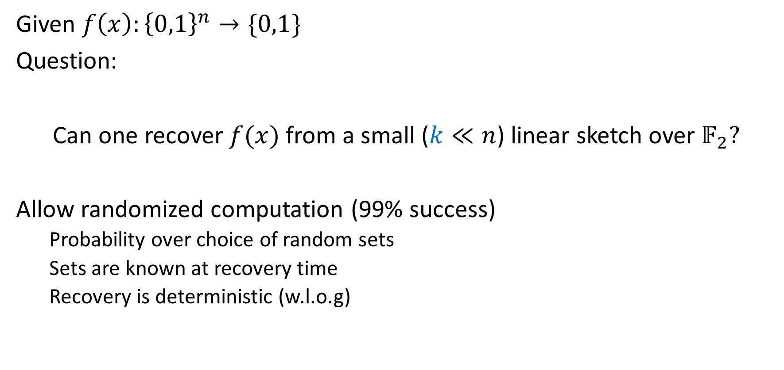
Linear sketching over $𝔽_{2}$
Given $f\left(x\right):{\left\{0,1\right\}}^{n}→\{0,1\}$
Question:
Can one recover $f(x)$ from a small ($k≪n$) linear sketch over $𝔽_{2}?$
Allow randomized computation (99% success)
Probability over choice of random sets
Sets are known at recovery time
Recovery is deterministic (w.l.o.g)

Slide 6

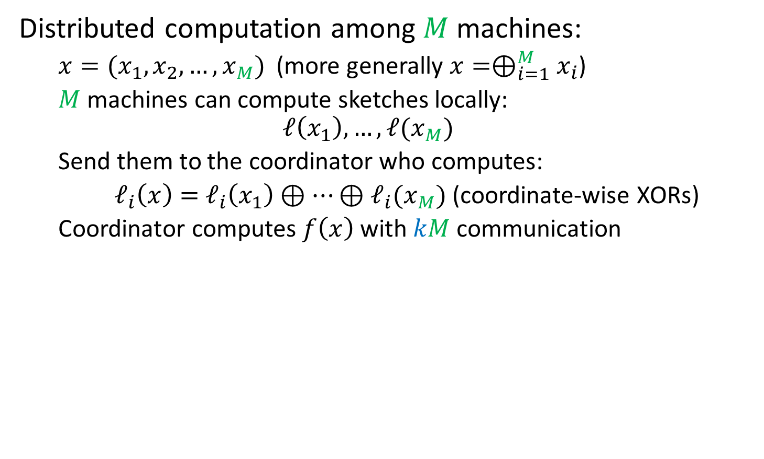


Application: Distributed Computing
Distributed computation among $M$ machines:
$x=(x_{1}, x_{2}, …, x_{M})$ (more generally $x=⊕_{i=1}^{M}x_{i}$)
$M$ machines can compute sketches locally:
$$ℓ\left(x_{1}\right), …, ℓ(x_{M})$$
Send them to the coordinator who computes:
$ℓ_{i}\left(x\right)=$ $ℓ_{i}\left(x_{1}\right)⊕⋯⊕ℓ_{i}(x_{M})$ (coordinate-wise XORs)
Coordinator computes $f\left(x\right)$ with $kM$ communication
$$x$$
0 | 1 | 1 | 1 | 1 | 1 | 0 | 0 | 0 | 0
$$x_{1}$$
$$x_{2}$$

Slide 7
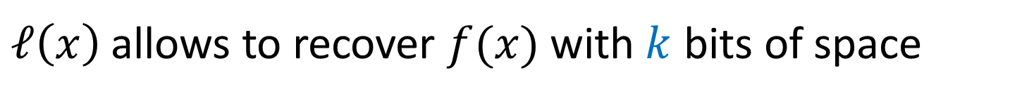


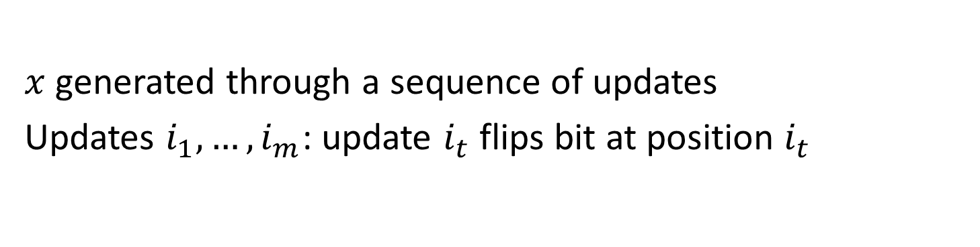



Application: Streaming
$x$ generated through a sequence of updates
Updates $i_{1},…, i_{m}$: update $i_{t}$ flips bit at position $i_{t}$
$$x^{(0)}$$
0 | 0 | 0 | 0 | 0 | 0 | 0 | 0 | 0 | 0
Updates: (1, 3, 8, 3)
$$x^{(1)}$$
1 | 0 | 0 | 0 | 0 | 0 | 0 | 0 | 0 | 0
$$x^{(2)}$$
1 | 0 | 1 | 0 | 0 | 0 | 0 | 0 | 0 | 0
$$x^{(3)}$$
1 | 0 | 1 | 0 | 0 | 0 | 0 | 1 | 0 | 0
$$x$$
1 | 0 | 0 | 0 | 0 | 0 | 0 | 1 | 0 | 0
$ℓ\left(x\right)$ allows to recover $f(x)$ with $k$ bits of space

Slide 8
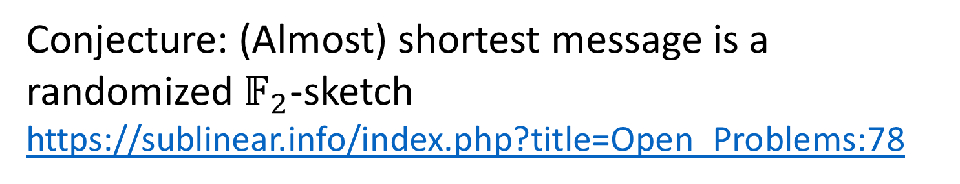

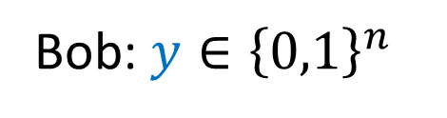

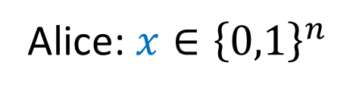
Puzzle: Open Problem 78 on Sublinear.info
Shared randomness
Alice: $x{∈\left\{0,1\right\}}^{n}$
Bob: $y{∈\left\{0,1\right\}}^{n}$
$M(x)$
$$f^{+}=f(x⊕y)$$
Conjecture: (Almost) shortest message is a randomized $𝔽_{2}$-sketch
https://sublinear.info/index.php?title=Open_Problems:78

Slide 9
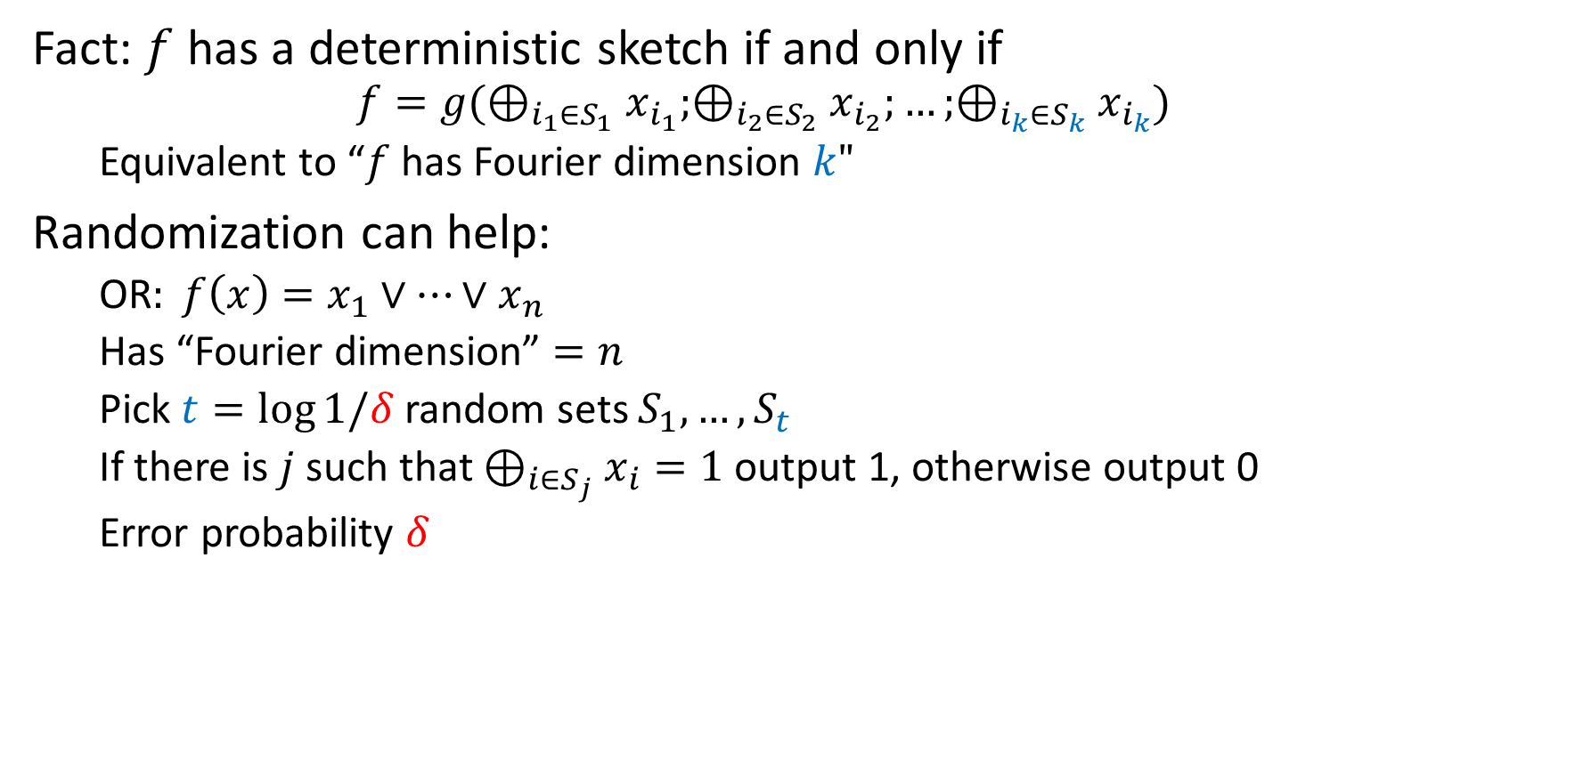
Deterministic vs. Randomized
Fact: $f$ has a deterministic sketch if and only if
$$f=g(⊕_{i_{1}∈S_{1}}x_{i_{1}};⊕_{i_{2}∈S_{2}}x_{i_{2}};…;⊕_{i_{k}∈S_{k}}x_{i_{k}})$$
Equivalent to “$f$ has Fourier dimension $k"$
Randomization can help:
OR$: f\left(x\right)=x_{1}∨⋯∨x_{n}$
Has “Fourier dimension” $=n$
Pick $t=\log{1/δ}$ random sets $S_{1},…, S_{t}$
If there is $j$ such that $⊕_{i∈S_{j}}x_{i}=1$ output 1, otherwise output 0
Error probability $δ$

Slide 10

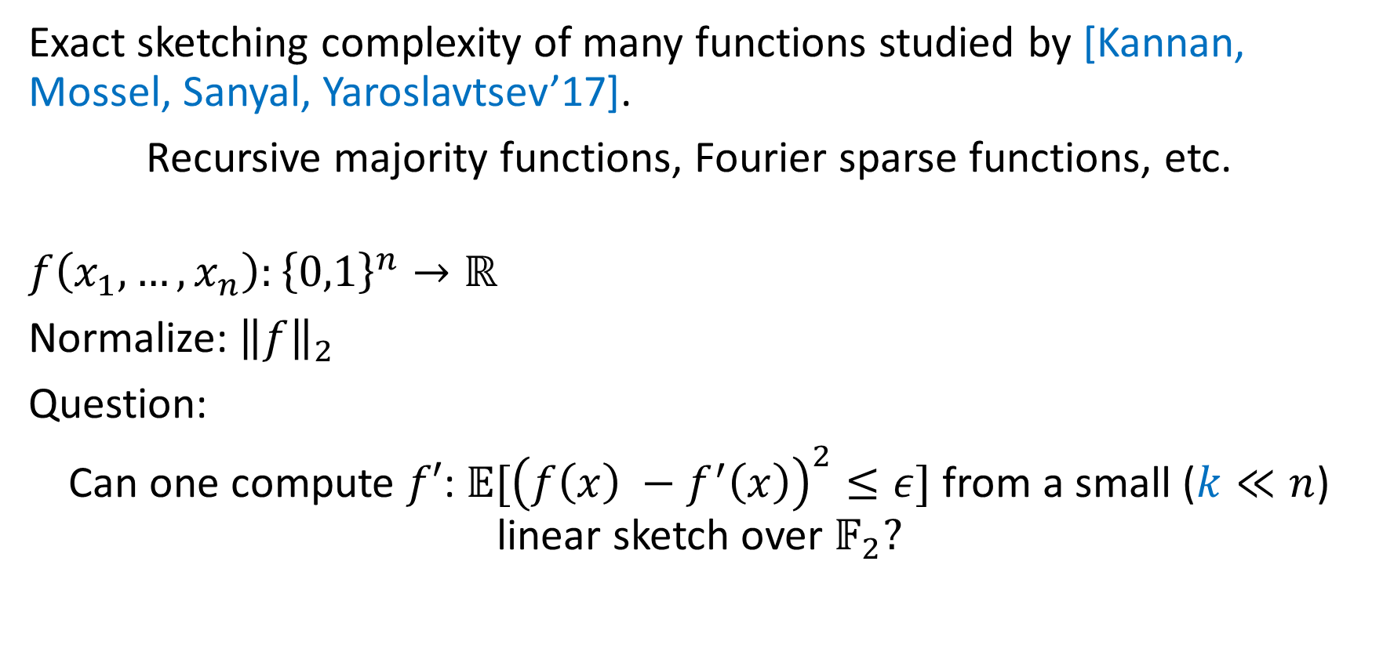
Approximate $𝔽_{2}$-Sketching
Exact sketching complexity of many functions studied by [Kannan, Mossel, Sanyal, Yaroslavtsev’17].
Recursive majority functions, Fourier sparse functions, etc.
$$f\left(x_{1}, …, x_{n}\right):{\left\{0,1\right\}}^{n}→ℝ$$
Normalize:${ \left\|f\right\|}_{2}$
Question:
Can one compute $f′$: 𝔼$[{\left(f\left(x\right) −f^{′}\left(x\right)\right)}^{2}≤ε]$ from a small ($k≪n$) linear sketch over $𝔽_{2}?$

Slide 11
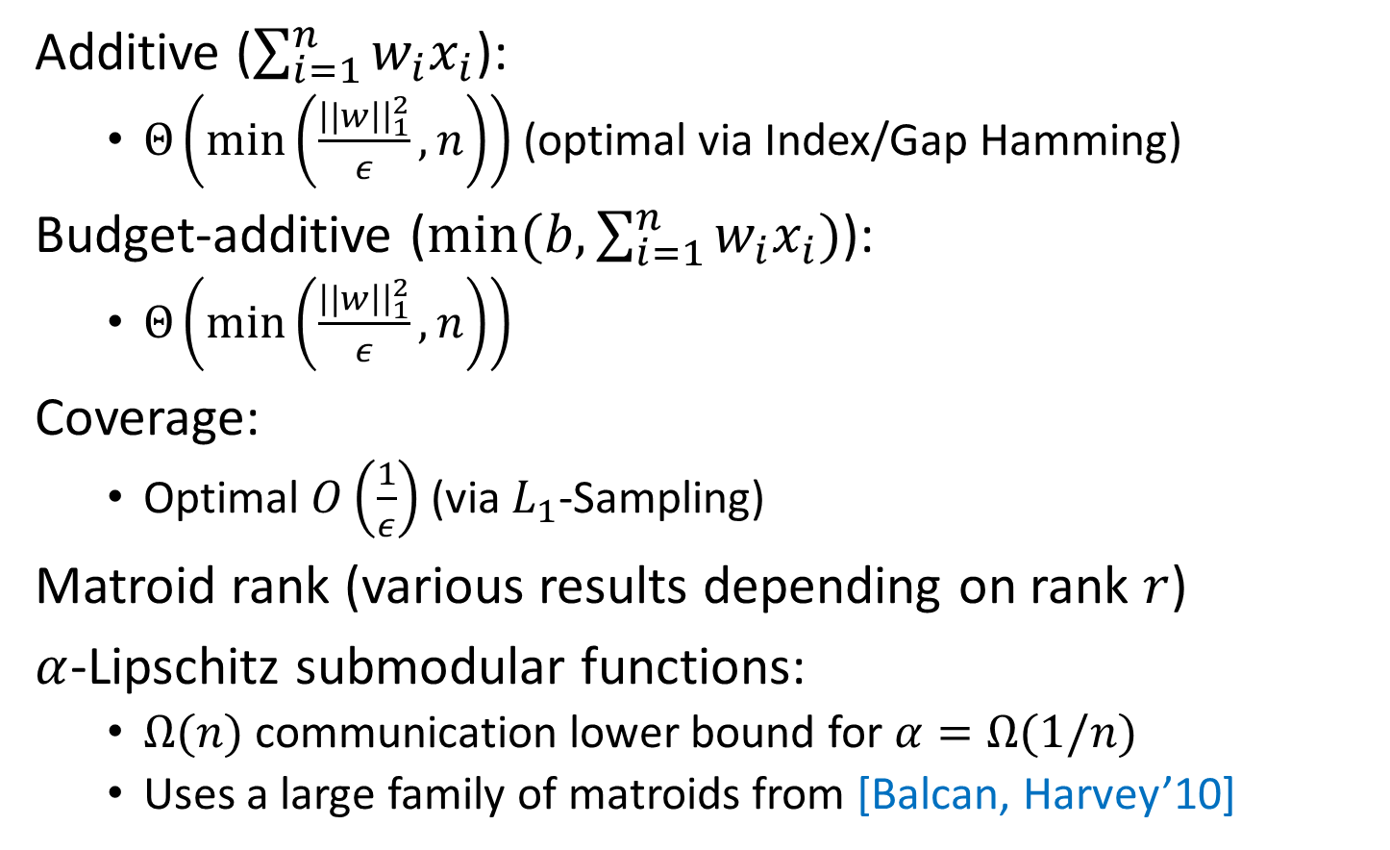
Our Results
Additive ($\sum_{i=1}^{n}{w_{i}x_{i}}$):
$Θ\left(\min\left(\frac{\left||w\right|{\left.​\right|}_{1}^{2}}{ε},n\right)\right)$(optimal via Index/Gap Hamming)
Budget-additive ($min(b,\sum_{i=1}^{n}{w_{i}x_{i}})$):
$Θ\left(\min\left(\frac{\left||w\right|{\left.​\right|}_{1}^{2}}{ε},n\right)\right)$
Coverage:
Optimal $O\left(\frac{1}{ε}\right)$ (via $L_{1}$-Sampling)
Matroid rank (various results depending on rank $r$)
$α$-Lipschitz submodular functions:
$Ω(n)$ communication lower bound for $α=Ω(1/n)$
Uses a large family of matroids from [Balcan, Harvey’10]

Slide 12
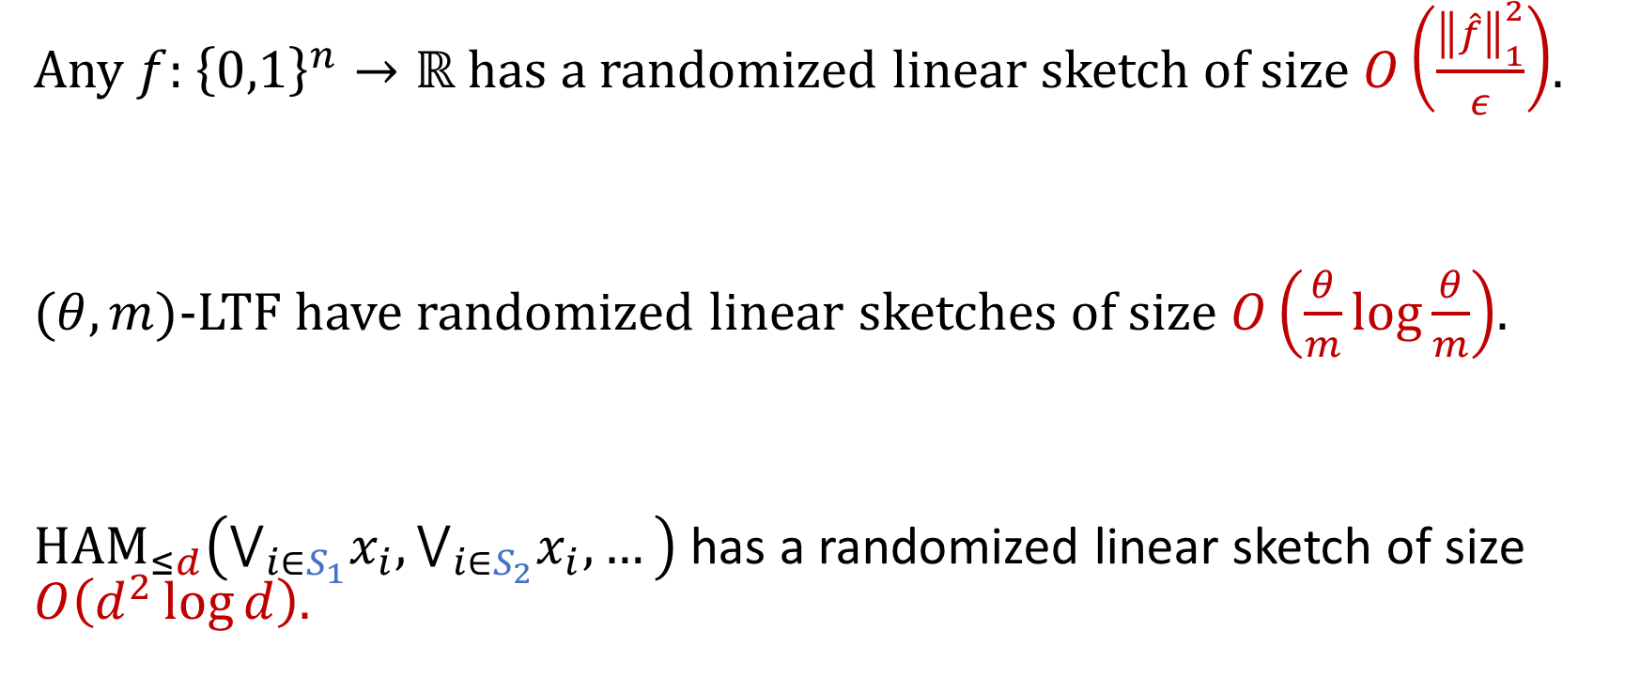
Technical Theorems
Any $f:$ ${\left\{0,1\right\}}^{n}→ℝ$ has a randomized linear sketch of size $O\left(\frac{{\left\|\hat{f}\right\|}_{1}^{2}}{ε}\right)$.
$(θ,m)$-LTF have randomized linear sketches of size $O\left(\frac{θ}{m}\log{\frac{θ}{m}}\right)$.
${HAM}_{≤d}\left(⋁_{i∈S_{1}}x_{i},⋁_{i∈S_{2}}x_{i},…\right)$ has a randomized linear sketch of size $O\left(d^{2}\log{d}\right).$

Slide 13
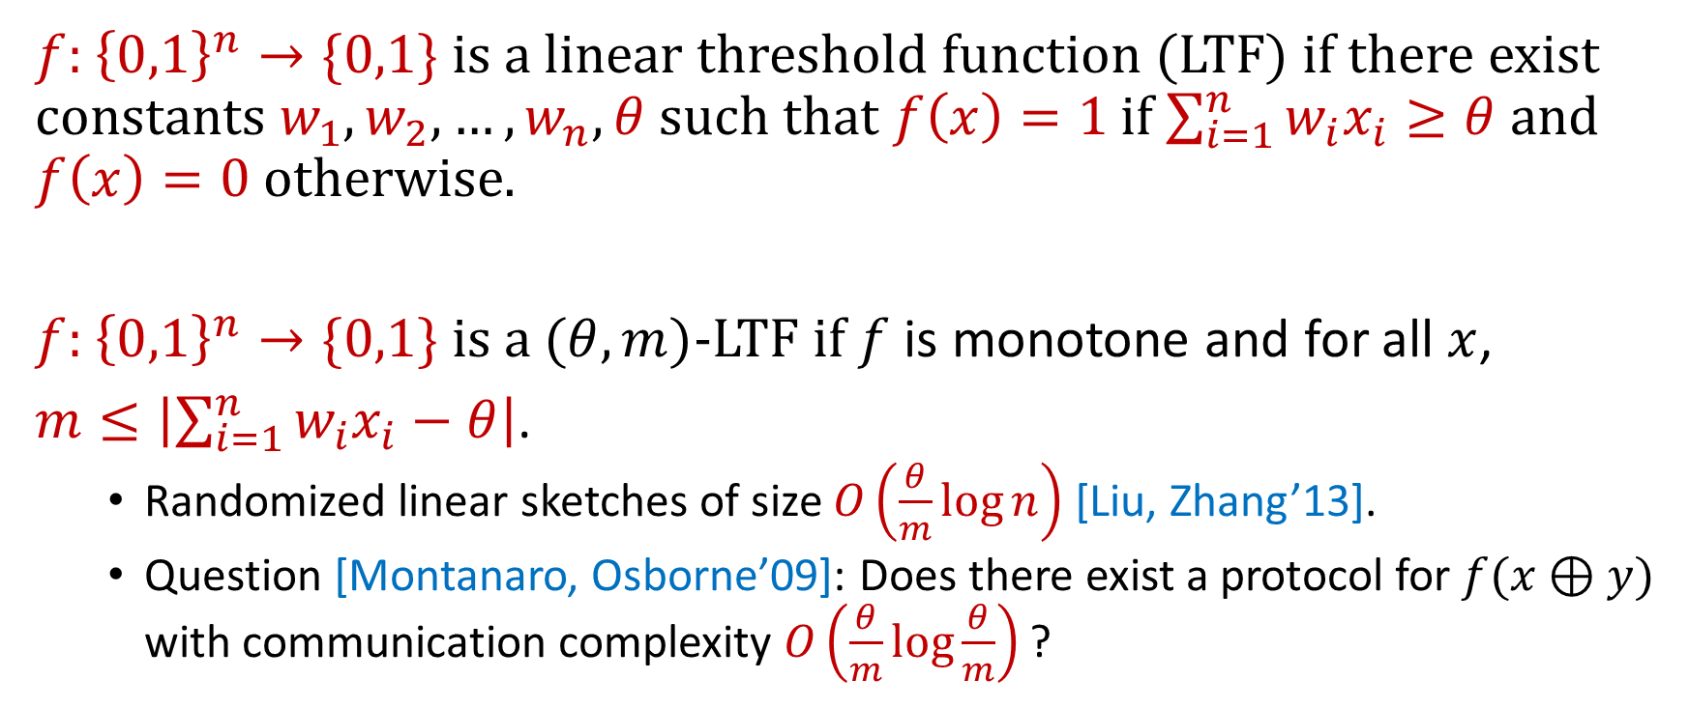
Linear Threshold Functions
$f:$ ${\left\{0,1\right\}}^{n}→\{0,1\}$ is a linear threshold function (LTF) if there exist constants $w_{1},w_{2},…,w_{n},θ$ such that $f\left(x\right)=1$ if $\sum_{i=1}^{n}{w_{i}x_{i}≥θ}$ and $f\left(x\right)=0$ otherwise.
$f:$ ${\left\{0,1\right\}}^{n}→\{0,1\}$ is a $(θ,m)$-LTF if $f$ is monotone and for all $x$,
$m≤\left|\sum_{i=1}^{n}{w_{i}x_{i}−θ}\right|$.
Randomized linear sketches of size $O\left(\frac{θ}{m}\log{n}\right)$ [Liu, Zhang’13].
Question [Montanaro, Osborne’09]: Does there exist a protocol for $f(x⊕y)$ with communication complexity $O\left(\frac{θ}{m}\log{\frac{θ}{m}}\right)$ ?

Slide 14
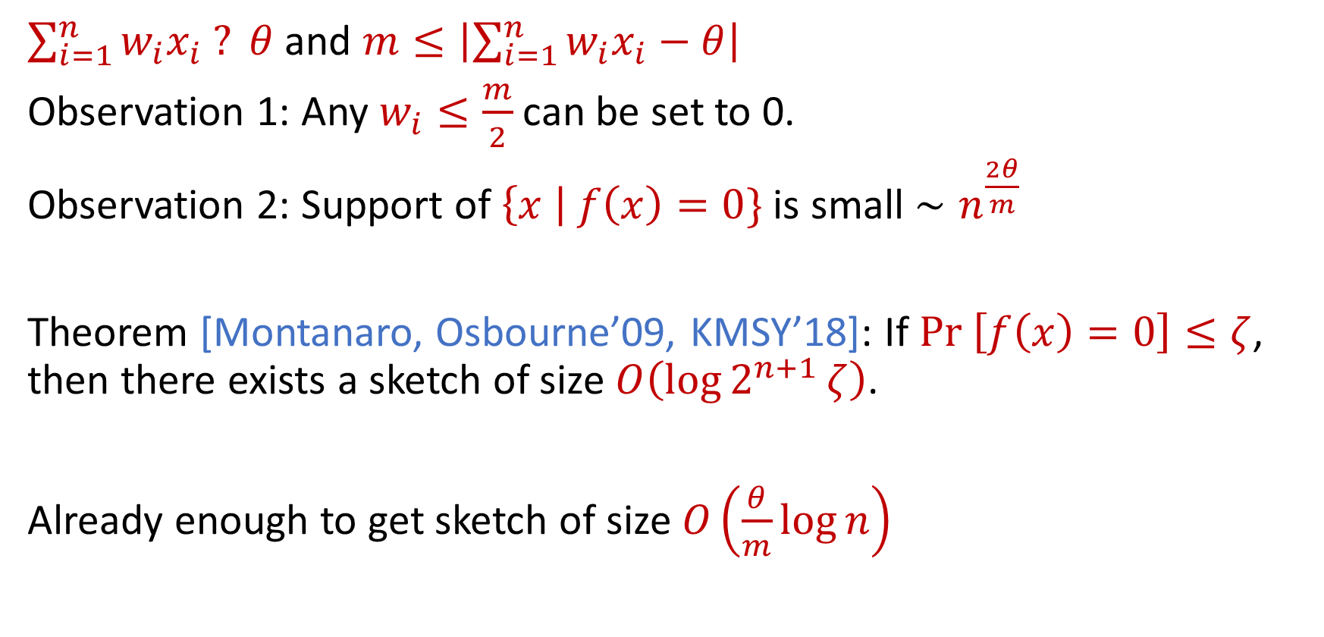

Sketching $(θ,m)$-LTFs
$\sum_{i=1}^{n}{w_{i}x_{i} ? θ}$ and $m≤\left|\sum_{i=1}^{n}{w_{i}x_{i}−θ}\right|$
Observation 1: Any $w_{i}≤\frac{m}{2}$ can be set to 0.
Observation 2: Support of $\left\{x \right| f\left(x\right)=0\}$ is small $∼n^{\frac{2θ}{m}}$
Theorem [Montanaro, Osbourne’09, KMSY’18]: If $Pr \left[f\left(x\right)=0\right]≤ζ$, then there exists a sketch of size $O\left(\log{2^{n+1}}ζ\right)$.
Already enough to get sketch of size $O\left(\frac{θ}{m}\log{n}\right)$

Slide 15
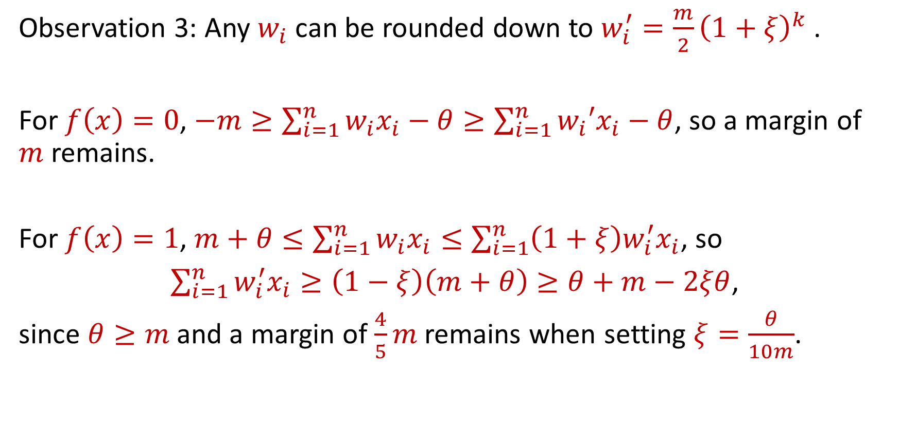
Sketching $(θ,m)$-LTFs
Observation 3: Any $w_{i}$ can be rounded down to $w_{i}^{′}=\frac{m}{2}{\left(1+ξ\right)}^{k}$ .
For $f\left(x\right)=0$, $−m≥\sum_{i=1}^{n}{w_{i}x_{i}−θ}≥\sum_{i=1}^{n}{w_{i}′x_{i}−θ}$, so a margin of $m$ remains.
For $f\left(x\right)=1$, $m+θ≤\sum_{i=1}^{n}{w_{i}x_{i}}≤\sum_{i=1}^{n}{{\left(1+ξ\right)w}_{i}^{′}x_{i}}$, so
$\sum_{i=1}^{n}{w_{i}^{′}x_{i}≥\left(1−ξ\right)\left(m+θ\right)≥θ+m−2ξθ}$,
since $θ≥m$and a margin of $\frac{4}{5}m$ remains when setting $ξ=\frac{θ}{10m}$.

Slide 16
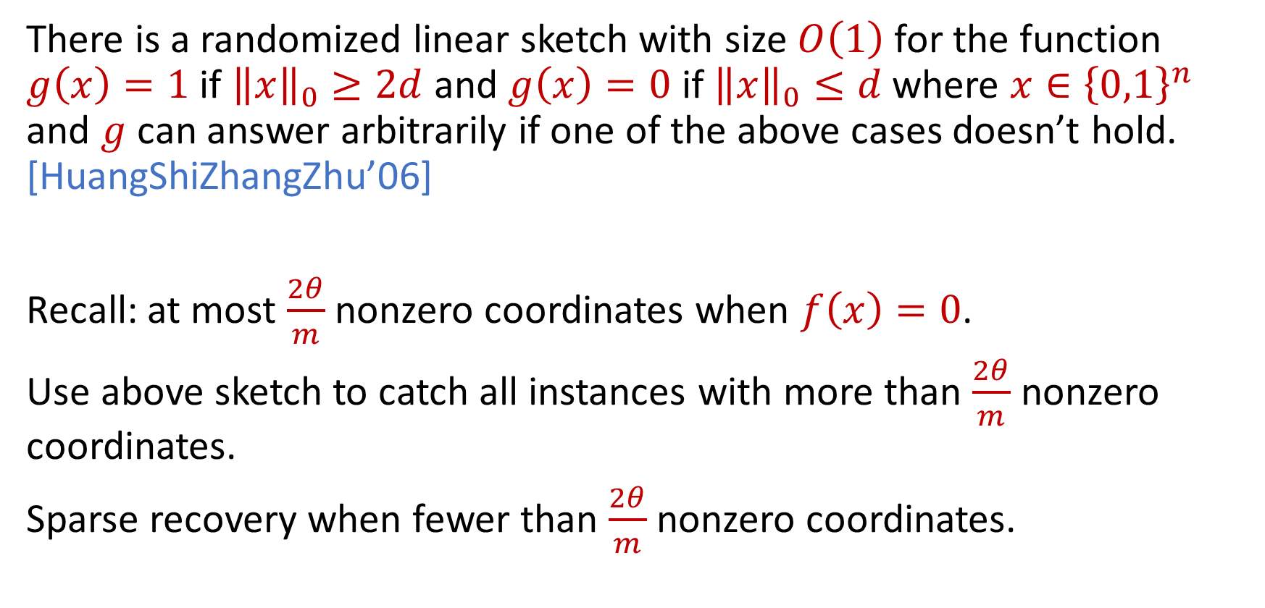
Separation Sketch
There is a randomized linear sketch with size $O\left(1\right)$ for the function $g\left(x\right)=1$ if ${\left\|x\right\|}_{0}≥2d$ and $g\left(x\right)=0$ if ${\left\|x\right\|}_{0}≤d$ where ${x∈\left\{0,1\right\}}^{n}$ and $g$ can answer arbitrarily if one of the above cases doesn’t hold. [HuangShiZhangZhu’06]
Recall: at most $\frac{2θ}{m}$ nonzero coordinates when $f\left(x\right)=0$.
Use above sketch to catch all instances with more than $\frac{2θ}{m}$ nonzero coordinates.
Sparse recovery when fewer than $\frac{2θ}{m}$ nonzero coordinates.

Slide 17
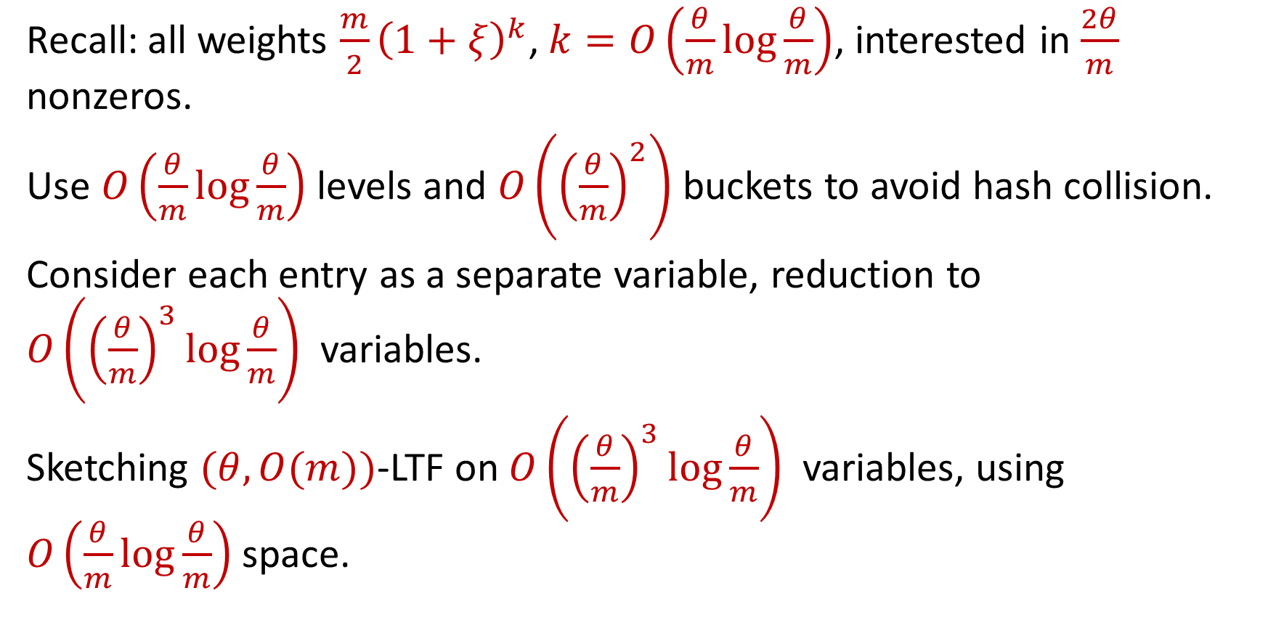
Sparse “Recovery”
Recall: all weights $\frac{m}{2}{\left(1+ξ\right)}^{k}$, $k=O\left(\frac{θ}{m}\log{\frac{θ}{m}}\right)$, interested in $\frac{2θ}{m}$ nonzeros.
Use $O\left(\frac{θ}{m}\log{\frac{θ}{m}}\right)$ levels and $O\left({\left(\frac{θ}{m}\right)}^{2}\right)$ buckets to avoid hash collision.
Consider each entry as a separate variable, reduction to $O\left({\left(\frac{θ}{m}\right)}^{3}\log{\frac{θ}{m}}\right)$ variables.
Sketching $(θ,O(m))$-LTF on $O\left({\left(\frac{θ}{m}\right)}^{3}\log{\frac{θ}{m}}\right)$ variables, using $O\left(\frac{θ}{m}\log{\frac{θ}{m}}\right)$ space.

Slide 18
Technical Theorems
Any $f:$ ${\left\{0,1\right\}}^{n}→ℝ$ has a randomized linear sketch of size $O\left(\frac{{\left\|\hat{f}\right\|}_{1}^{2}}{ε}\right)$.
$(θ,m)$-LTF have randomized linear sketches of size $O\left(\frac{θ}{m}\log{\frac{θ}{m}}\right)$.
${HAM}_{≤d}\left(⋁_{i∈S_{1}}x_{i},⋁_{i∈S_{2}}x_{i},…\right)$ has a randomized linear sketch of size $O\left(d^{2}\log{d}\right).$

Slide 19
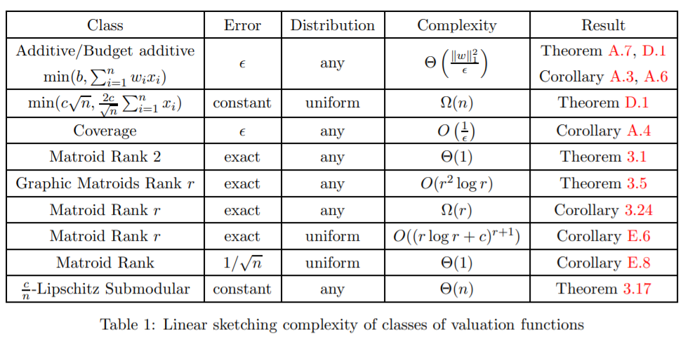
Our Results

Slide 20

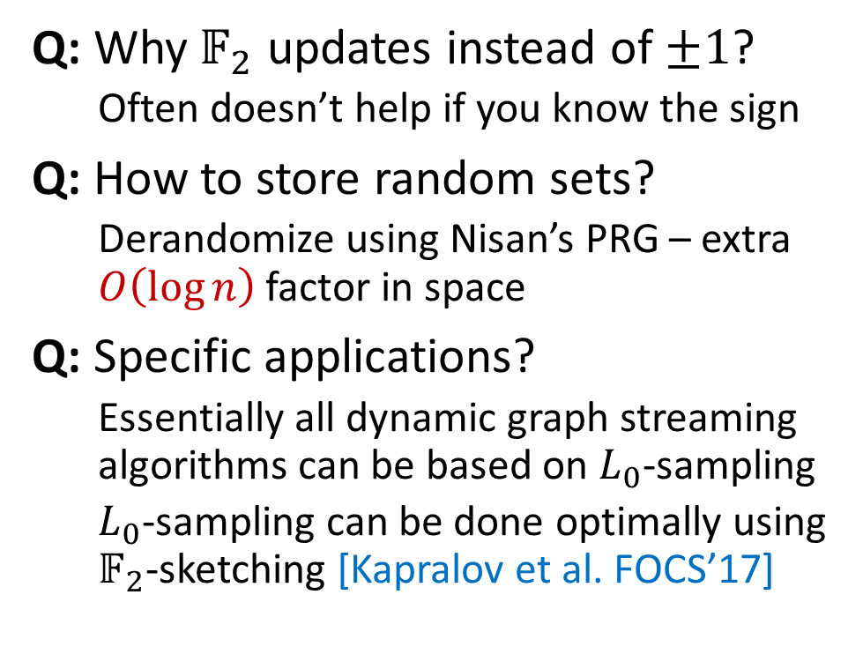
Frequently Asked Questions
Thanks!
Q: Why$𝔽_{2}$ updates instead of $±1$?
Often doesn’t help if you know the sign
Q: How to store random sets?
Derandomize using Nisan’s PRG – extra $O\left(\log{n}\right)$ factor in space
Q: Specific applications?
Essentially all dynamic graph streaming algorithms can be based on $L_{0}$-sampling
$L_{0}$-sampling can be done optimally using $𝔽_{2}$-sketching [Kapralov et al. FOCS’17]

Slide 21
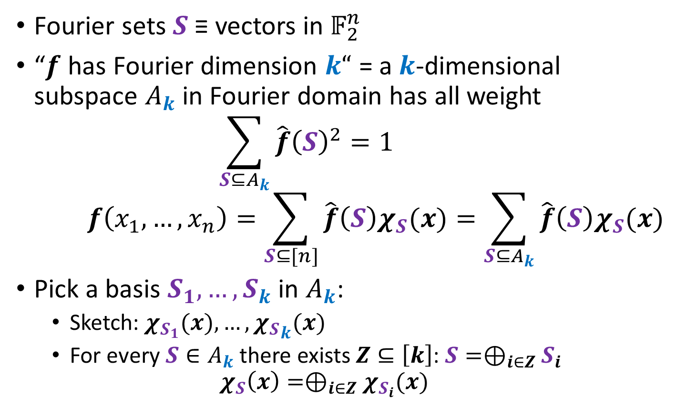
Fourier Dimension
Fourier sets $S$ ≡ vectors in $𝔽_{2}^{n}$
“$f$ has Fourier dimension $k“$ = a $k$-dimensional subspace $A_{k}$ in Fourier domain has all weight
$$\sum_{S⊆A_{k}}{\hat{f}{\left(S\right)}^{2}=1}$$
$$f\left(x_{1}, …, x_{n}\right)=\sum_{S⊆[n]}{\hat{f}\left(S\right)χ_{S}(x)}=\sum_{S⊆A_{k}}{\hat{f}\left(S\right)χ_{S}(x)}$$
Pick a basis $S_{1}, …, S_{k}$ in $A_{k}$:
Sketch: $χ_{S_{1}}(x), …, {χ_{S}}_{k}(x)$
For every $S∈A_{k}$ there exists $Z⊆\left[k\right]$: $S=⊕_{i∈Z}S_{i}$
$$χ_{S}\left(x\right)=⊕_{i∈Z}χ_{S_{i}}(x)$$

Slide 22
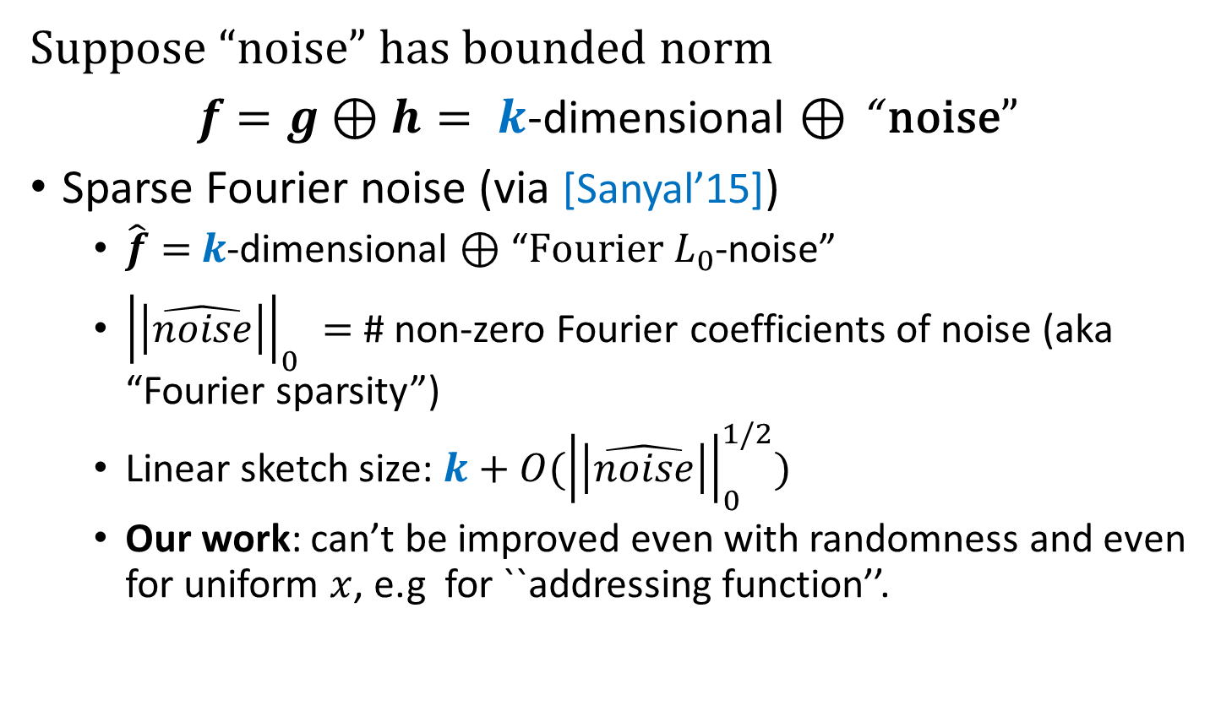
Deterministic Sketching and Noise
Suppose “noise” has bounded norm
$f$ $=g⊕h= k$-dimensional $⊕$ “ noise”
Sparse Fourier noise (via [Sanyal’15])
$\hat{f}=$ $k$-dimensional $⊕$ “$Fourier L_{0}$-noise”
${\left|\left|\hat{noise}\right|\right|}_{0}^{}=$ # non-zero Fourier coefficients of noise (aka “Fourier sparsity”)
Linear sketch size: $k+O({\left|\left|\hat{noise}\right|\right|}_{0}^{1/2})$
Our work: can’t be improved even with randomness and even for uniform $x$, e.g for ``addressing function’’.

Slide 23
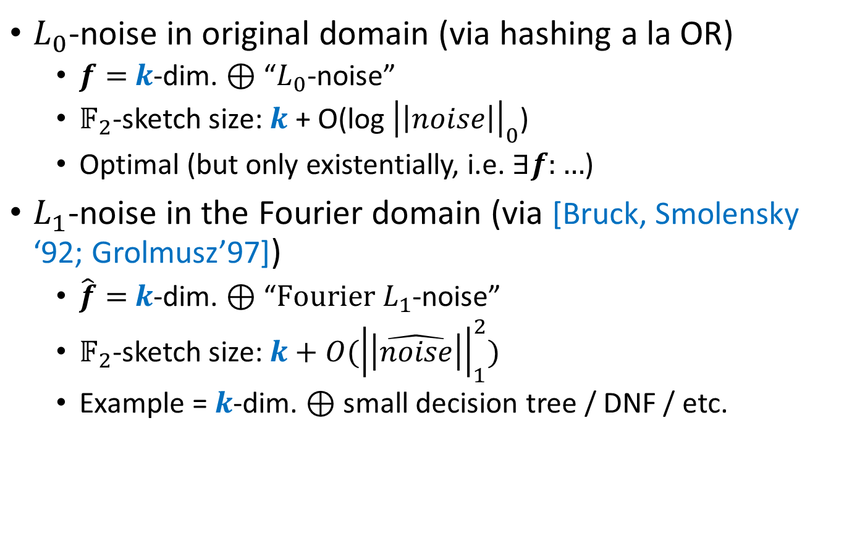
How Randomization Handles Noise
$L_{0}$-noise in original domain (via hashing a la OR)
$f=$ $k$-dim. $⊕$ “$L_{0}$-noise”
$𝔽_{2}$-sketch size: $k \text{+ }\text{O}\text{(}\text{log} {\left|\left|noise\right|\right|}_{0}\text{)}$
Optimal (but only existentially, i.e. $∃f:…$)
$L_{1}$-noise in the Fourier domain (via [Bruck, Smolensky ‘92; Grolmusz’97])
$\hat{f}=$ $k$-dim. $⊕$ “$Fourier L_{1}$-noise”
$𝔽_{2}$-sketch size: $k+O({\left|\left|\hat{noise}\right|\right|}_{1}^{2})$
Example = $k$-dim. $⊕$small decision tree / DNF / etc.

Slide 24
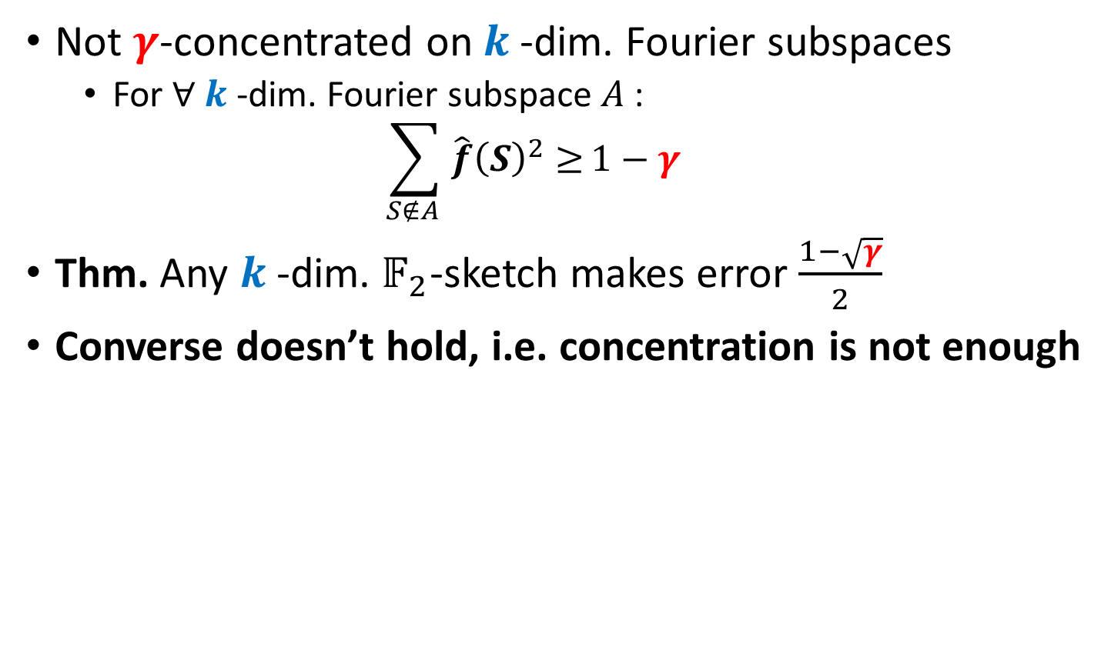
Randomized Sketching: Hardness
Not $γ$-concentrated on $k$-dim. Fourier subspaces
For $∀ k$-dim. Fourier subspace $A$ :
$$\sum_{S∉A }{\hat{f}{\left(S\right)}^{2}≥}1−γ$$
Thm. Any $k$-dim. $𝔽_{2}$-sketch makes error $\frac{1−\sqrt{γ}}{2}$
Converse doesn’t hold, i.e. concentration is not enough

Slide 25
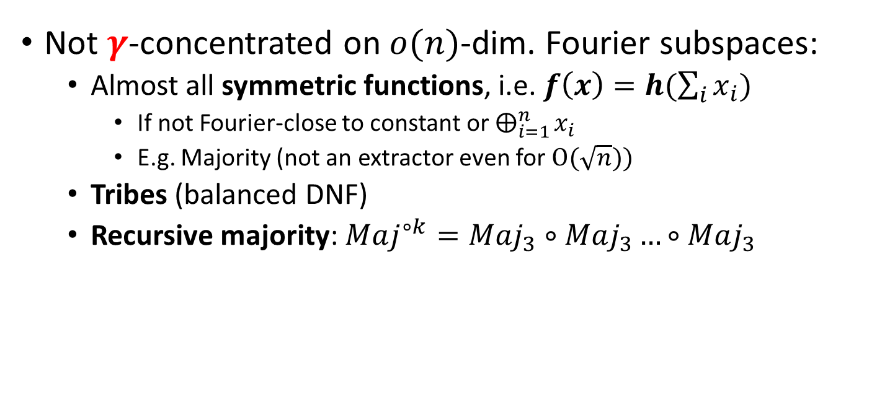
Randomized Sketching: Hardness
Not $γ$-concentrated on $o(n)$-dim. Fourier subspaces:
Almost all symmetric functions, i.e. $f\left(x\right)=h(\sum_{i}{x_{i}})$
If not Fourier-close to constant or $⨁_{i=1}^{n}{x_{i}}$
E.g. Majority (not an extractor even for $O(\sqrt{n}))$
Tribes (balanced DNF)
Recursive majority: $Maj^{∘k}=Maj_{3}∘Maj_{3}…∘Maj_{3}$

Slide 26



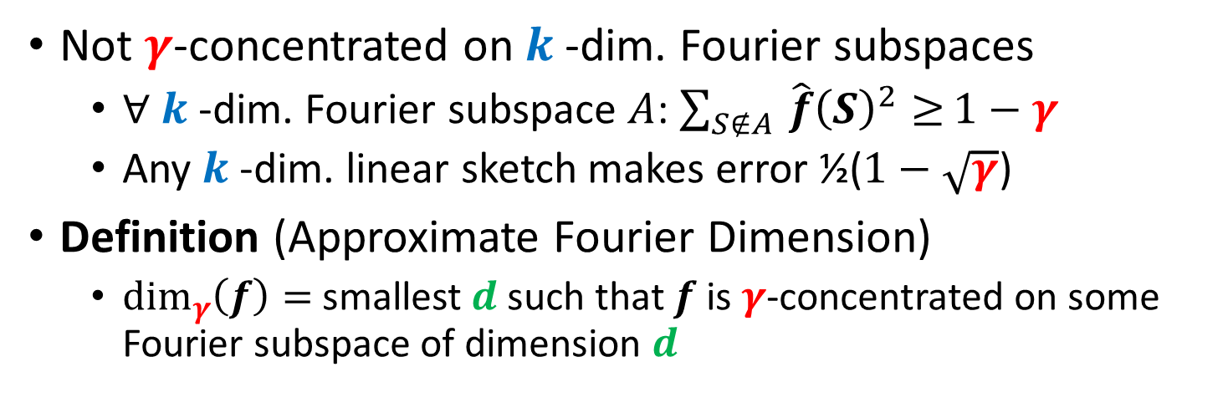





Approximate Fourier Dimension
Not $γ$-concentrated on $k$-dim. Fourier subspaces
$∀ k$-dim. Fourier subspace $A$: $\sum_{S∉A }{\hat{f}{\left(S\right)}^{2}≥}1−γ$
Any $k$-dim. linear sketch makes error ½($1−\sqrt{γ}$)
Definition (Approximate Fourier Dimension)
$\dim_{γ}\left(f\right)=$smallest $d$ such that $f$ is $γ$-concentrated on some Fourier subspace of dimension $d$
$$\hat{f}(S_{1}+S_{3})$$
$$\hat{f}({S_{1}+S}_{2}+S_{3})$$
$$\hat{f}(S_{1})$$
$$\hat{f}(S_{2}+S_{3})$$
$$\hat{f}(S_{2}+S_{3})$$
$$\hat{f}(S_{3})$$
$\sum_{S∈A }{\hat{f}{\left(S\right)}^{2}≥}$ $γ$
$$\hat{f}(S_{2})$$

