Slide 1
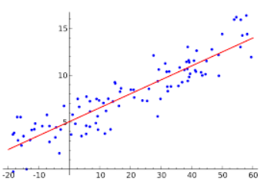
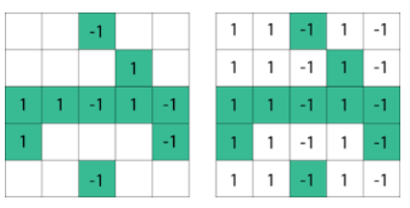

Why Randomized Numerical Linear Algebra?
Given massive sources of data
Predication and Optimization: Principle Component Analysis (PCA), Low-Rank Approximation (LRA), Regression

Slide 2

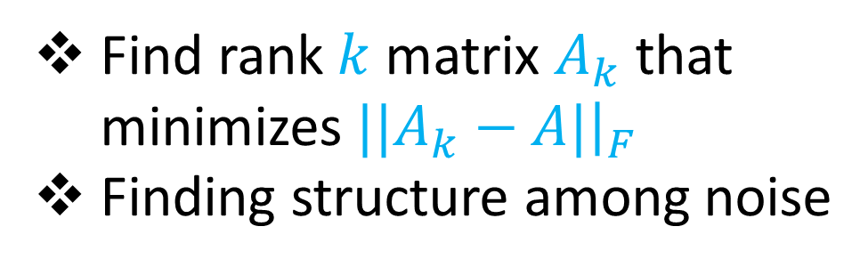

Low-Rank Approximation
1 3 5 -2 7 0 11 4 -8
0 0 -1 3 13 2 8 6 2
2 5 6 1 4 0 -7 5 3
8 7 2 1 -1 -3 -2 -4 -6
-5 3 -4 -1 -2 -1 0 -3 -1
7 1 3 2 4 1 0 11 1
Find rank $k$ matrix $A_{k}$ that minimizes ${||A}_{k}−A|{\left.​\right|}_{F}$
Finding structure among noise
$$W$$
$$n$$

Slide 3


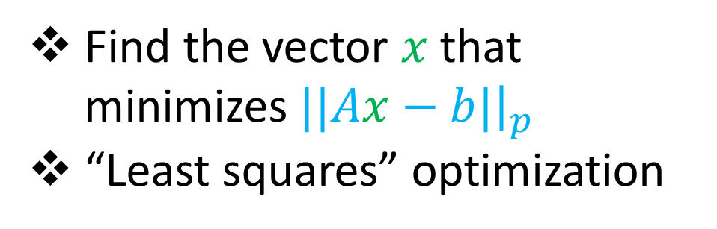






Regression
Find the vector $x$ that minimizes $||Ax−b|{\left.​\right|}_{p}$
“Least squares” optimization
$$n$$
$$≈$$
$$W$$
$$A$$
$$W$$
$$b$$
$$1$$
$$n$$
$$1$$

Slide 4

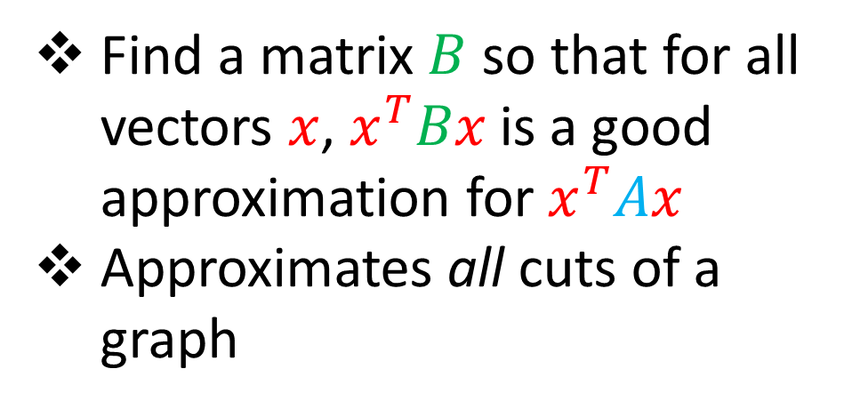



Spectral Sparsification
$$x^{T}$$
Find a matrix $B$ so that for all vectors $x$, $x^{T}Bx$ is a good approximation for $x^{T}Ax$
Approximates all cuts of a graph
$$A$$
$$x$$
$$n$$

Slide 5



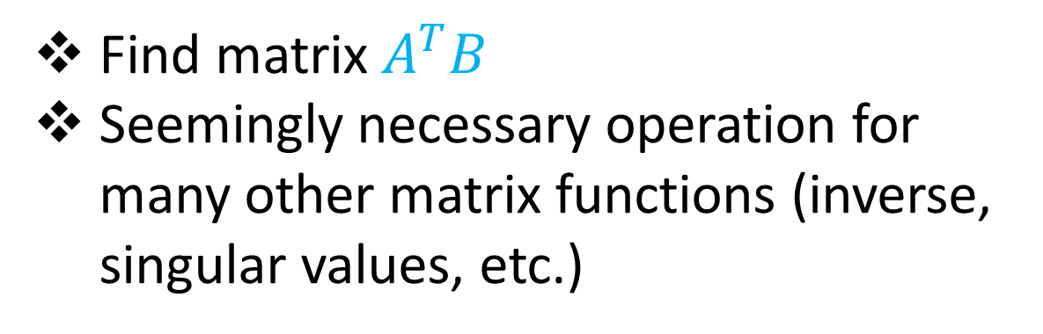



Matrix Multiplication
Find matrix $A^{T}B$
Seemingly necessary operation for many other matrix functions (inverse, singular values, etc.)
$$W$$
$$A$$
$$n$$
$$W$$
$$B$$
$$n$$

Slide 6
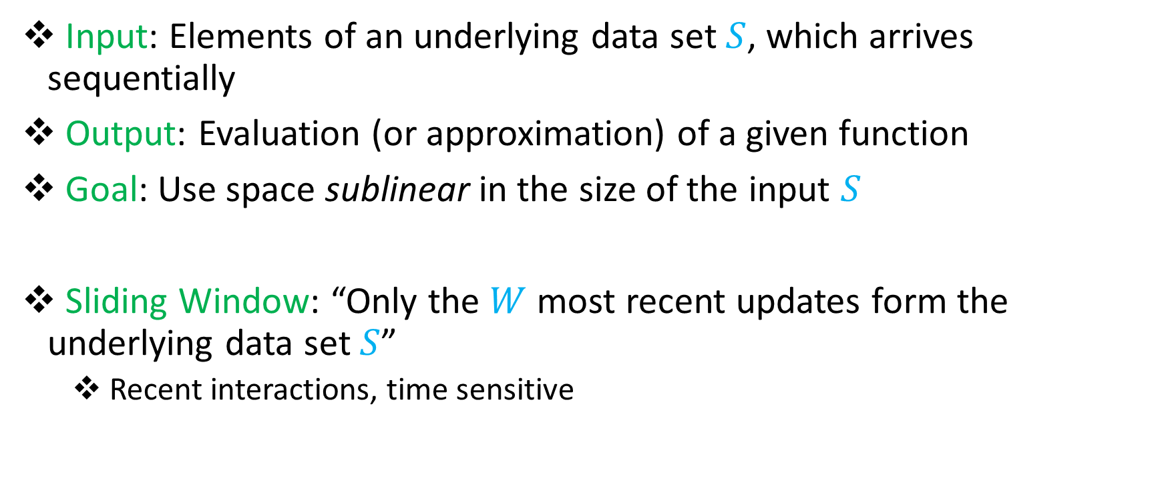
Streaming Model
Input: Elements of an underlying data set $S$, which arrives sequentially
Output: Evaluation (or approximation) of a given function
Goal: Use space sublinear in the size of the input $S$
Sliding Window: “Only the $W$ most recent updates form the underlying data set $S$”
Recent interactions, time sensitive

Slide 7
Randomized Numerical Linear Algebra (randNLA)
1 3 5 -2 7 0 11 4 -8
0 0 -1 3 13 2 8 6 2
2 5 6 1 4 0 -7 5 3
8 7 2 1 -1 -3 -2 -4 -6
-5 3 -4 -1 -2 -1 0 -3 -1
7 1 3 2 4 1 0 11 1
Various stream update models
In this talk, rows arrive one-by-one in the data stream

Slide 8
Randomized Numerical Linear Algebra (randNLA)
1 3 5 -2 7 0 11 4 -8
0 0 -1 3 13 2 8 6 2
2 5 6 1 4 0 -7 5 3
8 7 2 1 -1 -3 -2 -4 -6
-5 3 -4 -1 -2 -1 0 -3 -1
7 1 3 2 4 1 0 11 1
1 2 5 -5 4 1 23 4 -3
Rows arrive one-by-one in the data stream

Slide 9
Randomized Numerical Linear Algebra (randNLA)
1 3 5 -2 7 0 11 4 -8
0 0 -1 3 13 2 8 6 2
2 5 6 1 4 0 -7 5 3
8 7 2 1 -1 -3 -2 -4 -6
-5 3 -4 -1 -2 -1 0 -3 -1
7 1 3 2 4 1 0 11 1
1 2 5 -5 4 1 23 4 -3
0 5 0 0 7 0 1 31 6
Rows arrive one-by-one in the data stream

Slide 10
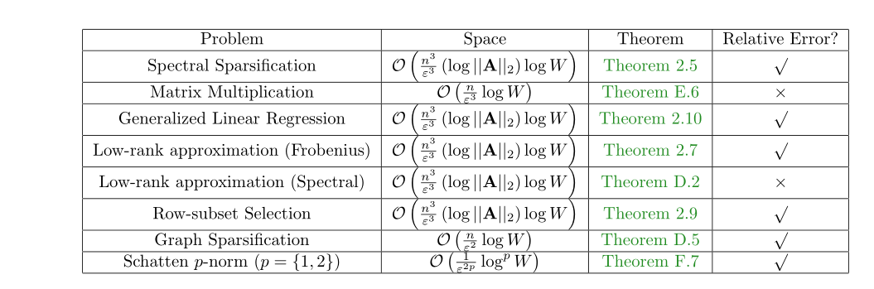
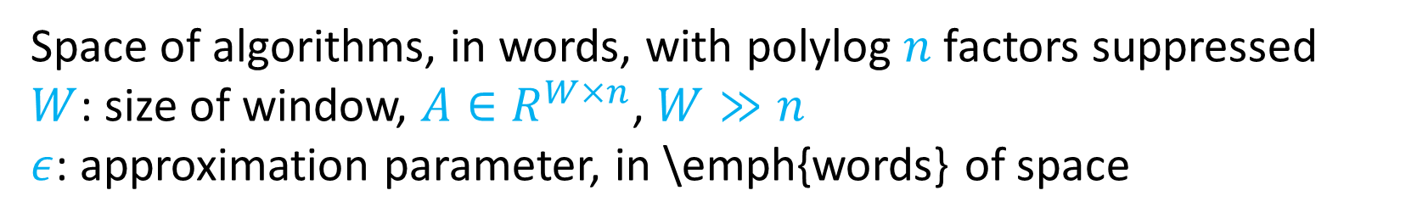
Results
Space of algorithms, in words, with polylog $n$factors suppressed
$W$: size of window, $A∈R^{W×n}$, $W≫n$
$ε$: approximation parameter, in \emph{words} of space

Slide 11
Smooth Histogram
Suppose we have a “smooth” function: monotonic, bounded, behaves well with the addition of each element
Use a number of different starting points to “sandwich” the sliding window
Example: Number of ones in sliding window:
1
1

Slide 12
Smooth Histogram
Suppose we have a “smooth” function: monotonic, bounded, behaves well with the addition of each element
Use a number of different starting points to “sandwich” the sliding window
Example: Number of ones in sliding window:
1 0
1

Slide 13
Smooth Histogram
Suppose we have a “smooth” function: monotonic, bounded, behaves well with the addition of each element
Use a number of different starting points to “sandwich” the sliding window
Example: Number of ones in sliding window:
1 0 1
2
1

Slide 14
Smooth Histogram
Suppose we have a “smooth” function: monotonic, bounded, behaves well with the addition of each element
Use a number of different starting points to “sandwich” the sliding window
Example: Number of ones in sliding window:
1 0 1 1
3
2
1

Slide 15
Smooth Histogram
Suppose we have a “smooth” function: monotonic, bounded, behaves well with the addition of each element
Use a number of different starting points to “sandwich” the sliding window
Example: Number of ones in sliding window:
1 0 1 1 1
4
3
2
1

Slide 16
Smooth Histogram
Suppose we have a “smooth” function: monotonic, bounded, behaves well with the addition of each element
Use a number of different starting points to “sandwich” the sliding window
Example: Number of ones in sliding window:
1 0 1 1 1
4
2
1

Slide 17
Smooth Histogram
Suppose we have a “smooth” function: monotonic, bounded, behaves well with the addition of each element
Use a number of different starting points to “sandwich” the sliding window
Example: Number of ones in sliding window:
1 0 1 1 1 0 0 1 1 0 1
7
4
2
1

Slide 18
Smooth Histogram
Suppose we have a “smooth” function: monotonic, bounded, behaves well with the addition of each element
Use a number of different starting points to “sandwich” the sliding window
Example: Number of ones in sliding window:
1 0 1 1 1 0 0 1 1 0 1
7
4
2
1

Slide 19

Smooth Histogram
Suppose we have a “smooth” function: monotonic, bounded, behaves well with the addition of each element
Use a number of different starting points to “sandwich” the sliding window
Example: Number of ones in sliding window:
We show this approach works for Schatten $1,2$ norms.
Other interesting matrix functions may not be smooth!
Ex: Low-rank approximation, matrix multiplication, linear regression
1 0 1 1 1 0 0 1 1 0 1
Number of ones in sliding window is at least 4 and at most 7
7 is a good approximation
7
4
2
1

Slide 20
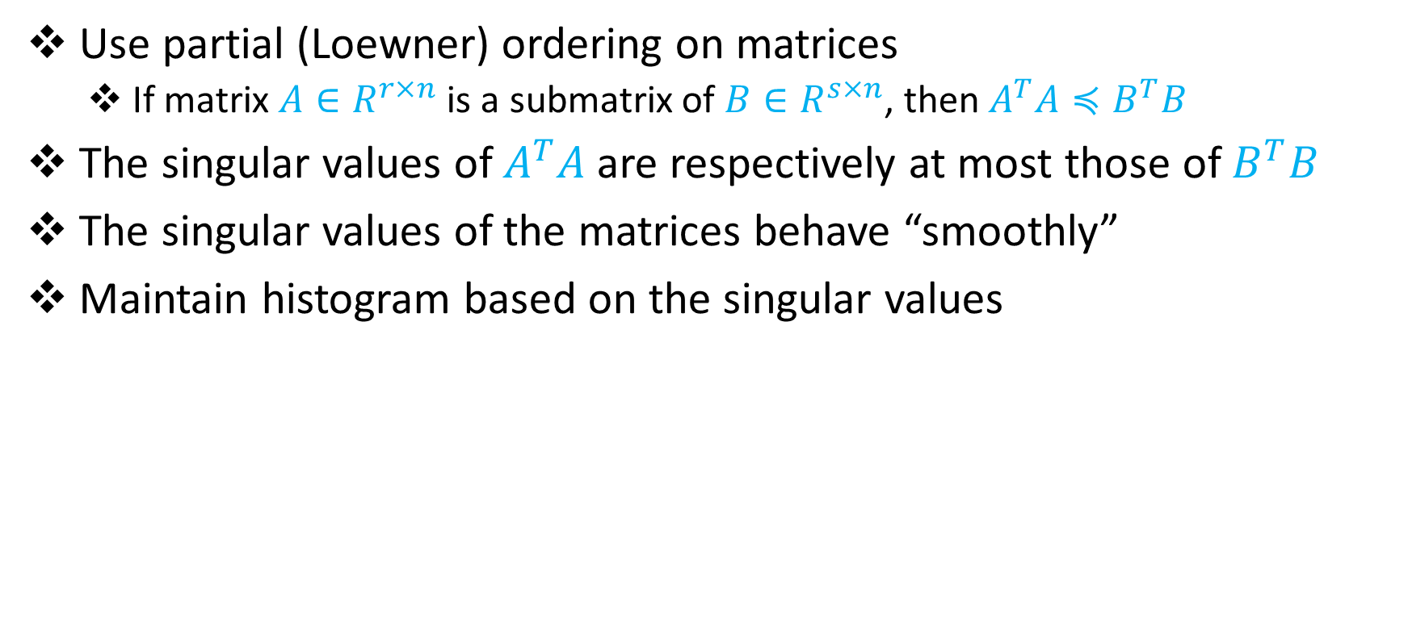
Our Approach (Smooth PSD Histogram)
Use partial (Loewner) ordering on matrices
If matrix $A∈R^{r×n}$ is a submatrix of $B∈R^{s×n}$, then $A^{T}A≼B^{T}B$
The singular values of $A^{T}A$are respectively at most those of $B^{T}B$
The singular values of the matrices behave “smoothly”
Maintain histogram based on the singular values

Slide 21
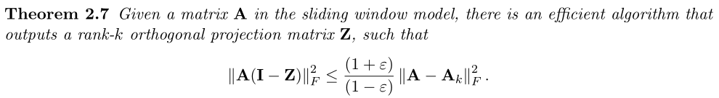
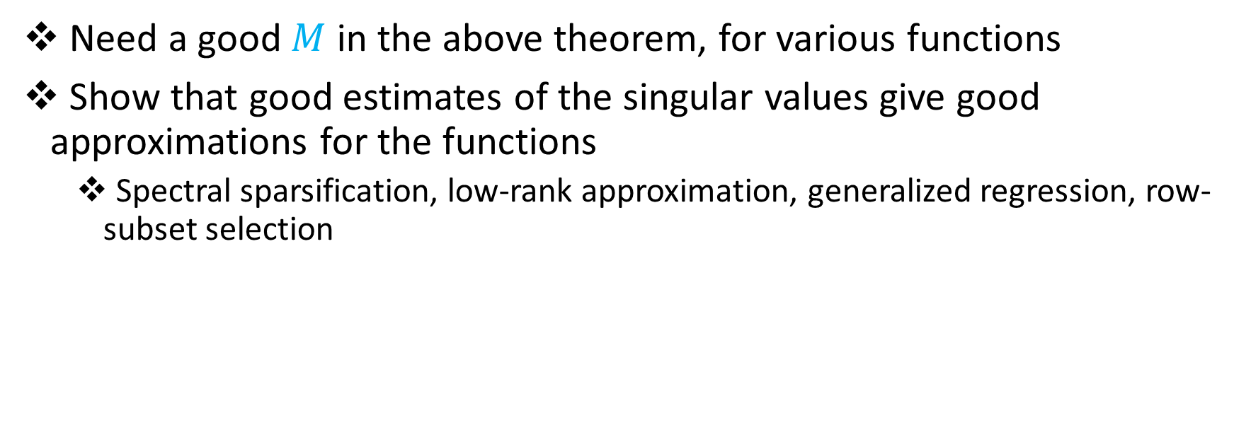
Our Approach (Smooth PSD Histogram)
Need a good $M$ in the above theorem, for various functions
Show that good estimates of the singular values give good approximations for the functions
Spectral sparsification, low-rank approximation, generalized regression, row-subset selection

