Slide 1
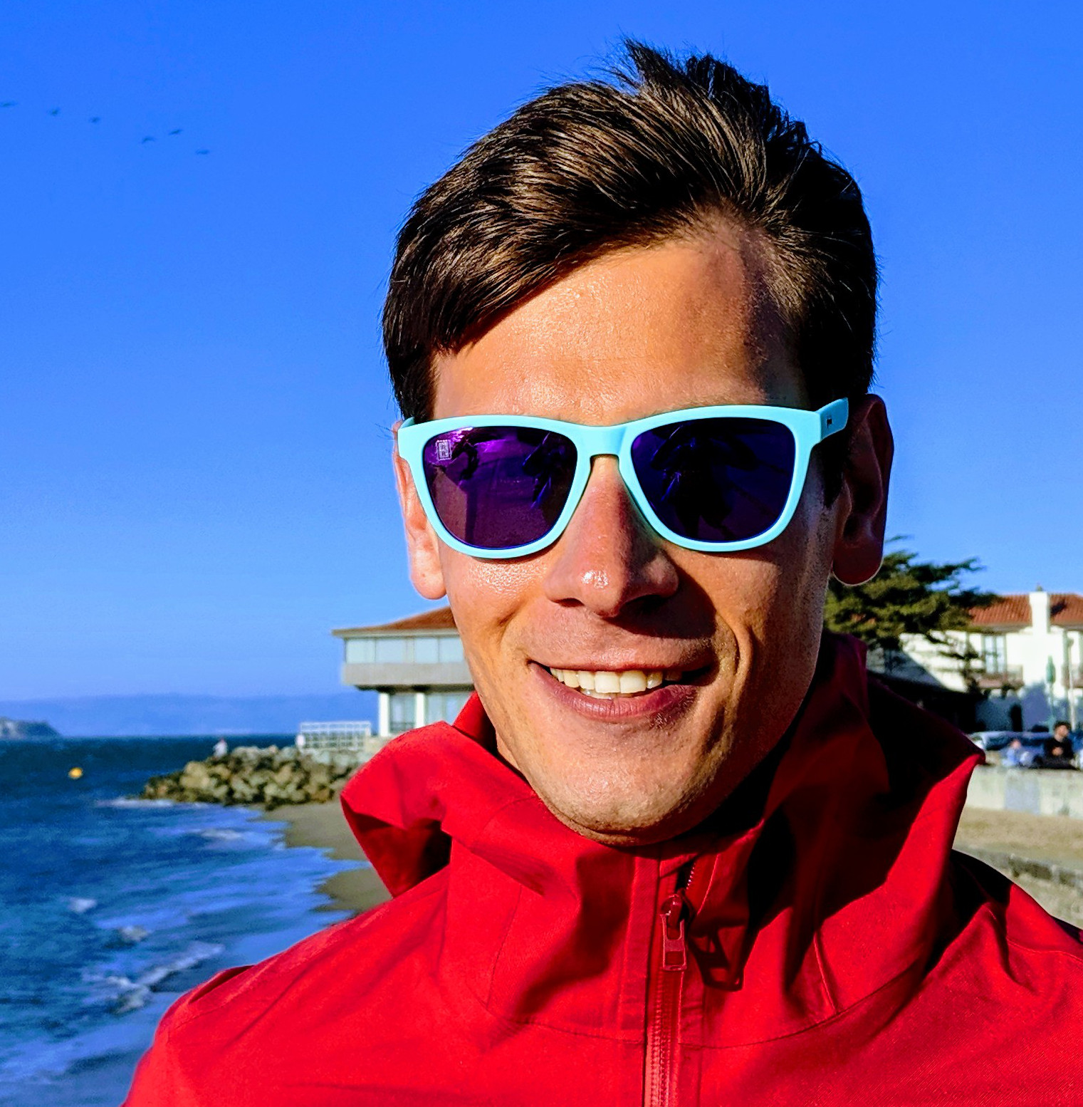
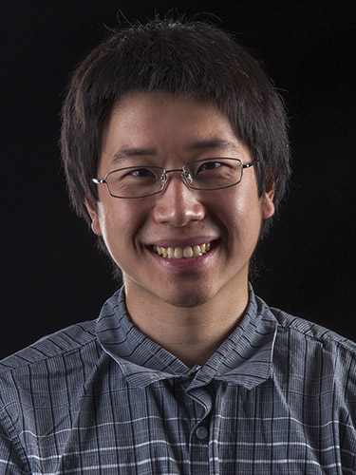



Fast Fourier Sparsity Testing
GRIGORY YAROSLAVTSEV
SAMSON ZHOU

Slide 2
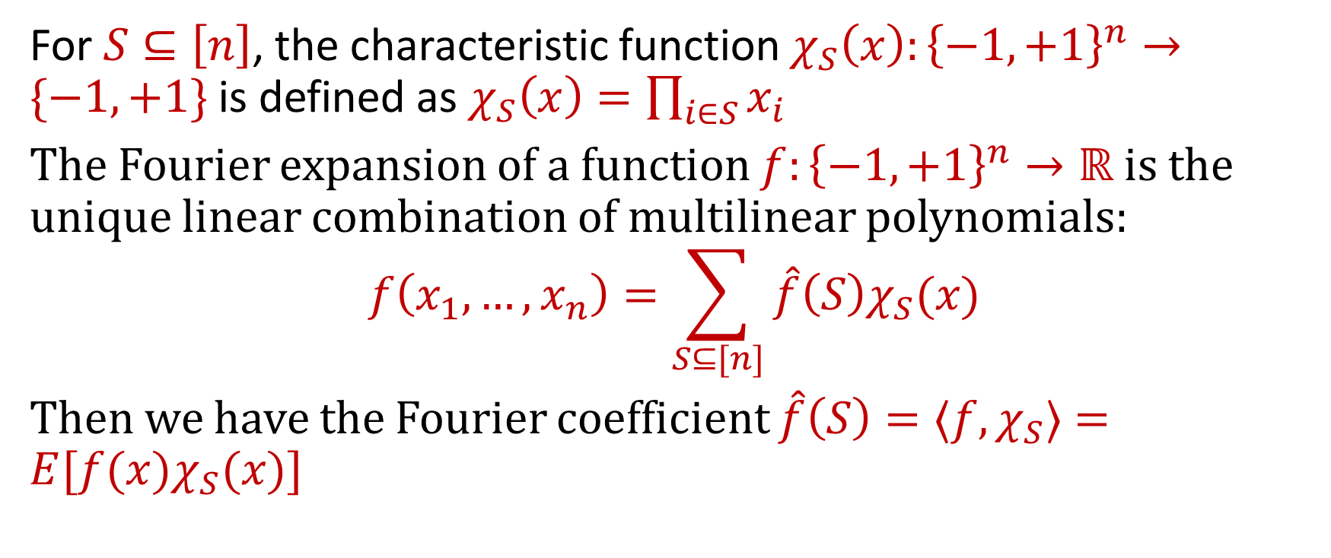
Fourier Expansion
For $S⊆\left[n\right]$, the characteristic function $χ_{S}\left(x\right):{\left\{−1,+1\right\}}^{n}→\{−1,+1\}$ is defined as $χ_{S}\left(x\right)=\prod_{i∈S}{x_{i}}$
The Fourier expansion of a function $f:{\left\{−1,+1\right\}}^{n}→ℝ$ is the unique linear combination of multilinear polynomials:
$$f\left(x_{1}, …, x_{n}\right)=\sum_{S⊆[n]}{\hat{f}\left(S\right)χ_{S}(x)}$$
Then we have the Fourier coefficient $\hat{f}\left(S\right)={⟨f,χ}_{S}⟩=E[f(x)χ_{S}(x)]$

Slide 3
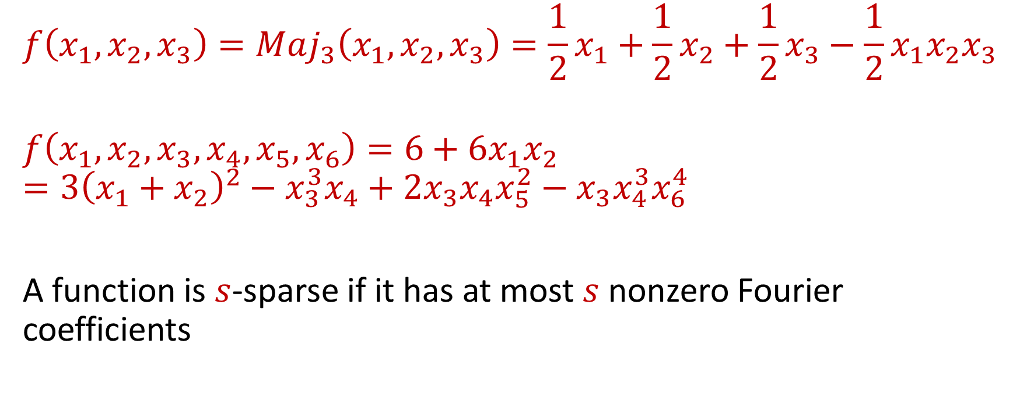
Fourier Sparsity
$$f\left(x_{1},x_{2},x_{3}\right)=Maj_{3}\left(x_{1},x_{2},x_{3}\right)=\frac{1}{2}x_{1}+\frac{1}{2}x_{2}+\frac{1}{2}x_{3}−\frac{1}{2}x_{1}x_{2}x_{3}$$
$$f\left(x_{1},x_{2},x_{3},x_{4},x_{5},x_{6}\right)=6+{{6x}_{1}x}_{2}=3{\left(x_{1}+x_{2}\right)}^{2}−x_{3}^{3}x_{4}+{2x}_{3}x_{4}x_{5}^{2}−x_{3}x_{4}^{3}x_{6}^{4}$$
A function is $s$-sparse if it has at most $s$ nonzero Fourier coefficients

Slide 4
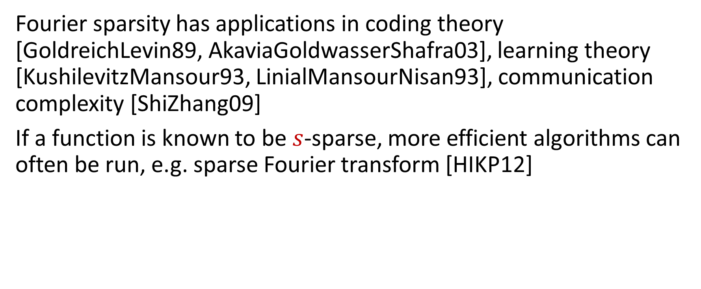
Why Fourier Sparsity?
Fourier sparsity has applications in coding theory [GoldreichLevin89, AkaviaGoldwasserShafra03], learning theory [KushilevitzMansour93, LinialMansourNisan93], communication complexity [ShiZhang09]
If a function is known to be $s$-sparse, more efficient algorithms can often be run, e.g. sparse Fourier transform [HIKP12]
Notes:
A characteristic of the error correcting codes which emerge and are addressed by our framework, is that code words can be approximated by a small number of heavy coefficients in their Fourier representation. Moreover, as long as corrupted words are close enough to legal code words, they will share a heavy Fourier coefficient.
Boolean functions in AC0 can be approximated by real polynomials of low degree. The algorithm receives as an input a boolean function f that can be approximated by a polynomially sparse function g (a function with a polynomial number of nonzero Fourier coefficients) such that the expected error square (i.e., E(f- g)2) is bounded by e. The algorithm finds some polynomially sparse function h that approximates f, such that E(f- h)2 O().. Essentially zeros out the small Fourier coefficients
The rank of the communication matrix is the Fourier sparsity, communication required is the log of the rank
GL learns large Fourier coefficients by hashing the space into buckets. KM takes the sign of the function with sparse coefficients output by GL

Slide 5

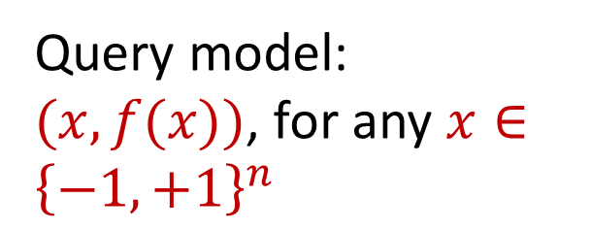
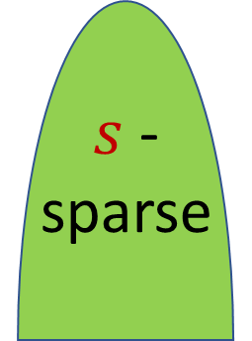

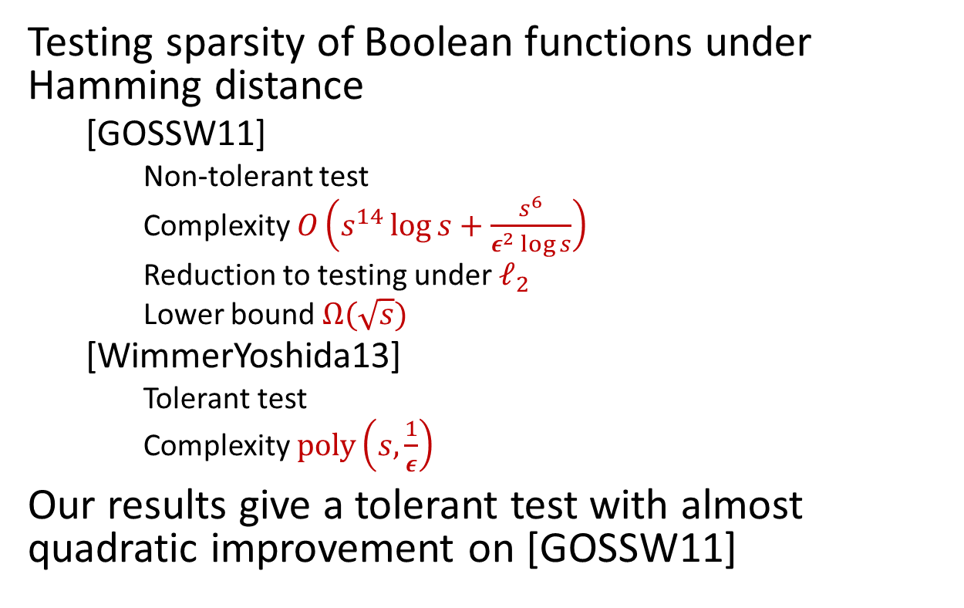


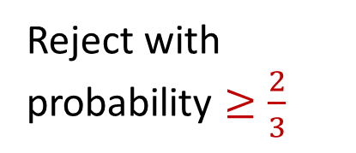
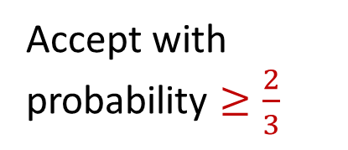
Property Tester
$s$-sparse
Testing sparsity of Boolean functions under Hamming distance
[GOSSW11]
Non-tolerant test
Complexity $O\left(s^{14}\log{s}+\frac{s^{6}}{ε^{2}\log{s}}\right)$
Reduction to testing under $ℓ_{2}$
Lower bound $Ω(\sqrt{s})$
[WimmerYoshida13]
Tolerant test
Complexity $poly\left(s,\frac{1}{ε}\right)$
Our results give a tolerant test with almost quadratic improvement on [GOSSW11]
$$⇒$$
Accept with probability $≥\frac{2}{3}$
$$⇒$$
Don’t care
$ε$-close
NO
$$⇒$$
Reject with probability $≥\frac{2}{3}$
Query model: $(x, f(x))$, for any $x∈{\left\{−1,+1\right\}}^{n}$

Slide 6
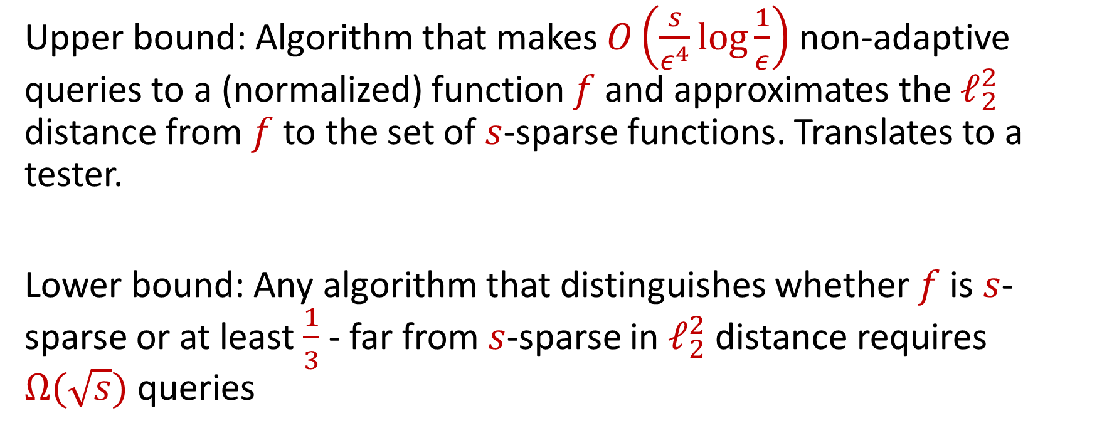
Our Contributions
Upper bound: Algorithm that makes $O\left(\frac{s}{ε^{4}}\log{\frac{1}{ε}}\right)$ non-adaptive queries to a (normalized) function $f$ and approximates the $ℓ_{2}^{2}$ distance from $f$ to the set of $s$-sparse functions. Translates to a tester.
Lower bound: Any algorithm that distinguishes whether $f$ is $s$-sparse or at least $\frac{1}{3}$ - far from $s$-sparse in $ℓ_{2}^{2}$ distance requires $Ω(\sqrt{s})$ queries
Notes:
Discuss challenges, can have large Hamming distance but small l2^2 distance

Slide 7
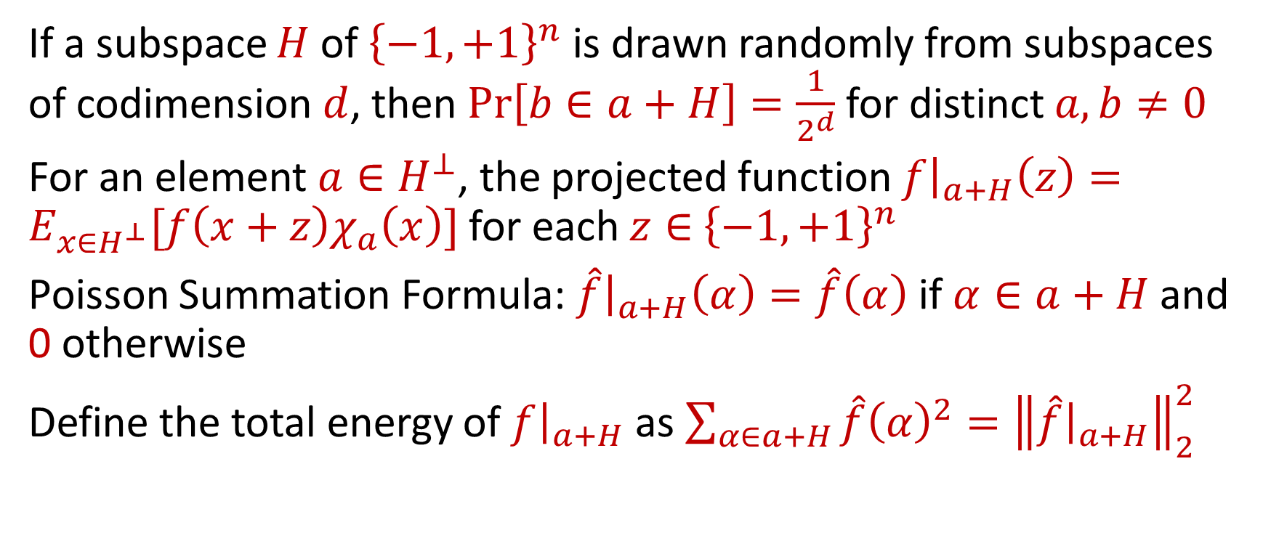
Random Hashing [FGKP09]
If a subspace $H$ of ${\left\{−1,+1\right\}}^{n}$ is drawn randomly from subspaces of codimension $d$, then $Pr\left[b∈a+H\right]=\frac{1}{2^{d}}$ for distinct $a,b≠0$
For an element $a∈H^{⊥}$, the projected function $f{\left.​\right|}_{a+H}\left(z\right)=E_{x∈H^{⊥}}[f\left(x+z\right)χ_{a}\left(x\right)]$ for each $z∈$ ${\left\{−1,+1\right\}}^{n}$
Poisson Summation Formula: $\hat{f}{\left.​\right|}_{a+H}\left(α\right)=\hat{f}\left(α\right)$ if $α∈a+H$ and 0 otherwise
Define the total energy of $f{\left.​\right|}_{a+H}$ as $\sum_{α∈a+H}{\hat{f}{\left(α\right)}^{2}={\left\|\hat{f}{\left.​\right|}_{a+H}\right\|}_{2}^{2}}$

Slide 8





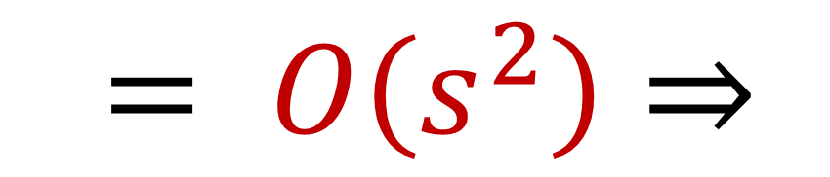
Testing $s$-Sparsity
#
$\sum_{α∈a+H}{\hat{f}{\left(α\right)}^{2}}=E[χ_{a}\left(z\right)f\left(x\right)f\left(x+z\right)]$, where $x∈{\left\{−1,+1\right\}}^{n}, z∈H^{⊥}$ [GOSSW11]
The set of queries ${\left\{f\left(x+z\right)\right\}}_{x∈H^{⊥}}$ can be used to compute $f{\left.​\right|}_{a+H}\left(z\right)$ for each of the cosets $a+H$ simultaneously
$$= O\left(s^{2}\right)⇒$$

Slide 9
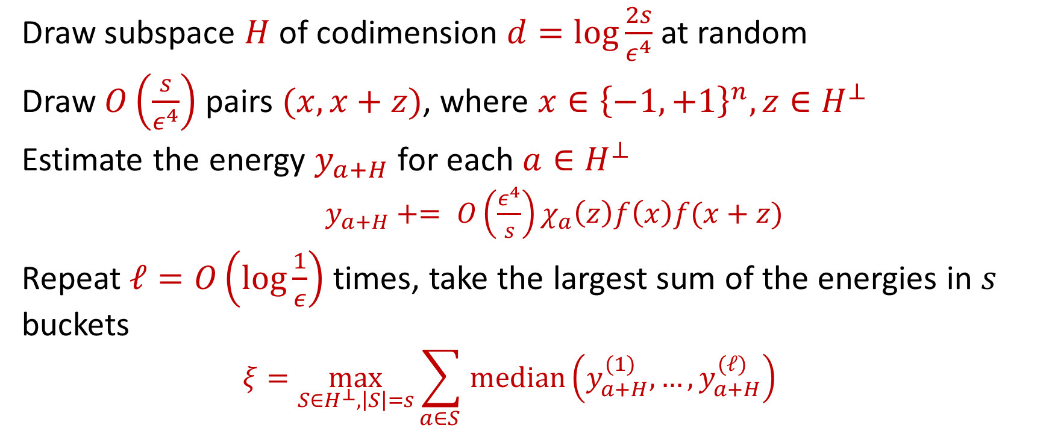
Algorithm
Draw subspace $H$of codimension $d=\log{\frac{2s}{ε^{4}}}$ at random
Draw $O\left(\frac{s}{ε^{4}}\right)$ pairs $(x,x+z)$, where $x∈{\left\{−1,+1\right\}}^{n}, z∈H^{⊥}$
Estimate the energy $y_{a+H}$ for each $a∈H^{⊥}$
$y_{a+H}+= O\left(\frac{ε^{4}}{s}\right)χ_{a}\left(z\right)f\left(x\right)f(x+z)$
Repeat $ℓ=O\left(\log{\frac{1}{ε}}\right)$ times, take the largest sum of the energies in $s$ buckets
$$ξ=\max_{S∈H^{⊥},\left|S\right|=s}\sum_{a∈S }{median}\left(y_{a+H}^{(1)},…,y_{a+H}^{(ℓ)}\right)$$

Slide 10
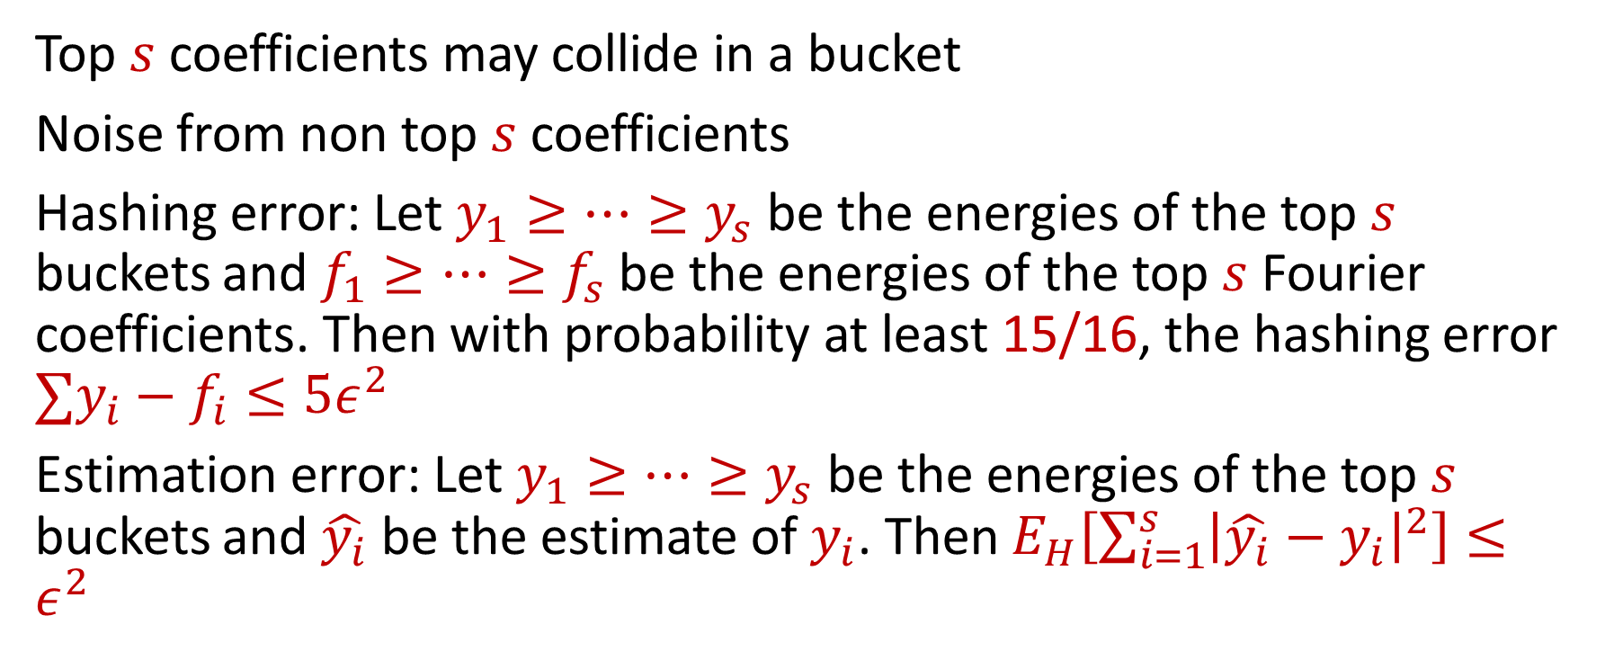
Analysis
Top $s$ coefficients may collide in a bucket
Noise from non top $s$ coefficients
Hashing error: Let $y_{1}≥…≥y_{s}$ be the energies of the top $s$ buckets and $f_{1}≥…≥f_{s}$ be the energies of the top $s$ Fourier coefficients. Then with probability at least 15/16, the hashing error ${∑y}_{i}−f_{i}≤5ε^{2}$
Estimation error: Let $y_{1}≥…≥y_{s}$ be the energies of the top $s$ buckets and $\hat{y_{i}}$ be the estimate of $y_{i}$. Then $E_{H}\left[\sum_{i=1}^{s}{{\left|\hat{y_{i}}−y_{i}\right|}^{2}}\right]≤ε^{2}$

Slide 11
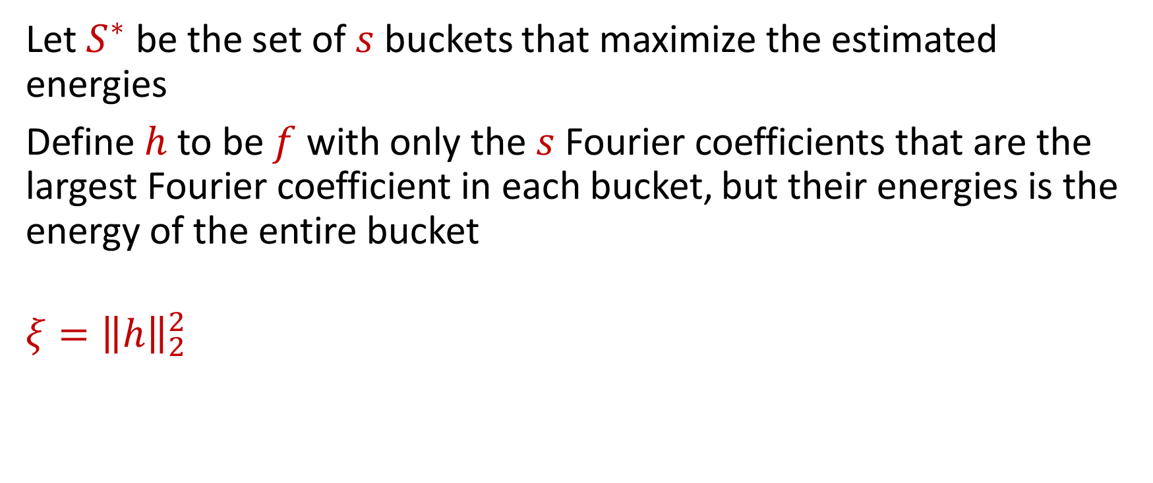
Putting it all together
Let $S^{∗}$ be the set of $s$ buckets that maximize the estimated energies
Define $h$ to be $f$ with only the $s$ Fourier coefficients that are the largest Fourier coefficient in each bucket, but their energies is the energy of the entire bucket
$$ξ={\left\|h\right\|}_{2}^{2}$$

Slide 12
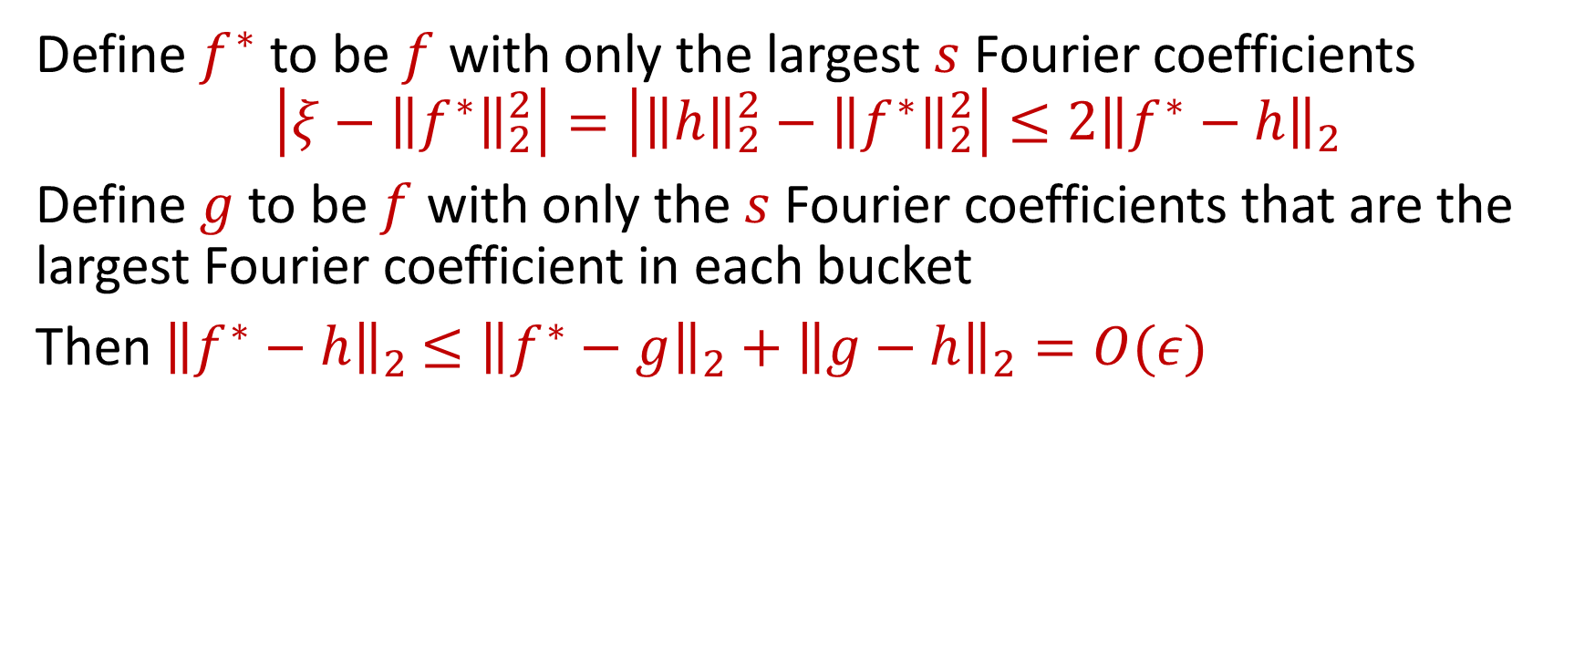
Putting it all together
Define $f^{∗}$ to be $f$ with only the largest $s$ Fourier coefficients
$$\left|ξ−{\left\|f^{∗}\right\|}_{2}^{2}\right|=\left|{\left\|h\right\|}_{2}^{2}−{\left\|f^{∗}\right\|}_{2}^{2}\right|≤2{\left\|f^{∗}−h\right\|}_{2}$$
Define $g$ to be $f$ with only the $s$ Fourier coefficients that are the largest Fourier coefficient in each bucket
Then ${\left\|f^{∗}−h\right\|}_{2}$ $≤{\left\|f^{∗}−g\right\|}_{2}+{\left\|g−h\right\|}_{2}=O(ε)$
Hashing error
Estimation error

Slide 13

Future Work?
Improve upper or lower bounds
Extensions to other domains (line, hypergrid)
Other properties that can be tested in $ℓ_{2}?$

Slide 14



Slide 15
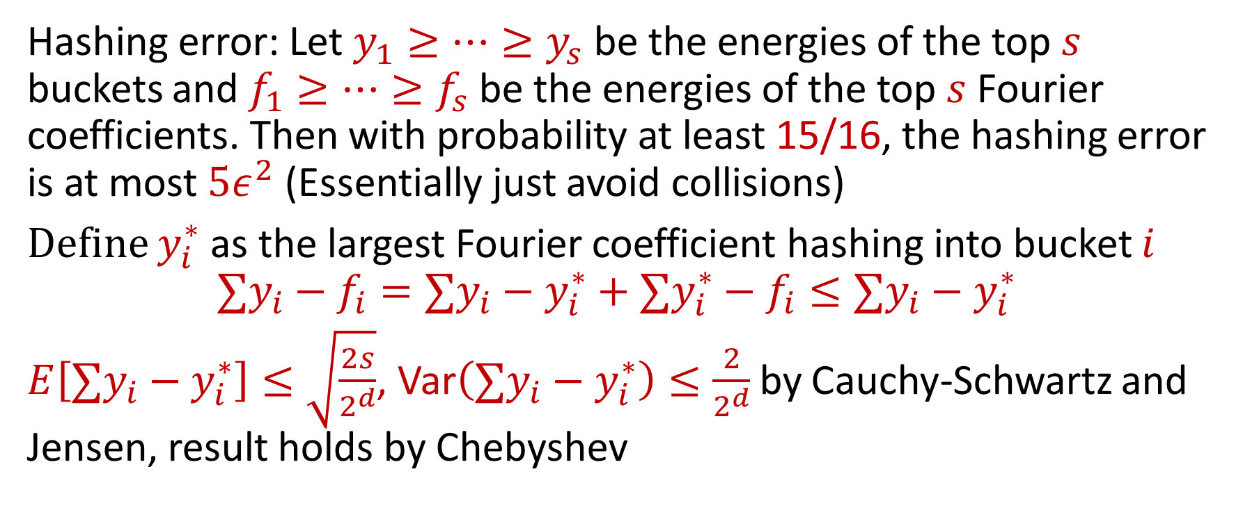
Hashing Error
Hashing error: Let $y_{1}≥…≥y_{s}$ be the energies of the top $s$ buckets and $f_{1}≥…≥f_{s}$ be the energies of the top $s$ Fourier coefficients. Then with probability at least 15/16, the hashing error is at most $5ε^{2}$ (Essentially just avoid collisions)
Define $y_{i}^{∗}$as the largest Fourier coefficient hashing into bucket $i$
$${∑y}_{i}−f_{i}=∑y_{i}−y_{i}^{∗}+∑y_{i}^{∗}−f_{i}≤∑y_{i}−y_{i}^{∗}$$
$E\left[∑y_{i}−y_{i}^{∗}\right]≤\sqrt{\frac{2s}{2^{d}}}$, Var$\left(∑y_{i}−y_{i}^{∗}\right)≤\frac{2}{2^{d}}$ by Cauchy-Schwartz and Jensen, result holds by Chebyshev

Slide 16
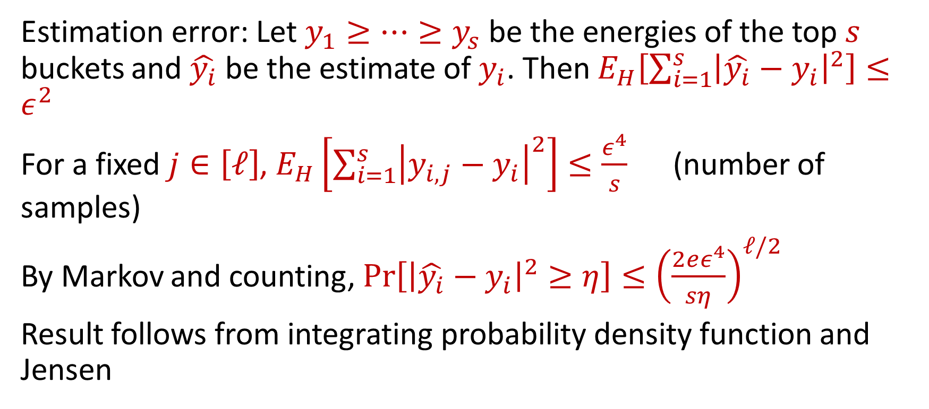
Estimation Error
Estimation error: Let $y_{1}≥…≥y_{s}$ be the energies of the top $s$ buckets and $\hat{y_{i}}$ be the estimate of $y_{i}$. Then $E_{H}\left[\sum_{i=1}^{s}{{\left|\hat{y_{i}}−y_{i}\right|}^{2}}\right]≤ε^{2}$
For a fixed $j∈\left[ℓ\right]$, $E_{H}\left[\sum_{i=1}^{s}{{\left|y_{i,j}−y_{i}\right|}^{2}}\right]≤\frac{ε^{4}}{s}$ (number of samples)
By Markov and counting, $Pr\left[{\left|\hat{y_{i}}−y_{i}\right|}^{2}≥η\right]≤{\left(\frac{2eε^{4}}{sη}\right)}^{ℓ/2}$
Result follows from integrating probability density function and Jensen

Slide 17


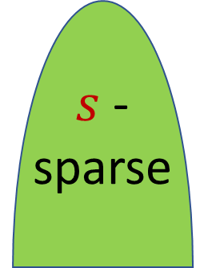

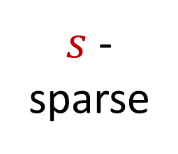
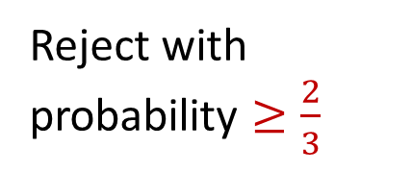
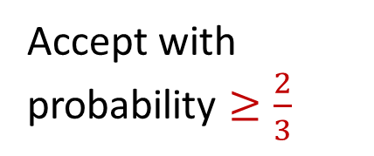




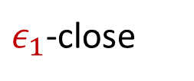

Testing Sparsity in $ℓ_{2}^{2}$
Property Tester
Tolerant Property Tester
$s$-sparse
$$⇒$$
Accept with probability $≥\frac{2}{3}$
$s$-sparse
$$⇒$$
Accept with probability $≥\frac{2}{3}$
$$⇒$$
Don’t care
$ε$-close
$ε_{1}$-close
NO
$$⇒$$
Don’t care
$$⇒$$
Reject with probability $≥\frac{2}{3}$
$(ε_{1},ε_{2})$-close
NO
$$⇒$$
Reject with probability $≥\frac{2}{3}$
$ε$-close : dist($f$, $s$-sparse) $=\inf_{g∈s\text{−}\text{sparse}}{dist(f,g)}≤ε$

