Slide 1



Nearly Optimal Distinct Elements and Heavy Hitters on Sliding Windows
VLADIMIR BRAVERMAN
ELENA GRIGORESCU
HARRY LANG
DAVID P. WOODRUFF
SAMSON ZHOU

Slide 2
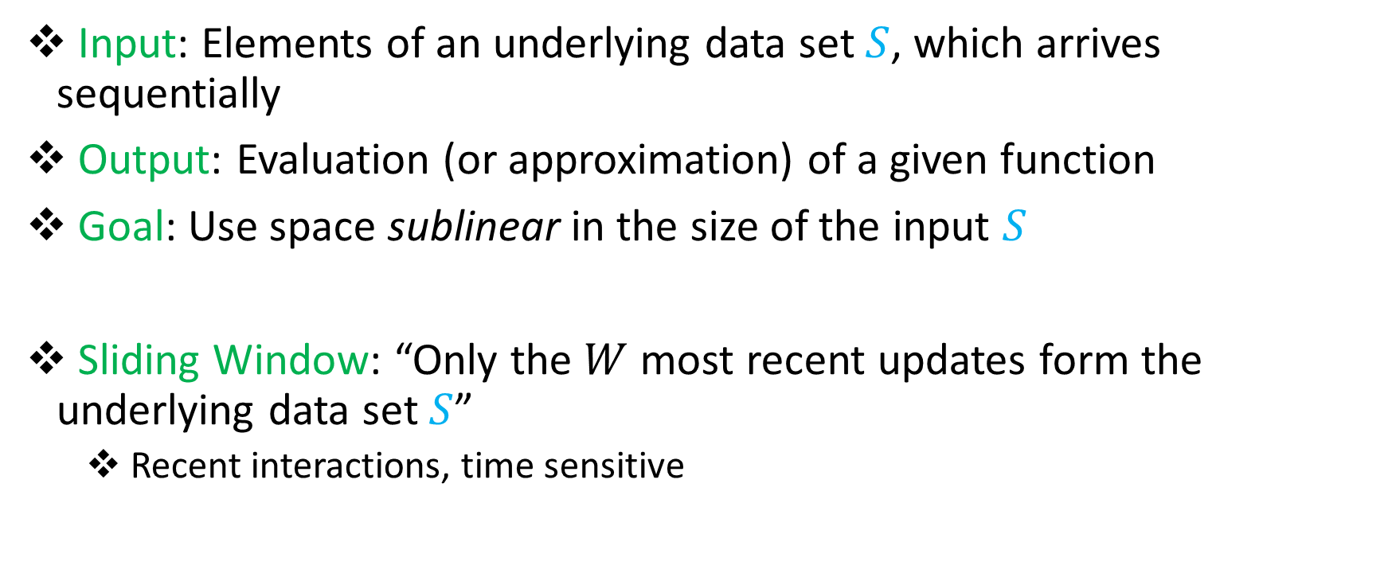
Streaming Model
Input: Elements of an underlying data set $S$, which arrives sequentially
Output: Evaluation (or approximation) of a given function
Goal: Use space sublinear in the size of the input $S$
Sliding Window: “Only the $W$ most recent updates form the underlying data set $S$”
Recent interactions, time sensitive

Slide 3
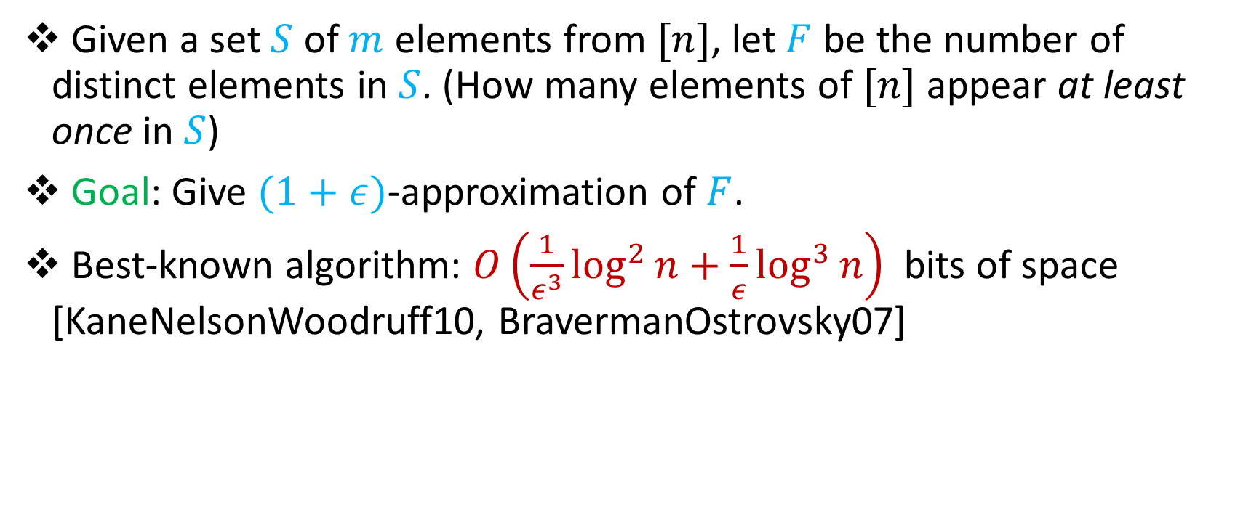

Distinct Elements ($L_{0}$ Norm)
Given a set $S$ of $m$ elements from $[n]$, let $F$ be the number of distinct elements in $S$. (How many elements of $[n]$ appear at least once in $S$)
Goal: Give $(1+ε)$-approximation of $F$.
Best-known algorithm: $O\left(\frac{1}{ε^{3}}\log^{2}{n}+\frac{1}{ε}\log^{3}{n}\right)$ bits of space [KaneNelsonWoodruff10, BravermanOstrovsky07]
Our result: $O\left(\frac{1}{ε^{2}}\log{n}\left(\log{\log{n\log{\frac{1}{ε}}}}\right)+\frac{1}{ε}\log^{2}{n}\right)$ bits of space

Slide 4
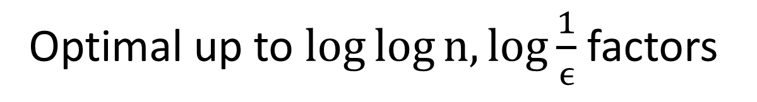
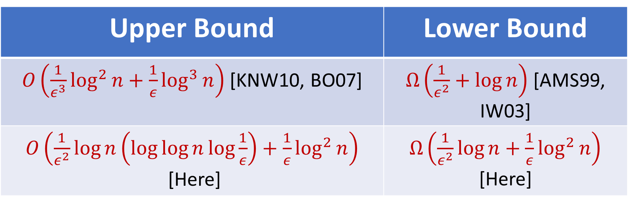
Distinct Elements
Upper Bound | Lower Bound
$O\left(\frac{1}{ε^{3}}\log^{2}{n}+\frac{1}{ε}\log^{3}{n}\right)$[KNW10, BO07] | $Ω\left(\frac{1}{ε^{2}}+\log{n}\right)$ [AMS99, IW03]
$O\left(\frac{1}{ε^{2}}\log{n}\left(\log{\log{n\log{\frac{1}{ε}}}}\right)+\frac{1}{ε}\log^{2}{n}\right)$ [Here] | $Ω\left(\frac{1}{ε^{2}}\log{n}+\frac{1}{ε}\log^{2}{n}\right)$ [Here]
Optimal up to $\log{\log{n,\log{\frac{1}{ϵ}}}}$ factors

Slide 5
Heavy Hitters
314 293 812 758 314 211
112 067 183 447
033 314 905 717 623 576
128 443 007 889 572 511
223 981 961 011 314 414
314 000 668 295 223 366
552 877 256 505 566 314
191 993 314 054 007 314

Slide 6
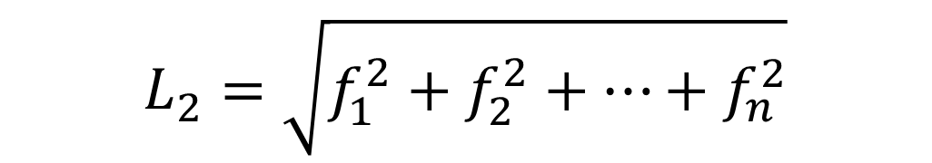
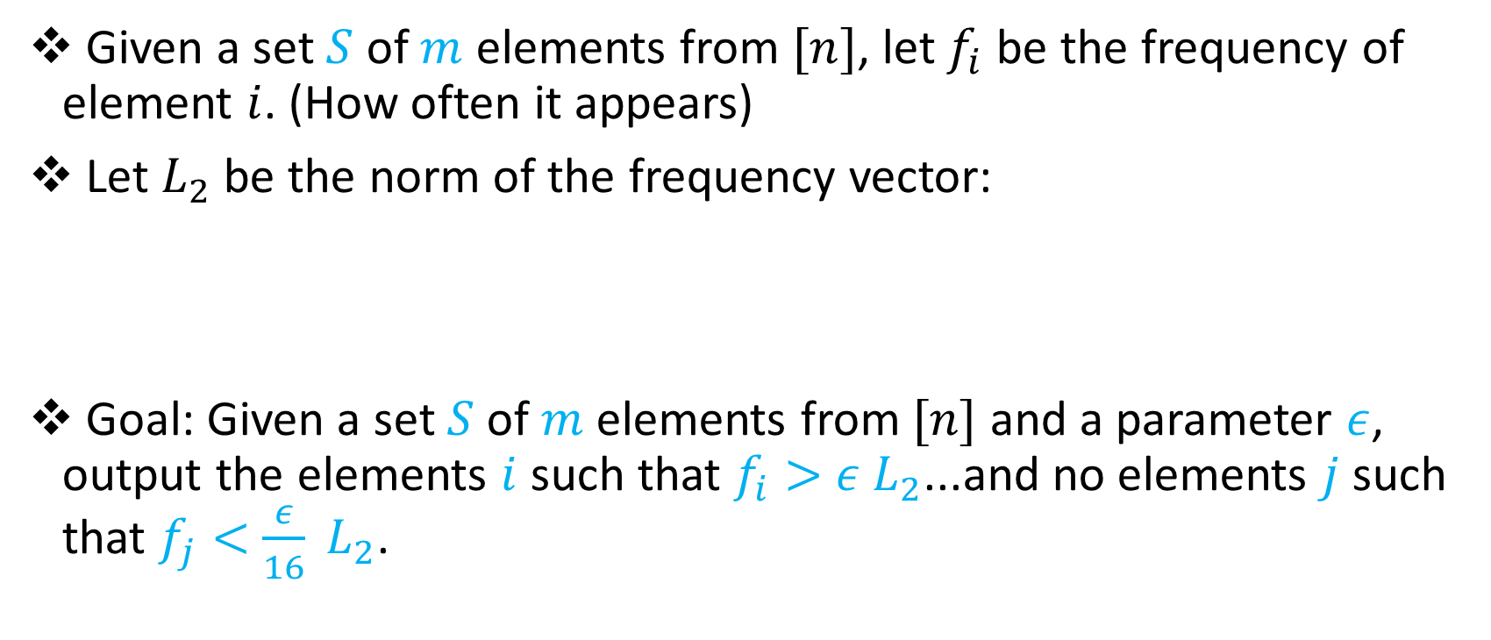
Heavy-Hitters
Given a set $S$ of $m$ elements from $[n]$, let $f_{i}$ be the frequency of element $i$. (How often it appears)
Let $L_{2}$ be the norm of the frequency vector:
Goal: Given a set $S$ of $m$ elements from $[n]$ and a parameter $ε$, output the elements $i$ such that $f_{i}>$ $ε L_{2}$...and no elements $j$ such that $f_{j}<$ $\frac{ε}{16} L_{2}$.
$$L_{2}=\sqrt{f_{1}^{2}+f_{2}^{2}+…+f_{n}^{2}}$$

Slide 7
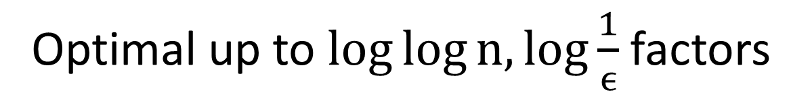
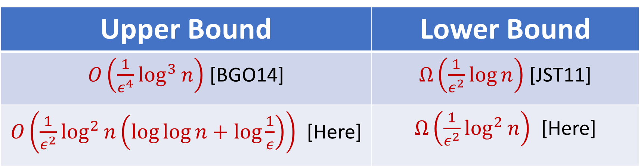
Heavy-Hitters in the Sliding Window Model
Upper Bound | Lower Bound
$O\left(\frac{1}{ε^{4}}\log^{3}{n}\right)$ [BGO14] | $Ω\left(\frac{1}{ε^{2}}\log{n}\right)$ [JST11]
$O\left(\frac{1}{ε^{2}}\log^{2}{n}\left(\log{\log{n+\log{\frac{1}{ε}}}}\right)\right)$ [Here] | $Ω\left(\frac{1}{ε^{2}}\log^{2}{n}\right)$ [Here]
Optimal up to $\log{\log{n,\log{\frac{1}{ϵ}}}}$ factors

