Slide 1
CSCE 689: Special Topics in Modern Algorithms for Data Science
Lecture 4
Samson Zhou

Slide 2
Today
Sign up for LaTeX scribe note slots
Receive and consider list of potential projects/groups

Slide 3
Future
Wednesday: Discuss potential project groups
Friday: Email me the members/group name
Future: Set up meetings to discuss proposed projects

Slide 4

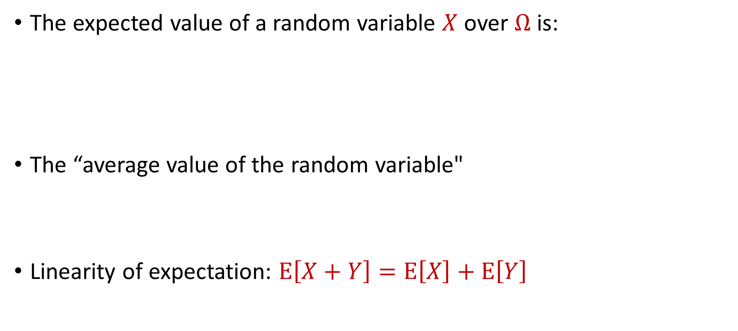
Last Time: Expected Value
The expected value of a random variable $X$ over $Ω$ is:
The “average value of the random variable"
Linearity of expectation: $E\left[X+Y\right]=E\left[X\right]+E\left[Y\right]$
$$E\left[X\right]=\sum_{x∈Ω}{Pr\left[X=x\right]⋅x}$$

Slide 5

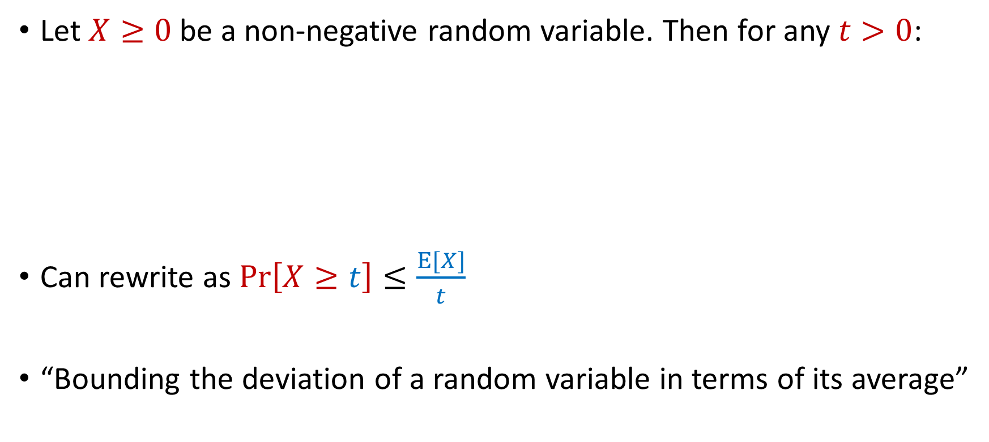
Last Time: Markov’s Inequality
Let $X≥0$be a non-negative random variable. Then for any $t>0$:
Can rewrite as $Pr\left[X≥t\right]≤\frac{E[X]}{t}$
“Bounding the deviation of a random variable in terms of its average”
$$Pr\left[X≥t⋅E[X]\right]≤\frac{1}{t}$$

Slide 6
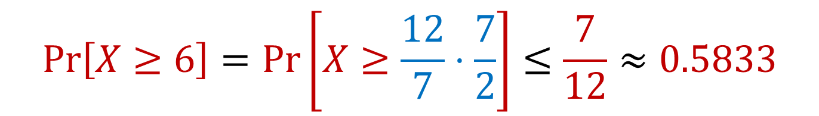

Limitations of Markov’s Inequality
Let $X$be the outcome of a roll of a die. Then $E\left[X\right]=3.5=\frac{7}{2}$
We know $Pr\left[X≥6\right]=\frac{1}{6}≈0.167$
$$Pr\left[X≥6\right]=Pr\left[X≥\frac{12}{7}⋅\frac{7}{2}\right]≤\frac{7}{12}≈0.5833$$

Slide 7


Moments
For $p>0$, the $p$-th moment of a random variable $X$ over $Ω$ is:
$$E\left[X^{p}\right]=\sum_{x∈Ω}{Pr\left[X=x\right]⋅x^{p}}$$

Slide 8
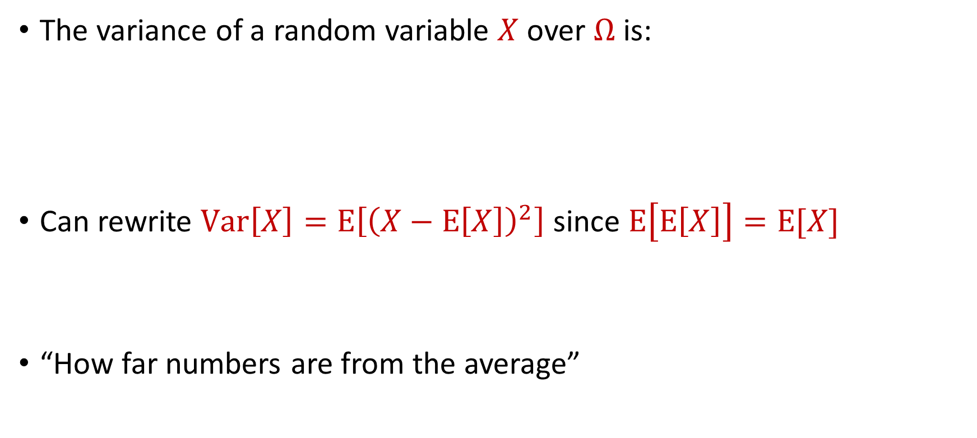
Variance
The variance of a random variable $X$ over $Ω$ is:
Can rewrite $Var\left[X\right]=E\left[{\left(X−E\left[X\right]\right)}^{2}\right]$ since $E\left[E\left[X\right]\right]=E[X]$
“How far numbers are from the average”
$$Var\left[X\right]=E\left[X^{2}\right]−{\left(E\left[X\right]\right)}^{2}$$

Slide 9

Variance
The variance of a random variable $X$ over $Ω$ is:
Linearity of variance for independent random variables: $Var\left[X+Y\right]=Var\left[X\right]+Var\left[Y\right]$
$$Var\left[X\right]=E\left[X^{2}\right]−{\left(E\left[X\right]\right)}^{2}$$

Slide 10
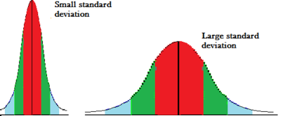
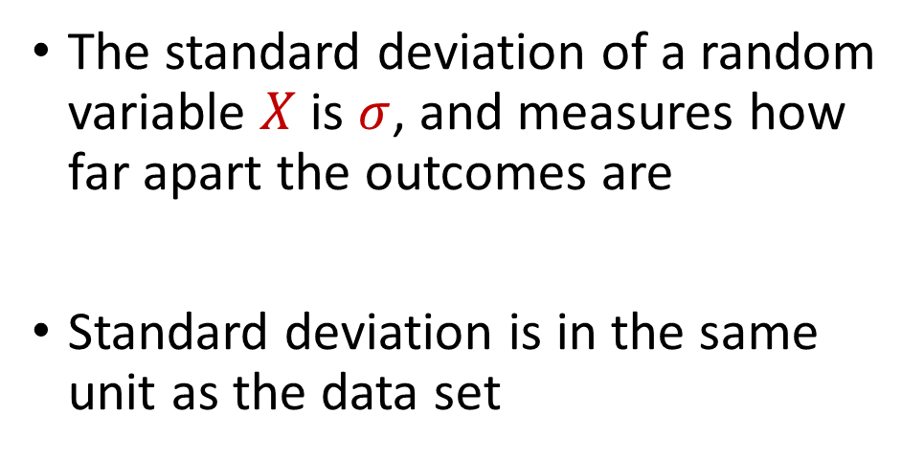
Variance and Standard Deviation
The variance of a random variable $X$ over $Ω$ is:
$$σ^{2}=Var\left[X\right]=E\left[X^{2}\right]−{\left(E\left[X\right]\right)}^{2}$$
The standard deviation of a random variable $X$ is $σ$, and measures how far apart the outcomes are
Standard deviation is in the same unit as the data set

Slide 11
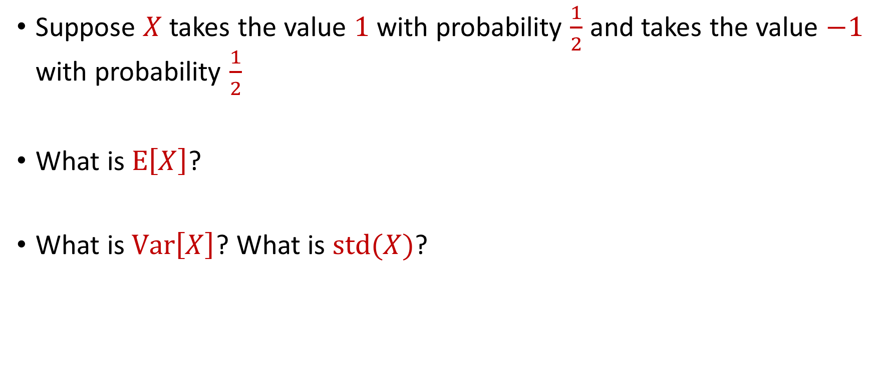
Variance
Suppose $X$ takes the value $1$ with probability $\frac{1}{2}$ and takes the value $−1$ with probability $\frac{1}{2}$
What is $E\left[X\right]$?
What is $Var\left[X\right]$? What is $std(X)$?

Slide 12
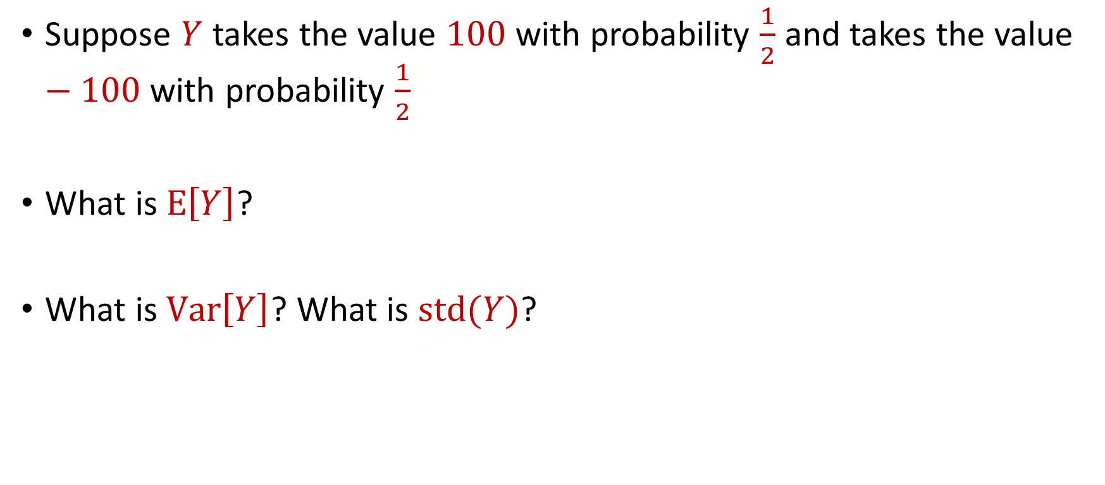
Variance
Suppose $Y$ takes the value $100$ with probability $\frac{1}{2}$ and takes the value $−100$ with probability $\frac{1}{2}$
What is $E\left[Y\right]$?
What is $Var\left[Y\right]$? What is $std(Y)$?

Slide 13

Markov’s Inequality
Let $X≥0$be a non-negative random variable. Then for any $t>0$:
Can rewrite as $Pr\left[X≥t\right]≤\frac{E[X]}{t}$
$$Pr\left[X≥t⋅E[X]\right]≤\frac{1}{t}$$

Slide 14

Markov’s Inequality
Let $X≥0$be a non-negative random variable. Then for any $t>0$:
Can rewrite as $Pr\left[X≥t\right]≤\frac{E[X]}{t}$
We have $Pr\left[\left|X\right|≥t\right]=Pr\left[X^{2}≥t^{2}\right]$
$$Pr\left[X≥t⋅E[X]\right]≤\frac{1}{t}$$

Slide 15



Using Markov’s Inequality
We have $Pr\left[\left|X\right|≥t\right]=Pr\left[X^{2}≥t^{2}\right]$
Plug in $X−E[X]$ for $X$
$$Pr\left[\left|X\right|≥t\right]=Pr\left[X^{2}≥t^{2}\right]≤\frac{E[X^{2}]}{t^{2}}$$
$$Pr\left[\left|X−E[X]\right|≥t\right]≤\frac{E[{(X−E\left[X\right])}^{2}]}{t^{2}}$$

Slide 16

Toward Chebyshev’s Inequality
$$Pr\left[\left|X−E[X]\right|≥t\right]≤\frac{E[{(X−E\left[X\right])}^{2}]}{t^{2}}$$

Slide 17

Chebyshev’s Inequality
Recall that $Var\left[X\right]=E\left[X^{2}\right]−{\left(E\left[X\right]\right)}^{2}=E\left[{\left(X−E\left[X\right]\right)}^{2}\right]$
$Pr\left[\left|X−E[X]\right|≥t\right]≤\frac{Var[X]}{t^{2}}$
$$Pr\left[\left|X−E[X]\right|≥t\right]≤\frac{E[{(X−E\left[X\right])}^{2}]}{t^{2}}$$

Slide 18

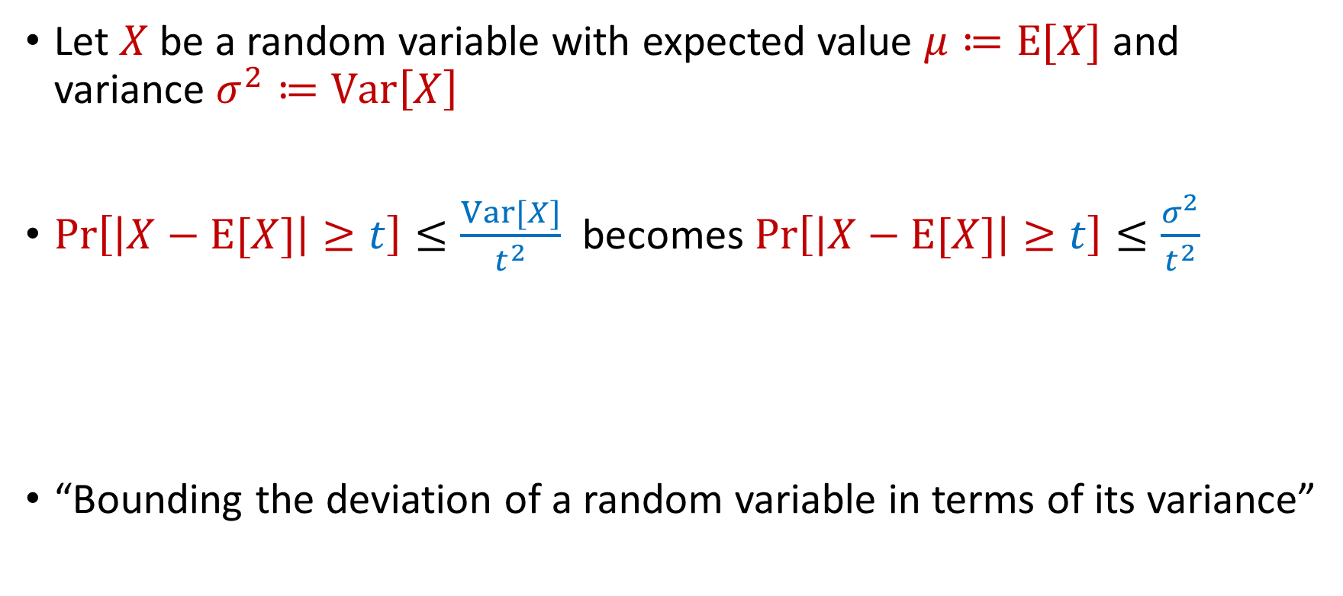
Chebyshev’s Inequality
Let $X$ be a random variable with expected value $μ≔E[X]$ and variance $σ^{2}≔Var\left[X\right]$
$Pr\left[\left|X−E[X]\right|≥t\right]≤\frac{Var[X]}{t^{2}}$ becomes $Pr\left[\left|X−E[X]\right|≥t\right]≤\frac{σ^{2}}{t^{2}}$
“Bounding the deviation of a random variable in terms of its variance”
$$Pr\left[\left|X−μ\right|≥kσ\right]≤\frac{1}{k^{2}}$$

Slide 19
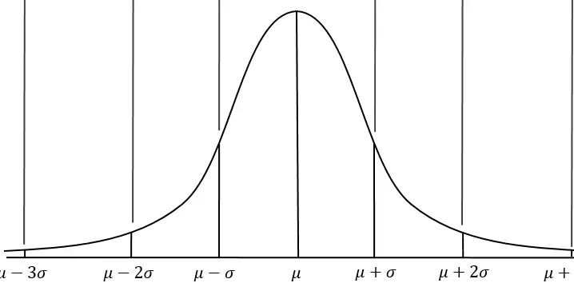


Chebyshev’s Inequality
Let $X$ be a random variable with expected value $μ≔E[X]$ and variance $σ^{2}≔Var\left[X\right]$
Do not require assumptions about $X$
$$Pr\left[\left|X−μ\right|≥kσ\right]≤\frac{1}{k^{2}}$$

Slide 20

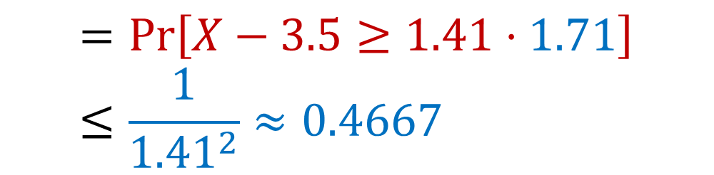
Chebyshev’s Inequality
Let $X$be the outcome of a roll of a die. Then $E\left[X\right]=3.5=\frac{7}{2}$ and $Var\left[X\right]=\frac{35}{12}≈2.92$ so $std(X)≈1.71$
Recall that Markov’s inequality bounded this $0.5833$
$$Pr\left[X≥6\right]=Pr\left[X−3.5≥2.5\right]$$
$$=Pr\left[X−3.5≥1.41⋅1.71\right]≤\frac{1}{{1.41}^{2}}≈0.4667$$

Slide 21
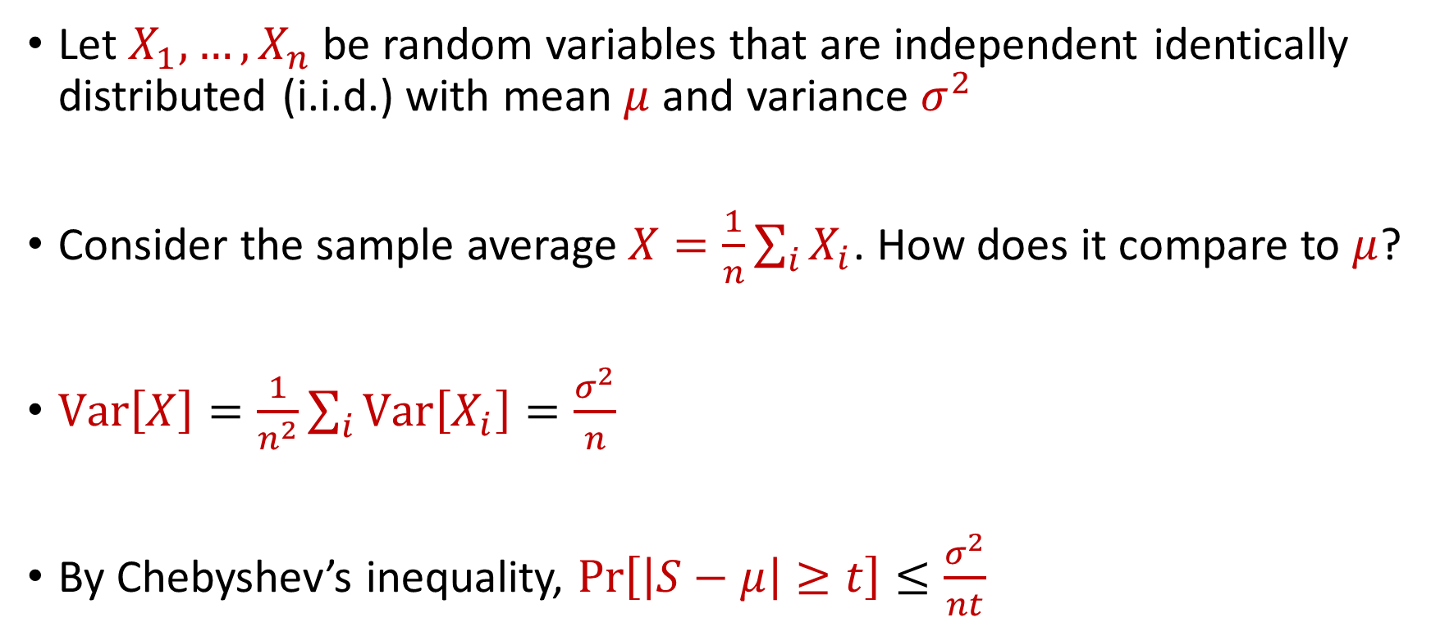
Law of Large Numbers
Let $X_{1},…,X_{n}$ be random variables that are independent identically distributed (i.i.d.) with mean $μ$ and variance $σ^{2}$
Consider the sample average $X=\frac{1}{n}\sum_{i}{X_{i}}$. How does it compare to $μ$?
$Var\left[X\right]=\frac{1}{n^{2}}\sum_{i}{Var\left[X_{i}\right]}=\frac{σ^{2}}{n}$
By Chebyshev’s inequality, $Pr\left[\left|S−μ\right|≥t\right]≤\frac{σ^{2}}{nt}$

Slide 22
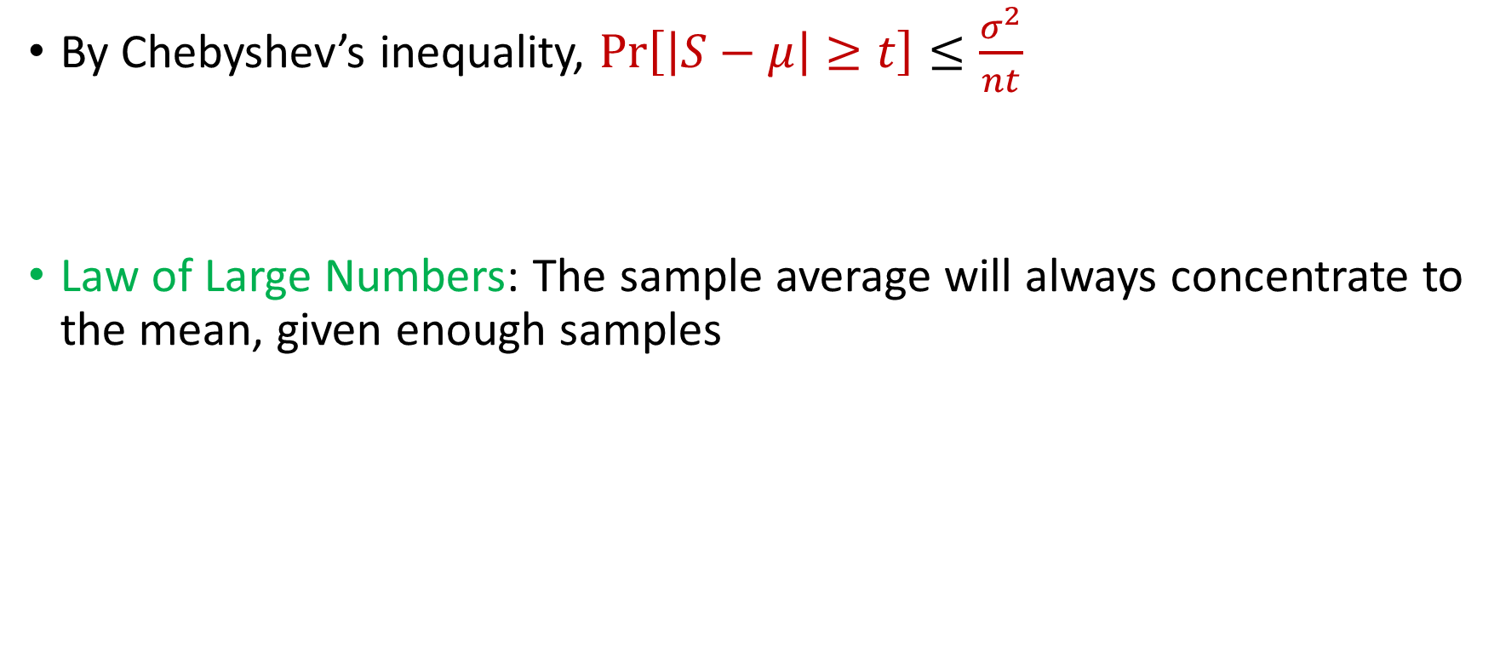
Law of Large Numbers
By Chebyshev’s inequality, $Pr\left[\left|S−μ\right|≥t\right]≤\frac{σ^{2}}{nt}$
Law of Large Numbers: The sample average will always concentrate to the mean, given enough samples

