Slide 1
CSCE 689: Special Topics in Modern Algorithms for Data Science
Lecture 5
Samson Zhou

Slide 2
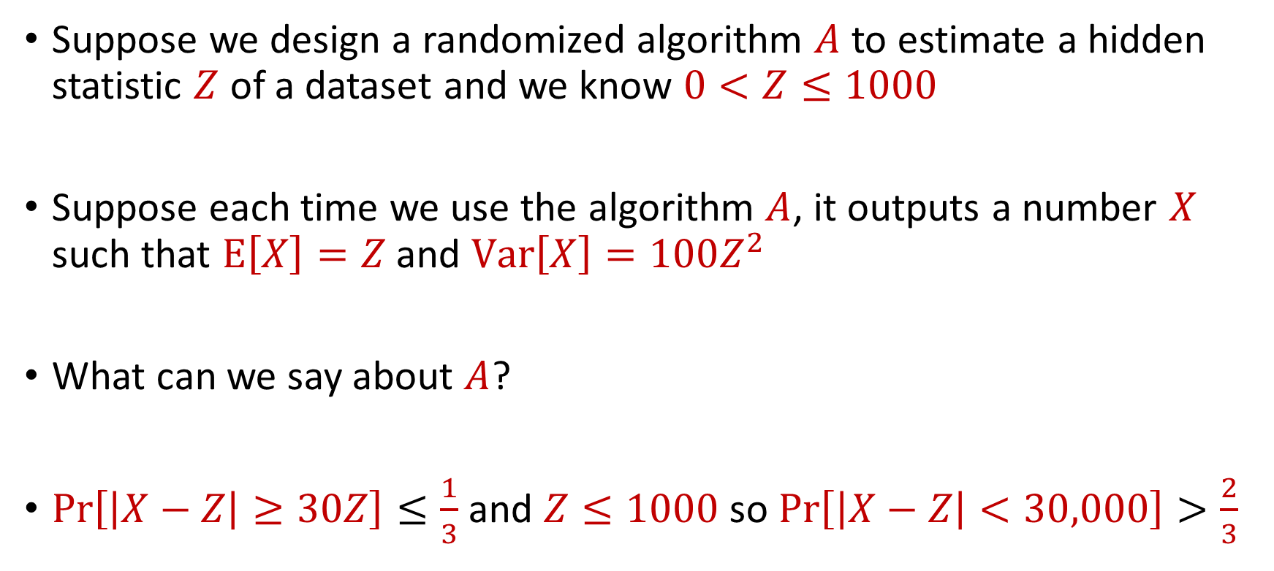
Use Case
Suppose we design a randomized algorithm $A$ to estimate a hidden statistic $Z$ of a dataset and we know $0<Z≤1000$
Suppose each time we use the algorithm $A$, it outputs a number $X$ such that $E\left[X\right]=Z$ and $Var\left[X\right]=100Z^{2}$
What can we say about $A$?
$Pr\left[\left|X−Z\right|≥30Z\right]≤\frac{1}{3}$ and $Z≤1000$ so $Pr\left[\left|X−Z\right|<30,000\right]>\frac{2}{3}$

Slide 3

Accuracy Boosting
How can we use $A$ to get additive error $ε$?

Slide 4
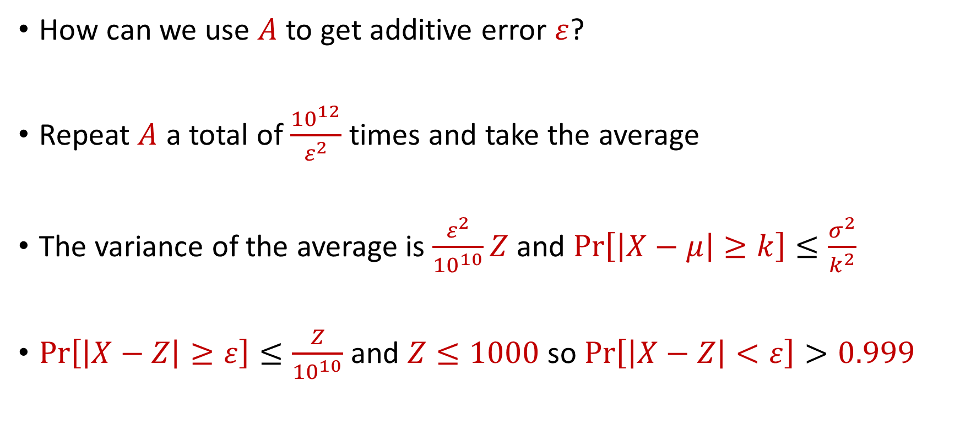
Accuracy Boosting
How can we use $A$ to get additive error $ε$?
Repeat $A$ a total of $\frac{{10}^{12}}{ε^{2}}$ times and take the average
The variance of the average is $\frac{ε^{2}}{{10}^{10}}Z$ and $Pr\left[\left|X−μ\right|≥k\right]≤\frac{σ^{2}}{k^{2}}$
$Pr\left[\left|X−Z\right|≥ε\right]≤\frac{Z}{{10}^{10}}$ and $Z≤1000$ so $Pr\left[\left|X−Z\right|<ε\right]>0.999$

Slide 5
Accuracy Boosting
Algorithmic consequence of Law of Large Numbers
To improve the accuracy of your algorithm, run it many times independently and take the average

Slide 6
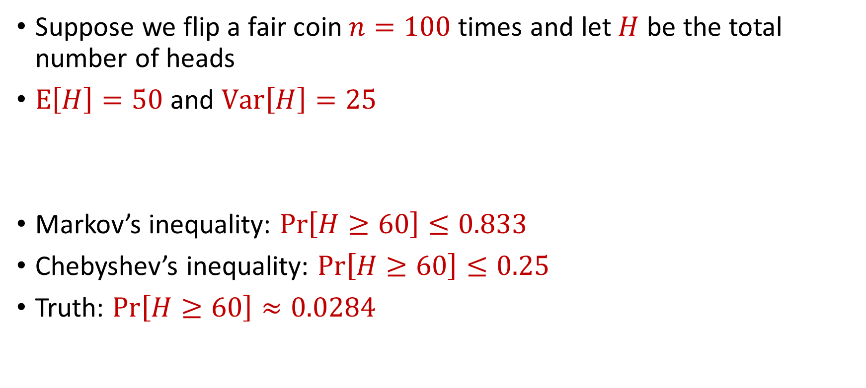
Limitations
Suppose we flip a fair coin $n=100$ times and let $H$ be the total number of heads
$E\left[H\right]=50$ and $Var\left[H\right]=25$
Markov’s inequality: $Pr\left[H≥60\right]≤0.833$
Chebyshev’s inequality: $Pr\left[H≥60\right]≤0.25$
Truth: $Pr\left[H≥60\right]≈0.0284$

Slide 7
CSCE 689: Special Topics in Modern Algorithms for Data Science
Lecture 5
Samson Zhou

Slide 8
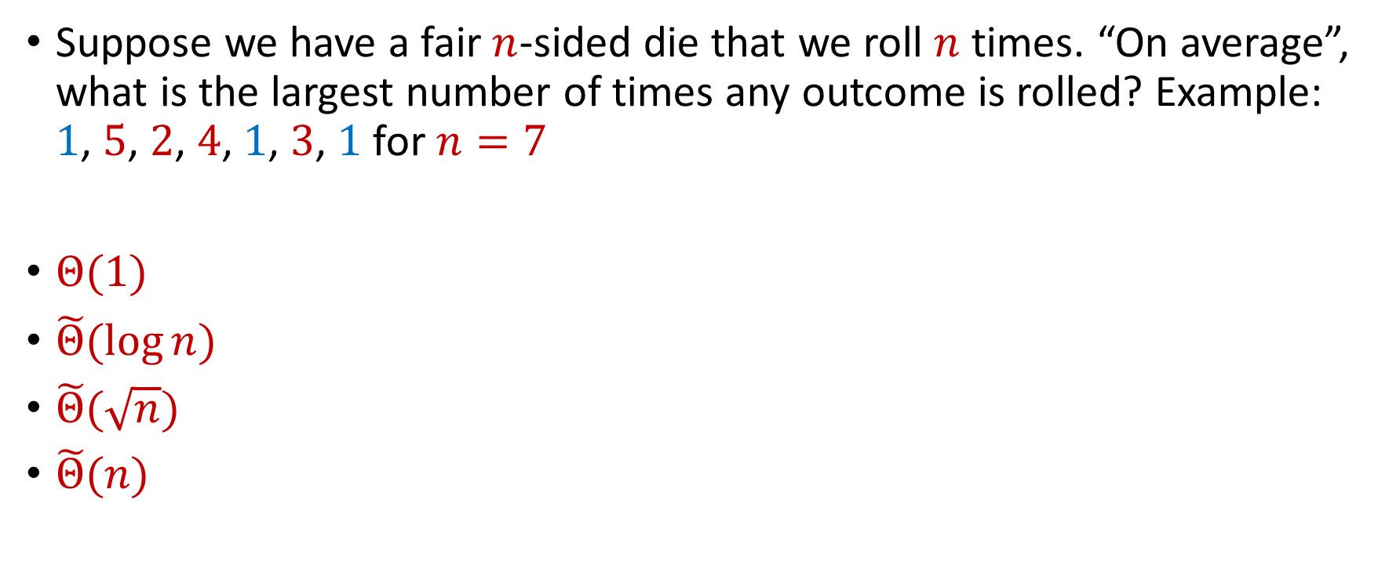
Trivia Question #3 (Max Load)
Suppose we have a fair $n$-sided die that we roll $n$ times. “On average”, what is the largest number of times any outcome is rolled? Example: $1$, $5$, $2$, $4$, $1$, $3$, $1$ for $n=7$
$Θ(1)$
$\tilde{Θ}(\log{n})$
$\tilde{Θ}(\sqrt{n})$
$\tilde{Θ}(n)$

Slide 9
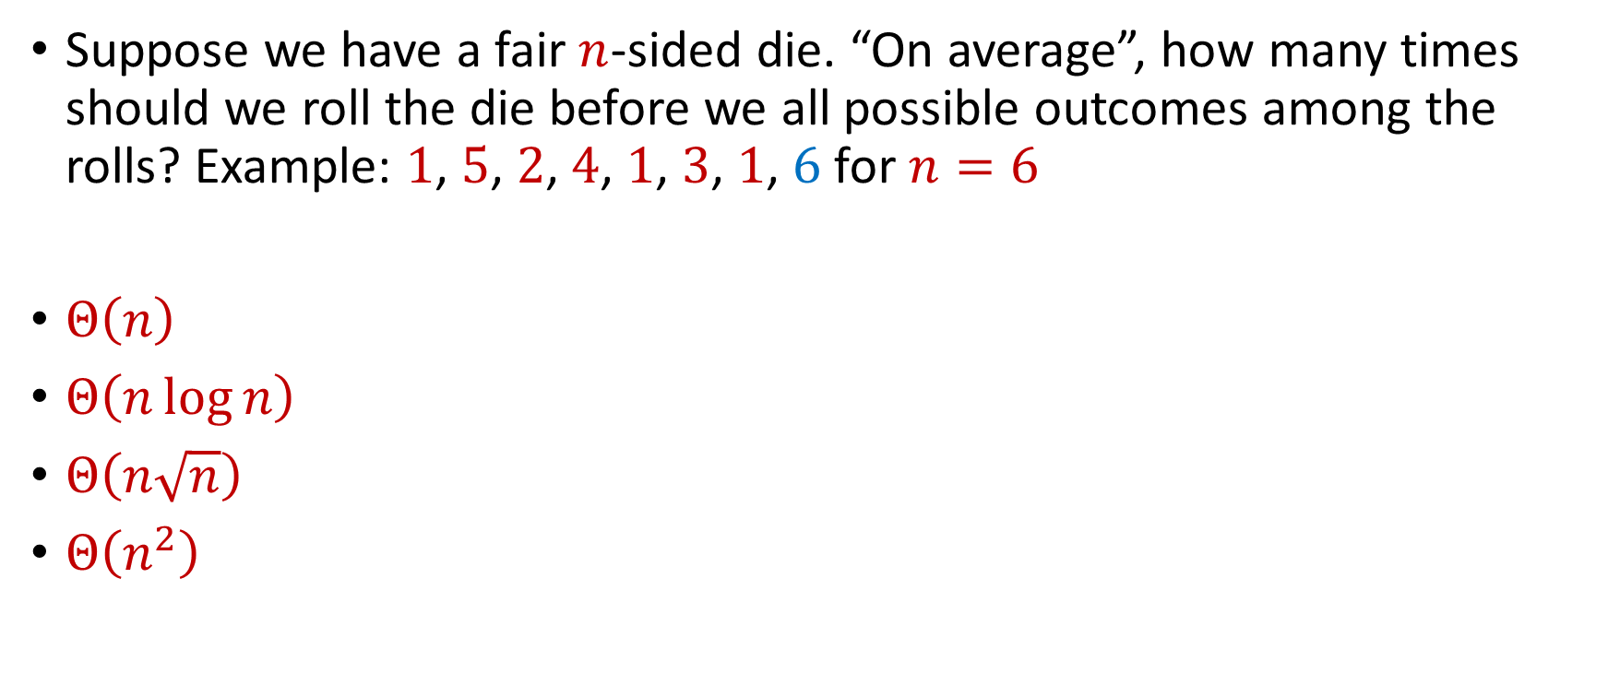
Trivia Question #4 (Coupon Collector)
Suppose we have a fair $n$-sided die. “On average”, how many times should we roll the die before we all possible outcomes among the rolls? Example: $1$, $5$, $2$, $4$, $1$, $3$, $1$, $6$ for $n=6$
$Θ\left(n\right)$
$Θ\left(n\log{n}\right)$
$Θ\left(n\sqrt{n}\right)$
$Θ\left(n^{2}\right)$

Slide 10
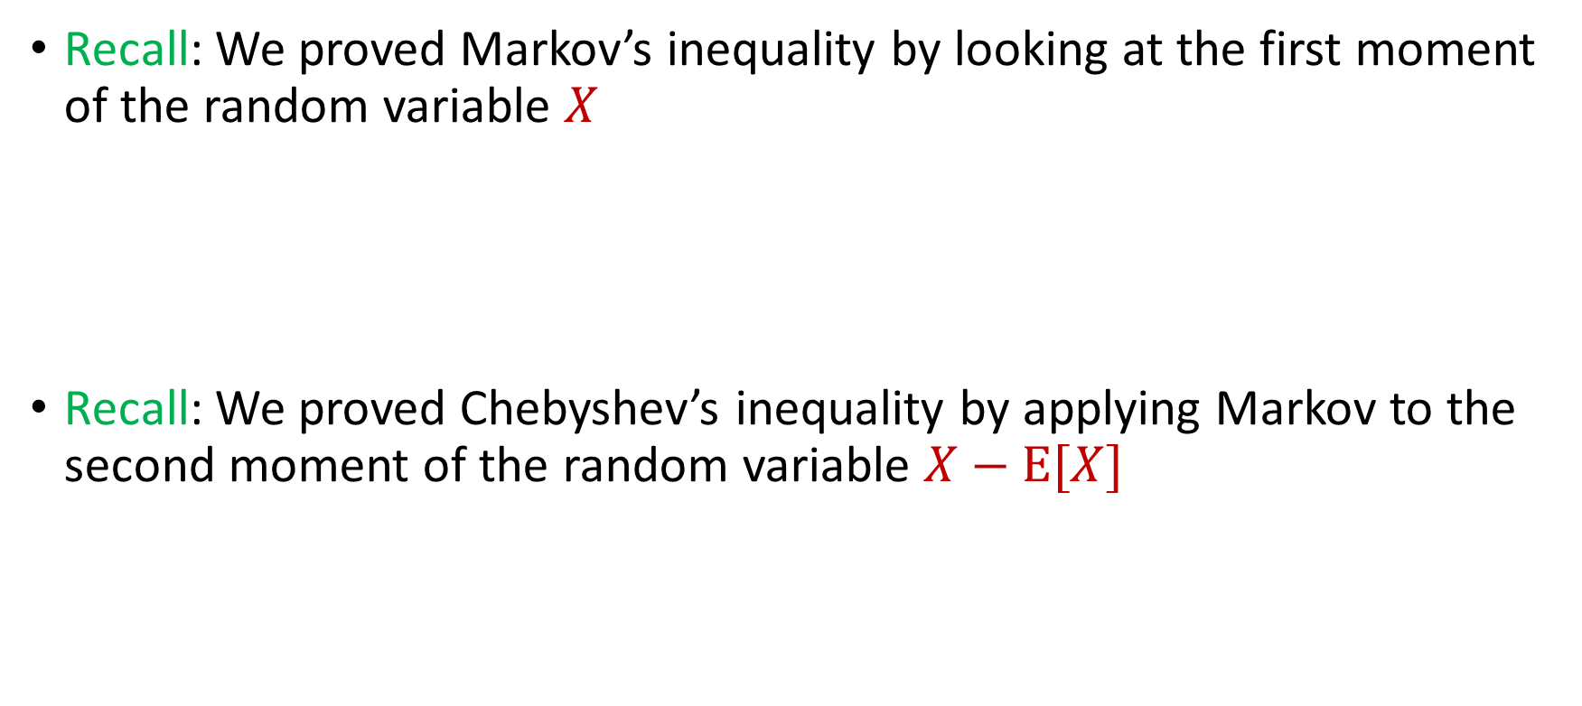

Intuition for Previous Inequalities
Recall: We proved Markov’s inequality by looking at the first moment of the random variable $X$
Recall: We proved Chebyshev’s inequality by applying Markov to the second moment of the random variable $X−E[X]$
$$Pr\left[X≥t⋅E[X]\right]≤\frac{1}{t}$$
$$Pr\left[\left|X−E[X]\right|≥t\right]=Pr\left[{\left|X−E\left[X\right]\right|}^{2}≥t^{2}\right]≤\frac{Var[X]}{t^{2}}$$

Slide 11
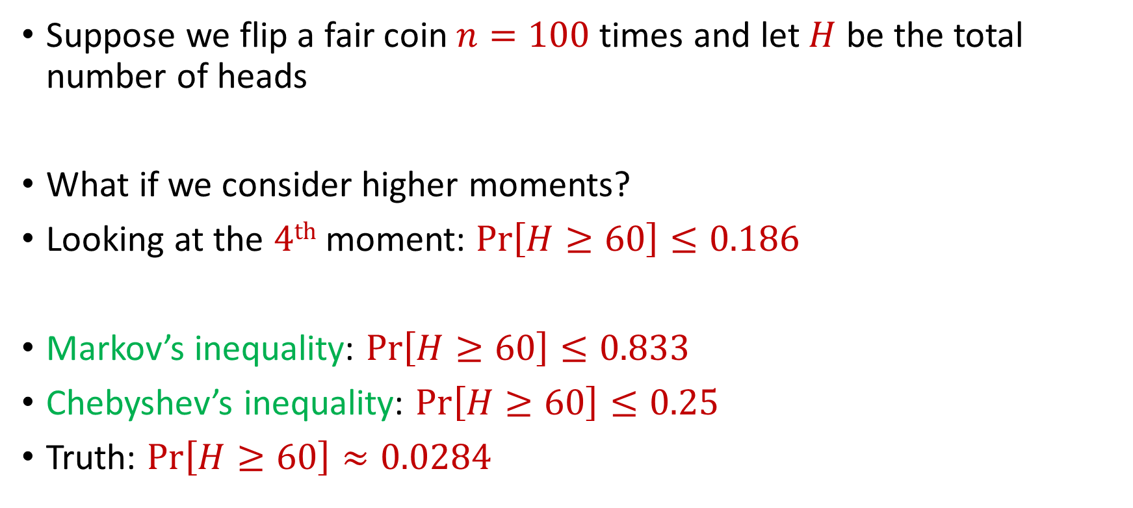
Generalizations
Suppose we flip a fair coin $n=100$ times and let $H$ be the total number of heads
What if we consider higher moments?
Looking at the $4th$ moment: $Pr\left[H≥60\right]≤0.186$
Markov’s inequality: $Pr\left[H≥60\right]≤0.833$
Chebyshev’s inequality: $Pr\left[H≥60\right]≤0.25$
Truth: $Pr\left[H≥60\right]≈0.0284$

Slide 12
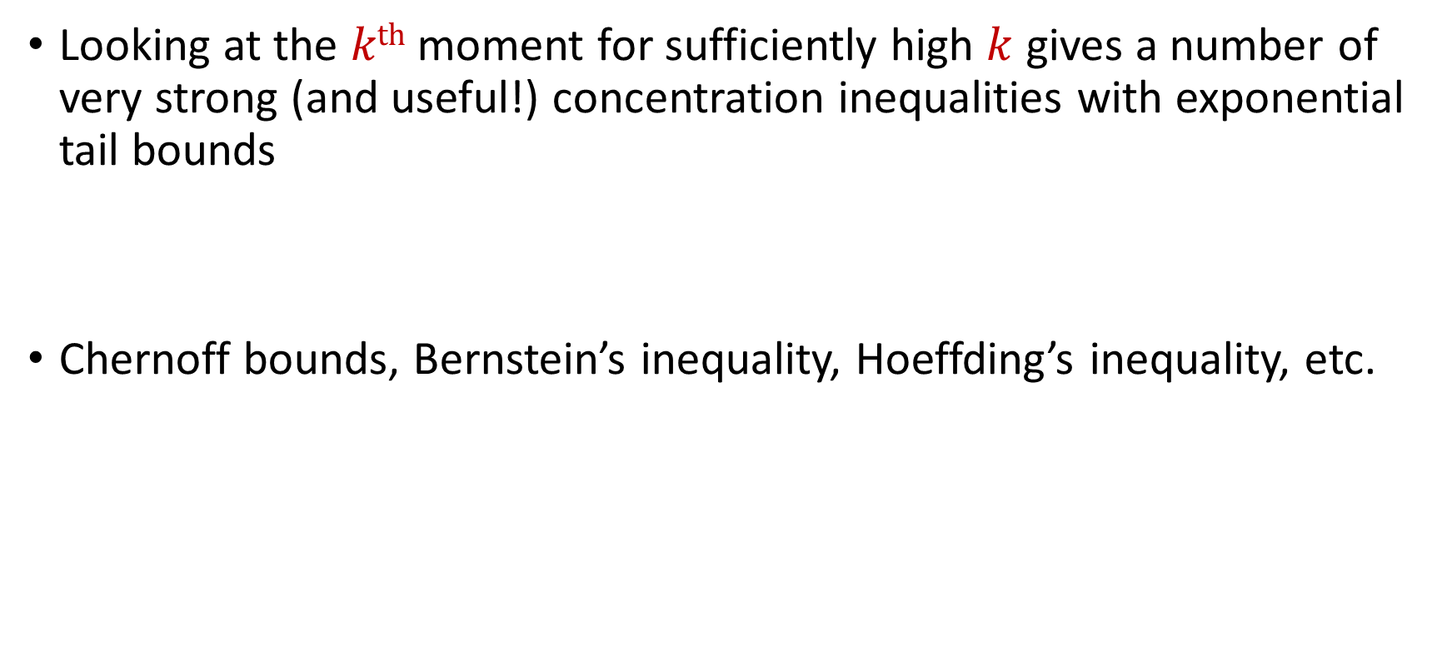
Concentration Inequalities
Looking at the $kth$ moment for sufficiently high $k$ gives a number of very strong (and useful!) concentration inequalities with exponential tail bounds
Chernoff bounds, Bernstein’s inequality, Hoeffding’s inequality, etc.

Slide 13
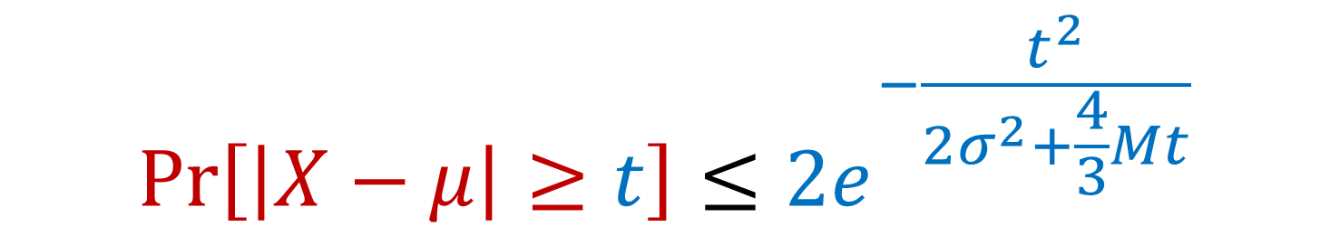

Bernstein’s Inequality
Berstein’s inequality: Let $X_{1},…,X_{n}∈[−M,M]$ be independent random variables and let ${X=X}_{1}+…+X_{n}$ have mean $μ$ and variance $σ^{2}$. Then for any $t≥0$:
$$Pr\left[\left|X−μ\right|≥t\right]≤2e^{−\frac{t^{2}}{2σ^{2}+\frac{4}{3}Mt}}$$

Slide 14


Bernstein’s Inequality
Berstein’s inequality: Let $X_{1},…,X_{n}∈[−M,M]$ be independent random variables and let ${X=X}_{1}+…+X_{n}$ have mean $μ$ and variance $σ^{2}$. Then for any $t≥0$:
Example: Suppose $M=1$ and let $t=kσ$. Then
$$Pr\left[\left|X−μ\right|≥t\right]≤2e^{−\frac{t^{2}}{2σ^{2}+\frac{4}{3}Mt}}$$
$$Pr\left[\left|X−μ\right|≥kσ\right]≤2exp\left(−\frac{k^{2}}{4}\right)$$

Slide 15



Bernstein’s Inequality
Suppose $M=1$ and let $t=kσ$. Then
Compare to Cheybshev’s inequality:
Exponential improvement!
$$Pr\left[\left|X−μ\right|≥kσ\right]≤2exp\left(−\frac{k^{2}}{4}\right)$$
$$Pr\left[\left|X−μ\right|≥kσ\right]≤\frac{1}{k^{2}}$$

Slide 16
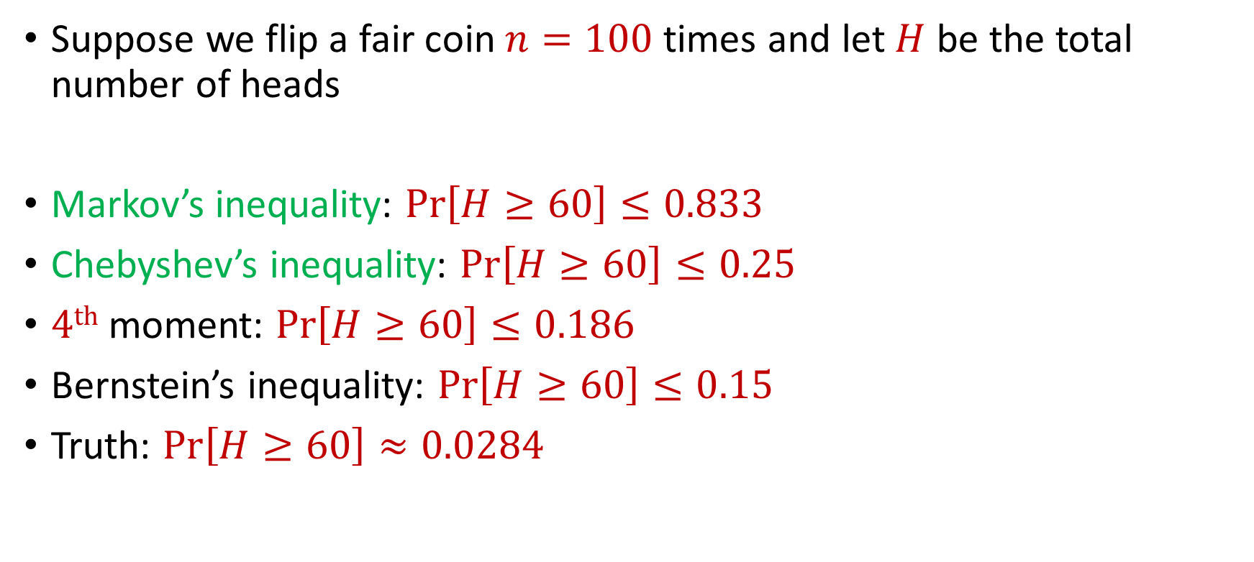
Bernstein’s Inequality
Suppose we flip a fair coin $n=100$ times and let $H$ be the total number of heads
Markov’s inequality: $Pr\left[H≥60\right]≤0.833$
Chebyshev’s inequality: $Pr\left[H≥60\right]≤0.25$
$4th$ moment: $Pr\left[H≥60\right]≤0.186$
Bernstein’s inequality: $Pr\left[H≥60\right]≤0.15$
Truth: $Pr\left[H≥60\right]≈0.0284$

Slide 17


Chernoff Bounds
Useful variant of Bernstein’s inequality when the random variables are binary
Chernoff bounds: Let $X_{1},…,X_{n}∈\{0, 1\}$ be independent random variables and let ${X=X}_{1}+…+X_{n}$ have mean $μ$. Then for any $δ≥0$:
$$Pr\left[\left|X−μ\right|≥δμ\right]≤2\exp\left(−\frac{δ^{2}μ}{2+δ}\right)$$

Slide 18




Multiplicative Error Chernoff Bounds
Chernoff bounds: Let $X_{1},…,X_{n}∈\{0, 1\}$ be independent random variables and let ${X=X}_{1}+…+X_{n}$ have mean $μ$. For $δ∈\left(0,1\right)$:
$$Pr\left[X≥\left(1+δ\right)μ\right]≤2\exp\left(−\frac{δ^{2}μ}{2+δ}\right)$$
$$Pr\left[X≤\left(1−δ\right)μ\right]≤\exp\left(−\frac{δ^{2}μ}{2}\right)$$
$$Pr\left[\left|X−μ\right|≥δμ\right]≤2\exp\left(−\frac{δ^{2}μ}{3}\right)$$

Slide 19
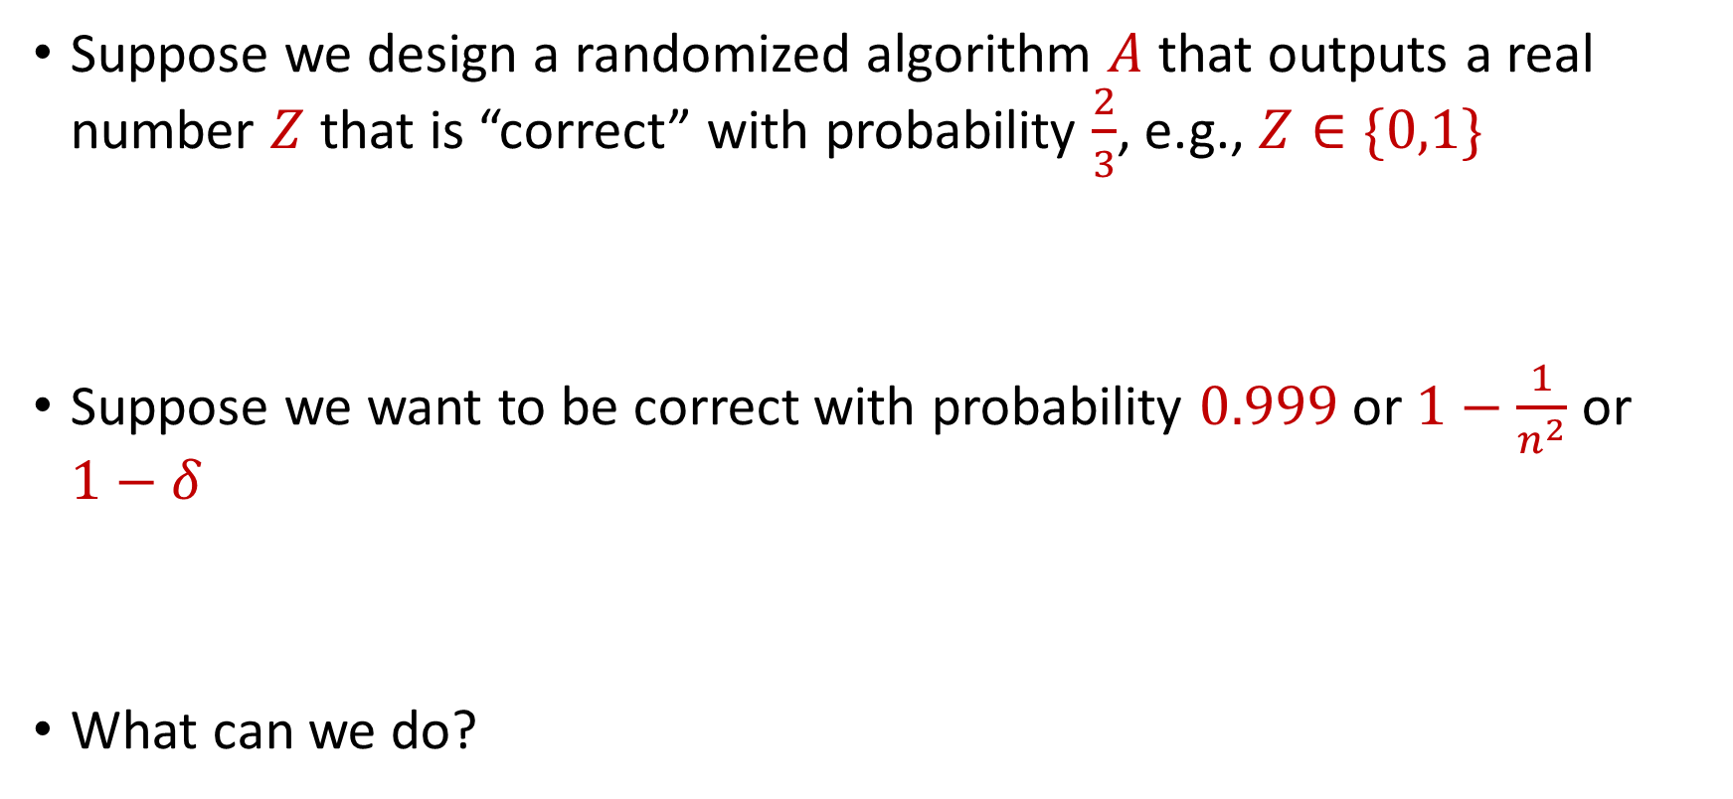
Use Case
Suppose we design a randomized algorithm $A$ that outputs a real number $Z$ that is “correct” with probability $\frac{2}{3}$, e.g., $Z∈\{0,1\}$
Suppose we want to be correct with probability $0.999$ or $1−\frac{1}{n^{2}}$ or $1−δ$
What can we do?

Slide 20

Success Boosting
Chernoff bounds: Run the algorithm $A$ a total of $O\left(\log{\frac{1}{δ}}\right)$ times and take the median. It will be correct with probability $1−δ$

Slide 21

Median-of-Means Framework
Suppose we design a randomized algorithm $A$ to estimate a hidden statistic $Z$ of a dataset and we know $0<Z≤1000$.
Suppose each time we use the algorithm $A$, it outputs a number $X$ such that $E\left[X\right]=Z$ and $Var\left[X\right]=100Z^{2}$
Suppose we want to estimate $Z$ to accuracy $ε$, with probability $1−δ$

Slide 22
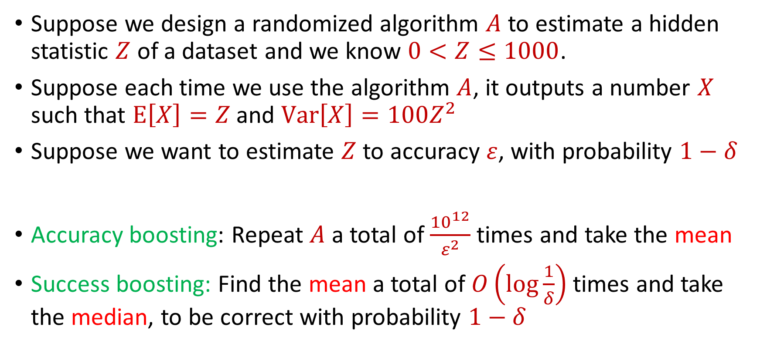
Median-of-Means Framework
Suppose we design a randomized algorithm $A$ to estimate a hidden statistic $Z$ of a dataset and we know $0<Z≤1000$.
Suppose each time we use the algorithm $A$, it outputs a number $X$ such that $E\left[X\right]=Z$ and $Var\left[X\right]=100Z^{2}$
Suppose we want to estimate $Z$ to accuracy $ε$, with probability $1−δ$
Accuracy boosting: Repeat $A$ a total of $\frac{{10}^{12}}{ε^{2}}$ times and take the mean
Success boosting: Find the mean a total of $O\left(\log{\frac{1}{δ}}\right)$ times and take the median, to be correct with probability $1−δ$

Slide 23
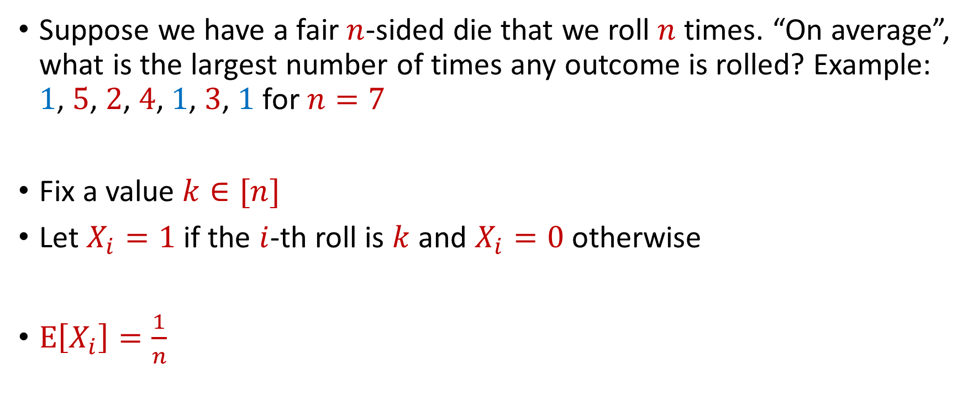
Max Load
Suppose we have a fair $n$-sided die that we roll $n$ times. “On average”, what is the largest number of times any outcome is rolled? Example: $1$, $5$, $2$, $4$, $1$, $3$, $1$ for $n=7$
Fix a value $k∈[n]$
Let $X_{i}=1$ if the $i$-th roll is $k$ and $X_{i}=0$ otherwise
$E\left[X_{i}\right]=\frac{1}{n}$

Slide 24


Max Load
The total number of rolls with value $k$ is $X=X_{1}+…+X_{n}$
$E\left[X\right]=1$
Recall Chernoff bounds:
$Pr\left[X≥3 log{n}\right]≤\frac{1}{n^{2}}$
$$Pr\left[X≥\left(1+δ\right)μ\right]≤2\exp\left(−\frac{δ^{2}μ}{2+δ}\right)$$

Slide 25
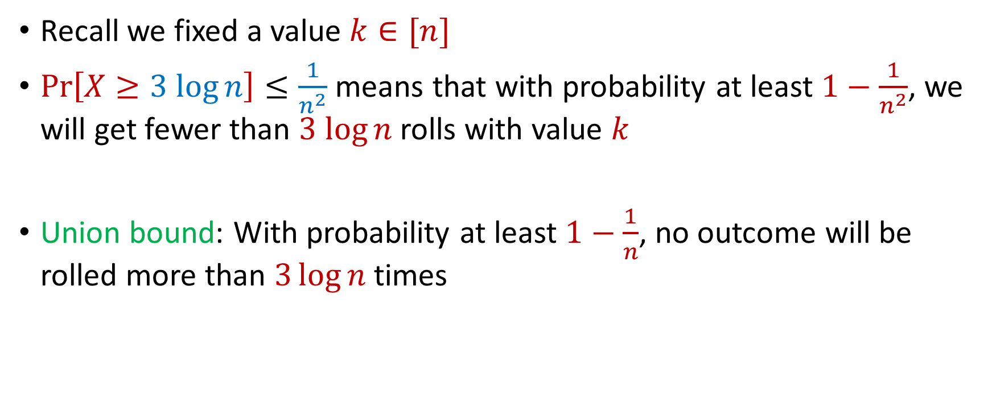
Max Load
Recall we fixed a value $k∈[n]$
$Pr\left[X≥3 log{n}\right]≤\frac{1}{n^{2}}$ means that with probability at least $1−\frac{1}{n^{2}}$, we will get fewer than $3 log{n}$ rolls with value $k$
Union bound: With probability at least $1−\frac{1}{n}$, no outcome will be rolled more than $3\log{n}$ times

Slide 26
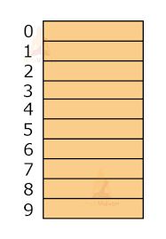

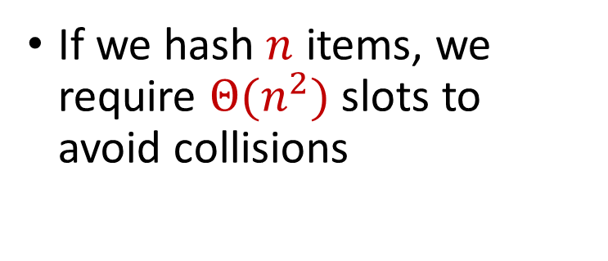
Hashing
Suppose we have a number of files, how do we consistently store them in memory?
$$h\left(x\right)$$
Wenjing Chen
If we hash $n$ items, we require $Θ(n^{2})$ slots to avoid collisions
Chunkai Fu
Ayesha Qamar
Shima Salehi
David Xiang
Shuo Xing

Slide 27

Dealing with Collisions
Suppose we store multiple items in the same location as a linked list
If the maximum number of collisions in a location is $c$, then could traverse a linked list of size $c$ for a query
Query runtime: $O(c)$
$$h(Matthew Chang)$$
$$Jung Seo$$
Matthew Chang

Slide 28
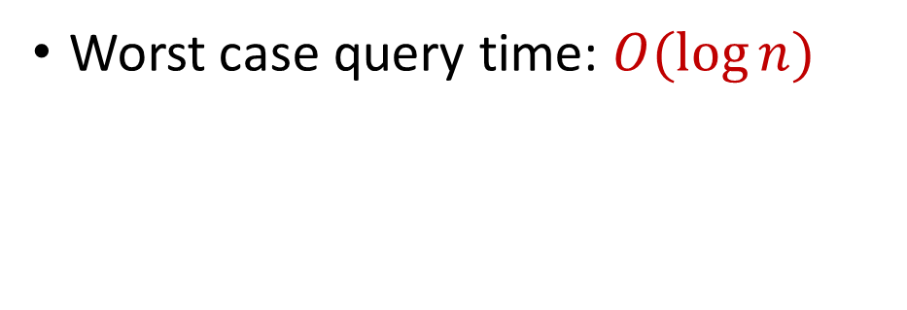
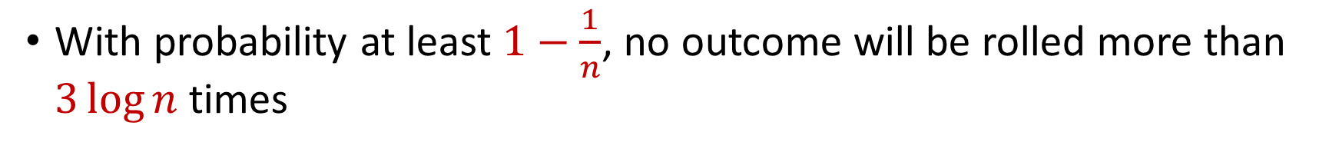

Collisions and Max Load
With probability at least $1−\frac{1}{n}$, no outcome will be rolled more than $3\log{n}$ times
Worst case query time: $O(\log{n})$
$$Jung Seo$$
Matthew Chang

Slide 29

Hashing
For $O(1)$ query time, use $Θ(n^{2})$ slots to avoid collisions
For $O(\log{n})$ query time, use $Θ(n)$ slots with linked lists
$$h\left(x\right)$$
Wenjing Chen
Chunkai Fu
Ayesha Qamar
Shima Salehi
David Xiang
Shuo Xing

