Slide 1
CSCE 689: Special Topics in Modern Algorithms for Data Science
Lecture 14
Samson Zhou

Slide 2
Presentation Schedule
September 25: Team DAP, Team Bokun, Team Jason
September 27: Galaxy AI, Team STMI
September 29: Jung, Anmol, Chunkai

Slide 3
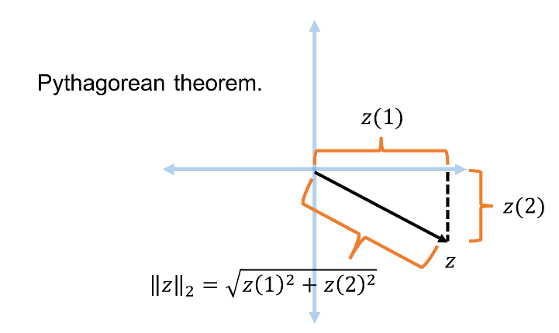




Recall: Euclidean Space and $L_{2}$ Norm
For $z$ $∈R^{n}$, the $L_{2}$ norm of $z$ is denoted by ${\left\|z\right\|}_{2}$ and defined as:
$${\left\|z\right\|}_{2}=\sqrt{z_{1}^{2}+z_{2}^{2}+…+z_{n}^{2}}$$
For $x,y$ $∈R^{n}$, the distance function $D$ is denoted by ${\left\|⋅\right\|}_{2}$ and defined as ${\left\|x−y\right\|}_{2}$

Slide 4
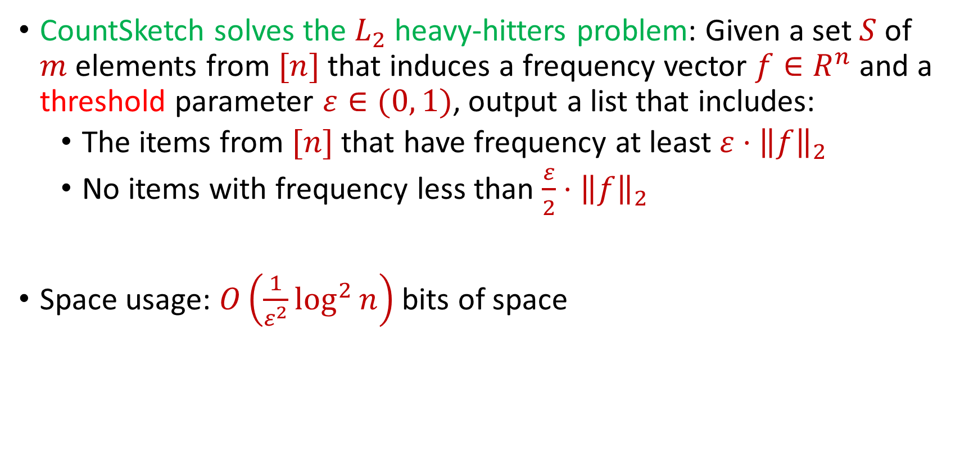
Recall: CountSketch Summary
CountSketch solves the $L_{2}$ heavy-hitters problem: Given a set $S$ of $m$ elements from $[n]$ that induces a frequency vector $f∈R^{n}$ and a threshold parameter $ε∈(0, 1)$, output a list that includes:
The items from $[n]$ that have frequency at least $ε⋅{\left\|f\right\|}_{2}$
No items with frequency less than $\frac{ε}{2}⋅{\left\|f\right\|}_{2}$
Space usage: $O\left(\frac{1}{ε^{2}}\log^{2}{n}\right)$ bits of space

Slide 5
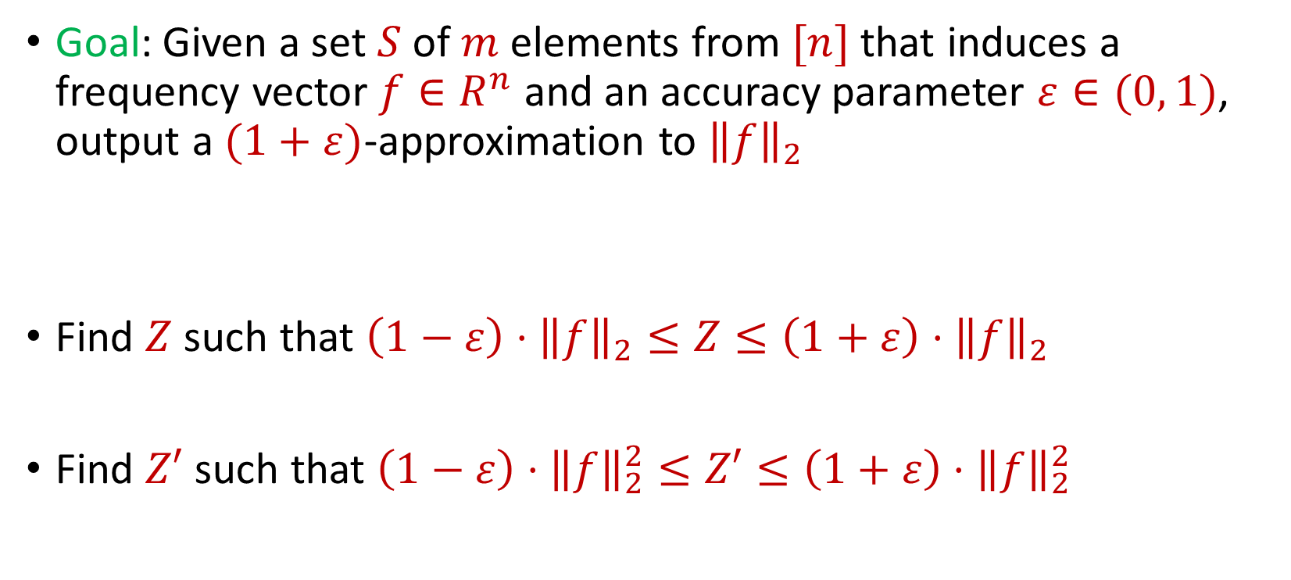
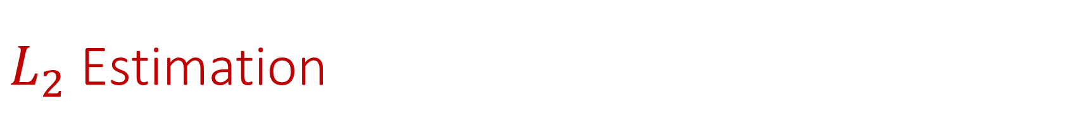
$L_{2}$ Estimation
Goal: Given a set $S$ of $m$ elements from $[n]$ that induces a frequency vector $f∈R^{n}$ and an accuracy parameter $ε∈(0, 1)$, output a $(1+ε)$-approximation to ${\left\|f\right\|}_{2}$
Find $Z$ such that ${\left(1−ε\right)⋅\left\|f\right\|}_{2}≤Z≤\left(1+ε\right)⋅{\left\|f\right\|}_{2}$
Find $Z′$ such that ${\left(1−ε\right)⋅\left\|f\right\|}_{2}^{2}≤Z′≤\left(1+ε\right)⋅{\left\|f\right\|}_{2}^{2}$

Slide 6

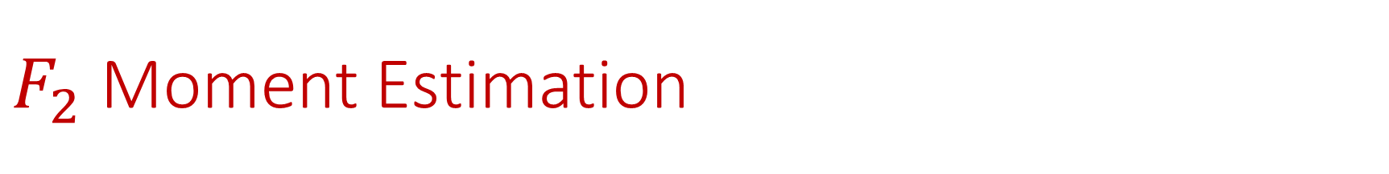
$F_{2}$ Moment Estimation
Goal: Find $Z′$ such that ${\left(1−ε\right)⋅\left\|f\right\|}_{2}^{2}≤Z′≤\left(1+ε\right)⋅{\left\|f\right\|}_{2}^{2}$

Slide 7
$F_{2}$ Moment Estimation
Goal: Find $Z′$ such that ${\left(1−ε\right)⋅\left\|f\right\|}_{2}^{2}≤Z′≤\left(1+ε\right)⋅{\left\|f\right\|}_{2}^{2}$
1 7 7 7 3 7 7 1 4 1 1 1 1 5 1 1 7 1 7 5 1 7 7

Slide 8
$F_{2}$ Moment Estimation
Goal: Find $Z′$ such that ${\left(1−ε\right)⋅\left\|f\right\|}_{2}^{2}≤Z′≤\left(1+ε\right)⋅{\left\|f\right\|}_{2}^{2}$
1 7 7 7 3 7 7 1 4 1 1 1 1 5 1 1 7 1 7 5 1 7 7
$f_{1}$ | $f_{2}$ | $f_{3}$ | $f_{4}$ | $f_{5}$ | $f_{6}$ | $f_{7}$
10 | 0 | 1 | 1 | 2 | 0 | 9

Slide 9

Johnson-Lindenstrauss Lemma
Distributional Johnson-Lindenstrauss Lemma: Given $Π∈R^{m×n}$ with $m=O\left(\frac{\log{1/δ}}{ε^{2}}\right)$ and each entry drawn from $\frac{1}{\sqrt{m}}N\left(0,1\right)$, then for any $x∈R^{n}$ and setting $y=Πx$, then with probability at least $1−δ$
$$\left(1−ε\right){\left\|x\right\|}_{2}≤{\left\|y\right\|}_{2}≤\left(1+ε\right){\left\|x\right\|}_{2}$$

Slide 10
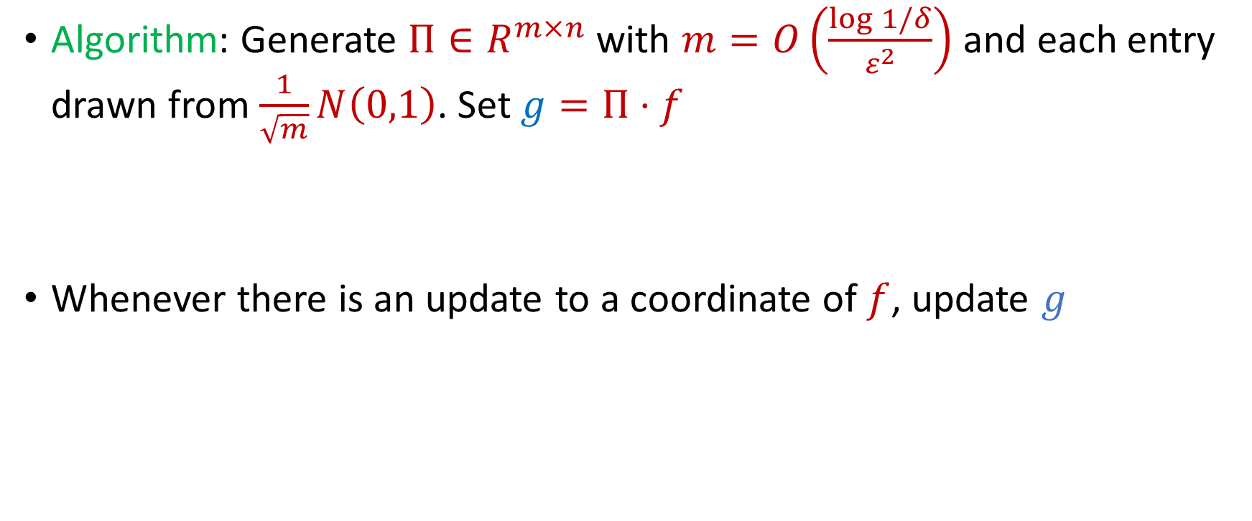
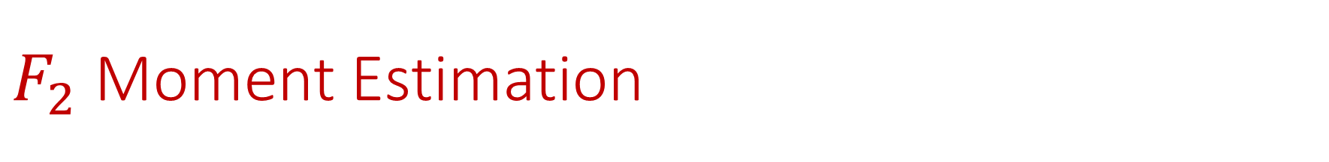
$F_{2}$ Moment Estimation
Algorithm: Generate $Π∈R^{m×n}$ with $m=O\left(\frac{\log{1/δ}}{ε^{2}}\right)$ and each entry drawn from $\frac{1}{\sqrt{m}}N\left(0,1\right)$. Set $g=Π⋅f$
Whenever there is an update to a coordinate of $f$, update $g$

Slide 11
$F_{2}$ Moment Estimation
Algorithm: Generate $Π∈R^{m×n}$ with $m=O\left(\frac{\log{1/δ}}{ε^{2}}\right)$ and each entry drawn from $\frac{1}{\sqrt{m}}N\left(0,1\right)$. Set $g=Π⋅f$
Whenever there is an update to a coordinate of $f$, update $g$
1 7 7 7 3 7 7 1 4 1 1 1 1 5 1 1 7 1 7 5 1 7 7

Slide 12
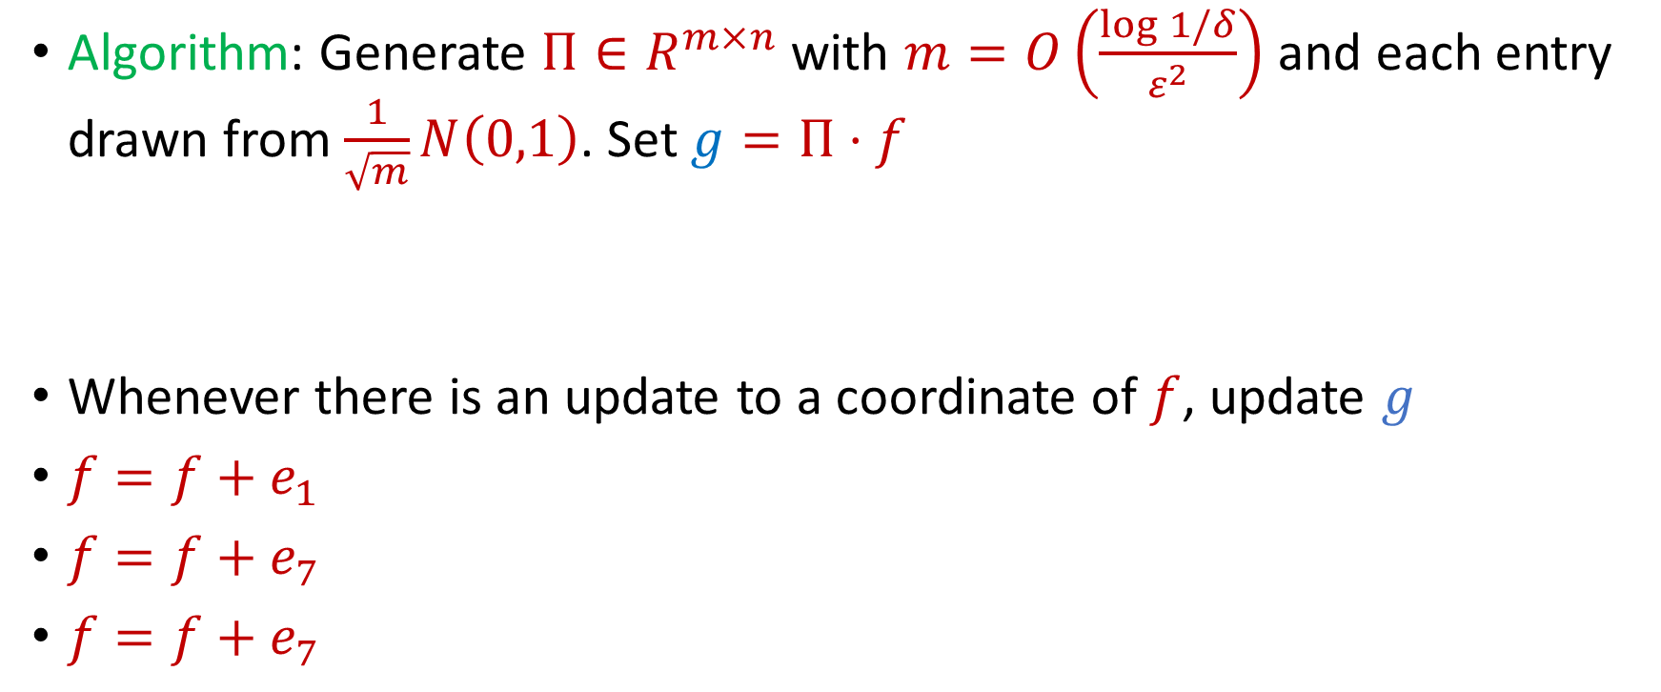
$F_{2}$ Moment Estimation
Algorithm: Generate $Π∈R^{m×n}$ with $m=O\left(\frac{\log{1/δ}}{ε^{2}}\right)$ and each entry drawn from $\frac{1}{\sqrt{m}}N\left(0,1\right)$. Set $g=Π⋅f$
Whenever there is an update to a coordinate of $f$, update $g$
$f=f+e_{1}$
$f=f+e_{7}$
$f=f+e_{7}$
1 7 7 7 3 7 7 1 4 1 1 1 1 5 1 1 7 1 7 5 1 7 7

Slide 13
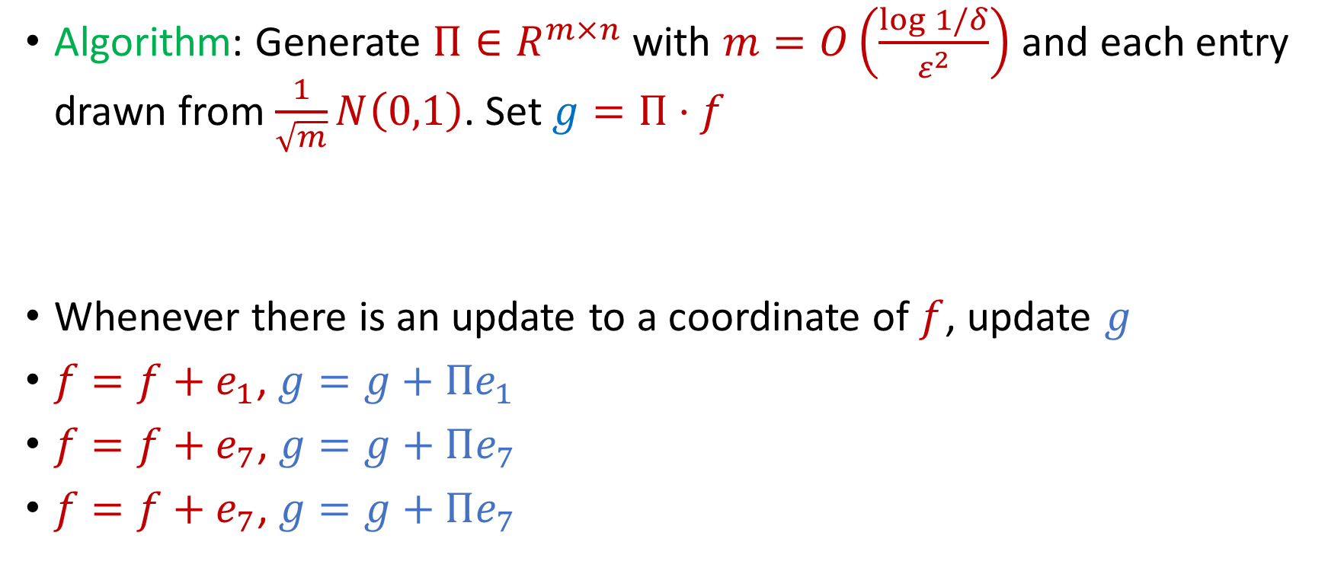
$F_{2}$ Moment Estimation
Algorithm: Generate $Π∈R^{m×n}$ with $m=O\left(\frac{\log{1/δ}}{ε^{2}}\right)$ and each entry drawn from $\frac{1}{\sqrt{m}}N\left(0,1\right)$. Set $g=Π⋅f$
Whenever there is an update to a coordinate of $f$, update $g$
$f=f+e_{1}$, $g=g+Πe_{1}$
$f=f+e_{7}$, $g=g+Πe_{7}$
$f=f+e_{7}$, $g=g+Πe_{7}$
1 7 7 7 3 7 7 1 4 1 1 1 1 5 1 1 7 1 7 5 1 7 7

Slide 14

AMS Algorithm
Generate a random sign vector $s∈{\left\{−1, +1\right\}}^{n}$
Maintain $Z=⟨s, f⟩$
Output $W≔Z^{2}$

Slide 15
$$1$$

Slide 16
$$1$$

Slide 17

$$2$$

Slide 18
$$1$$

Slide 19
$$2$$

Slide 20
$$1$$

Slide 21
$$1$$

Slide 22
$$1$$

Slide 23
$$2$$

Slide 24
$$1$$

Slide 25
$$1$$

Slide 26
$$2$$

Slide 27
$$2$$

Slide 28
$$2$$

Slide 29
$$1$$

Slide 30

AMS Algorithm
What values of $Z$ did you get?
$Z=\left\langle s, f\right\rangle =s_{1}f_{1}+s_{2}f_{2}+…+s_{n}f_{n}$
What values of $W$did you get?
$W=Z^{2}=\sum_{i,j}{s_{i}s_{j}f_{i}f_{j}}$

Slide 31

AMS Algorithm
What values of $W$did you get?
$W=Z^{2}=\sum_{i,j}{s_{i}s_{j}f_{i}f_{j}}$
$f_{1}$ | $f_{2}$ | $f_{3}$ | $f_{4}$ | $f_{5}$ | $f_{6}$ | $f_{7}$
9 | 6 | 0 | 0 | 0 | 0 | 0

Slide 32

AMS Algorithm
What is $E\left[W\right]$?
$Z=\left\langle s, f\right\rangle =s_{1}f_{1}+s_{2}f_{2}+…+s_{n}f_{n}$
$W=Z^{2}=\sum_{i,j}{s_{i}s_{j}f_{i}f_{j}}$
$E\left[W\right]=\sum_{i,j}{E\left[s_{i}s_{j}f_{i}f_{j}\right]}=\sum_{i}{E\left[f_{i}^{2}\right]}={\left\|f\right\|}_{2}^{2}$

Slide 33
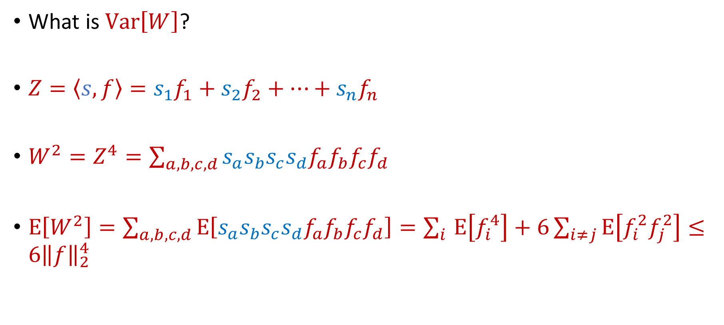
AMS Algorithm
What is $Var\left[W\right]$?
$Z=\left\langle s, f\right\rangle =s_{1}f_{1}+s_{2}f_{2}+…+s_{n}f_{n}$
$W^{2}=Z^{4}=\sum_{a,b,c,d}{s_{a}s_{b}s_{c}s_{d}f_{a}f_{b}f_{c}f_{d}}$
$E\left[W^{2}\right]=\sum_{a,b,c,d}{E\left[s_{a}s_{b}s_{c}s_{d}f_{a}f_{b}f_{c}f_{d}\right]}=\sum_{i }{E\left[f_{i}^{4}\right]}+6\sum_{i≠j}{E\left[f_{i}^{2}f_{j}^{2}\right]}≤6{\left\|f\right\|}_{2}^{4}$

Slide 34

AMS Algorithm
By Chebyshev’s inequality, $W$ will be a $9$-approximation to ${\left\|f\right\|}_{2}^{2}$ with probability 2/3

Slide 35

AMS Algorithm
How to get $(1+ε)$-approximation?
Repeat $O\left(\frac{1}{ε^{2}}\right)$ times and take the average

Slide 36

AMS Algorithm
Space of algorithm: $O\left(\frac{1}{ε^{2}}\right)$ words of space or $O\left(\frac{1}{ε^{2}}\log{m}\right)$ bits of space

Slide 37

Sparse Recovery
Suppose we have an insertion-deletion stream of length $m=Θ\left(n\right)$ and at the end we are promised there are at most $k$ nonzero coordinates
Recover the $k$ nonzero coordinates and their frequencies

Slide 38
Applications of Sparse Recovery
Anomaly detection and network traffic analysis:
Noiseless sparse recovery can be used to identify anomalies or outliers in streaming data. By modeling normal behavior as a sparse signal, deviations from this model can be detected in real-time. This is valuable for cybersecurity, fraud detection, and monitoring network traffic for unusual patterns.
Noiseless sparse recovery can be applied to analyze network traffic in real-time, identifying patterns and trends, and helping in network management, intrusion detection, and quality of service (QoS) optimization

Slide 39
Applications of Sparse Recovery
Online Natural Language Processing (NLP): In real-time natural language processing tasks, noiseless sparse recovery can assist in extracting relevant features or patterns from streaming text data, making it useful for sentiment analysis, topic modeling, and summarization

Slide 40
Applications of Sparse Recovery
Real-time Compressive Imaging: Compressive imaging techniques can be applied to streaming video or image data. By capturing and processing fewer measurements, noiseless sparse recovery can provide real-time reconstruction of high-resolution images or videos.

Slide 41
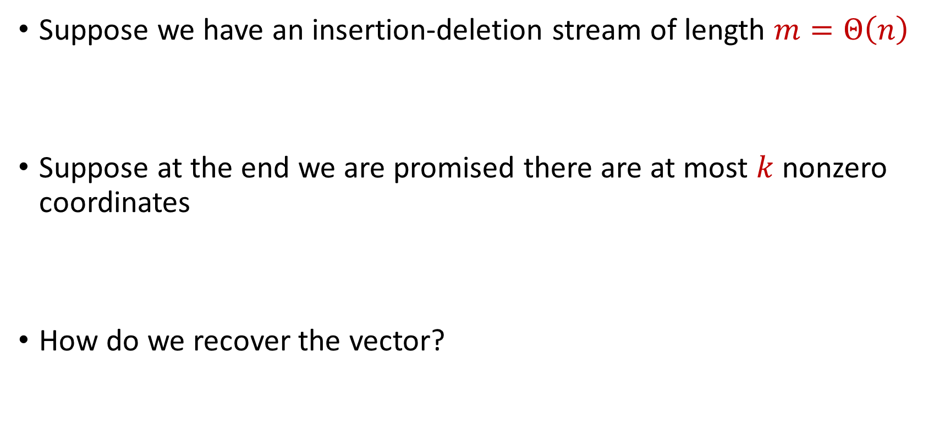
Sparse Recovery
Suppose we have an insertion-deletion stream of length $m=Θ\left(n\right)$
Suppose at the end we are promised there are at most $k$ nonzero coordinates
How do we recover the vector?

Slide 42

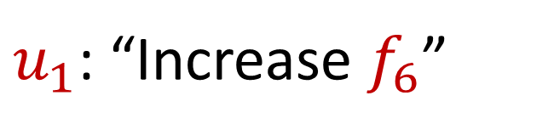
Sparse Recovery
Suppose at the end we are promised there are at most $k$ nonzero coordinates
Suppose $k=1$ and we are promised the coordinate has frequency $1$
$u_{1}$: “Increase $f_{6}$”

Slide 43
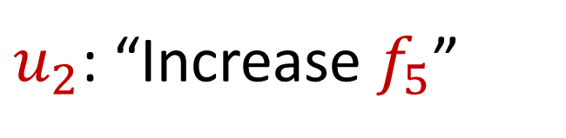
Sparse Recovery
Suppose at the end we are promised there are at most $k$ nonzero coordinates
Suppose $k=1$ and we are promised the coordinate has frequency $1$
$u_{2}$: “Increase $f_{5}$”

Slide 44
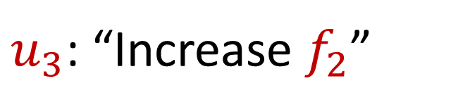
Sparse Recovery
Suppose at the end we are promised there are at most $k$ nonzero coordinates
Suppose $k=1$ and we are promised the coordinate has frequency $1$
$u_{3}$: “Increase $f_{2}$”

Slide 45
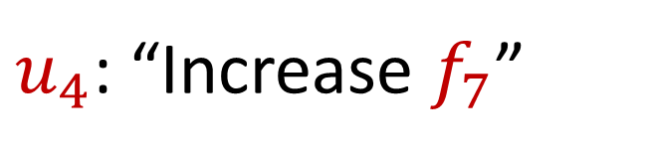
Sparse Recovery
Suppose at the end we are promised there are at most $k$ nonzero coordinates
Suppose $k=1$ and we are promised the coordinate has frequency $1$
$u_{4}$: “Increase $f_{7}$”

Slide 46
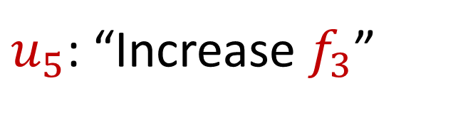
Sparse Recovery
Suppose at the end we are promised there are at most $k$ nonzero coordinates
Suppose $k=1$ and we are promised the coordinate has frequency $1$
$u_{5}$: “Increase $f_{3}$”

Slide 47
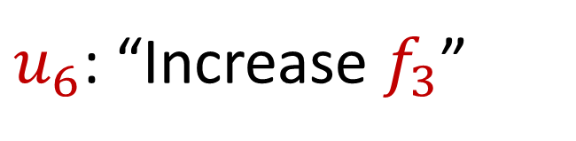
Sparse Recovery
Suppose at the end we are promised there are at most $k$ nonzero coordinates
Suppose $k=1$ and we are promised the coordinate has frequency $1$
$u_{6}$: “Increase $f_{3}$”

Slide 48
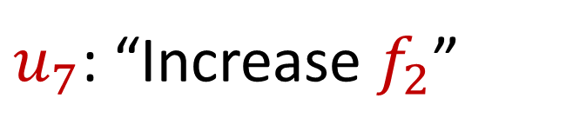
Sparse Recovery
Suppose at the end we are promised there are at most $k$ nonzero coordinates
Suppose $k=1$ and we are promised the coordinate has frequency $1$
$u_{7}$: “Increase $f_{2}$”

Slide 49
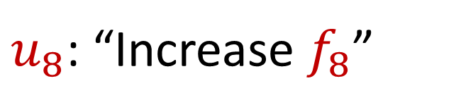
Sparse Recovery
Suppose at the end we are promised there are at most $k$ nonzero coordinates
Suppose $k=1$ and we are promised the coordinate has frequency $1$
$u_{8}$: “Increase $f_{8}$”

Slide 50
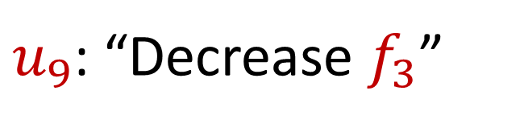
Sparse Recovery
Suppose at the end we are promised there are at most $k$ nonzero coordinates
Suppose $k=1$ and we are promised the coordinate has frequency $1$
$u_{9}$: “Decrease $f_{3}$”

Slide 51
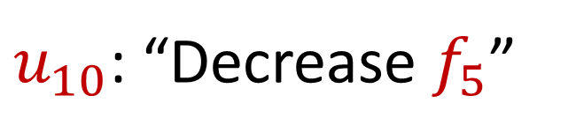
Sparse Recovery
Suppose at the end we are promised there are at most $k$ nonzero coordinates
Suppose $k=1$ and we are promised the coordinate has frequency $1$
$u_{10}$: “Decrease $f_{5}$”

Slide 52
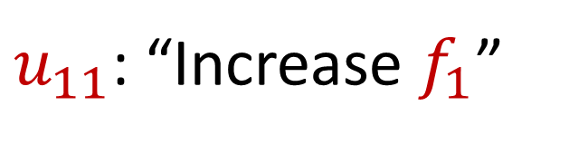
Sparse Recovery
Suppose at the end we are promised there are at most $k$ nonzero coordinates
Suppose $k=1$ and we are promised the coordinate has frequency $1$
$u_{11}$: “Increase $f_{1}$”

Slide 53
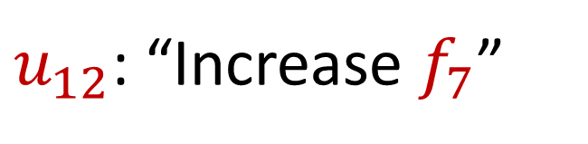
Sparse Recovery
Suppose at the end we are promised there are at most $k$ nonzero coordinates
Suppose $k=1$ and we are promised the coordinate has frequency $1$
$u_{12}$: “Increase $f_{7}$”

Slide 54
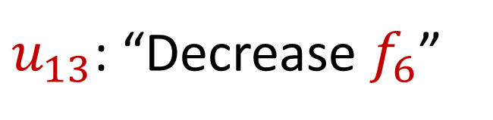
Sparse Recovery
Suppose at the end we are promised there are at most $k$ nonzero coordinates
Suppose $k=1$ and we are promised the coordinate has frequency $1$
$u_{13}$: “Decrease $f_{6}$”

Slide 55

Sparse Recovery
Suppose at the end we are promised there are at most $k$ nonzero coordinates
Suppose $k=1$ and we are promised the coordinate has frequency $1$
$u_{14}$: “Decrease $f_{8}$”

Slide 56
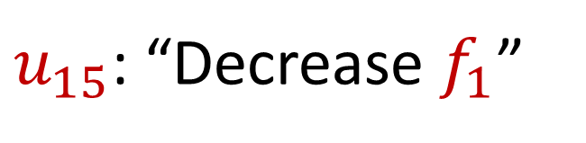
Sparse Recovery
Suppose at the end we are promised there are at most $k$ nonzero coordinates
Suppose $k=1$ and we are promised the coordinate has frequency $1$
$u_{15}$: “Decrease $f_{1}$”

Slide 57
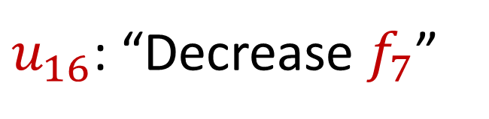
Sparse Recovery
Suppose at the end we are promised there are at most $k$ nonzero coordinates
Suppose $k=1$ and we are promised the coordinate has frequency $1$
$u_{16}$: “Decrease $f_{7}$”

Slide 58
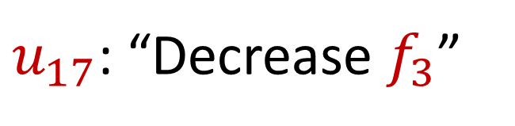
Sparse Recovery
Suppose at the end we are promised there are at most $k$ nonzero coordinates
Suppose $k=1$ and we are promised the coordinate has frequency $1$
$u_{17}$: “Decrease $f_{3}$”

Slide 59
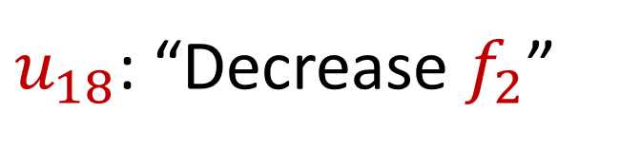
Sparse Recovery
Suppose at the end we are promised there are at most $k$ nonzero coordinates
Suppose $k=1$ and we are promised the coordinate has frequency $1$
$u_{18}$: “Decrease $f_{2}$”

Slide 60
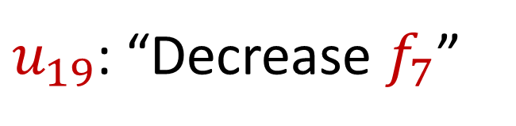
Sparse Recovery
Suppose at the end we are promised there are at most $k$ nonzero coordinates
Suppose $k=1$ and we are promised the coordinate has frequency $1$
$u_{19}$: “Decrease $f_{7}$”

Slide 61

Sparse Recovery
Suppose at the end we are promised there are at most $k$ nonzero coordinates
Suppose $k=1$ and we are promised the coordinate has frequency $1$
What is left?

Slide 62

Sparse Recovery
Suppose at the end we are promised there are at most $k$ nonzero coordinates
Suppose $k=1$ and we are promised the coordinate has frequency $1$
What is left?
$$f_{2}=1$$

Slide 63
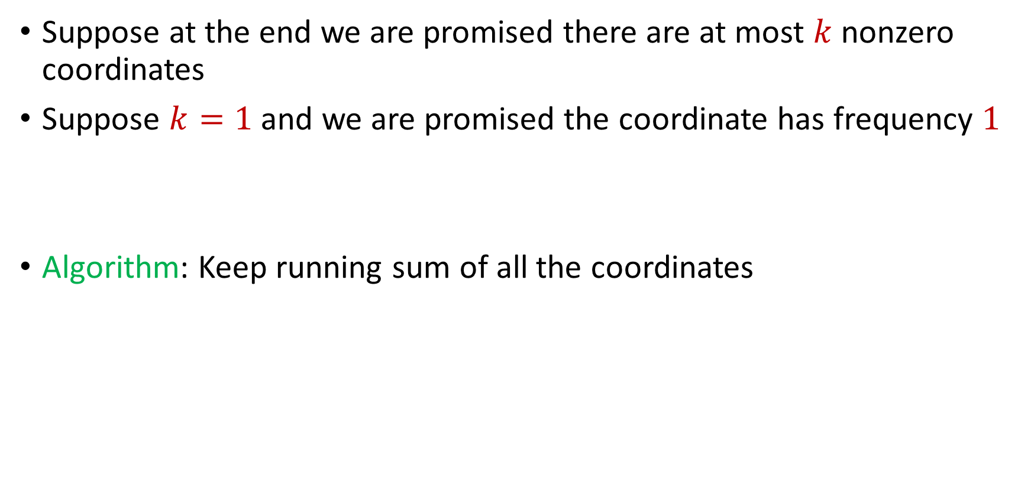
Sparse Recovery
Suppose at the end we are promised there are at most $k$ nonzero coordinates
Suppose $k=1$ and we are promised the coordinate has frequency $1$
Algorithm: Keep running sum of all the coordinates

Slide 64
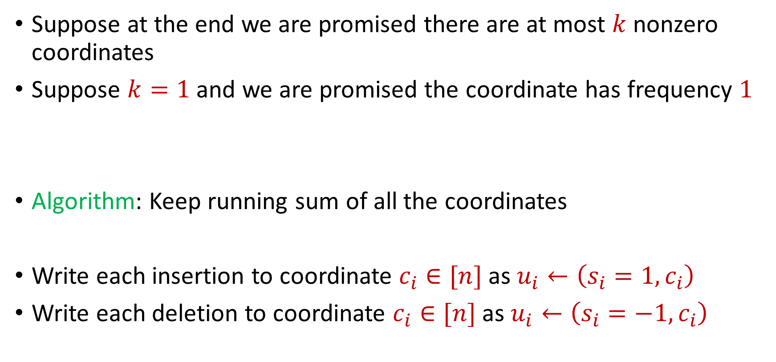
Sparse Recovery
Suppose at the end we are promised there are at most $k$ nonzero coordinates
Suppose $k=1$ and we are promised the coordinate has frequency $1$
Algorithm: Keep running sum of all the coordinates
Write each insertion to coordinate $c_{i}∈[n]$as $u_{i}←\left(s_{i}=1, c_{i}\right)$
Write each deletion to coordinate $c_{i}∈[n]$as $u_{i}←\left(s_{i}=−1, c_{i}\right)$

Slide 65
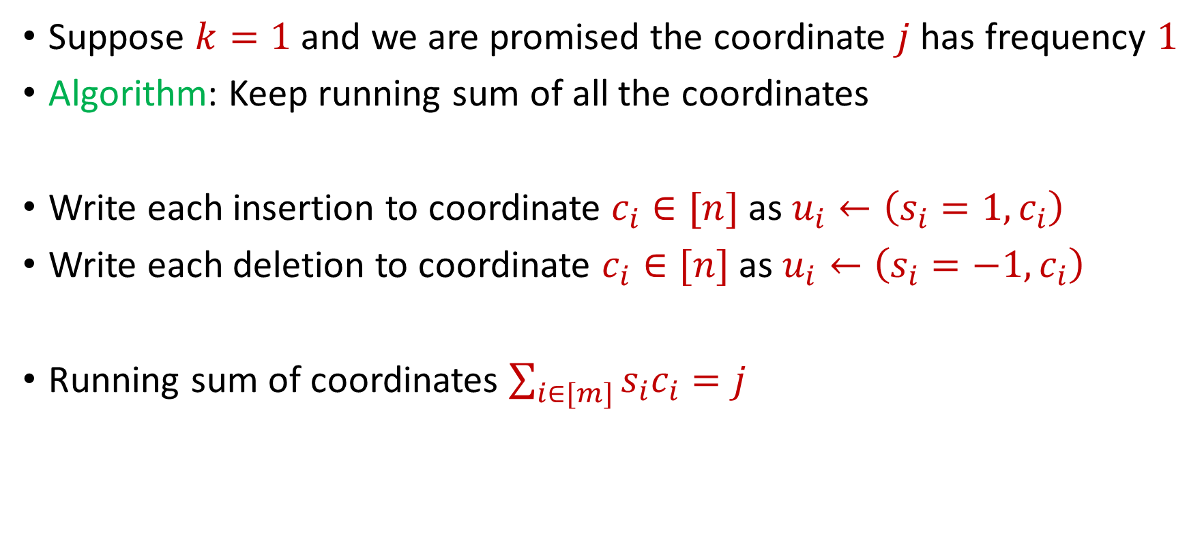
Sparse Recovery
Suppose $k=1$ and we are promised the coordinate $j$ has frequency $1$
Algorithm: Keep running sum of all the coordinates
Write each insertion to coordinate $c_{i}∈[n]$as $u_{i}←\left(s_{i}=1, c_{i}\right)$
Write each deletion to coordinate $c_{i}∈[n]$as $u_{i}←\left(s_{i}=−1, c_{i}\right)$
Running sum of coordinates $\sum_{i∈[m]}{s_{i}c_{i}}=j$

Slide 66
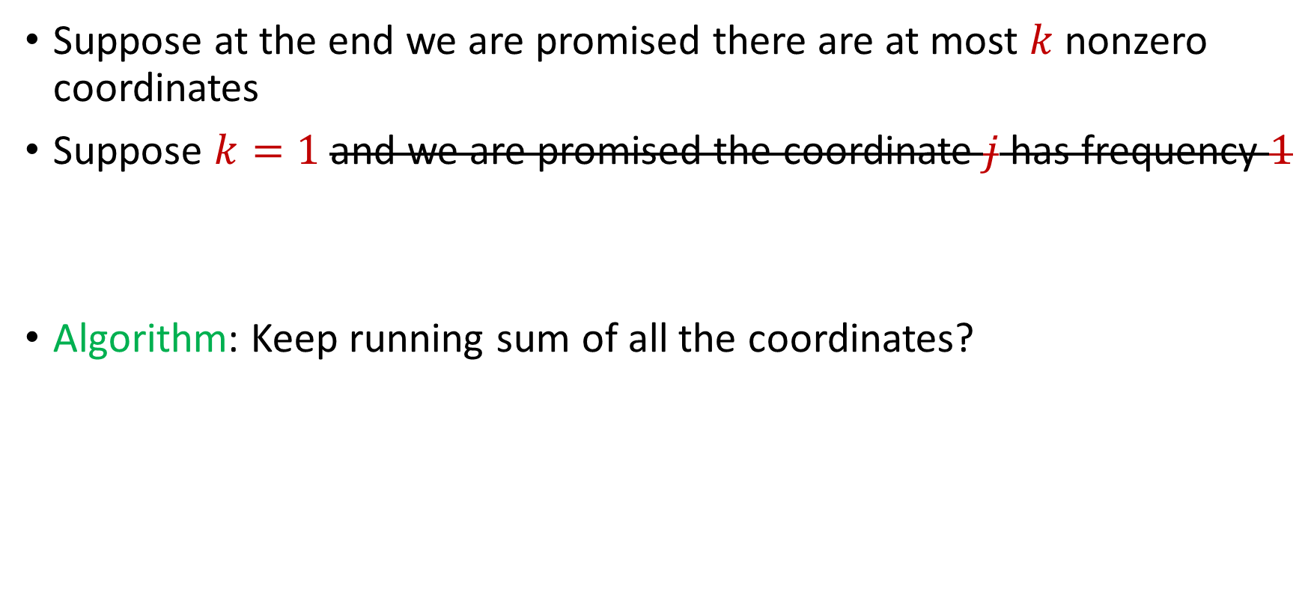
Sparse Recovery
Suppose at the end we are promised there are at most $k$ nonzero coordinates
Suppose $k=1$ and we are promised the coordinate $j$ has frequency $1$
Algorithm: Keep running sum of all the coordinates?

Slide 67
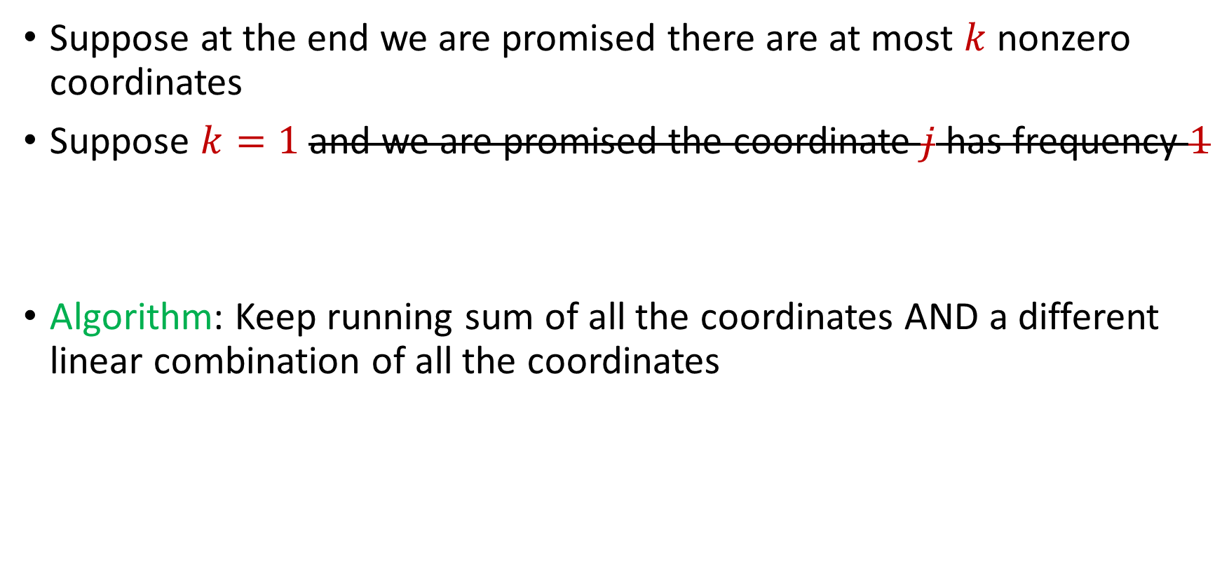
Sparse Recovery
Suppose at the end we are promised there are at most $k$ nonzero coordinates
Suppose $k=1$ and we are promised the coordinate $j$ has frequency $1$
Algorithm: Keep running sum of all the coordinates AND a different linear combination of all the coordinates

Slide 68
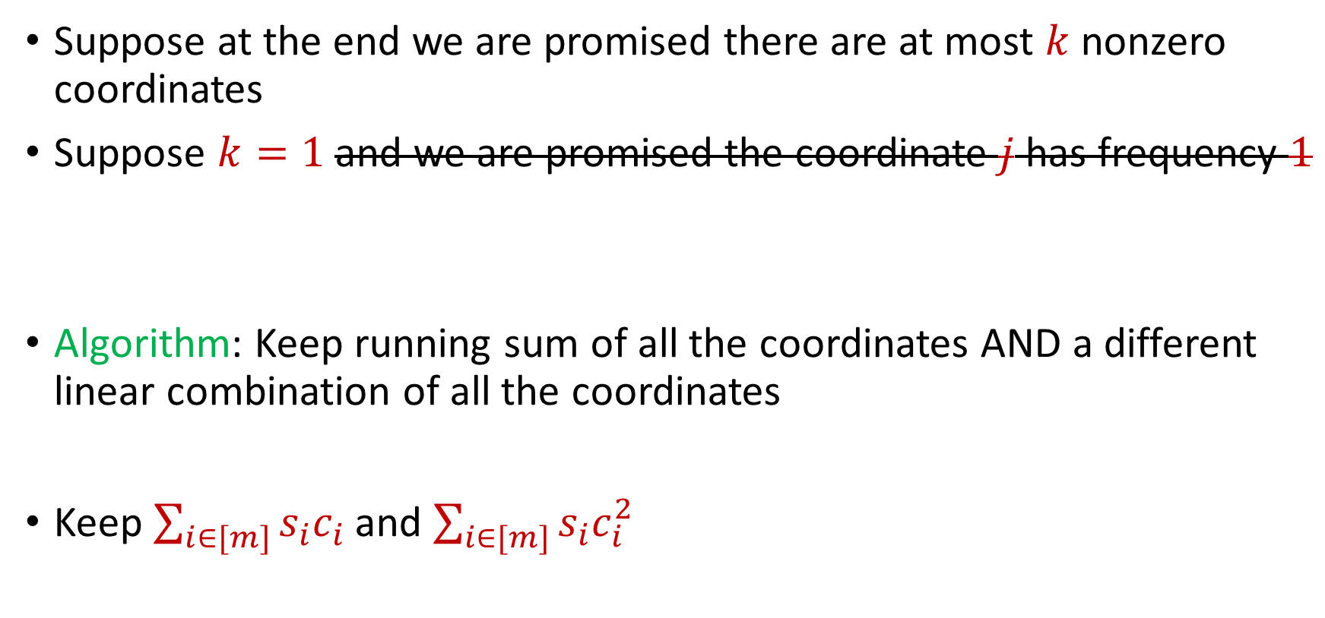
Sparse Recovery
Suppose at the end we are promised there are at most $k$ nonzero coordinates
Suppose $k=1$ and we are promised the coordinate $j$ has frequency $1$
Algorithm: Keep running sum of all the coordinates AND a different linear combination of all the coordinates
Keep $\sum_{i∈[m]}{s_{i}c_{i}}$ and $\sum_{i∈[m]}{s_{i}c_{i}^{2}}$

Slide 69

Sparse Recovery
Suppose at the end we are promised there are at most $k$ nonzero coordinates
Suppose $k=1$ and we are promised the coordinate $j$ has frequency $1$
$u_{1}$: “Increase $f_{6}$”

Slide 70
Sparse Recovery
Suppose at the end we are promised there are at most $k$ nonzero coordinates
Suppose $k=1$ and we are promised the coordinate $j$ has frequency $1$
$u_{2}$: “Increase $f_{5}$”

Slide 71
Sparse Recovery
Suppose at the end we are promised there are at most $k$ nonzero coordinates
Suppose $k=1$ and we are promised the coordinate $j$ has frequency $1$
$u_{3}$: “Increase $f_{2}$”

Slide 72
Sparse Recovery
Suppose at the end we are promised there are at most $k$ nonzero coordinates
Suppose $k=1$ and we are promised the coordinate $j$ has frequency $1$
$u_{4}$: “Increase $f_{7}$”

Slide 73
Sparse Recovery
Suppose at the end we are promised there are at most $k$ nonzero coordinates
Suppose $k=1$ and we are promised the coordinate $j$ has frequency $1$
$u_{5}$: “Increase $f_{3}$”

Slide 74
Sparse Recovery
Suppose at the end we are promised there are at most $k$ nonzero coordinates
Suppose $k=1$ and we are promised the coordinate $j$ has frequency $1$
$u_{6}$: “Increase $f_{3}$”

Slide 75
Sparse Recovery
Suppose at the end we are promised there are at most $k$ nonzero coordinates
Suppose $k=1$ and we are promised the coordinate $j$ has frequency $1$
$u_{7}$: “Increase $f_{2}$”

Slide 76
Sparse Recovery
Suppose at the end we are promised there are at most $k$ nonzero coordinates
Suppose $k=1$ and we are promised the coordinate $j$ has frequency $1$
$u_{8}$: “Increase $f_{8}$”

Slide 77
Sparse Recovery
Suppose at the end we are promised there are at most $k$ nonzero coordinates
Suppose $k=1$ and we are promised the coordinate $j$ has frequency $1$
$u_{9}$: “Decrease $f_{3}$”

Slide 78
Sparse Recovery
Suppose at the end we are promised there are at most $k$ nonzero coordinates
Suppose $k=1$ and we are promised the coordinate $j$ has frequency $1$
$u_{10}$: “Decrease $f_{5}$”

Slide 79
Sparse Recovery
Suppose at the end we are promised there are at most $k$ nonzero coordinates
Suppose $k=1$ and we are promised the coordinate $j$ has frequency $1$
$u_{11}$: “Increase $f_{1}$”

Slide 80
Sparse Recovery
Suppose at the end we are promised there are at most $k$ nonzero coordinates
Suppose $k=1$ and we are promised the coordinate $j$ has frequency $1$
$u_{12}$: “Increase $f_{7}$”

Slide 81
Sparse Recovery
Suppose at the end we are promised there are at most $k$ nonzero coordinates
Suppose $k=1$ and we are promised the coordinate $j$ has frequency $1$
$u_{13}$: “Decrease $f_{6}$”

Slide 82
Sparse Recovery
Suppose at the end we are promised there are at most $k$ nonzero coordinates
Suppose $k=1$ and we are promised the coordinate $j$ has frequency $1$
$u_{14}$: “Decrease $f_{8}$”

Slide 83
Sparse Recovery
Suppose at the end we are promised there are at most $k$ nonzero coordinates
Suppose $k=1$ and we are promised the coordinate $j$ has frequency $1$
$u_{15}$: “Decrease $f_{1}$”

Slide 84
Sparse Recovery
Suppose at the end we are promised there are at most $k$ nonzero coordinates
Suppose $k=1$ and we are promised the coordinate $j$ has frequency $1$
$u_{16}$: “Decrease $f_{7}$”

Slide 85
Sparse Recovery
Suppose at the end we are promised there are at most $k$ nonzero coordinates
Suppose $k=1$ and we are promised the coordinate $j$ has frequency $1$
$u_{17}$: “Decrease $f_{3}$”

Slide 86

Sparse Recovery
Suppose at the end we are promised there are at most $k$ nonzero coordinates
Suppose $k=1$ and we are promised the coordinate $j$ has frequency $1$
$u_{18}$: “Decrease $f_{7}$”

Slide 87

Sparse Recovery
Suppose at the end we are promised there are at most $k$ nonzero coordinates
Suppose $k=1$ and we are promised the coordinate $j$ has frequency $1$
What is the state of our algorithm?

Slide 88

Sparse Recovery
Suppose at the end we are promised there are at most $k$ nonzero coordinates
Suppose $k=1$ and we are promised the coordinate $j$ has frequency $1$
What is the state of our algorithm?
$\sum_{i∈[m]}{s_{i}c_{i}}=4$ and $\sum_{i∈[m]}{s_{i}c_{i}^{2}=8}$

Slide 89

Sparse Recovery
Suppose at the end we are promised there are at most $k$ nonzero coordinates
Suppose $k=1$ and we are promised the coordinate $j$ has frequency $1$
What is the state of our algorithm?
We know $\sum_{i∈[m]}{s_{i}c_{i}}=j⋅f_{j}$ and $\sum_{i∈[m]}{s_{i}c_{i}^{2}=j⋅f_{j}^{2}}$
$\sum_{i∈[m]}{s_{i}c_{i}}=4$ and $\sum_{i∈[m]}{s_{i}c_{i}^{2}=8}$

Slide 90

Sparse Recovery
Suppose at the end we are promised there are at most $k$ nonzero coordinates
Suppose $k=1$ and we are promised the coordinate $j$ has frequency $1$
What is the state of our algorithm?
We know $\sum_{i∈[m]}{s_{i}c_{i}}=j⋅f_{j}$ and $\sum_{i∈[m]}{s_{i}c_{i}^{2}=j⋅f_{j}^{2}}$
So $f_{j}=2$ and $j=2$
$\sum_{i∈[m]}{s_{i}c_{i}}=4$ and $\sum_{i∈[m]}{s_{i}c_{i}^{2}=8}$

Slide 91

Sparse Recovery
Suppose at the end we are promised there are at most $k$ nonzero coordinates
Suppose $k=1$ and we are promised the coordinate $j$ has frequency $1$
What is the state of our algorithm?
We know $\sum_{i∈[m]}{s_{i}c_{i}}=j⋅f_{j}$ and $\sum_{i∈[m]}{s_{i}c_{i}^{2}=j⋅f_{j}^{2}}$
So $f_{j}=2$ and $j=2$
$\sum_{i∈[m]}{s_{i}c_{i}}=4$ and $\sum_{i∈[m]}{s_{i}c_{i}^{2}=8}$
$f_{1}$ | $f_{2}$ | $f_{3}$ | $f_{4}$ | $f_{5}$ | $f_{6}$ | $f_{7}$
0 | 2 | 0 | 0 | 0 | 0 | 0

Slide 92

Sparse Recovery
Suppose at the end we are promised there are at most $k$ nonzero coordinates
Algorithm for $k=1$: Keep running sum of all the coordinates AND a different linear combination of all the coordinates

Slide 93

Sparse Recovery
Suppose at the end we are promised there are at most $k$ nonzero coordinates
Algorithm: Keep $2k$running sum of different linear combinations of all the coordinates
We have $2k$ equations and $2k$ unknown variables
Correctness can be shown from linear algebra

Slide 94

Sparse Recovery
Suppose at the end we are promised there are at most $k$ nonzero coordinates
Algorithm: Keep $2k$running sum of different linear combinations of all the coordinates
Space: $O(k)$ words of space

Slide 95


Heavy-Hitters (Frequent Items)
Given a set $S$ of $m$ elements from $[n]$, let $f_{i}$ be the frequency of element $i$. (How often it appears)
Let $L_{2}$ be the norm of the frequency vector:
Goal: Given a set $S$ of $m$ elements from $[n]$ and a threshold $ε$, output the elements $i$ such that $f_{i}>$ $ε L_{2}$...and no elements $j$ such that $f_{j}<$ $\frac{ε}{16} L_{2}$
Motivation: DDoS prevention, iceberg queries
$$L_{2}=\sqrt{f_{1}^{2}+f_{2}^{2}+…+f_{n}^{2}}$$

Slide 96



Frequency Moments ($L_{p}$ Norm)
Given a set $S$ of $m$ elements from $[n]$, let $f_{i}$ be the frequency of element $i$. (How often it appears)
Let $F_{p}$ be the frequency moment of the vector:
Goal: Given a set $S$ of $m$ elements from $[n]$ and an accuracy parameter $ε$, output a $(1+ε)$-approximation to $F_{p}$
Motivation: Entropy estimation, linear regression
$F_{p}=$ $f_{1}^{p}+f_{2}^{p}+…+f_{n}^{p}$

Slide 97


Distinct Elements ($F_{0}$ Estimation)
Given a set $S$ of $m$ elements from $[n]$, let $f_{i}$ be the frequency of element $i$. (How often it appears)
Let $F_{0}$ be the frequency moment of the vector:
Goal: Given a set $S$ of $m$ elements from $[n]$ and an accuracy parameter $ε$, output a $(1+ε)$-approximation to $F_{0}$
Motivation: Traffic monitoring
$F_{0}=$ $|\{i :f_{i}≠0\}|$

