Slide 1
CSCE 689: Special Topics in Modern Algorithms for Data Science
Lecture 14
Samson Zhou

Slide 2
Presentation Schedule
September 25: Team DAP, Team Bokun, Team Jason
September 27: Galaxy AI, Team STMI
September 29: Jung, Anmol, Chunkai

Slide 3
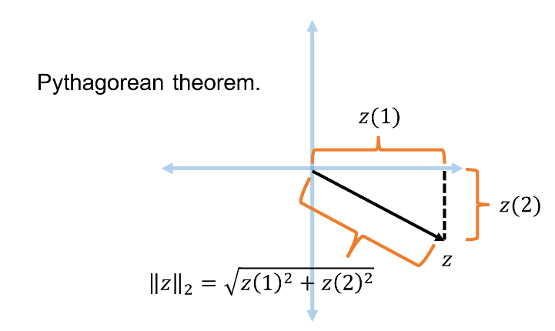




Recall: Euclidean Space and $L_{2}$ Norm
For $z$ $∈R^{n}$, the $L_{2}$ norm of $z$ is denoted by ${\left\|z\right\|}_{2}$ and defined as:
$${\left\|z\right\|}_{2}=\sqrt{z_{1}^{2}+z_{2}^{2}+…+z_{n}^{2}}$$
For $x,y$ $∈R^{n}$, the distance function $D$ is denoted by ${\left\|⋅\right\|}_{2}$ and defined as ${\left\|x−y\right\|}_{2}$

Slide 4
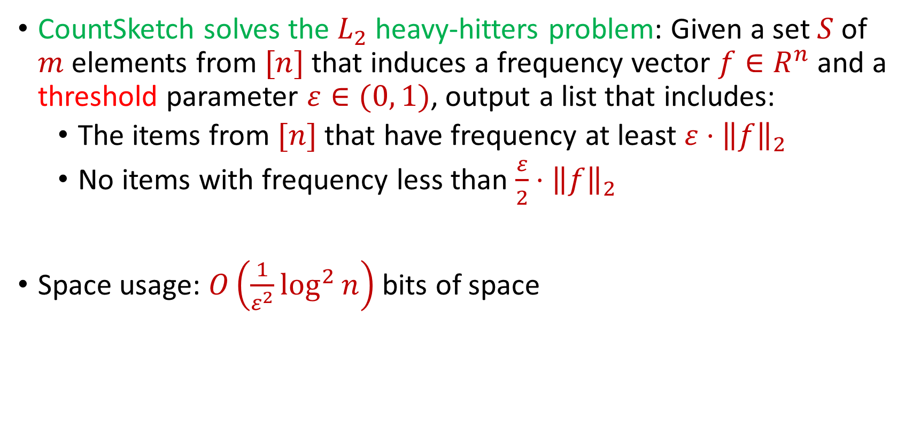
Recall: CountSketch Summary
CountSketch solves the $L_{2}$ heavy-hitters problem: Given a set $S$ of $m$ elements from $[n]$ that induces a frequency vector $f∈R^{n}$ and a threshold parameter $ε∈(0, 1)$, output a list that includes:
The items from $[n]$ that have frequency at least $ε⋅{\left\|f\right\|}_{2}$
No items with frequency less than $\frac{ε}{2}⋅{\left\|f\right\|}_{2}$
Space usage: $O\left(\frac{1}{ε^{2}}\log^{2}{n}\right)$ bits of space

Slide 5
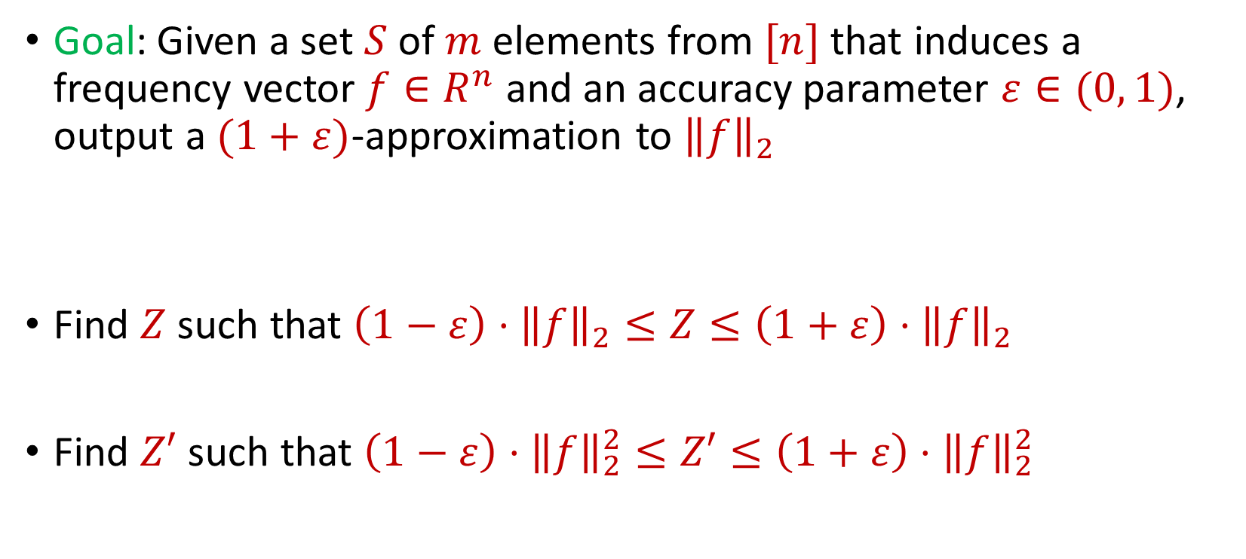
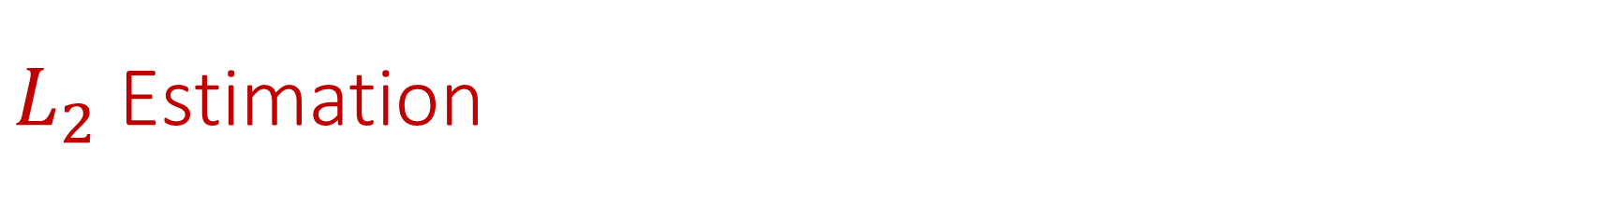
$L_{2}$ Estimation
Goal: Given a set $S$ of $m$ elements from $[n]$ that induces a frequency vector $f∈R^{n}$ and an accuracy parameter $ε∈(0, 1)$, output a $(1+ε)$-approximation to ${\left\|f\right\|}_{2}$
Find $Z$ such that ${\left(1−ε\right)⋅\left\|f\right\|}_{2}≤Z≤\left(1+ε\right)⋅{\left\|f\right\|}_{2}$
Find $Z′$ such that ${\left(1−ε\right)⋅\left\|f\right\|}_{2}^{2}≤Z′≤\left(1+ε\right)⋅{\left\|f\right\|}_{2}^{2}$

Slide 6

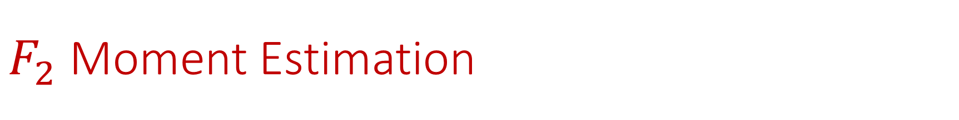
$F_{2}$ Moment Estimation
Goal: Find $Z′$ such that ${\left(1−ε\right)⋅\left\|f\right\|}_{2}^{2}≤Z′≤\left(1+ε\right)⋅{\left\|f\right\|}_{2}^{2}$

Slide 7
$F_{2}$ Moment Estimation
Goal: Find $Z′$ such that ${\left(1−ε\right)⋅\left\|f\right\|}_{2}^{2}≤Z′≤\left(1+ε\right)⋅{\left\|f\right\|}_{2}^{2}$
1 7 7 7 3 7 7 1 4 1 1 1 1 5 1 1 7 1 7 5 1 7 7

Slide 8
$F_{2}$ Moment Estimation
Goal: Find $Z′$ such that ${\left(1−ε\right)⋅\left\|f\right\|}_{2}^{2}≤Z′≤\left(1+ε\right)⋅{\left\|f\right\|}_{2}^{2}$
1 7 7 7 3 7 7 1 4 1 1 1 1 5 1 1 7 1 7 5 1 7 7
$f_{1}$ | $f_{2}$ | $f_{3}$ | $f_{4}$ | $f_{5}$ | $f_{6}$ | $f_{7}$
10 | 0 | 1 | 1 | 2 | 0 | 9

Slide 9

Johnson-Lindenstrauss Lemma
Distributional Johnson-Lindenstrauss Lemma: Given $Π∈R^{m×n}$ with $m=O\left(\frac{\log{1/δ}}{ε^{2}}\right)$ and each entry drawn from $\frac{1}{\sqrt{m}}N\left(0,1\right)$, then for any $x∈R^{n}$ and setting $y=Πx$, then with probability at least $1−δ$
$$\left(1−ε\right){\left\|x\right\|}_{2}≤{\left\|y\right\|}_{2}≤\left(1+ε\right){\left\|x\right\|}_{2}$$

Slide 10
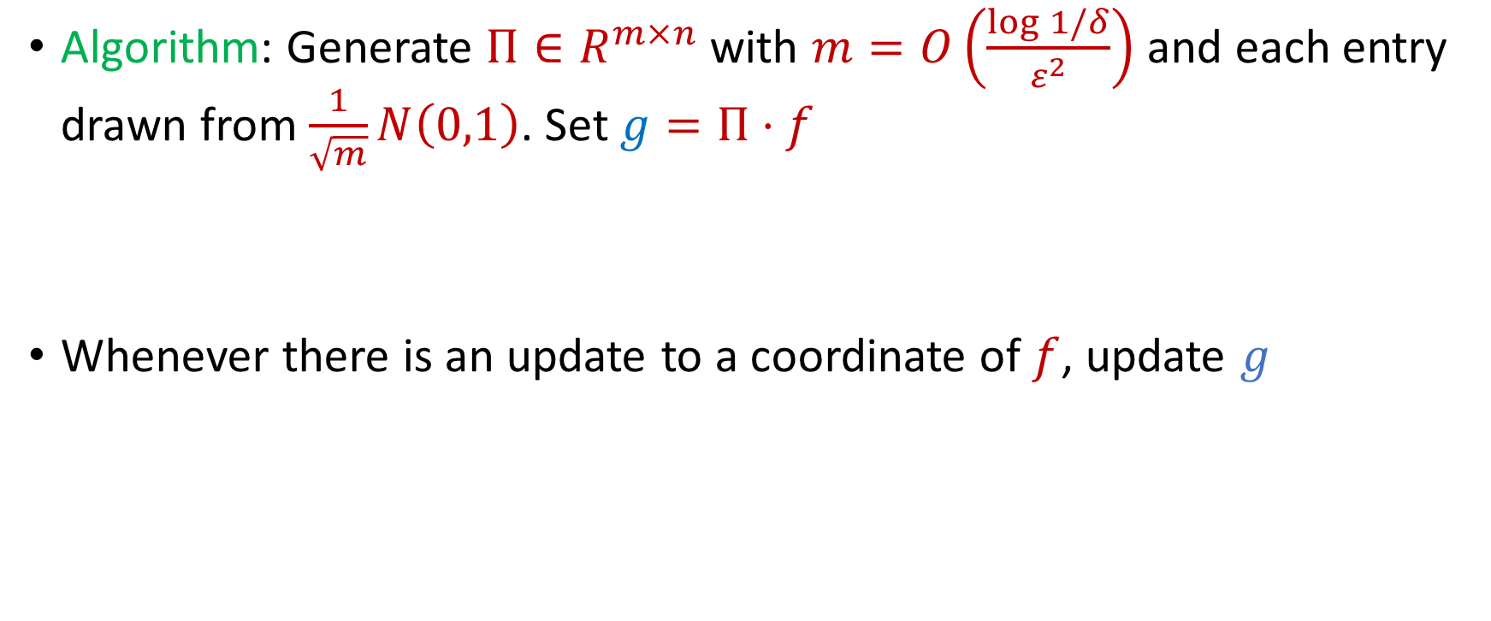
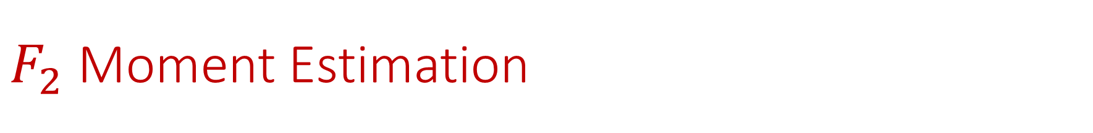
$F_{2}$ Moment Estimation
Algorithm: Generate $Π∈R^{m×n}$ with $m=O\left(\frac{\log{1/δ}}{ε^{2}}\right)$ and each entry drawn from $\frac{1}{\sqrt{m}}N\left(0,1\right)$. Set $g=Π⋅f$
Whenever there is an update to a coordinate of $f$, update $g$

Slide 11
$F_{2}$ Moment Estimation
Algorithm: Generate $Π∈R^{m×n}$ with $m=O\left(\frac{\log{1/δ}}{ε^{2}}\right)$ and each entry drawn from $\frac{1}{\sqrt{m}}N\left(0,1\right)$. Set $g=Π⋅f$
Whenever there is an update to a coordinate of $f$, update $g$
1 7 7 7 3 7 7 1 4 1 1 1 1 5 1 1 7 1 7 5 1 7 7

Slide 12
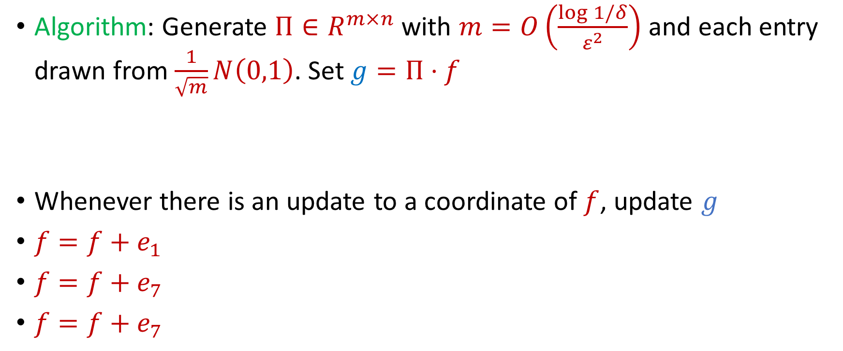
$F_{2}$ Moment Estimation
Algorithm: Generate $Π∈R^{m×n}$ with $m=O\left(\frac{\log{1/δ}}{ε^{2}}\right)$ and each entry drawn from $\frac{1}{\sqrt{m}}N\left(0,1\right)$. Set $g=Π⋅f$
Whenever there is an update to a coordinate of $f$, update $g$
$f=f+e_{1}$
$f=f+e_{7}$
$f=f+e_{7}$
1 7 7 7 3 7 7 1 4 1 1 1 1 5 1 1 7 1 7 5 1 7 7

Slide 13
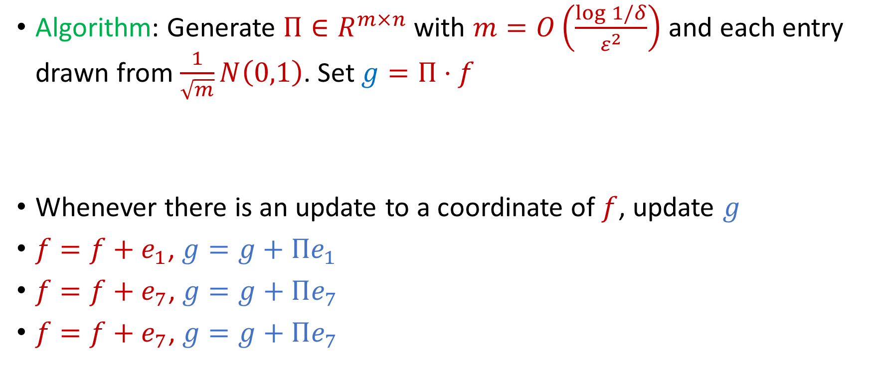
$F_{2}$ Moment Estimation
Algorithm: Generate $Π∈R^{m×n}$ with $m=O\left(\frac{\log{1/δ}}{ε^{2}}\right)$ and each entry drawn from $\frac{1}{\sqrt{m}}N\left(0,1\right)$. Set $g=Π⋅f$
Whenever there is an update to a coordinate of $f$, update $g$
$f=f+e_{1}$, $g=g+Πe_{1}$
$f=f+e_{7}$, $g=g+Πe_{7}$
$f=f+e_{7}$, $g=g+Πe_{7}$
1 7 7 7 3 7 7 1 4 1 1 1 1 5 1 1 7 1 7 5 1 7 7

Slide 14

AMS Algorithm
Generate a random sign vector $s∈{\left\{−1, +1\right\}}^{n}$
Maintain $Z=⟨s, f⟩$
Output $W≔Z^{2}$

Slide 15
$$1$$

Slide 16
$$1$$

Slide 17

$$2$$

Slide 18
$$1$$

Slide 19
$$2$$

Slide 20
$$1$$

Slide 21
$$1$$

Slide 22
$$1$$

Slide 23
$$2$$

Slide 24
$$1$$

Slide 25
$$1$$

Slide 26
$$2$$

Slide 27
$$2$$

Slide 28
$$2$$

Slide 29
$$1$$

Slide 30

AMS Algorithm
What values of $Z$ did you get?
$Z=\left\langle s, f\right\rangle =s_{1}f_{1}+s_{2}f_{2}+…+s_{n}f_{n}$
What values of $W$did you get?
$W=Z^{2}=\sum_{i,j}{s_{i}s_{j}f_{i}f_{j}}$

Slide 31

AMS Algorithm
What values of $W$did you get?
$W=Z^{2}=\sum_{i,j}{s_{i}s_{j}f_{i}f_{j}}$
$f_{1}$ | $f_{2}$ | $f_{3}$ | $f_{4}$ | $f_{5}$ | $f_{6}$ | $f_{7}$
9 | 6 | 0 | 0 | 0 | 0 | 0

Slide 32

AMS Algorithm
What is $E\left[W\right]$?
$Z=\left\langle s, f\right\rangle =s_{1}f_{1}+s_{2}f_{2}+…+s_{n}f_{n}$
$W=Z^{2}=\sum_{i,j}{s_{i}s_{j}f_{i}f_{j}}$
$E\left[W\right]=\sum_{i,j}{E\left[s_{i}s_{j}f_{i}f_{j}\right]}=\sum_{i}{E\left[f_{i}^{2}\right]}={\left\|f\right\|}_{2}^{2}$

Slide 33
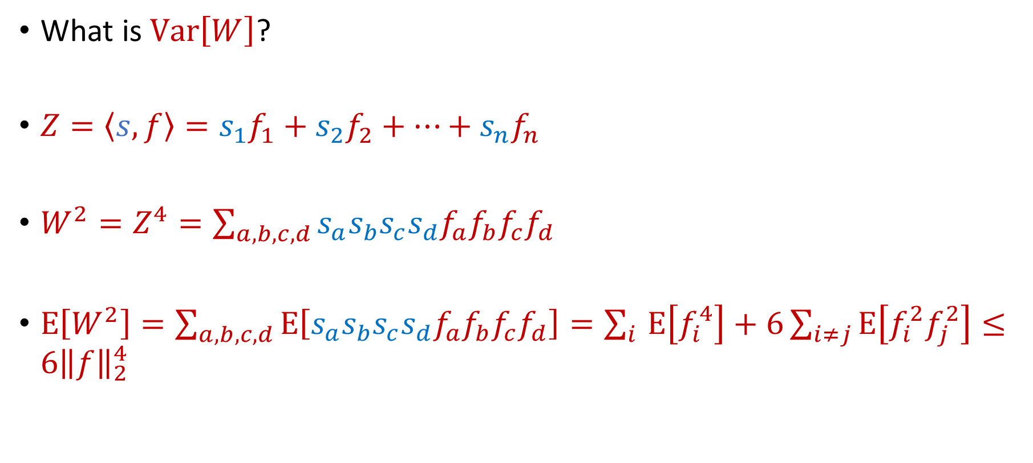
AMS Algorithm
What is $Var\left[W\right]$?
$Z=\left\langle s, f\right\rangle =s_{1}f_{1}+s_{2}f_{2}+…+s_{n}f_{n}$
$W^{2}=Z^{4}=\sum_{a,b,c,d}{s_{a}s_{b}s_{c}s_{d}f_{a}f_{b}f_{c}f_{d}}$
$E\left[W^{2}\right]=\sum_{a,b,c,d}{E\left[s_{a}s_{b}s_{c}s_{d}f_{a}f_{b}f_{c}f_{d}\right]}=\sum_{i }{E\left[f_{i}^{4}\right]}+6\sum_{i≠j}{E\left[f_{i}^{2}f_{j}^{2}\right]}≤6{\left\|f\right\|}_{2}^{4}$

Slide 34

AMS Algorithm
By Chebyshev’s inequality, $W$ will be a $9$-approximation to ${\left\|f\right\|}_{2}^{2}$ with probability $\frac{2}{3}$

Slide 35

AMS Algorithm
How to get $(1+ε)$-approximation?
Repeat $O\left(\frac{1}{ε^{2}}\right)$ times and take the average

Slide 36

AMS Algorithm
Space of algorithm: $O\left(\frac{1}{ε^{2}}\right)$ words of space or $O\left(\frac{1}{ε^{2}}\log{m}\right)$ bits of space

