Slide 1
CSCE 658: Randomized Algorithms
Lecture 22
Samson Zhou

Slide 2
Relevant Supplementary Material
Chapter 3-4 of “The Algorithmic Foundations of Differential Privacy”, by Cynthia Dwork and Aaron Roth (https://www.cis.upenn.edu/~aaroth/Papers/privacybook.pdf)

Slide 3




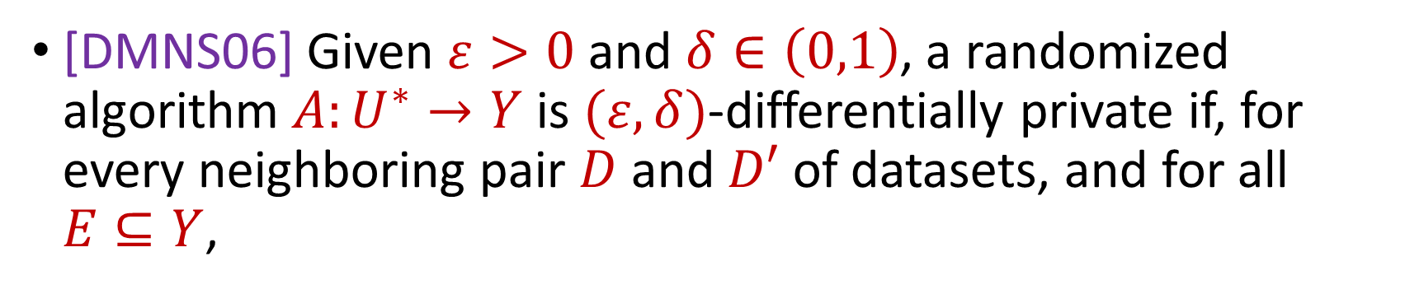

Previously: Differential Privacy
[DMNS06] Given $ε>0$and $δ∈\left(0,1\right)$, a randomized algorithm $A:U^{∗}→Y$ is $(ε,δ)$-differentially private if, for every neighboring pair $D$ and $D′$ of datasets, and for all $E⊆Y$,
$$Pr\left[A\left(D\right)∈E\right]≤e^{ε}⋅Pr\left[A\left(D^{′}\right)∈E\right]+δ$$
$$A\left( \right)≈A\left( \right)$$
Notes:
[DworkMcSherryNissimSmith06]

Slide 4
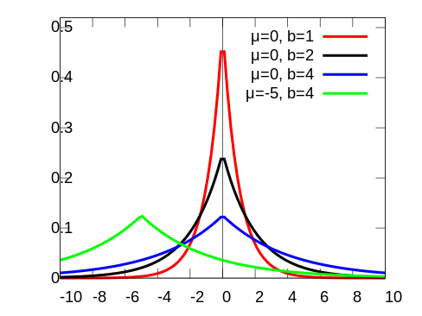
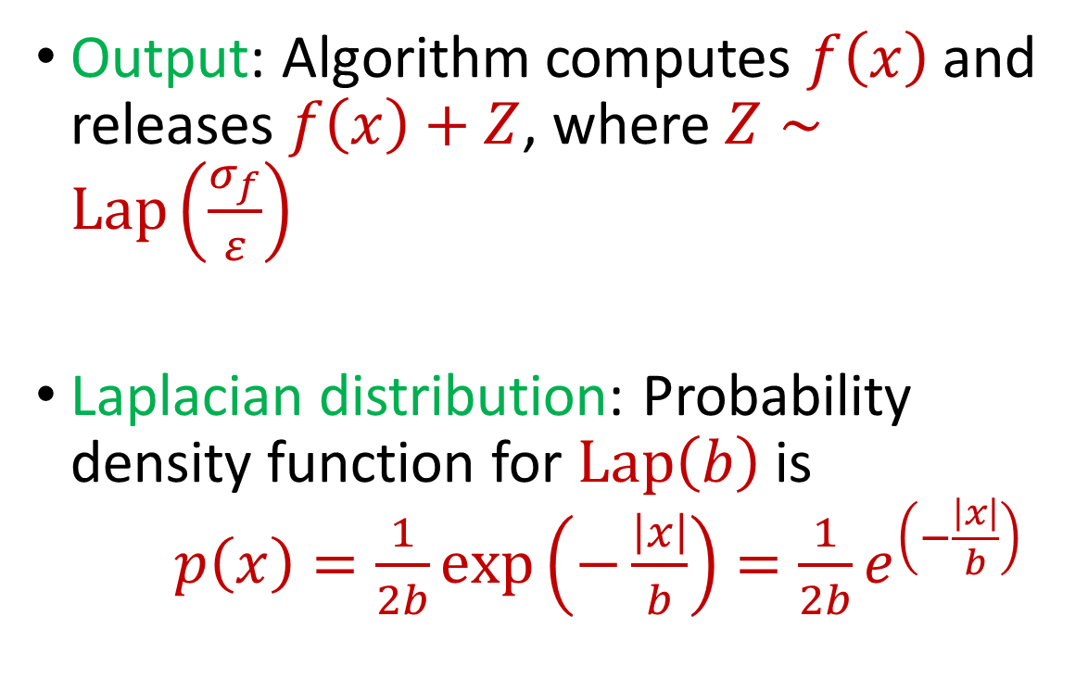
Previously: Laplace Mechanism
Output: Algorithm computes $f\left(x\right)$ and releases $f\left(x\right)+Z$, where $Z∼Lap\left(\frac{σ_{f}}{ε}\right)$
Laplacian distribution: Probability density function for $Lap\left(b\right)$ is $p\left(x\right)=\frac{1}{2b}exp\left(−\frac{\left|x\right|}{b}\right)=\frac{1}{2b}e^{\left(−\frac{\left|x\right|}{b}\right)}$
Notes:
[DworkMcSherryNissimSmith06]

Slide 5
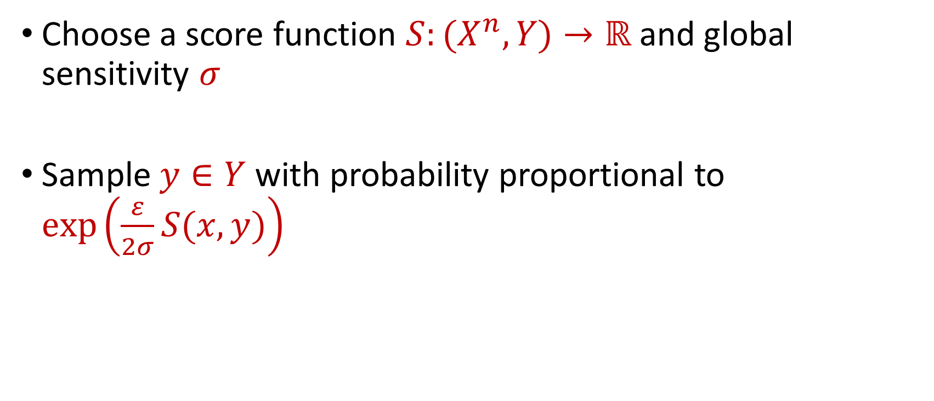
Previously: Exponential Mechanism
Choose a score function $S:(X^{n},Y)→ℝ$ and global sensitivity $σ$
Sample $y∈Y$ with probability proportional to $\exp\left(\frac{ε}{2σ}S(x,y)\right)$
Notes:
[DworkMcSherryNissimSmith06]

Slide 6
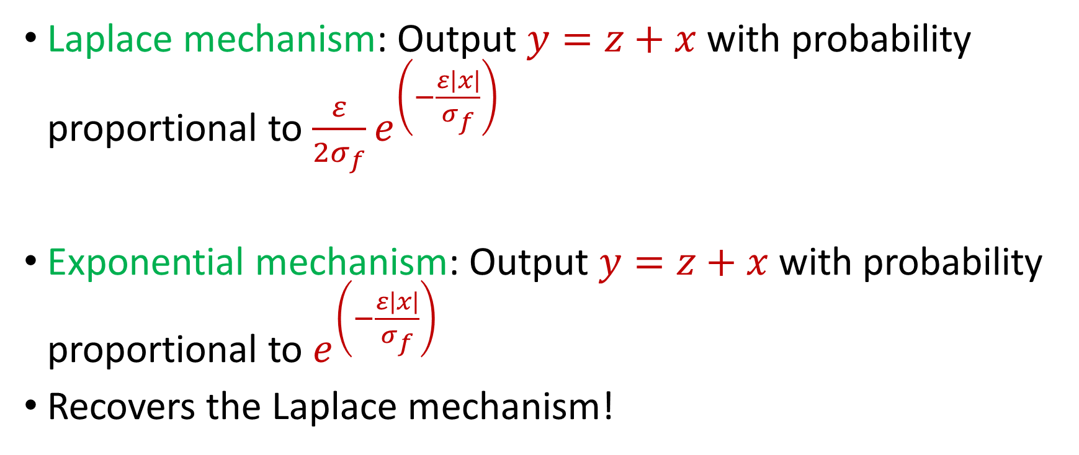
Mechanisms: Exponential vs. Laplace
Laplace mechanism: Output $y=z+x$ with probability proportional to $\frac{ε}{2σ_{f}}e^{\left(−\frac{ε\left|x\right|}{σ_{f}}\right)}$
Exponential mechanism: Output $y=z+x$ with probability proportional to $e^{\left(−\frac{ε\left|x\right|}{σ_{f}}\right)}$
Recovers the Laplace mechanism!
Notes:
[DworkMcSherryNissimSmith06]

Slide 7
Exponential Mechanism Drawbacks
Sampling process may be inefficient
Error can be large
Notes:
[DworkMcSherryNissimSmith06]

Slide 8
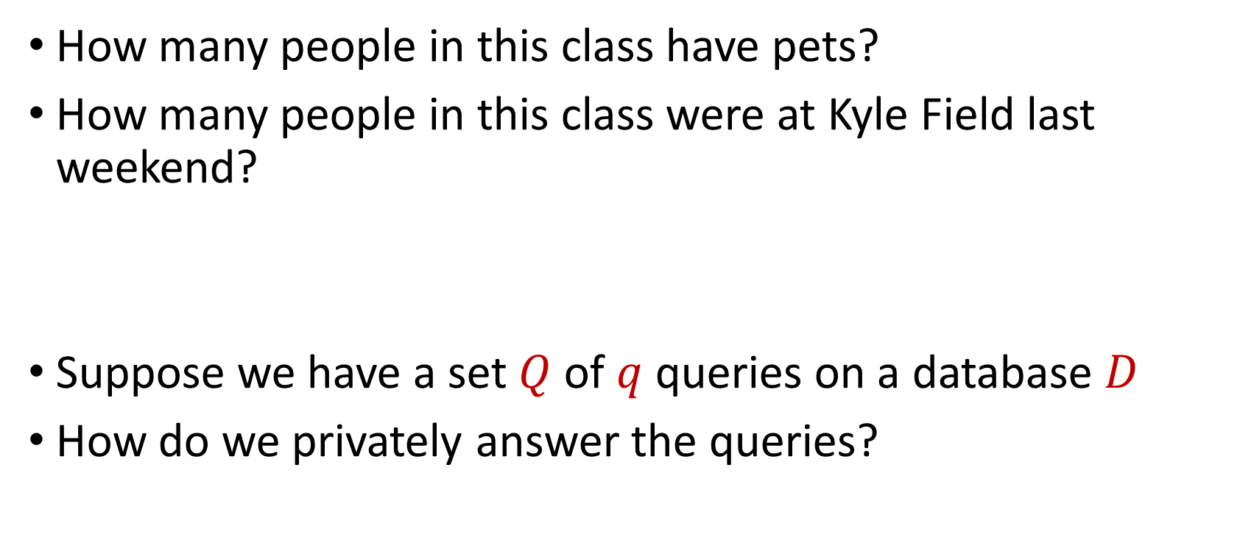
Counting Queries
How many people in this class have pets?
How many people in this class were at Kyle Field last weekend?
Suppose we have a set $Q$ of $q$ queries on a database $D$
How do we privately answer the queries?
Notes:
[DworkMcSherryNissimSmith06]

Slide 9
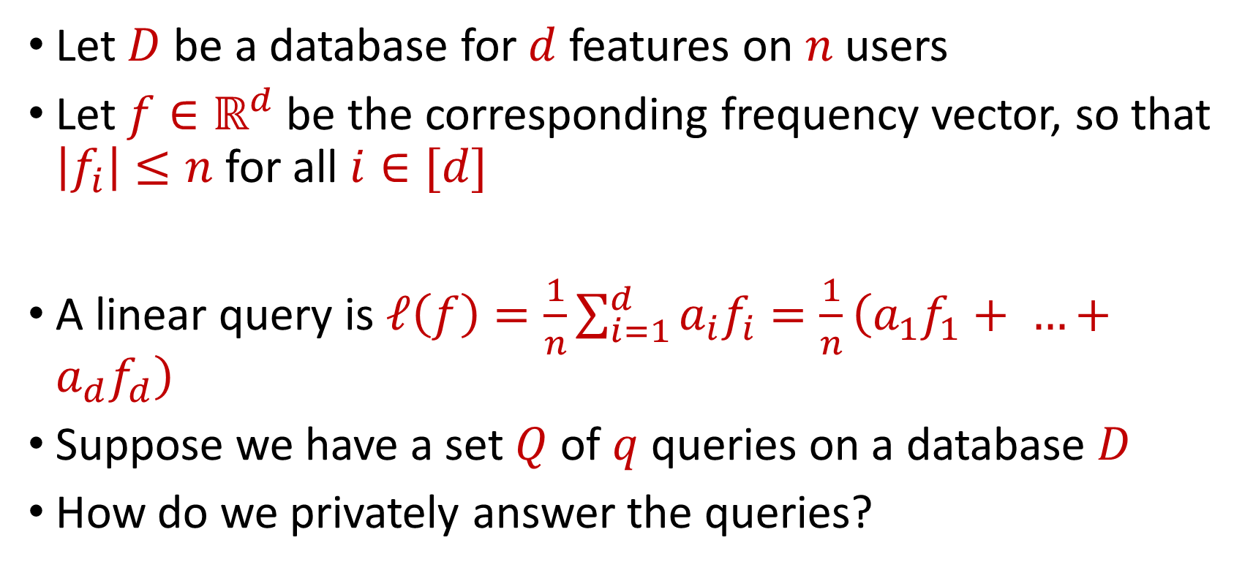
Linear Queries
Let $D$ be a database for $d$ features on $n$ users
Let $f∈ℝ^{d}$ be the corresponding frequency vector, so that $\left|f_{i}\right|≤n$ for all $i∈[d]$
A linear query is $ℓ\left(f\right)=\frac{1}{n}\sum_{i=1}^{d}{a_{i}f_{i}}=\frac{1}{n}\left(a_{1}f_{1}+ …+a_{d}f_{d}\right)$
Suppose we have a set $Q$ of $q$ queries on a database $D$
How do we privately answer the queries?
Notes:
[DworkMcSherryNissimSmith06]

Slide 10
Counting Queries
How many people in this class have pets?
How many people in this class besides the instructor have pets?
Intuition: we do not need to use additional privacy budget to answer the second query
Notes:
[DworkMcSherryNissimSmith06]

Slide 11
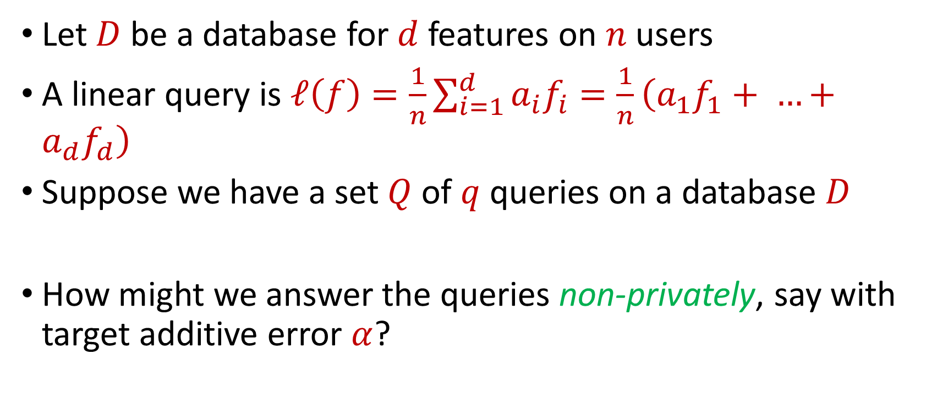
Linear Queries
Let $D$ be a database for $d$ features on $n$ users
A linear query is $ℓ\left(f\right)=\frac{1}{n}\sum_{i=1}^{d}{a_{i}f_{i}}=\frac{1}{n}\left(a_{1}f_{1}+ …+a_{d}f_{d}\right)$
Suppose we have a set $Q$ of $q$ queries on a database $D$
How might we answer the queries non-privately, say with target additive error $α$?
Notes:
[DworkMcSherryNissimSmith06]

Slide 12
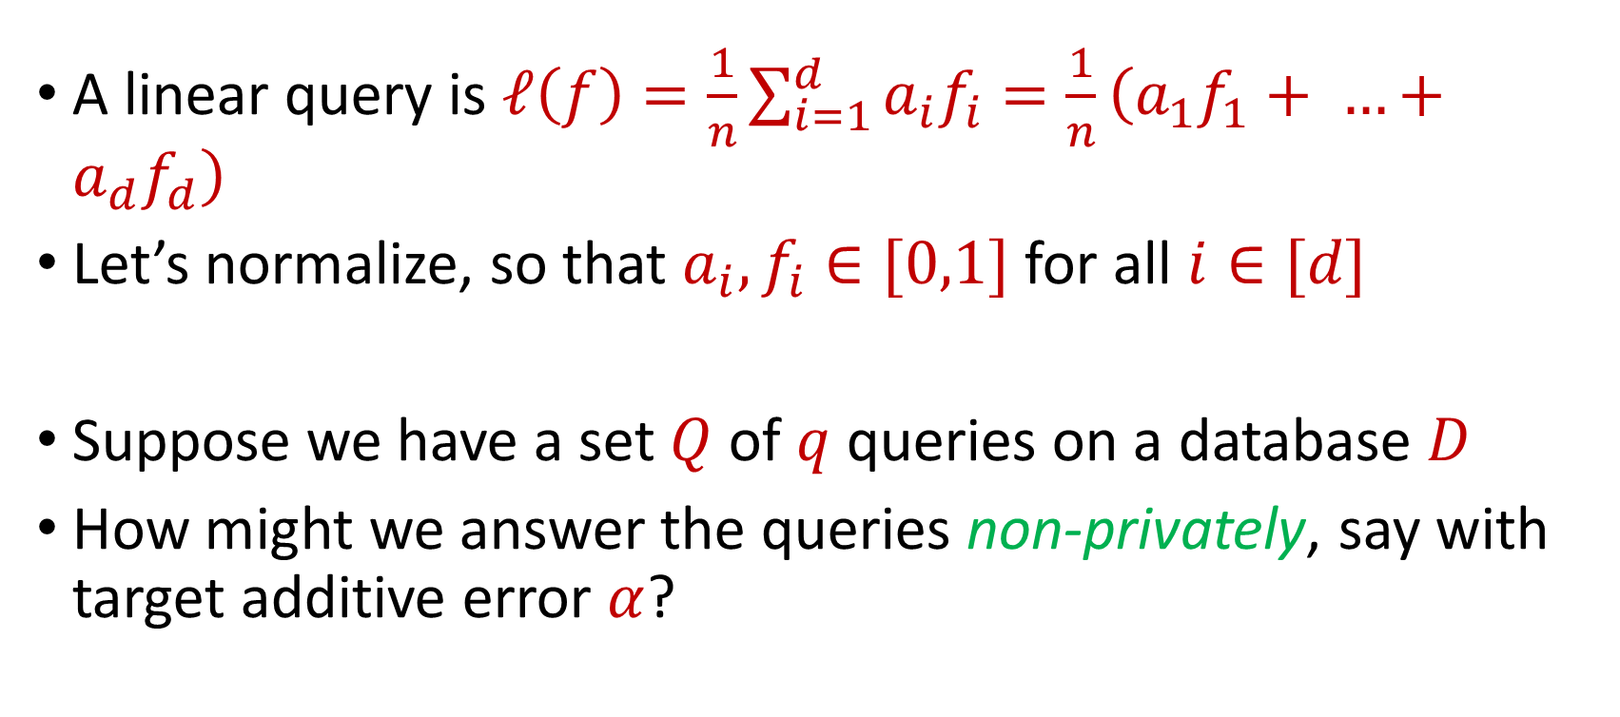
Linear Queries
A linear query is $ℓ\left(f\right)=\frac{1}{n}\sum_{i=1}^{d}{a_{i}f_{i}}=\frac{1}{n}\left(a_{1}f_{1}+ …+a_{d}f_{d}\right)$
Let’s normalize, so that $a_{i}, f_{i}∈[0,1]$ for all $i∈[d]$
Suppose we have a set $Q$ of $q$ queries on a database $D$
How might we answer the queries non-privately, say with target additive error $α$?
Notes:
[DworkMcSherryNissimSmith06]

Slide 13

Linear Queries
Suppose we sample $O\left(\frac{1}{α^{2}}\right)$ items of the database $D$ into a database $\tilde{D}$ and answer $ℓ\left(\tilde{f}\right)=\frac{1}{|D^{′}|}\sum_{i=1}^{d}{a_{i}\tilde{f_{i}}}$, where $\tilde{f}$ is the frequency vector for $\tilde{D}$
Notes:
[DworkMcSherryNissimSmith06]

Slide 14
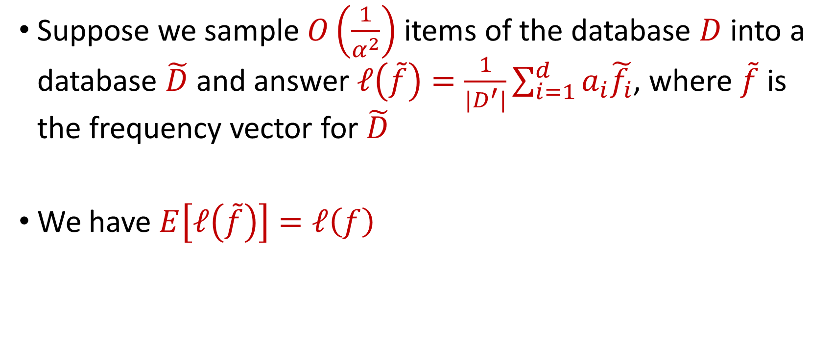
Linear Queries
Suppose we sample $O\left(\frac{1}{α^{2}}\right)$ items of the database $D$ into a database $\tilde{D}$ and answer $ℓ\left(\tilde{f}\right)=\frac{1}{|D^{′}|}\sum_{i=1}^{d}{a_{i}\tilde{f_{i}}}$, where $\tilde{f}$ is the frequency vector for $\tilde{D}$
We have $E\left[ℓ\left(\tilde{f}\right)\right]=ℓ\left(f\right)$
Notes:
[DworkMcSherryNissimSmith06]

Slide 15

Additive Chernoff Bound
Additive Chernoff bound: Let $X_{1},…,X_{n}∈[0,1]$ be independent random variables and let ${X=X}_{1}+…+X_{n}$ have expected value $μ$. Then for any $t≥0$:
$$Pr\left[\left|X−μ\right|≥t\right]≤2e^{−2nt^{2}}$$

Slide 16
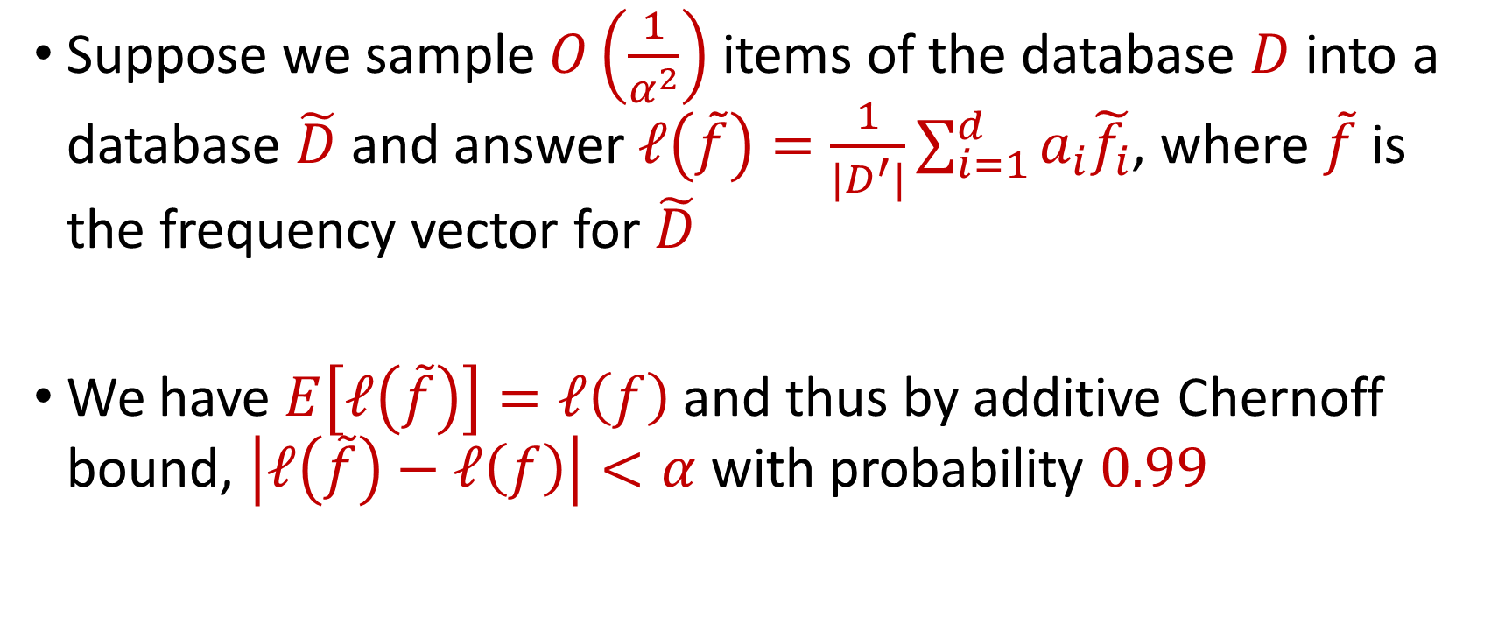
Linear Queries
Suppose we sample $O\left(\frac{1}{α^{2}}\right)$ items of the database $D$ into a database $\tilde{D}$ and answer $ℓ\left(\tilde{f}\right)=\frac{1}{|D^{′}|}\sum_{i=1}^{d}{a_{i}\tilde{f_{i}}}$, where $\tilde{f}$ is the frequency vector for $\tilde{D}$
We have $E\left[ℓ\left(\tilde{f}\right)\right]=ℓ\left(f\right)$ and thus by additive Chernoff bound, $\left|ℓ\left(\tilde{f}\right)−ℓ\left(f\right)\right|<α$ with probability $0.99$
Notes:
[DworkMcSherryNissimSmith06]

Slide 17
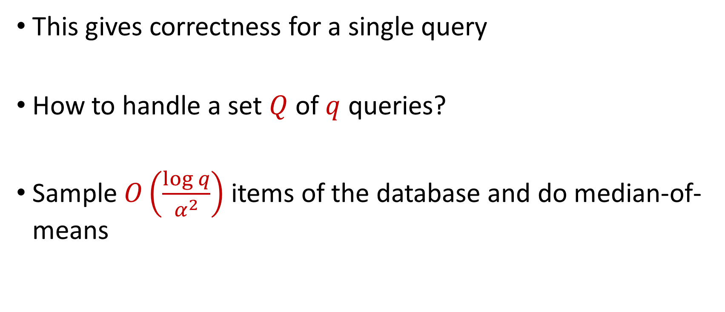
Linear Queries
This gives correctness for a single query
How to handle a set $Q$ of $q$ queries?
Sample $O\left(\frac{\log{q}}{α^{2}}\right)$ items of the database and do median-of-means
Notes:
[DworkMcSherryNissimSmith06]

Slide 18
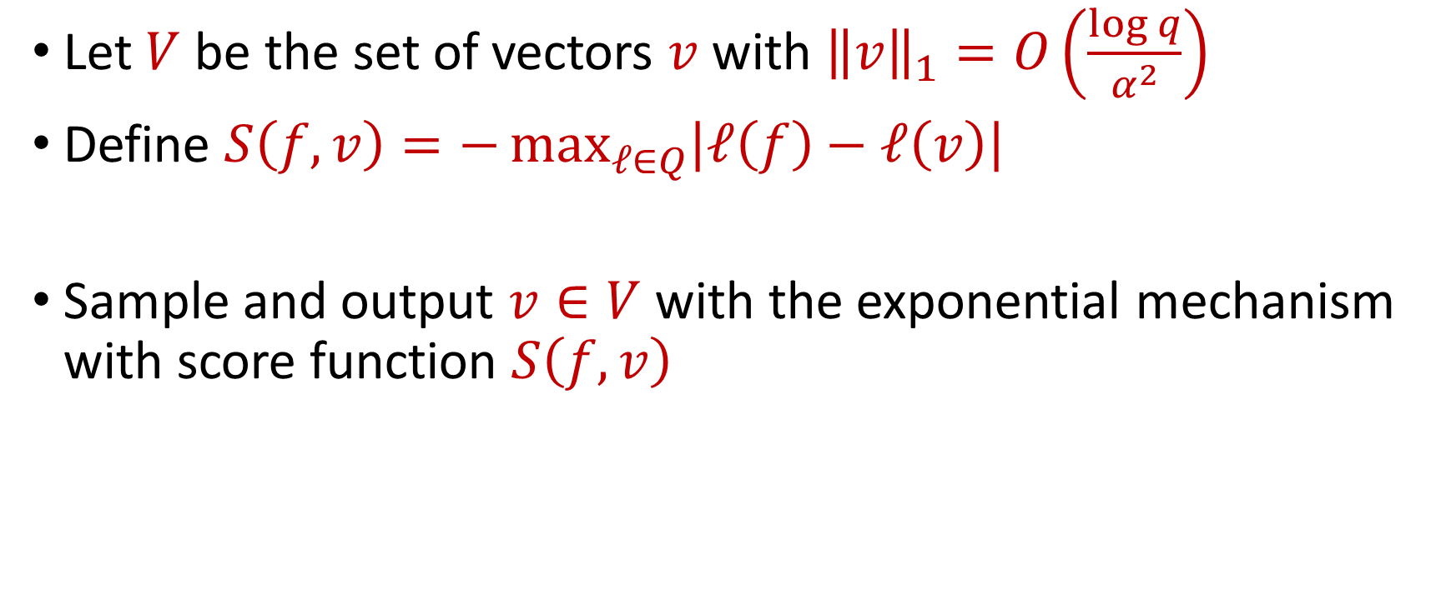
SmallDB Algorithm
Let $V$ be the set of vectors $v$with ${\left\|v\right\|}_{1}=O\left(\frac{\log{q}}{α^{2}}\right)$
Define $S\left(f,v\right)=−\max_{ℓ∈Q}\left|ℓ\left(f\right)−ℓ\left(v\right)\right|$
Sample and output $v∈V$ with the exponential mechanism with score function $S\left(f,v\right)$
Notes:
[DworkMcSherryNissimSmith06]

Slide 19
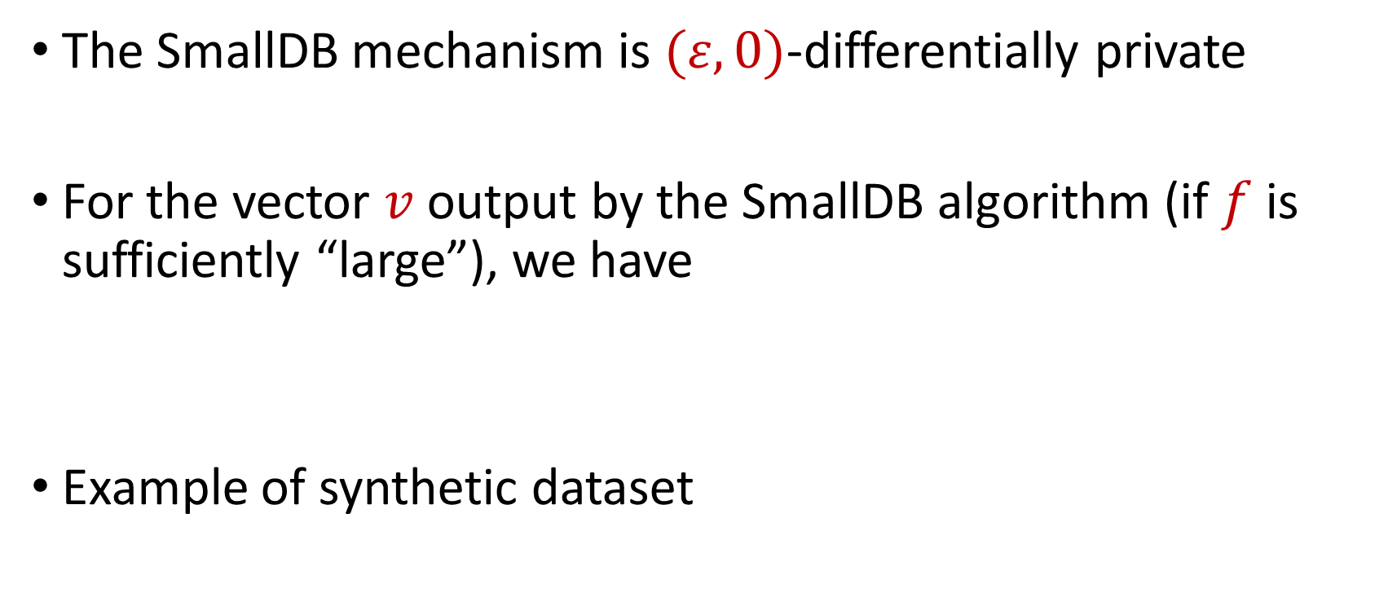

SmallDB Summary
The SmallDB mechanism is $(ε,0)$-differentially private
For the vector $v$ output by the SmallDB algorithm (if $f$ is sufficiently “large”), we have
Example of synthetic dataset
$$\max_{ℓ∈Q}\left|ℓ\left(f\right)−ℓ\left(v\right)\right|≤α$$
Notes:
[DworkMcSherryNissimSmith06]

Slide 20
Approximate DP
[DMNS06] Given $ε>0$and $δ∈\left(0,1\right)$, a randomized algorithm $A:U^{∗}→Y$ is $(ε,δ)$-differentially private if, for every neighboring pair $D$ and $D′$ of datasets, and for all $E⊆Y$,
$$Pr\left[A\left(D\right)∈E\right]≤e^{ε}⋅Pr\left[A\left(D^{′}\right)∈E\right]+δ$$
$$A\left( \right)≈A\left( \right)$$
Notes:
[DworkMcSherryNissimSmith06]

Slide 21
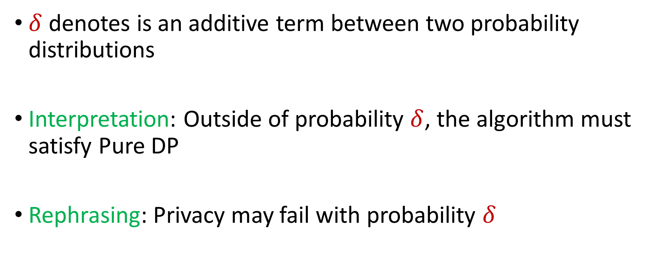
Approximate DP
$δ$ denotes is an additive term between two probability distributions
Interpretation: Outside of probability $δ$, the algorithm must satisfy Pure DP
Rephrasing: Privacy may fail with probability $δ$
Notes:
[DworkMcSherryNissimSmith06]

Slide 22
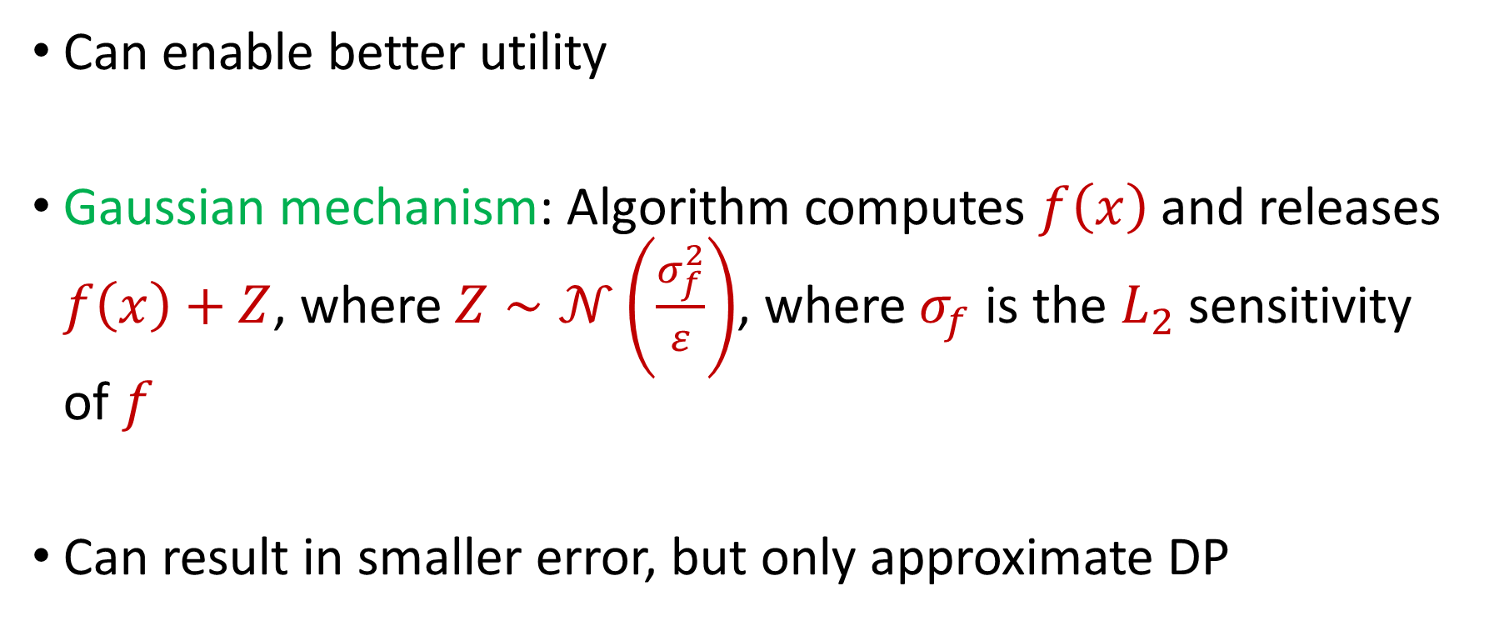
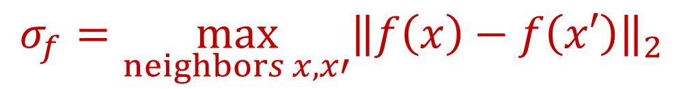
Approximate DP
Can enable better utility
Gaussian mechanism: Algorithm computes $f\left(x\right)$ and releases $f\left(x\right)+Z$, where $Z∼𝒩\left(\frac{σ_{f}^{2}}{ε}\right)$, where $σ_{f}$ is the $L_{2}$ sensitivity of $f$
Can result in smaller error, but only approximate DP
$$σ_{f}=\max_{neighbors x,x′}{\left\|f\left(x\right)−f\left(x′\right)\right\|}_{2}$$
Notes:
[DworkMcSherryNissimSmith06]

Slide 23
Laplace Mechanism
Output: Algorithm computes $f\left(x\right)$ and releases $f\left(x\right)+Z$, where $Z∼Lap\left(\frac{σ_{f}}{ε}\right)$
Laplacian distribution: Probability density function for $Lap\left(b\right)$ is $p\left(x\right)=\frac{1}{2b}exp\left(−\frac{\left|x\right|}{b}\right)=\frac{1}{2b}e^{\left(−\frac{\left|x\right|}{b}\right)}$
Notes:
[DworkMcSherryNissimSmith06]

Slide 24
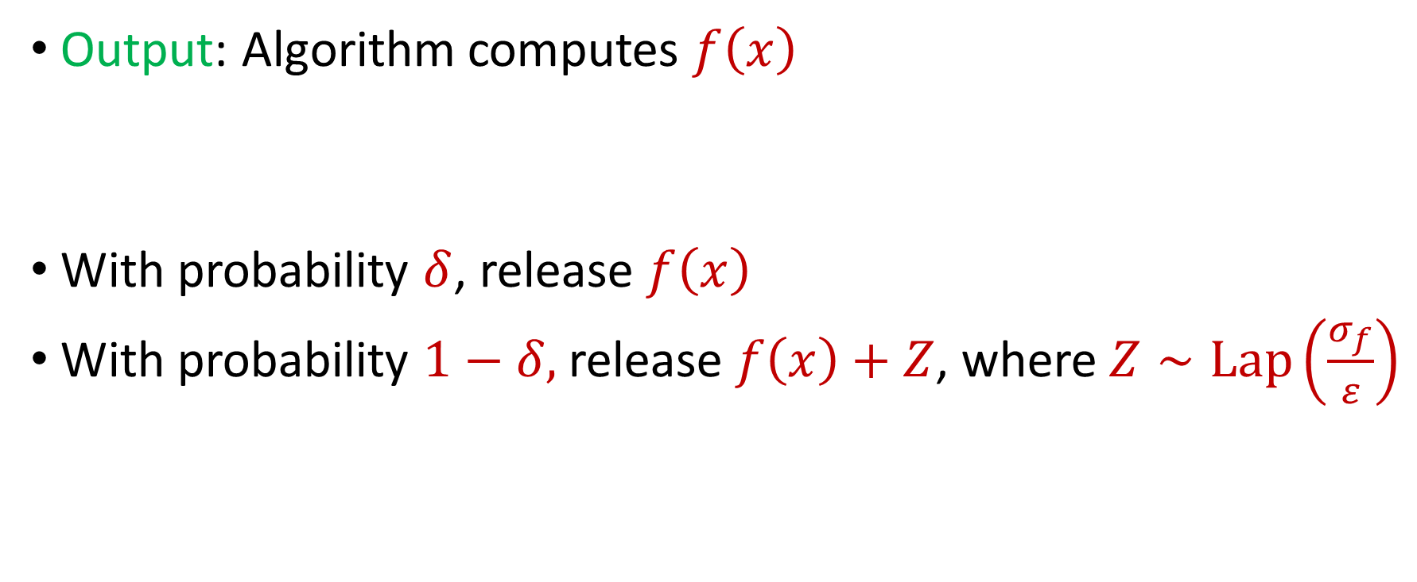
Catastrophic Mechanism
Output: Algorithm computes $f\left(x\right)$
With probability $δ$, release $f\left(x\right)$
With probability $1−δ,$release $f\left(x\right)+Z$, where $Z∼Lap\left(\frac{σ_{f}}{ε}\right)$
Notes:
[DworkMcSherryNissimSmith06]

Slide 25
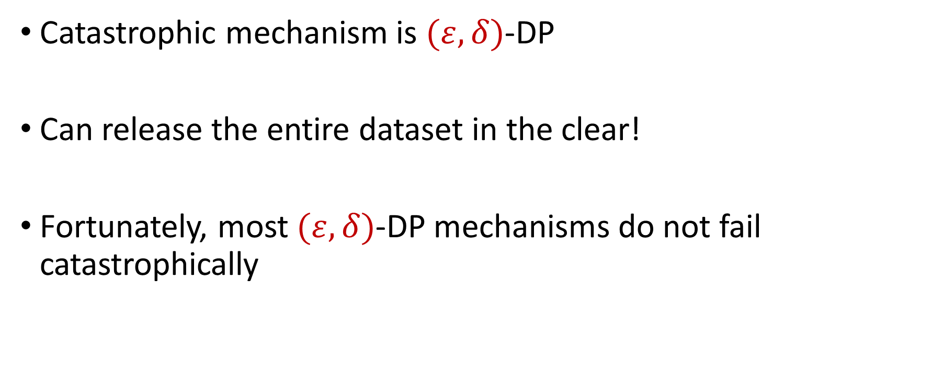
Catastrophic Mechanism
Catastrophic mechanism is $(ε,δ)$-DP
Can release the entire dataset in the clear!
Fortunately, most $(ε,δ)$-DP mechanisms do not fail catastrophically
Notes:
[DworkMcSherryNissimSmith06]

Slide 26
Martingales
Concentration inequalities when the random variables are not independent
Azuma, Doob, etc.
Notes:
[DworkMcSherryNissimSmith06]

Slide 27
Semester Review: Why Randomized Algorithms?
Polynomial identity testing
Karger’s min-cut algorithm

Slide 28
Semester Review: Why Randomized Algorithms?
Relevant study material: Randomized Algorithms and Probabilistic Analysis, by Greg Valiant (http://web.stanford.edu/class/cs265/)
Relevant study material: Chapter 1, Randomized Algorithms, by Rajeev Motwani and Prabhakar Raghavan

Slide 29
Semester Review: Probability Unit
Basic probability (conditional probability, joint probability)
Expectation, variance, moments
Concentration inequalities (Markov, Chebyshev, exponential tail bounds, e.g., Chernoff, Bernstein)

Slide 30
Trivia Question #1 (Birthday Paradox)
Suppose we have a fair $n$-sided die. How many times should we roll the die before the probability we see a repeated outcome among the rolls is at least $\frac{1}{2}$? Example: $1$, $5$, $2$, $4$, $5$
$Θ(1)$
$Θ(\log{n})$
$Θ(\sqrt{n})$
$Θ(n)$
Notes:
0, 1, 3, 6

Slide 31
Trivia Question #3 (Max Load)
Suppose we have a fair $n$-sided die that we roll $n$ times. “On average”, what is the largest number of times any outcome is rolled? Example: $1$, $5$, $2$, $4$, $1$, $3$, $1$ for $n=7$
$Θ(1)$
$\tilde{Θ}(\log{n})$
$\tilde{Θ}(\sqrt{n})$
$\tilde{Θ}(n)$

Slide 32
Trivia Question #4 (Coupon Collector)
Suppose we have a fair $n$-sided die. “On average”, how many times should we roll the die before we see all possible outcomes among the rolls? Example: $1$, $5$, $2$, $4$, $1$, $3$, $1$, $6$ for $n=6$
$Θ\left(n\right)$
$Θ\left(n\log{n}\right)$
$Θ\left(n\sqrt{n}\right)$
$Θ\left(n^{2}\right)$

Slide 33
Semester Review: Probability Unit
Relevant study material: Randomized Algorithms and Probabilistic Analysis, by Greg Valiant (http://web.stanford.edu/class/cs265/)
Relevant study material: Chapters 3-4, Randomized Algorithms, by Rajeev Motwani and Prabhakar Raghavan

Slide 34
Semester Review: Big Data Unit
Dimensionality reduction (Johnson-Lindenstrauss, coresets)
Streaming algorithms (insertion, insertion-deletion)
Reservoir Sampling
Heavy-Hitters (Misra-Gries, CountMin, CountSketch)
Norm estimation (AMS)
Information theory, lower bounds
Clustering

Slide 35
Semester Review: Big Data Unit
Relevant study material: Data Stream Algorithms, by Amit Chakrabarti (https://www.cs.dartmouth.edu/~ac/Teach/CS35-Fall23/)
Relevant study material: Chapters 3-4, Data Streams: Algorithms and Applications, by S. Muthukrishnan

Slide 36
Semester Review: Probabilistic Method
Suppose we want to argue the existence of a certain desirable object
Existential argument, non-constructive
If there is an algorithm that can find it, it must exist!
A random variable cannot always be less than its expected value
A random variable cannot always be more than its expected value

Slide 37
Semester Review: Probabilistic Method
Relevant study material: Chapters 5, Randomized Algorithms, by Rajeev Motwani and Prabhakar Raghavan

Slide 38
Semester Review: LLL
Approach to argue the existence of something that satisfies a large number of constraints
Probabilistic method (existence, not constructive)

Slide 39
Semester Review: LLL
Relevant study material: Chapters 5, Randomized Algorithms, by Rajeev Motwani and Prabhakar Raghavan

Slide 40
Semester Review: Linear Programming
Formulating LPs
Duality
Integer linear programs and rounding

Slide 41
Semester Review: Linear Programming
Chapter 29 in “Introduction to Algorithms”, by Thomas H. Cormen, Charles E. Leiserson, Ronald L. Rivest, and Clifford Stein
Chapters 5.1-5.5 in “The Design of Approximation Algorithms”, by David P. Williamson and David B. Shmoys

Slide 42
Semester Review: Online Learning
Weighted majority
Randomized weighted majority
Multiplicative weights
Hedge

Slide 43
Semester Review: Online Learning
Lecture 13 of “Advanced Algorithms” Course Notes (http://www.cs.cmu.edu/afs/cs.cmu.edu/academic/class/15850-f20/www/notes/lec14.pdf), by Anupam Gupta
Lecture 14 of “Advanced Algorithms” Course Notes (http://www.cs.cmu.edu/afs/cs.cmu.edu/academic/class/15850-f20/www/notes/lec15.pdf), by Anupam Gupta

Slide 44
Semester Review: Differential Privacy
Randomized response
Basic properties of DP (composition, post-processing)
Laplace mechanism
Exponential mechanism

Slide 45
Semester Review: Differential Privacy
Chapter 3-4 of “The Algorithmic Foundations of Differential Privacy”, by Cynthia Dwork and Aaron Roth (https://www.cis.upenn.edu/~aaroth/Papers/privacybook.pdf)

