Slide 1
CSCE 689: Special Topics in Modern Algorithms for Data Science
Lecture 30
Samson Zhou

Slide 2
Presentation Schedule
November 27: Chunkai, Jung, Galaxy AI
November 29: STMI, Anmol, Jason
December 1: Bokun, Ayesha, Dawei, Lipai

Slide 3






Linear Algebra Review
For $y=Ax$, we have $y_{i}=⟨a_{i}, x⟩$
$$A$$
$$x$$
$$d$$
$$n$$
$$d$$

Slide 4


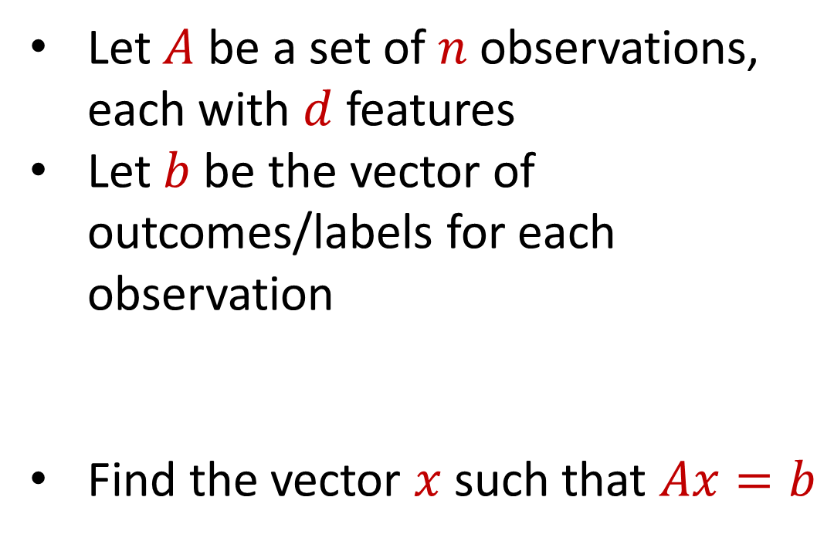



Regression
Let $A$ be a set of $n$ observations, each with $d$ features
Let $b$ be the vector of outcomes/labels for each observation
Find the vector $x$ such that $Ax=b$
$$d$$
$$x$$
$$=$$
$$n$$
$$A$$
$$n$$
$$b$$
$$1$$
$$d$$
$$1$$

Slide 5
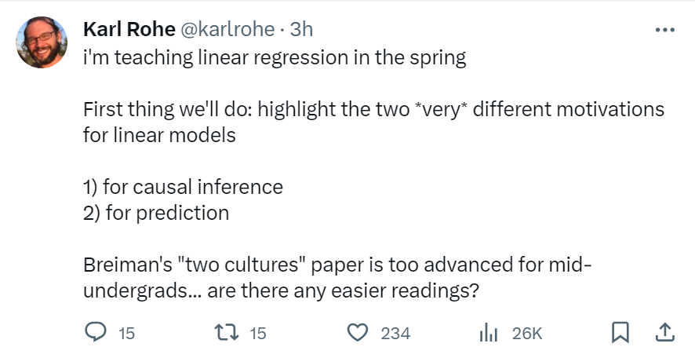

Slide 6

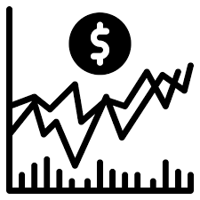
Regression
Economics and Finance:
Stock price prediction: Predict stock prices based on historical data and other relevant factors.
Econometric analysis: Study the relationships between economic variables like GDP, inflation, and interest rates.

Slide 7

Regression
Medicine and Healthcare:
Medical research: Understand the relationship between factors such as age, genetics, and lifestyle on health outcomes.
Disease prediction: Predicting the probability of disease occurrence based on risk factors like smoking, diet, and exercise.

Slide 8


Regression
Sports Analytics:
Player performance forecast: Predicting player performance in sports like baseball, basketball, or soccer based on historical data.
Game outcome prediction: Predicting the outcome of games based on team statistics and other factors.

Slide 9

Regression
Environmental Science:
Climate modeling: Model climate change variables like temperature, precipitation, and sea levels.
Pollution analysis: Analyze the relationship between pollution levels and various factors like industrial activity and population.

Slide 10
Regression
Let $A$ be a set of $n$ observations, each with $d$ features
Let $b$ be the vector of outcomes/labels for each observation
Find the vector $x$ such that $Ax=b$
$$d$$
$$x$$
$$=$$
$$n$$
$$A$$
$$n$$
$$b$$
$$1$$
$$d$$
$$1$$

Slide 11
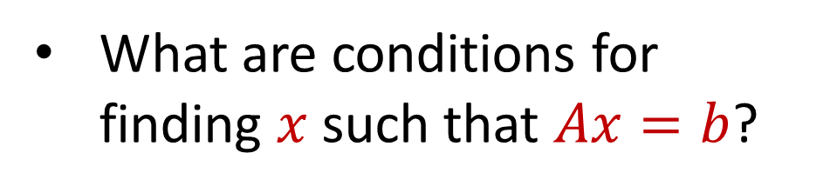
Linear Algebra Review
What are conditions for finding $x$ such that $Ax=b$?
$$d$$
$$x$$
$$=$$
$$n$$
$$A$$
$$n$$
$$b$$
$$1$$
$$d$$
$$1$$

Slide 12
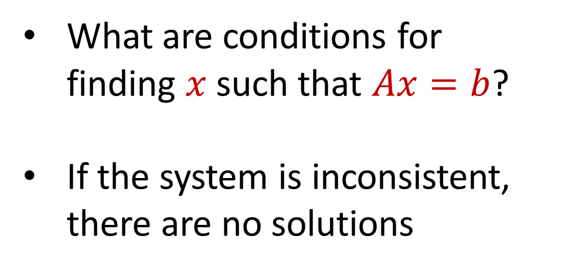
Linear Algebra Review
What are conditions for finding $x$ such that $Ax=b$?
If the system is inconsistent, there are no solutions
$$d$$
$$x$$
$$=$$
$$n$$
$$A$$
$$n$$
$$b$$
$$1$$
$$d$$
$$1$$

Slide 13
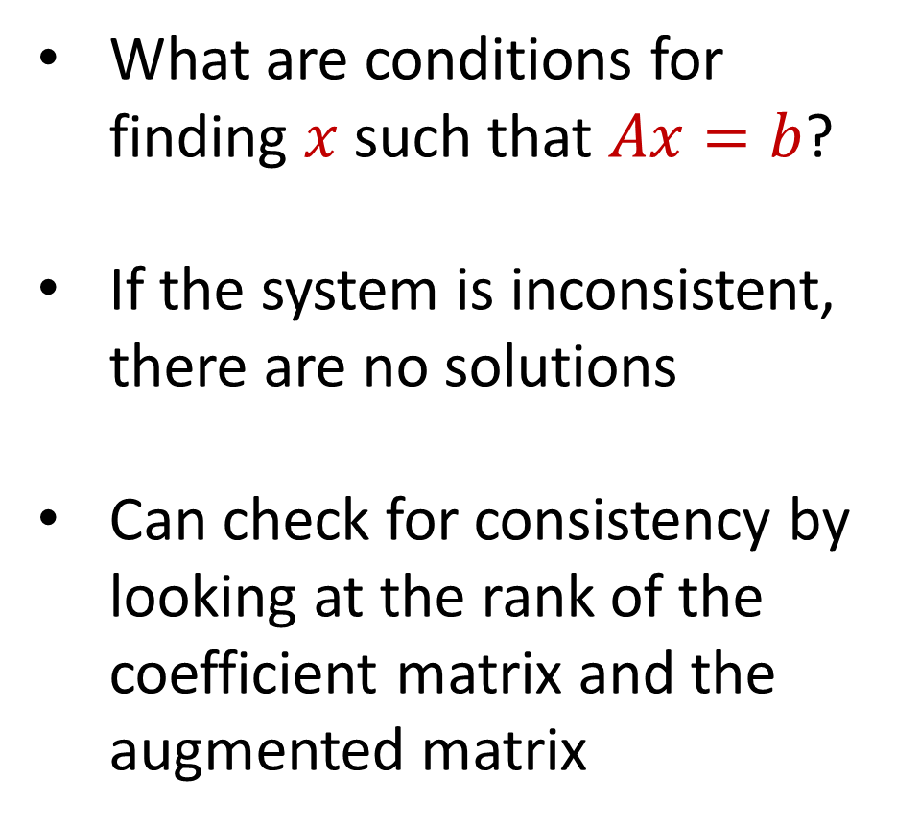
Linear Algebra Review
What are conditions for finding $x$ such that $Ax=b$?
If the system is inconsistent, there are no solutions
Can check for consistency by looking at the rank of the coefficient matrix and the augmented matrix
$$d$$
$$x$$
$$=$$
$$n$$
$$A$$
$$n$$
$$b$$
$$1$$
$$d$$
$$1$$

Slide 14
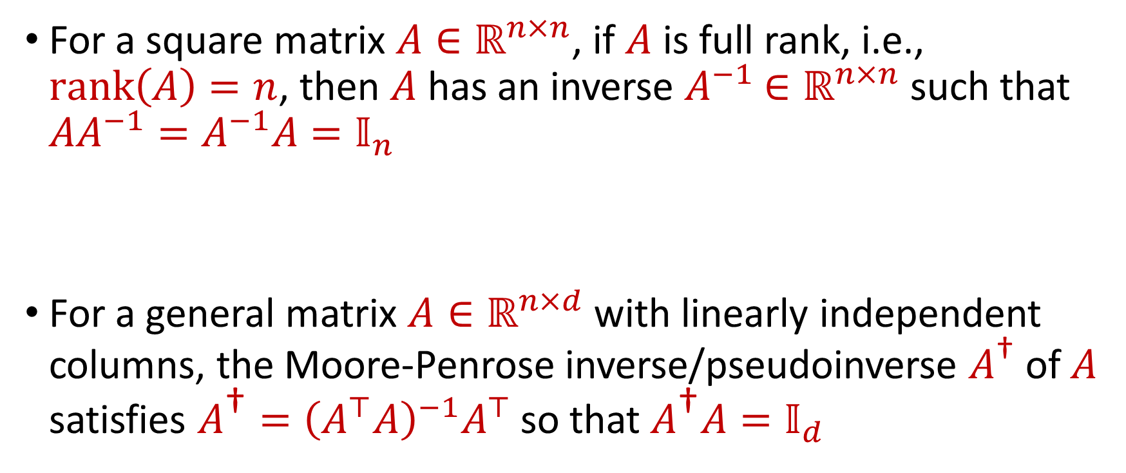
Linear Algebra Review
For a square matrix $A∈ℝ^{n×n}$, if $A$ is full rank, i.e., $rank\left(A\right)=n$, then $A$ has an inverse $A^{−1}$ $∈ℝ^{n×n}$ such that $AA^{−1}=A^{−1}A=𝕀_{n}$
For a general matrix $A∈ℝ^{n×d}$ with linearly independent columns, the Moore-Penrose inverse/pseudoinverse $A^{\text{†}}$ of $A$ satisfies $A^{\text{†}}={\left(A^{⊤}A\right)}^{−1}A^{⊤}$ so that $A^{\text{†}}A=𝕀_{d}$

Slide 15
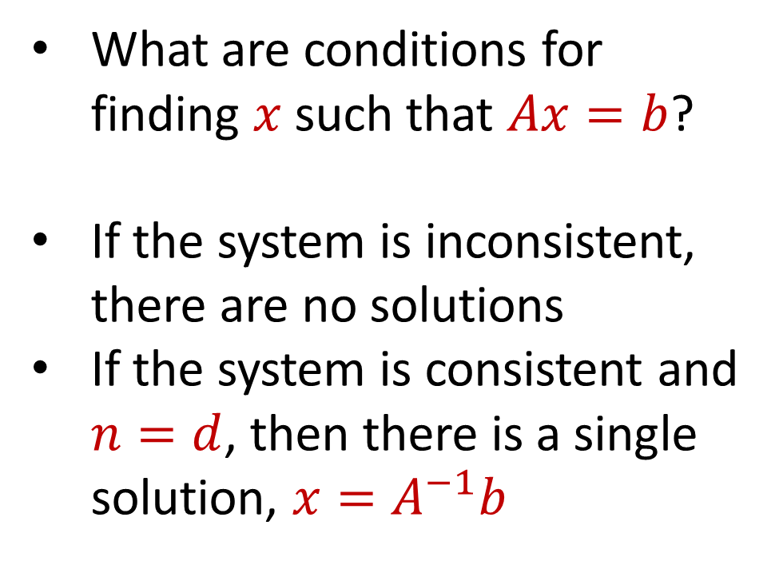
Linear Algebra Review
What are conditions for finding $x$ such that $Ax=b$?
If the system is inconsistent, there are no solutions
If the system is consistent and $n=d$, then there is a single solution, $x=A^{−1}b$
$$d$$
$$x$$
$$=$$
$$n$$
$$A$$
$$n$$
$$b$$
$$1$$
$$d$$
$$1$$

Slide 16
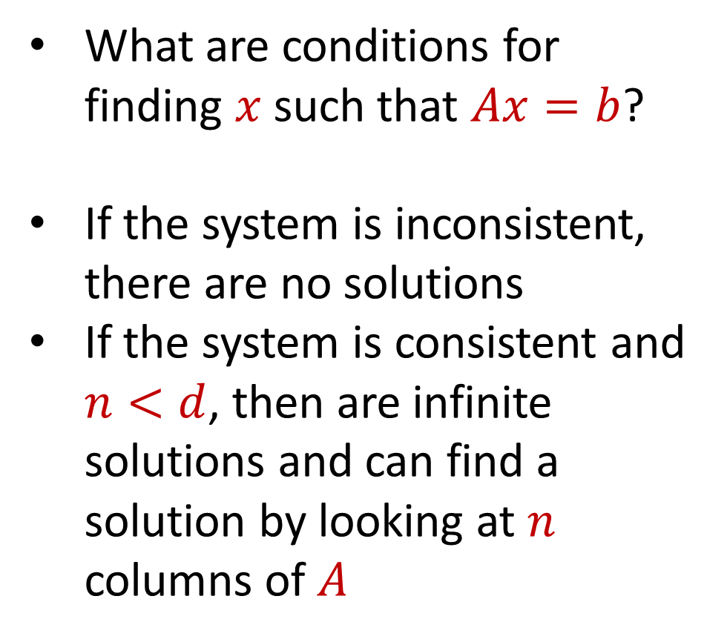
Linear Algebra Review
What are conditions for finding $x$ such that $Ax=b$?
If the system is inconsistent, there are no solutions
If the system is consistent and $n<d$, then are infinite solutions and can find a solution by looking at $n$ columns of $A$
$$d$$
$$x$$
$$=$$
$$n$$
$$A$$
$$n$$
$$b$$
$$1$$
$$d$$
$$1$$

Slide 17
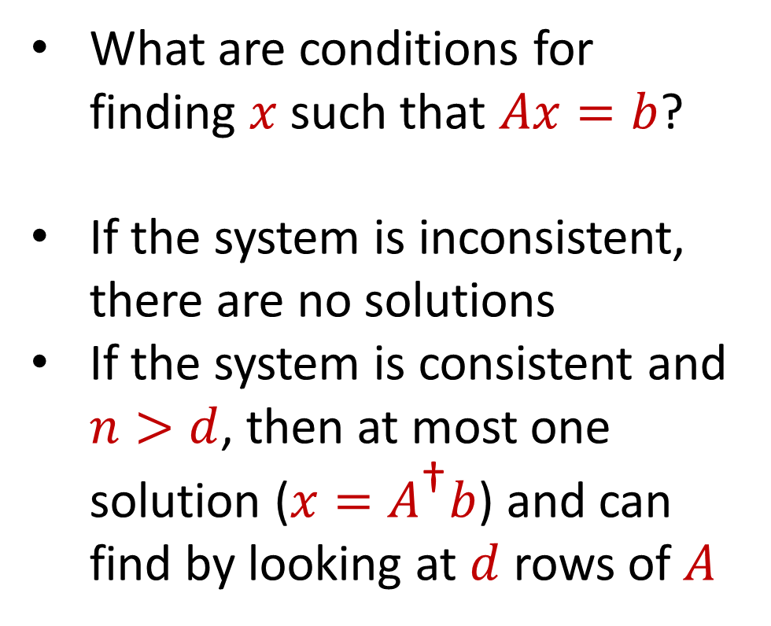
Linear Algebra Review
What are conditions for finding $x$ such that $Ax=b$?
If the system is inconsistent, there are no solutions
If the system is consistent and $n>d$, then at most one solution ($x=A^{\text{†}}b$) and can find by looking at $d$ rows of $A$
$$d$$
$$x$$
$$=$$
$$n$$
$$A$$
$$n$$
$$b$$
$$1$$
$$d$$
$$1$$

Slide 18
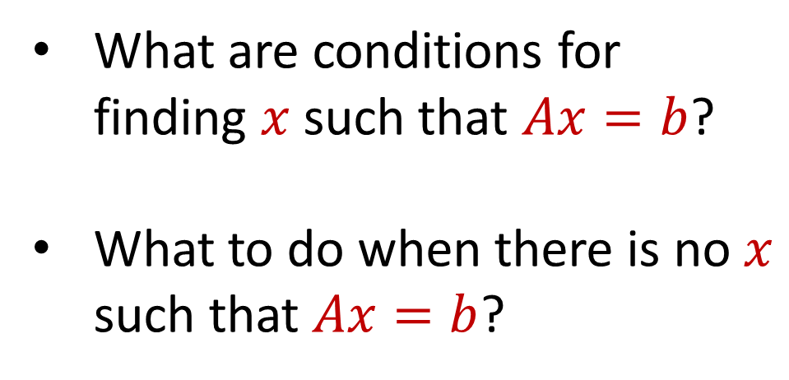
Regression
What are conditions for finding $x$ such that $Ax=b$?
What to do when there is no $x$ such that $Ax=b$?
$$d$$
$$x$$
$$=$$
$$n$$
$$A$$
$$n$$
$$b$$
$$1$$
$$d$$
$$1$$

Slide 19
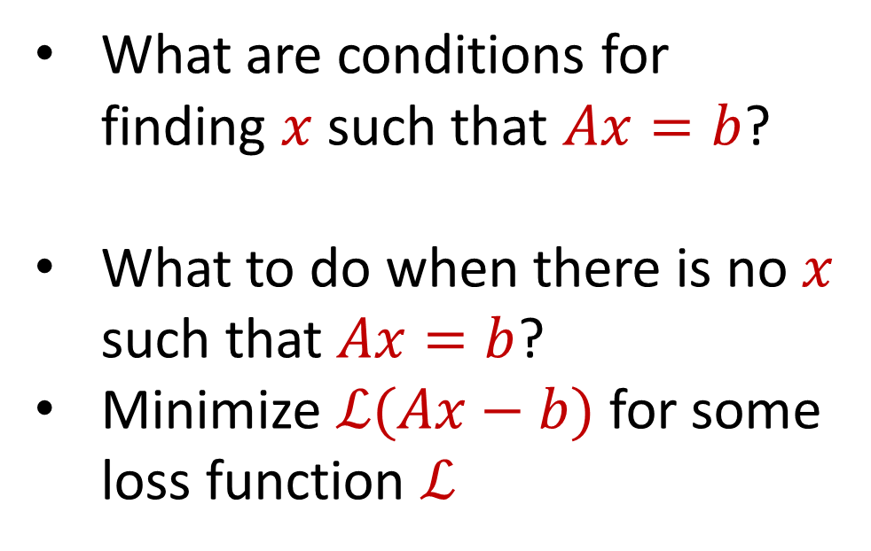
Regression
What are conditions for finding $x$ such that $Ax=b$?
What to do when there is no $x$ such that $Ax=b$?
Minimize $ℒ(Ax−b)$ for some loss function $ℒ$
$$d$$
$$x$$
$$=$$
$$n$$
$$A$$
$$n$$
$$b$$
$$1$$
$$d$$
$$1$$

Slide 20
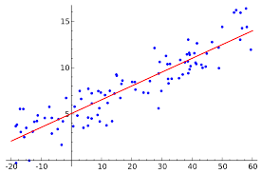
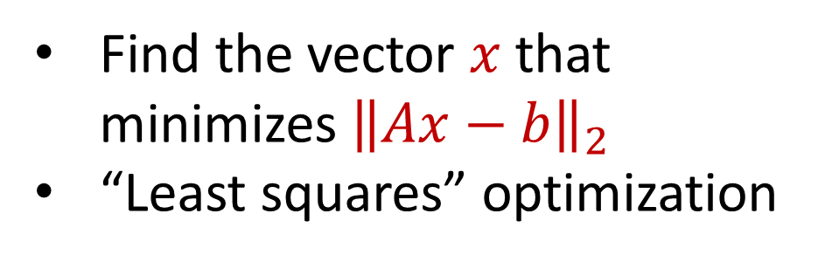
Linear Regression
Find the vector $x$ that minimizes ${\left\|Ax−b\right\|}_{2}$
“Least squares” optimization
$$d$$
$$x$$
$$≈$$
$$n$$
$$A$$
$$n$$
$$b$$
$$1$$
$$d$$
$$1$$

Slide 21
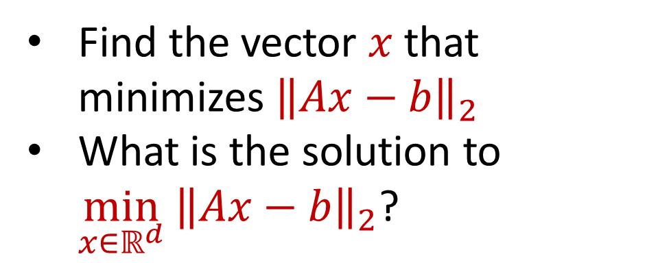
Linear Regression
Find the vector $x$ that minimizes ${\left\|Ax−b\right\|}_{2}$
What is the solution to $\min_{x∈ℝ^{d}} {\left\|Ax−b\right\|}_{2}$?
$$d$$
$$x$$
$$≈$$
$$n$$
$$A$$
$$n$$
$$b$$
$$1$$
$$d$$
$$1$$

Slide 22
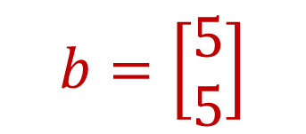
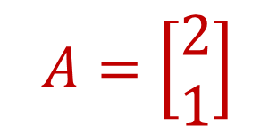
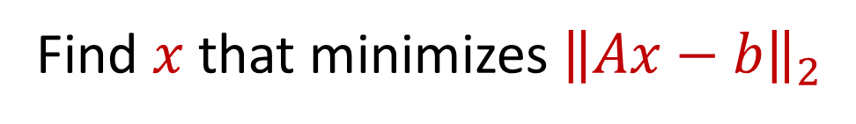
Linear Regression
$$b=\left[\begin{aligned}5 \\ 5\end{aligned}\right]$$
$$A=\left[\begin{aligned}2 \\ 1\end{aligned}\right]$$
Find $x$ that minimizes ${\left\|Ax−b\right\|}_{2}$

Slide 23
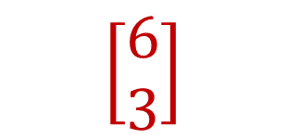
Linear Regression
$$b=\left[\begin{aligned}5 \\ 5\end{aligned}\right]$$
$$\left[\begin{aligned}6 \\ 3\end{aligned}\right]$$
$$A=\left[\begin{aligned}2 \\ 1\end{aligned}\right]$$
Find $x$ that minimizes ${\left\|Ax−b\right\|}_{2}$

Slide 24
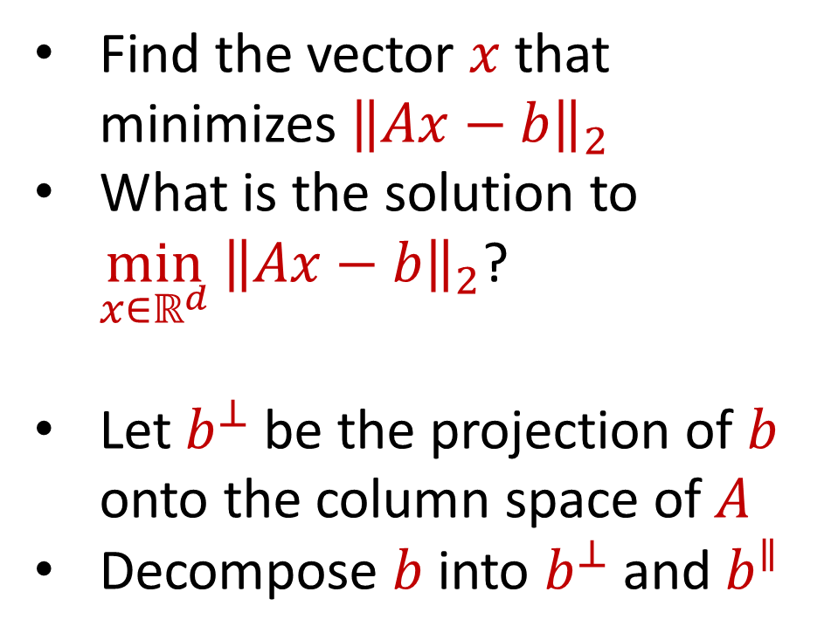
Linear Regression
Find the vector $x$ that minimizes ${\left\|Ax−b\right\|}_{2}$
What is the solution to $\min_{x∈ℝ^{d}} {\left\|Ax−b\right\|}_{2}$?
Let $b^{⊥}$ be the projection of $b$ onto the column space of $A$
Decompose $b$ into $b^{⊥}$ and $b^{∥}$
$$d$$
$$x$$
$$≈$$
$$n$$
$$A$$
$$n$$
$$b$$
$$1$$
$$d$$
$$1$$

Slide 25

Linear Regression
We have $\arg{\min_{x∈ℝ^{d}} {\left\|Ax−b\right\|}_{2} }=\arg{\min_{x∈ℝ^{d}} {\left\|Ax−b\right\|}_{2}^{2} }$
${\left\|Ax−b\right\|}_{2}^{2}={\left\|Ax−b^{⊥}−b^{∥}\right\|}_{2}^{2}$

Slide 26
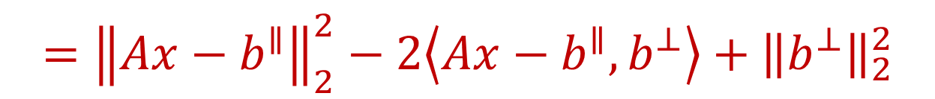
Linear Regression
We have $\arg{\min_{x∈ℝ^{d}} {\left\|Ax−b\right\|}_{2} }=\arg{\min_{x∈ℝ^{d}} {\left\|Ax−b\right\|}_{2}^{2} }$
${\left\|Ax−b\right\|}_{2}^{2}={\left\|Ax−b^{⊥}−b^{∥}\right\|}_{2}^{2}$
$$={\left\|Ax−b^{∥}\right\|}_{2}^{2}−2\left\langle Ax−b^{∥},b^{⊥}\right\rangle +{\left\|b^{⊥}\right\|}_{2}^{2}$$

Slide 27
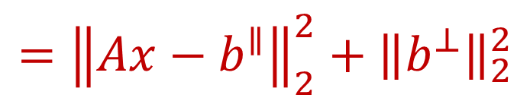
Linear Regression
We have $\arg{\min_{x∈ℝ^{d}} {\left\|Ax−b\right\|}_{2} }=\arg{\min_{x∈ℝ^{d}} {\left\|Ax−b\right\|}_{2}^{2} }$
${\left\|Ax−b\right\|}_{2}^{2}={\left\|Ax−b^{⊥}−b^{∥}\right\|}_{2}^{2}$
$$={\left\|Ax−b^{∥}\right\|}_{2}^{2}−2\left\langle Ax−b^{∥},b^{⊥}\right\rangle +{\left\|b^{⊥}\right\|}_{2}^{2}$$
$$={\left\|Ax−b^{∥}\right\|}_{2}^{2}+{\left\|b^{⊥}\right\|}_{2}^{2}$$

Slide 28
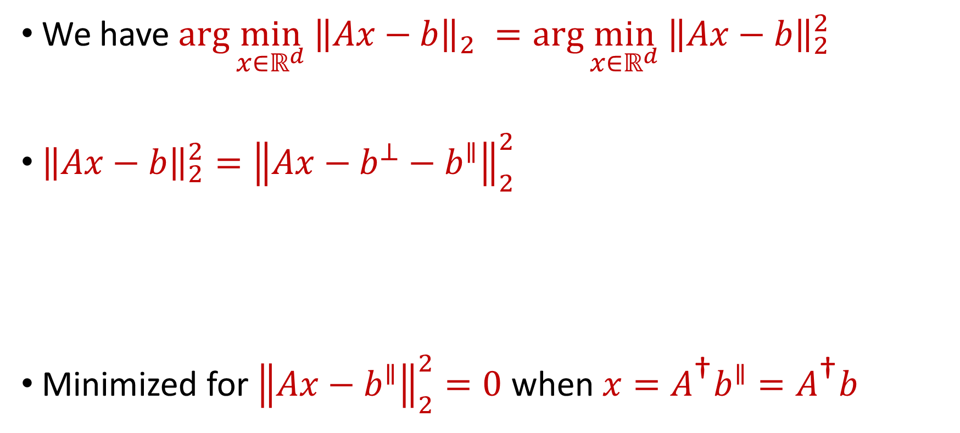
Linear Regression
We have $\arg{\min_{x∈ℝ^{d}} {\left\|Ax−b\right\|}_{2} }=\arg{\min_{x∈ℝ^{d}} {\left\|Ax−b\right\|}_{2}^{2} }$
${\left\|Ax−b\right\|}_{2}^{2}={\left\|Ax−b^{⊥}−b^{∥}\right\|}_{2}^{2}$
Minimized for ${\left\|Ax−b^{∥}\right\|}_{2}^{2}=0$ when $x=A^{\text{†}}b^{∥}=A^{\text{†}}b$
$$={\left\|Ax−b^{∥}\right\|}_{2}^{2}−2\left\langle Ax−b^{∥},b^{⊥}\right\rangle +{\left\|b^{⊥}\right\|}_{2}^{2}$$
$$={\left\|Ax−b^{∥}\right\|}_{2}^{2}+{\left\|b^{⊥}\right\|}_{2}^{2}$$

Slide 29
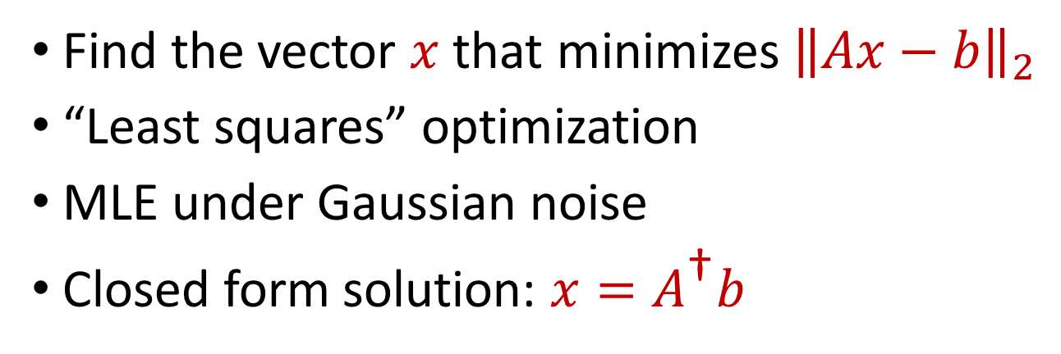
Linear Regression
Find the vector $x$ that minimizes ${\left\|Ax−b\right\|}_{2}$
“Least squares” optimization
MLE under Gaussian noise
Closed form solution: $x=A^{\text{†}}b$
$$d$$
$$x$$
$$≈$$
$$n$$
$$A$$
$$n$$
$$b$$
$$1$$
$$d$$
$$1$$

Slide 30

Linear Algebra Review
For $y=Ax$, we have $y_{i}=⟨a_{i}, x⟩$
${\left\|Ax\right\|}_{2}^{2}={\left\langle a_{1}, x\right\rangle }^{2}+…+{\left\langle a_{n}, x\right\rangle }^{2}$
$$A$$
$$x$$
$$d$$
$$n$$
$$d$$

Slide 31
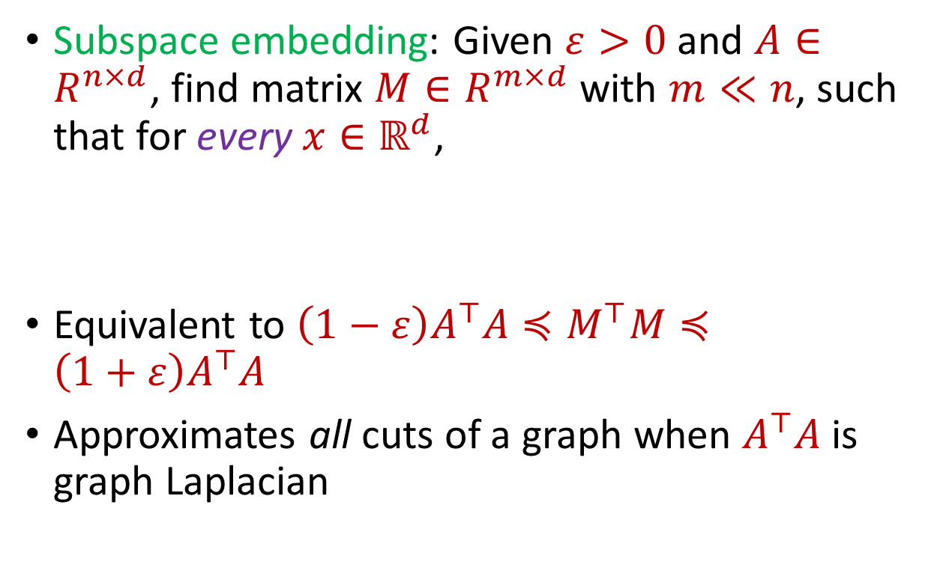

Subspace Embedding
Subspace embedding: Given $ε>0$ and $A∈R^{n×d}$, find matrix $M∈R^{m×d}$ with $m≪n$, such that for every $x∈ℝ^{d}$,
Equivalent to $\left(1−ε\right)A^{⊤}A≼M^{⊤}M≼\left(1+ε\right)A^{⊤}A$
Approximates all cuts of a graph when $A^{⊤}A$ is graph Laplacian
$$A$$
$$x$$
$$n$$
$$\left(1−ε\right){\left\|Ax\right\|}_{2}≤{\left\|Mx\right\|}_{2}≤\left(1+ε\right){\left\|Ax\right\|}_{2}$$
$$d$$

Slide 32
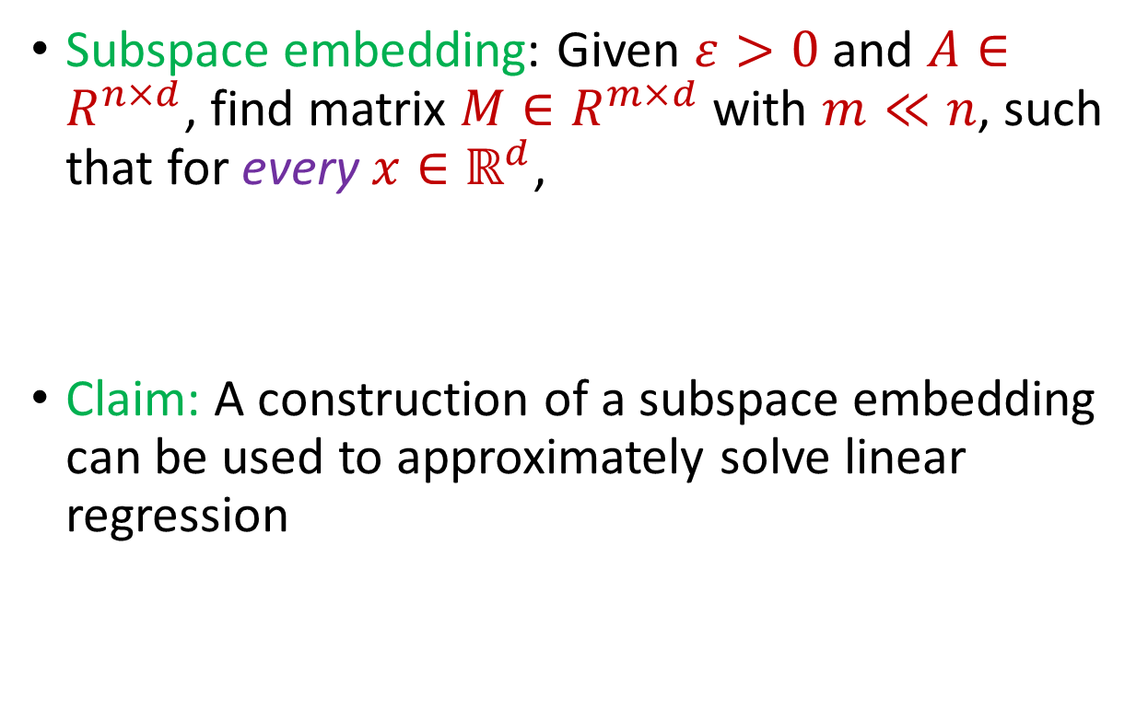
Subspace Embedding
Subspace embedding: Given $ε>0$ and $A∈R^{n×d}$, find matrix $M∈R^{m×d}$ with $m≪n$, such that for every $x∈ℝ^{d}$,
Claim: A construction of a subspace embedding can be used to approximately solve linear regression
$$A$$
$$x$$
$$n$$
$$\left(1−ε\right){\left\|Ax\right\|}_{2}≤{\left\|Mx\right\|}_{2}≤\left(1+ε\right){\left\|Ax\right\|}_{2}$$
$$d$$

Slide 33
















Regression and Subspace Embeddings
Recall: Goal is to find $x$ that minimizes ${\left\|Ax−b\right\|}_{2}$
$$−$$
$$A$$
$$x$$
$$b$$
$$A$$
$$b$$
$$x$$
$$n$$
$$n$$
$$n$$
$$−1$$
$$d$$
$$1$$
$$d$$
$$1$$

Slide 34




Regression and Subspace Embeddings
Recall: Goal is to find $x$ that minimizes ${\left\|Ax−b\right\|}_{2}$
$$B$$
$$y$$
$$A$$
$$b$$
$$x$$
$$n$$
$$n$$
$$−1$$
$$d+1$$
$$d$$
$$1$$

Slide 35

Regression and Subspace Embeddings
Recall: Goal is to find $x$ that minimizes ${\left\|Ax−b\right\|}_{2}$
$$B$$
$$y$$
$$A$$
$$b$$
$$x$$
$$n$$
$$n$$
$$−1$$
$${\left\|By\right\|}_{2}≈{\left\|Ax−b\right\|}_{2}$$
$$d+1$$
$$d$$
$$1$$

Slide 36

Previously: Coreset Construction and Sampling
Importance sampling only needs $X′$ to have size $O\left(\frac{1}{ε^{2}}\right)$ to achieve $\left(1+ε\right)$-approximation to $Cost(X,C)$
To handle all possible sets of $k$ centers:
Need to sample each point $x$ with probability $\max_{C}\frac{Cost\left(x,C\right)}{Cost\left(X,C\right)}$ instead of $\frac{Cost\left(x,C\right)}{Cost\left(X,C\right)}$
Need to union bound over a net of all possible sets of $k$ centers
Net with size ${\left(\frac{nΔ}{ε}\right)}^{O(kd)}$

Slide 37
Previously: Sensitivity Sampling
The quantity $s\left(x\right)=\max_{C}\frac{Cost\left(x,C\right)}{Cost\left(X,C\right)}$ is called the sensitivity of $x$ and intuitively measures how “important” the point $x$ is
The total sensitivity of $X$ is $\sum_{x∈X}{s(x)}$ and quantifies how many points will be sampled into $X′$ through importance/sensitivity sampling (before the union bound)

Slide 38
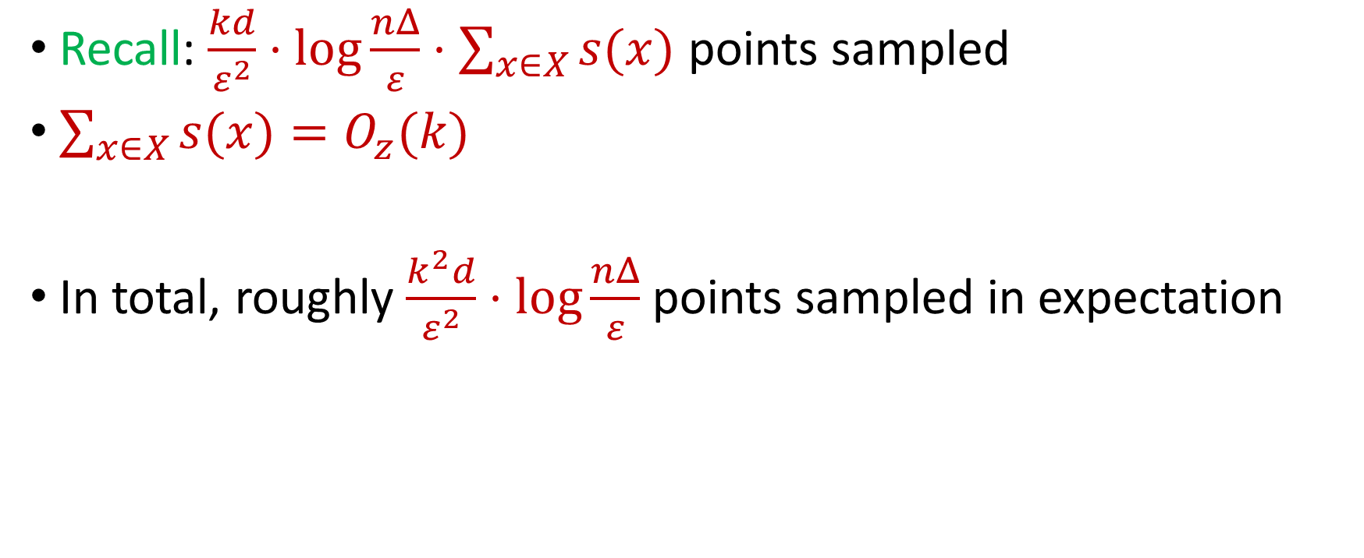
Previously: Sensitivity Sampling
Recall: $\frac{kd}{ε^{2}}⋅\log{\frac{nΔ}{ε}}⋅\sum_{x∈X}{s(x)}$ points sampled
$\sum_{x∈X}{s(x)}=O_{z}(k)$
In total, roughly $\frac{k^{2}d}{ε^{2}}⋅\log{\frac{nΔ}{ε}}$ points sampled in expectation

Slide 39

Subspace Embedding
Subspace embedding: Given $ε>0$ and $A∈R^{n×d}$, find matrix $M∈R^{m×d}$ with $m≪n$, such that for every $x∈ℝ^{d}$,
$$A$$
$$x$$
$$n$$
$$\left(1−ε\right){\left\|Ax\right\|}_{2}≤{\left\|Mx\right\|}_{2}≤\left(1+ε\right){\left\|Ax\right\|}_{2}$$
$$d$$

Slide 40
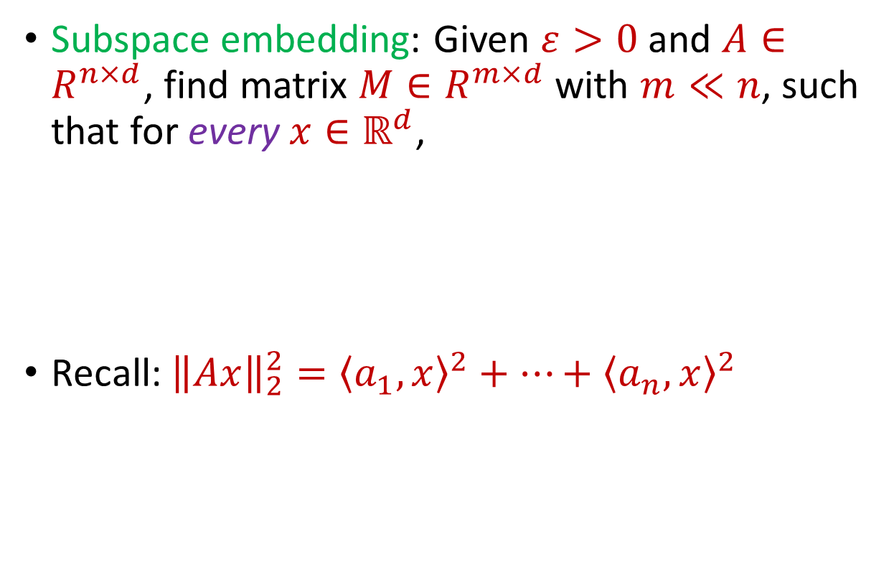
Subspace Embedding
Subspace embedding: Given $ε>0$ and $A∈R^{n×d}$, find matrix $M∈R^{m×d}$ with $m≪n$, such that for every $x∈ℝ^{d}$,
Recall: ${\left\|Ax\right\|}_{2}^{2}={\left\langle a_{1}, x\right\rangle }^{2}+…+{\left\langle a_{n}, x\right\rangle }^{2}$
$$A$$
$$x$$
$$n$$
$$\left(1−ε\right){\left\|Ax\right\|}_{2}^{2}≤{\left\|Mx\right\|}_{2}^{2}≤\left(1+ε\right){\left\|Ax\right\|}_{2}^{2}$$
$$d$$

Slide 41
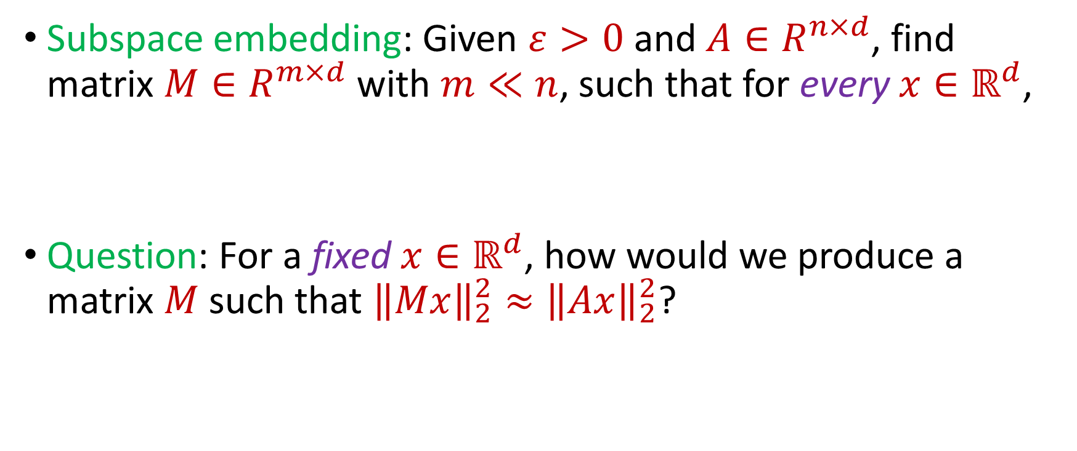
Subspace Embedding
Subspace embedding: Given $ε>0$ and $A∈R^{n×d}$, find matrix $M∈R^{m×d}$ with $m≪n$, such that for every $x∈ℝ^{d}$,
Question: For a fixed $x∈ℝ^{d}$, how would we produce a matrix $M$ such that ${\left\|Mx\right\|}_{2}^{2}≈{\left\|Ax\right\|}_{2}^{2}$?
$$\left(1−ε\right){\left\|Ax\right\|}_{2}^{2}≤{\left\|Mx\right\|}_{2}^{2}≤\left(1+ε\right){\left\|Ax\right\|}_{2}^{2}$$

Slide 42
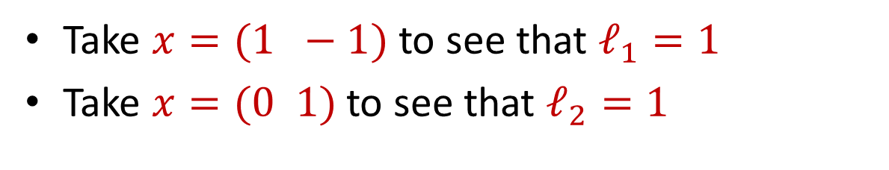
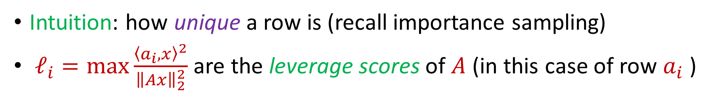
Leverage Scores
Intuition: how unique a row is (recall importance sampling)
$ℓ_{i}=\max{\frac{{\left\langle a_{i},x\right\rangle }^{2}}{{\left\|Ax\right\|}_{2}^{2}}}$ are the leverage scores of $A$ (in this case of row $a_{i}$ )
Take $x=(1 −1)$ to see that $ℓ_{1}=1$
Take $x=(0 1)$ to see that $ℓ_{2}=1$
1 0
1 1
$ℓ_{i}=a_{i}{\left(A^{⊤}A\right)}^{−1}a_{i}^{⊤}$, ${∑ℓ}_{i}=d$
$$A$$
$$a_{i}$$

Slide 43


census.gov:

Slide 44


Private Data Analysis
Sensitive dataset
Analyst
Analysis of medical datasets to predict possible issues
Pattern detection for social networks or epidemic spread
US Census information for apportionment

Slide 45

Anonymization
Sensitive dataset
Anonymized dataset
Analyst

Slide 46
Anonymizing Data
Age | Zip Code | Employer | Has Pet
56 | 77005 | Apple | Yes
32 | 77005 | Microsoft | No
71 | 77005 | Amazon | Yes
44 | 77005 | Petsmart | Yes
25 | 77005 | Netflix | No
61 | 77005 | Google | No

Slide 47
Anonymizing Data
Age | Zip Code | Employer | Has Pet
56 | 77005 | Apple | Yes
32 | 77005 | Microsoft | No
71 | 77005 | Amazon | Yes
44 | 77005 | Petsmart | Yes
25 | 77005 | Netflix | No
61 | 77005 | Google | No
Name | Age | Gender | Employer
Alice | 56 | Female | Apple
Bob | 32 | Male | Microsoft
Carol | 71 | Female | Amazon
Dale | 44 | Male | Petsmart
Erin | 25 | Female | Netflix
Fred | 61 | Male | Google

Slide 48
Reconstruction Attack
Name | Age | Zip Code | Gender | Employer | Has Pet
Alice | 56 | 77005 | Female | Apple | Yes
Bob | 32 | 77005 | Male | Microsoft | No
Carol | 71 | 77005 | Female | Amazon | Yes
Dale | 44 | 77005 | Male | Petsmart | Yes
Erin | 25 | 77005 | Female | Netflix | No
Fred | 61 | 77005 | Male | Google | No

Slide 49

Anonymizing Data

Slide 50
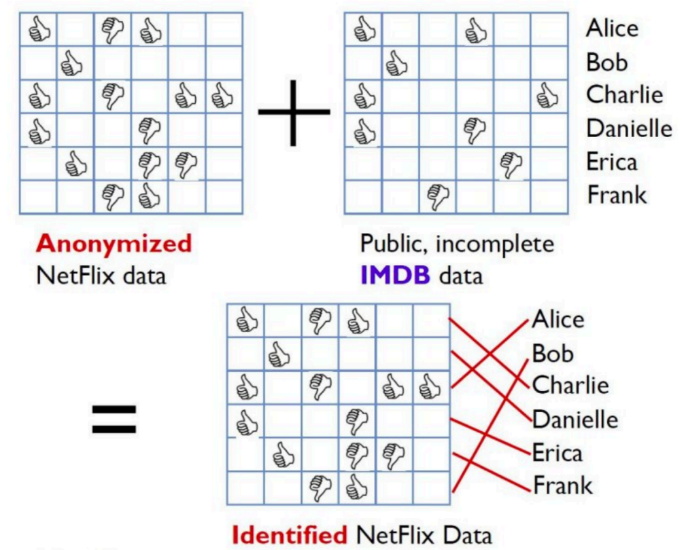
Image from Arvind Narayanan

Slide 51
Differencing Attacks
How many people in this classroom went to Kyle Field last weekend?
How many people in this classroom besides the instructor went to Kyle Field last weekend?

Slide 52
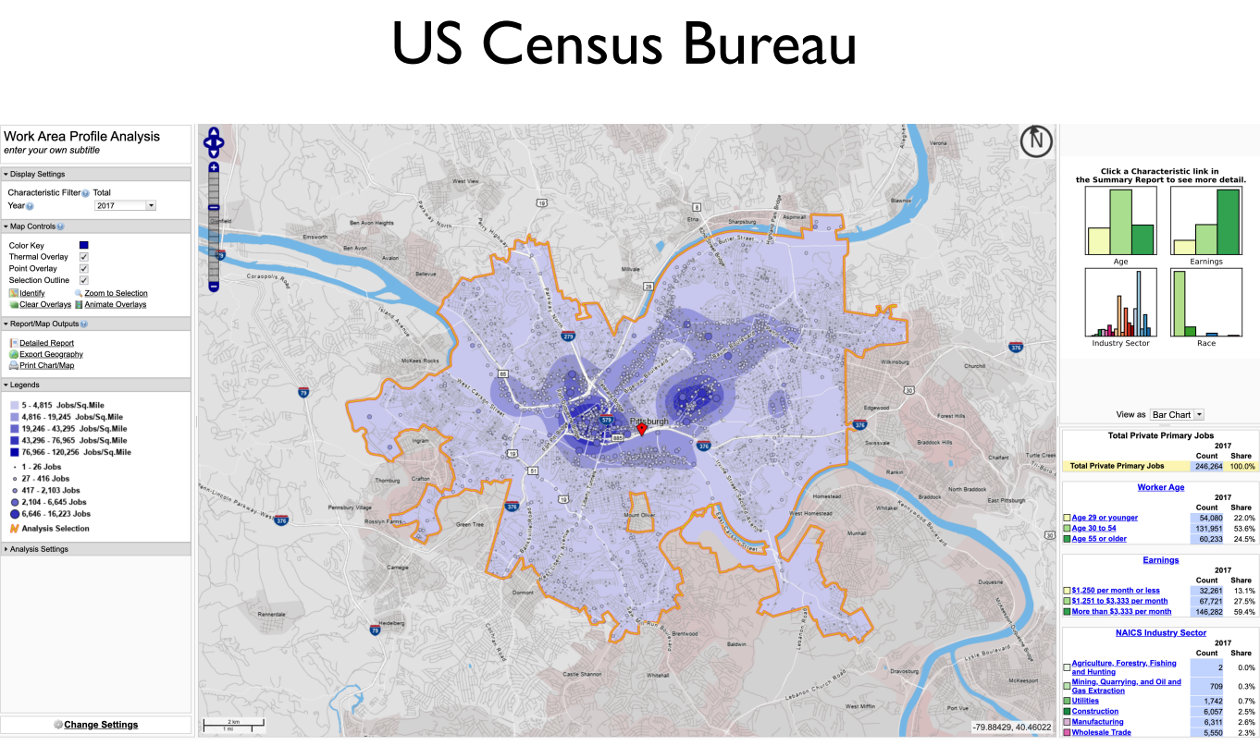
Slide from Steven Wu

Slide 53
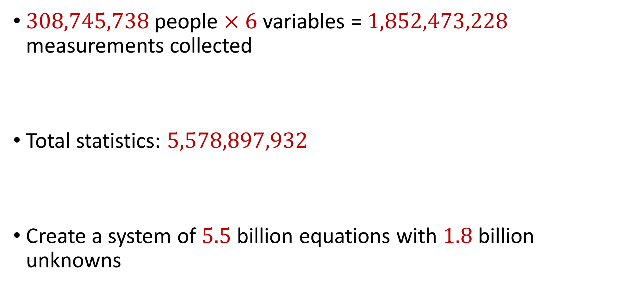
2010 US Census
$308,745,738$ people $×$ $6$ variables = $1,852,473,228$ measurements collected
Total statistics: $5,578,897,932$
Create a system of $5.5$ billion equations with $1.8$ billion unknowns

Slide 54
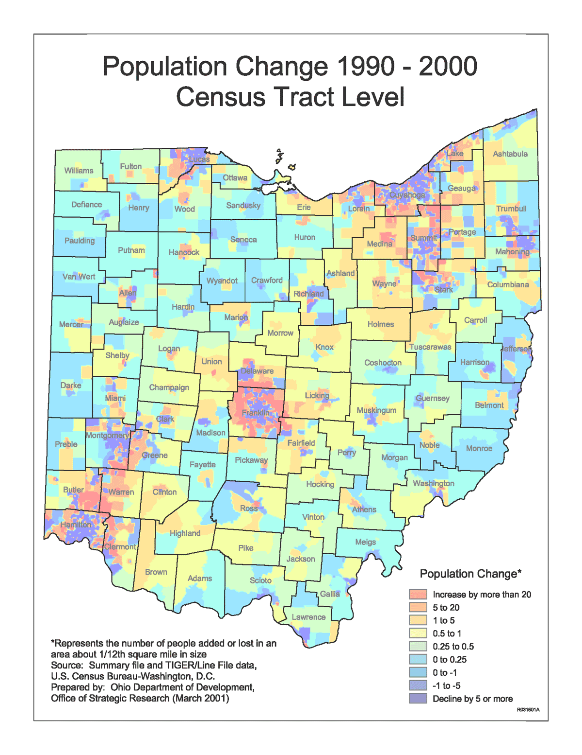
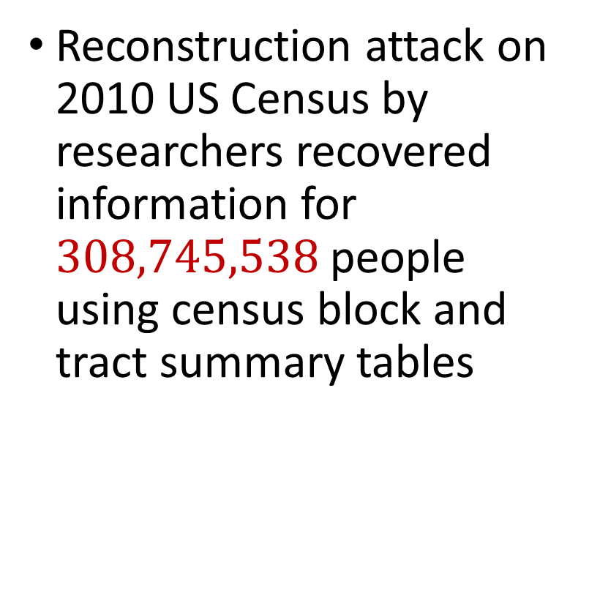
2010 US Census
Reconstruction attack on 2010 US Census by researchers recovered information for $308,745,538$ people using census block and tract summary tables

Slide 55
Summary
“Ad-hoc” privacy procedures like anonymization/deidentification often fails
Publishing too many queries on a sensitive database with too much accuracy can compromise the privacy of the database
Need a formal mathematical notion for measuring privacy

Slide 56

Possible Notion for Privacy #1
“The data analyst cannot learn anything about Alice”
Sensitive dataset
Analyst

Slide 57
Possible Notion for Privacy #1
“The data analyst cannot learn anything about Alice”
Most Aggies like Reveille
Alice is known to be an Aggie
Sensitive dataset
Analyst
Was Alice’s privacy violated?

Slide 58

Possible Notion for Privacy #1
“The data analyst cannot learn anything about Alice”
Most Aggies like Reveille
Bob participates in the survey
Sensitive dataset
Analyst
Even though Alice is not in the survey, it is still known that Alice is an Aggie

Slide 59
Possible Notion for Privacy #1
Suppose a survey is conducted on a sensitive dataset and concludes that “most Aggies like Reveille”
Alice is a known Aggie, and so a data analyst infers that Alice is more likely to be a dog owner and asks for higher apartment cleaning rates
Was Alice’s privacy violated by this study?

Slide 60
Possible Notion for Privacy #2
“A study is private…if the data analyst gains almost no additional information about Alice from the study than if the same study was performed without Alice’s data”

Slide 61

Possible Notion for Privacy #2
Stability: the data analyst reaches roughly similar conclusions if any individual data point is replaced by another data point of the population

Slide 62


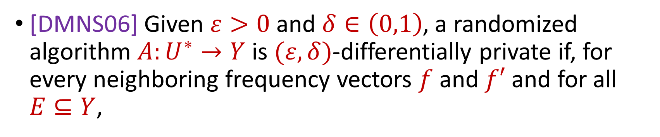

Differential Privacy
[DMNS06] Given $ε>0$and $δ∈\left(0,1\right)$, a randomized algorithm $A:U^{∗}→Y$ is $(ε,δ)$-differentially private if, for every neighboring frequency vectors $f$ and $f′$ and for all $E⊆Y$,
$$Pr\left[A\left(f\right)∈E\right]≤e^{ε}Pr\left[A\left(f^{′}\right)∈E\right]+δ$$
$$A\left( \right)≈A\left( \right)$$
Notes:
[DworkMcSherryNissimSmith06]

Slide 63
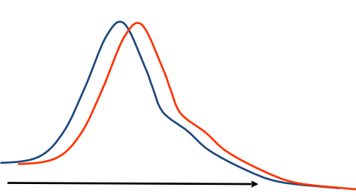
Differential Privacy
[DMNS06] Given $ε>0$and $δ∈\left(0,1\right)$, a randomized algorithm $A:U^{∗}→Y$ is $(ε,δ)$-differentially private if, for every neighboring frequency vectors $f$ and $f′$ and for all $E⊆Y$,
$$Pr\left[A\left(f\right)∈E\right]≤e^{ε}Pr\left[A\left(f^{′}\right)∈E\right]+δ$$
Sensitive dataset
Algorithm
Output distribution
Notes:
[DworkMcSherryNissimSmith06]

