Slide 1
CSCE 689: Special Topics in Modern Algorithms for Data Science
Lecture 21
Samson Zhou

Slide 2
Presentation Schedule
November 27: Chunkai, Jung, Galaxy AI
November 29: STMI, Anmol, Jason
December 1: Bokun, Ayesha, Dawei, Lipai

Slide 3
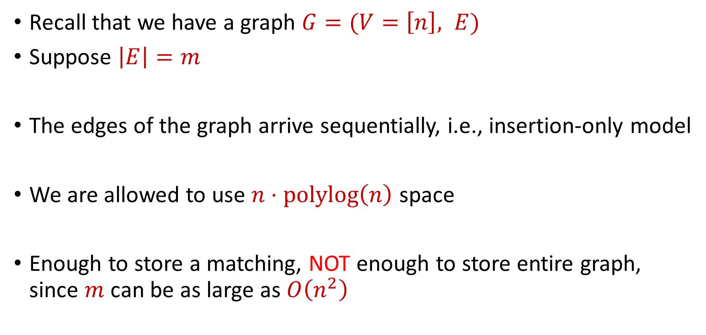
Previously: Semi-streaming Model
Recall that we have a graph $G=(V=\left[n\right], E)$
Suppose $\left|E\right|=m$
The edges of the graph arrive sequentially, i.e., insertion-only model
We are allowed to use $n⋅polylog\left(n\right)$ space
Enough to store a matching, NOT enough to store entire graph, since $m$ can be as large as $O\left(n^{2}\right)$

Slide 4
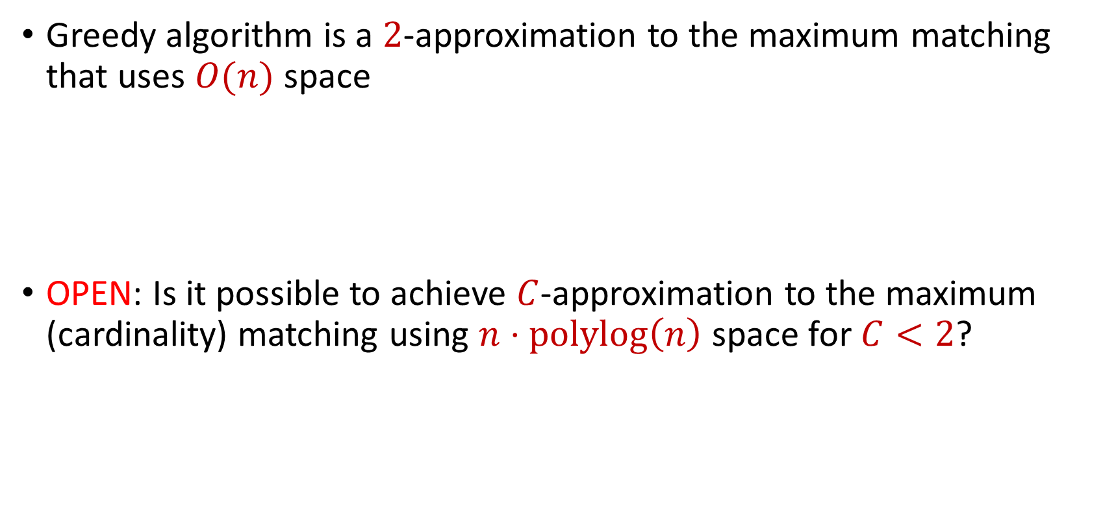
Last Time: Maximum Matching
Greedy algorithm is a $2$-approximation to the maximum matching that uses $O(n)$ space
OPEN: Is it possible to achieve $C$-approximation to the maximum (cardinality) matching using $n⋅polylog\left(n\right)$ space for $C<2$?

Slide 5
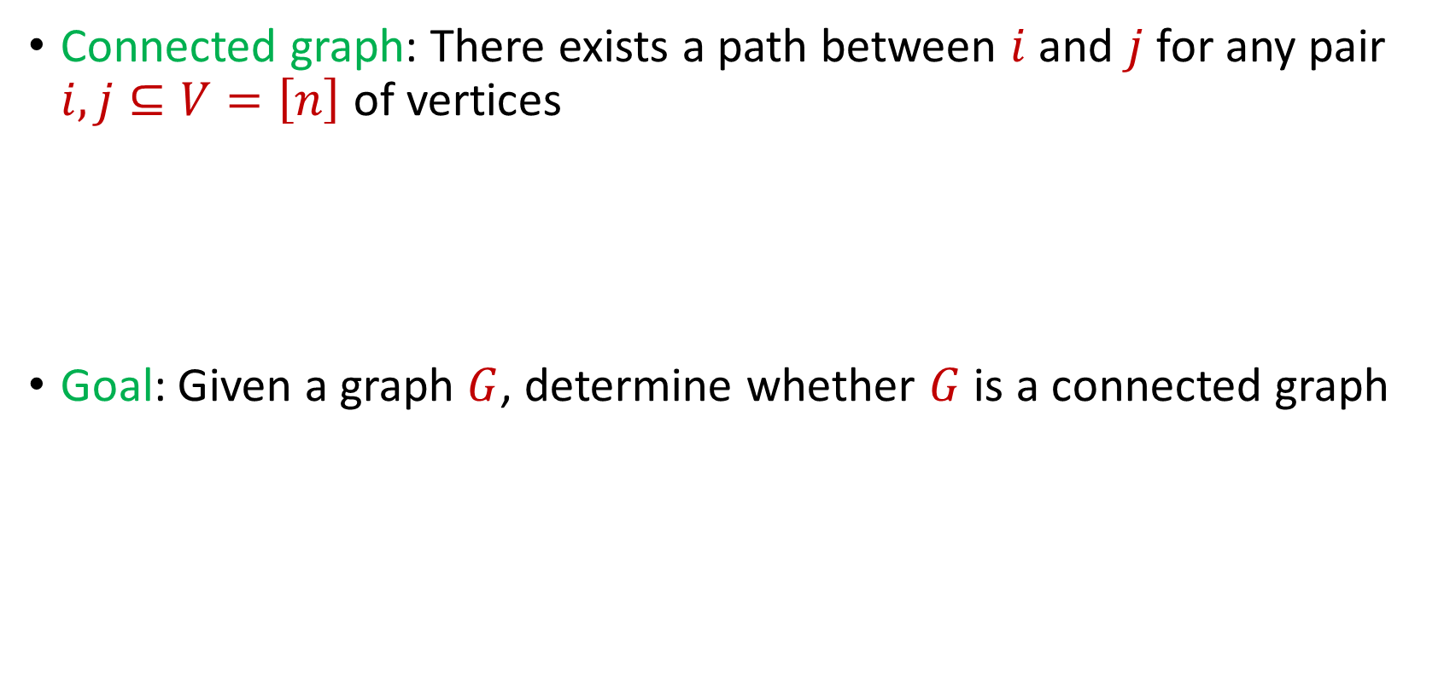
Last Time: Connectivity
Connected graph: There exists a path between $i$ and $j$ for any pair $i,j⊆V=\left[n\right]$ of vertices
Goal: Given a graph $G$, determine whether $G$ is a connected graph

Slide 6
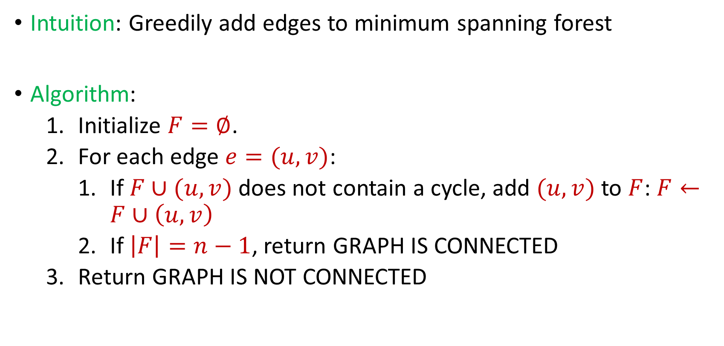
Last Time: Connectivity
Intuition: Greedily add edges to minimum spanning forest
Algorithm:
Initialize $F=∅$.
For each edge $e=(u,v)$:
If $F∪(u,v)$ does not contain a cycle, add $(u,v)$ to $F$: $F←F∪\left(u,v\right)$
If $\left|F\right|=n−1$, return GRAPH IS CONNECTED
Return GRAPH IS NOT CONNECTED

Slide 7

Last Time: Connectivity
Algorithm can keep at most $n$ edges, so the total space usage is $O(n)$ words of space.

Slide 8

Bipartitness
Bipartite graph: Graph can be partitioned into two disjoint sets $L$ and $R$ so that every edge is between a vertex in $L$ and a vertex in $R$
Goal: Given a graph $G$, determine whether $G$ is a bipartite graph

Slide 9






$$1$$
$$2$$
$$5$$
$$6$$
$$4$$
$$3$$

Slide 10






$$2$$
$$1$$
$$6$$
$$4$$
$$5$$
$$3$$

Slide 11
$$1$$
$$2$$
$$5$$
$$6$$
$$4$$
$$3$$

Slide 12
$$1$$
$$2$$
$$5$$
$$6$$
$$4$$
$$3$$

Slide 13
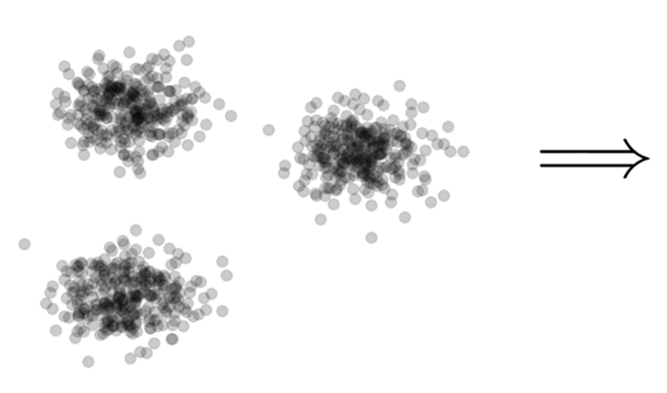

Clustering
Goal: Given input dataset $X$, partition $X$ so that “similar” points are in the same cluster and “different” points are in different clusters

Slide 14
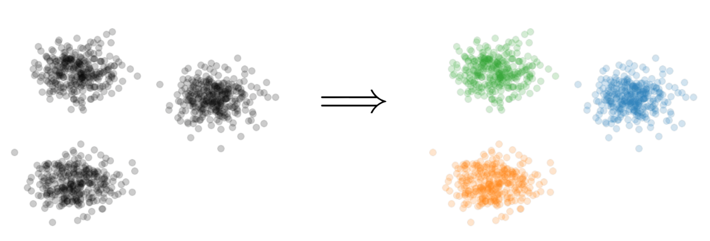
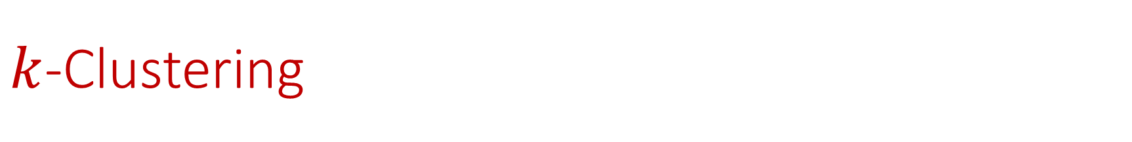

$k$-Clustering
Goal: Given input dataset $X$, partition $X$ so that “similar” points are in the same cluster and “different” points are in different clusters
There can be at most $k$ different clusters
$$k=3$$

Slide 15
$k$-Clustering
Question: How do we measure the “quality” of each clustering?
$$k=3$$

Slide 16
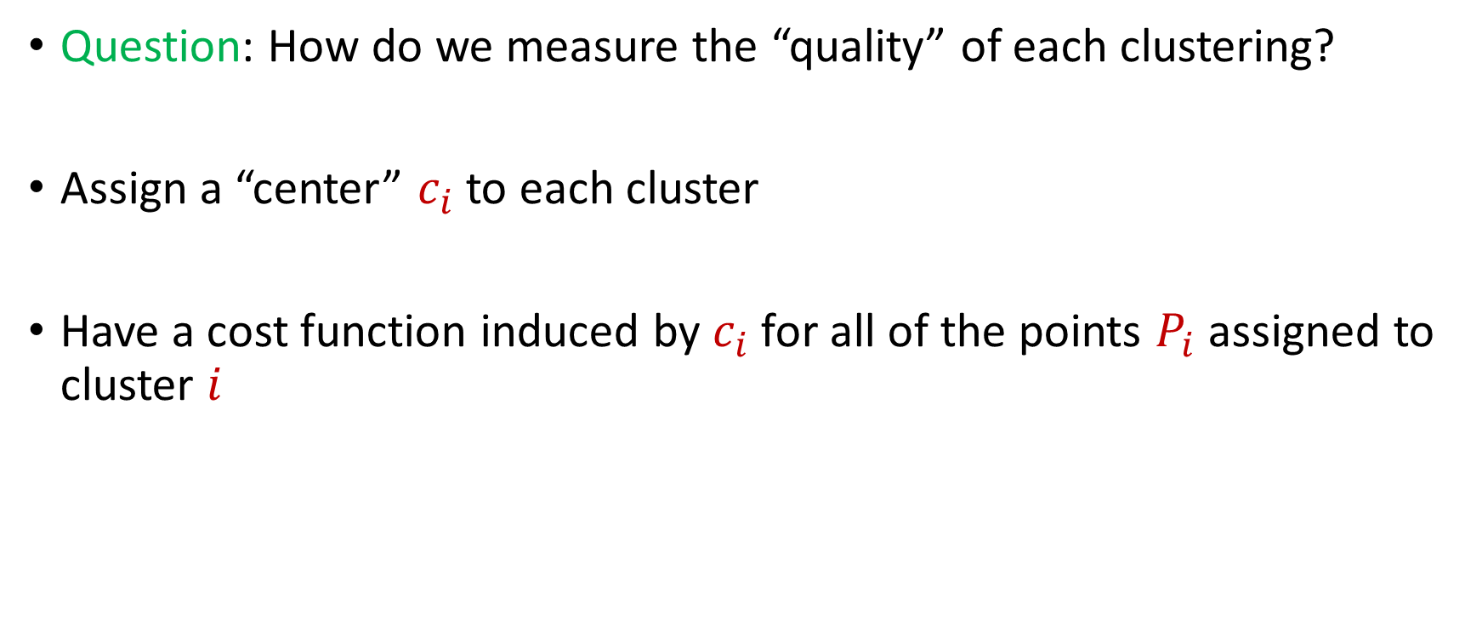
$k$-Clustering
Question: How do we measure the “quality” of each clustering?
Assign a “center” $c_{i}$ to each cluster
Have a cost function induced by $c_{i}$ for all of the points $P_{i}$ assigned to cluster $i$

Slide 17
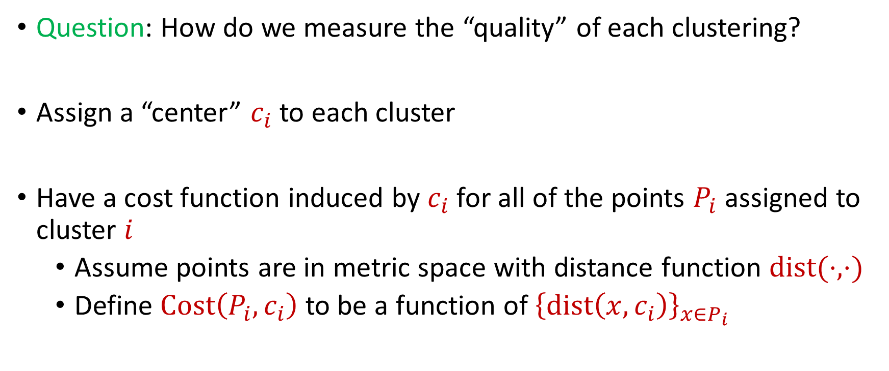
$k$-Clustering
Question: How do we measure the “quality” of each clustering?
Assign a “center” $c_{i}$ to each cluster
Have a cost function induced by $c_{i}$ for all of the points $P_{i}$ assigned to cluster $i$
Assume points are in metric space with distance function $dist(⋅,⋅)$
Define $Cost\left(P_{i},c_{i}\right)$ to be a function of ${\left\{dist\left(x,c_{i}\right)\right\}}_{x∈P_{i}}$

Slide 18
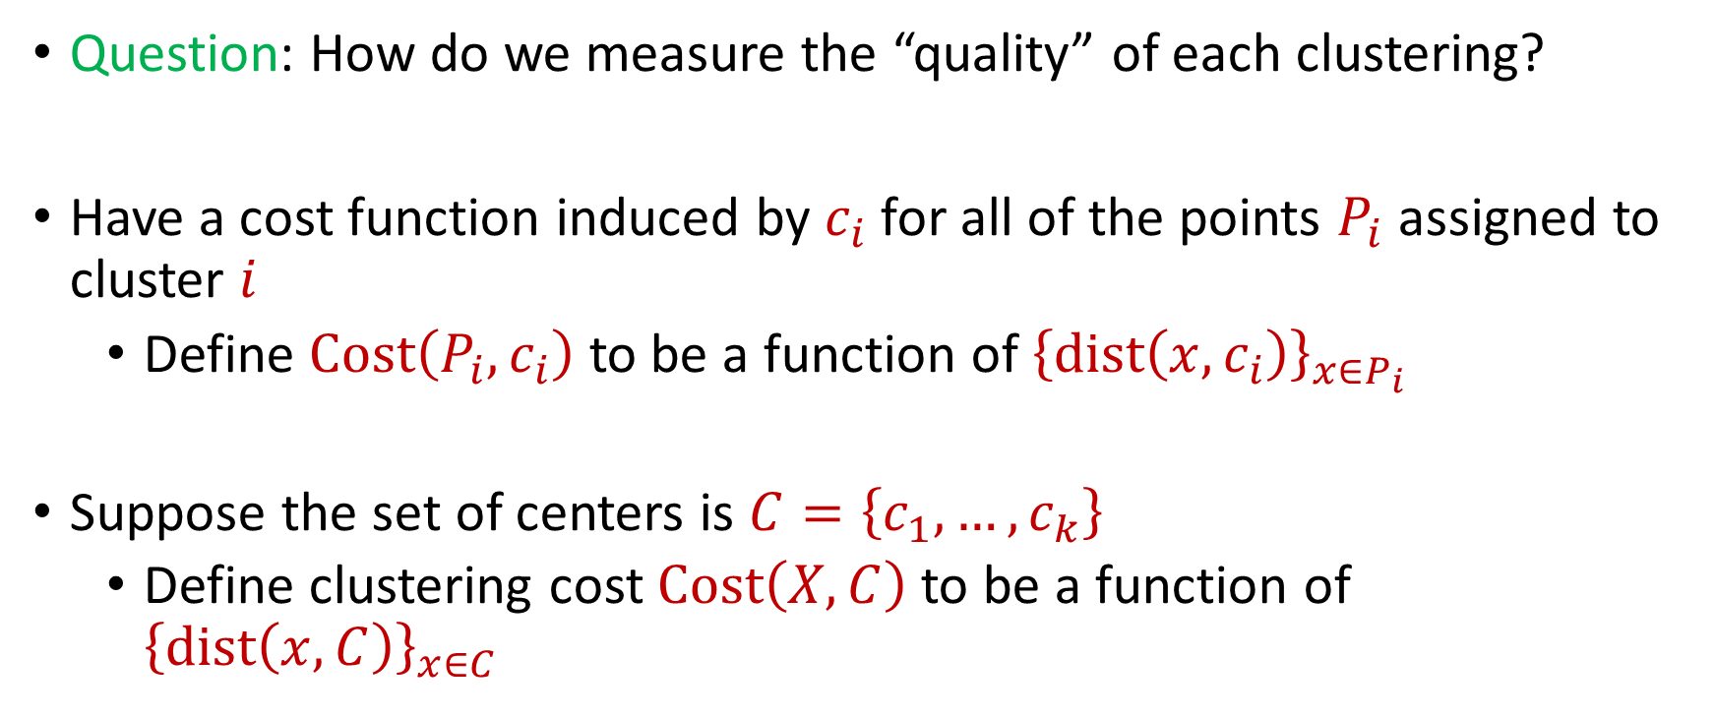
$k$-Clustering
Question: How do we measure the “quality” of each clustering?
Have a cost function induced by $c_{i}$ for all of the points $P_{i}$ assigned to cluster $i$
Define $Cost\left(P_{i},c_{i}\right)$ to be a function of ${\left\{dist\left(x,c_{i}\right)\right\}}_{x∈P_{i}}$
Suppose the set of centers is $C=\left\{c_{1},…, c_{k}\right\}$
Define clustering cost $Cost\left(X,C\right)$ to be a function of ${\left\{dist\left(x,C\right)\right\}}_{x∈C}$

Slide 19

$k$-Clustering
Define clustering cost $Cost\left(X,C\right)$ to be a function of ${\left\{dist\left(x,C\right)\right\}}_{x∈C}$

Slide 20
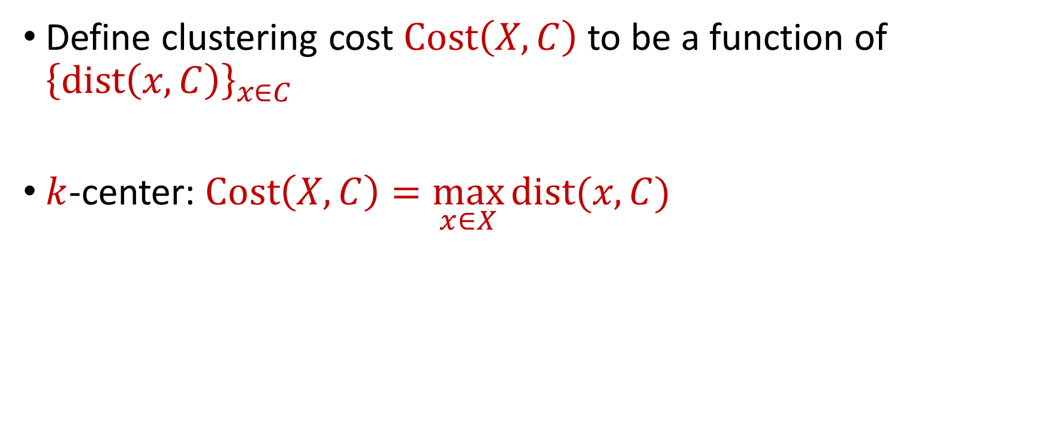
$k$-Clustering
Define clustering cost $Cost\left(X,C\right)$ to be a function of ${\left\{dist\left(x,C\right)\right\}}_{x∈C}$
$k$-center: $Cost\left(X,C\right)=\max_{x∈X}{dist(x,C)}$

Slide 21
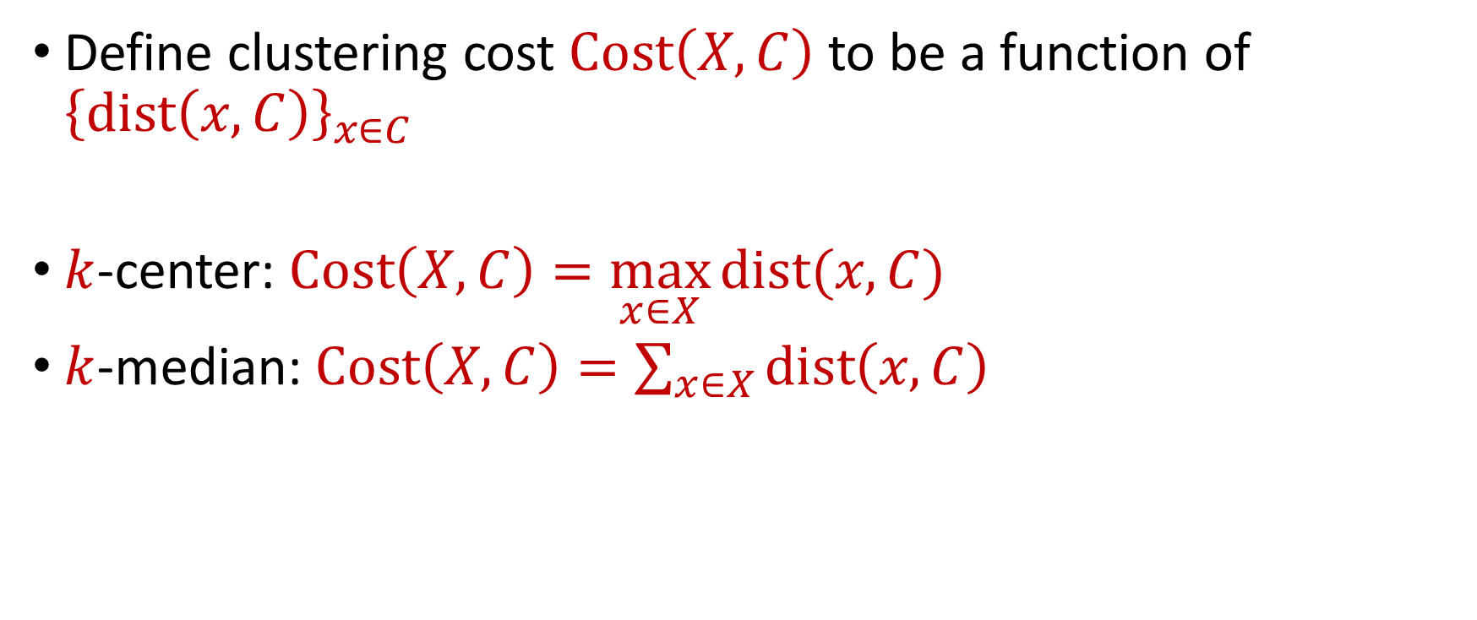
$k$-Clustering
Define clustering cost $Cost\left(X,C\right)$ to be a function of ${\left\{dist\left(x,C\right)\right\}}_{x∈C}$
$k$-center: $Cost\left(X,C\right)=\max_{x∈X}{dist(x,C)}$
$k$-median: $Cost\left(X,C\right)=\sum_{x∈X}{dist\left(x,C\right)}$

Slide 22

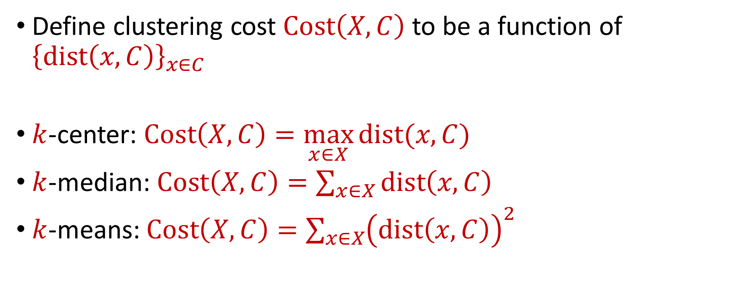






$k$-Clustering
Define clustering cost $Cost\left(X,C\right)$ to be a function of ${\left\{dist\left(x,C\right)\right\}}_{x∈C}$
$k$-center: $Cost\left(X,C\right)=\max_{x∈X}{dist(x,C)}$
$k$-median: $Cost\left(X,C\right)=\sum_{x∈X}{dist\left(x,C\right)}$
$k$-means: $Cost\left(X,C\right)=\sum_{x∈X}{{\left(dist\left(x,C\right)\right)}^{2}}$
$${\left(⋅\right)}^{2}$$
$${\left(⋅\right)}^{2}$$
$${\left(⋅\right)}^{2}$$
$${\left(⋅\right)}^{2}$$
$${\left(⋅\right)}^{2}$$
$${\left(⋅\right)}^{2}$$
$${\left(⋅\right)}^{2}$$

Slide 23

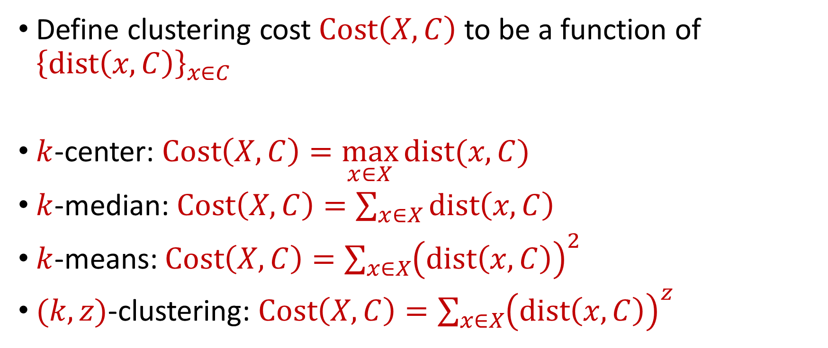






$k$-Clustering
Define clustering cost $Cost\left(X,C\right)$ to be a function of ${\left\{dist\left(x,C\right)\right\}}_{x∈C}$
$k$-center: $Cost\left(X,C\right)=\max_{x∈X}{dist(x,C)}$
$k$-median: $Cost\left(X,C\right)=\sum_{x∈X}{dist\left(x,C\right)}$
$k$-means: $Cost\left(X,C\right)=\sum_{x∈X}{{\left(dist\left(x,C\right)\right)}^{2}}$
$(k,z)$-clustering: $Cost\left(X,C\right)=\sum_{x∈X}{{\left(dist\left(x,C\right)\right)}^{z}}$
$${\left(⋅\right)}^{z}$$
$${\left(⋅\right)}^{z}$$
$${\left(⋅\right)}^{z}$$
$${\left(⋅\right)}^{z}$$
$${\left(⋅\right)}^{z}$$
$${\left(⋅\right)}^{z}$$
$${\left(⋅\right)}^{z}$$

Slide 24
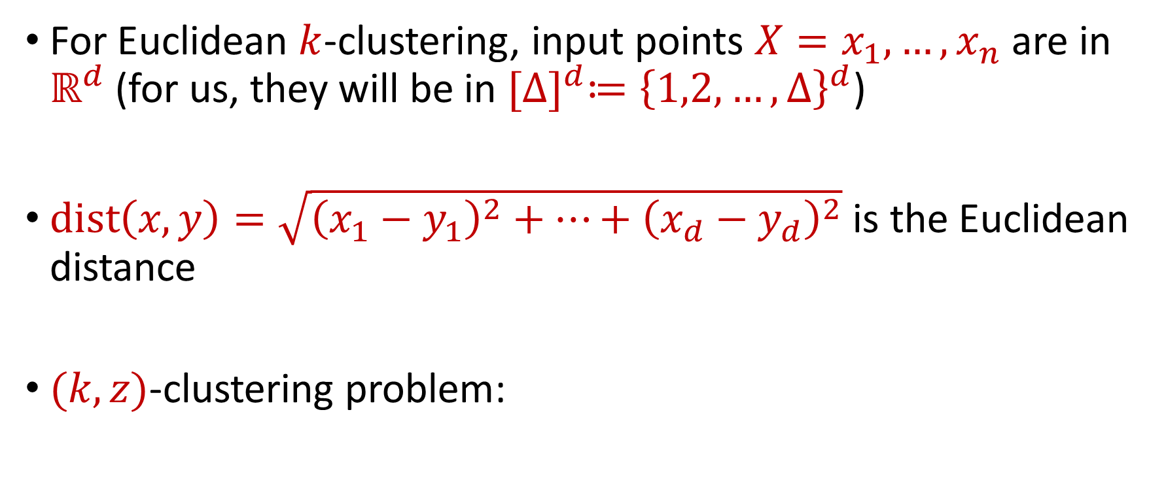


Euclidean $k$-Clustering
For Euclidean $k$-clustering, input points $X=x_{1},…,x_{n}$ are in $ℝ^{d}$ (for us, they will be in ${[Δ]}^{d}≔{\left\{1,2,…,Δ\right\}}^{d}$)
$dist\left(x,y\right)=\sqrt{{\left(x_{1}−y_{1}\right)}^{2}+…+{\left(x_{d}−y_{d}\right)}^{2}}$ is the Euclidean distance
$(k,z)$-clustering problem:
$$\min_{C:\left|C\right|≤k} Cost\left(X,C\right)=\min_{C:\left|C\right|≤k}{Σ_{x∈X}\left(dist\left(x,C\right)\right)}^{z}$$

Slide 25
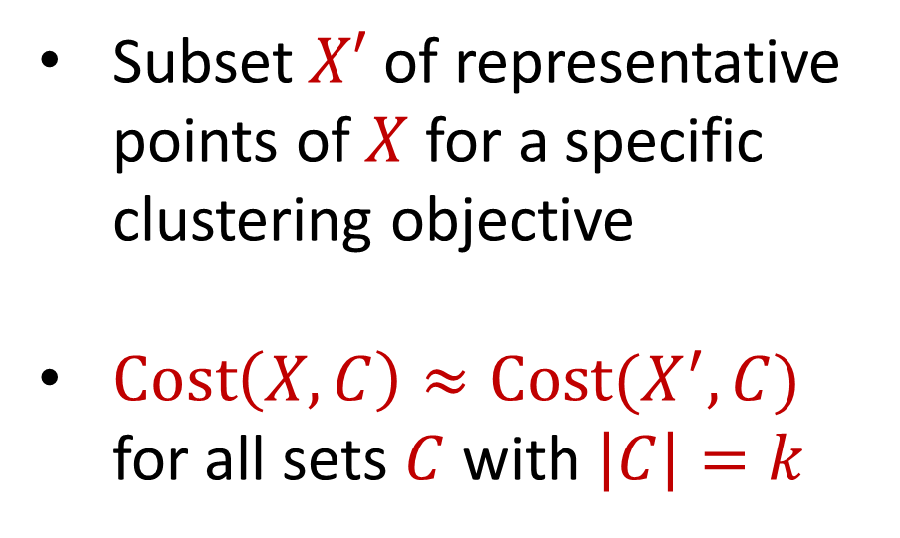
Coreset
Subset $X′$ of representative points of $X$ for a specific clustering objective
$Cost\left(X,C\right)≈Cost(X^{′},C)$ for all sets $C$ with $\left|C\right|=k$

Slide 26
Coreset
Subset $X′$ of representative points of $X$ for a specific clustering objective
$Cost\left(X,C\right)≈Cost(X^{′},C)$ for all sets $C$ with $\left|C\right|=k$

Slide 27
Coreset
Subset $X′$ of representative points of $X$ for a specific clustering objective
$Cost\left(X,C\right)≈Cost(X^{′},C)$ for all sets $C$ with $\left|C\right|=k$

Slide 28

Coreset (Formal Definition)
Given a set $X$ and an accuracy parameter $ε>0$, we say a set $X′$ with weight function $w$is an $(1+ε)$-multiplicative coreset for a cost function $Cost$, if for all queries $C$ with $\left|C\right|≤k$, we have
$$\left(1−ε\right)Cost(X,C)≤Cost(X′,C,w)≤\left(1+ε\right)Cost(X,C)$$
$(k,z)$-clustering: $Cost\left(X^{′},C,w\right)=\sum_{x∈X′}{{w\left(x\right)⋅\left(dist\left(x,C\right)\right)}^{z}}$

Slide 29
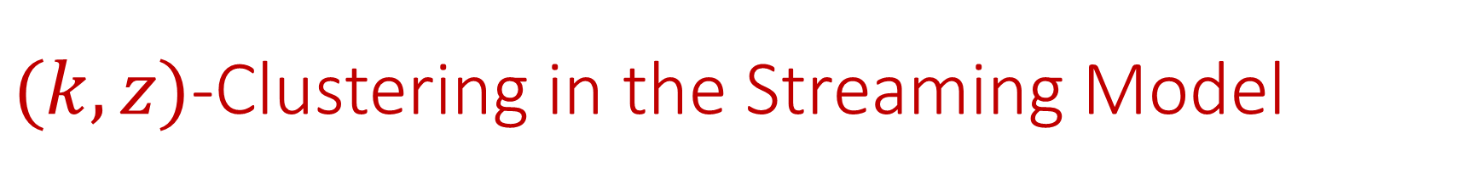

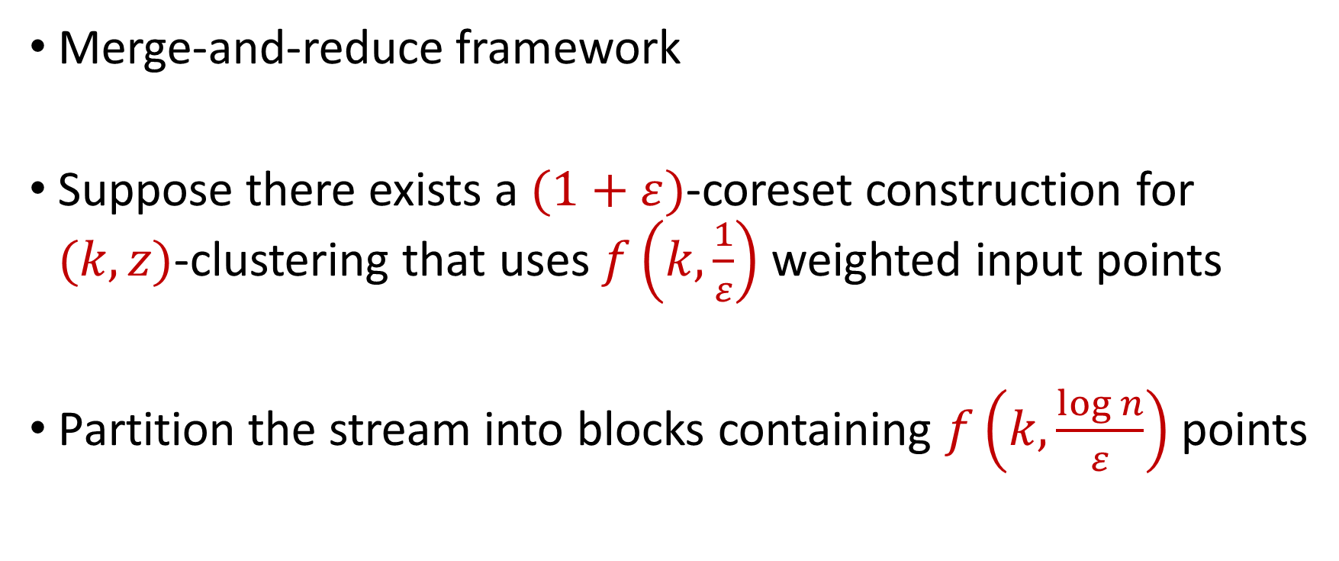
$(k,z)$-Clustering in the Streaming Model
Merge-and-reduce framework
Suppose there exists a $(1+ε)$-coreset construction for $(k,z)$-clustering that uses $f\left(k,\frac{1}{ε}\right)$ weighted input points
Partition the stream into blocks containing $f\left(k,\frac{\log{n}}{ε}\right)$ points
$$\tilde{O}\left(\frac{k^{2}}{ε^{2}}\right)$$

Slide 30
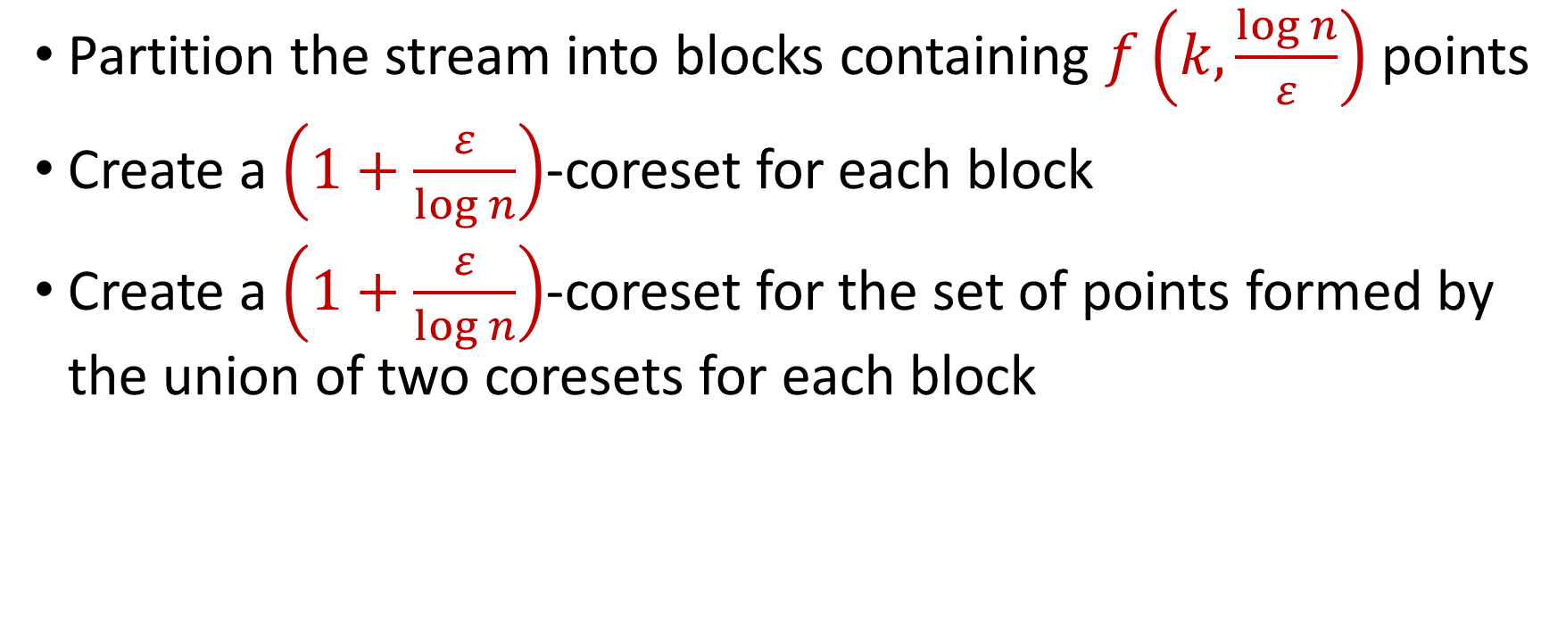
$(k,z)$-Clustering in the Streaming Model
Partition the stream into blocks containing $f\left(k,\frac{\log{n}}{ε}\right)$ points
Create a $\left(1+\frac{ε}{\log{n}}\right)$-coreset for each block
Create a $\left(1+\frac{ε}{\log{n}}\right)$-coreset for the set of points formed by the union of two coresets for each block
Reduce
Merge

Slide 31
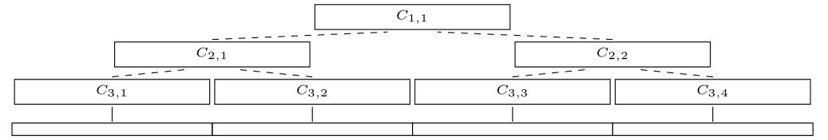
$(k,z)$-Clustering in the Streaming Model
Partition the stream into blocks containing $f\left(k,\frac{\log{n}}{ε}\right)$ points
Create a $\left(1+\frac{ε}{\log{n}}\right)$-coreset for each block
Create a $\left(1+\frac{ε}{\log{n}}\right)$-coreset for the set of points formed by the union of two coresets for each block

Slide 32
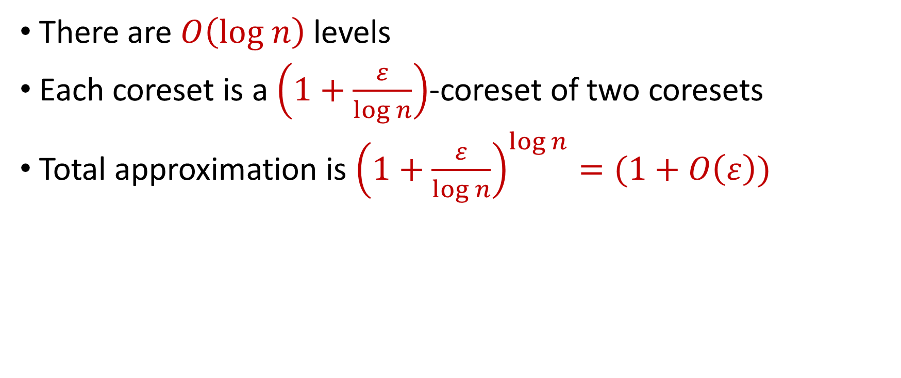
$(k,z)$-Clustering in the Streaming Model
There are $O\left(log n\right)$ levels
Each coreset is a $\left(1+\frac{ε}{\log{n}}\right)$-coreset of two coresets
Total approximation is ${\left(1+\frac{ε}{\log{n}}\right)}^{\log{n}}=(1+O\left(ε\right))$

Slide 33
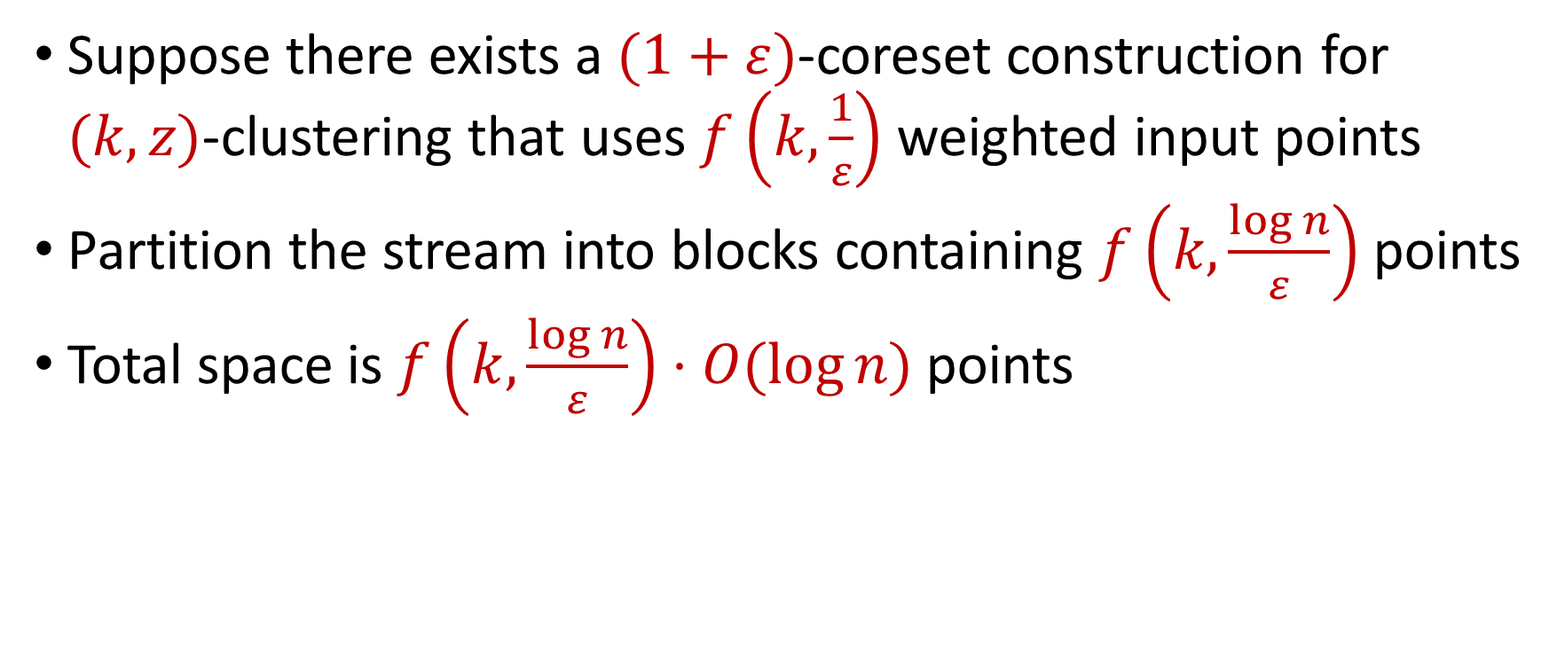
$(k,z)$-Clustering in the Streaming Model
Suppose there exists a $(1+ε)$-coreset construction for $(k,z)$-clustering that uses $f\left(k,\frac{1}{ε}\right)$ weighted input points
Partition the stream into blocks containing $f\left(k,\frac{\log{n}}{ε}\right)$ points
Total space is $f\left(k,\frac{\log{n}}{ε}\right)⋅O(log{n)}$ points
For $k$-means clustering, this is $\tilde{O}\left(\frac{k}{ε^{2}}⋅\log^{3}{n}\right)$ points

Slide 34

Clustering
Goal: Given input dataset $P$, partition $P$ so that “similar” points are in the same cluster and “different” points are in different clusters

Slide 35

$k$-Clustering
Goal: Given input dataset $P$, partition $P$ so that “similar” points are in the same cluster and “different” points are in different clusters
There can be at most $k$ different clusters
$$k=3$$

Slide 36
$k$-Clustering
Question: How do we measure the “quality” of each clustering?
$$k=3$$

Slide 37
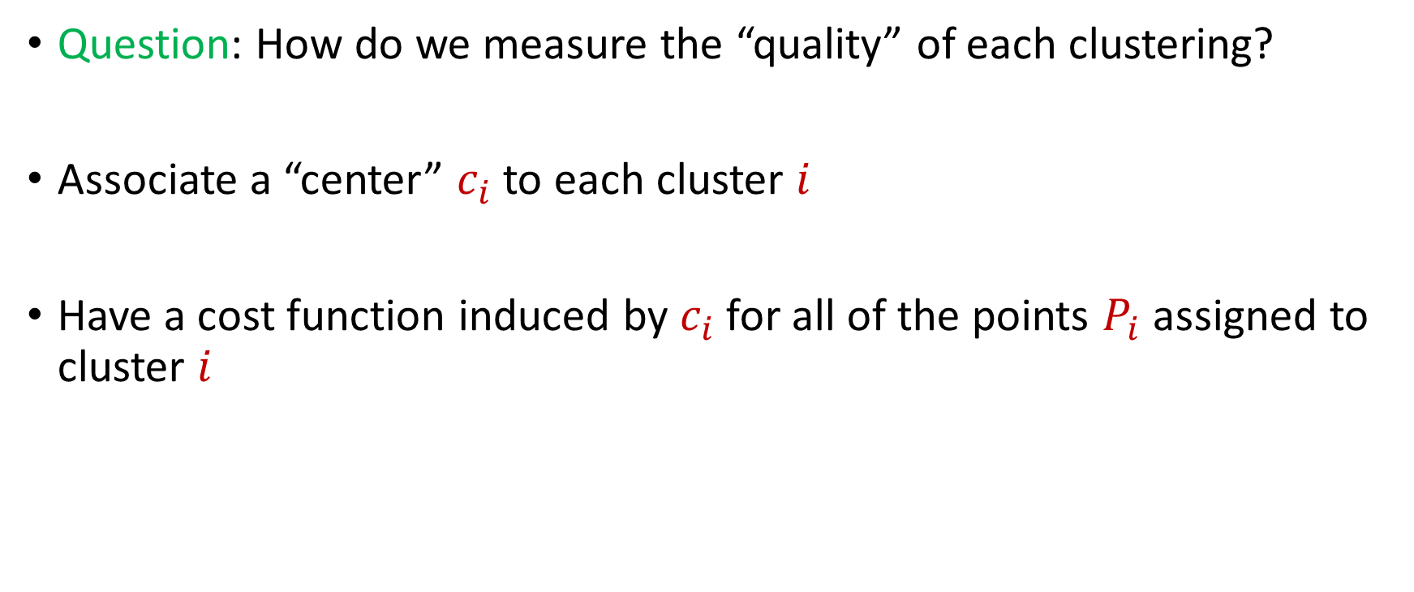
$k$-Clustering
Question: How do we measure the “quality” of each clustering?
Associate a “center” $c_{i}$ to each cluster $i$
Have a cost function induced by $c_{i}$ for all of the points $P_{i}$ assigned to cluster $i$
$$Cost\left(P_{i}, c_{i}\right)$$

Slide 40





1 0 3 0 1 1
1 1 0 0 2 8
2 0 1 3 0 8
1 1 0 0 0 8
0 0 0 7 0 0
7 0 0 8 0 0
3 4 1 1 0 2
4 2 0 1 0 1
9 1 0 0 3 2
1 1 6 0 0 0
8 1 0 1 2 0
1
1
2
1
0
7
3
4
9
1
8
$$n$$
$$A$$
$$b$$
$$d$$
$$1$$

Slide 41




$$x$$
$$n$$
$$A$$
$$≈$$
$$b$$
$$d$$
$$1$$

Slide 42




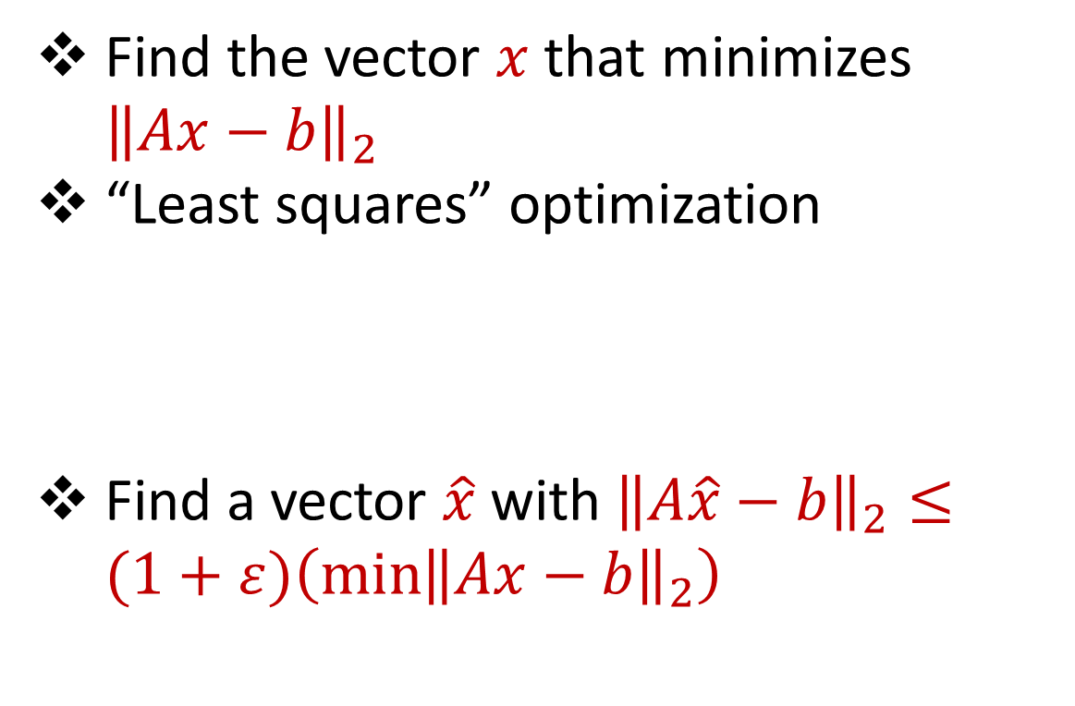






Linear Regression
Find the vector $x$ that minimizes ${\left\|Ax−b\right\|}_{2}$
“Least squares” optimization
Find a vector $\hat{x}$ with ${\left\|A\hat{x}−b\right\|}_{2}≤(1+ε)\left(\min{{\left\|Ax−b\right\|}_{2}}\right)$
$$d$$
$$x$$
$$≈$$
$$n$$
$$A$$
$$n$$
$$b$$
$$1$$
$$d$$
$$1$$

Slide 43




Dimensionality Reduction
Reduce $d$
Reduce $n$
Application depends on task!
Sampling, Sketching, Johnson-Lindenstrauss, IsoMap
$$n$$
$$A$$
Sampling, Sketching
$$d$$

Slide 44


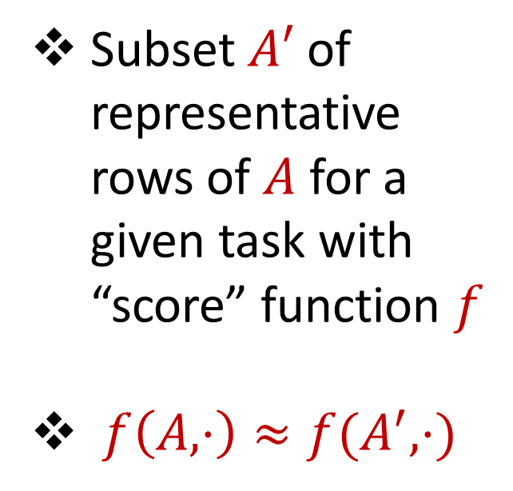



Coreset
Subset $A′$ of representative rows of $A$ for a given task with “score” function $f$
$f\left(A,⋅\right)≈f(A^{′},⋅)$
$$n$$
$$A$$
$$A′$$
$$d$$
$$d$$

Slide 45
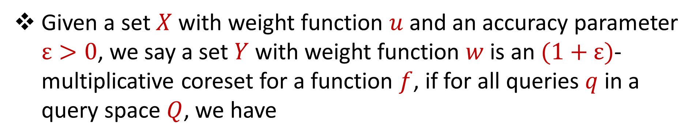
Coreset (Formal Definition)
Given a set $X$ with weight function $u$ and an accuracy parameter $ε>0$, we say a set $Y$ with weight function $w$is an $(1+ε)$-multiplicative coreset for a function $f$, if for all queries $q$ in a query space $Q$, we have
$$\left(1−ε\right)f\left(Y,q,w\right)≤f\left(X,q,u\right)≤\left(1+ε\right)f(Y,q,w)$$

Slide 46
Coreset
Lots of different constructions with various tradeoffs
Size vs. accuracy
Size vs. computation time
Size vs. interpretability
Average-case vs. worst-case performance

Slide 47
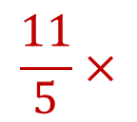
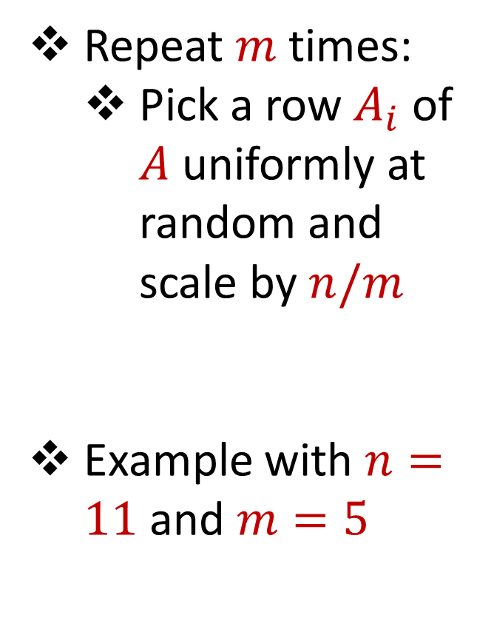
Uniform Sampling
1 0 3 0 1 1
1 1 0 0 2 8
2 0 1 3 0 8
1 1 0 0 0 8
0 0 0 7 0 0
7 0 0 8 0 0
3 4 1 1 0 2
4 2 0 1 0 1
9 1 0 0 3 2
1 1 6 0 0 0
8 1 0 1 2 0
Repeat $m$ times:
Pick a row $A_{i}$ of $A$ uniformly at random and scale by $n/m$
Example with $n=11$ and $m=5$
$$n$$
$$A$$
1 0 3 0 1 1
1 1 0 0 0 8
3 4 1 1 0 2
8 1 0 1 2 0
3 4 1 1 0 2
$$\frac{11}{5}×$$
$$A′$$
$$d$$
$$d$$

Slide 48

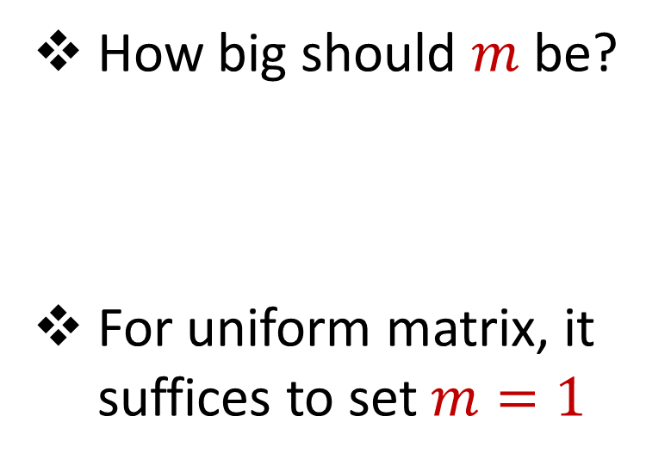


Uniform Sampling
1 0 0 0 0 0
1 0 0 0 0 0
1 0 0 0 0 0
1 0 0 0 0 0
1 0 0 0 0 0
1 0 0 0 0 0
1 0 0 0 0 0
1 0 0 0 0 0
1 0 0 0 0 0
1 0 0 0 0 0
1 0 0 0 0 0
How big should $m$ be?
For uniform matrix, it suffices to set $m=1$
$$n$$
$$A$$
$$d$$

Slide 49
Uniform Sampling
1 0 0 0 0 0
1 0 0 0 0 0
1 0 0 0 0 0
1 0 0 0 0 0
1 0 0 0 0 0
1 0 0 0 0 0
1 0 0 0 0 0
1 0 0 0 0 0
1 0 0 0 0 0
1 0 0 0 0 0
1 0 0 0 0 0
How big should $m$ be?
For uniform matrix, it suffices to set $m=1$
$$n$$
$$A$$
1 0 0 0 0 0
1 0 0 0 0 0
1 0 0 0 0 0
1 0 0 0 0 0
1 0 0 0 0 0
$$\frac{11}{5}×$$
$$A′$$
$$d$$
$$d$$

Slide 50
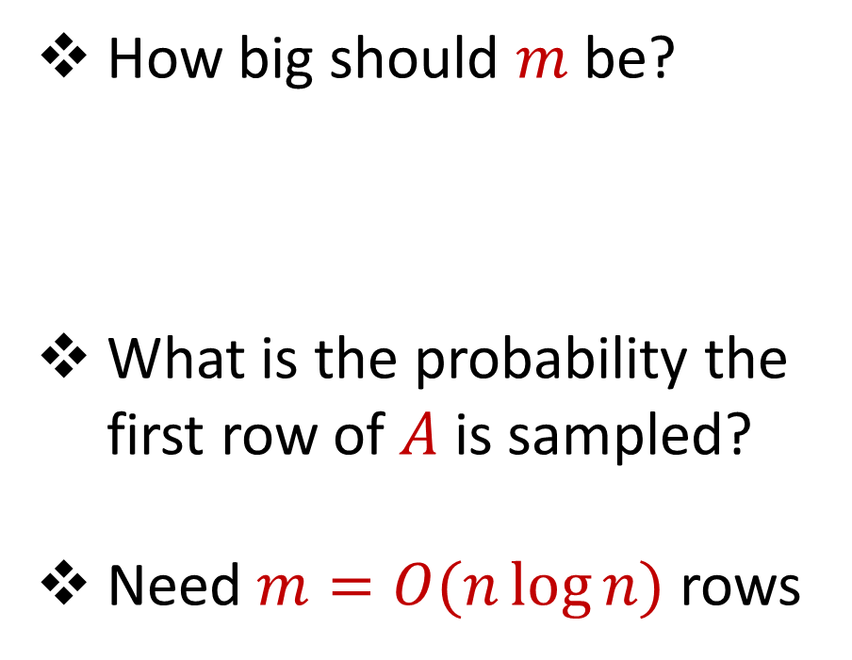
Uniform Sampling
0 0 0 0 0 1
1 0 0 0 0 0
1 0 0 0 0 0
1 0 0 0 0 0
1 0 0 0 0 0
1 0 0 0 0 0
1 0 0 0 0 0
1 0 0 0 0 0
1 0 0 0 0 0
1 0 0 0 0 0
1 0 0 0 0 0
How big should $m$ be?
What is the probability the first row of $A$ is sampled?
Need $m=O(n\log{n})$ rows
$$n$$
$$A$$
$$d$$

Slide 51
Uniform Sampling
Pros: intuitively simple, simple to implement, fast, good on uniform or “average-case” data
Cons: bad on “worst-case” data

Slide 52
Importance Sampling
1 0 0 0 0 0
1 0 0 0 0 0
1 0 0 0 0 0
1 0 0 0 0 0
1 0 0 0 0 0
1 0 0 0 0 0
0 0 0 0 0 1
1 0 0 0 0 0
1 0 0 0 0 0
1 0 0 0 0 0
1 0 0 0 0 0
What if we do not sample uniformly at random?
What is the probability that each row should be sampled?
$$n$$
$$A$$

Slide 53
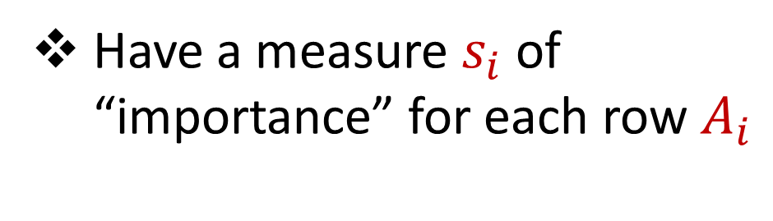
Importance Sampling
1 0 0 0 0 0
1 0 0 0 0 0
1 0 0 0 0 0
1 0 0 0 0 0
1 0 0 0 0 0
1 0 0 0 0 0
0 0 0 0 0 1
1 0 0 0 0 0
1 0 0 0 0 0
1 0 0 0 0 0
1 0 0 0 0 0
Have a measure $s_{i}$ of “importance” for each row $A_{i}$
$$n$$
$$A$$

Slide 54

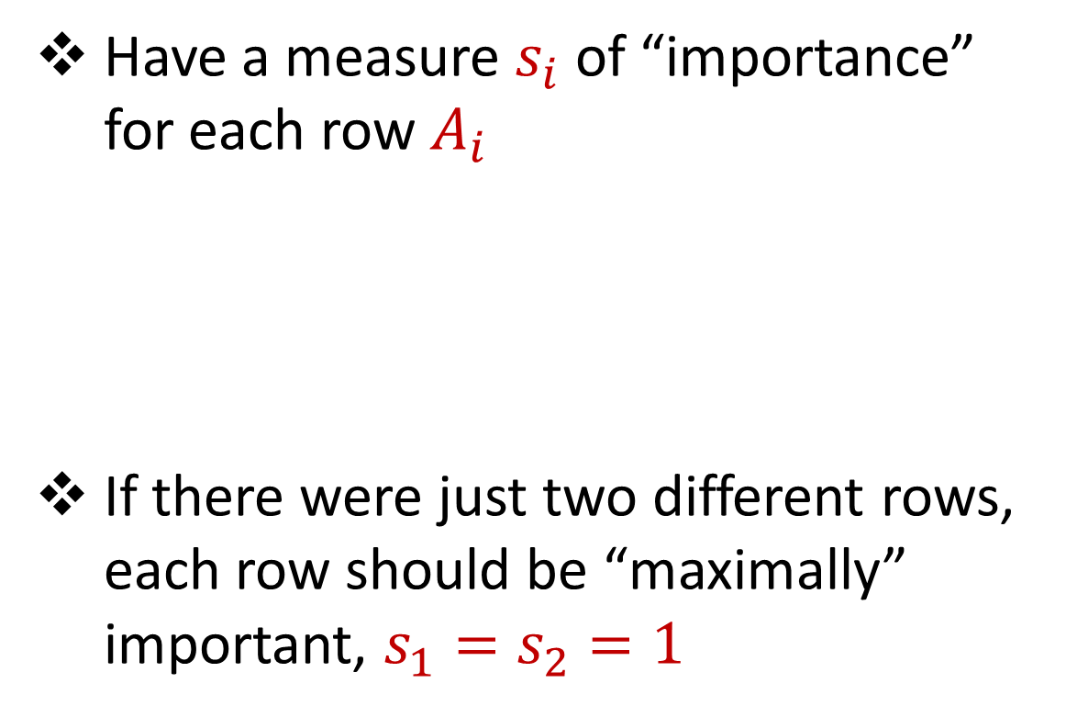



Importance Sampling
1 0 0 0 0 0
1 0 0 0 0 0
1 0 0 0 0 0
1 0 0 0 0 0
1 0 0 0 0 0
1 0 0 0 0 0
0 0 0 0 0 1
1 0 0 0 0 0
1 0 0 0 0 0
1 0 0 0 0 0
1 0 0 0 0 0
Have a measure $s_{i}$ of “importance” for each row $A_{i}$
If there were just two different rows, each row should be “maximally” important, $s_{1}=s_{2}=1$
$$n$$
$$A$$
1 0 0 0 0 0
0 0 0 0 0 1
$$n$$
$$A$$

Slide 55
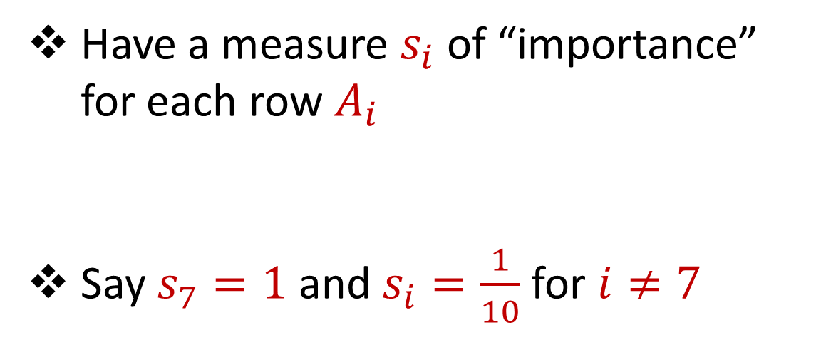
Importance Sampling
1 0 0 0 0 0
1 0 0 0 0 0
1 0 0 0 0 0
1 0 0 0 0 0
1 0 0 0 0 0
1 0 0 0 0 0
0 0 0 0 0 1
1 0 0 0 0 0
1 0 0 0 0 0
1 0 0 0 0 0
1 0 0 0 0 0
Have a measure $s_{i}$ of “importance” for each row $A_{i}$
Say $s_{7}=1$ and $s_{i}=\frac{1}{10}$ for $i≠7$
$$n$$
$$A$$

Slide 56
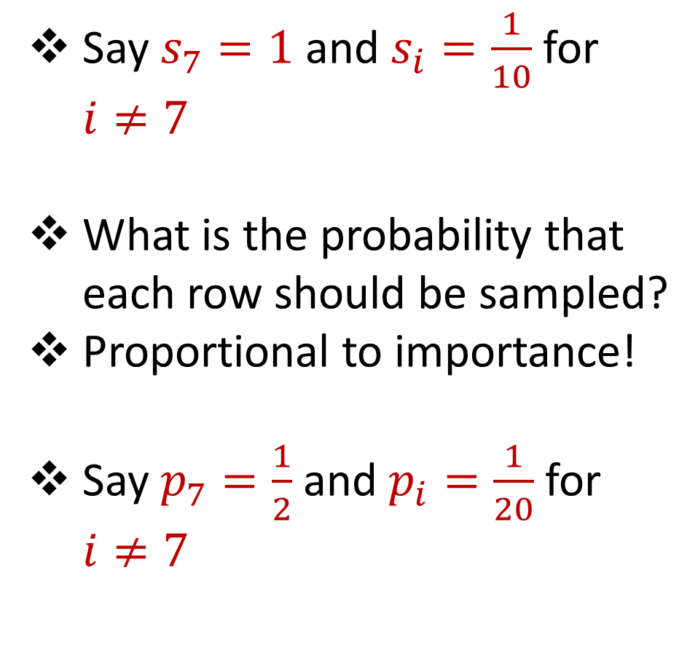
Importance Sampling
1 0 0 0 0 0
1 0 0 0 0 0
1 0 0 0 0 0
1 0 0 0 0 0
1 0 0 0 0 0
1 0 0 0 0 0
0 0 0 0 0 1
1 0 0 0 0 0
1 0 0 0 0 0
1 0 0 0 0 0
1 0 0 0 0 0
Say $s_{7}=1$ and $s_{i}=\frac{1}{10}$ for $i≠7$
What is the probability that each row should be sampled?
Proportional to importance!
Say $p_{7}=\frac{1}{2}$ and $p_{i}=\frac{1}{20}$ for $i≠7$
$$n$$
$$A$$

Slide 57
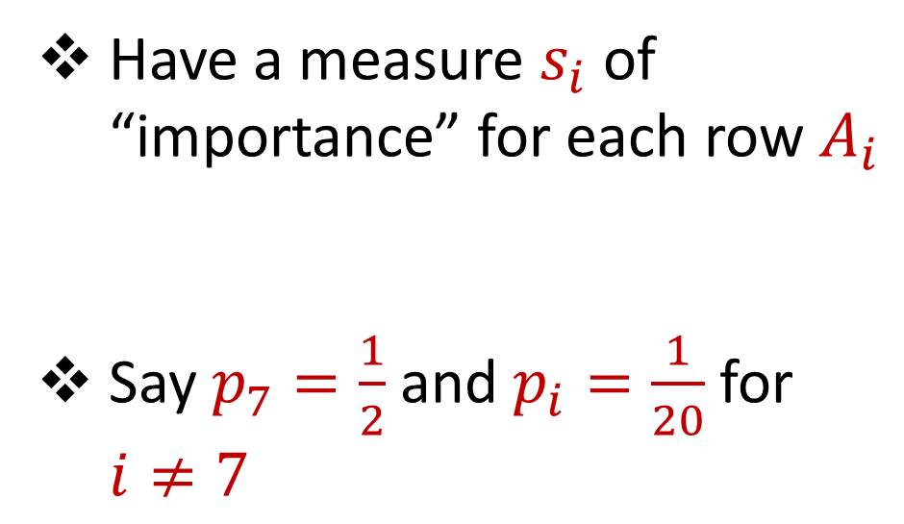
Importance Sampling
1 0 0 0 0 0
1 0 0 0 0 0
1 0 0 0 0 0
1 0 0 0 0 0
1 0 0 0 0 0
1 0 0 0 0 0
0 0 0 0 0 1
1 0 0 0 0 0
1 0 0 0 0 0
1 0 0 0 0 0
1 0 0 0 0 0
Have a measure $s_{i}$ of “importance” for each row $A_{i}$
Say $p_{7}=\frac{1}{2}$ and $p_{i}=\frac{1}{20}$ for $i≠7$
$$n$$
$$A$$

Slide 58

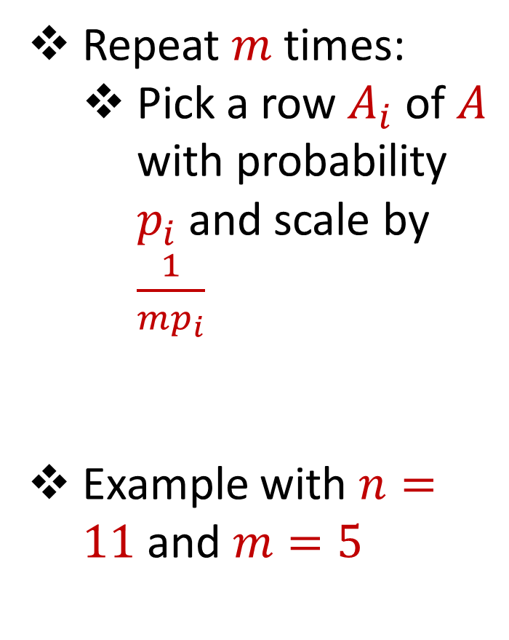

Importance Sampling
1 0 0 0 0 0
1 0 0 0 0 0
1 0 0 0 0 0
1 0 0 0 0 0
1 0 0 0 0 0
1 0 0 0 0 0
0 0 0 0 0 1
1 0 0 0 0 0
1 0 0 0 0 0
1 0 0 0 0 0
1 0 0 0 0 0
Repeat $m$ times:
Pick a row $A_{i}$ of $A$ with probability $p_{i}$and scale by $\frac{1}{mp_{i}}$
Example with $n=11$ and $m=5$
$$n$$
$$A$$
4 0 0 0 0 0
4 0 0 0 0 0
0 0 0 0 0 $\frac{2}{5}$
4 0 0 0 0 0
0 0 0 0 0 $\frac{2}{5}$
$$A′$$
$$d$$
$$d$$

Slide 59
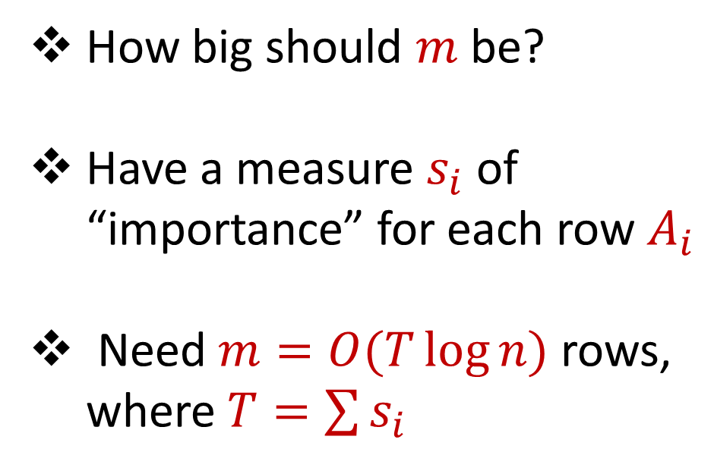
Importance Sampling
0 0 0 0 0 1
1 0 0 0 0 0
1 0 0 0 0 0
1 0 0 0 0 0
1 0 0 0 0 0
1 0 0 0 0 0
1 0 0 0 0 0
1 0 0 0 0 0
1 0 0 0 0 0
1 0 0 0 0 0
1 0 0 0 0 0
How big should $m$ be?
Have a measure $s_{i}$ of “importance” for each row $A_{i}$
Need $m=O(T\log{n})$ rows, where $T=\sum{s_{i}}$
$$n$$
$$A$$
$$d$$

Slide 60
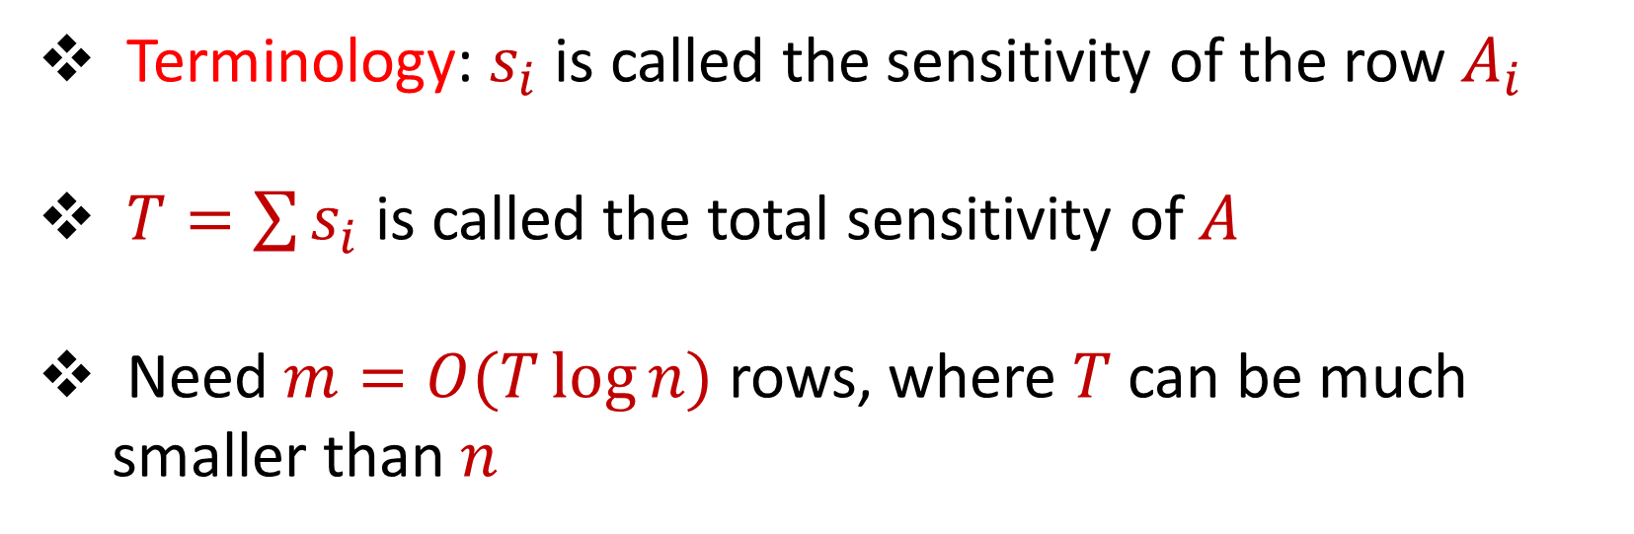
Sensitivity Sampling
Terminology: $s_{i}$ is called the sensitivity of the row $A_{i}$
$T=\sum{s_{i}}$ is called the total sensitivity of $A$
Need $m=O(T\log{n})$ rows, where $T$ can be much smaller than $n$

Slide 61

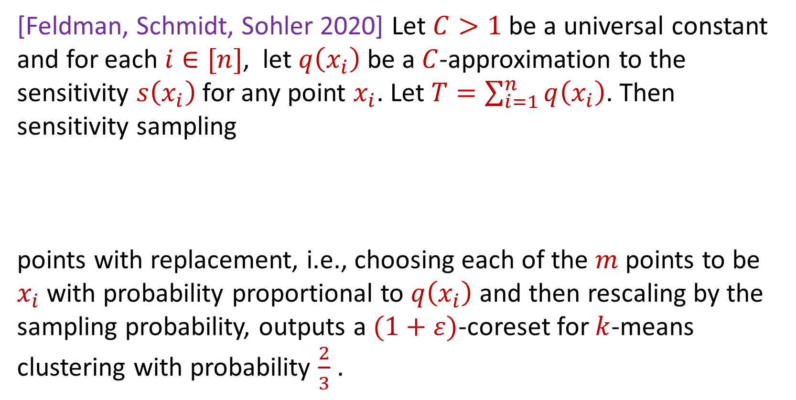
Sensitivity Sampling (Formal Theorem)
[Feldman, Schmidt, Sohler 2020] Let $C>1$ be a universal constant and for each $i∈[n]$, let $q\left(x_{i}\right)$ be a $C$-approximation to the sensitivity $s\left(x_{i}\right)$for any point $x_{i}$. Let $T=\sum_{i=1}^{n}{q\left(x_{i}\right)}$. Then sensitivity sampling
points with replacement, i.e., choosing each of the $m$ points to be $x_{i}$with probability proportional to $q\left(x_{i}\right)$ and then rescaling by the sampling probability, outputs a $(1+ε)$-coreset for $k$-means clustering with probability $\frac{2}{3}$ .
$$m=O\left(\frac{Tk}{ε^{2}}\log^{2}{k}\right)$$

Slide 62
Sensitivity Sampling
Pros: size is always better than uniform sampling and MUCH better on “worst-case” data
Cons: estimating the sensitivities can be a difficult design choice, computing the total sensitivity can be mathematically challenging, larger runtime

Slide 63
 | Uniform Sampling | Sensitivity Sampling
Average-case size | X | X
Worst-case size |  | X
Ease of implementation Computation of probabilities | X
Interpretability |  | X

Slide 64



Group / Stratified Sampling
0 0 0 0 0 1
1 0 0 0 0 0
1 0 0 0 0 0
1 0 0 0 0 0
1 0 0 0 0 0
1 0 0 0 0 0
1 0 0 0 0 0
1 0 0 0 0 0
1 0 0 0 0 0
1 0 0 0 0 0
1 0 0 0 0 0
Separate the data into “groups” and then perform uniform sampling on each group
If the data is uniform in each group, this is essentially sensitivity sampling
$$n$$
$$A$$
$$d$$

Slide 66
Coresets
Where to apply them?
Which sampling approach to use?
Worst-case mathematical bounds

Slide 67
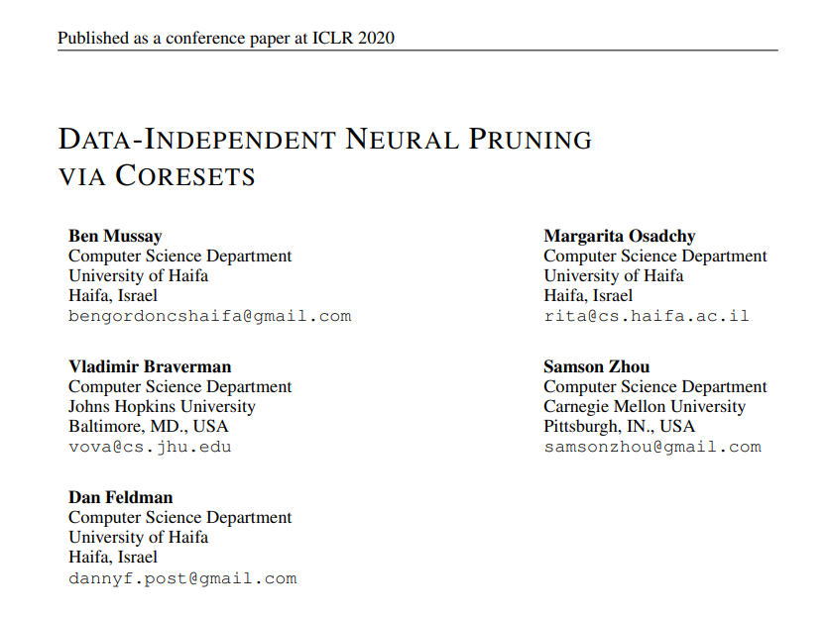
Coresets
Where to apply them?

Slide 68
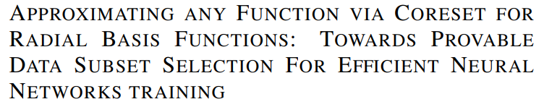

Coresets
Which sampling approach to use?

Slide 69

Coresets
Worst-case mathematical bounds

