Slide 1
CSCE 689: Special Topics in Modern Algorithms for Data Science
Lecture 22
Samson Zhou

Slide 2
Presentation Schedule
November 27: Chunkai, Jung, Galaxy AI
November 29: STMI, Anmol, Jason
December 1: Bokun, Ayesha, Dawei, Lipai

Slide 3
47 72 81 10 14 33 51 29 54 9 36 46 10

Slide 4






$$1$$
$$2$$
$$5$$
$$6$$
$$4$$
$$3$$

Slide 6
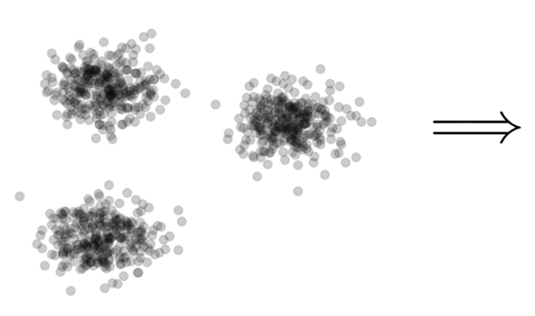

Clustering
Goal: Given input dataset $X$, partition $X$ so that “similar” points are in the same cluster and “different” points are in different clusters

Slide 7
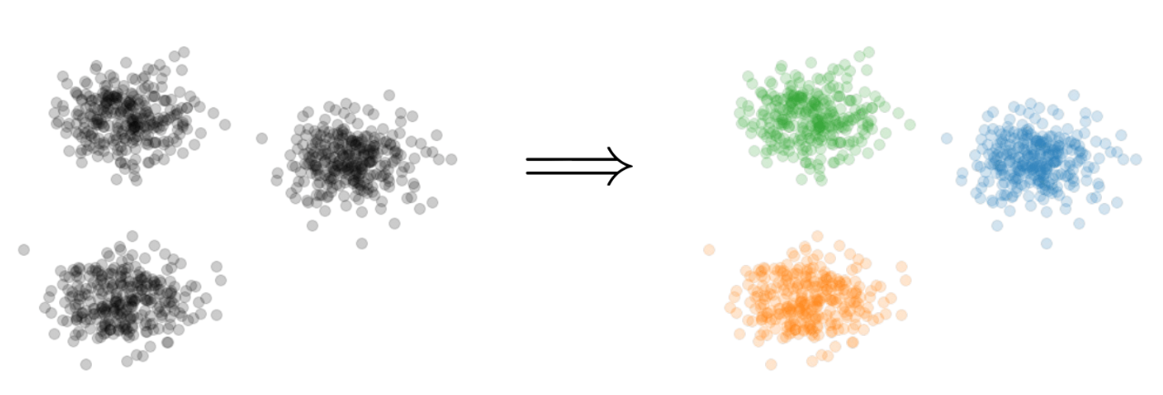
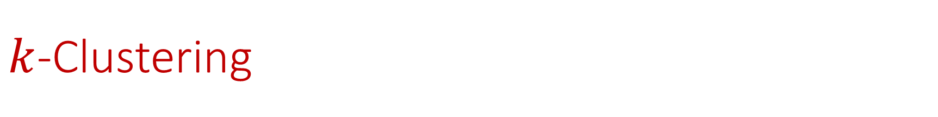

$k$-Clustering
Goal: Given input dataset $X$, partition $X$ so that “similar” points are in the same cluster and “different” points are in different clusters
There can be at most $k$ different clusters
$$k=3$$

Slide 8
$k$-Clustering
Question: How do we measure the “quality” of each clustering?
$$k=3$$

Slide 9
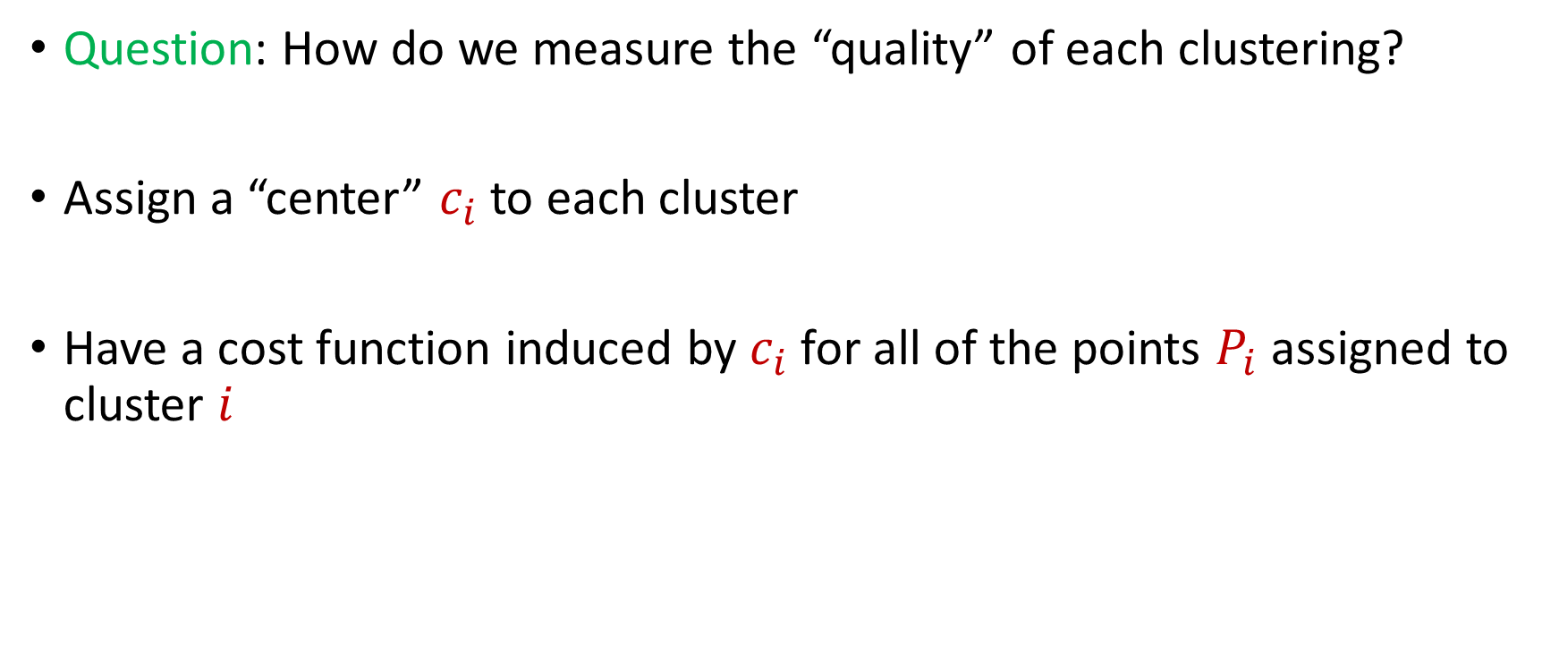
$k$-Clustering
Question: How do we measure the “quality” of each clustering?
Assign a “center” $c_{i}$ to each cluster
Have a cost function induced by $c_{i}$ for all of the points $P_{i}$ assigned to cluster $i$

Slide 10
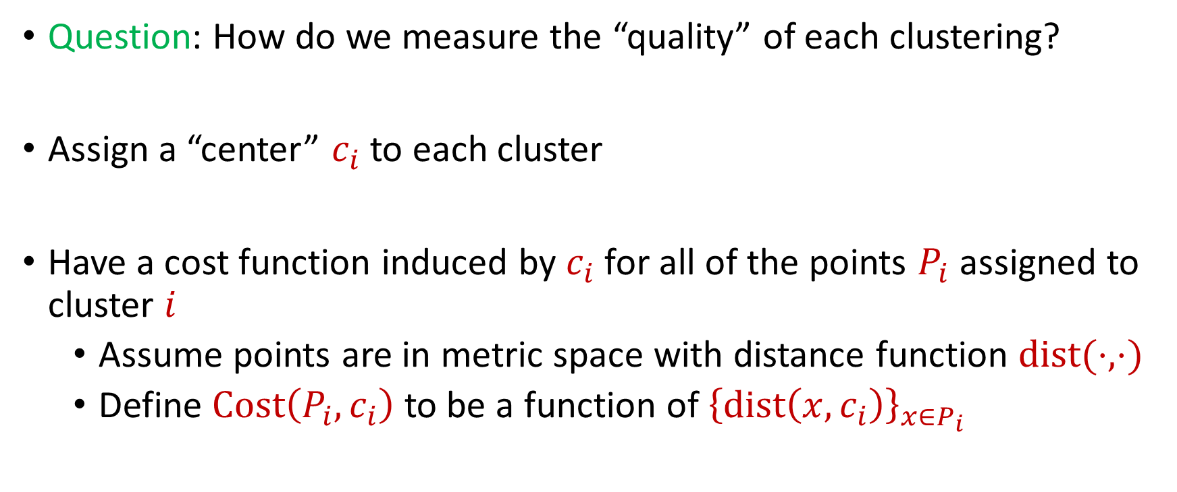
$k$-Clustering
Question: How do we measure the “quality” of each clustering?
Assign a “center” $c_{i}$ to each cluster
Have a cost function induced by $c_{i}$ for all of the points $P_{i}$ assigned to cluster $i$
Assume points are in metric space with distance function $dist(⋅,⋅)$
Define $Cost\left(P_{i},c_{i}\right)$ to be a function of ${\left\{dist\left(x,c_{i}\right)\right\}}_{x∈P_{i}}$

Slide 11
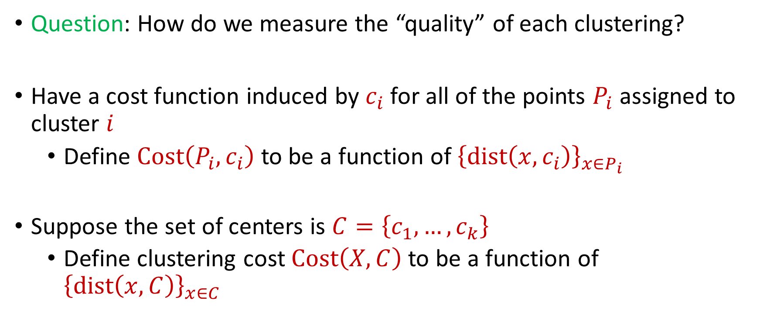
$k$-Clustering
Question: How do we measure the “quality” of each clustering?
Have a cost function induced by $c_{i}$ for all of the points $P_{i}$ assigned to cluster $i$
Define $Cost\left(P_{i},c_{i}\right)$ to be a function of ${\left\{dist\left(x,c_{i}\right)\right\}}_{x∈P_{i}}$
Suppose the set of centers is $C=\left\{c_{1},…, c_{k}\right\}$
Define clustering cost $Cost\left(X,C\right)$ to be a function of ${\left\{dist\left(x,C\right)\right\}}_{x∈C}$

Slide 12

$k$-Clustering
Define clustering cost $Cost\left(X,C\right)$ to be a function of ${\left\{dist\left(x,C\right)\right\}}_{x∈C}$

Slide 13
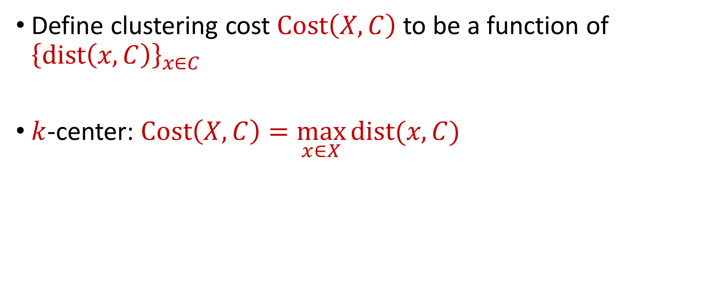
$k$-Clustering
Define clustering cost $Cost\left(X,C\right)$ to be a function of ${\left\{dist\left(x,C\right)\right\}}_{x∈C}$
$k$-center: $Cost\left(X,C\right)=\max_{x∈X}{dist(x,C)}$

Slide 14
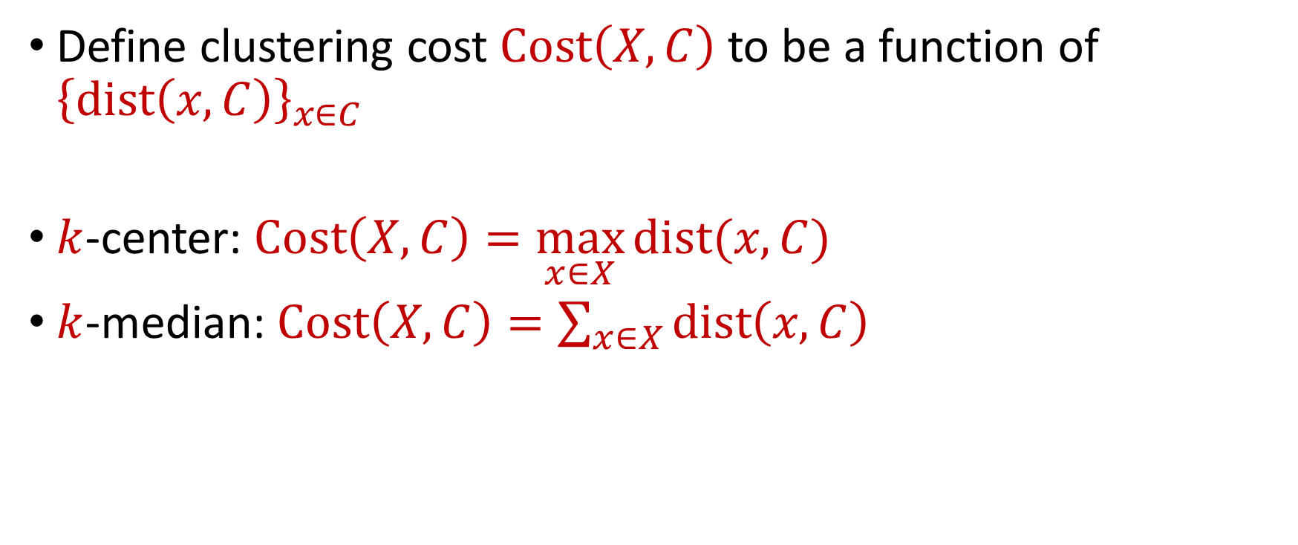
$k$-Clustering
Define clustering cost $Cost\left(X,C\right)$ to be a function of ${\left\{dist\left(x,C\right)\right\}}_{x∈C}$
$k$-center: $Cost\left(X,C\right)=\max_{x∈X}{dist(x,C)}$
$k$-median: $Cost\left(X,C\right)=\sum_{x∈X}{dist\left(x,C\right)}$

Slide 15

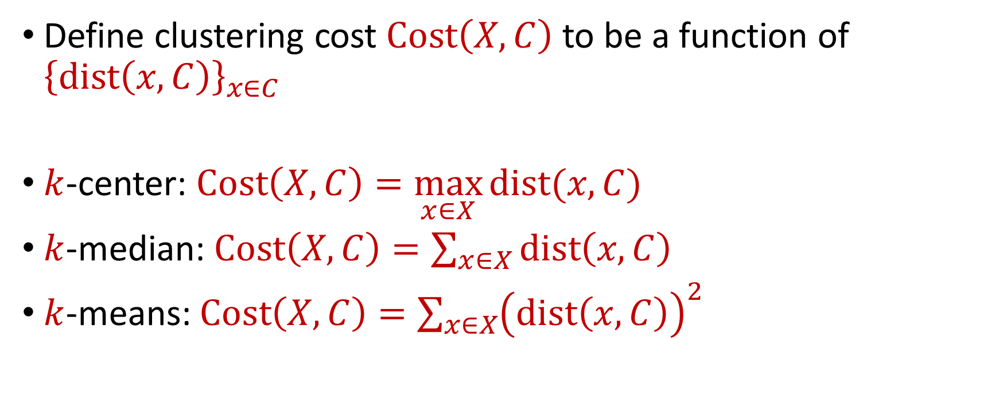






$k$-Clustering
Define clustering cost $Cost\left(X,C\right)$ to be a function of ${\left\{dist\left(x,C\right)\right\}}_{x∈C}$
$k$-center: $Cost\left(X,C\right)=\max_{x∈X}{dist(x,C)}$
$k$-median: $Cost\left(X,C\right)=\sum_{x∈X}{dist\left(x,C\right)}$
$k$-means: $Cost\left(X,C\right)=\sum_{x∈X}{{\left(dist\left(x,C\right)\right)}^{2}}$
$${\left(⋅\right)}^{2}$$
$${\left(⋅\right)}^{2}$$
$${\left(⋅\right)}^{2}$$
$${\left(⋅\right)}^{2}$$
$${\left(⋅\right)}^{2}$$
$${\left(⋅\right)}^{2}$$
$${\left(⋅\right)}^{2}$$

Slide 16

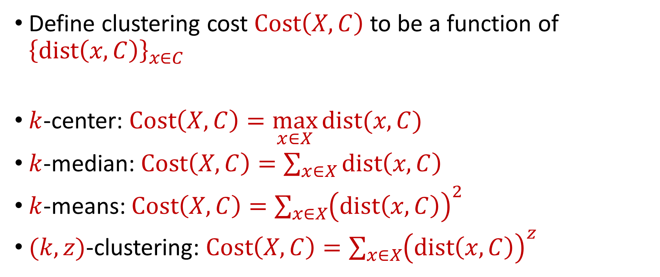






$k$-Clustering
Define clustering cost $Cost\left(X,C\right)$ to be a function of ${\left\{dist\left(x,C\right)\right\}}_{x∈C}$
$k$-center: $Cost\left(X,C\right)=\max_{x∈X}{dist(x,C)}$
$k$-median: $Cost\left(X,C\right)=\sum_{x∈X}{dist\left(x,C\right)}$
$k$-means: $Cost\left(X,C\right)=\sum_{x∈X}{{\left(dist\left(x,C\right)\right)}^{2}}$
$(k,z)$-clustering: $Cost\left(X,C\right)=\sum_{x∈X}{{\left(dist\left(x,C\right)\right)}^{z}}$
$${\left(⋅\right)}^{z}$$
$${\left(⋅\right)}^{z}$$
$${\left(⋅\right)}^{z}$$
$${\left(⋅\right)}^{z}$$
$${\left(⋅\right)}^{z}$$
$${\left(⋅\right)}^{z}$$
$${\left(⋅\right)}^{z}$$

Slide 17
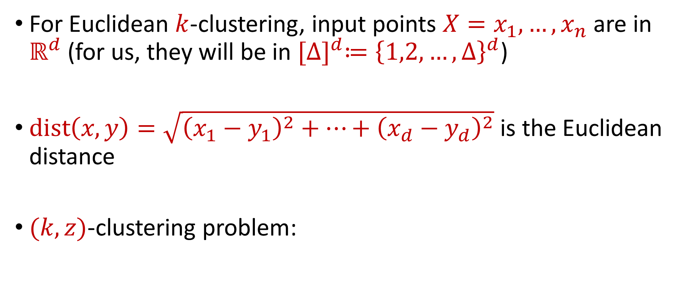


Euclidean $k$-Clustering
For Euclidean $k$-clustering, input points $X=x_{1},…,x_{n}$ are in $ℝ^{d}$ (for us, they will be in ${[Δ]}^{d}≔{\left\{1,2,…,Δ\right\}}^{d}$)
$dist\left(x,y\right)=\sqrt{{\left(x_{1}−y_{1}\right)}^{2}+…+{\left(x_{d}−y_{d}\right)}^{2}}$ is the Euclidean distance
$(k,z)$-clustering problem:
$$\min_{C:\left|C\right|≤k} Cost\left(X,C\right)=\min_{C:\left|C\right|≤k}{Σ_{x∈X}\left(dist\left(x,C\right)\right)}^{z}$$

Slide 18






$$(−8, 4)$$
$$(−4, 3)$$
$$(4, 3)$$
$$(−3, 0)$$
$$(−11, −4)$$
$$(0, −4)$$

Slide 19


$$(−8, 4)$$
$$(−4, 3)$$
$$(4, 3)$$
$$(−8, 0)$$
$$(−3, 0)$$
$$(0, 0)$$
$$(−11, −4)$$
$$(0, −4)$$

Slide 20






$$(−8, 4)$$
$$(−4, 3)$$
$$(4, 3)$$
$$4$$
$$5$$
$$5$$
$$3$$
$$(−8, 0)$$
$$(−3, 0)$$
$$(0, 0)$$
$$5$$
$$4$$
$$(−11, −4)$$
$$(0, −4)$$

Slide 21
$k$-center: $Cost\left(X,C\right)=\max_{x∈X}{dist\left(x,C\right)=5}$
$$(−8, 4)$$
$$(−4, 3)$$
$$(4, 3)$$
$$4$$
$$5$$
$$5$$
$$3$$
$$(−8, 0)$$
$$(−3, 0)$$
$$(0, 0)$$
$$5$$
$$4$$
$$(−11, −4)$$
$$(0, −4)$$

Slide 22
$k$-median: $Cost\left(X,C\right)=\sum_{x∈X}{dist\left(x,C\right)}=4+5+5+3+4+5=26$
$$(−8, 4)$$
$$(−4, 3)$$
$$(4, 3)$$
$$4$$
$$5$$
$$5$$
$$3$$
$$(−8, 0)$$
$$(−3, 0)$$
$$(0, 0)$$
$$5$$
$$4$$
$$(−11, −4)$$
$$(0, −4)$$

Slide 23

$k$-means: $Cost\left(X,C\right)=\sum_{x∈X}{{\left(dist\left(x,C\right)\right)}^{2}} =16+25+25+9+16+25$
$$(−8, 4)$$
$$=116$$
$$(−4, 3)$$
$$(4, 3)$$
$$4$$
$$5$$
$$5$$
$$3$$
$$(−8, 0)$$
$$(−3, 0)$$
$$(0, 0)$$
$$5$$
$$4$$
$$(−11, −4)$$
$$(0, −4)$$

Slide 24
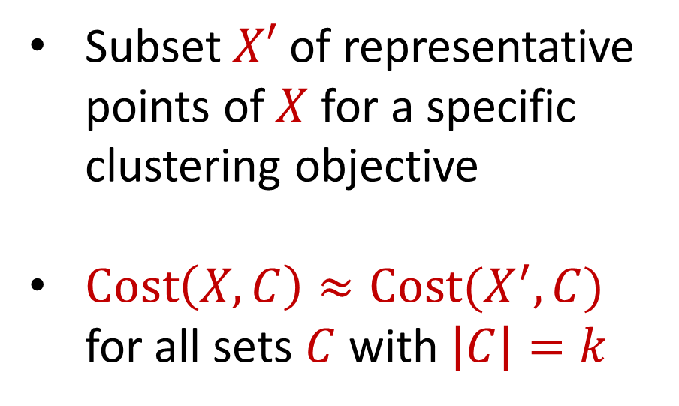
Coreset
Subset $X′$ of representative points of $X$ for a specific clustering objective
$Cost\left(X,C\right)≈Cost(X^{′},C)$ for all sets $C$ with $\left|C\right|=k$

Slide 25
Coreset
Subset $X′$ of representative points of $X$ for a specific clustering objective
$Cost\left(X,C\right)≈Cost(X^{′},C)$ for all sets $C$ with $\left|C\right|=k$

Slide 26
Coreset
Subset $X′$ of representative points of $X$ for a specific clustering objective
$Cost\left(X,C\right)≈Cost(X^{′},C)$ for all sets $C$ with $\left|C\right|=k$

Slide 27

Coreset (Formal Definition)
Given a set $X$ and an accuracy parameter $ε>0$, we say a set $X′$ with weight function $w$is an $(1+ε)$-multiplicative coreset for a cost function $Cost$, if for all queries $C$ with $\left|C\right|≤k$, we have
$$\left(1−ε\right)Cost(X,C)≤Cost(X′,C,w)≤\left(1+ε\right)Cost(X,C)$$
$(k,z)$-clustering: $Cost\left(X^{′},C,w\right)=\sum_{x∈X′}{{w\left(x\right)⋅\left(dist\left(x,C\right)\right)}^{z}}$

Slide 28
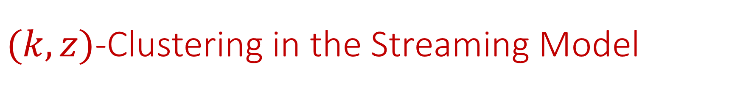

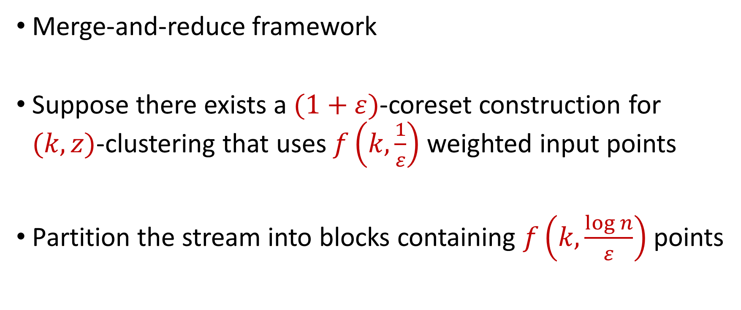
$(k,z)$-Clustering in the Streaming Model
Merge-and-reduce framework
Suppose there exists a $(1+ε)$-coreset construction for $(k,z)$-clustering that uses $f\left(k,\frac{1}{ε}\right)$ weighted input points
Partition the stream into blocks containing $f\left(k,\frac{\log{n}}{ε}\right)$ points
$$\tilde{O}\left(\frac{k^{2}}{ε^{2}}\right)$$

Slide 29
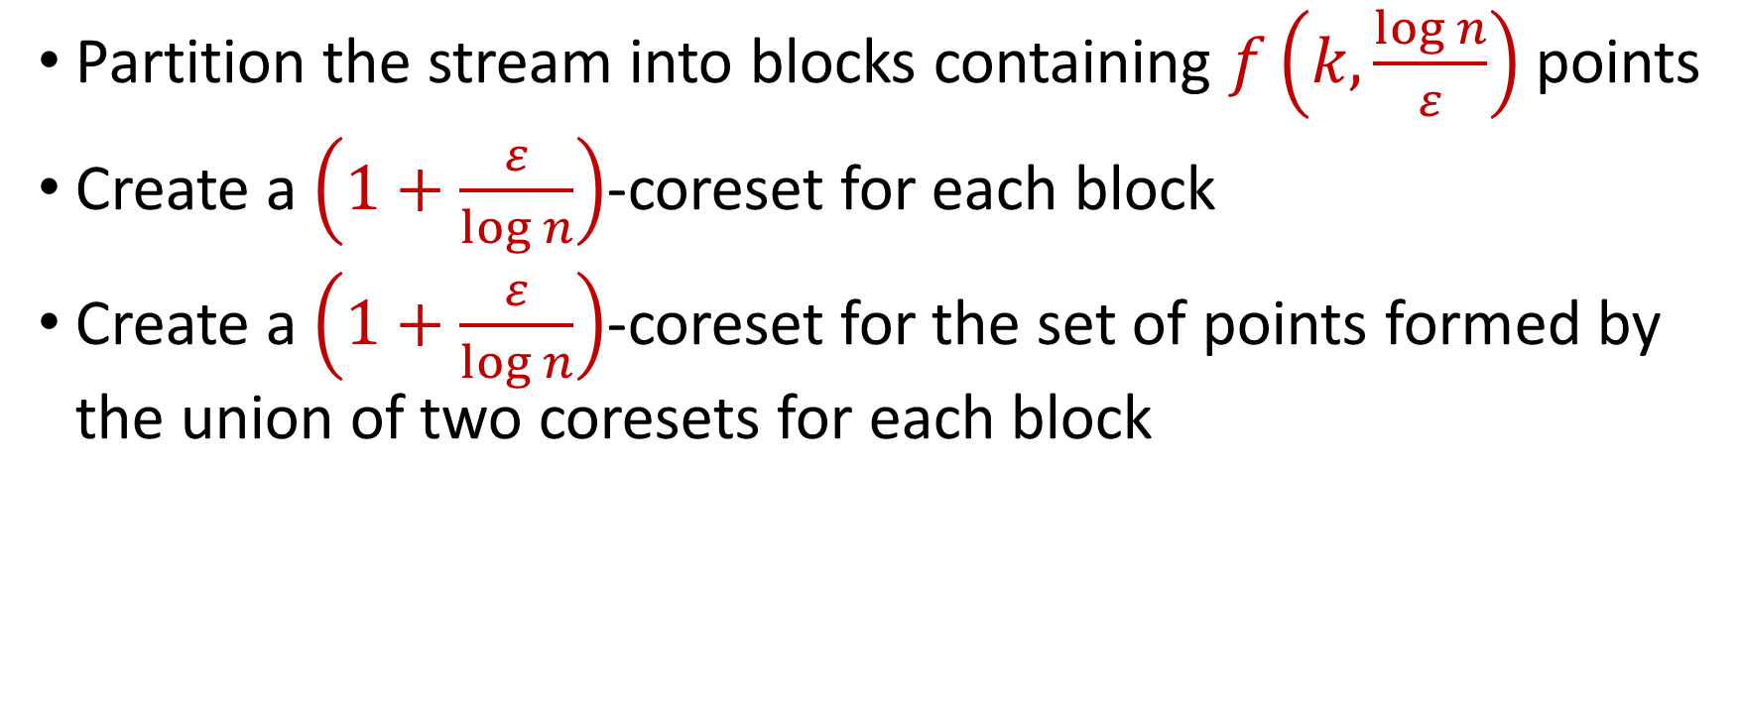
$(k,z)$-Clustering in the Streaming Model
Partition the stream into blocks containing $f\left(k,\frac{\log{n}}{ε}\right)$ points
Create a $\left(1+\frac{ε}{\log{n}}\right)$-coreset for each block
Create a $\left(1+\frac{ε}{\log{n}}\right)$-coreset for the set of points formed by the union of two coresets for each block
Reduce
Merge

Slide 30
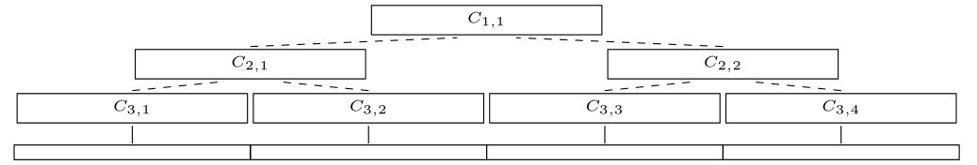
$(k,z)$-Clustering in the Streaming Model
Partition the stream into blocks containing $f\left(k,\frac{\log{n}}{ε}\right)$ points
Create a $\left(1+\frac{ε}{\log{n}}\right)$-coreset for each block
Create a $\left(1+\frac{ε}{\log{n}}\right)$-coreset for the set of points formed by the union of two coresets for each block

Slide 31
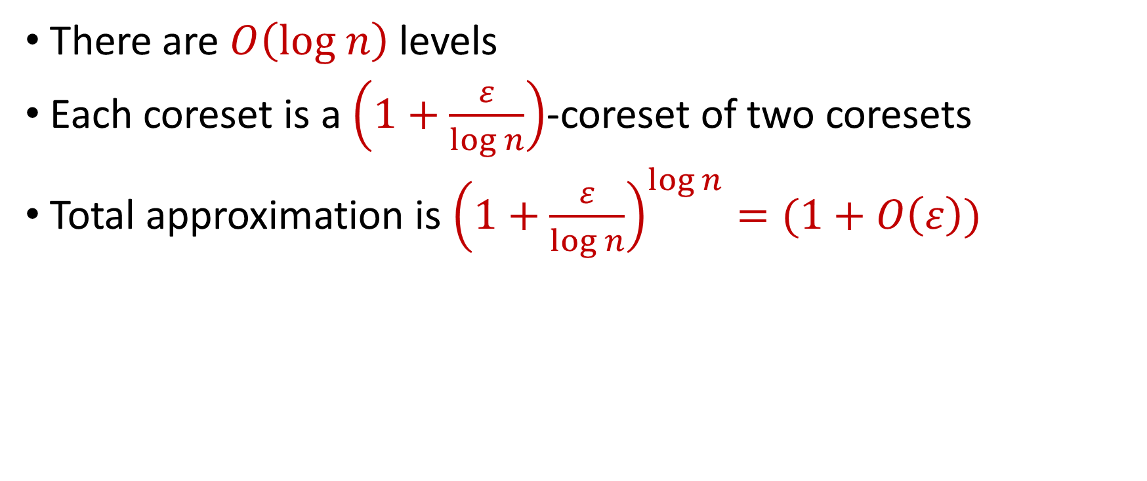
$(k,z)$-Clustering in the Streaming Model
There are $O\left(log n\right)$ levels
Each coreset is a $\left(1+\frac{ε}{\log{n}}\right)$-coreset of two coresets
Total approximation is ${\left(1+\frac{ε}{\log{n}}\right)}^{\log{n}}=(1+O\left(ε\right))$

Slide 32
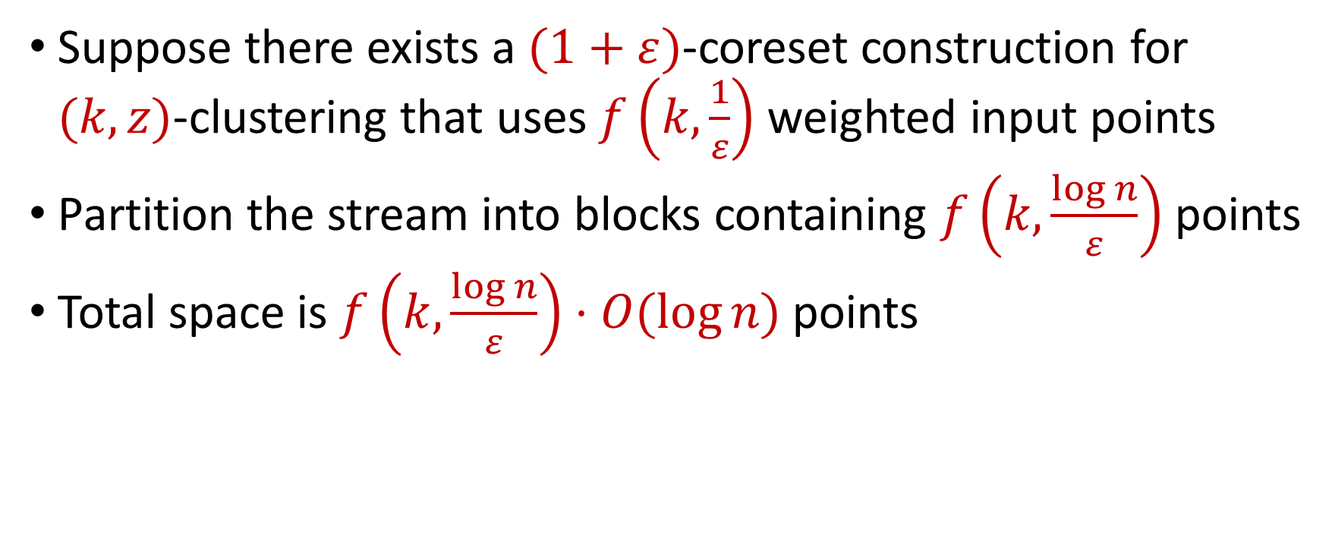
$(k,z)$-Clustering in the Streaming Model
Suppose there exists a $(1+ε)$-coreset construction for $(k,z)$-clustering that uses $f\left(k,\frac{1}{ε}\right)$ weighted input points
Partition the stream into blocks containing $f\left(k,\frac{\log{n}}{ε}\right)$ points
Total space is $f\left(k,\frac{\log{n}}{ε}\right)⋅O(log{n)}$ points
For $k$-means clustering, this is $\tilde{O}\left(\frac{k^{2}}{ε^{2}}⋅\log^{3}{n}\right)$ points

Slide 33


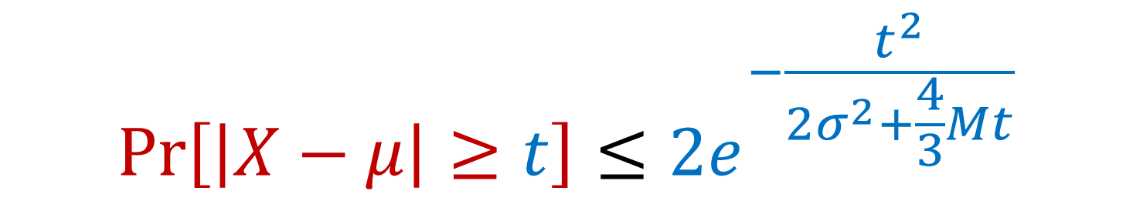
Previously: Bernstein’s Inequality
Bernstein’s inequality: Let $X_{1},…,X_{n}∈[−M,M]$ be independent random variables and let ${X=X}_{1}+…+X_{n}$ have mean $μ$ and variance $σ^{2}$. Then for any $t≥0$:
Example: Suppose $M=1$ and let $t=kσ$. Then
$$Pr\left[\left|X−μ\right|≥t\right]≤2e^{−\frac{t^{2}}{2σ^{2}+\frac{4}{3}Mt}}$$
$$Pr\left[\left|X−μ\right|≥kσ\right]≤2exp\left(−\frac{k^{2}}{4}\right)$$

Slide 34
Coreset Construction and Sampling
Consider a fixed set $X$ and a fixed set $C$ of $k$ centers, which induces a fixed cost $Cost(X,C)$

Slide 35
Coreset Construction and Sampling
Consider a fixed set $X$ and a fixed set $C$ of $k$ centers, which induces a fixed cost $Cost(X,C)$
A simple way to obtain $X′$with $Cost\left(X^{′},C\right)≈Cost(X,C)$ is to uniformly sample points of $X$ into $X′$

Slide 36
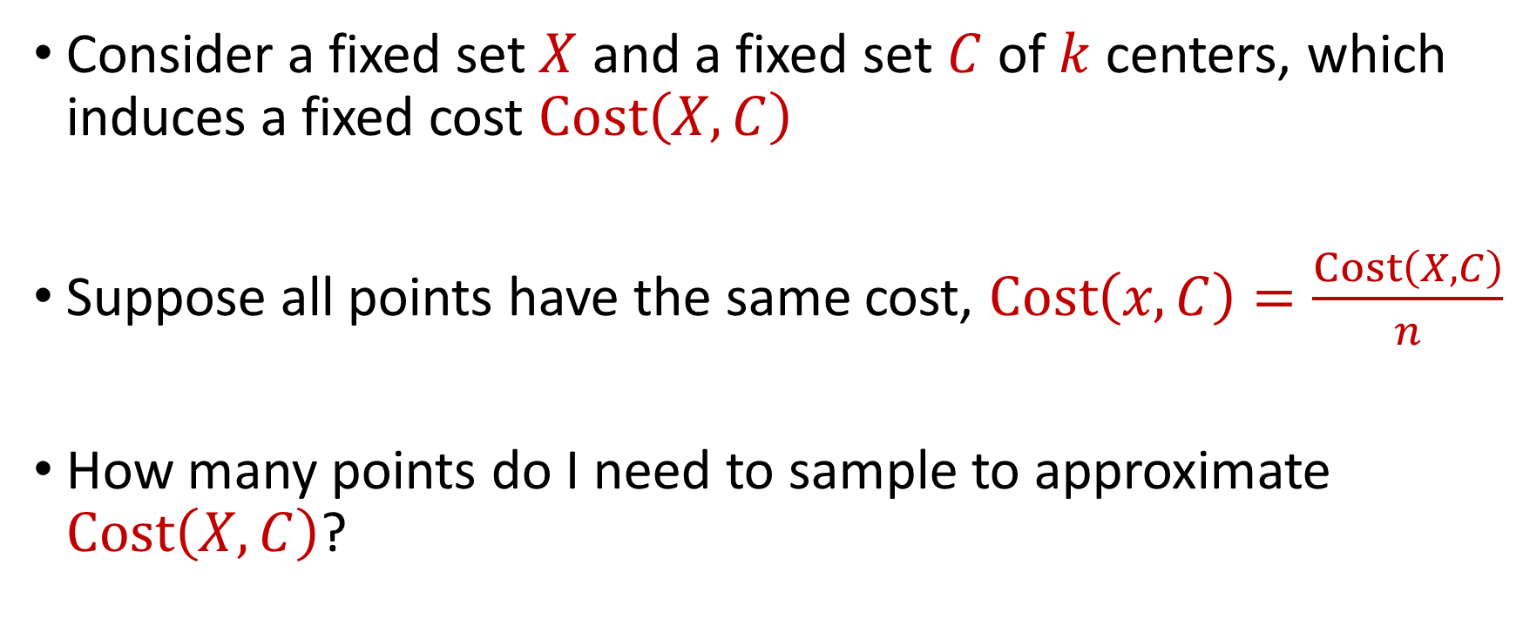
Coreset Construction and Uniform Sampling
Consider a fixed set $X$ and a fixed set $C$ of $k$ centers, which induces a fixed cost $Cost\left(X,C\right)$
Suppose all points have the same cost, $Cost\left(x,C\right)=\frac{Cost\left(X,C\right)}{n}$
How many points do I need to sample to approximate $Cost\left(X,C\right)$?

Slide 37
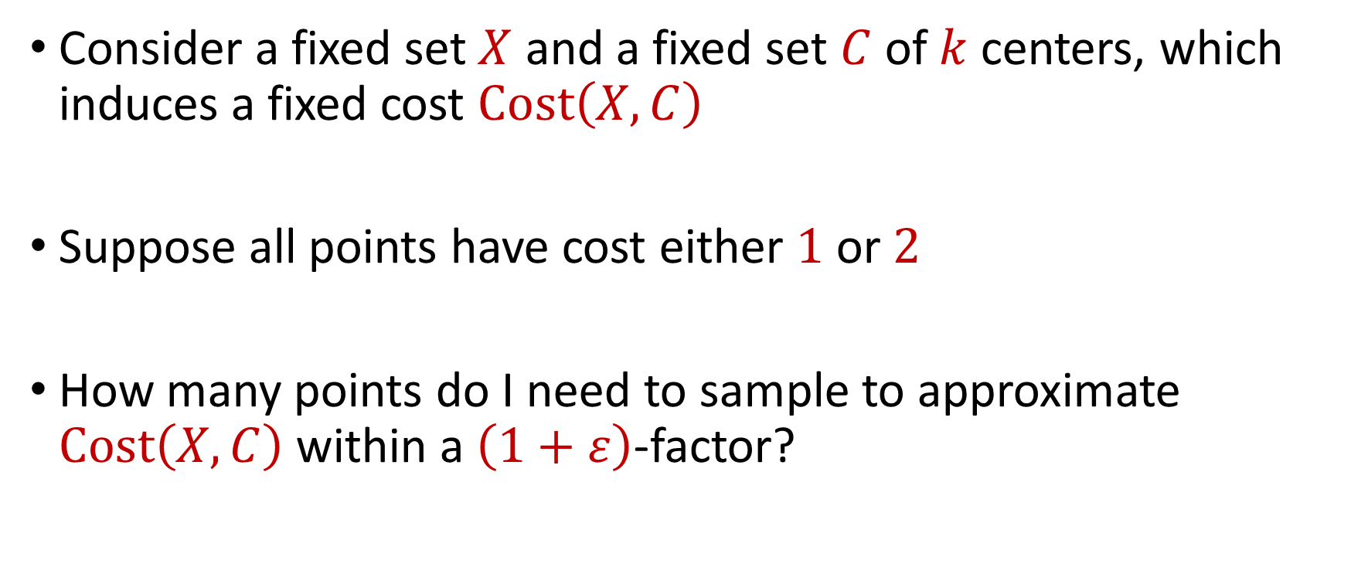
Coreset Construction and Uniform Sampling
Consider a fixed set $X$ and a fixed set $C$ of $k$ centers, which induces a fixed cost $Cost\left(X,C\right)$
Suppose all points have cost either $1$ or $2$
How many points do I need to sample to approximate $Cost\left(X,C\right)$ within a $\left(1+ε\right)$-factor?

Slide 38
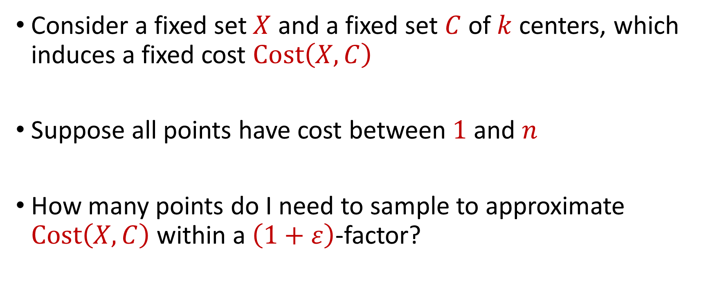
Coreset Construction and Uniform Sampling
Consider a fixed set $X$ and a fixed set $C$ of $k$ centers, which induces a fixed cost $Cost\left(X,C\right)$
Suppose all points have cost between $1$ and $n$
How many points do I need to sample to approximate $Cost\left(X,C\right)$ within a $\left(1+ε\right)$-factor?

Slide 39
Coreset Construction and Sampling
Consider a fixed set $X$ and a fixed set $C$ of $k$ centers, which induces a fixed cost $Cost(X,C)$
Uniform sampling needs a lot of samples if there is a single point that greatly contributes to $Cost(X,C)$

Slide 40
Coreset Construction and Sampling
Fix: Importance sampling, sample each point $x∈X$ into $X′$ with probability proportional $Cost(x,C)$, i.e., $Cost(x,C)/Cost(X,C)$

Slide 41
Coreset Construction and Sampling
Fix: Importance sampling, sample each point $x∈X$ into $X′$ with probability proportional $Cost(x,C)$, i.e., $Cost(x,C)/Cost(X,C)$
Importance sampling only needs $X′$ to have size $O\left(\frac{1}{ε^{2}}\right)$ to achieve $\left(1+ε\right)$-approximation to $Cost(X,C)$

Slide 42
Coreset Construction and Sampling
Importance sampling only needs $X′$ to have size $O\left(\frac{1}{ε^{2}}\right)$ to achieve $\left(1+ε\right)$-approximation to $Cost(X,C)$
What about a different choice $C$ of $k$ centers?

Slide 43
Coreset Construction and Sampling
Importance sampling only needs $X′$ to have size $O\left(\frac{1}{ε^{2}}\right)$ to achieve $\left(1+ε\right)$-approximation to $Cost(X,C)$
To handle all possible sets of $k$ centers:
Need to sample each point $x$ with probability $\max_{C}\frac{Cost\left(x,C\right)}{Cost\left(X,C\right)}$ instead of $\frac{Cost\left(x,C\right)}{Cost\left(X,C\right)}$
Need to union bound over a net of all possible sets of $k$ centers

Slide 44
Coreset Construction and Sampling
Importance sampling only needs $X′$ to have size $O\left(\frac{1}{ε^{2}}\right)$ to achieve $\left(1+ε\right)$-approximation to $Cost(X,C)$
To handle all possible sets of $k$ centers:
Need to sample each point $x$ with probability $\max_{C}\frac{Cost\left(x,C\right)}{Cost\left(X,C\right)}$ instead of $\frac{Cost\left(x,C\right)}{Cost\left(X,C\right)}$
Need to union bound over a net of all possible sets of $k$ centers
Net with size ${\left(\frac{nΔ}{ε}\right)}^{O(kd)}$

Slide 45
Sensitivity Sampling
The quantity $s\left(x\right)=\max_{C}\frac{Cost\left(x,C\right)}{Cost\left(X,C\right)}$ is called the sensitivity of $x$ and intuitively measures how “important” the point $x$ is
The total sensitivity of $X$ is $\sum_{x∈X}{s(x)}$ and quantifies how many points will be sampled into $X′$ through importance/sensitivity sampling (before the union bound)

Slide 46

$$s\left(x_{t}\right)=\max_{C:\left|C\right|≤k}{\frac{Cost\left(x_{t},C\right)}{Cost\left(X,C\right)}}=\max_{C:\left|C\right|≤k}{\frac{Cost\left(x_{t},C\right)}{\sum_{i=1}^{n}{Cost\left(x_{i},C\right)}}}$$

Slide 47
$$s\left(x_{t}\right)=\max_{C:\left|C\right|≤k}{\frac{Cost\left(x_{t},C\right)}{Cost\left(X,C\right)}}=\max_{C:\left|C\right|≤k}{\frac{Cost\left(x_{t},C\right)}{\sum_{i=1}^{n}{Cost\left(x_{i},C\right)}}}$$
Point has sensitivity $1$

Slide 48
$$s\left(x_{t}\right)=\max_{C:\left|C\right|≤k}{\frac{Cost\left(x_{t},C\right)}{Cost\left(X,C\right)}}=\max_{C:\left|C\right|≤k}{\frac{Cost\left(x_{t},C\right)}{\sum_{i=1}^{n}{Cost\left(x_{i},C\right)}}}$$
Point has sensitivity $1$
Point has sensitivity $1$

Slide 49
$$s\left(x_{t}\right)=\max_{C:\left|C\right|≤k}{\frac{Cost\left(x_{t},C\right)}{Cost\left(X,C\right)}}=\max_{C:\left|C\right|≤k}{\frac{Cost\left(x_{t},C\right)}{\sum_{i=1}^{n}{Cost\left(x_{i},C\right)}}}$$
Point has sensitivity $1$
Point has sensitivity $1$
Point has sensitivity $1$

Slide 50
$$s\left(x_{t}\right)=\max_{C:\left|C\right|≤k}{\frac{Cost\left(x_{t},C\right)}{Cost\left(X,C\right)}}=\max_{C:\left|C\right|≤k}{\frac{Cost\left(x_{t},C\right)}{\sum_{i=1}^{n}{Cost\left(x_{i},C\right)}}}$$
Point has sensitivity $1$
Point has sensitivity $1$
Point has sensitivity $1$
Point has sensitivity $1$

Slide 51
$$s\left(x_{t}\right)=\max_{C:\left|C\right|≤k}{\frac{Cost\left(x_{t},C\right)}{Cost\left(X,C\right)}}=\max_{C:\left|C\right|≤k}{\frac{Cost\left(x_{t},C\right)}{\sum_{i=1}^{n}{Cost\left(x_{i},C\right)}}}$$
Point has sensitivity $1$
Point has sensitivity $1$
Point has sensitivity $1$
Point has sensitivity $1$
Point has sensitivity $1$

Slide 52
$$s\left(x_{t}\right)=\max_{C:\left|C\right|≤k}{\frac{Cost\left(x_{t},C\right)}{Cost\left(X,C\right)}}=\max_{C:\left|C\right|≤k}{\frac{Cost\left(x_{t},C\right)}{\sum_{i=1}^{n}{Cost\left(x_{i},C\right)}}}$$
Point has sensitivity $1$
Point has sensitivity $1$
Point has sensitivity $1$
Point has sensitivity $1$
Point has sensitivity $1$
Point has sensitivity $1$

Slide 53
$$s\left(x_{t}\right)=\max_{C:\left|C\right|≤k}{\frac{Cost\left(x_{t},C\right)}{Cost\left(X,C\right)}}=\max_{C:\left|C\right|≤k}{\frac{Cost\left(x_{t},C\right)}{\sum_{i=1}^{n}{Cost\left(x_{i},C\right)}}}$$
Point has sensitivity $1$
Point has sensitivity $1$
Point has sensitivity $1$
Point has sensitivity $1$
Point has sensitivity $1$
Point has sensitivity $1$
Point has sensitivity $1$

Slide 54
Sum of Online Sensitivity
Sum of online sensitivities can be at least $k$
How large can it be?

Slide 55
$$s\left(x_{t}\right)=\max_{C:\left|C\right|≤k}{\frac{Cost\left(x_{t},C\right)}{Cost\left(X,C\right)}}=\max_{C:\left|C\right|≤k}{\frac{Cost\left(x_{t},C\right)}{\sum_{i=1}^{n}{Cost\left(x_{i},C\right)}}}$$

Slide 56
$$s\left(x_{t}\right)=\max_{C:\left|C\right|≤k}{\frac{Cost\left(x_{t},C\right)}{Cost\left(X,C\right)}}=\max_{C:\left|C\right|≤k}{\frac{Cost\left(x_{t},C\right)}{\sum_{i=1}^{n}{Cost\left(x_{i},C\right)}}}$$

Slide 57
$$s\left(x_{t}\right)=\max_{C:\left|C\right|≤k}{\frac{Cost\left(x_{t},C\right)}{Cost\left(X,C\right)}}=\max_{C:\left|C\right|≤k}{\frac{Cost\left(x_{t},C\right)}{\sum_{i=1}^{n}{Cost\left(x_{i},C\right)}}}$$

Slide 58
$$s\left(x_{t}\right)=\max_{C:\left|C\right|≤k}{\frac{Cost\left(x_{t},C\right)}{Cost\left(X,C\right)}}=\max_{C:\left|C\right|≤k}{\frac{Cost\left(x_{t},C\right)}{\sum_{i=1}^{n}{Cost\left(x_{i},C\right)}}}$$

Slide 59
$$s\left(x_{t}\right)=\max_{C:\left|C\right|≤k}{\frac{Cost\left(x_{t},C\right)}{Cost\left(X,C\right)}}=\max_{C:\left|C\right|≤k}{\frac{Cost\left(x_{t},C\right)}{\sum_{i=1}^{n}{Cost\left(x_{i},C\right)}}}$$
Partition the sum of the sensitivities by each cluster

Slide 60
$$s\left(x_{t}\right)=\max_{C:\left|C\right|≤k}{\frac{Cost\left(x_{t},C\right)}{Cost\left(X,C\right)}}=\max_{C:\left|C\right|≤k}{\frac{Cost\left(x_{t},C\right)}{\sum_{i=1}^{n}{Cost\left(x_{i},C\right)}}}$$
Charge to $OPT$
Charge to $OPT$

Slide 61
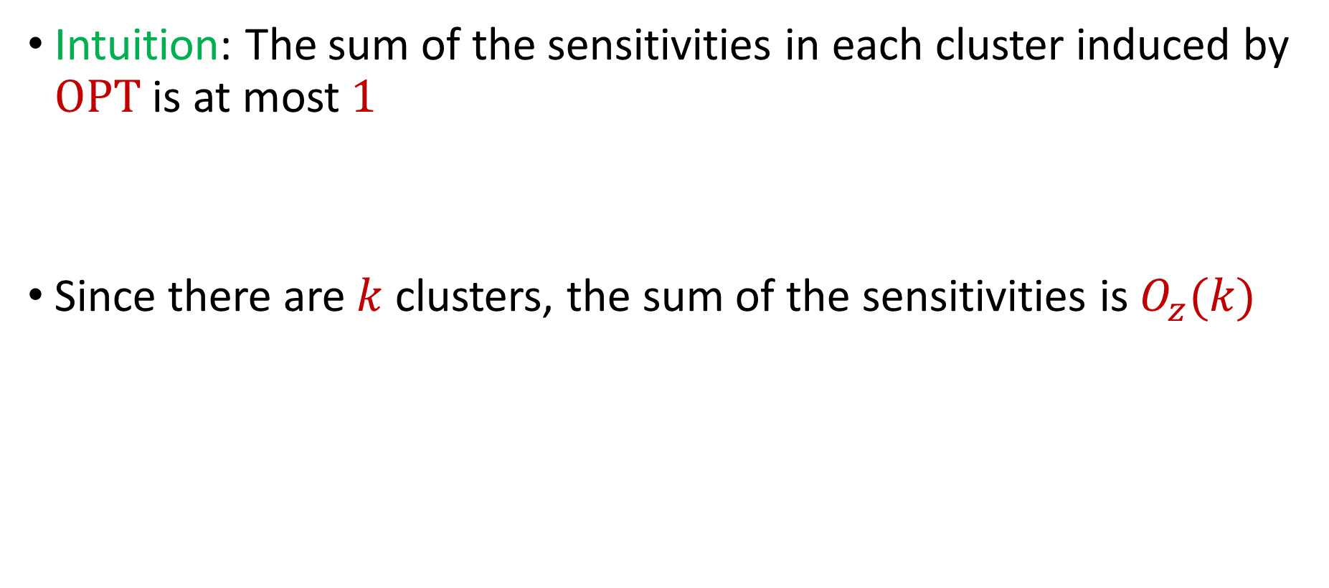
Sum of Online Sensitivity
Intuition: The sum of the sensitivities in each cluster induced by $OPT$ is at most $1$
Since there are $k$ clusters, the sum of the sensitivities is $O_{z}(k)$

Slide 62


census.gov:

Slide 63


Private Data Analysis
Sensitive dataset
Analyst
Analysis of medical datasets to predict possible issues
Pattern detection for social networks or epidemic spread
US Census information for apportionment

Slide 64

Anonymization
Sensitive dataset
Anonymized dataset
Analyst

Slide 65
Anonymizing Data
Age | Zip Code | Employer | Has Pet
56 | 77005 | Apple | Yes
32 | 77005 | Microsoft | No
71 | 77005 | Amazon | Yes
44 | 77005 | Petsmart | Yes
25 | 77005 | Netflix | No
61 | 77005 | Google | No

Slide 66
Anonymizing Data
Age | Zip Code | Employer | Has Pet
56 | 77005 | Apple | Yes
32 | 77005 | Microsoft | No
71 | 77005 | Amazon | Yes
44 | 77005 | Petsmart | Yes
25 | 77005 | Netflix | No
61 | 77005 | Google | No
Name | Age | Gender | Employer
Alice | 56 | Female | Apple
Bob | 32 | Male | Microsoft
Carol | 71 | Female | Amazon
Dale | 44 | Male | Petsmart
Erin | 25 | Female | Netflix
Fred | 61 | Male | Google

Slide 67
Reconstruction Attack
Name | Age | Zip Code | Gender | Employer | Has Pet
Alice | 56 | 77005 | Female | Apple | Yes
Bob | 32 | 77005 | Male | Microsoft | No
Carol | 71 | 77005 | Female | Amazon | Yes
Dale | 44 | 77005 | Male | Petsmart | Yes
Erin | 25 | 77005 | Female | Netflix | No
Fred | 61 | 77005 | Male | Google | No

Slide 68
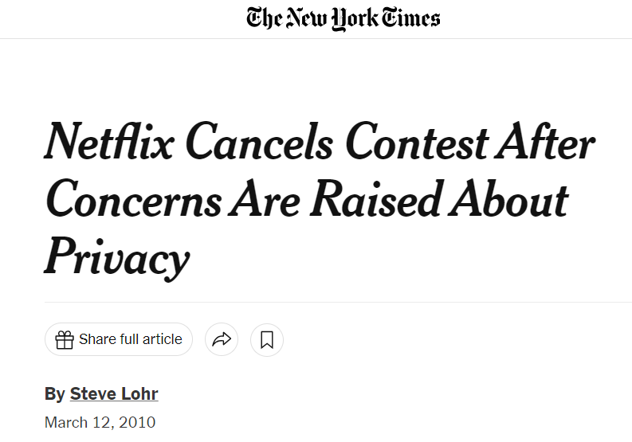
Anonymizing Data

Slide 69
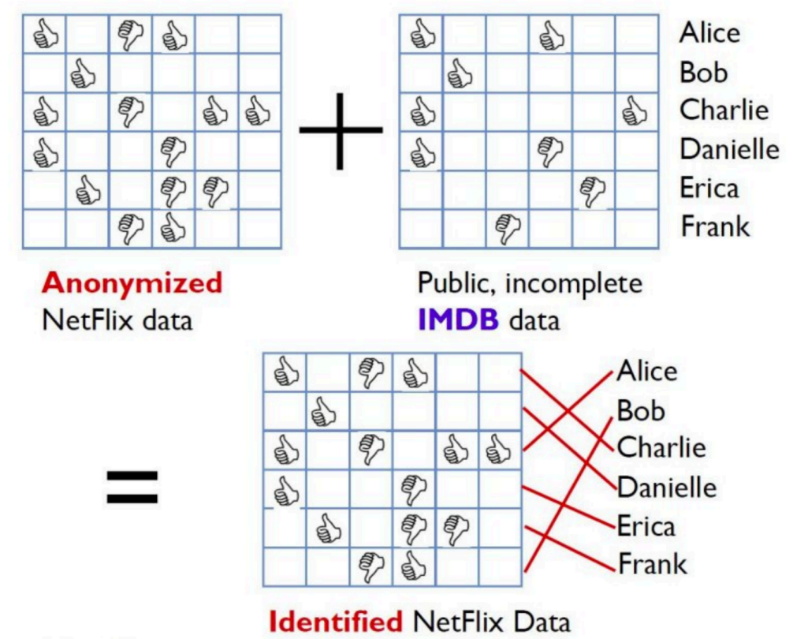
Image from Arvind Narayanan

Slide 70
Differencing Attacks
How many people in this classroom went to Kyle Field last weekend?
How many people in this classroom besides the instructor went to Kyle Field last weekend?

Slide 71
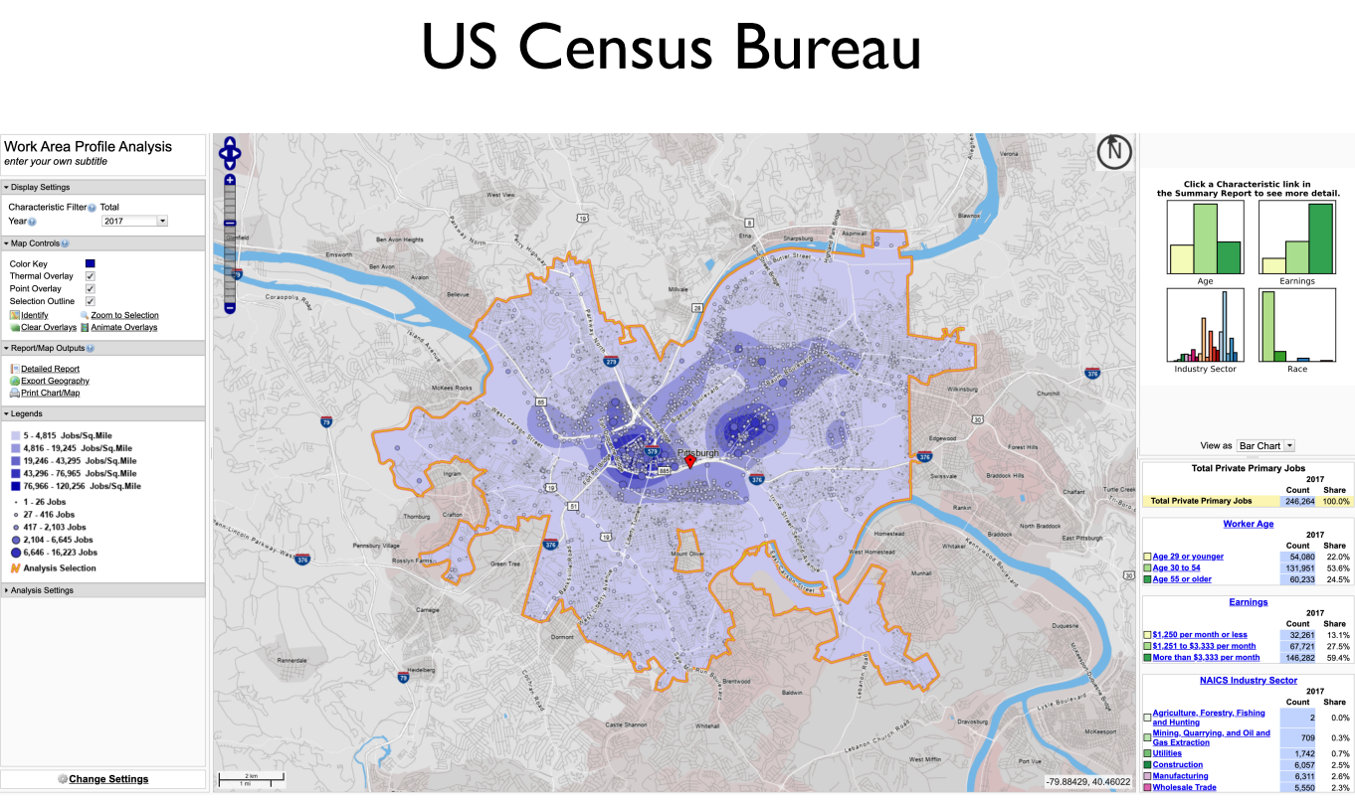
Slide from Steven Wu

Slide 72
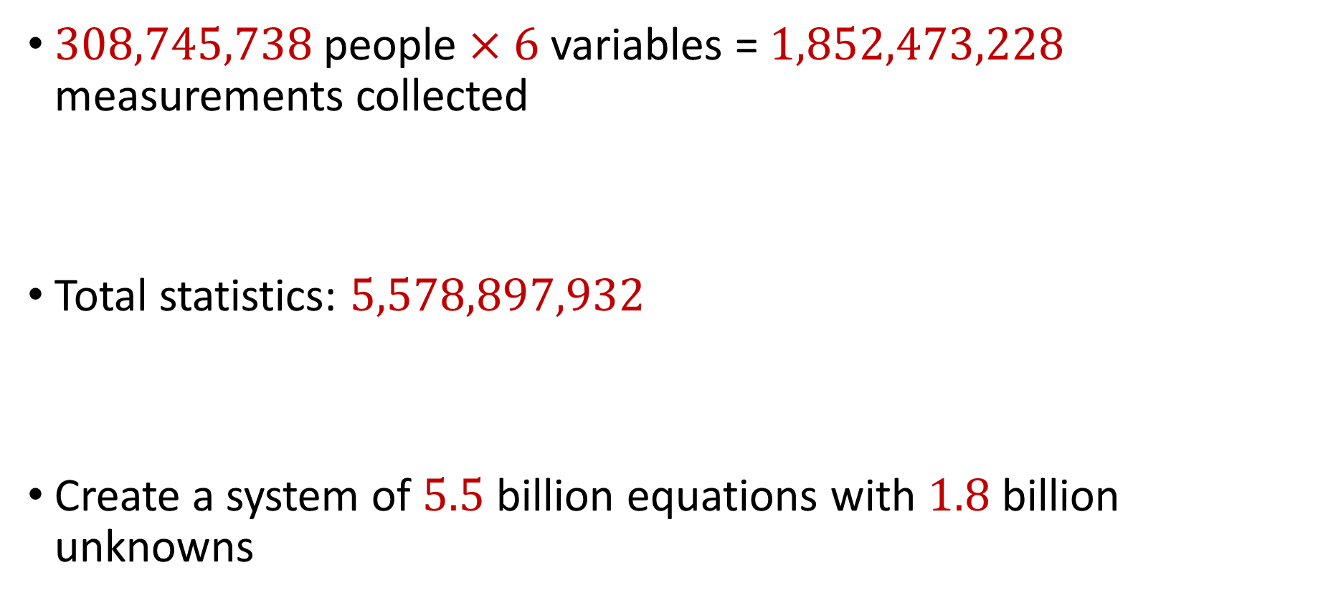
2010 US Census
$308,745,738$ people $×$ $6$ variables = $1,852,473,228$ measurements collected
Total statistics: $5,578,897,932$
Create a system of $5.5$ billion equations with $1.8$ billion unknowns

Slide 73
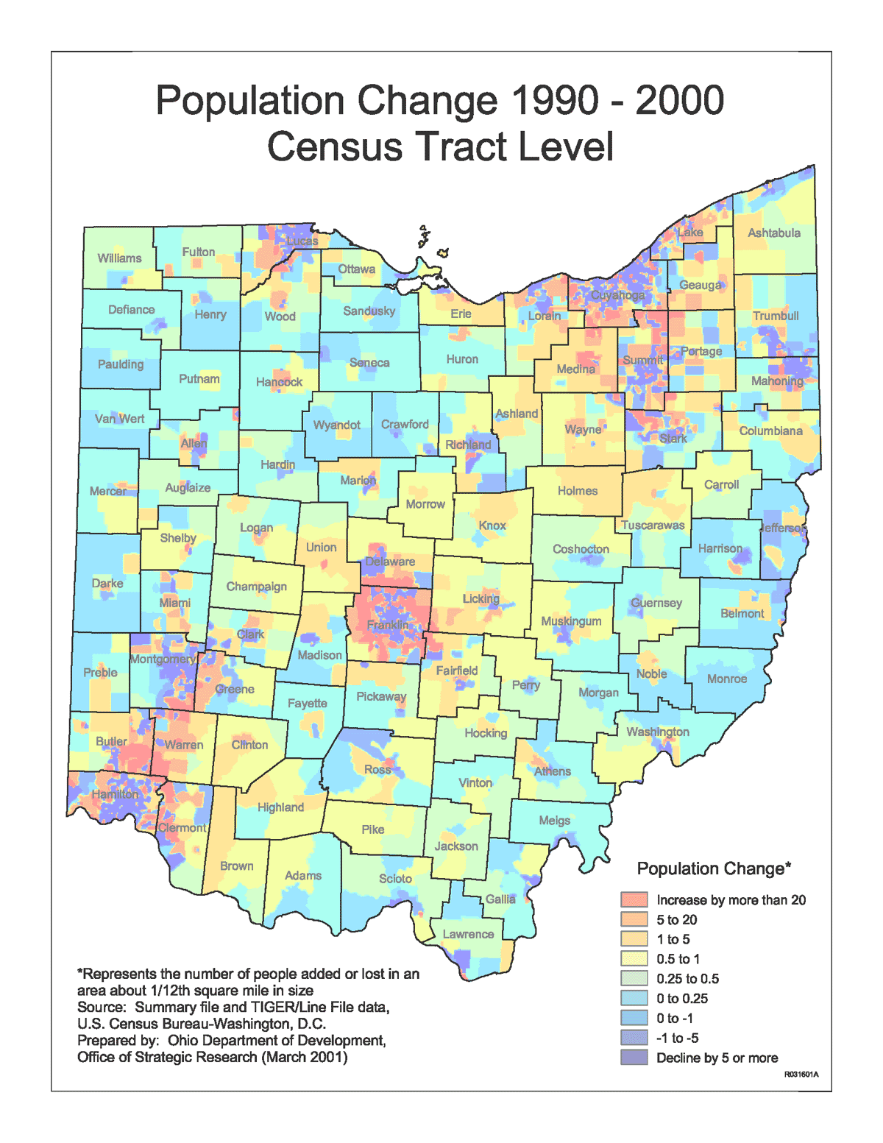
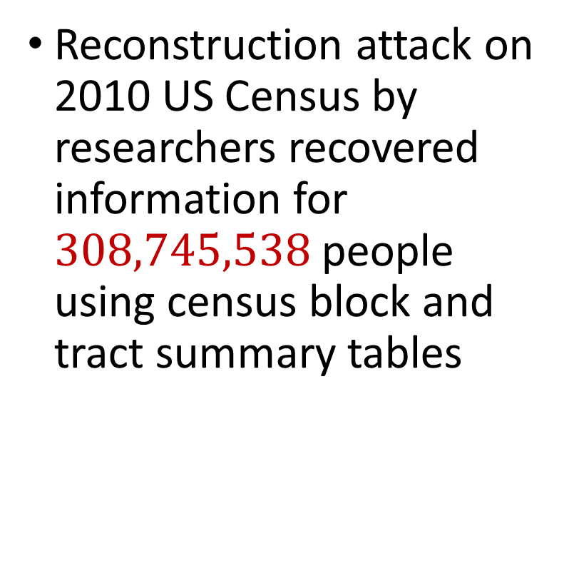
2010 US Census
Reconstruction attack on 2010 US Census by researchers recovered information for $308,745,538$ people using census block and tract summary tables

Slide 74
Summary
“Ad-hoc” privacy procedures like anonymization/deidentification often fails
Publishing too many queries on a sensitive database with too much accuracy can compromise the privacy of the database
Need a formal mathematical notion for measuring privacy

Slide 75

Possible Notion for Privacy #1
“The data analyst cannot learn anything about Alice”
Sensitive dataset
Analyst

Slide 76
Possible Notion for Privacy #1
“The data analyst cannot learn anything about Alice”
Most Aggies like Reveille
Alice is known to be an Aggie
Sensitive dataset
Analyst
Was Alice’s privacy violated?

Slide 77

Possible Notion for Privacy #1
“The data analyst cannot learn anything about Alice”
Most Aggies like Reveille
Bob participates in the survey
Sensitive dataset
Analyst
Even though Alice is not in the survey, it is still known that Alice is an Aggie

Slide 78
Possible Notion for Privacy #1
Suppose a survey is conducted on a sensitive dataset and concludes that “most Aggies like Reveille”
Alice is a known Aggie, and so a data analyst infers that Alice is more likely to be a dog owner and asks for higher apartment cleaning rates
Was Alice’s privacy violated by this study?

Slide 79
Possible Notion for Privacy #2
“A study is private…if the data analyst gains almost no additional information about Alice from the study than if the same study was performed without Alice’s data”

Slide 80

Possible Notion for Privacy #2
Stability: the data analyst reaches roughly similar conclusions if any individual data point is replaced by another data point of the population

Slide 81


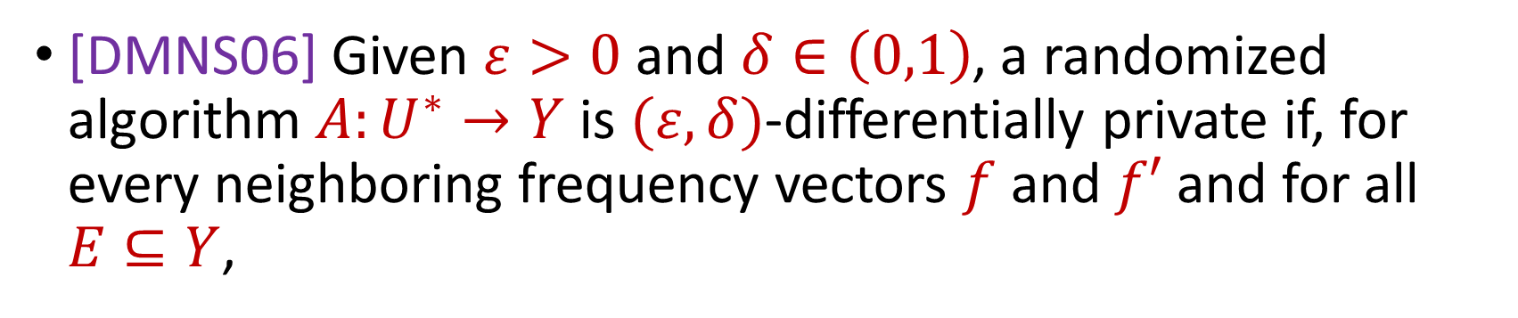

Differential Privacy
[DMNS06] Given $ε>0$and $δ∈\left(0,1\right)$, a randomized algorithm $A:U^{∗}→Y$ is $(ε,δ)$-differentially private if, for every neighboring frequency vectors $f$ and $f′$ and for all $E⊆Y$,
$$Pr\left[A\left(f\right)∈E\right]≤e^{ε}Pr\left[A\left(f^{′}\right)∈E\right]+δ$$
$$A\left( \right)≈A\left( \right)$$
Notes:
[DworkMcSherryNissimSmith06]

Slide 82
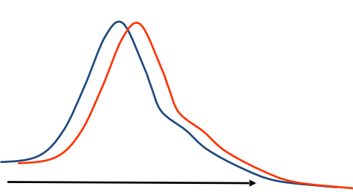
Differential Privacy
[DMNS06] Given $ε>0$and $δ∈\left(0,1\right)$, a randomized algorithm $A:U^{∗}→Y$ is $(ε,δ)$-differentially private if, for every neighboring frequency vectors $f$ and $f′$ and for all $E⊆Y$,
$$Pr\left[A\left(f\right)∈E\right]≤e^{ε}Pr\left[A\left(f^{′}\right)∈E\right]+δ$$
Sensitive dataset
Algorithm
Output distribution
Notes:
[DworkMcSherryNissimSmith06]

