Slide 1
CSCE 658: Randomized Algorithms
Lecture 19
Samson Zhou

Slide 2
Relevant Supplementary Material
Chapter 1-3 of “The Algorithmic Foundations of Differential Privacy”, by Cynthia Dwork and Aaron Roth (https://www.cis.upenn.edu/~aaroth/Papers/privacybook.pdf)

Slide 3

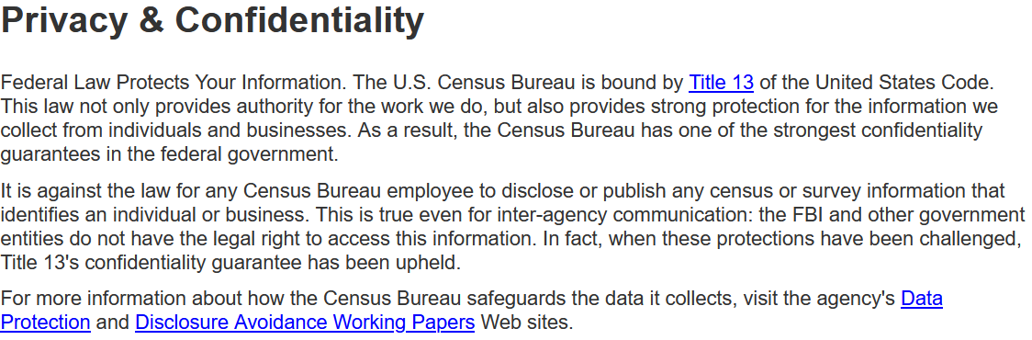
census.gov:

Slide 4


Private Data Analysis
Sensitive dataset
Analyst
Analysis of medical datasets to predict possible issues
Pattern detection for social networks or epidemic spread
US Census information for apportionment

Slide 5

Anonymization
Sensitive dataset
Anonymized dataset
Analyst

Slide 6
Anonymizing Data
Age | Zip Code | Employer | Has Pet
56 | 77005 | Apple | Yes
32 | 77005 | Microsoft | No
71 | 77005 | Amazon | Yes
44 | 77005 | Petsmart | Yes
25 | 77005 | Netflix | No
61 | 77005 | Google | No

Slide 7
Anonymizing Data
Age | Zip Code | Employer | Has Pet
56 | 77005 | Apple | Yes
32 | 77005 | Microsoft | No
71 | 77005 | Amazon | Yes
44 | 77005 | Petsmart | Yes
25 | 77005 | Netflix | No
61 | 77005 | Google | No
Name | Age | Gender | Employer
Alice | 56 | Female | Apple
Bob | 32 | Male | Microsoft
Carol | 71 | Female | Amazon
Dale | 44 | Male | Petsmart
Erin | 25 | Female | Netflix
Fred | 61 | Male | Google

Slide 8
Reconstruction Attack
Name | Age | Zip Code | Gender | Employer | Has Pet
Alice | 56 | 77005 | Female | Apple | Yes
Bob | 32 | 77005 | Male | Microsoft | No
Carol | 71 | 77005 | Female | Amazon | Yes
Dale | 44 | 77005 | Male | Petsmart | Yes
Erin | 25 | 77005 | Female | Netflix | No
Fred | 61 | 77005 | Male | Google | No

Slide 9
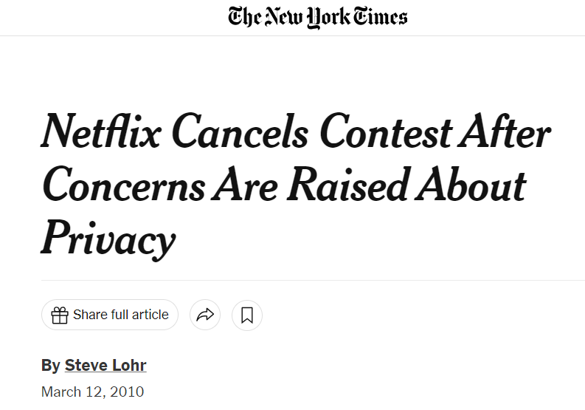
Anonymizing Data

Slide 10
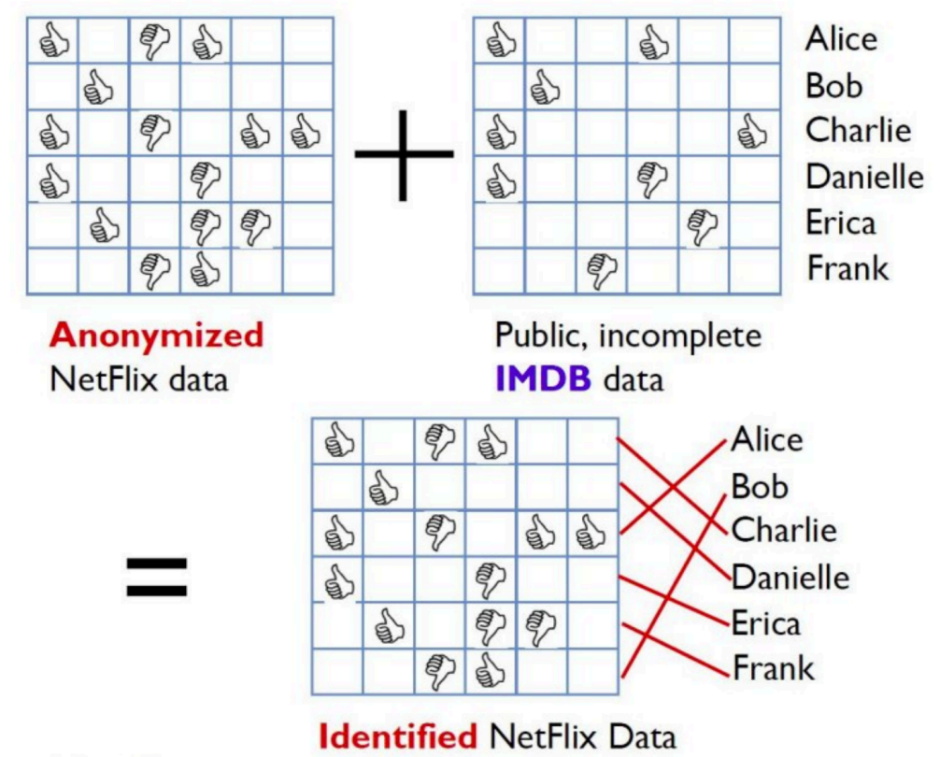
Image from Arvind Narayanan

Slide 11
Differencing Attacks
How many people in this classroom went to Kyle Field last weekend?

Slide 12
Differencing Attacks
How many people in this classroom went to Kyle Field last weekend?
How many people in this classroom besides the instructor went to Kyle Field last weekend?

Slide 13
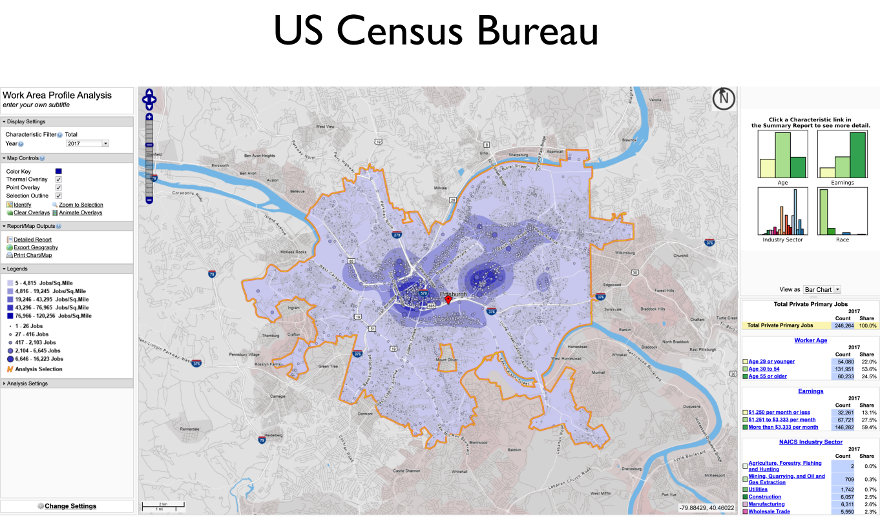
Slide from Steven Wu

Slide 14
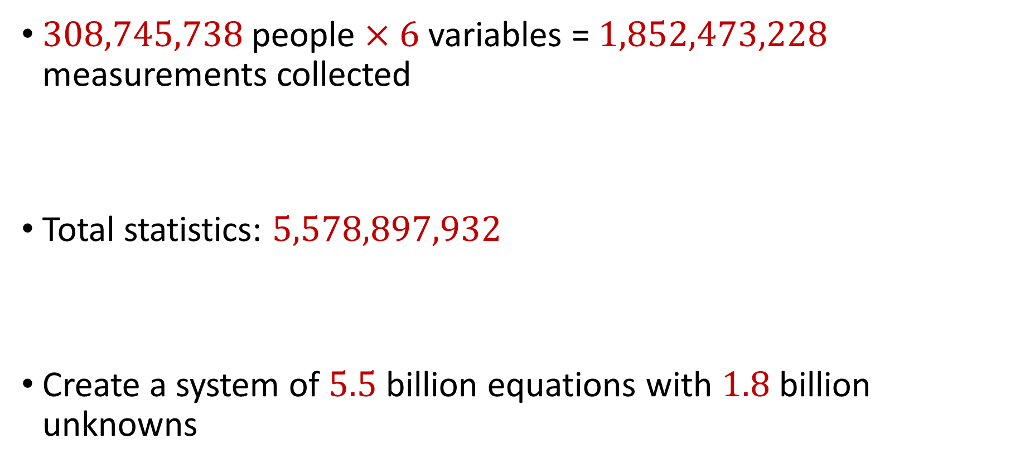
2010 US Census
$308,745,738$ people $×$ $6$ variables = $1,852,473,228$ measurements collected
Total statistics: $5,578,897,932$
Create a system of $5.5$ billion equations with $1.8$ billion unknowns

Slide 15
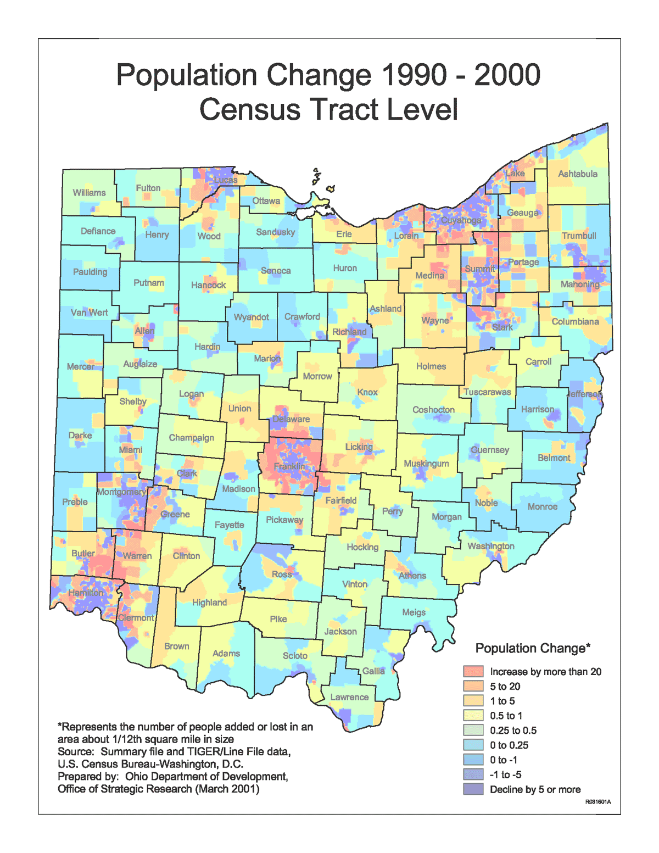
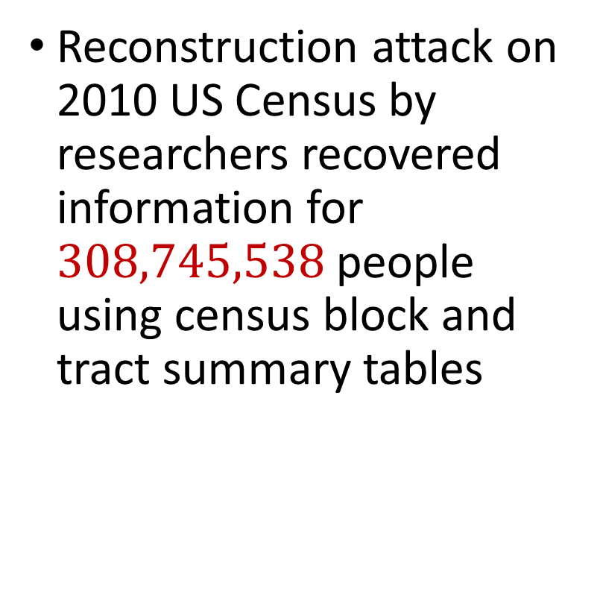
2010 US Census
Reconstruction attack on 2010 US Census by researchers recovered information for $308,745,538$ people using census block and tract summary tables

Slide 16
Summary
“Ad-hoc” privacy procedures like anonymization/deidentification often fails
Publishing too many queries on a sensitive database with too much accuracy can compromise the privacy of the database
Need a formal mathematical notion for measuring privacy

Slide 17
Counterpoints
Data cannot be fully anonymized and remain useful
Re-identification of anonymized records is not the only risk
Query auditing is problematic (can itself reveal information)

Slide 18

Possible Notion for Privacy #1
“The data analyst cannot learn anything about Alice”
Sensitive dataset
Analyst

Slide 19
Possible Notion for Privacy #1
“The data analyst cannot learn anything about Alice”
Most Aggies like Reveille
Alice is known to be an Aggie
Sensitive dataset
Analyst
Was Alice’s privacy violated?

Slide 20

Possible Notion for Privacy #1
“The data analyst cannot learn anything about Alice”
Most Aggies like Reveille
Bob participates in the survey
Sensitive dataset
Analyst
Even though Alice is not in the survey, it is still known that Alice is an Aggie

Slide 21
Possible Notion for Privacy #1
Suppose a survey is conducted on a sensitive dataset and concludes that “most Aggies like Reveille”
Alice is a known Aggie, and so a data analyst infers that Alice is more likely to be a dog owner and asks for higher apartment cleaning rates
Was Alice’s privacy violated by this study?

Slide 22
Possible Notion for Privacy #2
“A study is private…if the data analyst gains almost no additional information about Alice from the study than if the same study was performed without Alice’s data”

Slide 23

Possible Notion for Privacy #2
Stability: the data analyst reaches roughly similar conclusions if any individual data point is replaced by another data point of the population

Slide 24
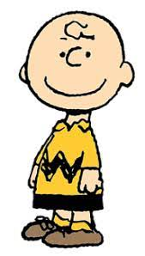

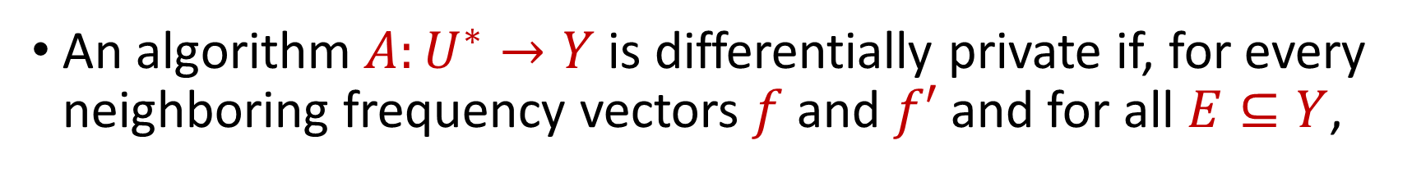

Toward Differential Privacy
An algorithm $A:U^{∗}→Y$ is differentially private if, for every neighboring frequency vectors $f$ and $f′$ and for all $E⊆Y$,
$$Pr\left[A\left(f\right)∈E\right]≈Pr\left[A\left(f^{′}\right)∈E\right]$$
$$A\left( \right)≈A\left( \right)$$
Notes:
[DworkMcSherryNissimSmith06]

Slide 25
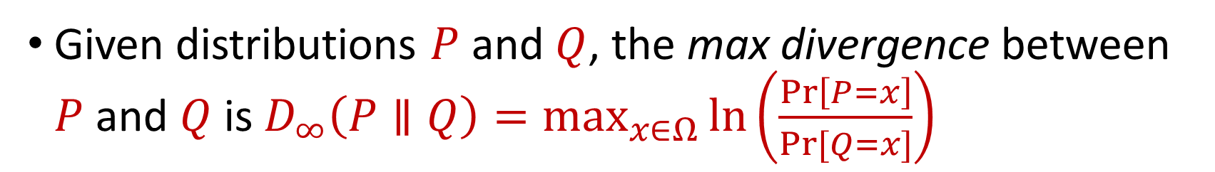
Max Divergence
Given distributions $P$ and $Q$, the max divergence between $P$ and $Q$ is $D_{∞}\left(P∥Q\right)=\max_{x∈Ω}{\ln\left(\frac{\operatorname{Pr}\left[P=x\right]}{Pr⁡[Q=x]}\right)}$
$$A\left( \right)≈A\left( \right)$$
Notes:
[DworkMcSherryNissimSmith06]

Slide 26
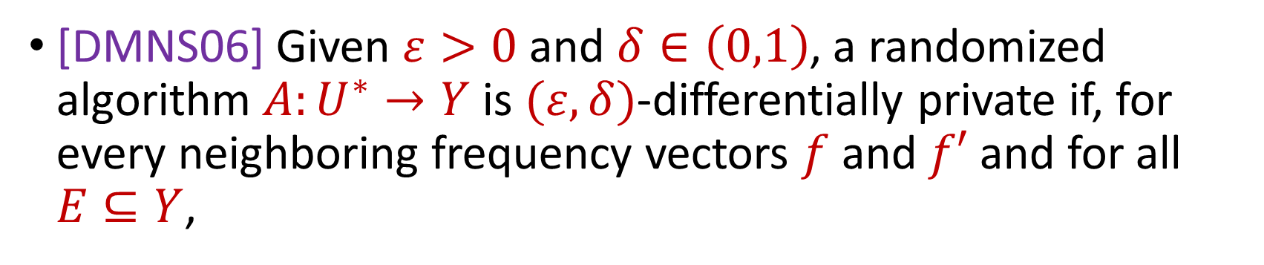
Differential Privacy
[DMNS06] Given $ε>0$and $δ∈\left(0,1\right)$, a randomized algorithm $A:U^{∗}→Y$ is $(ε,δ)$-differentially private if, for every neighboring frequency vectors $f$ and $f′$ and for all $E⊆Y$,
$$Pr\left[A\left(f\right)∈E\right]≤e^{ε}⋅Pr\left[A\left(f^{′}\right)∈E\right]+δ$$
$$A\left( \right)≈A\left( \right)$$
Notes:
[DworkMcSherryNissimSmith06]

Slide 27
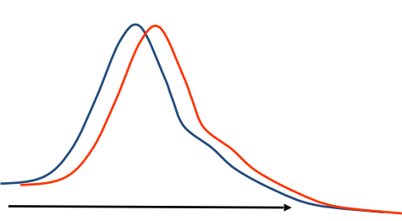
Differential Privacy
[DMNS06] Given $ε>0$and $δ∈\left(0,1\right)$, a randomized algorithm $A:U^{∗}→Y$ is $(ε,δ)$-differentially private if, for every neighboring frequency vectors $f$ and $f′$ and for all $E⊆Y$,
$$Pr\left[A\left(f\right)∈E\right]≤e^{ε}⋅Pr\left[A\left(f^{′}\right)∈E\right]+δ$$
Sensitive dataset
Algorithm
Output distribution
Notes:
[DworkMcSherryNissimSmith06]

Slide 28
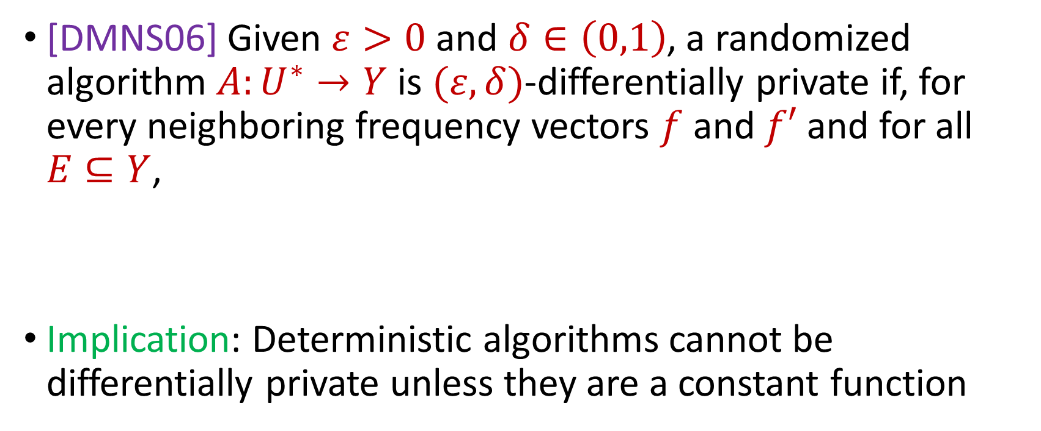
Differential Privacy
[DMNS06] Given $ε>0$and $δ∈\left(0,1\right)$, a randomized algorithm $A:U^{∗}→Y$ is $(ε,δ)$-differentially private if, for every neighboring frequency vectors $f$ and $f′$ and for all $E⊆Y$,
Implication: Deterministic algorithms cannot be differentially private unless they are a constant function
$$Pr\left[A\left(f\right)∈E\right]≤e^{ε}⋅Pr\left[A\left(f^{′}\right)∈E\right]+δ$$
Notes:
[DworkMcSherryNissimSmith06]

Slide 29
Differential Privacy Properties
What properties would we like from a rigorous definition of privacy?
Notes:
[DworkMcSherryNissimSmith06]

Slide 30
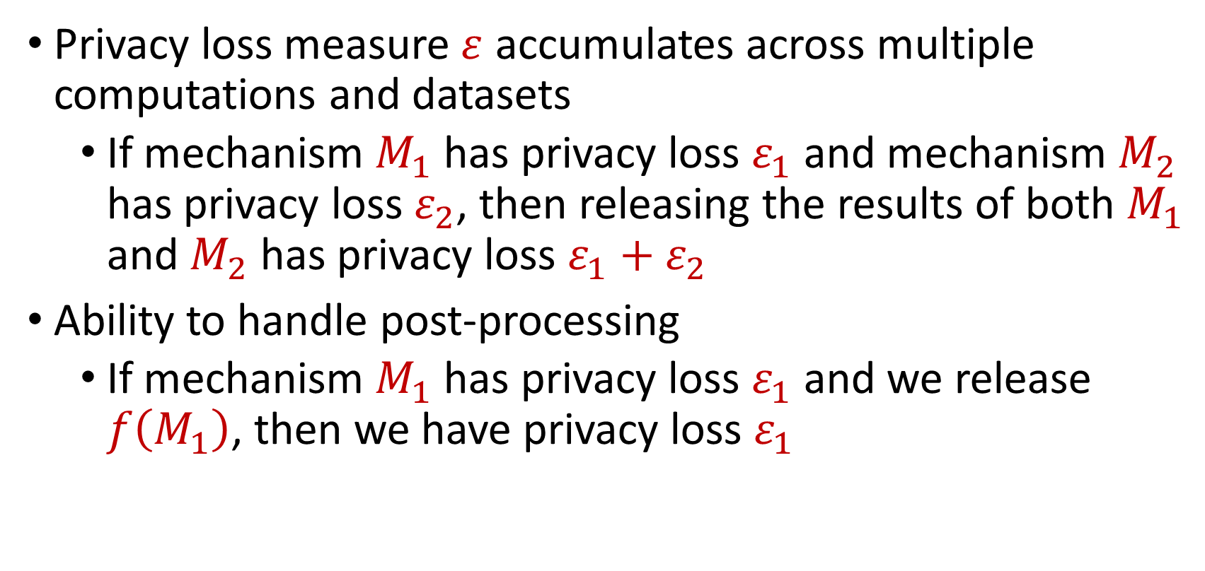
Differential Privacy Properties
Privacy loss measure $ε$ accumulates across multiple computations and datasets
If mechanism $M_{1}$ has privacy loss $ε_{1}$ and mechanism $M_{2}$ has privacy loss $ε_{2}$, then releasing the results of both $M_{1}$ and $M_{2}$ has privacy loss $ε_{1}+ε_{2}$
Ability to handle post-processing
If mechanism $M_{1}$ has privacy loss $ε_{1}$ and we release $f\left(M_{1}\right)$, then we have privacy loss $ε_{1}$
Notes:
[DworkMcSherryNissimSmith06]

Slide 31
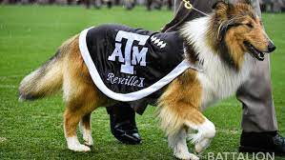
Counting
How many people in the population satisfy some property?
How many people in this class have a pet?
Notes:
[DworkMcSherryNissimSmith06]

Slide 32
Counting
How many people in this class have a pet?
What happens if each person answers with their truth?
Notes:
[DworkMcSherryNissimSmith06]

Slide 33
Counting
How many people in this class have a pet?
What happens if each person flips a coin and answers with the coin flip?
Think of your favorite (integer) number:
If it is even, answer YES
Otherwise if it is odd, answer NO
Notes:
[DworkMcSherryNissimSmith06]

Slide 34
Counting
How many people in this class have a pet?
Think of your home address:
If it is even, answer truthfully
Otherwise, proceed below
Think of your phone number:
If it is even, answer YES
Otherwise if it is odd, answer NO
Notes:
[DworkMcSherryNissimSmith06]

Slide 35
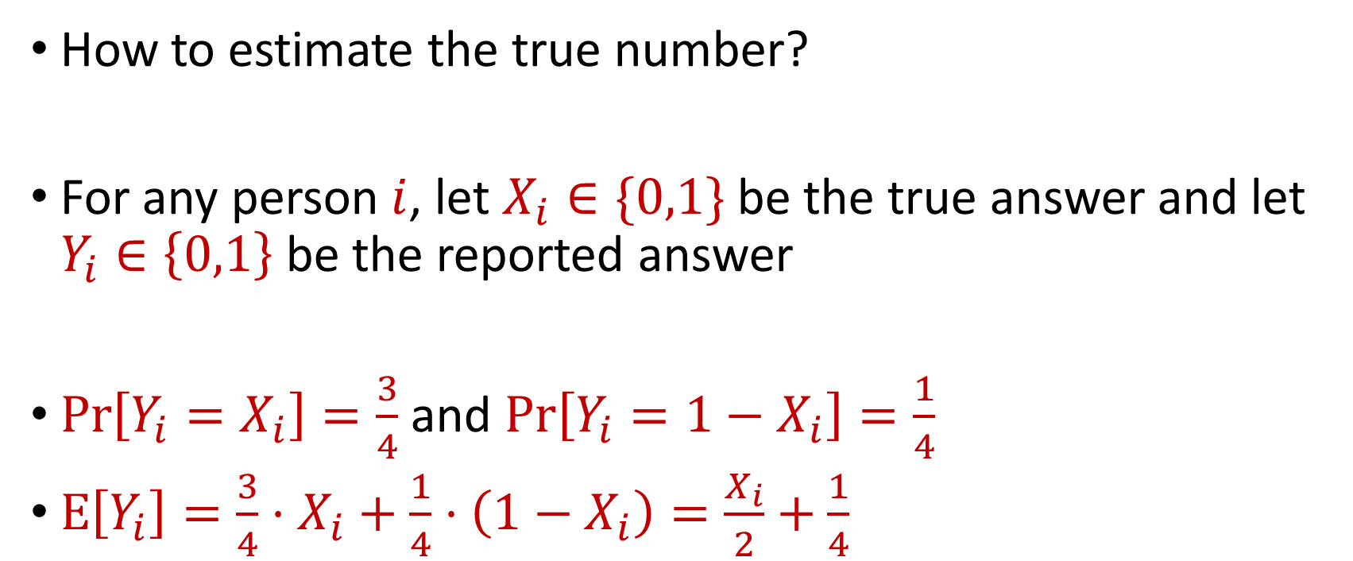
Counting
How to estimate the true number?
For any person $i$, let $X_{i}∈\{0,1\}$ be the true answer and let $Y_{i}∈\left\{0,1\right\}$ be the reported answer
$\operatorname{Pr}\left[Y_{i}=X_{i}\right]=\frac{3}{4}$ and $\operatorname{Pr}\left[Y_{i}=1−X_{i}\right]=\frac{1}{4}$
$E\left[Y_{i}\right]=\frac{3}{4}⋅X_{i}+\frac{1}{4}⋅\left(1−X_{i}\right)=\frac{X_{i}}{2}+\frac{1}{4}$
Notes:
[DworkMcSherryNissimSmith06]

Slide 36
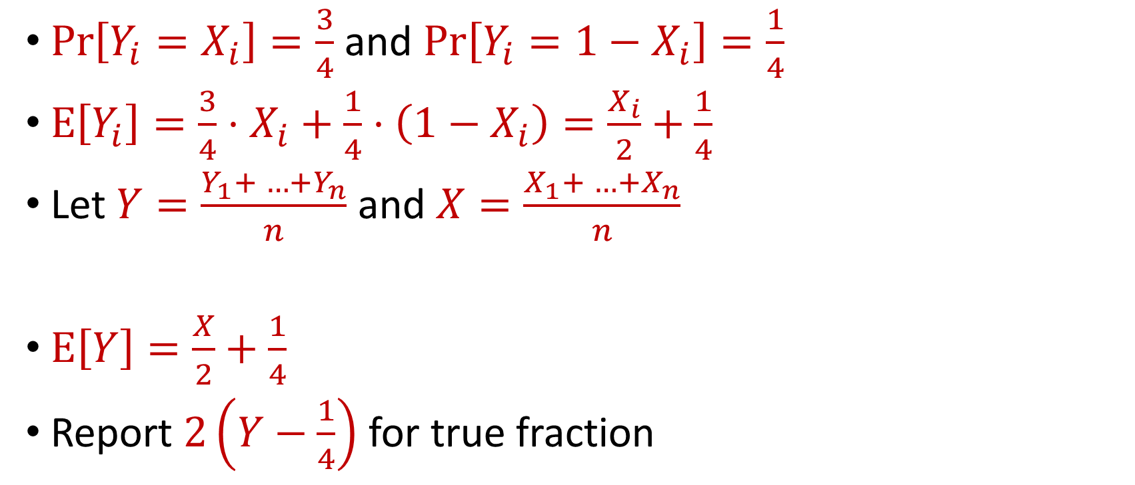
Counting
$\operatorname{Pr}\left[Y_{i}=X_{i}\right]=\frac{3}{4}$ and $\operatorname{Pr}\left[Y_{i}=1−X_{i}\right]=\frac{1}{4}$
$E\left[Y_{i}\right]=\frac{3}{4}⋅X_{i}+\frac{1}{4}⋅\left(1−X_{i}\right)=\frac{X_{i}}{2}+\frac{1}{4}$
Let $Y=\frac{Y_{1}+ …+Y_{n}}{n}$ and $X=\frac{X_{1}+ …+X_{n}}{n}$
$E\left[Y\right]=\frac{X}{2}+\frac{1}{4}$
Report $2\left(Y−\frac{1}{4}\right)$ for true fraction
Notes:
[DworkMcSherryNissimSmith06]

Slide 37
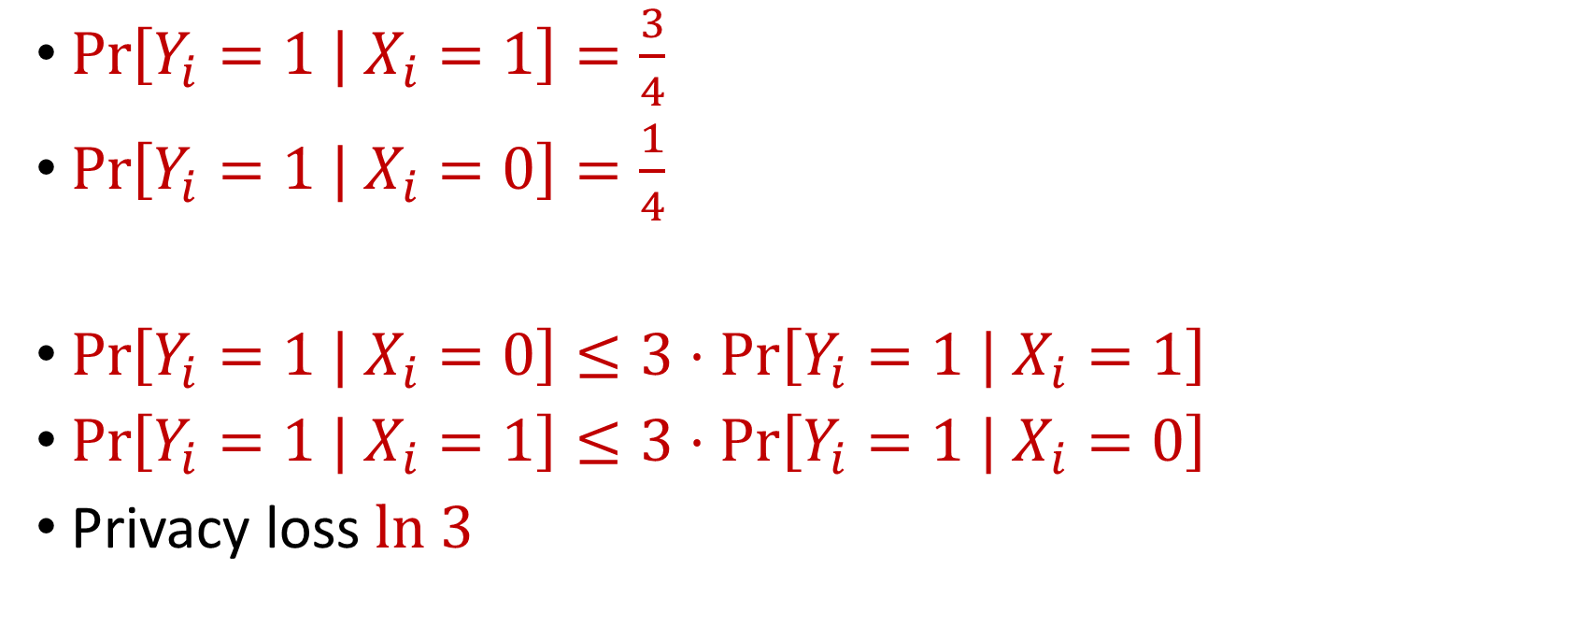
Randomized Response
$\operatorname{Pr}\left[Y_{i}=1 | X_{i}=1\right]=\frac{3}{4}$
$\operatorname{Pr}\left[Y_{i}=1 | X_{i}=0\right]=\frac{1}{4}$
$\operatorname{Pr}\left[Y_{i}=1 | X_{i}=0\right]≤3⋅\operatorname{Pr}\left[Y_{i}=1 | X_{i}=1\right]$
$\operatorname{Pr}\left[Y_{i}=1 | X_{i}=1\right]≤3⋅\operatorname{Pr}\left[Y_{i}=1 | X_{i}=0\right]$
Privacy loss $ln 3$
Notes:
[DworkMcSherryNissimSmith06]

Slide 38
Differential Privacy
[DMNS06] Given $ε>0$and $δ∈\left(0,1\right)$, a randomized algorithm $A:U^{∗}→Y$ is $(ε,δ)$-differentially private if, for every neighboring frequency vectors $f$ and $f′$ and for all $E⊆Y$,
$$Pr\left[A\left(f\right)∈E\right]≤e^{ε}⋅Pr\left[A\left(f^{′}\right)∈E\right]+δ$$
Notes:
[DworkMcSherryNissimSmith06]

Slide 39
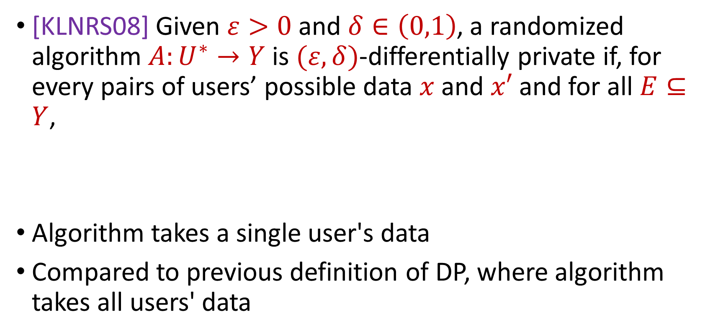
Local Differential Privacy (LDP)
[KLNRS08] Given $ε>0$and $δ∈\left(0,1\right)$, a randomized algorithm $A:U^{∗}→Y$ is $(ε,δ)$-differentially private if, for every pairs of users’ possible data $x$ and $x′$ and for all $E⊆Y$,
Algorithm takes a single user's data
Compared to previous definition of DP, where algorithm takes all users' data
$$Pr\left[A\left(x\right)∈E\right]≤e^{ε}⋅Pr\left[A\left(x^{′}\right)∈E\right]+δ$$
Notes:
[DworkMcSherryNissimSmith06]

Slide 40
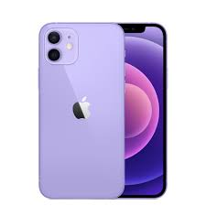
Local Differential Privacy (LDP)
Mobile Data Analytics: LDP can be applied to data collected from mobile devices to allow analysis of aggregate movement patterns and trends without compromising the privacy of individual users
Location-based services
User behavior analysis
Notes:
[DworkMcSherryNissimSmith06]

Slide 41






Privacy and Noise
$$Z$$
Random noise
$$x=x_{1},…,x_{n}$$
$$A(x)$$
$$A\left(x\right)=f\left(x\right)+Z$$
$$f(x)$$
Input
Algorithm
Output distribution
Notes:
[DworkMcSherryNissimSmith06]

Slide 42
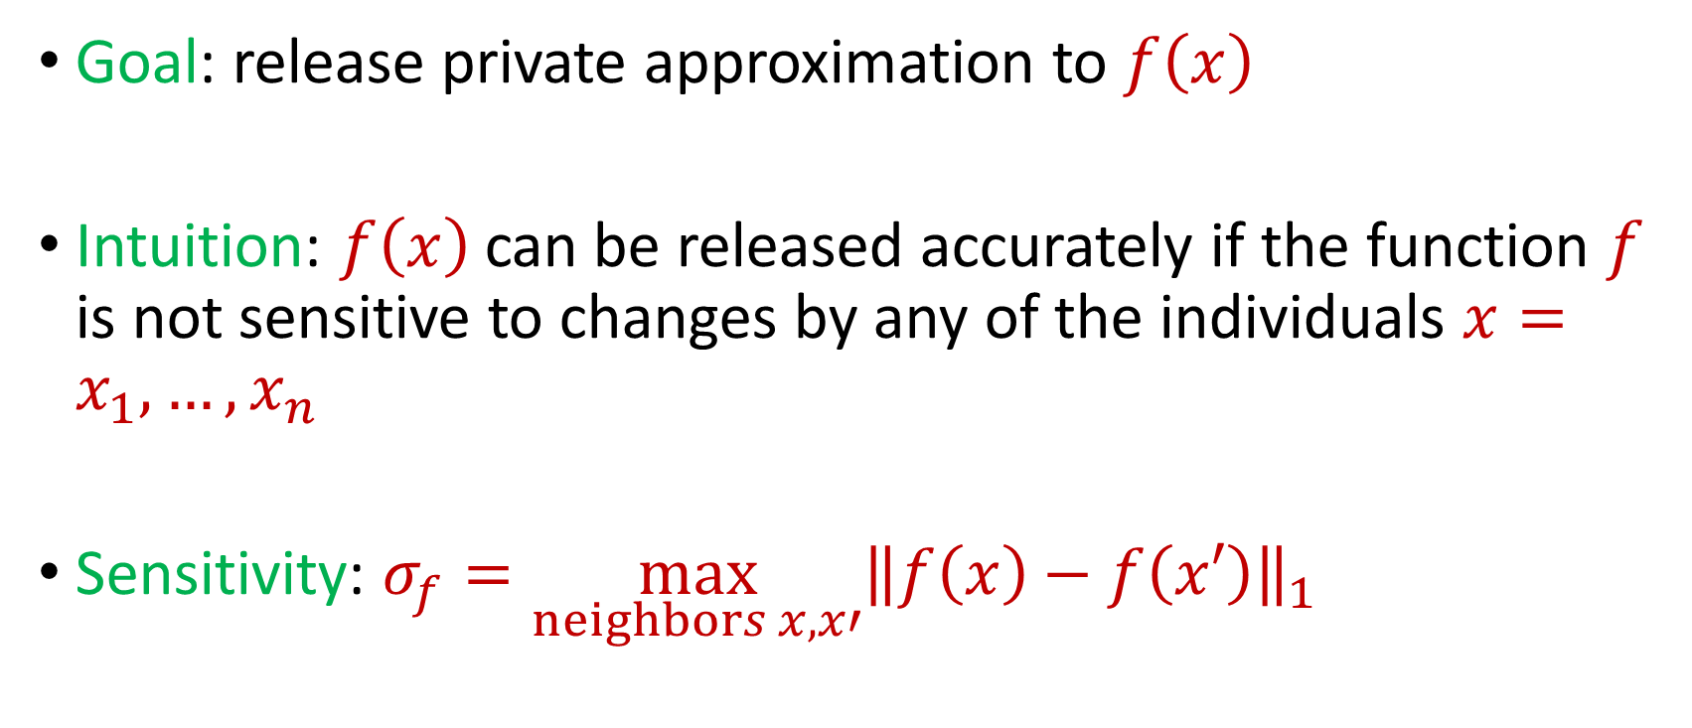
Privacy and Noise
Goal: release private approximation to $f\left(x\right)$
Intuition: $f\left(x\right)$ can be released accurately if the function $f$ is not sensitive to changes by any of the individuals $x=x_{1},…,x_{n}$
Sensitivity: $σ_{f}=\max_{neighbors x,x′}{\left\|f\left(x\right)−f\left(x′\right)\right\|}_{1}$
Notes:
[DworkMcSherryNissimSmith06]

Slide 43
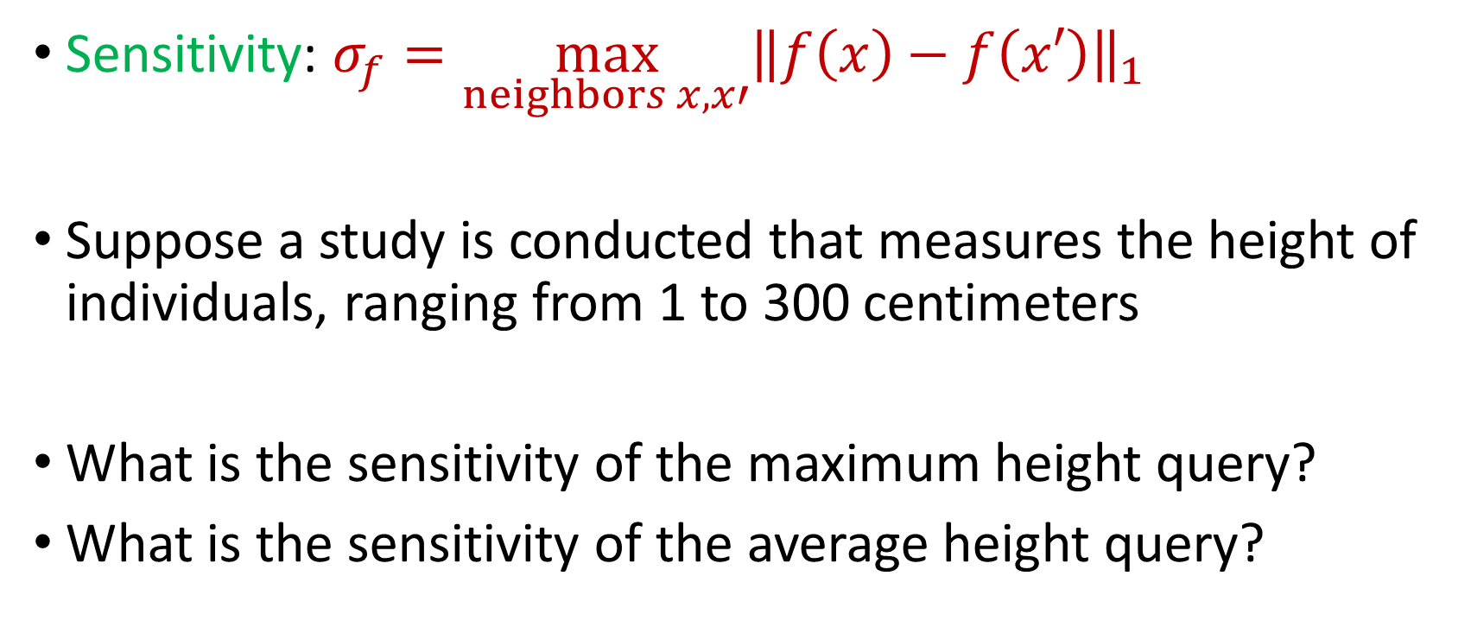
Sensitivity
Sensitivity: $σ_{f}=\max_{neighbors x,x′}{\left\|f\left(x\right)−f\left(x′\right)\right\|}_{1}$
Suppose a study is conducted that measures the height of individuals, ranging from 1 to 300 centimeters
What is the sensitivity of the maximum height query?
What is the sensitivity of the average height query?
Notes:
[DworkMcSherryNissimSmith06]

Slide 44
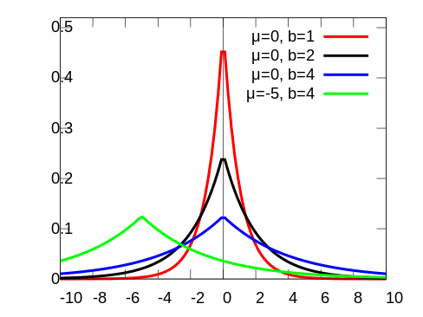
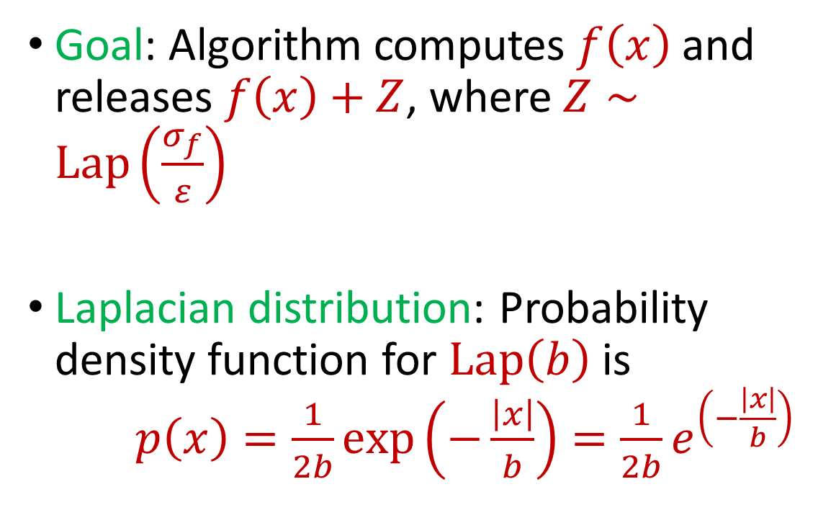
Laplace Mechanism
Goal: Algorithm computes $f\left(x\right)$ and releases $f\left(x\right)+Z$, where $Z∼Lap\left(\frac{σ_{f}}{ε}\right)$
Laplacian distribution: Probability density function for $Lap\left(b\right)$ is $p\left(x\right)=\frac{1}{2b}exp\left(−\frac{\left|x\right|}{b}\right)=\frac{1}{2b}e^{\left(−\frac{\left|x\right|}{b}\right)}$
Notes:
[DworkMcSherryNissimSmith06]

Slide 45
Laplace Mechanism
What does the Laplace mechanism do in the following cases?
Suppose a study is conducted that measures the height of individuals, ranging from 1 to 300 centimeters
What is the sensitivity of the maximum height query?
What is the sensitivity of the average height query?
Notes:
[DworkMcSherryNissimSmith06]

Slide 46

Laplace Mechanism
Theorem: Laplace mechanism is $ε$-differentially private (pure DP)
Notes:
[DworkMcSherryNissimSmith06]

Slide 47

Beyond Laplace Mechanism
What if the output is not a scalar, e.g., a vector?
Suppose the outputs lie in some space $Y$
Notes:
[DworkMcSherryNissimSmith06]

Slide 48
Beyond Laplace Mechanism
Suppose a study is conducted that finds the current location of individuals, in the two-dimensional plane
Who is the closest individual to a query location?
Notes:
[DworkMcSherryNissimSmith06]

Slide 49
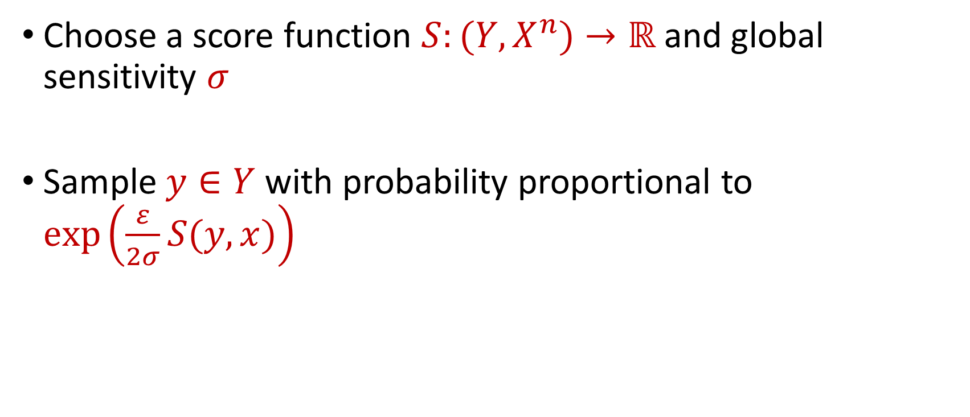
Exponential Mechanism
Choose a score function $S:(Y,X^{n})→ℝ$ and global sensitivity $σ$
Sample $y∈Y$ with probability proportional to $\exp\left(\frac{ε}{2σ}S(y,x)\right)$
Notes:
[DworkMcSherryNissimSmith06]

Slide 50
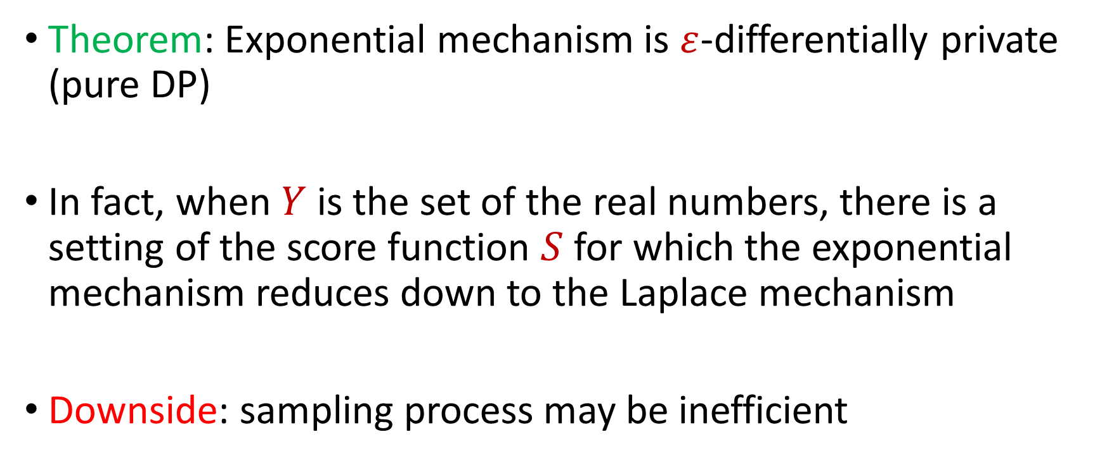
Exponential Mechanism
Theorem: Exponential mechanism is $ε$-differentially private (pure DP)
In fact, when $Y$ is the set of the real numbers, there is a setting of the score function $S$ for which the exponential mechanism reduces down to the Laplace mechanism
Downside: sampling process may be inefficient
Notes:
[DworkMcSherryNissimSmith06]

