Slide 1
CSCE 689: Special Topics in Modern Algorithms for Data Science
Lecture 10
Samson Zhou

Slide 2

Frequent Items
Goal: Given a set $S$ of $m$ elements from $[n]$ and a parameter $k$, output the items from $[n]$ that have frequency at least $\frac{m}{k}$

Slide 3
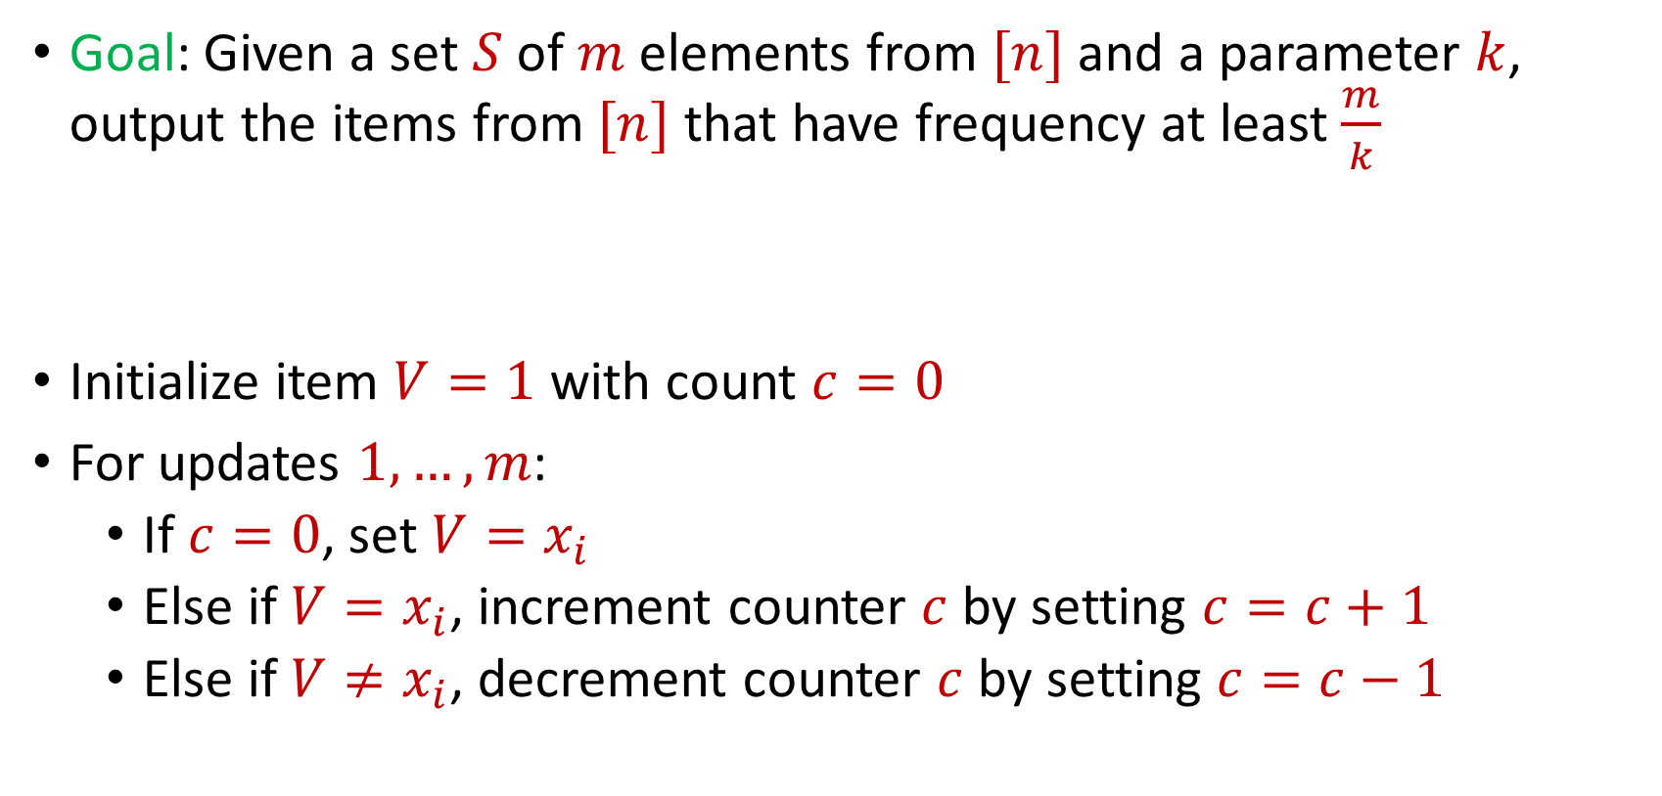
Frequent Items
Goal: Given a set $S$ of $m$ elements from $[n]$ and a parameter $k$, output the items from $[n]$ that have frequency at least $\frac{m}{k}$
Initialize item $V=1$ with count $c=0$
For updates $1,…,m$:
If $c=0$, set $V=x_{i}$
Else if $V=x_{i}$, increment counter $c$ by setting $c=c+1$
Else if $V≠x_{i}$, decrement counter $c$ by setting $c=c−1$

Slide 4
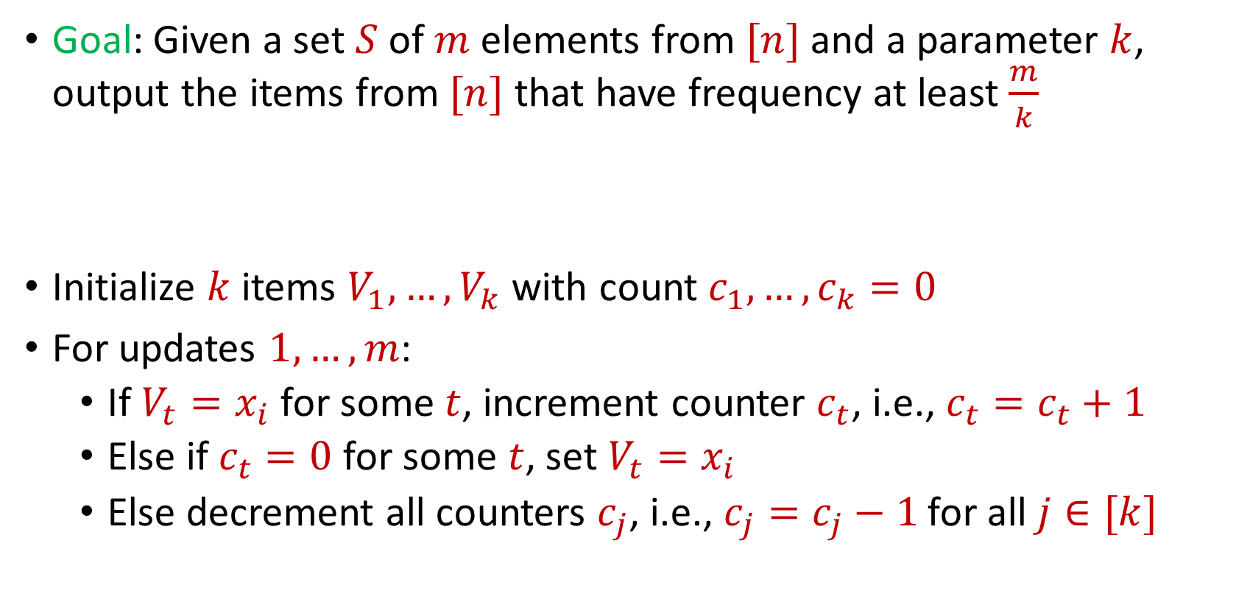
Misra Gries
Goal: Given a set $S$ of $m$ elements from $[n]$ and a parameter $k$, output the items from $[n]$ that have frequency at least $\frac{m}{k}$
Initialize $k$ items $V_{1},…,V_{k}$ with count $c_{1},…,c_{k}=0$
For updates $1,…,m$:
If $V_{t}=x_{i}$ for some $t$, increment counter $c_{t}$, i.e., $c_{t}=c_{t}+1$
Else if $c_{t}=0$ for some $t$, set $V_{t}=x_{i}$
Else decrement all counters $c_{j}$, i.e., $c_{j}=c_{j}−1$ for all $j∈[k]$

Slide 5

Misra Gries
$n=7$, $k=3$
$V_{1}= ⊥$, $c_{1}=0$
$V_{2}= ⊥$, $c_{2}=0$
$V_{3}= ⊥$, $c_{3}=0$
$f_{1}$ | $f_{2}$ | $f_{3}$ | $f_{4}$ | $f_{5}$ | $f_{6}$ | $f_{7}$
0 | 0 | 0 | 0 | 0 | 0 | 0

Slide 6


Misra Gries
$$3$$
$V_{1}= ⊥$, $c_{1}=0$
$V_{2}= ⊥$, $c_{2}=0$
$V_{3}= ⊥$, $c_{3}=0$
$f_{1}$ | $f_{2}$ | $f_{3}$ | $f_{4}$ | $f_{5}$ | $f_{6}$ | $f_{7}$
0 | 0 | 0 | 0 | 0 | 0 | 0

Slide 7

Misra Gries
$$3$$
$V_{1}=3$, $c_{1}=1$
$V_{2}= ⊥$, $c_{2}=0$
$V_{3}= ⊥$, $c_{3}=0$
$f_{1}$ | $f_{2}$ | $f_{3}$ | $f_{4}$ | $f_{5}$ | $f_{6}$ | $f_{7}$
0 | 0 | 1 | 0 | 0 | 0 | 0

Slide 8

Misra Gries
$$1$$
$V_{1}=3$, $c_{1}=1$
$V_{2}= ⊥$, $c_{2}=0$
$V_{3}= ⊥$, $c_{3}=0$
$f_{1}$ | $f_{2}$ | $f_{3}$ | $f_{4}$ | $f_{5}$ | $f_{6}$ | $f_{7}$
0 | 0 | 1 | 0 | 0 | 0 | 0

Slide 9

Misra Gries
$$1$$
$V_{1}=3$, $c_{1}=1$
$V_{2}=1$, $c_{2}=1$
$V_{3}= ⊥$, $c_{3}=0$
$f_{1}$ | $f_{2}$ | $f_{3}$ | $f_{4}$ | $f_{5}$ | $f_{6}$ | $f_{7}$
1 | 0 | 1 | 0 | 0 | 0 | 0

Slide 10

Misra Gries
$$2$$
$V_{1}=3$, $c_{1}=1$
$V_{2}=1$, $c_{2}=1$
$V_{3}= ⊥$, $c_{3}=0$
$f_{1}$ | $f_{2}$ | $f_{3}$ | $f_{4}$ | $f_{5}$ | $f_{6}$ | $f_{7}$
1 | 0 | 1 | 0 | 0 | 0 | 0

Slide 11

Misra Gries
$$2$$
$V_{1}=3$, $c_{1}=1$
$V_{2}=1$, $c_{2}=1$
$V_{3}=2$, $c_{3}=1$
$f_{1}$ | $f_{2}$ | $f_{3}$ | $f_{4}$ | $f_{5}$ | $f_{6}$ | $f_{7}$
1 | 1 | 1 | 0 | 0 | 0 | 0

Slide 12
Misra Gries
$$1$$
$V_{1}=3$, $c_{1}=1$
$V_{2}=1$, $c_{2}=1$
$V_{3}=2$, $c_{3}=1$
$f_{1}$ | $f_{2}$ | $f_{3}$ | $f_{4}$ | $f_{5}$ | $f_{6}$ | $f_{7}$
1 | 1 | 1 | 0 | 0 | 0 | 0

Slide 13

Misra Gries
$$1$$
$V_{1}=3$, $c_{1}=1$
$V_{2}=1$, $c_{2}=2$
$V_{3}=2$, $c_{3}=1$
$f_{1}$ | $f_{2}$ | $f_{3}$ | $f_{4}$ | $f_{5}$ | $f_{6}$ | $f_{7}$
2 | 1 | 1 | 0 | 0 | 0 | 0

Slide 14

Misra Gries
$$4$$
$V_{1}=3$, $c_{1}=1$
$V_{2}=1$, $c_{2}=2$
$V_{3}=2$, $c_{3}=1$
$f_{1}$ | $f_{2}$ | $f_{3}$ | $f_{4}$ | $f_{5}$ | $f_{6}$ | $f_{7}$
2 | 1 | 1 | 0 | 0 | 0 | 0

Slide 15

Misra Gries
$$4$$
$V_{1}=3$, $c_{1}=0$
$V_{2}=1$, $c_{2}=1$
$V_{3}=2$, $c_{3}=0$
$f_{1}$ | $f_{2}$ | $f_{3}$ | $f_{4}$ | $f_{5}$ | $f_{6}$ | $f_{7}$
2 | 1 | 1 | 1 | 0 | 0 | 0

Slide 16
Misra Gries
$$2$$
$V_{1}=3$, $c_{1}=0$
$V_{2}=1$, $c_{2}=1$
$V_{3}=2$, $c_{3}=0$
$f_{1}$ | $f_{2}$ | $f_{3}$ | $f_{4}$ | $f_{5}$ | $f_{6}$ | $f_{7}$
2 | 1 | 1 | 1 | 0 | 0 | 0

Slide 17

Misra Gries
$$2$$
$V_{1}=3$, $c_{1}=0$
$V_{2}=1$, $c_{2}=1$
$V_{3}=2$, $c_{3}=1$
$f_{1}$ | $f_{2}$ | $f_{3}$ | $f_{4}$ | $f_{5}$ | $f_{6}$ | $f_{7}$
2 | 2 | 1 | 1 | 0 | 0 | 0

Slide 18
Misra Gries
$$1$$
$V_{1}=3$, $c_{1}=0$
$V_{2}=1$, $c_{2}=1$
$V_{3}=2$, $c_{3}=1$
$f_{1}$ | $f_{2}$ | $f_{3}$ | $f_{4}$ | $f_{5}$ | $f_{6}$ | $f_{7}$
2 | 2 | 1 | 1 | 0 | 0 | 0

Slide 19

Misra Gries
$$1$$
$V_{1}=3$, $c_{1}=0$
$V_{2}=1$, $c_{2}=2$
$V_{3}=2$, $c_{3}=1$
$f_{1}$ | $f_{2}$ | $f_{3}$ | $f_{4}$ | $f_{5}$ | $f_{6}$ | $f_{7}$
3 | 2 | 1 | 1 | 0 | 0 | 0

Slide 20

Misra Gries
$$5$$
$V_{1}=3$, $c_{1}=0$
$V_{2}=1$, $c_{2}=2$
$V_{3}=2$, $c_{3}=1$
$f_{1}$ | $f_{2}$ | $f_{3}$ | $f_{4}$ | $f_{5}$ | $f_{6}$ | $f_{7}$
3 | 2 | 1 | 1 | 0 | 0 | 0

Slide 21

Misra Gries
$$5$$
$V_{1}=5$, $c_{1}=1$
$V_{2}=1$, $c_{2}=2$
$V_{3}=2$, $c_{3}=1$
$f_{1}$ | $f_{2}$ | $f_{3}$ | $f_{4}$ | $f_{5}$ | $f_{6}$ | $f_{7}$
3 | 2 | 1 | 1 | 1 | 0 | 0

Slide 22
Misra Gries
$$1$$
$V_{1}=5$, $c_{1}=1$
$V_{2}=1$, $c_{2}=2$
$V_{3}=2$, $c_{3}=1$
$f_{1}$ | $f_{2}$ | $f_{3}$ | $f_{4}$ | $f_{5}$ | $f_{6}$ | $f_{7}$
3 | 2 | 1 | 1 | 1 | 0 | 0

Slide 23

Misra Gries
$$1$$
$V_{1}=5$, $c_{1}=1$
$V_{2}=1$, $c_{2}=3$
$V_{3}=2$, $c_{3}=1$
$f_{1}$ | $f_{2}$ | $f_{3}$ | $f_{4}$ | $f_{5}$ | $f_{6}$ | $f_{7}$
4 | 2 | 1 | 1 | 1 | 0 | 0

Slide 24
Misra Gries
$$4$$
$V_{1}=5$, $c_{1}=1$
$V_{2}=1$, $c_{2}=3$
$V_{3}=2$, $c_{3}=1$
$f_{1}$ | $f_{2}$ | $f_{3}$ | $f_{4}$ | $f_{5}$ | $f_{6}$ | $f_{7}$
4 | 2 | 1 | 1 | 1 | 0 | 0

Slide 25

Misra Gries
$$4$$
$V_{1}=5$, $c_{1}=0$
$V_{2}=1$, $c_{2}=2$
$V_{3}=2$, $c_{3}=0$
$f_{1}$ | $f_{2}$ | $f_{3}$ | $f_{4}$ | $f_{5}$ | $f_{6}$ | $f_{7}$
4 | 2 | 1 | 2 | 1 | 0 | 0

Slide 26
Misra Gries
$$3$$
$V_{1}=5$, $c_{1}=0$
$V_{2}=1$, $c_{2}=2$
$V_{3}=2$, $c_{3}=0$
$f_{1}$ | $f_{2}$ | $f_{3}$ | $f_{4}$ | $f_{5}$ | $f_{6}$ | $f_{7}$
4 | 2 | 1 | 2 | 1 | 0 | 0

Slide 27

Misra Gries
$$3$$
$V_{1}=5$, $c_{1}=0$
$V_{2}=1$, $c_{2}=2$
$V_{3}=3$, $c_{3}=0$
$f_{1}$ | $f_{2}$ | $f_{3}$ | $f_{4}$ | $f_{5}$ | $f_{6}$ | $f_{7}$
4 | 2 | 2 | 2 | 1 | 0 | 0

Slide 28
Misra Gries
$$1$$
$V_{1}=5$, $c_{1}=0$
$V_{2}=1$, $c_{2}=2$
$V_{3}=3$, $c_{3}=0$
$f_{1}$ | $f_{2}$ | $f_{3}$ | $f_{4}$ | $f_{5}$ | $f_{6}$ | $f_{7}$
4 | 2 | 2 | 2 | 1 | 0 | 0

Slide 29

Misra Gries
$$1$$
$V_{1}=5$, $c_{1}=0$
$V_{2}=1$, $c_{2}=3$
$V_{3}=3$, $c_{3}=0$
$f_{1}$ | $f_{2}$ | $f_{3}$ | $f_{4}$ | $f_{5}$ | $f_{6}$ | $f_{7}$
5 | 2 | 2 | 2 | 1 | 0 | 0

Slide 30
Misra Gries
$$3$$
$V_{1}=5$, $c_{1}=0$
$V_{2}=1$, $c_{2}=3$
$V_{3}=3$, $c_{3}=0$
$f_{1}$ | $f_{2}$ | $f_{3}$ | $f_{4}$ | $f_{5}$ | $f_{6}$ | $f_{7}$
5 | 2 | 2 | 2 | 1 | 0 | 0

Slide 31

Misra Gries
$$3$$
$V_{1}=5$, $c_{1}=0$
$V_{2}=1$, $c_{2}=3$
$V_{3}=3$, $c_{3}=1$
$f_{1}$ | $f_{2}$ | $f_{3}$ | $f_{4}$ | $f_{5}$ | $f_{6}$ | $f_{7}$
5 | 2 | 3 | 2 | 1 | 0 | 0

Slide 32
Misra Gries
$$1$$
$V_{1}=5$, $c_{1}=0$
$V_{2}=1$, $c_{2}=3$
$V_{3}=3$, $c_{3}=1$
$f_{1}$ | $f_{2}$ | $f_{3}$ | $f_{4}$ | $f_{5}$ | $f_{6}$ | $f_{7}$
5 | 2 | 3 | 2 | 1 | 0 | 0

Slide 33

Misra Gries
$$1$$
$V_{1}=5$, $c_{1}=0$
$V_{2}=1$, $c_{2}=4$
$V_{3}=3$, $c_{3}=1$
$f_{1}$ | $f_{2}$ | $f_{3}$ | $f_{4}$ | $f_{5}$ | $f_{6}$ | $f_{7}$
6 | 2 | 3 | 2 | 1 | 0 | 0

Slide 34
Misra Gries
$$3$$
$V_{1}=5$, $c_{1}=0$
$V_{2}=1$, $c_{2}=4$
$V_{3}=3$, $c_{3}=1$
$f_{1}$ | $f_{2}$ | $f_{3}$ | $f_{4}$ | $f_{5}$ | $f_{6}$ | $f_{7}$
6 | 2 | 3 | 2 | 1 | 0 | 0

Slide 35

Misra Gries
$$3$$
$V_{1}=5$, $c_{1}=0$
$V_{2}=1$, $c_{2}=4$
$V_{3}=3$, $c_{3}=2$
$f_{1}$ | $f_{2}$ | $f_{3}$ | $f_{4}$ | $f_{5}$ | $f_{6}$ | $f_{7}$
6 | 2 | 4 | 2 | 1 | 0 | 0

Slide 36
Misra Gries
$$3$$
$V_{1}=5$, $c_{1}=0$
$V_{2}=1$, $c_{2}=4$
$V_{3}=3$, $c_{3}=2$
$f_{1}$ | $f_{2}$ | $f_{3}$ | $f_{4}$ | $f_{5}$ | $f_{6}$ | $f_{7}$
6 | 2 | 4 | 2 | 1 | 0 | 0

Slide 37

Misra Gries
$$3$$
$V_{1}=5$, $c_{1}=0$
$V_{2}=1$, $c_{2}=4$
$V_{3}=3$, $c_{3}=3$
$f_{1}$ | $f_{2}$ | $f_{3}$ | $f_{4}$ | $f_{5}$ | $f_{6}$ | $f_{7}$
6 | 2 | 5 | 2 | 1 | 0 | 0

Slide 38

Misra Gries
$$6$$
$V_{1}=5$, $c_{1}=0$
$V_{2}=1$, $c_{2}=4$
$V_{3}=3$, $c_{3}=3$
$f_{1}$ | $f_{2}$ | $f_{3}$ | $f_{4}$ | $f_{5}$ | $f_{6}$ | $f_{7}$
6 | 2 | 5 | 2 | 1 | 0 | 0

Slide 39

Misra Gries
$$6$$
$V_{1}=6$, $c_{1}=1$
$V_{2}=1$, $c_{2}=4$
$V_{3}=3$, $c_{3}=3$
$f_{1}$ | $f_{2}$ | $f_{3}$ | $f_{4}$ | $f_{5}$ | $f_{6}$ | $f_{7}$
6 | 2 | 5 | 2 | 1 | 1 | 0

Slide 40

Misra Gries
$$6$$
$V_{1}=6$, $c_{1}=1$
$V_{2}=1$, $c_{2}=4$
$V_{3}=3$, $c_{3}=3$
Report $1$, $3$, and $6$ as frequent items
$f_{1}$ | $f_{2}$ | $f_{3}$ | $f_{4}$ | $f_{5}$ | $f_{6}$ | $f_{7}$
6 | 2 | 5 | 2 | 1 | 1 | 0

Slide 41
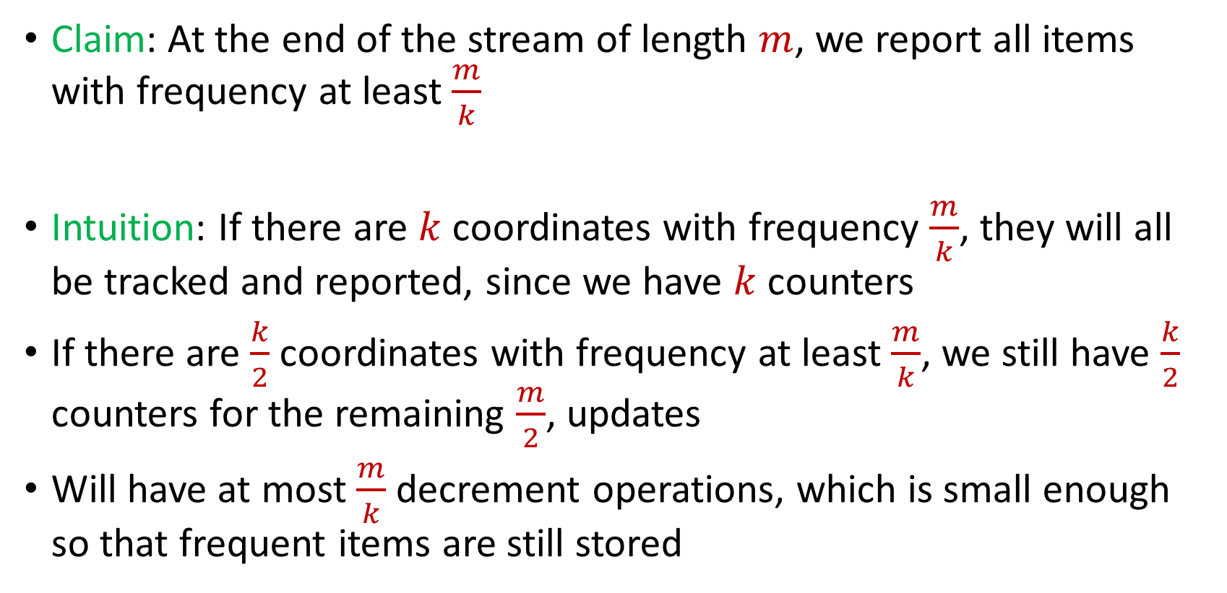
Misra Gries
Claim: At the end of the stream of length $m$, we report all items with frequency at least $\frac{m}{k}$
Intuition: If there are $k$ coordinates with frequency $\frac{m}{k}$, they will all be tracked and reported, since we have $k$counters
If there are $\frac{k}{2}$ coordinates with frequency at least $\frac{m}{k}$, we still have $\frac{k}{2}$ counters for the remaining $\frac{m}{2}$, updates
Will have at most $\frac{m}{k}$ decrement operations, which is small enough so that frequent items are still stored

Slide 42
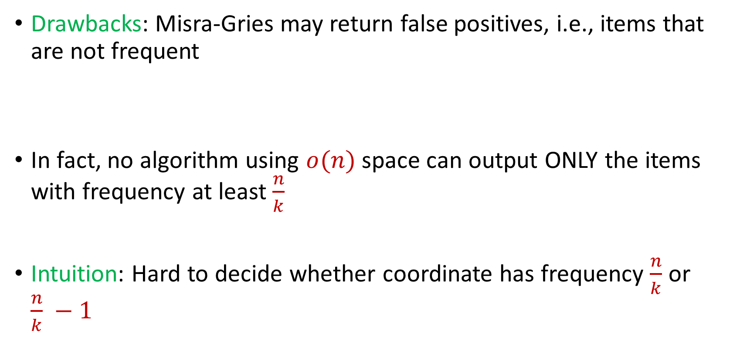
Misra Gries
Drawbacks: Misra-Gries may return false positives, i.e., items that are not frequent
In fact, no algorithm using $o(n)$ space can output ONLY the items with frequency at least $\frac{n}{k}$
Intuition: Hard to decide whether coordinate has frequency $\frac{n}{k}$ or $\frac{n}{k} −1$

Slide 43

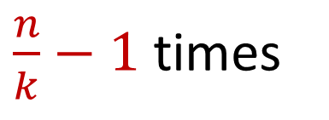
Misra Gries
Intuition: Hard to decide whether coordinate has frequency $\frac{n}{k}$ or $\frac{n}{k} −1$
$x_{1}=2$, $x_{2}=5$, $x_{3}=4$, $x_{4}=7$, $x_{5}=1$, $x_{6}=9$, …
$x_{n−\frac{n}{k}+1}=α$, $x_{n−\frac{n}{k}+2}=α$,…, $x_{n}=α$
$\frac{n}{k}−1$ times

Slide 44
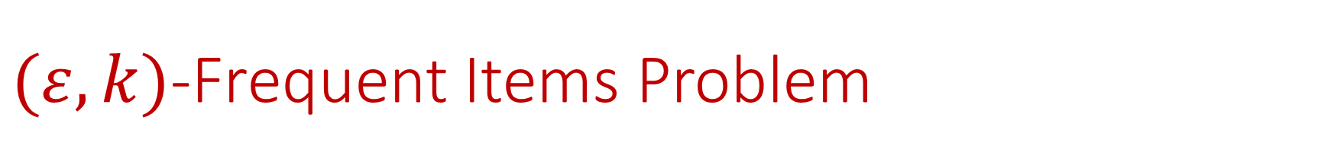

$(ε,k)$-Frequent Items Problem
Goal: Given a set $S$ of $m$ elements from $[n]$, an accuracy parameter $ε∈(0, 1)$, and a parameter $k$, output a list that includes:
The items from $[n]$ that have frequency at least $\frac{m}{k}$
No items with frequency less than $\left(1−ε\right)\frac{m}{k}$

Slide 45


Misra Gries for $(ε,k)$-Frequent Items Problem
Initialize $k$ items $V_{1},…,V_{k}$ with count $c_{1},…,c_{k}=0$
For updates $1,…,m$:
If $V_{t}=x_{i}$ for some $t$, increment counter $c_{t}$, i.e., $c_{t}=c_{t}+1$
Else if $c_{t}=0$ for some $t$, set $V_{t}=x_{i}$
Else decrement all counters $c_{j}$, i.e., $c_{j}=c_{j}−1$ for all $j∈[k]$

Slide 46
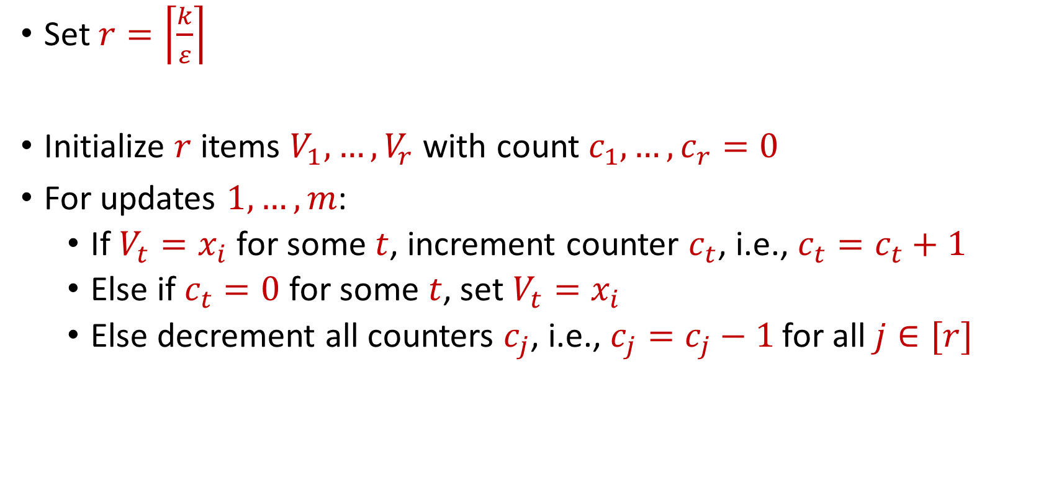
Misra Gries for $(ε,k)$-Frequent Items Problem
Set $r=\left\lceil \frac{k}{ε}\right\rceil$
Initialize $r$ items $V_{1},…,V_{r}$ with count $c_{1},…,c_{r}=0$
For updates $1,…,m$:
If $V_{t}=x_{i}$ for some $t$, increment counter $c_{t}$, i.e., $c_{t}=c_{t}+1$
Else if $c_{t}=0$ for some $t$, set $V_{t}=x_{i}$
Else decrement all counters $c_{j}$, i.e., $c_{j}=c_{j}−1$ for all $j∈[r]$

Slide 47


Misra Gries for $(ε,k)$-Frequent Items Problem
Claim: For all estimated frequencies $\hat{f_{i}}$ by Misra-Gries, we have
Intuition: Have a lot of counters, so relatively few decrements
$$f_{i}−\frac{εm}{k}≤\hat{f_{i}}≤f_{i}$$

Slide 48
$(ε,k)$-Frequent Items Problem
Goal: Given a set $S$ of $m$ elements from $[n]$, an accuracy parameter $ε∈(0, 1)$, and a parameter $k$, output a list that includes:
The items from $[n]$ that have frequency at least $\frac{m}{k}$
No items with frequency less than $\left(1−ε\right)\frac{m}{k}$

Slide 49
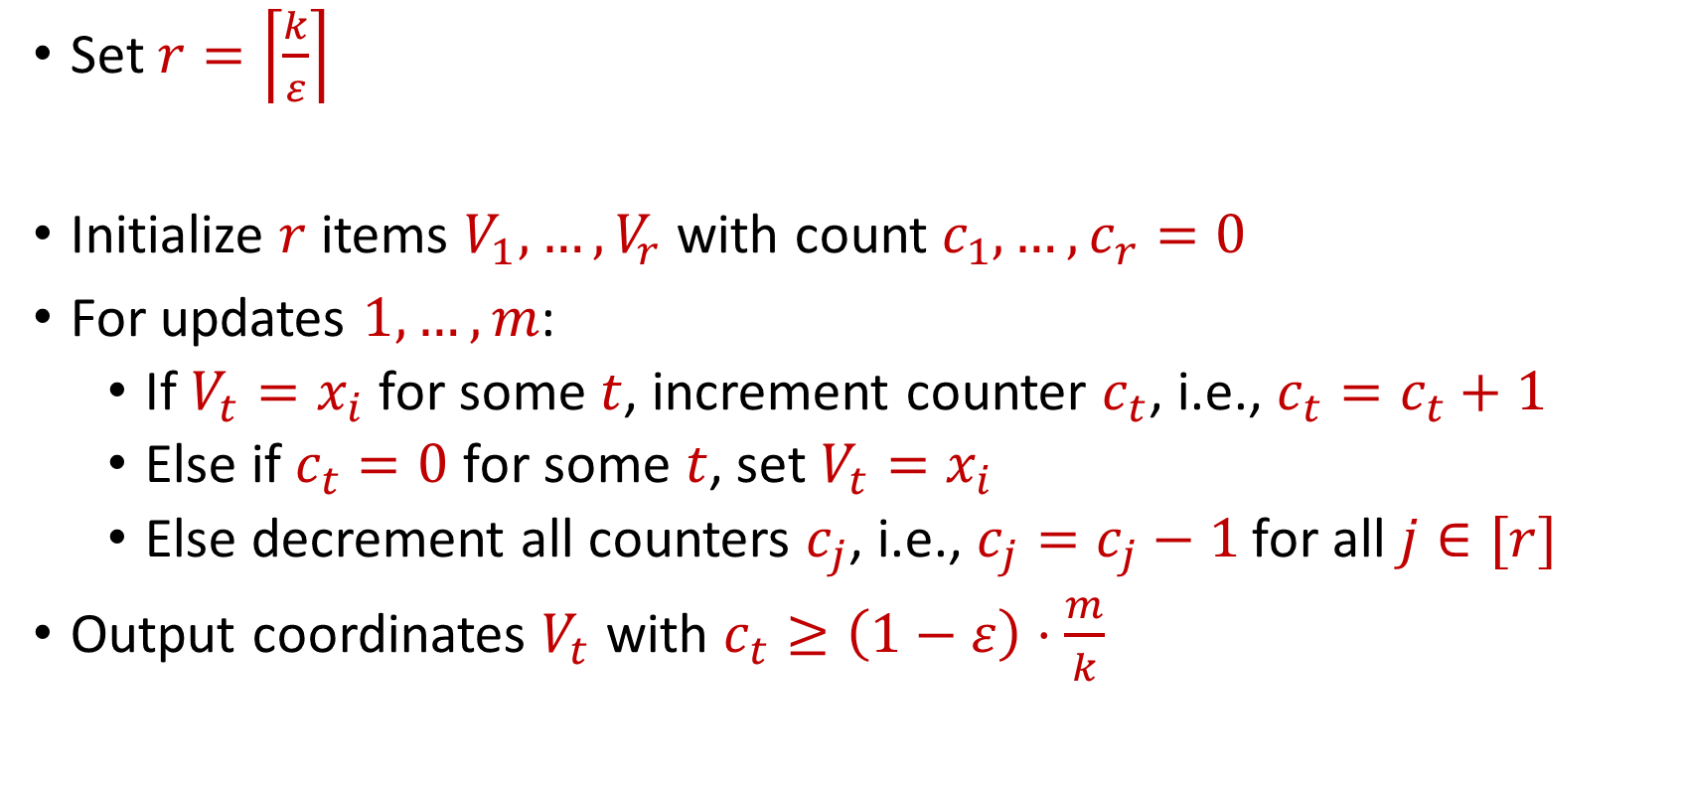
Misra Gries for $(ε,k)$-Frequent Items Problem
Set $r=\left\lceil \frac{k}{ε}\right\rceil$
Initialize $r$ items $V_{1},…,V_{r}$ with count $c_{1},…,c_{r}=0$
For updates $1,…,m$:
If $V_{t}=x_{i}$ for some $t$, increment counter $c_{t}$, i.e., $c_{t}=c_{t}+1$
Else if $c_{t}=0$ for some $t$, set $V_{t}=x_{i}$
Else decrement all counters $c_{j}$, i.e., $c_{j}=c_{j}−1$ for all $j∈[r]$
Output coordinates $V_{t}$ with $c_{t}≥\left(1−ε\right)⋅\frac{m}{k}$

Slide 50
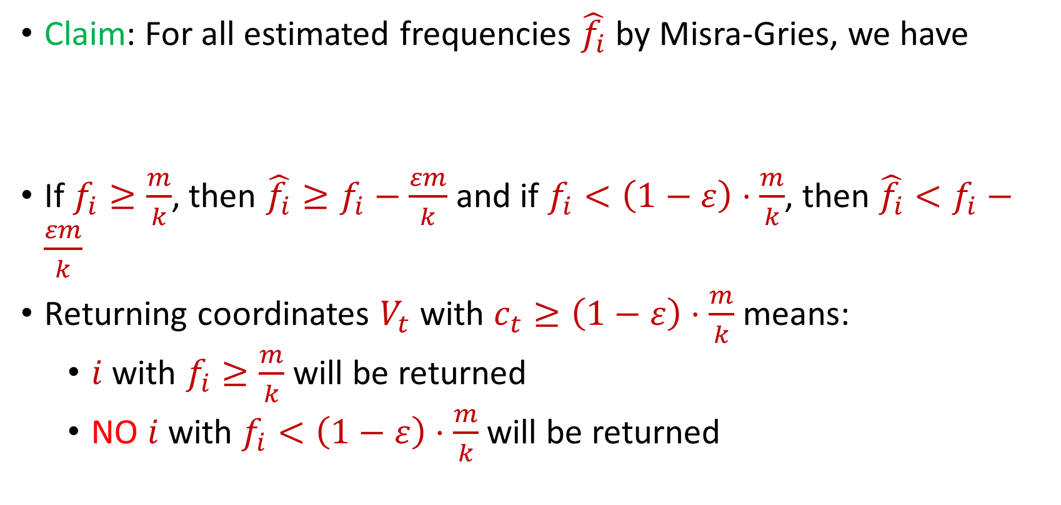
Misra Gries for $(ε,k)$-Frequent Items Problem
Claim: For all estimated frequencies $\hat{f_{i}}$ by Misra-Gries, we have
If $f_{i}≥\frac{m}{k}$, then ${\hat{f_{i}}≥f}_{i}−\frac{εm}{k}$ and if $f_{i}<\left(1−ε\right)⋅\frac{m}{k}$, then ${\hat{f_{i}}<f}_{i}−\frac{εm}{k}$
Returning coordinates $V_{t}$ with $c_{t}≥\left(1−ε\right)⋅\frac{m}{k}$ means:
$i$ with $f_{i}≥\frac{m}{k}$ will be returned
NO $i$ with $f_{i}<\left(1−ε\right)⋅\frac{m}{k}$will be returned
$$f_{i}−\frac{εm}{k}≤\hat{f_{i}}≤f_{i}$$

Slide 51
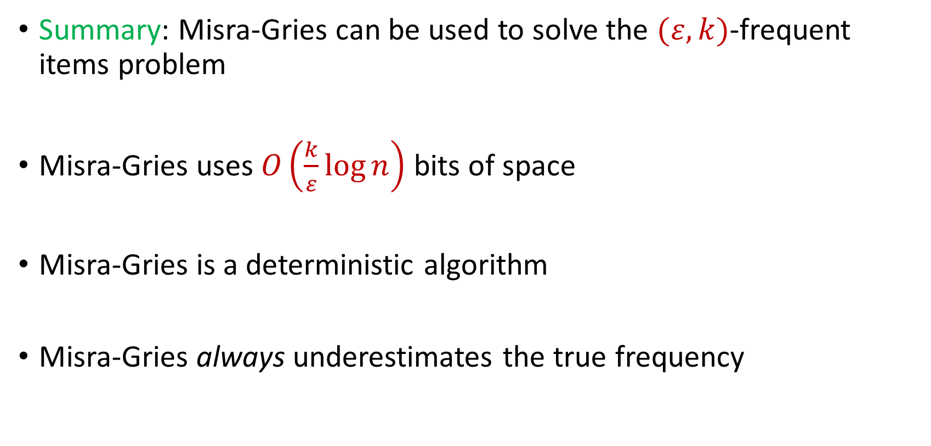
Misra Gries for $(ε,k)$-Frequent Items Problem
Summary: Misra-Gries can be used to solve the $(ε,k)$-frequent items problem
Misra-Gries uses $O\left(\frac{k}{ε}\log{n}\right)$ bits of space
Misra-Gries is a deterministic algorithm
Misra-Gries always underestimates the true frequency

Slide 52

CountMin
Another algorithm for the $(ε,k)$-frequent items problem
Can be easily parallelized across multiple servers

Slide 53
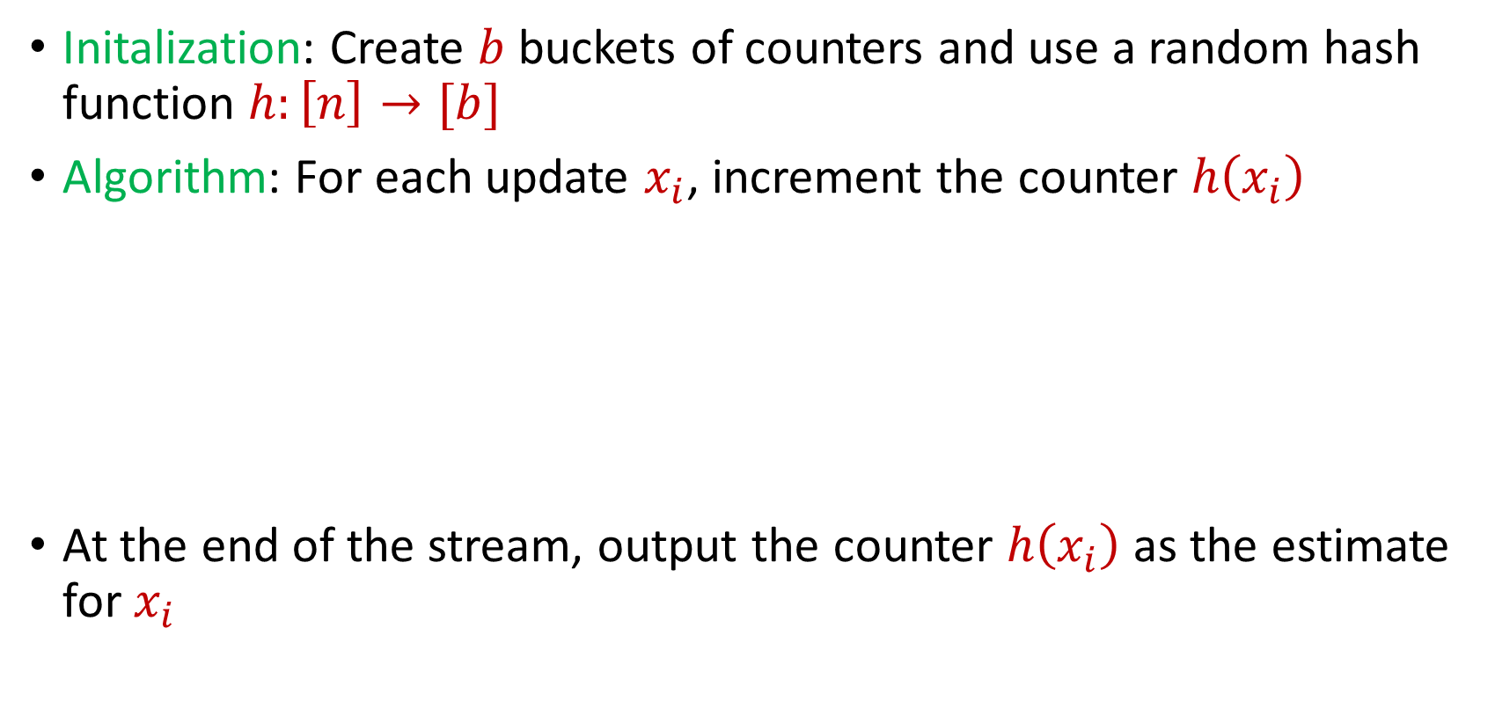
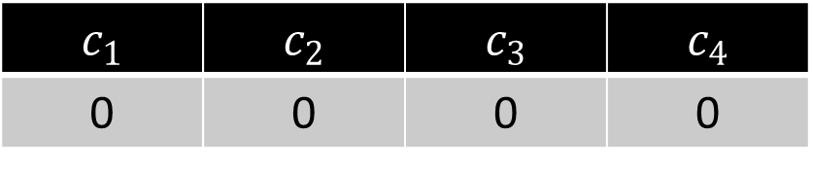
CountMin
Initalization: Create $b$ buckets of counters and use a random hash function $h:\left[n\right]→[b]$
Algorithm: For each update $x_{i}$, increment the counter $h\left(x_{i}\right)$
At the end of the stream, output the counter $h\left(x_{i}\right)$ as the estimate for $x_{i}$
$c_{1}$ | $c_{2}$ | $c_{3}$ | $c_{4}$
0 | 0 | 0 | 0

Slide 54
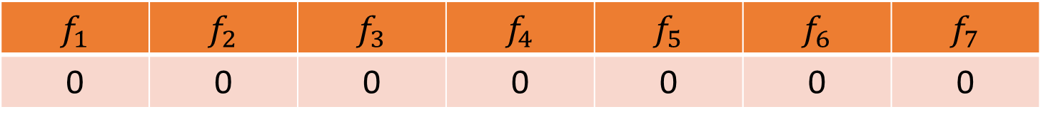


CountMin
$f_{1}$ | $f_{2}$ | $f_{3}$ | $f_{4}$ | $f_{5}$ | $f_{6}$ | $f_{7}$
0 | 0 | 0 | 0 | 0 | 0 | 0
$$1$$
$c_{1}$ | $c_{2}$ | $c_{3}$ | $c_{4}$
0 | 0 | 0 | 0

Slide 55
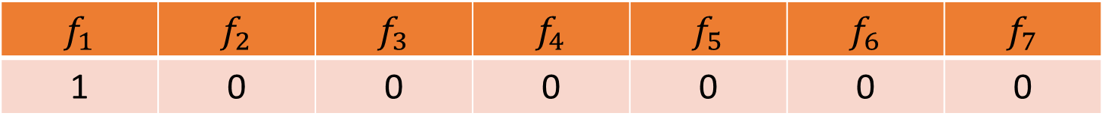

CountMin
$f_{1}$ | $f_{2}$ | $f_{3}$ | $f_{4}$ | $f_{5}$ | $f_{6}$ | $f_{7}$
1 | 0 | 0 | 0 | 0 | 0 | 0
$$1$$
$$h\left(x\right)=3x+2 (mod 4)$$
$c_{1}$ | $c_{2}$ | $c_{3}$ | $c_{4}$
0 | 0 | 0 | 0

Slide 56
CountMin
$f_{1}$ | $f_{2}$ | $f_{3}$ | $f_{4}$ | $f_{5}$ | $f_{6}$ | $f_{7}$
1 | 0 | 0 | 0 | 0 | 0 | 0
$$1$$
$$h\left(x\right)=3x+2 (mod 4)$$
$c_{1}$ | $c_{2}$ | $c_{3}$ | $c_{4}$
0 | 0 | 0 | 0

Slide 57
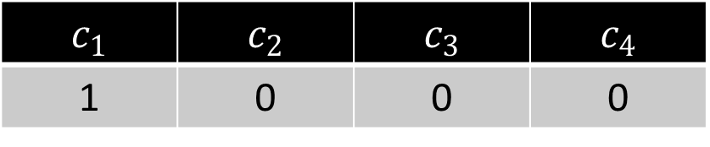
CountMin
$f_{1}$ | $f_{2}$ | $f_{3}$ | $f_{4}$ | $f_{5}$ | $f_{6}$ | $f_{7}$
1 | 0 | 0 | 0 | 0 | 0 | 0
$$1$$
$$h\left(x\right)=3x+2 (mod 4)$$
$c_{1}$ | $c_{2}$ | $c_{3}$ | $c_{4}$
1 | 0 | 0 | 0

Slide 58
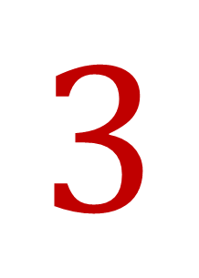
CountMin
$f_{1}$ | $f_{2}$ | $f_{3}$ | $f_{4}$ | $f_{5}$ | $f_{6}$ | $f_{7}$
1 | 0 | 0 | 0 | 0 | 0 | 0
$$3$$
$$h\left(x\right)=3x+2 (mod 4)$$
$c_{1}$ | $c_{2}$ | $c_{3}$ | $c_{4}$
1 | 0 | 0 | 0

Slide 59
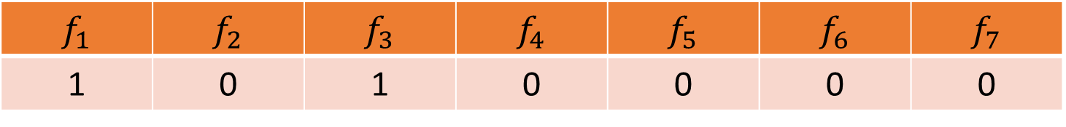
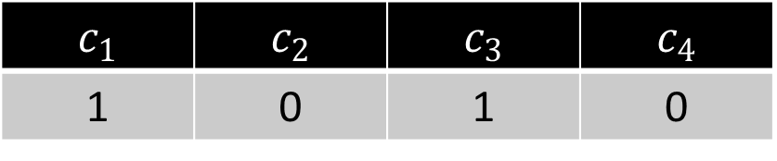
CountMin
$f_{1}$ | $f_{2}$ | $f_{3}$ | $f_{4}$ | $f_{5}$ | $f_{6}$ | $f_{7}$
1 | 0 | 1 | 0 | 0 | 0 | 0
$$3$$
$$h\left(x\right)=3x+2 (mod 4)$$
$c_{1}$ | $c_{2}$ | $c_{3}$ | $c_{4}$
1 | 0 | 1 | 0

Slide 60

CountMin
$f_{1}$ | $f_{2}$ | $f_{3}$ | $f_{4}$ | $f_{5}$ | $f_{6}$ | $f_{7}$
1 | 0 | 1 | 0 | 0 | 0 | 0
$$2$$
$$h\left(x\right)=3x+2 (mod 4)$$
$c_{1}$ | $c_{2}$ | $c_{3}$ | $c_{4}$
1 | 0 | 1 | 0

Slide 61
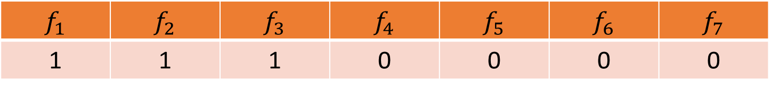
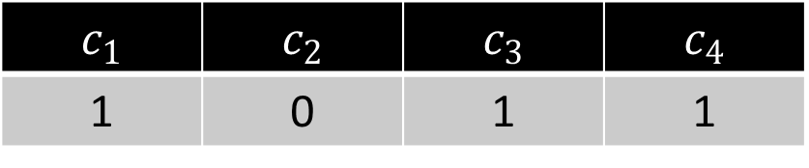
CountMin
$f_{1}$ | $f_{2}$ | $f_{3}$ | $f_{4}$ | $f_{5}$ | $f_{6}$ | $f_{7}$
1 | 1 | 1 | 0 | 0 | 0 | 0
$$2$$
$$h\left(x\right)=3x+2 (mod 4)$$
$c_{1}$ | $c_{2}$ | $c_{3}$ | $c_{4}$
1 | 0 | 1 | 1

Slide 62
CountMin
$f_{1}$ | $f_{2}$ | $f_{3}$ | $f_{4}$ | $f_{5}$ | $f_{6}$ | $f_{7}$
1 | 1 | 1 | 0 | 0 | 0 | 0
$$1$$
$$h\left(x\right)=3x+2 (mod 4)$$
$c_{1}$ | $c_{2}$ | $c_{3}$ | $c_{4}$
1 | 0 | 1 | 1

Slide 63
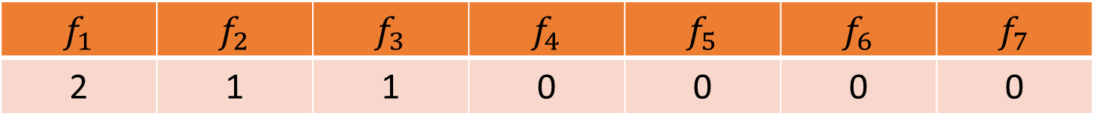
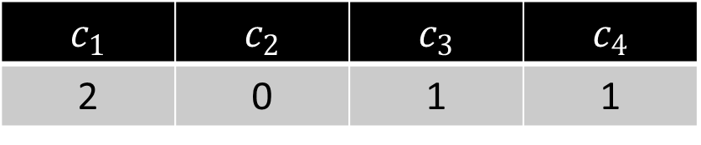
CountMin
$f_{1}$ | $f_{2}$ | $f_{3}$ | $f_{4}$ | $f_{5}$ | $f_{6}$ | $f_{7}$
2 | 1 | 1 | 0 | 0 | 0 | 0
$$1$$
$$h\left(x\right)=3x+2 (mod 4)$$
$c_{1}$ | $c_{2}$ | $c_{3}$ | $c_{4}$
2 | 0 | 1 | 1

Slide 64

CountMin
$f_{1}$ | $f_{2}$ | $f_{3}$ | $f_{4}$ | $f_{5}$ | $f_{6}$ | $f_{7}$
2 | 1 | 1 | 0 | 0 | 0 | 0
$$5$$
$$h\left(x\right)=3x+2 (mod 4)$$
$c_{1}$ | $c_{2}$ | $c_{3}$ | $c_{4}$
1 | 0 | 1 | 1

Slide 65
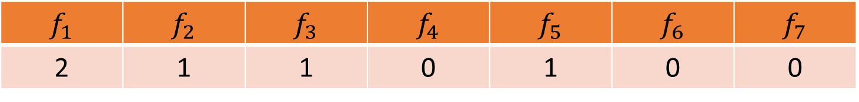
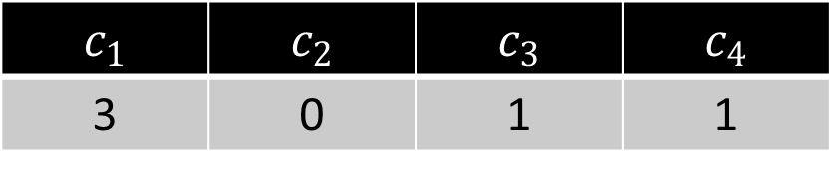
CountMin
$f_{1}$ | $f_{2}$ | $f_{3}$ | $f_{4}$ | $f_{5}$ | $f_{6}$ | $f_{7}$
2 | 1 | 1 | 0 | 1 | 0 | 0
$$5$$
$$h\left(x\right)=3x+2 (mod 4)$$
$c_{1}$ | $c_{2}$ | $c_{3}$ | $c_{4}$
3 | 0 | 1 | 1

Slide 66
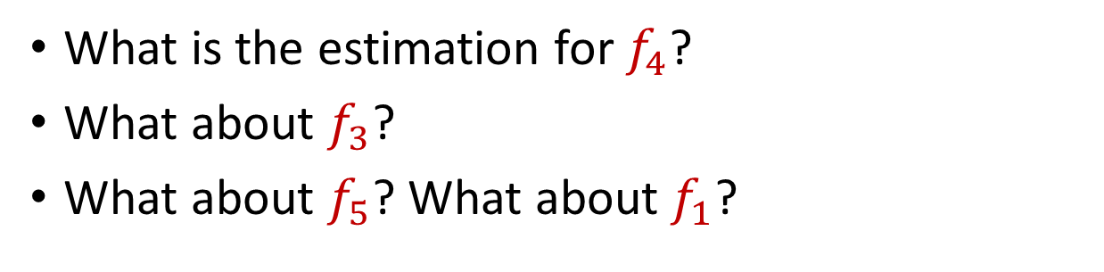
CountMin
$f_{1}$ | $f_{2}$ | $f_{3}$ | $f_{4}$ | $f_{5}$ | $f_{6}$ | $f_{7}$
2 | 1 | 1 | 0 | 1 | 0 | 0
What is the estimation for $f_{4}$?
What about $f_{3}$?
What about $f_{5}$? What about $f_{1}$?
$$h\left(x\right)=3x+2 (mod 4)$$
$c_{1}$ | $c_{2}$ | $c_{3}$ | $c_{4}$
3 | 0 | 1 | 1

Slide 67
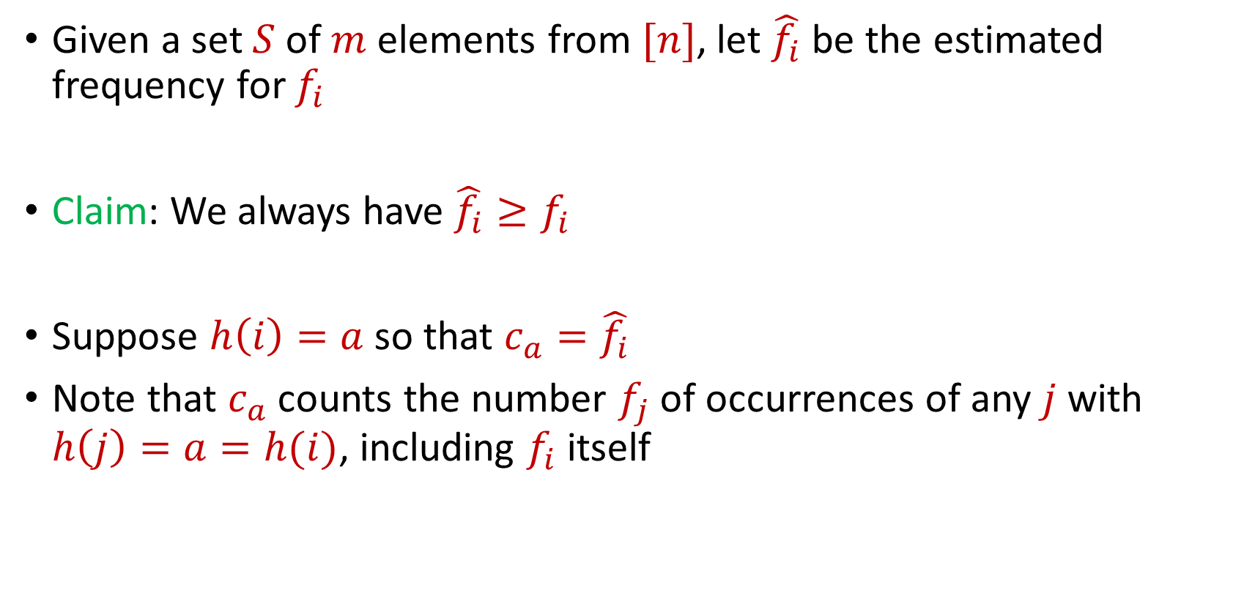
CountMin
Given a set $S$ of $m$ elements from $[n]$, let $\hat{f_{i}}$ be the estimated frequency for $f_{i}$
Claim: We always have $\hat{f_{i}}≥f_{i}$
Suppose $h\left(i\right)=a$ so that $c_{a}=\hat{f_{i}}$
Note that $c_{a}$counts the number $f_{j}$of occurrences of any $j$ with $h\left(j\right)=a=h(i)$, including $f_{i}$ itself

Slide 68
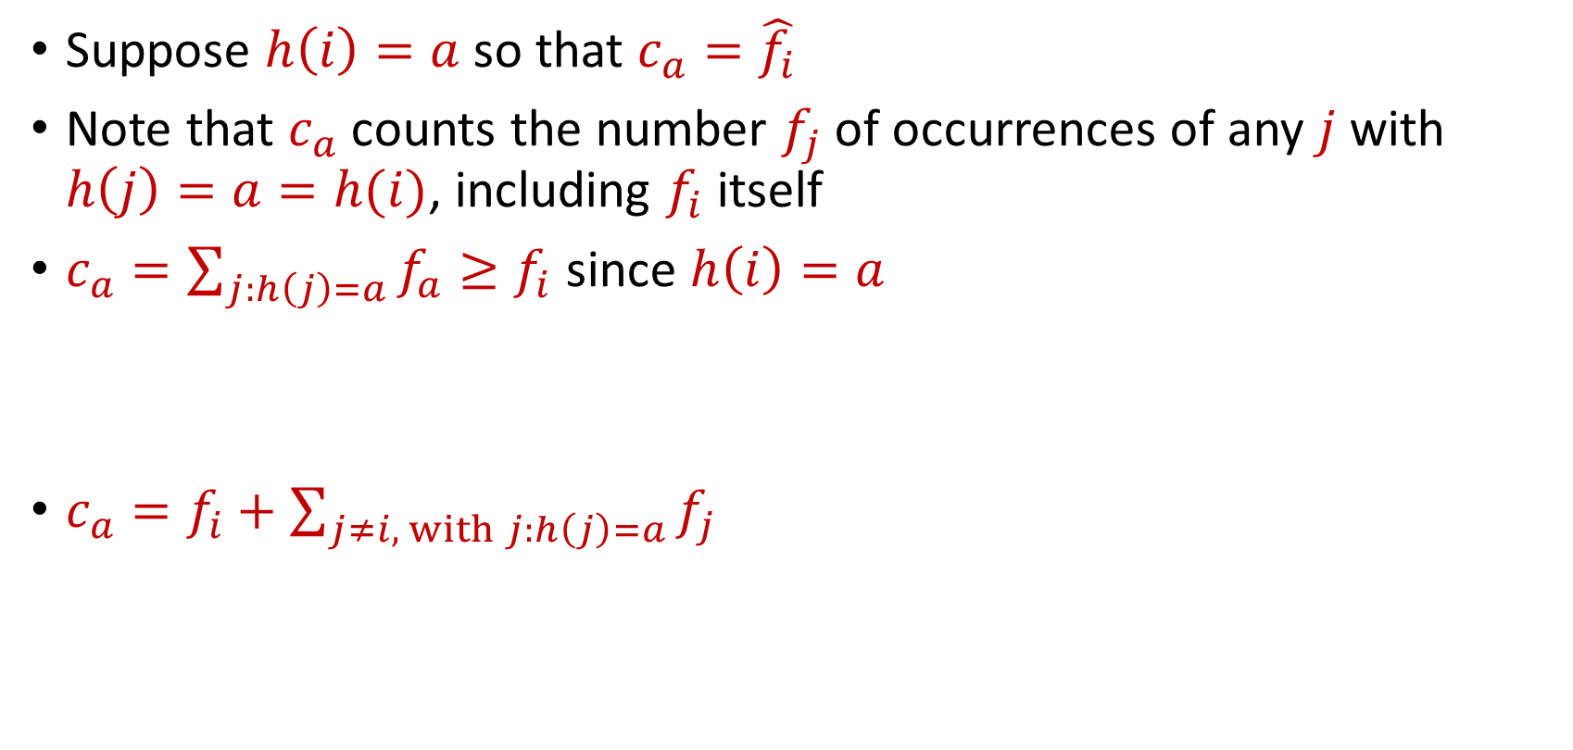
CountMin
Suppose $h\left(i\right)=a$ so that $c_{a}=\hat{f_{i}}$
Note that $c_{a}$counts the number $f_{j}$of occurrences of any $j$ with $h\left(j\right)=a=h(i)$, including $f_{i}$ itself
$c_{a}=\sum_{j:h\left(j\right)=a}{f_{a}}≥f_{i}$ since $h\left(i\right)=a$
$c_{a}=f_{i}+\sum_{j≠i, with j:h\left(j\right)=a}{f_{j}}$

Slide 69
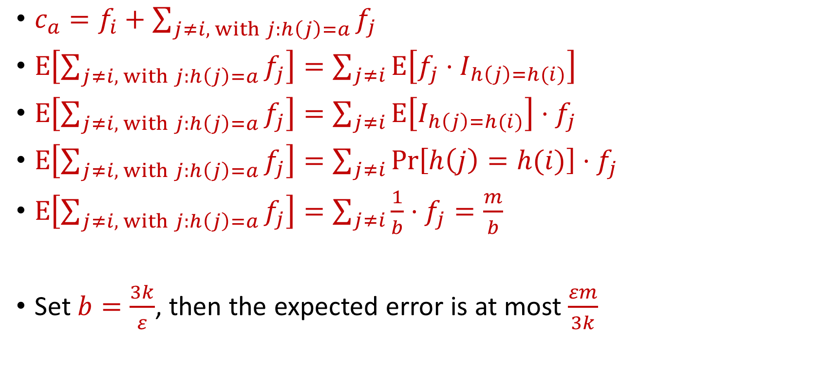
CountMin Error Analysis
$c_{a}=f_{i}+\sum_{j≠i, with j:h\left(j\right)=a}{f_{j}}$
$E\left[\sum_{j≠i, with j:h\left(j\right)=a}{f_{j}}\right]=\sum_{j≠i}{E\left[f_{j}⋅I_{h\left(j\right)=h(i)}\right]}$
$E\left[\sum_{j≠i, with j:h\left(j\right)=a}{f_{j}}\right]=\sum_{j≠i}{E\left[I_{h\left(j\right)=h(i)}\right]⋅f_{j}}$
$E\left[\sum_{j≠i, with j:h\left(j\right)=a}{f_{j}}\right]=\sum_{j≠i}{{Pr\left[h\left(j\right)=h(i)\right]⋅f}_{j}}$
$E\left[\sum_{j≠i, with j:h\left(j\right)=a}{f_{j}}\right]=\sum_{j≠i}{{\frac{1}{b}⋅f}_{j}=\frac{m}{b}}$
Set $b=\frac{3k}{ε}$, then the expected error is at most $\frac{εm}{3k}$

Slide 70
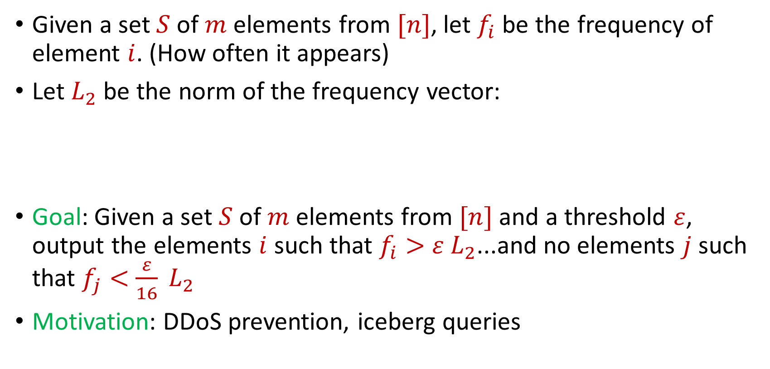
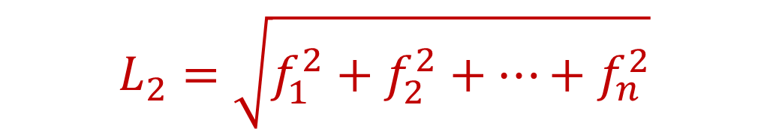
Heavy-Hitters (Frequent Items)
Given a set $S$ of $m$ elements from $[n]$, let $f_{i}$ be the frequency of element $i$. (How often it appears)
Let $L_{2}$ be the norm of the frequency vector:
Goal: Given a set $S$ of $m$ elements from $[n]$ and a threshold $ε$, output the elements $i$ such that $f_{i}>$ $ε L_{2}$...and no elements $j$ such that $f_{j}<$ $\frac{ε}{16} L_{2}$
Motivation: DDoS prevention, iceberg queries
$$L_{2}=\sqrt{f_{1}^{2}+f_{2}^{2}+…+f_{n}^{2}}$$

Slide 71
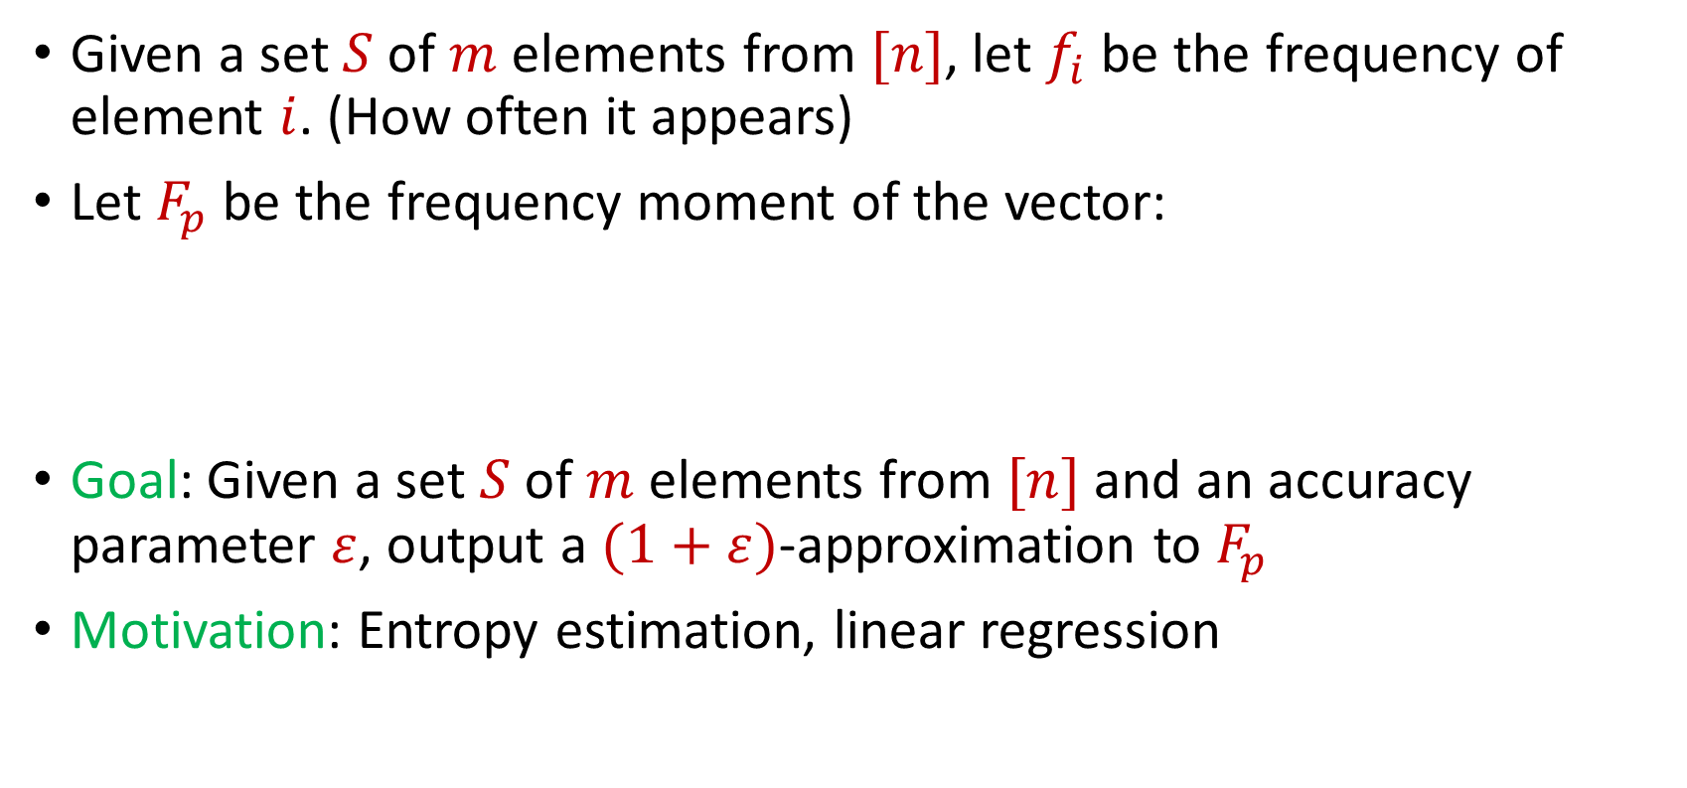
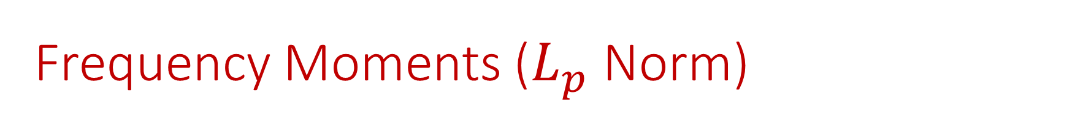
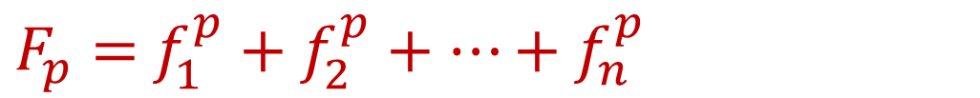
Frequency Moments ($L_{p}$ Norm)
Given a set $S$ of $m$ elements from $[n]$, let $f_{i}$ be the frequency of element $i$. (How often it appears)
Let $F_{p}$ be the frequency moment of the vector:
Goal: Given a set $S$ of $m$ elements from $[n]$ and an accuracy parameter $ε$, output a $(1+ε)$-approximation to $F_{p}$
Motivation: Entropy estimation, linear regression
$F_{p}=$ $f_{1}^{p}+f_{2}^{p}+…+f_{n}^{p}$

Slide 72
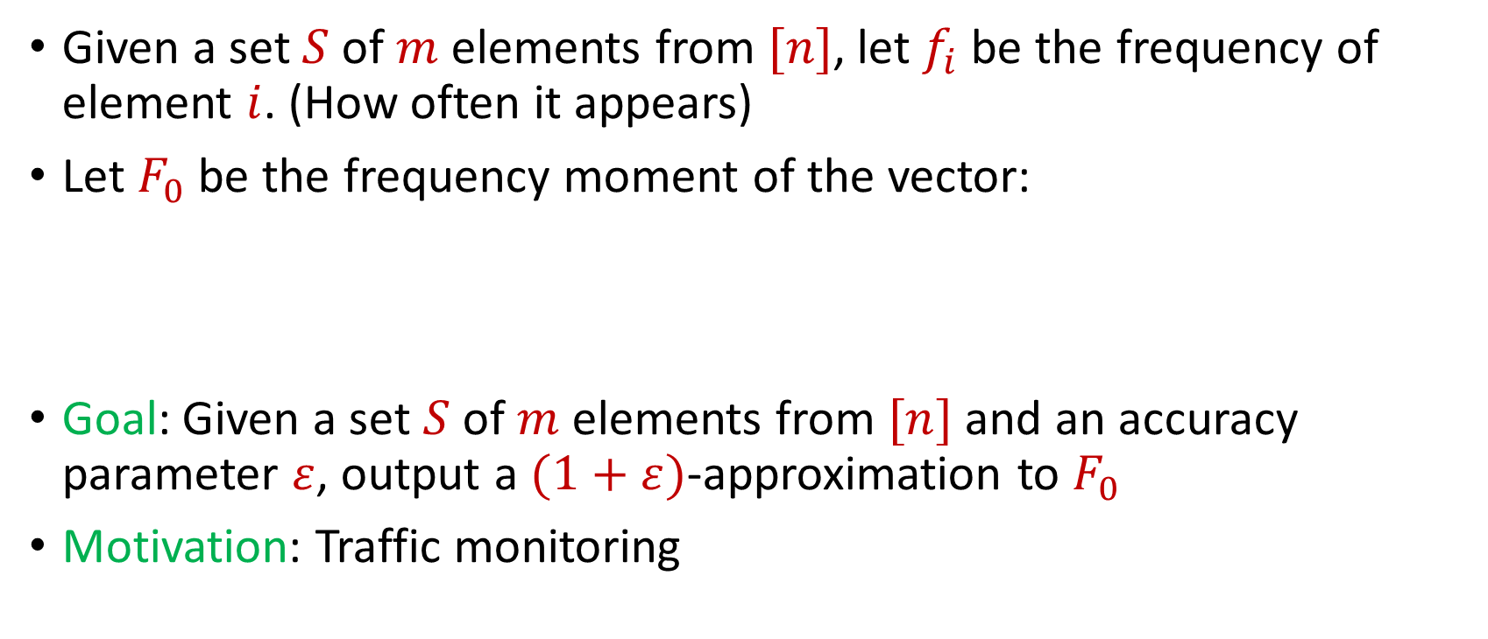

Distinct Elements ($F_{0}$ Estimation)
Given a set $S$ of $m$ elements from $[n]$, let $f_{i}$ be the frequency of element $i$. (How often it appears)
Let $F_{0}$ be the frequency moment of the vector:
Goal: Given a set $S$ of $m$ elements from $[n]$ and an accuracy parameter $ε$, output a $(1+ε)$-approximation to $F_{0}$
Motivation: Traffic monitoring
$F_{0}=$ $|\{i :f_{i}≠0\}|$

