Slide 1
CSCE 689: Special Topics in Modern Algorithms for Data Science
Lecture 22
Samson Zhou

Slide 2
Presentation Schedule
November 27: Chunkai, Jung, Galaxy AI
November 29: STMI, Anmol, Jason
December 1: Bokun, Ayesha, Dawei, Lipai

Slide 3
47 72 81 10 14 33 51 29 54 9 36 46 10

Slide 4






$$1$$
$$2$$
$$5$$
$$6$$
$$4$$
$$3$$

Slide 6
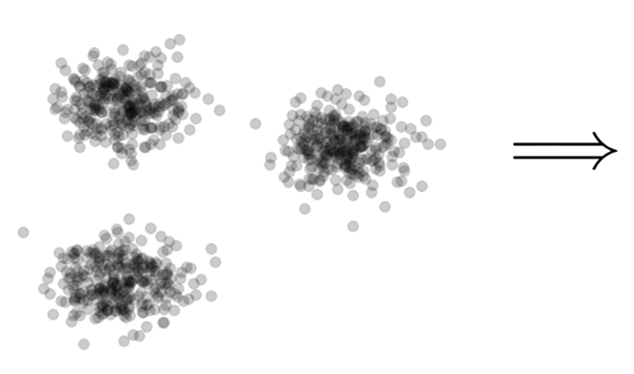

Clustering
Goal: Given input dataset $X$, partition $X$ so that “similar” points are in the same cluster and “different” points are in different clusters

Slide 7
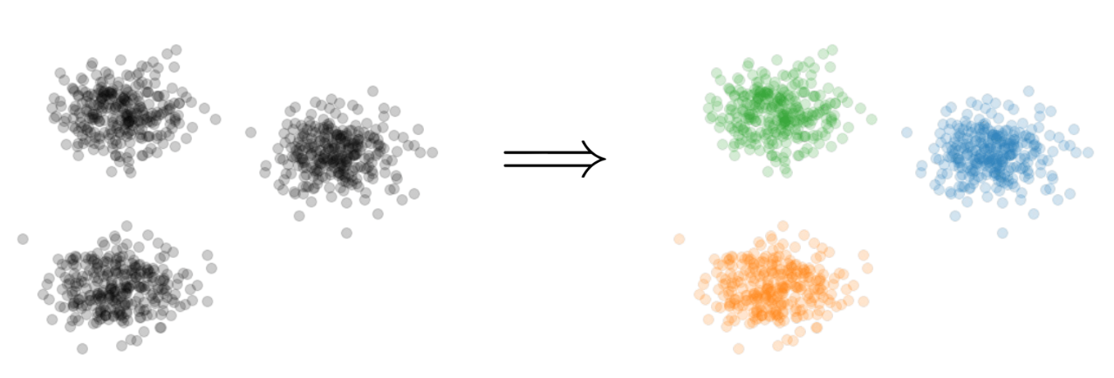
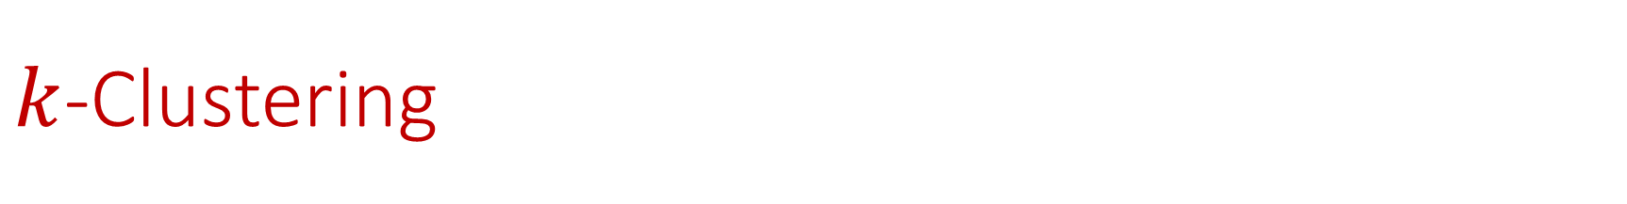

$k$-Clustering
Goal: Given input dataset $X$, partition $X$ so that “similar” points are in the same cluster and “different” points are in different clusters
There can be at most $k$ different clusters
$$k=3$$

Slide 8
$k$-Clustering
Question: How do we measure the “quality” of each clustering?
$$k=3$$

Slide 9
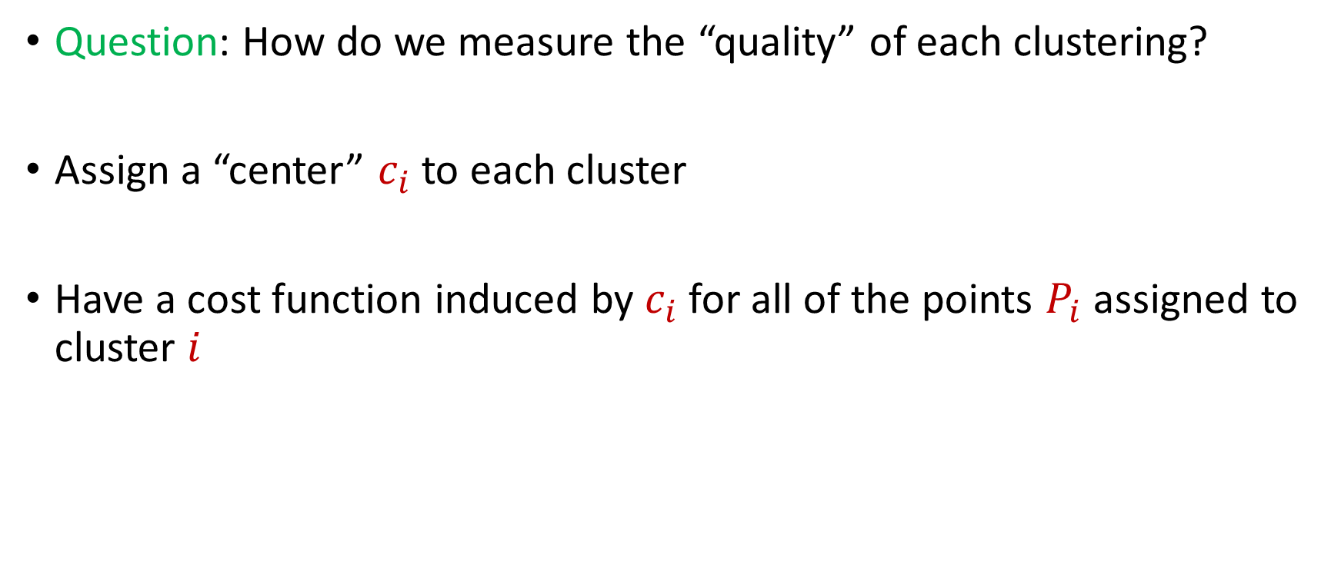
$k$-Clustering
Question: How do we measure the “quality” of each clustering?
Assign a “center” $c_{i}$ to each cluster
Have a cost function induced by $c_{i}$ for all of the points $P_{i}$ assigned to cluster $i$

Slide 10
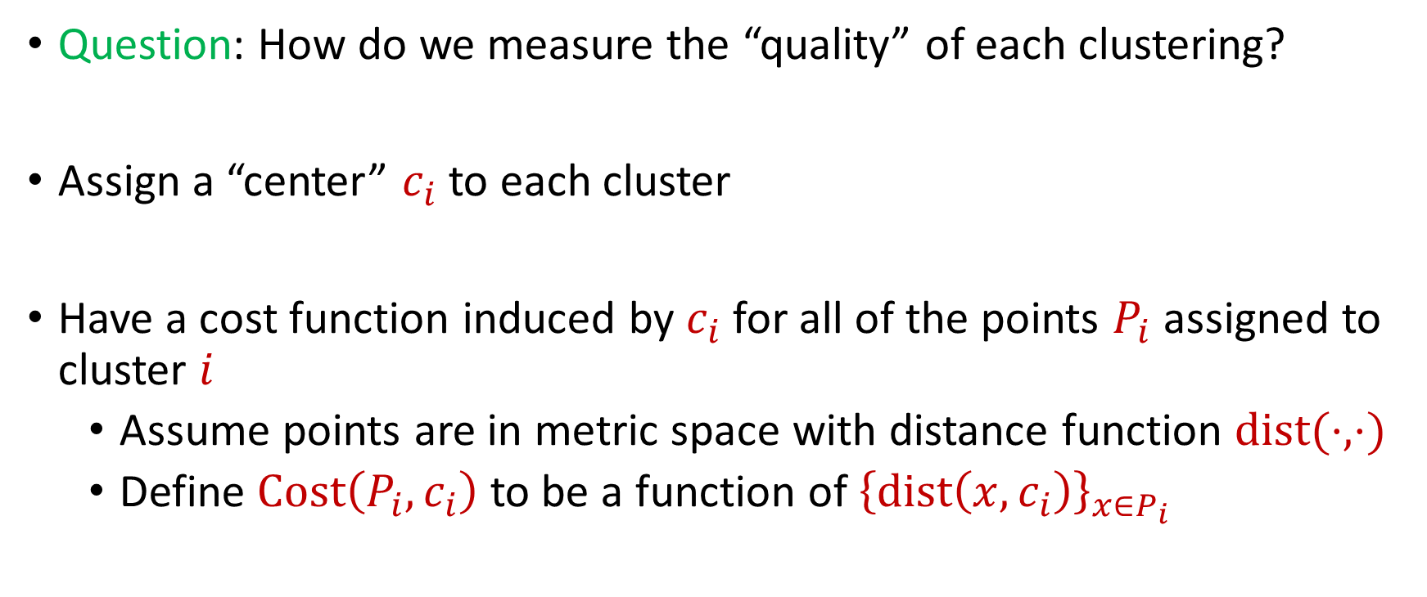
$k$-Clustering
Question: How do we measure the “quality” of each clustering?
Assign a “center” $c_{i}$ to each cluster
Have a cost function induced by $c_{i}$ for all of the points $P_{i}$ assigned to cluster $i$
Assume points are in metric space with distance function $dist(⋅,⋅)$
Define $Cost\left(P_{i},c_{i}\right)$ to be a function of ${\left\{dist\left(x,c_{i}\right)\right\}}_{x∈P_{i}}$

Slide 11
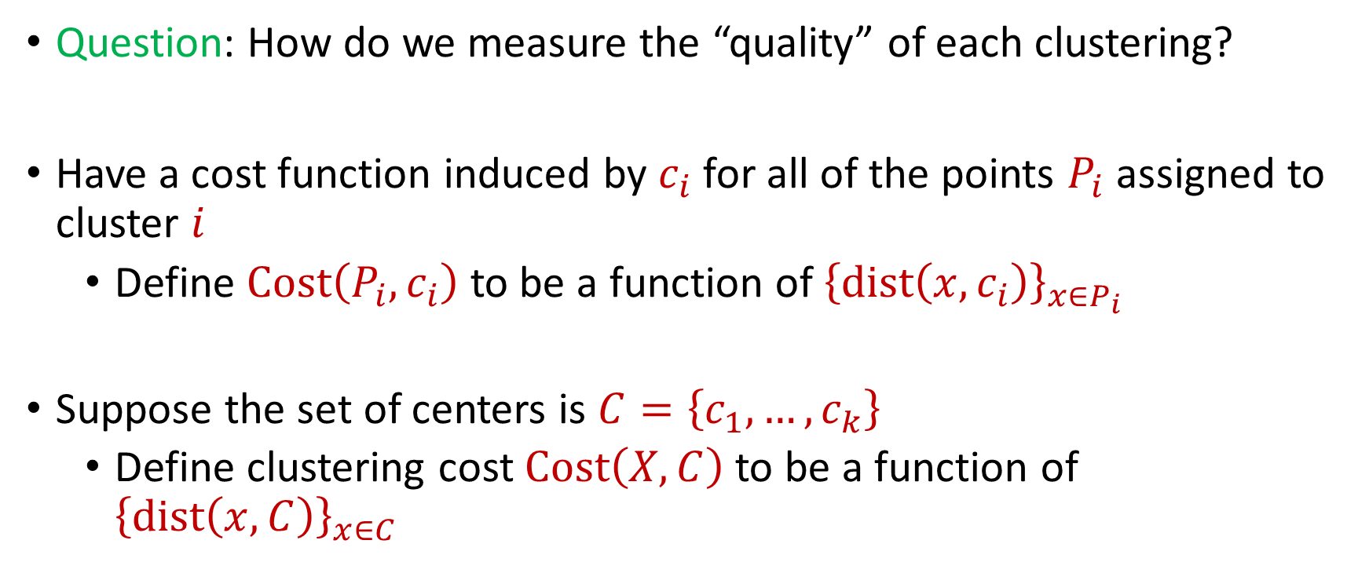
$k$-Clustering
Question: How do we measure the “quality” of each clustering?
Have a cost function induced by $c_{i}$ for all of the points $P_{i}$ assigned to cluster $i$
Define $Cost\left(P_{i},c_{i}\right)$ to be a function of ${\left\{dist\left(x,c_{i}\right)\right\}}_{x∈P_{i}}$
Suppose the set of centers is $C=\left\{c_{1},…, c_{k}\right\}$
Define clustering cost $Cost\left(X,C\right)$ to be a function of ${\left\{dist\left(x,C\right)\right\}}_{x∈C}$

Slide 12

$k$-Clustering
Define clustering cost $Cost\left(X,C\right)$ to be a function of ${\left\{dist\left(x,C\right)\right\}}_{x∈C}$

Slide 13
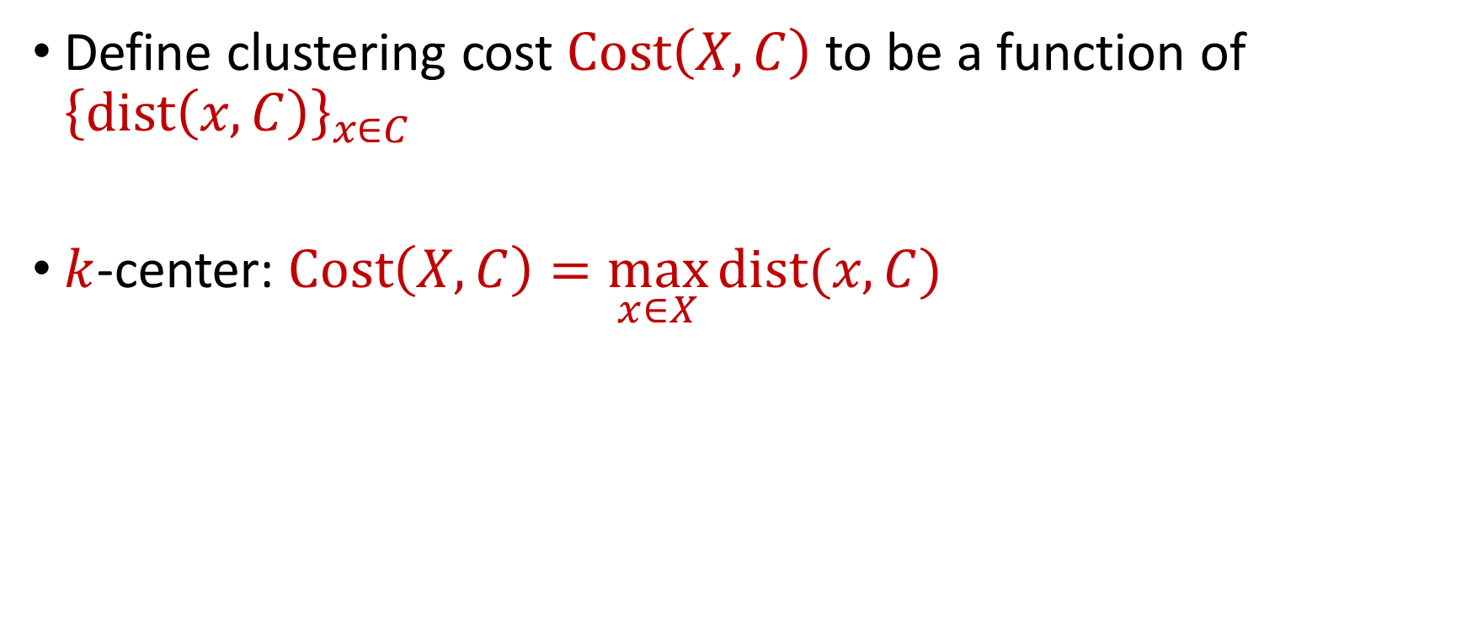
$k$-Clustering
Define clustering cost $Cost\left(X,C\right)$ to be a function of ${\left\{dist\left(x,C\right)\right\}}_{x∈C}$
$k$-center: $Cost\left(X,C\right)=\max_{x∈X}{dist(x,C)}$

Slide 14
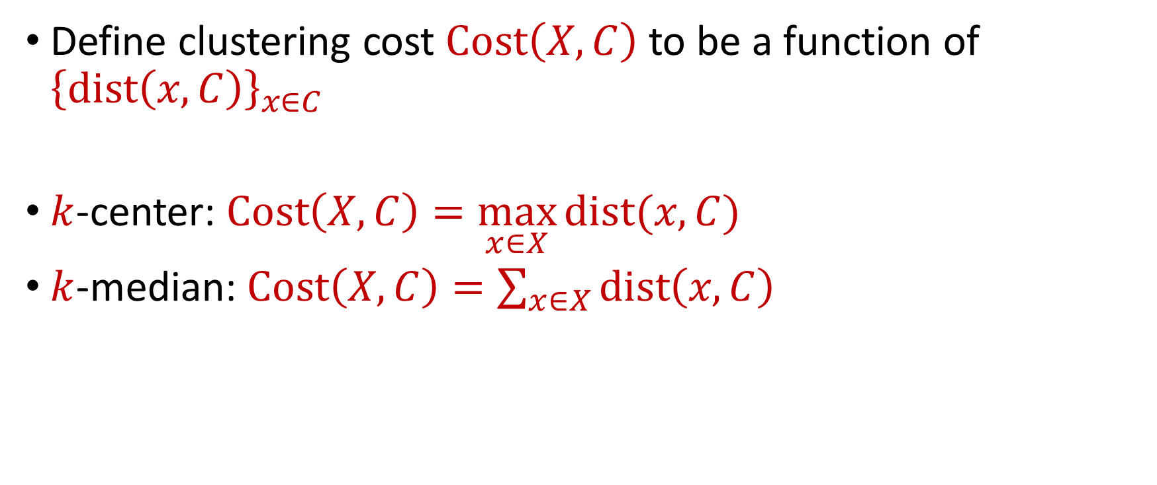
$k$-Clustering
Define clustering cost $Cost\left(X,C\right)$ to be a function of ${\left\{dist\left(x,C\right)\right\}}_{x∈C}$
$k$-center: $Cost\left(X,C\right)=\max_{x∈X}{dist(x,C)}$
$k$-median: $Cost\left(X,C\right)=\sum_{x∈X}{dist\left(x,C\right)}$

Slide 15

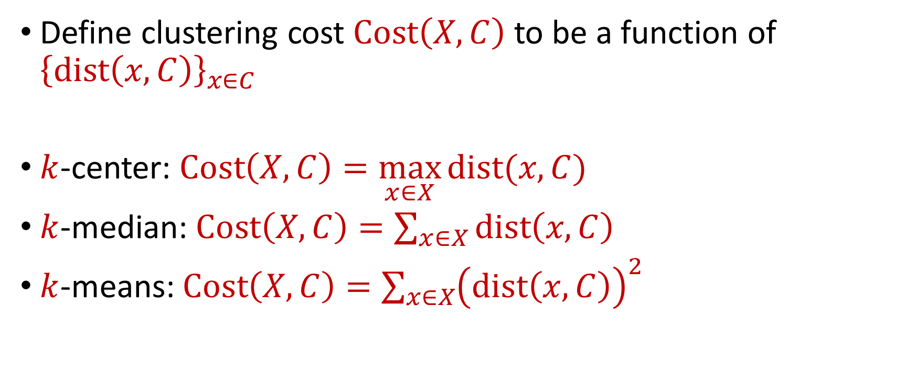






$k$-Clustering
Define clustering cost $Cost\left(X,C\right)$ to be a function of ${\left\{dist\left(x,C\right)\right\}}_{x∈C}$
$k$-center: $Cost\left(X,C\right)=\max_{x∈X}{dist(x,C)}$
$k$-median: $Cost\left(X,C\right)=\sum_{x∈X}{dist\left(x,C\right)}$
$k$-means: $Cost\left(X,C\right)=\sum_{x∈X}{{\left(dist\left(x,C\right)\right)}^{2}}$
$${\left(⋅\right)}^{2}$$
$${\left(⋅\right)}^{2}$$
$${\left(⋅\right)}^{2}$$
$${\left(⋅\right)}^{2}$$
$${\left(⋅\right)}^{2}$$
$${\left(⋅\right)}^{2}$$
$${\left(⋅\right)}^{2}$$

Slide 16

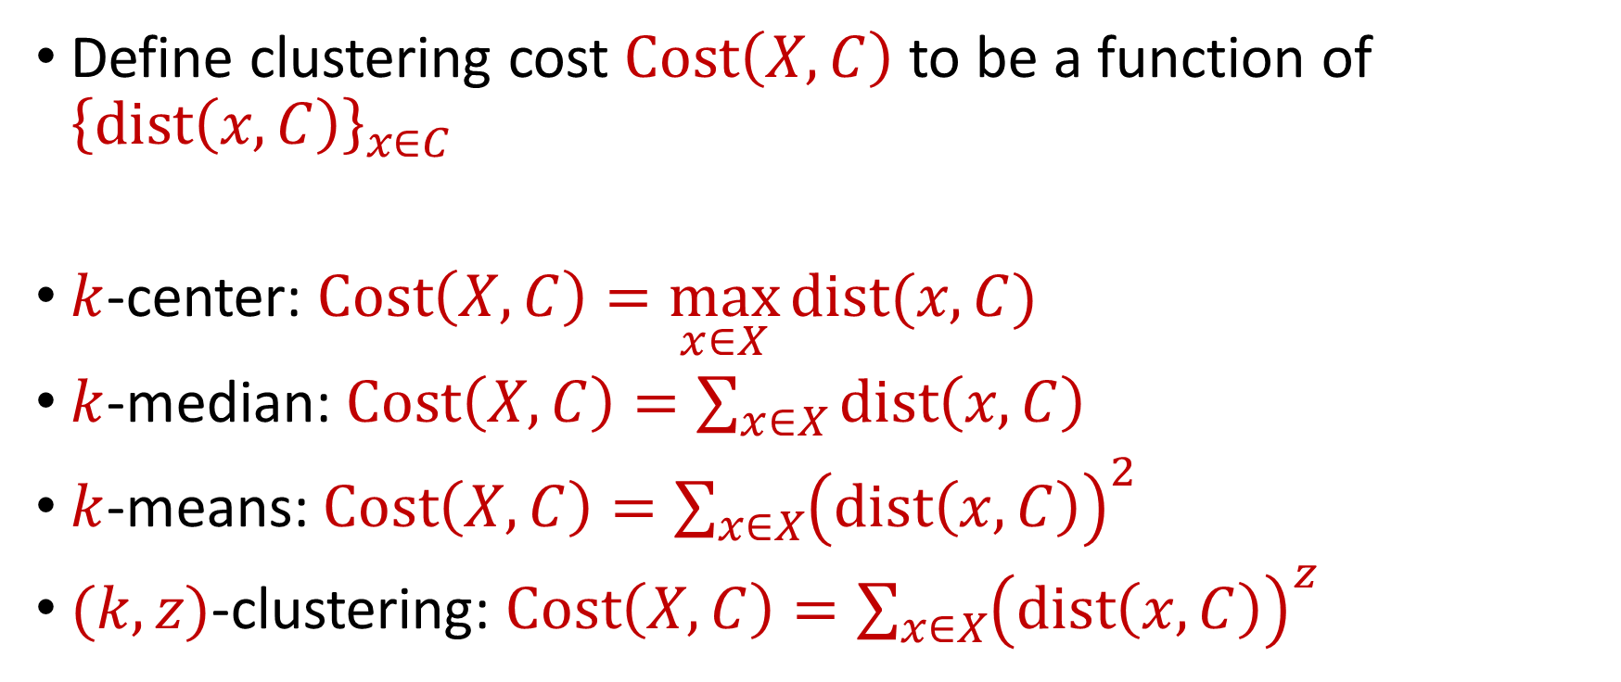






$k$-Clustering
Define clustering cost $Cost\left(X,C\right)$ to be a function of ${\left\{dist\left(x,C\right)\right\}}_{x∈C}$
$k$-center: $Cost\left(X,C\right)=\max_{x∈X}{dist(x,C)}$
$k$-median: $Cost\left(X,C\right)=\sum_{x∈X}{dist\left(x,C\right)}$
$k$-means: $Cost\left(X,C\right)=\sum_{x∈X}{{\left(dist\left(x,C\right)\right)}^{2}}$
$(k,z)$-clustering: $Cost\left(X,C\right)=\sum_{x∈X}{{\left(dist\left(x,C\right)\right)}^{z}}$
$${\left(⋅\right)}^{z}$$
$${\left(⋅\right)}^{z}$$
$${\left(⋅\right)}^{z}$$
$${\left(⋅\right)}^{z}$$
$${\left(⋅\right)}^{z}$$
$${\left(⋅\right)}^{z}$$
$${\left(⋅\right)}^{z}$$

Slide 17
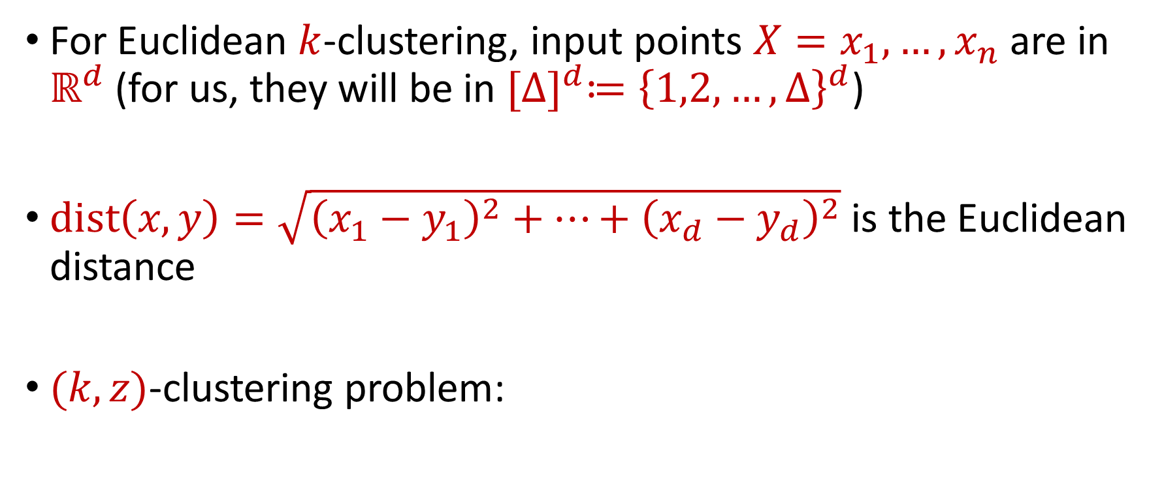


Euclidean $k$-Clustering
For Euclidean $k$-clustering, input points $X=x_{1},…,x_{n}$ are in $ℝ^{d}$ (for us, they will be in ${[Δ]}^{d}≔{\left\{1,2,…,Δ\right\}}^{d}$)
$dist\left(x,y\right)=\sqrt{{\left(x_{1}−y_{1}\right)}^{2}+…+{\left(x_{d}−y_{d}\right)}^{2}}$ is the Euclidean distance
$(k,z)$-clustering problem:
$$\min_{C:\left|C\right|≤k} Cost\left(X,C\right)=\min_{C:\left|C\right|≤k}{Σ_{x∈X}\left(dist\left(x,C\right)\right)}^{z}$$

Slide 18






$$(−8, 4)$$
$$(−4, 3)$$
$$(4, 3)$$
$$(−3, 0)$$
$$(−11, −4)$$
$$(0, −4)$$

Slide 19


$$(−8, 4)$$
$$(−4, 3)$$
$$(4, 3)$$
$$(−8, 0)$$
$$(−3, 0)$$
$$(0, 0)$$
$$(−11, −4)$$
$$(0, −4)$$

Slide 20






$$(−8, 4)$$
$$(−4, 3)$$
$$(4, 3)$$
$$4$$
$$5$$
$$5$$
$$3$$
$$(−8, 0)$$
$$(−3, 0)$$
$$(0, 0)$$
$$5$$
$$4$$
$$(−11, −4)$$
$$(0, −4)$$

Slide 21
$k$-center: $Cost\left(X,C\right)=\max_{x∈X}{dist\left(x,C\right)=5}$
$$(−8, 4)$$
$$(−4, 3)$$
$$(4, 3)$$
$$4$$
$$5$$
$$5$$
$$3$$
$$(−8, 0)$$
$$(−3, 0)$$
$$(0, 0)$$
$$5$$
$$4$$
$$(−11, −4)$$
$$(0, −4)$$

Slide 22
$k$-median: $Cost\left(X,C\right)=\sum_{x∈X}{dist\left(x,C\right)}=4+5+5+3+4+5=26$
$$(−8, 4)$$
$$(−4, 3)$$
$$(4, 3)$$
$$4$$
$$5$$
$$5$$
$$3$$
$$(−8, 0)$$
$$(−3, 0)$$
$$(0, 0)$$
$$5$$
$$4$$
$$(−11, −4)$$
$$(0, −4)$$

Slide 23

$k$-means: $Cost\left(X,C\right)=\sum_{x∈X}{{\left(dist\left(x,C\right)\right)}^{2}} =16+25+25+9+16+25$
$$(−8, 4)$$
$$=116$$
$$(−4, 3)$$
$$(4, 3)$$
$$4$$
$$5$$
$$5$$
$$3$$
$$(−8, 0)$$
$$(−3, 0)$$
$$(0, 0)$$
$$5$$
$$4$$
$$(−11, −4)$$
$$(0, −4)$$

Slide 24
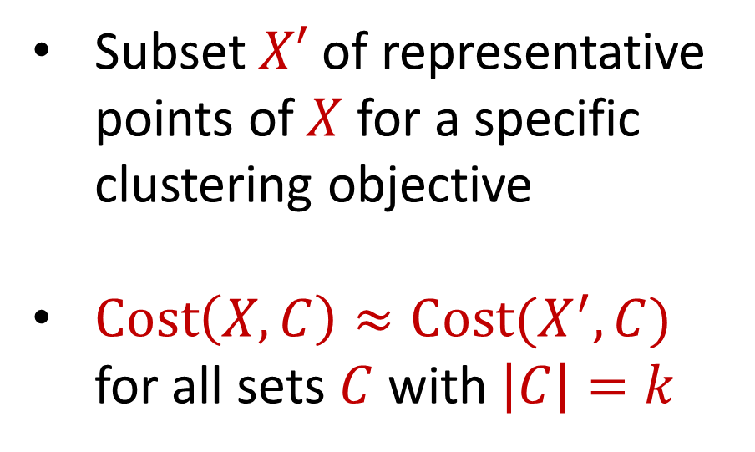
Coreset
Subset $X′$ of representative points of $X$ for a specific clustering objective
$Cost\left(X,C\right)≈Cost(X^{′},C)$ for all sets $C$ with $\left|C\right|=k$

Slide 25
Coreset
Subset $X′$ of representative points of $X$ for a specific clustering objective
$Cost\left(X,C\right)≈Cost(X^{′},C)$ for all sets $C$ with $\left|C\right|=k$

Slide 26
Coreset
Subset $X′$ of representative points of $X$ for a specific clustering objective
$Cost\left(X,C\right)≈Cost(X^{′},C)$ for all sets $C$ with $\left|C\right|=k$

Slide 27

Coreset (Formal Definition)
Given a set $X$ and an accuracy parameter $ε>0$, we say a set $X′$ with weight function $w$is an $(1+ε)$-multiplicative coreset for a cost function $Cost$, if for all queries $C$ with $\left|C\right|≤k$, we have
$$\left(1−ε\right)Cost(X,C)≤Cost(X′,C,w)≤\left(1+ε\right)Cost(X,C)$$
$(k,z)$-clustering: $Cost\left(X^{′},C,w\right)=\sum_{x∈X′}{{w\left(x\right)⋅\left(dist\left(x,C\right)\right)}^{z}}$

Slide 28
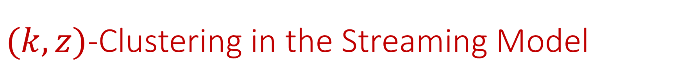

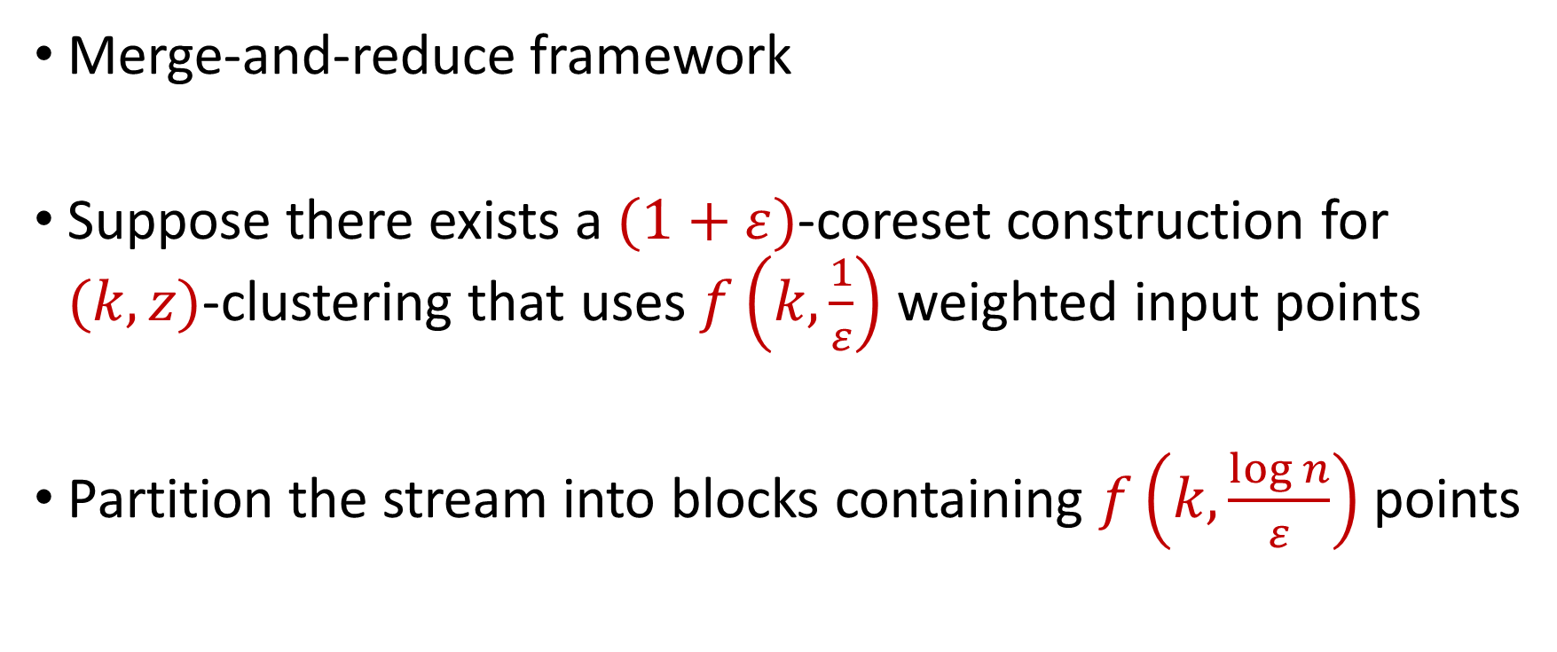
$(k,z)$-Clustering in the Streaming Model
Merge-and-reduce framework
Suppose there exists a $(1+ε)$-coreset construction for $(k,z)$-clustering that uses $f\left(k,\frac{1}{ε}\right)$ weighted input points
Partition the stream into blocks containing $f\left(k,\frac{\log{n}}{ε}\right)$ points
$$\tilde{O}\left(\frac{k^{2}}{ε^{2}}\right)$$

Slide 29
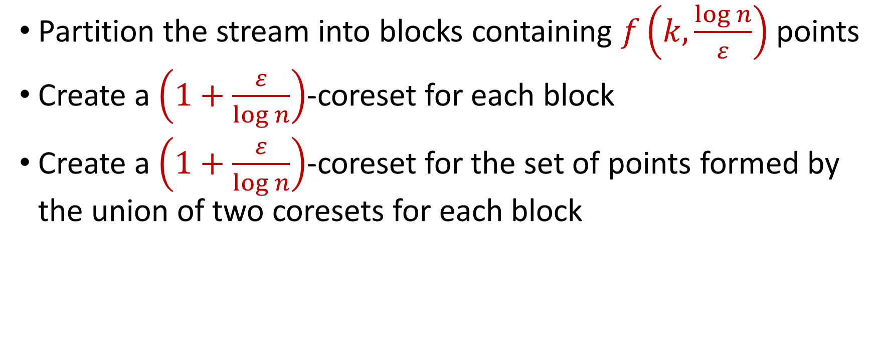
$(k,z)$-Clustering in the Streaming Model
Partition the stream into blocks containing $f\left(k,\frac{\log{n}}{ε}\right)$ points
Create a $\left(1+\frac{ε}{\log{n}}\right)$-coreset for each block
Create a $\left(1+\frac{ε}{\log{n}}\right)$-coreset for the set of points formed by the union of two coresets for each block
Reduce
Merge

Slide 30
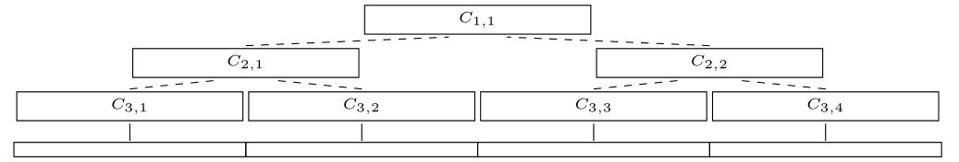
$(k,z)$-Clustering in the Streaming Model
Partition the stream into blocks containing $f\left(k,\frac{\log{n}}{ε}\right)$ points
Create a $\left(1+\frac{ε}{\log{n}}\right)$-coreset for each block
Create a $\left(1+\frac{ε}{\log{n}}\right)$-coreset for the set of points formed by the union of two coresets for each block

Slide 31
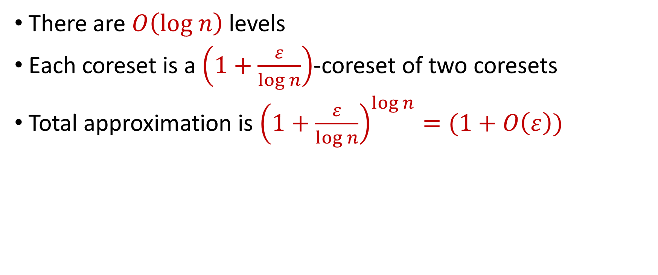
$(k,z)$-Clustering in the Streaming Model
There are $O\left(log n\right)$ levels
Each coreset is a $\left(1+\frac{ε}{\log{n}}\right)$-coreset of two coresets
Total approximation is ${\left(1+\frac{ε}{\log{n}}\right)}^{\log{n}}=(1+O\left(ε\right))$

Slide 32
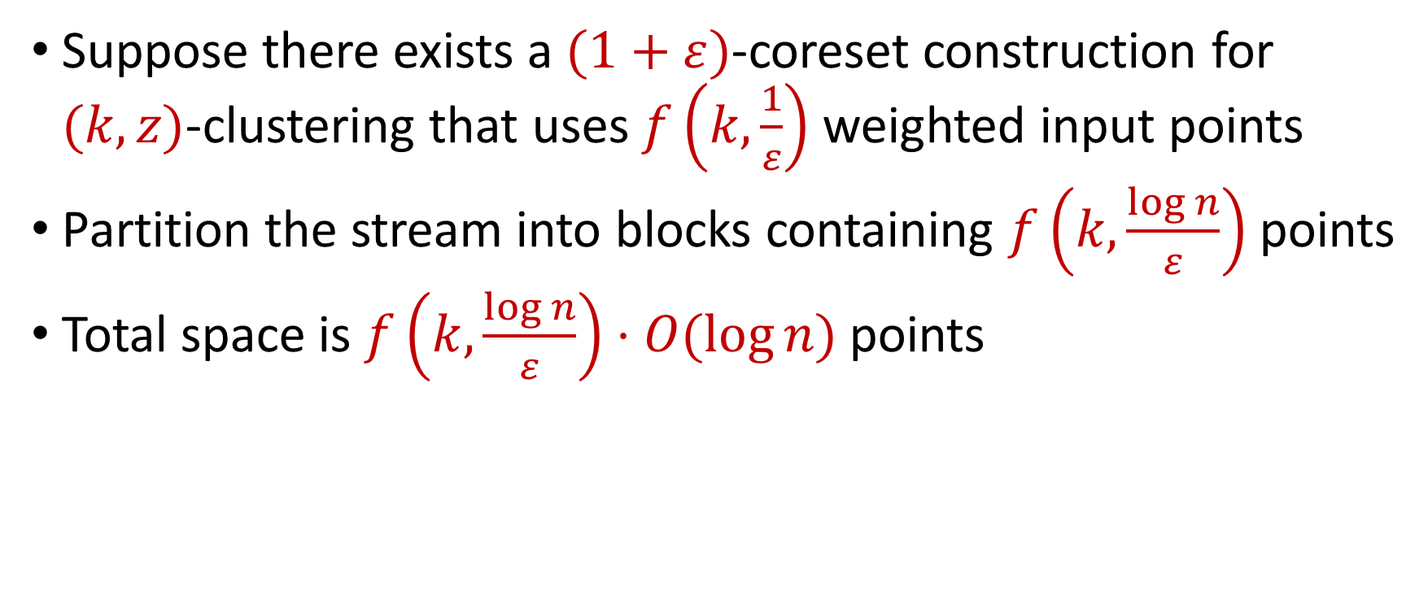
$(k,z)$-Clustering in the Streaming Model
Suppose there exists a $(1+ε)$-coreset construction for $(k,z)$-clustering that uses $f\left(k,\frac{1}{ε}\right)$ weighted input points
Partition the stream into blocks containing $f\left(k,\frac{\log{n}}{ε}\right)$ points
Total space is $f\left(k,\frac{\log{n}}{ε}\right)⋅O(log{n)}$ points
For $k$-means clustering, this is $\tilde{O}\left(\frac{k^{2}}{ε^{2}}⋅\log^{3}{n}\right)$ points

