Slide 1
CSCE 658: Randomized Algorithms
Lecture 12
Samson Zhou

Slide 2
Class Logistics
March 5: Lecture canceled, i.e., do NOT show up to HRBB 126 (unless you want to see an empty classroom)

Slide 4
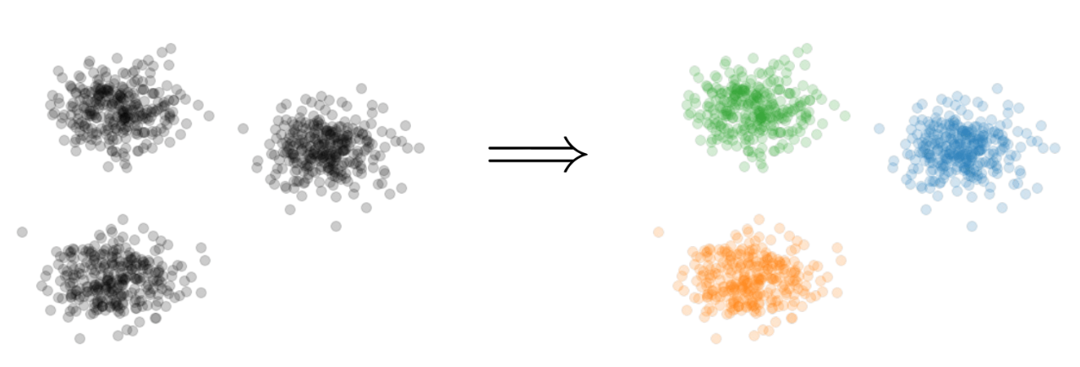


Last Time: $k$-Clustering
Goal: Given input dataset $X$, partition $X$ so that “similar” points are in the same cluster and “different” points are in different clusters
There can be at most $k$ different clusters
$$k=3$$

Slide 5

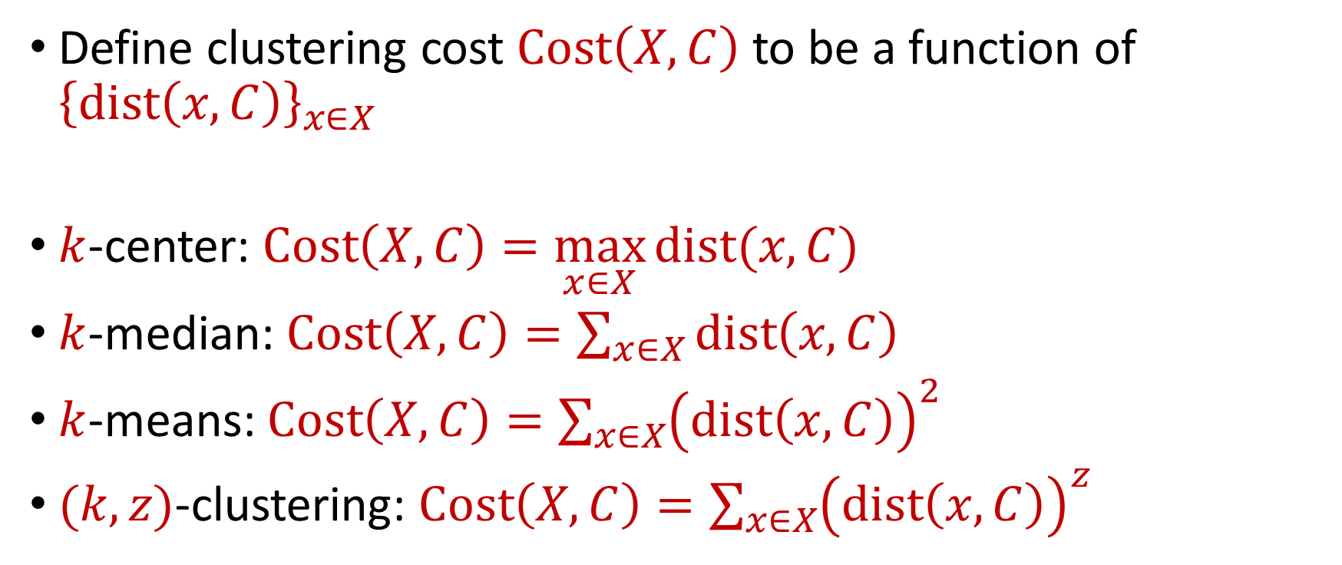






Last Time: $k$-Clustering
Define clustering cost $Cost\left(X,C\right)$ to be a function of ${\left\{dist\left(x,C\right)\right\}}_{x∈X}$
$k$-center: $Cost\left(X,C\right)=\max_{x∈X}{dist(x,C)}$
$k$-median: $Cost\left(X,C\right)=\sum_{x∈X}{dist\left(x,C\right)}$
$k$-means: $Cost\left(X,C\right)=\sum_{x∈X}{{\left(dist\left(x,C\right)\right)}^{2}}$
$(k,z)$-clustering: $Cost\left(X,C\right)=\sum_{x∈X}{{\left(dist\left(x,C\right)\right)}^{z}}$
$${\left(⋅\right)}^{z}$$
$${\left(⋅\right)}^{z}$$
$${\left(⋅\right)}^{z}$$
$${\left(⋅\right)}^{z}$$
$${\left(⋅\right)}^{z}$$
$${\left(⋅\right)}^{z}$$
$${\left(⋅\right)}^{z}$$

Slide 6
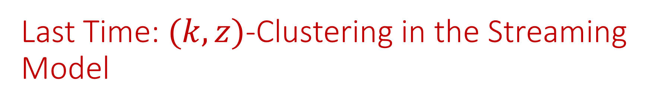

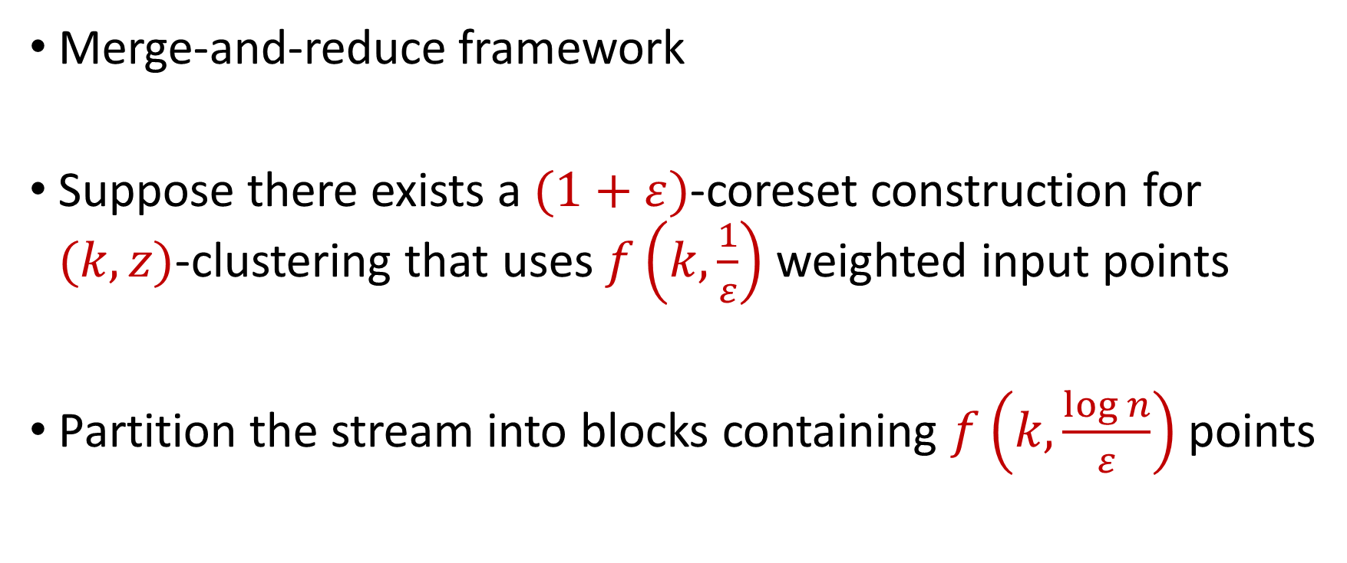
Last Time: $(k,z)$-Clustering in the Streaming Model
Merge-and-reduce framework
Suppose there exists a $(1+ε)$-coreset construction for $(k,z)$-clustering that uses $f\left(k,\frac{1}{ε}\right)$ weighted input points
Partition the stream into blocks containing $f\left(k,\frac{\log{n}}{ε}\right)$ points
$$\tilde{O}\left(\frac{k^{2}}{ε^{2}}\right)$$

Slide 7
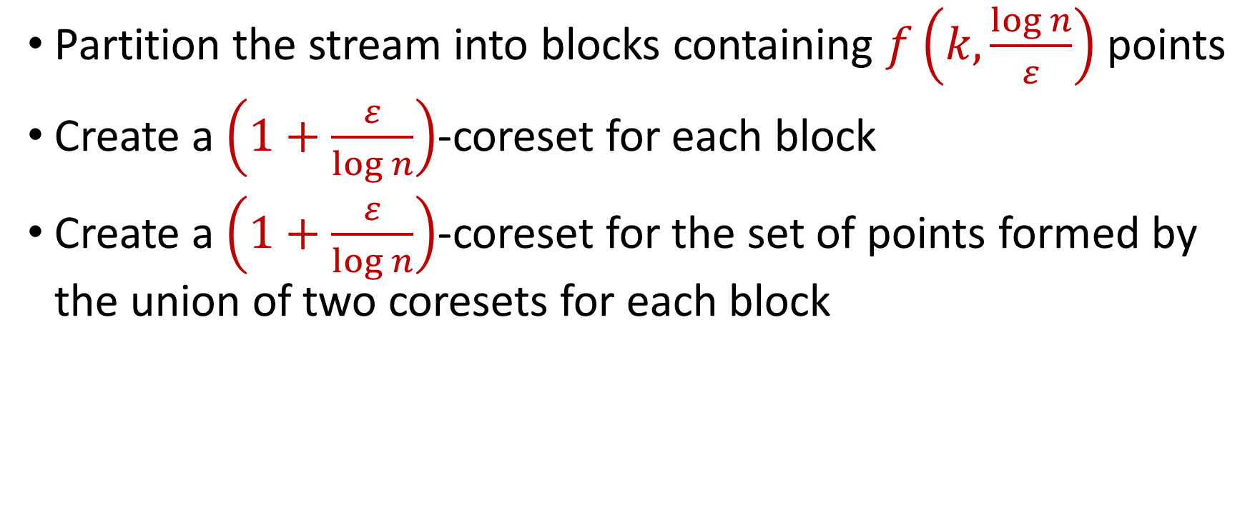
Last Time: $(k,z)$-Clustering in the Streaming Model
Partition the stream into blocks containing $f\left(k,\frac{\log{n}}{ε}\right)$ points
Create a $\left(1+\frac{ε}{\log{n}}\right)$-coreset for each block
Create a $\left(1+\frac{ε}{\log{n}}\right)$-coreset for the set of points formed by the union of two coresets for each block
Reduce
Merge

Slide 8
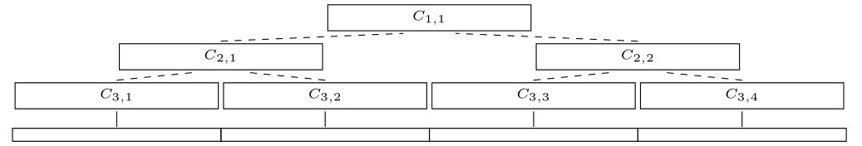
Last Time: $(k,z)$-Clustering in the Streaming Model
Partition the stream into blocks containing $f\left(k,\frac{\log{n}}{ε}\right)$ points
Create a $\left(1+\frac{ε}{\log{n}}\right)$-coreset for each block
Create a $\left(1+\frac{ε}{\log{n}}\right)$-coreset for the set of points formed by the union of two coresets for each block

Slide 9
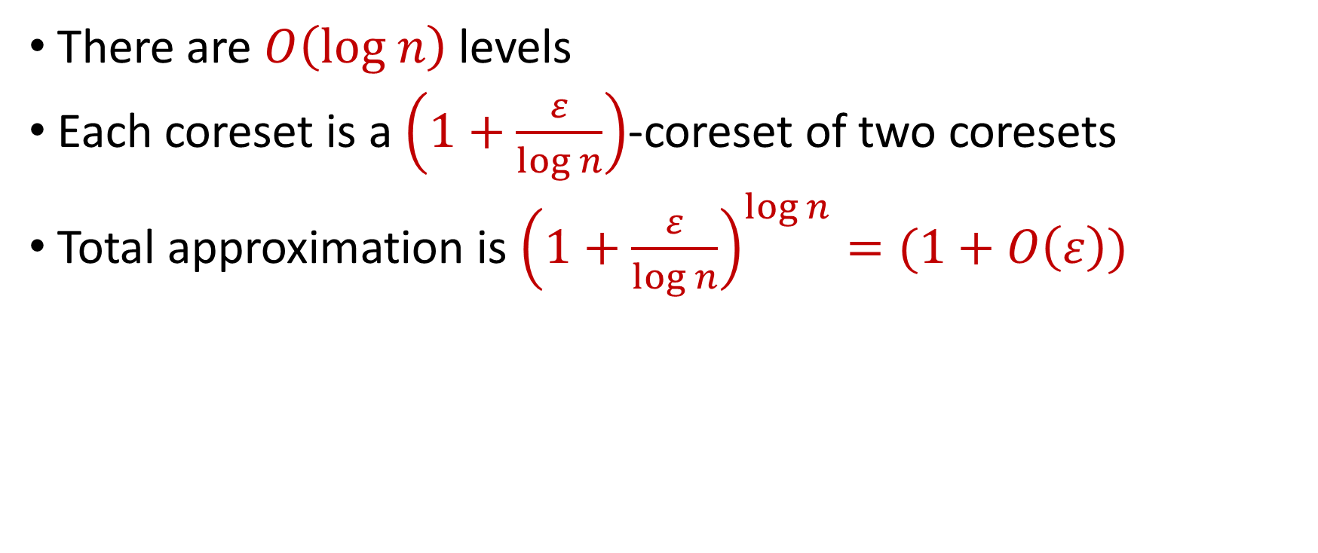
Last Time: $(k,z)$-Clustering in the Streaming Model
There are $O\left(log n\right)$ levels
Each coreset is a $\left(1+\frac{ε}{\log{n}}\right)$-coreset of two coresets
Total approximation is ${\left(1+\frac{ε}{\log{n}}\right)}^{\log{n}}=(1+O\left(ε\right))$

Slide 10
Previously: Bernstein’s Inequality
Bernstein’s inequality: Let $X_{1},…,X_{n}∈[−M,M]$ be independent random variables and let ${X=X}_{1}+…+X_{n}$ have mean $μ$ and variance $σ^{2}$. Then for any $t≥0$:
Example: Suppose $M=1$ and let $t=kσ$. Then
$$Pr\left[\left|X−μ\right|≥t\right]≤2e^{−\frac{t^{2}}{2σ^{2}+\frac{4}{3}Mt}}$$
$$Pr\left[\left|X−μ\right|≥kσ\right]≤2exp\left(−\frac{k^{2}}{4}\right)$$

Slide 11
Sampling for Sum Estimation
Consider a fixed set $X=\{x_{1},…,x_{n}\}$ of $n$ numbers
Suppose we sample each point $x_{i}$ with some probability $p_{i}$ and rescale by $\frac{1}{p_{i}}$
What is the expected sum?

Slide 12
Sampling for Sum Estimation
Let $y_{i}$ be the contribution of the sample corresponding to $x_{i}$
$y_{i}=0$ with probability $1−p_{i}$
$y_{i}=\frac{1}{p_{i}}⋅x_{i}$ with probability $p_{i}$
$E\left[y_{i}\right]=x_{i}$
$E\left[y_{1}+…+y_{n}\right]=x_{1}+ …+x_{n}$

Slide 13
Sampling for Sum Estimation
Consider a fixed set $X=\{x_{1},…,x_{n}\}$ of $n$ numbers
Suppose we sample each point $x_{i}$ with some probability $p_{i}$ and rescale by $\frac{1}{p_{i}}$
What is the expected sum? $E\left[y_{1}+…+y_{n}\right]=x_{1}+ …+x_{n}$

Slide 14
Sampling for Sum Estimation
Consider a fixed set $X=\{x_{1},…,x_{n}\}$ of $n$ numbers
Suppose we sample each point $x_{i}$ with some probability $p_{i}$ and rescale by $\frac{1}{p_{i}}$
What is the expected sum? $E\left[y_{1}+…+y_{n}\right]=x_{1}+ …+x_{n}$
What can we say about concentration?

Slide 15
Uniform Sampling for Sum Estimation
Consider a fixed set $X=\{x_{1},…,x_{n}\}$ of $n$ numbers
Suppose we sample each point $x_{i}$ with some probability $p_{i}$ and rescale by $\frac{1}{p_{i}}$
Suppose $p_{i}=p$ for all $i∈[n]$
What can we say about concentration?

Slide 16
Uniform Sampling for Sum Estimation
Suppose $x_{1}=…=x_{n}=1$
Suppose $p_{i}=p$ for all $i∈[n]$
What can we say about concentration?
Can we get a $2$-approximation with high probability?

Slide 17
Uniform Sampling for Sum Estimation
Bernstein’s inequality: Let $y_{1},…,y_{n}∈[−M,M]$ be independent random variables and let ${y=y}_{1}+…+y_{n}$ have mean $μ$ and variance $σ^{2}$. Then for any $t≥0$:
$$Pr\left[\left|y−μ\right|≥t\right]≤2e^{−\frac{t^{2}}{2σ^{2}+\frac{4}{3}Mt}}$$

Slide 18
Uniform Sampling for Sum Estimation
Bernstein’s inequality: Let $y_{1},…,y_{n}∈[−M,M]$ be independent random variables and let ${y=y}_{1}+…+y_{n}$ have mean $μ$ and variance $σ^{2}$. Then for any $t≥0$:
Set $M=\frac{1}{p}$ , $t=\frac{n}{2}$, and $σ^{2}=\frac{n}{p}$. Then
$$Pr\left[\left|y−μ\right|≥t\right]≤2e^{−\frac{t^{2}}{2σ^{2}+\frac{4}{3}Mt}}$$
$$Pr\left[\left|y−μ\right|≥\frac{n}{2}\right]≤2exp\left(−\frac{{\left(n/2\right)}^{2}}{2\left(n/p\right)+(4/3)(n/2p)}\right)$$

Slide 19
Uniform Sampling for Sum Estimation
Suppose $x_{1}=…=x_{n}=1$
Suppose $p_{i}=p$ for all $i∈[n]$
What can we say about concentration?
Can get a $2$-approximation even for $p=Θ\left(\frac{1}{n}\right)$

Slide 20
Uniform Sampling for Sum Estimation
Suppose $x_{1}=…=x_{n}=1$
Suppose $p_{i}=p$ for all $i∈[n]$
What can we say about concentration?
Can get a $2$-approximation even for $p=Θ\left(\frac{1}{n}\right)$
How many samples do we expect?

Slide 21
Uniform Sampling for Sum Estimation
Suppose $x_{1}=…=x_{n}=1$
Suppose $p_{i}=p$ for all $i∈[n]$
What can we say about concentration?
Can get a $2$-approximation even for $p=Θ\left(\frac{1}{n}\right)$
How many samples do we expect? $np=Θ\left(1\right)$

Slide 22
Uniform Sampling for Sum Estimation
Suppose $x_{1},…,x_{n}∈[1,2]$
Suppose $p_{i}=p$ for all $i∈[n]$
Can we get a $2$-approximation with high probability?

Slide 23
Uniform Sampling for Sum Estimation
Bernstein’s inequality: Let $y_{1},…,y_{n}∈[−M,M]$ be independent random variables and let ${y=y}_{1}+…+y_{n}$ have mean $μ$ and variance $σ^{2}$. Then for any $t≥0$:
Set $M=\frac{2}{p}$ , $t=\frac{x}{2}$, and $σ^{2}≈\frac{4n}{p}$. Then
$$Pr\left[\left|y−μ\right|≥t\right]≤2e^{−\frac{t^{2}}{2σ^{2}+\frac{4}{3}Mt}}$$
$$Pr\left[\left|y−μ\right|≥\frac{x}{2}\right]≤2exp\left(−\frac{{\left(x/2\right)}^{2}}{2\left(4n/p\right)+(4/3)(x/p)}\right)$$

Slide 24
Uniform Sampling for Sum Estimation
Suppose $x_{1},…,x_{n}∈[1,2]$
Suppose $p_{i}=p$ for all $i∈[n]$
For $Pr\left[\left|y−μ\right|≥\frac{x}{2}\right]≤2exp\left(−\frac{{\left(x/2\right)}^{2}}{2\left(4n/p\right)+(4/3)(x/p)}\right)$, we require $\frac{8n}{p}≈{\left(\frac{x}{2}\right)}^{2}$ and $x$ can be as small as $n$, so $p≈\frac{2}{n}$

Slide 25
Uniform Sampling for Sum Estimation
Suppose $x_{1},…,x_{n}∈[1,2]$
Suppose $p_{i}=p$ for all $i∈[n]$
What can we say about concentration?
Can get a $2$-approximation for $p≈\frac{2}{n}$
How many samples do we expect? $np$ is now slightly larger

Slide 26
Uniform Sampling for Sum Estimation
Suppose $x_{1},…,x_{n}∈[1,100]$
Suppose $p_{i}=p$ for all $i∈[n]$
Can we get a $2$-approximation with high probability?

Slide 27
Uniform Sampling for Sum Estimation
Bernstein’s inequality: Let $y_{1},…,y_{n}∈[−M,M]$ be independent random variables and let ${y=y}_{1}+…+y_{n}$ have mean $μ$ and variance $σ^{2}$. Then for any $t≥0$:
Set $M=\frac{100}{p}$ , $t=\frac{x}{2}$, and $σ^{2}≈\frac{10000n}{p}$. Then
$$Pr\left[\left|y−μ\right|≥t\right]≤2e^{−\frac{t^{2}}{2σ^{2}+\frac{4}{3}Mt}}$$
$$Pr\left[\left|y−μ\right|≥\frac{x}{2}\right]≤2exp\left(−\frac{{\left(x/2\right)}^{2}}{2\left(10000n/p\right)+(4/3)(100x/p)}\right)$$

Slide 28
Uniform Sampling for Sum Estimation
Suppose $x_{1},…,x_{n}∈[1,100]$
Suppose $p_{i}=p$ for all $i∈[n]$
For $Pr\left[\left|y−μ\right|≥\frac{x}{2}\right]≤2exp\left(−\frac{{\left(x/2\right)}^{2}}{2\left(10000n/p\right)+(4/3)(100x/p)}\right)$, we require $\frac{20000n}{p}≈{\left(\frac{x}{2}\right)}^{2}$ and $x$ can be as small as $n$, so we need $p≈\frac{80000}{n}$

Slide 29
Uniform Sampling for Sum Estimation
Suppose $x_{1},…,x_{n}∈[1,100]$
Suppose $p_{i}=p$ for all $i∈[n]$
What can we say about concentration?
Can get a $2$-approximation even for $p≈\frac{80000}{n}$
How many samples do we expect? $np$ is now WAY larger

Slide 30
Uniform Sampling for Sum Estimation
Suppose $x_{1},…,x_{n}∈[1,n]$
Suppose $p_{i}=p$ for all $i∈[n]$
Can we get a $2$-approximation with high probability?

Slide 31
Uniform Sampling for Sum Estimation
Bernstein’s inequality: Let $y_{1},…,y_{n}∈[−M,M]$ be independent random variables and let ${y=y}_{1}+…+y_{n}$ have mean $μ$ and variance $σ^{2}$. Then for any $t≥0$:
Set $M=\frac{n}{p}$ , $t=\frac{x}{2}$, and $σ^{2}≈\frac{n^{2}}{p}$. Then
$$Pr\left[\left|y−μ\right|≥t\right]≤2e^{−\frac{t^{2}}{2σ^{2}+\frac{4}{3}Mt}}$$
$$Pr\left[\left|y−μ\right|≥\frac{x}{2}\right]≤2exp\left(−\frac{{\left(x/2\right)}^{2}}{2\left(n^{2}/p\right)+(4/3)(nx/2p)}\right)$$

Slide 32
Uniform Sampling for Sum Estimation
Suppose $x_{1},…,x_{n}∈[1,n]$
Suppose $p_{i}=p$ for all $i∈[n]$
For $Pr\left[\left|y−μ\right|≥\frac{x}{2}\right]≤2exp\left(−\frac{{\left(x/2\right)}^{2}}{2\left(n^{2}/p\right)+(4/3)(nx/2p)}\right)$, we require $\frac{2n^{2}}{p}≈{\left(\frac{x}{2}\right)}^{2}$ and $x$ can be as small as $n$, so we need $p≈1$

Slide 33
Uniform Sampling for Sum Estimation
Suppose $x_{1},…,x_{n}∈[1,n]$
Suppose $p_{i}=p$ for all $i∈[n]$
What can we say about concentration?
Can get a $2$-approximation for $p≈1$
How many samples do we expect? $np$ is now $n$

Slide 34
Uniform Sampling for Sum Estimation
Suppose $x_{1},…,x_{n}∈[1,n]$
Suppose $p_{i}=p$ for all $i∈[n]$
Do we really need $p$ to be a constant?

Slide 35
Uniform Sampling for Sum Estimation
Suppose $x_{1},…,x_{n}∈[1,n]$
Suppose $p_{i}=p$ for all $i∈[n]$
Do we really need $p$ to be a constant? YES!
1 1 1 1 1 1 1 1 1 1 1 1 1 1 1 1 1 1 1 1 $n$ $n$

Slide 36
Sampling for Sum Estimation
Consider a fixed set $X=\{x_{1},…,x_{n}\}$ of $n$ numbers
Suppose we sample each point $x_{i}$ with some probability $p_{i}$ and rescale by $\frac{1}{p_{i}}$
What is the expected sum? $E\left[y_{1}+…+y_{n}\right]=x_{1}+ …+x_{n}$
What can we say about concentration?

Slide 37
Sampling for Sum Estimation
Consider a fixed set $X=\{x_{1},…,x_{n}\}$ of $n$ numbers
What if we choose the probability $p_{i}$ different for each $x_{i}$?

Slide 38
Sampling for Sum Estimation
Consider a fixed set $X=\{x_{1},…,x_{n}\}$ of $n$ numbers
What if we choose the probability $p_{i}$ different for each $x_{i}$?
Choose $p_{i}$ proportional to $x_{i}$

Slide 39
Importance Sampling for Sum Estimation
Consider a fixed set $X=\{x_{1},…,x_{n}\}$ of $n$ numbers
What if we choose the probability $p_{i}$ different for each $x_{i}$?
Choose $p_{i}$ proportional to $x_{i}$
Let $x=x_{1}+…+x_{n}$, set $p_{i}=\frac{x_{i}}{x}$

Slide 40
Importance Sampling for Sum Estimation
Bernstein’s inequality: Let $y_{1},…,y_{n}∈[−M,M]$ be independent random variables and let ${y=y}_{1}+…+y_{n}$ have mean $μ$ and variance $σ^{2}$. Then for any $t≥0$:
Set $t=\frac{x}{2}$. What about $M$and $σ^{2}$?
$$Pr\left[\left|y−μ\right|≥t\right]≤2e^{−\frac{t^{2}}{2σ^{2}+\frac{4}{3}Mt}}$$

Slide 41
Importance Sampling for Sum Estimation
$y_{i}≤\frac{1}{p}⋅x_{i}=\frac{x}{x_{i}}⋅x_{i}=x$
Can set $M=x$ in Bernstein’s inequality

Slide 42
Importance Sampling for Sum Estimation
What is the variance for each $y_{i}$?
$Var\left[y_{i}\right]≤\frac{1}{p_{i}}⋅x_{i}^{2}≤x_{i}⋅x$
$Var\left[y\right]=Var\left[y_{1}\right]+…+Var\left[y_{n}\right]≤x⋅\left(x_{1}+…+x_{n}\right)=x^{2}$
What is the variance for $y$under uniform sampling? $\frac{{nx}_{i}^{2}}{p}$
What is the variance for each $y_{i}$ under uniform sampling? $\frac{x_{i}^{2}}{p}$

Slide 43
Importance Sampling for Sum Estimation
Bernstein’s inequality: Let $y_{1},…,y_{n}∈[−M,M]$ be independent random variables and let ${y=y}_{1}+…+y_{n}$ have mean $μ$ and variance $σ^{2}$. Then for any $t≥0$:
Set $M=x$, $t=\frac{x}{2}$, and $σ^{2}≈x^{2}$. Then
$$Pr\left[\left|y−μ\right|≥t\right]≤2e^{−\frac{t^{2}}{2σ^{2}+\frac{4}{3}Mt}}$$
$$Pr\left[\left|y−μ\right|≥\frac{x}{2}\right]≤2exp\left(−\frac{{\left(x/2\right)}^{2}}{2x^{2}+(4/3)(x^{2}/2)}\right)$$

Slide 44
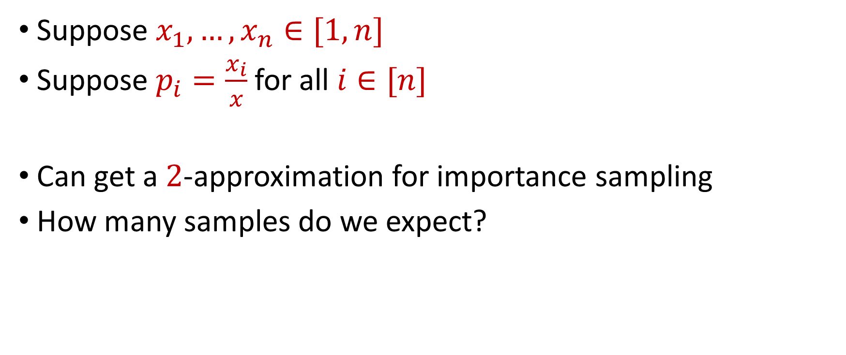
Importance Sampling for Sum Estimation
Suppose $x_{1},…,x_{n}∈[1,n]$
Suppose $p_{i}=\frac{x_{i}}{x}$ for all $i∈[n]$
Can get a $2$-approximation for importance sampling
How many samples do we expect?

Slide 45
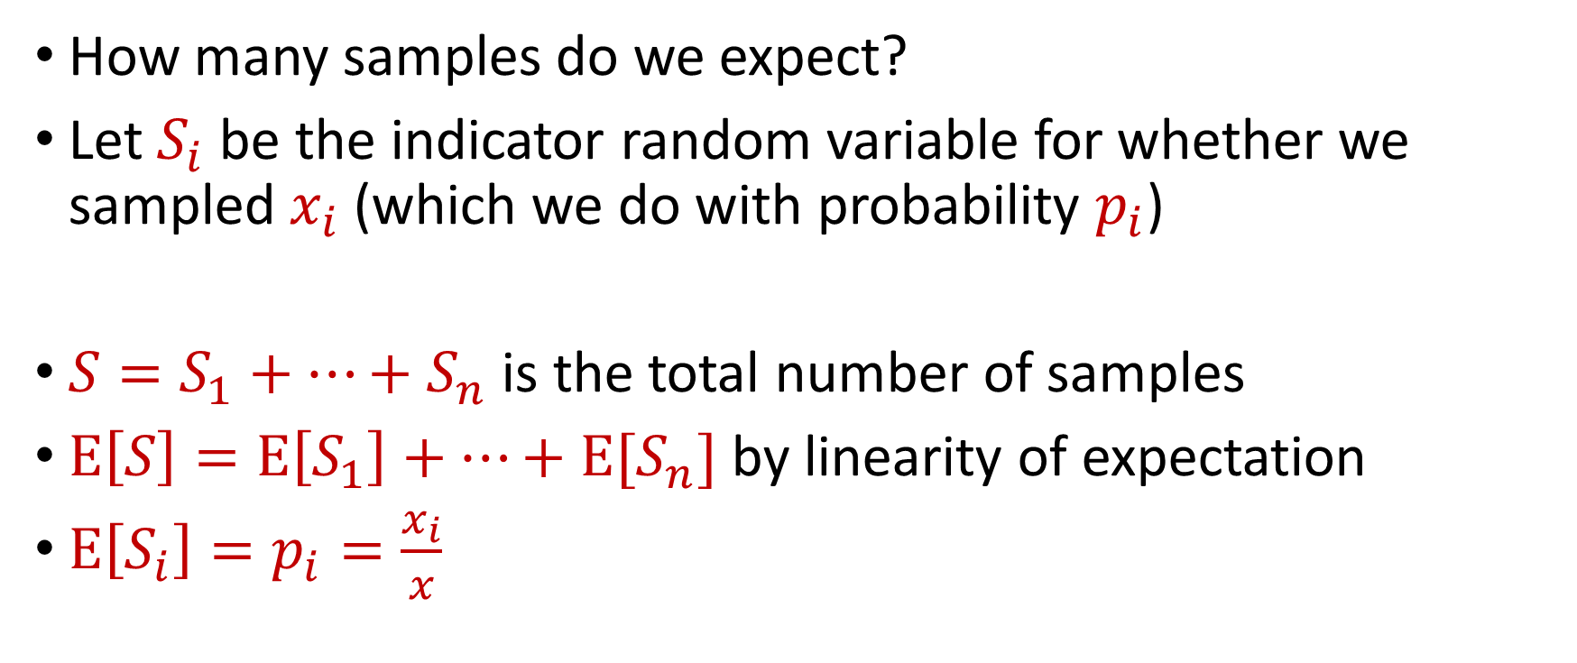
Importance Sampling for Sum Estimation
How many samples do we expect?
Let $S_{i}$ be the indicator random variable for whether we sampled $x_{i}$ (which we do with probability $p_{i}$)
$S=S_{1}+…+S_{n}$ is the total number of samples
$E\left[S\right]=E\left[S_{1}\right]+…+E[S_{n}]$ by linearity of expectation
$E\left[S_{i}\right]=p_{i}=\frac{x_{i}}{x}$

Slide 46
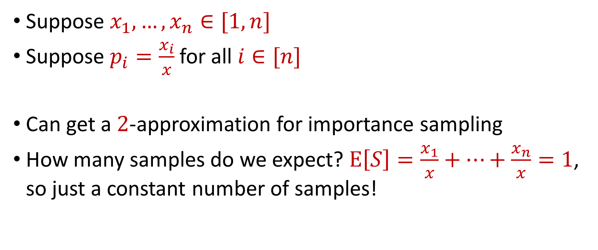
Importance Sampling for Sum Estimation
Suppose $x_{1},…,x_{n}∈[1,n]$
Suppose $p_{i}=\frac{x_{i}}{x}$ for all $i∈[n]$
Can get a $2$-approximation for importance sampling
How many samples do we expect? $E\left[S\right]=\frac{x_{1}}{x}+…+\frac{x_{n}}{x}=1$, so just a constant number of samples!

Slide 47
Coreset Construction and Sampling
Consider a fixed set $X$ and a fixed set $C$ of $k$ centers, which induces a fixed cost $Cost(X,C)$

Slide 48
Coreset Construction and Sampling
Consider a fixed set $X$ and a fixed set $C$ of $k$ centers, which induces a fixed cost $Cost(X,C)$
A simple way to obtain $X′$with $Cost\left(X^{′},C\right)≈Cost(X,C)$ is to uniformly sample points of $X$ into $X′$

Slide 49
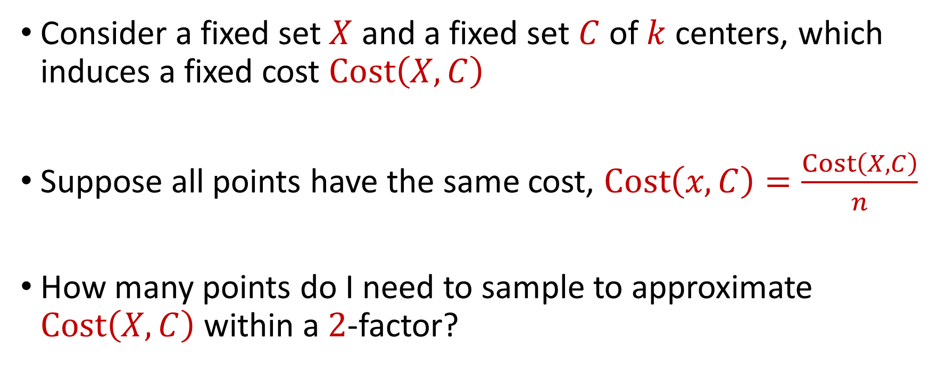
Coreset Construction and Uniform Sampling
Consider a fixed set $X$ and a fixed set $C$ of $k$ centers, which induces a fixed cost $Cost\left(X,C\right)$
Suppose all points have the same cost, $Cost\left(x,C\right)=\frac{Cost\left(X,C\right)}{n}$
How many points do I need to sample to approximate $Cost\left(X,C\right)$ within a $2$-factor?

Slide 50
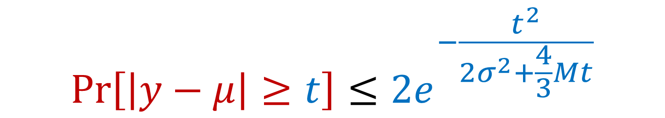

Bernstein’s Inequality
Bernstein’s inequality: Let $y_{1},…,y_{n}∈[−M,M]$ be independent random variables and let ${y=y}_{1}+…+y_{n}$ have mean $μ$ and variance $σ^{2}$. Then for any $t≥0$:
$$Pr\left[\left|y−μ\right|≥t\right]≤2e^{−\frac{t^{2}}{2σ^{2}+\frac{4}{3}Mt}}$$

Slide 51


Bernstein’s Inequality
Bernstein’s inequality: Let $y_{1},…,y_{n}∈[−M,M]$ be independent random variables and let ${y=y}_{1}+…+y_{n}$ have mean $μ$ and variance $σ^{2}$. Then for any $t≥0$:
Set $M=\frac{1}{p}$ , $t=\frac{1}{2}⋅Cost\left(X,C\right)$, and $σ^{2}≈\frac{n}{p}$. Then for $x=Cost\left(X,C\right)$,
$$Pr\left[\left|y−μ\right|≥t\right]≤2e^{−\frac{t^{2}}{2σ^{2}+\frac{4}{3}Mt}}$$
$$Pr\left[\left|y−μ\right|≥\frac{x}{2}\right]≤2exp\left(−\frac{{\left(x/2\right)}^{2}}{2\left(4n/p\right)+(4/3)(x/p)}\right)$$

Slide 52
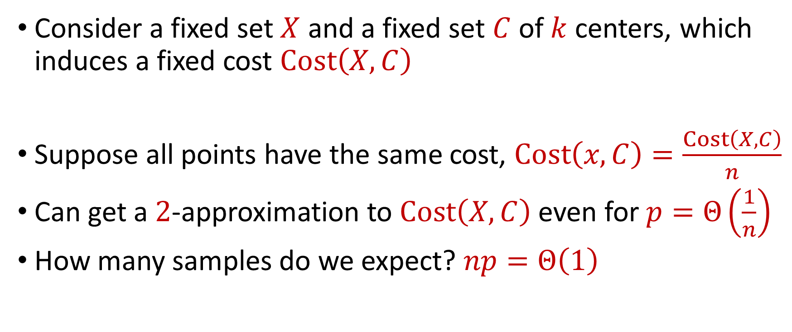
Coreset Construction and Uniform Sampling
Consider a fixed set $X$ and a fixed set $C$ of $k$ centers, which induces a fixed cost $Cost\left(X,C\right)$
Suppose all points have the same cost, $Cost\left(x,C\right)=\frac{Cost\left(X,C\right)}{n}$
Can get a $2$-approximation to $Cost\left(X,C\right)$even for $p=Θ\left(\frac{1}{n}\right)$
How many samples do we expect? $np=Θ\left(1\right)$

Slide 53

Coreset Construction and Uniform Sampling
Consider a fixed set $X$ and a fixed set $C$ of $k$ centers, which induces a fixed cost $Cost\left(X,C\right)$
Suppose all points have cost between $1$ and $100$
Suppose $p_{i}=p$ for all $i∈[n]$

Slide 54
Bernstein’s Inequality
Bernstein’s inequality: Let $y_{1},…,y_{n}∈[−M,M]$ be independent random variables and let ${y=y}_{1}+…+y_{n}$ have mean $μ$ and variance $σ^{2}$. Then for any $t≥0$:
$$Pr\left[\left|y−μ\right|≥t\right]≤2e^{−\frac{t^{2}}{2σ^{2}+\frac{4}{3}Mt}}$$

Slide 55
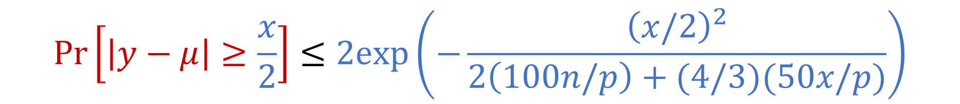

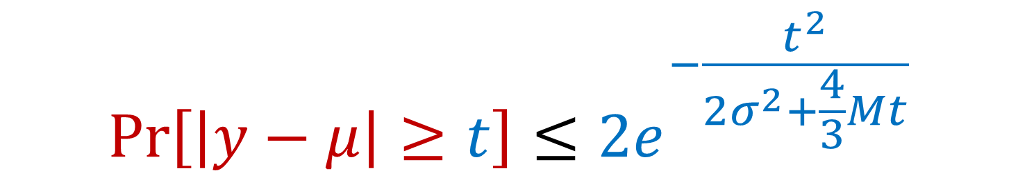
Bernstein’s Inequality
Bernstein’s inequality: Let $y_{1},…,y_{n}∈[−M,M]$ be independent random variables and let ${y=y}_{1}+…+y_{n}$ have mean $μ$ and variance $σ^{2}$. Then for any $t≥0$:
Set $M=\frac{100}{p}$ , $t=\frac{1}{2}⋅Cost\left(X,C\right)$, and $σ^{2}≈\frac{10000n}{p}$. Then for $x=Cost\left(X,C\right)$,
$$Pr\left[\left|y−μ\right|≥t\right]≤2e^{−\frac{t^{2}}{2σ^{2}+\frac{4}{3}Mt}}$$
$$Pr\left[\left|y−μ\right|≥\frac{x}{2}\right]≤2exp\left(−\frac{{\left(x/2\right)}^{2}}{2\left(100n/p\right)+(4/3)(50x/p)}\right)$$

Slide 56
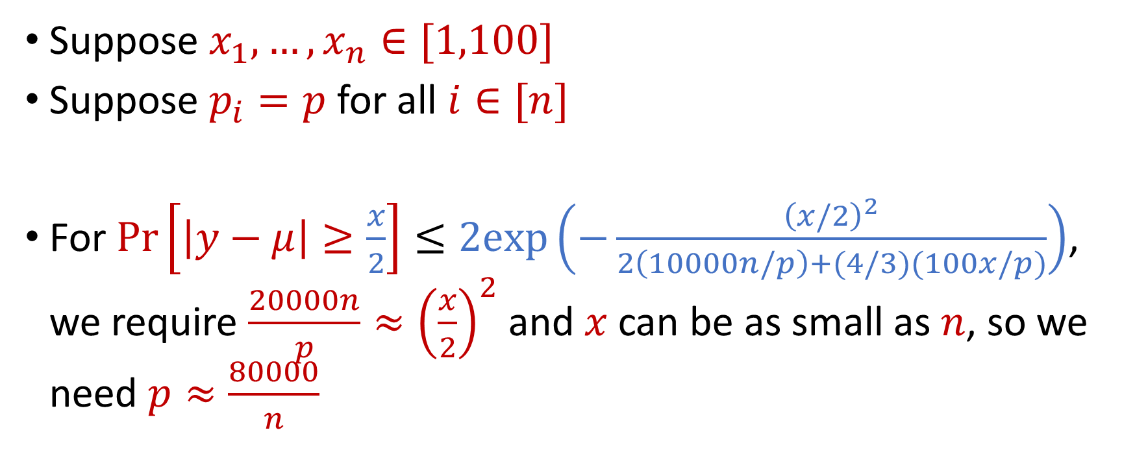
Coreset Construction and Uniform Sampling
Suppose $x_{1},…,x_{n}∈[1,100]$
Suppose $p_{i}=p$ for all $i∈[n]$
For $Pr\left[\left|y−μ\right|≥\frac{x}{2}\right]≤2exp\left(−\frac{{\left(x/2\right)}^{2}}{2\left(10000n/p\right)+(4/3)(100x/p)}\right)$, we require $\frac{20000n}{p}≈{\left(\frac{x}{2}\right)}^{2}$ and $x$ can be as small as $n$, so we need $p≈\frac{80000}{n}$

Slide 57
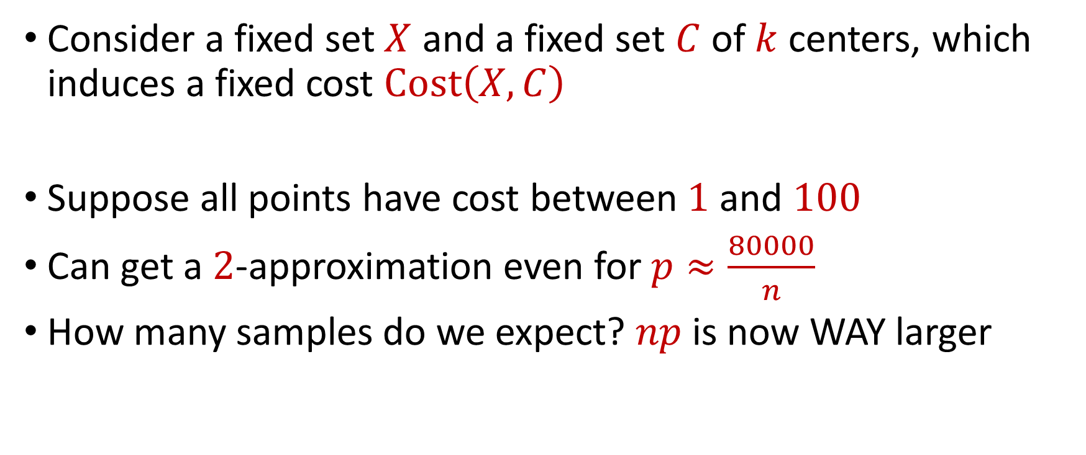
Coreset Construction and Uniform Sampling
Consider a fixed set $X$ and a fixed set $C$ of $k$ centers, which induces a fixed cost $Cost\left(X,C\right)$
Suppose all points have cost between $1$ and $100$
Can get a $2$-approximation even for $p≈\frac{80000}{n}$
How many samples do we expect? $np$ is now WAY larger

Slide 58
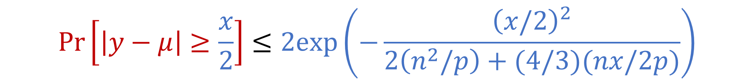

Coreset Construction and Uniform Sampling
Bernstein’s inequality: Let $y_{1},…,y_{n}∈[−M,M]$ be independent random variables and let ${y=y}_{1}+…+y_{n}$ have mean $μ$ and variance $σ^{2}$. Then for any $t≥0$:
Set $M=\frac{n}{p}$ , $t=\frac{1}{2}⋅Cost\left(X,C\right)$, and $σ^{2}≈\frac{n^{3}}{p}$. Then for $x=Cost\left(X,C\right)$,
$$Pr\left[\left|y−μ\right|≥t\right]≤2e^{−\frac{t^{2}}{2σ^{2}+\frac{4}{3}Mt}}$$
$$Pr\left[\left|y−μ\right|≥\frac{x}{2}\right]≤2exp\left(−\frac{{\left(x/2\right)}^{2}}{2\left(n^{2}/p\right)+(4/3)(nx/2p)}\right)$$

Slide 59
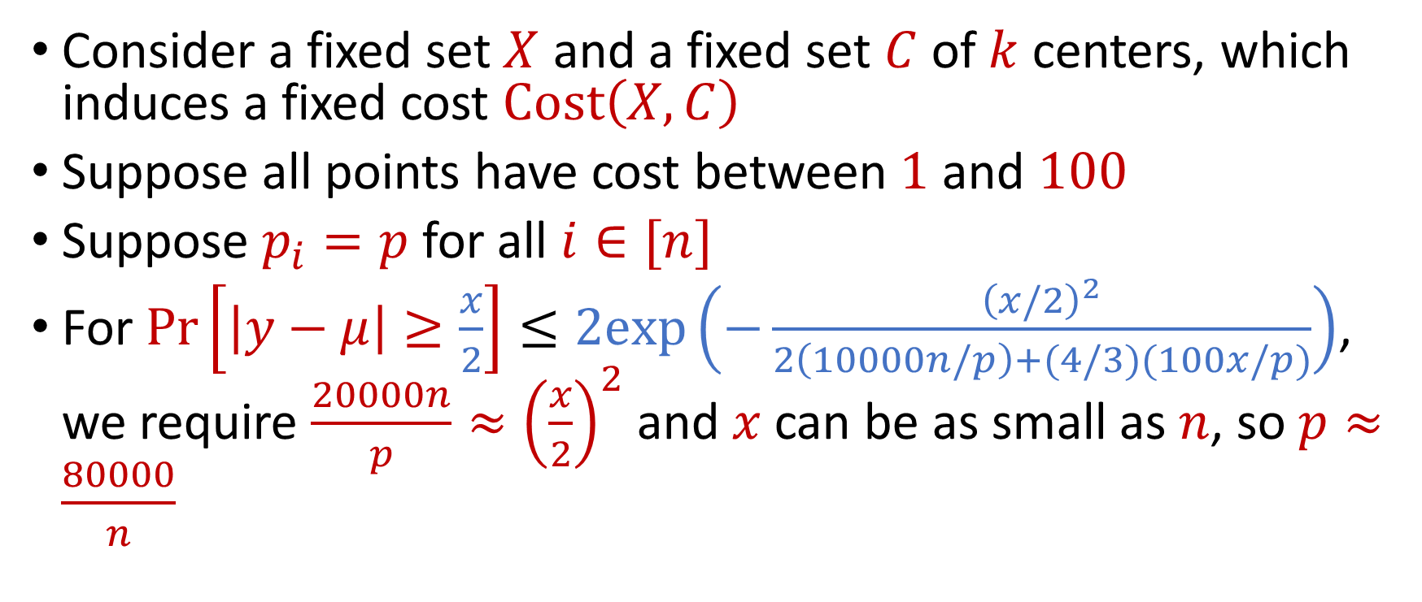
Coreset Construction and Uniform Sampling
Consider a fixed set $X$ and a fixed set $C$ of $k$ centers, which induces a fixed cost $Cost\left(X,C\right)$
Suppose all points have cost between $1$ and $100$
Suppose $p_{i}=p$ for all $i∈[n]$
For $Pr\left[\left|y−μ\right|≥\frac{x}{2}\right]≤2exp\left(−\frac{{\left(x/2\right)}^{2}}{2\left(10000n/p\right)+(4/3)(100x/p)}\right)$, we require $\frac{20000n}{p}≈{\left(\frac{x}{2}\right)}^{2}$ and $x$ can be as small as $n$, so $p≈\frac{80000}{n}$

Slide 60
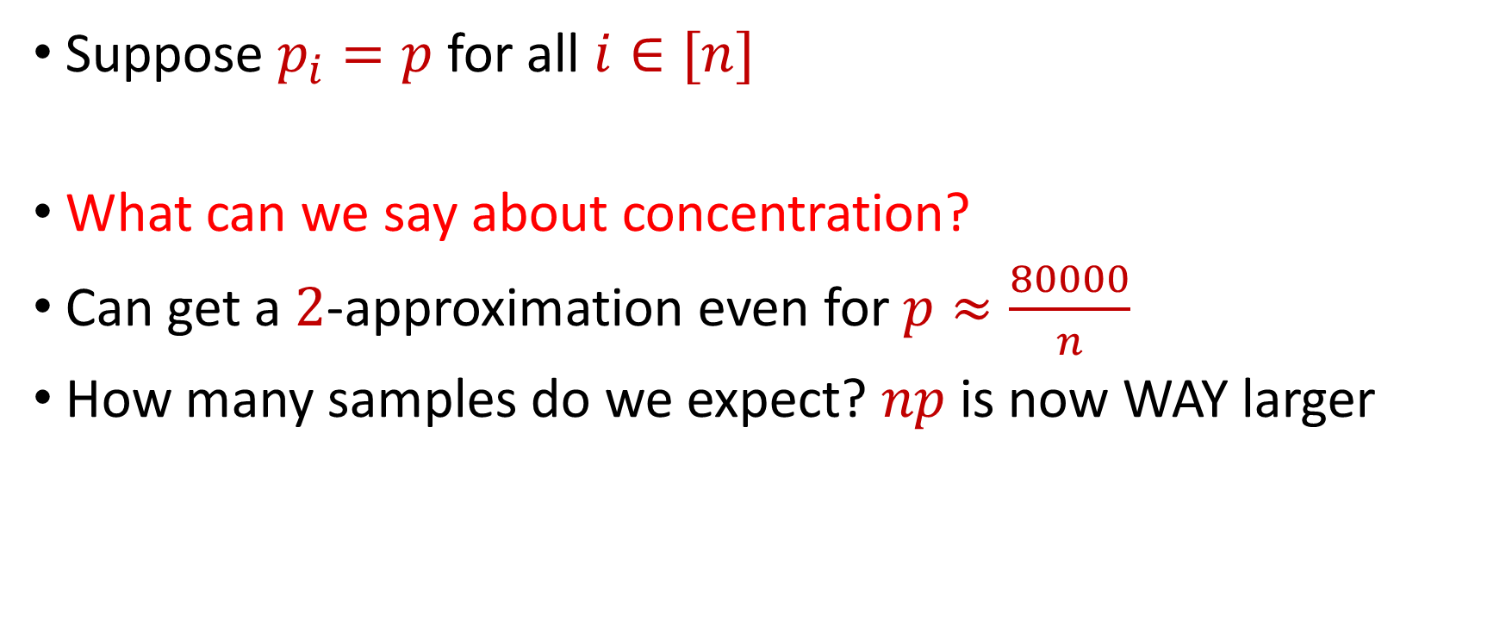
Coreset Construction and Uniform Sampling
Suppose $p_{i}=p$ for all $i∈[n]$
What can we say about concentration?
Can get a $2$-approximation even for $p≈\frac{80000}{n}$
How many samples do we expect? $np$ is now WAY larger

Slide 61
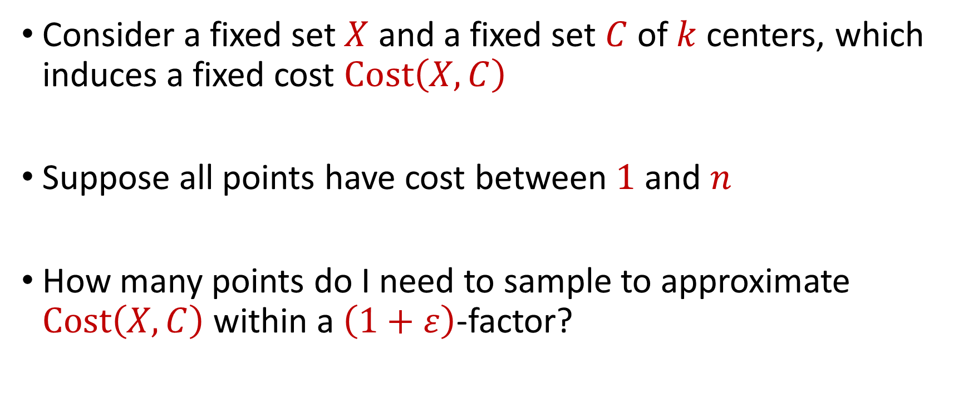
Coreset Construction and Uniform Sampling
Consider a fixed set $X$ and a fixed set $C$ of $k$ centers, which induces a fixed cost $Cost\left(X,C\right)$
Suppose all points have cost between $1$ and $n$
How many points do I need to sample to approximate $Cost\left(X,C\right)$ within a $\left(1+ε\right)$-factor?

Slide 62

Coreset Construction and Uniform Sampling
Bernstein’s inequality: Let $y_{1},…,y_{n}∈[−M,M]$ be independent random variables and let ${y=y}_{1}+…+y_{n}$ have mean $μ$ and variance $σ^{2}$. Then for any $t≥0$:
Set $M=\frac{n}{p}$ , $t=\frac{x}{2}$, and $σ^{2}≈\frac{n^{2}}{p}$. Then
$$Pr\left[\left|y−μ\right|≥t\right]≤2e^{−\frac{t^{2}}{2σ^{2}+\frac{4}{3}Mt}}$$
$$Pr\left[\left|y−μ\right|≥\frac{x}{2}\right]≤2exp\left(−\frac{{\left(x/2\right)}^{2}}{2\left(n^{2}/p\right)+(4/3)(nx/2p)}\right)$$

Slide 63
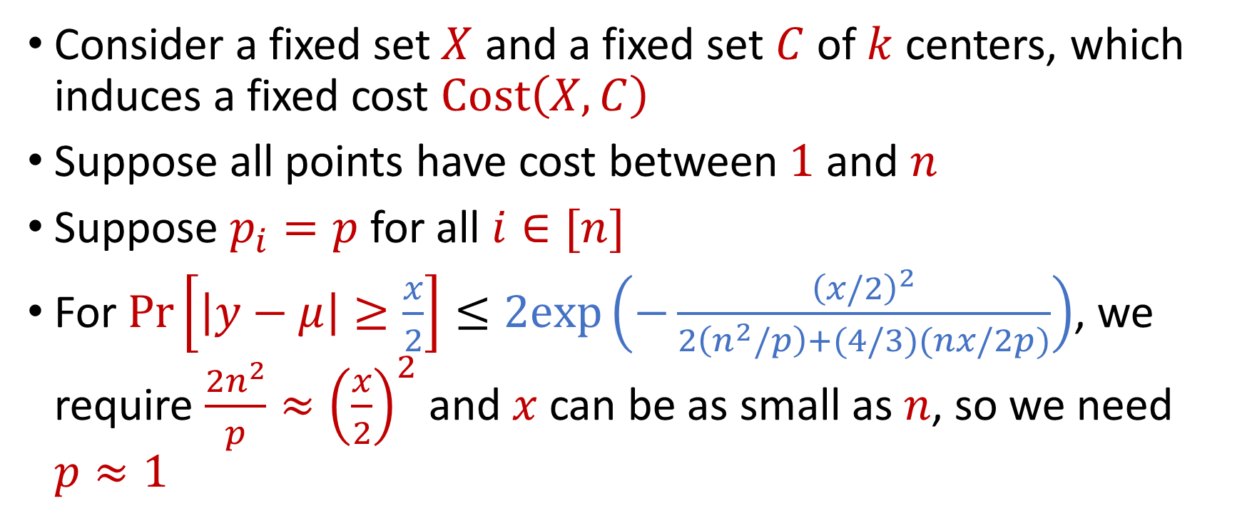
Uniform Sampling for Sum Estimation
Consider a fixed set $X$ and a fixed set $C$ of $k$ centers, which induces a fixed cost $Cost\left(X,C\right)$
Suppose all points have cost between $1$ and $n$
Suppose $p_{i}=p$ for all $i∈[n]$
For $Pr\left[\left|y−μ\right|≥\frac{x}{2}\right]≤2exp\left(−\frac{{\left(x/2\right)}^{2}}{2\left(n^{2}/p\right)+(4/3)(nx/2p)}\right)$, we require $\frac{2n^{2}}{p}≈{\left(\frac{x}{2}\right)}^{2}$ and $x$ can be as small as $n$, so we need $p≈1$

Slide 64
Coreset Construction and Sampling
Consider a fixed set $X$ and a fixed set $C$ of $k$ centers, which induces a fixed cost $Cost(X,C)$
Uniform sampling needs a lot of samples if there is a single point that greatly contributes to $Cost(X,C)$

Slide 65
Coreset Construction and Sampling
Fix: Importance sampling, sample each point $x∈X$ into $X′$ with probability proportional $Cost(x,C)$, i.e., $Cost(x,C)/Cost(X,C)$

Slide 66

Coreset Construction and Sampling
Fix: Importance sampling, sample each point $x∈X$ into $X′$ with probability proportional $Cost(x,C)$, i.e., $Cost(x,C)/Cost(X,C)$

Slide 67
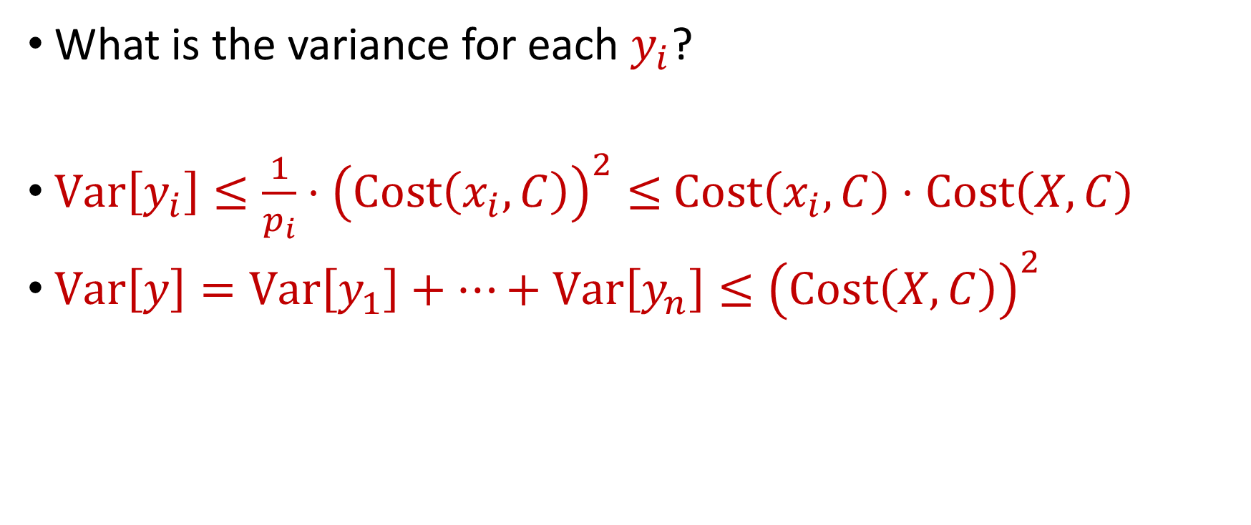
Importance Sampling for Coreset Construction
What is the variance for each $y_{i}$?
$Var\left[y_{i}\right]≤\frac{1}{p_{i}}⋅{\left(Cost\left(x_{i}, C\right)\right)}^{2}≤$ $Cost\left(x_{i}, C\right)⋅Cost\left(X, C\right)$
$Var\left[y\right]=Var\left[y_{1}\right]+…+Var\left[y_{n}\right]≤{\left(Cost\left(X, C\right)\right)}^{2}$

Slide 68
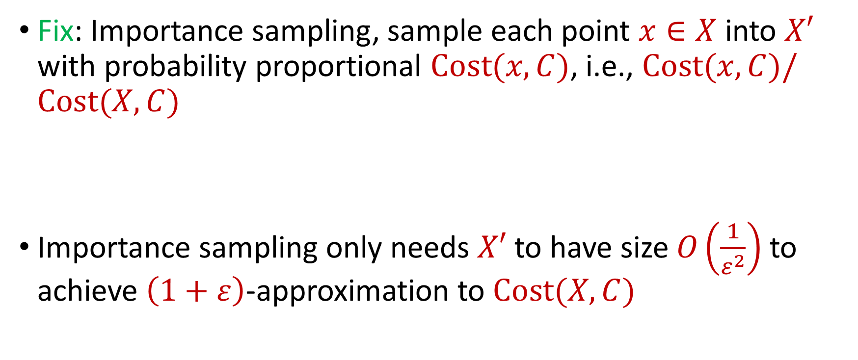
Coreset Construction and Sampling
Fix: Importance sampling, sample each point $x∈X$ into $X′$ with probability proportional $Cost(x,C)$, i.e., $Cost(x,C)/Cost(X,C)$
Importance sampling only needs $X′$ to have size $O\left(\frac{1}{ε^{2}}\right)$ to achieve $\left(1+ε\right)$-approximation to $Cost(X,C)$

Slide 69
Coreset Construction and Sampling
Importance sampling only needs $X′$ to have size $O\left(\frac{1}{ε^{2}}\right)$ to achieve $\left(1+ε\right)$-approximation to $Cost(X,C)$
What about a different choice $C$ of $k$ centers?

Slide 70
Coreset Construction and Sampling
Importance sampling only needs $X′$ to have size $O\left(\frac{1}{ε^{2}}\right)$ to achieve $\left(1+ε\right)$-approximation to $Cost(X,C)$
To handle all possible sets of $k$ centers:
Need to sample each point $x$ with probability $\max_{C}\frac{Cost\left(x,C\right)}{Cost\left(X,C\right)}$ instead of $\frac{Cost\left(x,C\right)}{Cost\left(X,C\right)}$
Need to union bound over a net of all possible sets of $k$ centers

Slide 71

Nets
A net $N$ is a set of sets $C$ of $k$ centers such that accuracy on $N$ implies accuracy everywhere

Slide 72
Coreset Construction and Sampling
Importance sampling only needs $X′$ to have size $O\left(\frac{1}{ε^{2}}\right)$ to achieve $\left(1+ε\right)$-approximation to $Cost(X,C)$
To handle all possible sets of $k$ centers:
Need to sample each point $x$ with probability $\max_{C}\frac{Cost\left(x,C\right)}{Cost\left(X,C\right)}$ instead of $\frac{Cost\left(x,C\right)}{Cost\left(X,C\right)}$
Need to union bound over a net of all possible sets of $k$ centers
Net with size ${\left(\frac{nΔ}{ε}\right)}^{O(kd)}$

Slide 73
Sensitivity Sampling
The quantity $s\left(x\right)=\max_{C}\frac{Cost\left(x,C\right)}{Cost\left(X,C\right)}$ is called the sensitivity of $x$ and intuitively measures how “important” the point $x$ is
The total sensitivity of $X$ is $\sum_{x∈X}{s(x)}$ and quantifies how many points will be sampled into $X′$ through importance/sensitivity sampling (before the union bound)

