Slide 1
CSCE 689: Special Topics in Modern Algorithms for Data Science
Lecture 11
Samson Zhou

Slide 2
Presentation Schedule
September 25: Team DAP, Team Bokun, Team Jason
September 27: Galaxy AI, Team STMI
September 29: Jung, Anmol, Chunkai

Slide 3
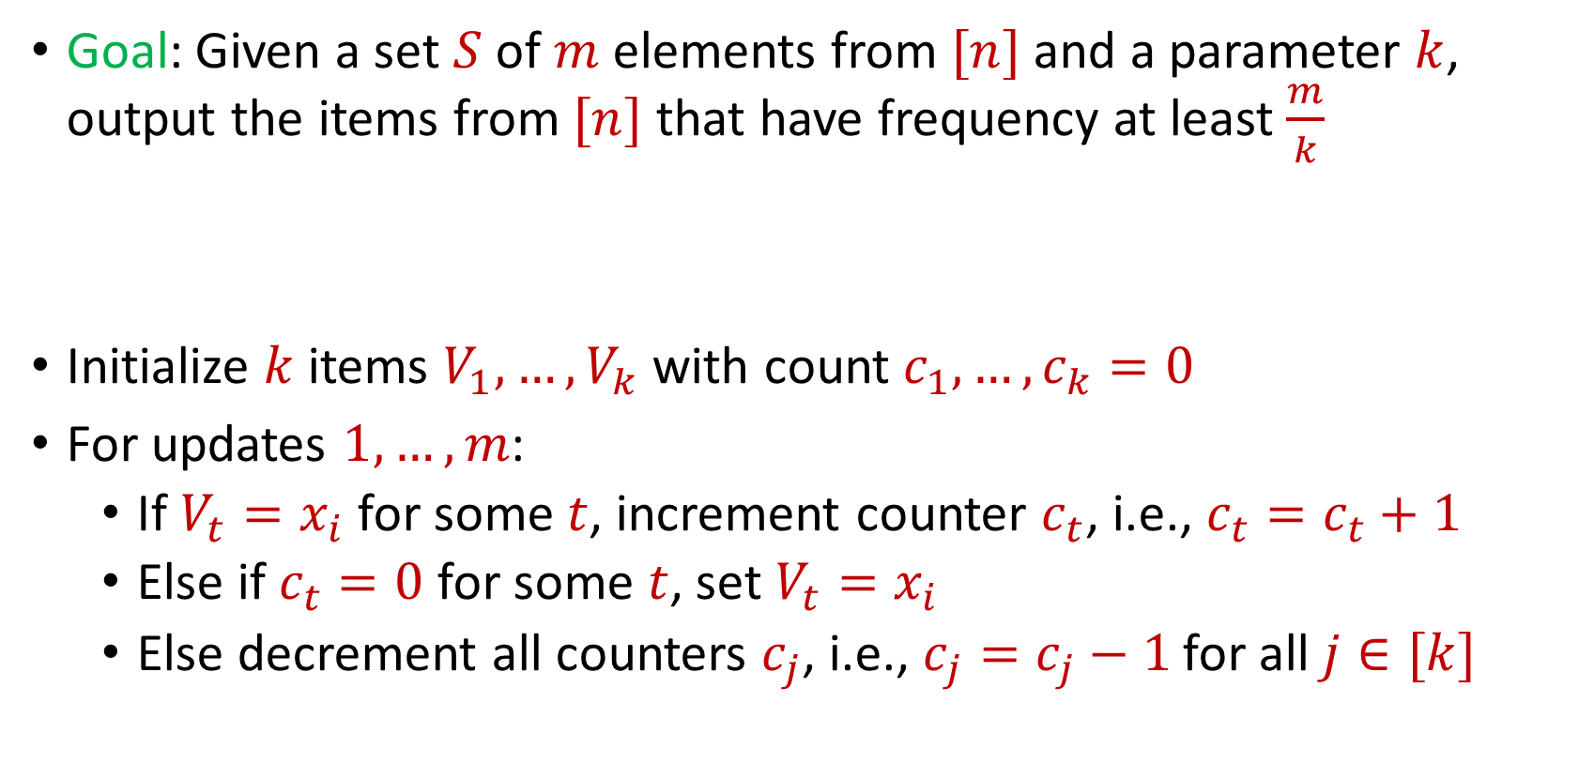
Last Time: Misra Gries
Goal: Given a set $S$ of $m$ elements from $[n]$ and a parameter $k$, output the items from $[n]$ that have frequency at least $\frac{m}{k}$
Initialize $k$ items $V_{1},…,V_{k}$ with count $c_{1},…,c_{k}=0$
For updates $1,…,m$:
If $V_{t}=x_{i}$ for some $t$, increment counter $c_{t}$, i.e., $c_{t}=c_{t}+1$
Else if $c_{t}=0$ for some $t$, set $V_{t}=x_{i}$
Else decrement all counters $c_{j}$, i.e., $c_{j}=c_{j}−1$ for all $j∈[k]$

Slide 4
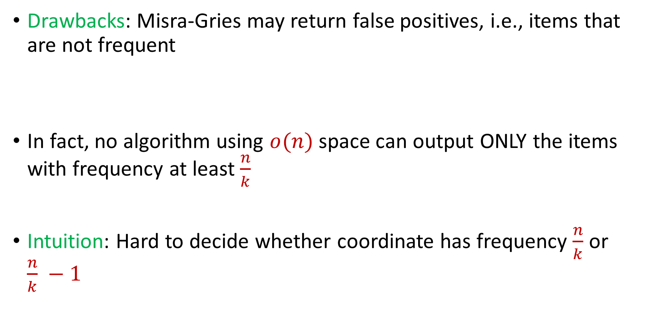
Last Time: Misra Gries
Drawbacks: Misra-Gries may return false positives, i.e., items that are not frequent
In fact, no algorithm using $o(n)$ space can output ONLY the items with frequency at least $\frac{n}{k}$
Intuition: Hard to decide whether coordinate has frequency $\frac{n}{k}$ or $\frac{n}{k} −1$

Slide 5


Last Time: $(ε,k)$-Frequent Items Problem
Goal: Given a set $S$ of $m$ elements from $[n]$, an accuracy parameter $ε∈(0, 1)$, and a parameter $k$, output a list that includes:
The items from $[n]$ that have frequency at least $\frac{m}{k}$
No items with frequency less than $\left(1−ε\right)\frac{m}{k}$

Slide 6

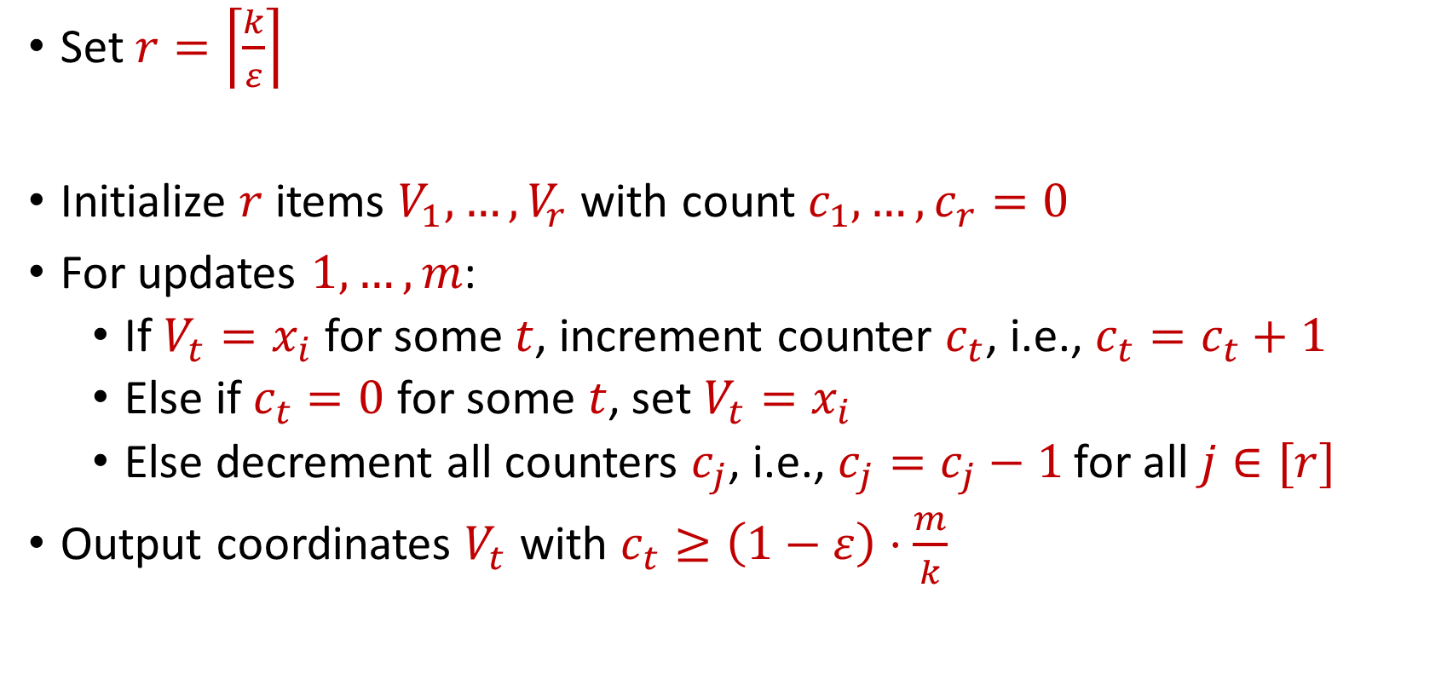
Last Time: Misra Gries for $(ε,k)$-Frequent Items Problem
Set $r=\left\lceil \frac{k}{ε}\right\rceil$
Initialize $r$ items $V_{1},…,V_{r}$ with count $c_{1},…,c_{r}=0$
For updates $1,…,m$:
If $V_{t}=x_{i}$ for some $t$, increment counter $c_{t}$, i.e., $c_{t}=c_{t}+1$
Else if $c_{t}=0$ for some $t$, set $V_{t}=x_{i}$
Else decrement all counters $c_{j}$, i.e., $c_{j}=c_{j}−1$ for all $j∈[r]$
Output coordinates $V_{t}$ with $c_{t}≥\left(1−ε\right)⋅\frac{m}{k}$

Slide 7

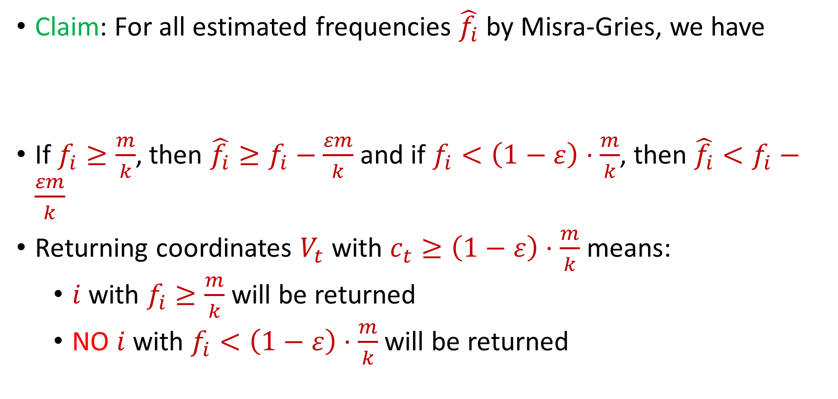
Last Time: Misra Gries for $(ε,k)$-Frequent Items Problem
Claim: For all estimated frequencies $\hat{f_{i}}$ by Misra-Gries, we have
If $f_{i}≥\frac{m}{k}$, then ${\hat{f_{i}}≥f}_{i}−\frac{εm}{k}$ and if $f_{i}<\left(1−ε\right)⋅\frac{m}{k}$, then ${\hat{f_{i}}<f}_{i}−\frac{εm}{k}$
Returning coordinates $V_{t}$ with $c_{t}≥\left(1−ε\right)⋅\frac{m}{k}$ means:
$i$ with $f_{i}≥\frac{m}{k}$ will be returned
NO $i$ with $f_{i}<\left(1−ε\right)⋅\frac{m}{k}$will be returned
$$f_{i}−\frac{εm}{k}≤\hat{f_{i}}≤f_{i}$$

Slide 8
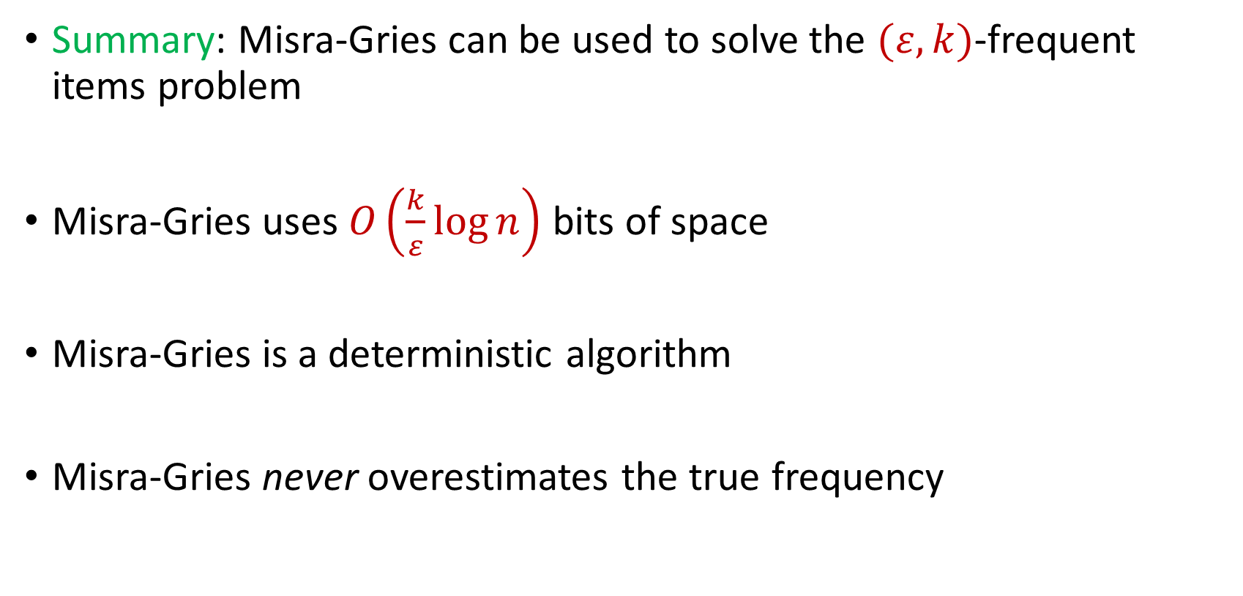
Last Time: Misra Gries for $(ε,k)$-Frequent Items Problem
Summary: Misra-Gries can be used to solve the $(ε,k)$-frequent items problem
Misra-Gries uses $O\left(\frac{k}{ε}\log{n}\right)$ bits of space
Misra-Gries is a deterministic algorithm
Misra-Gries never overestimates the true frequency

Slide 9

Insertion-Deletion Streams
Stream of length $m=Θ\left(n\right)$
Universe of size $[n]$, underlying vector $f∈R^{n}$
Each update increases or decreases a coordinate in $f$
“Decrease $f_{6}$”
$f_{1}$ | $f_{2}$ | $f_{3}$ | $f_{4}$ | $f_{5}$ | $f_{6}$ | $f_{7}$
0 | 0 | 0 | 0 | 0 | 0 | 0
$f_{1}$ | $f_{2}$ | $f_{3}$ | $f_{4}$ | $f_{5}$ | $f_{6}$ | $f_{7}$
0 | 0 | 0 | 0 | 0 | -1 | 0

Slide 10
Insertion-Deletion Streams
Database Management: In database management, insertion-deletion streams are used to track changes made to the database over time
Transaction logs often utilize this concept to record insertions and deletions to ensure data integrity and support features like rollbacks and recovery

Slide 11




Insertion-Deletion Streams
Version Control Systems: Insertion-deletion streams track changes made to files, enabling users to see what has been added (inserted) or removed (deleted) in each version
Crucial for collaboration and managing software development projects, central to version control systems

Slide 12

Insertion-Deletion Streams
Traffic Flow and Transportation Systems: Insertion-deletion streams are used to analyze traffic patterns and changes in transportation systems
This helps in optimizing traffic flow, managing congestion, and improving transportation infrastructure

Slide 13

Frequent Items on Insertion-Deletion Streams
Misra-Gries on Insertion-Deletion Streams
“Increase $f_{1}$”
“Increase $f_{3}$”
“Increase $f_{2}$”
“Increase $f_{2}$”
“Decrease $f_{2}$”
“Decrease $f_{2}$”
“Decrease $f_{3}$”

Slide 14
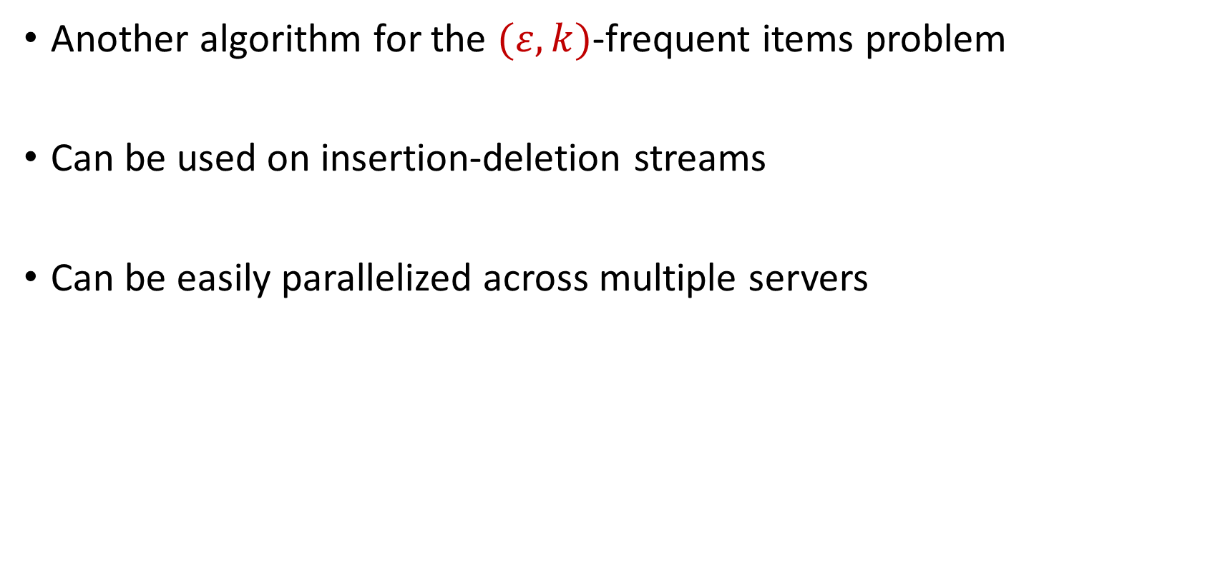
CountMin
Another algorithm for the $(ε,k)$-frequent items problem
Can be used on insertion-deletion streams
Can be easily parallelized across multiple servers

Slide 15
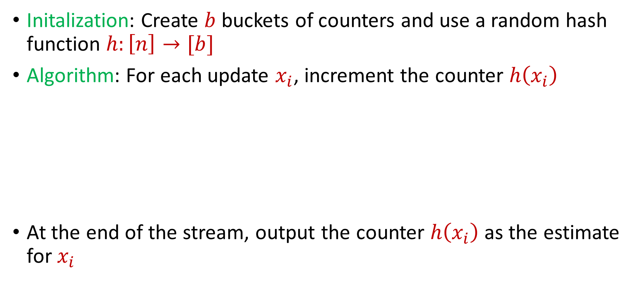
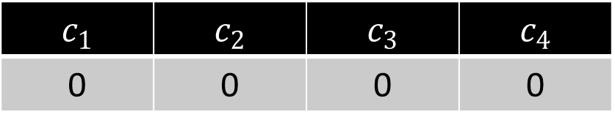
CountMin
Initalization: Create $b$ buckets of counters and use a random hash function $h:\left[n\right]→[b]$
Algorithm: For each update $x_{i}$, increment the counter $h\left(x_{i}\right)$
At the end of the stream, output the counter $h\left(x_{i}\right)$ as the estimate for $x_{i}$
$c_{1}$ | $c_{2}$ | $c_{3}$ | $c_{4}$
0 | 0 | 0 | 0

Slide 16
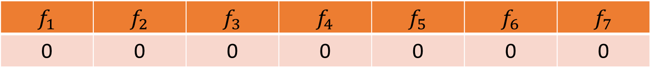


CountMin
$f_{1}$ | $f_{2}$ | $f_{3}$ | $f_{4}$ | $f_{5}$ | $f_{6}$ | $f_{7}$
0 | 0 | 0 | 0 | 0 | 0 | 0
$$1$$
$c_{1}$ | $c_{2}$ | $c_{3}$ | $c_{4}$
0 | 0 | 0 | 0

Slide 17
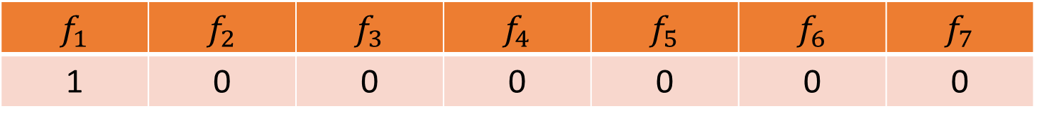

CountMin
$f_{1}$ | $f_{2}$ | $f_{3}$ | $f_{4}$ | $f_{5}$ | $f_{6}$ | $f_{7}$
1 | 0 | 0 | 0 | 0 | 0 | 0
$$1$$
$$h\left(x\right)=3x+2 (mod 4)$$
$c_{1}$ | $c_{2}$ | $c_{3}$ | $c_{4}$
0 | 0 | 0 | 0

Slide 18
CountMin
$f_{1}$ | $f_{2}$ | $f_{3}$ | $f_{4}$ | $f_{5}$ | $f_{6}$ | $f_{7}$
1 | 0 | 0 | 0 | 0 | 0 | 0
$$1$$
$$h\left(x\right)=3x+2 (mod 4)$$
$c_{1}$ | $c_{2}$ | $c_{3}$ | $c_{4}$
0 | 0 | 0 | 0

Slide 19
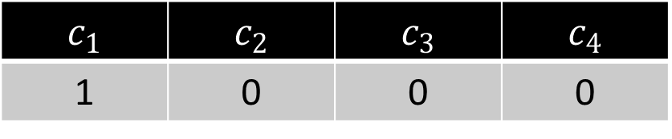
CountMin
$f_{1}$ | $f_{2}$ | $f_{3}$ | $f_{4}$ | $f_{5}$ | $f_{6}$ | $f_{7}$
1 | 0 | 0 | 0 | 0 | 0 | 0
$$1$$
$$h\left(x\right)=3x+2 (mod 4)$$
$c_{1}$ | $c_{2}$ | $c_{3}$ | $c_{4}$
1 | 0 | 0 | 0

Slide 20

CountMin
$f_{1}$ | $f_{2}$ | $f_{3}$ | $f_{4}$ | $f_{5}$ | $f_{6}$ | $f_{7}$
1 | 0 | 0 | 0 | 0 | 0 | 0
$$3$$
$$h\left(x\right)=3x+2 (mod 4)$$
$c_{1}$ | $c_{2}$ | $c_{3}$ | $c_{4}$
1 | 0 | 0 | 0

Slide 21
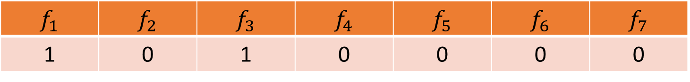
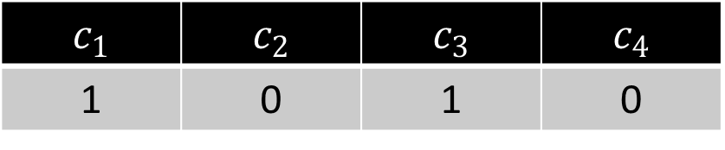
CountMin
$f_{1}$ | $f_{2}$ | $f_{3}$ | $f_{4}$ | $f_{5}$ | $f_{6}$ | $f_{7}$
1 | 0 | 1 | 0 | 0 | 0 | 0
$$3$$
$$h\left(x\right)=3x+2 (mod 4)$$
$c_{1}$ | $c_{2}$ | $c_{3}$ | $c_{4}$
1 | 0 | 1 | 0

Slide 22

CountMin
$f_{1}$ | $f_{2}$ | $f_{3}$ | $f_{4}$ | $f_{5}$ | $f_{6}$ | $f_{7}$
1 | 0 | 1 | 0 | 0 | 0 | 0
$$2$$
$$h\left(x\right)=3x+2 (mod 4)$$
$c_{1}$ | $c_{2}$ | $c_{3}$ | $c_{4}$
1 | 0 | 1 | 0

Slide 23
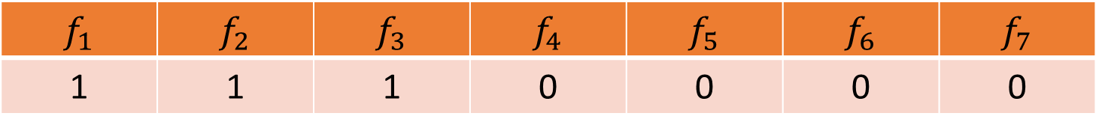
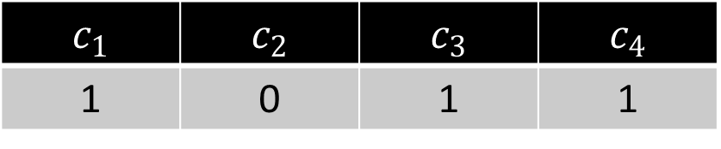
CountMin
$f_{1}$ | $f_{2}$ | $f_{3}$ | $f_{4}$ | $f_{5}$ | $f_{6}$ | $f_{7}$
1 | 1 | 1 | 0 | 0 | 0 | 0
$$2$$
$$h\left(x\right)=3x+2 (mod 4)$$
$c_{1}$ | $c_{2}$ | $c_{3}$ | $c_{4}$
1 | 0 | 1 | 1

Slide 24
CountMin
$f_{1}$ | $f_{2}$ | $f_{3}$ | $f_{4}$ | $f_{5}$ | $f_{6}$ | $f_{7}$
1 | 1 | 1 | 0 | 0 | 0 | 0
$$1$$
$$h\left(x\right)=3x+2 (mod 4)$$
$c_{1}$ | $c_{2}$ | $c_{3}$ | $c_{4}$
1 | 0 | 1 | 1

Slide 25
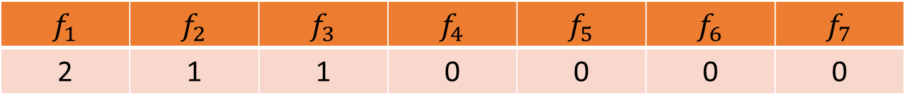
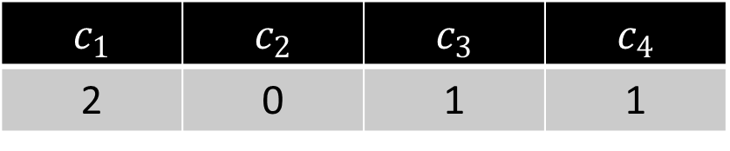
CountMin
$f_{1}$ | $f_{2}$ | $f_{3}$ | $f_{4}$ | $f_{5}$ | $f_{6}$ | $f_{7}$
2 | 1 | 1 | 0 | 0 | 0 | 0
$$1$$
$$h\left(x\right)=3x+2 (mod 4)$$
$c_{1}$ | $c_{2}$ | $c_{3}$ | $c_{4}$
2 | 0 | 1 | 1

Slide 26

CountMin
$f_{1}$ | $f_{2}$ | $f_{3}$ | $f_{4}$ | $f_{5}$ | $f_{6}$ | $f_{7}$
2 | 1 | 1 | 0 | 0 | 0 | 0
$$5$$
$$h\left(x\right)=3x+2 (mod 4)$$
$c_{1}$ | $c_{2}$ | $c_{3}$ | $c_{4}$
1 | 0 | 1 | 1

Slide 27
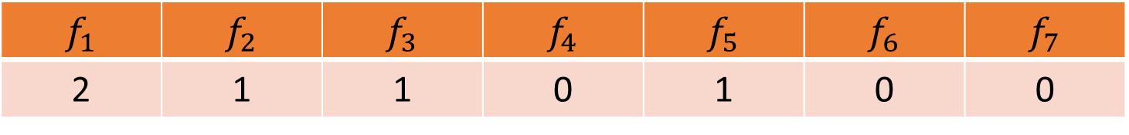
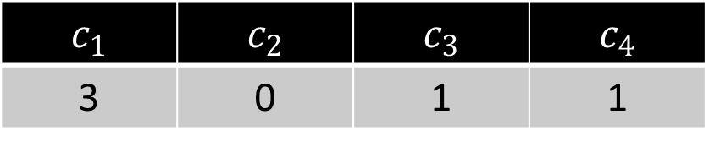
CountMin
$f_{1}$ | $f_{2}$ | $f_{3}$ | $f_{4}$ | $f_{5}$ | $f_{6}$ | $f_{7}$
2 | 1 | 1 | 0 | 1 | 0 | 0
$$5$$
$$h\left(x\right)=3x+2 (mod 4)$$
$c_{1}$ | $c_{2}$ | $c_{3}$ | $c_{4}$
3 | 0 | 1 | 1

Slide 28
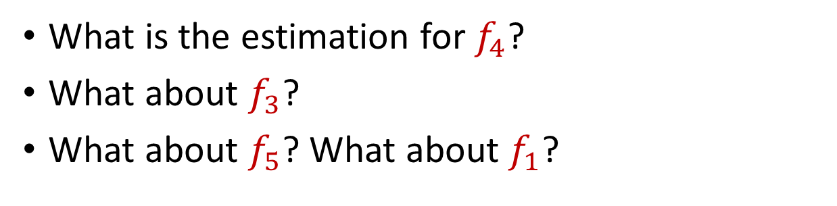
CountMin
$f_{1}$ | $f_{2}$ | $f_{3}$ | $f_{4}$ | $f_{5}$ | $f_{6}$ | $f_{7}$
2 | 1 | 1 | 0 | 1 | 0 | 0
What is the estimation for $f_{4}$?
What about $f_{3}$?
What about $f_{5}$? What about $f_{1}$?
$$h\left(x\right)=3x+2 (mod 4)$$
$c_{1}$ | $c_{2}$ | $c_{3}$ | $c_{4}$
3 | 0 | 1 | 1

Slide 29
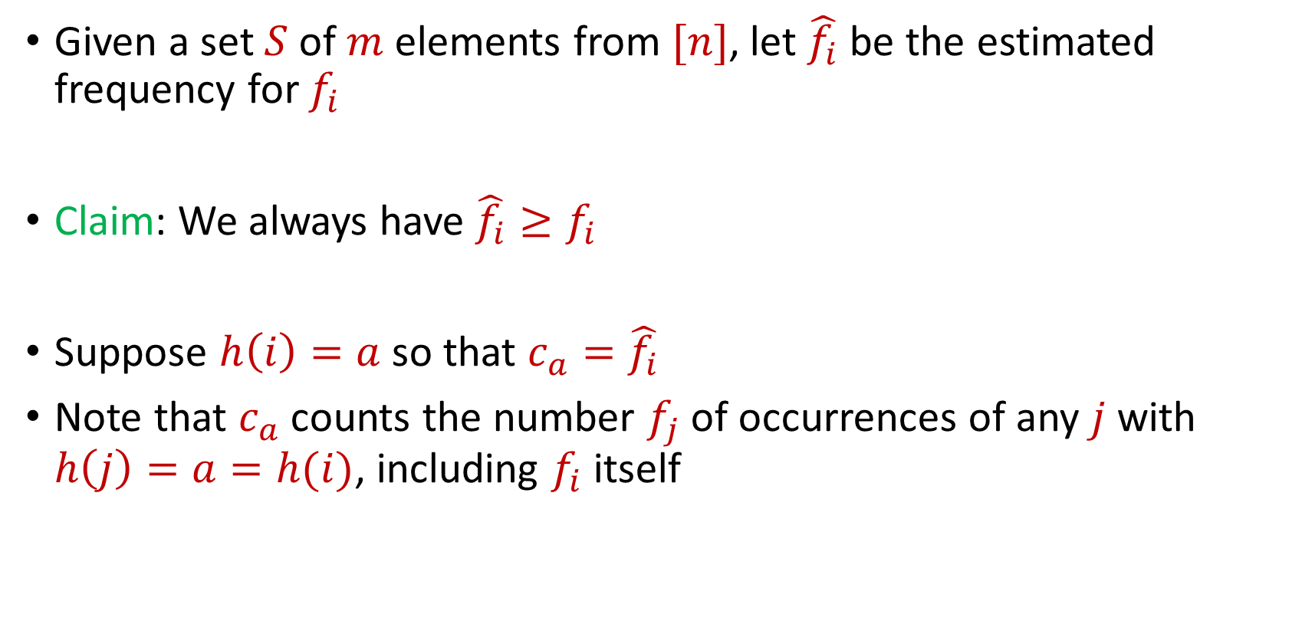
CountMin
Given a set $S$ of $m$ elements from $[n]$, let $\hat{f_{i}}$ be the estimated frequency for $f_{i}$
Claim: We always have $\hat{f_{i}}≥f_{i}$
Suppose $h\left(i\right)=a$ so that $c_{a}=\hat{f_{i}}$
Note that $c_{a}$counts the number $f_{j}$of occurrences of any $j$ with $h\left(j\right)=a=h(i)$, including $f_{i}$ itself

Slide 30
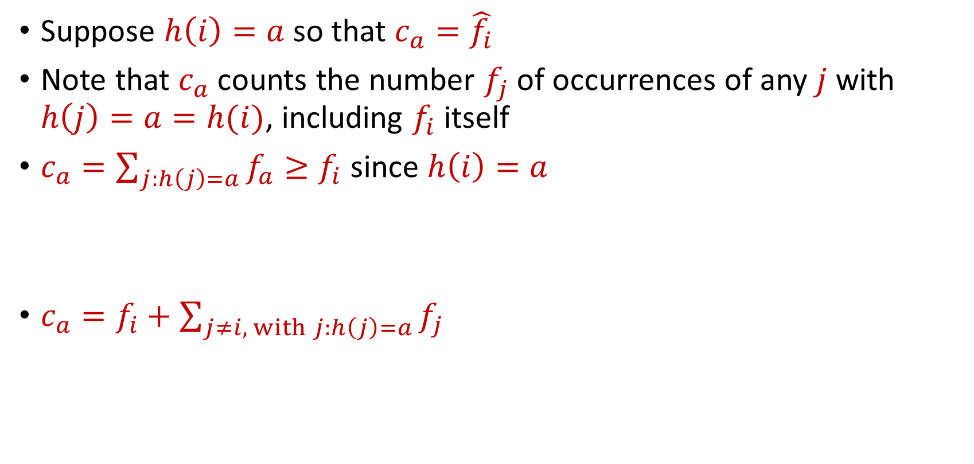
CountMin
Suppose $h\left(i\right)=a$ so that $c_{a}=\hat{f_{i}}$
Note that $c_{a}$counts the number $f_{j}$of occurrences of any $j$ with $h\left(j\right)=a=h(i)$, including $f_{i}$ itself
$c_{a}=\sum_{j:h\left(j\right)=a}{f_{a}}≥f_{i}$ since $h\left(i\right)=a$
$c_{a}=f_{i}+\sum_{j≠i, with j:h\left(j\right)=a}{f_{j}}$

Slide 31

CountMin Error Analysis
$c_{a}=f_{i}+\sum_{j≠i, with j:h\left(j\right)=a}{f_{j}}$
What is the expected error for $f_{i}$?

Slide 32

CountMin Error Analysis
$c_{a}=f_{i}+\sum_{j≠i, with j:h\left(j\right)=a}{f_{j}}$
What is the expected error for $f_{i}$?
$E\left[\sum_{j≠i, with j:h\left(j\right)=a}{f_{j}}\right]=Σ_{j≠i}E\left[f_{j}⋅I_{h\left(j\right)=h(i)}\right]$

Slide 33
CountMin Error Analysis
$c_{a}=f_{i}+\sum_{j≠i, with j:h\left(j\right)=a}{f_{j}}$
What is the expected error for $f_{i}$?
$E\left[\sum_{j≠i, with j:h\left(j\right)=a}{f_{j}}\right]=Σ_{j≠i}E\left[f_{j}⋅I_{h\left(j\right)=h(i)}\right]$
$$=Σ_{j≠i}E\left[I_{h\left(j\right)=h(i)}\right]⋅f_{j}$$

Slide 34
CountMin Error Analysis
$c_{a}=f_{i}+\sum_{j≠i, with j:h\left(j\right)=a}{f_{j}}$
What is the expected error for $f_{i}$?
$E\left[\sum_{j≠i, with j:h\left(j\right)=a}{f_{j}}\right]=Σ_{j≠i}E\left[f_{j}⋅I_{h\left(j\right)=h(i)}\right]$
$$=Σ_{j≠i}E\left[I_{h\left(j\right)=h(i)}\right]⋅f_{j}$$
$${=Σ_{j≠i}Pr\left[h\left(j\right)=h(i)\right]⋅f}_{j}$$

Slide 35

CountMin Error Analysis
$c_{a}=f_{i}+\sum_{j≠i, with j:h\left(j\right)=a}{f_{j}}$
What is the expected error for $f_{i}$?
$E\left[\sum_{j≠i, with j:h\left(j\right)=a}{f_{j}}\right]=Σ_{j≠i}E\left[f_{j}⋅I_{h\left(j\right)=h(i)}\right]$
$$=Σ_{j≠i}E\left[I_{h\left(j\right)=h(i)}\right]⋅f_{j}$$
$${=Σ_{j≠i}Pr\left[h\left(j\right)=h(i)\right]⋅f}_{j}$$
$$=Σ_{j≠i}{\frac{1}{b}⋅f}_{j}=\frac{m}{b}$$

Slide 36
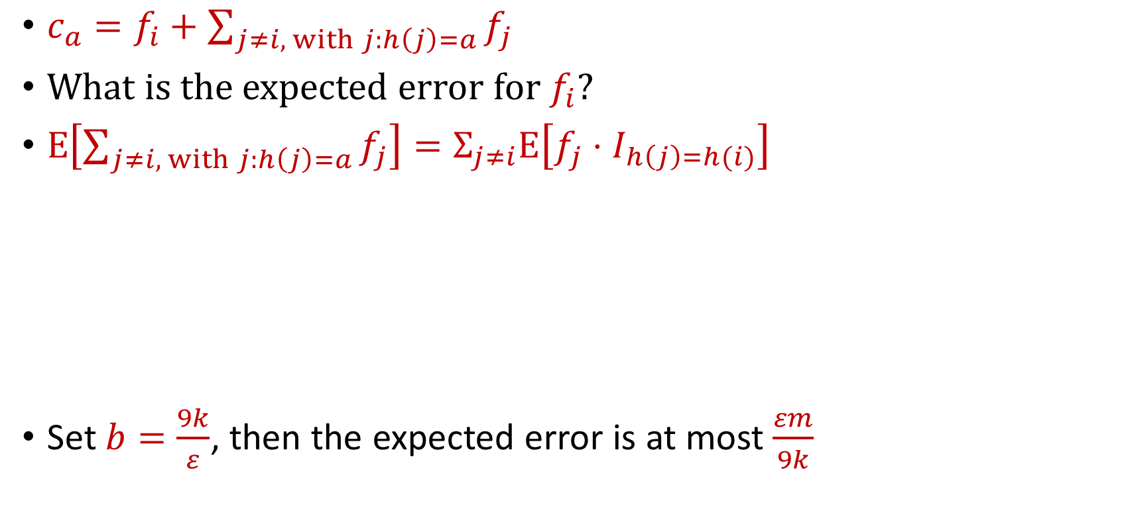
CountMin Error Analysis
$c_{a}=f_{i}+\sum_{j≠i, with j:h\left(j\right)=a}{f_{j}}$
What is the expected error for $f_{i}$?
$E\left[\sum_{j≠i, with j:h\left(j\right)=a}{f_{j}}\right]=Σ_{j≠i}E\left[f_{j}⋅I_{h\left(j\right)=h(i)}\right]$
Set $b=\frac{9k}{ε}$, then the expected error is at most $\frac{εm}{9k}$
$$=Σ_{j≠i}E\left[I_{h\left(j\right)=h(i)}\right]⋅f_{j}$$
$${=Σ_{j≠i}Pr\left[h\left(j\right)=h(i)\right]⋅f}_{j}$$
$$=Σ_{j≠i}{\frac{1}{b}⋅f}_{j}=\frac{m}{b}$$

Slide 37
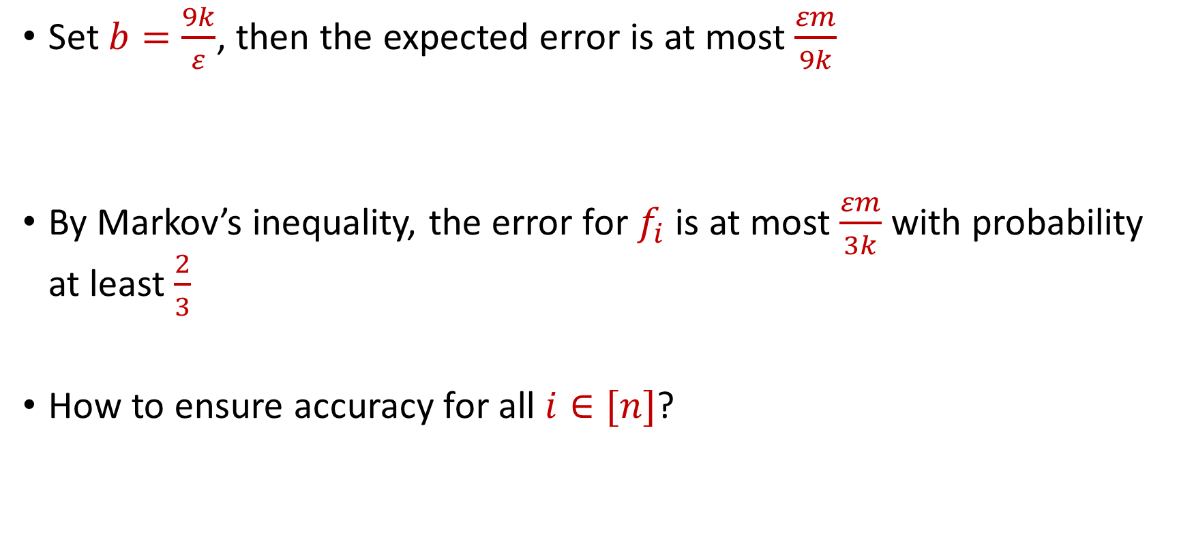
CountMin Error Analysis
Set $b=\frac{9k}{ε}$, then the expected error is at most $\frac{εm}{9k}$
By Markov’s inequality, the error for $f_{i}$ is at most $\frac{εm}{3k}$ with probability at least $\frac{2}{3}$
How to ensure accuracy for all $i∈[n]$?

Slide 38
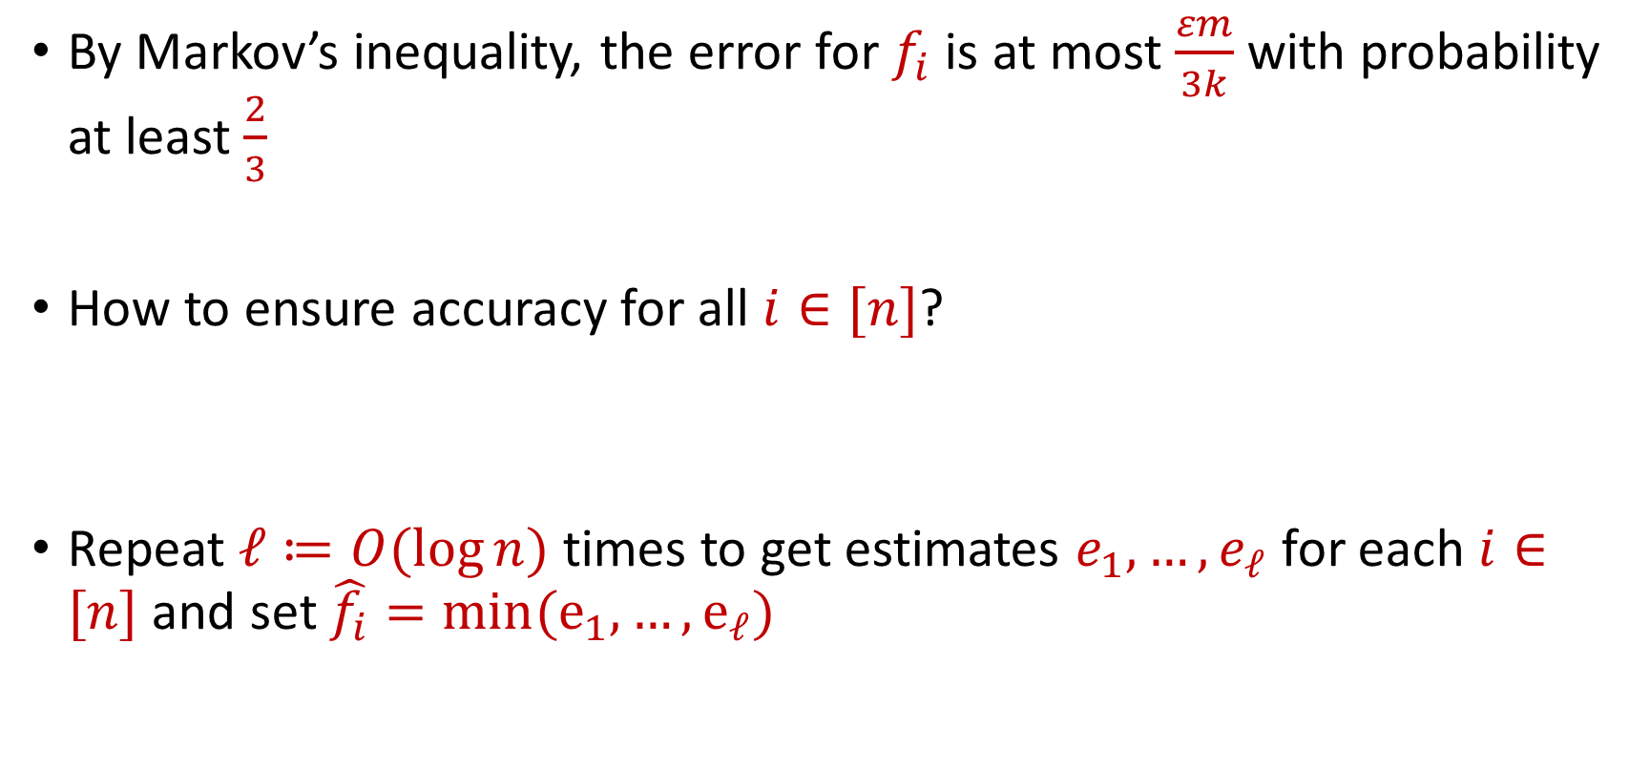
CountMin Error Analysis
By Markov’s inequality, the error for $f_{i}$ is at most $\frac{εm}{3k}$ with probability at least $\frac{2}{3}$
How to ensure accuracy for all $i∈[n]$?
Repeat $ℓ≔O(\log{n)}$ times to get estimates $e_{1},…,e_{ℓ}$ for each $i∈[n]$ and set $\hat{f_{i}}=min(e_{1},…, e_{ℓ})$

Slide 39

Sparse Recovery
Suppose we have an insertion-deletion stream of length $m=Θ\left(n\right)$ and at the end we are promised there are at most $k$ nonzero coordinates
Recover the $k$ nonzero coordinates and their frequencies

Slide 40
Applications of Sparse Recovery
Anomaly detection and network traffic analysis:
Noiseless sparse recovery can be used to identify anomalies or outliers in streaming data. By modeling normal behavior as a sparse signal, deviations from this model can be detected in real-time. This is valuable for cybersecurity, fraud detection, and monitoring network traffic for unusual patterns.
Noiseless sparse recovery can be applied to analyze network traffic in real-time, identifying patterns and trends, and helping in network management, intrusion detection, and quality of service (QoS) optimization

Slide 41
Applications of Sparse Recovery
Online Natural Language Processing (NLP): In real-time natural language processing tasks, noiseless sparse recovery can assist in extracting relevant features or patterns from streaming text data, making it useful for sentiment analysis, topic modeling, and summarization

Slide 42
Applications of Sparse Recovery
Real-time Compressive Imaging: Compressive imaging techniques can be applied to streaming video or image data. By capturing and processing fewer measurements, noiseless sparse recovery can provide real-time reconstruction of high-resolution images or videos.

Slide 43
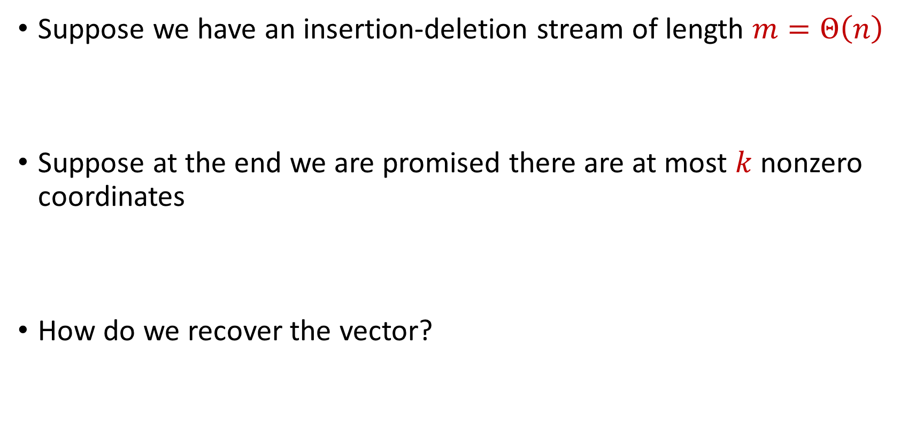
Sparse Recovery
Suppose we have an insertion-deletion stream of length $m=Θ\left(n\right)$
Suppose at the end we are promised there are at most $k$ nonzero coordinates
How do we recover the vector?

Slide 44

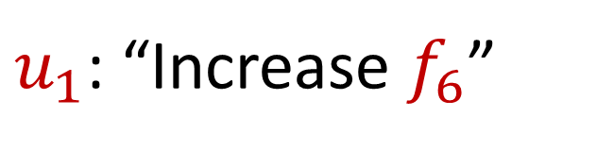
Sparse Recovery
Suppose at the end we are promised there are at most $k$ nonzero coordinates
Suppose $k=1$ and we are promised the coordinate has frequency $1$
$u_{1}$: “Increase $f_{6}$”

Slide 45
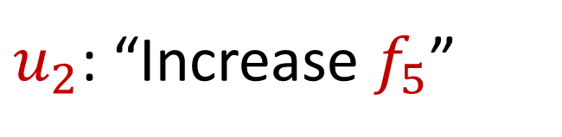
Sparse Recovery
Suppose at the end we are promised there are at most $k$ nonzero coordinates
Suppose $k=1$ and we are promised the coordinate has frequency $1$
$u_{2}$: “Increase $f_{5}$”

Slide 46
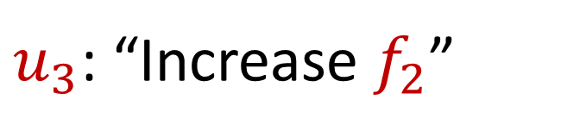
Sparse Recovery
Suppose at the end we are promised there are at most $k$ nonzero coordinates
Suppose $k=1$ and we are promised the coordinate has frequency $1$
$u_{3}$: “Increase $f_{2}$”

Slide 47
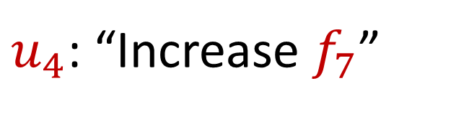
Sparse Recovery
Suppose at the end we are promised there are at most $k$ nonzero coordinates
Suppose $k=1$ and we are promised the coordinate has frequency $1$
$u_{4}$: “Increase $f_{7}$”

Slide 48
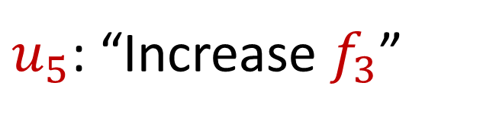
Sparse Recovery
Suppose at the end we are promised there are at most $k$ nonzero coordinates
Suppose $k=1$ and we are promised the coordinate has frequency $1$
$u_{5}$: “Increase $f_{3}$”

Slide 49
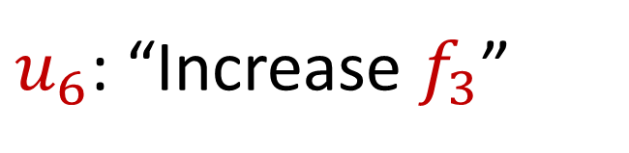
Sparse Recovery
Suppose at the end we are promised there are at most $k$ nonzero coordinates
Suppose $k=1$ and we are promised the coordinate has frequency $1$
$u_{6}$: “Increase $f_{3}$”

Slide 50
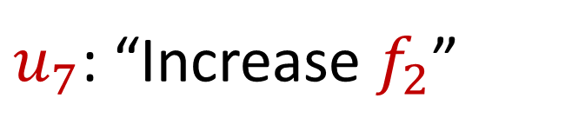
Sparse Recovery
Suppose at the end we are promised there are at most $k$ nonzero coordinates
Suppose $k=1$ and we are promised the coordinate has frequency $1$
$u_{7}$: “Increase $f_{2}$”

Slide 51
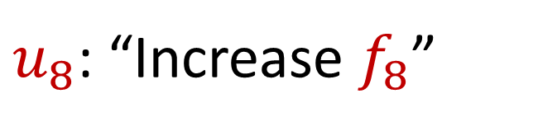
Sparse Recovery
Suppose at the end we are promised there are at most $k$ nonzero coordinates
Suppose $k=1$ and we are promised the coordinate has frequency $1$
$u_{8}$: “Increase $f_{8}$”

Slide 52
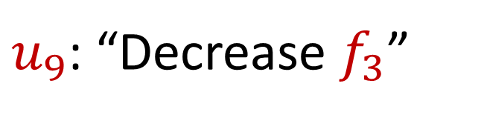
Sparse Recovery
Suppose at the end we are promised there are at most $k$ nonzero coordinates
Suppose $k=1$ and we are promised the coordinate has frequency $1$
$u_{9}$: “Decrease $f_{3}$”

Slide 53
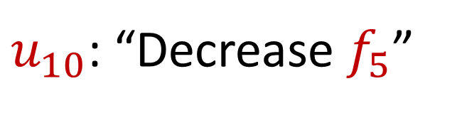
Sparse Recovery
Suppose at the end we are promised there are at most $k$ nonzero coordinates
Suppose $k=1$ and we are promised the coordinate has frequency $1$
$u_{10}$: “Decrease $f_{5}$”

Slide 54
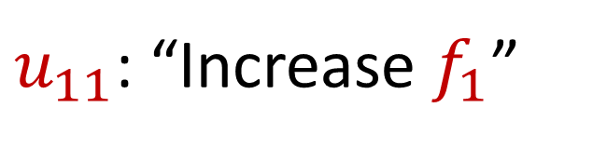
Sparse Recovery
Suppose at the end we are promised there are at most $k$ nonzero coordinates
Suppose $k=1$ and we are promised the coordinate has frequency $1$
$u_{11}$: “Increase $f_{1}$”

Slide 55
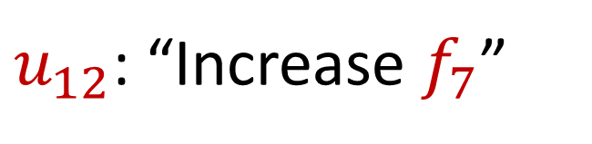
Sparse Recovery
Suppose at the end we are promised there are at most $k$ nonzero coordinates
Suppose $k=1$ and we are promised the coordinate has frequency $1$
$u_{12}$: “Increase $f_{7}$”

Slide 56
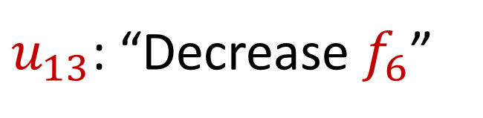
Sparse Recovery
Suppose at the end we are promised there are at most $k$ nonzero coordinates
Suppose $k=1$ and we are promised the coordinate has frequency $1$
$u_{13}$: “Decrease $f_{6}$”

Slide 57

Sparse Recovery
Suppose at the end we are promised there are at most $k$ nonzero coordinates
Suppose $k=1$ and we are promised the coordinate has frequency $1$
$u_{14}$: “Decrease $f_{8}$”

Slide 58
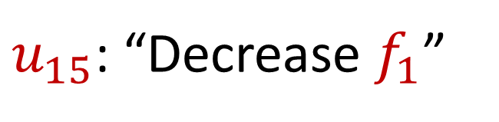
Sparse Recovery
Suppose at the end we are promised there are at most $k$ nonzero coordinates
Suppose $k=1$ and we are promised the coordinate has frequency $1$
$u_{15}$: “Decrease $f_{1}$”

Slide 59
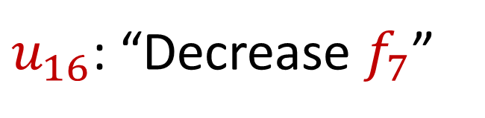
Sparse Recovery
Suppose at the end we are promised there are at most $k$ nonzero coordinates
Suppose $k=1$ and we are promised the coordinate has frequency $1$
$u_{16}$: “Decrease $f_{7}$”

Slide 60
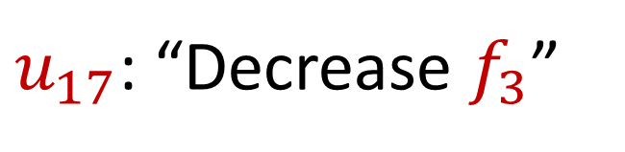
Sparse Recovery
Suppose at the end we are promised there are at most $k$ nonzero coordinates
Suppose $k=1$ and we are promised the coordinate has frequency $1$
$u_{17}$: “Decrease $f_{3}$”

Slide 61
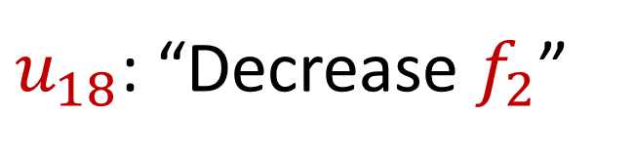
Sparse Recovery
Suppose at the end we are promised there are at most $k$ nonzero coordinates
Suppose $k=1$ and we are promised the coordinate has frequency $1$
$u_{18}$: “Decrease $f_{2}$”

Slide 62

Sparse Recovery
Suppose at the end we are promised there are at most $k$ nonzero coordinates
Suppose $k=1$ and we are promised the coordinate has frequency $1$
$u_{19}$: “Decrease $f_{7}$”

Slide 63

Sparse Recovery
Suppose at the end we are promised there are at most $k$ nonzero coordinates
Suppose $k=1$ and we are promised the coordinate has frequency $1$
What is left?

Slide 64

Sparse Recovery
Suppose at the end we are promised there are at most $k$ nonzero coordinates
Suppose $k=1$ and we are promised the coordinate has frequency $1$
What is left?
$$f_{2}=1$$

Slide 65

Sparse Recovery
Suppose at the end we are promised there are at most $k$ nonzero coordinates
Suppose $k=1$ and we are promised the coordinate has frequency $1$
Algorithm: Keep running sum of all the coordinates

Slide 66

Sparse Recovery
Suppose at the end we are promised there are at most $k$ nonzero coordinates
Suppose $k=1$ and we are promised the coordinate has frequency $1$
Algorithm: Keep running sum of all the coordinates
Write each insertion to coordinate $c_{i}∈[n]$as $u_{i}←\left(s_{i}=1, c_{i}\right)$
Write each deletion to coordinate $c_{i}∈[n]$as $u_{i}←\left(s_{i}=−1, c_{i}\right)$

Slide 67

Sparse Recovery
Suppose $k=1$ and we are promised the coordinate $j$ has frequency $1$
Algorithm: Keep running sum of all the coordinates
Write each insertion to coordinate $c_{i}∈[n]$as $u_{i}←\left(s_{i}=1, c_{i}\right)$
Write each deletion to coordinate $c_{i}∈[n]$as $u_{i}←\left(s_{i}=−1, c_{i}\right)$
Running sum of coordinates $\sum_{i∈[m]}{s_{i}c_{i}}=j$

Slide 68

Sparse Recovery
Suppose at the end we are promised there are at most $k$ nonzero coordinates
Suppose $k=1$ and we are promised the coordinate $j$ has frequency $1$
Algorithm: Keep running sum of all the coordinates?

Slide 69

Sparse Recovery
Suppose at the end we are promised there are at most $k$ nonzero coordinates
Suppose $k=1$ and we are promised the coordinate $j$ has frequency $1$
Algorithm: Keep running sum of all the coordinates AND a different linear combination of all the coordinates

Slide 70

Sparse Recovery
Suppose at the end we are promised there are at most $k$ nonzero coordinates
Suppose $k=1$ and we are promised the coordinate $j$ has frequency $1$
Algorithm: Keep running sum of all the coordinates AND a different linear combination of all the coordinates
Keep $\sum_{i∈[m]}{s_{i}c_{i}}$ and $\sum_{i∈[m]}{s_{i}c_{i}^{2}}$

Slide 71

Sparse Recovery
Suppose at the end we are promised there are at most $k$ nonzero coordinates
Suppose $k=1$ and we are promised the coordinate $j$ has frequency $1$
$u_{1}$: “Increase $f_{6}$”

Slide 72
Sparse Recovery
Suppose at the end we are promised there are at most $k$ nonzero coordinates
Suppose $k=1$ and we are promised the coordinate $j$ has frequency $1$
$u_{2}$: “Increase $f_{5}$”

Slide 73
Sparse Recovery
Suppose at the end we are promised there are at most $k$ nonzero coordinates
Suppose $k=1$ and we are promised the coordinate $j$ has frequency $1$
$u_{3}$: “Increase $f_{2}$”

Slide 74
Sparse Recovery
Suppose at the end we are promised there are at most $k$ nonzero coordinates
Suppose $k=1$ and we are promised the coordinate $j$ has frequency $1$
$u_{4}$: “Increase $f_{7}$”

Slide 75
Sparse Recovery
Suppose at the end we are promised there are at most $k$ nonzero coordinates
Suppose $k=1$ and we are promised the coordinate $j$ has frequency $1$
$u_{5}$: “Increase $f_{3}$”

Slide 76
Sparse Recovery
Suppose at the end we are promised there are at most $k$ nonzero coordinates
Suppose $k=1$ and we are promised the coordinate $j$ has frequency $1$
$u_{6}$: “Increase $f_{3}$”

Slide 77
Sparse Recovery
Suppose at the end we are promised there are at most $k$ nonzero coordinates
Suppose $k=1$ and we are promised the coordinate $j$ has frequency $1$
$u_{7}$: “Increase $f_{2}$”

Slide 78
Sparse Recovery
Suppose at the end we are promised there are at most $k$ nonzero coordinates
Suppose $k=1$ and we are promised the coordinate $j$ has frequency $1$
$u_{8}$: “Increase $f_{8}$”

Slide 79
Sparse Recovery
Suppose at the end we are promised there are at most $k$ nonzero coordinates
Suppose $k=1$ and we are promised the coordinate $j$ has frequency $1$
$u_{9}$: “Decrease $f_{3}$”

Slide 80
Sparse Recovery
Suppose at the end we are promised there are at most $k$ nonzero coordinates
Suppose $k=1$ and we are promised the coordinate $j$ has frequency $1$
$u_{10}$: “Decrease $f_{5}$”

Slide 81
Sparse Recovery
Suppose at the end we are promised there are at most $k$ nonzero coordinates
Suppose $k=1$ and we are promised the coordinate $j$ has frequency $1$
$u_{11}$: “Increase $f_{1}$”

Slide 82
Sparse Recovery
Suppose at the end we are promised there are at most $k$ nonzero coordinates
Suppose $k=1$ and we are promised the coordinate $j$ has frequency $1$
$u_{12}$: “Increase $f_{7}$”

Slide 83
Sparse Recovery
Suppose at the end we are promised there are at most $k$ nonzero coordinates
Suppose $k=1$ and we are promised the coordinate $j$ has frequency $1$
$u_{13}$: “Decrease $f_{6}$”

Slide 84
Sparse Recovery
Suppose at the end we are promised there are at most $k$ nonzero coordinates
Suppose $k=1$ and we are promised the coordinate $j$ has frequency $1$
$u_{14}$: “Decrease $f_{8}$”

Slide 85
Sparse Recovery
Suppose at the end we are promised there are at most $k$ nonzero coordinates
Suppose $k=1$ and we are promised the coordinate $j$ has frequency $1$
$u_{15}$: “Decrease $f_{1}$”

Slide 86
Sparse Recovery
Suppose at the end we are promised there are at most $k$ nonzero coordinates
Suppose $k=1$ and we are promised the coordinate $j$ has frequency $1$
$u_{16}$: “Decrease $f_{7}$”

Slide 87
Sparse Recovery
Suppose at the end we are promised there are at most $k$ nonzero coordinates
Suppose $k=1$ and we are promised the coordinate $j$ has frequency $1$
$u_{17}$: “Decrease $f_{3}$”

Slide 88

Sparse Recovery
Suppose at the end we are promised there are at most $k$ nonzero coordinates
Suppose $k=1$ and we are promised the coordinate $j$ has frequency $1$
$u_{18}$: “Decrease $f_{7}$”

Slide 89

Sparse Recovery
Suppose at the end we are promised there are at most $k$ nonzero coordinates
Suppose $k=1$ and we are promised the coordinate $j$ has frequency $1$
What is the state of our algorithm?

Slide 90

Sparse Recovery
Suppose at the end we are promised there are at most $k$ nonzero coordinates
Suppose $k=1$ and we are promised the coordinate $j$ has frequency $1$
What is the state of our algorithm?
$\sum_{i∈[m]}{s_{i}c_{i}}=4$ and $\sum_{i∈[m]}{s_{i}c_{i}^{2}=8}$

Slide 91

Sparse Recovery
Suppose at the end we are promised there are at most $k$ nonzero coordinates
Suppose $k=1$ and we are promised the coordinate $j$ has frequency $1$
What is the state of our algorithm?
We know $\sum_{i∈[m]}{s_{i}c_{i}}=j⋅f_{j}$ and $\sum_{i∈[m]}{s_{i}c_{i}^{2}=j⋅f_{j}^{2}}$
$\sum_{i∈[m]}{s_{i}c_{i}}=4$ and $\sum_{i∈[m]}{s_{i}c_{i}^{2}=8}$

Slide 92

Sparse Recovery
Suppose at the end we are promised there are at most $k$ nonzero coordinates
Suppose $k=1$ and we are promised the coordinate $j$ has frequency $1$
What is the state of our algorithm?
We know $\sum_{i∈[m]}{s_{i}c_{i}}=j⋅f_{j}$ and $\sum_{i∈[m]}{s_{i}c_{i}^{2}=j⋅f_{j}^{2}}$
So $f_{j}=2$ and $j=2$
$\sum_{i∈[m]}{s_{i}c_{i}}=4$ and $\sum_{i∈[m]}{s_{i}c_{i}^{2}=8}$

Slide 93

Sparse Recovery
Suppose at the end we are promised there are at most $k$ nonzero coordinates
Suppose $k=1$ and we are promised the coordinate $j$ has frequency $1$
What is the state of our algorithm?
We know $\sum_{i∈[m]}{s_{i}c_{i}}=j⋅f_{j}$ and $\sum_{i∈[m]}{s_{i}c_{i}^{2}=j⋅f_{j}^{2}}$
So $f_{j}=2$ and $j=2$
$\sum_{i∈[m]}{s_{i}c_{i}}=4$ and $\sum_{i∈[m]}{s_{i}c_{i}^{2}=8}$
$f_{1}$ | $f_{2}$ | $f_{3}$ | $f_{4}$ | $f_{5}$ | $f_{6}$ | $f_{7}$
0 | 2 | 0 | 0 | 0 | 0 | 0

Slide 94

Sparse Recovery
Suppose at the end we are promised there are at most $k$ nonzero coordinates
Algorithm for $k=1$: Keep running sum of all the coordinates AND a different linear combination of all the coordinates

Slide 95

Sparse Recovery
Suppose at the end we are promised there are at most $k$ nonzero coordinates
Algorithm: Keep $2k$running sum of different linear combinations of all the coordinates
We have $2k$ equations and $2k$ unknown variables
Correctness can be shown from linear algebra

Slide 96

Sparse Recovery
Suppose at the end we are promised there are at most $k$ nonzero coordinates
Algorithm: Keep $2k$running sum of different linear combinations of all the coordinates
Space: $O(k)$ words of space

Slide 97


Heavy-Hitters (Frequent Items)
Given a set $S$ of $m$ elements from $[n]$, let $f_{i}$ be the frequency of element $i$. (How often it appears)
Let $L_{2}$ be the norm of the frequency vector:
Goal: Given a set $S$ of $m$ elements from $[n]$ and a threshold $ε$, output the elements $i$ such that $f_{i}>$ $ε L_{2}$...and no elements $j$ such that $f_{j}<$ $\frac{ε}{16} L_{2}$
Motivation: DDoS prevention, iceberg queries
$$L_{2}=\sqrt{f_{1}^{2}+f_{2}^{2}+…+f_{n}^{2}}$$

Slide 98



Frequency Moments ($L_{p}$ Norm)
Given a set $S$ of $m$ elements from $[n]$, let $f_{i}$ be the frequency of element $i$. (How often it appears)
Let $F_{p}$ be the frequency moment of the vector:
Goal: Given a set $S$ of $m$ elements from $[n]$ and an accuracy parameter $ε$, output a $(1+ε)$-approximation to $F_{p}$
Motivation: Entropy estimation, linear regression
$F_{p}=$ $f_{1}^{p}+f_{2}^{p}+…+f_{n}^{p}$

Slide 99


Distinct Elements ($F_{0}$ Estimation)
Given a set $S$ of $m$ elements from $[n]$, let $f_{i}$ be the frequency of element $i$. (How often it appears)
Let $F_{0}$ be the frequency moment of the vector:
Goal: Given a set $S$ of $m$ elements from $[n]$ and an accuracy parameter $ε$, output a $(1+ε)$-approximation to $F_{0}$
Motivation: Traffic monitoring
$F_{0}=$ $|\{i :f_{i}≠0\}|$

