Slide 1
CSCE 689: Special Topics in Modern Algorithms for Data Science
Lecture 4
Samson Zhou

Slide 2
Today
Sign up for LaTeX scribe note slots
Receive and consider list of potential projects/groups

Slide 3
Future
Wednesday: Discuss potential project groups
Friday: Email me the members/group name
Future: Set up meetings to discuss proposed projects

Slide 4

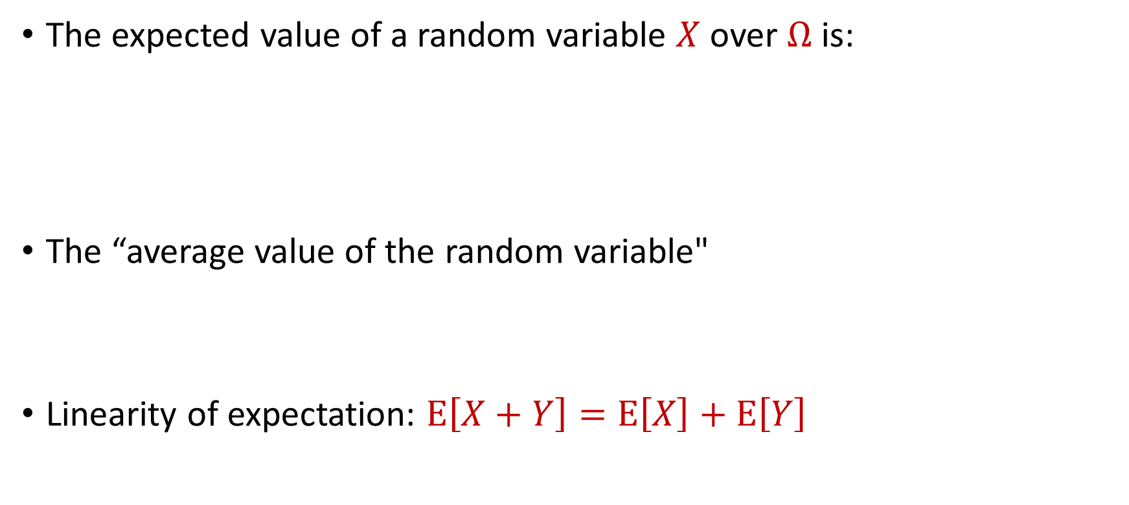
Last Time: Expected Value
The expected value of a random variable $X$ over $Ω$ is:
The “average value of the random variable"
Linearity of expectation: $E\left[X+Y\right]=E\left[X\right]+E\left[Y\right]$
$$E\left[X\right]=\sum_{x∈Ω}{Pr\left[X=x\right]⋅x}$$

Slide 5

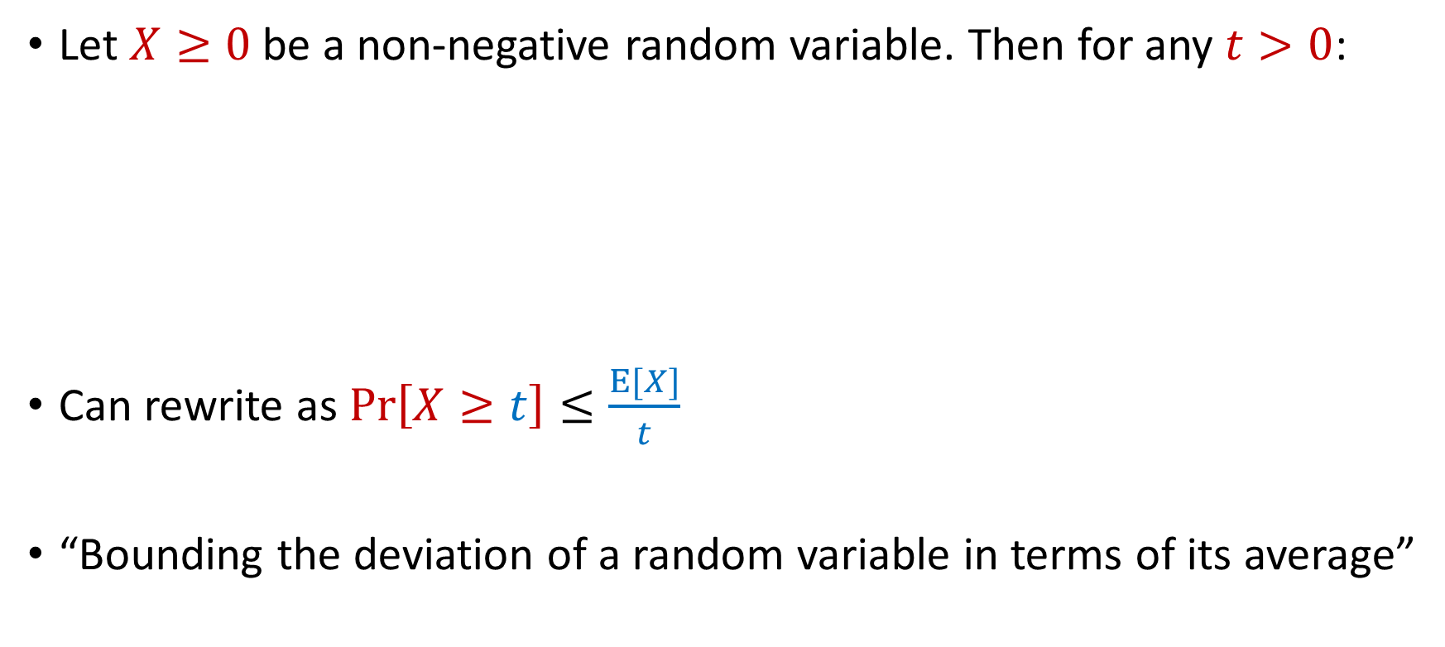
Last Time: Markov’s Inequality
Let $X≥0$be a non-negative random variable. Then for any $t>0$:
Can rewrite as $Pr\left[X≥t\right]≤\frac{E[X]}{t}$
“Bounding the deviation of a random variable in terms of its average”
$$Pr\left[X≥t⋅E[X]\right]≤\frac{1}{t}$$

Slide 6
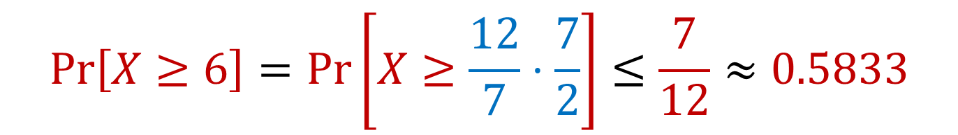

Limitations of Markov’s Inequality
Let $X$be the outcome of a roll of a die. Then $E\left[X\right]=3.5=\frac{7}{2}$
We know $Pr\left[X≥6\right]=\frac{1}{6}≈0.167$
$$Pr\left[X≥6\right]=Pr\left[X≥\frac{12}{7}⋅\frac{7}{2}\right]≤\frac{7}{12}≈0.5833$$

Slide 7


Moments
For $p>0$, the $p$-th moment of a random variable $X$ over $Ω$ is:
$$E\left[X^{p}\right]=\sum_{x∈Ω}{Pr\left[X=x\right]⋅x^{p}}$$

Slide 8
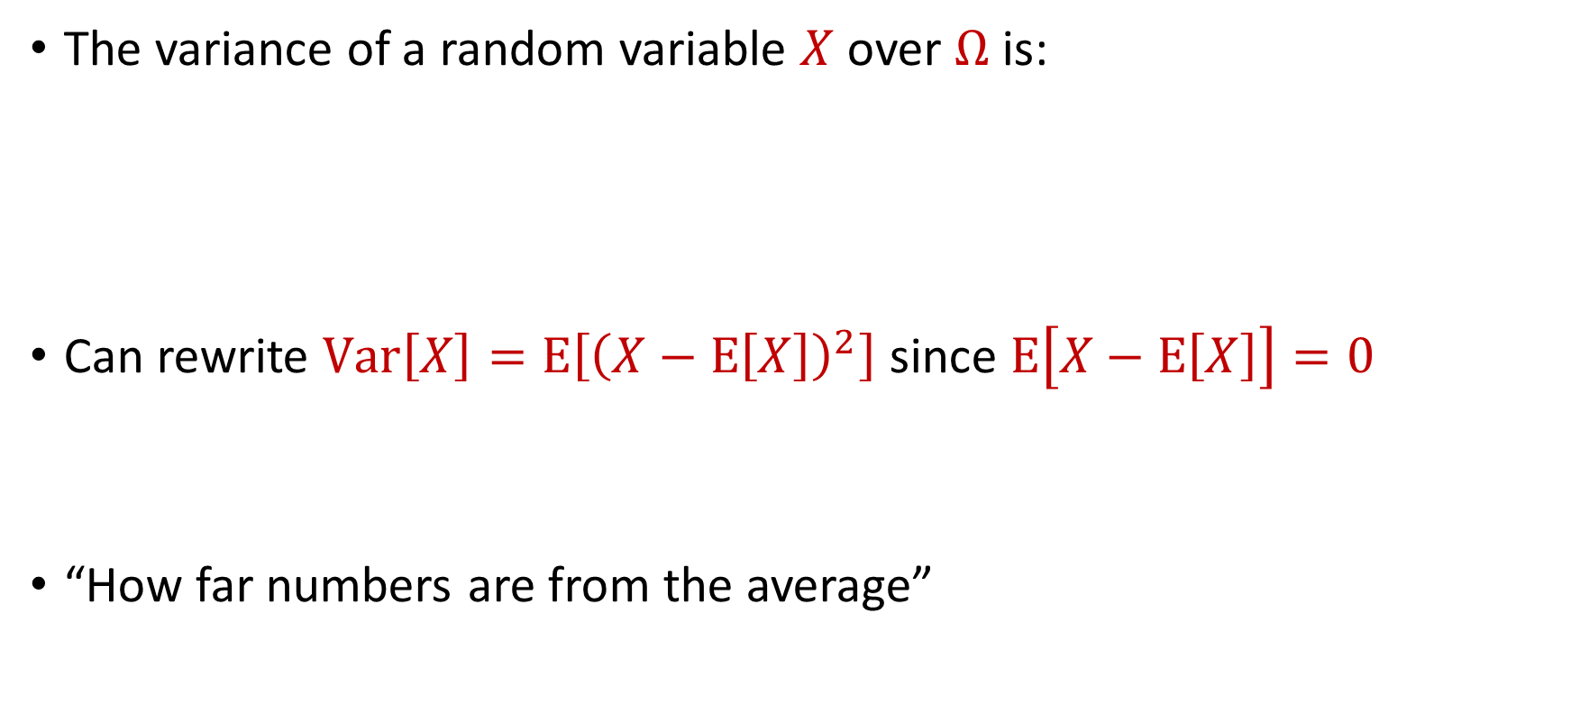
Variance
The variance of a random variable $X$ over $Ω$ is:
Can rewrite $Var\left[X\right]=E\left[{\left(X−E\left[X\right]\right)}^{2}\right]$ since $E\left[X−E\left[X\right]\right]=0$
“How far numbers are from the average”
$$Var\left[X\right]=E\left[X^{2}\right]−{\left(E\left[X\right]\right)}^{2}$$

Slide 9

Variance
The variance of a random variable $X$ over $Ω$ is:
Linearity of variance for independent random variables: $Var\left[X+Y\right]=Var\left[X\right]+Var\left[Y\right]$
$$Var\left[X\right]=E\left[X^{2}\right]−{\left(E\left[X\right]\right)}^{2}$$

Slide 10
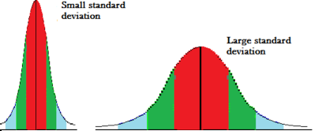
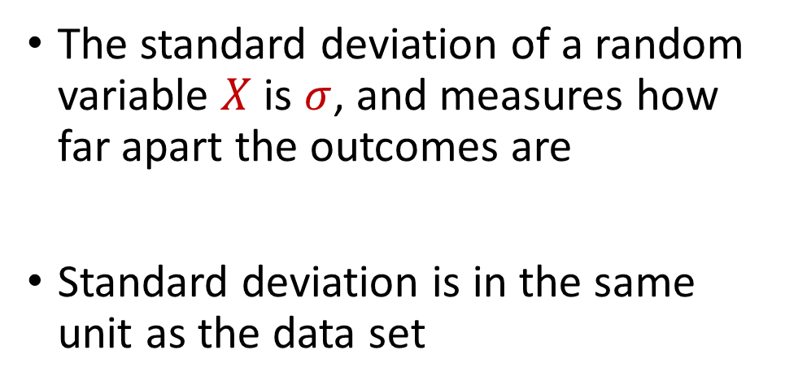
Variance and Standard Deviation
The variance of a random variable $X$ over $Ω$ is:
$$σ^{2}=Var\left[X\right]=E\left[X^{2}\right]−{\left(E\left[X\right]\right)}^{2}$$
The standard deviation of a random variable $X$ is $σ$, and measures how far apart the outcomes are
Standard deviation is in the same unit as the data set

Slide 11
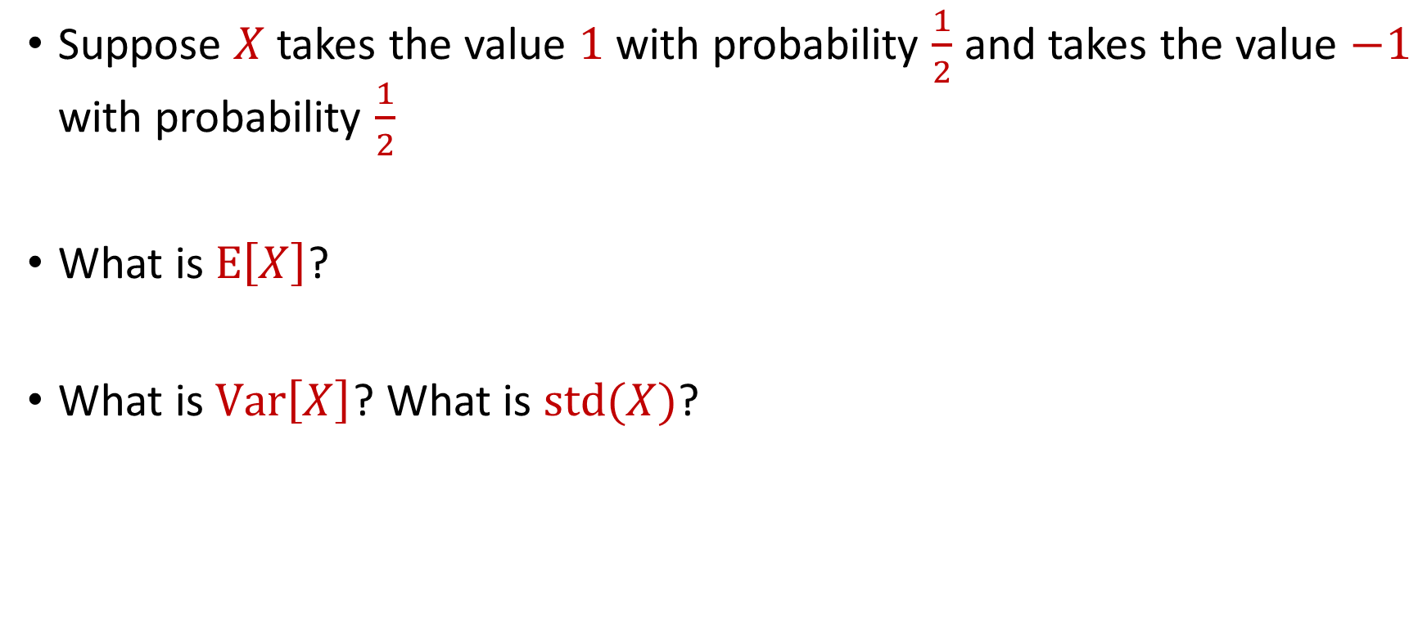
Variance
Suppose $X$ takes the value $1$ with probability $\frac{1}{2}$ and takes the value $−1$ with probability $\frac{1}{2}$
What is $E\left[X\right]$?
What is $Var\left[X\right]$? What is $std(X)$?

Slide 12
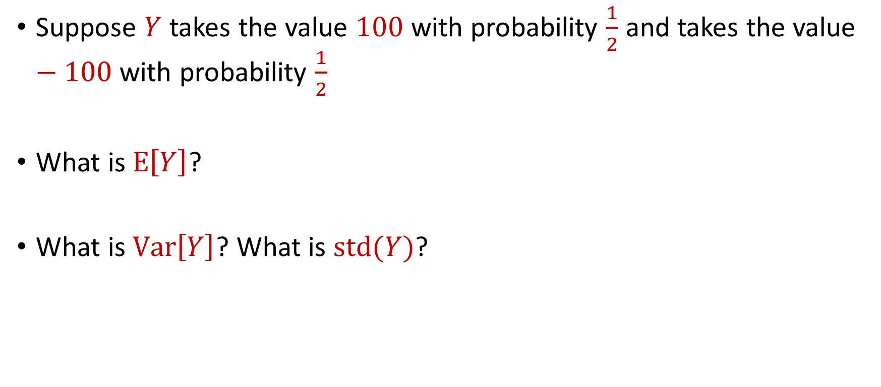
Variance
Suppose $Y$ takes the value $100$ with probability $\frac{1}{2}$ and takes the value $−100$ with probability $\frac{1}{2}$
What is $E\left[Y\right]$?
What is $Var\left[Y\right]$? What is $std(Y)$?

Slide 13

Markov’s Inequality
Let $X≥0$be a non-negative random variable. Then for any $t>0$:
Can rewrite as $Pr\left[X≥t\right]≤\frac{E[X]}{t}$
$$Pr\left[X≥t⋅E[X]\right]≤\frac{1}{t}$$

Slide 14

Markov’s Inequality
Let $X≥0$be a non-negative random variable. Then for any $t>0$:
Can rewrite as $Pr\left[X≥t\right]≤\frac{E[X]}{t}$
We have $Pr\left[\left|X\right|≥t\right]=Pr\left[X^{2}≥t^{2}\right]$
$$Pr\left[X≥t⋅E[X]\right]≤\frac{1}{t}$$

Slide 15


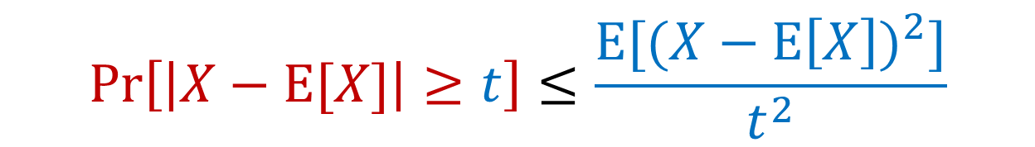
Using Markov’s Inequality
We have $Pr\left[\left|X\right|≥t\right]=Pr\left[X^{2}≥t^{2}\right]$
Plug in $X−E[X]$ for $X$
$$Pr\left[\left|X\right|≥t\right]=Pr\left[X^{2}≥t^{2}\right]≤\frac{E[X^{2}]}{t^{2}}$$
$$Pr\left[\left|X−E[X]\right|≥t\right]≤\frac{E[{(X−E\left[X\right])}^{2}]}{t^{2}}$$

Slide 16
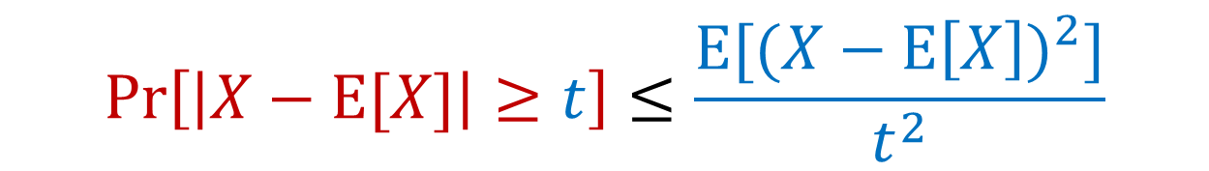
Toward Chebyshev’s Inequality
$$Pr\left[\left|X−E[X]\right|≥t\right]≤\frac{E[{(X−E\left[X\right])}^{2}]}{t^{2}}$$

Slide 17

Chebyshev’s Inequality
Recall that $Var\left[X\right]=E\left[X^{2}\right]−{\left(E\left[X\right]\right)}^{2}=E\left[{\left(X−E\left[X\right]\right)}^{2}\right]$
$Pr\left[\left|X−E[X]\right|≥t\right]≤\frac{Var[X]}{t^{2}}$
$$Pr\left[\left|X−E[X]\right|≥t\right]≤\frac{E[{(X−E\left[X\right])}^{2}]}{t^{2}}$$

Slide 18

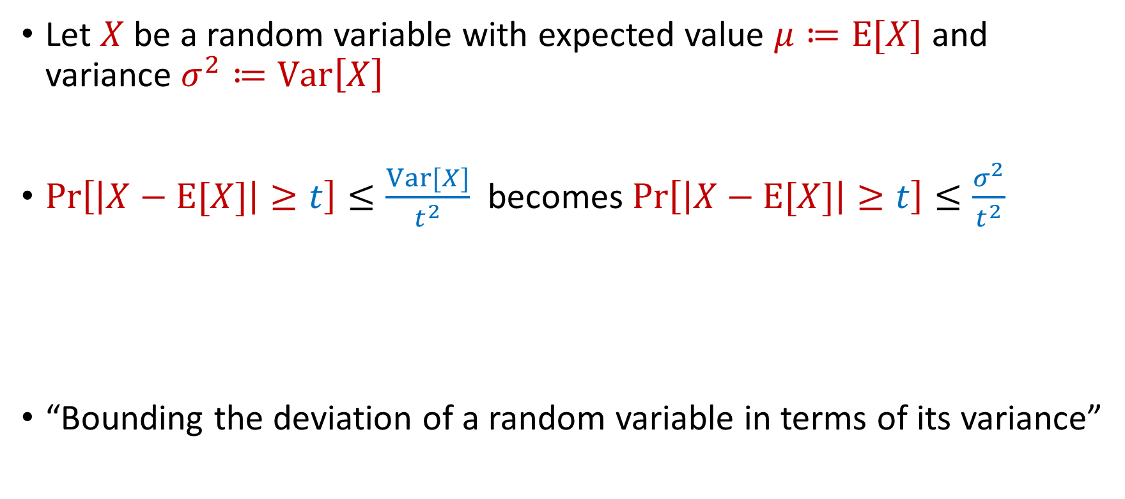
Chebyshev’s Inequality
Let $X$ be a random variable with expected value $μ≔E[X]$ and variance $σ^{2}≔Var\left[X\right]$
$Pr\left[\left|X−E[X]\right|≥t\right]≤\frac{Var[X]}{t^{2}}$ becomes $Pr\left[\left|X−E[X]\right|≥t\right]≤\frac{σ^{2}}{t^{2}}$
“Bounding the deviation of a random variable in terms of its variance”
$$Pr\left[\left|X−μ\right|≥kσ\right]≤\frac{1}{k^{2}}$$

Slide 19
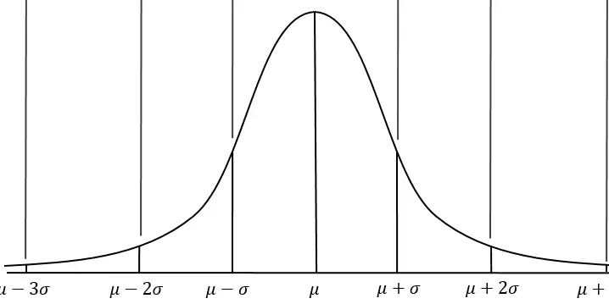


Chebyshev’s Inequality
Let $X$ be a random variable with expected value $μ≔E[X]$ and variance $σ^{2}≔Var\left[X\right]$
Do not require assumptions about $X$
$$Pr\left[\left|X−μ\right|≥kσ\right]≤\frac{1}{k^{2}}$$

Slide 20

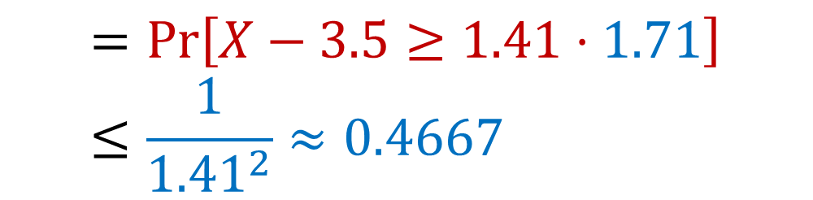
Chebyshev’s Inequality
Let $X$be the outcome of a roll of a die. Then $E\left[X\right]=3.5=\frac{7}{2}$ and $Var\left[X\right]=\frac{35}{12}≈2.92$ so $std(X)≈1.71$
Recall that Markov’s inequality bounded this $0.5833$
$$Pr\left[X≥6\right]=Pr\left[X−3.5≥2.5\right]$$
$$=Pr\left[X−3.5≥1.41⋅1.71\right]≤\frac{1}{{1.41}^{2}}≈0.4667$$

Slide 21
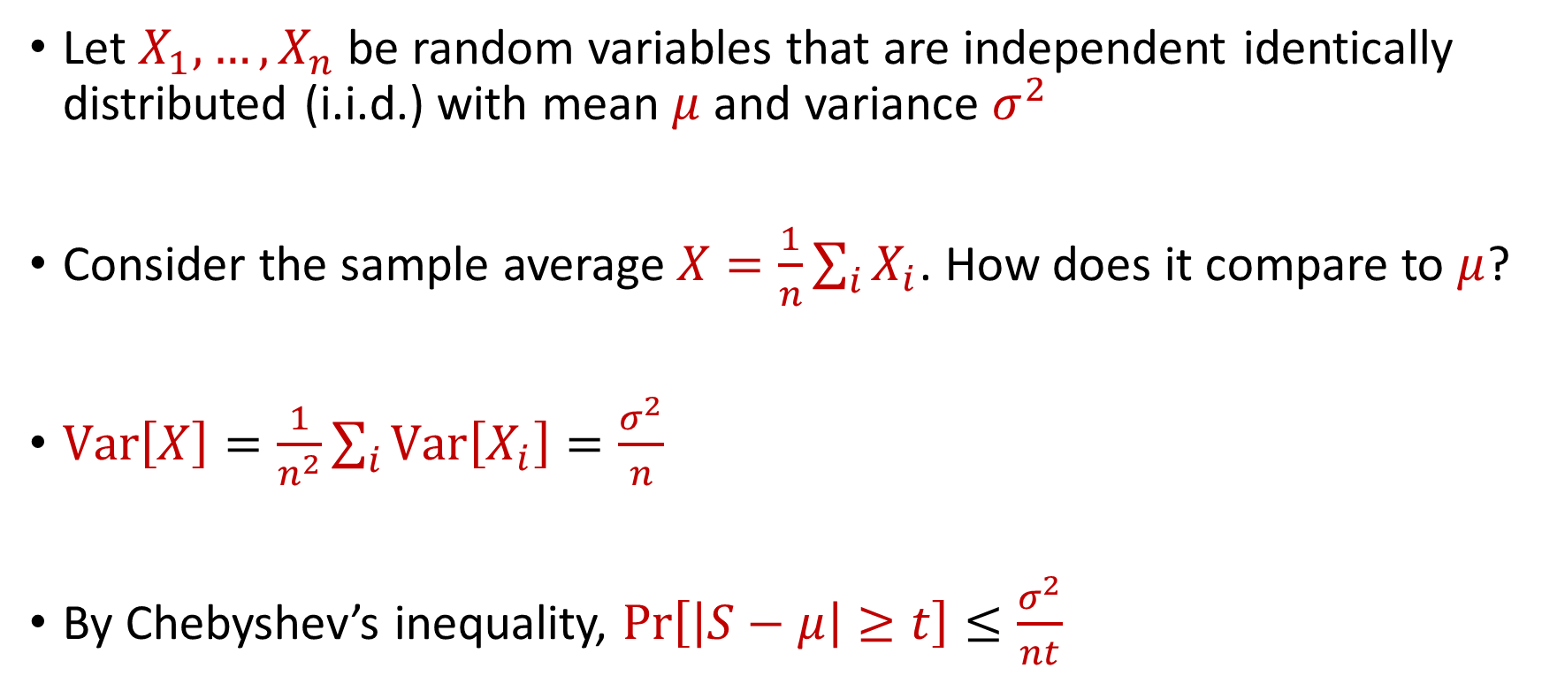
Law of Large Numbers
Let $X_{1},…,X_{n}$ be random variables that are independent identically distributed (i.i.d.) with mean $μ$ and variance $σ^{2}$
Consider the sample average $X=\frac{1}{n}\sum_{i}{X_{i}}$. How does it compare to $μ$?
$Var\left[X\right]=\frac{1}{n^{2}}\sum_{i}{Var\left[X_{i}\right]}=\frac{σ^{2}}{n}$
By Chebyshev’s inequality, $Pr\left[\left|S−μ\right|≥t\right]≤\frac{σ^{2}}{nt}$

Slide 22
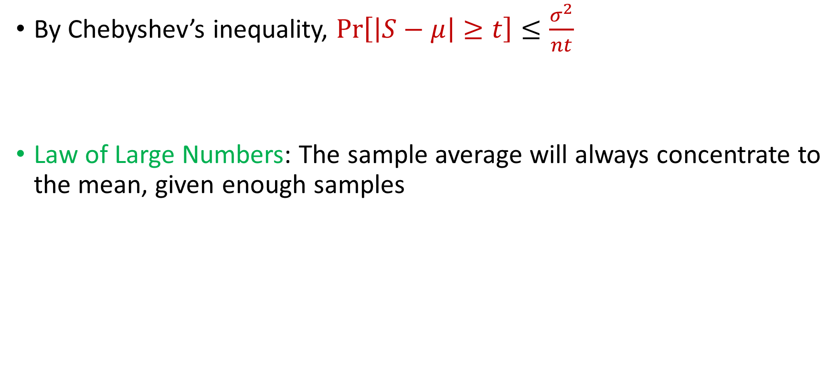
Law of Large Numbers
By Chebyshev’s inequality, $Pr\left[\left|S−μ\right|≥t\right]≤\frac{σ^{2}}{nt}$
Law of Large Numbers: The sample average will always concentrate to the mean, given enough samples

Slide 23
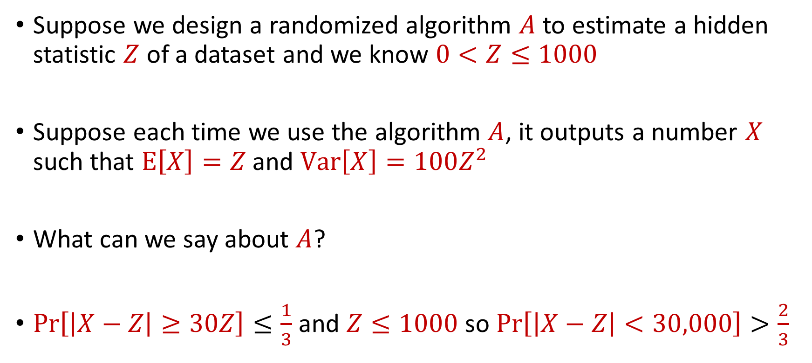
Use Case
Suppose we design a randomized algorithm $A$ to estimate a hidden statistic $Z$ of a dataset and we know $0<Z≤1000$
Suppose each time we use the algorithm $A$, it outputs a number $X$ such that $E\left[X\right]=Z$ and $Var\left[X\right]=100Z^{2}$
What can we say about $A$?
$Pr\left[\left|X−Z\right|≥30Z\right]≤\frac{1}{3}$ and $Z≤1000$ so $Pr\left[\left|X−Z\right|<30,000\right]>\frac{2}{3}$

Slide 24

Accuracy Boosting
How can we use $A$ to get additive error $ε$?

Slide 25
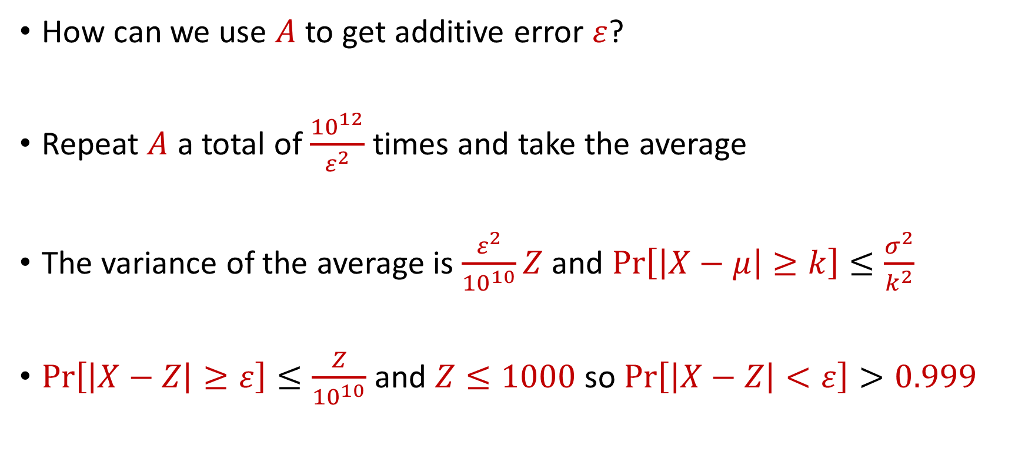
Accuracy Boosting
How can we use $A$ to get additive error $ε$?
Repeat $A$ a total of $\frac{{10}^{12}}{ε^{2}}$ times and take the average
The variance of the average is $\frac{ε^{2}}{{10}^{10}}Z$ and $Pr\left[\left|X−μ\right|≥k\right]≤\frac{σ^{2}}{k^{2}}$
$Pr\left[\left|X−Z\right|≥ε\right]≤\frac{Z}{{10}^{10}}$ and $Z≤1000$ so $Pr\left[\left|X−Z\right|<ε\right]>0.999$

Slide 26
Accuracy Boosting
Algorithmic consequence of Law of Large Numbers
To improve the accuracy of your algorithm, run it many times independently and take the average

Slide 27
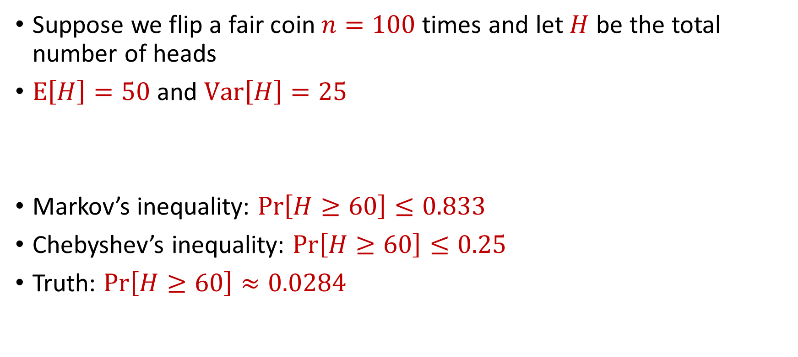
Limitations
Suppose we flip a fair coin $n=100$ times and let $H$ be the total number of heads
$E\left[H\right]=50$ and $Var\left[H\right]=25$
Markov’s inequality: $Pr\left[H≥60\right]≤0.833$
Chebyshev’s inequality: $Pr\left[H≥60\right]≤0.25$
Truth: $Pr\left[H≥60\right]≈0.0284$

Slide 28
CSCE 689: Special Topics in Modern Algorithms for Data Science
Lecture 5
Samson Zhou

Slide 29
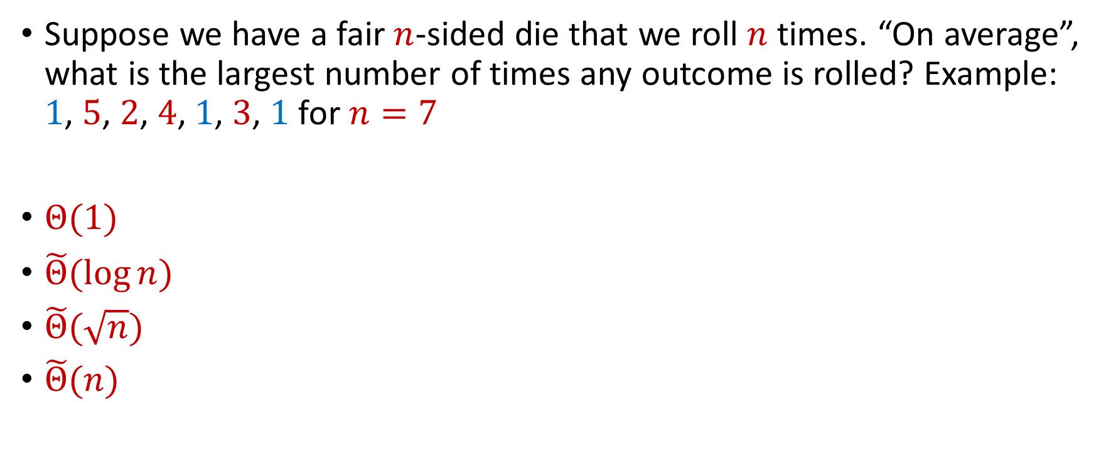
Trivia Question #3 (Max Load)
Suppose we have a fair $n$-sided die that we roll $n$ times. “On average”, what is the largest number of times any outcome is rolled? Example: $1$, $5$, $2$, $4$, $1$, $3$, $1$ for $n=7$
$Θ(1)$
$\tilde{Θ}(\log{n})$
$\tilde{Θ}(\sqrt{n})$
$\tilde{Θ}(n)$

Slide 30
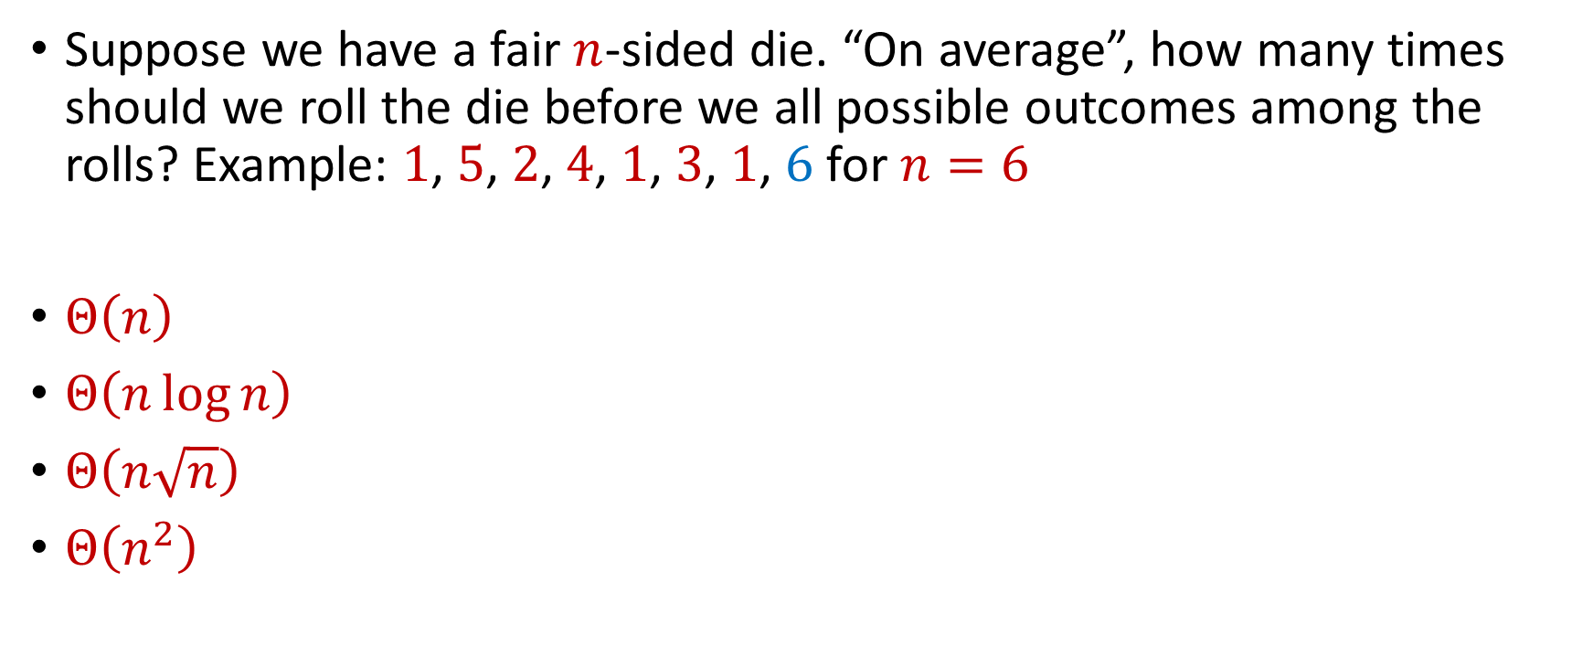
Trivia Question #4 (Coupon Collector)
Suppose we have a fair $n$-sided die. “On average”, how many times should we roll the die before we all possible outcomes among the rolls? Example: $1$, $5$, $2$, $4$, $1$, $3$, $1$, $6$ for $n=6$
$Θ\left(n\right)$
$Θ\left(n\log{n}\right)$
$Θ\left(n\sqrt{n}\right)$
$Θ\left(n^{2}\right)$

Slide 31
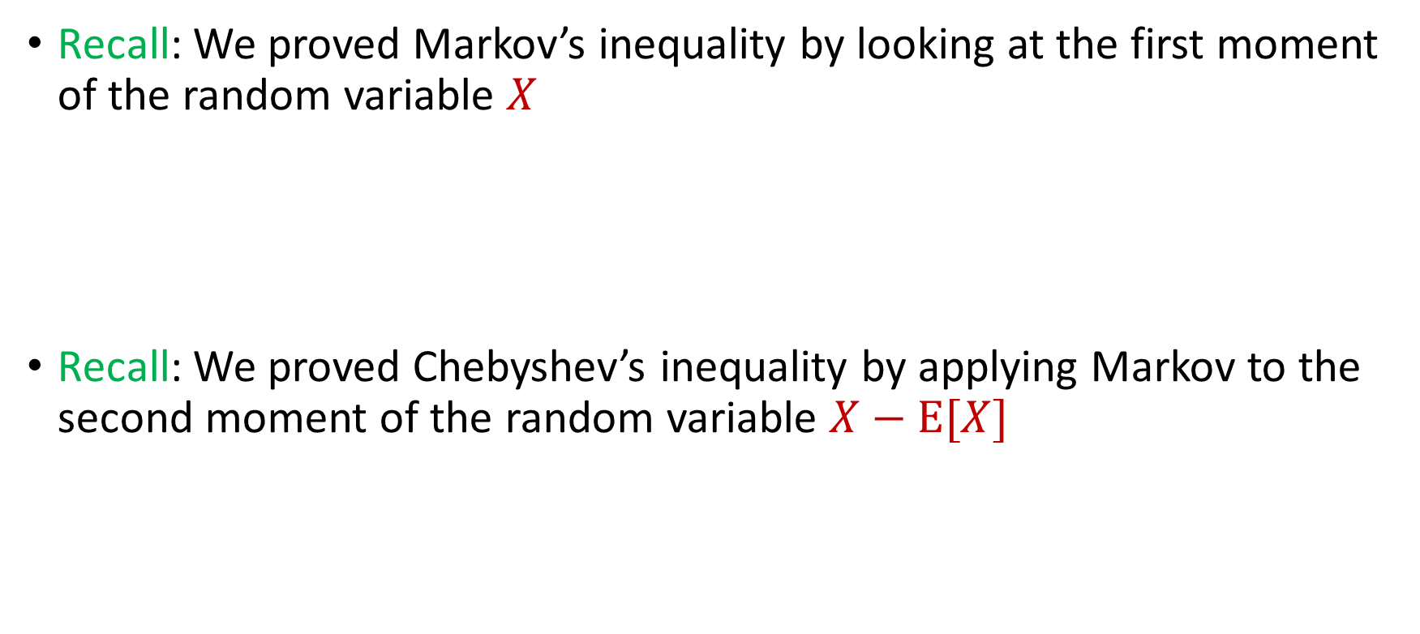

Intuition for Previous Inequalities
Recall: We proved Markov’s inequality by looking at the first moment of the random variable $X$
Recall: We proved Chebyshev’s inequality by applying Markov to the second moment of the random variable $X−E[X]$
$$Pr\left[X≥t⋅E[X]\right]≤\frac{1}{t}$$
$$Pr\left[\left|X−E[X]\right|≥t\right]=Pr\left[{\left|X−E\left[X\right]\right|}^{2}≥t^{2}\right]≤\frac{Var[X]}{t^{2}}$$

Slide 32
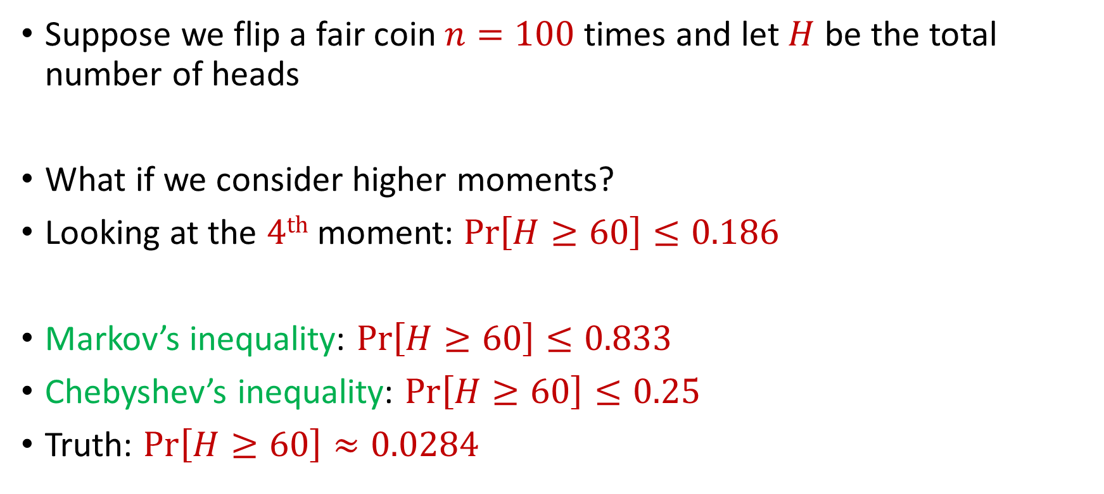
Generalizations
Suppose we flip a fair coin $n=100$ times and let $H$ be the total number of heads
What if we consider higher moments?
Looking at the $4th$ moment: $Pr\left[H≥60\right]≤0.186$
Markov’s inequality: $Pr\left[H≥60\right]≤0.833$
Chebyshev’s inequality: $Pr\left[H≥60\right]≤0.25$
Truth: $Pr\left[H≥60\right]≈0.0284$

Slide 33
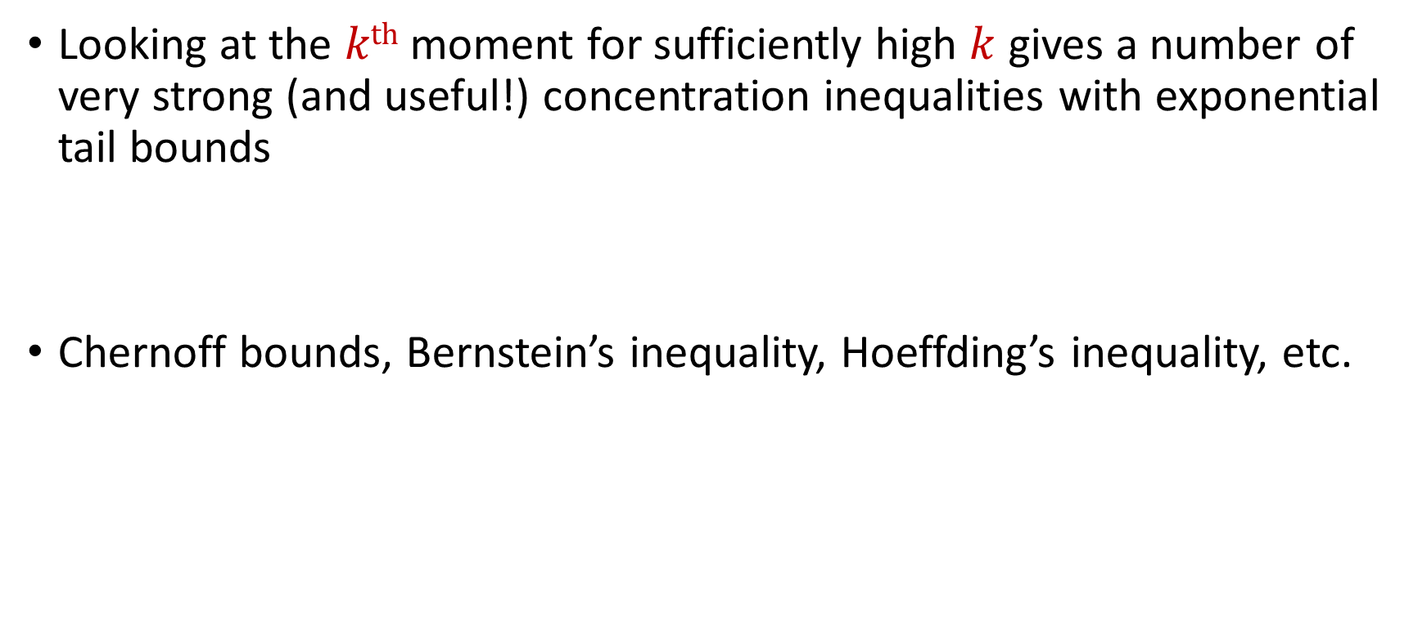
Concentration Inequalities
Looking at the $kth$ moment for sufficiently high $k$ gives a number of very strong (and useful!) concentration inequalities with exponential tail bounds
Chernoff bounds, Bernstein’s inequality, Hoeffding’s inequality, etc.

Slide 34
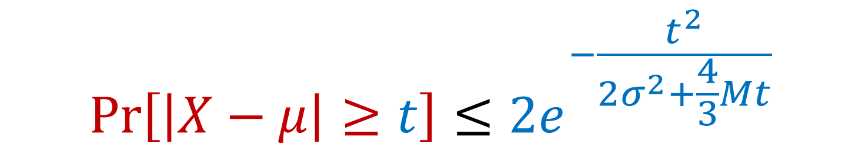

Bernstein’s Inequality
Berstein’s inequality: Let $X_{1},…,X_{n}∈[−M,M]$ be independent random variables and let ${X=X}_{1}+…+X_{n}$ have mean $μ$ and variance $σ^{2}$. Then for any $t≥0$:
$$Pr\left[\left|X−μ\right|≥t\right]≤2e^{−\frac{t^{2}}{2σ^{2}+\frac{4}{3}Mt}}$$

Slide 35


Bernstein’s Inequality
Berstein’s inequality: Let $X_{1},…,X_{n}∈[−M,M]$ be independent random variables and let ${X=X}_{1}+…+X_{n}$ have mean $μ$ and variance $σ^{2}$. Then for any $t≥0$:
Example: Suppose $M=1$ and let $t=kσ$. Then
$$Pr\left[\left|X−μ\right|≥t\right]≤2e^{−\frac{t^{2}}{2σ^{2}+\frac{4}{3}Mt}}$$
$$Pr\left[\left|X−μ\right|≥kσ\right]≤2exp\left(−\frac{k^{2}}{4}\right)$$

Slide 36



Bernstein’s Inequality
Suppose $M=1$ and let $t=kσ$. Then
Compare to Cheybshev’s inequality:
Exponential improvement!
$$Pr\left[\left|X−μ\right|≥kσ\right]≤2exp\left(−\frac{k^{2}}{4}\right)$$
$$Pr\left[\left|X−μ\right|≥kσ\right]≤\frac{1}{k^{2}}$$

Slide 37
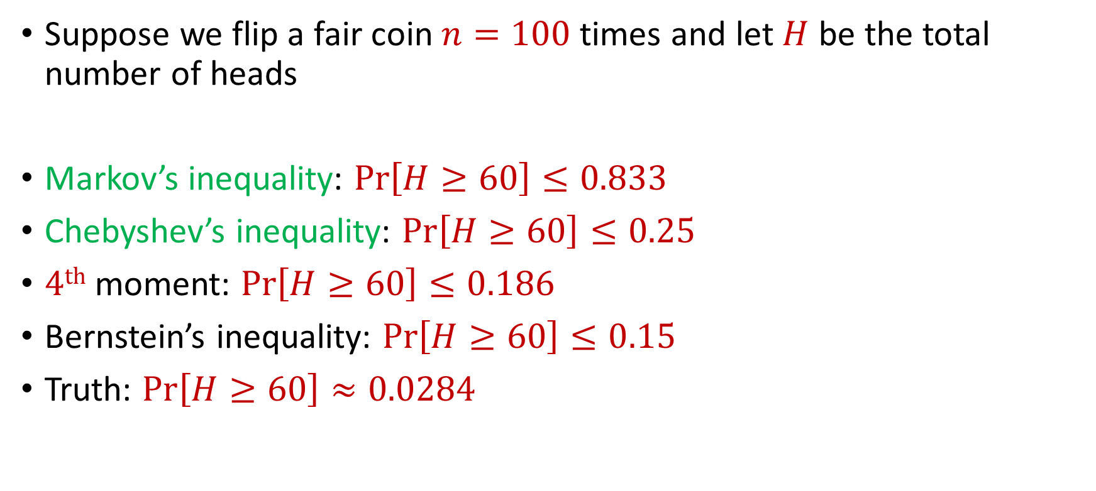
Bernstein’s Inequality
Suppose we flip a fair coin $n=100$ times and let $H$ be the total number of heads
Markov’s inequality: $Pr\left[H≥60\right]≤0.833$
Chebyshev’s inequality: $Pr\left[H≥60\right]≤0.25$
$4th$ moment: $Pr\left[H≥60\right]≤0.186$
Bernstein’s inequality: $Pr\left[H≥60\right]≤0.15$
Truth: $Pr\left[H≥60\right]≈0.0284$

Slide 38


Chernoff Bounds
Useful variant of Bernstein’s inequality when the random variables are binary
Chernoff bounds: Let $X_{1},…,X_{n}∈\{0, 1\}$ be independent random variables and let ${X=X}_{1}+…+X_{n}$ have mean $μ$. Then for any $δ≥0$:
$$Pr\left[\left|X−μ\right|≥δμ\right]≤2\exp\left(−\frac{δ^{2}μ}{2+δ}\right)$$

Slide 39




Multiplicative Error Chernoff Bounds
Chernoff bounds: Let $X_{1},…,X_{n}∈\{0, 1\}$ be independent random variables and let ${X=X}_{1}+…+X_{n}$ have mean $μ$. For $δ∈\left(0,1\right)$:
$$Pr\left[X≥\left(1+δ\right)μ\right]≤2\exp\left(−\frac{δ^{2}μ}{2+δ}\right)$$
$$Pr\left[X≤\left(1−δ\right)μ\right]≤\exp\left(−\frac{δ^{2}μ}{2}\right)$$
$$Pr\left[\left|X−μ\right|≥δμ\right]≤2\exp\left(−\frac{δ^{2}μ}{3}\right)$$

Slide 40
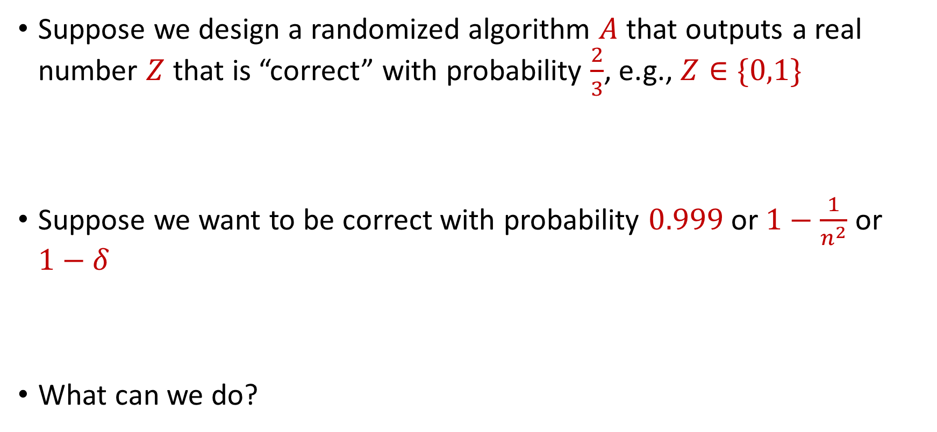
Use Case
Suppose we design a randomized algorithm $A$ that outputs a real number $Z$ that is “correct” with probability $\frac{2}{3}$, e.g., $Z∈\{0,1\}$
Suppose we want to be correct with probability $0.999$ or $1−\frac{1}{n^{2}}$ or $1−δ$
What can we do?

Slide 41

Success Boosting
Chernoff bounds: Run the algorithm $A$ a total of $O\left(\log{\frac{1}{δ}}\right)$ times and take the median. It will be correct with probability $1−δ$

Slide 42

Median-of-Means Framework
Suppose we design a randomized algorithm $A$ to estimate a hidden statistic $Z$ of a dataset and we know $0<Z≤1000$.
Suppose each time we use the algorithm $A$, it outputs a number $X$ such that $E\left[X\right]=Z$ and $Var\left[X\right]=100Z^{2}$
Suppose we want to estimate $Z$ to accuracy $ε$, with probability $1−δ$

Slide 43
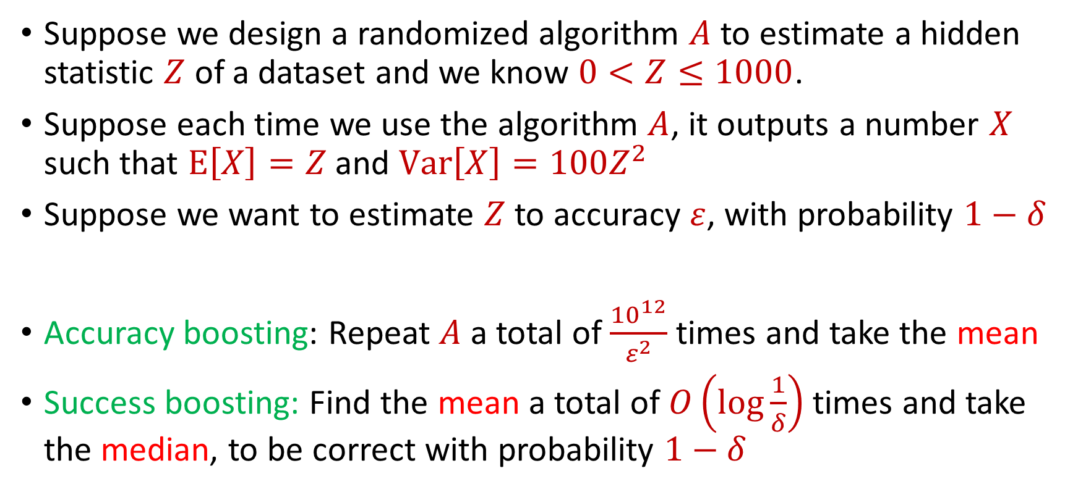
Median-of-Means Framework
Suppose we design a randomized algorithm $A$ to estimate a hidden statistic $Z$ of a dataset and we know $0<Z≤1000$.
Suppose each time we use the algorithm $A$, it outputs a number $X$ such that $E\left[X\right]=Z$ and $Var\left[X\right]=100Z^{2}$
Suppose we want to estimate $Z$ to accuracy $ε$, with probability $1−δ$
Accuracy boosting: Repeat $A$ a total of $\frac{{10}^{12}}{ε^{2}}$ times and take the mean
Success boosting: Find the mean a total of $O\left(\log{\frac{1}{δ}}\right)$ times and take the median, to be correct with probability $1−δ$

Slide 44
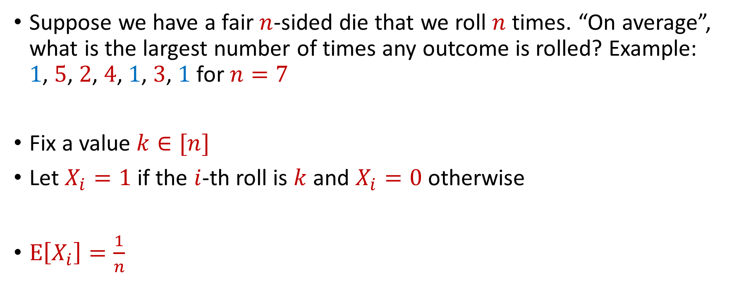
Max Load
Suppose we have a fair $n$-sided die that we roll $n$ times. “On average”, what is the largest number of times any outcome is rolled? Example: $1$, $5$, $2$, $4$, $1$, $3$, $1$ for $n=7$
Fix a value $k∈[n]$
Let $X_{i}=1$ if the $i$-th roll is $k$ and $X_{i}=0$ otherwise
$E\left[X_{i}\right]=\frac{1}{n}$

Slide 45


Max Load
The total number of rolls with value $k$ is $X=X_{1}+…+X_{n}$
$E\left[X\right]=1$
Recall Chernoff bounds:
$Pr\left[X≥3 log{n}\right]≤\frac{1}{n^{2}}$
$$Pr\left[X≥\left(1+δ\right)μ\right]≤2\exp\left(−\frac{δ^{2}μ}{2+δ}\right)$$

Slide 46
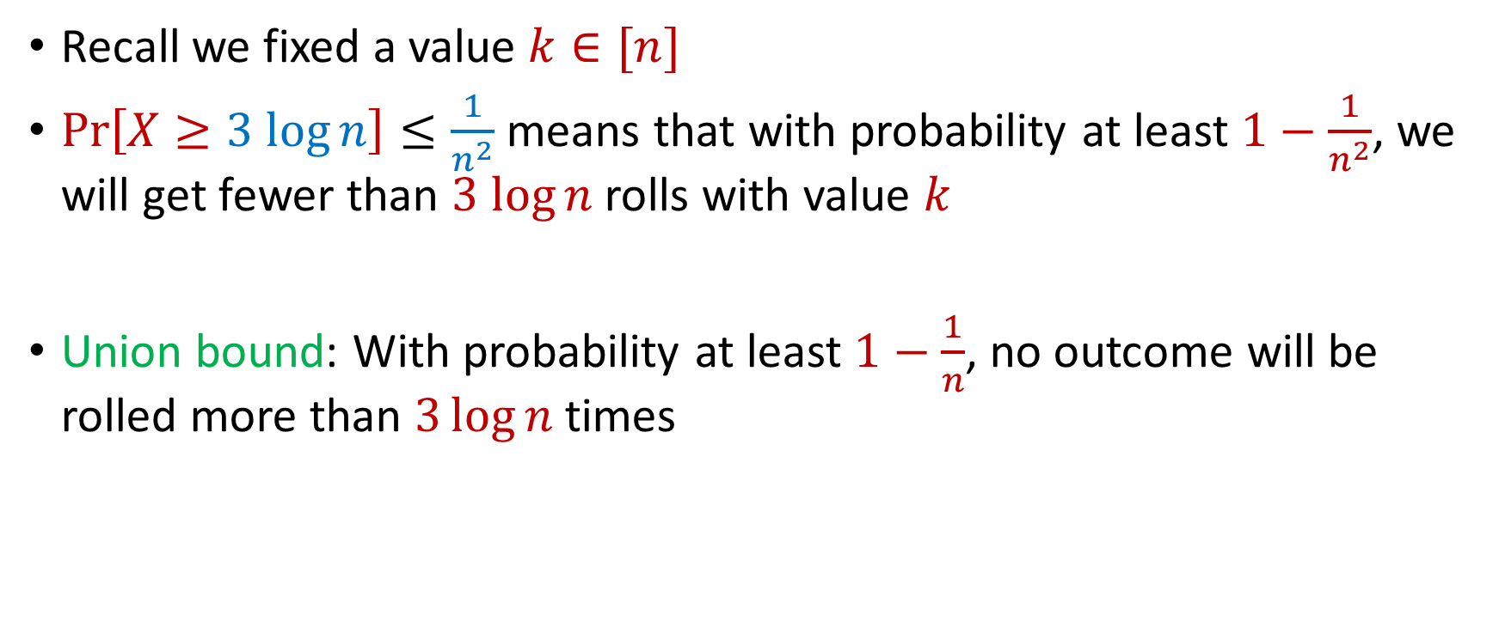
Max Load
Recall we fixed a value $k∈[n]$
$Pr\left[X≥3 log{n}\right]≤\frac{1}{n^{2}}$ means that with probability at least $1−\frac{1}{n^{2}}$, we will get fewer than $3 log{n}$ rolls with value $k$
Union bound: With probability at least $1−\frac{1}{n}$, no outcome will be rolled more than $3\log{n}$ times

Slide 47
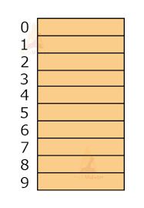

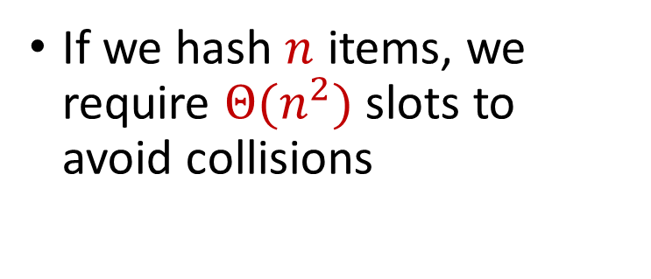
Hashing
Suppose we have a number of files, how do we consistently store them in memory?
$$h\left(x\right)$$
Wenjing Chen
If we hash $n$ items, we require $Θ(n^{2})$ slots to avoid collisions
Chunkai Fu
Ayesha Qamar
Shima Salehi
David Xiang
Shuo Xing

Slide 48

Dealing with Collisions
Suppose we store multiple items in the same location as a linked list
If the maximum number of collisions in a location is $c$, then could traverse a linked list of size $c$ for a query
Query runtime: $O(c)$
$$h(Matthew Chang)$$
$$Jung Seo$$
Matthew Chang

Slide 49
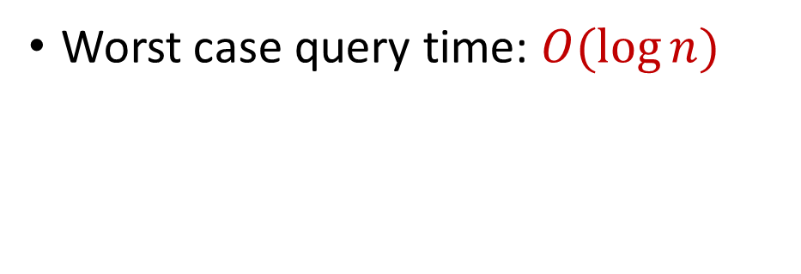


Collisions and Max Load
With probability at least $1−\frac{1}{n}$, no outcome will be rolled more than $3\log{n}$ times
Worst case query time: $O(\log{n})$
$$Jung Seo$$
Matthew Chang

Slide 50

Hashing
For $O(1)$ query time, use $Θ(n^{2})$ slots to avoid collisions
For $O(\log{n})$ query time, use $Θ(n)$ slots with linked lists
$$h\left(x\right)$$
Wenjing Chen
Chunkai Fu
Ayesha Qamar
Shima Salehi
David Xiang
Shuo Xing

