Slide 1
CSCE 689: Special Topics in Modern Algorithms for Data Science
Lecture 19
Samson Zhou

Slide 2
Presentation Schedule
November 27: Chunkai, Jung, Galaxy AI
November 29: STMI, Anmol, Jason
December 1: Bokun, Team DAP

Slide 3
Previously in the Streaming Model
Reservoir sampling
Heavy-hitters
Misra-Gries
CountMin
CountSketch
Moment estimation
AMS algorithm
Sparse recovery
Distinct elements estimation

Slide 4

Reservoir Sampling
Suppose we see a stream of elements from $[n]$. How do we uniformly sample one of the positions of the stream?
47 72 81 10 14 33 51 29 54 9 36 46 10

Slide 5
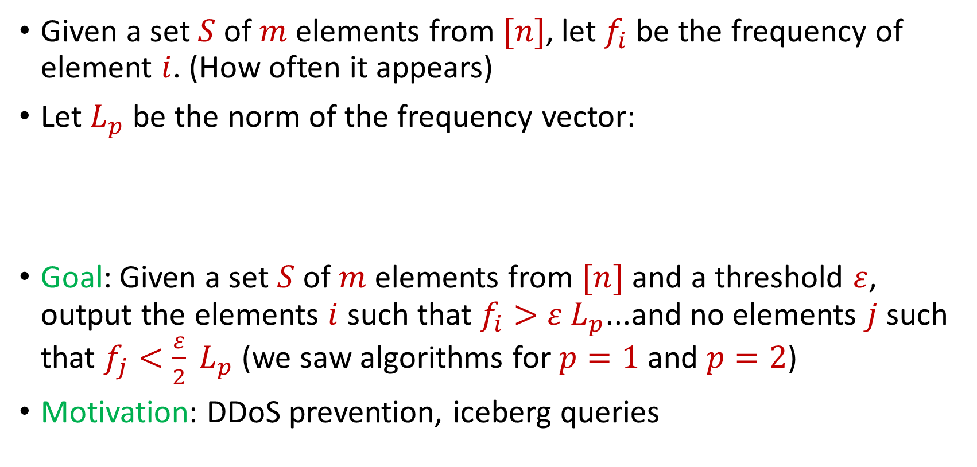

Heavy-Hitters (Frequent Items)
Given a set $S$ of $m$ elements from $[n]$, let $f_{i}$ be the frequency of element $i$. (How often it appears)
Let $L_{p}$ be the norm of the frequency vector:
Goal: Given a set $S$ of $m$ elements from $[n]$ and a threshold $ε$, output the elements $i$ such that $f_{i}>$ $ε L_{p}$...and no elements $j$ such that $f_{j}<$ $\frac{ε}{2} L_{p}$ (we saw algorithms for $p=1$ and $p=2$)
Motivation: DDoS prevention, iceberg queries
$$L_{p}={\left(f_{1}^{p}+f_{2}^{p}+…+f_{n}^{p}\right)}^{1/p}$$

Slide 6
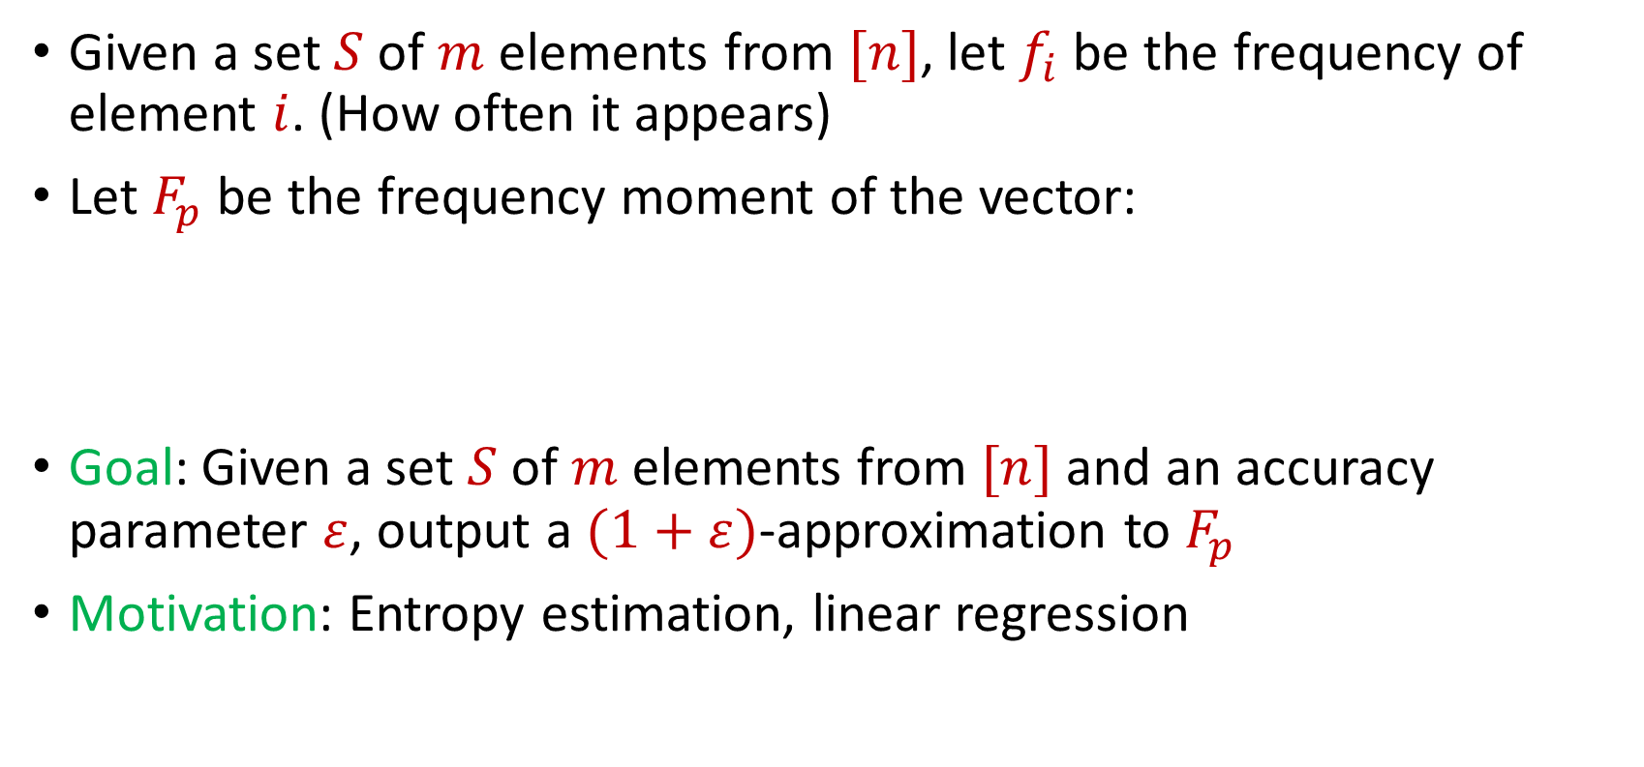

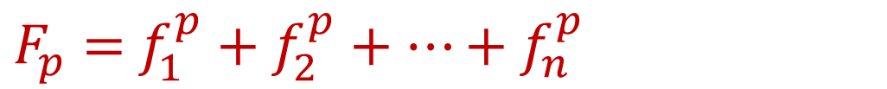
Frequency Moments ($L_{p}$ Norm)
Given a set $S$ of $m$ elements from $[n]$, let $f_{i}$ be the frequency of element $i$. (How often it appears)
Let $F_{p}$ be the frequency moment of the vector:
Goal: Given a set $S$ of $m$ elements from $[n]$ and an accuracy parameter $ε$, output a $(1+ε)$-approximation to $F_{p}$
Motivation: Entropy estimation, linear regression
$F_{p}=$ $f_{1}^{p}+f_{2}^{p}+…+f_{n}^{p}$

Slide 7
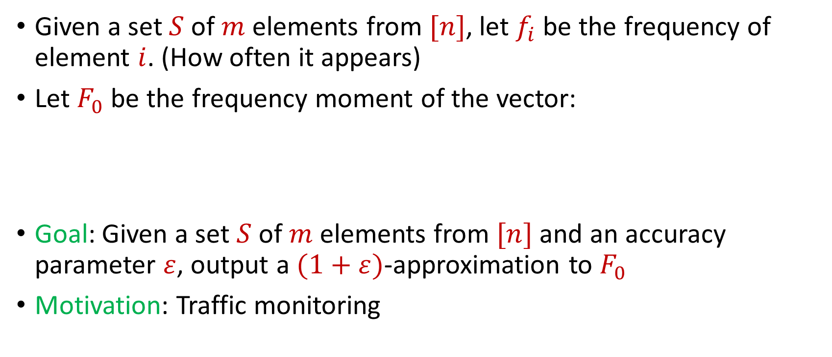

Distinct Elements ($F_{0}$ Estimation)
Given a set $S$ of $m$ elements from $[n]$, let $f_{i}$ be the frequency of element $i$. (How often it appears)
Let $F_{0}$ be the frequency moment of the vector:
Goal: Given a set $S$ of $m$ elements from $[n]$ and an accuracy parameter $ε$, output a $(1+ε)$-approximation to $F_{0}$
Motivation: Traffic monitoring
$F_{0}=$ $|\{i :f_{i}≠0\}|$

Slide 8

Sparse Recovery
Suppose we have an insertion-deletion stream of length $m=Θ\left(n\right)$ and at the end we are promised there are at most $k$ nonzero coordinates
Goal: Recover the $k$ nonzero coordinates and their frequencies

Slide 9
The Streaming Model
So far, all questions have been statistical
What other questions can be asked? (Think in general, outside of the streaming model)

Slide 10
The Streaming Model
So far, all questions have been statistical
What other questions can be asked? (Think in general, outside of the streaming model)
Algebraic, geometric

Slide 11
The Streaming Model
So far, all questions have been statistical
What other questions can be asked? (Think in general, outside of the streaming model)
Algebraic, geometric
TODAY

Slide 12
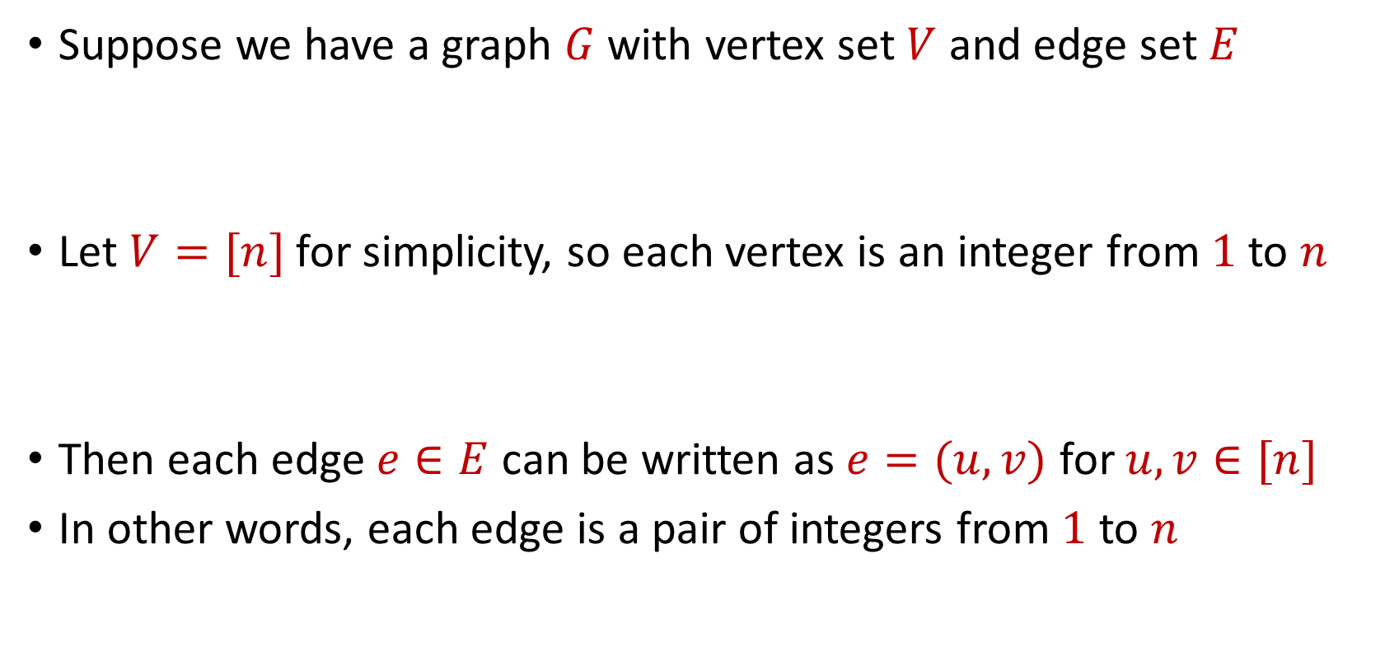
Graph Theory
Suppose we have a graph $G$ with vertex set $V$ and edge set $E$
Let $V=[n]$ for simplicity, so each vertex is an integer from $1$ to $n$
Then each edge $e∈E$ can be written as $e=(u,v)$ for $u,v∈[n]$
In other words, each edge is a pair of integers from $1$ to $n$

Slide 13
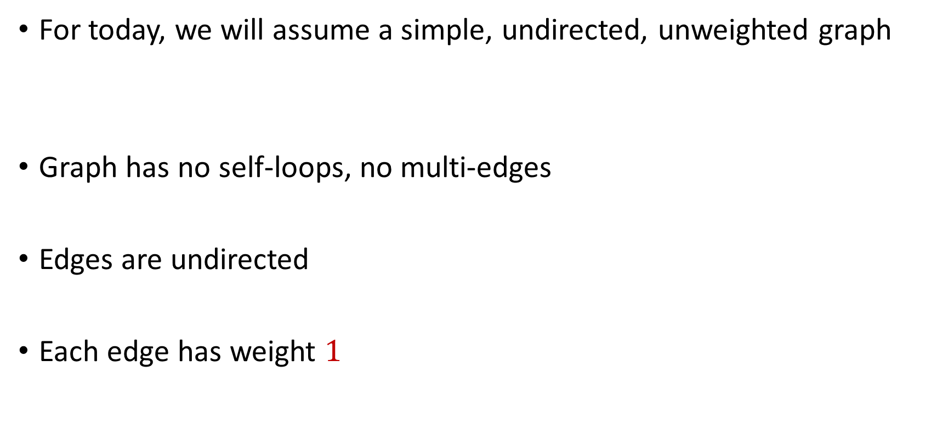
Graph Theory
For today, we will assume a simple, undirected, unweighted graph
Graph has no self-loops, no multi-edges
Edges are undirected
Each edge has weight $1$

Slide 14






$$1$$
$$2$$
$$5$$
$$6$$
$$4$$
$$3$$

Slide 15

Matchings
A matching $M$ is a subset of edges of $E$ such that no two edges share a common vertex

Slide 16
$$1$$
$$2$$
$$5$$
$$6$$
$$4$$
$$3$$

Slide 17
$$1$$
$$2$$
$$5$$
$$6$$
$$4$$
$$3$$

Slide 18

Maximal Matching
A matching $M$ of $G$ such that any additional edges would no longer be a matching

Slide 19
$$1$$
$$2$$
$$5$$
$$6$$
$$4$$
$$3$$

Slide 20

Maximum Matching
Find a matching $M$ of $G$ with the largest possible number of edges

Slide 21
$$1$$
$$2$$
$$5$$
$$6$$
$$4$$
$$3$$

Slide 22
$$1$$
$$2$$
$$5$$
$$6$$
$$4$$
$$3$$

Slide 23
Maximum Matching
How to find maximum matching?
An augmenting path is any path of edges that does not start and does not end at a vertex in the matching
“Flipping” all the edges in an augmenting path increases the matching size

Slide 24
$$1$$
$$2$$
$$5$$
$$6$$
$$4$$
$$3$$

Slide 25
$$1$$
$$2$$
$$5$$
$$6$$
$$4$$
$$3$$

Slide 26
$$1$$
$$2$$
$$5$$
$$6$$
$$4$$
$$3$$

Slide 27
Maximum Matching
It turns out repeatedly finding augmenting paths is sufficient for finding a maximum matching
Formally: If a matching is not a maximum matching, there exists an augmenting path to the matching
Algorithms by Hopcroft and Karp (1973) and Edmonds (1965) for finding augmenting paths – can be done in polynomial time

Slide 28
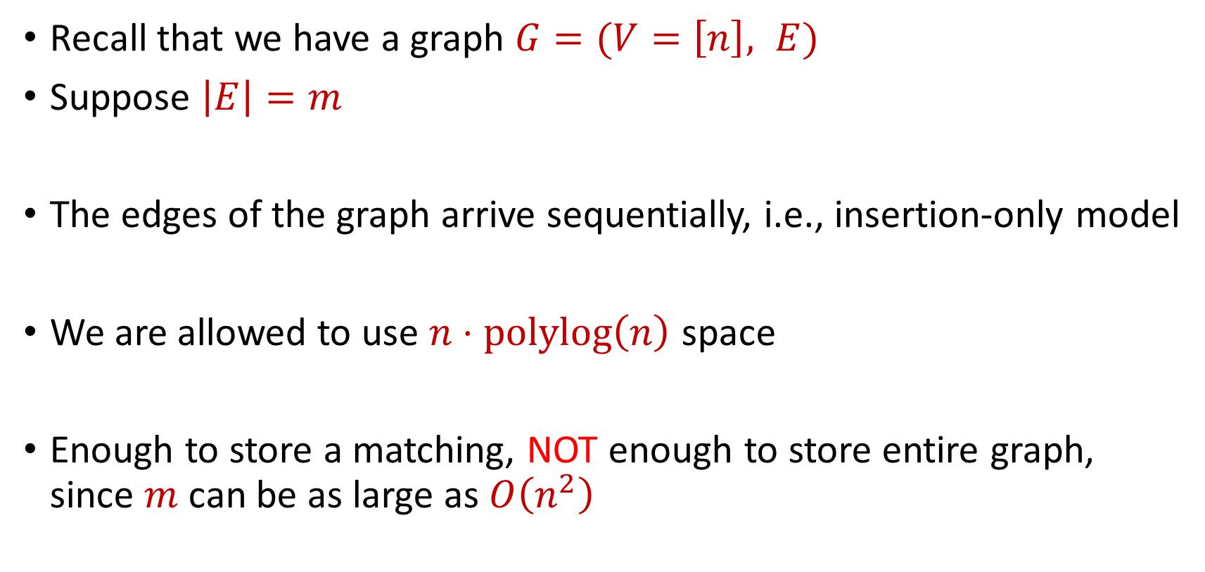
Semi-streaming Model
Recall that we have a graph $G=(V=\left[n\right], E)$
Suppose $\left|E\right|=m$
The edges of the graph arrive sequentially, i.e., insertion-only model
We are allowed to use $n⋅polylog\left(n\right)$ space
Enough to store a matching, NOT enough to store entire graph, since $m$ can be as large as $O\left(n^{2}\right)$

Slide 29
Semi-streaming Model
Can we run the augmenting paths algorithm?

Slide 30
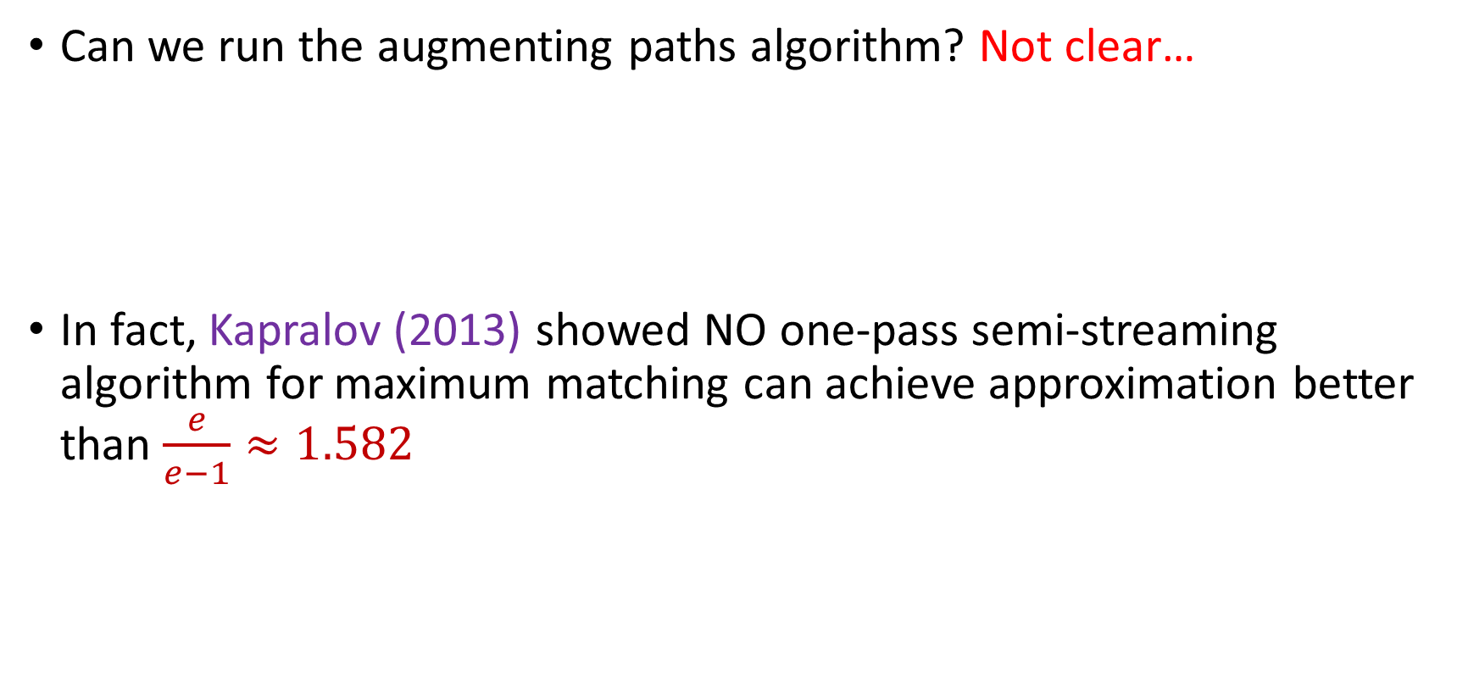
Semi-streaming Model
Can we run the augmenting paths algorithm? Not clear…
In fact, Kapralov (2013) showed NO one-pass semi-streaming algorithm for maximum matching can achieve approximation better than $\frac{e}{e−1}≈1.582$

Slide 31
Maximal Matching
What if we just wanted to find a maximal matching?

Slide 32

Maximal Matching
What if we just wanted to find a maximal matching?
Greedy algorithm: Add each unmatched edge $e$in the stream to the matching $M$

Slide 33
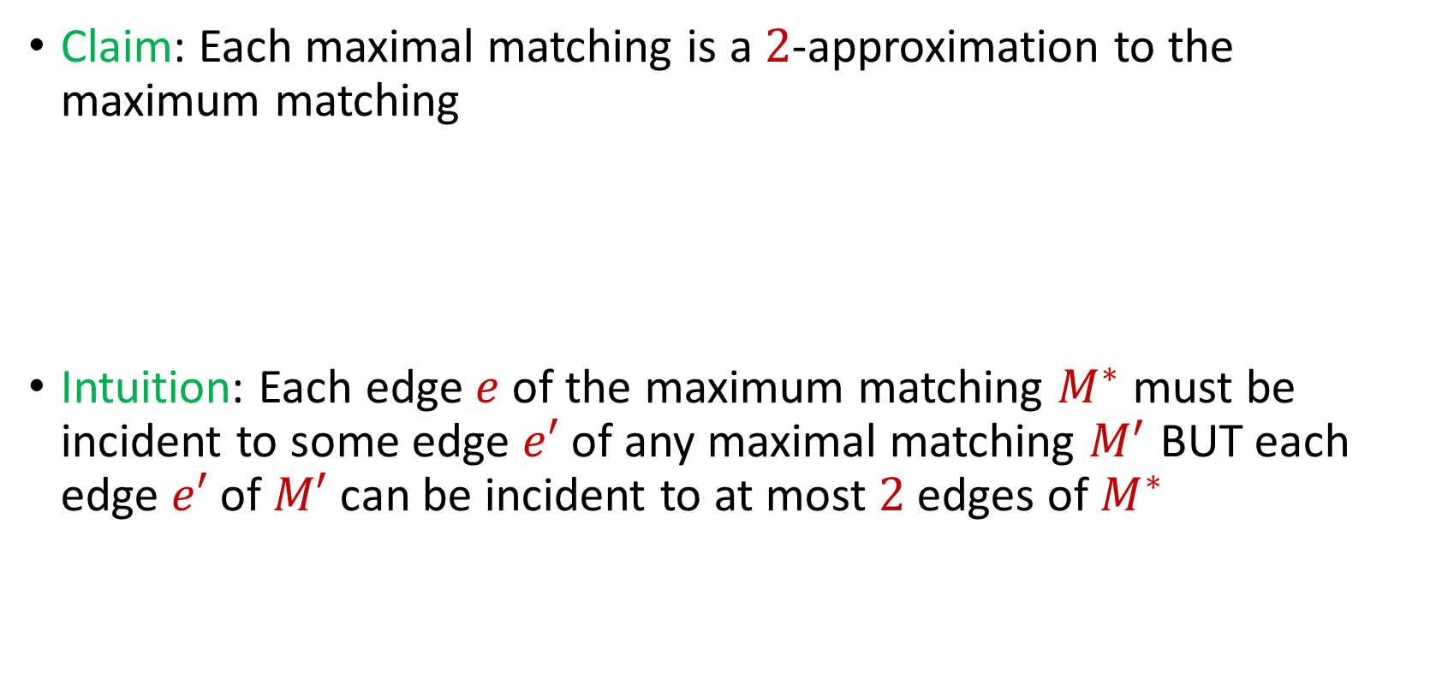
Maximal Matching
Claim: Each maximal matching is a $2$-approximation to the maximum matching
Intuition: Each edge $e$ of the maximum matching $M^{∗}$ must be incident to some edge $e′$ of any maximal matching $M^{′}$ BUT each edge $e′$ of $M′$ can be incident to at most $2$ edges of $M^{∗}$

Slide 34
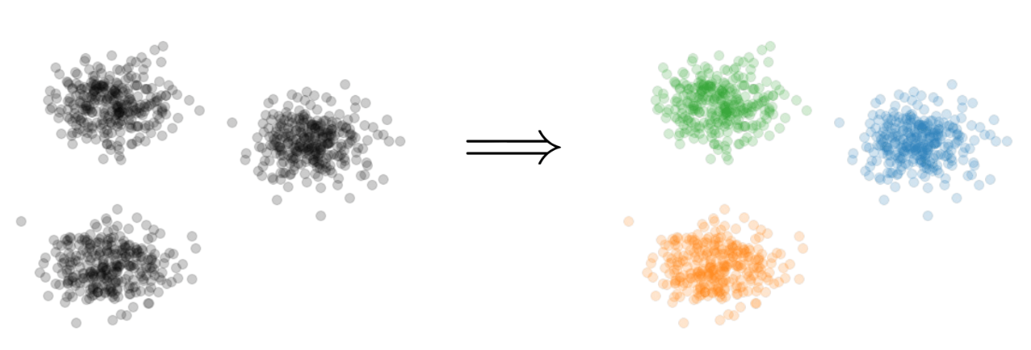

Clustering
Goal: Given input dataset $P$, partition $P$ so that “similar” points are in the same cluster and “different” points are in different clusters

Slide 35


$k$-Clustering
Goal: Given input dataset $P$, partition $P$ so that “similar” points are in the same cluster and “different” points are in different clusters
There can be at most $k$ different clusters
$$k=3$$

Slide 36
$k$-Clustering
Question: How do we measure the “quality” of each clustering?
$$k=3$$

Slide 37
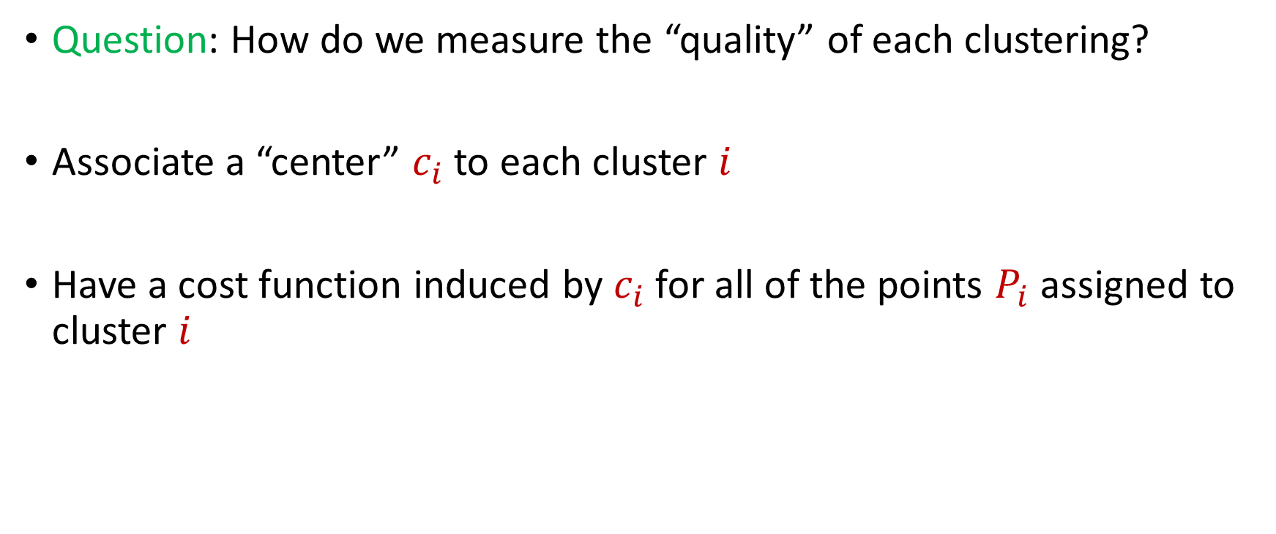
$k$-Clustering
Question: How do we measure the “quality” of each clustering?
Associate a “center” $c_{i}$ to each cluster $i$
Have a cost function induced by $c_{i}$ for all of the points $P_{i}$ assigned to cluster $i$
$$Cost\left(P_{i}, c_{i}\right)$$

Slide 40





1 0 3 0 1 1
1 1 0 0 2 8
2 0 1 3 0 8
1 1 0 0 0 8
0 0 0 7 0 0
7 0 0 8 0 0
3 4 1 1 0 2
4 2 0 1 0 1
9 1 0 0 3 2
1 1 6 0 0 0
8 1 0 1 2 0
1
1
2
1
0
7
3
4
9
1
8
$$n$$
$$A$$
$$b$$
$$d$$
$$1$$

Slide 41




$$x$$
$$n$$
$$A$$
$$≈$$
$$b$$
$$d$$
$$1$$

Slide 42




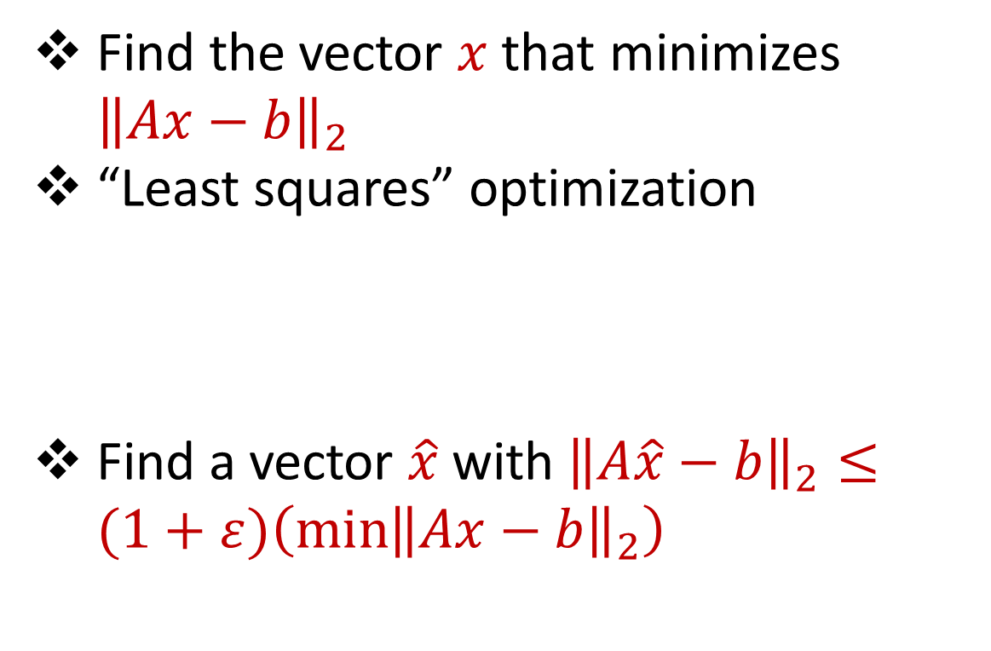






Linear Regression
Find the vector $x$ that minimizes ${\left\|Ax−b\right\|}_{2}$
“Least squares” optimization
Find a vector $\hat{x}$ with ${\left\|A\hat{x}−b\right\|}_{2}≤(1+ε)\left(\min{{\left\|Ax−b\right\|}_{2}}\right)$
$$d$$
$$x$$
$$≈$$
$$n$$
$$A$$
$$n$$
$$b$$
$$1$$
$$d$$
$$1$$

Slide 43




Dimensionality Reduction
Reduce $d$
Reduce $n$
Application depends on task!
Sampling, Sketching, Johnson-Lindenstrauss, IsoMap
$$n$$
$$A$$
Sampling, Sketching
$$d$$

Slide 44


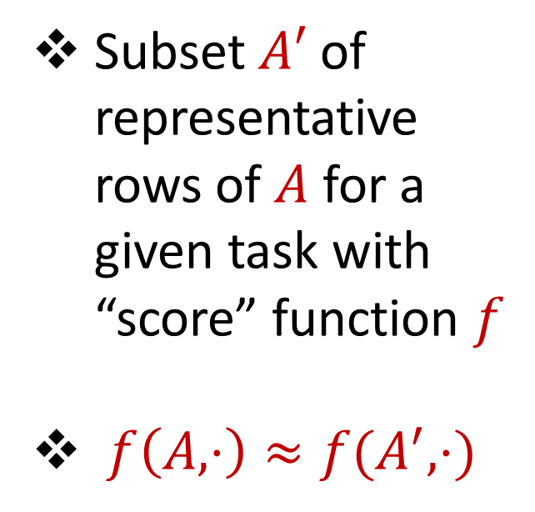



Coreset
Subset $A′$ of representative rows of $A$ for a given task with “score” function $f$
$f\left(A,⋅\right)≈f(A^{′},⋅)$
$$n$$
$$A$$
$$A′$$
$$d$$
$$d$$

Slide 45
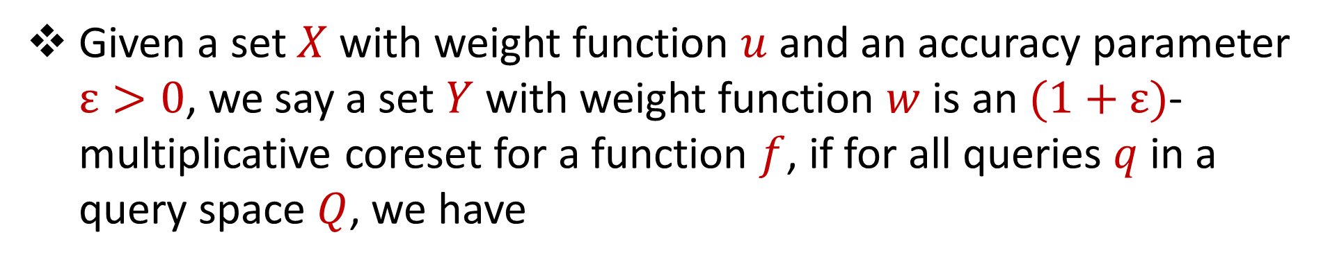
Coreset (Formal Definition)
Given a set $X$ with weight function $u$ and an accuracy parameter $ε>0$, we say a set $Y$ with weight function $w$is an $(1+ε)$-multiplicative coreset for a function $f$, if for all queries $q$ in a query space $Q$, we have
$$\left(1−ε\right)f\left(Y,q,w\right)≤f\left(X,q,u\right)≤\left(1+ε\right)f(Y,q,w)$$

Slide 46
Coreset
Lots of different constructions with various tradeoffs
Size vs. accuracy
Size vs. computation time
Size vs. interpretability
Average-case vs. worst-case performance

Slide 47
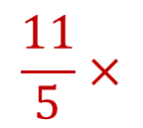
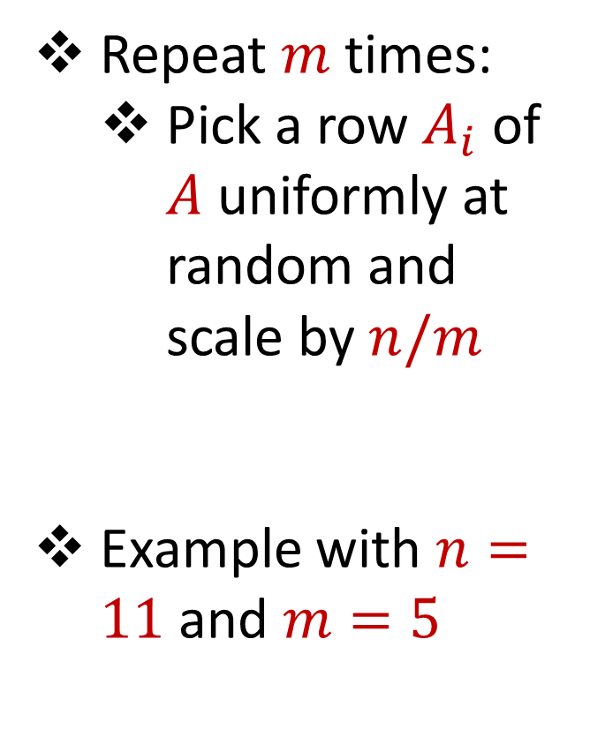
Uniform Sampling
1 0 3 0 1 1
1 1 0 0 2 8
2 0 1 3 0 8
1 1 0 0 0 8
0 0 0 7 0 0
7 0 0 8 0 0
3 4 1 1 0 2
4 2 0 1 0 1
9 1 0 0 3 2
1 1 6 0 0 0
8 1 0 1 2 0
Repeat $m$ times:
Pick a row $A_{i}$ of $A$ uniformly at random and scale by $n/m$
Example with $n=11$ and $m=5$
$$n$$
$$A$$
1 0 3 0 1 1
1 1 0 0 0 8
3 4 1 1 0 2
8 1 0 1 2 0
3 4 1 1 0 2
$$\frac{11}{5}×$$
$$A′$$
$$d$$
$$d$$

Slide 48

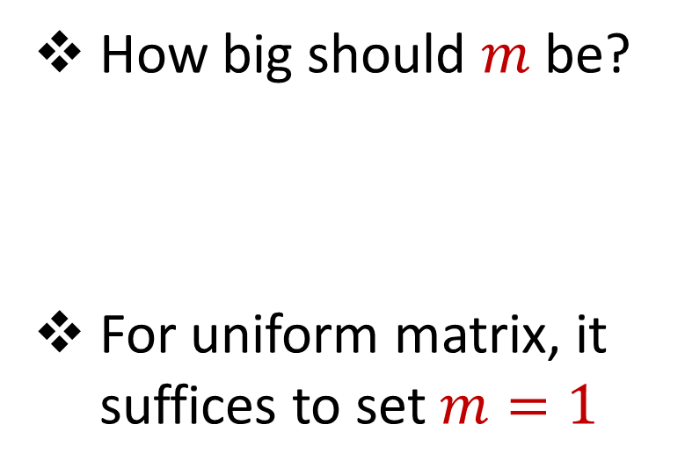


Uniform Sampling
1 0 0 0 0 0
1 0 0 0 0 0
1 0 0 0 0 0
1 0 0 0 0 0
1 0 0 0 0 0
1 0 0 0 0 0
1 0 0 0 0 0
1 0 0 0 0 0
1 0 0 0 0 0
1 0 0 0 0 0
1 0 0 0 0 0
How big should $m$ be?
For uniform matrix, it suffices to set $m=1$
$$n$$
$$A$$
$$d$$

Slide 49
Uniform Sampling
1 0 0 0 0 0
1 0 0 0 0 0
1 0 0 0 0 0
1 0 0 0 0 0
1 0 0 0 0 0
1 0 0 0 0 0
1 0 0 0 0 0
1 0 0 0 0 0
1 0 0 0 0 0
1 0 0 0 0 0
1 0 0 0 0 0
How big should $m$ be?
For uniform matrix, it suffices to set $m=1$
$$n$$
$$A$$
1 0 0 0 0 0
1 0 0 0 0 0
1 0 0 0 0 0
1 0 0 0 0 0
1 0 0 0 0 0
$$\frac{11}{5}×$$
$$A′$$
$$d$$
$$d$$

Slide 50
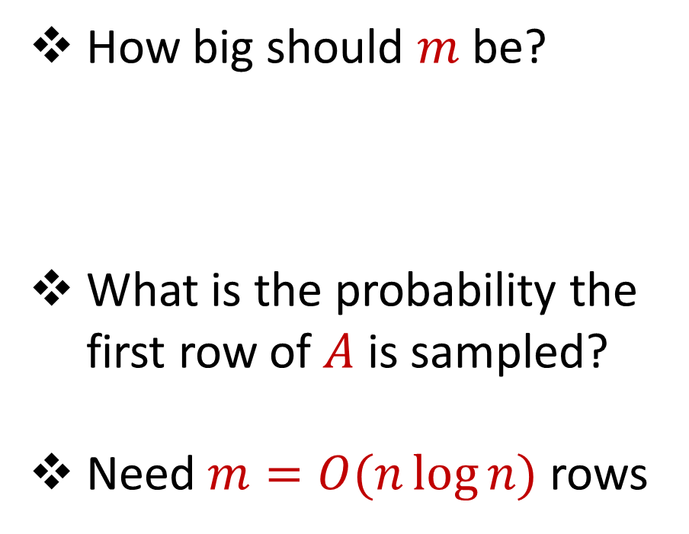
Uniform Sampling
0 0 0 0 0 1
1 0 0 0 0 0
1 0 0 0 0 0
1 0 0 0 0 0
1 0 0 0 0 0
1 0 0 0 0 0
1 0 0 0 0 0
1 0 0 0 0 0
1 0 0 0 0 0
1 0 0 0 0 0
1 0 0 0 0 0
How big should $m$ be?
What is the probability the first row of $A$ is sampled?
Need $m=O(n\log{n})$ rows
$$n$$
$$A$$
$$d$$

Slide 51
Uniform Sampling
Pros: intuitively simple, simple to implement, fast, good on uniform or “average-case” data
Cons: bad on “worst-case” data

Slide 52
Importance Sampling
1 0 0 0 0 0
1 0 0 0 0 0
1 0 0 0 0 0
1 0 0 0 0 0
1 0 0 0 0 0
1 0 0 0 0 0
0 0 0 0 0 1
1 0 0 0 0 0
1 0 0 0 0 0
1 0 0 0 0 0
1 0 0 0 0 0
What if we do not sample uniformly at random?
What is the probability that each row should be sampled?
$$n$$
$$A$$

Slide 53
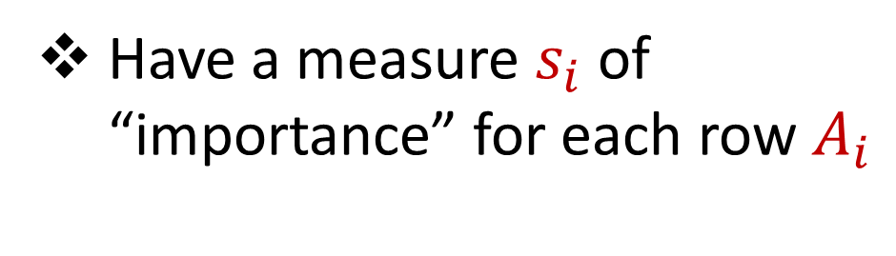
Importance Sampling
1 0 0 0 0 0
1 0 0 0 0 0
1 0 0 0 0 0
1 0 0 0 0 0
1 0 0 0 0 0
1 0 0 0 0 0
0 0 0 0 0 1
1 0 0 0 0 0
1 0 0 0 0 0
1 0 0 0 0 0
1 0 0 0 0 0
Have a measure $s_{i}$ of “importance” for each row $A_{i}$
$$n$$
$$A$$

Slide 54

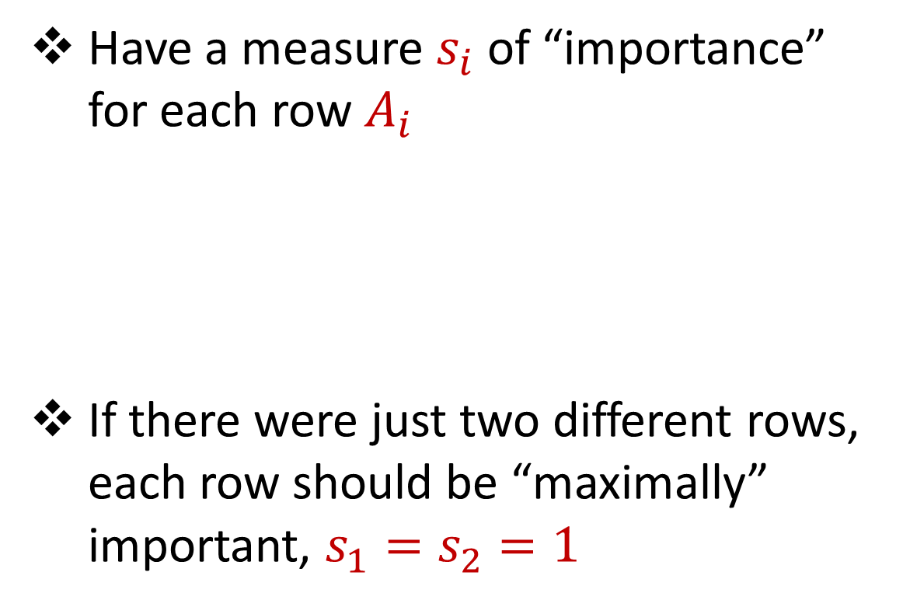



Importance Sampling
1 0 0 0 0 0
1 0 0 0 0 0
1 0 0 0 0 0
1 0 0 0 0 0
1 0 0 0 0 0
1 0 0 0 0 0
0 0 0 0 0 1
1 0 0 0 0 0
1 0 0 0 0 0
1 0 0 0 0 0
1 0 0 0 0 0
Have a measure $s_{i}$ of “importance” for each row $A_{i}$
If there were just two different rows, each row should be “maximally” important, $s_{1}=s_{2}=1$
$$n$$
$$A$$
1 0 0 0 0 0
0 0 0 0 0 1
$$n$$
$$A$$

Slide 55
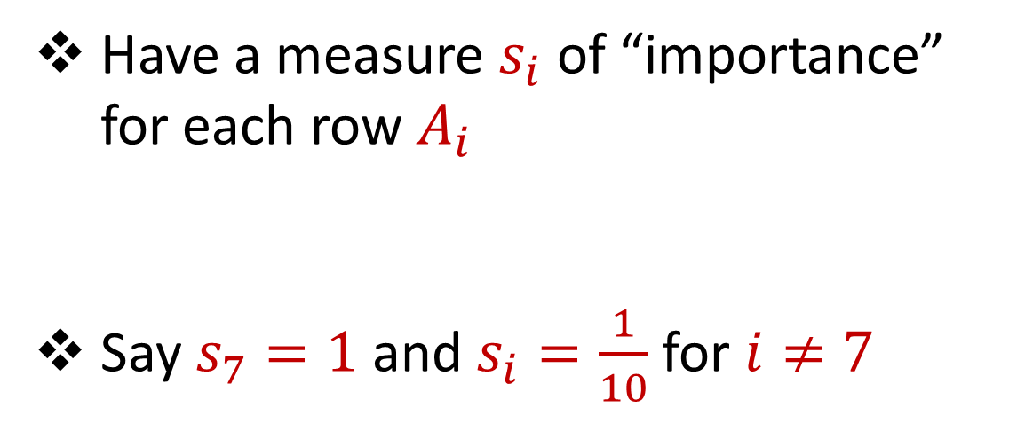
Importance Sampling
1 0 0 0 0 0
1 0 0 0 0 0
1 0 0 0 0 0
1 0 0 0 0 0
1 0 0 0 0 0
1 0 0 0 0 0
0 0 0 0 0 1
1 0 0 0 0 0
1 0 0 0 0 0
1 0 0 0 0 0
1 0 0 0 0 0
Have a measure $s_{i}$ of “importance” for each row $A_{i}$
Say $s_{7}=1$ and $s_{i}=\frac{1}{10}$ for $i≠7$
$$n$$
$$A$$

Slide 56
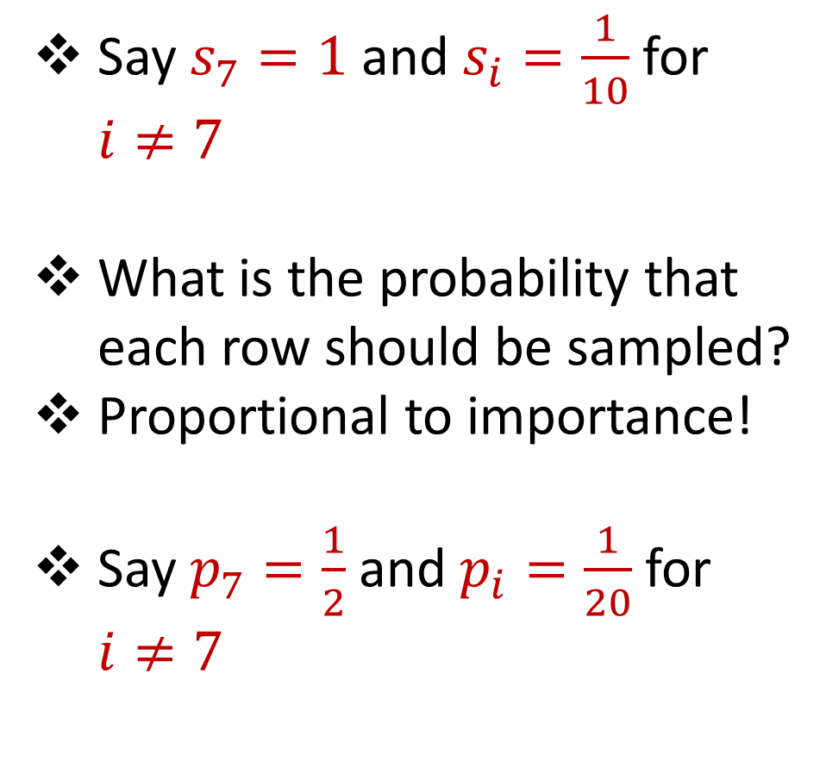
Importance Sampling
1 0 0 0 0 0
1 0 0 0 0 0
1 0 0 0 0 0
1 0 0 0 0 0
1 0 0 0 0 0
1 0 0 0 0 0
0 0 0 0 0 1
1 0 0 0 0 0
1 0 0 0 0 0
1 0 0 0 0 0
1 0 0 0 0 0
Say $s_{7}=1$ and $s_{i}=\frac{1}{10}$ for $i≠7$
What is the probability that each row should be sampled?
Proportional to importance!
Say $p_{7}=\frac{1}{2}$ and $p_{i}=\frac{1}{20}$ for $i≠7$
$$n$$
$$A$$

Slide 57
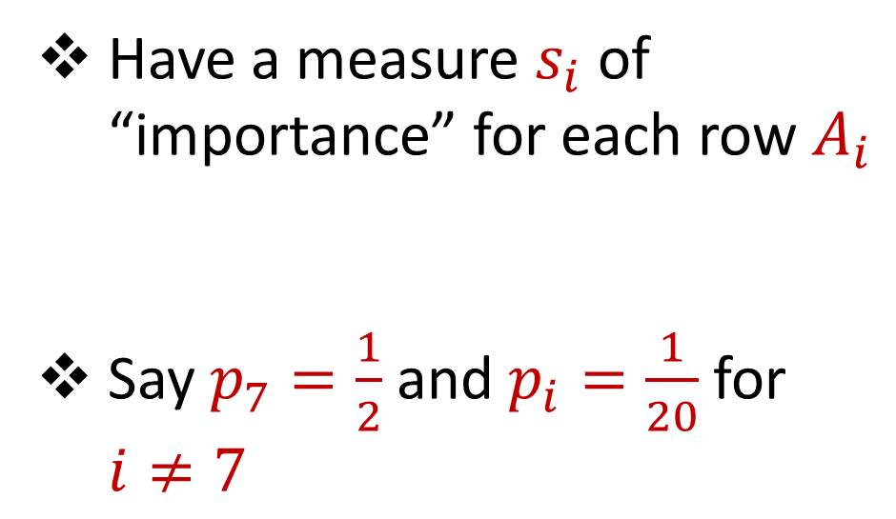
Importance Sampling
1 0 0 0 0 0
1 0 0 0 0 0
1 0 0 0 0 0
1 0 0 0 0 0
1 0 0 0 0 0
1 0 0 0 0 0
0 0 0 0 0 1
1 0 0 0 0 0
1 0 0 0 0 0
1 0 0 0 0 0
1 0 0 0 0 0
Have a measure $s_{i}$ of “importance” for each row $A_{i}$
Say $p_{7}=\frac{1}{2}$ and $p_{i}=\frac{1}{20}$ for $i≠7$
$$n$$
$$A$$

Slide 58

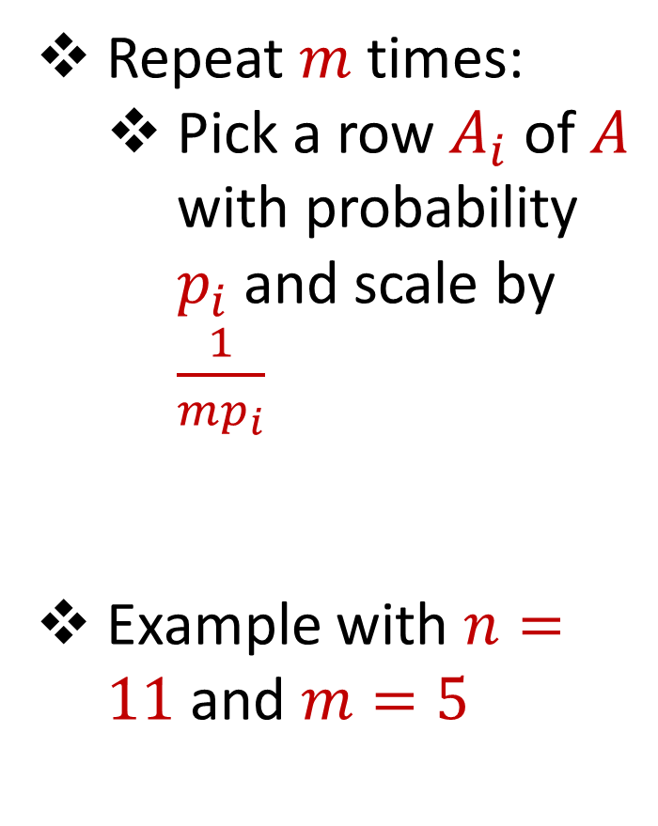

Importance Sampling
1 0 0 0 0 0
1 0 0 0 0 0
1 0 0 0 0 0
1 0 0 0 0 0
1 0 0 0 0 0
1 0 0 0 0 0
0 0 0 0 0 1
1 0 0 0 0 0
1 0 0 0 0 0
1 0 0 0 0 0
1 0 0 0 0 0
Repeat $m$ times:
Pick a row $A_{i}$ of $A$ with probability $p_{i}$and scale by $\frac{1}{mp_{i}}$
Example with $n=11$ and $m=5$
$$n$$
$$A$$
4 0 0 0 0 0
4 0 0 0 0 0
0 0 0 0 0 $\frac{2}{5}$
4 0 0 0 0 0
0 0 0 0 0 $\frac{2}{5}$
$$A′$$
$$d$$
$$d$$

Slide 59
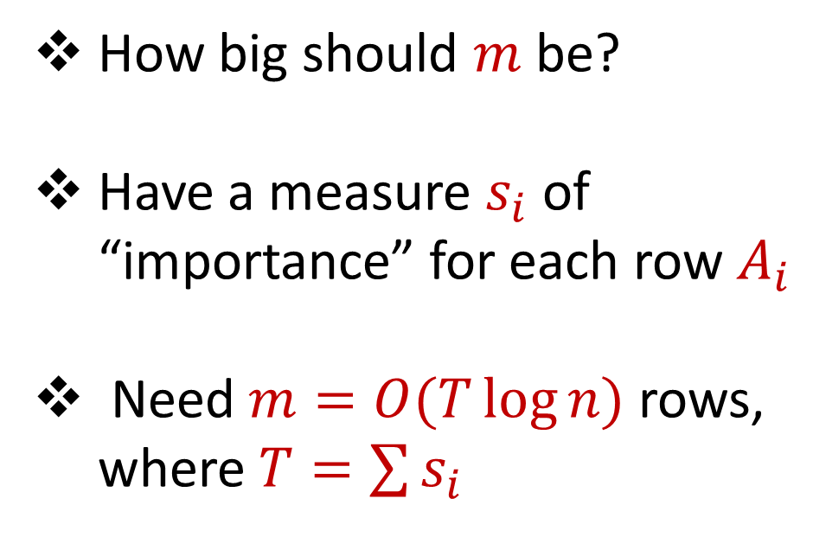
Importance Sampling
0 0 0 0 0 1
1 0 0 0 0 0
1 0 0 0 0 0
1 0 0 0 0 0
1 0 0 0 0 0
1 0 0 0 0 0
1 0 0 0 0 0
1 0 0 0 0 0
1 0 0 0 0 0
1 0 0 0 0 0
1 0 0 0 0 0
How big should $m$ be?
Have a measure $s_{i}$ of “importance” for each row $A_{i}$
Need $m=O(T\log{n})$ rows, where $T=\sum{s_{i}}$
$$n$$
$$A$$
$$d$$

Slide 60
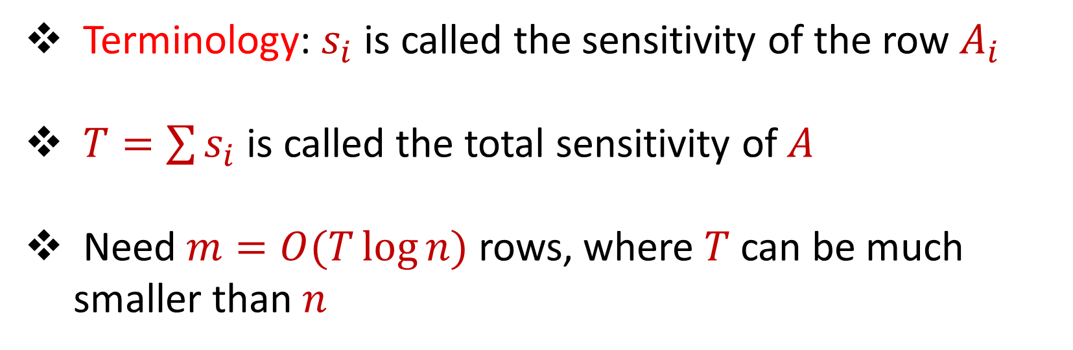
Sensitivity Sampling
Terminology: $s_{i}$ is called the sensitivity of the row $A_{i}$
$T=\sum{s_{i}}$ is called the total sensitivity of $A$
Need $m=O(T\log{n})$ rows, where $T$ can be much smaller than $n$

Slide 61

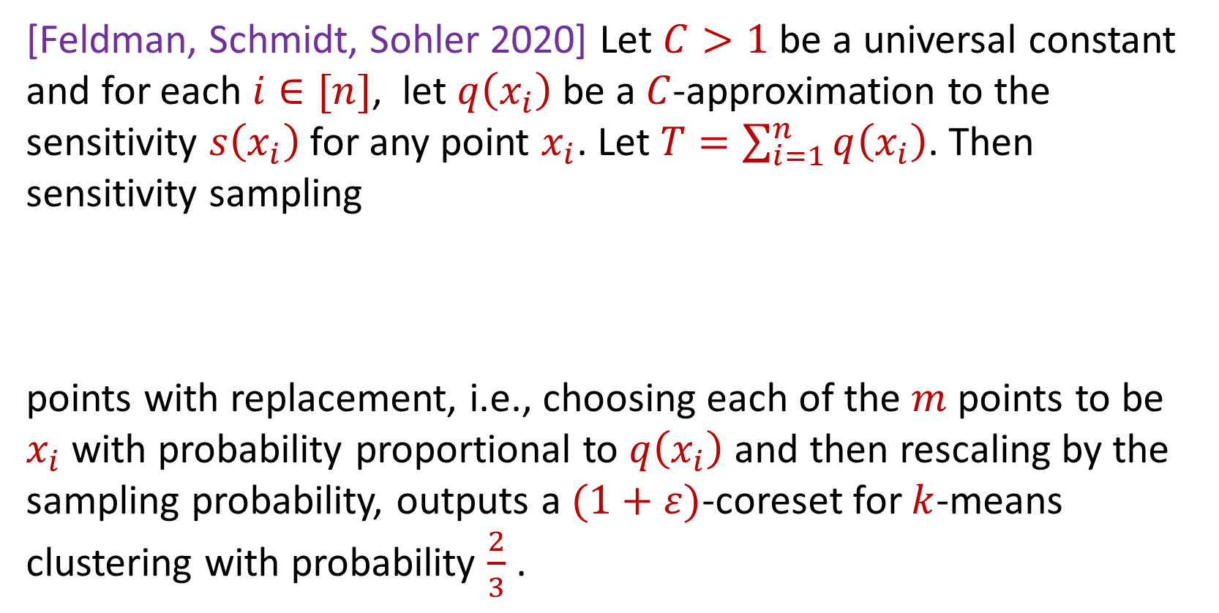
Sensitivity Sampling (Formal Theorem)
[Feldman, Schmidt, Sohler 2020] Let $C>1$ be a universal constant and for each $i∈[n]$, let $q\left(x_{i}\right)$ be a $C$-approximation to the sensitivity $s\left(x_{i}\right)$for any point $x_{i}$. Let $T=\sum_{i=1}^{n}{q\left(x_{i}\right)}$. Then sensitivity sampling
points with replacement, i.e., choosing each of the $m$ points to be $x_{i}$with probability proportional to $q\left(x_{i}\right)$ and then rescaling by the sampling probability, outputs a $(1+ε)$-coreset for $k$-means clustering with probability $\frac{2}{3}$ .
$$m=O\left(\frac{Tk}{ε^{2}}\log^{2}{k}\right)$$

Slide 62
Sensitivity Sampling
Pros: size is always better than uniform sampling and MUCH better on “worst-case” data
Cons: estimating the sensitivities can be a difficult design choice, computing the total sensitivity can be mathematically challenging, larger runtime

Slide 63
 | Uniform Sampling | Sensitivity Sampling
Average-case size | X | X
Worst-case size |  | X
Ease of implementation Computation of probabilities | X
Interpretability |  | X

Slide 64



Group / Stratified Sampling
0 0 0 0 0 1
1 0 0 0 0 0
1 0 0 0 0 0
1 0 0 0 0 0
1 0 0 0 0 0
1 0 0 0 0 0
1 0 0 0 0 0
1 0 0 0 0 0
1 0 0 0 0 0
1 0 0 0 0 0
1 0 0 0 0 0
Separate the data into “groups” and then perform uniform sampling on each group
If the data is uniform in each group, this is essentially sensitivity sampling
$$n$$
$$A$$
$$d$$

Slide 66
Coresets
Where to apply them?
Which sampling approach to use?
Worst-case mathematical bounds

Slide 67
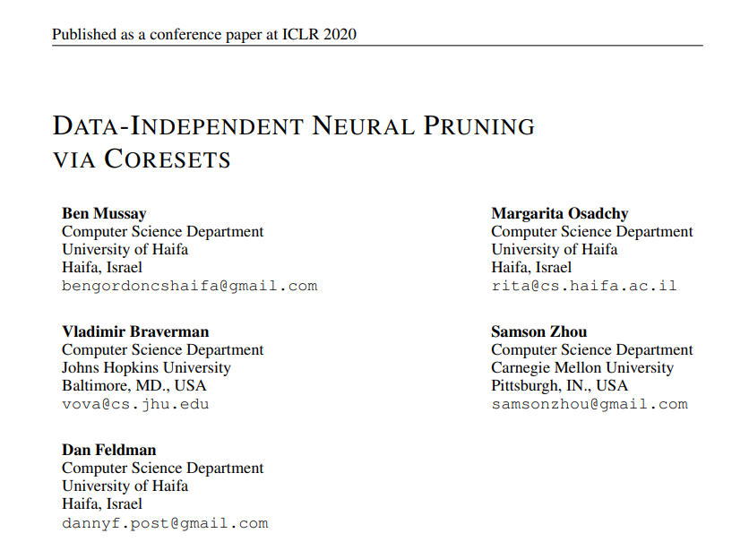
Coresets
Where to apply them?

Slide 68
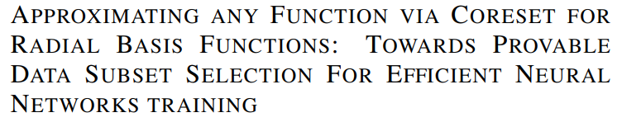
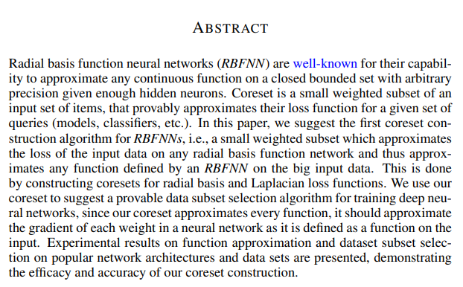
Coresets
Which sampling approach to use?

Slide 69
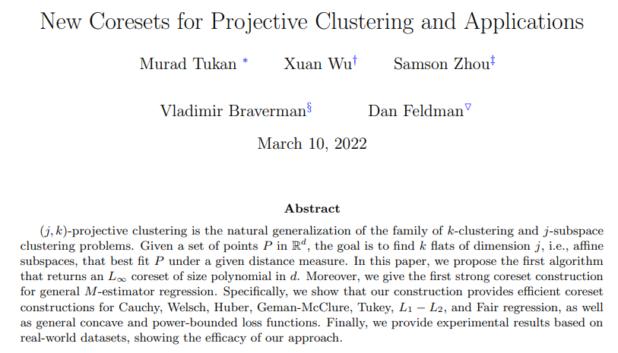
Coresets
Worst-case mathematical bounds

