Slide 2
CSCE 689: Special Topics in Modern Algorithms for Data Science
Lecture 7
Samson Zhou

Slide 3
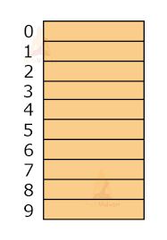

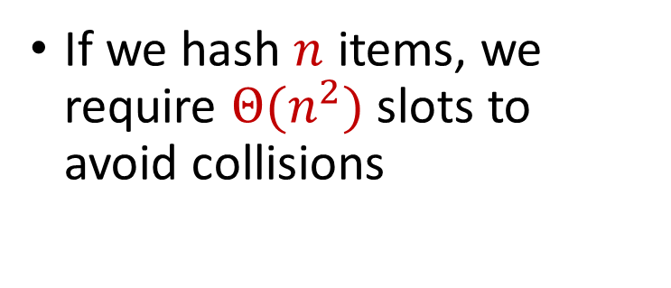
Hashing
Suppose we have a number of files, how do we consistently store them in memory?
$$h\left(x\right)$$
Wenjing Chen
If we hash $n$ items, we require $Θ(n^{2})$ slots to avoid collisions
Chunkai Fu
Ayesha Qamar
Shima Salehi
David Xiang
Shuo Xing

Slide 4

Dealing with Collisions
Suppose we store multiple items in the same location as a linked list
If the maximum number of collisions in a location is $c$, then could traverse a linked list of size $c$ for a query
Query runtime: $O(c)$
$$h(Matthew Chang)$$
$$Jung Seo$$
Matthew Chang

Slide 5
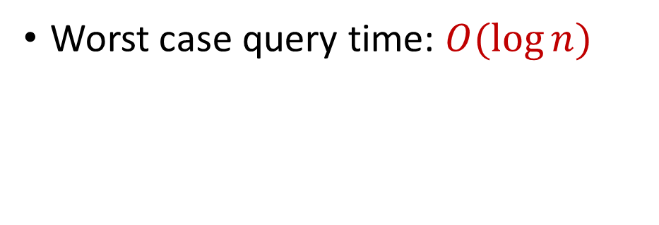
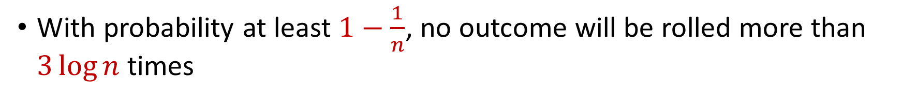

Collisions and Max Load
With probability at least $1−\frac{1}{n}$, no outcome will be rolled more than $3\log{n}$ times
Worst case query time: $O(\log{n})$
$$Jung Seo$$
Matthew Chang

Slide 6

Hashing
For $O(1)$ query time, use $Θ(n^{2})$ slots to avoid collisions
For $O(\log{n})$ query time, use $Θ(n)$ slots with linked lists
$$h\left(x\right)$$
Wenjing Chen
Chunkai Fu
Ayesha Qamar
Shima Salehi
David Xiang
Shuo Xing

Slide 7
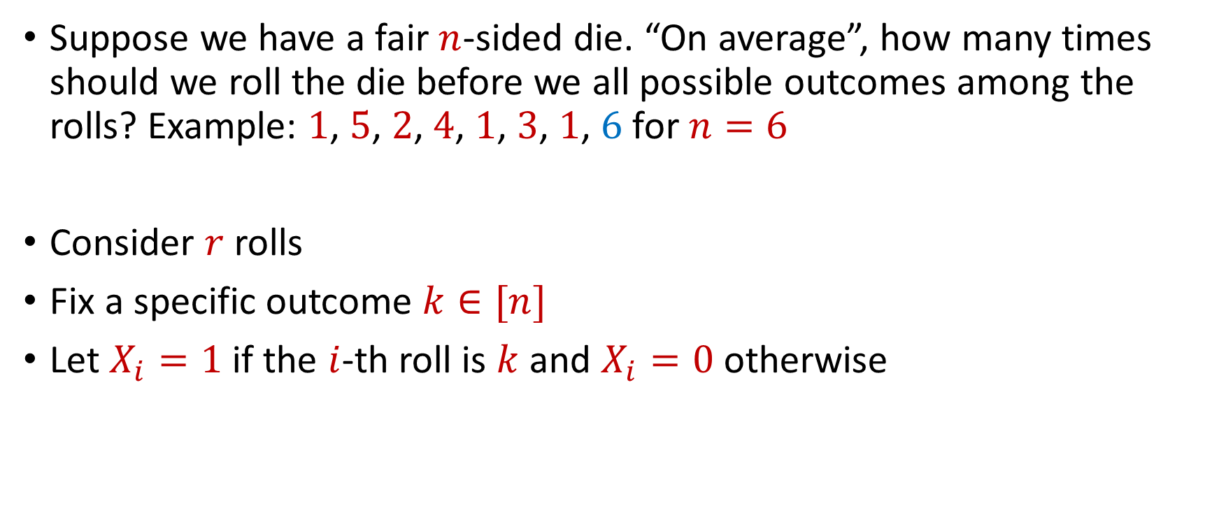
Coupon Collector
Suppose we have a fair $n$-sided die. “On average”, how many times should we roll the die before we all possible outcomes among the rolls? Example: $1$, $5$, $2$, $4$, $1$, $3$, $1$, $6$ for $n=6$
Consider $r$ rolls
Fix a specific outcome $k∈[n]$
Let $X_{i}=1$ if the $i$-th roll is $k$ and $X_{i}=0$ otherwise

Slide 8


Coupon Collector
The total number of rolls with value $k$ is $X=X_{1}+…+X_{r}$
$E\left[X\right]=\frac{r}{n}=6\log{n}$ for $r=6n\log{n}$
Recall Chernoff bounds:
$Pr\left[X≤\log{n}\right]≤\frac{1}{n^{2}}$
$$Pr\left[X≤\left(1−δ\right)μ\right]≤\exp\left(−\frac{δ^{2}μ}{2}\right)$$

Slide 9
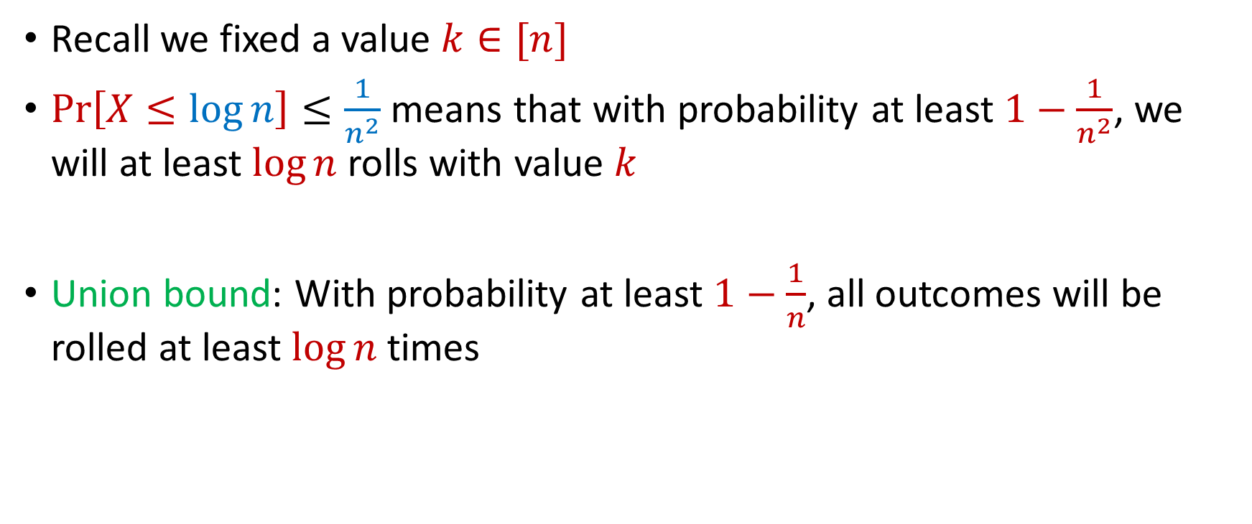
Coupon Collector
Recall we fixed a value $k∈[n]$
$Pr\left[X≤\log{n}\right]≤\frac{1}{n^{2}}$ means that with probability at least $1−\frac{1}{n^{2}}$, we will at least $\log{n}$ rolls with value $k$
Union bound: With probability at least $1−\frac{1}{n}$, all outcomes will be rolled at least $\log{n}$ times

Slide 10
Big Data
Not only many data points, but also many measurements per data point, i.e., very high dimensional data

Slide 11
Big Data
Not only many data points, but also many measurements per data point, i.e., very high dimensional data
Twitter has 450 million active monthly users (as of 2022), records (tens of) thousands of measurements per user: who they follow, who follows them, when they last visited the site, timestamps for specific interactions, how many tweets they have sent, the text of those tweets, etc...

Slide 12
Big Data
Not only many data points, but also many measurements per data point, i.e., very high dimensional data
A 3 minute Youtube clip with a resolution of 500 x 500 pixels at 15 frames/second with 3 color channels is a recording of 2 billion pixel values. Even a 500 x 500 pixel color image has 750, 000 pixel values

Slide 13
Big Data
Not only many data points, but also many measurements per data point, i.e., very high dimensional data
The human genome contains 3 billion+ base pairs. Genetic datasets often contain information on 100s of thousands+ mutations and genetic markers

Slide 14
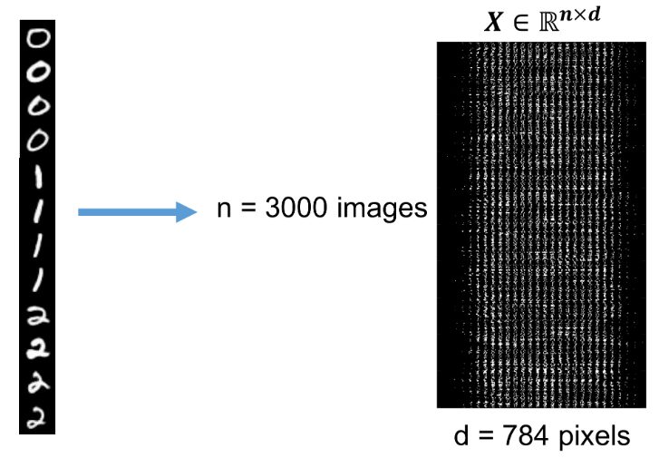


Visualizing Big Data
Data points are interpreted as high dimensional vectors, with real valued entries: $x_{1},…,x_{n}∈R^{d}$
Dataset is interpreted as a matrix: $X∈R^{n×d}$ with $k$-th row $x_{k}$

Slide 15







Dimensionality Reduction
Dimensionality Reduction: Transform the data points so that they have much smaller dimension
Transformation should still capture the key aspects of $x_{1},…,x_{n}$
$x_{1},…,x_{n}$ $∈R^{d}$
$y_{1},…,y_{n}$ $∈R^{m}$
for $m≪d$
$$x_{i}=(0, 1, 0, 0, 1, 0, 1, 1)$$
$$y_{i}=(−1, 2, 1)$$

Slide 16

Low Distortion Embedding
Given $x_{1},…,x_{n}$ $∈R^{d}$, a distance function $D$, and an accuracy parameter $ε>0$, a low-distortion embedding of $x_{1},…,x_{n}$ is a set of points $y_{1},…,y_{n}$, and a distance function $D′$ such that for all $i,j∈[n]$
$$\left(1−ε\right)D\left(x_{i},x_{j}\right)≤D^{′}\left(y_{i},y_{j}\right)≤\left(1+ε\right)D\left(x_{i}, x_{j}\right)$$

Slide 17
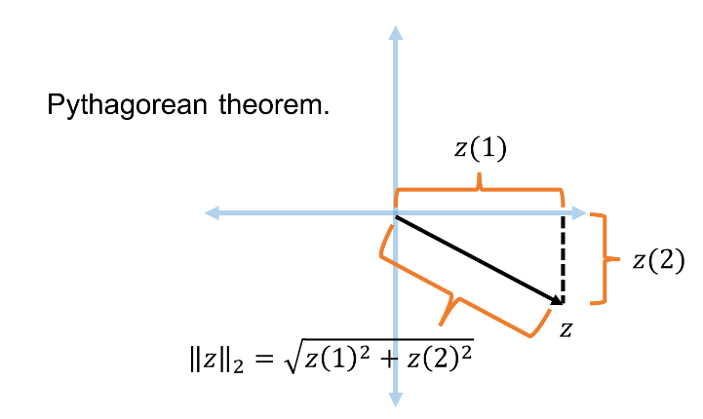


Euclidean Space
For $z$ $∈R^{d}$, the $ℓ_{2}$ norm of $z$ is denoted by ${\left\|z\right\|}_{2}$ and defined as:
$${\left\|z\right\|}_{2}=\sqrt{z_{1}^{2}+z_{2}^{2}+…+z_{d}^{2}}$$

Slide 18

Euclidean Space
For $z$ $∈R^{d}$, the $ℓ_{2}$ norm of $z$ is denoted by ${\left\|z\right\|}_{2}$ and defined as:
$${\left\|z\right\|}_{2}=\sqrt{z_{1}^{2}+z_{2}^{2}+…+z_{d}^{2}}$$
For $x,y$ $∈R^{d}$, the distance function $D$ is denoted by ${\left\|⋅\right\|}_{2}$ and defined as ${\left\|x−y\right\|}_{2}$

Slide 19
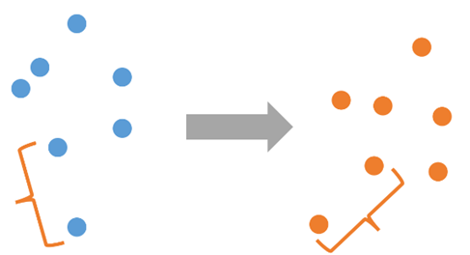

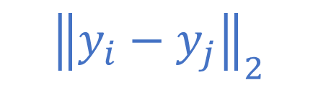
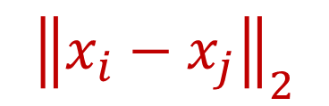
Low Distortion Embedding for Euclidean Space
Given $x_{1},…,x_{n}$ $∈R^{d}$ and an accuracy parameter $ε>0$, a low-distortion embedding of $x_{1},…,x_{n}$ is a set of points $y_{1},…,y_{n}$ such that for all $i,j∈[n]$
$$\left(1−ε\right){\left\|x_{i}−x_{j}\right\|}_{2}≤{\left\|y_{i}−y_{j}\right\|}_{2}≤\left(1+ε\right){\left\|x_{i}−x_{j}\right\|}_{2}$$
$${\left\|x_{i}−x_{j}\right\|}_{2}$$
$${\left\|y_{i}−y_{j}\right\|}_{2}$$

Slide 20
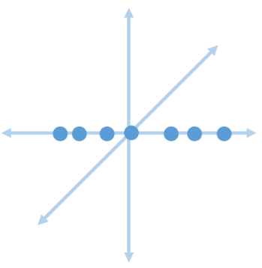
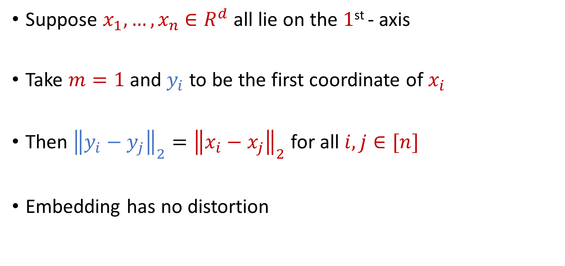
Examples: Embeddings for Euclidean Space
Suppose $x_{1},…,x_{n}$ $∈R^{d}$ all lie on the $1$^{st} - axis
Take $m=1$ and $y_{i}$ to be the first coordinate of $x_{i}$
Then ${\left\|y_{i}−y_{j}\right\|}_{2}={\left\|x_{i}−x_{j}\right\|}_{2}$ for all $i,j∈[n]$
Embedding has no distortion

Slide 21
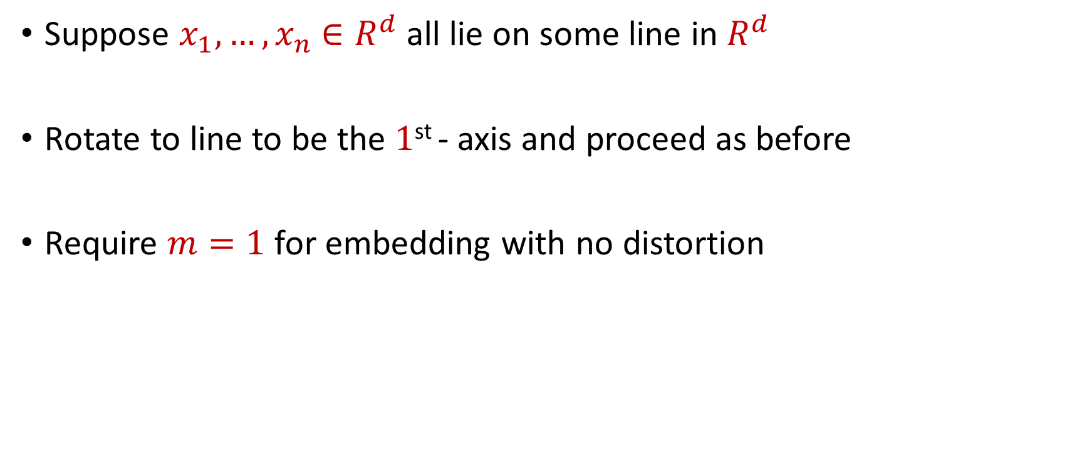
Examples: Embeddings for Euclidean Space
Suppose $x_{1},…,x_{n}$ $∈R^{d}$ all lie on some line in $R^{d}$
Rotate to line to be the $1$^{st} - axis and proceed as before
Require $m=1$ for embedding with no distortion

Slide 22
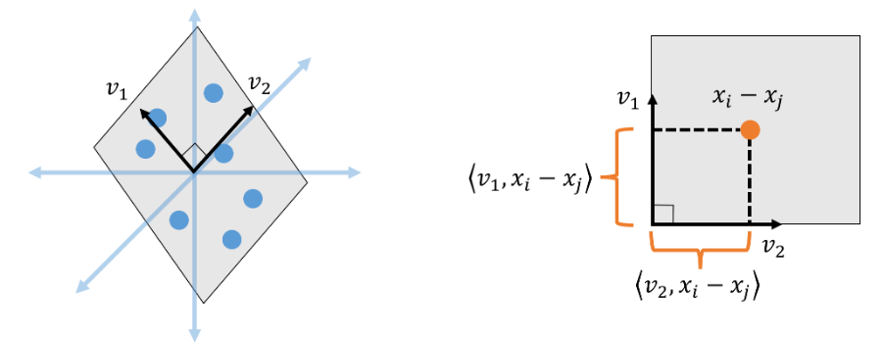
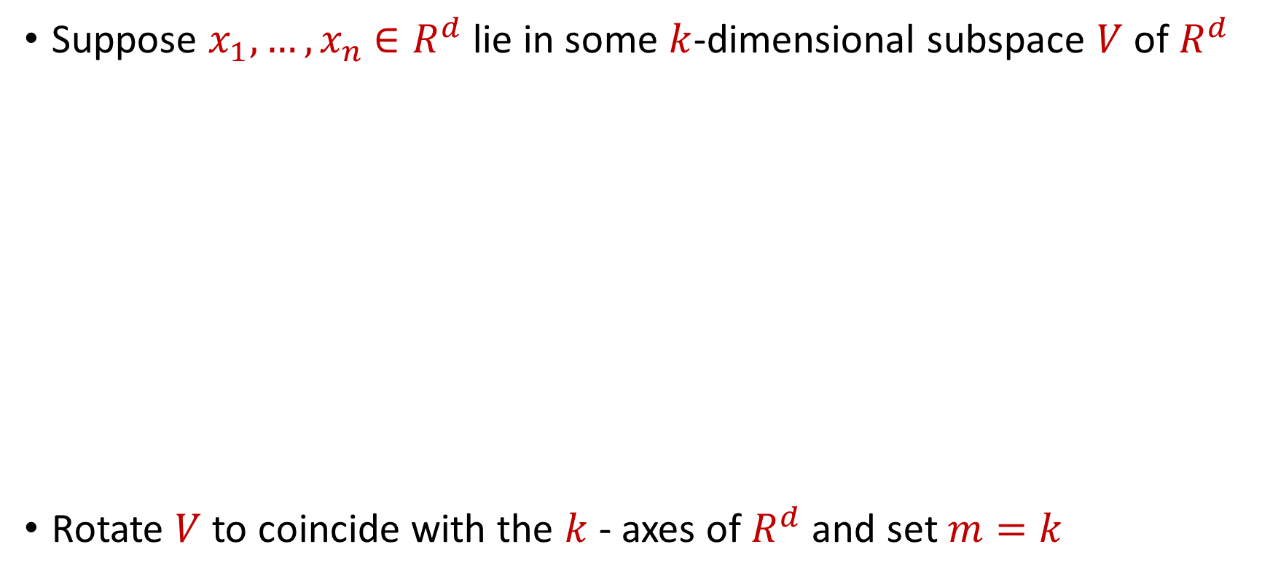
Examples: Embeddings for Euclidean Space
Suppose $x_{1},…,x_{n}$ $∈R^{d}$ lie in some $k$-dimensional subspace $V$ of $R^{d}$
Rotate $V$ to coincide with the $k$- axes of $R^{d}$ and set $m=k$

Slide 23

Embeddings for Euclidean Space
Given $x_{1},…,x_{n}$ $∈R^{d}$ that lie in general position, does there exist an embedding with no distortion?

Slide 24
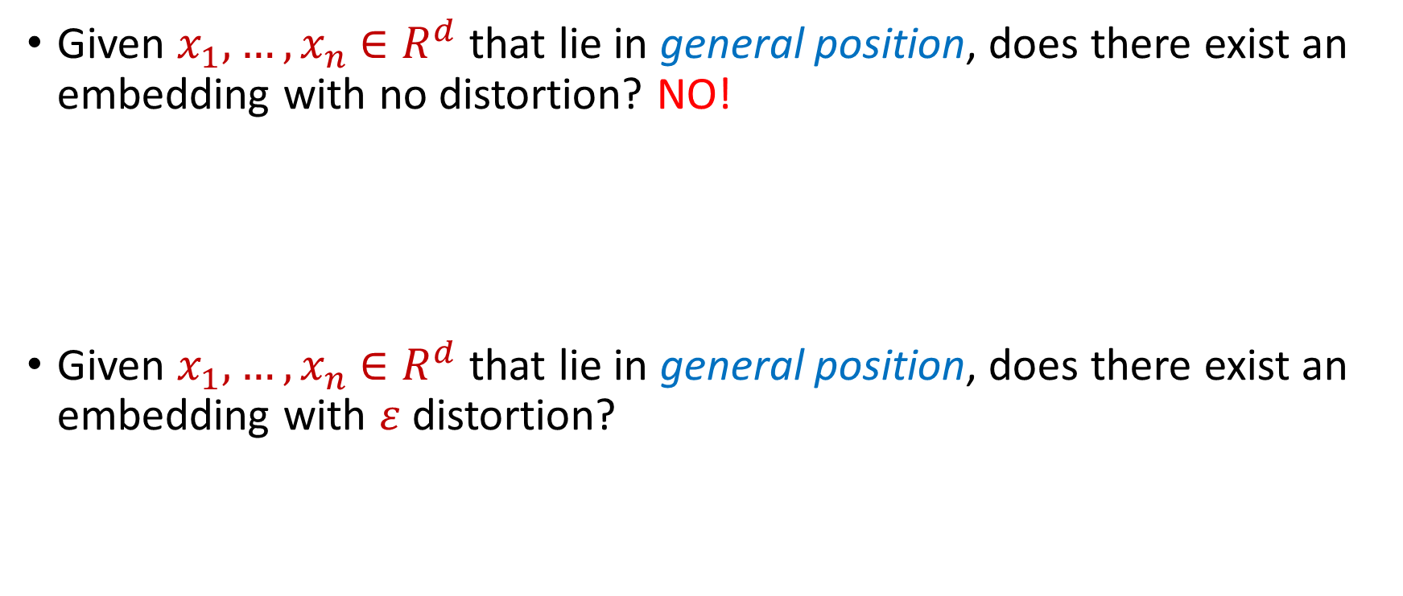
Embeddings for Euclidean Space
Given $x_{1},…,x_{n}$ $∈R^{d}$ that lie in general position, does there exist an embedding with no distortion? NO!
Given $x_{1},…,x_{n}$ $∈R^{d}$ that lie in general position, does there exist an embedding with $ε$ distortion?

Slide 25
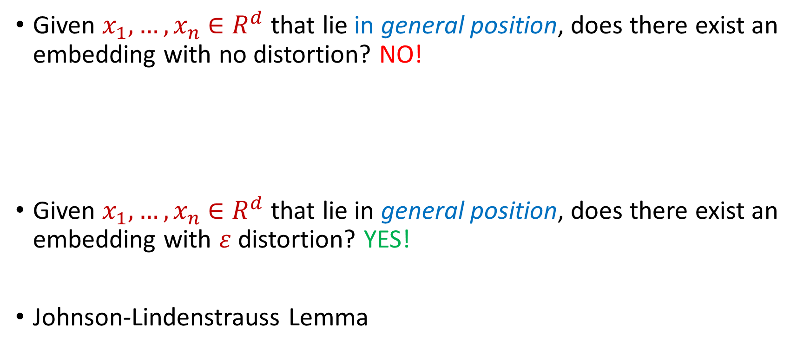
Embeddings for Euclidean Space
Given $x_{1},…,x_{n}$ $∈R^{d}$ that lie in general position, does there exist an embedding with no distortion? NO!
Given $x_{1},…,x_{n}$ $∈R^{d}$ that lie in general position, does there exist an embedding with $ε$ distortion? YES!
Johnson-Lindenstrauss Lemma

Slide 26

Johnson-Lindenstrauss Lemma
Johnson-Lindenstrauss Lemma: Given $x_{1},…,x_{n}$ $∈R^{d}$ and an accuracy parameter $ε>0$, there exists a linear map $Π:R^{d}→R^{m}$ with $m=\left(\frac{\log{n}}{ε^{2}}\right)$ so that if $y_{i}=Πx_{i}$, then for all $i,j∈[n]$:
$$\left(1−ε\right){\left\|x_{i}−x_{j}\right\|}_{2}≤{\left\|y_{i}−y_{j}\right\|}_{2}≤\left(1+ε\right){\left\|x_{i}−x_{j}\right\|}_{2}$$

Slide 27
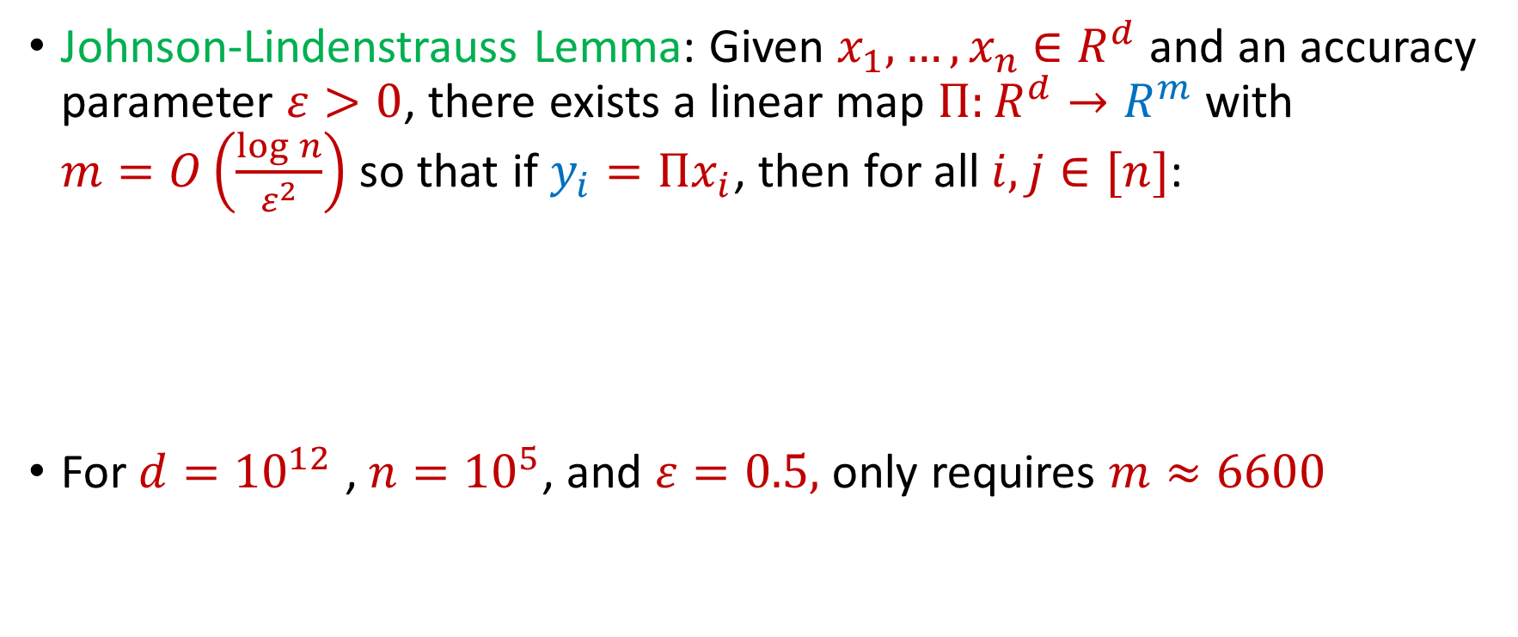
Johnson-Lindenstrauss Lemma
Johnson-Lindenstrauss Lemma: Given $x_{1},…,x_{n}$ $∈R^{d}$ and an accuracy parameter $ε>0$, there exists a linear map $Π:R^{d}→R^{m}$ with $m=O\left(\frac{\log{n}}{ε^{2}}\right)$ so that if $y_{i}=Πx_{i}$, then for all $i,j∈[n]$:
For $d={10}^{12}$ , $n={10}^{5}$, and $ε=0.5,$ only requires $m≈6600$
$$\left(1−ε\right){\left\|x_{i}−x_{j}\right\|}_{2}≤{\left\|y_{i}−y_{j}\right\|}_{2}≤\left(1+ε\right){\left\|x_{i}−x_{j}\right\|}_{2}$$

Slide 28
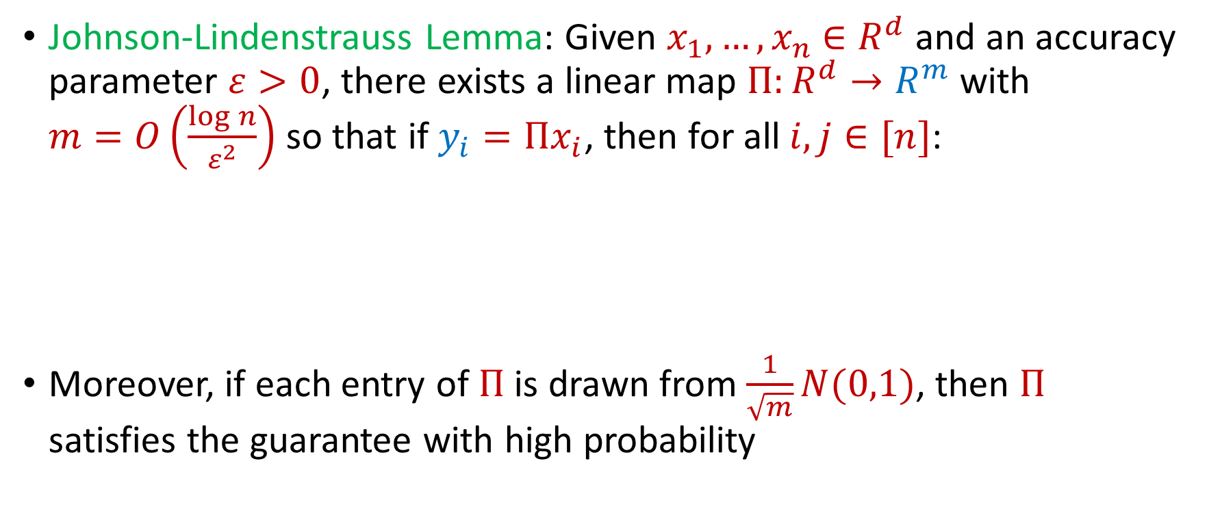
Johnson-Lindenstrauss Lemma
Johnson-Lindenstrauss Lemma: Given $x_{1},…,x_{n}$ $∈R^{d}$ and an accuracy parameter $ε>0$, there exists a linear map $Π:R^{d}→R^{m}$ with $m=O\left(\frac{\log{n}}{ε^{2}}\right)$ so that if $y_{i}=Πx_{i}$, then for all $i,j∈[n]$:
Moreover, if each entry of $Π$ is drawn from $\frac{1}{\sqrt{m}}N(0,1)$, then $Π$ satisfies the guarantee with high probability
$$\left(1−ε\right){\left\|x_{i}−x_{j}\right\|}_{2}≤{\left\|y_{i}−y_{j}\right\|}_{2}≤\left(1+ε\right){\left\|x_{i}−x_{j}\right\|}_{2}$$

Slide 29
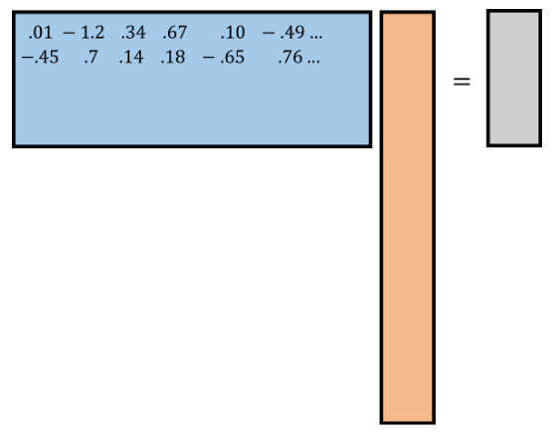
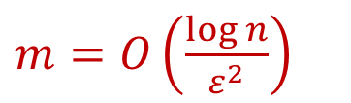
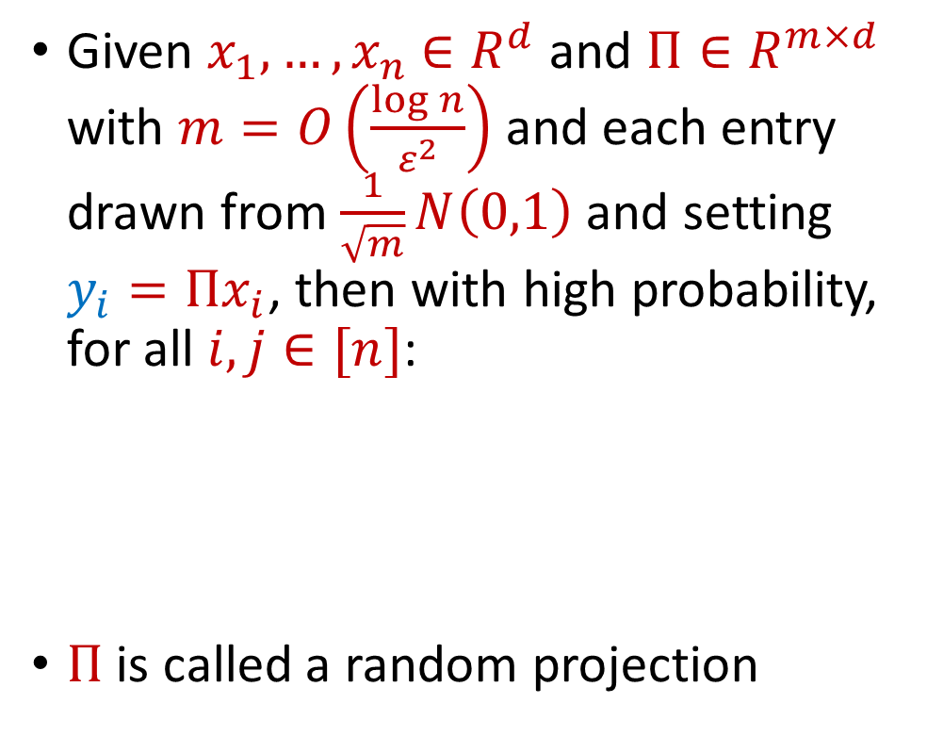






Johnson-Lindenstrauss Lemma
$$R^{m×d}$$
$$R^{d}$$
$$R^{m}$$
Given $x_{1},…,x_{n}$ $∈R^{d}$ and $Π∈R^{m×d}$ with $m=O\left(\frac{\log{n}}{ε^{2}}\right)$ and each entry drawn from $\frac{1}{\sqrt{m}}N\left(0,1\right)$ and setting $y_{i}=Πx_{i}$, then with high probability, for all $i,j∈[n]$:
$Π$ is called a random projection
$$y_{i}$$
$$Π$$
$m=O\left(\frac{\log{n}}{ε^{2}}\right)$
$$x_{i}$$
$$\left(1−ε\right){\left\|x_{i}−x_{j}\right\|}_{2}≤{\left\|y_{i}−y_{j}\right\|}_{2}≤\left(1+ε\right){\left\|x_{i}−x_{j}\right\|}_{2}$$

Slide 30
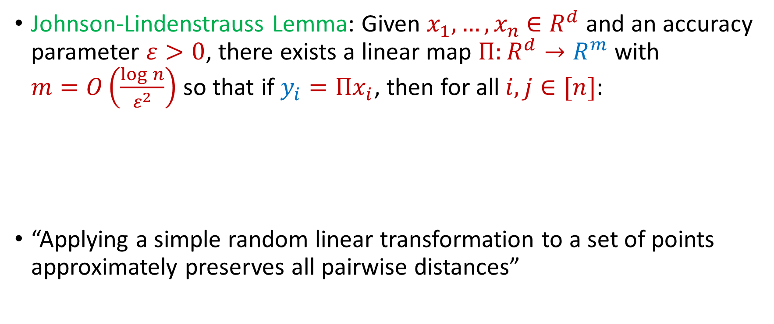
Johnson-Lindenstrauss Lemma
Johnson-Lindenstrauss Lemma: Given $x_{1},…,x_{n}$ $∈R^{d}$ and an accuracy parameter $ε>0$, there exists a linear map $Π:R^{d}→R^{m}$ with $m=O\left(\frac{\log{n}}{ε^{2}}\right)$ so that if $y_{i}=Πx_{i}$, then for all $i,j∈[n]$:
“Applying a simple random linear transformation to a set of points approximately preserves all pairwise distances”
$$\left(1−ε\right){\left\|x_{i}−x_{j}\right\|}_{2}≤{\left\|y_{i}−y_{j}\right\|}_{2}≤\left(1+ε\right){\left\|x_{i}−x_{j}\right\|}_{2}$$

