Slide 1
CSCE 658: Randomized Algorithms
Lecture 8
Samson Zhou

Slide 2

Last Time: The Streaming Model
Input: Elements of an underlying data set $S$, which arrive sequentially
Output: Evaluation (or approximation) of a given function
Goal: Use space sublinear in the size $m$of the input $S$
1 0 1 1 1 0 0 1

Slide 3

Last Time: Reservoir Sampling
Suppose we see a stream of elements from $[n]$. How do we uniformly sample one of the positions of the stream?
[Vitter 1985]: Initialize $s=⊥$
On the arrival of element $i$, replace $s$ with $x_{i}$ with probability $\frac{1}{i}$
47 72 81 10 14 33 51 29 54 9 36 46 10

Slide 4
Last Time: Reservoir Sampling
Suppose we see a stream of elements from $[n]$. How do we uniformly sample one of the positions of the stream?
[Vitter 1985]: Initialize $s=⊥$
On the arrival of element $i$, replace $s$ with $x_{i}$ with probability $\frac{1}{i}$
47 72 81 10 14 33 51 29 54 9 36 46 10

Slide 5
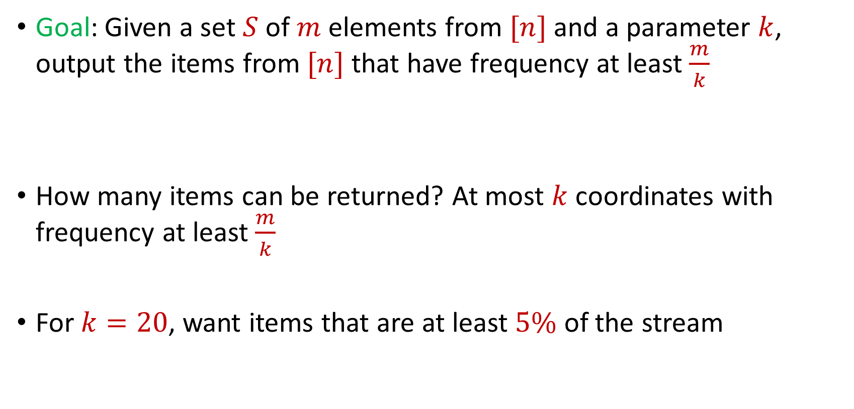
Last Time: Frequent Items
Goal: Given a set $S$ of $m$ elements from $[n]$ and a parameter $k$, output the items from $[n]$ that have frequency at least $\frac{m}{k}$
How many items can be returned? At most $k$ coordinates with frequency at least $\frac{m}{k}$
For $k=20$, want items that are at least $5\%$ of the stream
$f_{1}$ | $f_{2}$ | $f_{3}$ | $f_{4}$ | $f_{5}$ | $f_{6}$ | $f_{7}$
10 | 0 | 1 | 1 | 2 | 0 | 9

Slide 6
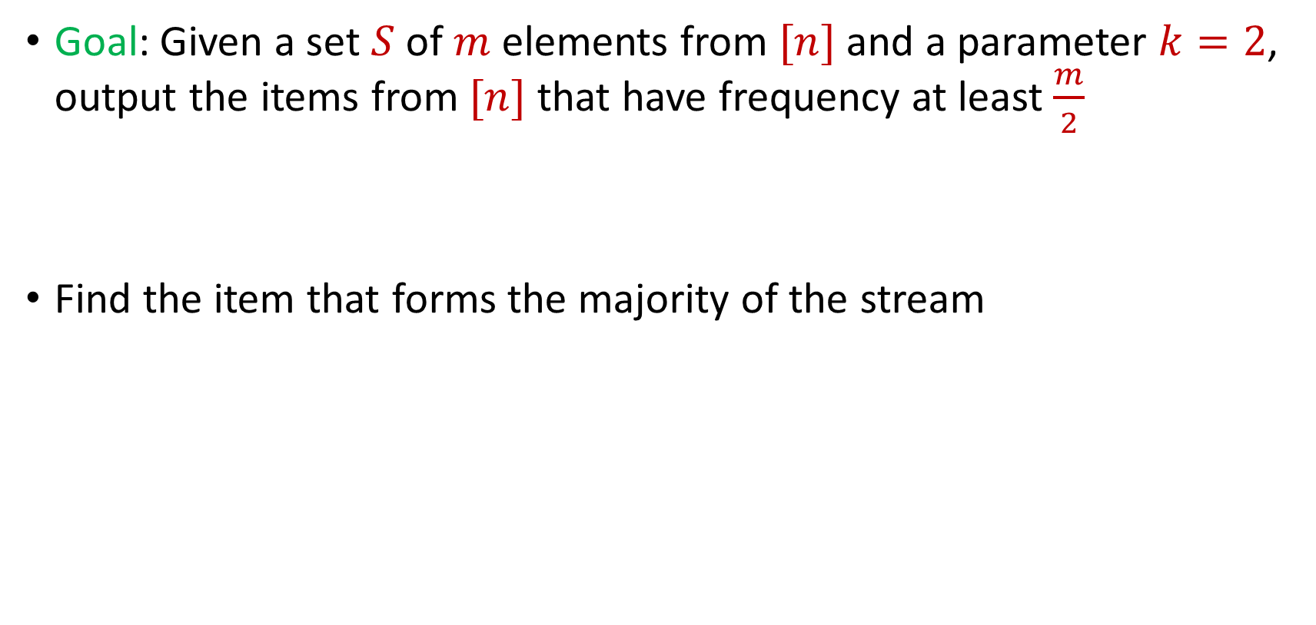
Last Time: Majority
Goal: Given a set $S$ of $m$ elements from $[n]$ and a parameter $k=2$, output the items from $[n]$ that have frequency at least $\frac{m}{2}$
Find the item that forms the majority of the stream

Slide 7
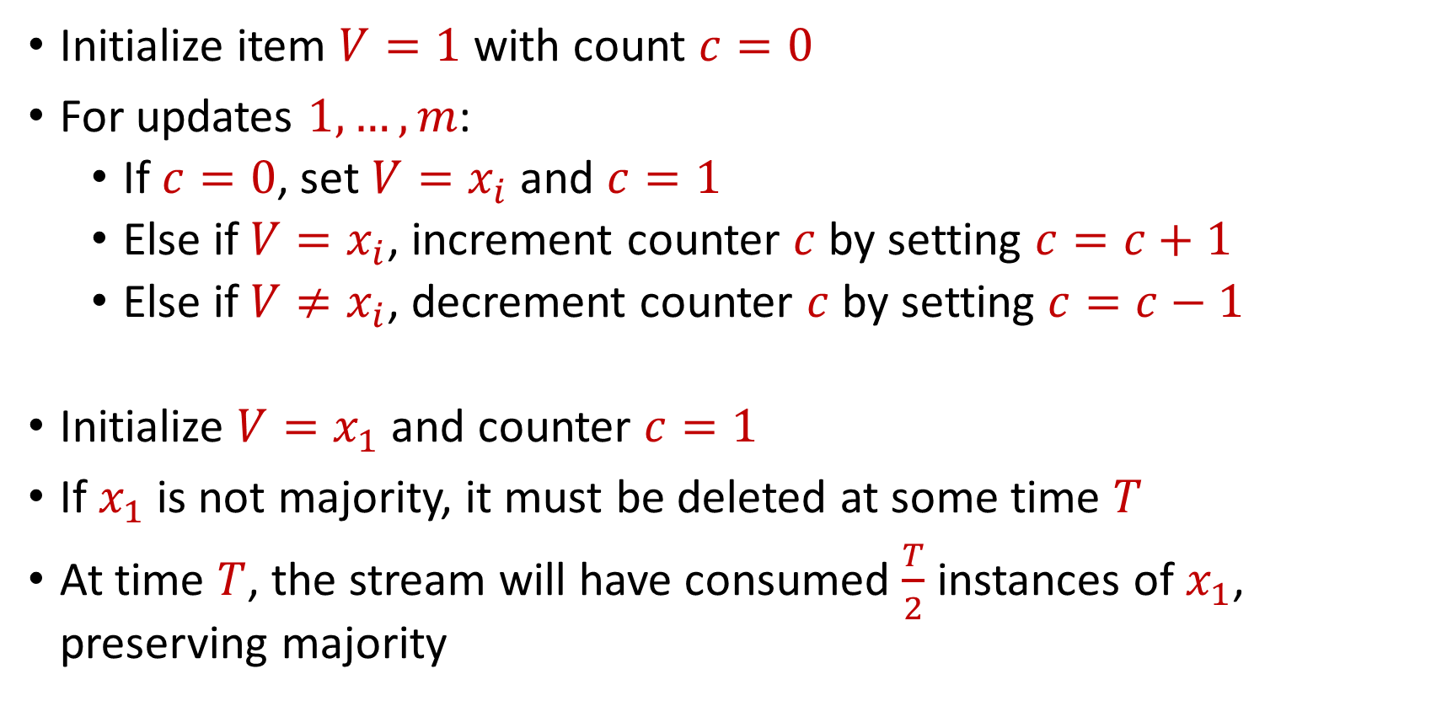
Last Time: Majority
Initialize item $V=1$ with count $c=0$
For updates $1,…,m$:
If $c=0$, set $V=x_{i}$ and $c=1$
Else if $V=x_{i}$, increment counter $c$ by setting $c=c+1$
Else if $V≠x_{i}$, decrement counter $c$ by setting $c=c−1$
Initialize $V=x_{1}$ and counter $c=1$
If $x_{1}$ is not majority, it must be deleted at some time $T$
At time $T$, the stream will have consumed $\frac{T}{2}$ instances of $x_{1}$, preserving majority

Slide 8
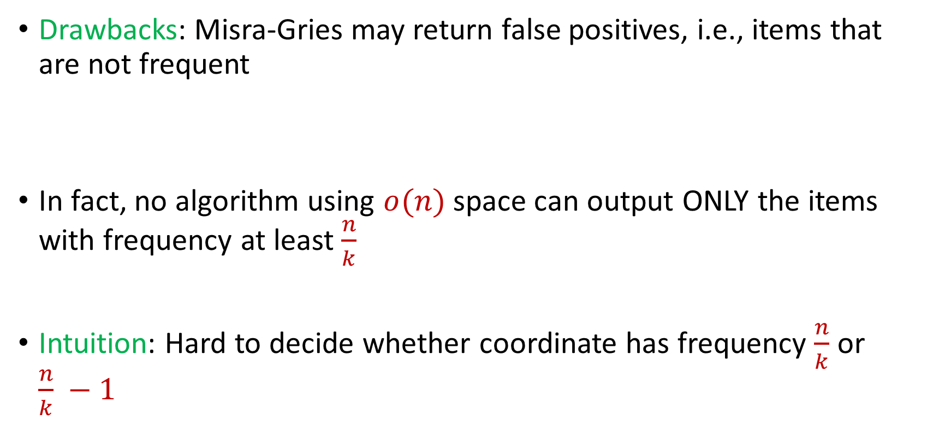
Misra Gries
Drawbacks: Misra-Gries may return false positives, i.e., items that are not frequent
In fact, no algorithm using $o(n)$ space can output ONLY the items with frequency at least $\frac{n}{k}$
Intuition: Hard to decide whether coordinate has frequency $\frac{n}{k}$ or $\frac{n}{k} −1$

Slide 9

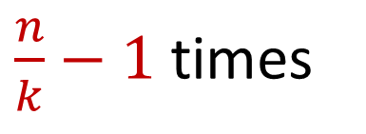
Misra Gries
Intuition: Hard to decide whether coordinate has frequency $\frac{n}{k}$ or $\frac{n}{k} −1$
$x_{1}=2$, $x_{2}=5$, $x_{3}=4$, $x_{4}=7$, $x_{5}=1$, $x_{6}=9$, …
$x_{n−\frac{n}{k}+1}=α$, $x_{n−\frac{n}{k}+2}=α$,…, $x_{n}=α$
$\frac{n}{k}−1$ times

Slide 10
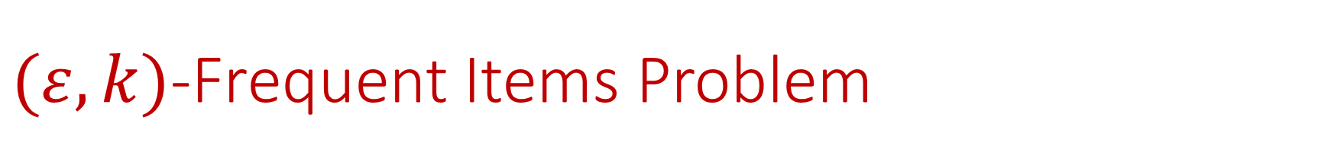

$(ε,k)$-Frequent Items Problem
Goal: Given a set $S$ of $m$ elements from $[n]$, an accuracy parameter $ε∈(0, 1)$, and a parameter $k$, output a list that includes:
The items from $[n]$ that have frequency at least $\frac{m}{k}$
No items with frequency less than $\left(1−ε\right)\frac{m}{k}$

Slide 11


Misra Gries for $(ε,k)$-Frequent Items Problem
Initialize $k$ items $V_{1},…,V_{k}$ with count $c_{1},…,c_{k}=0$
For updates $1,…,m$:
If $V_{t}=x_{i}$ for some $t$, increment counter $c_{t}$, i.e., $c_{t}=c_{t}+1$
Else if $c_{t}=0$ for some $t$, set $V_{t}=x_{i}$
Else decrement all counters $c_{j}$, i.e., $c_{j}=c_{j}−1$ for all $j∈[k]$

Slide 12
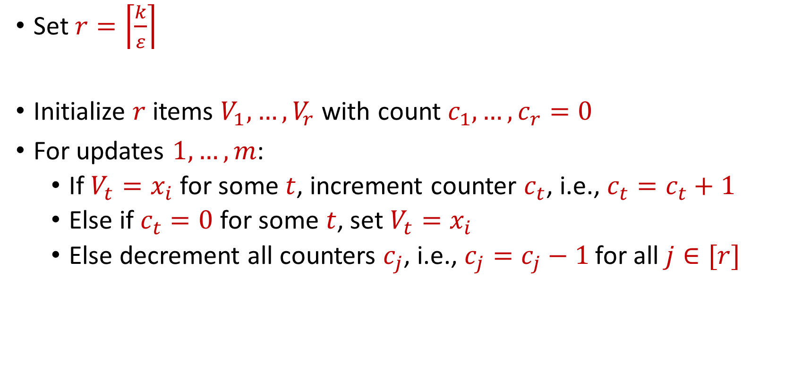
Misra Gries for $(ε,k)$-Frequent Items Problem
Set $r=\left\lceil \frac{k}{ε}\right\rceil$
Initialize $r$ items $V_{1},…,V_{r}$ with count $c_{1},…,c_{r}=0$
For updates $1,…,m$:
If $V_{t}=x_{i}$ for some $t$, increment counter $c_{t}$, i.e., $c_{t}=c_{t}+1$
Else if $c_{t}=0$ for some $t$, set $V_{t}=x_{i}$
Else decrement all counters $c_{j}$, i.e., $c_{j}=c_{j}−1$ for all $j∈[r]$

Slide 13


Misra Gries for $(ε,k)$-Frequent Items Problem
Claim: For all estimated frequencies $\hat{f_{i}}$ by Misra-Gries, we have
Intuition: Have a lot of counters, so relatively few decrements
$$f_{i}−\frac{εm}{k}≤\hat{f_{i}}≤f_{i}$$

Slide 14
$(ε,k)$-Frequent Items Problem
Goal: Given a set $S$ of $m$ elements from $[n]$, an accuracy parameter $ε∈(0, 1)$, and a parameter $k$, output a list that includes:
The items from $[n]$ that have frequency at least $\frac{m}{k}$
No items with frequency less than $\left(1−ε\right)\frac{m}{k}$

Slide 15
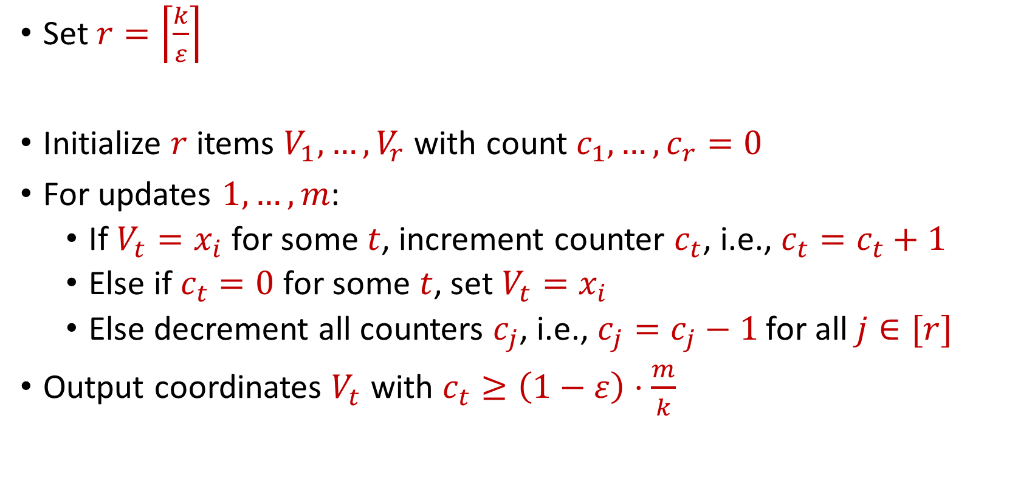
Misra Gries for $(ε,k)$-Frequent Items Problem
Set $r=\left\lceil \frac{k}{ε}\right\rceil$
Initialize $r$ items $V_{1},…,V_{r}$ with count $c_{1},…,c_{r}=0$
For updates $1,…,m$:
If $V_{t}=x_{i}$ for some $t$, increment counter $c_{t}$, i.e., $c_{t}=c_{t}+1$
Else if $c_{t}=0$ for some $t$, set $V_{t}=x_{i}$
Else decrement all counters $c_{j}$, i.e., $c_{j}=c_{j}−1$ for all $j∈[r]$
Output coordinates $V_{t}$ with $c_{t}≥\left(1−ε\right)⋅\frac{m}{k}$

Slide 16
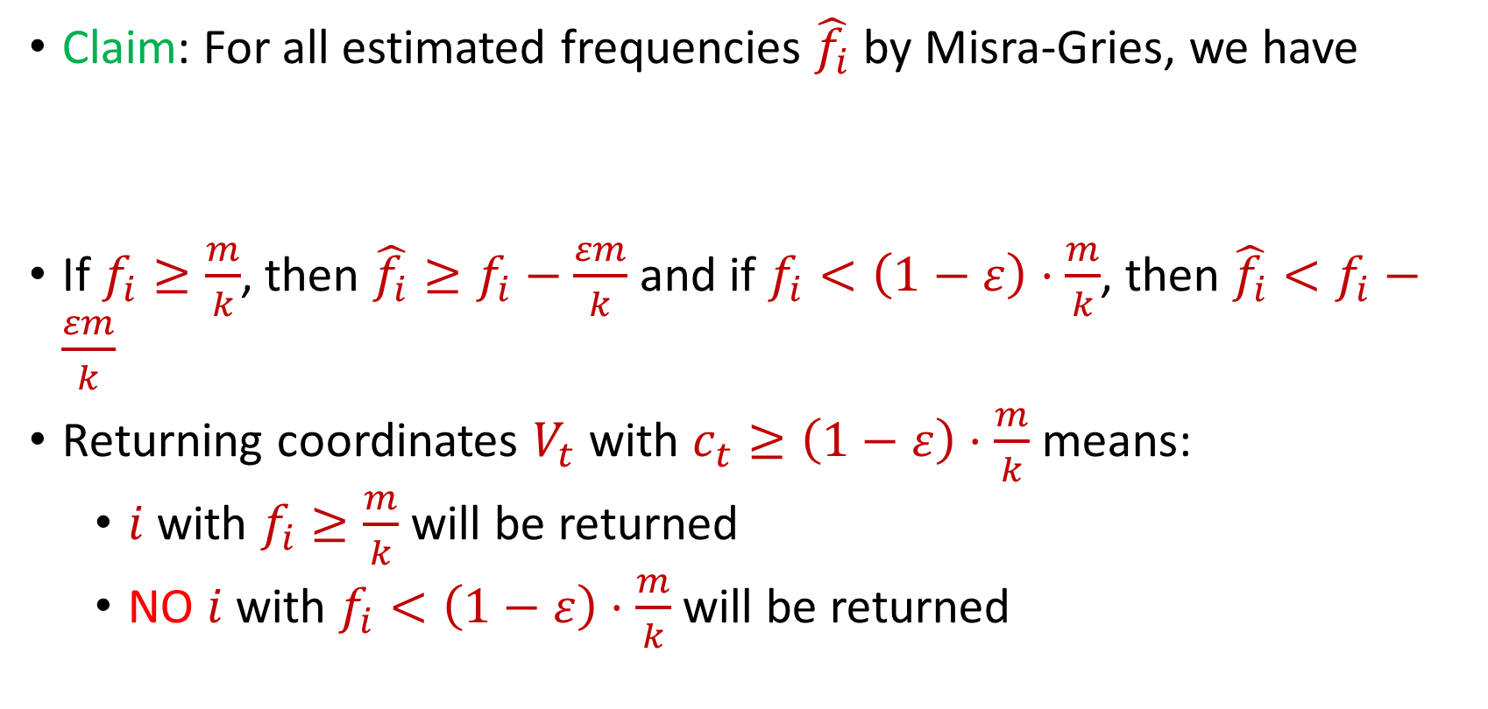
Misra Gries for $(ε,k)$-Frequent Items Problem
Claim: For all estimated frequencies $\hat{f_{i}}$ by Misra-Gries, we have
If $f_{i}≥\frac{m}{k}$, then ${\hat{f_{i}}≥f}_{i}−\frac{εm}{k}$ and if $f_{i}<\left(1−ε\right)⋅\frac{m}{k}$, then ${\hat{f_{i}}<f}_{i}−\frac{εm}{k}$
Returning coordinates $V_{t}$ with $c_{t}≥\left(1−ε\right)⋅\frac{m}{k}$ means:
$i$ with $f_{i}≥\frac{m}{k}$ will be returned
NO $i$ with $f_{i}<\left(1−ε\right)⋅\frac{m}{k}$will be returned
$$f_{i}−\frac{εm}{k}≤\hat{f_{i}}≤f_{i}$$

Slide 17
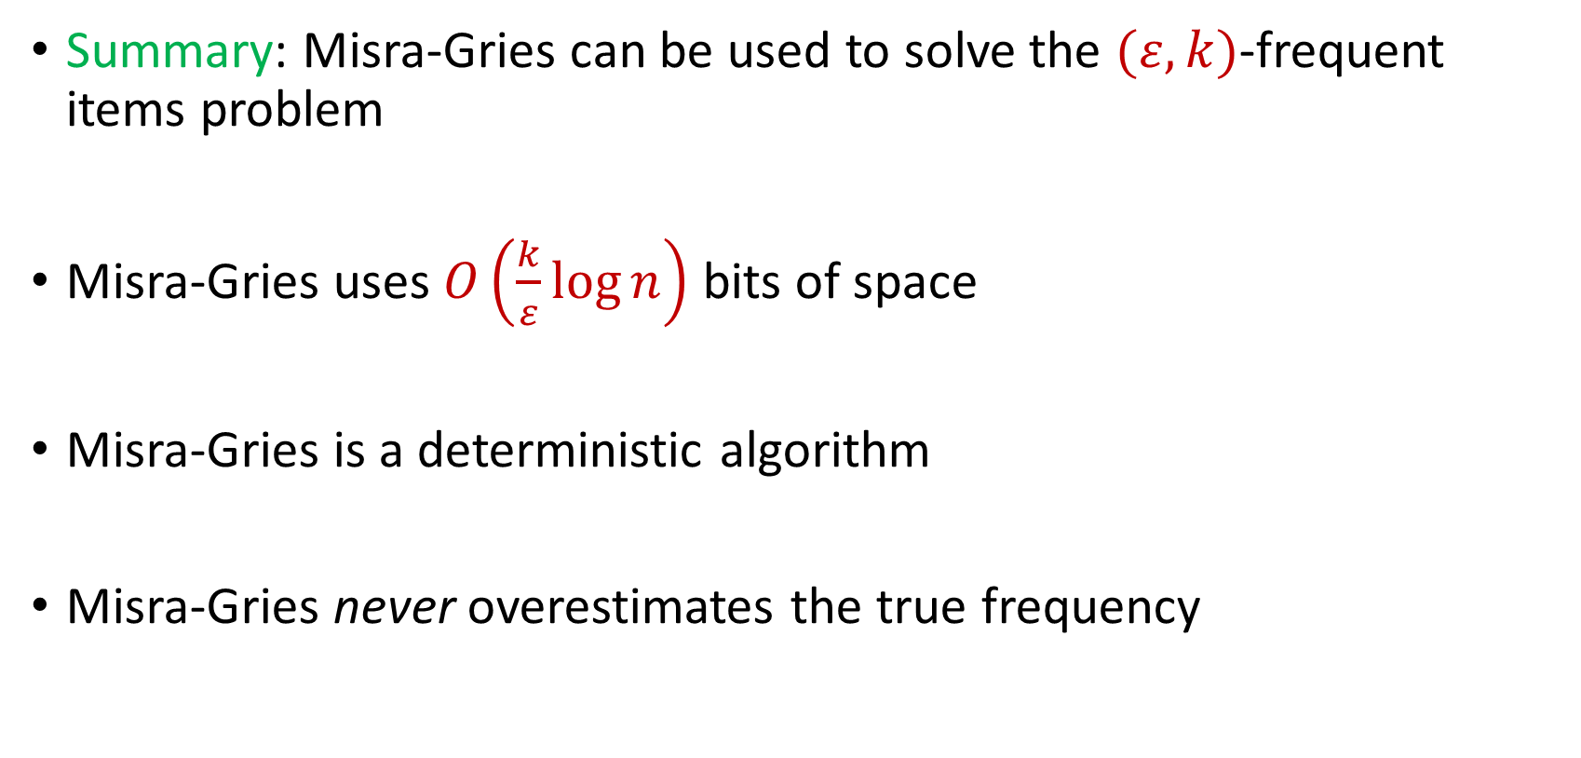
Misra Gries for $(ε,k)$-Frequent Items Problem
Summary: Misra-Gries can be used to solve the $(ε,k)$-frequent items problem
Misra-Gries uses $O\left(\frac{k}{ε}\log{n}\right)$ bits of space
Misra-Gries is a deterministic algorithm
Misra-Gries never overestimates the true frequency

Slide 18

Insertion-Deletion Streams
Stream of length $m=Θ\left(n\right)$
Universe of size $[n]$, underlying vector $f∈R^{n}$
Each update increases or decreases a coordinate in $f$
“Decrease $f_{6}$”
$f_{1}$ | $f_{2}$ | $f_{3}$ | $f_{4}$ | $f_{5}$ | $f_{6}$ | $f_{7}$
0 | 0 | 0 | 0 | 0 | 0 | 0
$f_{1}$ | $f_{2}$ | $f_{3}$ | $f_{4}$ | $f_{5}$ | $f_{6}$ | $f_{7}$
0 | 0 | 0 | 0 | 0 | -1 | 0

Slide 19
Insertion-Deletion Streams
Database Management: In database management, insertion-deletion streams are used to track changes made to the database over time
Transaction logs often utilize this concept to record insertions and deletions to ensure data integrity and support features like rollbacks and recovery

Slide 20




Insertion-Deletion Streams
Version Control Systems: Insertion-deletion streams track changes made to files, enabling users to see what has been added (inserted) or removed (deleted) in each version
Crucial for collaboration and managing software development projects, central to version control systems

Slide 21

Insertion-Deletion Streams
Traffic Flow and Transportation Systems: Insertion-deletion streams are used to analyze traffic patterns and changes in transportation systems
This helps in optimizing traffic flow, managing congestion, and improving transportation infrastructure

Slide 22

Frequent Items on Insertion-Deletion Streams
Misra-Gries on Insertion-Deletion Streams
“Increase $f_{1}$”
“Increase $f_{3}$”
“Increase $f_{2}$”
“Increase $f_{2}$”
“Decrease $f_{2}$”
“Decrease $f_{2}$”
“Decrease $f_{3}$”

Slide 23
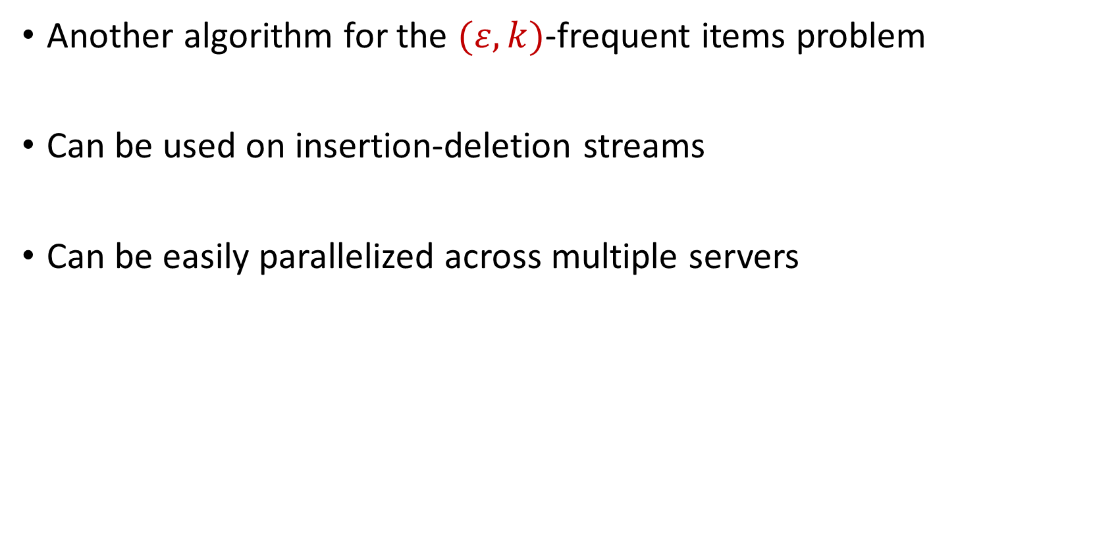
CountMin
Another algorithm for the $(ε,k)$-frequent items problem
Can be used on insertion-deletion streams
Can be easily parallelized across multiple servers

Slide 24
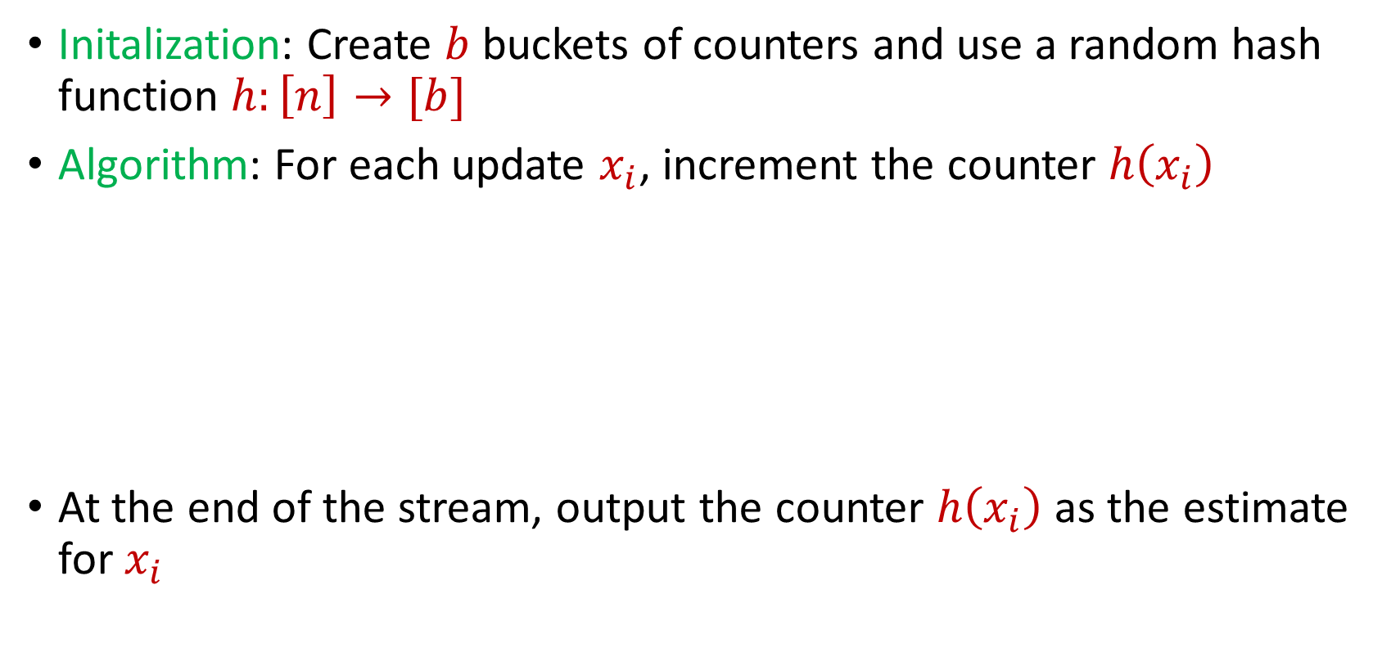
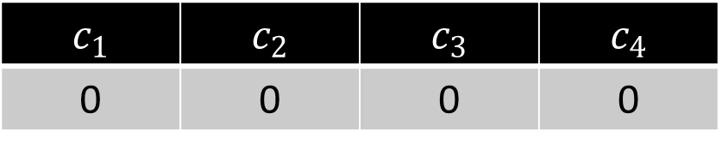
CountMin
Initalization: Create $b$ buckets of counters and use a random hash function $h:\left[n\right]→[b]$
Algorithm: For each update $x_{i}$, increment the counter $h\left(x_{i}\right)$
At the end of the stream, output the counter $h\left(x_{i}\right)$ as the estimate for $x_{i}$
$c_{1}$ | $c_{2}$ | $c_{3}$ | $c_{4}$
0 | 0 | 0 | 0

Slide 25
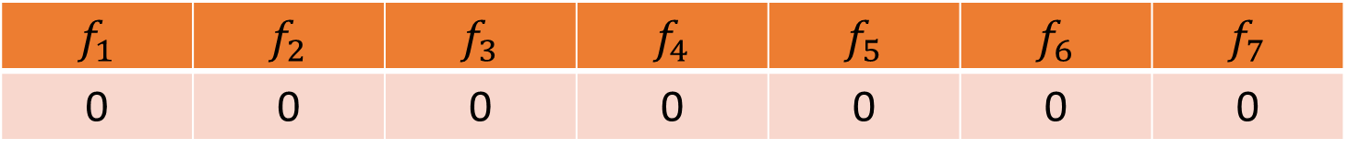


CountMin
$f_{1}$ | $f_{2}$ | $f_{3}$ | $f_{4}$ | $f_{5}$ | $f_{6}$ | $f_{7}$
0 | 0 | 0 | 0 | 0 | 0 | 0
$$1$$
$c_{1}$ | $c_{2}$ | $c_{3}$ | $c_{4}$
0 | 0 | 0 | 0

Slide 26
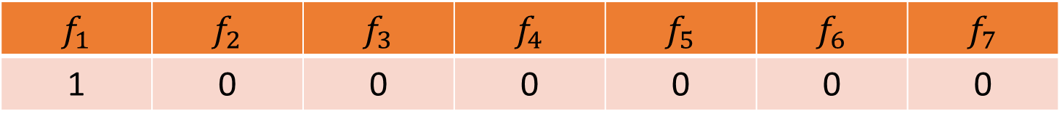

CountMin
$f_{1}$ | $f_{2}$ | $f_{3}$ | $f_{4}$ | $f_{5}$ | $f_{6}$ | $f_{7}$
1 | 0 | 0 | 0 | 0 | 0 | 0
$$1$$
$$h\left(x\right)=3x+2 (mod 4)$$
$c_{1}$ | $c_{2}$ | $c_{3}$ | $c_{4}$
0 | 0 | 0 | 0

Slide 27
CountMin
$f_{1}$ | $f_{2}$ | $f_{3}$ | $f_{4}$ | $f_{5}$ | $f_{6}$ | $f_{7}$
1 | 0 | 0 | 0 | 0 | 0 | 0
$$1$$
$$h\left(x\right)=3x+2 (mod 4)$$
$c_{1}$ | $c_{2}$ | $c_{3}$ | $c_{4}$
0 | 0 | 0 | 0

Slide 28
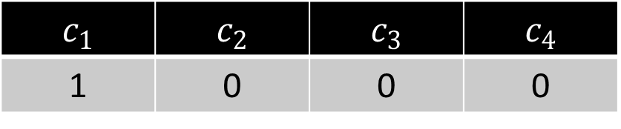
CountMin
$f_{1}$ | $f_{2}$ | $f_{3}$ | $f_{4}$ | $f_{5}$ | $f_{6}$ | $f_{7}$
1 | 0 | 0 | 0 | 0 | 0 | 0
$$1$$
$$h\left(x\right)=3x+2 (mod 4)$$
$c_{1}$ | $c_{2}$ | $c_{3}$ | $c_{4}$
1 | 0 | 0 | 0

Slide 29

CountMin
$f_{1}$ | $f_{2}$ | $f_{3}$ | $f_{4}$ | $f_{5}$ | $f_{6}$ | $f_{7}$
1 | 0 | 0 | 0 | 0 | 0 | 0
$$3$$
$$h\left(x\right)=3x+2 (mod 4)$$
$c_{1}$ | $c_{2}$ | $c_{3}$ | $c_{4}$
1 | 0 | 0 | 0

Slide 30
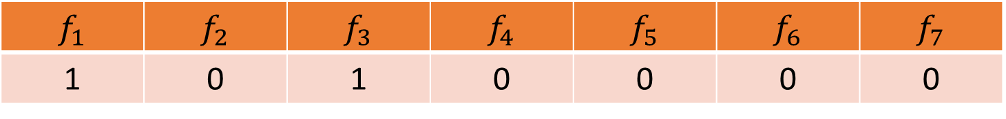
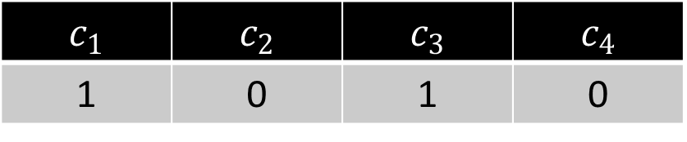
CountMin
$f_{1}$ | $f_{2}$ | $f_{3}$ | $f_{4}$ | $f_{5}$ | $f_{6}$ | $f_{7}$
1 | 0 | 1 | 0 | 0 | 0 | 0
$$3$$
$$h\left(x\right)=3x+2 (mod 4)$$
$c_{1}$ | $c_{2}$ | $c_{3}$ | $c_{4}$
1 | 0 | 1 | 0

Slide 31

CountMin
$f_{1}$ | $f_{2}$ | $f_{3}$ | $f_{4}$ | $f_{5}$ | $f_{6}$ | $f_{7}$
1 | 0 | 1 | 0 | 0 | 0 | 0
$$2$$
$$h\left(x\right)=3x+2 (mod 4)$$
$c_{1}$ | $c_{2}$ | $c_{3}$ | $c_{4}$
1 | 0 | 1 | 0

Slide 32
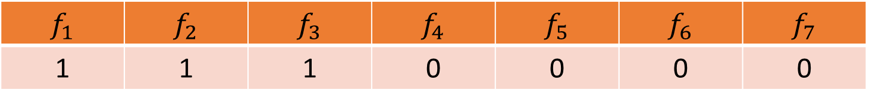
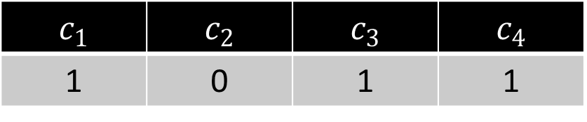
CountMin
$f_{1}$ | $f_{2}$ | $f_{3}$ | $f_{4}$ | $f_{5}$ | $f_{6}$ | $f_{7}$
1 | 1 | 1 | 0 | 0 | 0 | 0
$$2$$
$$h\left(x\right)=3x+2 (mod 4)$$
$c_{1}$ | $c_{2}$ | $c_{3}$ | $c_{4}$
1 | 0 | 1 | 1

Slide 33
CountMin
$f_{1}$ | $f_{2}$ | $f_{3}$ | $f_{4}$ | $f_{5}$ | $f_{6}$ | $f_{7}$
1 | 1 | 1 | 0 | 0 | 0 | 0
$$1$$
$$h\left(x\right)=3x+2 (mod 4)$$
$c_{1}$ | $c_{2}$ | $c_{3}$ | $c_{4}$
1 | 0 | 1 | 1

Slide 34
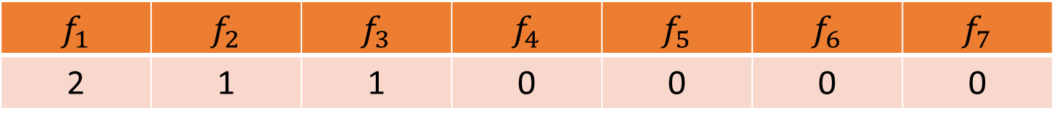
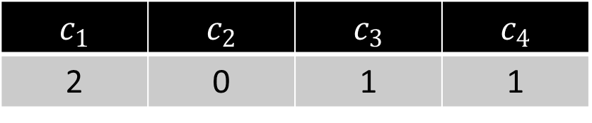
CountMin
$f_{1}$ | $f_{2}$ | $f_{3}$ | $f_{4}$ | $f_{5}$ | $f_{6}$ | $f_{7}$
2 | 1 | 1 | 0 | 0 | 0 | 0
$$1$$
$$h\left(x\right)=3x+2 (mod 4)$$
$c_{1}$ | $c_{2}$ | $c_{3}$ | $c_{4}$
2 | 0 | 1 | 1

Slide 35
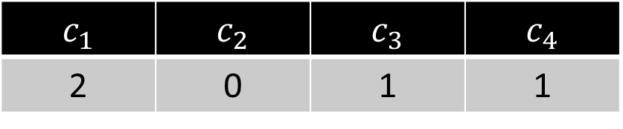

CountMin
$f_{1}$ | $f_{2}$ | $f_{3}$ | $f_{4}$ | $f_{5}$ | $f_{6}$ | $f_{7}$
2 | 1 | 1 | 0 | 0 | 0 | 0
$$5$$
$$h\left(x\right)=3x+2 (mod 4)$$
$c_{1}$ | $c_{2}$ | $c_{3}$ | $c_{4}$
2 | 0 | 1 | 1

Slide 36
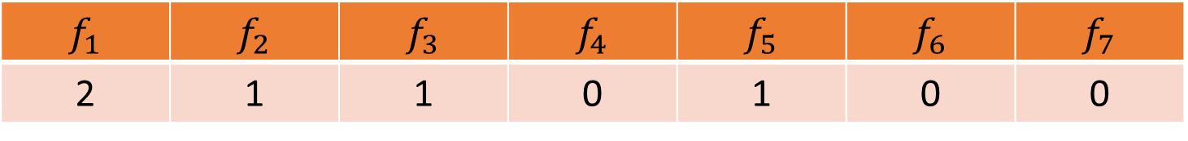
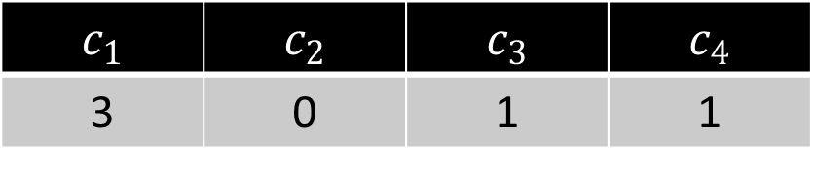
CountMin
$f_{1}$ | $f_{2}$ | $f_{3}$ | $f_{4}$ | $f_{5}$ | $f_{6}$ | $f_{7}$
2 | 1 | 1 | 0 | 1 | 0 | 0
$$5$$
$$h\left(x\right)=3x+2 (mod 4)$$
$c_{1}$ | $c_{2}$ | $c_{3}$ | $c_{4}$
3 | 0 | 1 | 1

Slide 37

CountMin
$f_{1}$ | $f_{2}$ | $f_{3}$ | $f_{4}$ | $f_{5}$ | $f_{6}$ | $f_{7}$
2 | 1 | 1 | 0 | 1 | 0 | 0
What is the estimation for $f_{4}$?
What about $f_{3}$?
What about $f_{5}$? What about $f_{1}$?
$$h\left(x\right)=3x+2 (mod 4)$$
$c_{1}$ | $c_{2}$ | $c_{3}$ | $c_{4}$
3 | 0 | 1 | 1

Slide 38
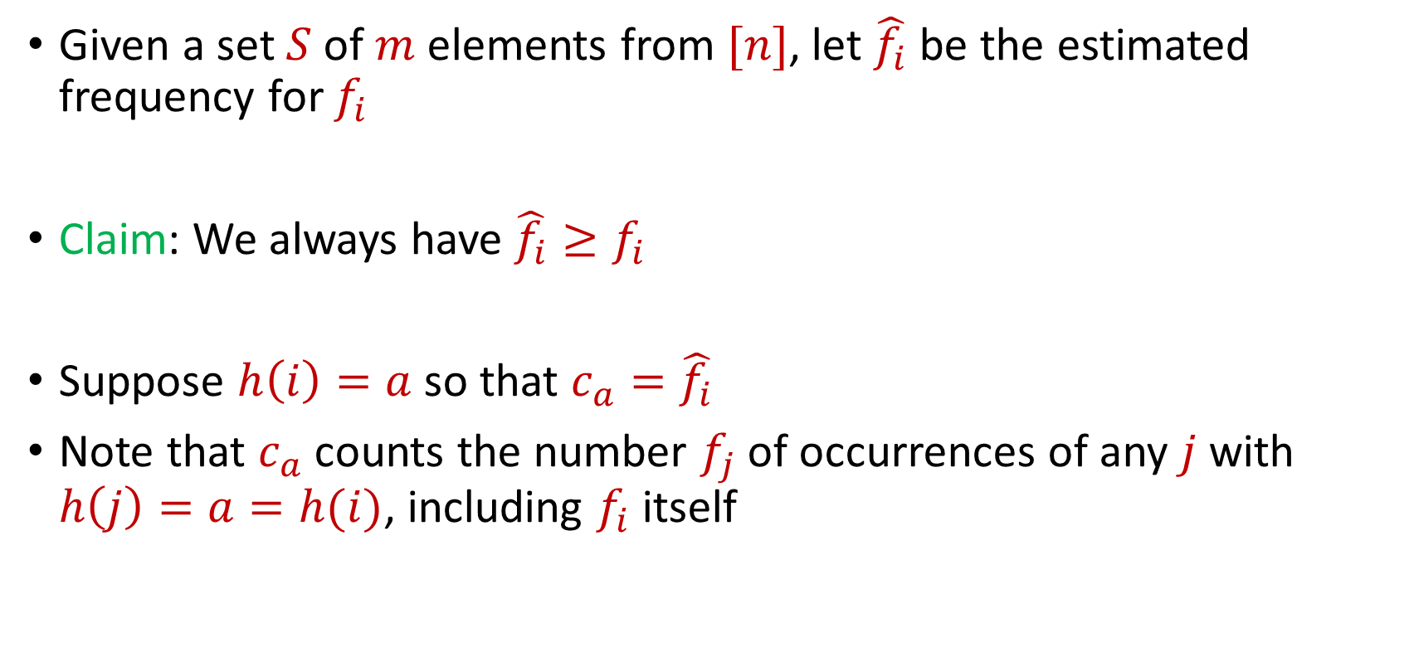
CountMin
Given a set $S$ of $m$ elements from $[n]$, let $\hat{f_{i}}$ be the estimated frequency for $f_{i}$
Claim: We always have $\hat{f_{i}}≥f_{i}$
Suppose $h\left(i\right)=a$ so that $c_{a}=\hat{f_{i}}$
Note that $c_{a}$counts the number $f_{j}$of occurrences of any $j$ with $h\left(j\right)=a=h(i)$, including $f_{i}$ itself

Slide 39
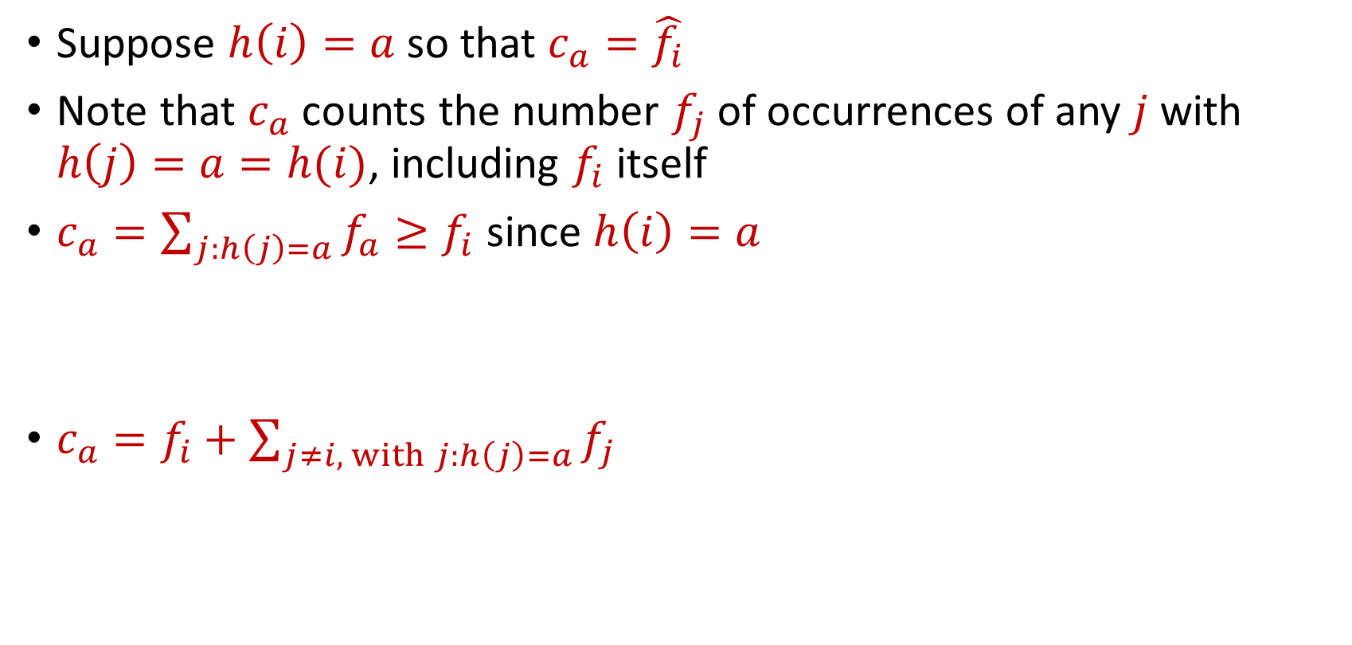
CountMin
Suppose $h\left(i\right)=a$ so that $c_{a}=\hat{f_{i}}$
Note that $c_{a}$counts the number $f_{j}$of occurrences of any $j$ with $h\left(j\right)=a=h(i)$, including $f_{i}$ itself
$c_{a}=\sum_{j:h\left(j\right)=a}{f_{a}}≥f_{i}$ since $h\left(i\right)=a$
$c_{a}=f_{i}+\sum_{j≠i, with j:h\left(j\right)=a}{f_{j}}$

Slide 40

CountMin Error Analysis
$c_{a}=f_{i}+\sum_{j≠i, with j:h\left(j\right)=a}{f_{j}}$
What is the expected error for $f_{i}$?

Slide 41

CountMin Error Analysis
$c_{a}=f_{i}+\sum_{j≠i, with j:h\left(j\right)=a}{f_{j}}$
What is the expected error for $f_{i}$?
$E\left[\left|\sum_{j≠i, with j:h\left(j\right)=a}{f_{j}}\right|\right]≤Σ_{j≠i}E\left[\left|f_{j}\right|⋅I_{h\left(j\right)=h(i)}\right]$

Slide 42
CountMin Error Analysis
$c_{a}=f_{i}+\sum_{j≠i, with j:h\left(j\right)=a}{f_{j}}$
What is the expected error for $f_{i}$?
$E\left[\left|\sum_{j≠i, with j:h\left(j\right)=a}{f_{j}}\right|\right]≤Σ_{j≠i}E\left[\left|f_{j}\right|⋅I_{h\left(j\right)=h(i)}\right]$
$$=Σ_{j≠i}E\left[I_{h\left(j\right)=h(i)}\right]⋅\left|f_{j}\right|$$

Slide 43
CountMin Error Analysis
$c_{a}=f_{i}+\sum_{j≠i, with j:h\left(j\right)=a}{f_{j}}$
What is the expected error for $f_{i}$?
$E\left[\left|\sum_{j≠i, with j:h\left(j\right)=a}{f_{j}}\right|\right]≤Σ_{j≠i}E\left[\left|f_{j}\right|⋅I_{h\left(j\right)=h(i)}\right]$
$$=Σ_{j≠i}E\left[I_{h\left(j\right)=h(i)}\right]⋅\left|f_{j}\right|$$
$$=Σ_{j≠i}Pr\left[h\left(j\right)=h(i)\right]⋅\left|f_{j}\right|$$

Slide 44

CountMin Error Analysis
$c_{a}=f_{i}+\sum_{j≠i, with j:h\left(j\right)=a}{f_{j}}$
What is the expected error for $f_{i}$?
$E\left[\left|\sum_{j≠i, with j:h\left(j\right)=a}{f_{j}}\right|\right]≤Σ_{j≠i}E\left[\left|f_{j}\right|⋅I_{h\left(j\right)=h(i)}\right]$
$$=Σ_{j≠i}E\left[I_{h\left(j\right)=h(i)}\right]⋅\left|f_{j}\right|$$
$$=Σ_{j≠i}Pr\left[h\left(j\right)=h(i)\right]⋅\left|f_{j}\right|$$
$$=Σ_{j≠i}\frac{1}{b}⋅\left|f_{j}\right|=\frac{{\left\|f\right\|}_{1}}{b}$$

Slide 45
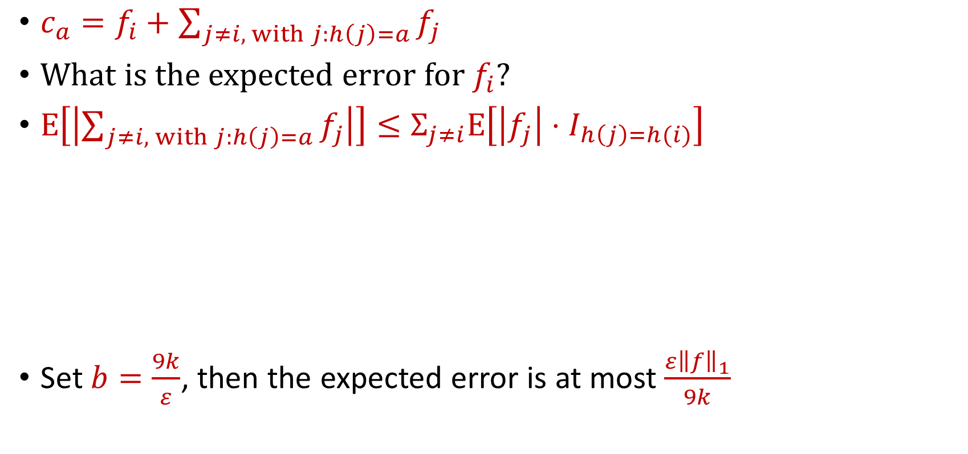

CountMin Error Analysis
$c_{a}=f_{i}+\sum_{j≠i, with j:h\left(j\right)=a}{f_{j}}$
What is the expected error for $f_{i}$?
$E\left[\left|\sum_{j≠i, with j:h\left(j\right)=a}{f_{j}}\right|\right]≤Σ_{j≠i}E\left[\left|f_{j}\right|⋅I_{h\left(j\right)=h(i)}\right]$
Set $b=\frac{9k}{ε}$, then the expected error is at most $\frac{ε{\left\|f\right\|}_{1}}{9k}$
$$=Σ_{j≠i}E\left[I_{h\left(j\right)=h(i)}\right]⋅\left|f_{j}\right|$$
$$=Σ_{j≠i}Pr\left[h\left(j\right)=h(i)\right]⋅\left|f_{j}\right|$$
$$=Σ_{j≠i}\frac{1}{b}⋅\left|f_{j}\right|=\frac{{\left\|f\right\|}_{1}}{b}$$

Slide 46
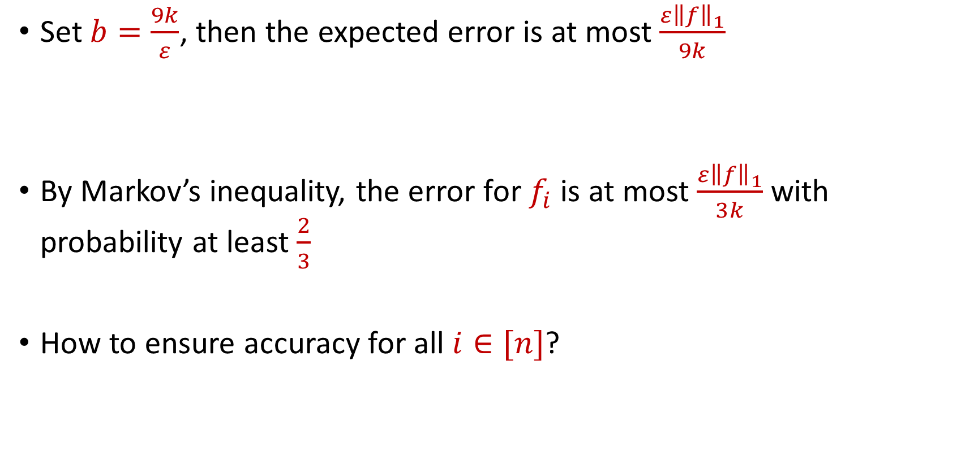
CountMin Error Analysis
Set $b=\frac{9k}{ε}$, then the expected error is at most $\frac{ε{\left\|f\right\|}_{1}}{9k}$
By Markov’s inequality, the error for $f_{i}$ is at most $\frac{ε{\left\|f\right\|}_{1}}{3k}$ with probability at least $\frac{2}{3}$
How to ensure accuracy for all $i∈[n]$?

Slide 47
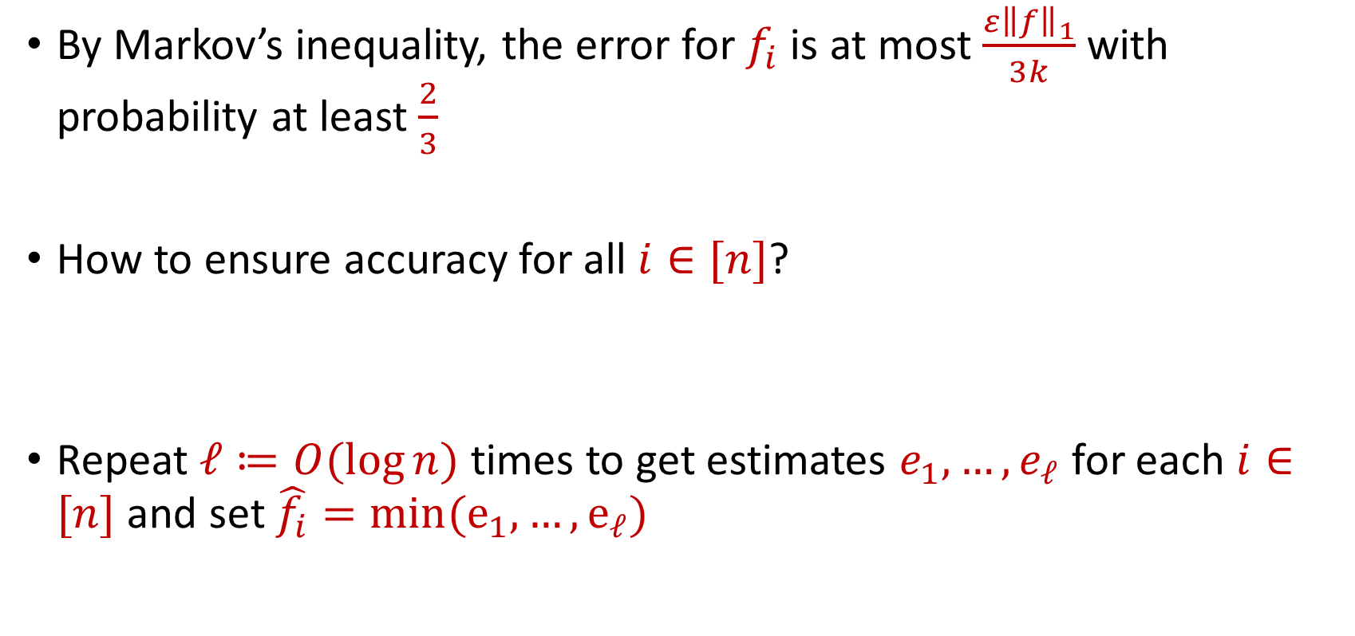
CountMin Error Analysis
By Markov’s inequality, the error for $f_{i}$ is at most $\frac{ε{\left\|f\right\|}_{1}}{3k}$ with probability at least $\frac{2}{3}$
How to ensure accuracy for all $i∈[n]$?
Repeat $ℓ≔O(\log{n)}$ times to get estimates $e_{1},…,e_{ℓ}$ for each $i∈[n]$ and set $\hat{f_{i}}=min(e_{1},…, e_{ℓ})$

Slide 48


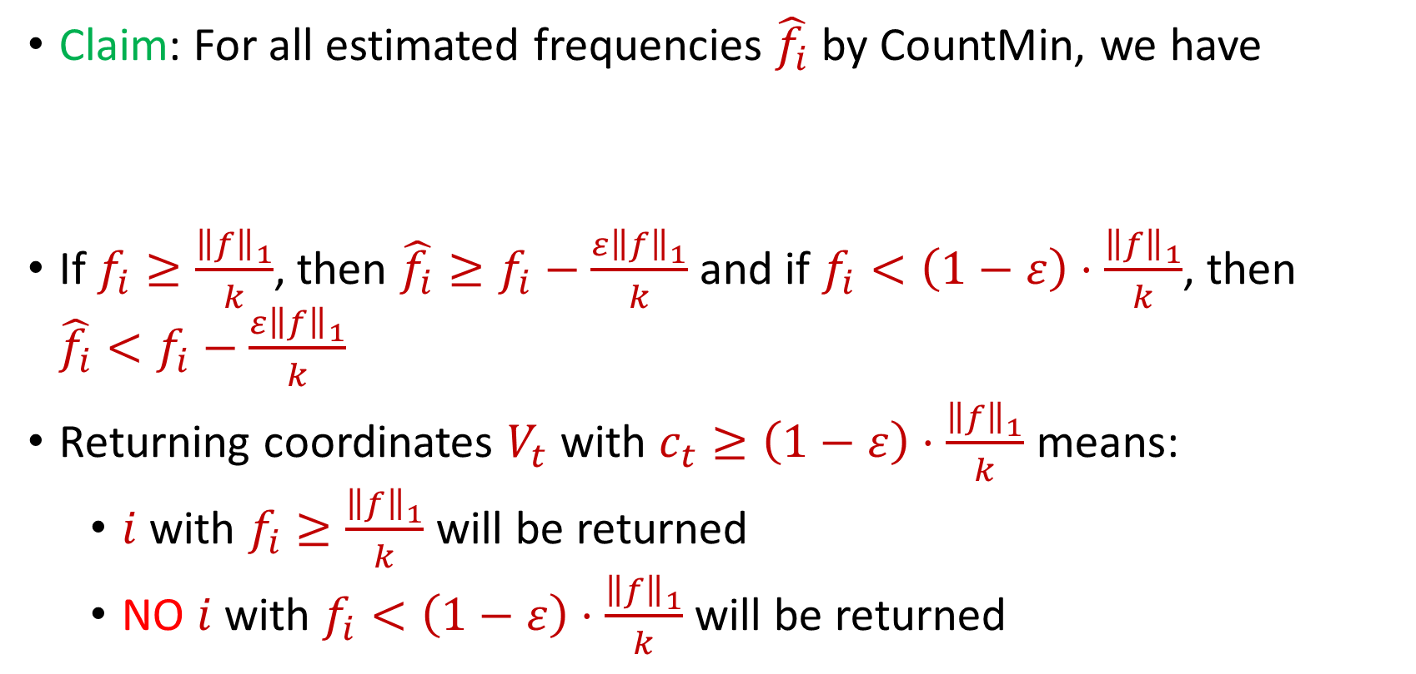
CountMin for $(ε,k)$-Frequent Items Problem
Claim: For all estimated frequencies $\hat{f_{i}}$ by CountMin, we have
If $f_{i}≥\frac{{\left\|f\right\|}_{1}}{k}$, then ${\hat{f_{i}}≥f}_{i}−\frac{ε{\left\|f\right\|}_{1}}{k}$ and if $f_{i}<\left(1−ε\right)⋅\frac{{\left\|f\right\|}_{1}}{k}$, then ${\hat{f_{i}}<f}_{i}−\frac{ε{\left\|f\right\|}_{1}}{k}$
Returning coordinates $V_{t}$ with $c_{t}≥\left(1−ε\right)⋅\frac{{\left\|f\right\|}_{1}}{k}$ means:
$i$ with $f_{i}≥\frac{{\left\|f\right\|}_{1}}{k}$ will be returned
NO $i$ with $f_{i}<\left(1−ε\right)⋅\frac{{\left\|f\right\|}_{1}}{k}$will be returned
$$f_{i}−\frac{ε{\left\|f\right\|}_{1}}{k}≤\hat{f_{i}}≤f_{i}+\frac{ε{\left\|f\right\|}_{1}}{k}$$

Slide 49
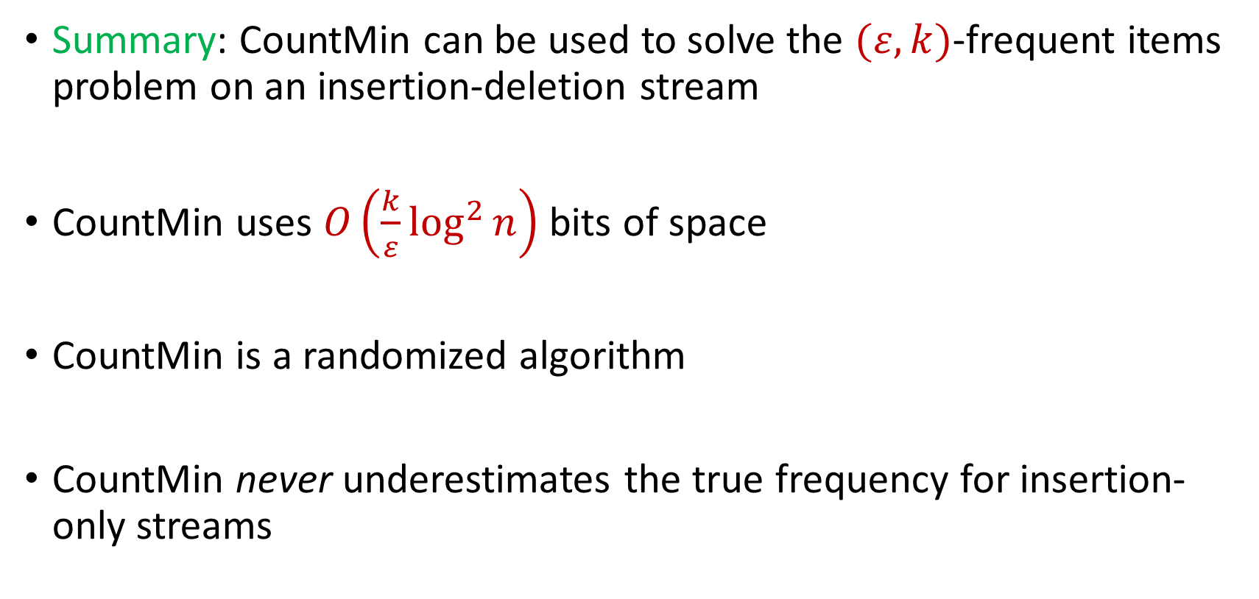
CountMin for $(ε,k)$-Frequent Items Problem
Summary: CountMin can be used to solve the $(ε,k)$-frequent items problem on an insertion-deletion stream
CountMin uses $O\left(\frac{k}{ε}\log^{2}{n}\right)$ bits of space
CountMin is a randomized algorithm
CountMin never underestimates the true frequency for insertion-only streams

Slide 50
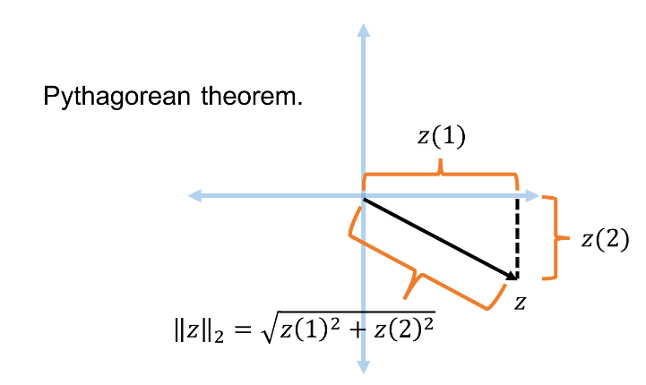




Recall: Euclidean Space and $L_{2}$ Norm
For $z$ $∈R^{n}$, the $L_{2}$ norm of $z$ is denoted by ${\left\|z\right\|}_{2}$ and defined as:
$${\left\|z\right\|}_{2}=\sqrt{z_{1}^{2}+z_{2}^{2}+…+z_{n}^{2}}$$
For $x,y$ $∈R^{n}$, the distance function $D$ is denoted by ${\left\|⋅\right\|}_{2}$ and defined as ${\left\|x−y\right\|}_{2}$

Slide 51
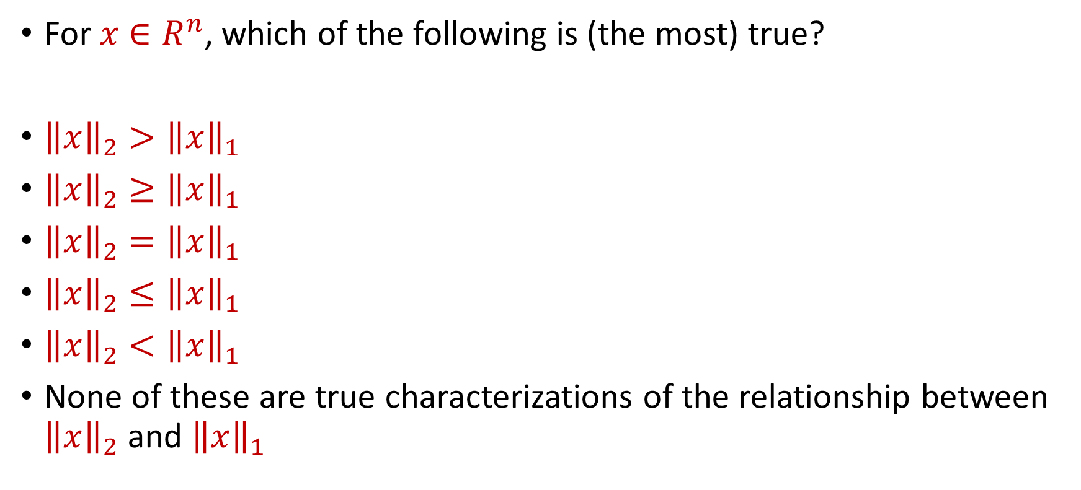
Trivia Question #7 (Norms)
For $x$ $∈R^{n}$, which of the following is (the most) true?
${\left\|x\right\|}_{2}>{\left\|x\right\|}_{1}$
${\left\|x\right\|}_{2}≥{\left\|x\right\|}_{1}$
${\left\|x\right\|}_{2}={\left\|x\right\|}_{1}$
${\left\|x\right\|}_{2}≤{\left\|x\right\|}_{1}$
${\left\|x\right\|}_{2}<{\left\|x\right\|}_{1}$
None of these are true characterizations of the relationship between ${\left\|x\right\|}_{2}$ and ${\left\|x\right\|}_{1}$

Slide 52

Trivia Question #8 (Norms)
For $x$ $∈R^{n}$, how much large can ${\left\|x\right\|}_{1}/{\left\|x\right\|}_{2}$ be?
$O\left(n\right)$
$O\left(\sqrt{n}\right)$
$O\left(\log{n}\right)$
$O\left(1\right)$

Slide 53
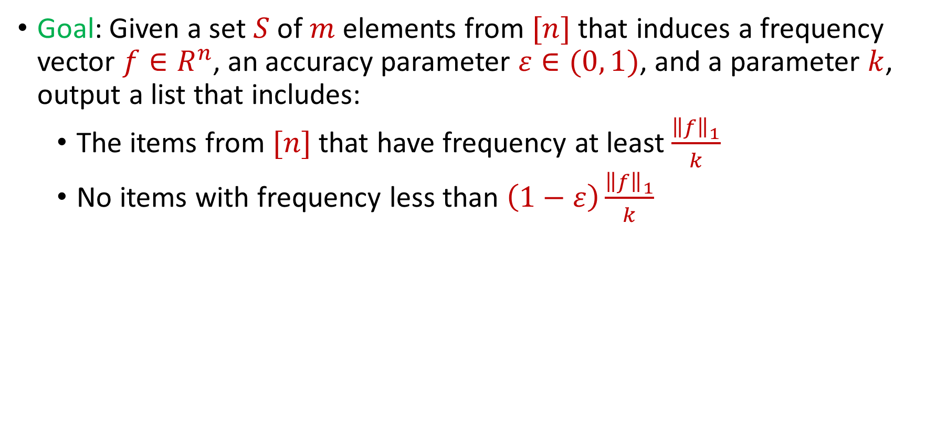
$(ε,k)$-Frequent Items Problem
Goal: Given a set $S$ of $m$ elements from $[n]$ that induces a frequency vector $f∈R^{n}$, an accuracy parameter $ε∈(0, 1)$, and a parameter $k$, output a list that includes:
The items from $[n]$ that have frequency at least $\frac{{\left\|f\right\|}_{1}}{k}$
No items with frequency less than $\left(1−ε\right)\frac{{\left\|f\right\|}_{1}}{k}$

Slide 54
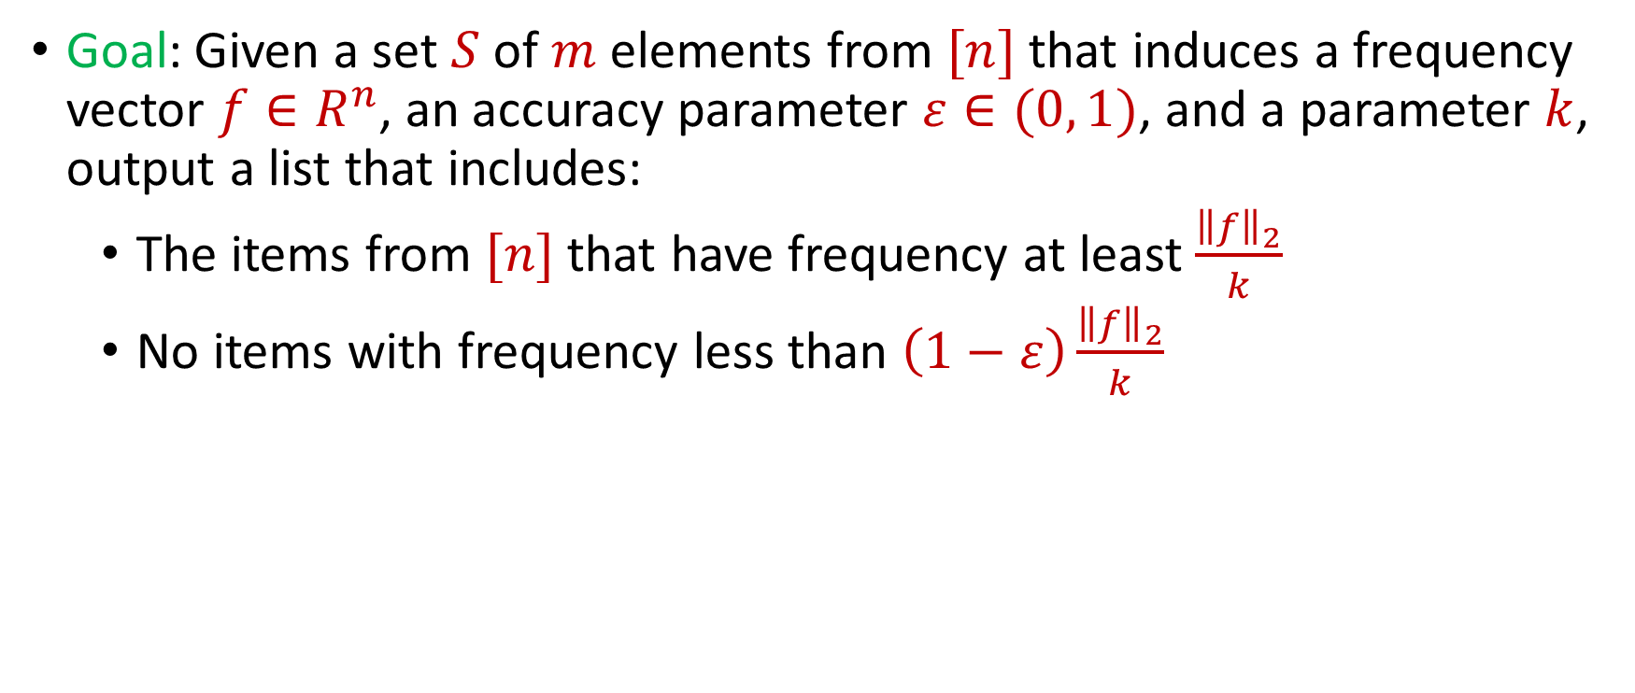
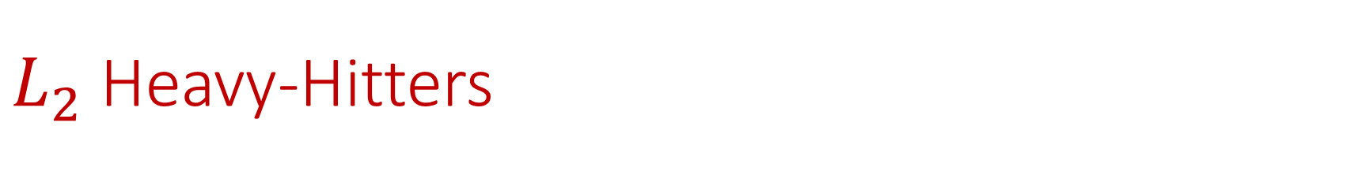
$L_{2}$ Heavy-Hitters
Goal: Given a set $S$ of $m$ elements from $[n]$ that induces a frequency vector $f∈R^{n}$, an accuracy parameter $ε∈(0, 1)$, and a parameter $k$, output a list that includes:
The items from $[n]$ that have frequency at least $\frac{{\left\|f\right\|}_{2}}{k}$
No items with frequency less than $\left(1−ε\right)\frac{{\left\|f\right\|}_{2}}{k}$

Slide 55

$L_{2}$ Heavy-Hitters
Goal: Given a set $S$ of $m$ elements from $[n]$ that induces a frequency vector $f∈R^{n}$ and a threshold parameter $ε∈(0, 1)$, output a list that includes:
The items from $[n]$ that have frequency at least $ε⋅{\left\|f\right\|}_{2}$
No items with frequency less than $\frac{ε}{2}⋅{\left\|f\right\|}_{2}$

Slide 56


$L_{2}$ Estimation
Goal: Given a set $S$ of $m$ elements from $[n]$ that induces a frequency vector $f∈R^{n}$ and an accuracy parameter $ε∈(0, 1)$, output a $(1+ε)$-approximation to ${\left\|f\right\|}_{2}$
Find $Z$ such that ${\left(1−ε\right)⋅\left\|f\right\|}_{2}≤Z≤\left(1+ε\right)⋅{\left\|f\right\|}_{2}$
Find $Z′$ such that ${\left(1−ε\right)⋅\left\|f\right\|}_{2}^{2}≤Z′≤\left(1+ε\right)⋅{\left\|f\right\|}_{2}^{2}$

Slide 57
$L_{2}$ Estimation
How to do?

Slide 58

$L_{2}$ Estimation
How to do?
Sorry, won’t reveal until next lecture (wait, don’t we already have a tool for this)?
Assume for now we are given ${\left\|f\right\|}_{2}$

Slide 59

Revisiting CountMin
Initalization: Create $b$ buckets of counters and use a random hash function $h:\left[n\right]→[b]$
Algorithm: For each insertion (or deletion) to $x_{i}$, increment (or decrement) the counter $h\left(x_{i}\right)$
At the end of the stream, output the counter $h\left(x_{i}\right)$ as the estimate for $x_{i}$
$c_{1}$ | $c_{2}$ | $c_{3}$ | $c_{4}$
0 | 0 | 0 | 0

Slide 60


CountMin and the Power of Random Signs
Initalization: Create $b$ buckets of counters and use a random hash function $h:\left[n\right]→[b]$ and a uniformly random sign function $s:\left[n\right]→\{−1,+1\}$, i.e., $Pr\left[s\left(i\right)=+1\right]=Pr\left[s\left(i\right)=−1\right]=\frac{1}{2}$
Algorithm: For each insertion (or deletion) to $x_{i}$, change the counter $h\left(x_{i}\right)$ by $s\left(x_{i}\right)$ (or $−s\left(x_{i}\right)$)
At the end of the stream, output the quantity $s\left(x_{i}\right)⋅h\left(x_{i}\right)$ as the estimate for $x_{i}$
$c_{1}$ | $c_{2}$ | $c_{3}$ | $c_{4}$
0 | 0 | 0 | 0

Slide 61
CountSketch
$f_{1}$ | $f_{2}$ | $f_{3}$ | $f_{4}$ | $f_{5}$ | $f_{6}$ | $f_{7}$
0 | 0 | 0 | 0 | 0 | 0 | 0
$$1$$
$c_{1}$ | $c_{2}$ | $c_{3}$ | $c_{4}$
0 | 0 | 0 | 0

Slide 62

CountSketch
$f_{1}$ | $f_{2}$ | $f_{3}$ | $f_{4}$ | $f_{5}$ | $f_{6}$ | $f_{7}$
1 | 0 | 0 | 0 | 0 | 0 | 0
$$1$$
$$h\left(x\right)=3x+2 (mod 4)$$
$s\left(x\right)=+1$ for $x∈\left\{1,2,3\right\}$
$s\left(x\right)=−1$ for $x∈\{4,5\}$
$c_{1}$ | $c_{2}$ | $c_{3}$ | $c_{4}$
0 | 0 | 0 | 0

Slide 63
CountSketch
$f_{1}$ | $f_{2}$ | $f_{3}$ | $f_{4}$ | $f_{5}$ | $f_{6}$ | $f_{7}$
1 | 0 | 0 | 0 | 0 | 0 | 0
$$1$$
$$h\left(x\right)=3x+2 (mod 4)$$
$s\left(x\right)=+1$ for $x∈\left\{1,2,3\right\}$
$s\left(x\right)=−1$ for $x∈\{4,5\}$
$c_{1}$ | $c_{2}$ | $c_{3}$ | $c_{4}$
0 | 0 | 0 | 0

Slide 64
CountSketch
$f_{1}$ | $f_{2}$ | $f_{3}$ | $f_{4}$ | $f_{5}$ | $f_{6}$ | $f_{7}$
1 | 0 | 0 | 0 | 0 | 0 | 0
$$1$$
$$h\left(x\right)=3x+2 (mod 4)$$
$s\left(x\right)=+1$ for $x∈\left\{1,2,3\right\}$
$s\left(x\right)=−1$ for $x∈\{4,5\}$
$c_{1}$ | $c_{2}$ | $c_{3}$ | $c_{4}$
1 | 0 | 0 | 0

Slide 65
CountSketch
$f_{1}$ | $f_{2}$ | $f_{3}$ | $f_{4}$ | $f_{5}$ | $f_{6}$ | $f_{7}$
1 | 0 | 0 | 0 | 0 | 0 | 0
$$3$$
$$h\left(x\right)=3x+2 (mod 4)$$
$s\left(x\right)=+1$ for $x∈\left\{1,2,3\right\}$
$s\left(x\right)=−1$ for $x∈\{4,5\}$
$c_{1}$ | $c_{2}$ | $c_{3}$ | $c_{4}$
1 | 0 | 0 | 0

Slide 66

CountSketch
$f_{1}$ | $f_{2}$ | $f_{3}$ | $f_{4}$ | $f_{5}$ | $f_{6}$ | $f_{7}$
1 | 0 | 1 | 0 | 0 | 0 | 0
$$3$$
$$h\left(x\right)=3x+2 (mod 4)$$
$s\left(x\right)=+1$ for $x∈\left\{1,2,3\right\}$
$s\left(x\right)=−1$ for $x∈\{4,5\}$
$c_{1}$ | $c_{2}$ | $c_{3}$ | $c_{4}$
1 | 0 | 1 | 0

Slide 67
CountSketch
$f_{1}$ | $f_{2}$ | $f_{3}$ | $f_{4}$ | $f_{5}$ | $f_{6}$ | $f_{7}$
1 | 0 | 1 | 0 | 0 | 0 | 0
$$2$$
$$h\left(x\right)=3x+2 (mod 4)$$
$s\left(x\right)=+1$ for $x∈\left\{1,2,3\right\}$
$s\left(x\right)=−1$ for $x∈\{4,5\}$
$c_{1}$ | $c_{2}$ | $c_{3}$ | $c_{4}$
1 | 0 | 1 | 0

Slide 68

CountSketch
$f_{1}$ | $f_{2}$ | $f_{3}$ | $f_{4}$ | $f_{5}$ | $f_{6}$ | $f_{7}$
1 | 1 | 1 | 0 | 0 | 0 | 0
$$2$$
$$h\left(x\right)=3x+2 (mod 4)$$
$s\left(x\right)=+1$ for $x∈\left\{1,2,3\right\}$
$s\left(x\right)=−1$ for $x∈\{4,5\}$
$c_{1}$ | $c_{2}$ | $c_{3}$ | $c_{4}$
1 | 0 | 1 | 1

Slide 69
CountSketch
$f_{1}$ | $f_{2}$ | $f_{3}$ | $f_{4}$ | $f_{5}$ | $f_{6}$ | $f_{7}$
1 | 1 | 1 | 0 | 0 | 0 | 0
$$1$$
$$h\left(x\right)=3x+2 (mod 4)$$
$s\left(x\right)=+1$ for $x∈\left\{1,2,3\right\}$
$s\left(x\right)=−1$ for $x∈\{4,5\}$
$c_{1}$ | $c_{2}$ | $c_{3}$ | $c_{4}$
1 | 0 | 1 | 1

Slide 70
CountSketch
$f_{1}$ | $f_{2}$ | $f_{3}$ | $f_{4}$ | $f_{5}$ | $f_{6}$ | $f_{7}$
2 | 1 | 1 | 0 | 0 | 0 | 0
$$1$$
$$h\left(x\right)=3x+2 (mod 4)$$
$s\left(x\right)=+1$ for $x∈\left\{1,2,3\right\}$
$s\left(x\right)=−1$ for $x∈\{4,5\}$
$c_{1}$ | $c_{2}$ | $c_{3}$ | $c_{4}$
2 | 0 | 1 | 1

Slide 71
CountSketch
$f_{1}$ | $f_{2}$ | $f_{3}$ | $f_{4}$ | $f_{5}$ | $f_{6}$ | $f_{7}$
2 | 1 | 1 | 0 | 0 | 0 | 0
$$5$$
$$h\left(x\right)=3x+2 (mod 4)$$
$s\left(x\right)=+1$ for $x∈\left\{1,2,3\right\}$
$s\left(x\right)=−1$ for $x∈\{4,5\}$
$c_{1}$ | $c_{2}$ | $c_{3}$ | $c_{4}$
2 | 0 | 1 | 1

Slide 72
CountSketch
$f_{1}$ | $f_{2}$ | $f_{3}$ | $f_{4}$ | $f_{5}$ | $f_{6}$ | $f_{7}$
2 | 1 | 1 | 0 | 1 | 0 | 0
$$5$$
$$h\left(x\right)=3x+2 (mod 4)$$
$s\left(x\right)=+1$ for $x∈\left\{1,2,3\right\}$
$s\left(x\right)=−1$ for $x∈\{4,5\}$
$c_{1}$ | $c_{2}$ | $c_{3}$ | $c_{4}$
1 | 0 | 1 | 1

Slide 73
CountSketch
$f_{1}$ | $f_{2}$ | $f_{3}$ | $f_{4}$ | $f_{5}$ | $f_{6}$ | $f_{7}$
2 | 1 | 1 | 0 | 1 | 0 | 0
What is the estimation for $f_{4}$?
What about $f_{3}$?
What about $f_{5}$? What about $f_{1}$?
$$h\left(x\right)=3x+2 (mod 4)$$
$s\left(x\right)=+1$ for $x∈\left\{1,2,3\right\}$
$s\left(x\right)=−1$ for $x∈\{4,5\}$
$c_{1}$ | $c_{2}$ | $c_{3}$ | $c_{4}$
1 | 0 | 1 | 1

