Slide 1
CSCE 689: Special Topics in Modern Algorithms for Data Science
Lecture 8
Samson Zhou

Slide 2
Dimensionality Reduction
Many images from:
Cameron Musco’s
COMPSCI 514: Algorithms for Data Science

Slide 3

Last Time: Low Distortion Embedding
Given $x_{1},…,x_{n}$ $∈R^{d}$, a distance function $D$, and an accuracy parameter $ε∈[0,1)$, a low-distortion embedding of $x_{1},…,x_{n}$ is a set of points $y_{1},…,y_{n}$, and a distance function $D′$ such that for all $i,j∈[n]$
$$\left(1−ε\right)D\left(x_{i},x_{j}\right)≤D^{′}\left(y_{i},y_{j}\right)≤\left(1+ε\right)D\left(x_{i}, x_{j}\right)$$

Slide 4
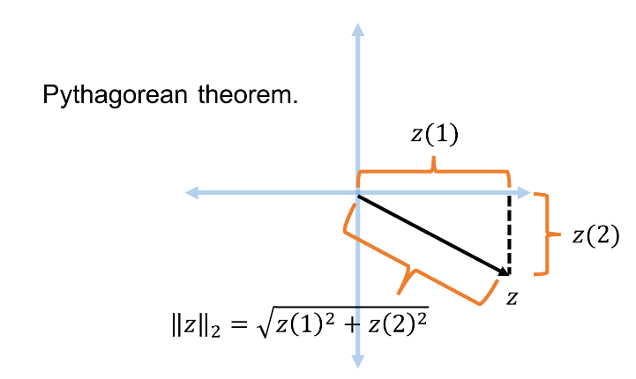



Last Time: Euclidean Space
For $z$ $∈R^{d}$, the $ℓ_{2}$ norm of $z$ is denoted by ${\left\|z\right\|}_{2}$ and defined as:
$${\left\|z\right\|}_{2}=\sqrt{z_{1}^{2}+z_{2}^{2}+…+z_{d}^{2}}$$
For $x,y$ $∈R^{d}$, the distance function $D$ is denoted by ${\left\|⋅\right\|}_{2}$ and defined as ${\left\|x−y\right\|}_{2}$

Slide 5
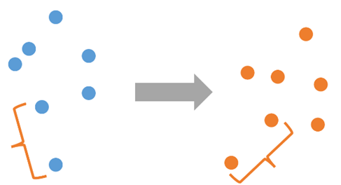



Last Time: Low Distortion Embedding for Euclidean Space
Given $x_{1},…,x_{n}$ $∈R^{d}$ and an accuracy parameter $ε∈[0,1)$, a low-distortion embedding of $x_{1},…,x_{n}$ is a set of points $y_{1},…,y_{n}$ such that for all $i,j∈[n]$
$$\left(1−ε\right){\left\|x_{i}−x_{j}\right\|}_{2}≤{\left\|y_{i}−y_{j}\right\|}_{2}≤\left(1+ε\right){\left\|x_{i}−x_{j}\right\|}_{2}$$
$${\left\|x_{i}−x_{j}\right\|}_{2}$$
$${\left\|y_{i}−y_{j}\right\|}_{2}$$

Slide 6
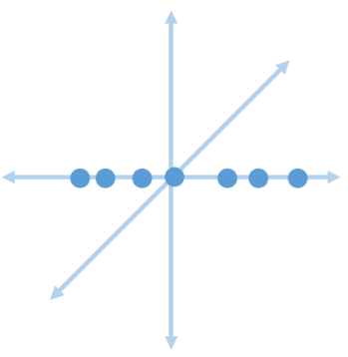
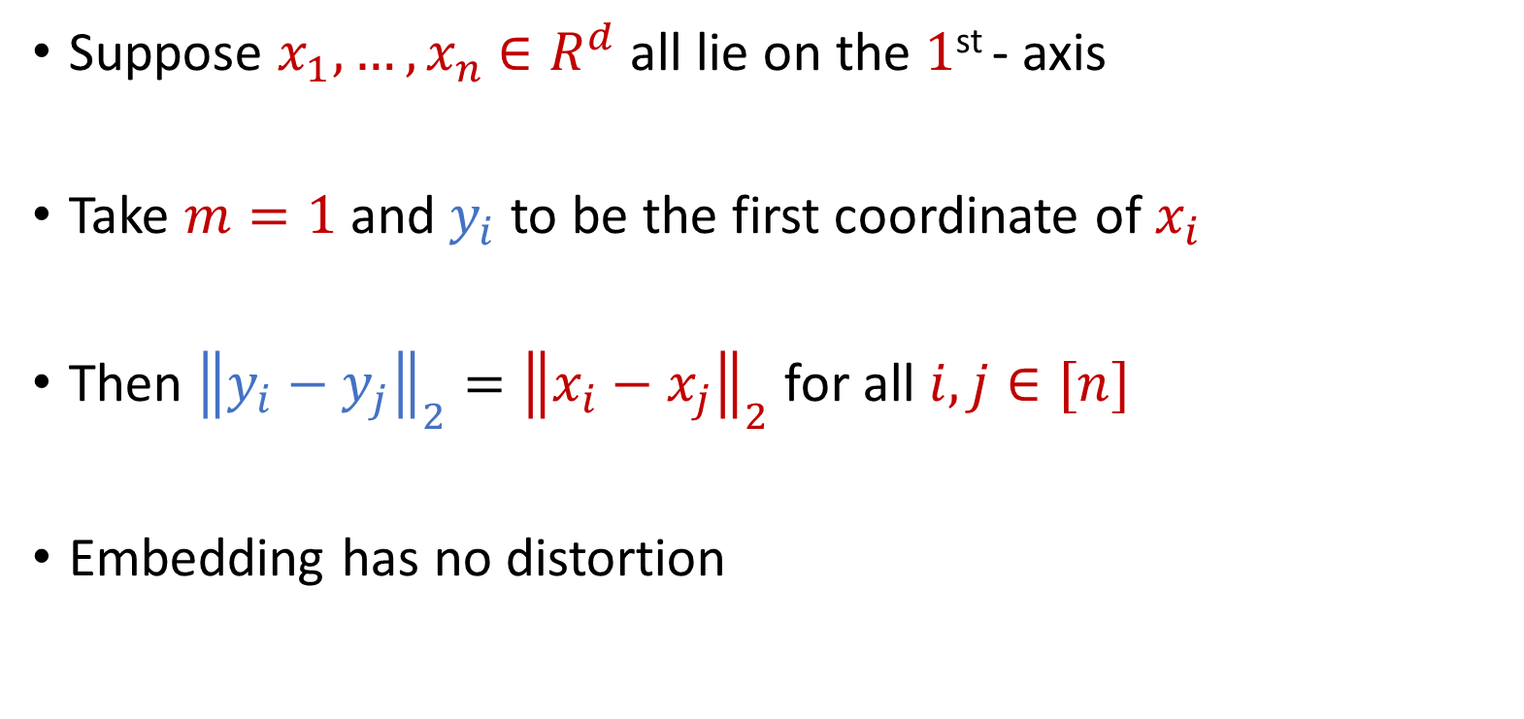
Examples: Embeddings for Euclidean Space
Suppose $x_{1},…,x_{n}$ $∈R^{d}$ all lie on the $1$^{st} - axis
Take $m=1$ and $y_{i}$ to be the first coordinate of $x_{i}$
Then ${\left\|y_{i}−y_{j}\right\|}_{2}={\left\|x_{i}−x_{j}\right\|}_{2}$ for all $i,j∈[n]$
Embedding has no distortion

Slide 7
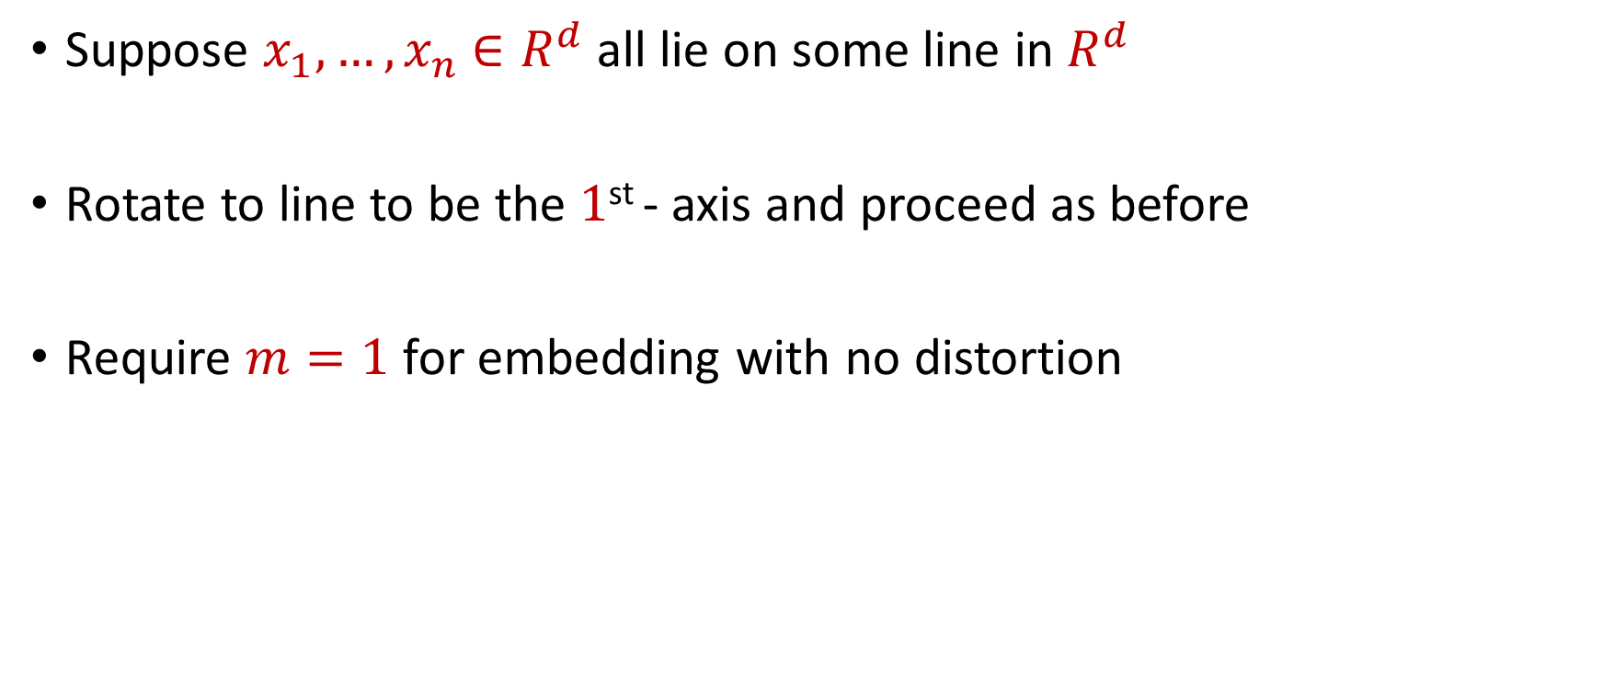
Examples: Embeddings for Euclidean Space
Suppose $x_{1},…,x_{n}$ $∈R^{d}$ all lie on some line in $R^{d}$
Rotate to line to be the $1$^{st} - axis and proceed as before
Require $m=1$ for embedding with no distortion

Slide 8
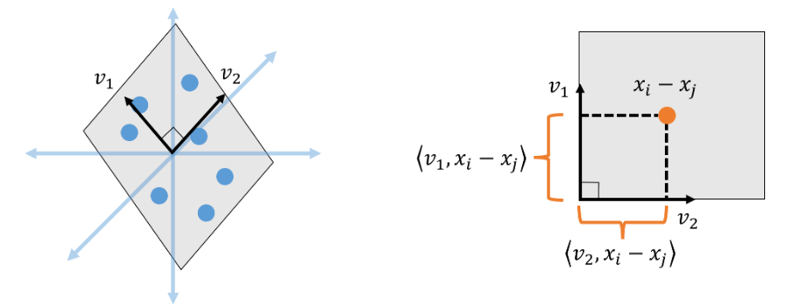
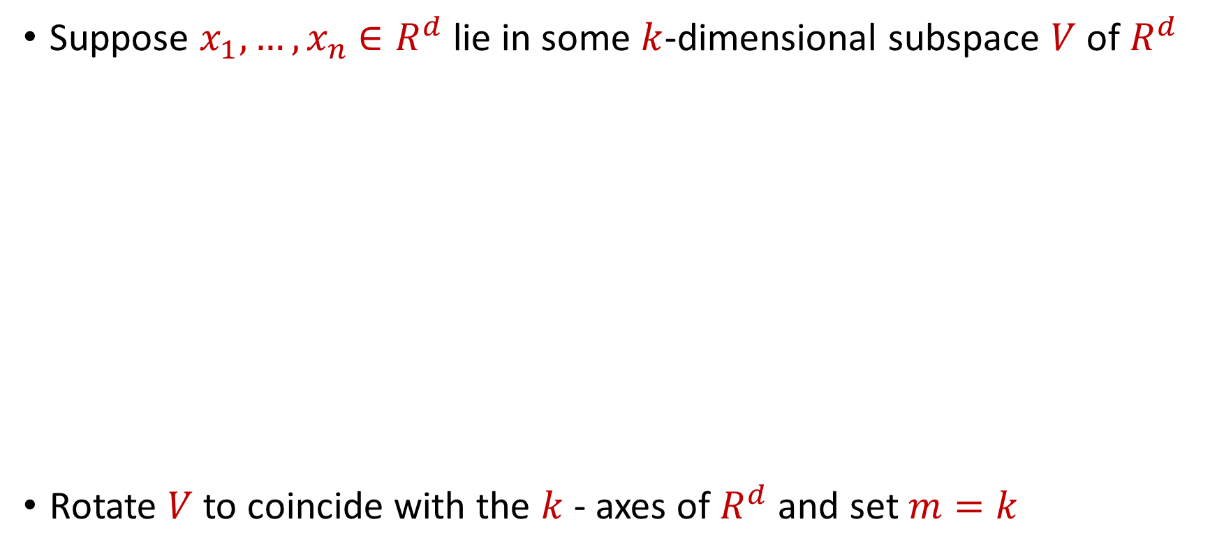
Examples: Embeddings for Euclidean Space
Suppose $x_{1},…,x_{n}$ $∈R^{d}$ lie in some $k$-dimensional subspace $V$ of $R^{d}$
Rotate $V$ to coincide with the $k$- axes of $R^{d}$ and set $m=k$

Slide 9

Embeddings for Euclidean Space
Given $x_{1},…,x_{n}$ $∈R^{d}$ that lie in general position, does there exist an embedding with no distortion?

Slide 10
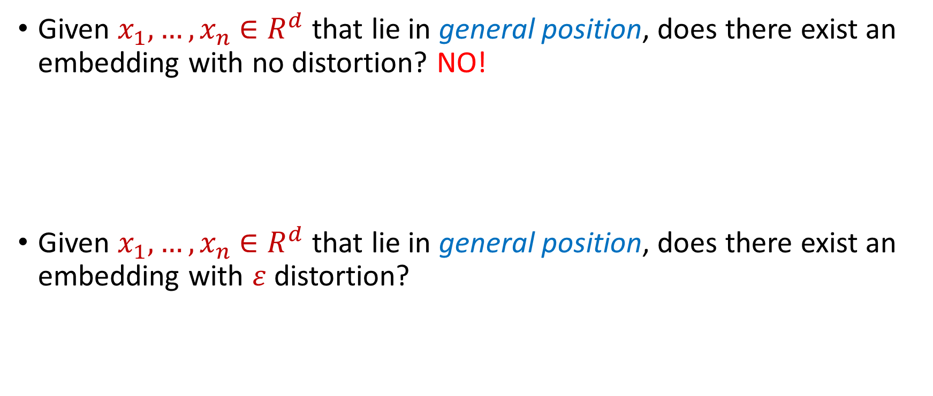
Embeddings for Euclidean Space
Given $x_{1},…,x_{n}$ $∈R^{d}$ that lie in general position, does there exist an embedding with no distortion? NO!
Given $x_{1},…,x_{n}$ $∈R^{d}$ that lie in general position, does there exist an embedding with $ε$ distortion?

Slide 11
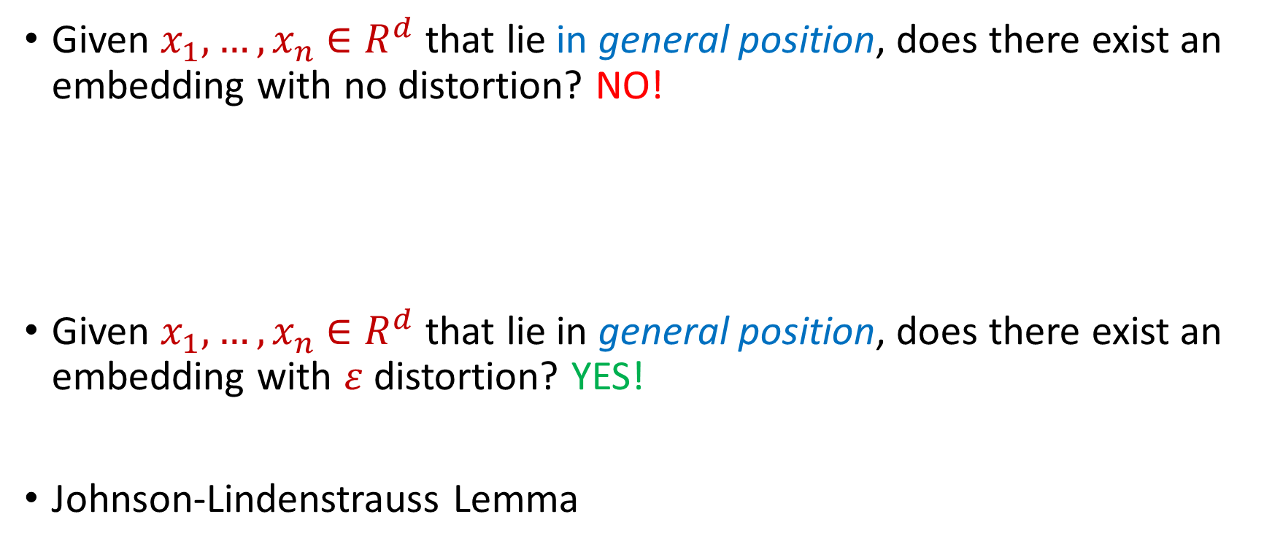
Embeddings for Euclidean Space
Given $x_{1},…,x_{n}$ $∈R^{d}$ that lie in general position, does there exist an embedding with no distortion? NO!
Given $x_{1},…,x_{n}$ $∈R^{d}$ that lie in general position, does there exist an embedding with $ε$ distortion? YES!
Johnson-Lindenstrauss Lemma

Slide 12

Johnson-Lindenstrauss Lemma
Johnson-Lindenstrauss Lemma: Given $x_{1},…,x_{n}$ $∈R^{d}$ and an accuracy parameter $ε∈[0,1)$, there exists a linear map $Π:R^{d}→R^{m}$ with $m=O\left(\frac{\log{n}}{ε^{2}}\right)$ so that if $y_{i}=Πx_{i}$, then for all $i,j∈[n]$:
$$\left(1−ε\right){\left\|x_{i}−x_{j}\right\|}_{2}≤{\left\|y_{i}−y_{j}\right\|}_{2}≤\left(1+ε\right){\left\|x_{i}−x_{j}\right\|}_{2}$$

Slide 13
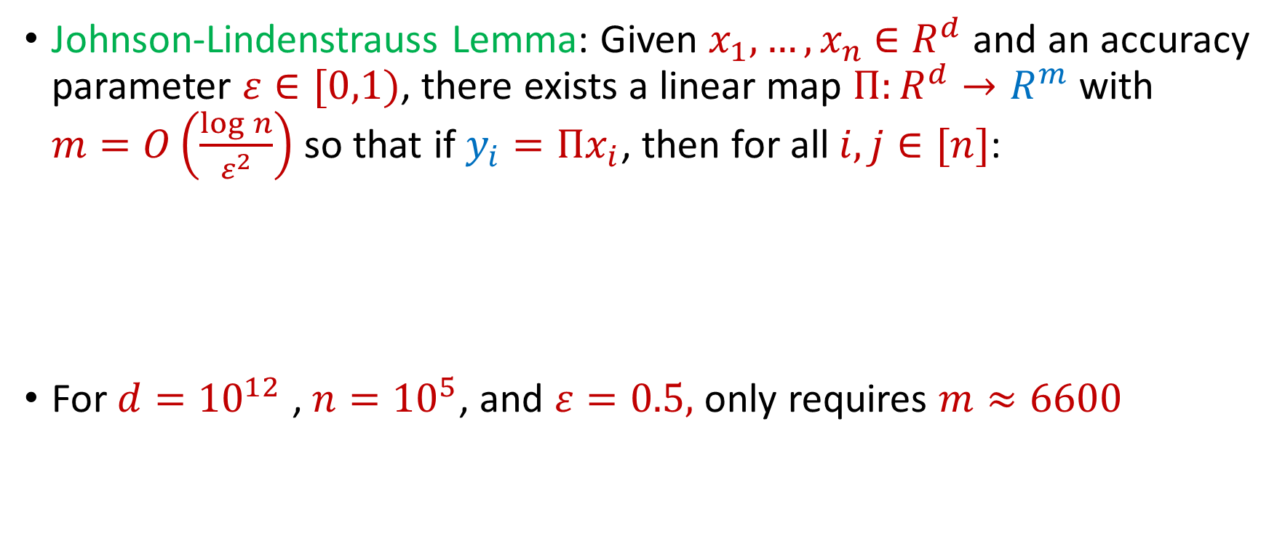
Johnson-Lindenstrauss Lemma
Johnson-Lindenstrauss Lemma: Given $x_{1},…,x_{n}$ $∈R^{d}$ and an accuracy parameter $ε∈[0,1)$, there exists a linear map $Π:R^{d}→R^{m}$ with $m=O\left(\frac{\log{n}}{ε^{2}}\right)$ so that if $y_{i}=Πx_{i}$, then for all $i,j∈[n]$:
For $d={10}^{12}$ , $n={10}^{5}$, and $ε=0.5,$ only requires $m≈6600$
$$\left(1−ε\right){\left\|x_{i}−x_{j}\right\|}_{2}≤{\left\|y_{i}−y_{j}\right\|}_{2}≤\left(1+ε\right){\left\|x_{i}−x_{j}\right\|}_{2}$$

Slide 14
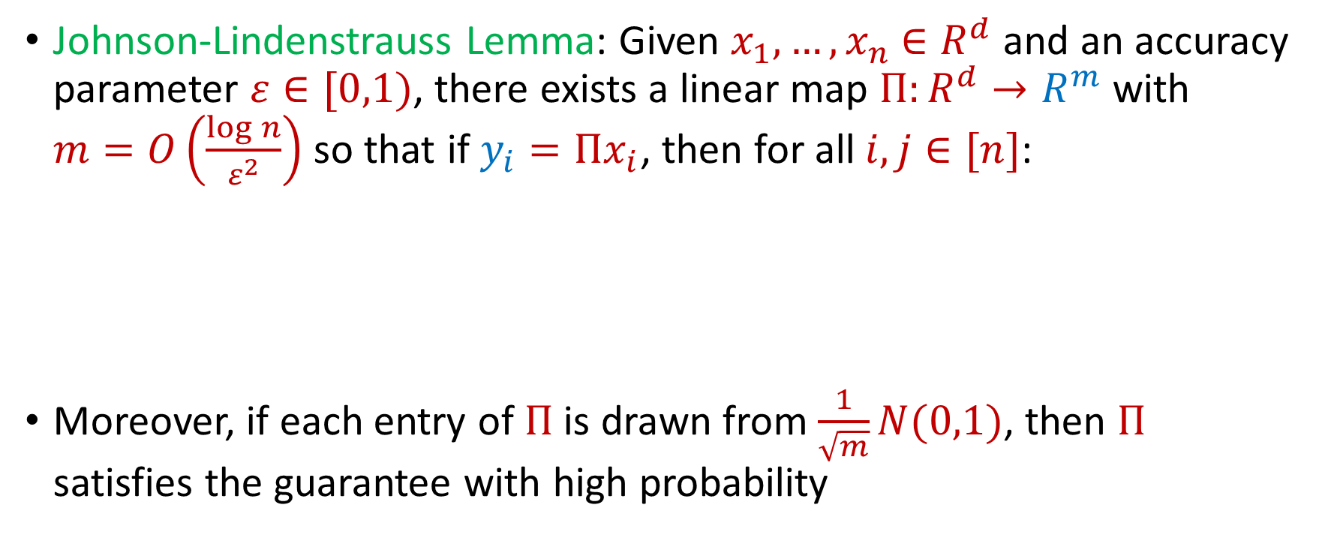
Johnson-Lindenstrauss Lemma
Johnson-Lindenstrauss Lemma: Given $x_{1},…,x_{n}$ $∈R^{d}$ and an accuracy parameter $ε∈[0,1)$, there exists a linear map $Π:R^{d}→R^{m}$ with $m=O\left(\frac{\log{n}}{ε^{2}}\right)$ so that if $y_{i}=Πx_{i}$, then for all $i,j∈[n]$:
Moreover, if each entry of $Π$ is drawn from $\frac{1}{\sqrt{m}}N(0,1)$, then $Π$ satisfies the guarantee with high probability
$$\left(1−ε\right){\left\|x_{i}−x_{j}\right\|}_{2}≤{\left\|y_{i}−y_{j}\right\|}_{2}≤\left(1+ε\right){\left\|x_{i}−x_{j}\right\|}_{2}$$

Slide 15
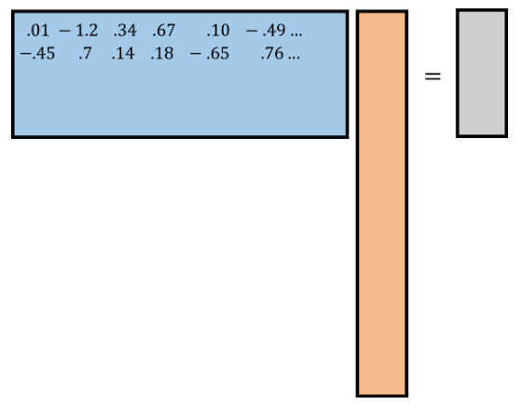
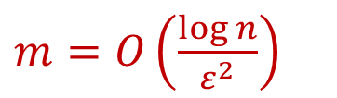
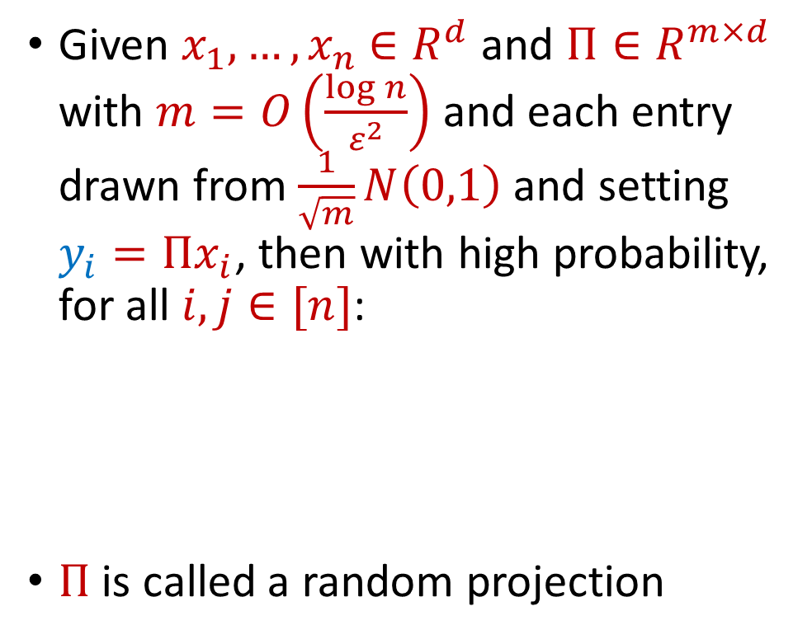






Johnson-Lindenstrauss Lemma
$$R^{m×d}$$
$$R^{d}$$
$$R^{m}$$
Given $x_{1},…,x_{n}$ $∈R^{d}$ and $Π∈R^{m×d}$ with $m=O\left(\frac{\log{n}}{ε^{2}}\right)$ and each entry drawn from $\frac{1}{\sqrt{m}}N\left(0,1\right)$ and setting $y_{i}=Πx_{i}$, then with high probability, for all $i,j∈[n]$:
$Π$ is called a random projection
$$y_{i}$$
$$Π$$
$m=O\left(\frac{\log{n}}{ε^{2}}\right)$
$$x_{i}$$
$$\left(1−ε\right){\left\|x_{i}−x_{j}\right\|}_{2}≤{\left\|y_{i}−y_{j}\right\|}_{2}≤\left(1+ε\right){\left\|x_{i}−x_{j}\right\|}_{2}$$

Slide 16
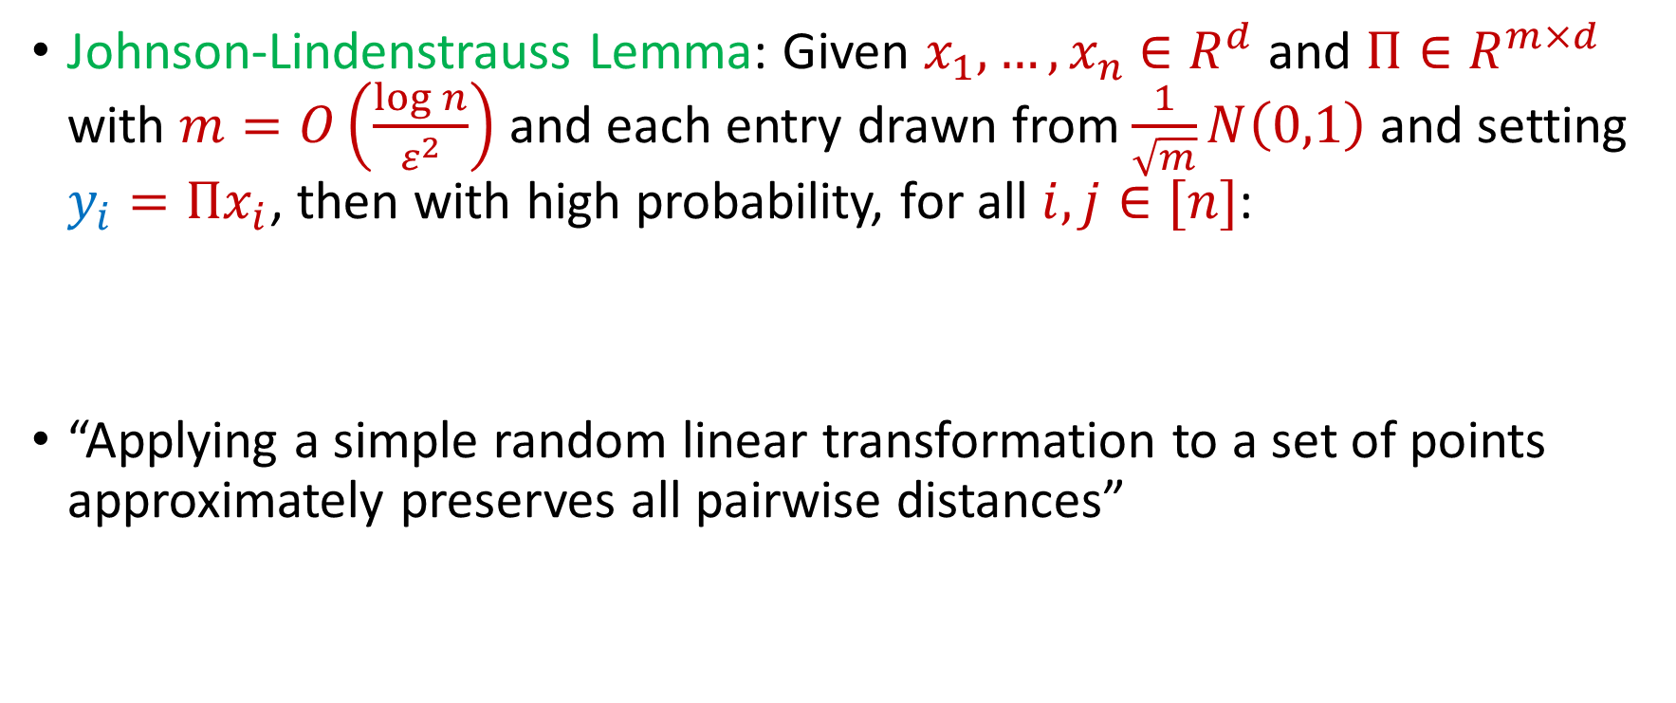
Johnson-Lindenstrauss Lemma
Johnson-Lindenstrauss Lemma: Given $x_{1},…,x_{n}$ $∈R^{d}$ and $Π∈R^{m×d}$ with $m=O\left(\frac{\log{n}}{ε^{2}}\right)$ and each entry drawn from $\frac{1}{\sqrt{m}}N\left(0,1\right)$ and setting $y_{i}=Πx_{i}$, then with high probability, for all $i,j∈[n]$:
“Applying a simple random linear transformation to a set of points approximately preserves all pairwise distances”
$$\left(1−ε\right){\left\|x_{i}−x_{j}\right\|}_{2}≤{\left\|y_{i}−y_{j}\right\|}_{2}≤\left(1+ε\right){\left\|x_{i}−x_{j}\right\|}_{2}$$

Slide 17

Johnson-Lindenstrauss Lemma
Distributional Johnson-Lindenstrauss Lemma: Given $Π∈R^{m×d}$ with $m=O\left(\frac{\log{1/δ}}{ε^{2}}\right)$ and each entry drawn from $\frac{1}{\sqrt{m}}N\left(0,1\right)$, then for any $x∈R^{d}$ and setting $y=Πx$, then with probability at least $1−δ$
$$\left(1−ε\right){\left\|x\right\|}_{2}≤{\left\|y\right\|}_{2}≤\left(1+ε\right){\left\|x\right\|}_{2}$$

Slide 18
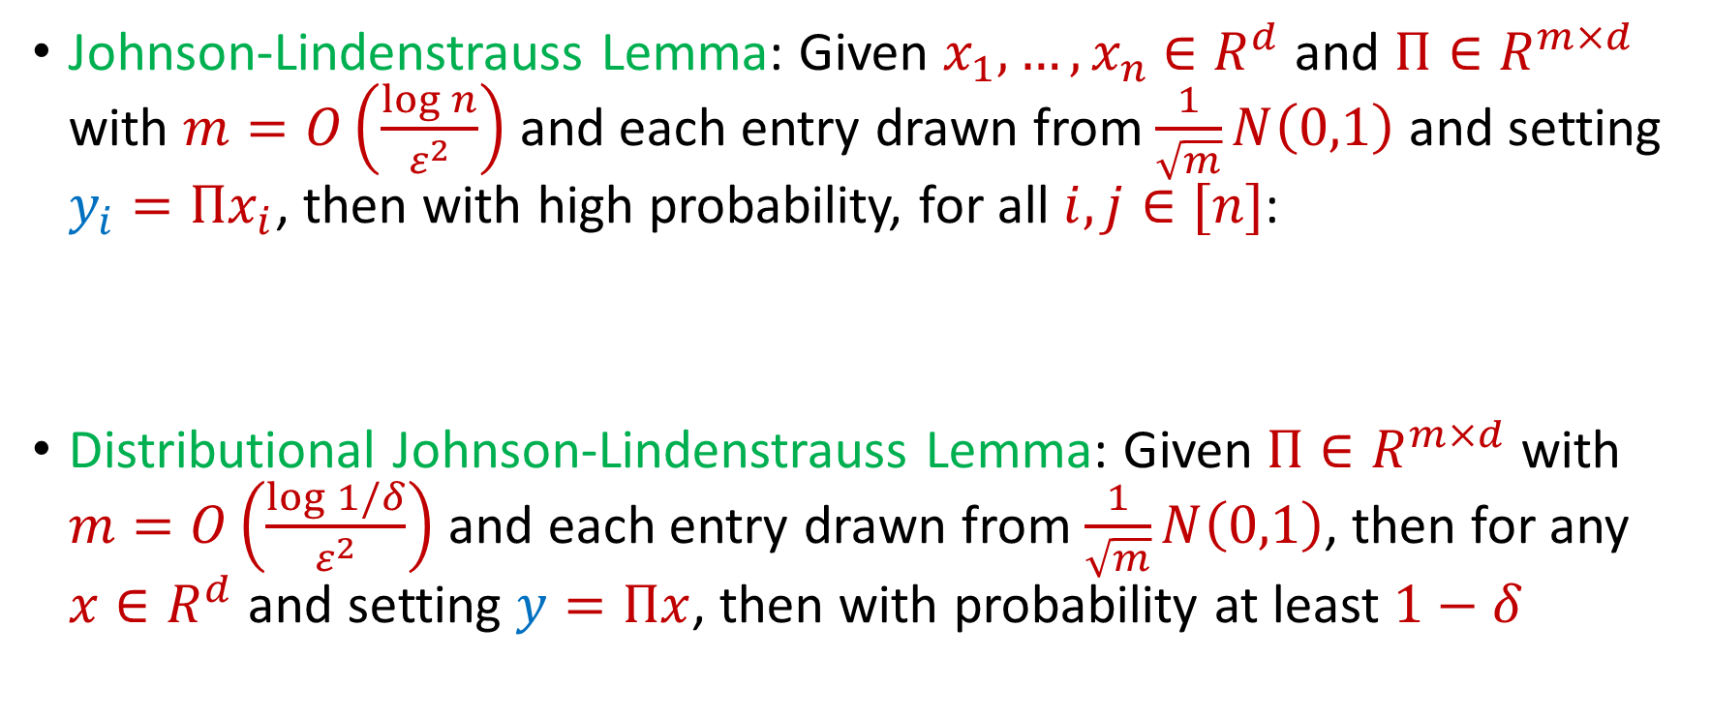
Johnson-Lindenstrauss Lemma
Johnson-Lindenstrauss Lemma: Given $x_{1},…,x_{n}$ $∈R^{d}$ and $Π∈R^{m×d}$ with $m=O\left(\frac{\log{n}}{ε^{2}}\right)$ and each entry drawn from $\frac{1}{\sqrt{m}}N\left(0,1\right)$ and setting $y_{i}=Πx_{i}$, then with high probability, for all $i,j∈[n]$:
Distributional Johnson-Lindenstrauss Lemma: Given $Π∈R^{m×d}$ with $m=O\left(\frac{\log{1/δ}}{ε^{2}}\right)$ and each entry drawn from $\frac{1}{\sqrt{m}}N\left(0,1\right)$, then for any $x∈R^{d}$ and setting $y=Πx$, then with probability at least $1−δ$
$$\left(1−ε\right){\left\|x_{i}−x_{j}\right\|}_{2}≤{\left\|y_{i}−y_{j}\right\|}_{2}≤\left(1+ε\right){\left\|x_{i}−x_{j}\right\|}_{2}$$
$$\left(1−ε\right){\left\|x\right\|}_{2}≤{\left\|y\right\|}_{2}≤\left(1+ε\right){\left\|x\right\|}_{2}$$

Slide 19
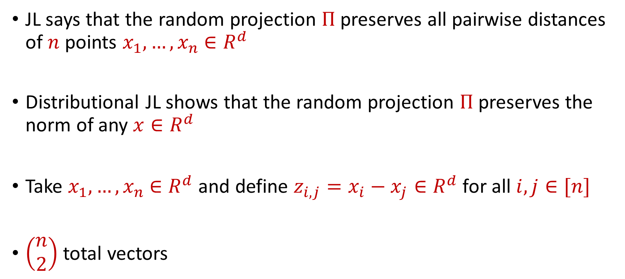
Johnson-Lindenstrauss Lemma
JL says that the random projection $Π$ preserves all pairwise distances of $n$ points $x_{1},…,x_{n}$ $∈R^{d}$
Distributional JL shows that the random projection $Π$ preserves the norm of any $x∈R^{d}$
Take $x_{1},…,x_{n}$ $∈R^{d}$ and define $z_{i,j}=x_{i}−x_{j}∈R^{d}$ for all $i,j∈[n]$
$\left(\begin{aligned}n \\ 2\end{aligned}\right)$ total vectors

Slide 20
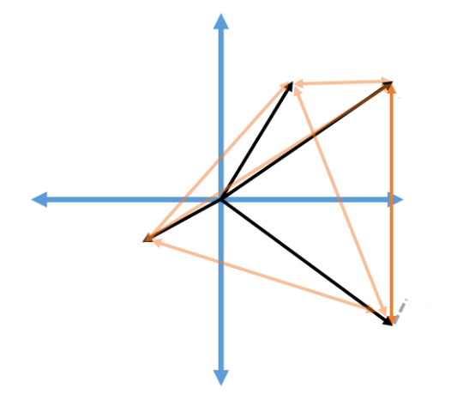






Johnson-Lindenstrauss Lemma
Take $x_{1},…,x_{n}$ $∈R^{d}$ and define $z_{i,j}=x_{i}−x_{j}∈R^{d}$ for all $i,j∈[n]$
$\left(\begin{aligned}n \\ 2\end{aligned}\right)$ total vectors
$$x_{1}$$
$$x_{2}$$
$$z_{2.4}$$
$$x_{3}$$
$$x_{4}$$

Slide 21
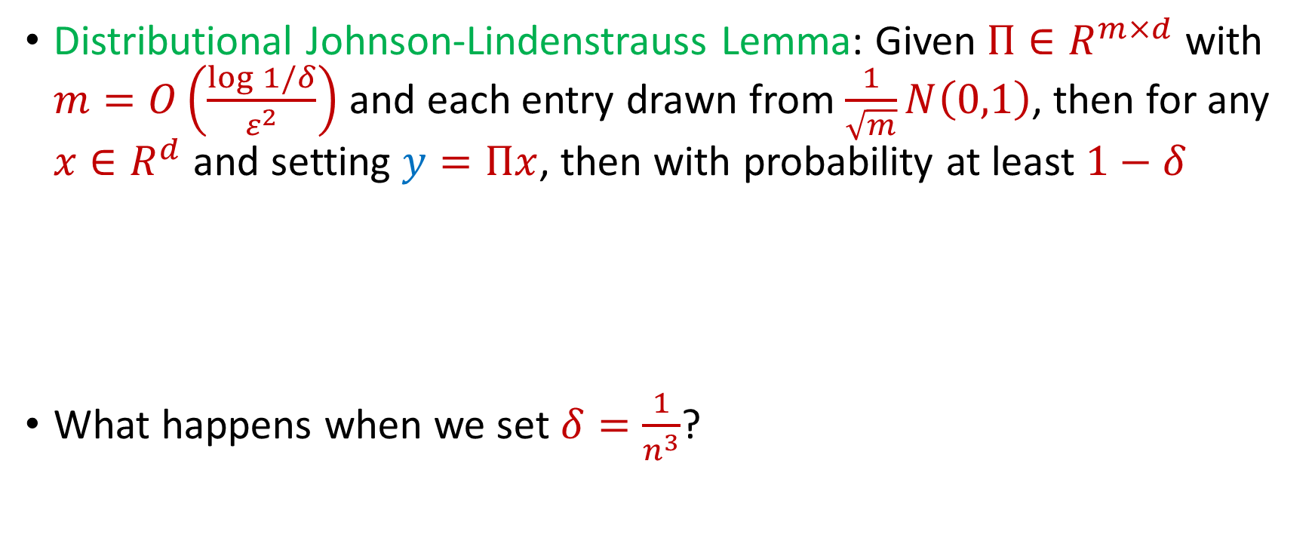
Johnson-Lindenstrauss Lemma
Distributional Johnson-Lindenstrauss Lemma: Given $Π∈R^{m×d}$ with $m=O\left(\frac{\log{1/δ}}{ε^{2}}\right)$ and each entry drawn from $\frac{1}{\sqrt{m}}N\left(0,1\right)$, then for any $x∈R^{d}$ and setting $y=Πx$, then with probability at least $1−δ$
What happens when we set $δ=\frac{1}{n^{3}}$?
$$\left(1−ε\right){\left\|x\right\|}_{2}≤{\left\|y\right\|}_{2}≤\left(1+ε\right){\left\|x\right\|}_{2}$$

Slide 22
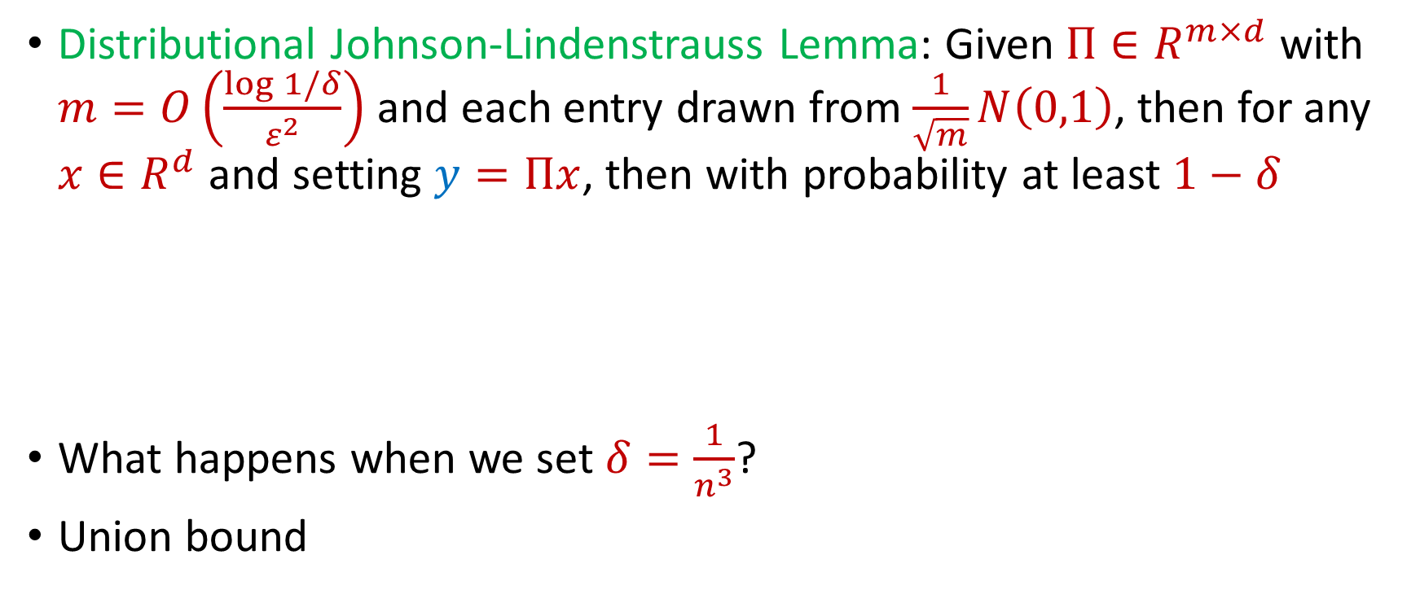
Johnson-Lindenstrauss Lemma
Distributional Johnson-Lindenstrauss Lemma: Given $Π∈R^{m×d}$ with $m=O\left(\frac{\log{1/δ}}{ε^{2}}\right)$ and each entry drawn from $\frac{1}{\sqrt{m}}N\left(0,1\right)$, then for any $x∈R^{d}$ and setting $y=Πx$, then with probability at least $1−δ$
What happens when we set $δ=\frac{1}{n^{3}}$?
Union bound
$$\left(1−ε\right){\left\|x\right\|}_{2}≤{\left\|y\right\|}_{2}≤\left(1+ε\right){\left\|x\right\|}_{2}$$

Slide 23
Johnson-Lindenstrauss Lemma
Distributional Johnson-Lindenstrauss Lemma: Given $Π∈R^{m×d}$ with $m=O\left(\frac{\log{1/δ}}{ε^{2}}\right)$ and each entry drawn from $\frac{1}{\sqrt{m}}N\left(0,1\right)$, then for any $x∈R^{d}$ and setting $y=Πx$, then with probability at least $1−δ$
$$\left(1−ε\right){\left\|x\right\|}_{2}≤{\left\|y\right\|}_{2}≤\left(1+ε\right){\left\|x\right\|}_{2}$$

Slide 24




Johnson-Lindenstrauss Lemma
Distributional Johnson-Lindenstrauss Lemma: Given $Π∈R^{m×d}$ with $m=O\left(\frac{\log{1/δ}}{ε^{2}}\right)$ and each entry drawn from $\frac{1}{\sqrt{m}}N\left(0,1\right)$, then for any $x∈R^{d}$ and setting $y=Πx$, then with probability at least $1−δ$
(Here $x_{1}$ is the first coordinate of $x$)
$$\left(1−ε\right){\left\|x\right\|}_{2}≤{\left\|y\right\|}_{2}≤\left(1+ε\right){\left\|x\right\|}_{2}$$
$$x_{1}$$
$$⋮$$
$$⋮$$
$$⋮$$
$$x_{d}$$
$$y_{1}$$
$$⋮$$
$$y_{m}$$
$$Π$$

Slide 25

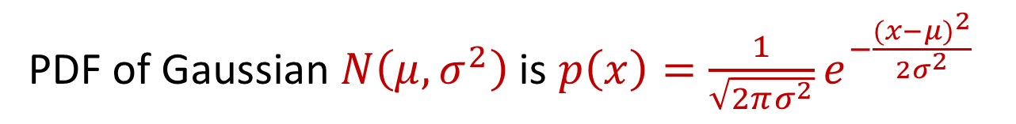
Trivia Question #5 (Gaussian Behavior)
Let $x∼N\left(μ,σ^{2}\right)$. What is $E\left[x\right]$ and what is $E\left[{\left|x−μ\right|}^{2}\right]$?
$\left(0, 1\right)$
$(0, σ)$
$(μ,σ)$
$(μ,σ^{2})$
PDF of Gaussian $N\left(μ,σ^{2}\right)$is $p\left(x\right)=\frac{1}{\sqrt{2πσ^{2}}}e^{−\frac{({x−μ)}^{2}}{2σ^{2}}}$
Notes:
0, 1, 3, 6

Slide 26
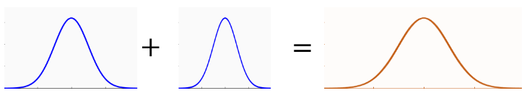
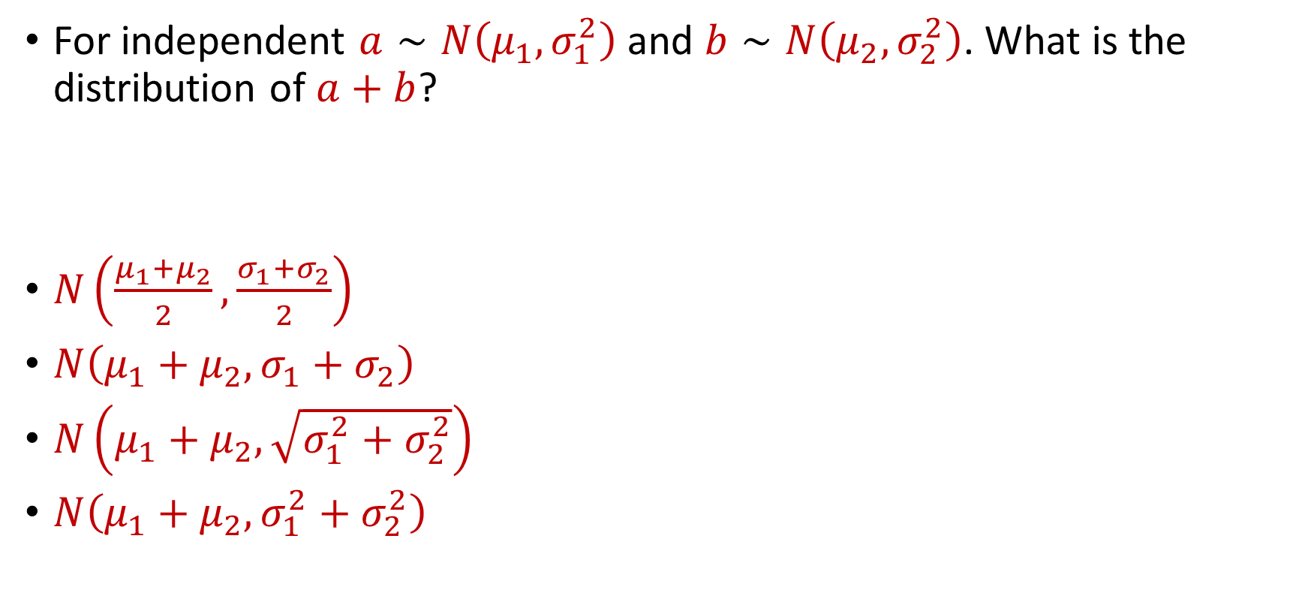
Trivia Question #6 (Gaussian Stability)
For independent $a∼N\left(μ_{1},σ_{1}^{2}\right)$ and $b∼N\left(μ_{2},σ_{2}^{2}\right)$. What is the distribution of $a+b$?
$N\left(\frac{μ_{1}+μ_{2}}{2}, \frac{σ_{1}+σ_{2}}{2}\right)$
$N\left(μ_{1}+μ_{2}, σ_{1}+σ_{2}\right)$
$N\left(μ_{1}+μ_{2},\sqrt{σ_{1}^{2}+σ_{2}^{2}}\right)$
$N\left(μ_{1}+μ_{2},σ_{1}^{2}+σ_{2}^{2}\right)$

Slide 27
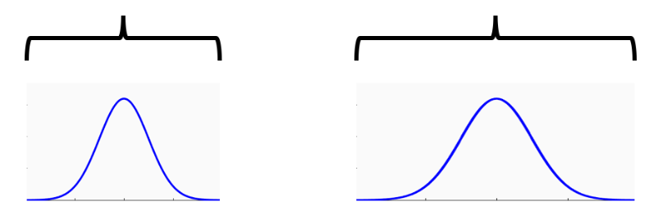




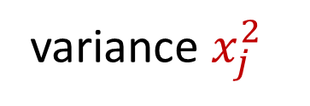
Johnson-Lindenstrauss Lemma
$y_{i}=\left\langle Π_{i},x\right\rangle =\frac{1}{\sqrt{m}}\sum_{j=1}^{d}{g_{j}⋅x_{j}}$ for $g_{j}∼N\left(0, 1\right)$
$g_{j}⋅x_{j}$ $∼N\left(0,x_{j}^{2}\right)$, normal random variable with variance $x_{j}^{2}$
variance $1$
variance $x_{j}^{2}$
$$g_{j}$$
$g_{j}⋅x_{j}$

Slide 28
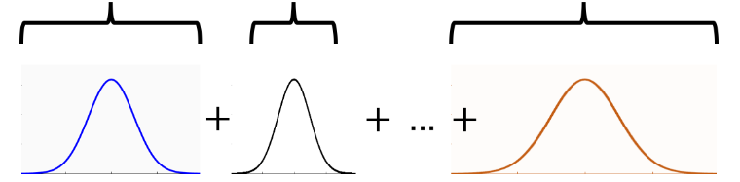
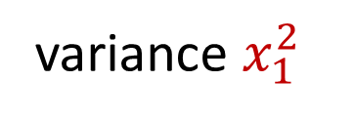

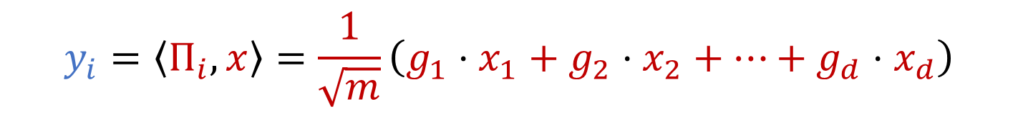
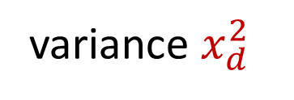
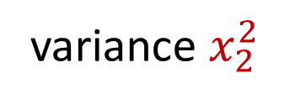
Gaussian Stability
variance $x_{1}^{2}$
variance $x_{2}^{2}$
variance $x_{d}^{2}$
$$y_{i}=\left\langle Π_{i},x\right\rangle =\frac{1}{\sqrt{m}}\left(g_{1}⋅x_{1}+g_{2}⋅x_{2}+…+g_{d}⋅x_{d}\right)$$
What is the distribution of $y_{i}$?

Slide 29

Gaussian Stability
For independent $a∼N\left(μ_{1},σ_{1}^{2}\right)$ and $b∼N\left(μ_{2},σ_{2}^{2}\right)$, we have
$$a+b∼N\left(μ_{1}+μ_{2},σ_{1}^{2}+σ_{2}^{2}\right)$$

Slide 30

Gaussian Stability
For independent $a∼N\left(μ_{1},σ_{1}^{2}\right)$ and $b∼N\left(μ_{2},σ_{2}^{2}\right)$, we have
$$a+b∼N\left(μ_{1}+μ_{2},σ_{1}^{2}+σ_{2}^{2}\right)$$
$$y_{i}=\left\langle Π_{i},x\right\rangle =\frac{1}{\sqrt{m}}\left(g_{1}⋅x_{1}+g_{2}⋅x_{2}+…+g_{d}⋅x_{d}\right)$$
$y_{i}∼$ $N\left(0,{\frac{1}{m}\left\|x\right\|}_{2}^{2}\right)$

Slide 31
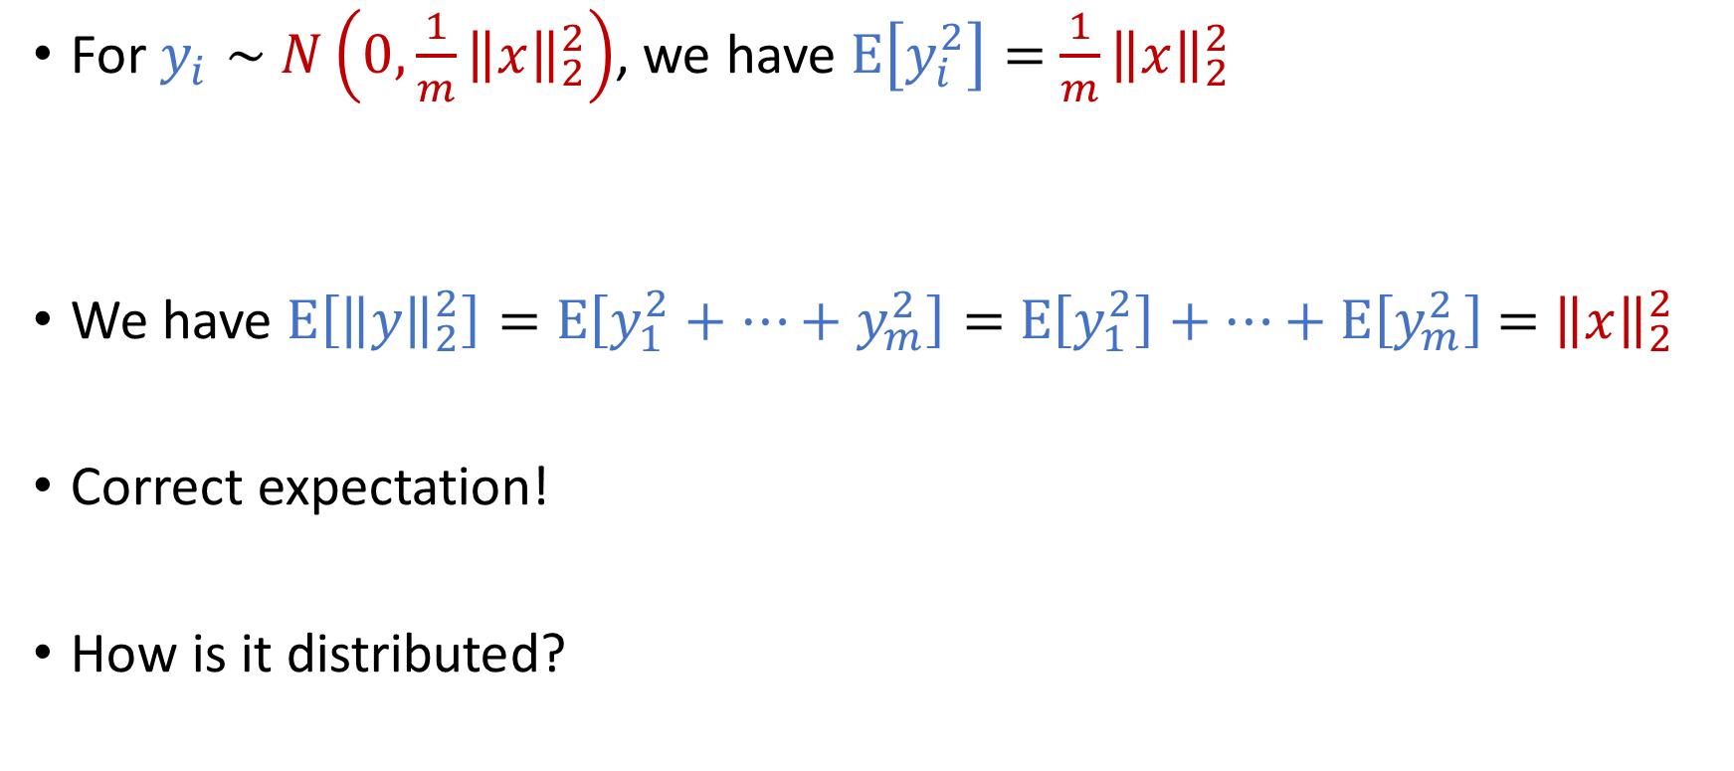
Gaussian Stability
For $y_{i}∼$ $N\left(0,{\frac{1}{m}\left\|x\right\|}_{2}^{2}\right)$, we have $E\left[y_{i}^{2}\right]=$ ${\frac{1}{m}\left\|x\right\|}_{2}^{2}$
We have $E\left[{\left\|y\right\|}_{2}^{2}\right]=$ $E\left[y_{1}^{2}+…+y_{m}^{2}\right]=$ $E\left[y_{1}^{2}\right]+…+E\left[y_{m}^{2}\right]$ $=$ ${\left\|x\right\|}_{2}^{2}$
Correct expectation!
How is it distributed?

Slide 32
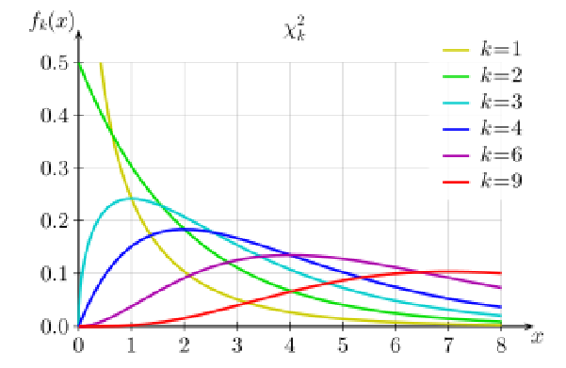

Johnson-Lindenstrauss Lemma
${\left\|y\right\|}_{2}^{2}$ is distributed as Chi-Squared random variable with $m$ degrees of freedom (sum of $m$ squared independent Gaussians)

Slide 33
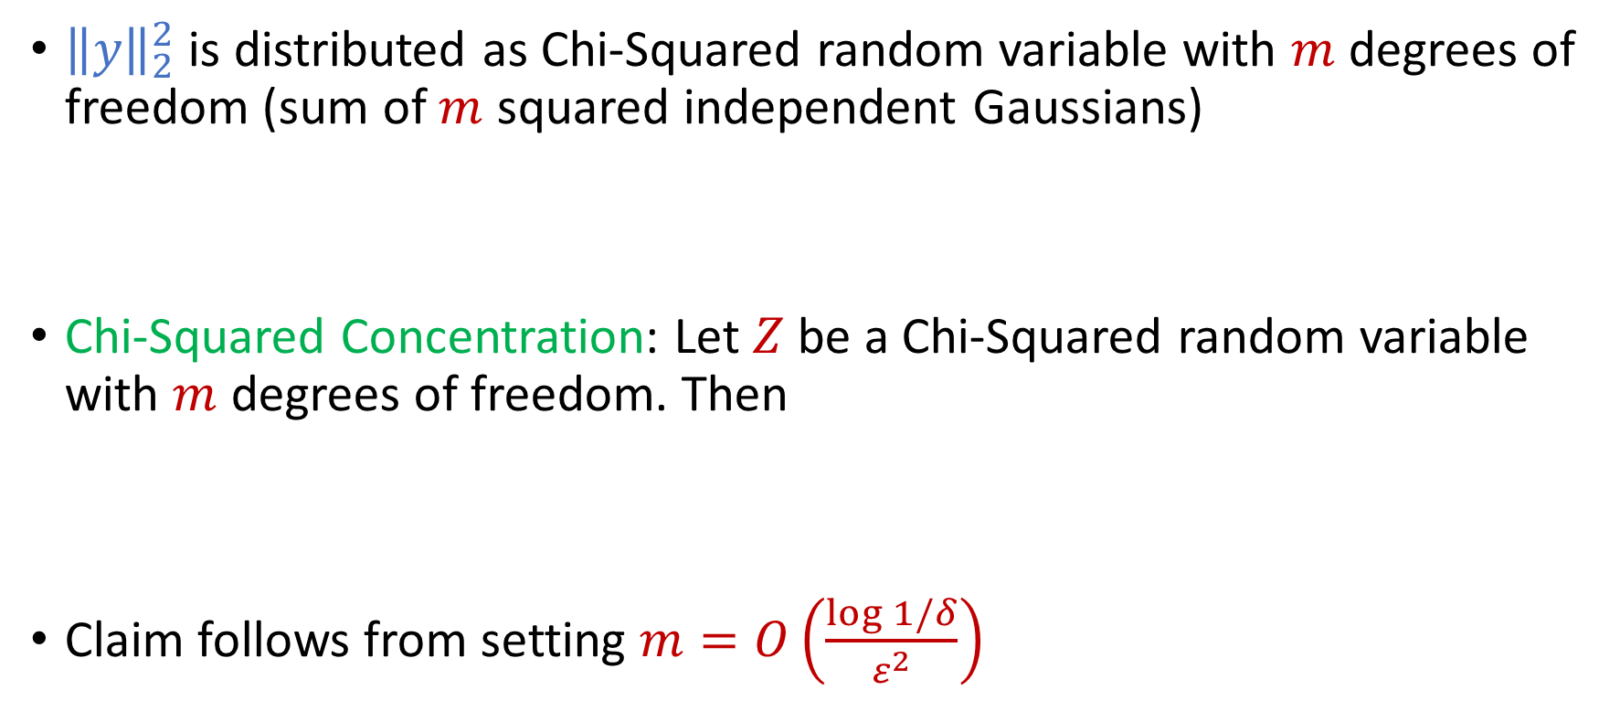
Johnson-Lindenstrauss Lemma
${\left\|y\right\|}_{2}^{2}$ is distributed as Chi-Squared random variable with $m$ degrees of freedom (sum of $m$ squared independent Gaussians)
Chi-Squared Concentration: Let $Z$ be a Chi-Squared random variable with $m$ degrees of freedom. Then
Claim follows from setting $m=O\left(\frac{\log{1/δ}}{ε^{2}}\right)$
$$Pr\left[\left|Z−E[Z]\right|≥ε⋅E[Z]\right]≤2e^{−mε^{2}/8}$$

