Slide 1
CSCE 658: Randomized Algorithms
Lecture 21
Samson Zhou

Slide 2
Relevant Supplementary Material
Chapter 1-3 of “The Algorithmic Foundations of Differential Privacy”, by Cynthia Dwork and Aaron Roth (https://www.cis.upenn.edu/~aaroth/Papers/privacybook.pdf)

Slide 3




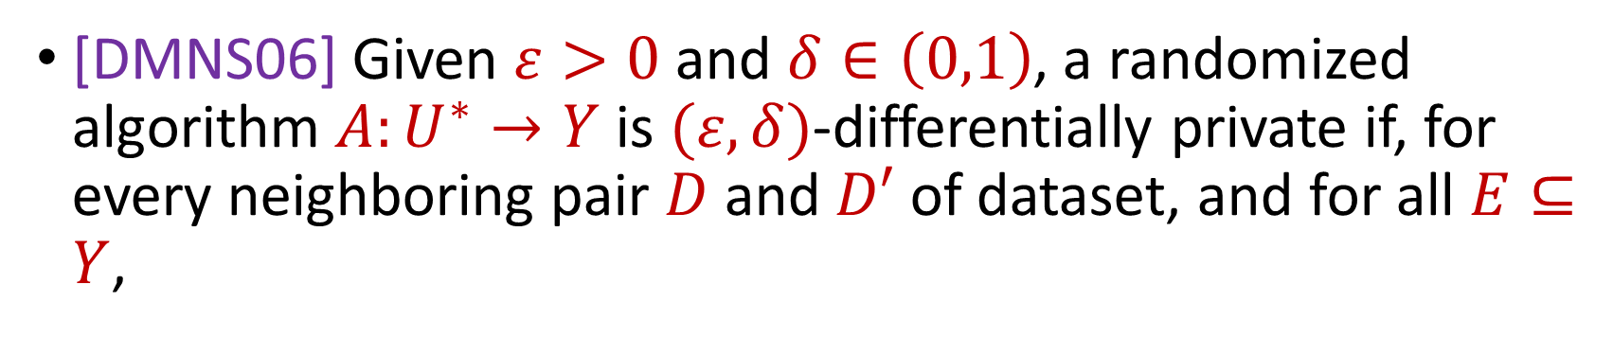

Last Time: Differential Privacy
[DMNS06] Given $ε>0$and $δ∈\left(0,1\right)$, a randomized algorithm $A:U^{∗}→Y$ is $(ε,δ)$-differentially private if, for every neighboring pair $D$ and $D′$ of dataset, and for all $E⊆Y$,
$$Pr\left[A\left(D\right)∈E\right]≤e^{ε}⋅Pr\left[A\left(D^{′}\right)∈E\right]+δ$$
$$A\left( \right)≈A\left( \right)$$
Notes:
[DworkMcSherryNissimSmith06]

Slide 4


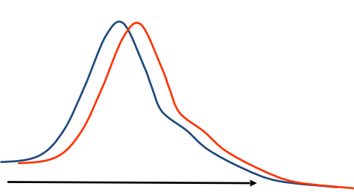
Last Time: Differential Privacy
[DMNS06] Given $ε>0$and $δ∈\left(0,1\right)$, a randomized algorithm $A:U^{∗}→Y$ is $(ε,δ)$-differentially private if, for every neighboring pair $D$ and $D′$ of dataset, and for all $E⊆Y$,
$$Pr\left[A\left(D\right)∈E\right]≤e^{ε}⋅Pr\left[A\left(D^{′}\right)∈E\right]+δ$$
Sensitive dataset
Algorithm
Output distribution
Notes:
[DworkMcSherryNissimSmith06]

Slide 5
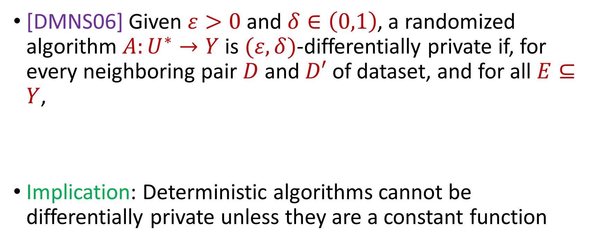
Last Time: Differential Privacy
[DMNS06] Given $ε>0$and $δ∈\left(0,1\right)$, a randomized algorithm $A:U^{∗}→Y$ is $(ε,δ)$-differentially private if, for every neighboring pair $D$ and $D′$ of dataset, and for all $E⊆Y$,
Implication: Deterministic algorithms cannot be differentially private unless they are a constant function
$$Pr\left[A\left(D\right)∈E\right]≤e^{ε}⋅Pr\left[A\left(D^{′}\right)∈E\right]+δ$$
Notes:
[DworkMcSherryNissimSmith06]

Slide 6
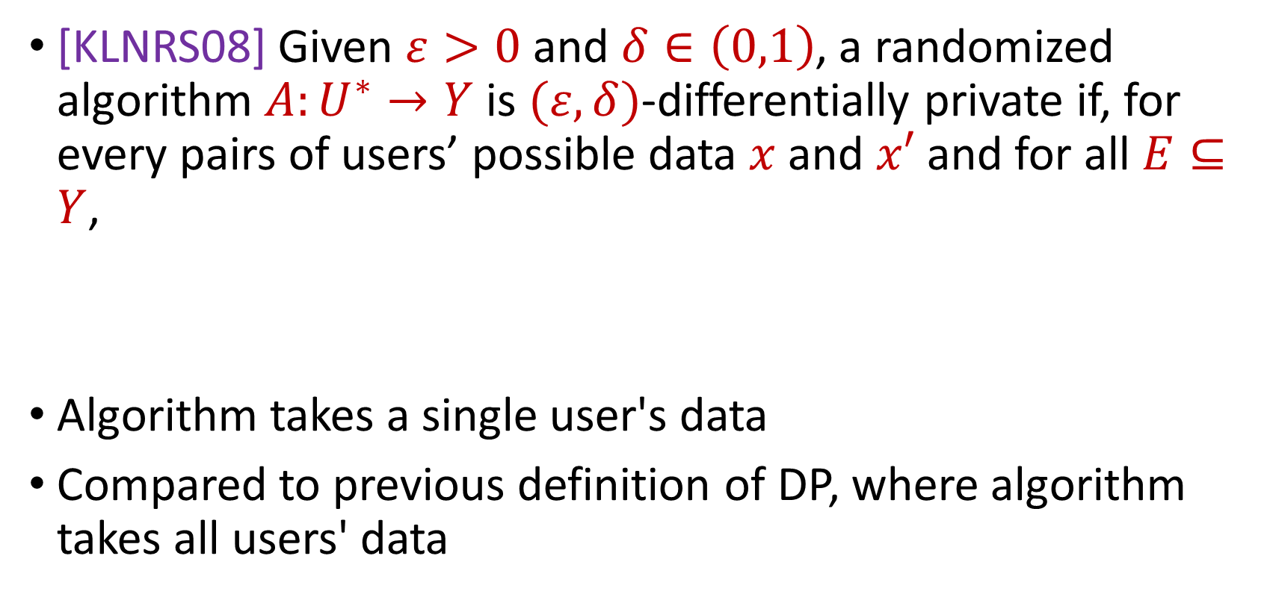
Last Time: Local Differential Privacy (LDP)
[KLNRS08] Given $ε>0$and $δ∈\left(0,1\right)$, a randomized algorithm $A:U^{∗}→Y$ is $(ε,δ)$-differentially private if, for every pairs of users’ possible data $x$ and $x′$ and for all $E⊆Y$,
Algorithm takes a single user's data
Compared to previous definition of DP, where algorithm takes all users' data
$$Pr\left[A\left(x\right)∈E\right]≤e^{ε}⋅Pr\left[A\left(x^{′}\right)∈E\right]+δ$$
Notes:
[DworkMcSherryNissimSmith06]

Slide 7

Last Time: Randomized Response, Revisisted
How many people in this class have a pet?
Generate a random integer:
If it is even, answer truthfully
Otherwise, proceed below
Generate another random integer:
If it is even, answer YES
Otherwise if it is odd, answer NO
Notes:
[DworkMcSherryNissimSmith06]

Slide 8
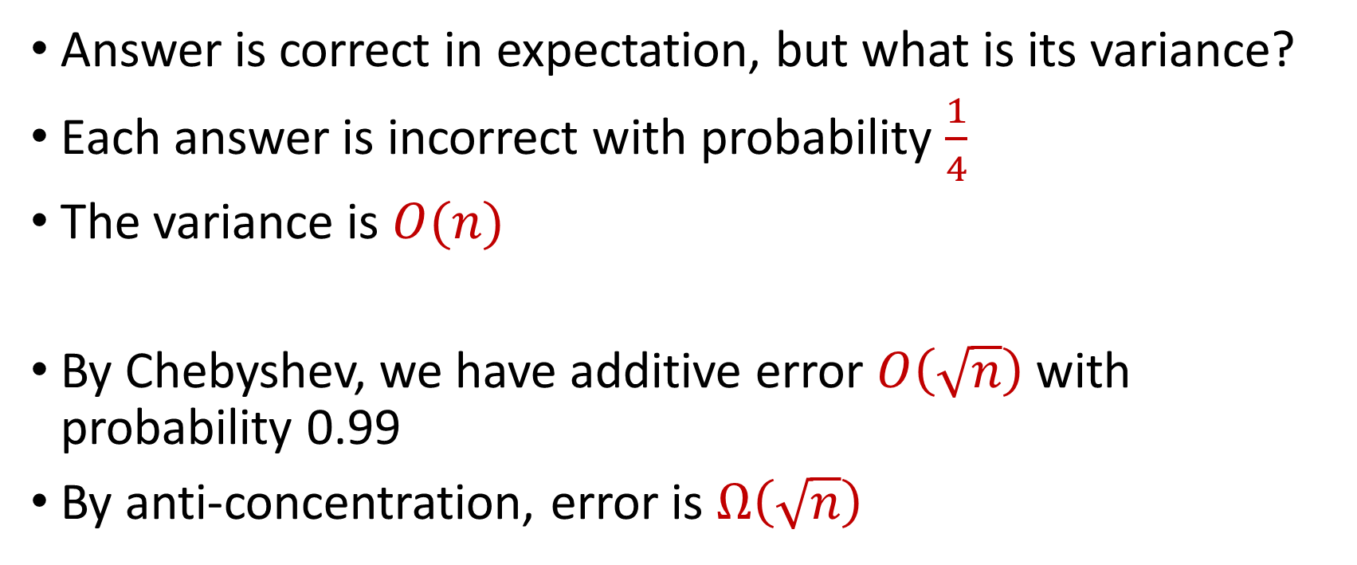
Last Time: Randomized Response, Revisisted
Answer is correct in expectation, but what is its variance?
Each answer is incorrect with probability $\frac{1}{4}$
The variance is $O(n)$
By Chebyshev, we have additive error $O\left(\sqrt{n}\right)$ with probability 0.99
By anti-concentration, error is $Ω\left(\sqrt{n}\right)$
Notes:
[DworkMcSherryNissimSmith06]

Slide 9
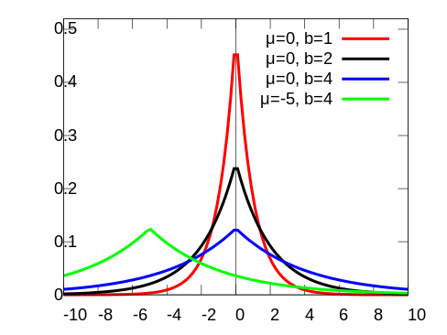
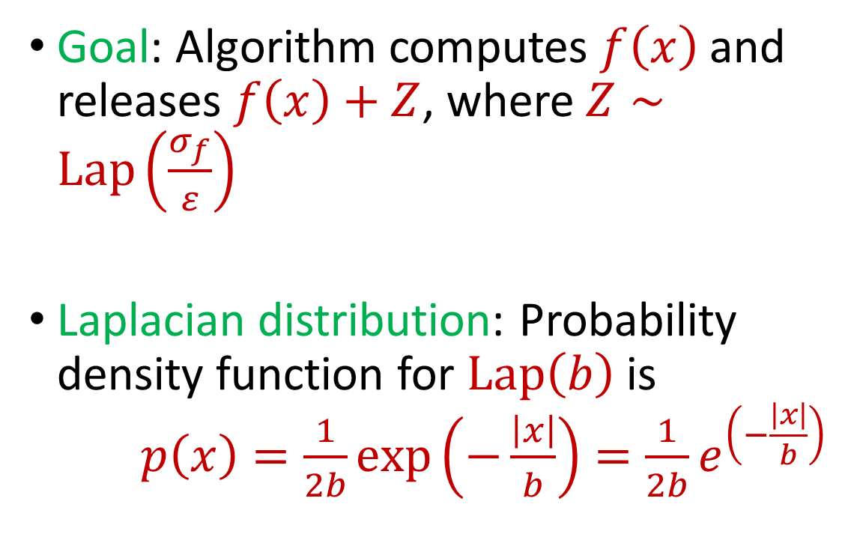
Last Time: Laplace Mechanism
Goal: Algorithm computes $f\left(x\right)$ and releases $f\left(x\right)+Z$, where $Z∼Lap\left(\frac{σ_{f}}{ε}\right)$
Laplacian distribution: Probability density function for $Lap\left(b\right)$ is $p\left(x\right)=\frac{1}{2b}exp\left(−\frac{\left|x\right|}{b}\right)=\frac{1}{2b}e^{\left(−\frac{\left|x\right|}{b}\right)}$
Notes:
[DworkMcSherryNissimSmith06]

Slide 10
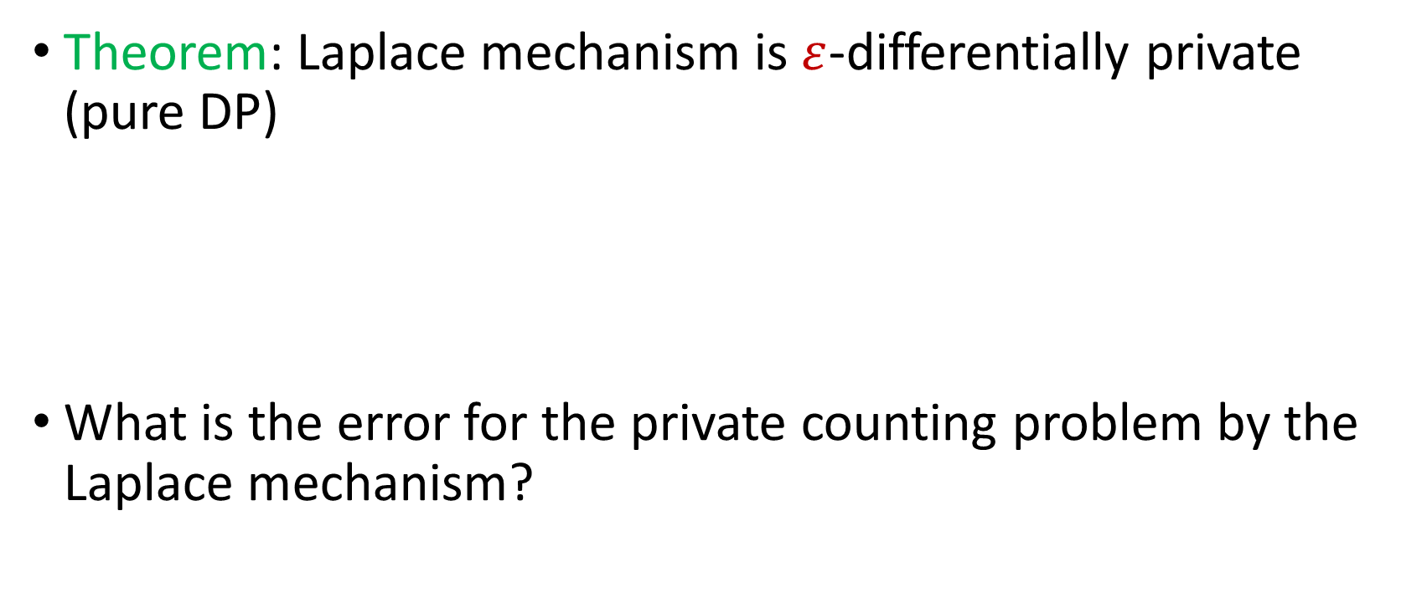
Last Time: Laplace Mechanism
Theorem: Laplace mechanism is $ε$-differentially private (pure DP)
What is the error for the private counting problem by the Laplace mechanism?
Notes:
[DworkMcSherryNissimSmith06]

Slide 11
Beyond Laplace Mechanism
What if we want to output the “best” answer, but noise can significantly destroy the answer?
Example: Suppose we have a large number of apples, and A, B, C each bid $1.00 and D bids $4.01. What is the optimal price?
At $4.01 the revenue, the revenue is $4.01, at $4.00 and at $1.00 the revenue is $4.00, but at $3.02 the revenue is zero!
Notes:
[DworkMcSherryNissimSmith06]

Slide 12
Beyond Laplace Mechanism
Example: Suppose a study is conducted that finds the current location of individuals, in the two-dimensional plane
Who is the closest individual to a query location?
Notes:
[DworkMcSherryNissimSmith06]

Slide 13
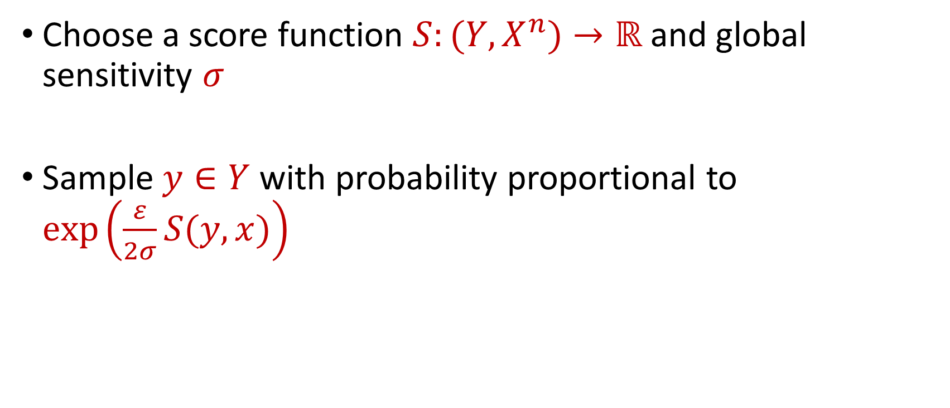
Exponential Mechanism
Choose a score function $S:(Y,X^{n})→ℝ$ and global sensitivity $σ$
Sample $y∈Y$ with probability proportional to $\exp\left(\frac{ε}{2σ}S(y,x)\right)$
Notes:
[DworkMcSherryNissimSmith06]

Slide 14
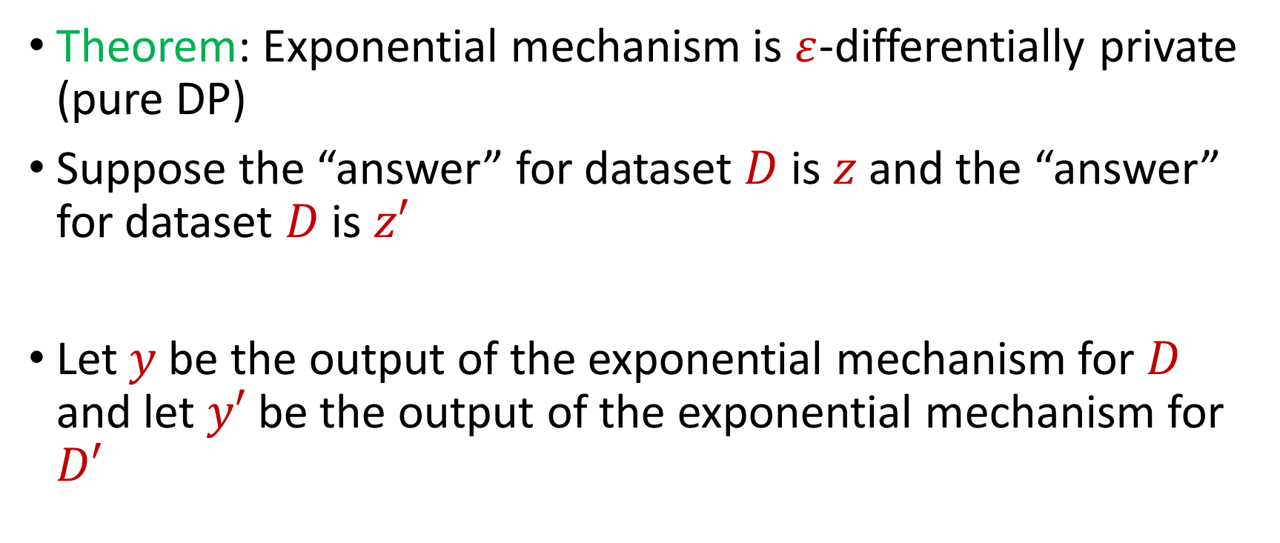
Exponential Mechanism
Theorem: Exponential mechanism is $ε$-differentially private (pure DP)
Suppose the “answer” for dataset $D$ is $z$ and the “answer” for dataset $D$ is $z′$
Let $y$ be the output of the exponential mechanism for $D$ and let $y′$ be the output of the exponential mechanism for $D′$
Notes:
[DworkMcSherryNissimSmith06]

Slide 15

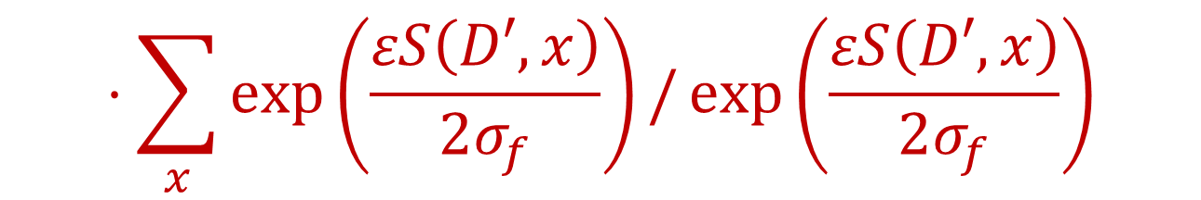

Exponential Mechanism
Want to show that for any fixed $x$, $\frac{Pr\left[y=x\right]}{Pr\left[y^{′}=x\right]}≤e^{ε}$
$$\frac{Pr\left[y=x\right]}{Pr\left[y^{′}=x\right]}≤\exp\left(\frac{εS\left(D,x\right)}{2σ_{f}}\right)/\sum_{x}{\exp\left(\frac{εS\left(D,x\right)}{2σ_{f}}\right)}$$
$$⋅\sum_{x}{\exp\left(\frac{εS\left(D′,x\right)}{2σ_{f}}\right)}/\exp\left(\frac{εS\left(D′,x\right)}{2σ_{f}}\right)$$
Notes:
[DworkMcSherryNissimSmith06]

Slide 16
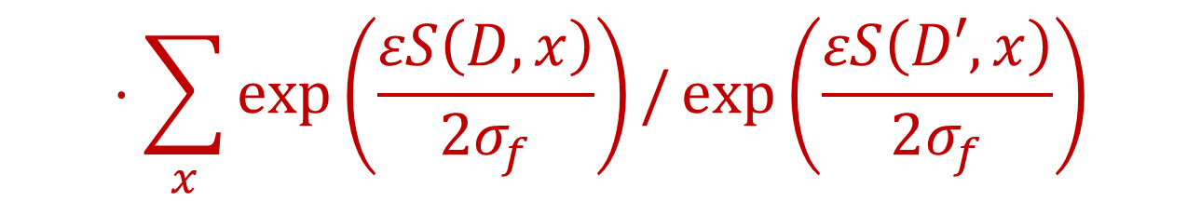

Exponential Mechanism
Want to show that for any fixed $x$, $\frac{Pr\left[y=x\right]}{Pr\left[y^{′}=x\right]}≤e^{ε}$
$$\frac{Pr\left[y=x\right]}{Pr\left[y^{′}=x\right]}≤\exp\left(\frac{ε(S\left(D,x\right)−S\left(D^{′},x\right))}{2σ_{f}}\right)$$
$$⋅\sum_{x}{\exp\left(\frac{εS\left(D,x\right)}{2σ_{f}}\right)}/\exp\left(\frac{εS\left(D′,x\right)}{2σ_{f}}\right)$$
Notes:
[DworkMcSherryNissimSmith06]

Slide 17

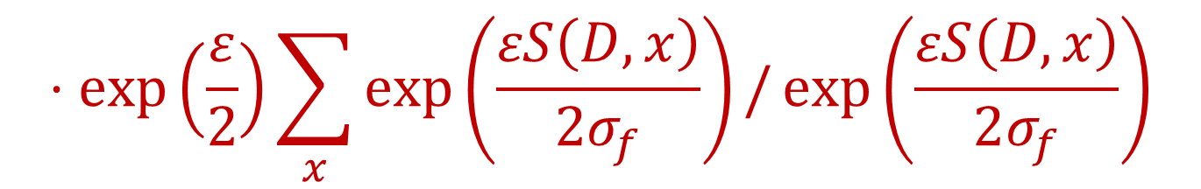
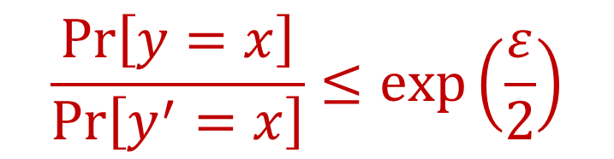
Exponential Mechanism
Want to show that for any fixed $x$, $\frac{Pr\left[y=x\right]}{Pr\left[y^{′}=x\right]}≤e^{ε}$
$$\frac{Pr\left[y=x\right]}{Pr\left[y^{′}=x\right]}≤\exp\left(\frac{ε}{2}\right)$$
$$⋅\exp\left(\frac{ε}{2}\right)\sum_{x}{\exp\left(\frac{εS\left(D,x\right)}{2σ_{f}}\right)}/\exp\left(\frac{εS\left(D,x\right)}{2σ_{f}}\right)$$
$$=\exp\left(ε\right)$$
Notes:
[DworkMcSherryNissimSmith06]

Slide 18
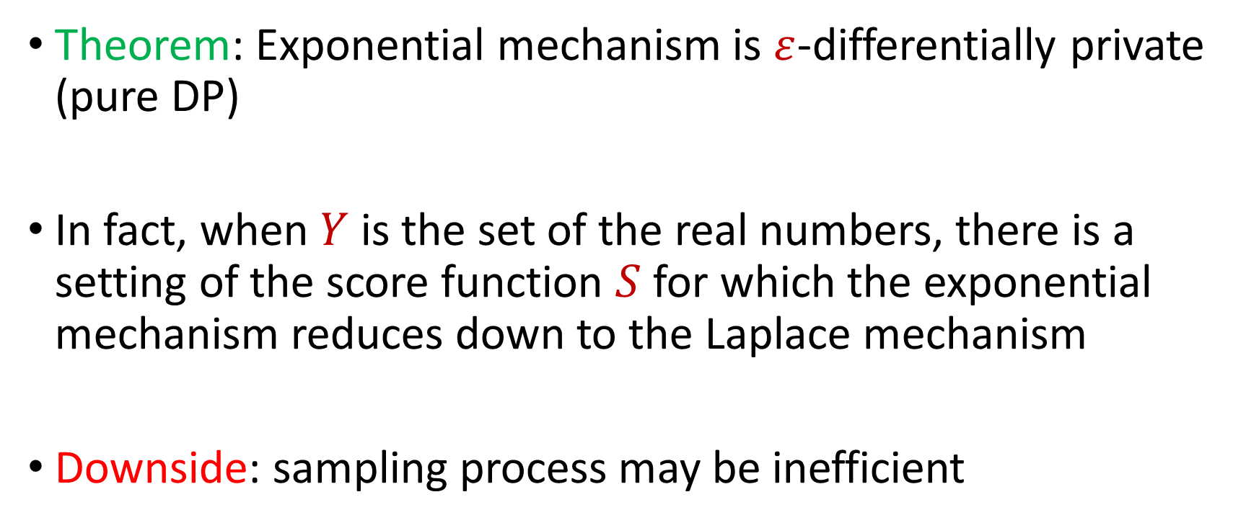
Exponential Mechanism
Theorem: Exponential mechanism is $ε$-differentially private (pure DP)
In fact, when $Y$ is the set of the real numbers, there is a setting of the score function $S$ for which the exponential mechanism reduces down to the Laplace mechanism
Downside: sampling process may be inefficient
Notes:
[DworkMcSherryNissimSmith06]

