Slide 1
CSCE 411 Design and Analysis of Algorithms (Honors)
You can already log into Canvas and download a blank set of lecture notes that we will fill in today.
lec-1-blank.pdf

Slide 2
What is this course about?
Designing algorithms to solve computational problems
Analyzing algorithms (correctness, runtime, space requirements)
Analyzing the inherent complexity of computational problems
More on this in later slides!

Slide 4
First: a speed walk through the syllabus
You are responsible for knowing and following the course policy details in the syllabus!
This will be a brief overview to get you familiar with the overall logistics of the course.
You will need to read the syllabus (and complete a syllabus quiz) to get the full details.

Slide 5
Little to no actual programming will be required (though you may find you still want to sometimes!)

Slide 6
Course content
The course is structured roughly into three units, which for the most part line up with the three tests.
High-level design and analysis paradigms (Test 1)
Graph algorithms and optimization (Test 2)
Complexity, NP-completeness, and advanced algorithms (Test 3)
Final exam is cumulative

Slide 7
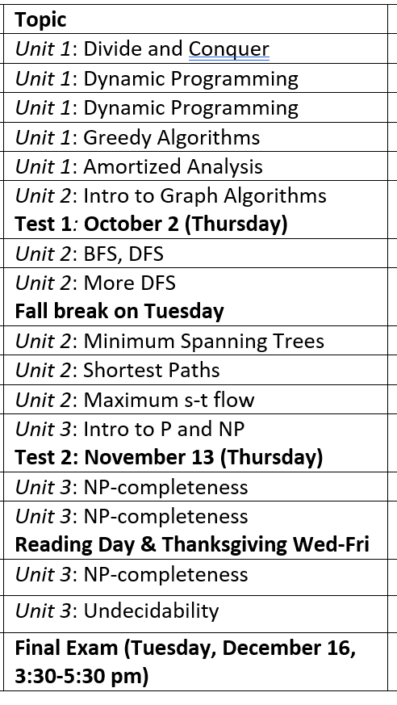
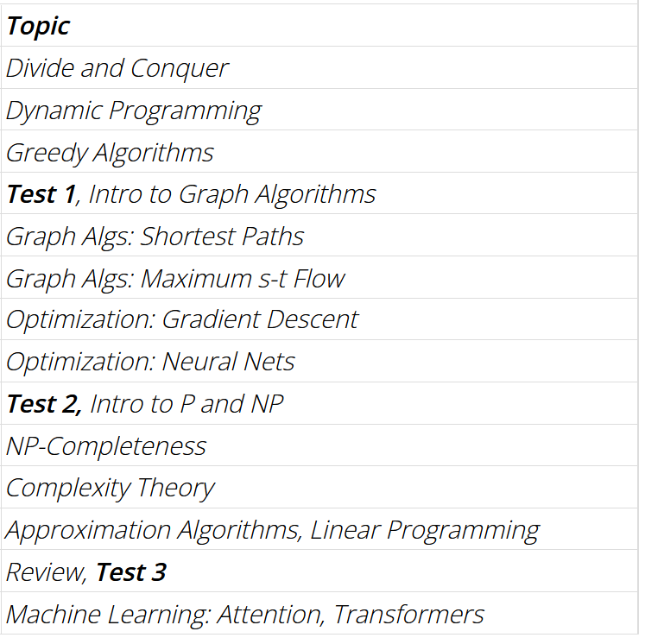

Slide 8
Assignment schedule
There will be 9-10 homework sets
Due most weeks on Friday, starting next week
Typically posted one week ahead of time
No homework on test weeks
Turn in on Gradescope (can be accessed through Canvas)
There will be three in-class midterms.
Test 1: September 15 (Tuesday)
Test 2: October 20 (Tuesday)
Test 3: November 19 (Thursday)
The final exam will be on Thursday, December 10: 3:30 pm – 5:30 pm

Slide 9
Grade breakdown
Participation: 2%
Homework: 17%
Test 1: 27%
Test 2: 27%
Test 3: 27%
Final exam: 27% (Lowest among four exams dropped)
The grading scale will be: A ≥ 85% > B ≥ 75% > C ≥ 65% > D ≥ 55% > F.

Slide 10
Homework collaboration policy
Students may collaborate on homework, under the following requirements
You may discuss solution strategies.
You must write up your own solution in your own words
Do not copy down the same solution!
You must disclose on your homework who you worked with and one what problem.
You are responsible for knowing and following the course policy details in the syllabus!

Slide 11
Outside resource policy
You may use outside textbooks and existing written resource
This means you can read information on existing webpages
You are responsible for anything you write!
You must write up your own solution in your own words
Do not copy down the same solution!
You must disclose on your homework any outside resources used.
You are responsible for knowing and following the course policy details in the syllabus!

Slide 12
Use of AI in CSCE 411, Section 502
General guideline: you may use GenAI tools such as ChatGPT insofar as they are used to gain knowledge and understand a topic better, and are not used to simply generate an answer which is turned in as your work.
Specific guidelines
All AI tools are considered an outside resource and must follow course guidelines on collaborators and outside resources
Students may not directly copy-paste any course lecture notes or homework problems as a prompt to an AI (this content is copyrighted)
Students must be responsible for their own writing. AI is only allowed to slightly check or slightly refine writing already produced by the student Students must cite their use of all AI tools

Slide 13
Use of AI in CSCE 411, Section 502
Short version
It’s an outside resource (and kind of a collaborator). All prior rules apply
Don’t copy-paste questions into the AI tool
Don’t copy-paste answers from the AI tool
Cite your sources (e.g., “I used ChatGPT, ensuring that I followed all course policies on Generative AI”)
These policies highlight what is allowed, and should in no way be viewed as an endorsement of AI tools nor an encouragement to use them for this course.

Slide 14
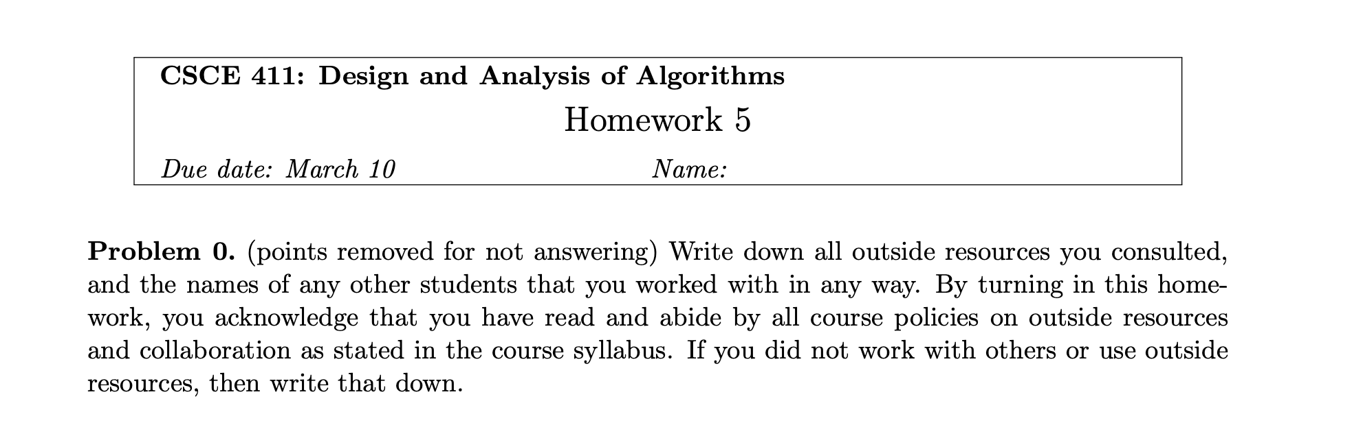
Homeworks will always begin with a “Problem 0” like this where you will list outside resources and outside help.
You must always answer this explicitly, even if just to say “I did not get outside help or use outside resources for this homework.”
You do not need to list (1) the textbook or (2) lecture notes. These are not “outside” help, these are the main resources for the course which you are expected to use.

Slide 15
Late work and make-up policy
Homework may be submitted up to 1 day late for a penalty. Lowest homework grade is dropped. (Homeworks can be worth different amounts. I will drop the homework that is most beneficial for your grade)
Excused absences from tests require advance notification and formal verification (e.g., doctor’s note).
The lowest homework will be dropped.
You are responsible for knowing and following the course policy details in the syllabus!

Slide 16
How/where do I keep up with the course?
In-class: I will give frequent reminders about where we are logistically in the course.
Canvas: for announcements, homework assignments, syllabus, any recordings, lecture notes (before and after class), accessing gradescope (do not trust the “grade” feature on Canvas though!!)
Gradescope: for turning in homework and checking homework grades and answers (Be sure to assign problems to pages)
Campuswire: mainly for in-class polls. Can also be used as a forum for course content questions and basic questions about homework (that do not reveal any partial answers).

Slide 17
Participation and Attendance
Attendance is NOT MANDATORY
“Participation” can only be met by:
Submitting an intro video (Due next Friday!)
Completing a simple syllabus quiz (Due next Tuesday!)

Slide 18
Three assignments you should already have on your radar
Intro video – Due Friday, September 4 (11:59pm), uploaded on Canvas
Syllabus quiz – Due Friday, September 4 (11:59pm), on Canvas
Homework 1 – Due Friday, September 4, on Gradescope. Will be released Friday. Be sure to assign problems to pages on Gradescope so grader can find them.

Slide 19
Can I use ChatGPT? Or other GenAI tools?
My opinion? You should not for this course. You will learn the material better and be better off if you do not.
But if you follow certain guidelines carefully, you can use it.

