Slide 1
CSCE 689: Special Topics in Modern Algorithms for Data Science
Lecture 25
Samson Zhou

Slide 2
Presentation Schedule
November 27: Chunkai, Jung, Galaxy AI
November 29: STMI, Anmol, Jason
December 1: Bokun, Ayesha, Dawei, Lipai

Slide 3
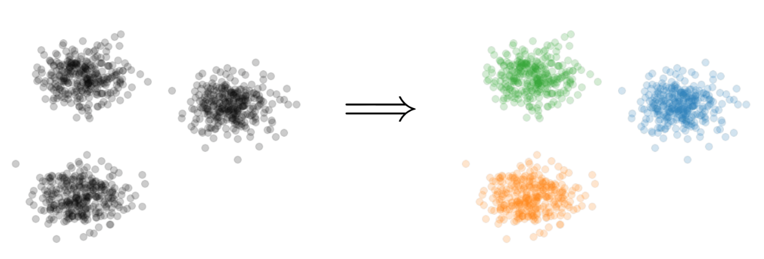


Previously: $k$-Clustering
Goal: Given input dataset $X$, partition $X$ so that “similar” points are in the same cluster and “different” points are in different clusters
There can be at most $k$ different clusters
$$k=3$$

Slide 4

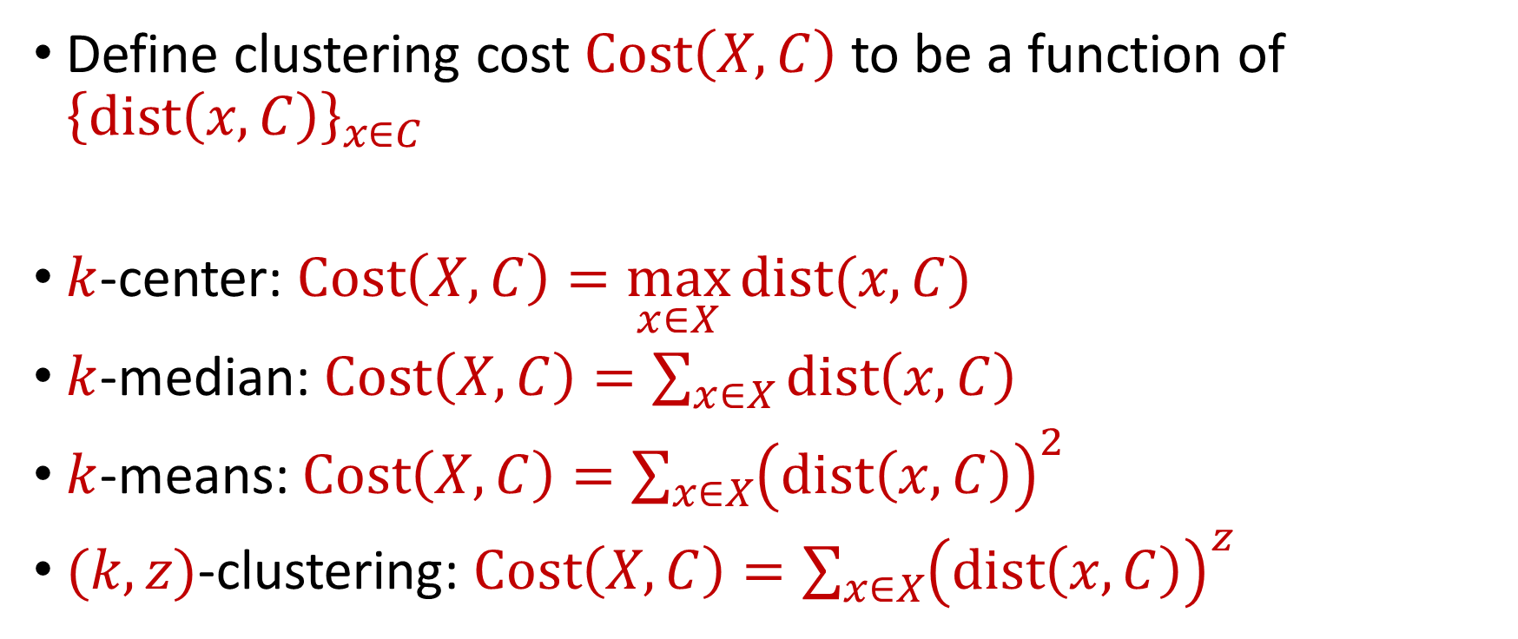






Previously: $k$-Clustering
Define clustering cost $Cost\left(X,C\right)$ to be a function of ${\left\{dist\left(x,C\right)\right\}}_{x∈C}$
$k$-center: $Cost\left(X,C\right)=\max_{x∈X}{dist(x,C)}$
$k$-median: $Cost\left(X,C\right)=\sum_{x∈X}{dist\left(x,C\right)}$
$k$-means: $Cost\left(X,C\right)=\sum_{x∈X}{{\left(dist\left(x,C\right)\right)}^{2}}$
$(k,z)$-clustering: $Cost\left(X,C\right)=\sum_{x∈X}{{\left(dist\left(x,C\right)\right)}^{z}}$
$${\left(⋅\right)}^{z}$$
$${\left(⋅\right)}^{z}$$
$${\left(⋅\right)}^{z}$$
$${\left(⋅\right)}^{z}$$
$${\left(⋅\right)}^{z}$$
$${\left(⋅\right)}^{z}$$
$${\left(⋅\right)}^{z}$$

Slide 5
Previously: Coreset
Subset $X′$ of representative points of $X$ for a specific clustering objective
$Cost\left(X,C\right)≈Cost(X^{′},C)$ for all sets $C$ with $\left|C\right|=k$

Slide 6
Previously: Coreset
Given a set $X$ and an accuracy parameter $ε>0$, we say a set $X′$ with weight function $w$is an $(1+ε)$-multiplicative coreset for a cost function $Cost$, if for all queries $C$ with $\left|C\right|≤k$, we have
$$\left(1−ε\right)Cost(X,C)≤Cost(X′,C,w)≤\left(1+ε\right)Cost(X,C)$$
$(k,z)$-clustering: $Cost\left(X^{′},C,w\right)=\sum_{x∈X′}{{w\left(x\right)⋅\left(dist\left(x,C\right)\right)}^{z}}$

Slide 7


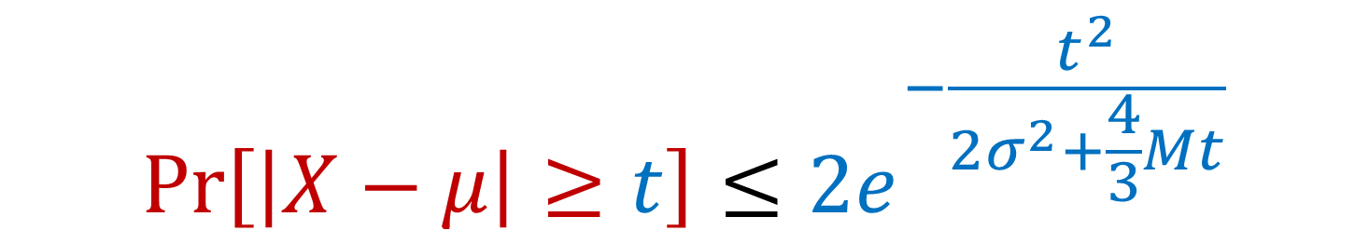
Previously: Bernstein’s Inequality
Bernstein’s inequality: Let $X_{1},…,X_{n}∈[−M,M]$ be independent random variables and let ${X=X}_{1}+…+X_{n}$ have mean $μ$ and variance $σ^{2}$. Then for any $t≥0$:
Example: Suppose $M=1$ and let $t=kσ$. Then
$$Pr\left[\left|X−μ\right|≥t\right]≤2e^{−\frac{t^{2}}{2σ^{2}+\frac{4}{3}Mt}}$$
$$Pr\left[\left|X−μ\right|≥kσ\right]≤2exp\left(−\frac{k^{2}}{4}\right)$$

Slide 8
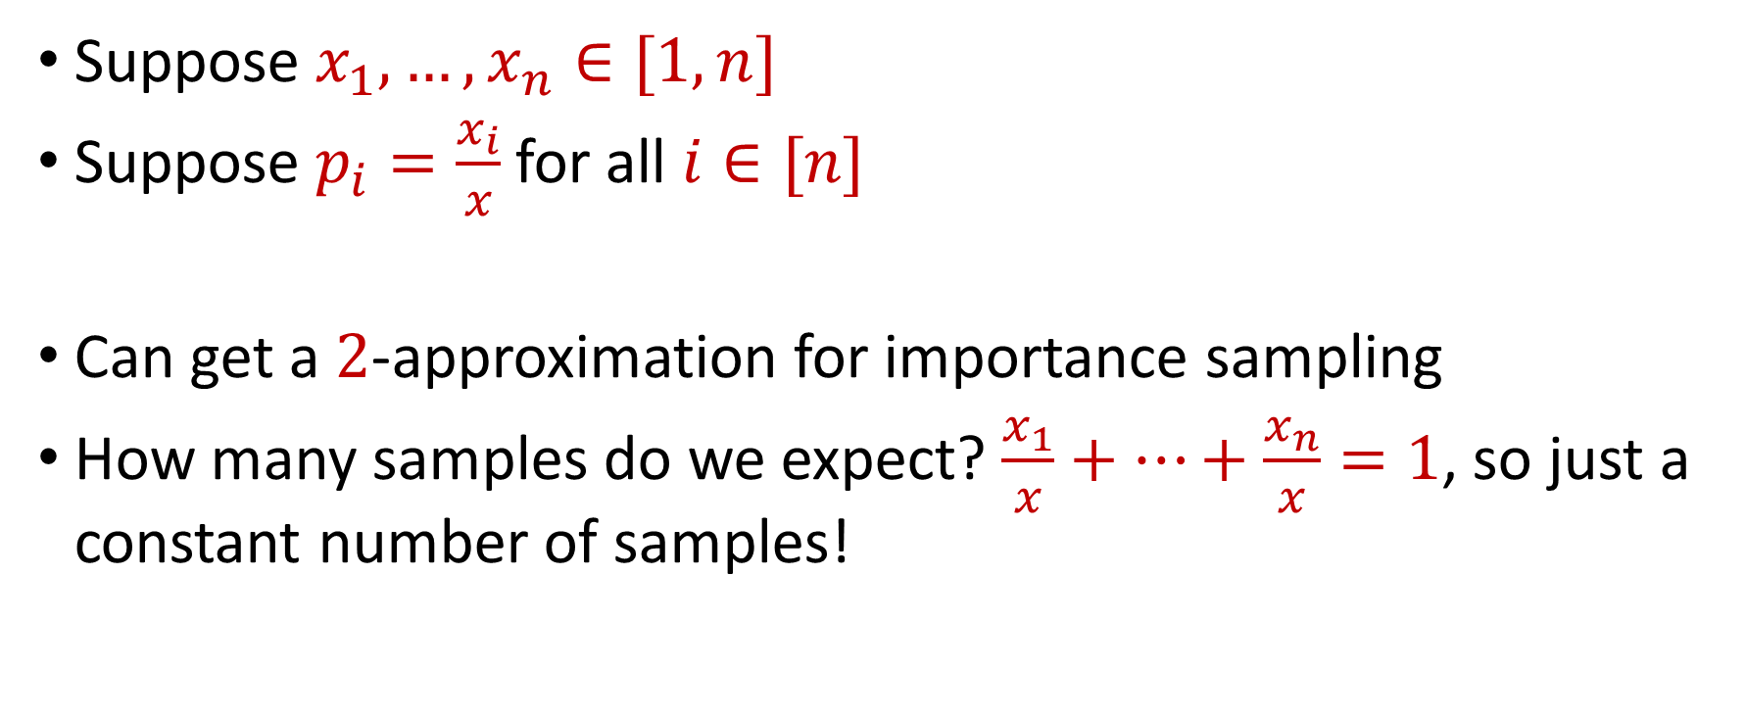
Previously: Importance Sampling for Sum Estimation
Suppose $x_{1},…,x_{n}∈[1,n]$
Suppose $p_{i}=\frac{x_{i}}{x}$ for all $i∈[n]$
Can get a $2$-approximation for importance sampling
How many samples do we expect? $\frac{x_{1}}{x}+…+\frac{x_{n}}{x}=1$, so just a constant number of samples!

Slide 9
Last Time: Coreset Construction and Sampling
Consider a fixed set $X$ and a fixed set $C$ of $k$ centers, which induces a fixed cost $Cost(X,C)$
Uniform sampling needs a lot of samples if there is a single point that greatly contributes to $Cost(X,C)$

Slide 10
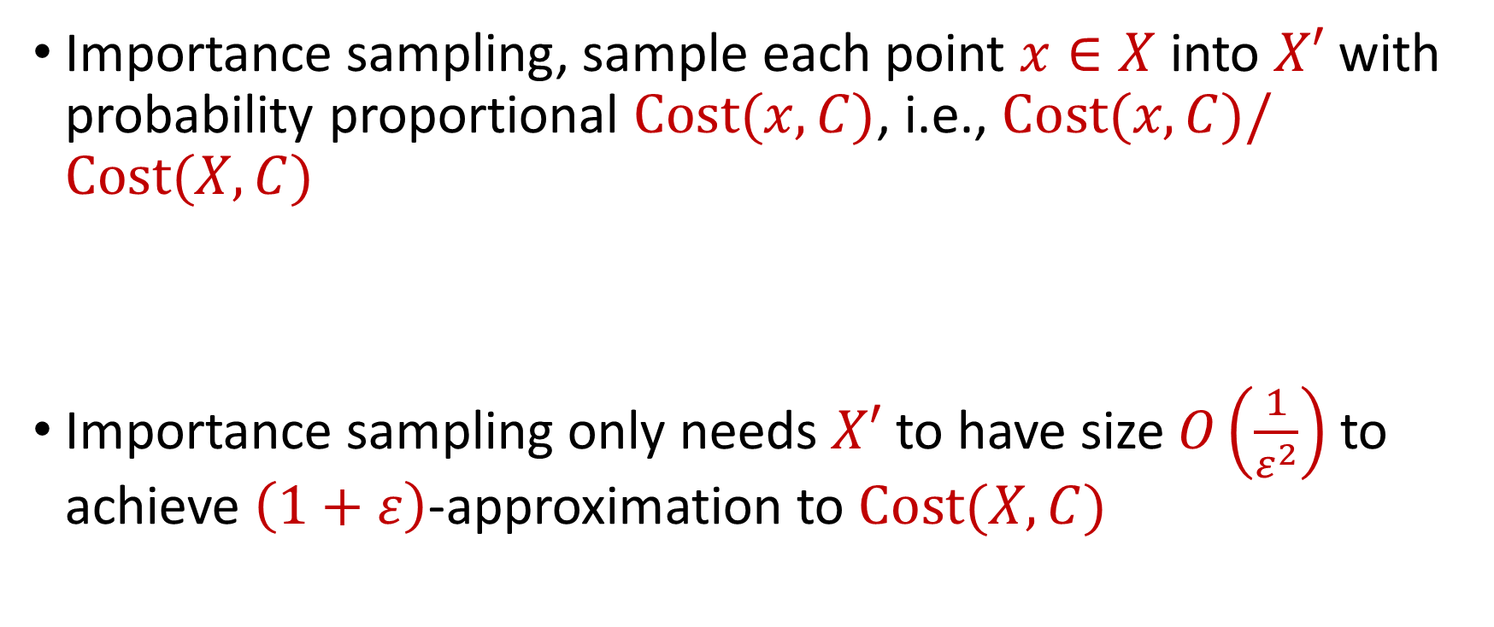
Last Time: Coreset Construction and Sampling
Importance sampling, sample each point $x∈X$ into $X′$ with probability proportional $Cost(x,C)$, i.e., $Cost(x,C)/Cost(X,C)$
Importance sampling only needs $X′$ to have size $O\left(\frac{1}{ε^{2}}\right)$ to achieve $\left(1+ε\right)$-approximation to $Cost(X,C)$

Slide 11
Last Time: Coreset Construction and Sampling
Importance sampling only needs $X′$ to have size $O\left(\frac{1}{ε^{2}}\right)$ to achieve $\left(1+ε\right)$-approximation to $Cost(X,C)$
What about a different choice $C$ of $k$ centers?

Slide 12

Last Time: Coreset Construction and Sampling
Importance sampling only needs $X′$ to have size $O\left(\frac{1}{ε^{2}}\right)$ to achieve $\left(1+ε\right)$-approximation to $Cost(X,C)$
To handle all possible sets of $k$ centers:
Need to sample each point $x$ with probability $\max_{C}\frac{Cost\left(x,C\right)}{Cost\left(X,C\right)}$ instead of $\frac{Cost\left(x,C\right)}{Cost\left(X,C\right)}$
Need to union bound over a net of all possible sets of $k$ centers
Net with size ${\left(\frac{nΔ}{ε}\right)}^{O(kd)}$

Slide 13
Last Time: Sensitivity Sampling
The quantity $s\left(x\right)=\max_{C}\frac{Cost\left(x,C\right)}{Cost\left(X,C\right)}$ is called the sensitivity of $x$ and intuitively measures how “important” the point $x$ is
The total sensitivity of $X$ is $\sum_{x∈X}{s(x)}$ and quantifies how many points will be sampled into $X′$ through importance/sensitivity sampling (before the union bound)

Slide 14
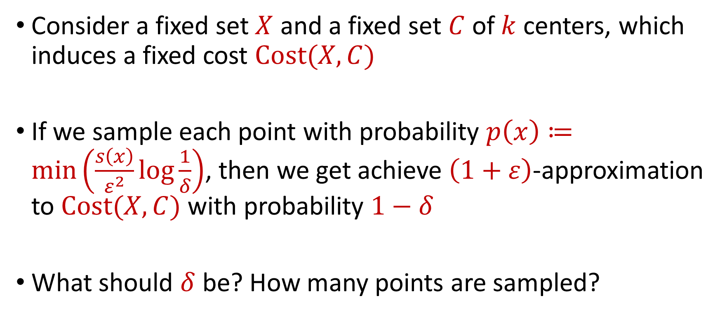
Putting Things Together
Consider a fixed set $X$ and a fixed set $C$ of $k$ centers, which induces a fixed cost $Cost(X,C)$
If we sample each point with probability $p\left(x\right)≔\min\left(\frac{s\left(x\right)}{ε^{2}}log\frac{1}{δ}\right)$, then we get achieve $\left(1+ε\right)$-approximation to $Cost(X,C)$ with probability $1−δ$
What should $δ$ be? How many points are sampled?

Slide 15
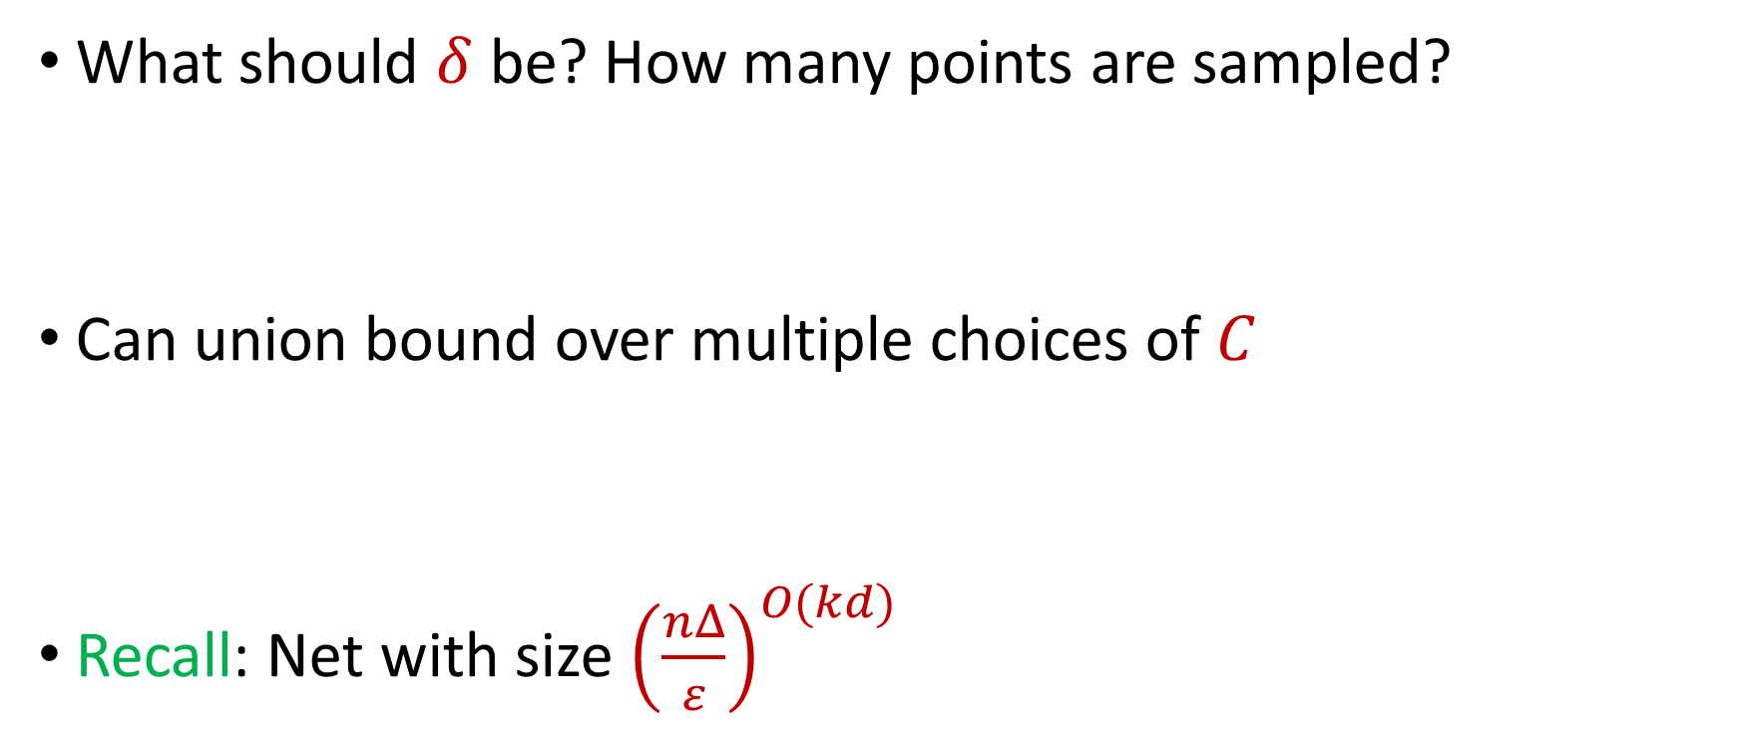
Putting Things Together
What should $δ$ be? How many points are sampled?
Can union bound over multiple choices of $C$
Recall: Net with size ${\left(\frac{nΔ}{ε}\right)}^{O(kd)}$

Slide 16
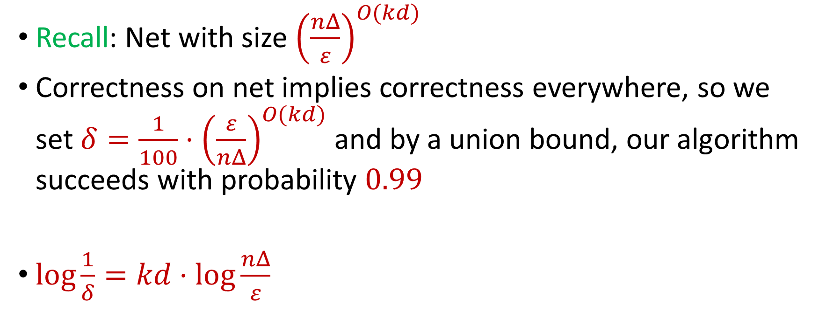
Putting Things Together
Recall: Net with size ${\left(\frac{nΔ}{ε}\right)}^{O(kd)}$
Correctness on net implies correctness everywhere, so we set $δ=\frac{1}{100}⋅{\left(\frac{ε}{nΔ}\right)}^{O(kd)}$ and by a union bound, our algorithm succeeds with probability $0.99$
$\log{\frac{1}{δ}}=kd⋅\log{\frac{nΔ}{ε}}$

Slide 17
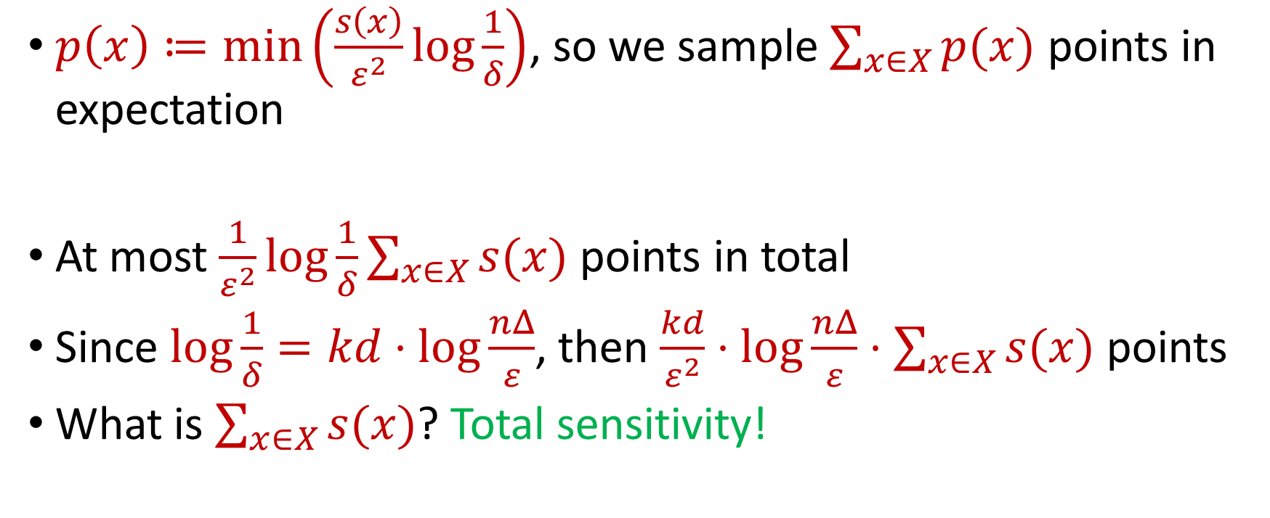
Putting Things Together
$p\left(x\right)≔\min\left(\frac{s\left(x\right)}{ε^{2}}log\frac{1}{δ}\right)$, so we sample $\sum_{x∈X}{p(x)}$ points in expectation
At most $\frac{1}{ε^{2}}log\frac{1}{δ}\sum_{x∈X}{s(x)}$ points in total
Since $\log{\frac{1}{δ}}=kd⋅\log{\frac{nΔ}{ε}}$, then $\frac{kd}{ε^{2}}⋅\log{\frac{nΔ}{ε}}⋅\sum_{x∈X}{s(x)}$ points
What is $\sum_{x∈X}{s(x)}$? Total sensitivity!

Slide 18

$$s\left(x_{t}\right)=\max_{C:\left|C\right|≤k}{\frac{Cost\left(x_{t},C\right)}{Cost\left(X,C\right)}}=\max_{C:\left|C\right|≤k}{\frac{Cost\left(x_{t},C\right)}{\sum_{i=1}^{n}{Cost\left(x_{i},C\right)}}}$$

Slide 19
$$s\left(x_{t}\right)=\max_{C:\left|C\right|≤k}{\frac{Cost\left(x_{t},C\right)}{Cost\left(X,C\right)}}=\max_{C:\left|C\right|≤k}{\frac{Cost\left(x_{t},C\right)}{\sum_{i=1}^{n}{Cost\left(x_{i},C\right)}}}$$
Point has sensitivity $1$

Slide 20
$$s\left(x_{t}\right)=\max_{C:\left|C\right|≤k}{\frac{Cost\left(x_{t},C\right)}{Cost\left(X,C\right)}}=\max_{C:\left|C\right|≤k}{\frac{Cost\left(x_{t},C\right)}{\sum_{i=1}^{n}{Cost\left(x_{i},C\right)}}}$$
Point has sensitivity $1$
Point has sensitivity $1$

Slide 21
$$s\left(x_{t}\right)=\max_{C:\left|C\right|≤k}{\frac{Cost\left(x_{t},C\right)}{Cost\left(X,C\right)}}=\max_{C:\left|C\right|≤k}{\frac{Cost\left(x_{t},C\right)}{\sum_{i=1}^{n}{Cost\left(x_{i},C\right)}}}$$
Point has sensitivity $1$
Point has sensitivity $1$
Point has sensitivity $1$

Slide 22
$$s\left(x_{t}\right)=\max_{C:\left|C\right|≤k}{\frac{Cost\left(x_{t},C\right)}{Cost\left(X,C\right)}}=\max_{C:\left|C\right|≤k}{\frac{Cost\left(x_{t},C\right)}{\sum_{i=1}^{n}{Cost\left(x_{i},C\right)}}}$$
Point has sensitivity $1$
Point has sensitivity $1$
Point has sensitivity $1$
Point has sensitivity $1$

Slide 23
$$s\left(x_{t}\right)=\max_{C:\left|C\right|≤k}{\frac{Cost\left(x_{t},C\right)}{Cost\left(X,C\right)}}=\max_{C:\left|C\right|≤k}{\frac{Cost\left(x_{t},C\right)}{\sum_{i=1}^{n}{Cost\left(x_{i},C\right)}}}$$
Point has sensitivity $1$
Point has sensitivity $1$
Point has sensitivity $1$
Point has sensitivity $1$
Point has sensitivity $1$

Slide 24
$$s\left(x_{t}\right)=\max_{C:\left|C\right|≤k}{\frac{Cost\left(x_{t},C\right)}{Cost\left(X,C\right)}}=\max_{C:\left|C\right|≤k}{\frac{Cost\left(x_{t},C\right)}{\sum_{i=1}^{n}{Cost\left(x_{i},C\right)}}}$$
Point has sensitivity $1$
Point has sensitivity $1$
Point has sensitivity $1$
Point has sensitivity $1$
Point has sensitivity $1$
Point has sensitivity $1$

Slide 25
$$s\left(x_{t}\right)=\max_{C:\left|C\right|≤k}{\frac{Cost\left(x_{t},C\right)}{Cost\left(X,C\right)}}=\max_{C:\left|C\right|≤k}{\frac{Cost\left(x_{t},C\right)}{\sum_{i=1}^{n}{Cost\left(x_{i},C\right)}}}$$
Point has sensitivity $1$
Point has sensitivity $1$
Point has sensitivity $1$
Point has sensitivity $1$
Point has sensitivity $1$
Point has sensitivity $1$
Point has sensitivity $1$

Slide 26

Total Sensitivity
Total sensitivity = Sum of sensitivities can be at least $k$
How large can it be?

Slide 27
$$s\left(x_{t}\right)=\max_{C:\left|C\right|≤k}{\frac{Cost\left(x_{t},C\right)}{Cost\left(X,C\right)}}=\max_{C:\left|C\right|≤k}{\frac{Cost\left(x_{t},C\right)}{\sum_{i=1}^{n}{Cost\left(x_{i},C\right)}}}$$

Slide 28
$$s\left(x_{t}\right)=\max_{C:\left|C\right|≤k}{\frac{Cost\left(x_{t},C\right)}{Cost\left(X,C\right)}}=\max_{C:\left|C\right|≤k}{\frac{Cost\left(x_{t},C\right)}{\sum_{i=1}^{n}{Cost\left(x_{i},C\right)}}}$$

Slide 29
$$s\left(x_{t}\right)=\max_{C:\left|C\right|≤k}{\frac{Cost\left(x_{t},C\right)}{Cost\left(X,C\right)}}=\max_{C:\left|C\right|≤k}{\frac{Cost\left(x_{t},C\right)}{\sum_{i=1}^{n}{Cost\left(x_{i},C\right)}}}$$

Slide 30
$$s\left(x_{t}\right)=\max_{C:\left|C\right|≤k}{\frac{Cost\left(x_{t},C\right)}{Cost\left(X,C\right)}}=\max_{C:\left|C\right|≤k}{\frac{Cost\left(x_{t},C\right)}{\sum_{i=1}^{n}{Cost\left(x_{i},C\right)}}}$$

Slide 31
$$s\left(x_{t}\right)=\max_{C:\left|C\right|≤k}{\frac{Cost\left(x_{t},C\right)}{Cost\left(X,C\right)}}=\max_{C:\left|C\right|≤k}{\frac{Cost\left(x_{t},C\right)}{\sum_{i=1}^{n}{Cost\left(x_{i},C\right)}}}$$
Partition the sum of the sensitivities by each cluster

Slide 32
$$s\left(x_{t}\right)=\max_{C:\left|C\right|≤k}{\frac{Cost\left(x_{t},C\right)}{Cost\left(X,C\right)}}=\max_{C:\left|C\right|≤k}{\frac{Cost\left(x_{t},C\right)}{\sum_{i=1}^{n}{Cost\left(x_{i},C\right)}}}$$
Charge to $OPT$
Charge to $OPT$

Slide 33
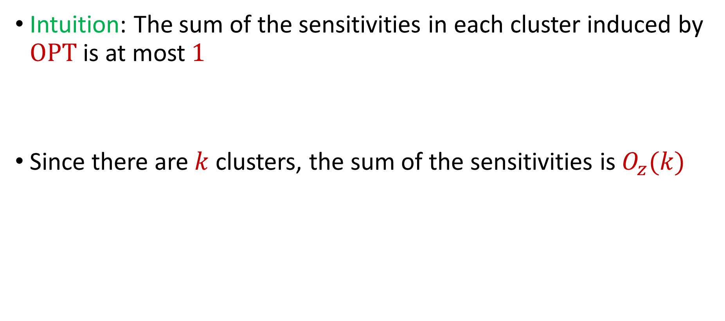
Total Sensitivity
Intuition: The sum of the sensitivities in each cluster induced by $OPT$ is at most $1$
Since there are $k$ clusters, the sum of the sensitivities is $O_{z}(k)$

Slide 34
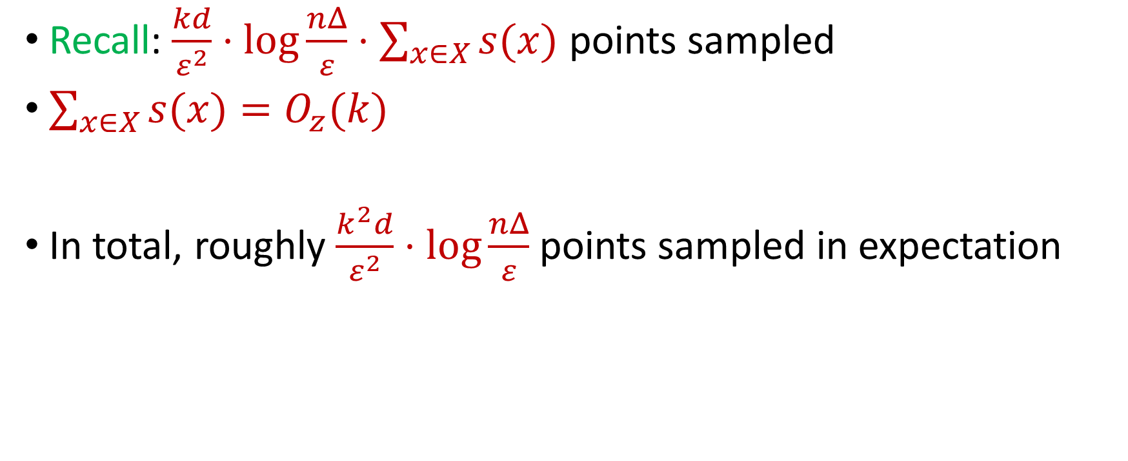
Putting Things Together
Recall: $\frac{kd}{ε^{2}}⋅\log{\frac{nΔ}{ε}}⋅\sum_{x∈X}{s(x)}$ points sampled
$\sum_{x∈X}{s(x)}=O_{z}(k)$
In total, roughly $\frac{k^{2}d}{ε^{2}}⋅\log{\frac{nΔ}{ε}}$ points sampled in expectation

Slide 35
How to Compute Sensitivities?
Estimations to sensitivities suffice
Bicriteria algorithms, e.g., online facility location

