Slide 1
CSCE 689: Special Topics in Modern Algorithms for Data Science
Lecture 32
Samson Zhou

Slide 2
Presentation Schedule
November 27: Chunkai, Jung, Galaxy AI
November 29: STMI, Anmol, Jason
December 1: Bokun, Ayesha, Dawei, Lipai

Slide 3

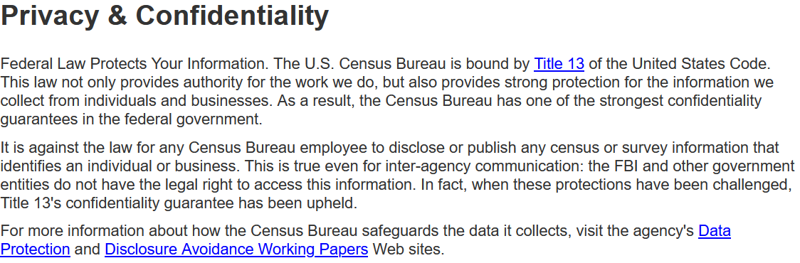
census.gov:

Slide 4


Private Data Analysis
Sensitive dataset
Analyst
Analysis of medical datasets to predict possible issues
Pattern detection for social networks or epidemic spread
US Census information for apportionment

Slide 5

Anonymization
Sensitive dataset
Anonymized dataset
Analyst

Slide 6
Anonymizing Data
Age | Zip Code | Employer | Has Pet
56 | 77005 | Apple | Yes
32 | 77005 | Microsoft | No
71 | 77005 | Amazon | Yes
44 | 77005 | Petsmart | Yes
25 | 77005 | Netflix | No
61 | 77005 | Google | No

Slide 7
Anonymizing Data
Age | Zip Code | Employer | Has Pet
56 | 77005 | Apple | Yes
32 | 77005 | Microsoft | No
71 | 77005 | Amazon | Yes
44 | 77005 | Petsmart | Yes
25 | 77005 | Netflix | No
61 | 77005 | Google | No
Name | Age | Gender | Employer
Alice | 56 | Female | Apple
Bob | 32 | Male | Microsoft
Carol | 71 | Female | Amazon
Dale | 44 | Male | Petsmart
Erin | 25 | Female | Netflix
Fred | 61 | Male | Google

Slide 8
Reconstruction Attack
Name | Age | Zip Code | Gender | Employer | Has Pet
Alice | 56 | 77005 | Female | Apple | Yes
Bob | 32 | 77005 | Male | Microsoft | No
Carol | 71 | 77005 | Female | Amazon | Yes
Dale | 44 | 77005 | Male | Petsmart | Yes
Erin | 25 | 77005 | Female | Netflix | No
Fred | 61 | 77005 | Male | Google | No

Slide 9
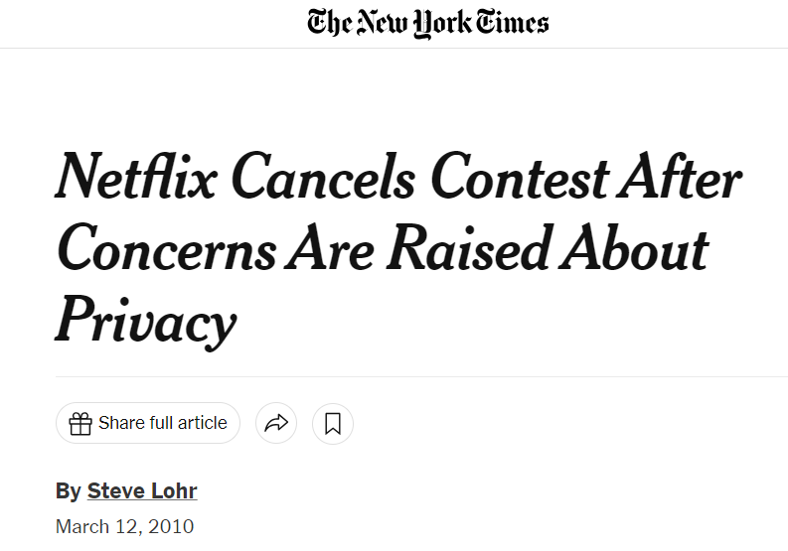
Anonymizing Data

Slide 10
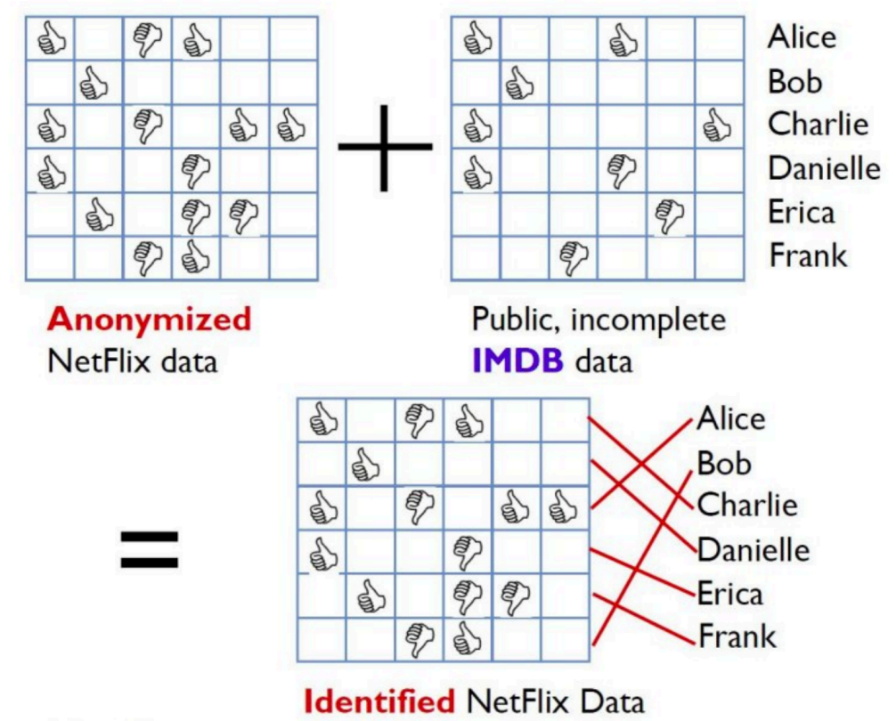
Image from Arvind Narayanan

Slide 11
Differencing Attacks
How many people in this classroom went to Kyle Field last weekend?
How many people in this classroom besides the instructor went to Kyle Field last weekend?

Slide 12
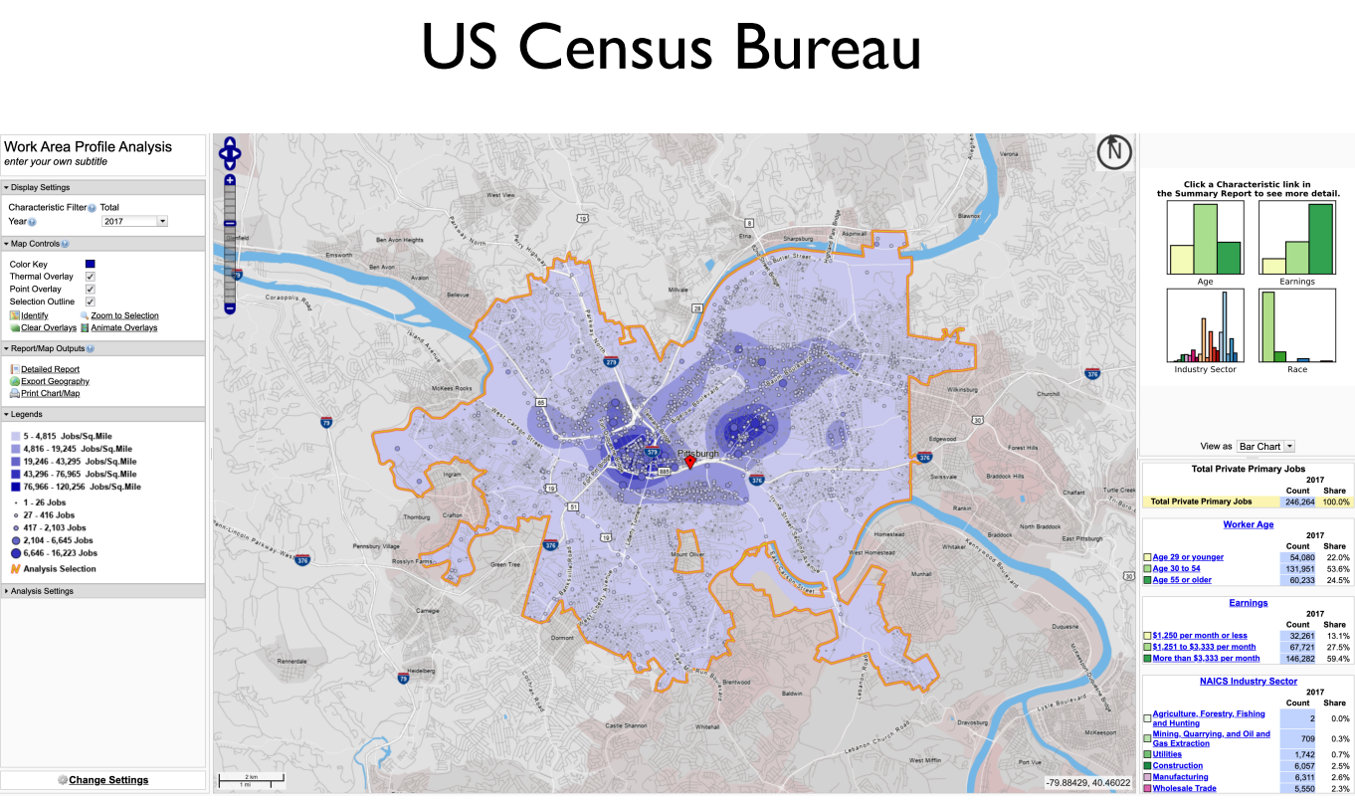
Slide from Steven Wu

Slide 13
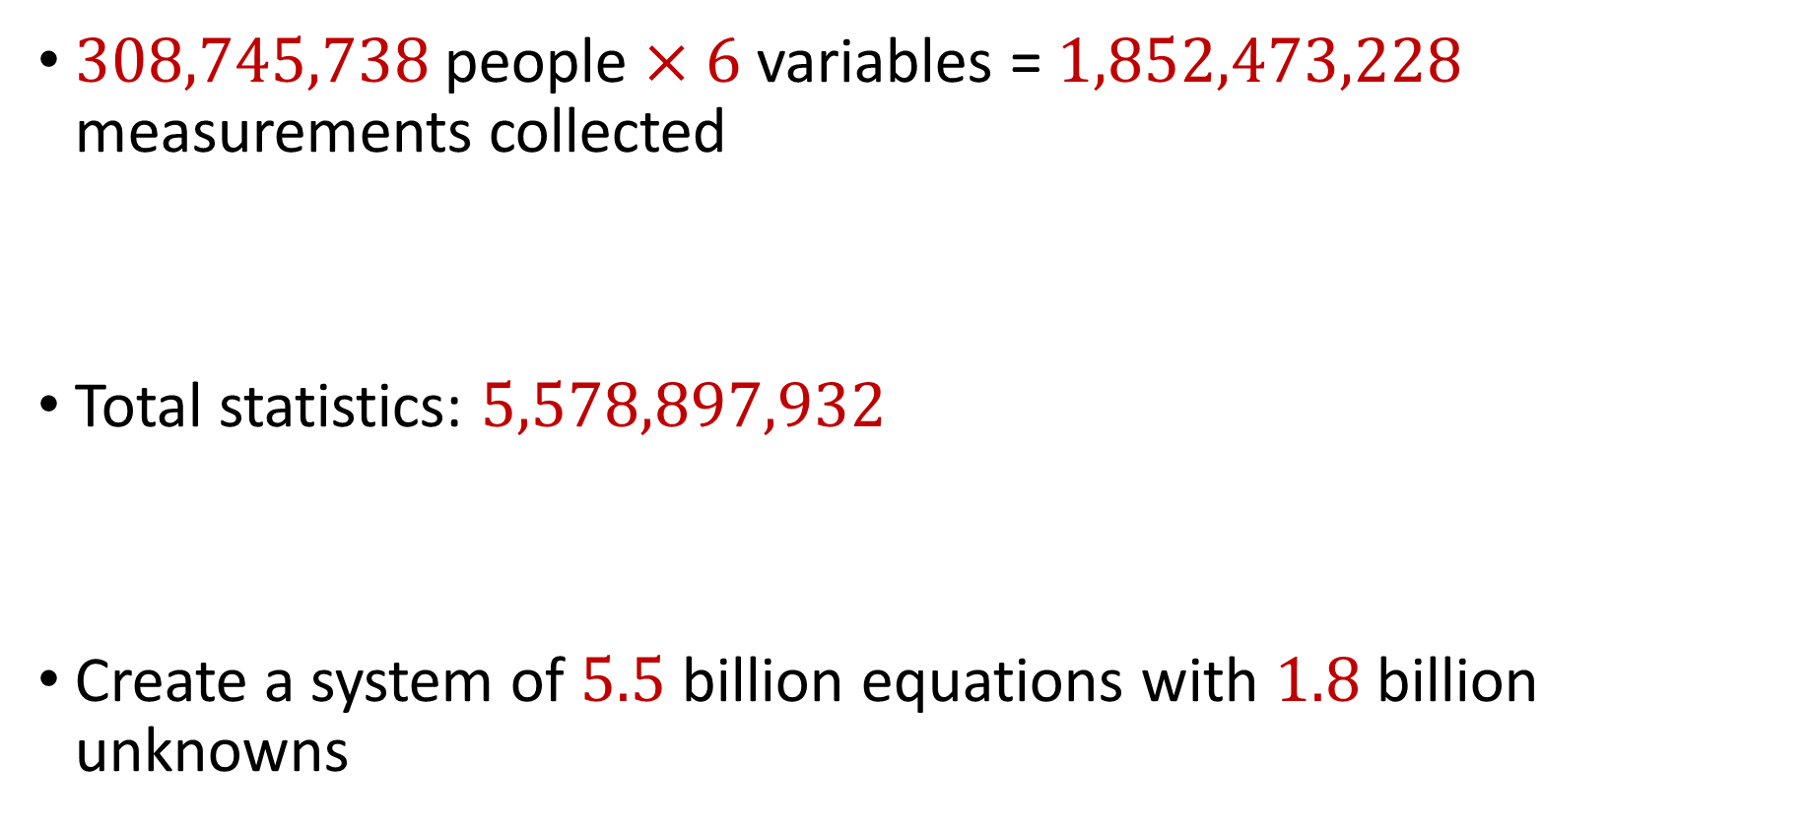
2010 US Census
$308,745,738$ people $×$ $6$ variables = $1,852,473,228$ measurements collected
Total statistics: $5,578,897,932$
Create a system of $5.5$ billion equations with $1.8$ billion unknowns

Slide 14
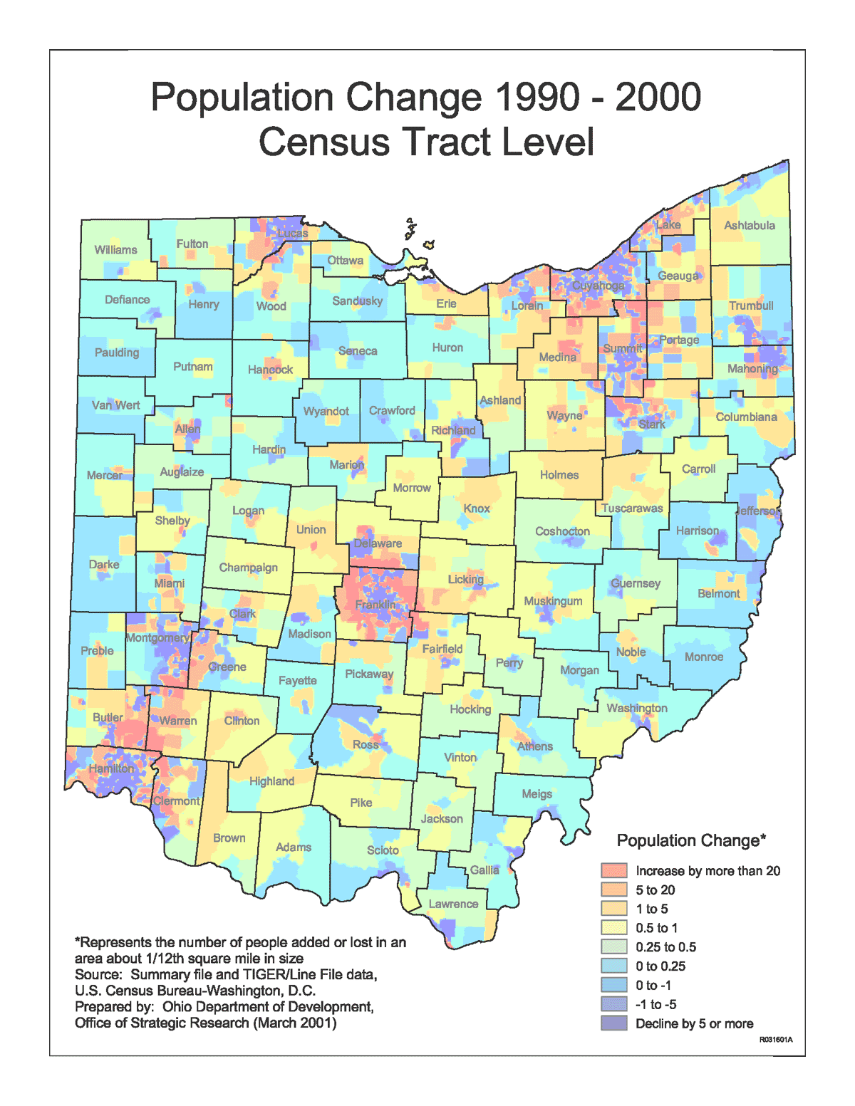
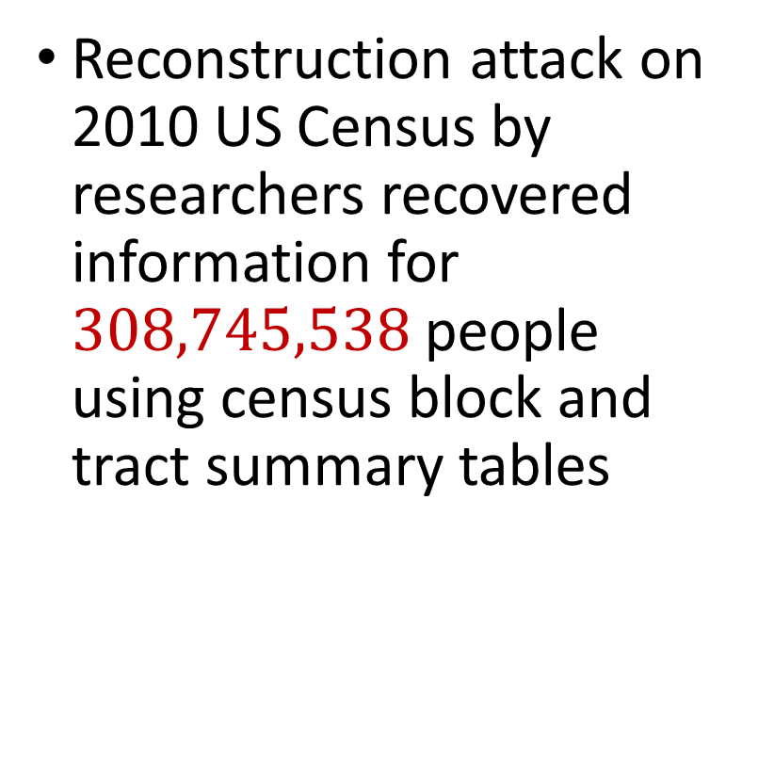
2010 US Census
Reconstruction attack on 2010 US Census by researchers recovered information for $308,745,538$ people using census block and tract summary tables

Slide 15
Summary
“Ad-hoc” privacy procedures like anonymization/deidentification often fails
Publishing too many queries on a sensitive database with too much accuracy can compromise the privacy of the database
Need a formal mathematical notion for measuring privacy

Slide 16

Possible Notion for Privacy #1
“The data analyst cannot learn anything about Alice”
Sensitive dataset
Analyst

Slide 17
Possible Notion for Privacy #1
“The data analyst cannot learn anything about Alice”
Most Aggies like Reveille
Alice is known to be an Aggie
Sensitive dataset
Analyst
Was Alice’s privacy violated?

Slide 18

Possible Notion for Privacy #1
“The data analyst cannot learn anything about Alice”
Most Aggies like Reveille
Bob participates in the survey
Sensitive dataset
Analyst
Even though Alice is not in the survey, it is still known that Alice is an Aggie

Slide 19
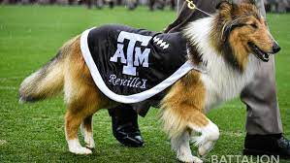
Possible Notion for Privacy #1
Suppose a survey is conducted on a sensitive dataset and concludes that “most Aggies like dogs, e.g., Reveille”
Alice is a known Aggie, and so a data analyst infers that Alice is more likely to be a dog owner and asks for higher apartment cleaning rates
Was Alice’s privacy violated by this study?

Slide 20
Possible Notion for Privacy #2
“A study is private…if the data analyst gains almost no additional information about Alice from the study than if the same study was performed without Alice’s data”

Slide 21

Possible Notion for Privacy #2
Stability: the data analyst reaches roughly similar conclusions if any individual data point is replaced by another data point of the population

Slide 22
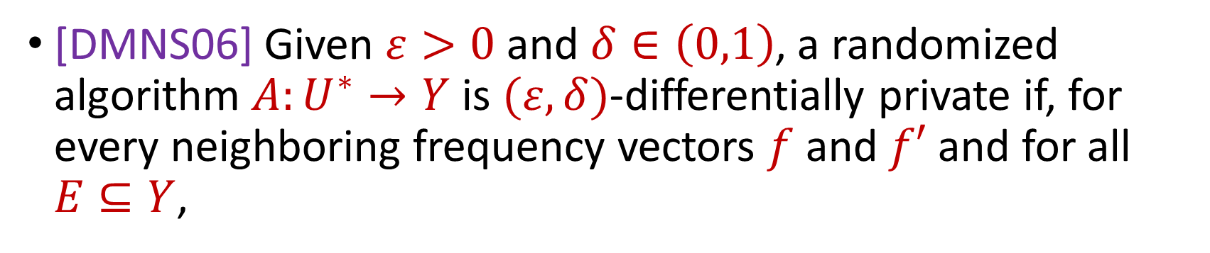
Differential Privacy
[DMNS06] Given $ε>0$and $δ∈\left(0,1\right)$, a randomized algorithm $A:U^{∗}→Y$ is $(ε,δ)$-differentially private if, for every neighboring frequency vectors $f$ and $f′$ and for all $E⊆Y$,
$$Pr\left[A\left(f\right)∈E\right]≤e^{ε}⋅Pr\left[A\left(f^{′}\right)∈E\right]+δ$$
Notes:
[DworkMcSherryNissimSmith06]

Slide 23



Differential Privacy
[DMNS06] Given $ε>0$and $δ∈\left(0,1\right)$, a randomized algorithm $A:U^{∗}→Y$ is $(ε,δ)$-differentially private if, for every neighboring frequency vectors $f$ and $f′$ and for all $E⊆Y$,
$$Pr\left[A\left(f\right)∈E\right]≤e^{ε}⋅Pr\left[A\left(f^{′}\right)∈E\right]+δ$$
$$A\left( \right)≈A\left( \right)$$
Notes:
[DworkMcSherryNissimSmith06]

Slide 24
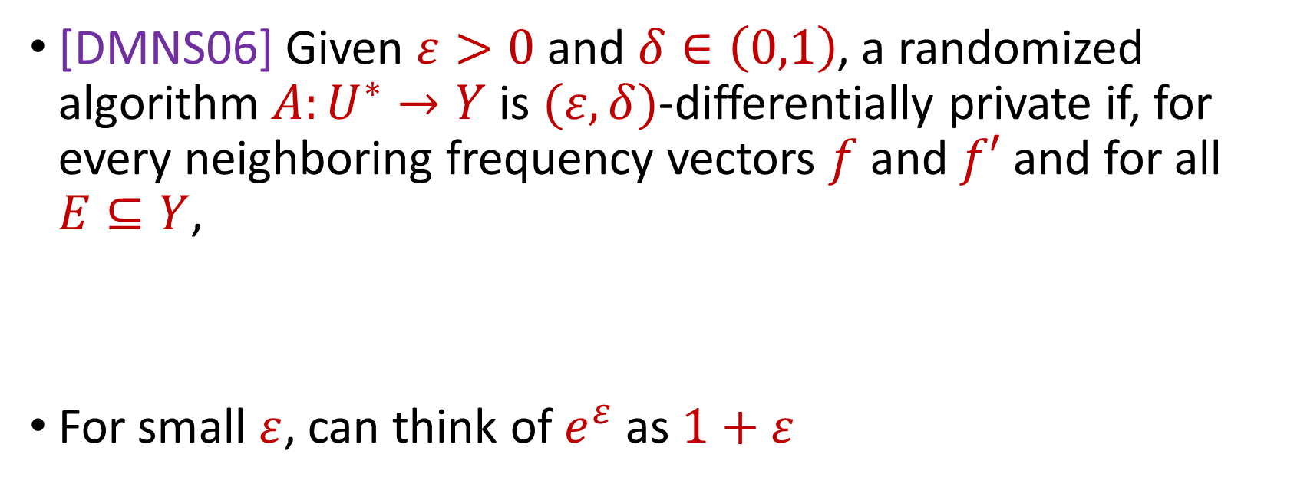
Differential Privacy
[DMNS06] Given $ε>0$and $δ∈\left(0,1\right)$, a randomized algorithm $A:U^{∗}→Y$ is $(ε,δ)$-differentially private if, for every neighboring frequency vectors $f$ and $f′$ and for all $E⊆Y$,
For small $ε$, can think of $e^{ε}$ as $1+ε$
$$Pr\left[A\left(f\right)∈E\right]≤e^{ε}⋅Pr\left[A\left(f^{′}\right)∈E\right]+δ$$
$$Pr\left[A\left(f\right)∈E\right]≤\left(1+ε\right)⋅Pr\left[A\left(f^{′}\right)∈E\right]+δ$$
Notes:
[DworkMcSherryNissimSmith06]

Slide 25
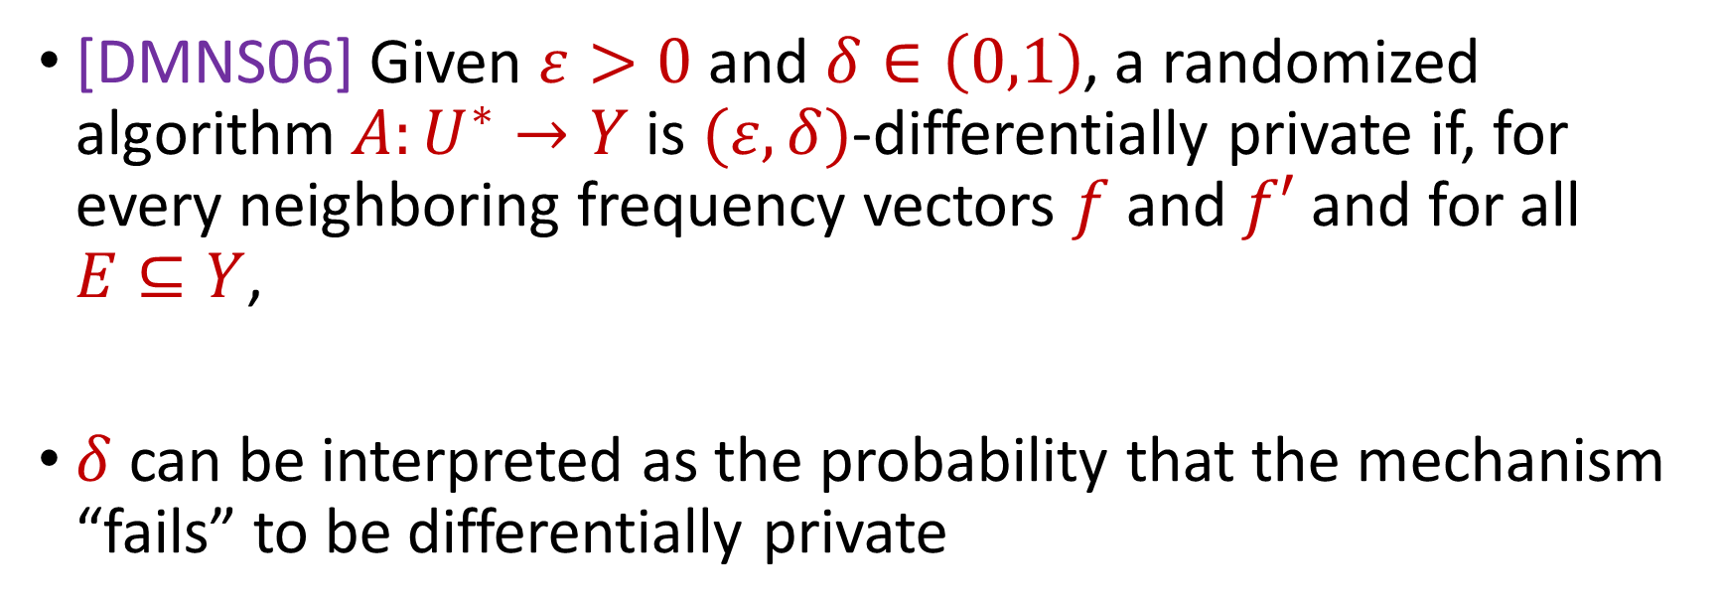
Differential Privacy
[DMNS06] Given $ε>0$and $δ∈\left(0,1\right)$, a randomized algorithm $A:U^{∗}→Y$ is $(ε,δ)$-differentially private if, for every neighboring frequency vectors $f$ and $f′$ and for all $E⊆Y$,
$δ$ can be interpreted as the probability that the mechanism “fails” to be differentially private
$$Pr\left[A\left(f\right)∈E\right]≤e^{ε}⋅Pr\left[A\left(f^{′}\right)∈E\right]+δ$$
Notes:
[DworkMcSherryNissimSmith06]

Slide 26
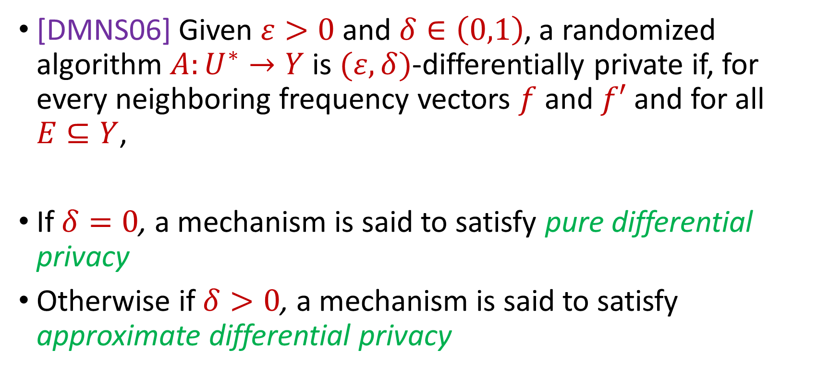
Differential Privacy
[DMNS06] Given $ε>0$and $δ∈\left(0,1\right)$, a randomized algorithm $A:U^{∗}→Y$ is $(ε,δ)$-differentially private if, for every neighboring frequency vectors $f$ and $f′$ and for all $E⊆Y$,
If $δ=0$, a mechanism is said to satisfy pure differential privacy
Otherwise if $δ>0$, a mechanism is said to satisfy approximate differential privacy
$$Pr\left[A\left(f\right)∈E\right]≤e^{ε}⋅Pr\left[A\left(f^{′}\right)∈E\right]+δ$$
Notes:
[DworkMcSherryNissimSmith06]

Slide 27
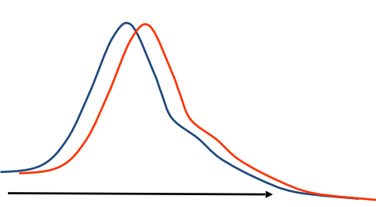
Differential Privacy
[DMNS06] Given $ε>0$and $δ∈\left(0,1\right)$, a randomized algorithm $A:U^{∗}→Y$ is $(ε,δ)$-differentially private if, for every neighboring frequency vectors $f$ and $f′$ and for all $E⊆Y$,
$$Pr\left[A\left(f\right)∈E\right]≤e^{ε}⋅Pr\left[A\left(f^{′}\right)∈E\right]+δ$$
Sensitive dataset
Algorithm
Output distribution
Notes:
[DworkMcSherryNissimSmith06]

Slide 28
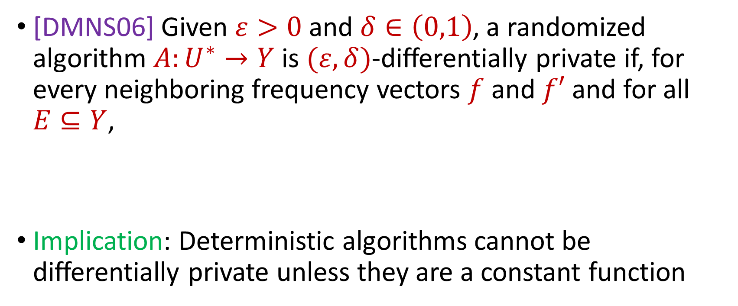
Differential Privacy
[DMNS06] Given $ε>0$and $δ∈\left(0,1\right)$, a randomized algorithm $A:U^{∗}→Y$ is $(ε,δ)$-differentially private if, for every neighboring frequency vectors $f$ and $f′$ and for all $E⊆Y$,
Implication: Deterministic algorithms cannot be differentially private unless they are a constant function
$$Pr\left[A\left(f\right)∈E\right]≤e^{ε}⋅Pr\left[A\left(f^{′}\right)∈E\right]+δ$$
Notes:
[DworkMcSherryNissimSmith06]

