Slide 1
CSCE 689: Special Topics in Modern Algorithms for Data Science
Lecture 31
Samson Zhou

Slide 2
Presentation Schedule
November 27: Chunkai, Jung, Galaxy AI
November 29: STMI, Anmol, Jason
December 1: Bokun, Ayesha, Dawei, Lipai

Slide 3






Linear Algebra Review
For $y=Ax$, we have $y_{i}=⟨a_{i}, x⟩$
${\left\|Ax\right\|}_{2}^{2}={\left\langle a_{1}, x\right\rangle }^{2}+…+{\left\langle a_{n}, x\right\rangle }^{2}$
$$A$$
$$x$$
$$d$$
$$n$$
$$d$$

Slide 4
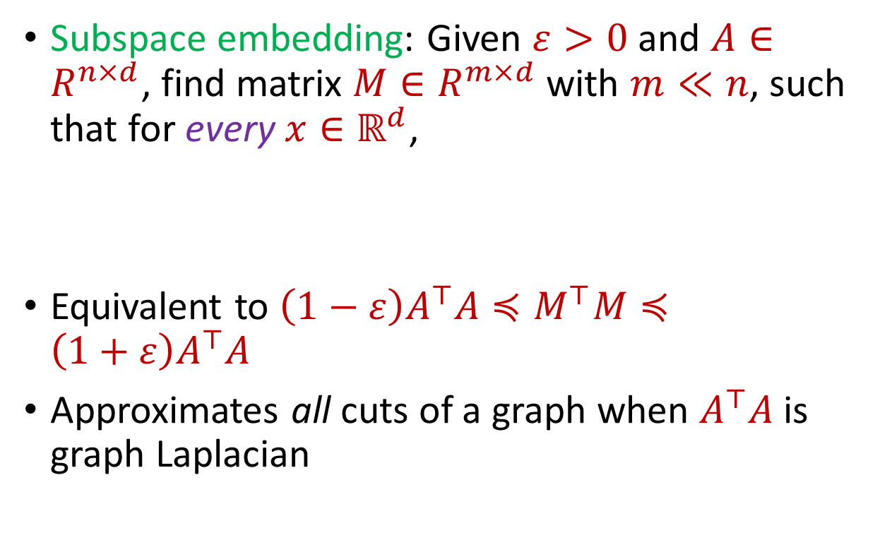


Subspace Embedding
Subspace embedding: Given $ε>0$ and $A∈R^{n×d}$, find matrix $M∈R^{m×d}$ with $m≪n$, such that for every $x∈ℝ^{d}$,
Equivalent to $\left(1−ε\right)A^{⊤}A≼M^{⊤}M≼\left(1+ε\right)A^{⊤}A$
Approximates all cuts of a graph when $A^{⊤}A$ is graph Laplacian
$$A$$
$$x$$
$$n$$
$$\left(1−ε\right){\left\|Ax\right\|}_{2}≤{\left\|Mx\right\|}_{2}≤\left(1+ε\right){\left\|Ax\right\|}_{2}$$
$$d$$

Slide 5
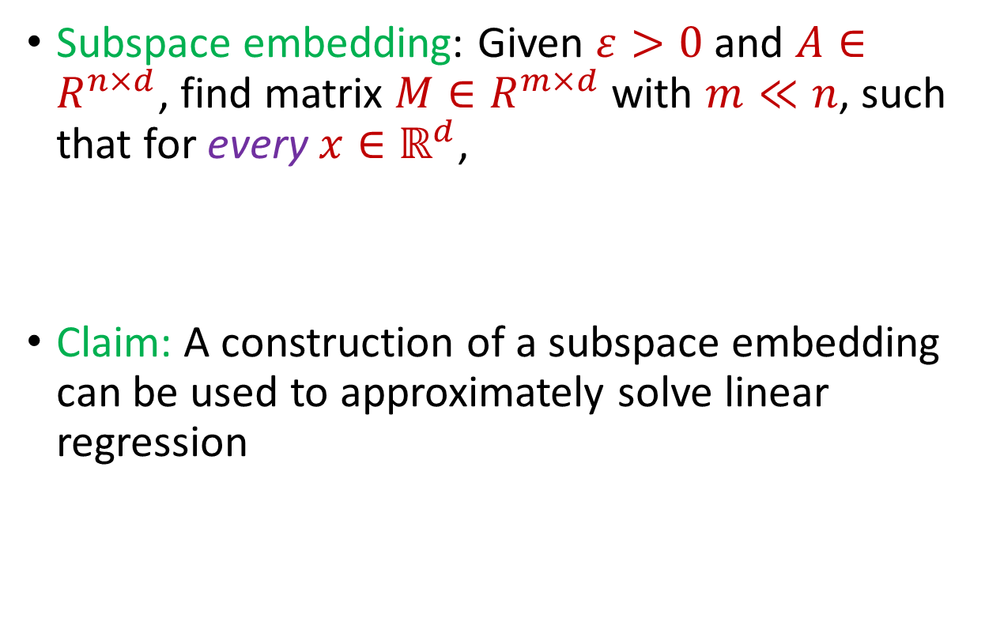
Subspace Embedding
Subspace embedding: Given $ε>0$ and $A∈R^{n×d}$, find matrix $M∈R^{m×d}$ with $m≪n$, such that for every $x∈ℝ^{d}$,
Claim: A construction of a subspace embedding can be used to approximately solve linear regression
$$A$$
$$x$$
$$n$$
$$\left(1−ε\right){\left\|Ax\right\|}_{2}≤{\left\|Mx\right\|}_{2}≤\left(1+ε\right){\left\|Ax\right\|}_{2}$$
$$d$$

Slide 6
















Regression and Subspace Embeddings
Recall: Goal is to find $x$ that minimizes ${\left\|Ax−b\right\|}_{2}$
$$−$$
$$A$$
$$x$$
$$b$$
$$A$$
$$b$$
$$x$$
$$n$$
$$n$$
$$n$$
$$−1$$
$$d$$
$$1$$
$$d$$
$$1$$

Slide 7




Regression and Subspace Embeddings
Recall: Goal is to find $x$ that minimizes ${\left\|Ax−b\right\|}_{2}$
$$B$$
$$y$$
$$A$$
$$b$$
$$x$$
$$n$$
$$n$$
$$−1$$
$$d+1$$
$$d$$
$$1$$

Slide 8

Regression and Subspace Embeddings
Recall: Goal is to find $x$ that minimizes ${\left\|Ax−b\right\|}_{2}$
$$B$$
$$y$$
$$A$$
$$b$$
$$x$$
$$n$$
$$n$$
$$−1$$
$${\left\|By\right\|}_{2}≈{\left\|Ax−b\right\|}_{2}$$
$$d+1$$
$$d$$
$$1$$

Slide 9

Previously: Coreset Construction and Sampling
Importance sampling only needs $X′$ to have size $O\left(\frac{1}{ε^{2}}\right)$ to achieve $\left(1+ε\right)$-approximation to $Cost(X,C)$
To handle all possible sets of $k$ centers:
Need to sample each point $x$ with probability $\max_{C}\frac{Cost\left(x,C\right)}{Cost\left(X,C\right)}$ instead of $\frac{Cost\left(x,C\right)}{Cost\left(X,C\right)}$
Need to union bound over a net of all possible sets of $k$ centers
Net with size ${\left(\frac{nΔ}{ε}\right)}^{O(kd)}$

Slide 10
Previously: Sensitivity Sampling
The quantity $s\left(x\right)=\max_{C}\frac{Cost\left(x,C\right)}{Cost\left(X,C\right)}$ is called the sensitivity of $x$ and intuitively measures how “important” the point $x$ is
The total sensitivity of $X$ is $\sum_{x∈X}{s(x)}$ and quantifies how many points will be sampled into $X′$ through importance/sensitivity sampling (before the union bound)

Slide 11
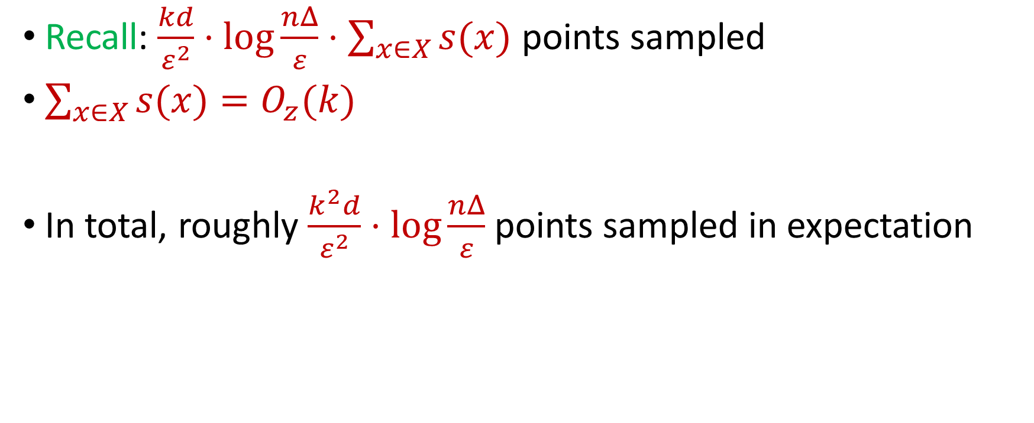
Previously: Sensitivity Sampling
Recall: $\frac{kd}{ε^{2}}⋅\log{\frac{nΔ}{ε}}⋅\sum_{x∈X}{s(x)}$ points sampled
$\sum_{x∈X}{s(x)}=O_{z}(k)$
In total, roughly $\frac{k^{2}d}{ε^{2}}⋅\log{\frac{nΔ}{ε}}$ points sampled in expectation

Slide 12

Subspace Embedding
Subspace embedding: Given $ε>0$ and $A∈R^{n×d}$, find matrix $M∈R^{m×d}$ with $m≪n$, such that for every $x∈ℝ^{d}$,
$$A$$
$$x$$
$$n$$
$$\left(1−ε\right){\left\|Ax\right\|}_{2}≤{\left\|Mx\right\|}_{2}≤\left(1+ε\right){\left\|Ax\right\|}_{2}$$
$$d$$

Slide 13
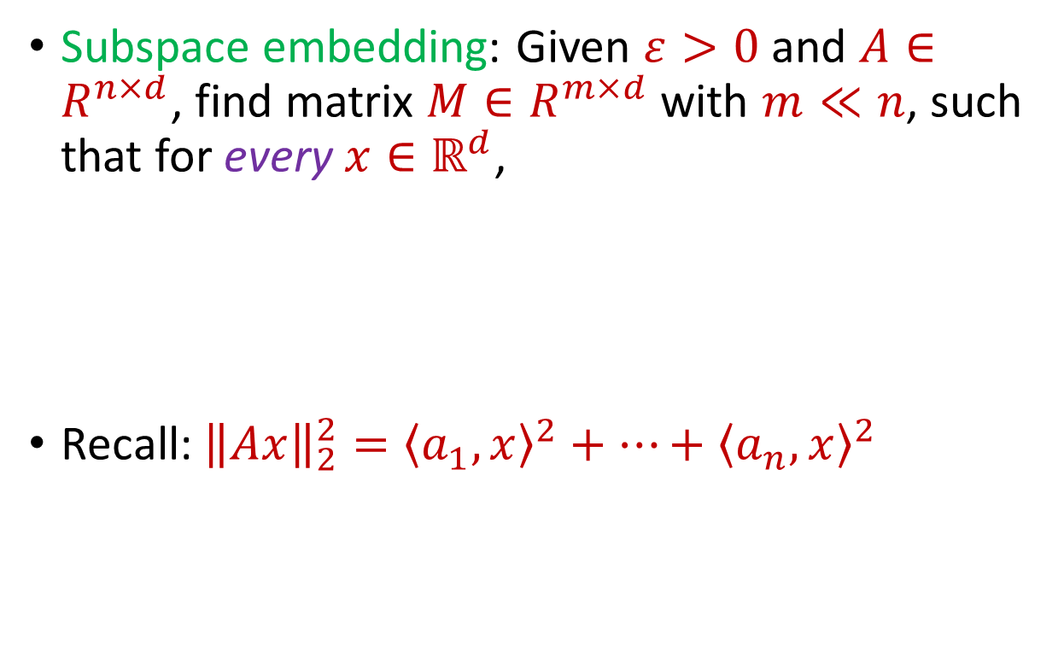
Subspace Embedding
Subspace embedding: Given $ε>0$ and $A∈R^{n×d}$, find matrix $M∈R^{m×d}$ with $m≪n$, such that for every $x∈ℝ^{d}$,
Recall: ${\left\|Ax\right\|}_{2}^{2}={\left\langle a_{1}, x\right\rangle }^{2}+…+{\left\langle a_{n}, x\right\rangle }^{2}$
$$A$$
$$x$$
$$n$$
$$\left(1−ε\right){\left\|Ax\right\|}_{2}^{2}≤{\left\|Mx\right\|}_{2}^{2}≤\left(1+ε\right){\left\|Ax\right\|}_{2}^{2}$$
$$d$$

Slide 14
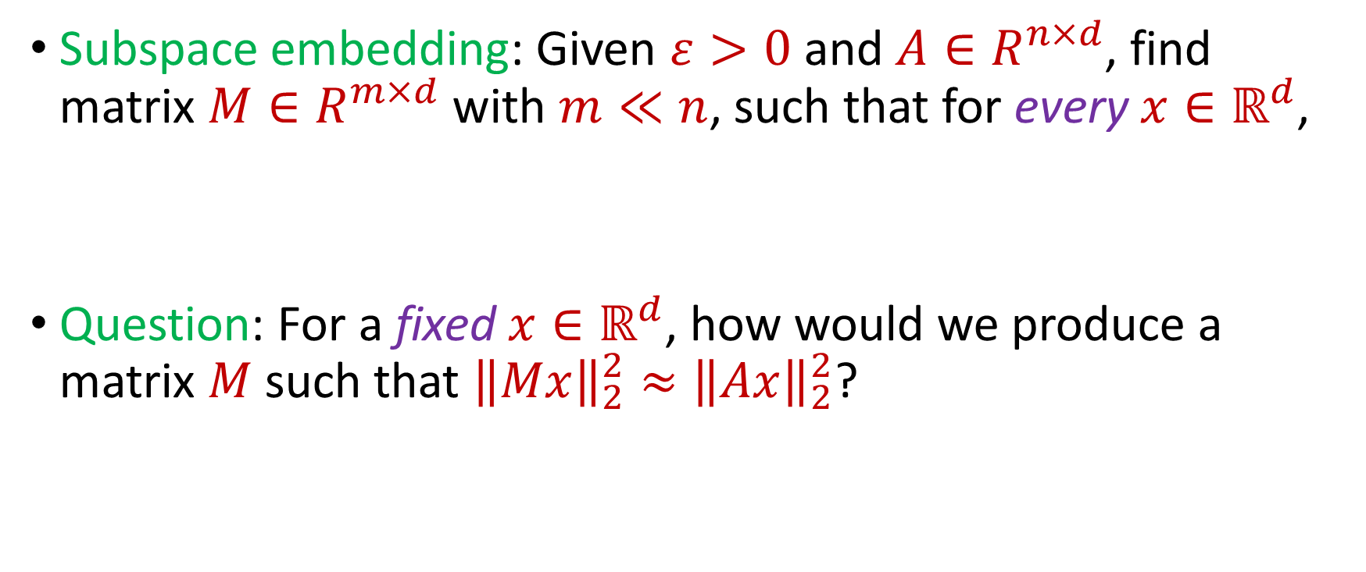
Subspace Embedding
Subspace embedding: Given $ε>0$ and $A∈R^{n×d}$, find matrix $M∈R^{m×d}$ with $m≪n$, such that for every $x∈ℝ^{d}$,
Question: For a fixed $x∈ℝ^{d}$, how would we produce a matrix $M$ such that ${\left\|Mx\right\|}_{2}^{2}≈{\left\|Ax\right\|}_{2}^{2}$?
$$\left(1−ε\right){\left\|Ax\right\|}_{2}^{2}≤{\left\|Mx\right\|}_{2}^{2}≤\left(1+ε\right){\left\|Ax\right\|}_{2}^{2}$$

Slide 15
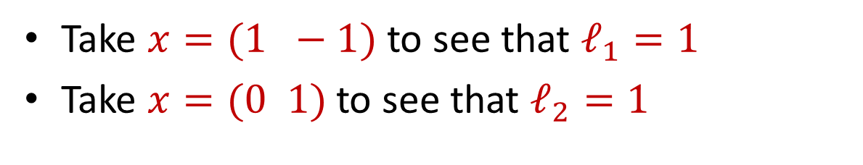
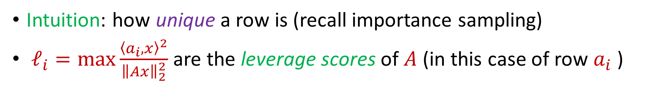
Leverage Scores
Intuition: how unique a row is (recall importance sampling)
$ℓ_{i}=\max{\frac{{\left\langle a_{i},x\right\rangle }^{2}}{{\left\|Ax\right\|}_{2}^{2}}}$ are the leverage scores of $A$ (in this case of row $a_{i}$ )
Take $x=(1 −1)$ to see that $ℓ_{1}=1$
Take $x=(0 1)$ to see that $ℓ_{2}=1$
1 0
1 1
$ℓ_{i}=a_{i}{\left(A^{⊤}A\right)}^{−1}a_{i}^{⊤}$, ${∑ℓ}_{i}=d$
$$A$$
$$a_{i}$$

Slide 16


census.gov:

Slide 17


Private Data Analysis
Sensitive dataset
Analyst
Analysis of medical datasets to predict possible issues
Pattern detection for social networks or epidemic spread
US Census information for apportionment

Slide 18

Anonymization
Sensitive dataset
Anonymized dataset
Analyst

Slide 19
Anonymizing Data
Age | Zip Code | Employer | Has Pet
56 | 77005 | Apple | Yes
32 | 77005 | Microsoft | No
71 | 77005 | Amazon | Yes
44 | 77005 | Petsmart | Yes
25 | 77005 | Netflix | No
61 | 77005 | Google | No

Slide 20
Anonymizing Data
Age | Zip Code | Employer | Has Pet
56 | 77005 | Apple | Yes
32 | 77005 | Microsoft | No
71 | 77005 | Amazon | Yes
44 | 77005 | Petsmart | Yes
25 | 77005 | Netflix | No
61 | 77005 | Google | No
Name | Age | Gender | Employer
Alice | 56 | Female | Apple
Bob | 32 | Male | Microsoft
Carol | 71 | Female | Amazon
Dale | 44 | Male | Petsmart
Erin | 25 | Female | Netflix
Fred | 61 | Male | Google

Slide 21
Reconstruction Attack
Name | Age | Zip Code | Gender | Employer | Has Pet
Alice | 56 | 77005 | Female | Apple | Yes
Bob | 32 | 77005 | Male | Microsoft | No
Carol | 71 | 77005 | Female | Amazon | Yes
Dale | 44 | 77005 | Male | Petsmart | Yes
Erin | 25 | 77005 | Female | Netflix | No
Fred | 61 | 77005 | Male | Google | No

Slide 22

Anonymizing Data

Slide 23
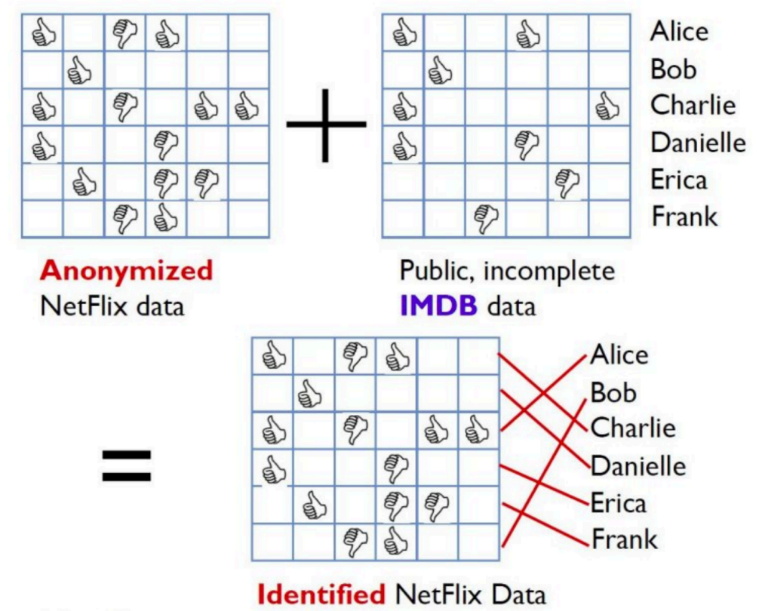
Image from Arvind Narayanan

Slide 24
Differencing Attacks
How many people in this classroom went to Kyle Field last weekend?
How many people in this classroom besides the instructor went to Kyle Field last weekend?

Slide 25
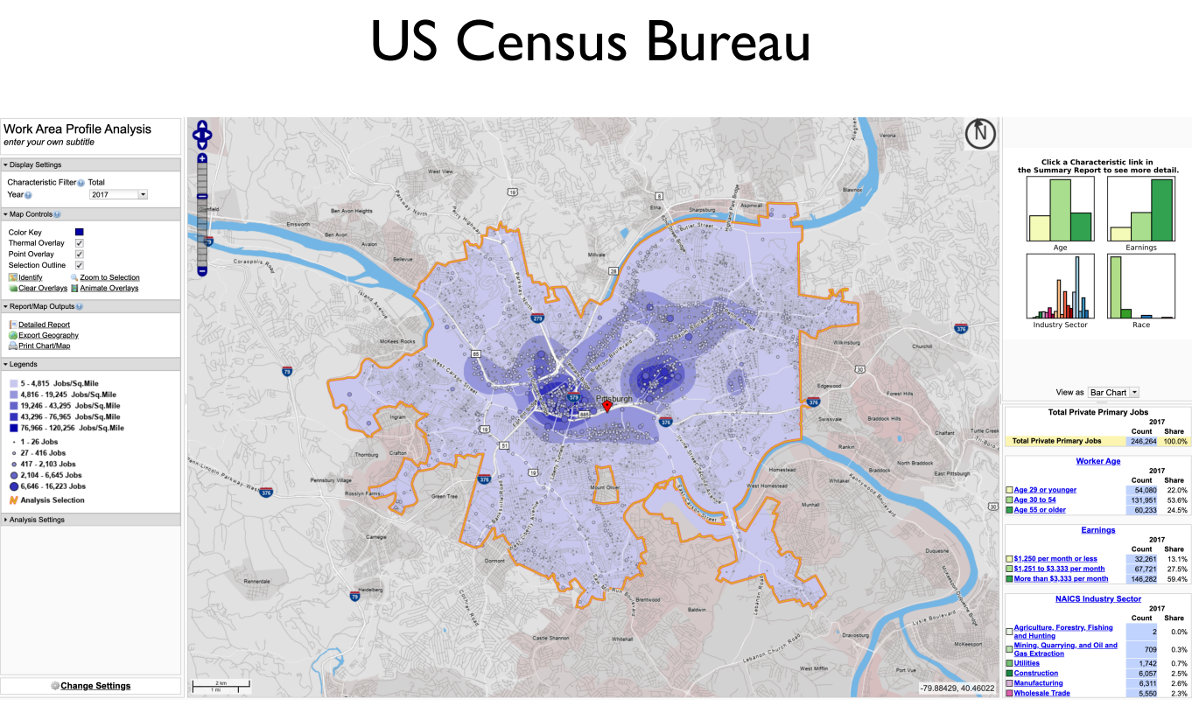
Slide from Steven Wu

Slide 26
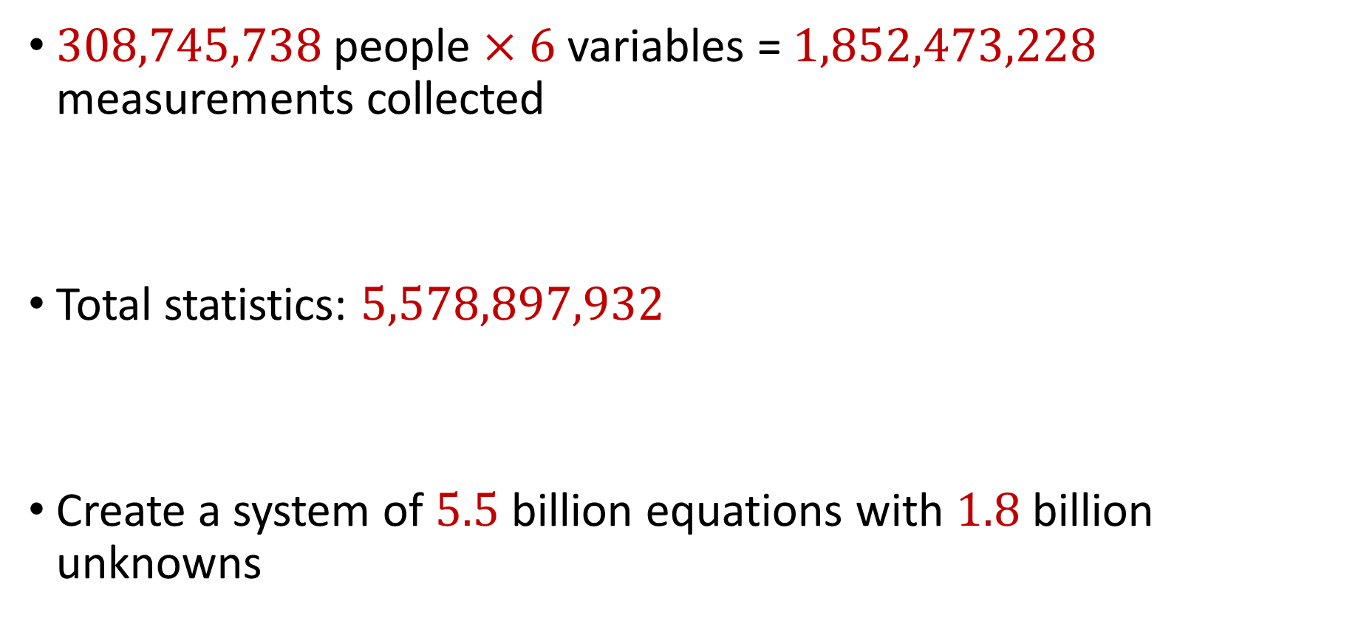
2010 US Census
$308,745,738$ people $×$ $6$ variables = $1,852,473,228$ measurements collected
Total statistics: $5,578,897,932$
Create a system of $5.5$ billion equations with $1.8$ billion unknowns

Slide 27
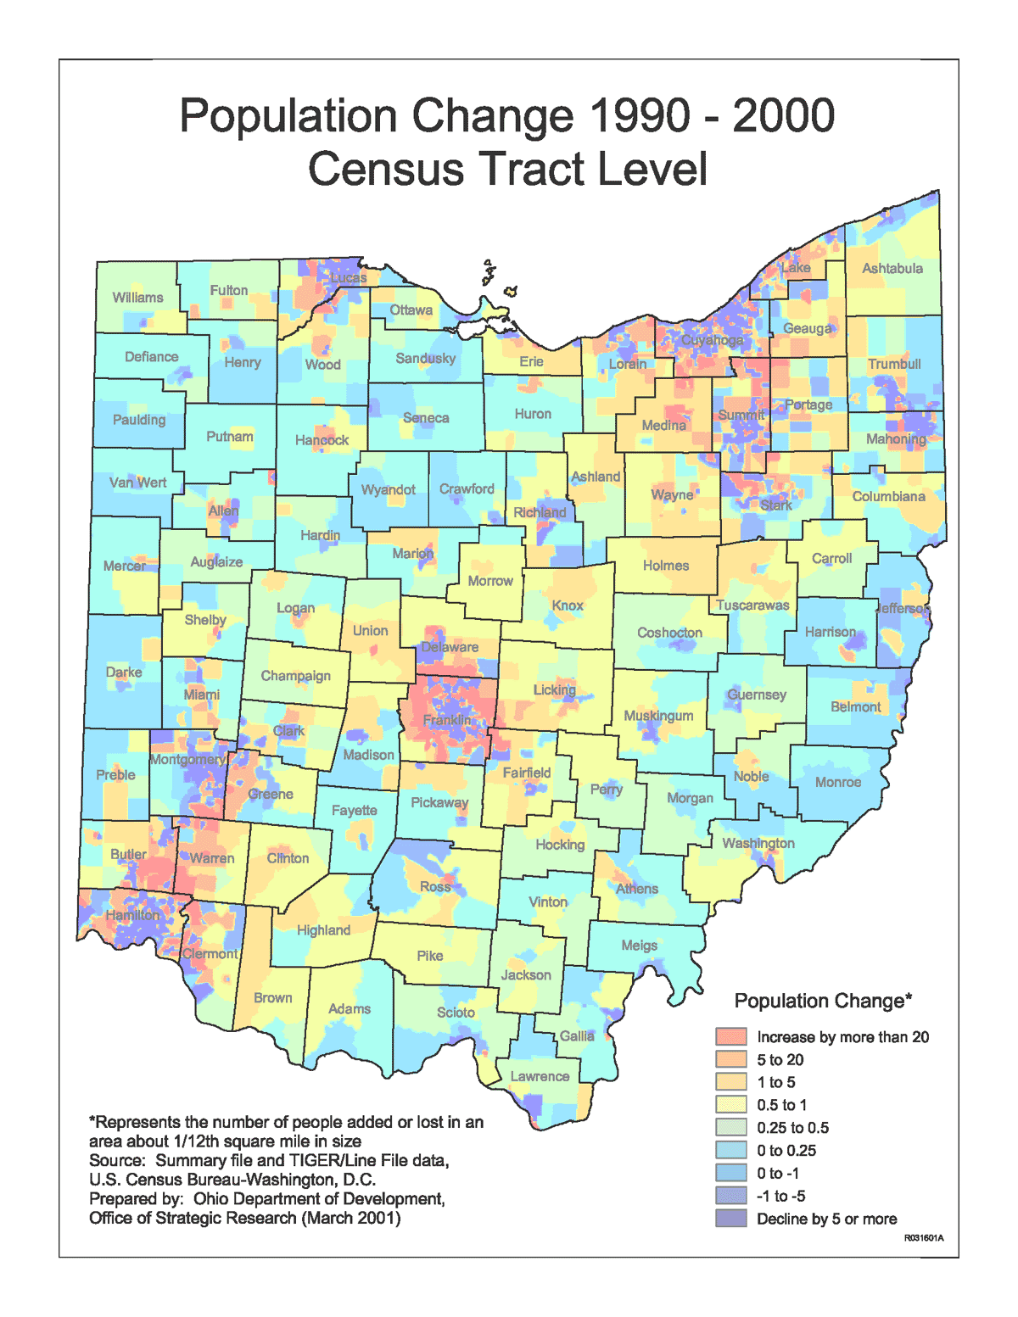
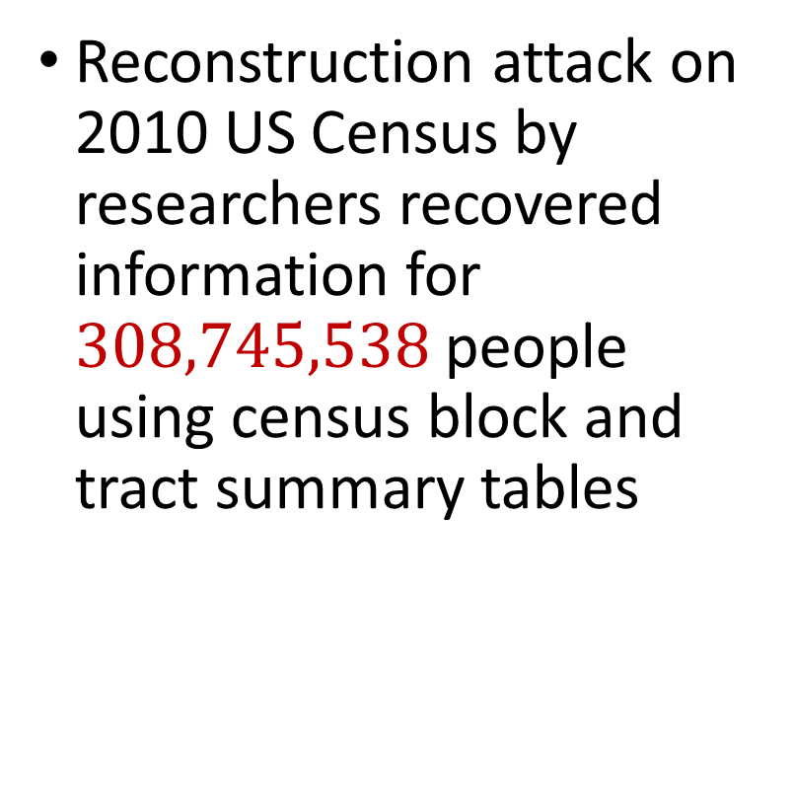
2010 US Census
Reconstruction attack on 2010 US Census by researchers recovered information for $308,745,538$ people using census block and tract summary tables

Slide 28
Summary
“Ad-hoc” privacy procedures like anonymization/deidentification often fails
Publishing too many queries on a sensitive database with too much accuracy can compromise the privacy of the database
Need a formal mathematical notion for measuring privacy

Slide 29

Possible Notion for Privacy #1
“The data analyst cannot learn anything about Alice”
Sensitive dataset
Analyst

Slide 30
Possible Notion for Privacy #1
“The data analyst cannot learn anything about Alice”
Most Aggies like Reveille
Alice is known to be an Aggie
Sensitive dataset
Analyst
Was Alice’s privacy violated?

Slide 31

Possible Notion for Privacy #1
“The data analyst cannot learn anything about Alice”
Most Aggies like Reveille
Bob participates in the survey
Sensitive dataset
Analyst
Even though Alice is not in the survey, it is still known that Alice is an Aggie

Slide 32
Possible Notion for Privacy #1
Suppose a survey is conducted on a sensitive dataset and concludes that “most Aggies like Reveille”
Alice is a known Aggie, and so a data analyst infers that Alice is more likely to be a dog owner and asks for higher apartment cleaning rates
Was Alice’s privacy violated by this study?

Slide 33
Possible Notion for Privacy #2
“A study is private…if the data analyst gains almost no additional information about Alice from the study than if the same study was performed without Alice’s data”

Slide 34

Possible Notion for Privacy #2
Stability: the data analyst reaches roughly similar conclusions if any individual data point is replaced by another data point of the population

Slide 35


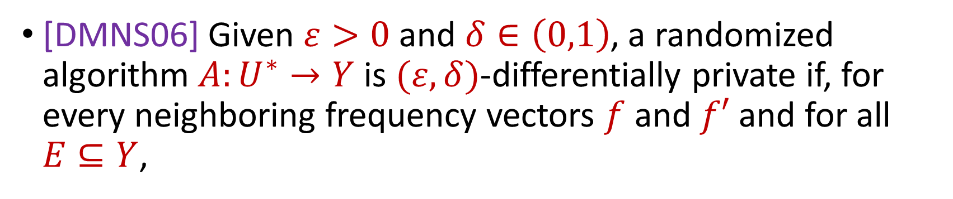

Differential Privacy
[DMNS06] Given $ε>0$and $δ∈\left(0,1\right)$, a randomized algorithm $A:U^{∗}→Y$ is $(ε,δ)$-differentially private if, for every neighboring frequency vectors $f$ and $f′$ and for all $E⊆Y$,
$$Pr\left[A\left(f\right)∈E\right]≤e^{ε}Pr\left[A\left(f^{′}\right)∈E\right]+δ$$
$$A\left( \right)≈A\left( \right)$$
Notes:
[DworkMcSherryNissimSmith06]

Slide 36
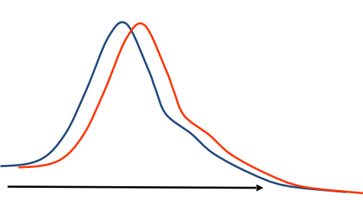
Differential Privacy
[DMNS06] Given $ε>0$and $δ∈\left(0,1\right)$, a randomized algorithm $A:U^{∗}→Y$ is $(ε,δ)$-differentially private if, for every neighboring frequency vectors $f$ and $f′$ and for all $E⊆Y$,
$$Pr\left[A\left(f\right)∈E\right]≤e^{ε}Pr\left[A\left(f^{′}\right)∈E\right]+δ$$
Sensitive dataset
Algorithm
Output distribution
Notes:
[DworkMcSherryNissimSmith06]

