Slide 1
CSCE 689: Special Topics in Modern Algorithms for Data Science
Lecture 4
Samson Zhou

Slide 2
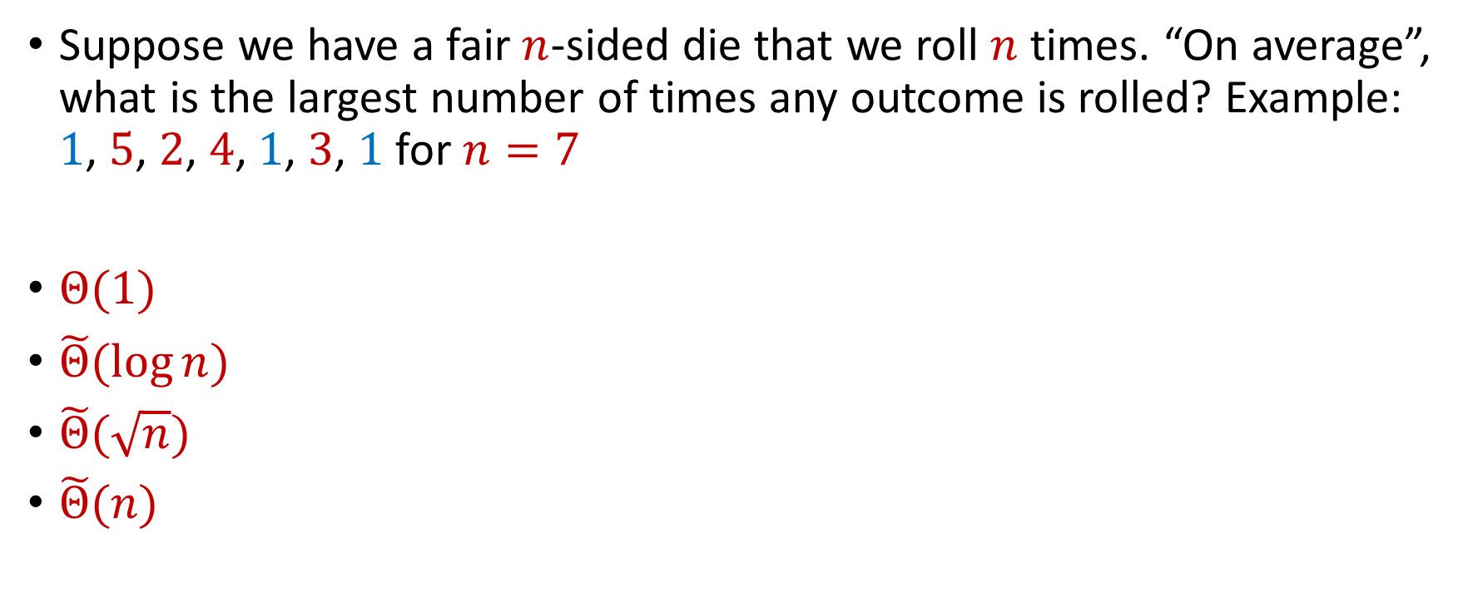
Trivia Question #3 (Max Load)
Suppose we have a fair $n$-sided die that we roll $n$ times. “On average”, what is the largest number of times any outcome is rolled? Example: $1$, $5$, $2$, $4$, $1$, $3$, $1$ for $n=7$
$Θ(1)$
$\tilde{Θ}(\log{n})$
$\tilde{Θ}(\sqrt{n})$
$\tilde{Θ}(n)$

Slide 3
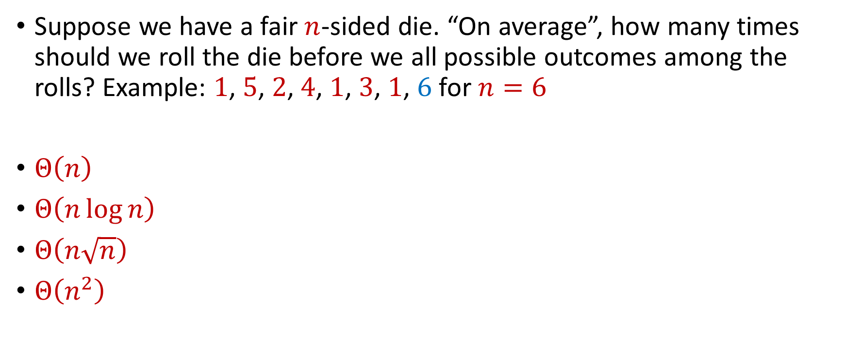
Trivia Question #4 (Coupon Collector)
Suppose we have a fair $n$-sided die. “On average”, how many times should we roll the die before we all possible outcomes among the rolls? Example: $1$, $5$, $2$, $4$, $1$, $3$, $1$, $6$ for $n=6$
$Θ\left(n\right)$
$Θ\left(n\log{n}\right)$
$Θ\left(n\sqrt{n}\right)$
$Θ\left(n^{2}\right)$

Slide 4


Moments
For $p>0$, the $p$-th moment of a random variable $X$ over $Ω$ is:
$$E\left[X^{p}\right]=\sum_{x∈Ω}{Pr\left[X=x\right]⋅x^{p}}$$

Slide 5
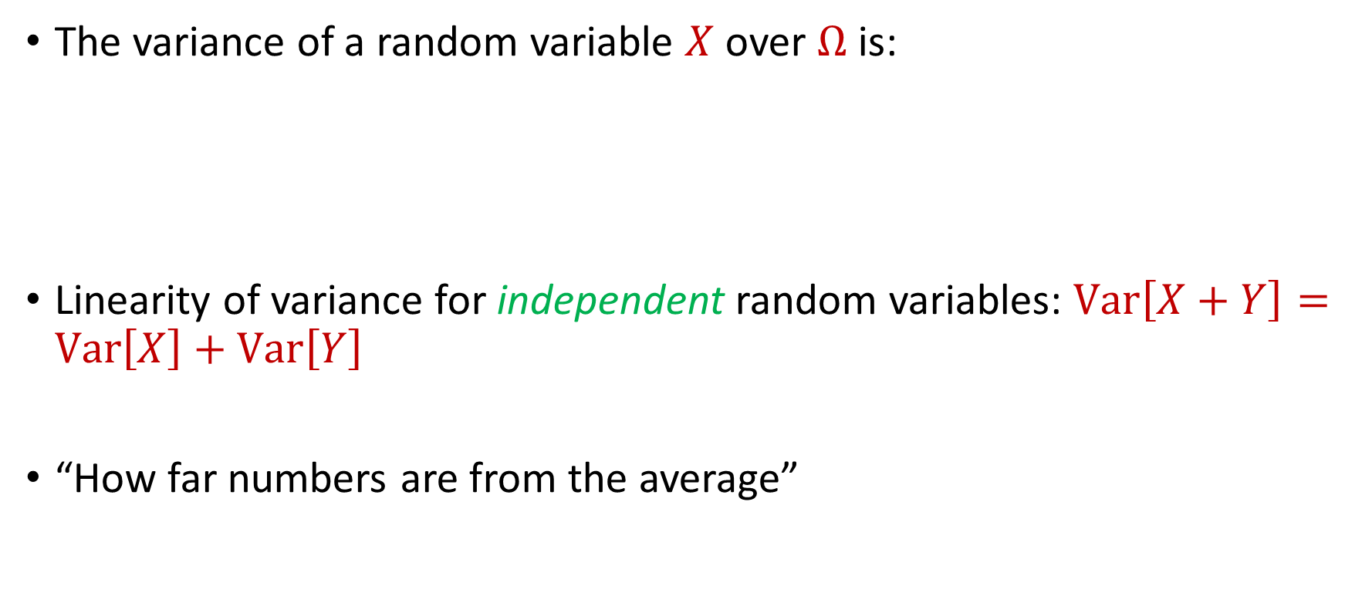
Variance
The variance of a random variable $X$ over $Ω$ is:
Linearity of variance for independent random variables: $Var\left[X+Y\right]=Var\left[X\right]+Var\left[Y\right]$
“How far numbers are from the average”
$$Var\left[X\right]=E\left[X^{2}\right]−{\left(E\left[X\right]\right)}^{2}$$

Slide 6

Variance
Suppose $X$ takes the value $1$ with probability $\frac{1}{2}$ and takes the value $−1$ with probability $\frac{1}{2}$
What is $E\left[X\right]$?
What is $Var\left[X\right]$?

Slide 7

Variance
Suppose $Y$ takes the value $100$ with probability $\frac{1}{2}$ and takes the value $−100$ with probability $\frac{1}{2}$
What is $E\left[Y\right]$?
What is $Var\left[Y\right]$?

Slide 8


Chebyshev’s Inequality
Let $X$ be a random variable with expected value $μ≔E[X]$ and variance $σ^{2}≔Var\left[X\right]$
“What is the probability a random variable is far away from its average?”
$$Pr\left[\left|X−μ\right|≥kσ\right]≤\frac{1}{k^{2}}$$

