Slide 1
CSCE 689: Special Topics in Modern Algorithms for Data Science
Lecture 5
Samson Zhou

Slide 2
Present and Future
Today: Discuss potential project groups
Friday: Email me the members/group name
Future: Set up meetings to discuss proposed projects

Slide 3
Recall: Concentration Inequalities
Concentration inequalities bound the probability that a random variable is “far away” from its expectation
Often used in understanding the performance of statistical tests, the behavior of data sampled from various distributions, and for our purposes, the guarantees of randomized algorithms

Slide 4


Last Time: Moments
For $p>0$, the $p$-th moment of a random variable $X$ over $Ω$ is:
$$E\left[X^{p}\right]=\sum_{x∈Ω}{Pr\left[X=x\right]⋅x^{p}}$$

Slide 5
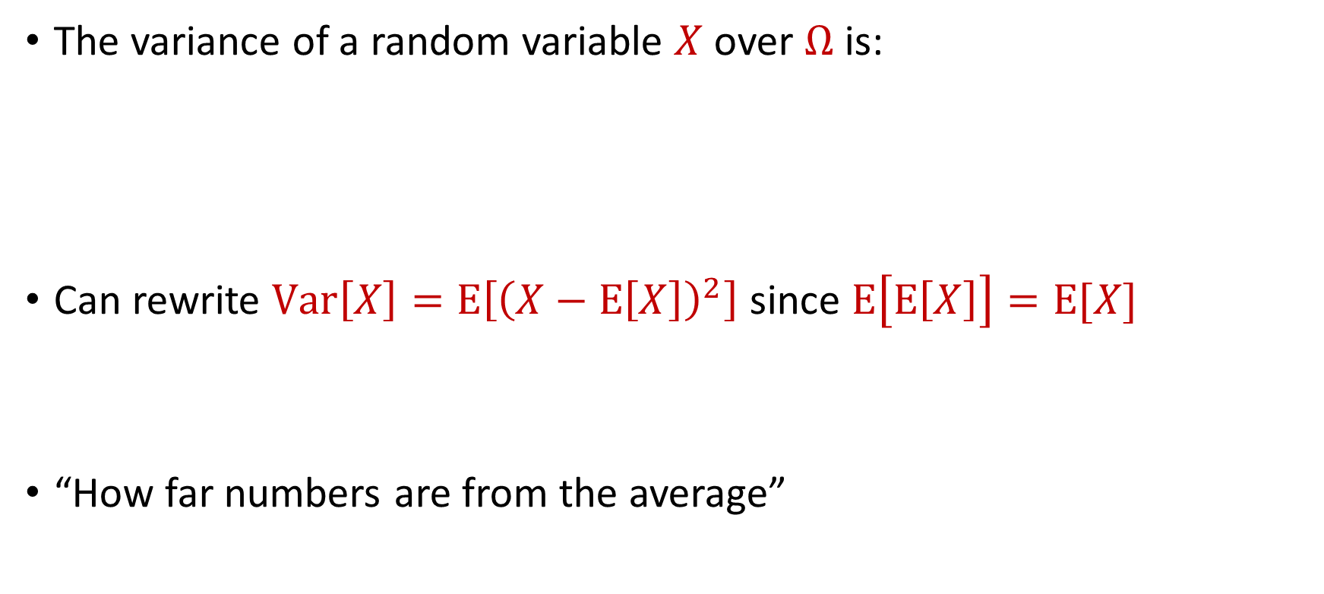
Last Time: Variance
The variance of a random variable $X$ over $Ω$ is:
Can rewrite $Var\left[X\right]=E\left[{\left(X−E\left[X\right]\right)}^{2}\right]$ since $E\left[E\left[X\right]\right]=E[X]$
“How far numbers are from the average”
$$Var\left[X\right]=E\left[X^{2}\right]−{\left(E\left[X\right]\right)}^{2}$$

Slide 6

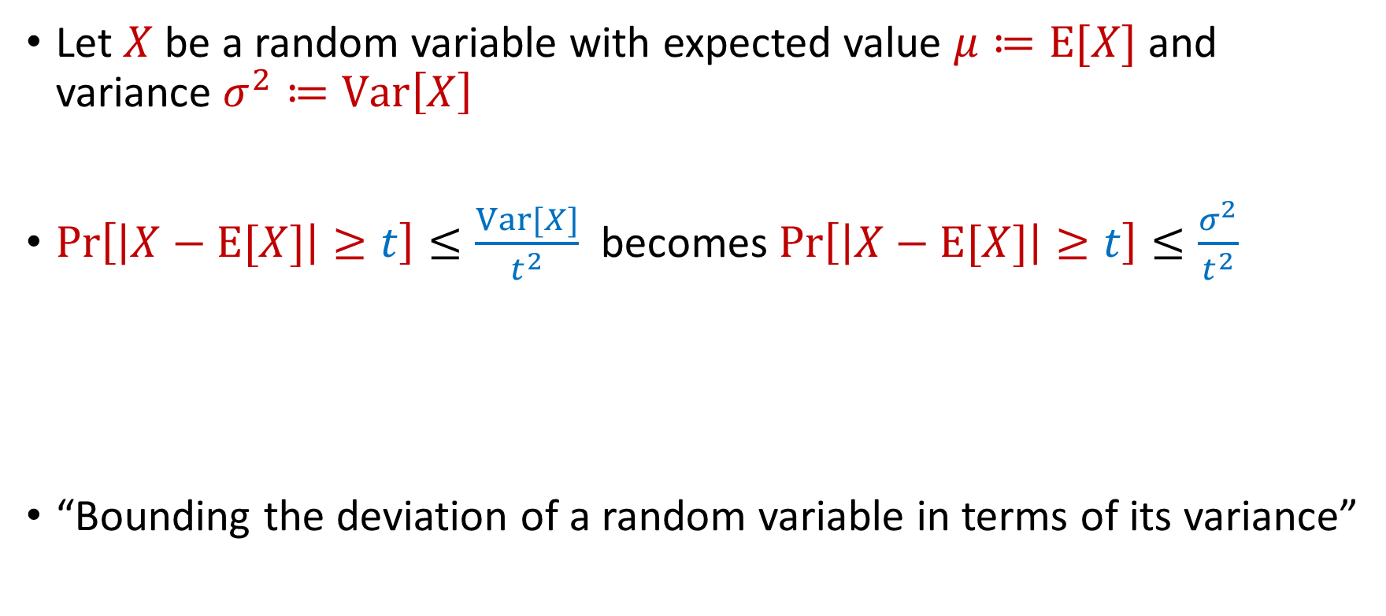
Last Time: Chebyshev’s Inequality
Let $X$ be a random variable with expected value $μ≔E[X]$ and variance $σ^{2}≔Var\left[X\right]$
$Pr\left[\left|X−E[X]\right|≥t\right]≤\frac{Var[X]}{t^{2}}$ becomes $Pr\left[\left|X−E[X]\right|≥t\right]≤\frac{σ^{2}}{t^{2}}$
“Bounding the deviation of a random variable in terms of its variance”
$$Pr\left[\left|X−μ\right|≥kσ\right]≤\frac{1}{k^{2}}$$

Slide 7
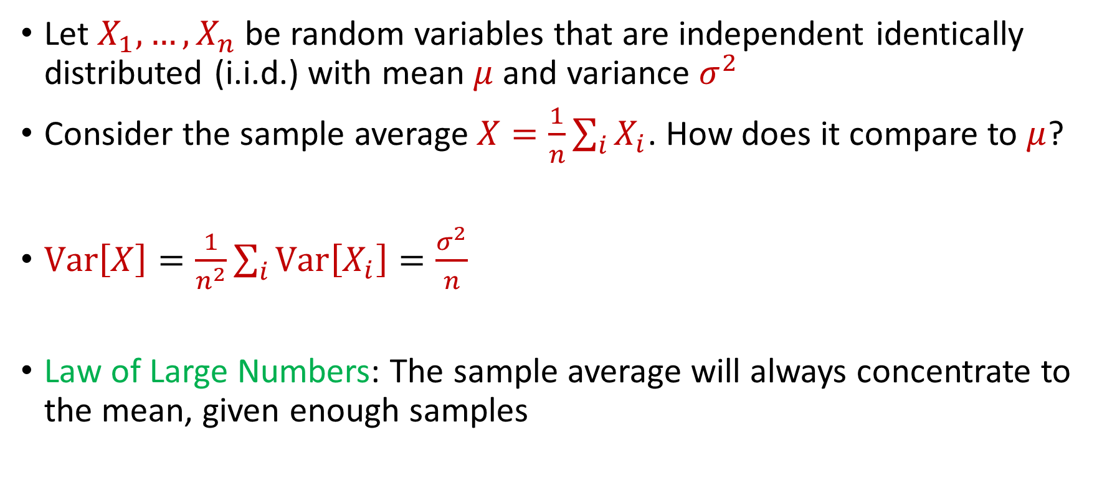
Last Time: Law of Large Numbers
Let $X_{1},…,X_{n}$ be random variables that are independent identically distributed (i.i.d.) with mean $μ$ and variance $σ^{2}$
Consider the sample average $X=\frac{1}{n}\sum_{i}{X_{i}}$. How does it compare to $μ$?
$Var\left[X\right]=\frac{1}{n^{2}}\sum_{i}{Var\left[X_{i}\right]}=\frac{σ^{2}}{n}$
Law of Large Numbers: The sample average will always concentrate to the mean, given enough samples

Slide 8
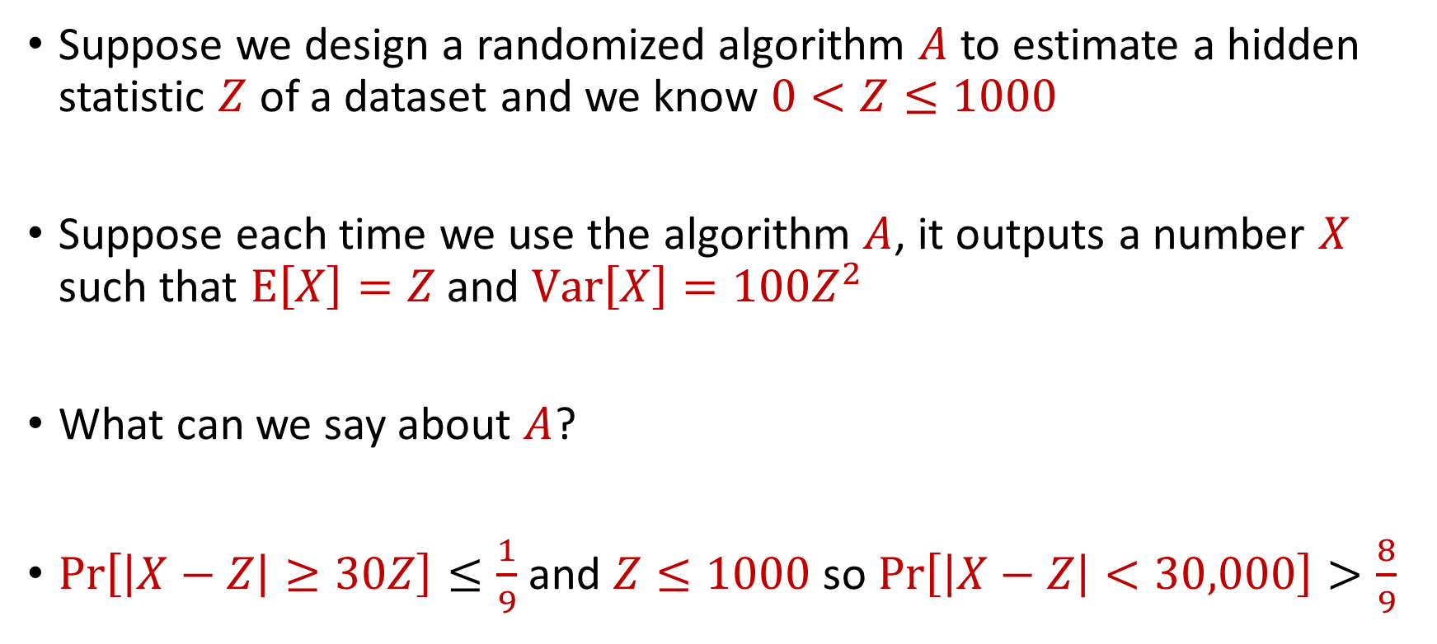
Use Case
Suppose we design a randomized algorithm $A$ to estimate a hidden statistic $Z$ of a dataset and we know $0<Z≤1000$
Suppose each time we use the algorithm $A$, it outputs a number $X$ such that $E\left[X\right]=Z$ and $Var\left[X\right]=100Z^{2}$
What can we say about $A$?
$Pr\left[\left|X−Z\right|≥30Z\right]≤\frac{1}{9}$ and $Z≤1000$ so $Pr\left[\left|X−Z\right|<30,000\right]>\frac{8}{9}$

Slide 9

Accuracy Boosting
How can we use $A$ to get additive error $ε$?

Slide 10
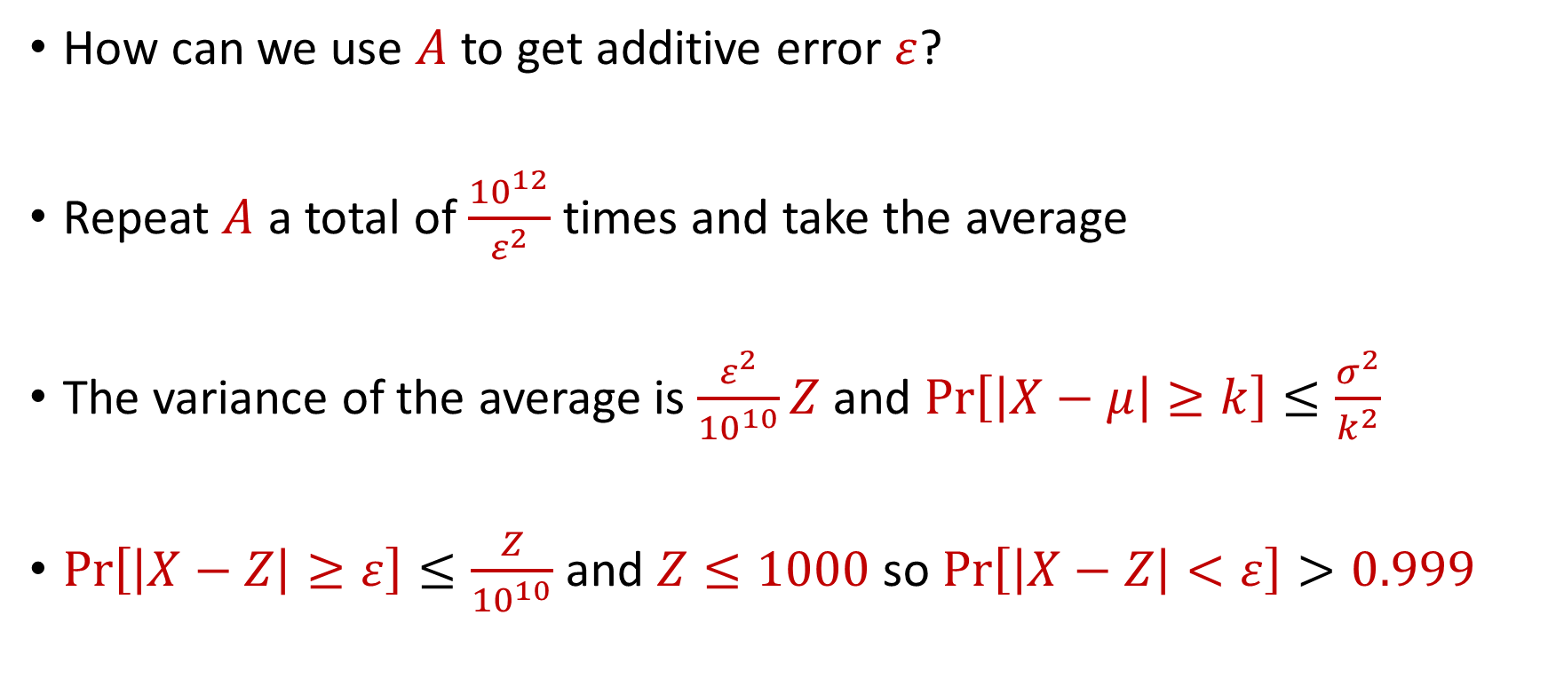
Accuracy Boosting
How can we use $A$ to get additive error $ε$?
Repeat $A$ a total of $\frac{{10}^{12}}{ε^{2}}$ times and take the average
The variance of the average is $\frac{ε^{2}}{{10}^{10}}Z$ and $Pr\left[\left|X−μ\right|≥k\right]≤\frac{σ^{2}}{k^{2}}$
$Pr\left[\left|X−Z\right|≥ε\right]≤\frac{Z}{{10}^{10}}$ and $Z≤1000$ so $Pr\left[\left|X−Z\right|<ε\right]>0.999$

Slide 11
Accuracy Boosting
Algorithmic consequence of Law of Large Numbers
To improve the accuracy of your algorithm, run it many times independently and take the average

Slide 12
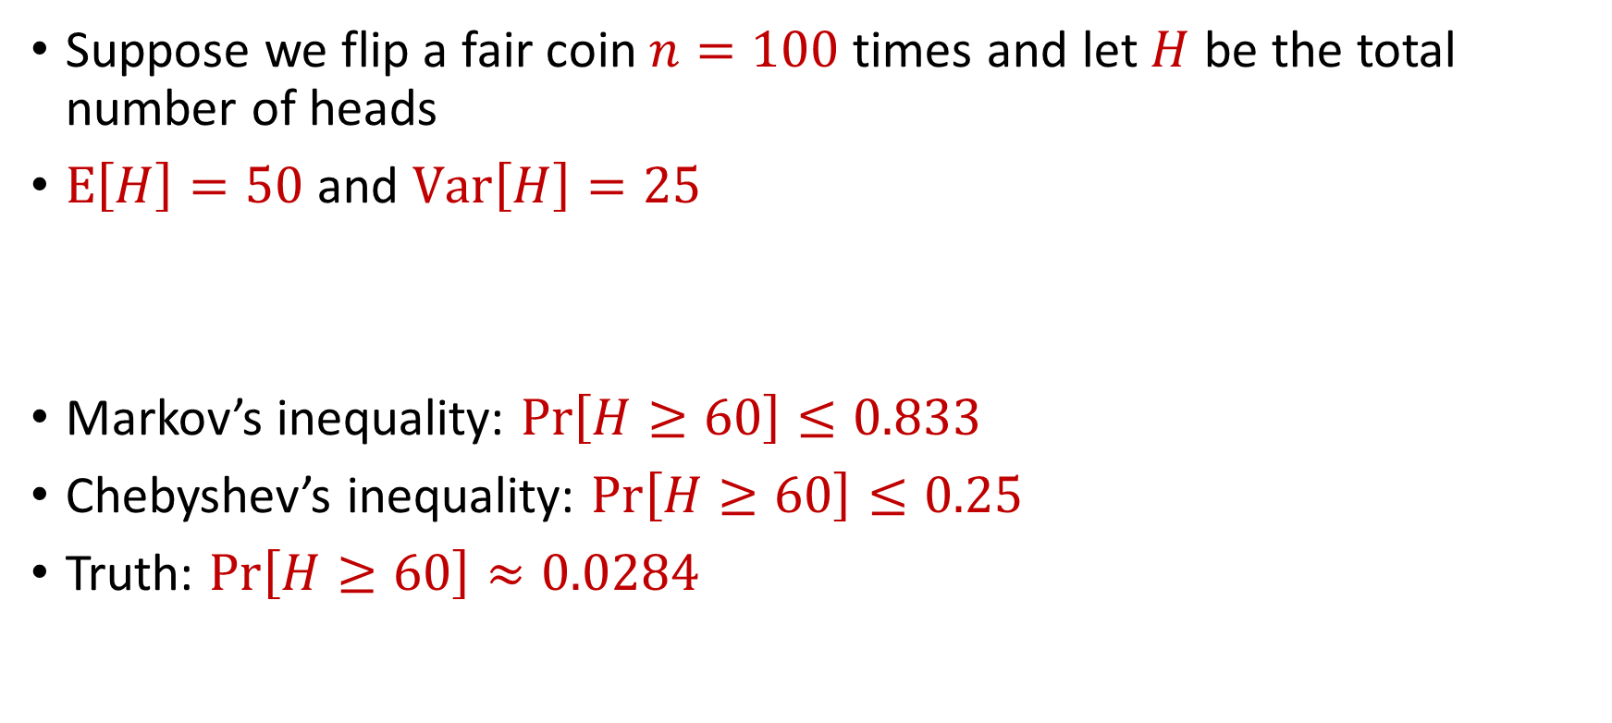
Limitations
Suppose we flip a fair coin $n=100$ times and let $H$ be the total number of heads
$E\left[H\right]=50$ and $Var\left[H\right]=25$
Markov’s inequality: $Pr\left[H≥60\right]≤0.833$
Chebyshev’s inequality: $Pr\left[H≥60\right]≤0.25$
Truth: $Pr\left[H≥60\right]≈0.0284$

Slide 13
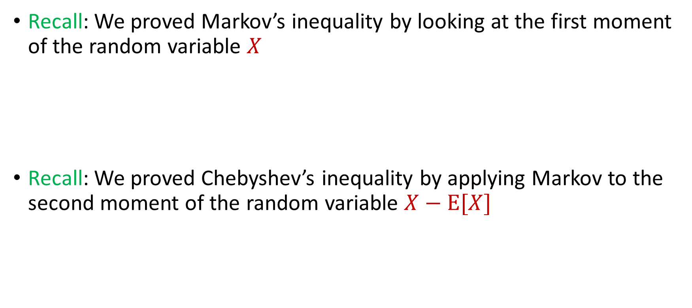

Intuition for Previous Inequalities
Recall: We proved Markov’s inequality by looking at the first moment of the random variable $X$
Recall: We proved Chebyshev’s inequality by applying Markov to the second moment of the random variable $X−E[X]$
$$Pr\left[X≥t⋅E[X]\right]≤\frac{1}{t}$$
$$Pr\left[\left|X−E[X]\right|≥t\right]=Pr\left[{\left|X−E\left[X\right]\right|}^{2}≥t^{2}\right]≤\frac{Var[X]}{t^{2}}$$

Slide 14
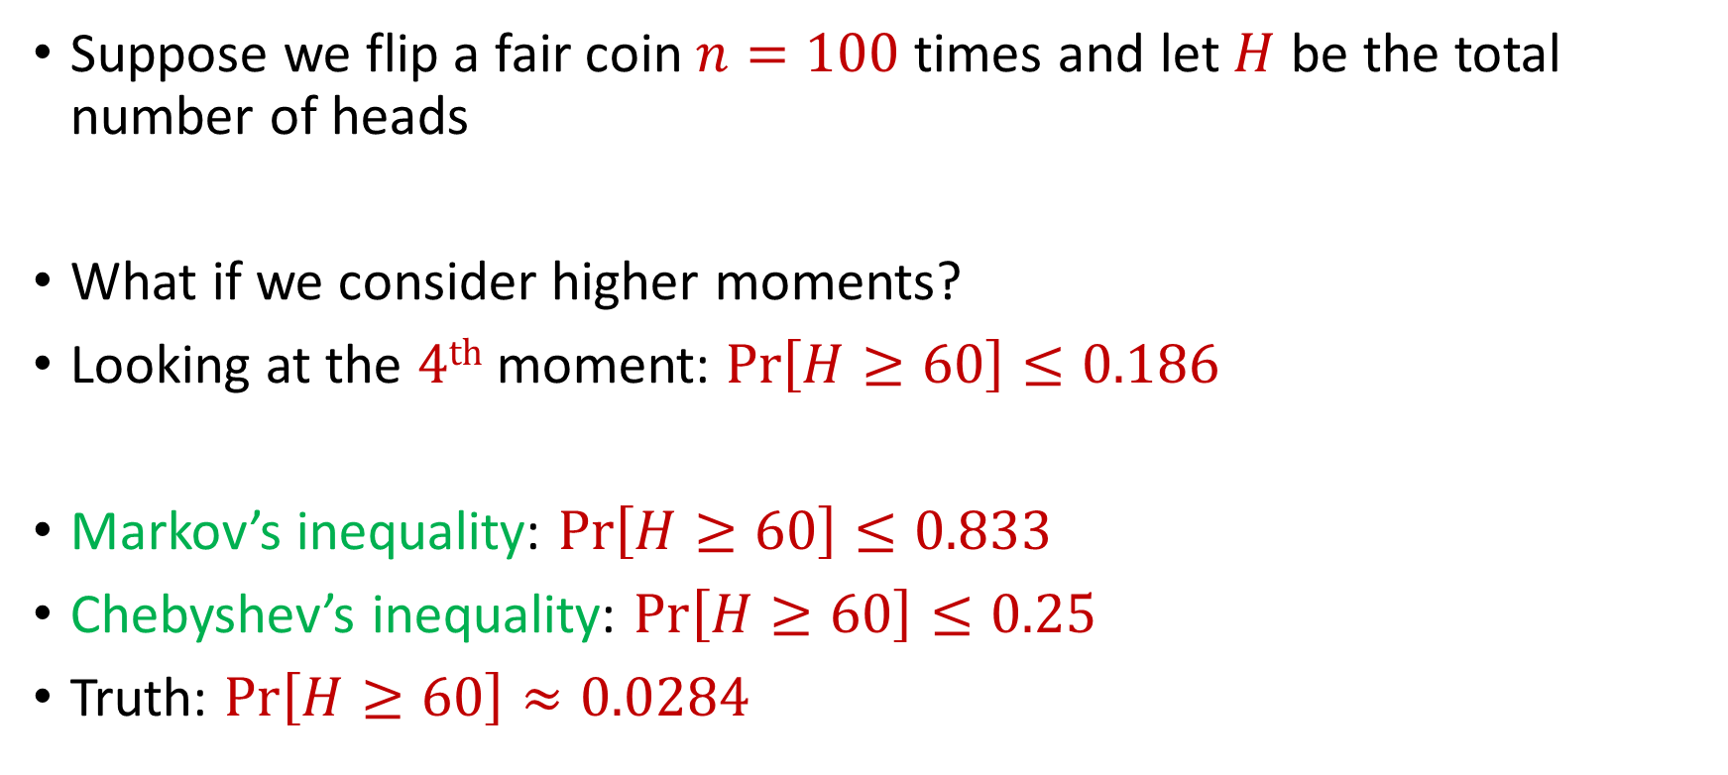
Generalizations
Suppose we flip a fair coin $n=100$ times and let $H$ be the total number of heads
What if we consider higher moments?
Looking at the $4th$ moment: $Pr\left[H≥60\right]≤0.186$
Markov’s inequality: $Pr\left[H≥60\right]≤0.833$
Chebyshev’s inequality: $Pr\left[H≥60\right]≤0.25$
Truth: $Pr\left[H≥60\right]≈0.0284$

Slide 15
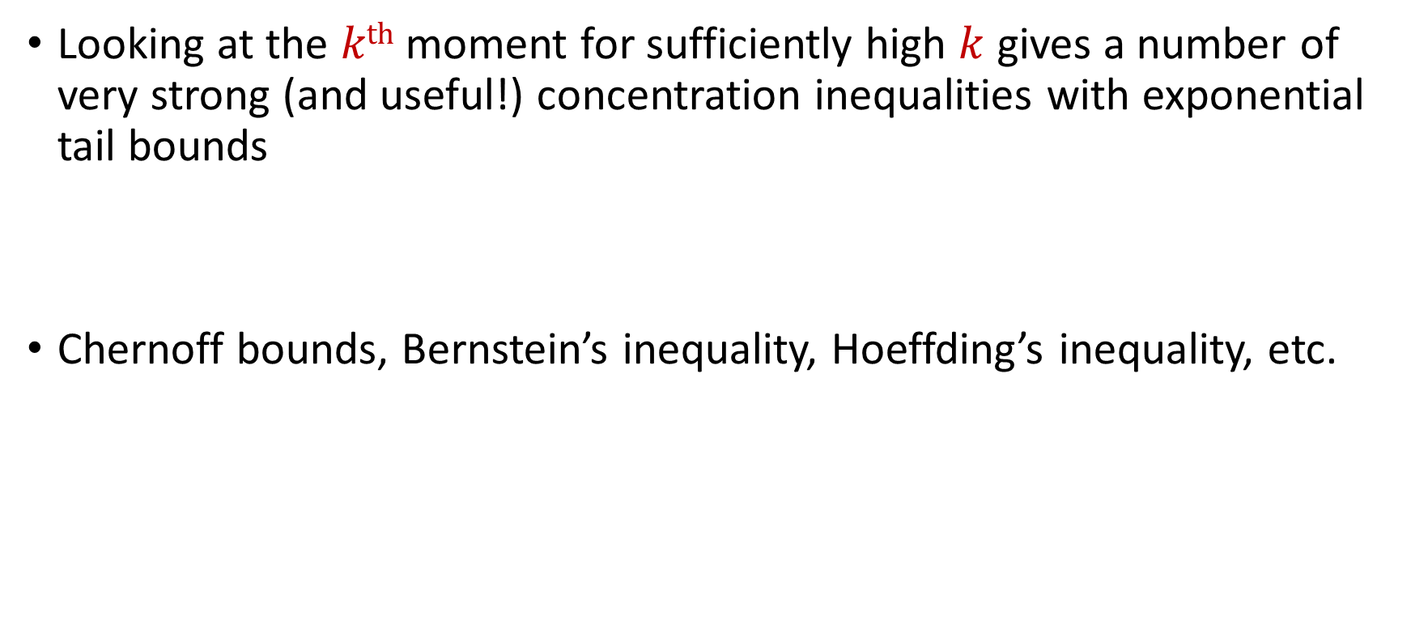
Concentration Inequalities
Looking at the $kth$ moment for sufficiently high $k$ gives a number of very strong (and useful!) concentration inequalities with exponential tail bounds
Chernoff bounds, Bernstein’s inequality, Hoeffding’s inequality, etc.

Slide 16
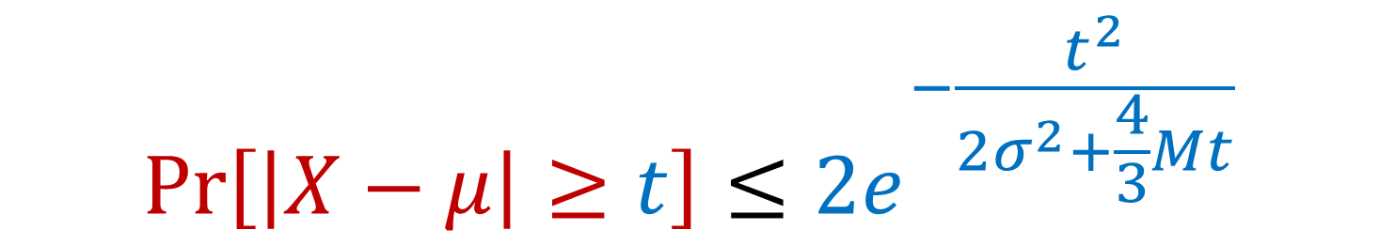

Bernstein’s Inequality
Berstein’s inequality: Let $X_{1},…,X_{n}∈[−M,M]$ be independent random variables and let ${X=X}_{1}+…+X_{n}$ have mean $μ$ and variance $σ^{2}$. Then for any $t≥0$:
$$Pr\left[\left|X−μ\right|≥t\right]≤2e^{−\frac{t^{2}}{2σ^{2}+\frac{4}{3}Mt}}$$

Slide 17


Bernstein’s Inequality
Berstein’s inequality: Let $X_{1},…,X_{n}∈[−M,M]$ be independent random variables and let ${X=X}_{1}+…+X_{n}$ have mean $μ$ and variance $σ^{2}$. Then for any $t≥0$:
Example: Suppose $M=1$ and let $t=kσ$. Then
$$Pr\left[\left|X−μ\right|≥t\right]≤2e^{−\frac{t^{2}}{2σ^{2}+\frac{4}{3}Mt}}$$
$$Pr\left[\left|X−μ\right|≥kσ\right]≤2exp\left(−\frac{k^{2}}{4}\right)$$

Slide 18



Bernstein’s Inequality
Suppose $M=1$ and let $t=kσ$. Then
Compare to Chebyshev’s inequality:
Exponential improvement!
$$Pr\left[\left|X−μ\right|≥kσ\right]≤2exp\left(−\frac{k^{2}}{4}\right)$$
$$Pr\left[\left|X−μ\right|≥kσ\right]≤\frac{1}{k^{2}}$$

Slide 19
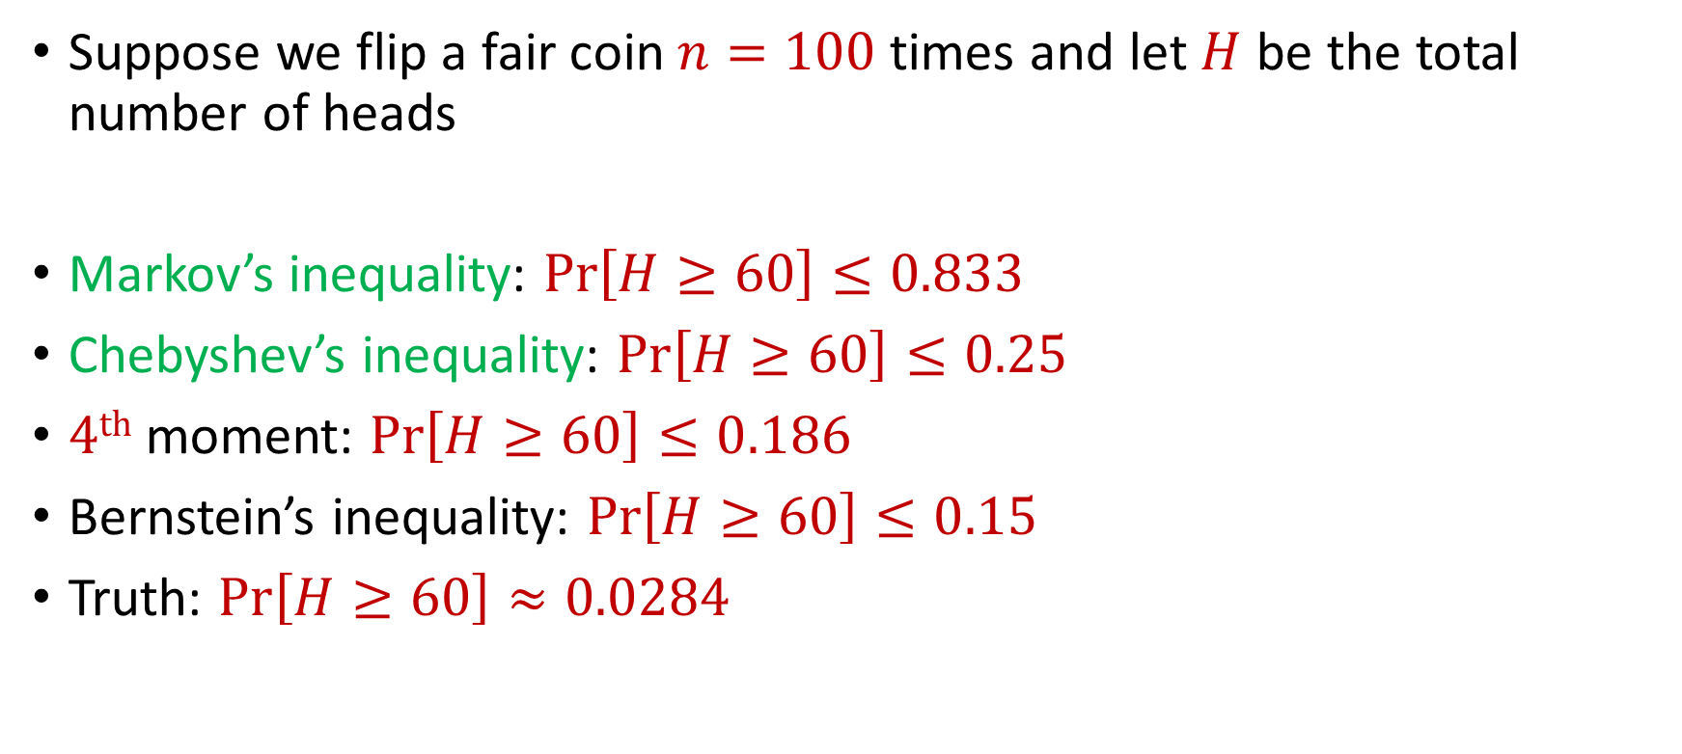
Bernstein’s Inequality
Suppose we flip a fair coin $n=100$ times and let $H$ be the total number of heads
Markov’s inequality: $Pr\left[H≥60\right]≤0.833$
Chebyshev’s inequality: $Pr\left[H≥60\right]≤0.25$
$4th$ moment: $Pr\left[H≥60\right]≤0.186$
Bernstein’s inequality: $Pr\left[H≥60\right]≤0.15$
Truth: $Pr\left[H≥60\right]≈0.0284$

Slide 20
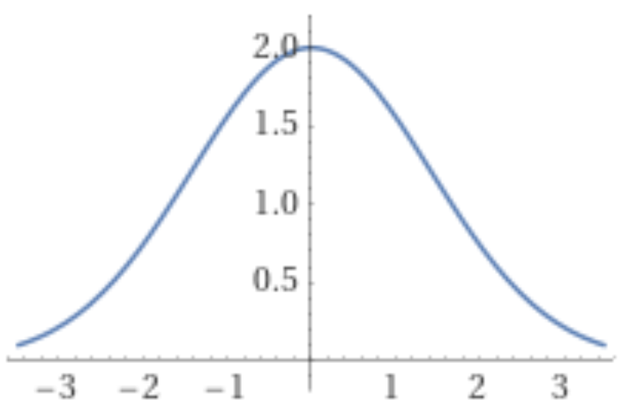
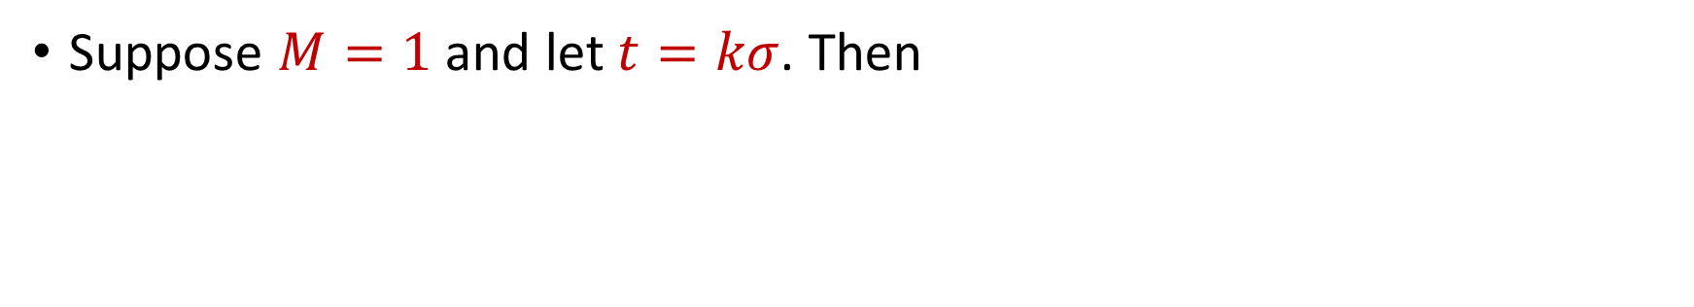
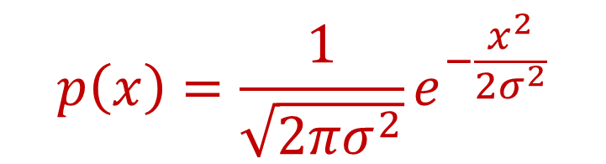
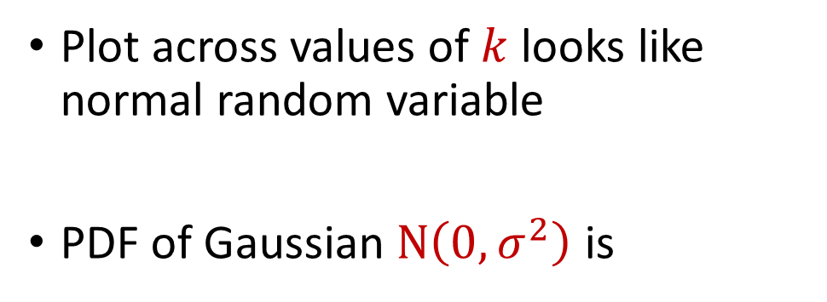
Bernstein’s Inequality
Suppose $M=1$ and let $t=kσ$. Then
$$Pr\left[\left|X−μ\right|≥kσ\right]≤2exp\left(−\frac{k^{2}}{4}\right)$$
Plot across values of $k$ looks like normal random variable
PDF of Gaussian $N\left(0,σ^{2}\right)$ is
$$p\left(x\right)=\frac{1}{\sqrt{2πσ^{2}}}e^{−\frac{x^{2}}{2σ^{2}}}$$

Slide 21
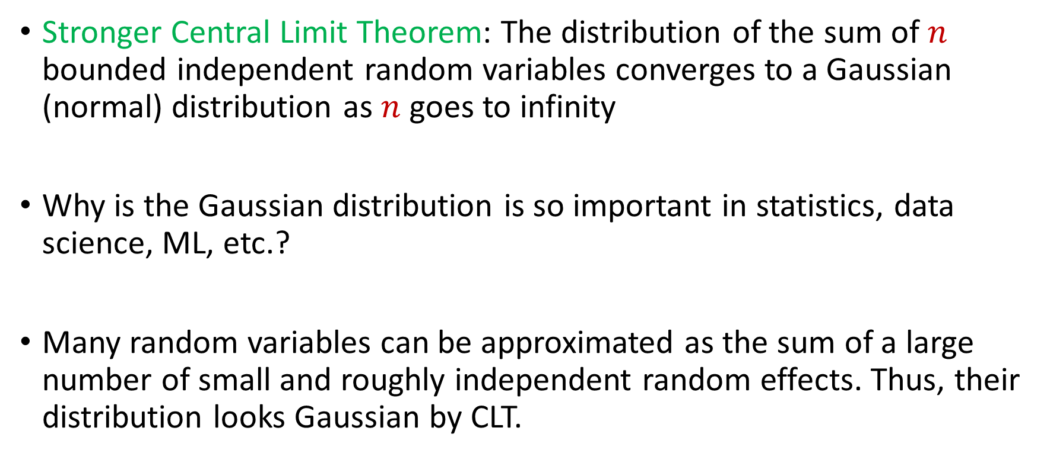
Central Limit Theorem
Stronger Central Limit Theorem: The distribution of the sum of $n$ bounded independent random variables converges to a Gaussian (normal) distribution as $n$ goes to infinity
Why is the Gaussian distribution is so important in statistics, data science, ML, etc.?
Many random variables can be approximated as the sum of a large number of small and roughly independent random effects. Thus, their distribution looks Gaussian by CLT.

