Slide 1
CSCE 689: Special Topics in Modern Algorithms for Data Science
Lecture 11
Samson Zhou

Slide 2
Presentation Schedule
September 25: Team DAP, Team Bokun, Team Jason
September 27: Galaxy AI, Team STMI
September 29: Jung, Anmol, Chunkai

Slide 3

Insertion-Deletion Streams
Stream of length $m=Θ\left(n\right)$
Universe of size $[n]$, underlying vector $f∈R^{n}$
Each update increases or decreases a coordinate in $f$
“Decrease $f_{6}$”
$f_{1}$ | $f_{2}$ | $f_{3}$ | $f_{4}$ | $f_{5}$ | $f_{6}$ | $f_{7}$
0 | 0 | 0 | 0 | 0 | 0 | 0
$f_{1}$ | $f_{2}$ | $f_{3}$ | $f_{4}$ | $f_{5}$ | $f_{6}$ | $f_{7}$
0 | 0 | 0 | 0 | 0 | -1 | 0

Slide 4

Sparse Recovery
Suppose we have an insertion-deletion stream of length $m=Θ\left(n\right)$ and at the end we are promised there are at most $k$ nonzero coordinates
Recover the $k$ nonzero coordinates and their frequencies

Slide 5
Applications of Sparse Recovery
Anomaly detection and network traffic analysis:
Noiseless sparse recovery can be used to identify anomalies or outliers in streaming data. By modeling normal behavior as a sparse signal, deviations from this model can be detected in real-time. This is valuable for cybersecurity, fraud detection, and monitoring network traffic for unusual patterns.
Noiseless sparse recovery can be applied to analyze network traffic in real-time, identifying patterns and trends, and helping in network management, intrusion detection, and quality of service (QoS) optimization

Slide 6
Applications of Sparse Recovery
Online Natural Language Processing (NLP): In real-time natural language processing tasks, noiseless sparse recovery can assist in extracting relevant features or patterns from streaming text data, making it useful for sentiment analysis, topic modeling, and summarization.

Slide 7
Applications of Sparse Recovery
Real-time Compressive Imaging: Compressive imaging techniques can be applied to streaming video or image data. By capturing and processing fewer measurements, noiseless sparse recovery can provide real-time reconstruction of high-resolution images or videos.

Slide 8
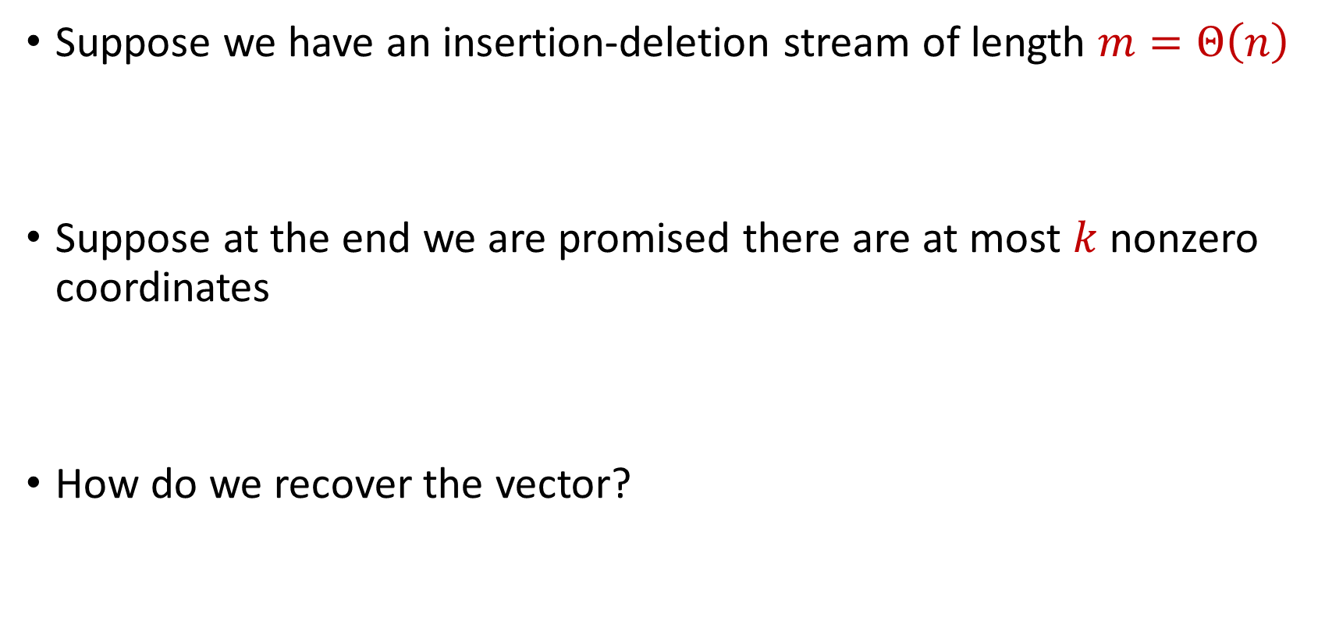
Sparse Recovery
Suppose we have an insertion-deletion stream of length $m=Θ\left(n\right)$
Suppose at the end we are promised there are at most $k$ nonzero coordinates
How do we recover the vector?

Slide 9

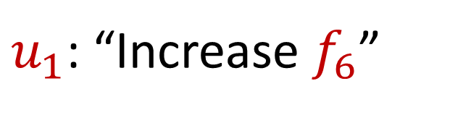
Sparse Recovery
Suppose at the end we are promised there are at most $k$ nonzero coordinates
Suppose $k=1$ and we are promised the coordinate has frequency $1$
$u_{1}$: “Increase $f_{6}$”

Slide 10
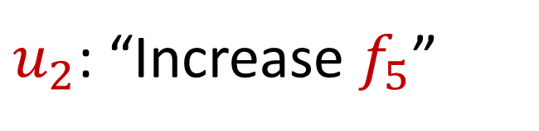
Sparse Recovery
Suppose at the end we are promised there are at most $k$ nonzero coordinates
Suppose $k=1$ and we are promised the coordinate has frequency $1$
$u_{2}$: “Increase $f_{5}$”

Slide 11
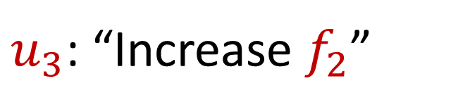
Sparse Recovery
Suppose at the end we are promised there are at most $k$ nonzero coordinates
Suppose $k=1$ and we are promised the coordinate has frequency $1$
$u_{3}$: “Increase $f_{2}$”

Slide 12
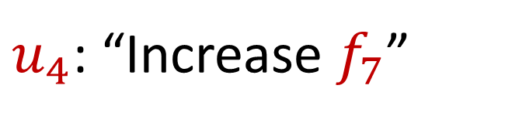
Sparse Recovery
Suppose at the end we are promised there are at most $k$ nonzero coordinates
Suppose $k=1$ and we are promised the coordinate has frequency $1$
$u_{4}$: “Increase $f_{7}$”

Slide 13
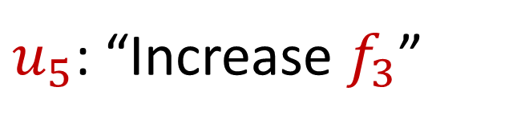
Sparse Recovery
Suppose at the end we are promised there are at most $k$ nonzero coordinates
Suppose $k=1$ and we are promised the coordinate has frequency $1$
$u_{5}$: “Increase $f_{3}$”

Slide 14
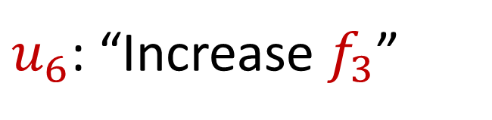
Sparse Recovery
Suppose at the end we are promised there are at most $k$ nonzero coordinates
Suppose $k=1$ and we are promised the coordinate has frequency $1$
$u_{6}$: “Increase $f_{3}$”

Slide 15
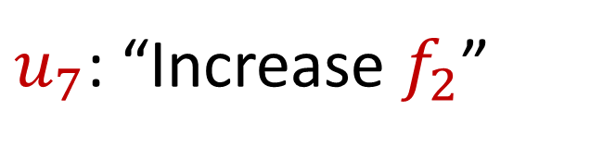
Sparse Recovery
Suppose at the end we are promised there are at most $k$ nonzero coordinates
Suppose $k=1$ and we are promised the coordinate has frequency $1$
$u_{7}$: “Increase $f_{2}$”

Slide 16
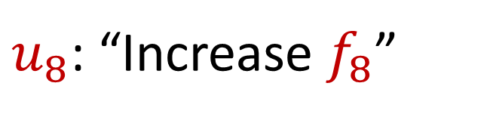
Sparse Recovery
Suppose at the end we are promised there are at most $k$ nonzero coordinates
Suppose $k=1$ and we are promised the coordinate has frequency $1$
$u_{8}$: “Increase $f_{8}$”

Slide 17
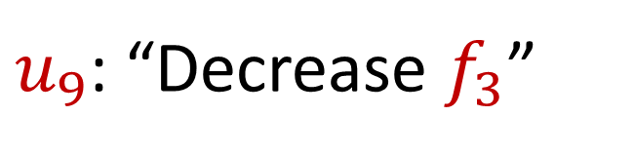
Sparse Recovery
Suppose at the end we are promised there are at most $k$ nonzero coordinates
Suppose $k=1$ and we are promised the coordinate has frequency $1$
$u_{9}$: “Decrease $f_{3}$”

Slide 18
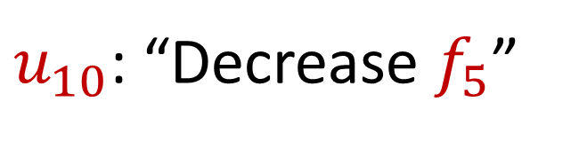
Sparse Recovery
Suppose at the end we are promised there are at most $k$ nonzero coordinates
Suppose $k=1$ and we are promised the coordinate has frequency $1$
$u_{10}$: “Decrease $f_{5}$”

Slide 19
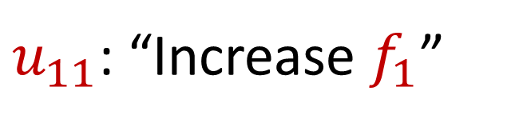
Sparse Recovery
Suppose at the end we are promised there are at most $k$ nonzero coordinates
Suppose $k=1$ and we are promised the coordinate has frequency $1$
$u_{11}$: “Increase $f_{1}$”

Slide 20
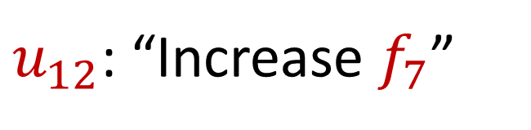
Sparse Recovery
Suppose at the end we are promised there are at most $k$ nonzero coordinates
Suppose $k=1$ and we are promised the coordinate has frequency $1$
$u_{12}$: “Increase $f_{7}$”

Slide 21
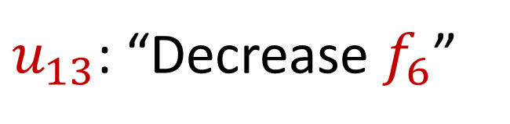
Sparse Recovery
Suppose at the end we are promised there are at most $k$ nonzero coordinates
Suppose $k=1$ and we are promised the coordinate has frequency $1$
$u_{13}$: “Decrease $f_{6}$”

Slide 22

Sparse Recovery
Suppose at the end we are promised there are at most $k$ nonzero coordinates
Suppose $k=1$ and we are promised the coordinate has frequency $1$
$u_{14}$: “Decrease $f_{8}$”

Slide 23
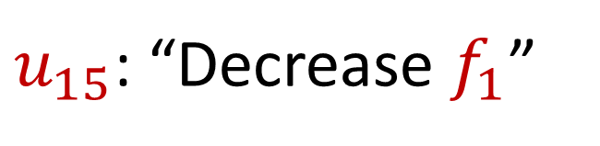
Sparse Recovery
Suppose at the end we are promised there are at most $k$ nonzero coordinates
Suppose $k=1$ and we are promised the coordinate has frequency $1$
$u_{15}$: “Decrease $f_{1}$”

Slide 24
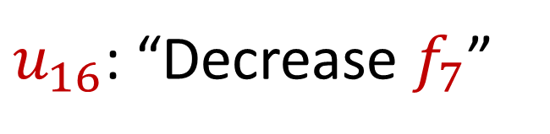
Sparse Recovery
Suppose at the end we are promised there are at most $k$ nonzero coordinates
Suppose $k=1$ and we are promised the coordinate has frequency $1$
$u_{16}$: “Decrease $f_{7}$”

Slide 25
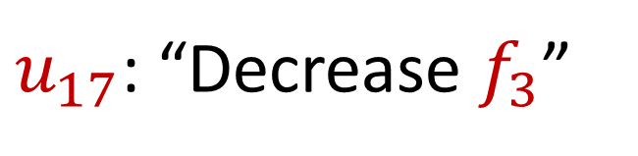
Sparse Recovery
Suppose at the end we are promised there are at most $k$ nonzero coordinates
Suppose $k=1$ and we are promised the coordinate has frequency $1$
$u_{17}$: “Decrease $f_{3}$”

Slide 26
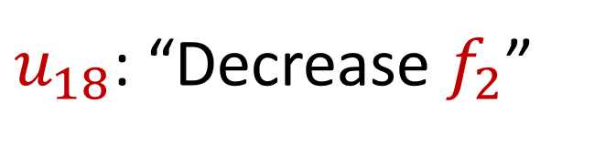
Sparse Recovery
Suppose at the end we are promised there are at most $k$ nonzero coordinates
Suppose $k=1$ and we are promised the coordinate has frequency $1$
$u_{18}$: “Decrease $f_{2}$”

Slide 27
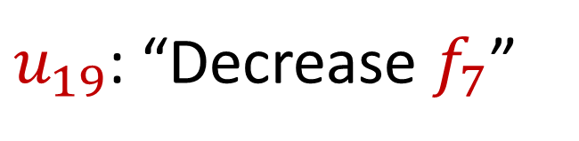
Sparse Recovery
Suppose at the end we are promised there are at most $k$ nonzero coordinates
Suppose $k=1$ and we are promised the coordinate has frequency $1$
$u_{19}$: “Decrease $f_{7}$”

Slide 28

Sparse Recovery
Suppose at the end we are promised there are at most $k$ nonzero coordinates
Suppose $k=1$ and we are promised the coordinate has frequency $1$
What is left?

Slide 29

Sparse Recovery
Suppose at the end we are promised there are at most $k$ nonzero coordinates
Suppose $k=1$ and we are promised the coordinate has frequency $1$
What is left?
$$f_{2}=1$$

Slide 30
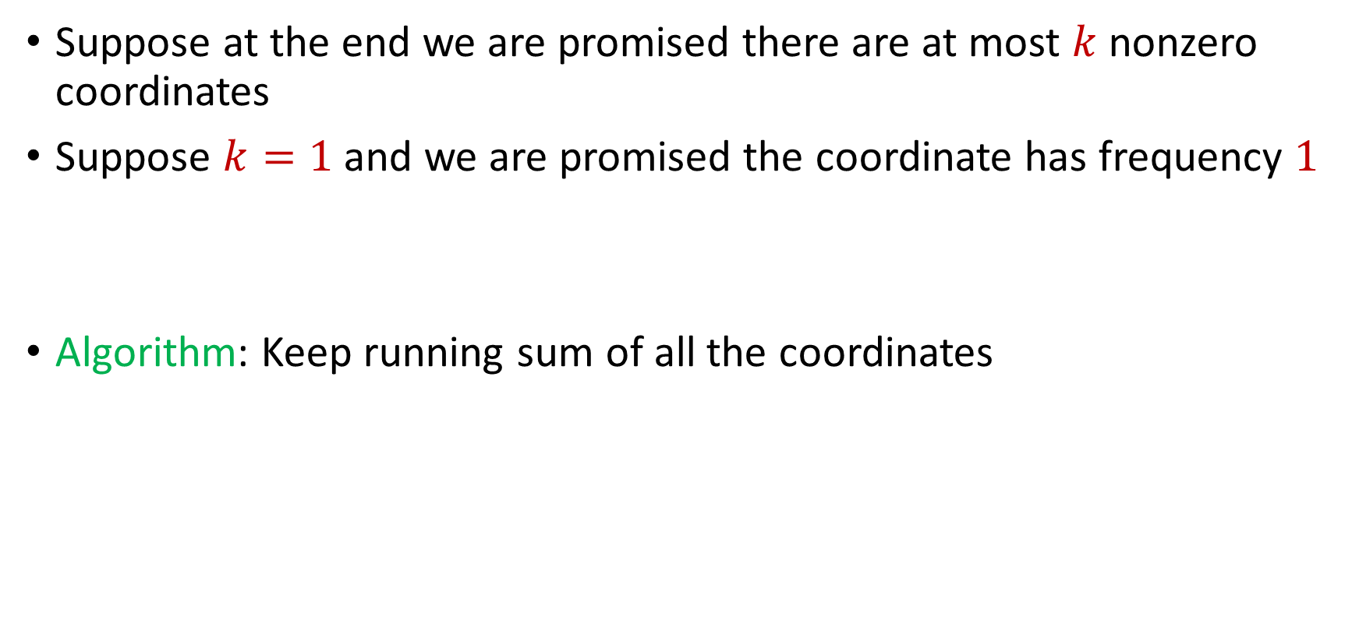
Sparse Recovery
Suppose at the end we are promised there are at most $k$ nonzero coordinates
Suppose $k=1$ and we are promised the coordinate has frequency $1$
Algorithm: Keep running sum of all the coordinates

Slide 31
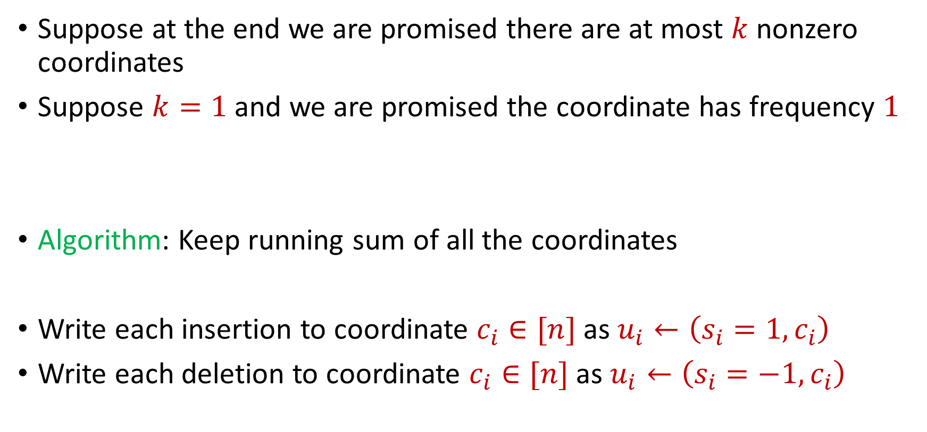
Sparse Recovery
Suppose at the end we are promised there are at most $k$ nonzero coordinates
Suppose $k=1$ and we are promised the coordinate has frequency $1$
Algorithm: Keep running sum of all the coordinates
Write each insertion to coordinate $c_{i}∈[n]$as $u_{i}←\left(s_{i}=1, c_{i}\right)$
Write each deletion to coordinate $c_{i}∈[n]$as $u_{i}←\left(s_{i}=−1, c_{i}\right)$

Slide 32
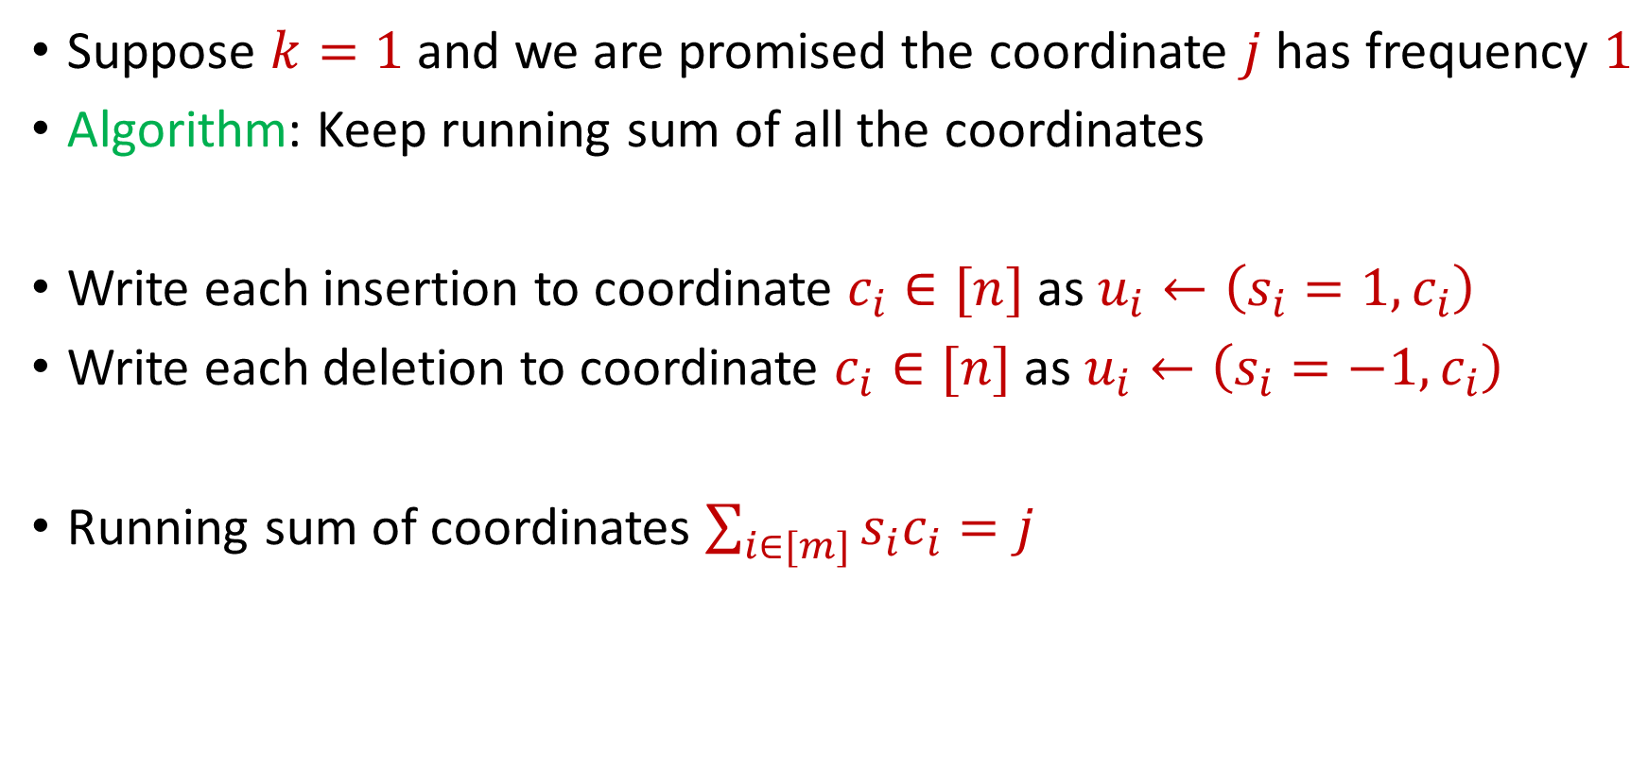
Sparse Recovery
Suppose $k=1$ and we are promised the coordinate $j$ has frequency $1$
Algorithm: Keep running sum of all the coordinates
Write each insertion to coordinate $c_{i}∈[n]$as $u_{i}←\left(s_{i}=1, c_{i}\right)$
Write each deletion to coordinate $c_{i}∈[n]$as $u_{i}←\left(s_{i}=−1, c_{i}\right)$
Running sum of coordinates $\sum_{i∈[m]}{s_{i}c_{i}}=j$

Slide 33
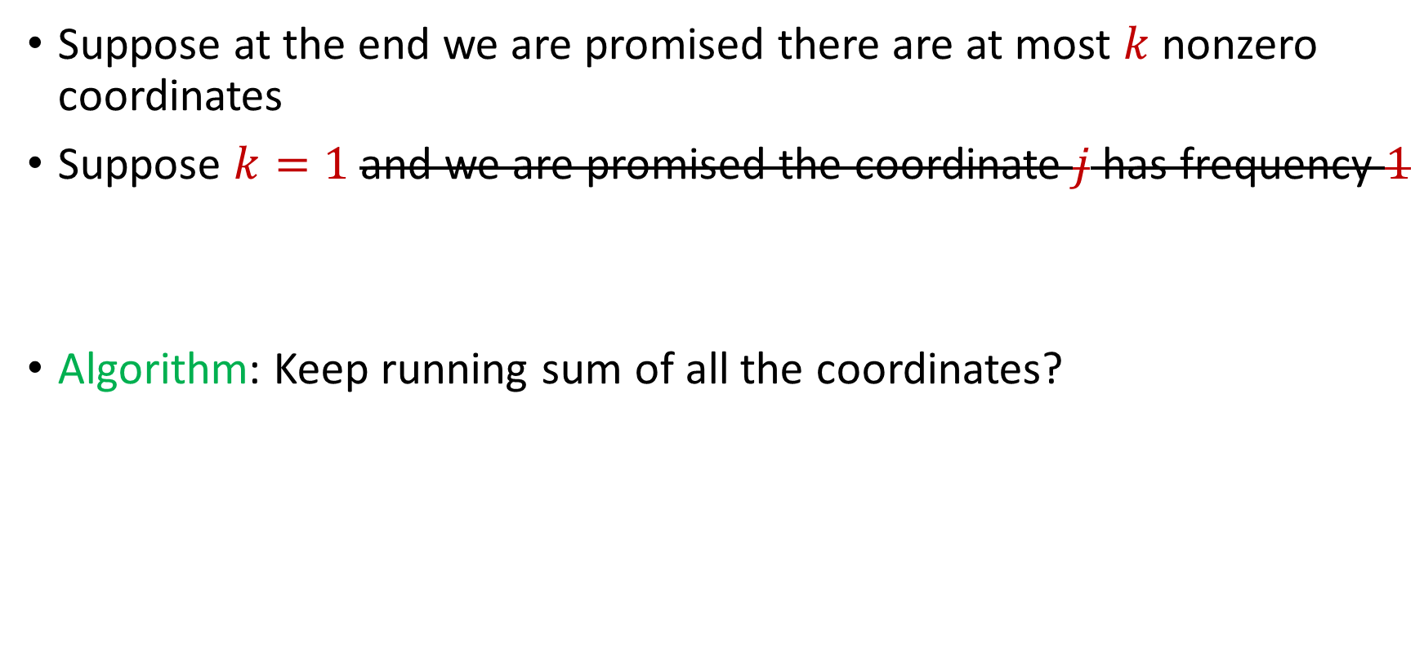
Sparse Recovery
Suppose at the end we are promised there are at most $k$ nonzero coordinates
Suppose $k=1$ and we are promised the coordinate $j$ has frequency $1$
Algorithm: Keep running sum of all the coordinates?

Slide 34
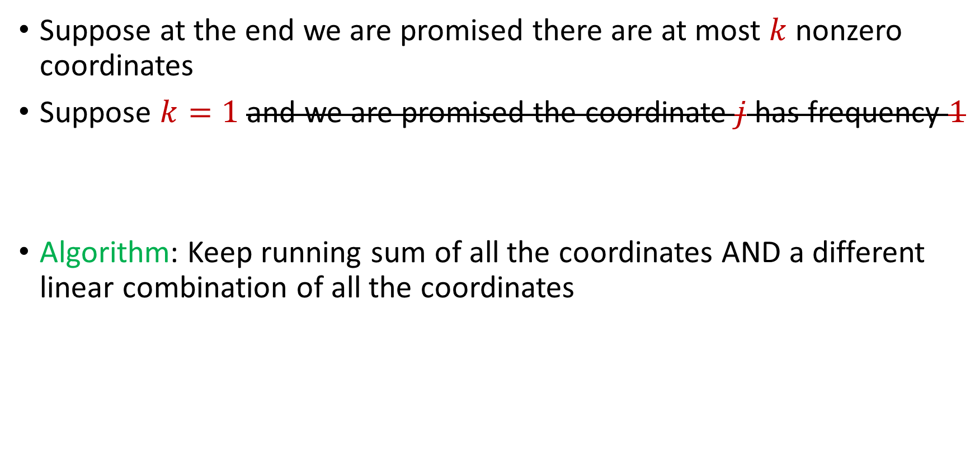
Sparse Recovery
Suppose at the end we are promised there are at most $k$ nonzero coordinates
Suppose $k=1$ and we are promised the coordinate $j$ has frequency $1$
Algorithm: Keep running sum of all the coordinates AND a different linear combination of all the coordinates

Slide 35
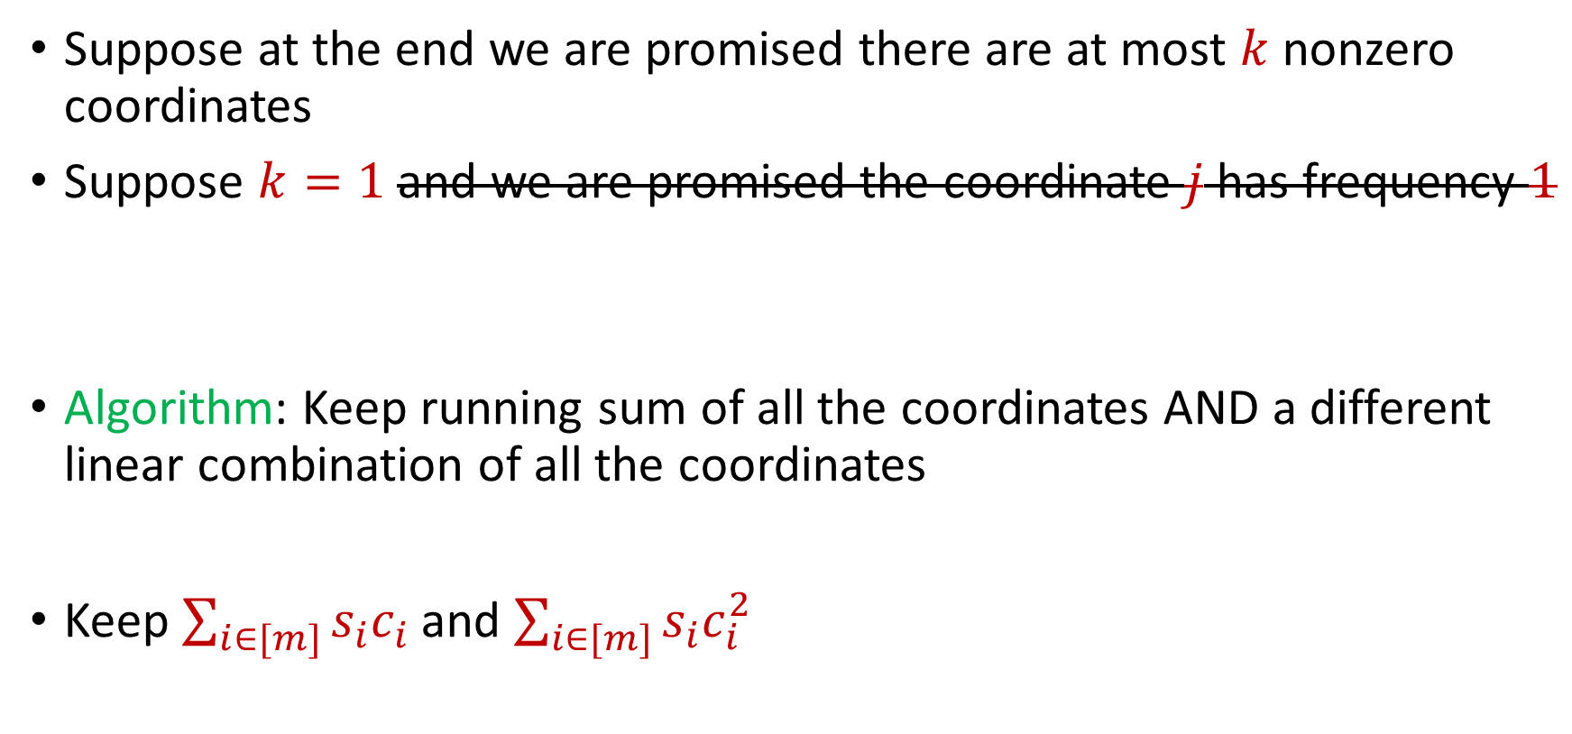
Sparse Recovery
Suppose at the end we are promised there are at most $k$ nonzero coordinates
Suppose $k=1$ and we are promised the coordinate $j$ has frequency $1$
Algorithm: Keep running sum of all the coordinates AND a different linear combination of all the coordinates
Keep $\sum_{i∈[m]}{s_{i}c_{i}}$ and $\sum_{i∈[m]}{s_{i}c_{i}^{2}}$

Slide 36

Sparse Recovery
Suppose at the end we are promised there are at most $k$ nonzero coordinates
Suppose $k=1$ and we are promised the coordinate $j$ has frequency $1$
$u_{1}$: “Increase $f_{6}$”

Slide 37
Sparse Recovery
Suppose at the end we are promised there are at most $k$ nonzero coordinates
Suppose $k=1$ and we are promised the coordinate $j$ has frequency $1$
$u_{2}$: “Increase $f_{5}$”

Slide 38
Sparse Recovery
Suppose at the end we are promised there are at most $k$ nonzero coordinates
Suppose $k=1$ and we are promised the coordinate $j$ has frequency $1$
$u_{3}$: “Increase $f_{2}$”

Slide 39
Sparse Recovery
Suppose at the end we are promised there are at most $k$ nonzero coordinates
Suppose $k=1$ and we are promised the coordinate $j$ has frequency $1$
$u_{4}$: “Increase $f_{7}$”

Slide 40
Sparse Recovery
Suppose at the end we are promised there are at most $k$ nonzero coordinates
Suppose $k=1$ and we are promised the coordinate $j$ has frequency $1$
$u_{5}$: “Increase $f_{3}$”

Slide 41
Sparse Recovery
Suppose at the end we are promised there are at most $k$ nonzero coordinates
Suppose $k=1$ and we are promised the coordinate $j$ has frequency $1$
$u_{6}$: “Increase $f_{3}$”

Slide 42
Sparse Recovery
Suppose at the end we are promised there are at most $k$ nonzero coordinates
Suppose $k=1$ and we are promised the coordinate $j$ has frequency $1$
$u_{7}$: “Increase $f_{2}$”

Slide 43
Sparse Recovery
Suppose at the end we are promised there are at most $k$ nonzero coordinates
Suppose $k=1$ and we are promised the coordinate $j$ has frequency $1$
$u_{8}$: “Increase $f_{8}$”

Slide 44
Sparse Recovery
Suppose at the end we are promised there are at most $k$ nonzero coordinates
Suppose $k=1$ and we are promised the coordinate $j$ has frequency $1$
$u_{9}$: “Decrease $f_{3}$”

Slide 45
Sparse Recovery
Suppose at the end we are promised there are at most $k$ nonzero coordinates
Suppose $k=1$ and we are promised the coordinate $j$ has frequency $1$
$u_{10}$: “Decrease $f_{5}$”

Slide 46
Sparse Recovery
Suppose at the end we are promised there are at most $k$ nonzero coordinates
Suppose $k=1$ and we are promised the coordinate $j$ has frequency $1$
$u_{11}$: “Increase $f_{1}$”

Slide 47
Sparse Recovery
Suppose at the end we are promised there are at most $k$ nonzero coordinates
Suppose $k=1$ and we are promised the coordinate $j$ has frequency $1$
$u_{12}$: “Increase $f_{7}$”

Slide 48
Sparse Recovery
Suppose at the end we are promised there are at most $k$ nonzero coordinates
Suppose $k=1$ and we are promised the coordinate $j$ has frequency $1$
$u_{13}$: “Decrease $f_{6}$”

Slide 49
Sparse Recovery
Suppose at the end we are promised there are at most $k$ nonzero coordinates
Suppose $k=1$ and we are promised the coordinate $j$ has frequency $1$
$u_{14}$: “Decrease $f_{8}$”

Slide 50
Sparse Recovery
Suppose at the end we are promised there are at most $k$ nonzero coordinates
Suppose $k=1$ and we are promised the coordinate $j$ has frequency $1$
$u_{15}$: “Decrease $f_{1}$”

Slide 51
Sparse Recovery
Suppose at the end we are promised there are at most $k$ nonzero coordinates
Suppose $k=1$ and we are promised the coordinate $j$ has frequency $1$
$u_{16}$: “Decrease $f_{7}$”

Slide 52
Sparse Recovery
Suppose at the end we are promised there are at most $k$ nonzero coordinates
Suppose $k=1$ and we are promised the coordinate $j$ has frequency $1$
$u_{17}$: “Decrease $f_{3}$”

Slide 53
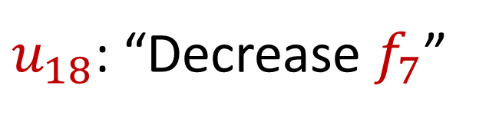
Sparse Recovery
Suppose at the end we are promised there are at most $k$ nonzero coordinates
Suppose $k=1$ and we are promised the coordinate $j$ has frequency $1$
$u_{18}$: “Decrease $f_{7}$”

Slide 54

Sparse Recovery
Suppose at the end we are promised there are at most $k$ nonzero coordinates
Suppose $k=1$ and we are promised the coordinate $j$ has frequency $1$
What is the state of our algorithm?

Slide 55
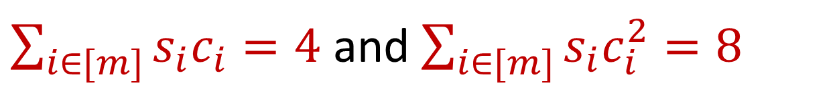
Sparse Recovery
Suppose at the end we are promised there are at most $k$ nonzero coordinates
Suppose $k=1$ and we are promised the coordinate $j$ has frequency $1$
What is the state of our algorithm?
$\sum_{i∈[m]}{s_{i}c_{i}}=4$ and $\sum_{i∈[m]}{s_{i}c_{i}^{2}=8}$

Slide 56
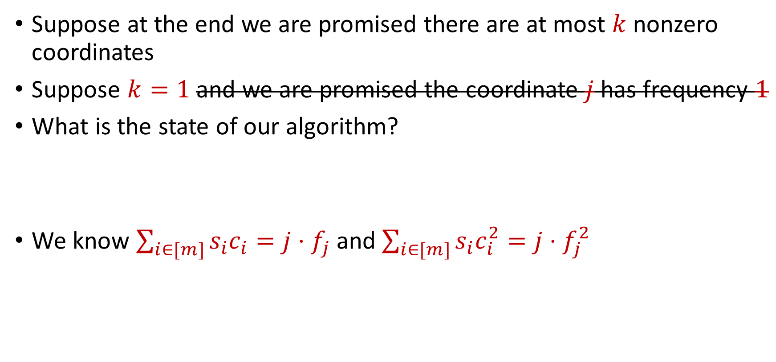
Sparse Recovery
Suppose at the end we are promised there are at most $k$ nonzero coordinates
Suppose $k=1$ and we are promised the coordinate $j$ has frequency $1$
What is the state of our algorithm?
We know $\sum_{i∈[m]}{s_{i}c_{i}}=j⋅f_{j}$ and $\sum_{i∈[m]}{s_{i}c_{i}^{2}=j⋅f_{j}^{2}}$
$\sum_{i∈[m]}{s_{i}c_{i}}=4$ and $\sum_{i∈[m]}{s_{i}c_{i}^{2}=8}$

Slide 57
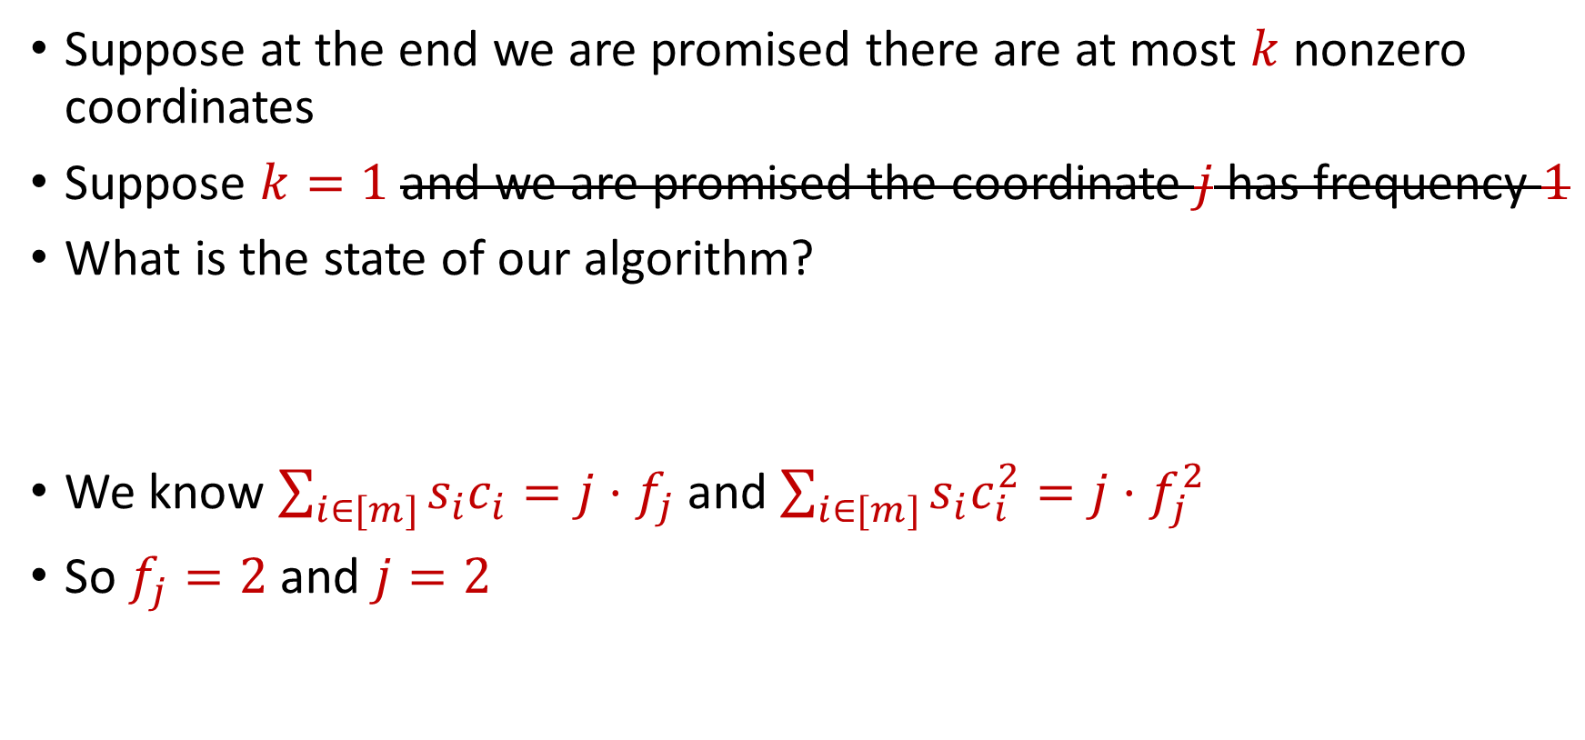
Sparse Recovery
Suppose at the end we are promised there are at most $k$ nonzero coordinates
Suppose $k=1$ and we are promised the coordinate $j$ has frequency $1$
What is the state of our algorithm?
We know $\sum_{i∈[m]}{s_{i}c_{i}}=j⋅f_{j}$ and $\sum_{i∈[m]}{s_{i}c_{i}^{2}=j⋅f_{j}^{2}}$
So $f_{j}=2$ and $j=2$
$\sum_{i∈[m]}{s_{i}c_{i}}=4$ and $\sum_{i∈[m]}{s_{i}c_{i}^{2}=8}$

Slide 58

Sparse Recovery
Suppose at the end we are promised there are at most $k$ nonzero coordinates
Suppose $k=1$ and we are promised the coordinate $j$ has frequency $1$
What is the state of our algorithm?
We know $\sum_{i∈[m]}{s_{i}c_{i}}=j⋅f_{j}$ and $\sum_{i∈[m]}{s_{i}c_{i}^{2}=j⋅f_{j}^{2}}$
So $f_{j}=2$ and $j=2$
$\sum_{i∈[m]}{s_{i}c_{i}}=4$ and $\sum_{i∈[m]}{s_{i}c_{i}^{2}=8}$
$f_{1}$ | $f_{2}$ | $f_{3}$ | $f_{4}$ | $f_{5}$ | $f_{6}$ | $f_{7}$
0 | 2 | 0 | 0 | 0 | 0 | 0

Slide 59

Sparse Recovery
Suppose at the end we are promised there are at most $k$ nonzero coordinates
Algorithm for $k=1$: Keep running sum of all the coordinates AND a different linear combination of all the coordinates

Slide 60
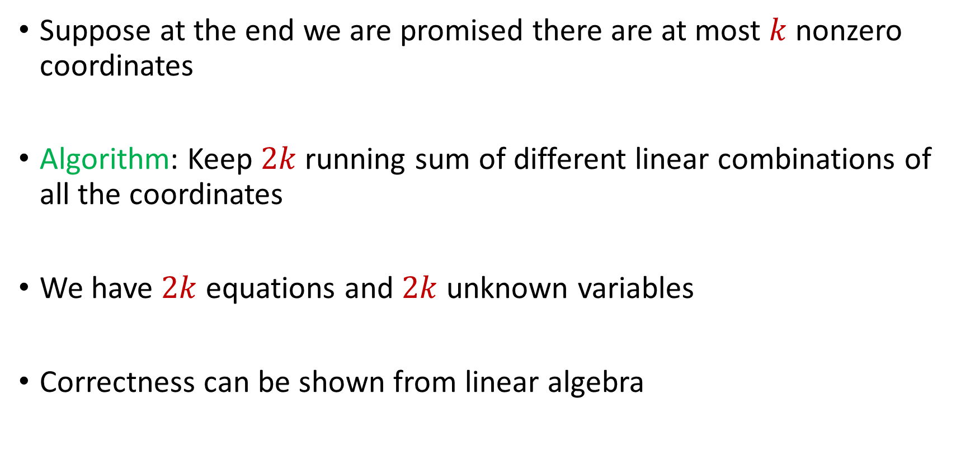
Sparse Recovery
Suppose at the end we are promised there are at most $k$ nonzero coordinates
Algorithm: Keep $2k$running sum of different linear combinations of all the coordinates
We have $2k$ equations and $2k$ unknown variables
Correctness can be shown from linear algebra

Slide 61
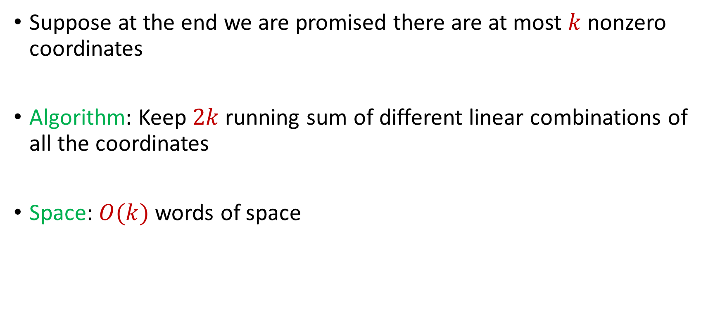
Sparse Recovery
Suppose at the end we are promised there are at most $k$ nonzero coordinates
Algorithm: Keep $2k$running sum of different linear combinations of all the coordinates
Space: $O(k)$ words of space

Slide 62

Frequent Items on Insertion-Deletion Streams
Misra-Gries on Insertion-Deletion Streams
“Increase $f_{1}$”
“Increase $f_{2}$”
“Increase $f_{2}$”
“Decrease $f_{2}$”
“Decrease $f_{2}$”

Slide 63
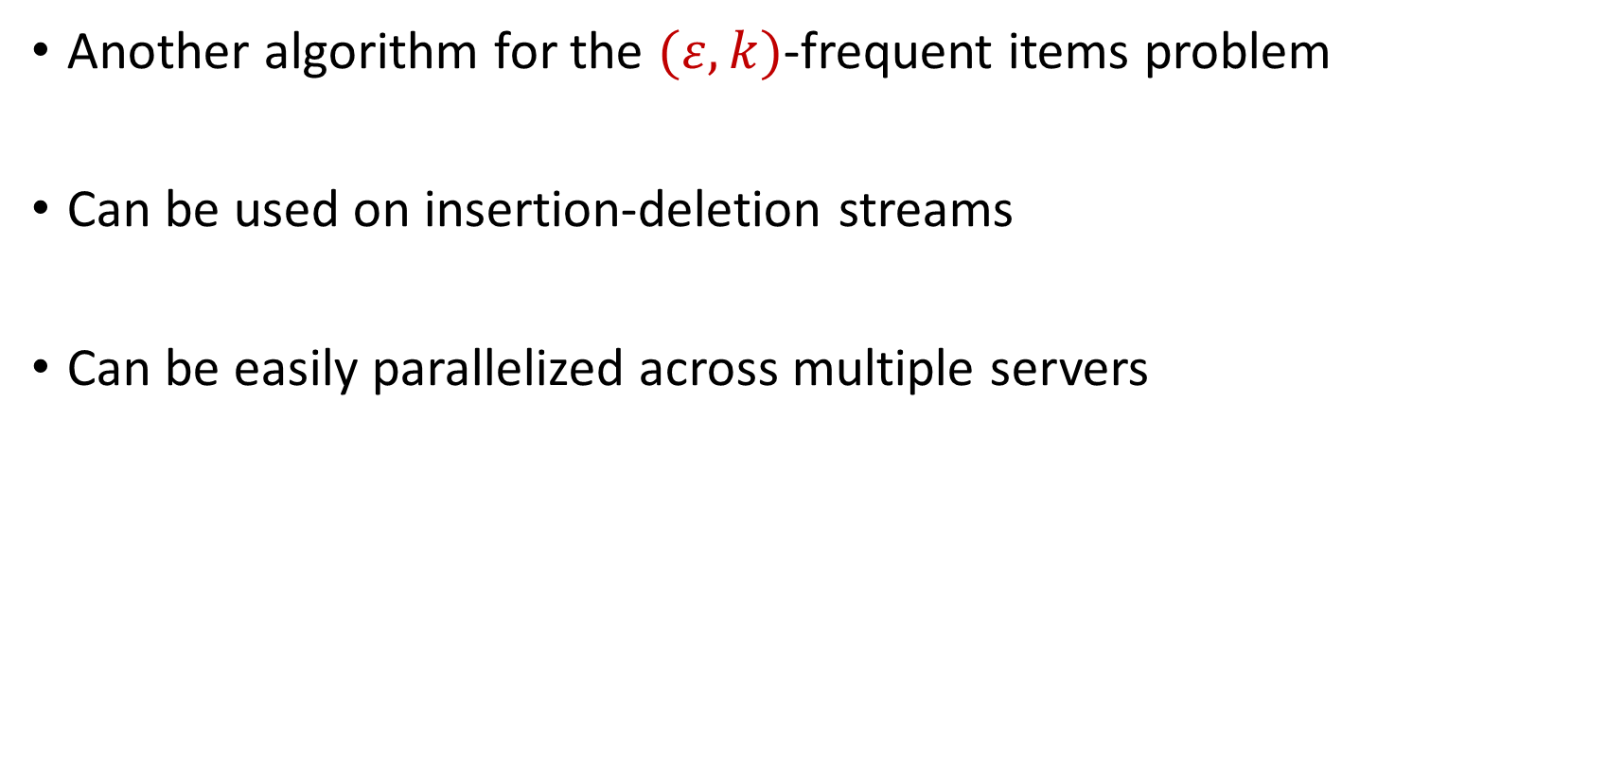
CountMin
Another algorithm for the $(ε,k)$-frequent items problem
Can be used on insertion-deletion streams
Can be easily parallelized across multiple servers

Slide 64
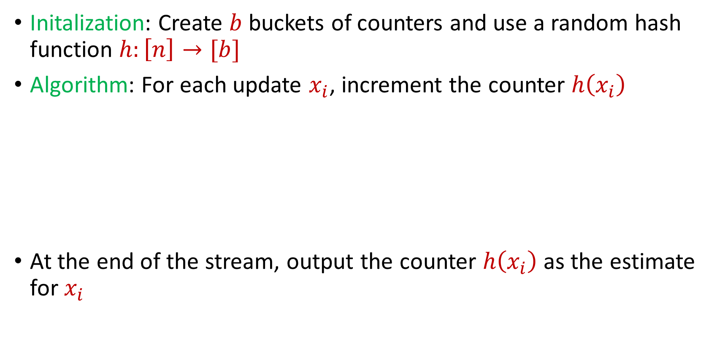
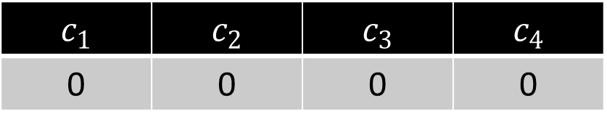
CountMin
Initalization: Create $b$ buckets of counters and use a random hash function $h:\left[n\right]→[b]$
Algorithm: For each update $x_{i}$, increment the counter $h\left(x_{i}\right)$
At the end of the stream, output the counter $h\left(x_{i}\right)$ as the estimate for $x_{i}$
$c_{1}$ | $c_{2}$ | $c_{3}$ | $c_{4}$
0 | 0 | 0 | 0

Slide 65
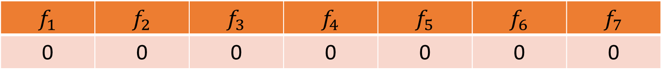


CountMin
$f_{1}$ | $f_{2}$ | $f_{3}$ | $f_{4}$ | $f_{5}$ | $f_{6}$ | $f_{7}$
0 | 0 | 0 | 0 | 0 | 0 | 0
$$1$$
$c_{1}$ | $c_{2}$ | $c_{3}$ | $c_{4}$
0 | 0 | 0 | 0

Slide 66
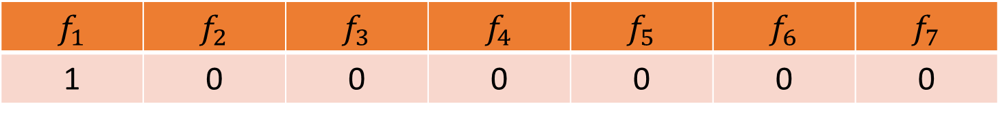

CountMin
$f_{1}$ | $f_{2}$ | $f_{3}$ | $f_{4}$ | $f_{5}$ | $f_{6}$ | $f_{7}$
1 | 0 | 0 | 0 | 0 | 0 | 0
$$1$$
$$h\left(x\right)=3x+2 (mod 4)$$
$c_{1}$ | $c_{2}$ | $c_{3}$ | $c_{4}$
0 | 0 | 0 | 0

Slide 67
CountMin
$f_{1}$ | $f_{2}$ | $f_{3}$ | $f_{4}$ | $f_{5}$ | $f_{6}$ | $f_{7}$
1 | 0 | 0 | 0 | 0 | 0 | 0
$$1$$
$$h\left(x\right)=3x+2 (mod 4)$$
$c_{1}$ | $c_{2}$ | $c_{3}$ | $c_{4}$
0 | 0 | 0 | 0

Slide 68
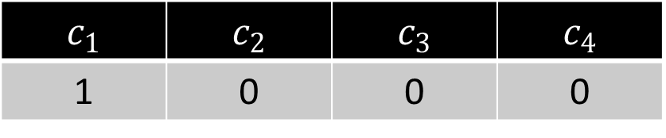
CountMin
$f_{1}$ | $f_{2}$ | $f_{3}$ | $f_{4}$ | $f_{5}$ | $f_{6}$ | $f_{7}$
1 | 0 | 0 | 0 | 0 | 0 | 0
$$1$$
$$h\left(x\right)=3x+2 (mod 4)$$
$c_{1}$ | $c_{2}$ | $c_{3}$ | $c_{4}$
1 | 0 | 0 | 0

Slide 69

CountMin
$f_{1}$ | $f_{2}$ | $f_{3}$ | $f_{4}$ | $f_{5}$ | $f_{6}$ | $f_{7}$
1 | 0 | 0 | 0 | 0 | 0 | 0
$$3$$
$$h\left(x\right)=3x+2 (mod 4)$$
$c_{1}$ | $c_{2}$ | $c_{3}$ | $c_{4}$
1 | 0 | 0 | 0

Slide 70
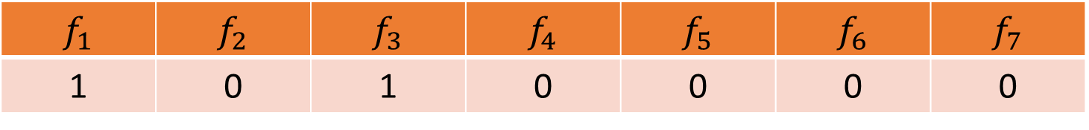
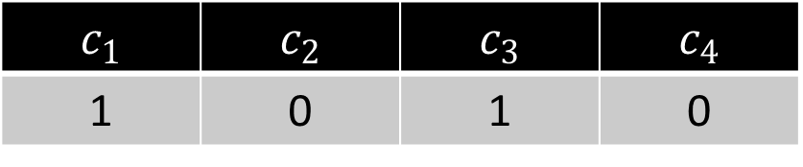
CountMin
$f_{1}$ | $f_{2}$ | $f_{3}$ | $f_{4}$ | $f_{5}$ | $f_{6}$ | $f_{7}$
1 | 0 | 1 | 0 | 0 | 0 | 0
$$3$$
$$h\left(x\right)=3x+2 (mod 4)$$
$c_{1}$ | $c_{2}$ | $c_{3}$ | $c_{4}$
1 | 0 | 1 | 0

Slide 71

CountMin
$f_{1}$ | $f_{2}$ | $f_{3}$ | $f_{4}$ | $f_{5}$ | $f_{6}$ | $f_{7}$
1 | 0 | 1 | 0 | 0 | 0 | 0
$$2$$
$$h\left(x\right)=3x+2 (mod 4)$$
$c_{1}$ | $c_{2}$ | $c_{3}$ | $c_{4}$
1 | 0 | 1 | 0

Slide 72
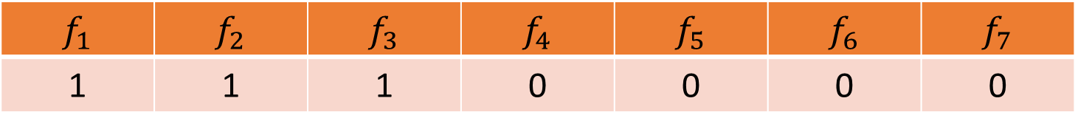
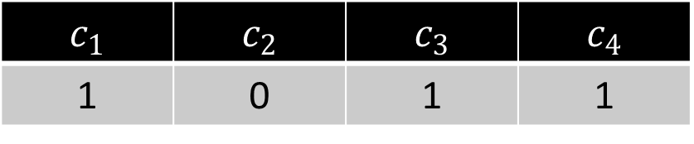
CountMin
$f_{1}$ | $f_{2}$ | $f_{3}$ | $f_{4}$ | $f_{5}$ | $f_{6}$ | $f_{7}$
1 | 1 | 1 | 0 | 0 | 0 | 0
$$2$$
$$h\left(x\right)=3x+2 (mod 4)$$
$c_{1}$ | $c_{2}$ | $c_{3}$ | $c_{4}$
1 | 0 | 1 | 1

Slide 73
CountMin
$f_{1}$ | $f_{2}$ | $f_{3}$ | $f_{4}$ | $f_{5}$ | $f_{6}$ | $f_{7}$
1 | 1 | 1 | 0 | 0 | 0 | 0
$$1$$
$$h\left(x\right)=3x+2 (mod 4)$$
$c_{1}$ | $c_{2}$ | $c_{3}$ | $c_{4}$
1 | 0 | 1 | 1

Slide 74
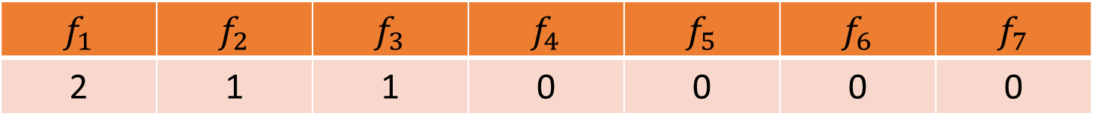

CountMin
$f_{1}$ | $f_{2}$ | $f_{3}$ | $f_{4}$ | $f_{5}$ | $f_{6}$ | $f_{7}$
2 | 1 | 1 | 0 | 0 | 0 | 0
$$1$$
$$h\left(x\right)=3x+2 (mod 4)$$
$c_{1}$ | $c_{2}$ | $c_{3}$ | $c_{4}$
2 | 0 | 1 | 1

Slide 75

CountMin
$f_{1}$ | $f_{2}$ | $f_{3}$ | $f_{4}$ | $f_{5}$ | $f_{6}$ | $f_{7}$
2 | 1 | 1 | 0 | 0 | 0 | 0
$$5$$
$$h\left(x\right)=3x+2 (mod 4)$$
$c_{1}$ | $c_{2}$ | $c_{3}$ | $c_{4}$
1 | 0 | 1 | 1

Slide 76


CountMin
$f_{1}$ | $f_{2}$ | $f_{3}$ | $f_{4}$ | $f_{5}$ | $f_{6}$ | $f_{7}$
2 | 1 | 1 | 0 | 1 | 0 | 0
$$5$$
$$h\left(x\right)=3x+2 (mod 4)$$
$c_{1}$ | $c_{2}$ | $c_{3}$ | $c_{4}$
3 | 0 | 1 | 1

Slide 77

CountMin
$f_{1}$ | $f_{2}$ | $f_{3}$ | $f_{4}$ | $f_{5}$ | $f_{6}$ | $f_{7}$
2 | 1 | 1 | 0 | 1 | 0 | 0
What is the estimation for $f_{4}$?
What about $f_{3}$?
What about $f_{5}$? What about $f_{1}$?
$$h\left(x\right)=3x+2 (mod 4)$$
$c_{1}$ | $c_{2}$ | $c_{3}$ | $c_{4}$
3 | 0 | 1 | 1

Slide 78

CountMin
Given a set $S$ of $m$ elements from $[n]$, let $\hat{f_{i}}$ be the estimated frequency for $f_{i}$
Claim: We always have $\hat{f_{i}}≥f_{i}$
Suppose $h\left(i\right)=a$ so that $c_{a}=\hat{f_{i}}$
Note that $c_{a}$counts the number $f_{j}$of occurrences of any $j$ with $h\left(j\right)=a=h(i)$, including $f_{i}$ itself

Slide 79

CountMin
Suppose $h\left(i\right)=a$ so that $c_{a}=\hat{f_{i}}$
Note that $c_{a}$counts the number $f_{j}$of occurrences of any $j$ with $h\left(j\right)=a=h(i)$, including $f_{i}$ itself
$c_{a}=\sum_{j:h\left(j\right)=a}{f_{a}}≥f_{i}$ since $h\left(i\right)=a$
$c_{a}=f_{i}+\sum_{j≠i, with j:h\left(j\right)=a}{f_{j}}$

Slide 80

CountMin Error Analysis
$c_{a}=f_{i}+\sum_{j≠i, with j:h\left(j\right)=a}{f_{j}}$
$E\left[\sum_{j≠i, with j:h\left(j\right)=a}{f_{j}}\right]=\sum_{j≠i}{E\left[f_{j}⋅I_{h\left(j\right)=h(i)}\right]}$
$E\left[\sum_{j≠i, with j:h\left(j\right)=a}{f_{j}}\right]=\sum_{j≠i}{E\left[I_{h\left(j\right)=h(i)}\right]⋅f_{j}}$
$E\left[\sum_{j≠i, with j:h\left(j\right)=a}{f_{j}}\right]=\sum_{j≠i}{{Pr\left[h\left(j\right)=h(i)\right]⋅f}_{j}}$
$E\left[\sum_{j≠i, with j:h\left(j\right)=a}{f_{j}}\right]=\sum_{j≠i}{{\frac{1}{b}⋅f}_{j}=\frac{m}{b}}$
Set $b=\frac{3k}{ε}$, then the expected error is at most $\frac{εm}{3k}$

Slide 81


Heavy-Hitters (Frequent Items)
Given a set $S$ of $m$ elements from $[n]$, let $f_{i}$ be the frequency of element $i$. (How often it appears)
Let $L_{2}$ be the norm of the frequency vector:
Goal: Given a set $S$ of $m$ elements from $[n]$ and a threshold $ε$, output the elements $i$ such that $f_{i}>$ $ε L_{2}$...and no elements $j$ such that $f_{j}<$ $\frac{ε}{16} L_{2}$
Motivation: DDoS prevention, iceberg queries
$$L_{2}=\sqrt{f_{1}^{2}+f_{2}^{2}+…+f_{n}^{2}}$$

Slide 82



Frequency Moments ($L_{p}$ Norm)
Given a set $S$ of $m$ elements from $[n]$, let $f_{i}$ be the frequency of element $i$. (How often it appears)
Let $F_{p}$ be the frequency moment of the vector:
Goal: Given a set $S$ of $m$ elements from $[n]$ and an accuracy parameter $ε$, output a $(1+ε)$-approximation to $F_{p}$
Motivation: Entropy estimation, linear regression
$F_{p}=$ $f_{1}^{p}+f_{2}^{p}+…+f_{n}^{p}$

Slide 83


Distinct Elements ($F_{0}$ Estimation)
Given a set $S$ of $m$ elements from $[n]$, let $f_{i}$ be the frequency of element $i$. (How often it appears)
Let $F_{0}$ be the frequency moment of the vector:
Goal: Given a set $S$ of $m$ elements from $[n]$ and an accuracy parameter $ε$, output a $(1+ε)$-approximation to $F_{0}$
Motivation: Traffic monitoring
$F_{0}=$ $|\{i :f_{i}≠0\}|$

