Slide 1
CSCE 658: Randomized Algorithms
Lecture 23
Samson Zhou

Slide 2
Previously in the Streaming Model
Reservoir sampling
Heavy-hitters
Misra-Gries
CountMin
CountSketch
Moment estimation
AMS algorithm

Slide 3

Sparse Recovery
Suppose we have an insertion-deletion stream of length $m=Θ\left(n\right)$ and at the end we are promised there are at most $k$ nonzero coordinates
Goal: Recover the $k$ nonzero coordinates and their frequencies

Slide 4
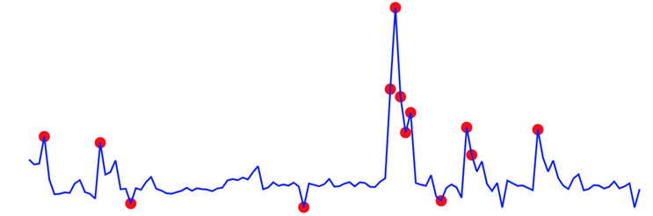
Applications of Sparse Recovery
Anomaly detection: Noiseless sparse recovery can be used to identify anomalies or outliers in streaming data
By modeling normal behavior as a sparse signal, deviations from this model can be detected in real-time. This is valuable for cybersecurity, fraud detection, and monitoring network traffic for unusual patterns.

Slide 5
Applications of Sparse Recovery
Network traffic analysis: Noiseless sparse recovery can be applied to analyze network traffic in real-time, identifying patterns and trends, and helping in network management, intrusion detection, and quality of service (QoS) optimization

Slide 6
Applications of Sparse Recovery
Real-time compressive imaging: Compressive imaging techniques can be applied to streaming video or image data. By capturing and processing fewer measurements, noiseless sparse recovery can provide real-time reconstruction of high-resolution images or videos.

Slide 7
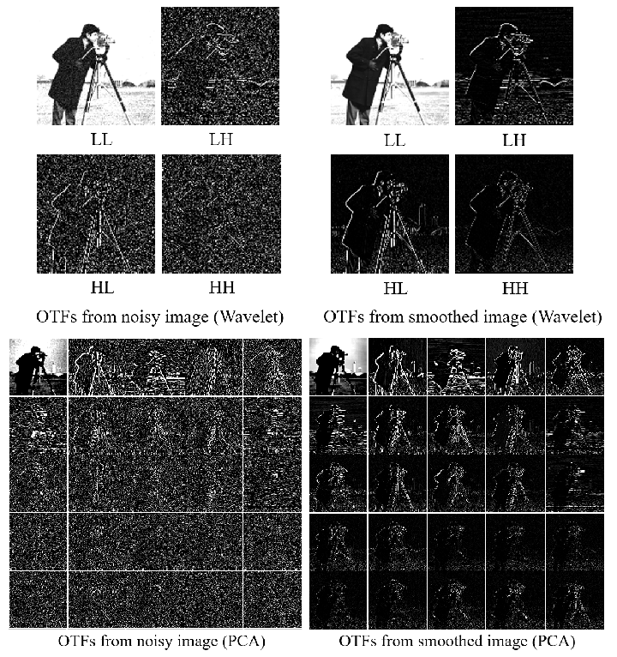
“Deep Orthogonal Transform Feature for Image Denoising”, Shin, et. al. [2020]

Slide 8
Applications of Sparse Recovery
Online natural language processing (NLP): In real-time natural language processing tasks, noiseless sparse recovery can assist in extracting relevant features or patterns from streaming text data, making it useful for sentiment analysis, topic modeling, and summarization

Slide 9
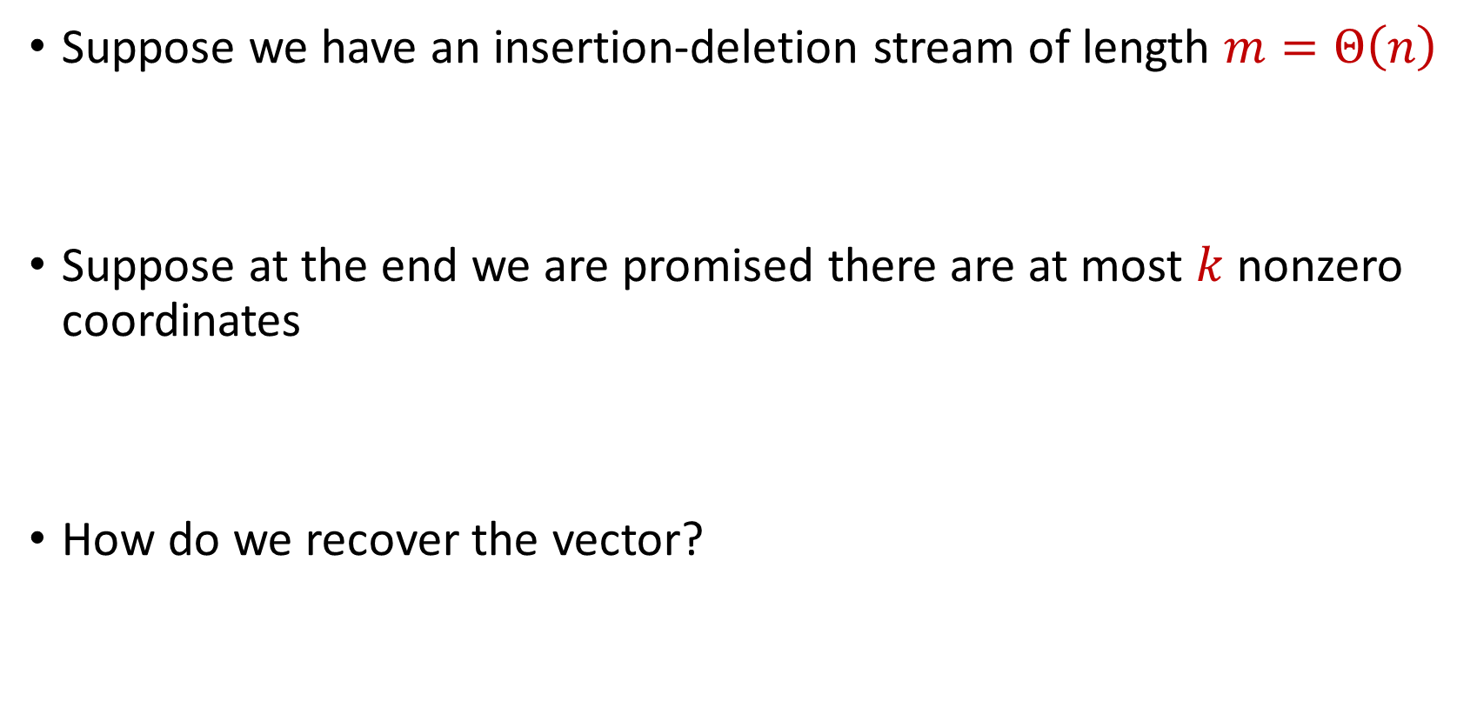
Sparse Recovery
Suppose we have an insertion-deletion stream of length $m=Θ\left(n\right)$
Suppose at the end we are promised there are at most $k$ nonzero coordinates
How do we recover the vector?

Slide 10

Sparse Recovery
Suppose at the end we are promised there are at most $k$ nonzero coordinates
Suppose $k=1$ and we are promised the coordinate has frequency $1$

Slide 11
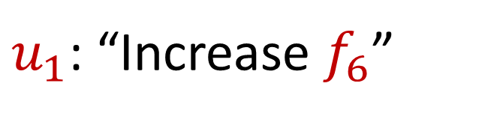
Sparse Recovery
Suppose at the end we are promised there are at most $k$ nonzero coordinates
Suppose $k=1$ and we are promised the coordinate has frequency $1$
$u_{1}$: “Increase $f_{6}$”

Slide 12
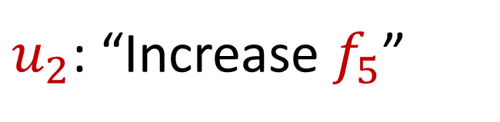
Sparse Recovery
Suppose at the end we are promised there are at most $k$ nonzero coordinates
Suppose $k=1$ and we are promised the coordinate has frequency $1$
$u_{2}$: “Increase $f_{5}$”

Slide 13
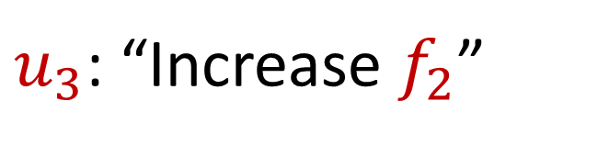
Sparse Recovery
Suppose at the end we are promised there are at most $k$ nonzero coordinates
Suppose $k=1$ and we are promised the coordinate has frequency $1$
$u_{3}$: “Increase $f_{2}$”

Slide 14
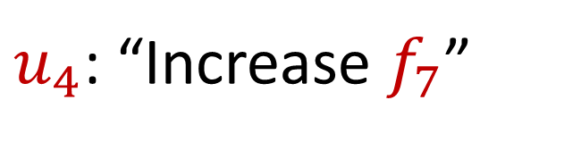
Sparse Recovery
Suppose at the end we are promised there are at most $k$ nonzero coordinates
Suppose $k=1$ and we are promised the coordinate has frequency $1$
$u_{4}$: “Increase $f_{7}$”

Slide 15
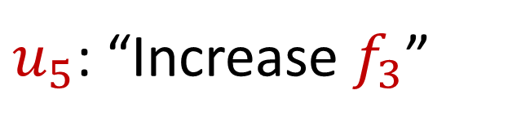
Sparse Recovery
Suppose at the end we are promised there are at most $k$ nonzero coordinates
Suppose $k=1$ and we are promised the coordinate has frequency $1$
$u_{5}$: “Increase $f_{3}$”

Slide 16
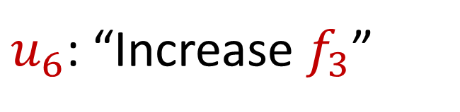
Sparse Recovery
Suppose at the end we are promised there are at most $k$ nonzero coordinates
Suppose $k=1$ and we are promised the coordinate has frequency $1$
$u_{6}$: “Increase $f_{3}$”

Slide 17
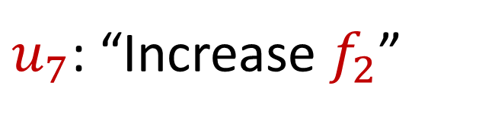
Sparse Recovery
Suppose at the end we are promised there are at most $k$ nonzero coordinates
Suppose $k=1$ and we are promised the coordinate has frequency $1$
$u_{7}$: “Increase $f_{2}$”

Slide 18
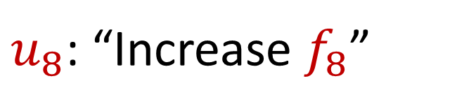
Sparse Recovery
Suppose at the end we are promised there are at most $k$ nonzero coordinates
Suppose $k=1$ and we are promised the coordinate has frequency $1$
$u_{8}$: “Increase $f_{8}$”

Slide 19
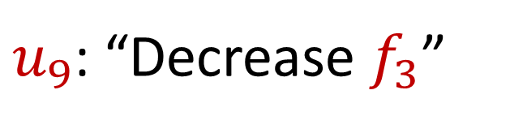
Sparse Recovery
Suppose at the end we are promised there are at most $k$ nonzero coordinates
Suppose $k=1$ and we are promised the coordinate has frequency $1$
$u_{9}$: “Decrease $f_{3}$”

Slide 20
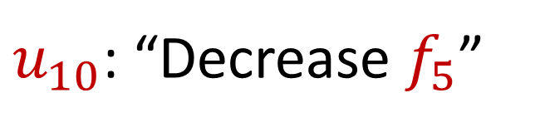
Sparse Recovery
Suppose at the end we are promised there are at most $k$ nonzero coordinates
Suppose $k=1$ and we are promised the coordinate has frequency $1$
$u_{10}$: “Decrease $f_{5}$”

Slide 21
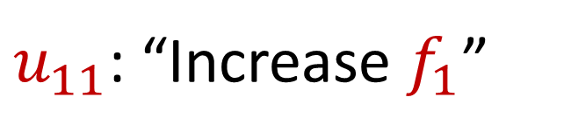
Sparse Recovery
Suppose at the end we are promised there are at most $k$ nonzero coordinates
Suppose $k=1$ and we are promised the coordinate has frequency $1$
$u_{11}$: “Increase $f_{1}$”

Slide 22
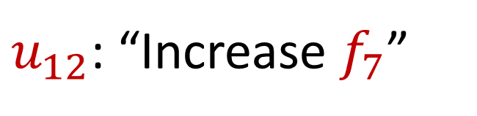
Sparse Recovery
Suppose at the end we are promised there are at most $k$ nonzero coordinates
Suppose $k=1$ and we are promised the coordinate has frequency $1$
$u_{12}$: “Increase $f_{7}$”

Slide 23
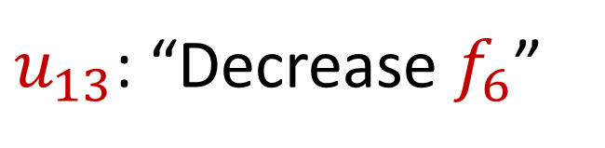
Sparse Recovery
Suppose at the end we are promised there are at most $k$ nonzero coordinates
Suppose $k=1$ and we are promised the coordinate has frequency $1$
$u_{13}$: “Decrease $f_{6}$”

Slide 24

Sparse Recovery
Suppose at the end we are promised there are at most $k$ nonzero coordinates
Suppose $k=1$ and we are promised the coordinate has frequency $1$
$u_{14}$: “Decrease $f_{8}$”

Slide 25
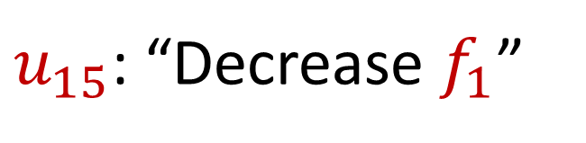
Sparse Recovery
Suppose at the end we are promised there are at most $k$ nonzero coordinates
Suppose $k=1$ and we are promised the coordinate has frequency $1$
$u_{15}$: “Decrease $f_{1}$”

Slide 26
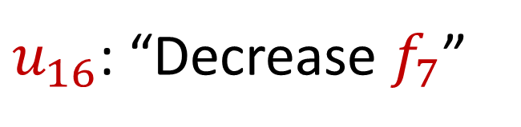
Sparse Recovery
Suppose at the end we are promised there are at most $k$ nonzero coordinates
Suppose $k=1$ and we are promised the coordinate has frequency $1$
$u_{16}$: “Decrease $f_{7}$”

Slide 27
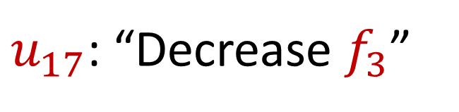
Sparse Recovery
Suppose at the end we are promised there are at most $k$ nonzero coordinates
Suppose $k=1$ and we are promised the coordinate has frequency $1$
$u_{17}$: “Decrease $f_{3}$”

Slide 28
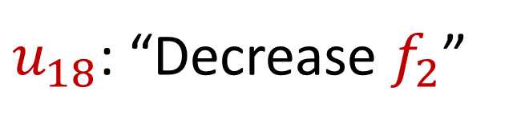
Sparse Recovery
Suppose at the end we are promised there are at most $k$ nonzero coordinates
Suppose $k=1$ and we are promised the coordinate has frequency $1$
$u_{18}$: “Decrease $f_{2}$”

Slide 29
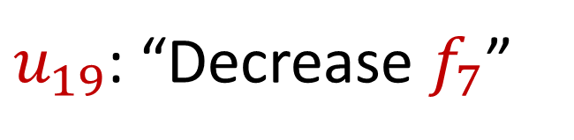
Sparse Recovery
Suppose at the end we are promised there are at most $k$ nonzero coordinates
Suppose $k=1$ and we are promised the coordinate has frequency $1$
$u_{19}$: “Decrease $f_{7}$”

Slide 30

Sparse Recovery
Suppose at the end we are promised there are at most $k$ nonzero coordinates
Suppose $k=1$ and we are promised the coordinate has frequency $1$
What is left?

Slide 31

Sparse Recovery
Suppose at the end we are promised there are at most $k$ nonzero coordinates
Suppose $k=1$ and we are promised the coordinate has frequency $1$
What is left?
$$f_{2}=1$$

Slide 32
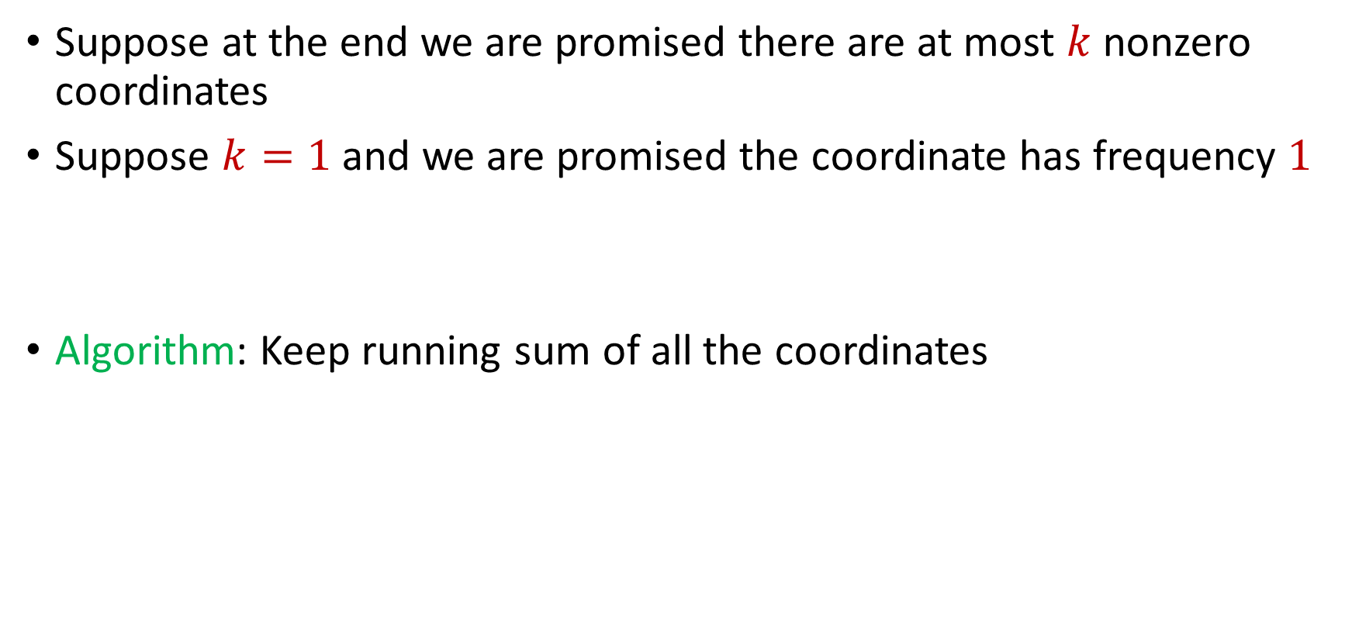
Sparse Recovery
Suppose at the end we are promised there are at most $k$ nonzero coordinates
Suppose $k=1$ and we are promised the coordinate has frequency $1$
Algorithm: Keep running sum of all the coordinates

Slide 33
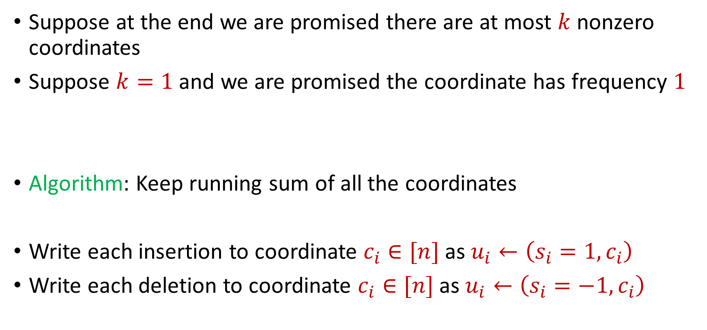
Sparse Recovery
Suppose at the end we are promised there are at most $k$ nonzero coordinates
Suppose $k=1$ and we are promised the coordinate has frequency $1$
Algorithm: Keep running sum of all the coordinates
Write each insertion to coordinate $c_{i}∈[n]$as $u_{i}←\left(s_{i}=1, c_{i}\right)$
Write each deletion to coordinate $c_{i}∈[n]$as $u_{i}←\left(s_{i}=−1, c_{i}\right)$

Slide 34
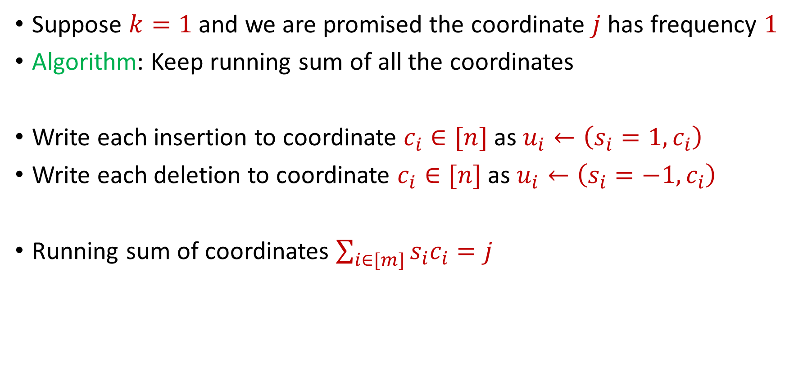
Sparse Recovery
Suppose $k=1$ and we are promised the coordinate $j$ has frequency $1$
Algorithm: Keep running sum of all the coordinates
Write each insertion to coordinate $c_{i}∈[n]$as $u_{i}←\left(s_{i}=1, c_{i}\right)$
Write each deletion to coordinate $c_{i}∈[n]$as $u_{i}←\left(s_{i}=−1, c_{i}\right)$
Running sum of coordinates $\sum_{i∈[m]}{s_{i}c_{i}}=j$

Slide 35
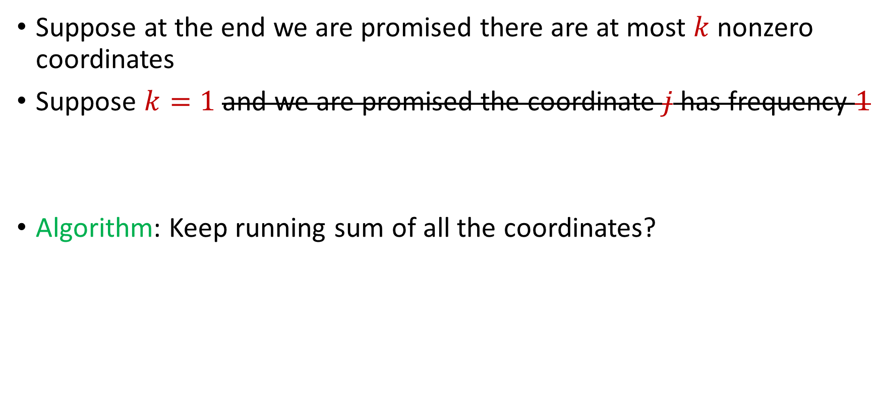
Sparse Recovery
Suppose at the end we are promised there are at most $k$ nonzero coordinates
Suppose $k=1$ and we are promised the coordinate $j$ has frequency $1$
Algorithm: Keep running sum of all the coordinates?

Slide 36
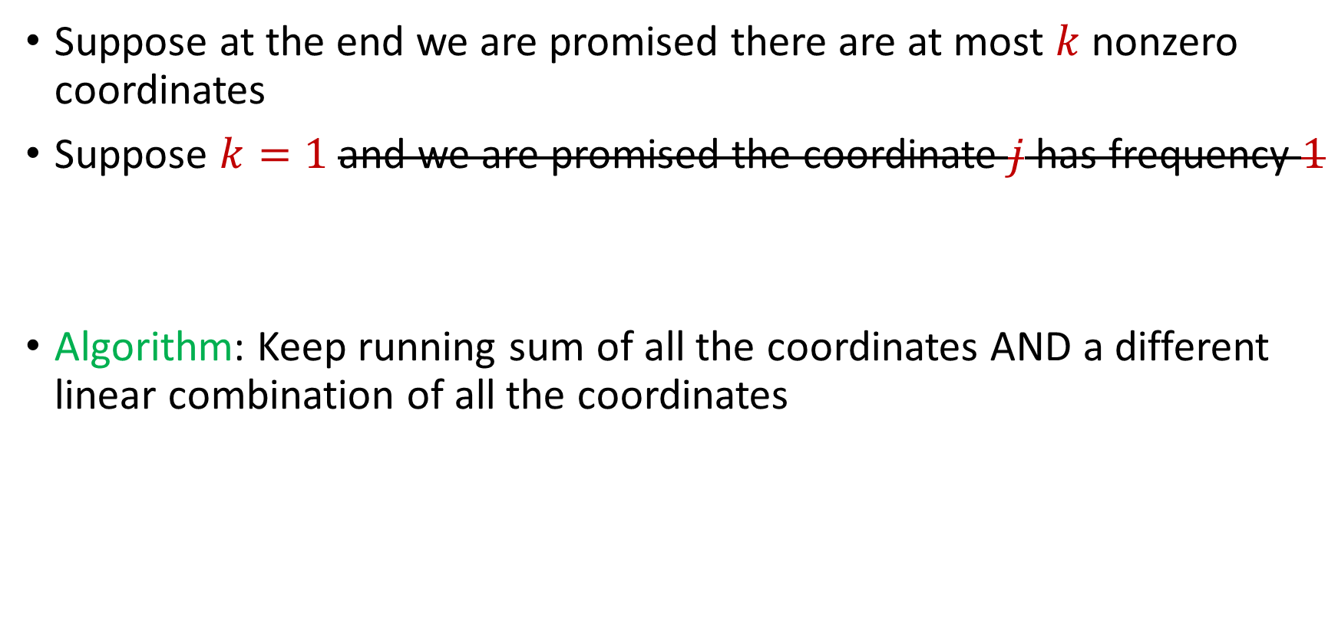
Sparse Recovery
Suppose at the end we are promised there are at most $k$ nonzero coordinates
Suppose $k=1$ and we are promised the coordinate $j$ has frequency $1$
Algorithm: Keep running sum of all the coordinates AND a different linear combination of all the coordinates

Slide 37
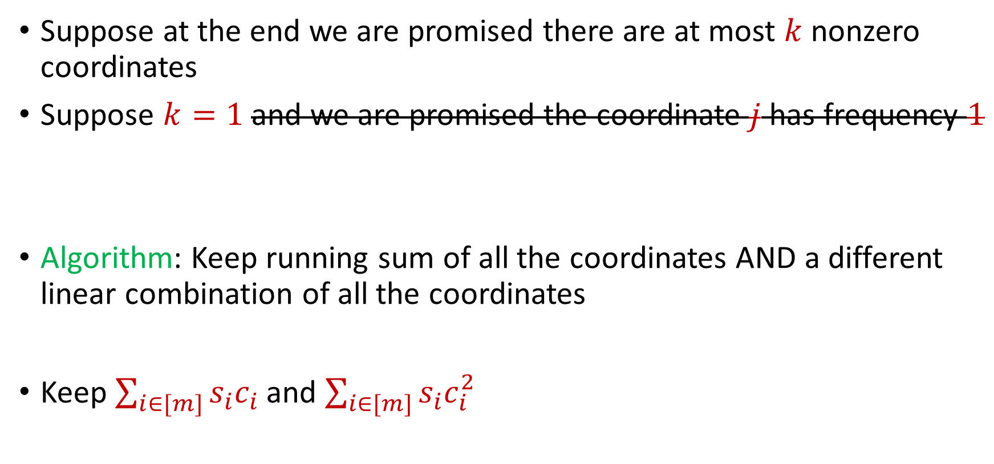
Sparse Recovery
Suppose at the end we are promised there are at most $k$ nonzero coordinates
Suppose $k=1$ and we are promised the coordinate $j$ has frequency $1$
Algorithm: Keep running sum of all the coordinates AND a different linear combination of all the coordinates
Keep $\sum_{i∈[m]}{s_{i}c_{i}}$ and $\sum_{i∈[m]}{s_{i}c_{i}^{2}}$

Slide 38

Sparse Recovery
Suppose at the end we are promised there are at most $k$ nonzero coordinates
Suppose $k=1$ and we are promised the coordinate $j$ has frequency $1$
$u_{1}$: “Increase $f_{6}$”

Slide 39
Sparse Recovery
Suppose at the end we are promised there are at most $k$ nonzero coordinates
Suppose $k=1$ and we are promised the coordinate $j$ has frequency $1$
$u_{2}$: “Increase $f_{5}$”

Slide 40
Sparse Recovery
Suppose at the end we are promised there are at most $k$ nonzero coordinates
Suppose $k=1$ and we are promised the coordinate $j$ has frequency $1$
$u_{3}$: “Increase $f_{2}$”

Slide 41
Sparse Recovery
Suppose at the end we are promised there are at most $k$ nonzero coordinates
Suppose $k=1$ and we are promised the coordinate $j$ has frequency $1$
$u_{4}$: “Increase $f_{7}$”

Slide 42
Sparse Recovery
Suppose at the end we are promised there are at most $k$ nonzero coordinates
Suppose $k=1$ and we are promised the coordinate $j$ has frequency $1$
$u_{5}$: “Increase $f_{3}$”

Slide 43
Sparse Recovery
Suppose at the end we are promised there are at most $k$ nonzero coordinates
Suppose $k=1$ and we are promised the coordinate $j$ has frequency $1$
$u_{6}$: “Increase $f_{3}$”

Slide 44
Sparse Recovery
Suppose at the end we are promised there are at most $k$ nonzero coordinates
Suppose $k=1$ and we are promised the coordinate $j$ has frequency $1$
$u_{7}$: “Increase $f_{2}$”

Slide 45
Sparse Recovery
Suppose at the end we are promised there are at most $k$ nonzero coordinates
Suppose $k=1$ and we are promised the coordinate $j$ has frequency $1$
$u_{8}$: “Increase $f_{8}$”

Slide 46
Sparse Recovery
Suppose at the end we are promised there are at most $k$ nonzero coordinates
Suppose $k=1$ and we are promised the coordinate $j$ has frequency $1$
$u_{9}$: “Decrease $f_{3}$”

Slide 47
Sparse Recovery
Suppose at the end we are promised there are at most $k$ nonzero coordinates
Suppose $k=1$ and we are promised the coordinate $j$ has frequency $1$
$u_{10}$: “Decrease $f_{5}$”

Slide 48
Sparse Recovery
Suppose at the end we are promised there are at most $k$ nonzero coordinates
Suppose $k=1$ and we are promised the coordinate $j$ has frequency $1$
$u_{11}$: “Increase $f_{1}$”

Slide 49
Sparse Recovery
Suppose at the end we are promised there are at most $k$ nonzero coordinates
Suppose $k=1$ and we are promised the coordinate $j$ has frequency $1$
$u_{12}$: “Increase $f_{7}$”

Slide 50
Sparse Recovery
Suppose at the end we are promised there are at most $k$ nonzero coordinates
Suppose $k=1$ and we are promised the coordinate $j$ has frequency $1$
$u_{13}$: “Decrease $f_{6}$”

Slide 51
Sparse Recovery
Suppose at the end we are promised there are at most $k$ nonzero coordinates
Suppose $k=1$ and we are promised the coordinate $j$ has frequency $1$
$u_{14}$: “Decrease $f_{8}$”

Slide 52
Sparse Recovery
Suppose at the end we are promised there are at most $k$ nonzero coordinates
Suppose $k=1$ and we are promised the coordinate $j$ has frequency $1$
$u_{15}$: “Decrease $f_{1}$”

Slide 53
Sparse Recovery
Suppose at the end we are promised there are at most $k$ nonzero coordinates
Suppose $k=1$ and we are promised the coordinate $j$ has frequency $1$
$u_{16}$: “Decrease $f_{7}$”

Slide 54
Sparse Recovery
Suppose at the end we are promised there are at most $k$ nonzero coordinates
Suppose $k=1$ and we are promised the coordinate $j$ has frequency $1$
$u_{17}$: “Decrease $f_{3}$”

Slide 55
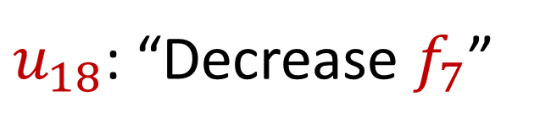
Sparse Recovery
Suppose at the end we are promised there are at most $k$ nonzero coordinates
Suppose $k=1$ and we are promised the coordinate $j$ has frequency $1$
$u_{18}$: “Decrease $f_{7}$”

Slide 56

Sparse Recovery
Suppose at the end we are promised there are at most $k$ nonzero coordinates
Suppose $k=1$ and we are promised the coordinate $j$ has frequency $1$
What is the state of our algorithm?

Slide 57
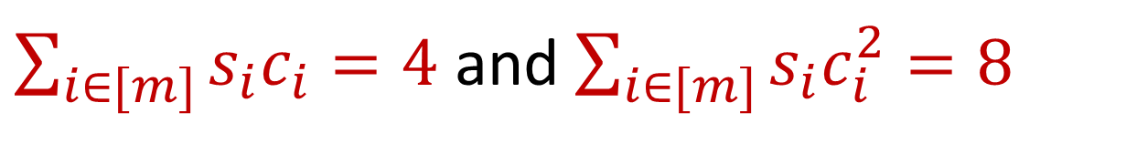
Sparse Recovery
Suppose at the end we are promised there are at most $k$ nonzero coordinates
Suppose $k=1$ and we are promised the coordinate $j$ has frequency $1$
What is the state of our algorithm?
$\sum_{i∈[m]}{s_{i}c_{i}}=4$ and $\sum_{i∈[m]}{s_{i}c_{i}^{2}=8}$

Slide 58
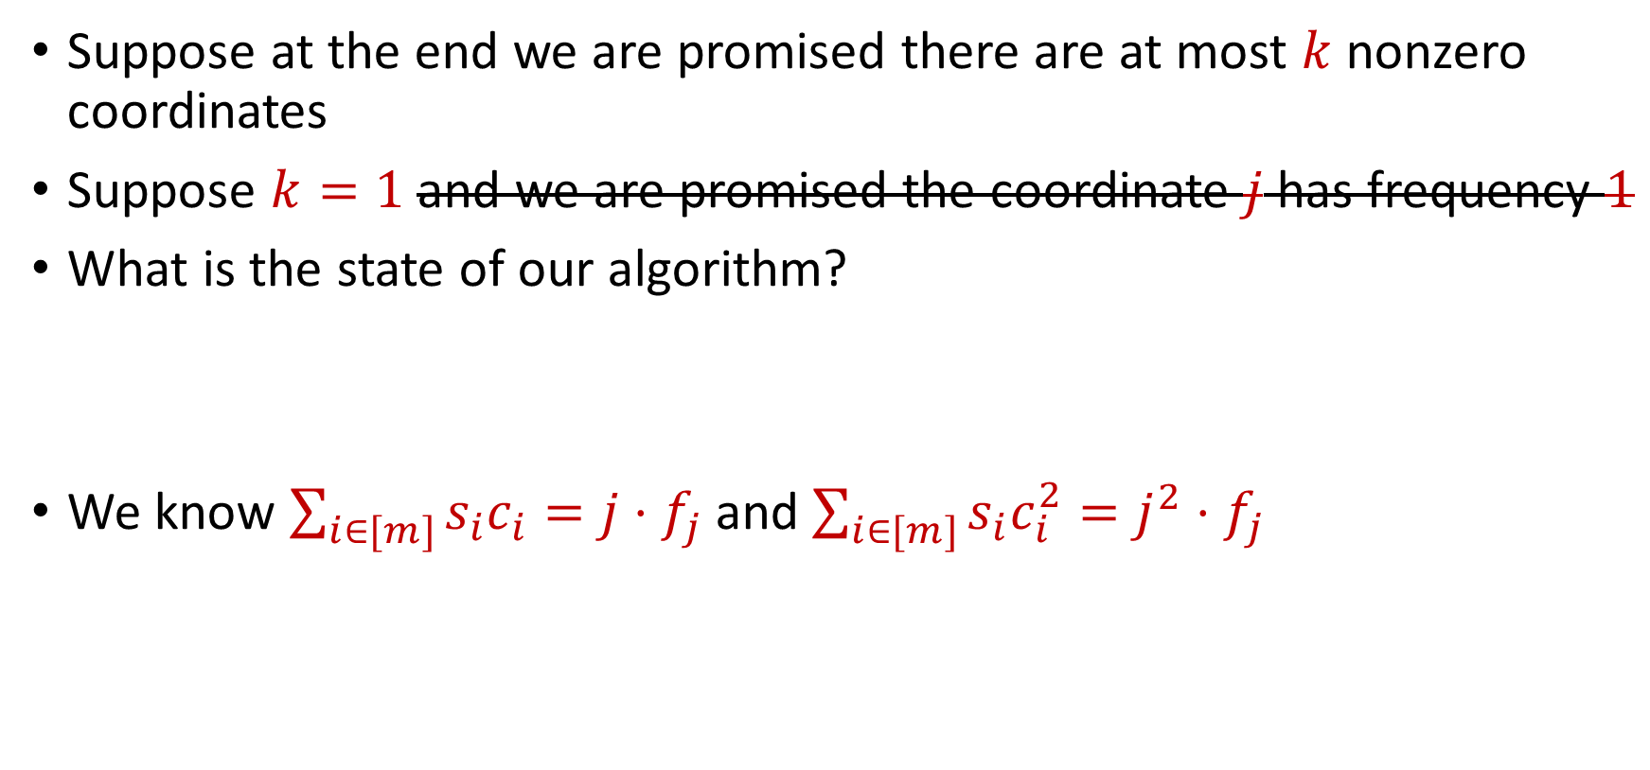
Sparse Recovery
Suppose at the end we are promised there are at most $k$ nonzero coordinates
Suppose $k=1$ and we are promised the coordinate $j$ has frequency $1$
What is the state of our algorithm?
We know $\sum_{i∈[m]}{s_{i}c_{i}}=j⋅f_{j}$ and $\sum_{i∈[m]}{s_{i}c_{i}^{2}=j^{2}⋅f_{j}}$
$\sum_{i∈[m]}{s_{i}c_{i}}=4$ and $\sum_{i∈[m]}{s_{i}c_{i}^{2}=8}$

Slide 59
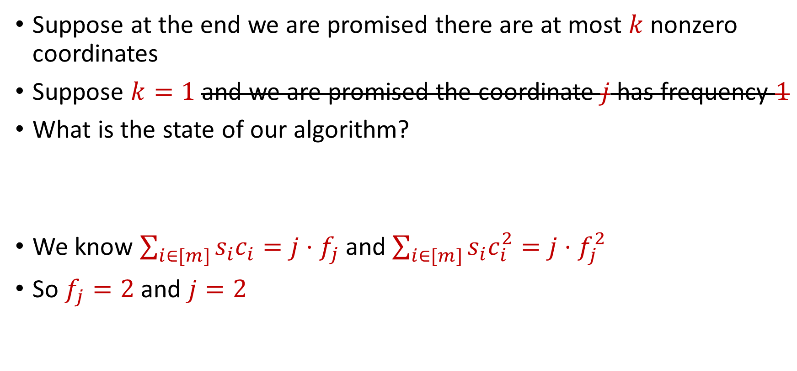
Sparse Recovery
Suppose at the end we are promised there are at most $k$ nonzero coordinates
Suppose $k=1$ and we are promised the coordinate $j$ has frequency $1$
What is the state of our algorithm?
We know $\sum_{i∈[m]}{s_{i}c_{i}}=j⋅f_{j}$ and $\sum_{i∈[m]}{s_{i}c_{i}^{2}=j⋅f_{j}^{2}}$
So $f_{j}=2$ and $j=2$
$\sum_{i∈[m]}{s_{i}c_{i}}=4$ and $\sum_{i∈[m]}{s_{i}c_{i}^{2}=8}$

Slide 60

Sparse Recovery
Suppose at the end we are promised there are at most $k$ nonzero coordinates
Suppose $k=1$ and we are promised the coordinate $j$ has frequency $1$
What is the state of our algorithm?
We know $\sum_{i∈[m]}{s_{i}c_{i}}=j⋅f_{j}$ and $\sum_{i∈[m]}{s_{i}c_{i}^{2}=j⋅f_{j}^{2}}$
So $f_{j}=2$ and $j=2$
$\sum_{i∈[m]}{s_{i}c_{i}}=4$ and $\sum_{i∈[m]}{s_{i}c_{i}^{2}=8}$
$f_{1}$ | $f_{2}$ | $f_{3}$ | $f_{4}$ | $f_{5}$ | $f_{6}$ | $f_{7}$
0 | 2 | 0 | 0 | 0 | 0 | 0

Slide 61

Sparse Recovery
Suppose at the end we are promised there are at most $k$ nonzero coordinates
Algorithm for $k=1$: Keep running sum of all the coordinates AND a different linear combination of all the coordinates

Slide 62
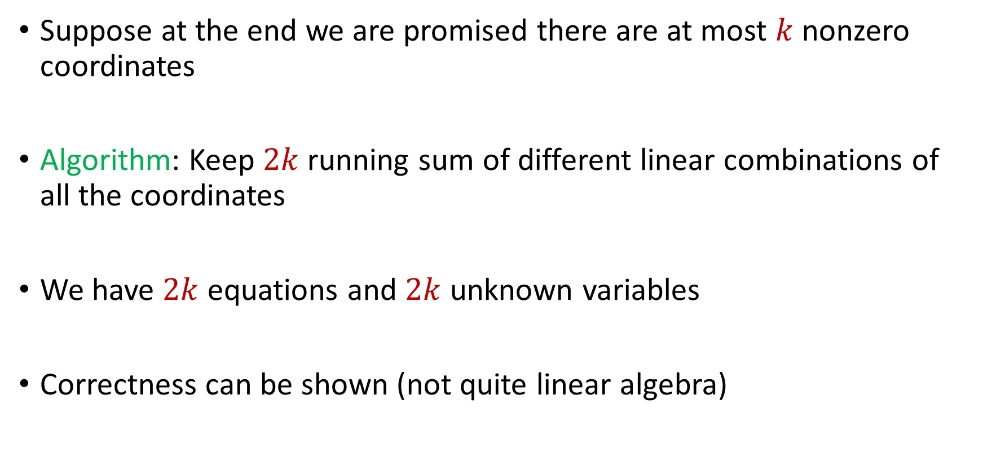
Sparse Recovery
Suppose at the end we are promised there are at most $k$ nonzero coordinates
Algorithm: Keep $2k$running sum of different linear combinations of all the coordinates
We have $2k$ equations and $2k$ unknown variables
Correctness can be shown (not quite linear algebra)

Slide 63
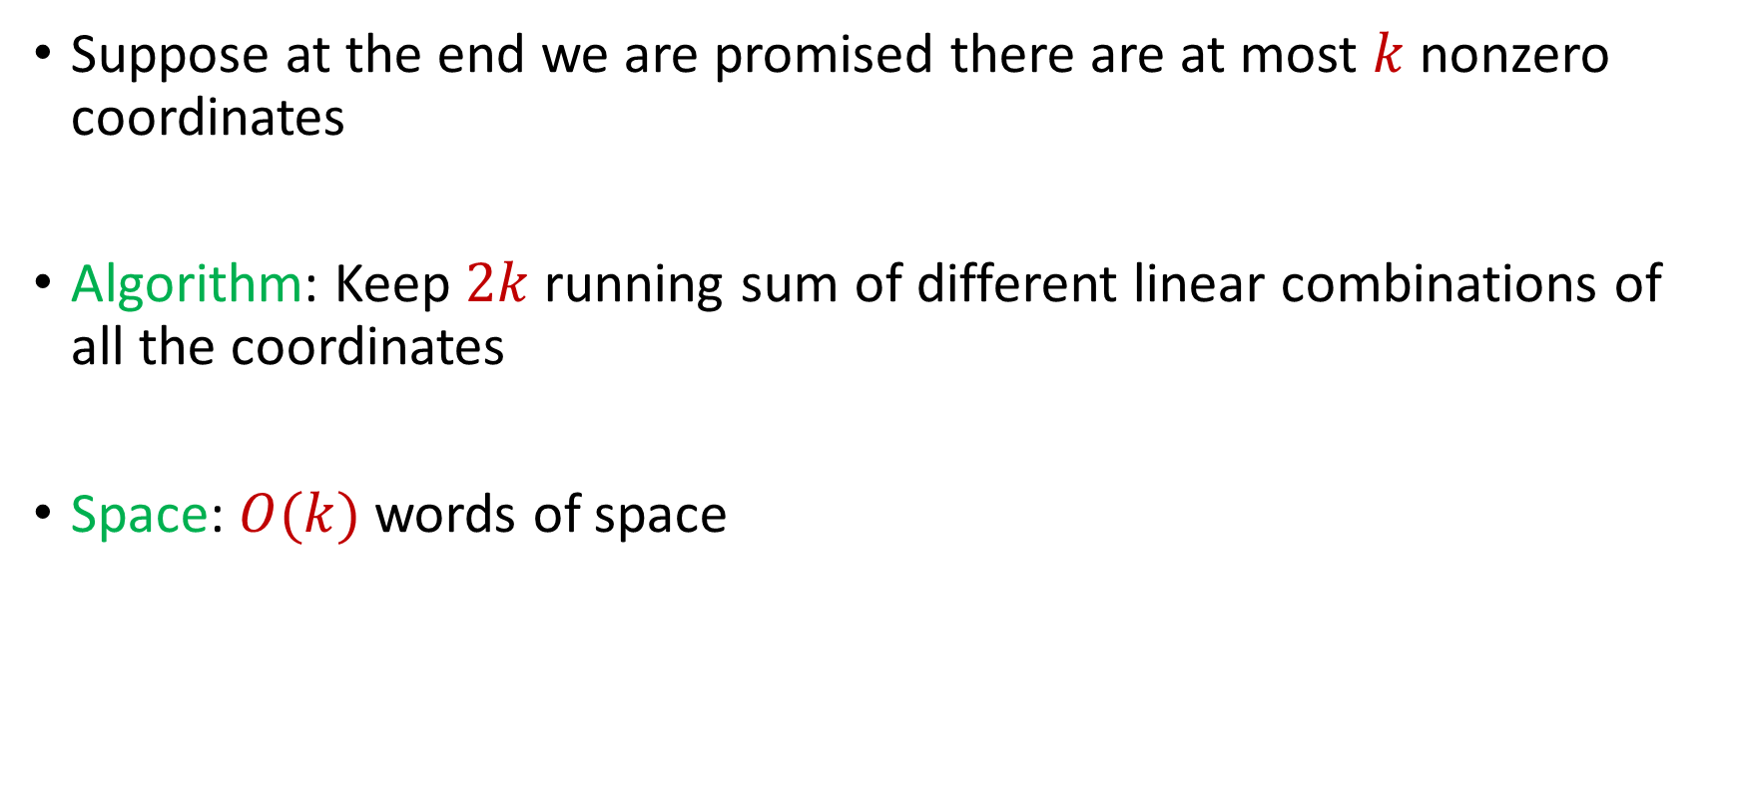
Sparse Recovery
Suppose at the end we are promised there are at most $k$ nonzero coordinates
Algorithm: Keep $2k$running sum of different linear combinations of all the coordinates
Space: $O(k)$ words of space

Slide 64
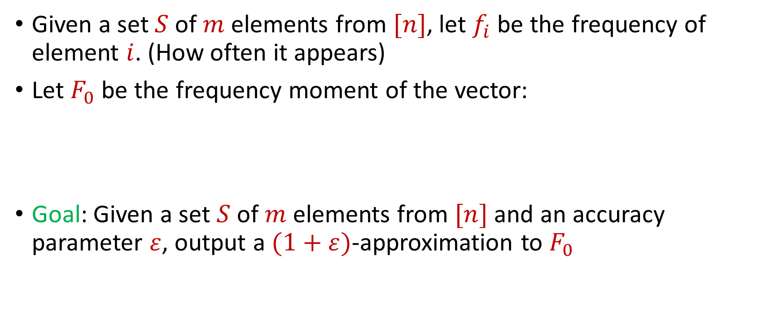

Distinct Elements ($F_{0}$ Estimation)
Given a set $S$ of $m$ elements from $[n]$, let $f_{i}$ be the frequency of element $i$. (How often it appears)
Let $F_{0}$ be the frequency moment of the vector:
Goal: Given a set $S$ of $m$ elements from $[n]$ and an accuracy parameter $ε$, output a $(1+ε)$-approximation to $F_{0}$
$F_{0}=$ $|\{i :f_{i}≠0\}|$

Slide 65



Slide 66


Slide 67


Slide 68


Slide 69


Slide 70


Slide 71


Slide 75


Slide 84


Slide 85
Distinct Elements ($F_{0}$ Estimation)
How many different fruits left in fruit basket?

Slide 86
Distinct Elements ($F_{0}$ Estimation)
How many different fruits left in fruit basket? 8

Slide 87

Distinct Elements ($F_{0}$ Estimation)
Ad allocation: Distinct IP addresses clicking an ad

Slide 88
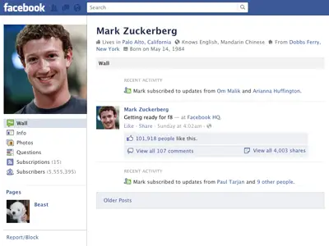
Distinct Elements ($F_{0}$ Estimation)
Traffic monitoring: Distinct IP addresses visiting a site or number of unique search engine queries
3 billion monthly active users

Slide 89
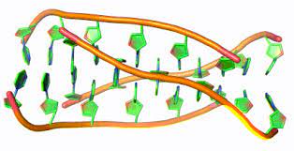
Distinct Elements ($F_{0}$ Estimation)
Computational biology: Counting number of distinct motifs in DNA sequencing
Sequence motifs are short, recurring patterns in DNA that are presumed to have a biological function

Slide 90

Distinct Elements ($F_{0}$ Estimation)
Let $S$ be a set of $N$ numbers
Suppose we form set $S′$ by sampling each item of $S$ with probability $\frac{1}{2}$
How many numbers are in $S′$?

Slide 91
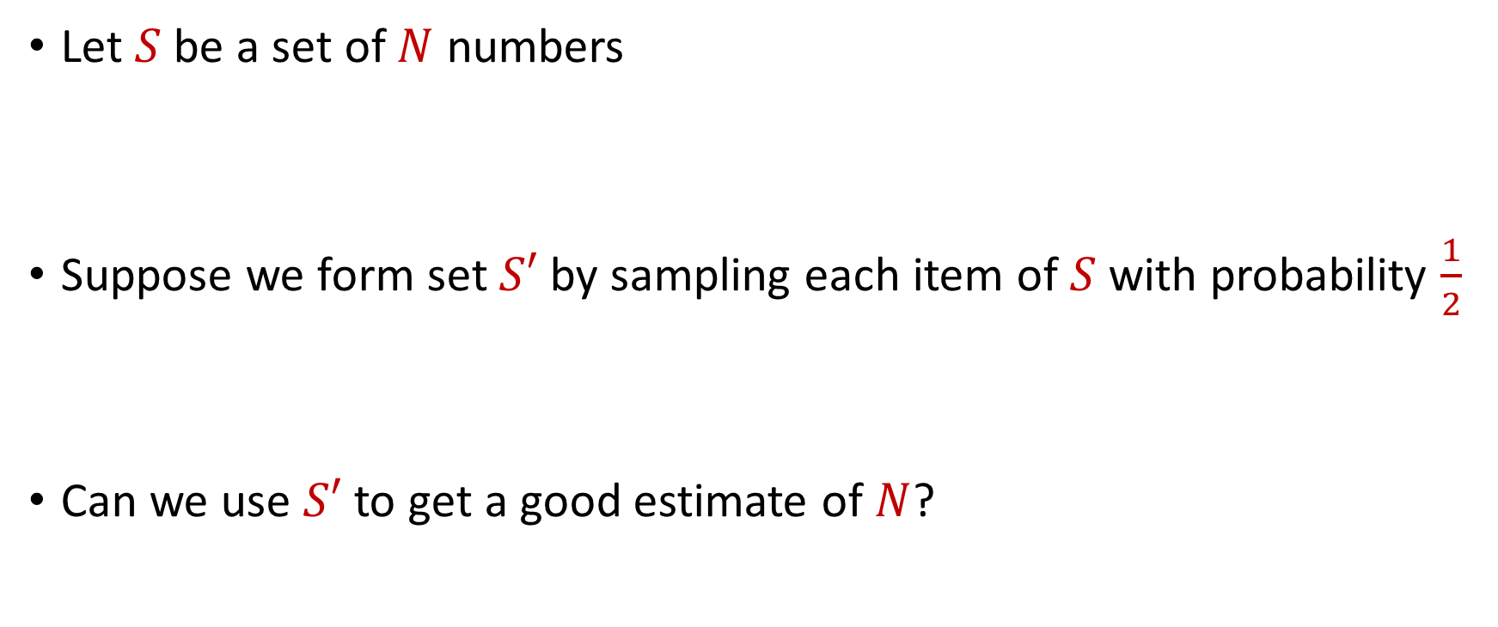
Distinct Elements ($F_{0}$ Estimation)
Let $S$ be a set of $N$ numbers
Suppose we form set $S′$ by sampling each item of $S$ with probability $\frac{1}{2}$
Can we use $S′$ to get a good estimate of $N$?

Slide 92
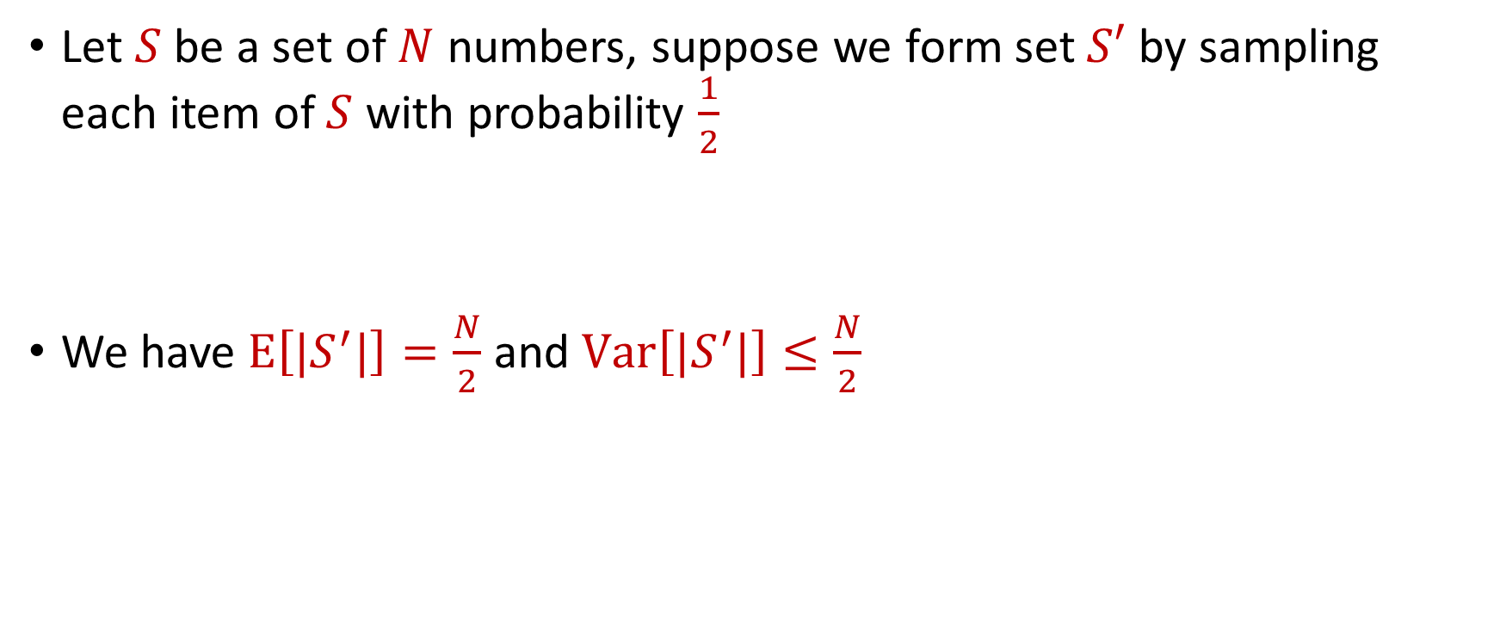
Distinct Elements ($F_{0}$ Estimation)
Let $S$ be a set of $N$ numbers, suppose we form set $S′$ by sampling each item of $S$ with probability $\frac{1}{2}$
We have $E\left[|S^{′}|\right]=\frac{N}{2}$ and $Var\left[|S^{′}|\right]≤\frac{N}{2}$

Slide 93

Distinct Elements ($F_{0}$ Estimation)
What can we say about $Pr\left[\left|\left|S^{′}\right|−\frac{N}{2}\right|≥t\right]$?
By Chebyshev’s inequality, we have $Pr\left[\left|\left|S^{′}\right|−\frac{N}{2}\right|≥100\sqrt{N}\right]≤\frac{1}{10}$

Slide 94
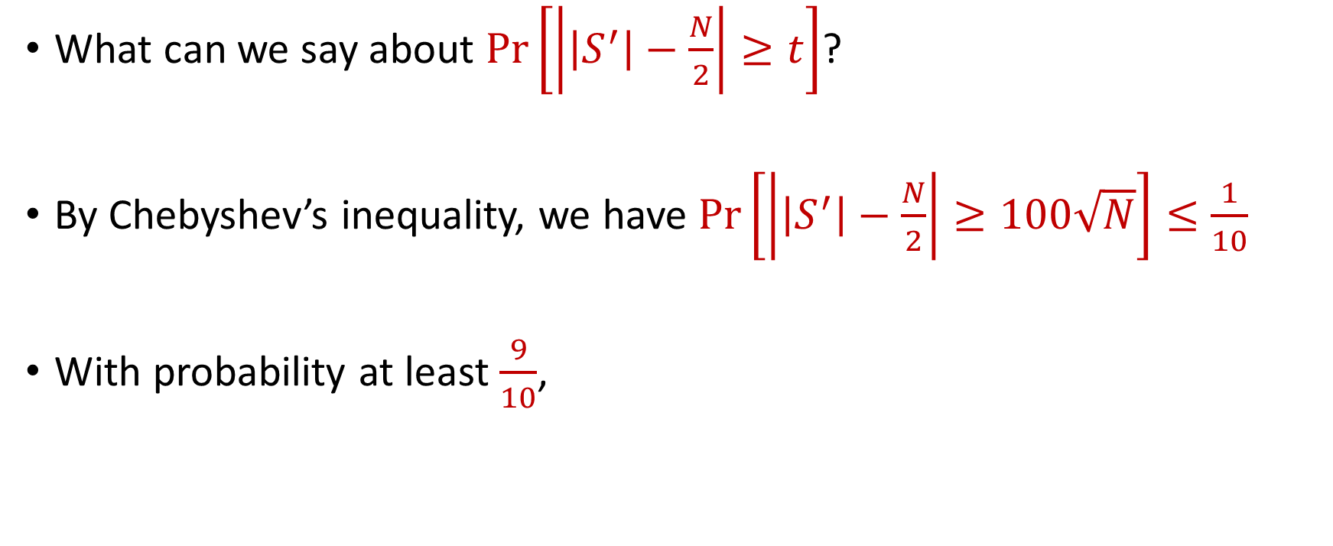
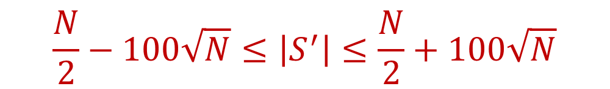
Distinct Elements ($F_{0}$ Estimation)
What can we say about $Pr\left[\left|\left|S^{′}\right|−\frac{N}{2}\right|≥t\right]$?
By Chebyshev’s inequality, we have $Pr\left[\left|\left|S^{′}\right|−\frac{N}{2}\right|≥100\sqrt{N}\right]≤\frac{1}{10}$
With probability at least $\frac{9}{10}$,
$$\frac{N}{2}−100\sqrt{N}≤\left|S^{′}\right|≤\frac{N}{2}+100\sqrt{N}$$

Slide 95

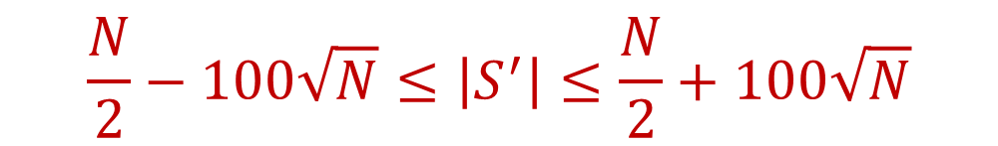
Distinct Elements ($F_{0}$ Estimation)
With probability at least $\frac{9}{10}$,
Thus with probability at least $\frac{9}{10}$,
$$\frac{N}{2}−100\sqrt{N}≤\left|S^{′}\right|≤\frac{N}{2}+100\sqrt{N}$$
$$N−200\sqrt{N}≤2\left|S^{′}\right|≤N+200\sqrt{N}$$

