Slide 1
CSCE 689: Special Topics in Modern Algorithms for Data Science
Lecture 25
Samson Zhou

Slide 2
Presentation Schedule
November 27: Chunkai, Jung, Galaxy AI
November 29: STMI, Anmol, Jason
December 1: Bokun, Ayesha, Dawei, Lipai

Slide 3
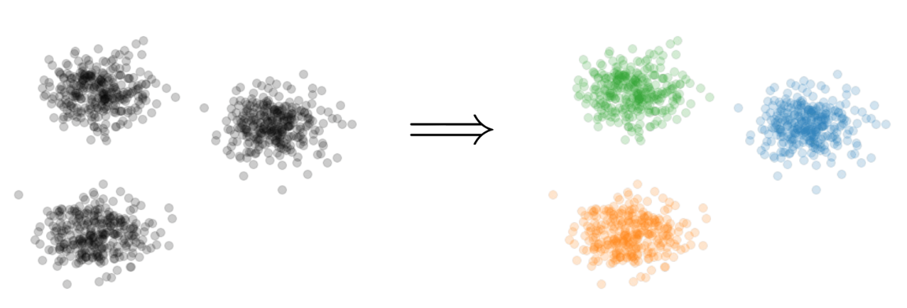


Previously: $k$-Clustering
Goal: Given input dataset $X$, partition $X$ so that “similar” points are in the same cluster and “different” points are in different clusters
There can be at most $k$ different clusters
$$k=3$$

Slide 4

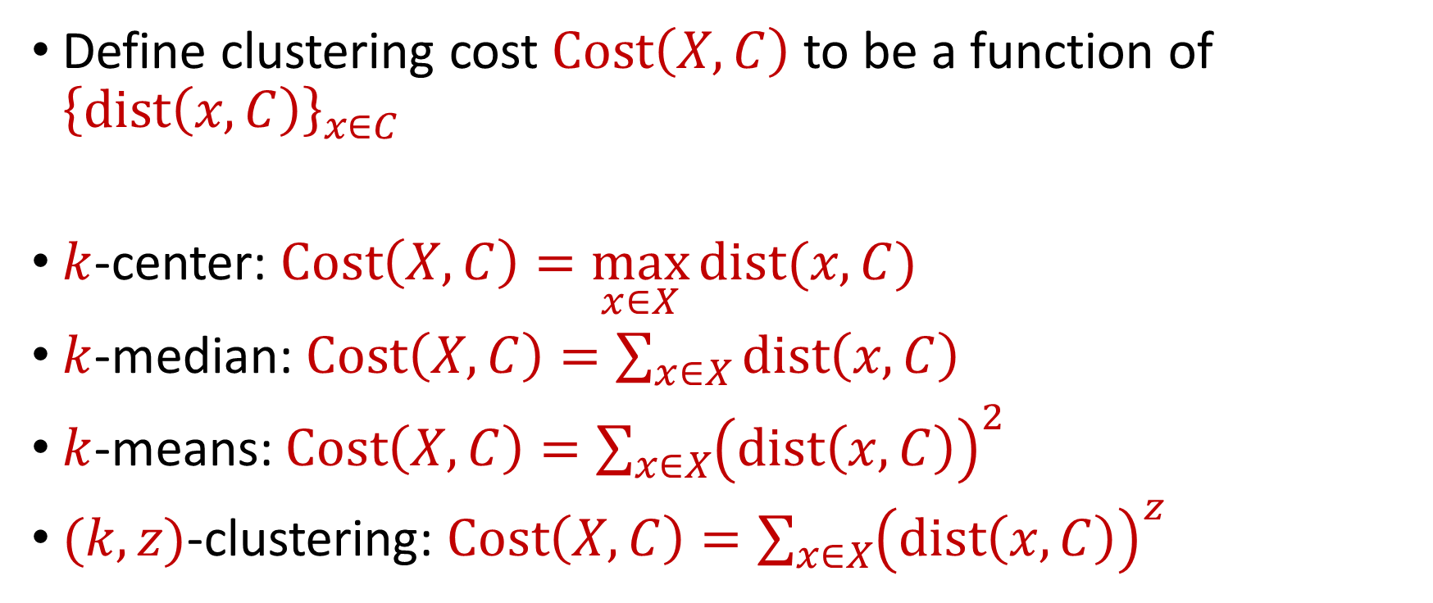






Previously: $k$-Clustering
Define clustering cost $Cost\left(X,C\right)$ to be a function of ${\left\{dist\left(x,C\right)\right\}}_{x∈C}$
$k$-center: $Cost\left(X,C\right)=\max_{x∈X}{dist(x,C)}$
$k$-median: $Cost\left(X,C\right)=\sum_{x∈X}{dist\left(x,C\right)}$
$k$-means: $Cost\left(X,C\right)=\sum_{x∈X}{{\left(dist\left(x,C\right)\right)}^{2}}$
$(k,z)$-clustering: $Cost\left(X,C\right)=\sum_{x∈X}{{\left(dist\left(x,C\right)\right)}^{z}}$
$${\left(⋅\right)}^{z}$$
$${\left(⋅\right)}^{z}$$
$${\left(⋅\right)}^{z}$$
$${\left(⋅\right)}^{z}$$
$${\left(⋅\right)}^{z}$$
$${\left(⋅\right)}^{z}$$
$${\left(⋅\right)}^{z}$$

Slide 5
Previously: Coreset
Subset $X′$ of representative points of $X$ for a specific clustering objective
$Cost\left(X,C\right)≈Cost(X^{′},C)$ for all sets $C$ with $\left|C\right|=k$

Slide 6
Previously: Coreset
Given a set $X$ and an accuracy parameter $ε>0$, we say a set $X′$ with weight function $w$is an $(1+ε)$-multiplicative coreset for a cost function $Cost$, if for all queries $C$ with $\left|C\right|≤k$, we have
$$\left(1−ε\right)Cost(X,C)≤Cost(X′,C,w)≤\left(1+ε\right)Cost(X,C)$$
$(k,z)$-clustering: $Cost\left(X^{′},C,w\right)=\sum_{x∈X′}{{w\left(x\right)⋅\left(dist\left(x,C\right)\right)}^{z}}$

Slide 7


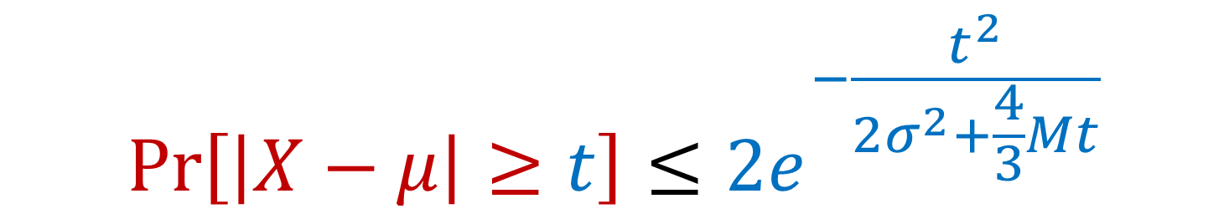
Previously: Bernstein’s Inequality
Bernstein’s inequality: Let $X_{1},…,X_{n}∈[−M,M]$ be independent random variables and let ${X=X}_{1}+…+X_{n}$ have mean $μ$ and variance $σ^{2}$. Then for any $t≥0$:
Example: Suppose $M=1$ and let $t=kσ$. Then
$$Pr\left[\left|X−μ\right|≥t\right]≤2e^{−\frac{t^{2}}{2σ^{2}+\frac{4}{3}Mt}}$$
$$Pr\left[\left|X−μ\right|≥kσ\right]≤2exp\left(−\frac{k^{2}}{4}\right)$$

Slide 8
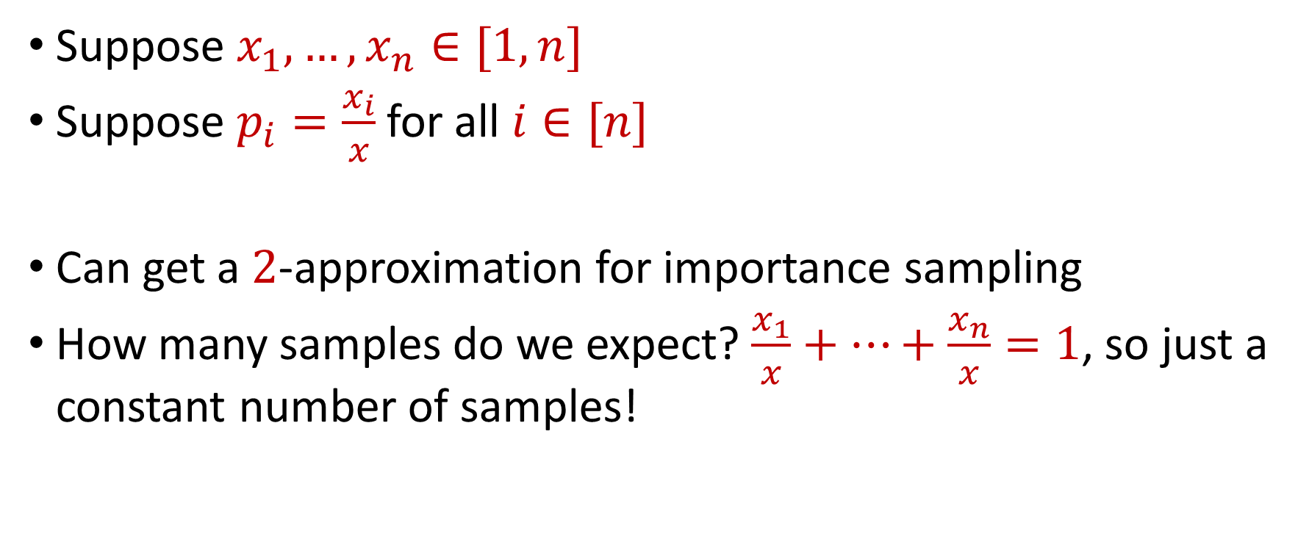
Previously: Importance Sampling for Sum Estimation
Suppose $x_{1},…,x_{n}∈[1,n]$
Suppose $p_{i}=\frac{x_{i}}{x}$ for all $i∈[n]$
Can get a $2$-approximation for importance sampling
How many samples do we expect? $\frac{x_{1}}{x}+…+\frac{x_{n}}{x}=1$, so just a constant number of samples!

Slide 9
Last Time: Coreset Construction and Sampling
Consider a fixed set $X$ and a fixed set $C$ of $k$ centers, which induces a fixed cost $Cost(X,C)$
Uniform sampling needs a lot of samples if there is a single point that greatly contributes to $Cost(X,C)$

Slide 10
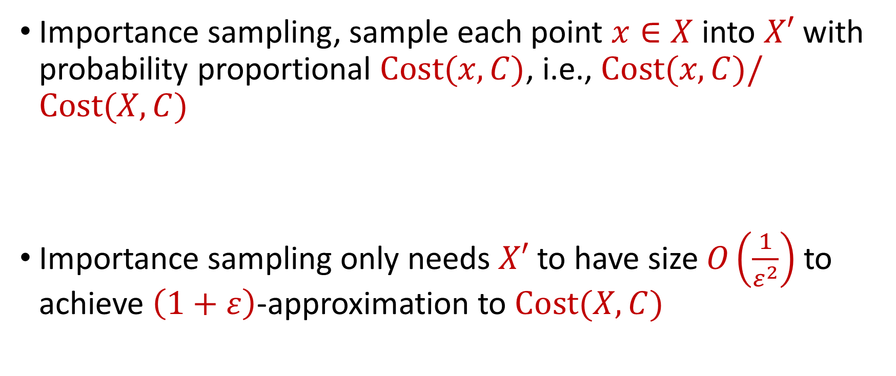
Last Time: Coreset Construction and Sampling
Importance sampling, sample each point $x∈X$ into $X′$ with probability proportional $Cost(x,C)$, i.e., $Cost(x,C)/Cost(X,C)$
Importance sampling only needs $X′$ to have size $O\left(\frac{1}{ε^{2}}\right)$ to achieve $\left(1+ε\right)$-approximation to $Cost(X,C)$

Slide 11
Last Time: Coreset Construction and Sampling
Importance sampling only needs $X′$ to have size $O\left(\frac{1}{ε^{2}}\right)$ to achieve $\left(1+ε\right)$-approximation to $Cost(X,C)$
What about a different choice $C$ of $k$ centers?

Slide 12

Last Time: Coreset Construction and Sampling
Importance sampling only needs $X′$ to have size $O\left(\frac{1}{ε^{2}}\right)$ to achieve $\left(1+ε\right)$-approximation to $Cost(X,C)$
To handle all possible sets of $k$ centers:
Need to sample each point $x$ with probability $\max_{C}\frac{Cost\left(x,C\right)}{Cost\left(X,C\right)}$ instead of $\frac{Cost\left(x,C\right)}{Cost\left(X,C\right)}$
Need to union bound over a net of all possible sets of $k$ centers
Net with size ${\left(\frac{nΔ}{ε}\right)}^{O(kd)}$

Slide 13
Last Time: Sensitivity Sampling
The quantity $s\left(x\right)=\max_{C}\frac{Cost\left(x,C\right)}{Cost\left(X,C\right)}$ is called the sensitivity of $x$ and intuitively measures how “important” the point $x$ is
The total sensitivity of $X$ is $\sum_{x∈X}{s(x)}$ and quantifies how many points will be sampled into $X′$ through importance/sensitivity sampling (before the union bound)

Slide 14
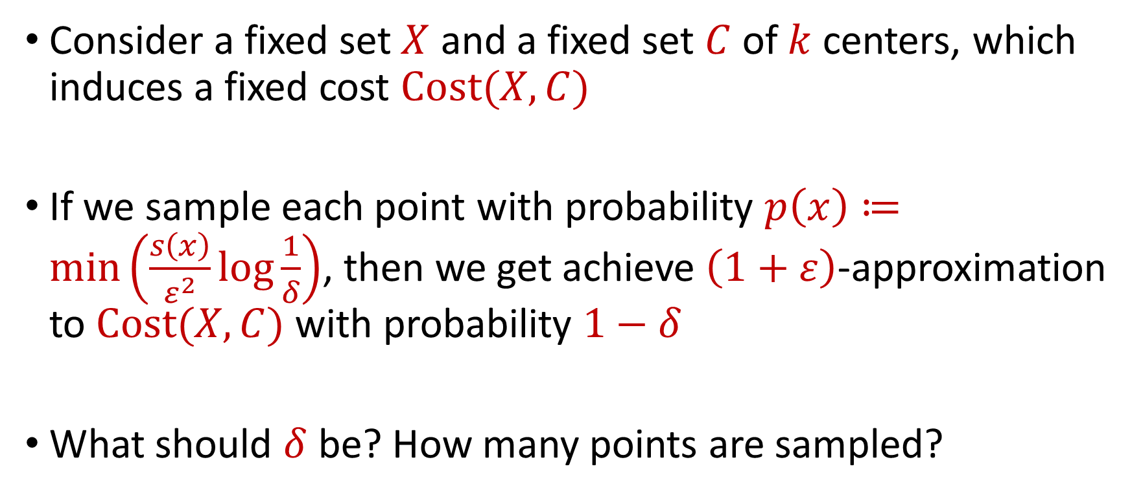
Putting Things Together
Consider a fixed set $X$ and a fixed set $C$ of $k$ centers, which induces a fixed cost $Cost(X,C)$
If we sample each point with probability $p\left(x\right)≔\min\left(\frac{s\left(x\right)}{ε^{2}}log\frac{1}{δ}\right)$, then we get achieve $\left(1+ε\right)$-approximation to $Cost(X,C)$ with probability $1−δ$
What should $δ$ be? How many points are sampled?

Slide 15
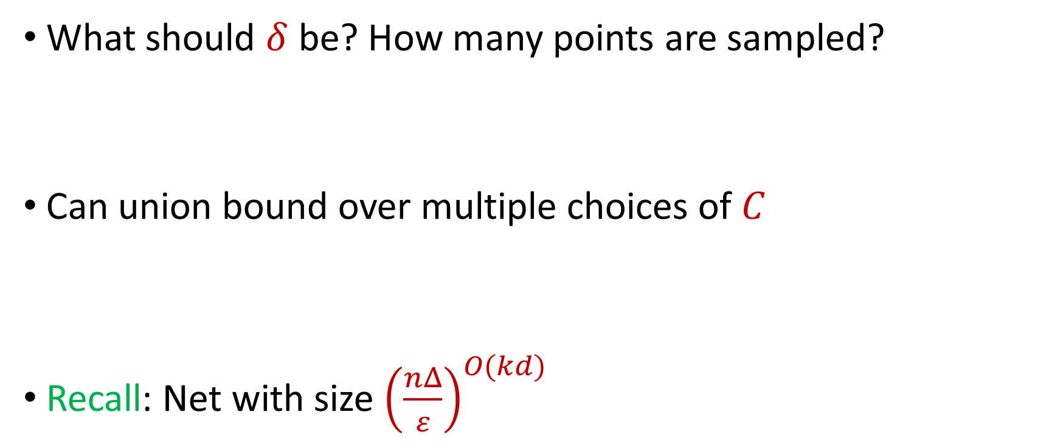
Putting Things Together
What should $δ$ be? How many points are sampled?
Can union bound over multiple choices of $C$
Recall: Net with size ${\left(\frac{nΔ}{ε}\right)}^{O(kd)}$

Slide 16
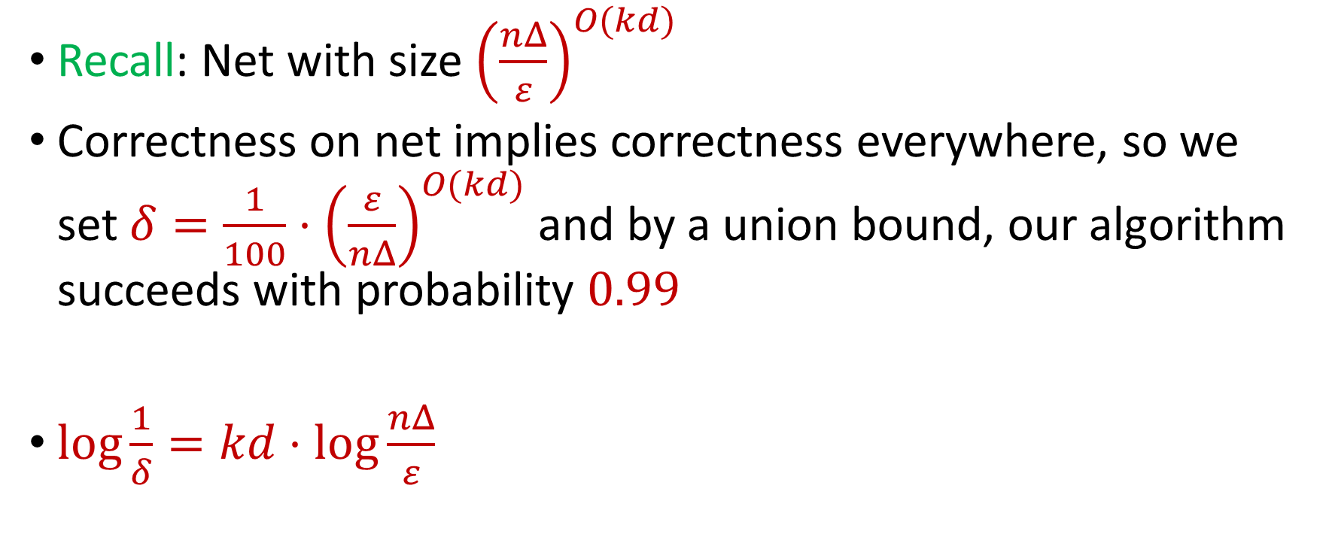
Putting Things Together
Recall: Net with size ${\left(\frac{nΔ}{ε}\right)}^{O(kd)}$
Correctness on net implies correctness everywhere, so we set $δ=\frac{1}{100}⋅{\left(\frac{ε}{nΔ}\right)}^{O(kd)}$ and by a union bound, our algorithm succeeds with probability $0.99$
$\log{\frac{1}{δ}}=kd⋅\log{\frac{nΔ}{ε}}$

Slide 17
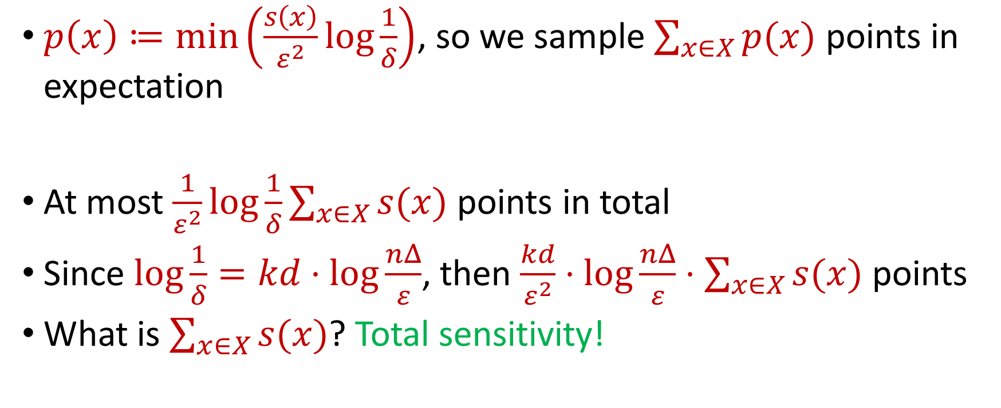
Putting Things Together
$p\left(x\right)≔\min\left(\frac{s\left(x\right)}{ε^{2}}log\frac{1}{δ}\right)$, so we sample $\sum_{x∈X}{p(x)}$ points in expectation
At most $\frac{1}{ε^{2}}log\frac{1}{δ}\sum_{x∈X}{s(x)}$ points in total
Since $\log{\frac{1}{δ}}=kd⋅\log{\frac{nΔ}{ε}}$, then $\frac{kd}{ε^{2}}⋅\log{\frac{nΔ}{ε}}⋅\sum_{x∈X}{s(x)}$ points
What is $\sum_{x∈X}{s(x)}$? Total sensitivity!

Slide 18

$$s\left(x_{t}\right)=\max_{C:\left|C\right|≤k}{\frac{Cost\left(x_{t},C\right)}{Cost\left(X,C\right)}}=\max_{C:\left|C\right|≤k}{\frac{Cost\left(x_{t},C\right)}{\sum_{i=1}^{n}{Cost\left(x_{i},C\right)}}}$$

Slide 19
$$s\left(x_{t}\right)=\max_{C:\left|C\right|≤k}{\frac{Cost\left(x_{t},C\right)}{Cost\left(X,C\right)}}=\max_{C:\left|C\right|≤k}{\frac{Cost\left(x_{t},C\right)}{\sum_{i=1}^{n}{Cost\left(x_{i},C\right)}}}$$
Point has sensitivity $1$

Slide 20
$$s\left(x_{t}\right)=\max_{C:\left|C\right|≤k}{\frac{Cost\left(x_{t},C\right)}{Cost\left(X,C\right)}}=\max_{C:\left|C\right|≤k}{\frac{Cost\left(x_{t},C\right)}{\sum_{i=1}^{n}{Cost\left(x_{i},C\right)}}}$$
Point has sensitivity $1$
Point has sensitivity $1$

Slide 21
$$s\left(x_{t}\right)=\max_{C:\left|C\right|≤k}{\frac{Cost\left(x_{t},C\right)}{Cost\left(X,C\right)}}=\max_{C:\left|C\right|≤k}{\frac{Cost\left(x_{t},C\right)}{\sum_{i=1}^{n}{Cost\left(x_{i},C\right)}}}$$
Point has sensitivity $1$
Point has sensitivity $1$
Point has sensitivity $1$

Slide 22
$$s\left(x_{t}\right)=\max_{C:\left|C\right|≤k}{\frac{Cost\left(x_{t},C\right)}{Cost\left(X,C\right)}}=\max_{C:\left|C\right|≤k}{\frac{Cost\left(x_{t},C\right)}{\sum_{i=1}^{n}{Cost\left(x_{i},C\right)}}}$$
Point has sensitivity $1$
Point has sensitivity $1$
Point has sensitivity $1$
Point has sensitivity $1$

Slide 23
$$s\left(x_{t}\right)=\max_{C:\left|C\right|≤k}{\frac{Cost\left(x_{t},C\right)}{Cost\left(X,C\right)}}=\max_{C:\left|C\right|≤k}{\frac{Cost\left(x_{t},C\right)}{\sum_{i=1}^{n}{Cost\left(x_{i},C\right)}}}$$
Point has sensitivity $1$
Point has sensitivity $1$
Point has sensitivity $1$
Point has sensitivity $1$
Point has sensitivity $1$

Slide 24
$$s\left(x_{t}\right)=\max_{C:\left|C\right|≤k}{\frac{Cost\left(x_{t},C\right)}{Cost\left(X,C\right)}}=\max_{C:\left|C\right|≤k}{\frac{Cost\left(x_{t},C\right)}{\sum_{i=1}^{n}{Cost\left(x_{i},C\right)}}}$$
Point has sensitivity $1$
Point has sensitivity $1$
Point has sensitivity $1$
Point has sensitivity $1$
Point has sensitivity $1$
Point has sensitivity $1$

Slide 25
$$s\left(x_{t}\right)=\max_{C:\left|C\right|≤k}{\frac{Cost\left(x_{t},C\right)}{Cost\left(X,C\right)}}=\max_{C:\left|C\right|≤k}{\frac{Cost\left(x_{t},C\right)}{\sum_{i=1}^{n}{Cost\left(x_{i},C\right)}}}$$
Point has sensitivity $1$
Point has sensitivity $1$
Point has sensitivity $1$
Point has sensitivity $1$
Point has sensitivity $1$
Point has sensitivity $1$
Point has sensitivity $1$

Slide 26

Total Sensitivity
Total sensitivity = Sum of sensitivities can be at least $k$
How large can it be?

Slide 27
$$s\left(x_{t}\right)=\max_{C:\left|C\right|≤k}{\frac{Cost\left(x_{t},C\right)}{Cost\left(X,C\right)}}=\max_{C:\left|C\right|≤k}{\frac{Cost\left(x_{t},C\right)}{\sum_{i=1}^{n}{Cost\left(x_{i},C\right)}}}$$

Slide 28
$$s\left(x_{t}\right)=\max_{C:\left|C\right|≤k}{\frac{Cost\left(x_{t},C\right)}{Cost\left(X,C\right)}}=\max_{C:\left|C\right|≤k}{\frac{Cost\left(x_{t},C\right)}{\sum_{i=1}^{n}{Cost\left(x_{i},C\right)}}}$$

Slide 29
$$s\left(x_{t}\right)=\max_{C:\left|C\right|≤k}{\frac{Cost\left(x_{t},C\right)}{Cost\left(X,C\right)}}=\max_{C:\left|C\right|≤k}{\frac{Cost\left(x_{t},C\right)}{\sum_{i=1}^{n}{Cost\left(x_{i},C\right)}}}$$

Slide 30
$$s\left(x_{t}\right)=\max_{C:\left|C\right|≤k}{\frac{Cost\left(x_{t},C\right)}{Cost\left(X,C\right)}}=\max_{C:\left|C\right|≤k}{\frac{Cost\left(x_{t},C\right)}{\sum_{i=1}^{n}{Cost\left(x_{i},C\right)}}}$$

Slide 31
$$s\left(x_{t}\right)=\max_{C:\left|C\right|≤k}{\frac{Cost\left(x_{t},C\right)}{Cost\left(X,C\right)}}=\max_{C:\left|C\right|≤k}{\frac{Cost\left(x_{t},C\right)}{\sum_{i=1}^{n}{Cost\left(x_{i},C\right)}}}$$
Partition the sum of the sensitivities by each cluster

Slide 32
$$s\left(x_{t}\right)=\max_{C:\left|C\right|≤k}{\frac{Cost\left(x_{t},C\right)}{Cost\left(X,C\right)}}=\max_{C:\left|C\right|≤k}{\frac{Cost\left(x_{t},C\right)}{\sum_{i=1}^{n}{Cost\left(x_{i},C\right)}}}$$
Charge to $OPT$
Charge to $OPT$

Slide 33
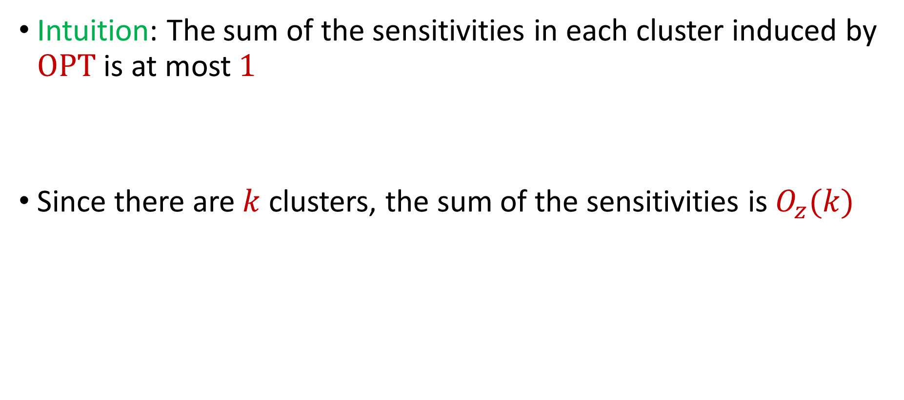
Total Sensitivity
Intuition: The sum of the sensitivities in each cluster induced by $OPT$ is at most $1$
Since there are $k$ clusters, the sum of the sensitivities is $O_{z}(k)$

Slide 34
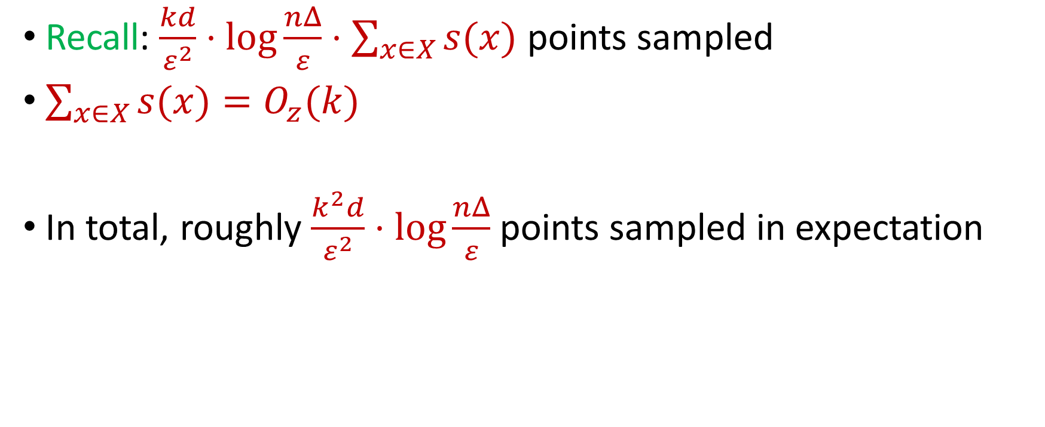
Putting Things Together
Recall: $\frac{kd}{ε^{2}}⋅\log{\frac{nΔ}{ε}}⋅\sum_{x∈X}{s(x)}$ points sampled
$\sum_{x∈X}{s(x)}=O_{z}(k)$
In total, roughly $\frac{k^{2}d}{ε^{2}}⋅\log{\frac{nΔ}{ε}}$ points sampled in expectation

Slide 35
How to Compute Sensitivities?
Estimations to sensitivities suffice
Bicriteria algorithms, e.g., online facility location

Slide 36






Linear Algebra Review
For $y=Ax$, we have $y_{i}=⟨a_{i}, x⟩$
${\left\|Ax\right\|}_{2}^{2}={\left\langle a_{1}, x\right\rangle }^{2}+…+{\left\langle a_{n}, x\right\rangle }^{2}$
$\left(1−ε\right){\left\|Ax\right\|}_{2}≤{\left\|Mx\right\|}_{2}≤\left(1+ε\right){\left\|Ax\right\|}_{2}$
$$A$$
$$x$$
$$d$$
$$n$$
$$d$$

Slide 37
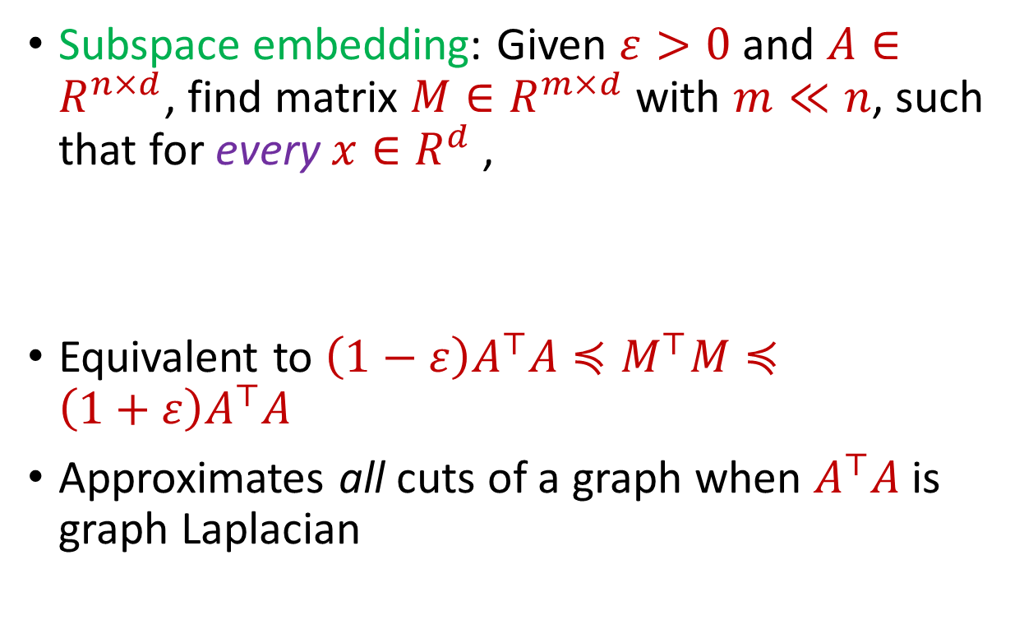


Subspace Embedding
Subspace embedding: Given $ε>0$ and $A∈R^{n×d}$, find matrix $M∈R^{m×d}$ with $m≪n$, such that for every $x∈R^{d}$,
Equivalent to $\left(1−ε\right)A^{⊤}A≼M^{⊤}M≼\left(1+ε\right)A^{⊤}A$
Approximates all cuts of a graph when $A^{⊤}A$ is graph Laplacian
$$A$$
$$x$$
$$n$$
$$\left(1−ε\right){\left\|Ax\right\|}_{2}≤{\left\|Mx\right\|}_{2}≤\left(1+ε\right){\left\|Ax\right\|}_{2}$$
$$d$$

Slide 38
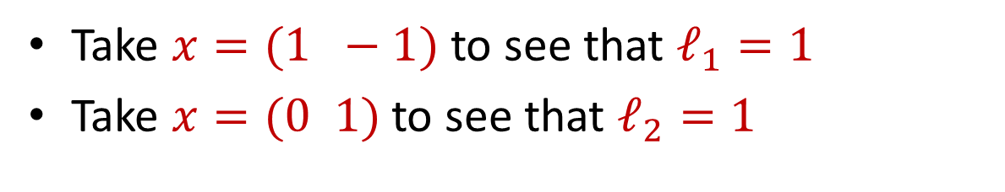
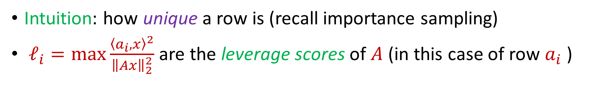
Leverage Scores
Intuition: how unique a row is (recall importance sampling)
$ℓ_{i}=\max{\frac{{\left\langle a_{i},x\right\rangle }^{2}}{{\left\|Ax\right\|}_{2}^{2}}}$ are the leverage scores of $A$ (in this case of row $a_{i}$ )
Take $x=(1 −1)$ to see that $ℓ_{1}=1$
Take $x=(0 1)$ to see that $ℓ_{2}=1$
1 0
1 1
$ℓ_{i}=a_{i}{\left(A^{⊤}A\right)}^{−1}a_{i}^{⊤}$, ${∑ℓ}_{i}=d$
$$A$$
$$a_{i}$$

Slide 39
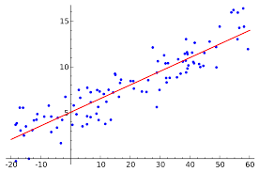

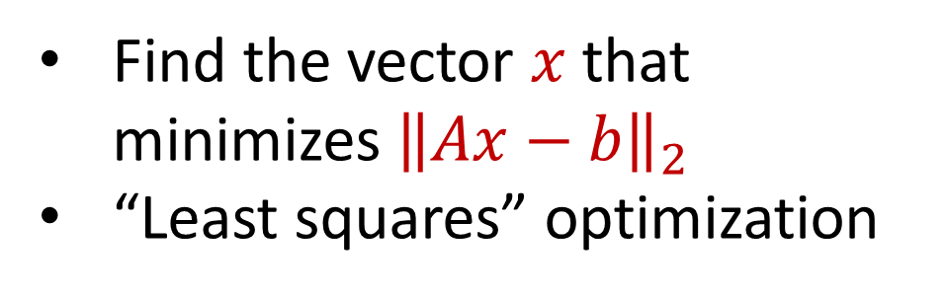


Linear Regression
Find the vector $x$ that minimizes ${\left\|Ax−b\right\|}_{2}$
“Least squares” optimization
$$d$$
$$x$$
$$≈$$
$$n$$
$$A$$
$$n$$
$$b$$
$$1$$
$$d$$
$$1$$

Slide 40


census.gov:

Slide 41


Private Data Analysis
Sensitive dataset
Analyst
Analysis of medical datasets to predict possible issues
Pattern detection for social networks or epidemic spread
US Census information for apportionment

Slide 42

Anonymization
Sensitive dataset
Anonymized dataset
Analyst

Slide 43
Anonymizing Data
Age | Zip Code | Employer | Has Pet
56 | 77005 | Apple | Yes
32 | 77005 | Microsoft | No
71 | 77005 | Amazon | Yes
44 | 77005 | Petsmart | Yes
25 | 77005 | Netflix | No
61 | 77005 | Google | No

Slide 44
Anonymizing Data
Age | Zip Code | Employer | Has Pet
56 | 77005 | Apple | Yes
32 | 77005 | Microsoft | No
71 | 77005 | Amazon | Yes
44 | 77005 | Petsmart | Yes
25 | 77005 | Netflix | No
61 | 77005 | Google | No
Name | Age | Gender | Employer
Alice | 56 | Female | Apple
Bob | 32 | Male | Microsoft
Carol | 71 | Female | Amazon
Dale | 44 | Male | Petsmart
Erin | 25 | Female | Netflix
Fred | 61 | Male | Google

Slide 45
Reconstruction Attack
Name | Age | Zip Code | Gender | Employer | Has Pet
Alice | 56 | 77005 | Female | Apple | Yes
Bob | 32 | 77005 | Male | Microsoft | No
Carol | 71 | 77005 | Female | Amazon | Yes
Dale | 44 | 77005 | Male | Petsmart | Yes
Erin | 25 | 77005 | Female | Netflix | No
Fred | 61 | 77005 | Male | Google | No

Slide 46

Anonymizing Data

Slide 47
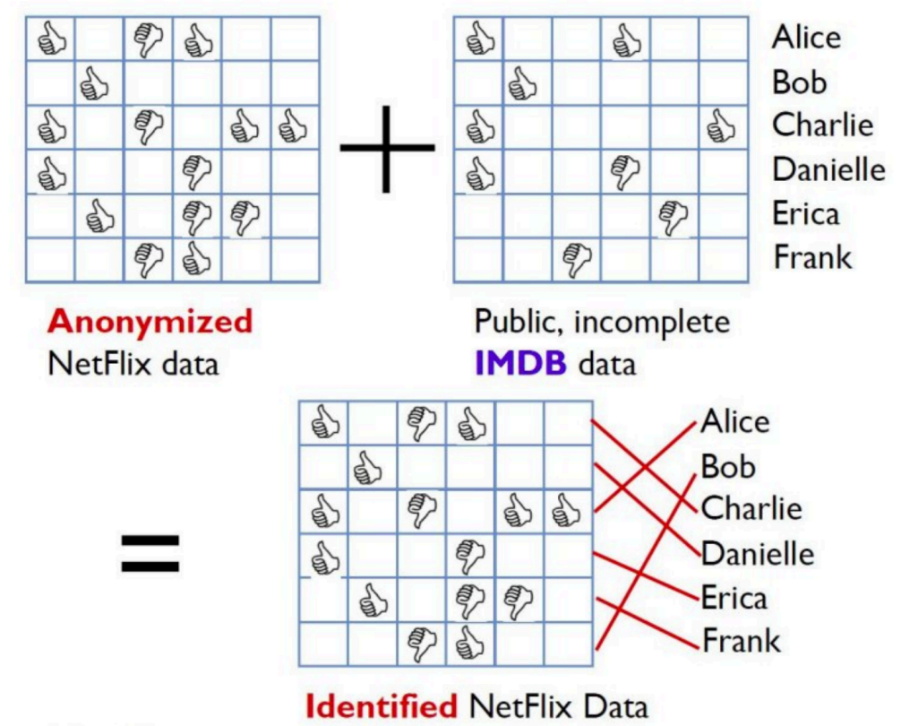
Image from Arvind Narayanan

Slide 48
Differencing Attacks
How many people in this classroom went to Kyle Field last weekend?
How many people in this classroom besides the instructor went to Kyle Field last weekend?

Slide 49
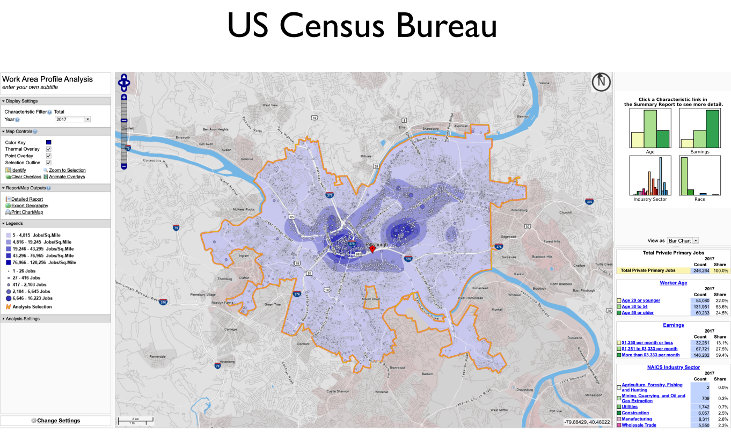
Slide from Steven Wu

Slide 50
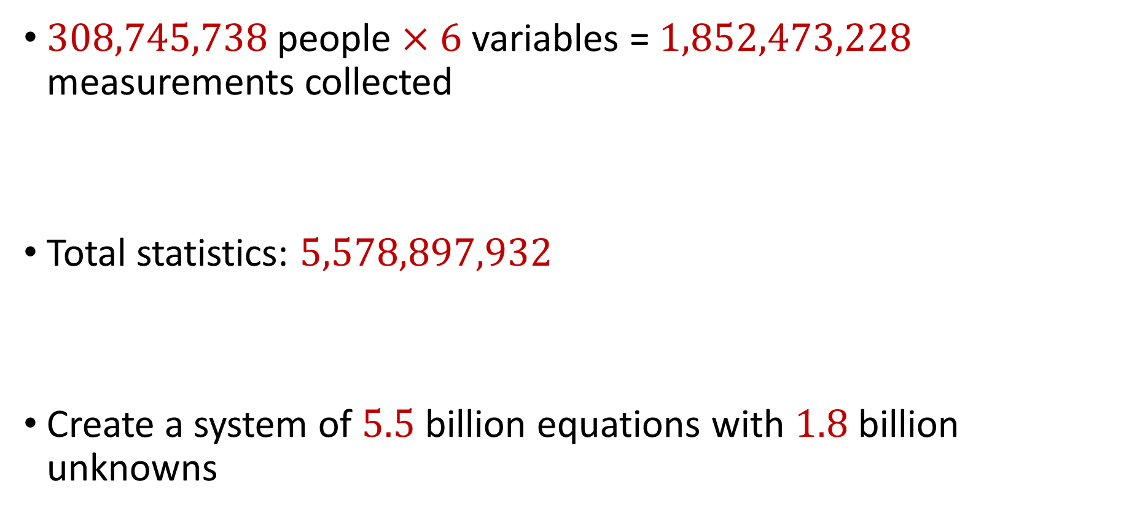
2010 US Census
$308,745,738$ people $×$ $6$ variables = $1,852,473,228$ measurements collected
Total statistics: $5,578,897,932$
Create a system of $5.5$ billion equations with $1.8$ billion unknowns

Slide 51
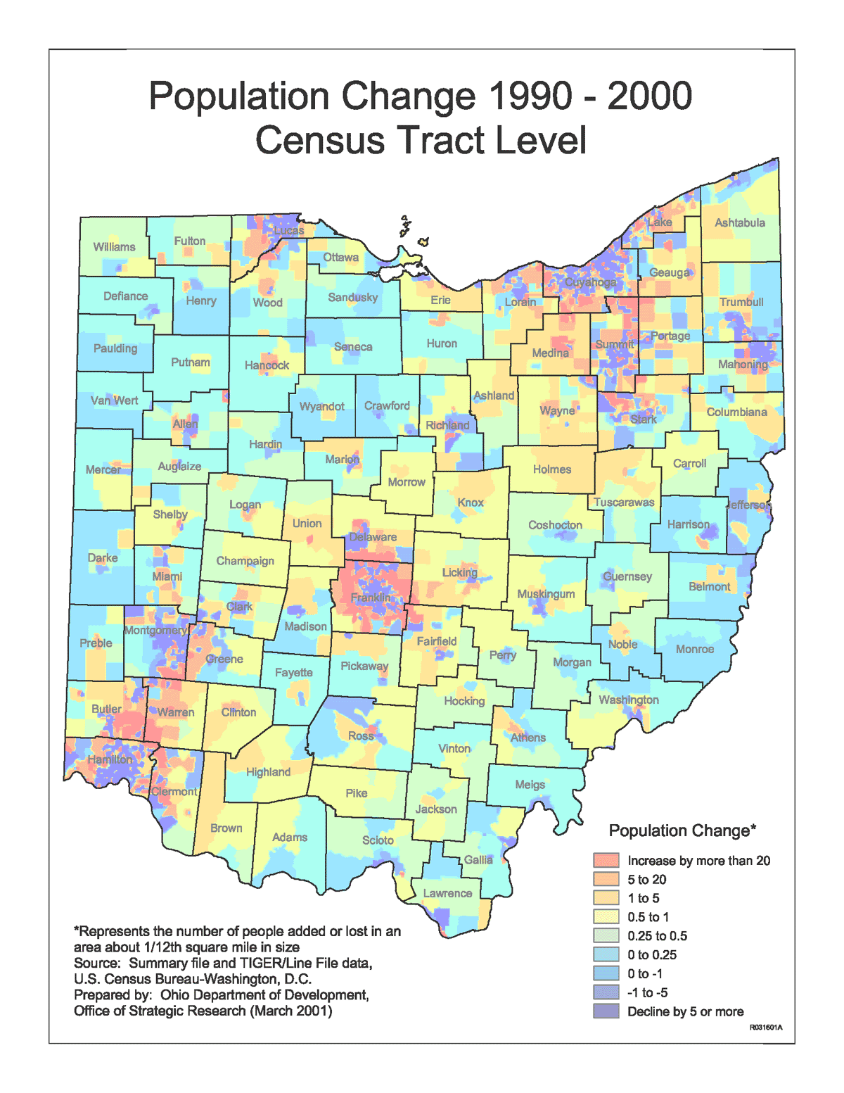
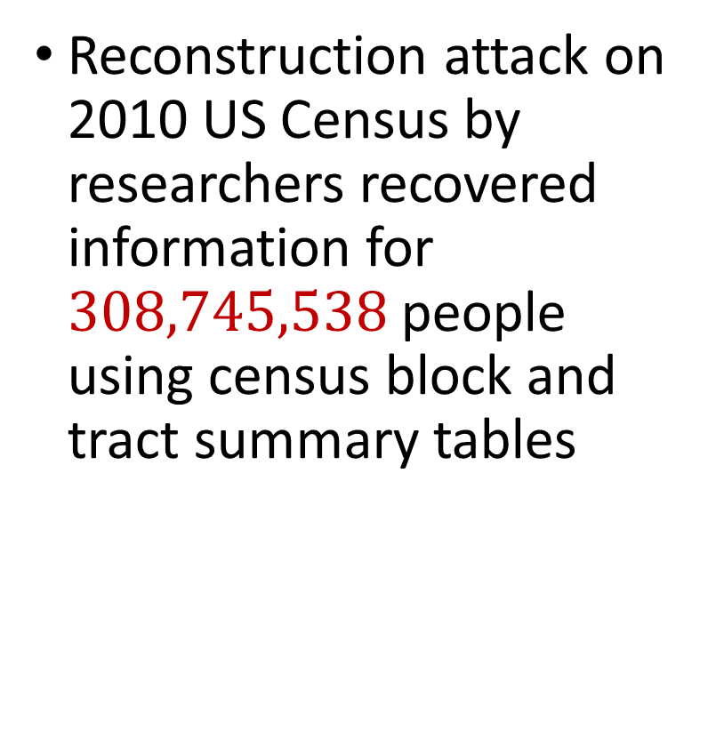
2010 US Census
Reconstruction attack on 2010 US Census by researchers recovered information for $308,745,538$ people using census block and tract summary tables

Slide 52
Summary
“Ad-hoc” privacy procedures like anonymization/deidentification often fails
Publishing too many queries on a sensitive database with too much accuracy can compromise the privacy of the database
Need a formal mathematical notion for measuring privacy

Slide 53

Possible Notion for Privacy #1
“The data analyst cannot learn anything about Alice”
Sensitive dataset
Analyst

Slide 54
Possible Notion for Privacy #1
“The data analyst cannot learn anything about Alice”
Most Aggies like Reveille
Alice is known to be an Aggie
Sensitive dataset
Analyst
Was Alice’s privacy violated?

Slide 55

Possible Notion for Privacy #1
“The data analyst cannot learn anything about Alice”
Most Aggies like Reveille
Bob participates in the survey
Sensitive dataset
Analyst
Even though Alice is not in the survey, it is still known that Alice is an Aggie

Slide 56
Possible Notion for Privacy #1
Suppose a survey is conducted on a sensitive dataset and concludes that “most Aggies like Reveille”
Alice is a known Aggie, and so a data analyst infers that Alice is more likely to be a dog owner and asks for higher apartment cleaning rates
Was Alice’s privacy violated by this study?

Slide 57
Possible Notion for Privacy #2
“A study is private…if the data analyst gains almost no additional information about Alice from the study than if the same study was performed without Alice’s data”

Slide 58

Possible Notion for Privacy #2
Stability: the data analyst reaches roughly similar conclusions if any individual data point is replaced by another data point of the population

Slide 59
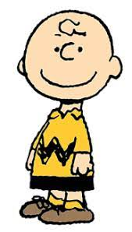

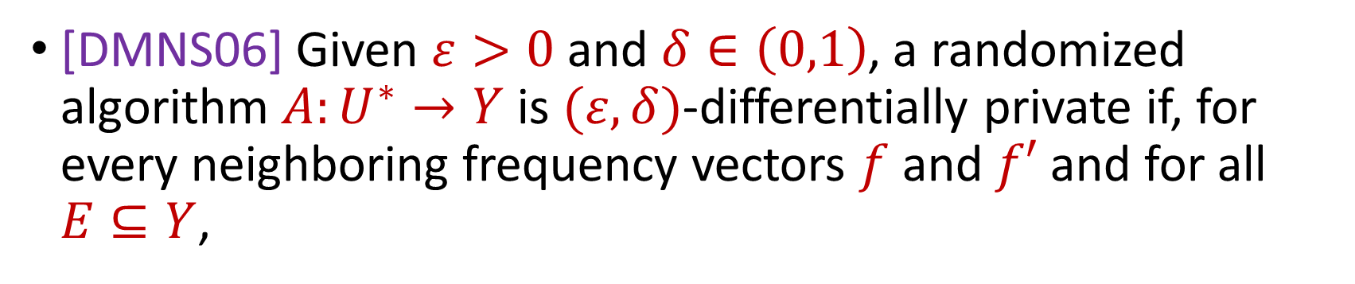

Differential Privacy
[DMNS06] Given $ε>0$and $δ∈\left(0,1\right)$, a randomized algorithm $A:U^{∗}→Y$ is $(ε,δ)$-differentially private if, for every neighboring frequency vectors $f$ and $f′$ and for all $E⊆Y$,
$$Pr\left[A\left(f\right)∈E\right]≤e^{ε}Pr\left[A\left(f^{′}\right)∈E\right]+δ$$
$$A\left( \right)≈A\left( \right)$$
Notes:
[DworkMcSherryNissimSmith06]

Slide 60
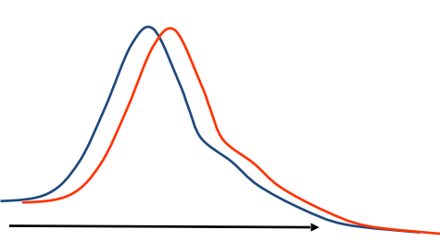
Differential Privacy
[DMNS06] Given $ε>0$and $δ∈\left(0,1\right)$, a randomized algorithm $A:U^{∗}→Y$ is $(ε,δ)$-differentially private if, for every neighboring frequency vectors $f$ and $f′$ and for all $E⊆Y$,
$$Pr\left[A\left(f\right)∈E\right]≤e^{ε}Pr\left[A\left(f^{′}\right)∈E\right]+δ$$
Sensitive dataset
Algorithm
Output distribution
Notes:
[DworkMcSherryNissimSmith06]

