Slide 1
CSCE 689: Special Topics in Modern Algorithms for Data Science
Lecture 31
Samson Zhou

Slide 2
Presentation Schedule
November 27: Chunkai, Jung, Galaxy AI
November 29: STMI, Anmol, Jason
December 1: Bokun, Ayesha, Dawei, Lipai

Slide 3

Previously: Coreset Construction and Sampling
Importance sampling only needs $X′$ to have size $O\left(\frac{1}{ε^{2}}\right)$ to achieve $\left(1+ε\right)$-approximation to $Cost(X,C)$
To handle all possible sets of $k$ centers:
Need to sample each point $x$ with probability $\max_{C}\frac{Cost\left(x,C\right)}{Cost\left(X,C\right)}$ instead of $\frac{Cost\left(x,C\right)}{Cost\left(X,C\right)}$
Need to union bound over a net of all possible sets of $k$ centers
Net with size ${\left(\frac{nΔ}{ε}\right)}^{O(kd)}$

Slide 4
Previously: Sensitivity Sampling
The quantity $s\left(x\right)=\max_{C}\frac{Cost\left(x,C\right)}{Cost\left(X,C\right)}$ is called the sensitivity of $x$ and intuitively measures how “important” the point $x$ is
The total sensitivity of $X$ is $\sum_{x∈X}{s(x)}$ and quantifies how many points will be sampled into $X′$ through importance/sensitivity sampling (before the union bound)

Slide 5
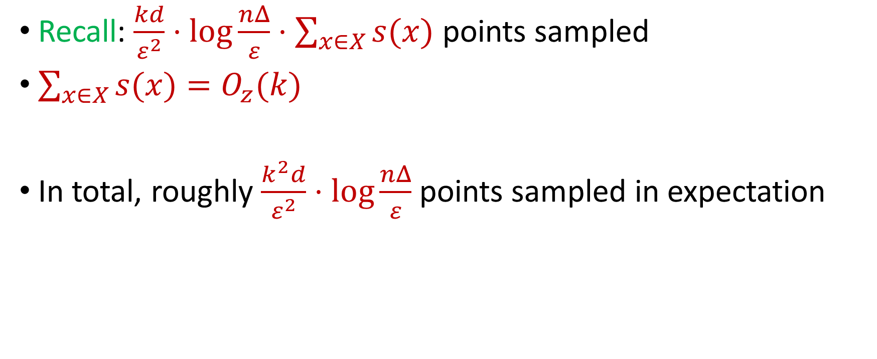
Previously: Sensitivity Sampling
Recall: $\frac{kd}{ε^{2}}⋅\log{\frac{nΔ}{ε}}⋅\sum_{x∈X}{s(x)}$ points sampled
$\sum_{x∈X}{s(x)}=O_{z}(k)$
In total, roughly $\frac{k^{2}d}{ε^{2}}⋅\log{\frac{nΔ}{ε}}$ points sampled in expectation

Slide 6






Linear Algebra Review
For $y=Ax$, we have $y_{i}=⟨a_{i}, x⟩$
${\left\|Ax\right\|}_{2}^{2}={\left\langle a_{1}, x\right\rangle }^{2}+…+{\left\langle a_{n}, x\right\rangle }^{2}$
$$A$$
$$x$$
$$d$$
$$n$$
$$d$$

Slide 7
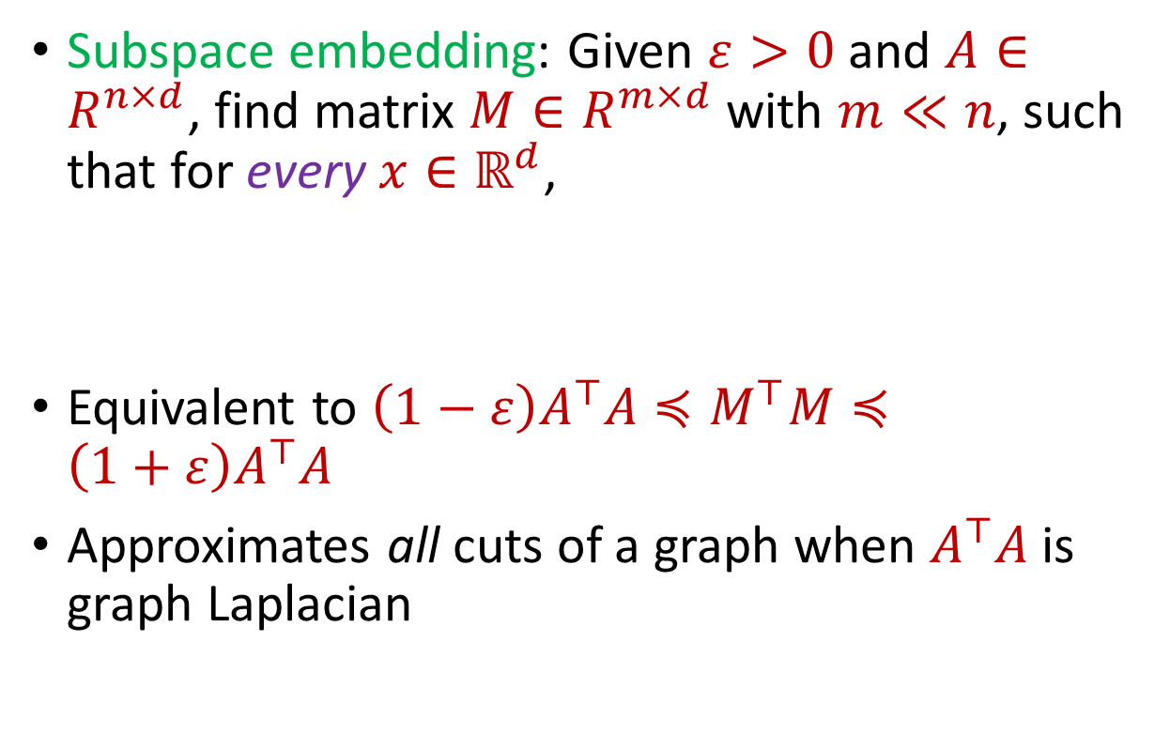


Subspace Embedding
Subspace embedding: Given $ε>0$ and $A∈R^{n×d}$, find matrix $M∈R^{m×d}$ with $m≪n$, such that for every $x∈ℝ^{d}$,
Equivalent to $\left(1−ε\right)A^{⊤}A≼M^{⊤}M≼\left(1+ε\right)A^{⊤}A$
Approximates all cuts of a graph when $A^{⊤}A$ is graph Laplacian
$$A$$
$$x$$
$$n$$
$$\left(1−ε\right){\left\|Ax\right\|}_{2}≤{\left\|Mx\right\|}_{2}≤\left(1+ε\right){\left\|Ax\right\|}_{2}$$
$$d$$

Slide 8
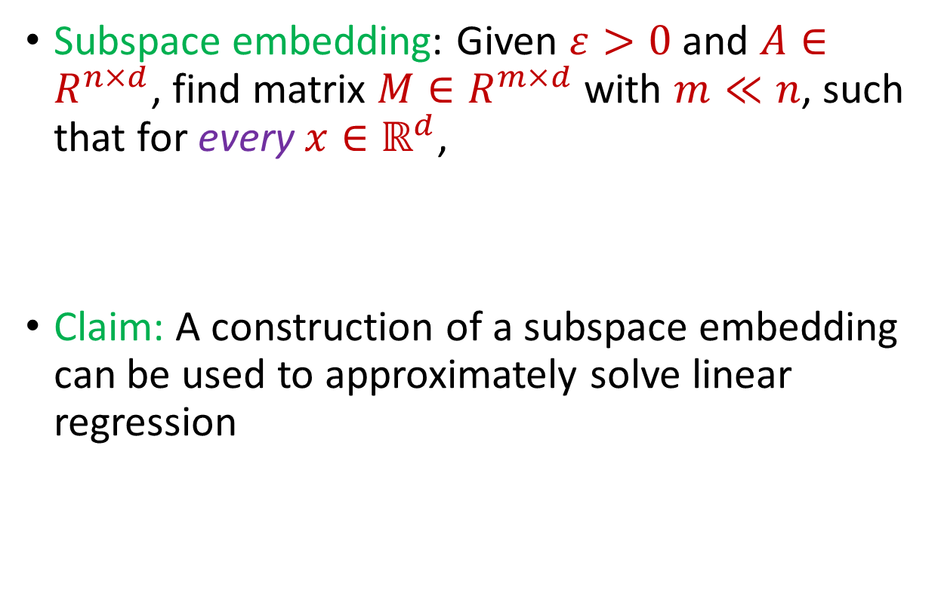
Subspace Embedding
Subspace embedding: Given $ε>0$ and $A∈R^{n×d}$, find matrix $M∈R^{m×d}$ with $m≪n$, such that for every $x∈ℝ^{d}$,
Claim: A construction of a subspace embedding can be used to approximately solve linear regression
$$A$$
$$x$$
$$n$$
$$\left(1−ε\right){\left\|Ax\right\|}_{2}≤{\left\|Mx\right\|}_{2}≤\left(1+ε\right){\left\|Ax\right\|}_{2}$$
$$d$$

Slide 9
















Regression and Subspace Embeddings
Recall: Goal is to find $x$ that minimizes ${\left\|Ax−b\right\|}_{2}$
$$−$$
$$A$$
$$x$$
$$b$$
$$A$$
$$b$$
$$x$$
$$n$$
$$n$$
$$n$$
$$−1$$
$$d$$
$$1$$
$$d$$
$$1$$

Slide 10




Regression and Subspace Embeddings
Recall: Goal is to find $x$ that minimizes ${\left\|Ax−b\right\|}_{2}$
$$B$$
$$y$$
$$A$$
$$b$$
$$x$$
$$n$$
$$n$$
$$−1$$
$$d+1$$
$$d$$
$$1$$

Slide 11

Regression and Subspace Embeddings
Recall: Goal is to find $x$ that minimizes ${\left\|Ax−b\right\|}_{2}$
$$B$$
$$y$$
$$A$$
$$b$$
$$x$$
$$n$$
$$n$$
$$−1$$
$${\left\|By\right\|}_{2}≈{\left\|Ax−b\right\|}_{2}$$
$$d+1$$
$$d$$
$$1$$

Slide 12
Previously: Coreset Construction and Sampling
Importance sampling only needs $X′$ to have size $O\left(\frac{1}{ε^{2}}\right)$ to achieve $\left(1+ε\right)$-approximation to $Cost(X,C)$
To handle all possible sets of $k$ centers:
Need to sample each point $x$ with probability $\max_{C}\frac{Cost\left(x,C\right)}{Cost\left(X,C\right)}$ instead of $\frac{Cost\left(x,C\right)}{Cost\left(X,C\right)}$
Need to union bound over a net of all possible sets of $k$ centers
Net with size ${\left(\frac{nΔ}{ε}\right)}^{O(kd)}$

Slide 13
Previously: Sensitivity Sampling
The quantity $s\left(x\right)=\max_{C}\frac{Cost\left(x,C\right)}{Cost\left(X,C\right)}$ is called the sensitivity of $x$ and intuitively measures how “important” the point $x$ is
The total sensitivity of $X$ is $\sum_{x∈X}{s(x)}$ and quantifies how many points will be sampled into $X′$ through importance/sensitivity sampling (before the union bound)

Slide 14
Previously: Sensitivity Sampling
Recall: $\frac{kd}{ε^{2}}⋅\log{\frac{nΔ}{ε}}⋅\sum_{x∈X}{s(x)}$ points sampled
$\sum_{x∈X}{s(x)}=O_{z}(k)$
In total, roughly $\frac{k^{2}d}{ε^{2}}⋅\log{\frac{nΔ}{ε}}$ points sampled in expectation

Slide 15

Subspace Embedding
Subspace embedding: Given $ε>0$ and $A∈ℝ^{n×d}$, find matrix $M∈ℝ^{m×d}$ with $m≪n$, such that for every $x∈ℝ^{d}$,
$$A$$
$$x$$
$$n$$
$$\left(1−ε\right){\left\|Ax\right\|}_{2}≤{\left\|Mx\right\|}_{2}≤\left(1+ε\right){\left\|Ax\right\|}_{2}$$
$$d$$

Slide 16
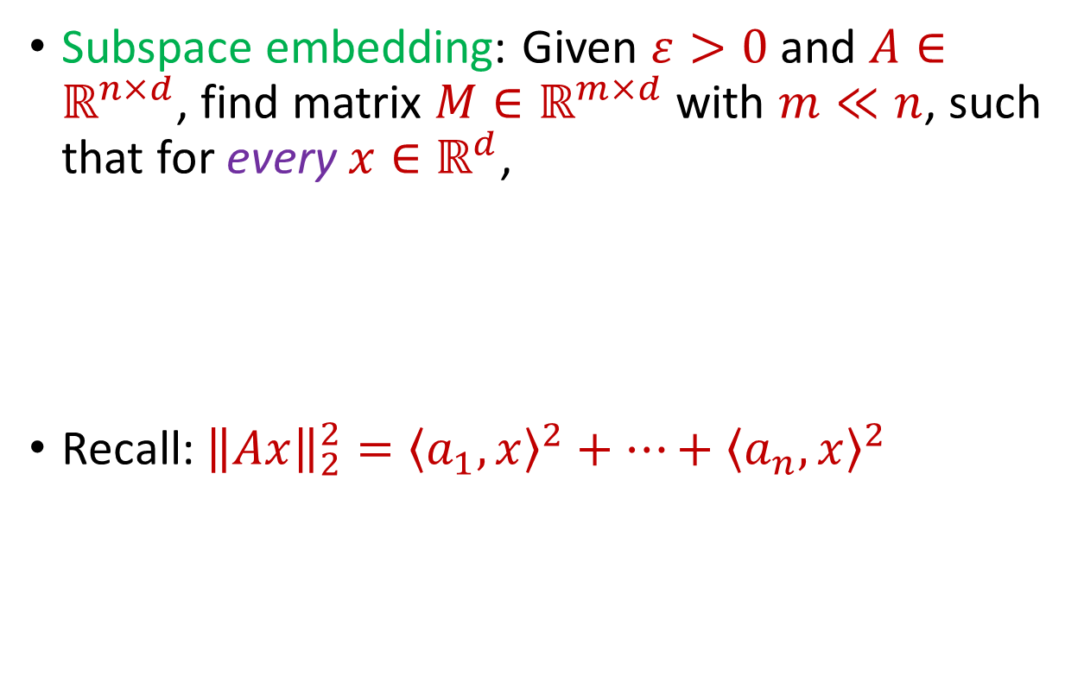
Subspace Embedding
Subspace embedding: Given $ε>0$ and $A∈ℝ^{n×d}$, find matrix $M∈ℝ^{m×d}$ with $m≪n$, such that for every $x∈ℝ^{d}$,
Recall: ${\left\|Ax\right\|}_{2}^{2}={\left\langle a_{1}, x\right\rangle }^{2}+…+{\left\langle a_{n}, x\right\rangle }^{2}$
$$A$$
$$x$$
$$n$$
$$\left(1−ε\right){\left\|Ax\right\|}_{2}^{2}≤{\left\|Mx\right\|}_{2}^{2}≤\left(1+ε\right){\left\|Ax\right\|}_{2}^{2}$$
$$d$$

Slide 17
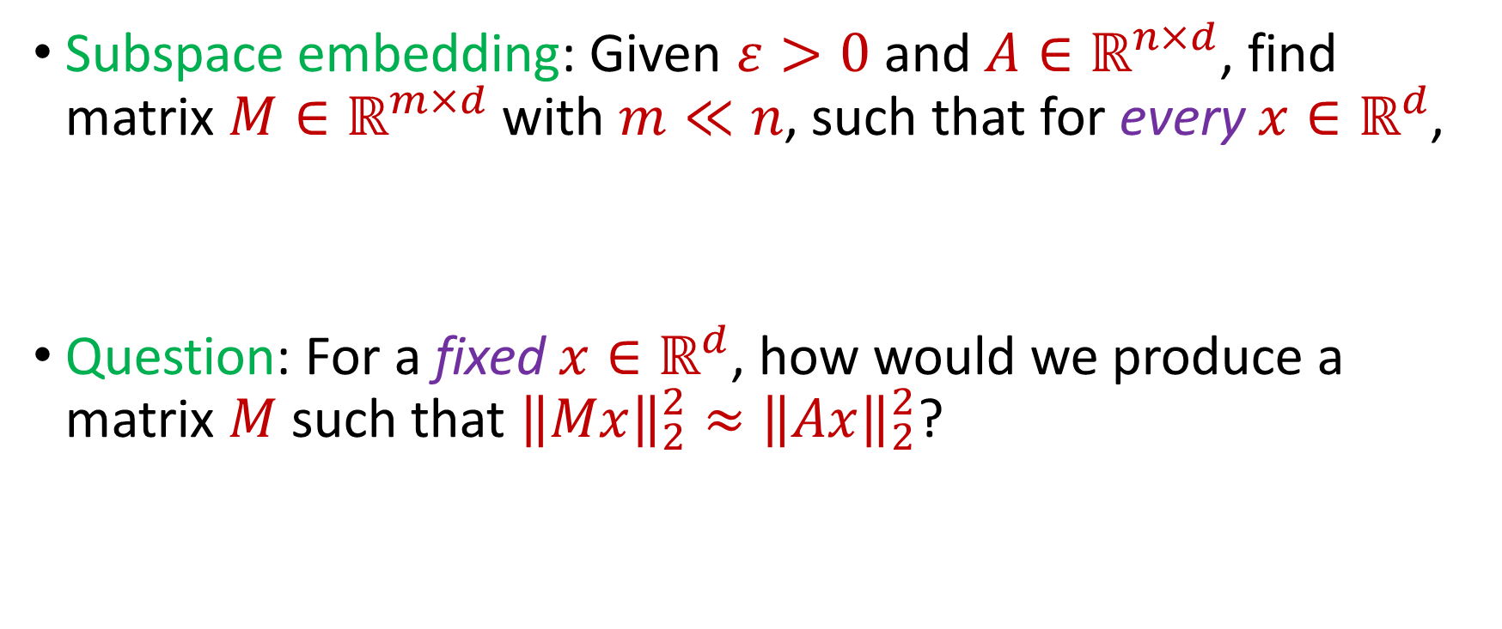
Subspace Embedding
Subspace embedding: Given $ε>0$ and $A∈ℝ^{n×d}$, find matrix $M∈ℝ^{m×d}$ with $m≪n$, such that for every $x∈ℝ^{d}$,
Question: For a fixed $x∈ℝ^{d}$, how would we produce a matrix $M$ such that ${\left\|Mx\right\|}_{2}^{2}≈{\left\|Ax\right\|}_{2}^{2}$?
$$\left(1−ε\right){\left\|Ax\right\|}_{2}^{2}≤{\left\|Mx\right\|}_{2}^{2}≤\left(1+ε\right){\left\|Ax\right\|}_{2}^{2}$$

Slide 18
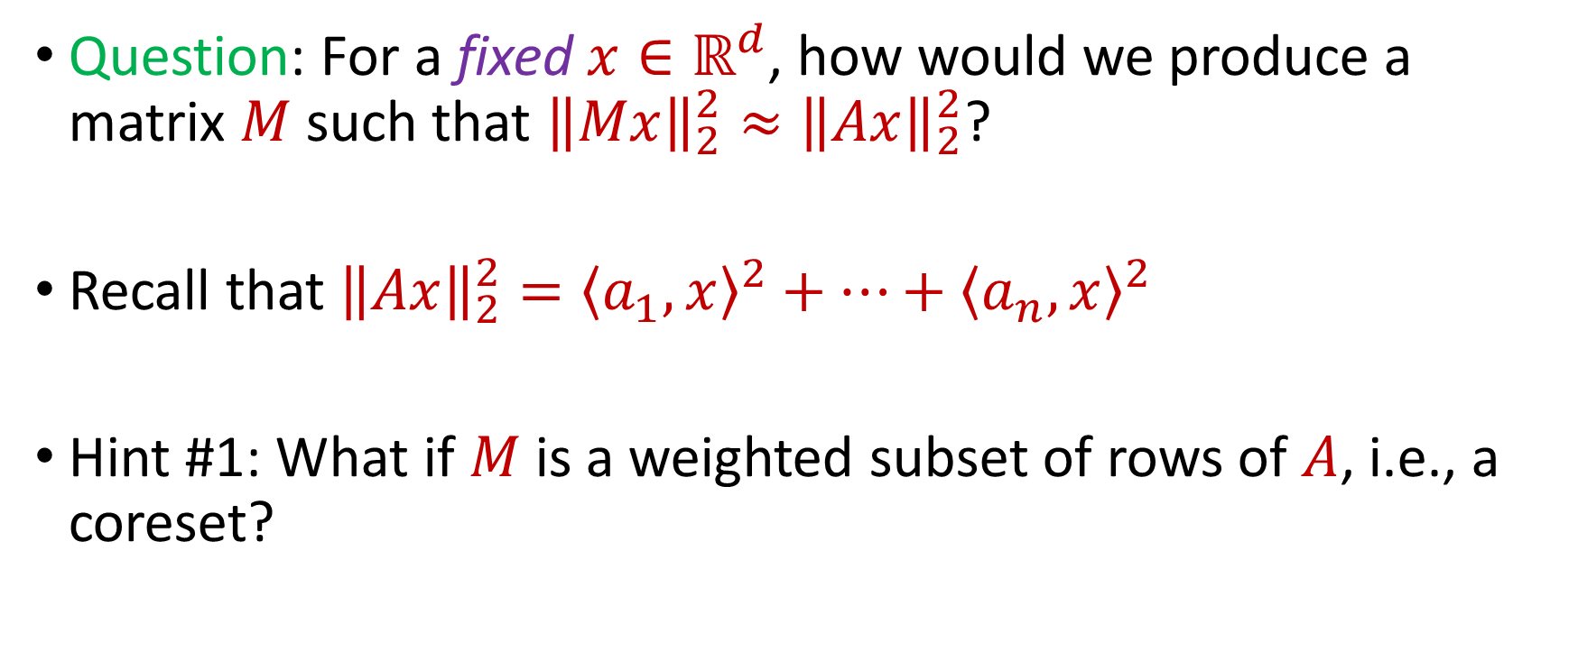
Subspace Embedding
Question: For a fixed $x∈ℝ^{d}$, how would we produce a matrix $M$ such that ${\left\|Mx\right\|}_{2}^{2}≈{\left\|Ax\right\|}_{2}^{2}$?
Recall that ${\left\|Ax\right\|}_{2}^{2}={\left\langle a_{1}, x\right\rangle }^{2}+…+{\left\langle a_{n}, x\right\rangle }^{2}$
Hint #1: What if $M$ is a weighted subset of rows of $A$, i.e., a coreset?

Slide 19
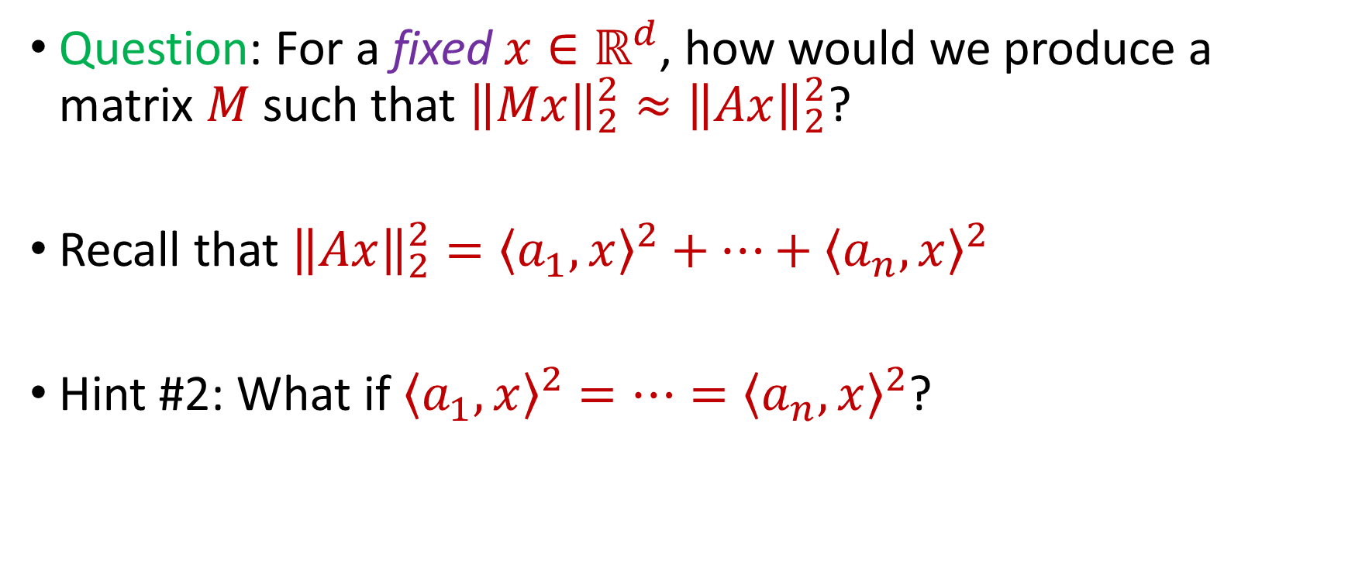
Subspace Embedding
Question: For a fixed $x∈ℝ^{d}$, how would we produce a matrix $M$ such that ${\left\|Mx\right\|}_{2}^{2}≈{\left\|Ax\right\|}_{2}^{2}$?
Recall that ${\left\|Ax\right\|}_{2}^{2}={\left\langle a_{1}, x\right\rangle }^{2}+…+{\left\langle a_{n}, x\right\rangle }^{2}$
Hint #2: What if ${\left\langle a_{1}, x\right\rangle }^{2}=…={\left\langle a_{n}, x\right\rangle }^{2}$?

Slide 20


Bernstein’s Inequality
Bernstein’s inequality: Let $y_{1},…,y_{n}∈[−M,M]$ be independent random variables and let ${y=y}_{1}+…+y_{n}$ have mean $μ$ and variance $σ^{2}$. Then for any $t≥0$:
$$Pr\left[\left|y−μ\right|≥t\right]≤2e^{−\frac{t^{2}}{2σ^{2}+\frac{4}{3}Mt}}$$

Slide 21
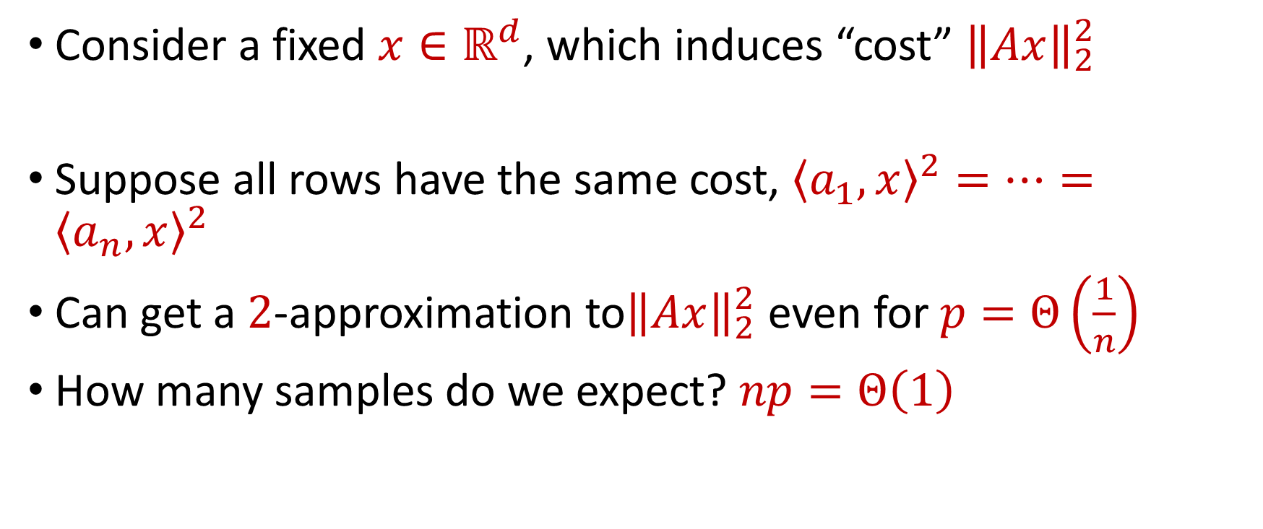
Coreset Construction and Uniform Sampling
Consider a fixed $x∈ℝ^{d}$, which induces “cost” ${\left\|Ax\right\|}_{2}^{2}$
Suppose all rows have the same cost, ${\left\langle a_{1}, x\right\rangle }^{2}=…={\left\langle a_{n}, x\right\rangle }^{2}$
Can get a $2$-approximation to${\left\|Ax\right\|}_{2}^{2}$ even for $p=Θ\left(\frac{1}{n}\right)$
How many samples do we expect? $np=Θ\left(1\right)$

Slide 22
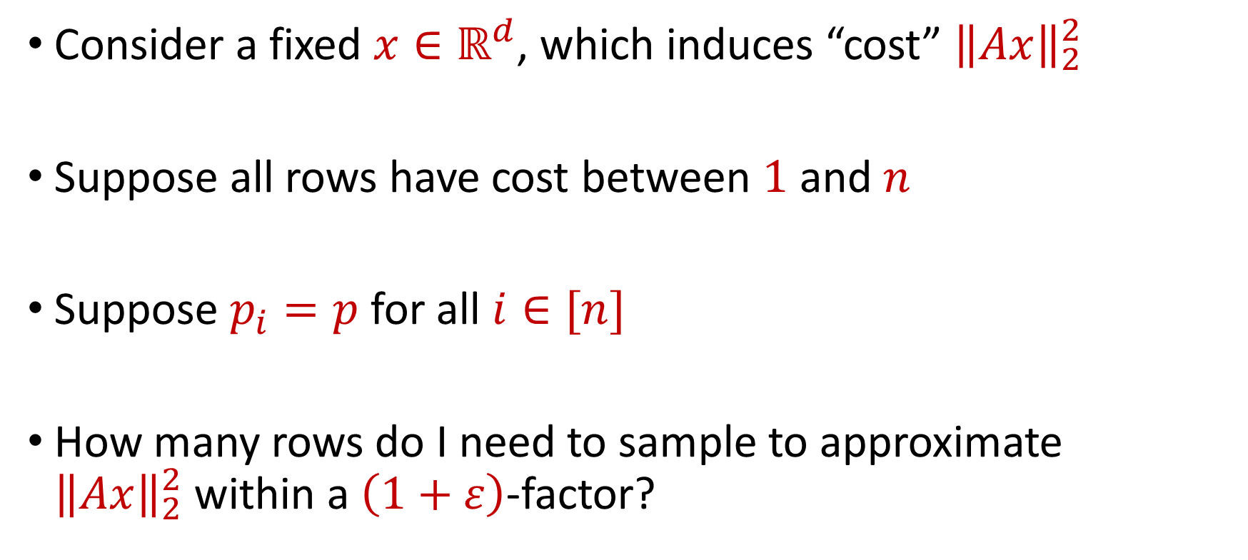
Coreset Construction and Uniform Sampling
Consider a fixed $x∈ℝ^{d}$, which induces “cost” ${\left\|Ax\right\|}_{2}^{2}$
Suppose all rows have cost between $1$ and $n$
Suppose $p_{i}=p$ for all $i∈[n]$
How many rows do I need to sample to approximate ${\left\|Ax\right\|}_{2}^{2}$within a $\left(1+ε\right)$-factor?

Slide 23
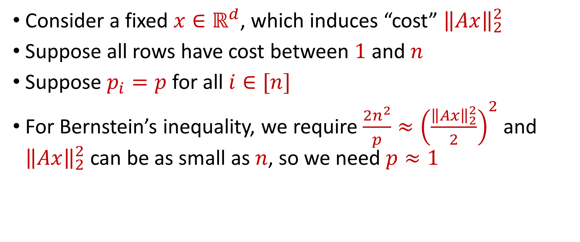
Uniform Sampling for Subspace Embedding
Consider a fixed $x∈ℝ^{d}$, which induces “cost” ${\left\|Ax\right\|}_{2}^{2}$
Suppose all rows have cost between $1$ and $n$
Suppose $p_{i}=p$ for all $i∈[n]$
For Bernstein’s inequality, we require $\frac{2n^{2}}{p}≈{\left(\frac{{\left\|Ax\right\|}_{2}^{2}}{2}\right)}^{2}$ and ${\left\|Ax\right\|}_{2}^{2}$ can be as small as $n$, so we need $p≈1$

Slide 24
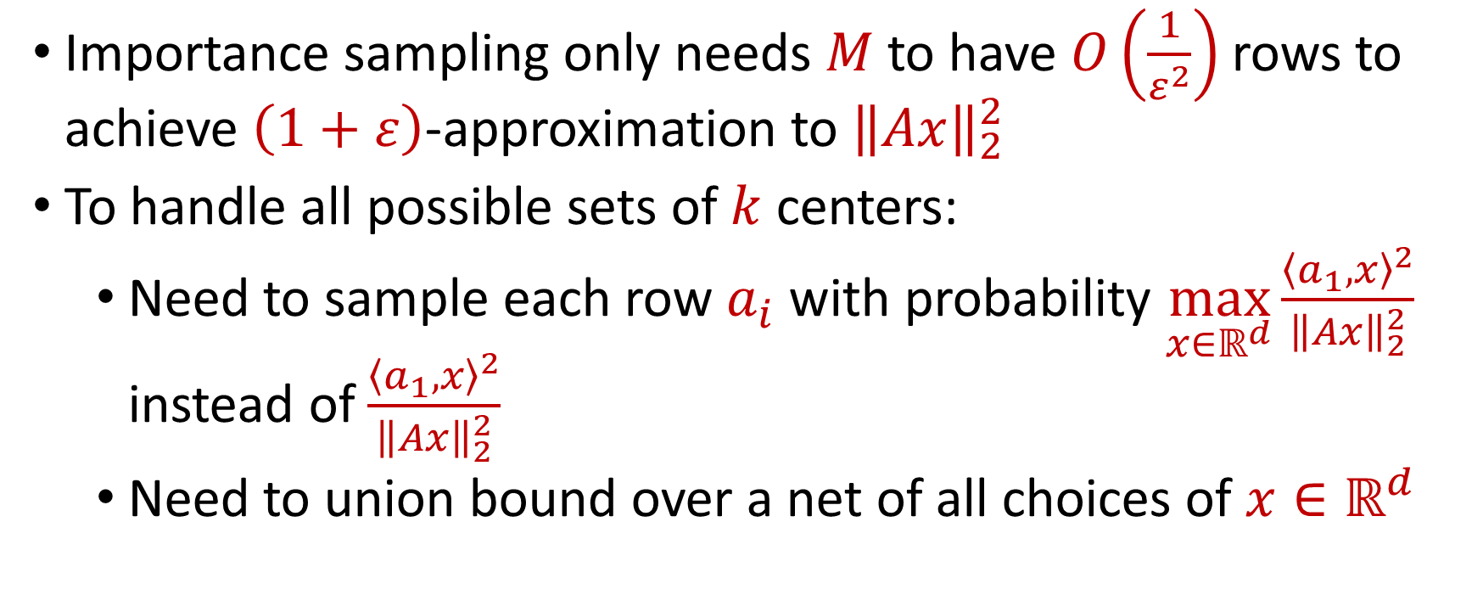
Coreset Construction and Sampling
Importance sampling only needs $M$ to have $O\left(\frac{1}{ε^{2}}\right)$ rows to achieve $\left(1+ε\right)$-approximation to ${\left\|Ax\right\|}_{2}^{2}$
To handle all possible sets of $k$ centers:
Need to sample each row $a_{i}$ with probability $\max_{x∈ℝ^{d}}\frac{{\left\langle a_{1}, x\right\rangle }^{2}}{{\left\|Ax\right\|}_{2}^{2}}$ instead of $\frac{{\left\langle a_{1}, x\right\rangle }^{2}}{{\left\|Ax\right\|}_{2}^{2}}$
Need to union bound over a net of all choices of $x∈ℝ^{d}$

Slide 25
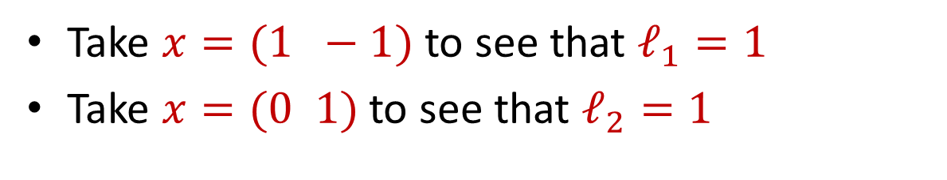
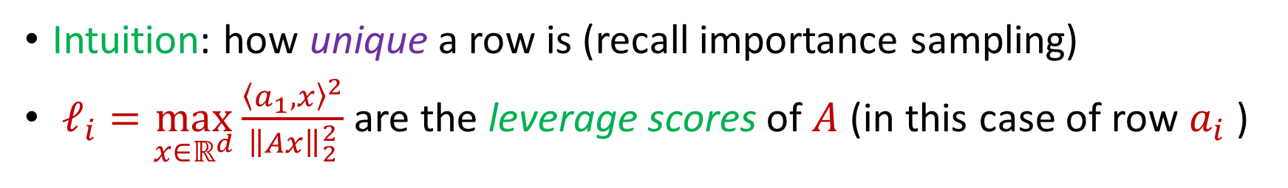
Leverage Scores
Intuition: how unique a row is (recall importance sampling)
$ℓ_{i}=\max_{x∈ℝ^{d}}\frac{{\left\langle a_{1}, x\right\rangle }^{2}}{{\left\|Ax\right\|}_{2}^{2}}$ are the leverage scores of $A$ (in this case of row $a_{i}$ )
Take $x=(1 −1)$ to see that $ℓ_{1}=1$
Take $x=(0 1)$ to see that $ℓ_{2}=1$
1 0
1 1
$ℓ_{i}=a_{i}{\left(A^{⊤}A\right)}^{−1}a_{i}^{⊤}$, ${∑ℓ}_{i}=d$
$$A$$
$$a_{i}$$

Slide 26


census.gov:

Slide 27


Private Data Analysis
Sensitive dataset
Analyst
Analysis of medical datasets to predict possible issues
Pattern detection for social networks or epidemic spread
US Census information for apportionment

Slide 28

Anonymization
Sensitive dataset
Anonymized dataset
Analyst

Slide 29
Anonymizing Data
Age | Zip Code | Employer | Has Pet
56 | 77005 | Apple | Yes
32 | 77005 | Microsoft | No
71 | 77005 | Amazon | Yes
44 | 77005 | Petsmart | Yes
25 | 77005 | Netflix | No
61 | 77005 | Google | No

Slide 30
Anonymizing Data
Age | Zip Code | Employer | Has Pet
56 | 77005 | Apple | Yes
32 | 77005 | Microsoft | No
71 | 77005 | Amazon | Yes
44 | 77005 | Petsmart | Yes
25 | 77005 | Netflix | No
61 | 77005 | Google | No
Name | Age | Gender | Employer
Alice | 56 | Female | Apple
Bob | 32 | Male | Microsoft
Carol | 71 | Female | Amazon
Dale | 44 | Male | Petsmart
Erin | 25 | Female | Netflix
Fred | 61 | Male | Google

Slide 31
Reconstruction Attack
Name | Age | Zip Code | Gender | Employer | Has Pet
Alice | 56 | 77005 | Female | Apple | Yes
Bob | 32 | 77005 | Male | Microsoft | No
Carol | 71 | 77005 | Female | Amazon | Yes
Dale | 44 | 77005 | Male | Petsmart | Yes
Erin | 25 | 77005 | Female | Netflix | No
Fred | 61 | 77005 | Male | Google | No

Slide 32

Anonymizing Data

Slide 33
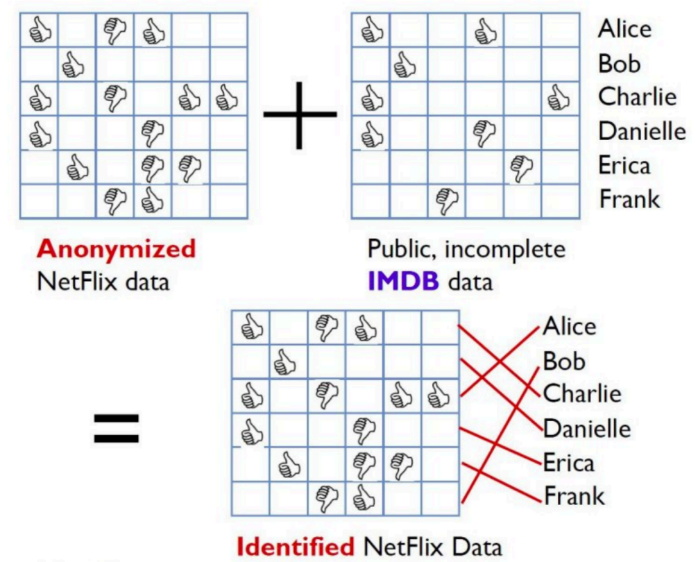
Image from Arvind Narayanan

Slide 34
Differencing Attacks
How many people in this classroom went to Kyle Field last weekend?
How many people in this classroom besides the instructor went to Kyle Field last weekend?

Slide 35
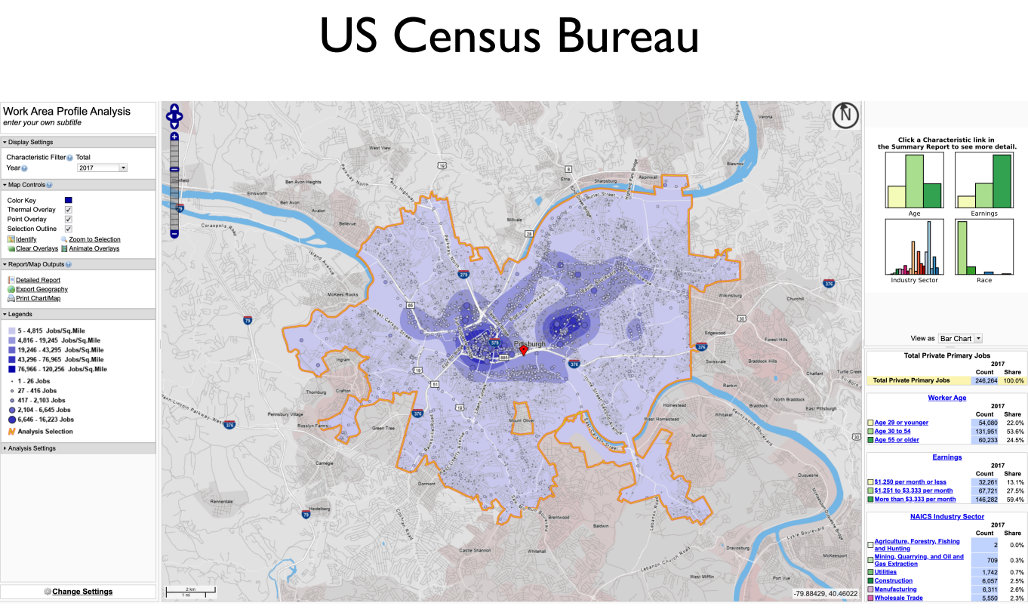
Slide from Steven Wu

Slide 36
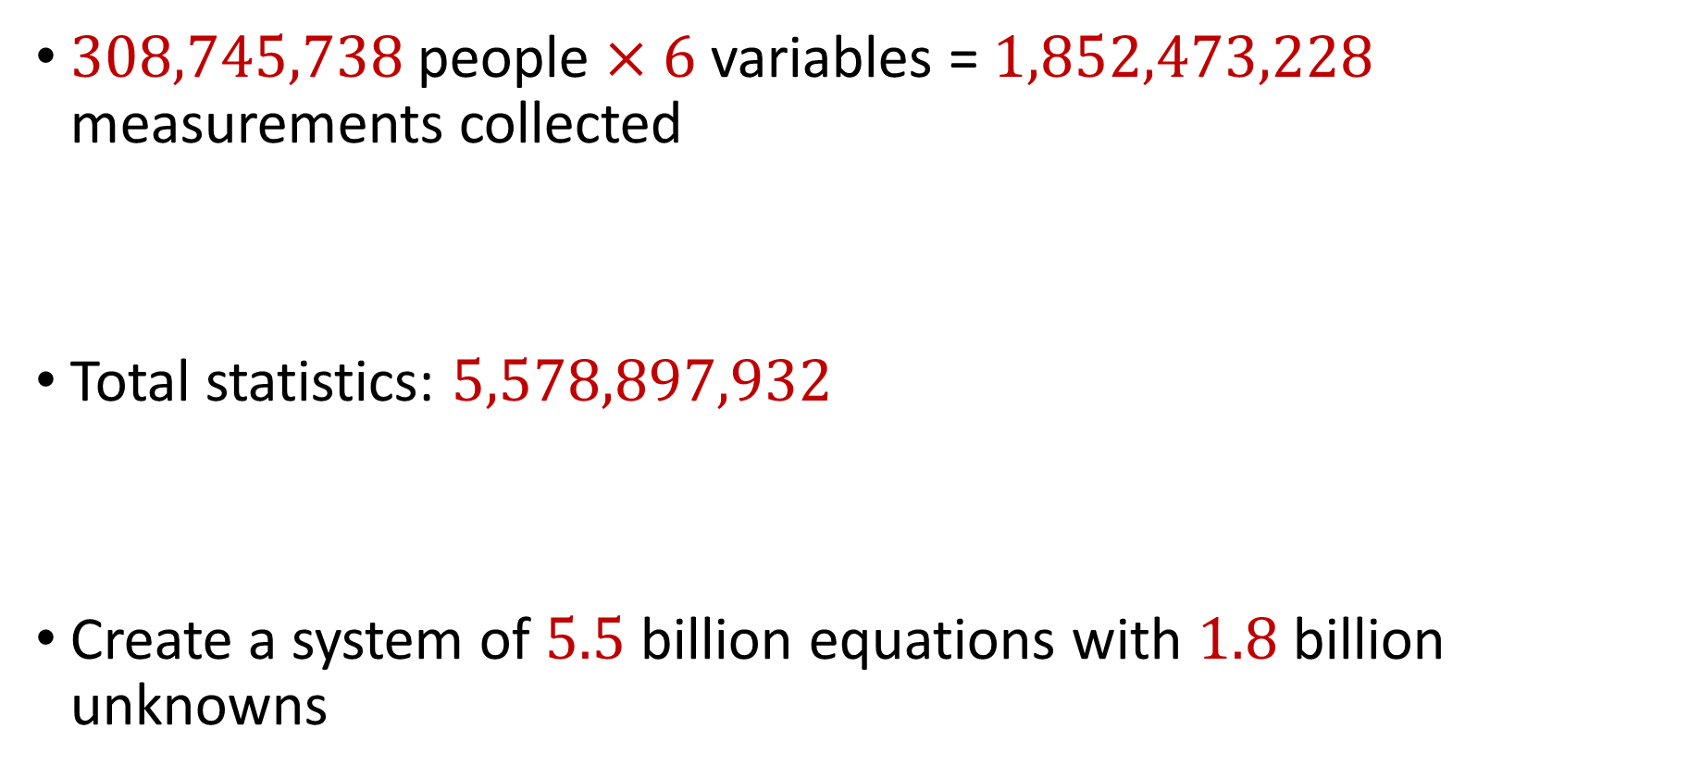
2010 US Census
$308,745,738$ people $×$ $6$ variables = $1,852,473,228$ measurements collected
Total statistics: $5,578,897,932$
Create a system of $5.5$ billion equations with $1.8$ billion unknowns

Slide 37
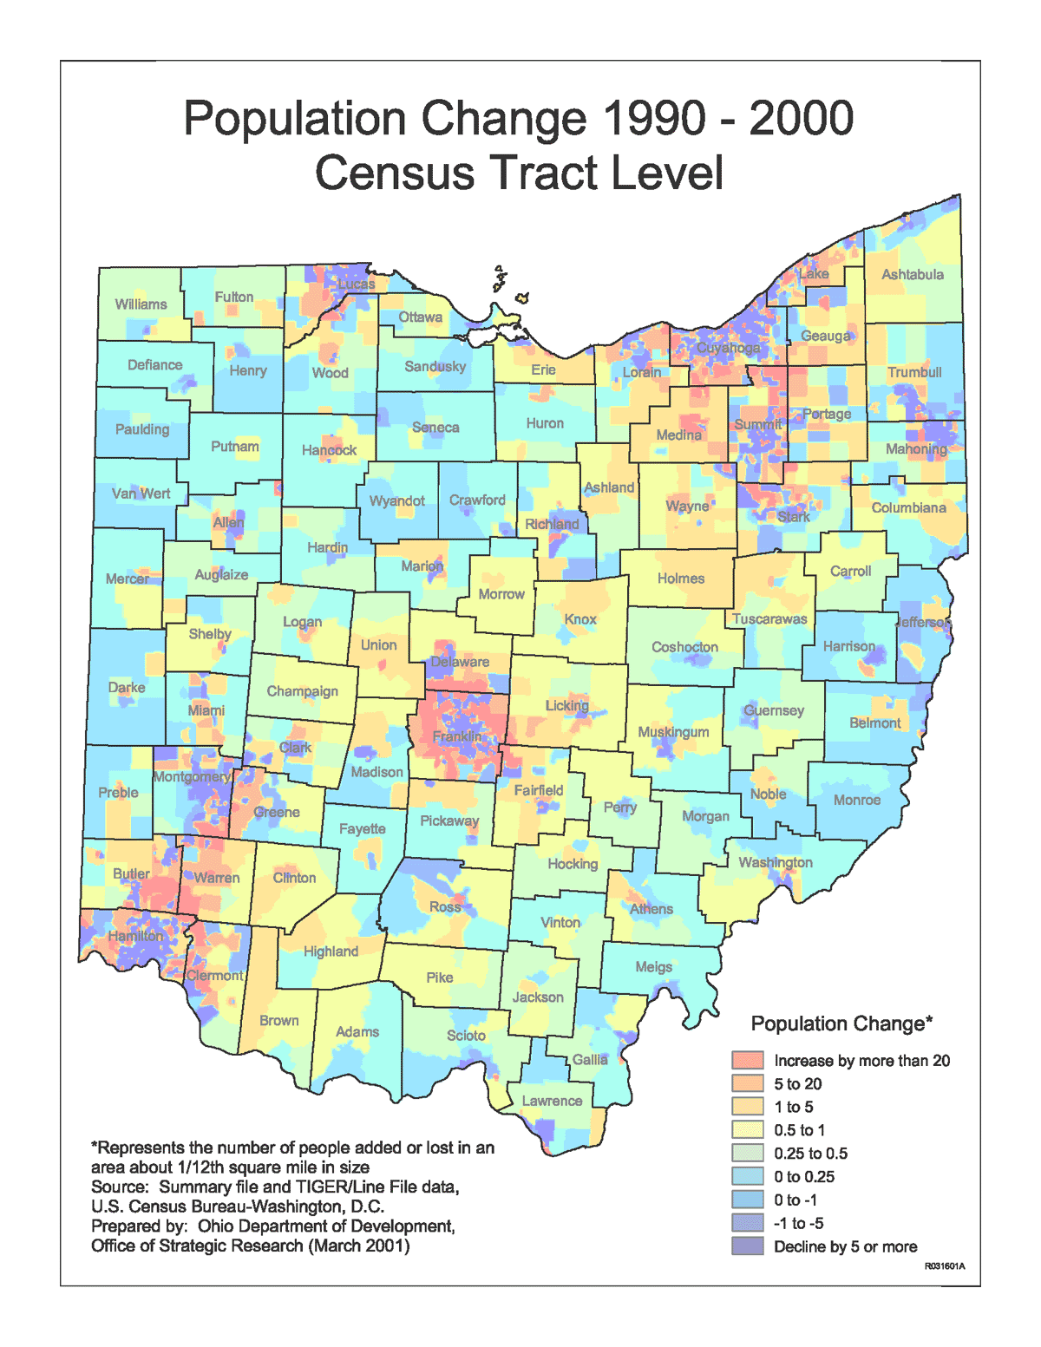
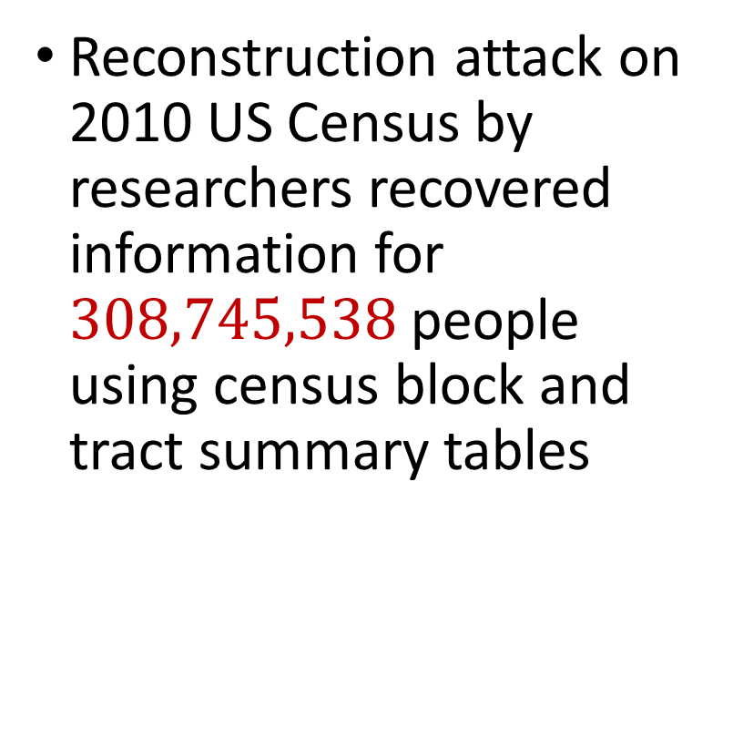
2010 US Census
Reconstruction attack on 2010 US Census by researchers recovered information for $308,745,538$ people using census block and tract summary tables

Slide 38
Summary
“Ad-hoc” privacy procedures like anonymization/deidentification often fails
Publishing too many queries on a sensitive database with too much accuracy can compromise the privacy of the database
Need a formal mathematical notion for measuring privacy

Slide 39

Possible Notion for Privacy #1
“The data analyst cannot learn anything about Alice”
Sensitive dataset
Analyst

Slide 40
Possible Notion for Privacy #1
“The data analyst cannot learn anything about Alice”
Most Aggies like Reveille
Alice is known to be an Aggie
Sensitive dataset
Analyst
Was Alice’s privacy violated?

Slide 41

Possible Notion for Privacy #1
“The data analyst cannot learn anything about Alice”
Most Aggies like Reveille
Bob participates in the survey
Sensitive dataset
Analyst
Even though Alice is not in the survey, it is still known that Alice is an Aggie

Slide 42
Possible Notion for Privacy #1
Suppose a survey is conducted on a sensitive dataset and concludes that “most Aggies like Reveille”
Alice is a known Aggie, and so a data analyst infers that Alice is more likely to be a dog owner and asks for higher apartment cleaning rates
Was Alice’s privacy violated by this study?

Slide 43
Possible Notion for Privacy #2
“A study is private…if the data analyst gains almost no additional information about Alice from the study than if the same study was performed without Alice’s data”

Slide 44

Possible Notion for Privacy #2
Stability: the data analyst reaches roughly similar conclusions if any individual data point is replaced by another data point of the population

Slide 45


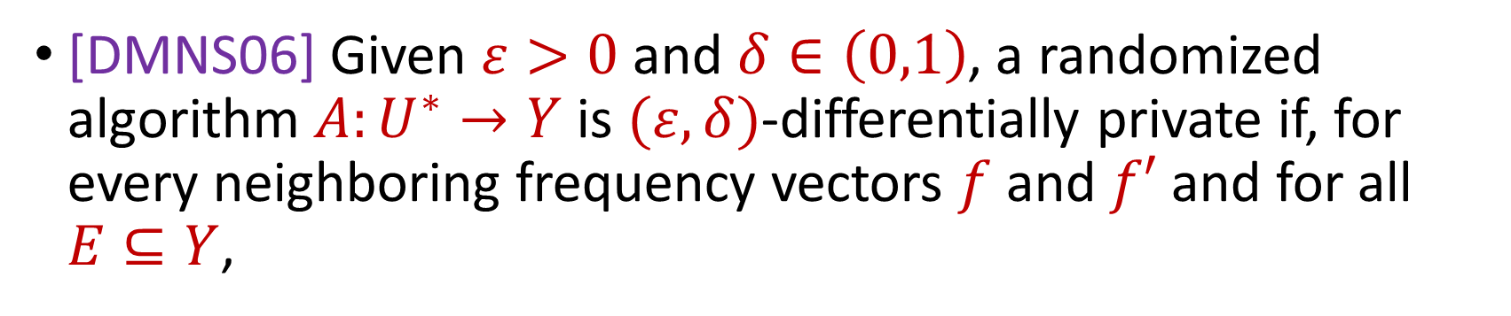

Differential Privacy
[DMNS06] Given $ε>0$and $δ∈\left(0,1\right)$, a randomized algorithm $A:U^{∗}→Y$ is $(ε,δ)$-differentially private if, for every neighboring frequency vectors $f$ and $f′$ and for all $E⊆Y$,
$$Pr\left[A\left(f\right)∈E\right]≤e^{ε}Pr\left[A\left(f^{′}\right)∈E\right]+δ$$
$$A\left( \right)≈A\left( \right)$$
Notes:
[DworkMcSherryNissimSmith06]

Slide 46
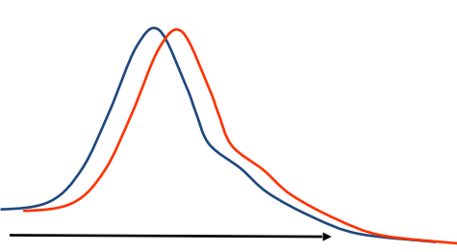
Differential Privacy
[DMNS06] Given $ε>0$and $δ∈\left(0,1\right)$, a randomized algorithm $A:U^{∗}→Y$ is $(ε,δ)$-differentially private if, for every neighboring frequency vectors $f$ and $f′$ and for all $E⊆Y$,
$$Pr\left[A\left(f\right)∈E\right]≤e^{ε}Pr\left[A\left(f^{′}\right)∈E\right]+δ$$
Sensitive dataset
Algorithm
Output distribution
Notes:
[DworkMcSherryNissimSmith06]

