Slide 1
CSCE 689: Special Topics in Modern Algorithms for Data Science
Lecture 20
Samson Zhou

Slide 2
Presentation Schedule
November 27: Chunkai, Jung, Galaxy AI
November 29: STMI, Anmol, Jason
December 1: Bokun, Ayesha, Dawei, Lipai

Slide 3
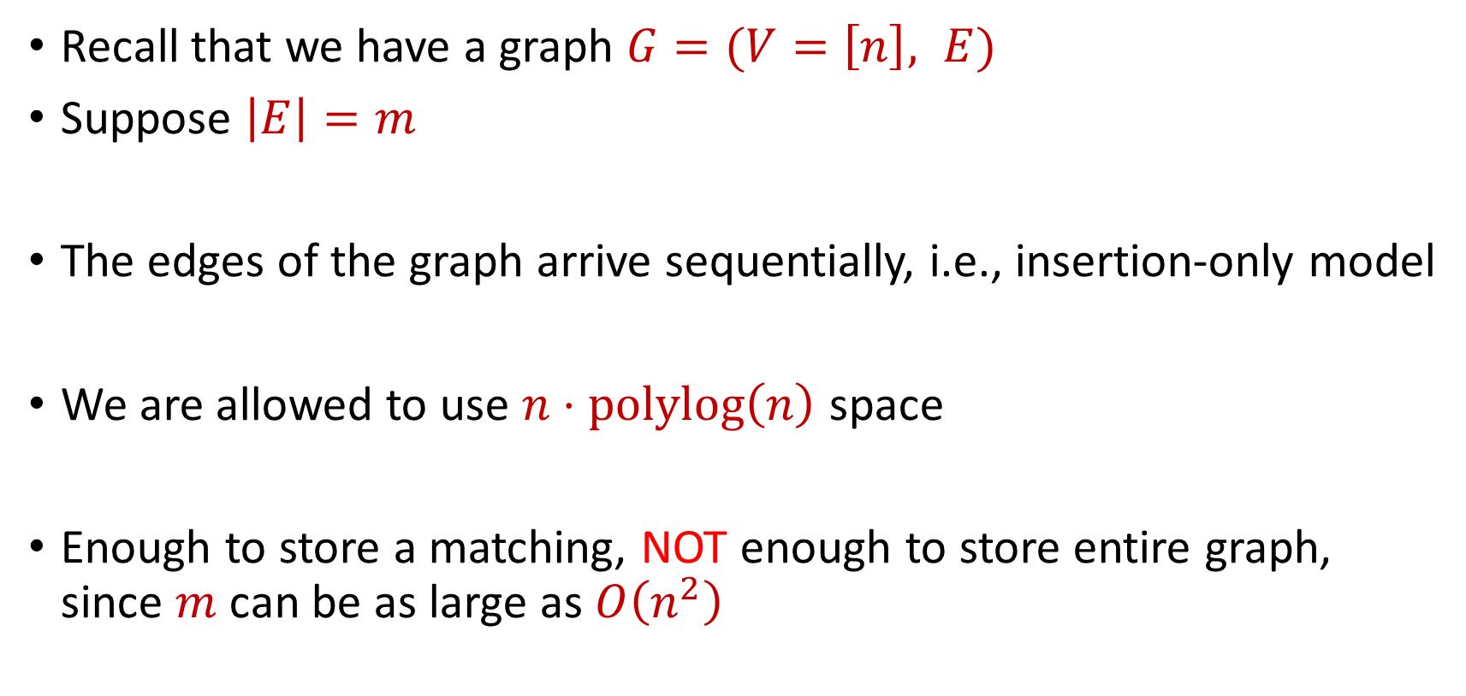
Last Time: Semi-streaming Model
Recall that we have a graph $G=(V=\left[n\right], E)$
Suppose $\left|E\right|=m$
The edges of the graph arrive sequentially, i.e., insertion-only model
We are allowed to use $n⋅polylog\left(n\right)$ space
Enough to store a matching, NOT enough to store entire graph, since $m$ can be as large as $O\left(n^{2}\right)$

Slide 4
Last Time: Maximum Matching
How to find maximum matching?
An alternating path is any path of edges that alternates between edges in and not in the matching
An augmenting path is any alternating path of edges that does not start and does not end at a vertex in the matching
“Flipping” all the edges in an augmenting path increases the matching size

Slide 5

Maximal Matching
A maximal matching is a matching $M$ of $G$ such that any additional edges would no longer be a matching

Slide 6

Maximal Matching
What if we just wanted to find a maximal matching?
Greedy algorithm: Add each unmatched edge $e$in the stream to the matching $M$

Slide 7

Maximal Matching
Claim: Each maximal matching is a $2$-approximation to the maximum matching

Slide 8






$$1$$
$$2$$
$$5$$
$$6$$
$$4$$
$$3$$

Slide 9
$$1$$
$$2$$
$$5$$
$$6$$
$$4$$
$$3$$

Slide 10
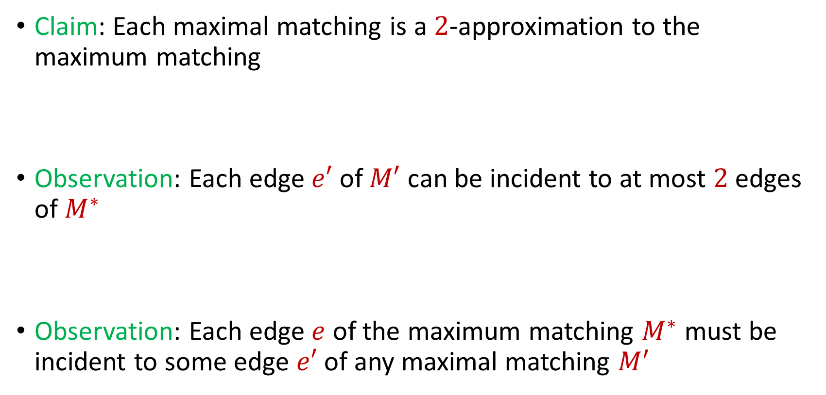
Maximal Matching
Claim: Each maximal matching is a $2$-approximation to the maximum matching
Observation: Each edge $e′$ of $M′$ can be incident to at most $2$ edges of $M^{∗}$
Observation: Each edge $e$ of the maximum matching $M^{∗}$ must be incident to some edge $e′$ of any maximal matching $M^{′}$

Slide 11
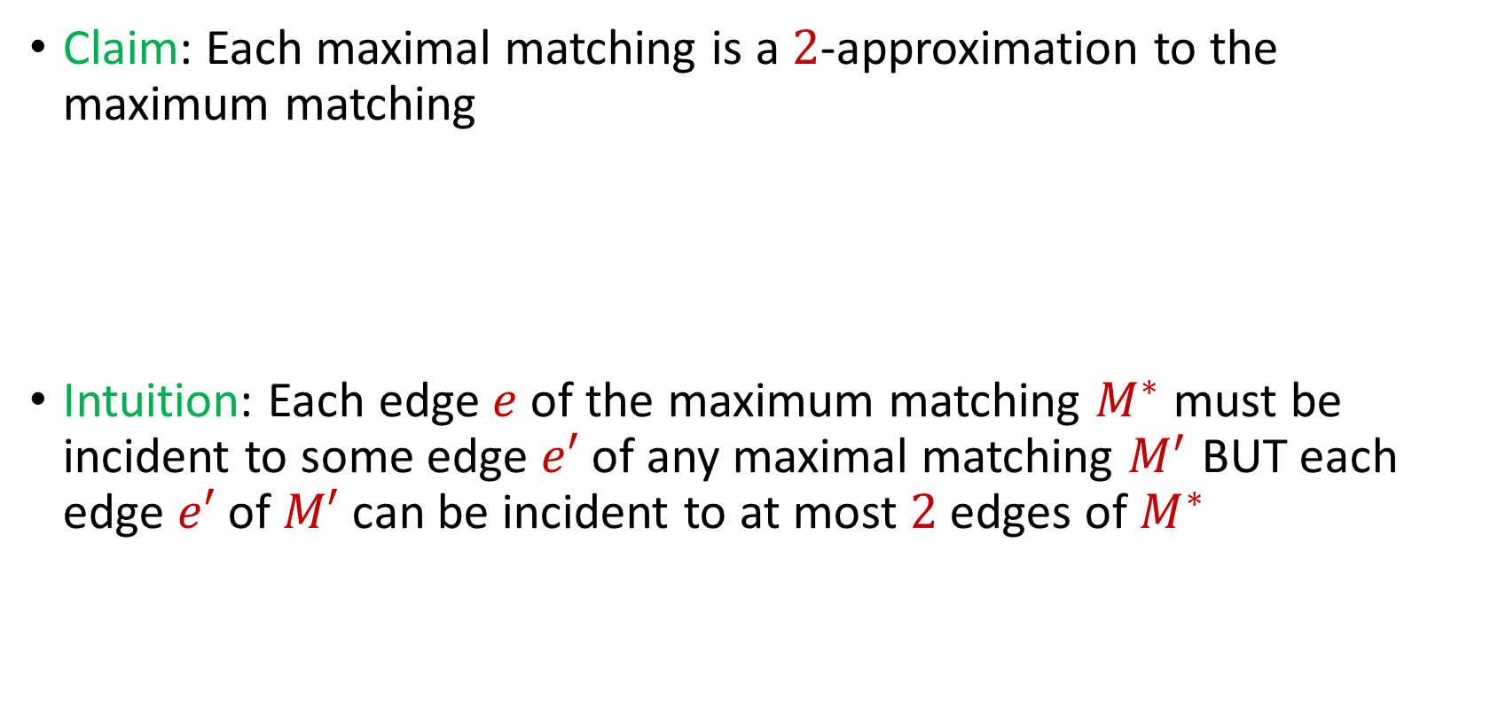
Maximal Matching
Claim: Each maximal matching is a $2$-approximation to the maximum matching
Intuition: Each edge $e$ of the maximum matching $M^{∗}$ must be incident to some edge $e′$ of any maximal matching $M^{′}$ BUT each edge $e′$ of $M′$ can be incident to at most $2$ edges of $M^{∗}$

Slide 12

Maximal Matching
Charging argument: Give each edge $e′$ of the maximal matching $M′$ two dollars

Slide 13
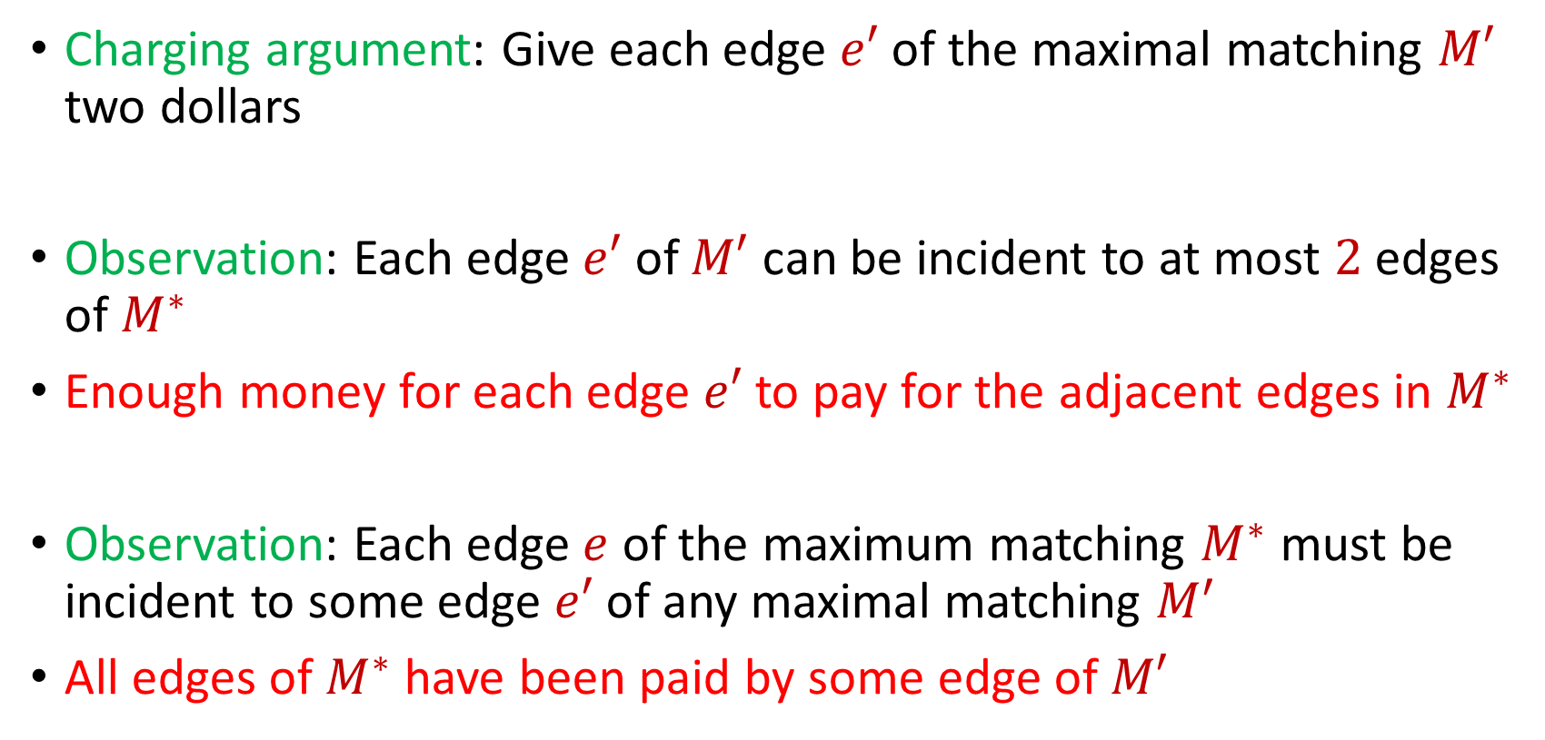
Maximal Matching
Charging argument: Give each edge $e′$ of the maximal matching $M′$ two dollars
Observation: Each edge $e′$ of $M′$ can be incident to at most $2$ edges of $M^{∗}$
Enough money for each edge $e′$ to pay for the adjacent edges in $M^{∗}$
Observation: Each edge $e$ of the maximum matching $M^{∗}$ must be incident to some edge $e′$ of any maximal matching $M^{′}$
All edges of $M^{∗}$ have been paid by some edge of $M′$

Slide 14
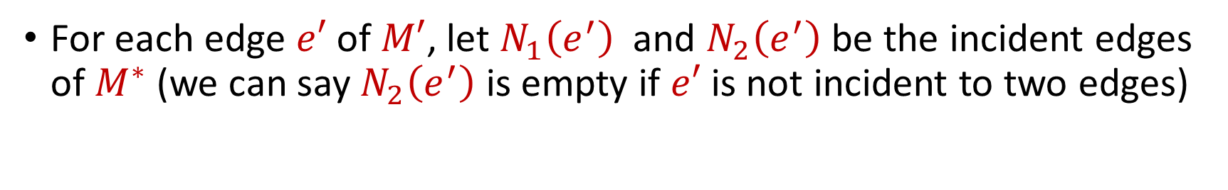

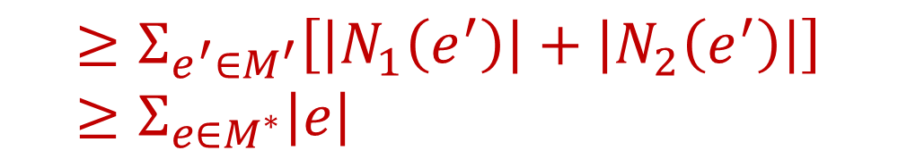

Maximal Matching
For each edge $e′$ of $M′$, let $N_{1}\left(e^{′}\right)$ and $N_{2}\left(e^{′}\right)$ be the incident edges of $M^{∗}$ (we can say $N_{2}\left(e^{′}\right)$ is empty if $e′$ is not incident to two edges)
$$2\left|M^{′}\right|=Σ_{e^{′}∈M^{′}}2\left|e′\right|$$
$$≥Σ_{e^{′}∈M^{′}}\left[\left|N_{1}\left(e^{′}\right)\right|+\left|N_{2}\left(e^{′}\right)\right|\right]≥Σ_{e∈M^{∗}}\left|e\right|$$
$$=|M^{∗}|$$

Slide 15

Matchings in the Semi-Streaming Model
Geedy algorithm is a $2$-approximation to the maximum matching that uses $O(n)$ space

Slide 16
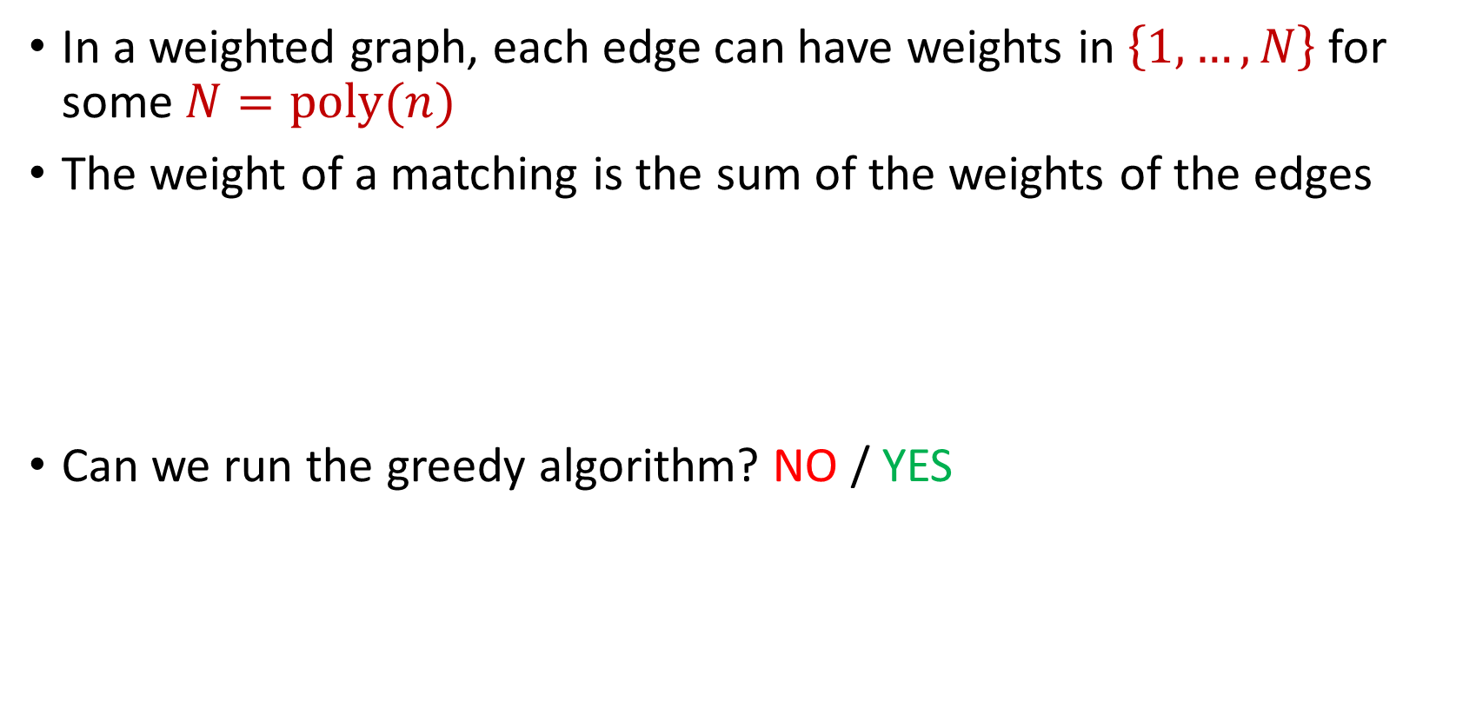
Matchings in the Semi-Streaming Model
In a weighted graph, each edge can have weights in $\left\{1,…,N\right\}$ for some $N=poly(n)$
The weight of a matching is the sum of the weights of the edges
Can we run the greedy algorithm? NO / YES

Slide 17
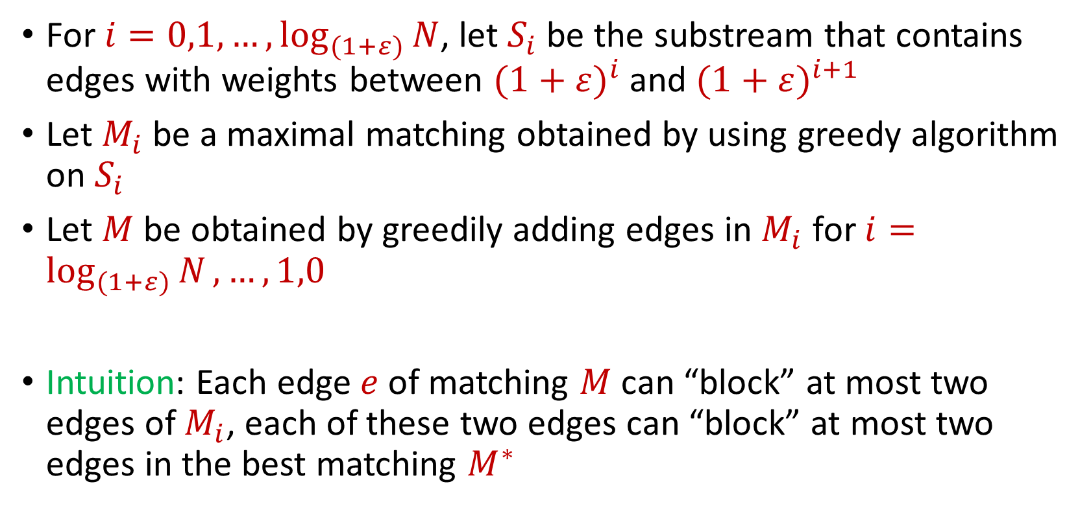
Matchings in the Semi-Streaming Model
For $i=0,1,…, \log_{(1+ε)}{N}$, let $S_{i}$ be the substream that contains edges with weights between ${(1+ε)}^{i}$ and ${(1+ε)}^{i+1}$
Let $M_{i}$ be a maximal matching obtained by using greedy algorithm on $S_{i}$
Let $M$ be obtained by greedily adding edges in $M_{i}$ for $i=\log_{(1+ε)}{N},…,1,0$
Intuition: Each edge $e$ of matching $M$ can “block” at most two edges of $M_{i}$, each of these two edges can “block” at most two edges in the best matching $M^{∗}$

Slide 18
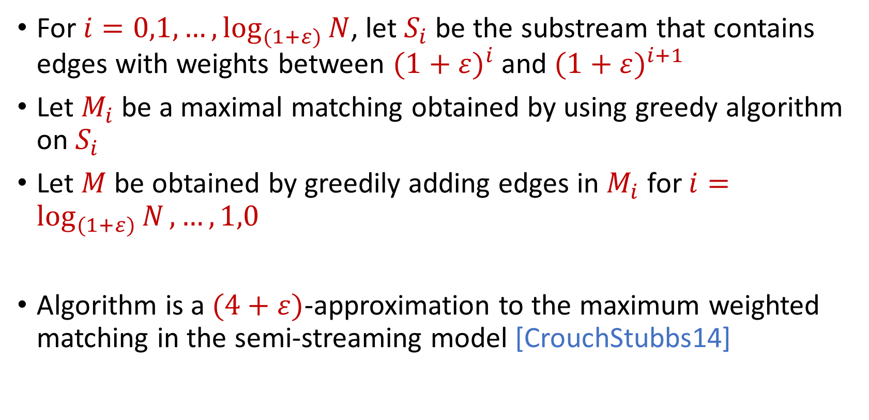
Matchings in the Semi-Streaming Model
For $i=0,1,…, \log_{(1+ε)}{N}$, let $S_{i}$ be the substream that contains edges with weights between ${(1+ε)}^{i}$ and ${(1+ε)}^{i+1}$
Let $M_{i}$ be a maximal matching obtained by using greedy algorithm on $S_{i}$
Let $M$ be obtained by greedily adding edges in $M_{i}$ for $i=\log_{(1+ε)}{N},…,1,0$
Algorithm is a $(4+ε)$-approximation to the maximum weighted matching in the semi-streaming model [CrouchStubbs14]

Slide 19
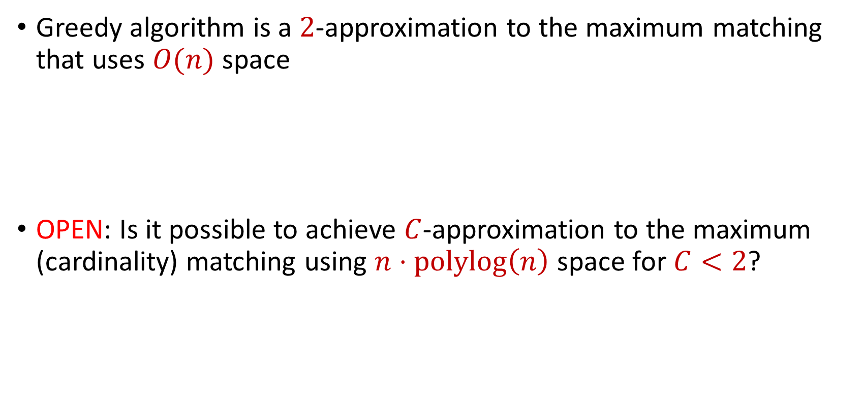
Matchings in the Semi-Streaming Model
Greedy algorithm is a $2$-approximation to the maximum matching that uses $O(n)$ space
OPEN: Is it possible to achieve $C$-approximation to the maximum (cardinality) matching using $n⋅polylog\left(n\right)$ space for $C<2$?

Slide 20
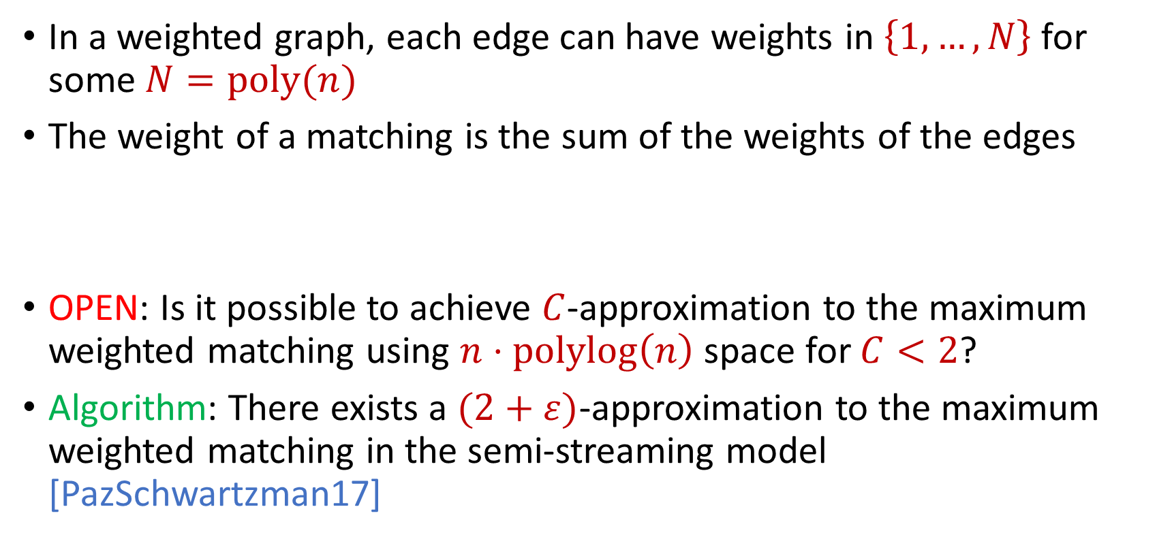
Matchings in the Semi-Streaming Model
In a weighted graph, each edge can have weights in $\left\{1,…,N\right\}$ for some $N=poly(n)$
The weight of a matching is the sum of the weights of the edges
OPEN: Is it possible to achieve $C$-approximation to the maximum weighted matching using $n⋅polylog\left(n\right)$ space for $C<2$?
Algorithm: There exists a $(2+ε)$-approximation to the maximum weighted matching in the semi-streaming model [PazSchwartzman17]

Slide 21
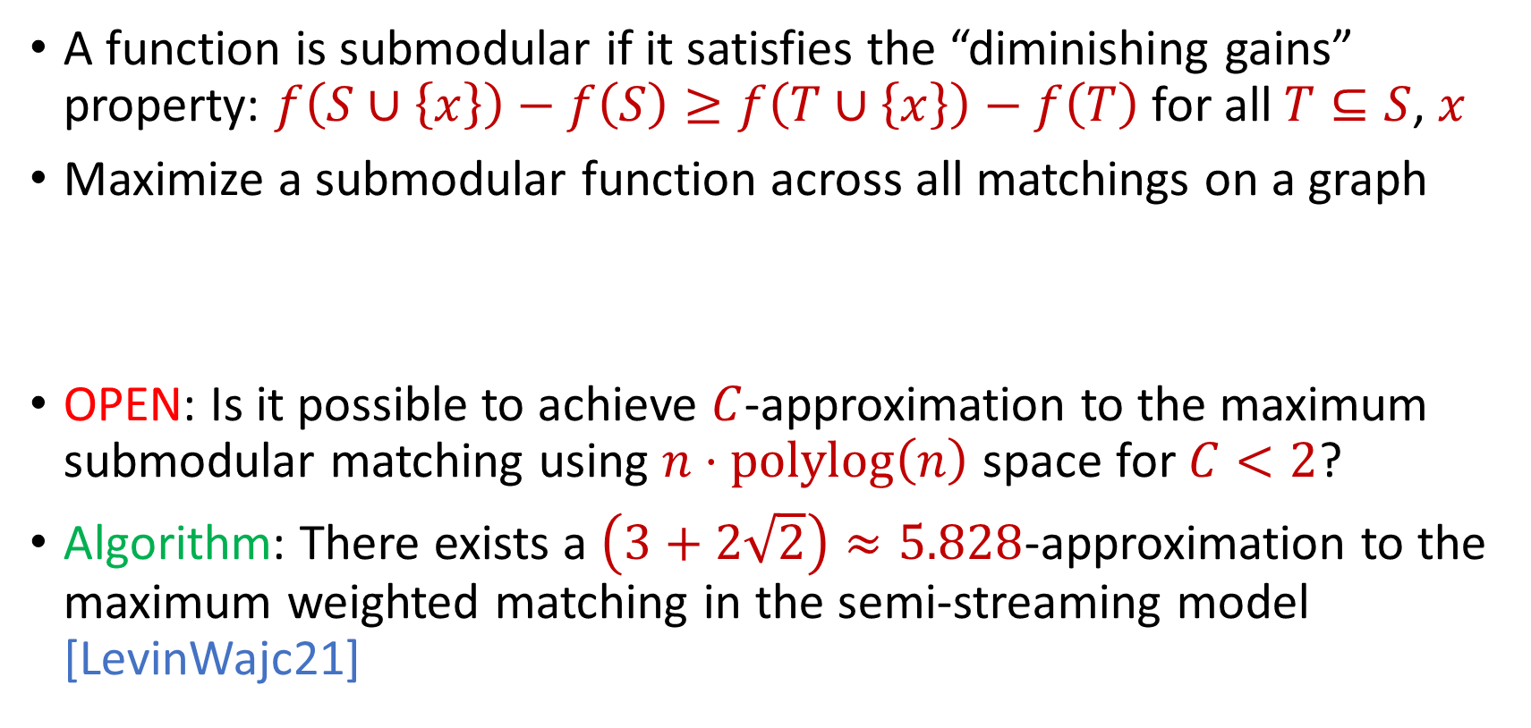
Matchings in the Semi-Streaming Model
A function is submodular if it satisfies the “diminishing gains” property: $f\left(S∪\left\{x\right\}\right)−f\left(S\right)≥f\left(T∪\left\{x\right\}\right)−f\left(T\right)$ for all $T⊆S$, $x$
Maximize a submodular function across all matchings on a graph
OPEN: Is it possible to achieve $C$-approximation to the maximum submodular matching using $n⋅polylog\left(n\right)$ space for $C<2$?
Algorithm: There exists a $\left(3+2\sqrt{2}\right)≈5.828$-approximation to the maximum weighted matching in the semi-streaming model [LevinWajc21]

Slide 22
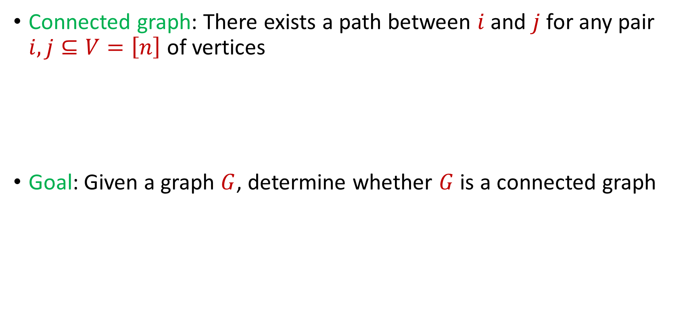
Connectivity
Connected graph: There exists a path between $i$ and $j$ for any pair $i,j⊆V=\left[n\right]$ of vertices
Goal: Given a graph $G$, determine whether $G$ is a connected graph

Slide 23
$$1$$
$$2$$
$$5$$
$$6$$
$$4$$
$$3$$

Slide 24
$$1$$
$$2$$
$$5$$
$$6$$
$$4$$
$$3$$

Slide 25
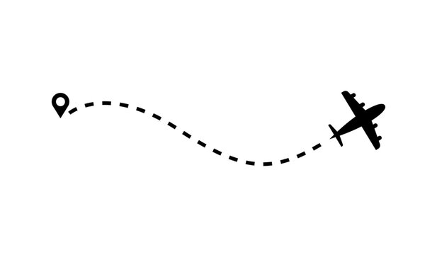
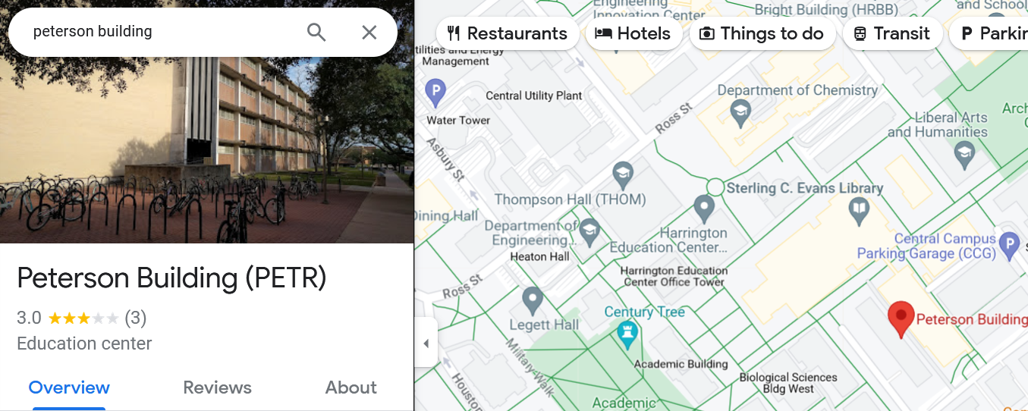
Connectivity
Transportation networks: Analyzing the connectivity of transportation networks, e.g., roads, railways, flight routes, is critical for optimizing routes, planning public transportation, identifying congested areas, and ensuring efficient travel

Slide 26


Connectivity
Electrical power grids: Determining the connectivity of an electric power grid is essential for ensuring a reliable and resilient power supply. Identifying isolated components helps in quickly restoring power after outages.

Slide 27

Spanning Forest
Spanning tree: A subgraph of $G$ that is a tree and contains all the vertices of the graph $G$
Spanning forest: A subgraph of $G$ that is a union of trees that contains all the vertices of the graph $G$

Slide 28
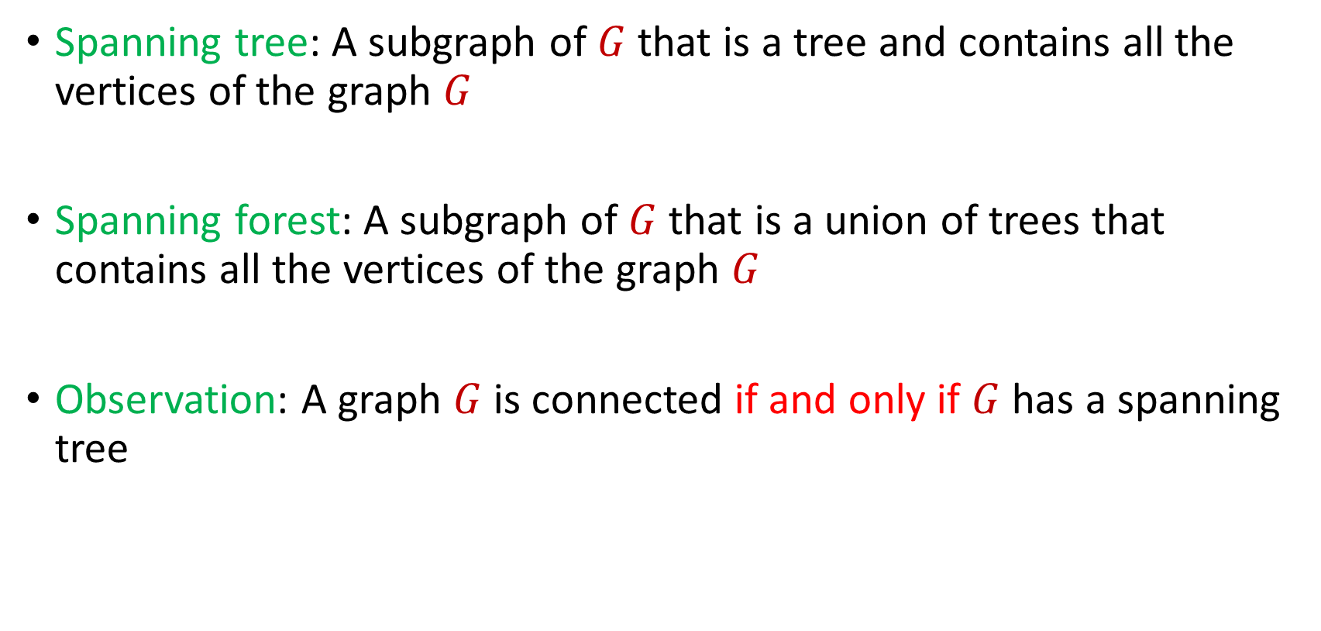
Spanning Forest
Spanning tree: A subgraph of $G$ that is a tree and contains all the vertices of the graph $G$
Spanning forest: A subgraph of $G$ that is a union of trees that contains all the vertices of the graph $G$
Observation: A graph $G$is connected if and only if $G$ has a spanning tree

Slide 29
$$1$$
$$2$$
$$5$$
$$6$$
$$4$$
$$3$$

Slide 30
$$1$$
$$2$$
$$5$$
$$6$$
$$4$$
$$3$$

Slide 31
$$1$$
$$2$$
$$5$$
$$6$$
$$4$$
$$3$$

Slide 32
Spanning Tree
How to find a spanning tree in the offline setting?

Slide 33
Spanning Tree
How to find a spanning tree in the offline setting?
Minimum spanning tree algorithms (Kruskal, Prim)
Kruskal: Greedily add minimum weight edge to spanning forest
Prim: Greedily grow minimum spanning tree

Slide 34
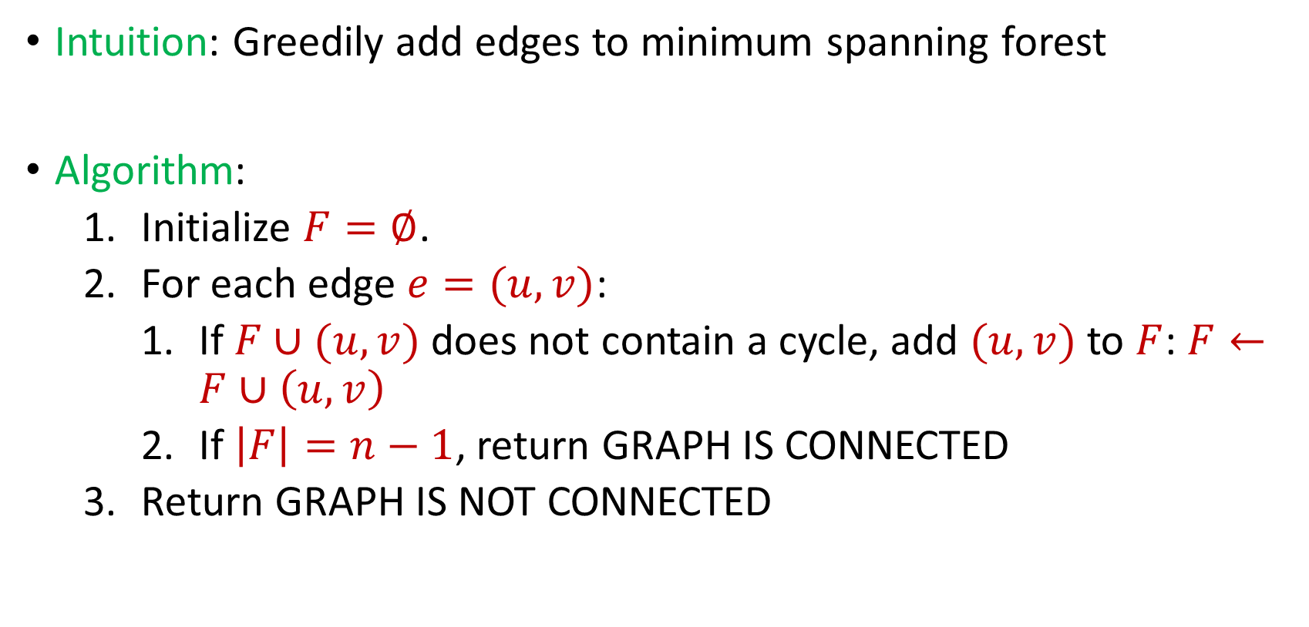
Connectivity
Intuition: Greedily add edges to minimum spanning forest
Algorithm:
Initialize $F=∅$.
For each edge $e=(u,v)$:
If $F∪(u,v)$ does not contain a cycle, add $(u,v)$ to $F$: $F←F∪\left(u,v\right)$
If $\left|F\right|=n−1$, return GRAPH IS CONNECTED
Return GRAPH IS NOT CONNECTED

Slide 35

Connectivity
Algorithm can keep at most $n$ edges, so the total space usage is $O(n)$ words of space.

