Slide 1
CSCE 689: Special Topics in Modern Algorithms for Data Science
Lecture 21
Samson Zhou

Slide 2
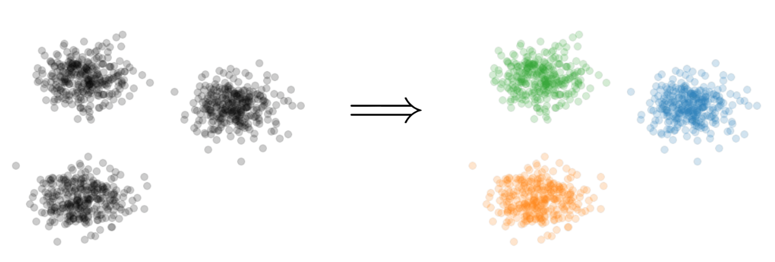

Clustering
Goal: Given input dataset $P$, partition $P$ so that “similar” points are in the same cluster and “different” points are in different clusters

Slide 3
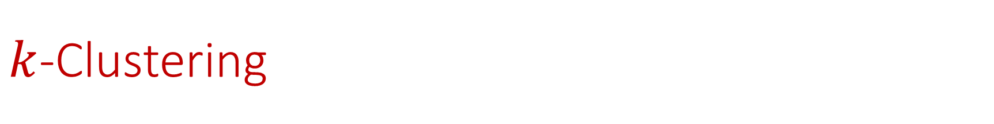

$k$-Clustering
Goal: Given input dataset $P$, partition $P$ so that “similar” points are in the same cluster and “different” points are in different clusters
There can be at most $k$ different clusters
$$k=3$$

Slide 4
$k$-Clustering
Question: How do we measure the “quality” of each clustering?
$$k=3$$

Slide 5
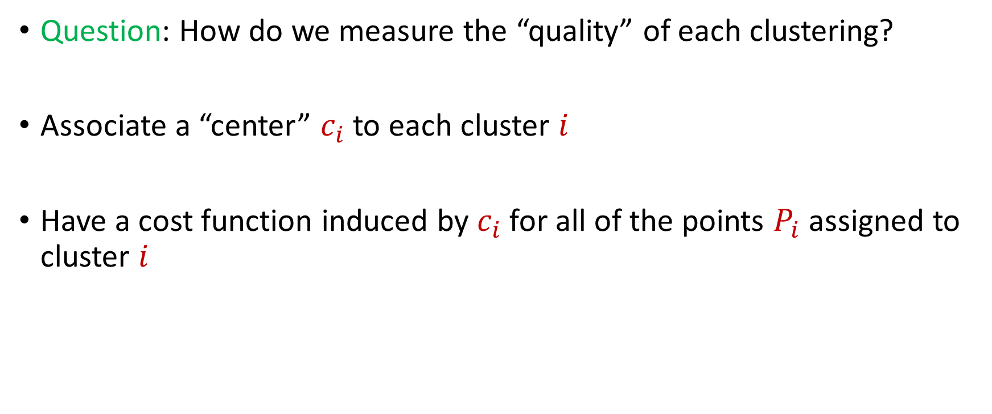
$k$-Clustering
Question: How do we measure the “quality” of each clustering?
Associate a “center” $c_{i}$ to each cluster $i$
Have a cost function induced by $c_{i}$ for all of the points $P_{i}$ assigned to cluster $i$
$$Cost\left(P_{i}, c_{i}\right)$$

Slide 8





1 0 3 0 1 1
1 1 0 0 2 8
2 0 1 3 0 8
1 1 0 0 0 8
0 0 0 7 0 0
7 0 0 8 0 0
3 4 1 1 0 2
4 2 0 1 0 1
9 1 0 0 3 2
1 1 6 0 0 0
8 1 0 1 2 0
1
1
2
1
0
7
3
4
9
1
8
$$n$$
$$A$$
$$b$$
$$d$$
$$1$$

Slide 9




$$x$$
$$n$$
$$A$$
$$≈$$
$$b$$
$$d$$
$$1$$

Slide 10




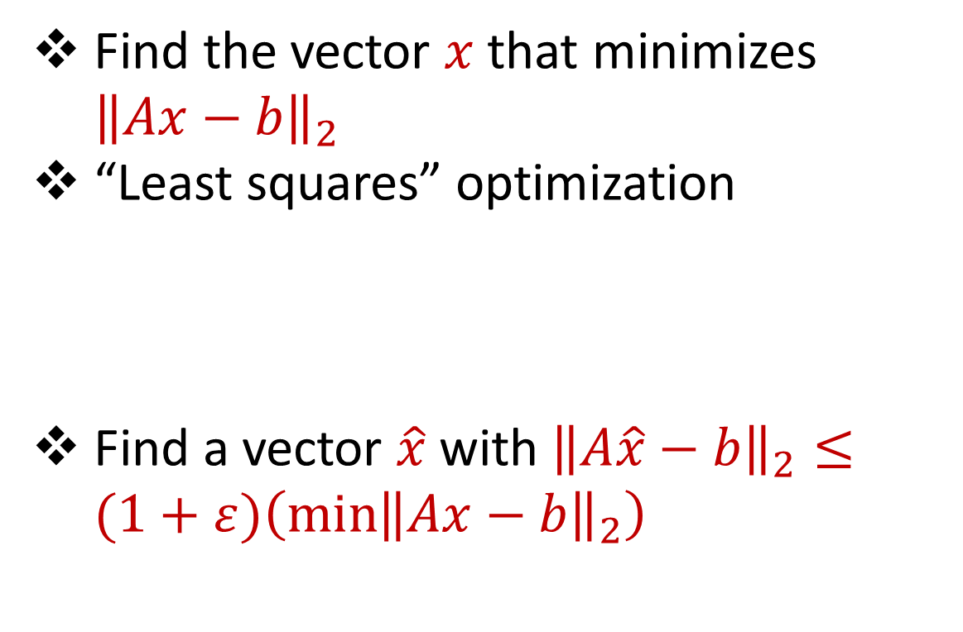






Linear Regression
Find the vector $x$ that minimizes ${\left\|Ax−b\right\|}_{2}$
“Least squares” optimization
Find a vector $\hat{x}$ with ${\left\|A\hat{x}−b\right\|}_{2}≤(1+ε)\left(\min{{\left\|Ax−b\right\|}_{2}}\right)$
$$d$$
$$x$$
$$≈$$
$$n$$
$$A$$
$$n$$
$$b$$
$$1$$
$$d$$
$$1$$

Slide 11




Dimensionality Reduction
Reduce $d$
Reduce $n$
Application depends on task!
Sampling, Sketching, Johnson-Lindenstrauss, IsoMap
$$n$$
$$A$$
Sampling, Sketching
$$d$$

Slide 12


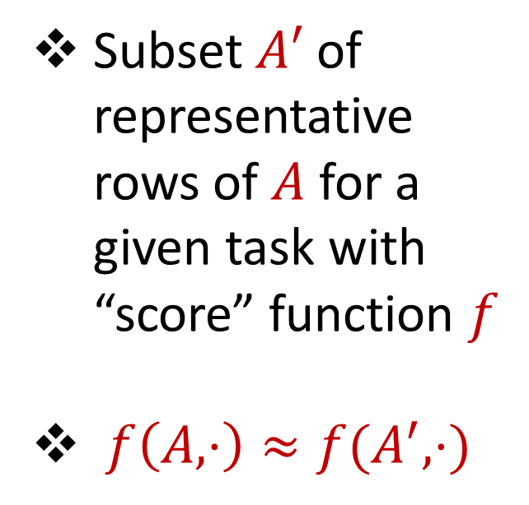



Coreset
Subset $A′$ of representative rows of $A$ for a given task with “score” function $f$
$f\left(A,⋅\right)≈f(A^{′},⋅)$
$$n$$
$$A$$
$$A′$$
$$d$$
$$d$$

Slide 13
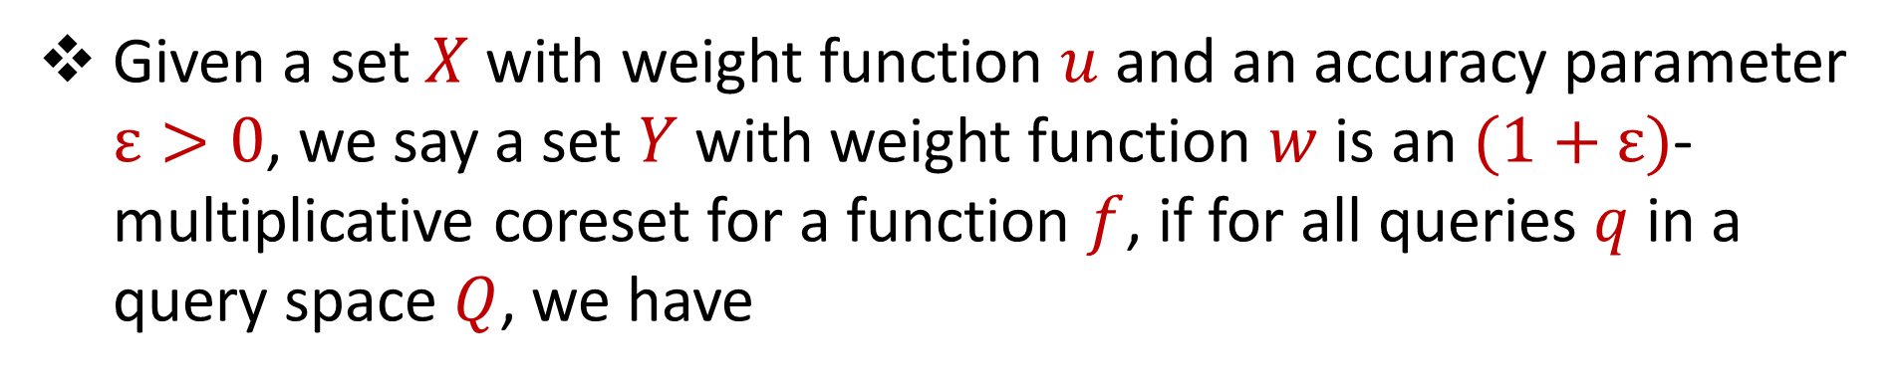
Coreset (Formal Definition)
Given a set $X$ with weight function $u$ and an accuracy parameter $ε>0$, we say a set $Y$ with weight function $w$is an $(1+ε)$-multiplicative coreset for a function $f$, if for all queries $q$ in a query space $Q$, we have
$$\left(1−ε\right)f\left(Y,q,w\right)≤f\left(X,q,u\right)≤\left(1+ε\right)f(Y,q,w)$$

Slide 14
Coreset
Lots of different constructions with various tradeoffs
Size vs. accuracy
Size vs. computation time
Size vs. interpretability
Average-case vs. worst-case performance

Slide 15
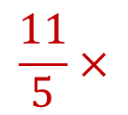
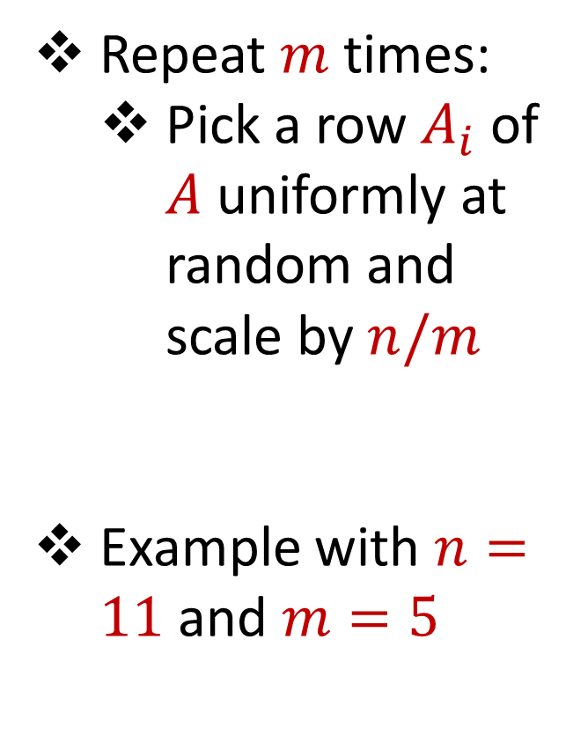
Uniform Sampling
1 0 3 0 1 1
1 1 0 0 2 8
2 0 1 3 0 8
1 1 0 0 0 8
0 0 0 7 0 0
7 0 0 8 0 0
3 4 1 1 0 2
4 2 0 1 0 1
9 1 0 0 3 2
1 1 6 0 0 0
8 1 0 1 2 0
Repeat $m$ times:
Pick a row $A_{i}$ of $A$ uniformly at random and scale by $n/m$
Example with $n=11$ and $m=5$
$$n$$
$$A$$
1 0 3 0 1 1
1 1 0 0 0 8
3 4 1 1 0 2
8 1 0 1 2 0
3 4 1 1 0 2
$$\frac{11}{5}×$$
$$A′$$
$$d$$
$$d$$

Slide 16

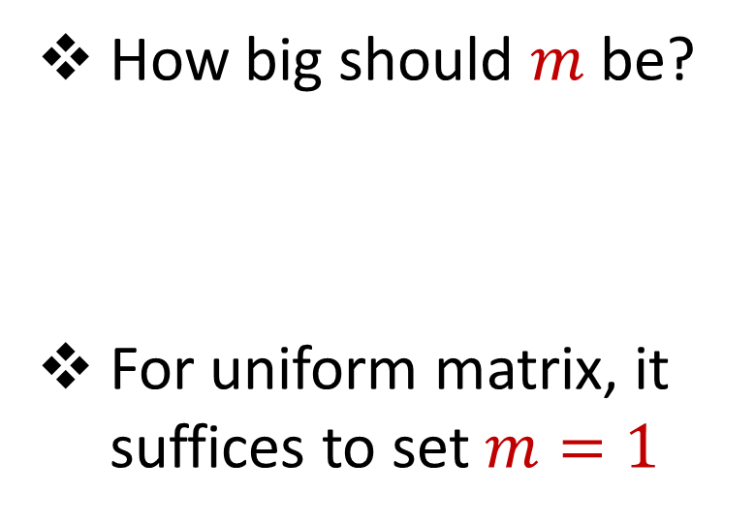


Uniform Sampling
1 0 0 0 0 0
1 0 0 0 0 0
1 0 0 0 0 0
1 0 0 0 0 0
1 0 0 0 0 0
1 0 0 0 0 0
1 0 0 0 0 0
1 0 0 0 0 0
1 0 0 0 0 0
1 0 0 0 0 0
1 0 0 0 0 0
How big should $m$ be?
For uniform matrix, it suffices to set $m=1$
$$n$$
$$A$$
$$d$$

Slide 17
Uniform Sampling
1 0 0 0 0 0
1 0 0 0 0 0
1 0 0 0 0 0
1 0 0 0 0 0
1 0 0 0 0 0
1 0 0 0 0 0
1 0 0 0 0 0
1 0 0 0 0 0
1 0 0 0 0 0
1 0 0 0 0 0
1 0 0 0 0 0
How big should $m$ be?
For uniform matrix, it suffices to set $m=1$
$$n$$
$$A$$
1 0 0 0 0 0
1 0 0 0 0 0
1 0 0 0 0 0
1 0 0 0 0 0
1 0 0 0 0 0
$$\frac{11}{5}×$$
$$A′$$
$$d$$
$$d$$

Slide 18
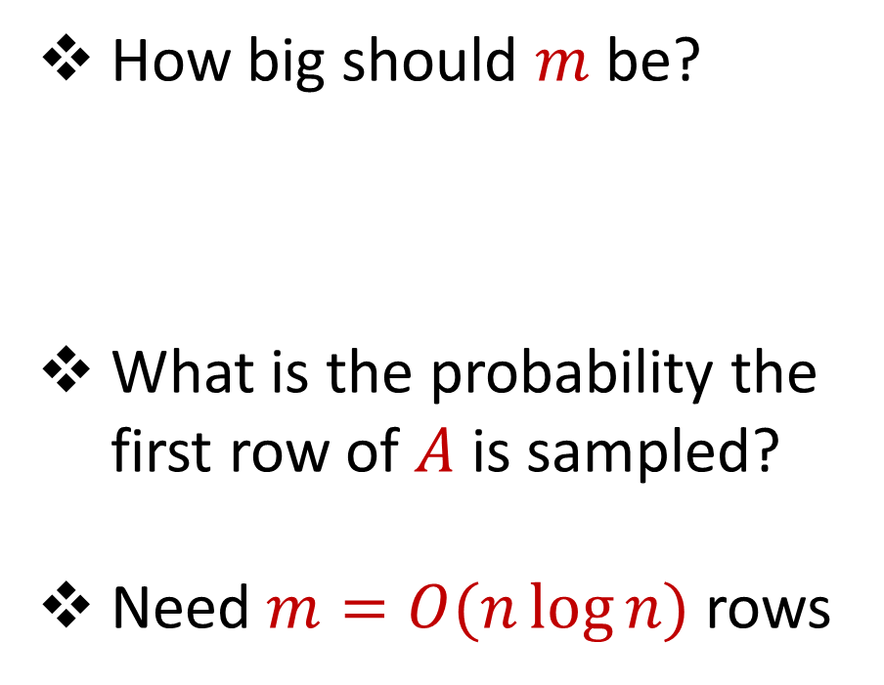
Uniform Sampling
0 0 0 0 0 1
1 0 0 0 0 0
1 0 0 0 0 0
1 0 0 0 0 0
1 0 0 0 0 0
1 0 0 0 0 0
1 0 0 0 0 0
1 0 0 0 0 0
1 0 0 0 0 0
1 0 0 0 0 0
1 0 0 0 0 0
How big should $m$ be?
What is the probability the first row of $A$ is sampled?
Need $m=O(n\log{n})$ rows
$$n$$
$$A$$
$$d$$

Slide 19
Uniform Sampling
Pros: intuitively simple, simple to implement, fast, good on uniform or “average-case” data
Cons: bad on “worst-case” data

Slide 20
Importance Sampling
1 0 0 0 0 0
1 0 0 0 0 0
1 0 0 0 0 0
1 0 0 0 0 0
1 0 0 0 0 0
1 0 0 0 0 0
0 0 0 0 0 1
1 0 0 0 0 0
1 0 0 0 0 0
1 0 0 0 0 0
1 0 0 0 0 0
What if we do not sample uniformly at random?
What is the probability that each row should be sampled?
$$n$$
$$A$$

Slide 21
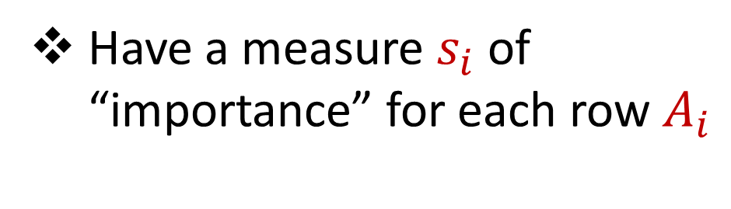
Importance Sampling
1 0 0 0 0 0
1 0 0 0 0 0
1 0 0 0 0 0
1 0 0 0 0 0
1 0 0 0 0 0
1 0 0 0 0 0
0 0 0 0 0 1
1 0 0 0 0 0
1 0 0 0 0 0
1 0 0 0 0 0
1 0 0 0 0 0
Have a measure $s_{i}$ of “importance” for each row $A_{i}$
$$n$$
$$A$$

Slide 22

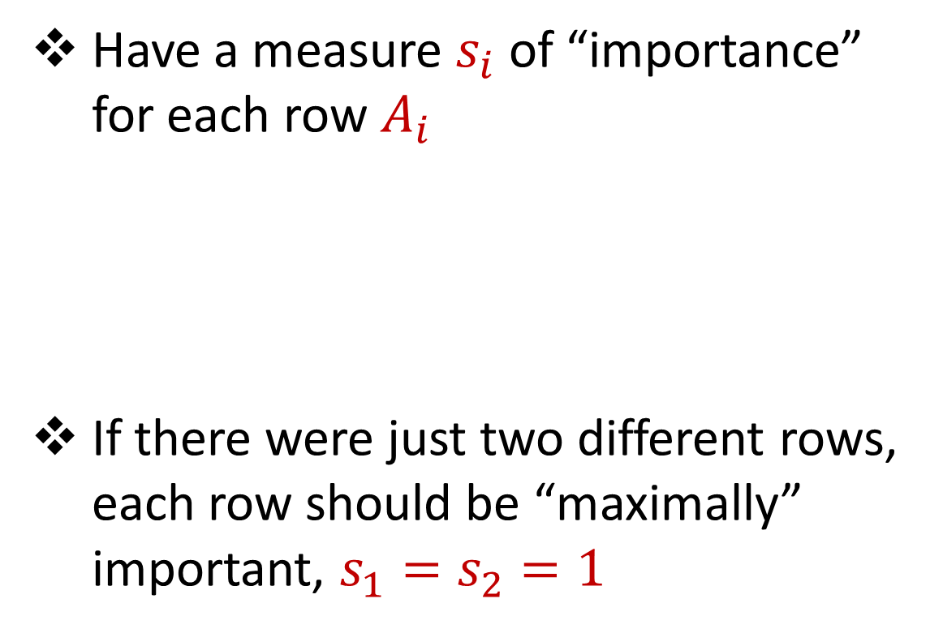



Importance Sampling
1 0 0 0 0 0
1 0 0 0 0 0
1 0 0 0 0 0
1 0 0 0 0 0
1 0 0 0 0 0
1 0 0 0 0 0
0 0 0 0 0 1
1 0 0 0 0 0
1 0 0 0 0 0
1 0 0 0 0 0
1 0 0 0 0 0
Have a measure $s_{i}$ of “importance” for each row $A_{i}$
If there were just two different rows, each row should be “maximally” important, $s_{1}=s_{2}=1$
$$n$$
$$A$$
1 0 0 0 0 0
0 0 0 0 0 1
$$n$$
$$A$$

Slide 23
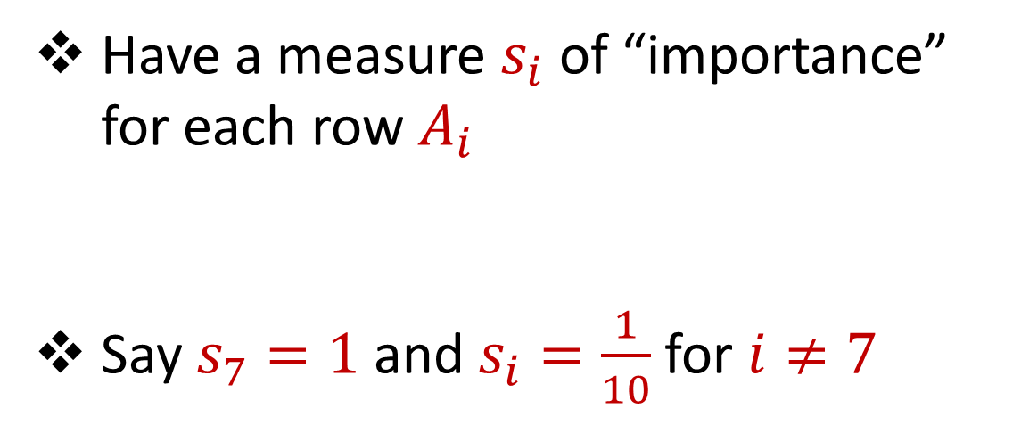
Importance Sampling
1 0 0 0 0 0
1 0 0 0 0 0
1 0 0 0 0 0
1 0 0 0 0 0
1 0 0 0 0 0
1 0 0 0 0 0
0 0 0 0 0 1
1 0 0 0 0 0
1 0 0 0 0 0
1 0 0 0 0 0
1 0 0 0 0 0
Have a measure $s_{i}$ of “importance” for each row $A_{i}$
Say $s_{7}=1$ and $s_{i}=\frac{1}{10}$ for $i≠7$
$$n$$
$$A$$

Slide 24
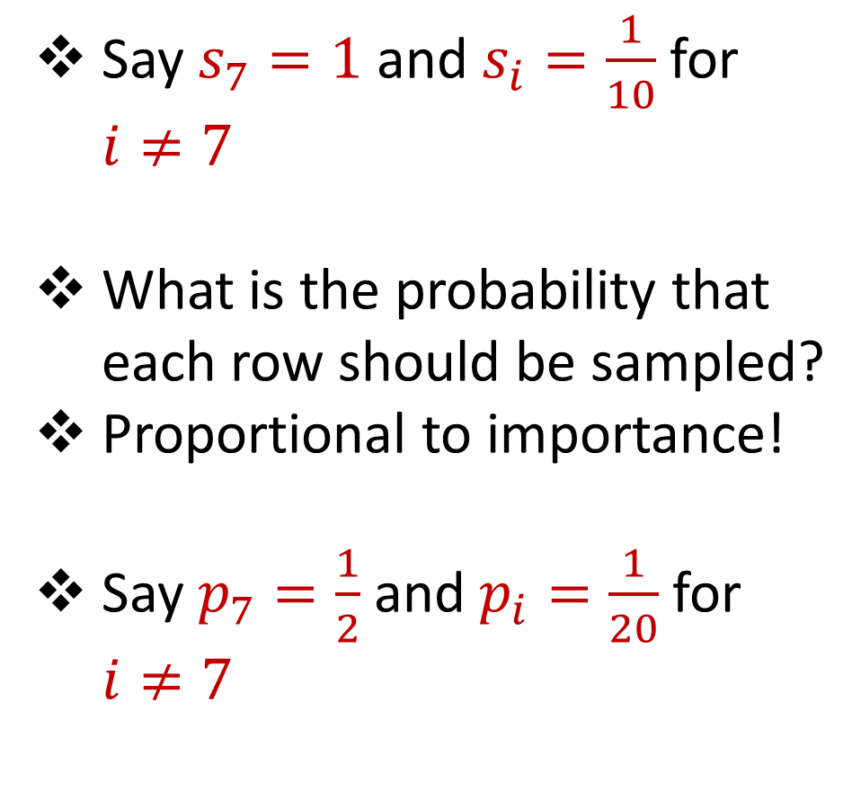
Importance Sampling
1 0 0 0 0 0
1 0 0 0 0 0
1 0 0 0 0 0
1 0 0 0 0 0
1 0 0 0 0 0
1 0 0 0 0 0
0 0 0 0 0 1
1 0 0 0 0 0
1 0 0 0 0 0
1 0 0 0 0 0
1 0 0 0 0 0
Say $s_{7}=1$ and $s_{i}=\frac{1}{10}$ for $i≠7$
What is the probability that each row should be sampled?
Proportional to importance!
Say $p_{7}=\frac{1}{2}$ and $p_{i}=\frac{1}{20}$ for $i≠7$
$$n$$
$$A$$

Slide 25
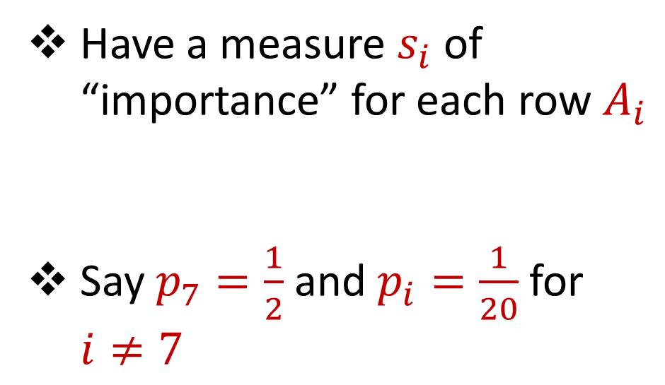
Importance Sampling
1 0 0 0 0 0
1 0 0 0 0 0
1 0 0 0 0 0
1 0 0 0 0 0
1 0 0 0 0 0
1 0 0 0 0 0
0 0 0 0 0 1
1 0 0 0 0 0
1 0 0 0 0 0
1 0 0 0 0 0
1 0 0 0 0 0
Have a measure $s_{i}$ of “importance” for each row $A_{i}$
Say $p_{7}=\frac{1}{2}$ and $p_{i}=\frac{1}{20}$ for $i≠7$
$$n$$
$$A$$

Slide 26

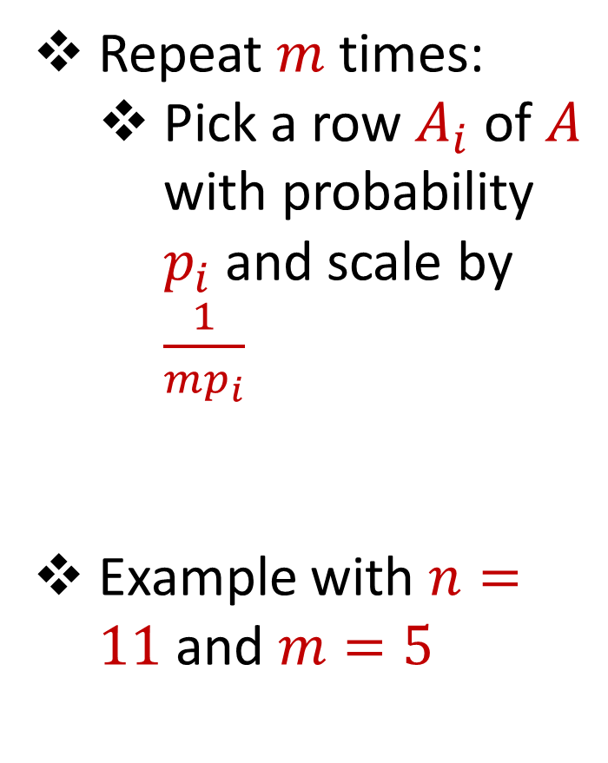

Importance Sampling
1 0 0 0 0 0
1 0 0 0 0 0
1 0 0 0 0 0
1 0 0 0 0 0
1 0 0 0 0 0
1 0 0 0 0 0
0 0 0 0 0 1
1 0 0 0 0 0
1 0 0 0 0 0
1 0 0 0 0 0
1 0 0 0 0 0
Repeat $m$ times:
Pick a row $A_{i}$ of $A$ with probability $p_{i}$and scale by $\frac{1}{mp_{i}}$
Example with $n=11$ and $m=5$
$$n$$
$$A$$
4 0 0 0 0 0
4 0 0 0 0 0
0 0 0 0 0 $\frac{2}{5}$
4 0 0 0 0 0
0 0 0 0 0 $\frac{2}{5}$
$$A′$$
$$d$$
$$d$$

Slide 27
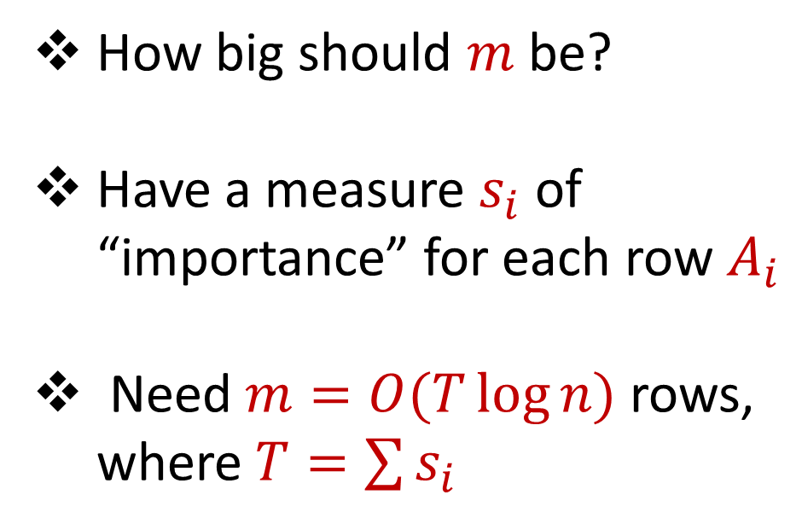
Importance Sampling
0 0 0 0 0 1
1 0 0 0 0 0
1 0 0 0 0 0
1 0 0 0 0 0
1 0 0 0 0 0
1 0 0 0 0 0
1 0 0 0 0 0
1 0 0 0 0 0
1 0 0 0 0 0
1 0 0 0 0 0
1 0 0 0 0 0
How big should $m$ be?
Have a measure $s_{i}$ of “importance” for each row $A_{i}$
Need $m=O(T\log{n})$ rows, where $T=\sum{s_{i}}$
$$n$$
$$A$$
$$d$$

Slide 28
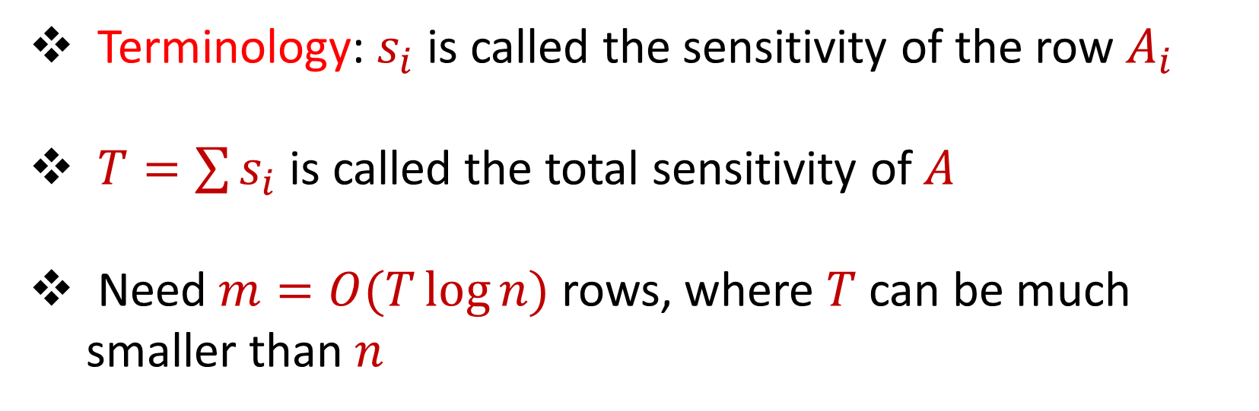
Sensitivity Sampling
Terminology: $s_{i}$ is called the sensitivity of the row $A_{i}$
$T=\sum{s_{i}}$ is called the total sensitivity of $A$
Need $m=O(T\log{n})$ rows, where $T$ can be much smaller than $n$

Slide 29

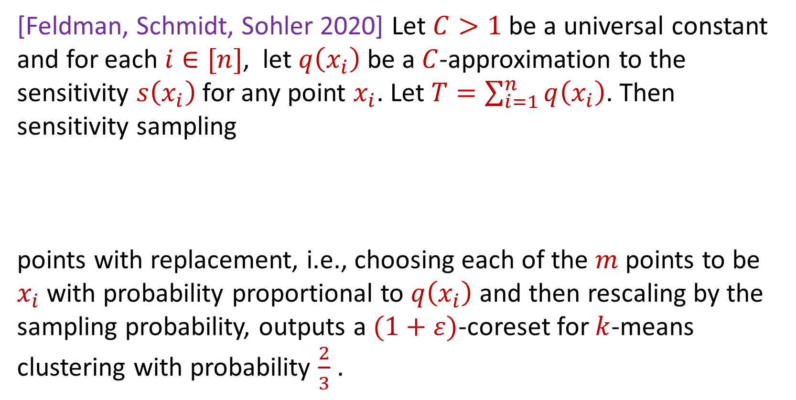
Sensitivity Sampling (Formal Theorem)
[Feldman, Schmidt, Sohler 2020] Let $C>1$ be a universal constant and for each $i∈[n]$, let $q\left(x_{i}\right)$ be a $C$-approximation to the sensitivity $s\left(x_{i}\right)$for any point $x_{i}$. Let $T=\sum_{i=1}^{n}{q\left(x_{i}\right)}$. Then sensitivity sampling
points with replacement, i.e., choosing each of the $m$ points to be $x_{i}$with probability proportional to $q\left(x_{i}\right)$ and then rescaling by the sampling probability, outputs a $(1+ε)$-coreset for $k$-means clustering with probability $\frac{2}{3}$ .
$$m=O\left(\frac{Tk}{ε^{2}}\log^{2}{k}\right)$$

Slide 30
Sensitivity Sampling
Pros: size is always better than uniform sampling and MUCH better on “worst-case” data
Cons: estimating the sensitivities can be a difficult design choice, computing the total sensitivity can be mathematically challenging, larger runtime

Slide 31
 | Uniform Sampling | Sensitivity Sampling
Average-case size | X | X
Worst-case size |  | X
Ease of implementation Computation of probabilities | X
Interpretability |  | X

Slide 32



Group / Stratified Sampling
0 0 0 0 0 1
1 0 0 0 0 0
1 0 0 0 0 0
1 0 0 0 0 0
1 0 0 0 0 0
1 0 0 0 0 0
1 0 0 0 0 0
1 0 0 0 0 0
1 0 0 0 0 0
1 0 0 0 0 0
1 0 0 0 0 0
Separate the data into “groups” and then perform uniform sampling on each group
If the data is uniform in each group, this is essentially sensitivity sampling
$$n$$
$$A$$
$$d$$

Slide 34
Coresets
Where to apply them?
Which sampling approach to use?
Worst-case mathematical bounds

Slide 35
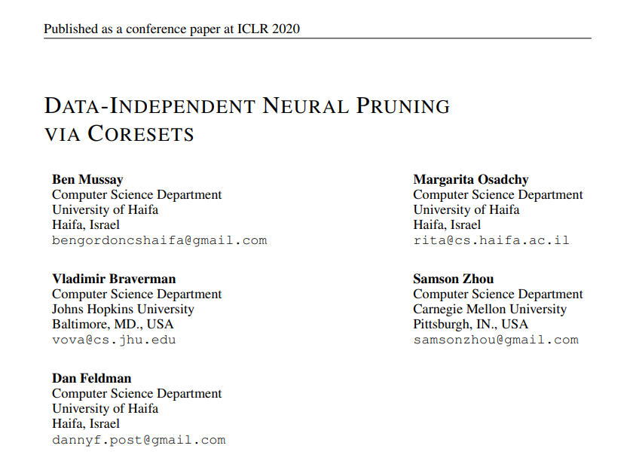
Coresets
Where to apply them?

Slide 36
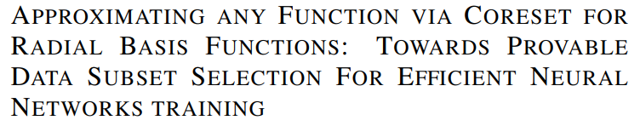
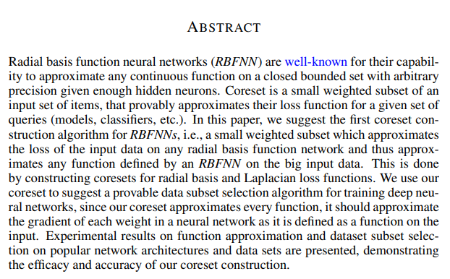
Coresets
Which sampling approach to use?

Slide 37
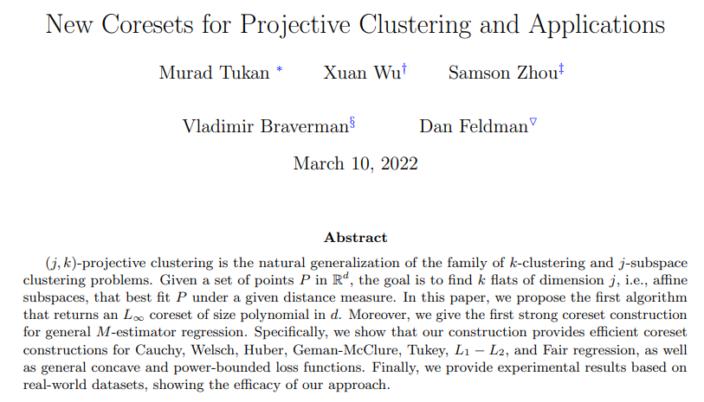
Coresets
Worst-case mathematical bounds

