Slide 1
CSCE 658: Randomized Algorithms
Lecture 10
Samson Zhou

Slide 2

CountSketch Error Analysis
$c_{a}=s\left(i\right)⋅s\left(i\right)⋅f_{i}+\sum_{j≠i, with j:h\left(j\right)=a}{s\left(i\right)⋅s\left(j\right)⋅f_{j}}$
Since $s\left(i\right)∈\{−1,+1\}$, we have $s\left(i\right)⋅s\left(i\right)=1$
What is the expectation of the error term for $f_{i}$?

Slide 3

CountSketch Error Analysis
$c_{a}=s\left(i\right)⋅s\left(i\right)⋅f_{i}+\sum_{j≠i, with j:h\left(j\right)=a}{s\left(i\right)⋅s\left(j\right)⋅f_{j}}$
What is the expectation of the error term for $f_{i}$?
$E\left[\sum_{j≠i, with j:h\left(j\right)=a}{{s\left(i\right)⋅s\left(j\right)⋅f}_{j}}\right]=Σ_{j≠i}E\left[{s\left(i\right)⋅s\left(j\right)⋅f}_{j}⋅I_{h\left(j\right)=h(i)}\right]$

Slide 4

CountSketch Error Analysis
$c_{a}=s\left(i\right)⋅s\left(i\right)⋅f_{i}+\sum_{j≠i, with j:h\left(j\right)=a}{s\left(i\right)⋅s\left(j\right)⋅f_{j}}$
What is the expectation of the error term for $f_{i}$?
$E\left[\sum_{j≠i, with j:h\left(j\right)=a}{{s\left(i\right)⋅s\left(j\right)⋅f}_{j}}\right]=0$

Slide 5

CountSketch Error Analysis
$c_{a}=s\left(i\right)⋅s\left(i\right)⋅f_{i}+\sum_{j≠i, with j:h\left(j\right)=a}{s\left(i\right)⋅s\left(j\right)⋅f_{j}}$
What is the expectation of the error term for $f_{i}$?
$E\left[\sum_{j≠i, with j:h\left(j\right)=a}{{s\left(i\right)⋅s\left(j\right)⋅f}_{j}}\right]=0$
What is the variance of the error term for $f_{i}$?

Slide 6

CountSketch Error Analysis
Variance is at most the 2nd moment of the error term
$E\left[{\left(\sum_{j≠i, with j:h\left(j\right)=a}{{s\left(i\right)⋅s\left(j\right)⋅f}_{j}}\right)}^{2}\right]$

Slide 7

CountSketch Error Analysis
Variance is at most the 2nd moment of the error term
$E\left[{\left(\sum_{j≠i, with j:h\left(j\right)=a}{{s\left(i\right)⋅s\left(j\right)⋅f}_{j}}\right)}^{2}\right]=Σ_{j≠i}E\left[{\left|f_{j}\right|}^{2}⋅I_{h\left(j\right)=h(i)}\right]$

Slide 8

CountSketch Error Analysis
Variance is at most the 2nd moment of the error term
$E\left[{\left(\sum_{j≠i, with j:h\left(j\right)=a}{{s\left(i\right)⋅s\left(j\right)⋅f}_{j}}\right)}^{2}\right]=Σ_{j≠i}E\left[{\left|f_{j}\right|}^{2}⋅I_{h\left(j\right)=h(i)}\right]$
$$=Σ_{j≠i}E\left[I_{h\left(j\right)=h(i)}\right]⋅{\left|f_{j}\right|}^{2}$$

Slide 9

CountSketch Error Analysis
Variance is at most the 2nd moment of the error term
$E\left[{\left(\sum_{j≠i, with j:h\left(j\right)=a}{{s\left(i\right)⋅s\left(j\right)⋅f}_{j}}\right)}^{2}\right]=Σ_{j≠i}E\left[{\left|f_{j}\right|}^{2}⋅I_{h\left(j\right)=h(i)}\right]$
$$=Σ_{j≠i}E\left[I_{h\left(j\right)=h(i)}\right]⋅{\left|f_{j}\right|}^{2}$$
$$=Σ_{j≠i}Pr\left[h\left(j\right)=h(i)\right]⋅{\left|f_{j}\right|}^{2}$$

Slide 10

CountSketch Error Analysis
Variance is at most the 2nd moment of the error term
$E\left[{\left(\sum_{j≠i, with j:h\left(j\right)=a}{{s\left(i\right)⋅s\left(j\right)⋅f}_{j}}\right)}^{2}\right]=Σ_{j≠i}E\left[{\left|f_{j}\right|}^{2}⋅I_{h\left(j\right)=h(i)}\right]$
$$=Σ_{j≠i}E\left[I_{h\left(j\right)=h(i)}\right]⋅{\left|f_{j}\right|}^{2}$$
$$=Σ_{j≠i}Pr\left[h\left(j\right)=h(i)\right]⋅{\left|f_{j}\right|}^{2}$$
$$=Σ_{j≠i}\frac{1}{b}⋅{\left|f_{j}\right|}^{2}≤\frac{{\left\|f\right\|}_{2}^{2}}{b}$$

Slide 11
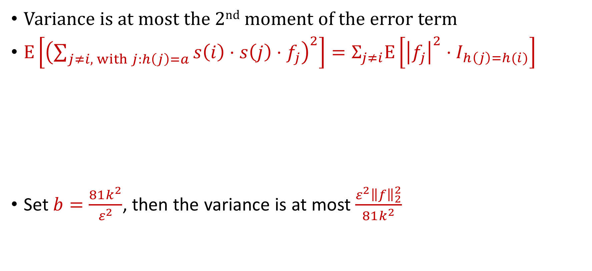
CountSketch Error Analysis
Variance is at most the 2nd moment of the error term
$E\left[{\left(\sum_{j≠i, with j:h\left(j\right)=a}{{s\left(i\right)⋅s\left(j\right)⋅f}_{j}}\right)}^{2}\right]=Σ_{j≠i}E\left[{\left|f_{j}\right|}^{2}⋅I_{h\left(j\right)=h(i)}\right]$
Set $b=\frac{81k^{2}}{ε^{2}}$, then the variance is at most $\frac{ε^{2}{\left\|f\right\|}_{2}^{2}}{81k^{2}}$
$$=Σ_{j≠i}E\left[I_{h\left(j\right)=h(i)}\right]⋅{\left|f_{j}\right|}^{2}$$
$$=Σ_{j≠i}Pr\left[h\left(j\right)=h(i)\right]⋅{\left|f_{j}\right|}^{2}$$
$$=Σ_{j≠i}\frac{1}{b}⋅{\left|f_{j}\right|}^{2}≤\frac{{\left\|f\right\|}_{2}^{2}}{b}$$

Slide 12
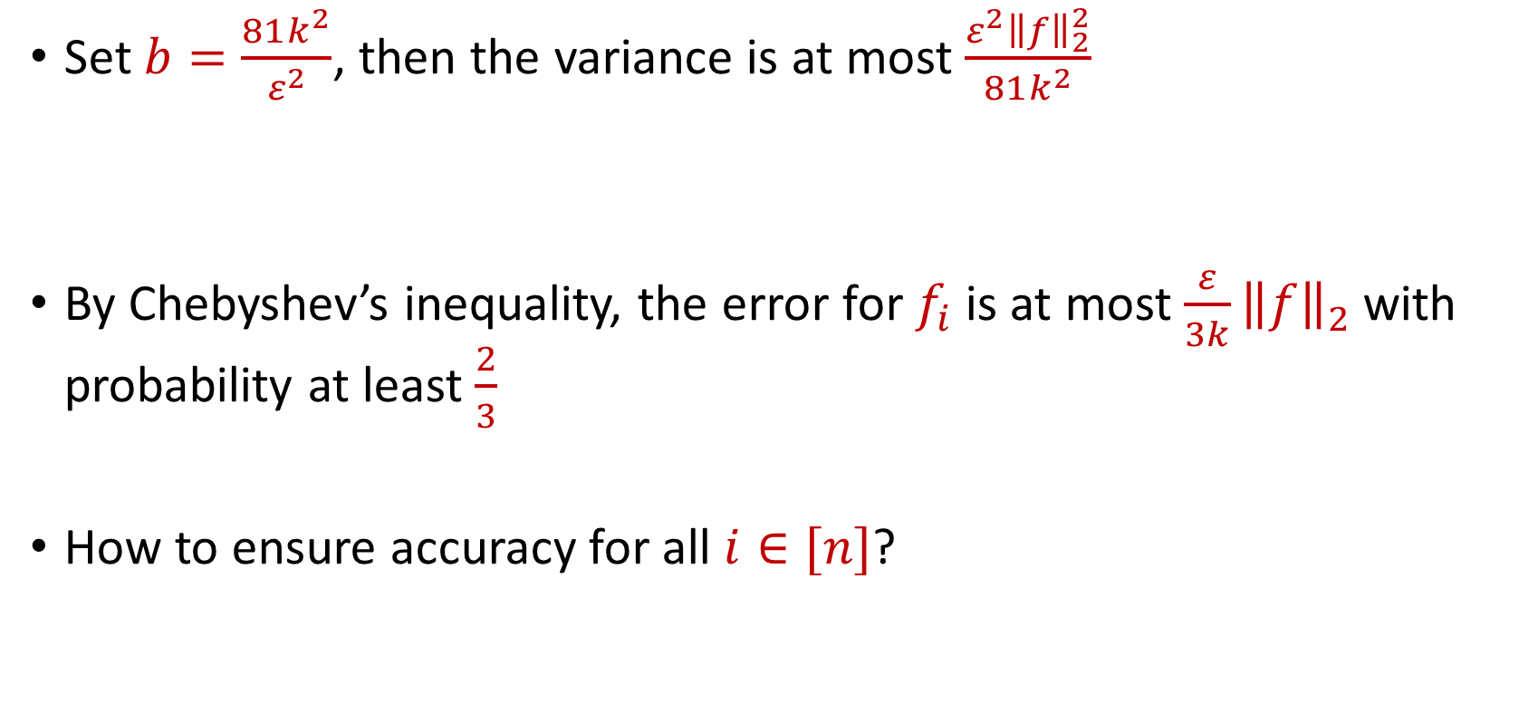
CountSketch Error Analysis
Set $b=\frac{81k^{2}}{ε^{2}}$, then the variance is at most $\frac{ε^{2}{\left\|f\right\|}_{2}^{2}}{81k^{2}}$
By Chebyshev’s inequality, the error for $f_{i}$ is at most $\frac{ε}{3k}{\left\|f\right\|}_{2}$with probability at least $\frac{2}{3}$
How to ensure accuracy for all $i∈[n]$?

Slide 13
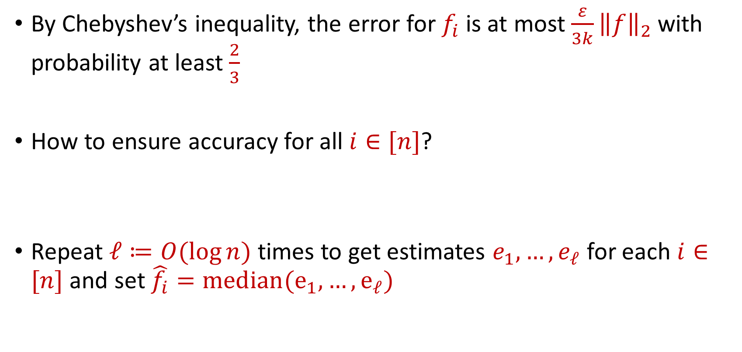
CountSketch Error Analysis
By Chebyshev’s inequality, the error for $f_{i}$ is at most $\frac{ε}{3k}{\left\|f\right\|}_{2}$with probability at least $\frac{2}{3}$
How to ensure accuracy for all $i∈[n]$?
Repeat $ℓ≔O(\log{n)}$ times to get estimates $e_{1},…,e_{ℓ}$ for each $i∈[n]$ and set $\hat{f_{i}}=median(e_{1},…, e_{ℓ})$

Slide 14


CountSketch Error Analysis
Claim: For all estimated frequencies $\hat{f_{i}}$ by CountSketch, we have
$$f_{i}−\frac{ε{\left\|f\right\|}_{2}}{3k}≤\hat{f_{i}}≤f_{i}+\frac{ε{\left\|f\right\|}_{2}}{3k}$$

Slide 15
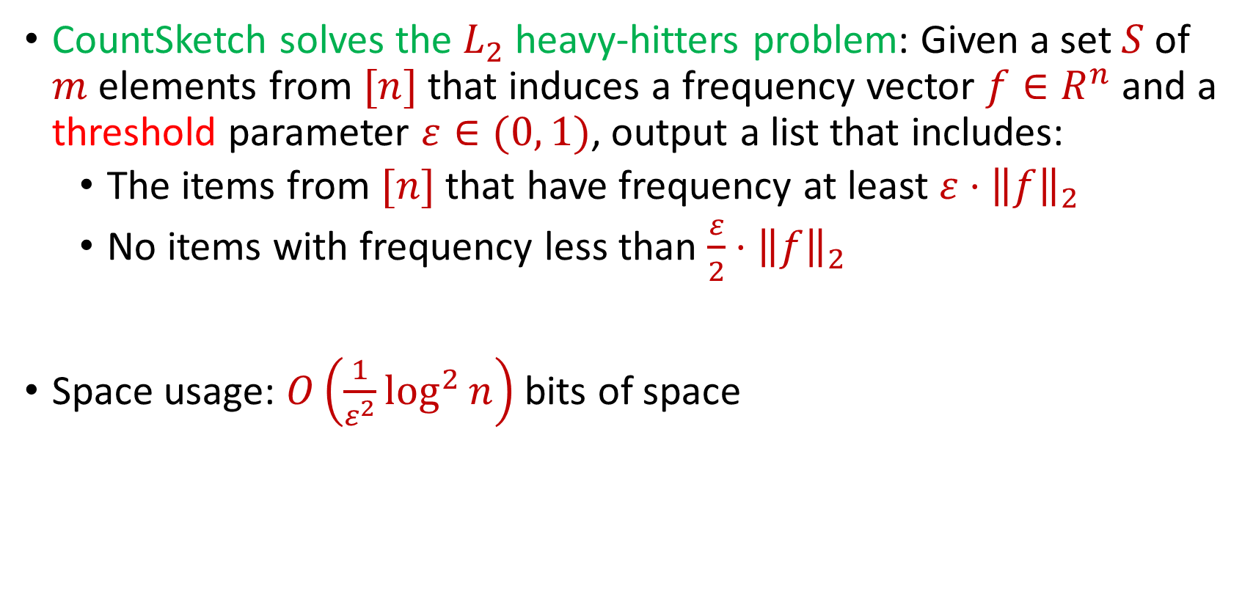
CountSketch Summary
CountSketch solves the $L_{2}$ heavy-hitters problem: Given a set $S$ of $m$ elements from $[n]$ that induces a frequency vector $f∈R^{n}$ and a threshold parameter $ε∈(0, 1)$, output a list that includes:
The items from $[n]$ that have frequency at least $ε⋅{\left\|f\right\|}_{2}$
No items with frequency less than $\frac{ε}{2}⋅{\left\|f\right\|}_{2}$
Space usage: $O\left(\frac{1}{ε^{2}}\log^{2}{n}\right)$ bits of space

