Slide 1
CSCE 689: Special Topics in Modern Algorithms for Data Science
Lecture 24
Samson Zhou

Slide 2
Presentation Schedule
November 27: Chunkai, Jung, Galaxy AI
November 29: STMI, Anmol, Jason
December 1: Bokun, Ayesha, Dawei, Lipai

Slide 3
Previously: Coreset
Subset $X′$ of representative points of $X$ for a specific clustering objective
$Cost\left(X,C\right)≈Cost(X^{′},C)$ for all sets $C$ with $\left|C\right|=k$

Slide 4
Previously: Coreset
Given a set $X$ and an accuracy parameter $ε>0$, we say a set $X′$ with weight function $w$is an $(1+ε)$-multiplicative coreset for a cost function $Cost$, if for all queries $C$ with $\left|C\right|≤k$, we have
$$\left(1−ε\right)Cost(X,C)≤Cost(X′,C,w)≤\left(1+ε\right)Cost(X,C)$$
$(k,z)$-clustering: $Cost\left(X^{′},C,w\right)=\sum_{x∈X′}{{w\left(x\right)⋅\left(dist\left(x,C\right)\right)}^{z}}$

Slide 5


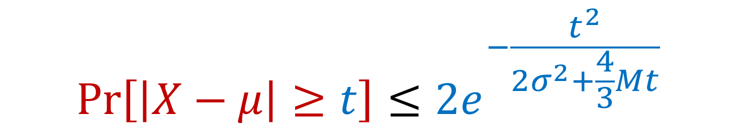
Previously: Bernstein’s Inequality
Bernstein’s inequality: Let $X_{1},…,X_{n}∈[−M,M]$ be independent random variables and let ${X=X}_{1}+…+X_{n}$ have mean $μ$ and variance $σ^{2}$. Then for any $t≥0$:
Example: Suppose $M=1$ and let $t=kσ$. Then
$$Pr\left[\left|X−μ\right|≥t\right]≤2e^{−\frac{t^{2}}{2σ^{2}+\frac{4}{3}Mt}}$$
$$Pr\left[\left|X−μ\right|≥kσ\right]≤2exp\left(−\frac{k^{2}}{4}\right)$$

Slide 6
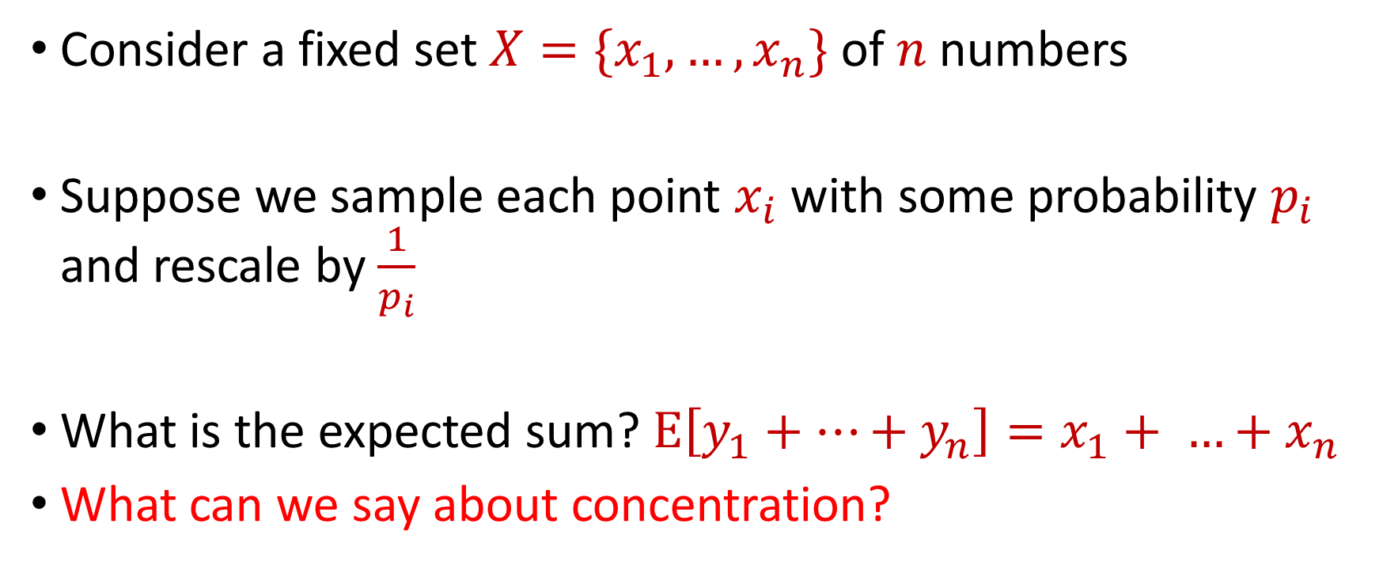
Last Time: Sampling for Sum Estimation
Consider a fixed set $X=\{x_{1},…,x_{n}\}$ of $n$ numbers
Suppose we sample each point $x_{i}$ with some probability $p_{i}$ and rescale by $\frac{1}{p_{i}}$
What is the expected sum? $E\left[y_{1}+…+y_{n}\right]=x_{1}+ …+x_{n}$
What can we say about concentration?

Slide 7
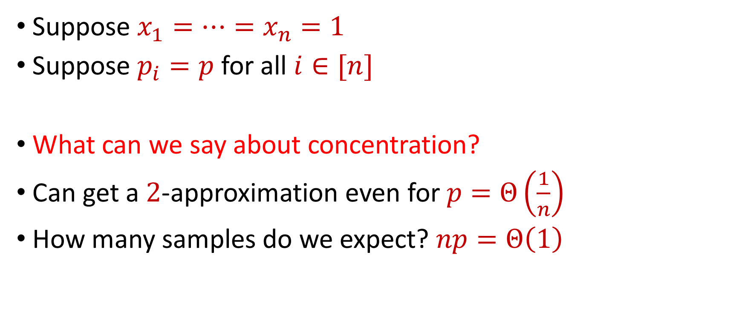
Last Time: Uniform Sampling for Sum Estimation
Suppose $x_{1}=…=x_{n}=1$
Suppose $p_{i}=p$ for all $i∈[n]$
What can we say about concentration?
Can get a $2$-approximation even for $p=Θ\left(\frac{1}{n}\right)$
How many samples do we expect? $np=Θ\left(1\right)$

Slide 8
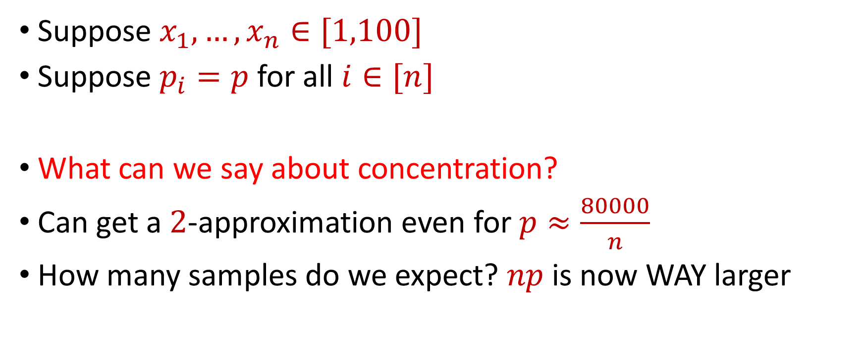
Last Time: Uniform Sampling for Sum Estimation
Suppose $x_{1},…,x_{n}∈[1,100]$
Suppose $p_{i}=p$ for all $i∈[n]$
What can we say about concentration?
Can get a $2$-approximation even for $p≈\frac{80000}{n}$
How many samples do we expect? $np$ is now WAY larger

Slide 9
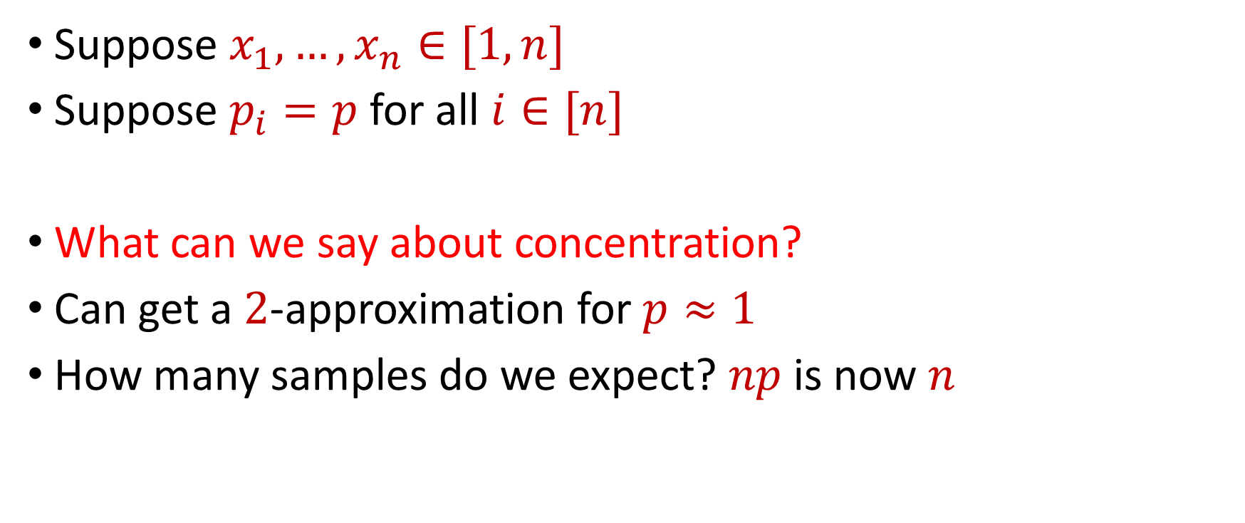
Last Time: Uniform Sampling for Sum Estimation
Suppose $x_{1},…,x_{n}∈[1,n]$
Suppose $p_{i}=p$ for all $i∈[n]$
What can we say about concentration?
Can get a $2$-approximation for $p≈1$
How many samples do we expect? $np$ is now $n$

Slide 10

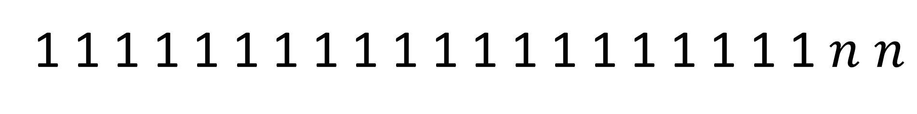
Uniform Sampling for Sum Estimation
Suppose $x_{1},…,x_{n}∈[1,n]$
Suppose $p_{i}=p$ for all $i∈[n]$
Do we really need $p$ to be a constant? YES!
1 1 1 1 1 1 1 1 1 1 1 1 1 1 1 1 1 1 1 1 $n$ $n$

Slide 11
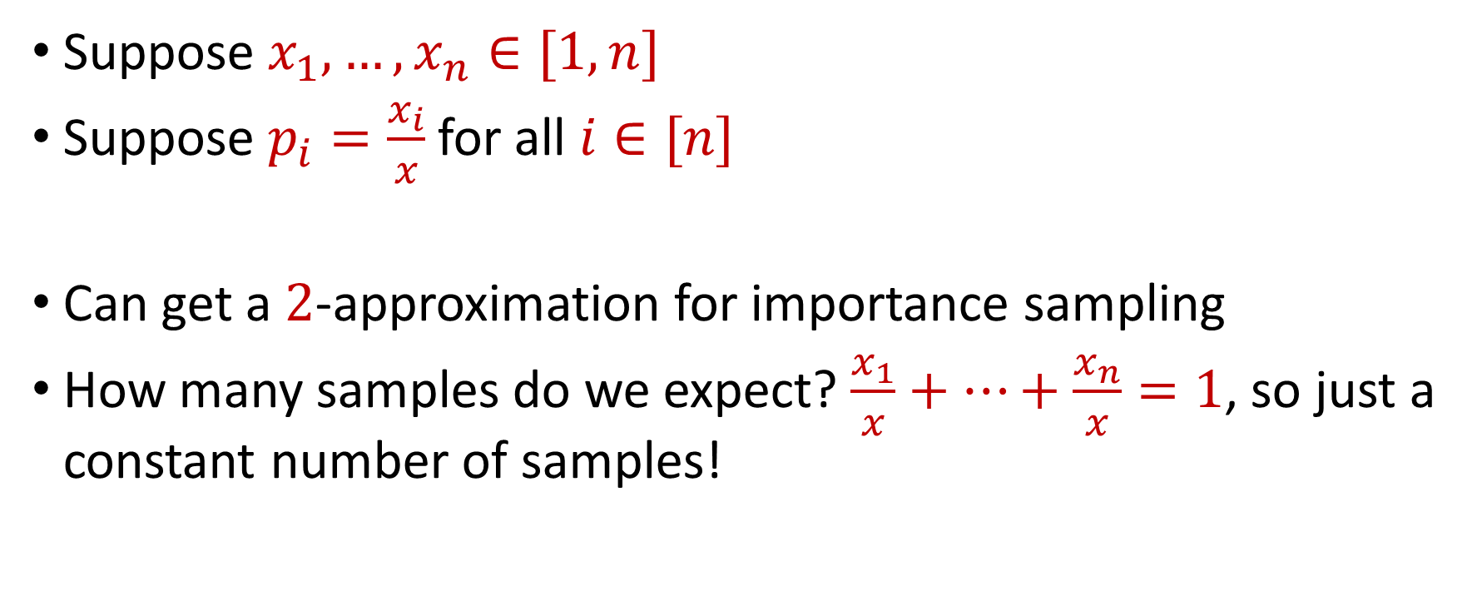
Last Time: Importance Sampling for Sum Estimation
Suppose $x_{1},…,x_{n}∈[1,n]$
Suppose $p_{i}=\frac{x_{i}}{x}$ for all $i∈[n]$
Can get a $2$-approximation for importance sampling
How many samples do we expect? $\frac{x_{1}}{x}+…+\frac{x_{n}}{x}=1$, so just a constant number of samples!

Slide 12
Coreset Construction and Sampling
Consider a fixed set $X$ and a fixed set $C$ of $k$ centers, which induces a fixed cost $Cost(X,C)$

Slide 13
Coreset Construction and Sampling
Consider a fixed set $X$ and a fixed set $C$ of $k$ centers, which induces a fixed cost $Cost(X,C)$
A simple way to obtain $X′$with $Cost\left(X^{′},C\right)≈Cost(X,C)$ is to uniformly sample points of $X$ into $X′$

Slide 14
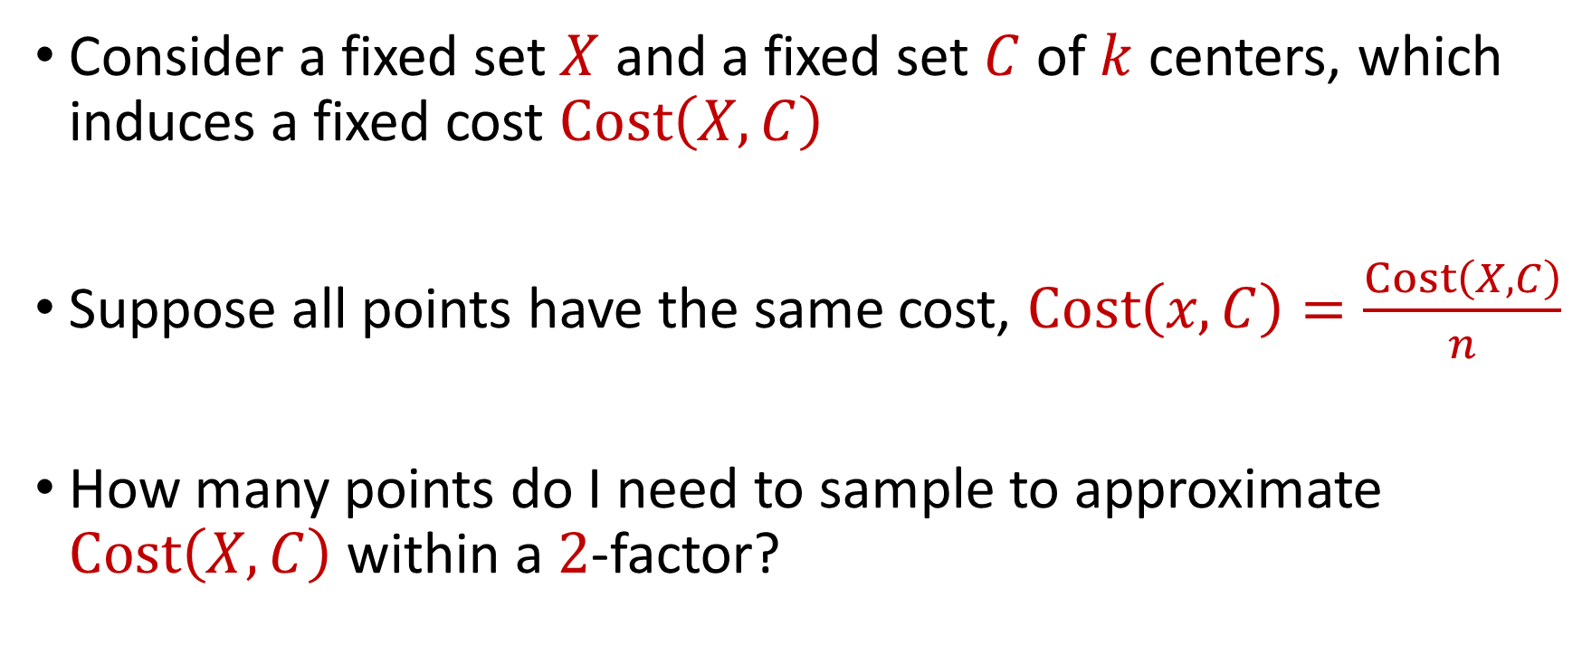
Coreset Construction and Uniform Sampling
Consider a fixed set $X$ and a fixed set $C$ of $k$ centers, which induces a fixed cost $Cost\left(X,C\right)$
Suppose all points have the same cost, $Cost\left(x,C\right)=\frac{Cost\left(X,C\right)}{n}$
How many points do I need to sample to approximate $Cost\left(X,C\right)$ within a $2$-factor?

Slide 15
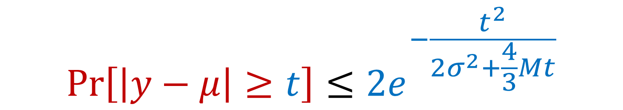

Bernstein’s Inequality
Bernstein’s inequality: Let $y_{1},…,y_{n}∈[−M,M]$ be independent random variables and let ${y=y}_{1}+…+y_{n}$ have mean $μ$ and variance $σ^{2}$. Then for any $t≥0$:
$$Pr\left[\left|y−μ\right|≥t\right]≤2e^{−\frac{t^{2}}{2σ^{2}+\frac{4}{3}Mt}}$$

Slide 16


Bernstein’s Inequality
Bernstein’s inequality: Let $y_{1},…,y_{n}∈[−M,M]$ be independent random variables and let ${y=y}_{1}+…+y_{n}$ have mean $μ$ and variance $σ^{2}$. Then for any $t≥0$:
Set $M=\frac{1}{p}$ , $t=\frac{1}{2}⋅Cost\left(X,C\right)$, and $σ^{2}≈\frac{n}{p}$. Then for $x=Cost\left(X,C\right)$,
$$Pr\left[\left|y−μ\right|≥t\right]≤2e^{−\frac{t^{2}}{2σ^{2}+\frac{4}{3}Mt}}$$
$$Pr\left[\left|y−μ\right|≥\frac{x}{2}\right]≤2exp\left(−\frac{{\left(x/2\right)}^{2}}{2\left(4n/p\right)+(4/3)(x/p)}\right)$$

Slide 17
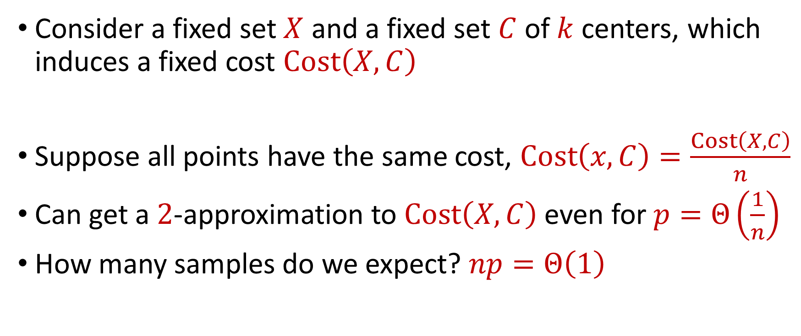
Coreset Construction and Uniform Sampling
Consider a fixed set $X$ and a fixed set $C$ of $k$ centers, which induces a fixed cost $Cost\left(X,C\right)$
Suppose all points have the same cost, $Cost\left(x,C\right)=\frac{Cost\left(X,C\right)}{n}$
Can get a $2$-approximation to $Cost\left(X,C\right)$even for $p=Θ\left(\frac{1}{n}\right)$
How many samples do we expect? $np=Θ\left(1\right)$

Slide 18

Coreset Construction and Uniform Sampling
Consider a fixed set $X$ and a fixed set $C$ of $k$ centers, which induces a fixed cost $Cost\left(X,C\right)$
Suppose all points have cost between $1$ and $100$
Suppose $p_{i}=p$ for all $i∈[n]$

Slide 19
Bernstein’s Inequality
Bernstein’s inequality: Let $y_{1},…,y_{n}∈[−M,M]$ be independent random variables and let ${y=y}_{1}+…+y_{n}$ have mean $μ$ and variance $σ^{2}$. Then for any $t≥0$:
$$Pr\left[\left|y−μ\right|≥t\right]≤2e^{−\frac{t^{2}}{2σ^{2}+\frac{4}{3}Mt}}$$

Slide 20
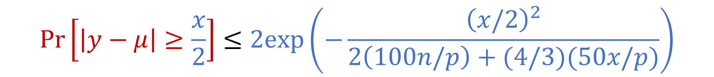

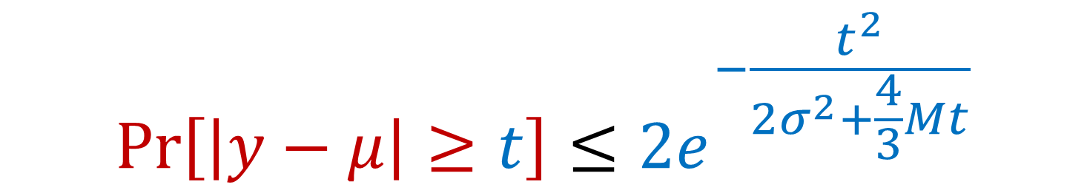
Bernstein’s Inequality
Bernstein’s inequality: Let $y_{1},…,y_{n}∈[−M,M]$ be independent random variables and let ${y=y}_{1}+…+y_{n}$ have mean $μ$ and variance $σ^{2}$. Then for any $t≥0$:
Set $M=\frac{100}{p}$ , $t=\frac{1}{2}⋅Cost\left(X,C\right)$, and $σ^{2}≈\frac{10000n}{p}$. Then for $x=Cost\left(X,C\right)$,
$$Pr\left[\left|y−μ\right|≥t\right]≤2e^{−\frac{t^{2}}{2σ^{2}+\frac{4}{3}Mt}}$$
$$Pr\left[\left|y−μ\right|≥\frac{x}{2}\right]≤2exp\left(−\frac{{\left(x/2\right)}^{2}}{2\left(100n/p\right)+(4/3)(50x/p)}\right)$$

Slide 21
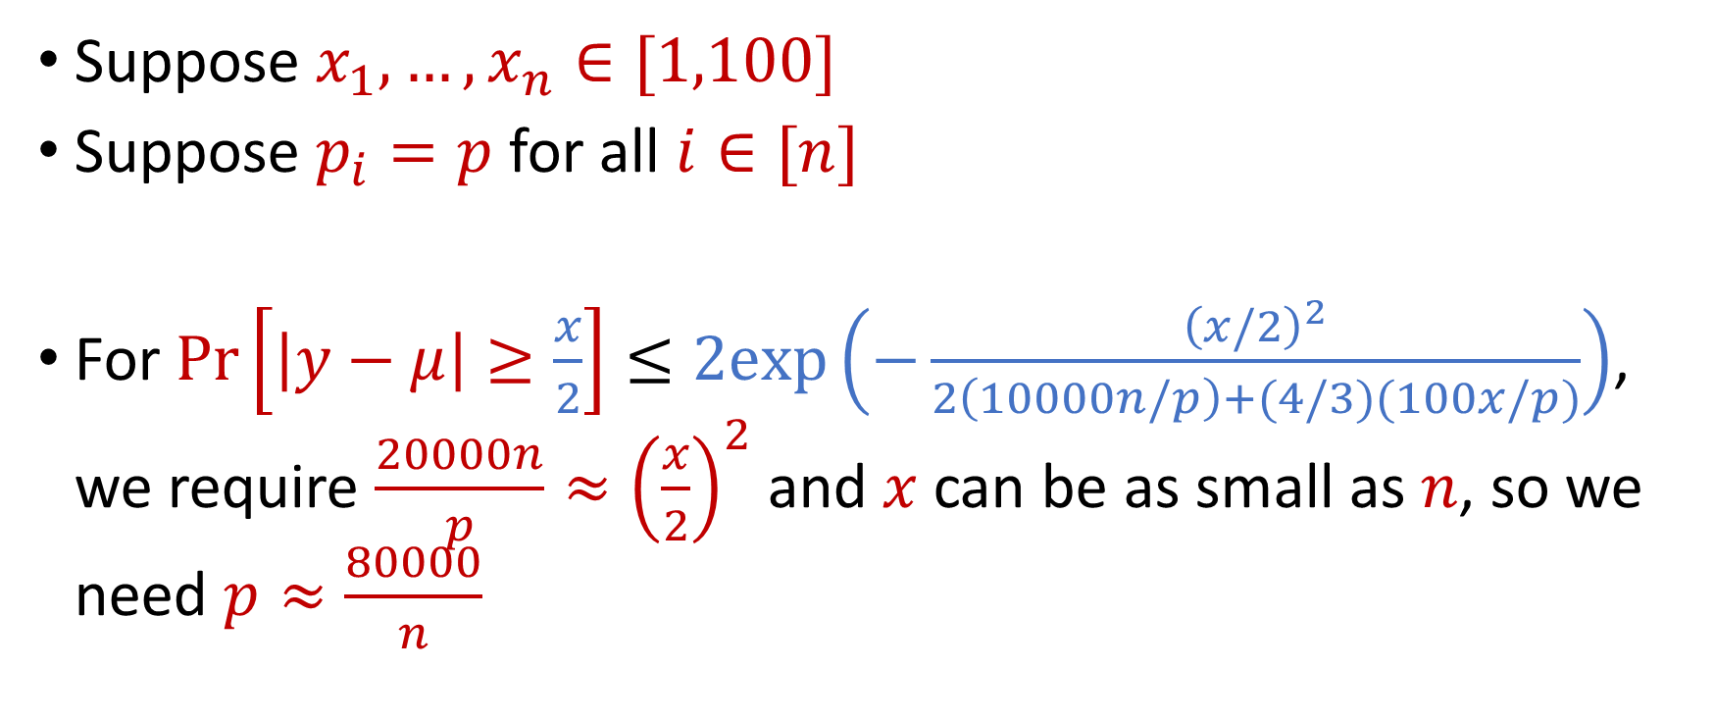
Coreset Construction and Uniform Sampling
Suppose $x_{1},…,x_{n}∈[1,100]$
Suppose $p_{i}=p$ for all $i∈[n]$
For $Pr\left[\left|y−μ\right|≥\frac{x}{2}\right]≤2exp\left(−\frac{{\left(x/2\right)}^{2}}{2\left(10000n/p\right)+(4/3)(100x/p)}\right)$, we require $\frac{20000n}{p}≈{\left(\frac{x}{2}\right)}^{2}$ and $x$ can be as small as $n$, so we need $p≈\frac{80000}{n}$

Slide 22
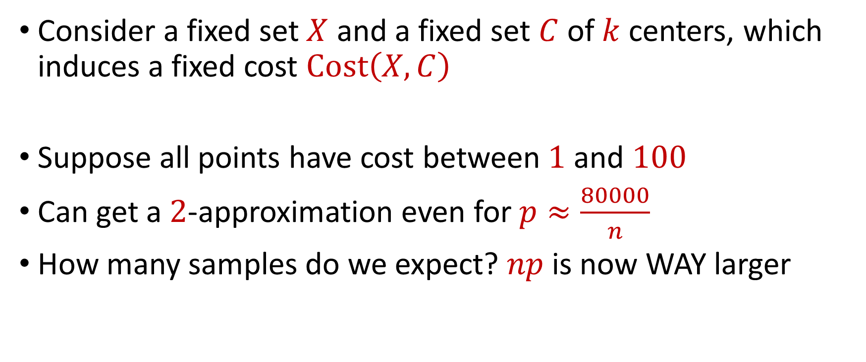
Coreset Construction and Uniform Sampling
Consider a fixed set $X$ and a fixed set $C$ of $k$ centers, which induces a fixed cost $Cost\left(X,C\right)$
Suppose all points have cost between $1$ and $100$
Can get a $2$-approximation even for $p≈\frac{80000}{n}$
How many samples do we expect? $np$ is now WAY larger

Slide 23
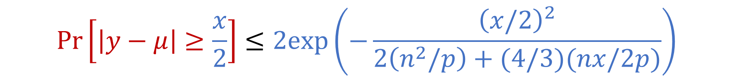

Coreset Construction and Uniform Sampling
Bernstein’s inequality: Let $y_{1},…,y_{n}∈[−M,M]$ be independent random variables and let ${y=y}_{1}+…+y_{n}$ have mean $μ$ and variance $σ^{2}$. Then for any $t≥0$:
Set $M=\frac{n}{p}$ , $t=\frac{1}{2}⋅Cost\left(X,C\right)$, and $σ^{2}≈\frac{n^{3}}{p}$. Then for $x=Cost\left(X,C\right)$,
$$Pr\left[\left|y−μ\right|≥t\right]≤2e^{−\frac{t^{2}}{2σ^{2}+\frac{4}{3}Mt}}$$
$$Pr\left[\left|y−μ\right|≥\frac{x}{2}\right]≤2exp\left(−\frac{{\left(x/2\right)}^{2}}{2\left(n^{2}/p\right)+(4/3)(nx/2p)}\right)$$

Slide 24
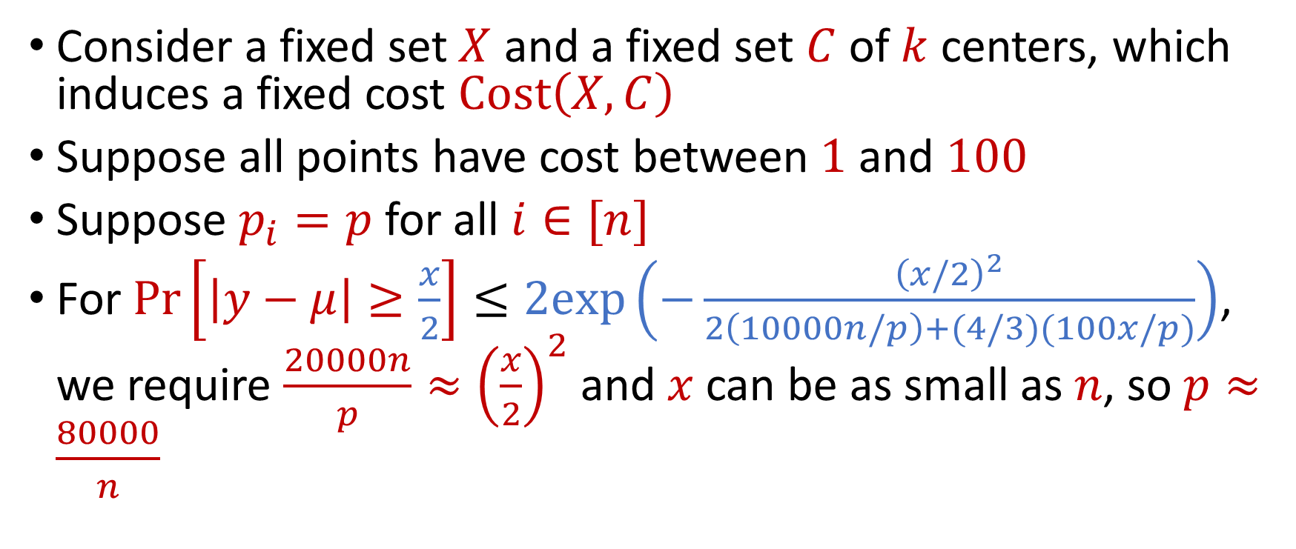
Coreset Construction and Uniform Sampling
Consider a fixed set $X$ and a fixed set $C$ of $k$ centers, which induces a fixed cost $Cost\left(X,C\right)$
Suppose all points have cost between $1$ and $100$
Suppose $p_{i}=p$ for all $i∈[n]$
For $Pr\left[\left|y−μ\right|≥\frac{x}{2}\right]≤2exp\left(−\frac{{\left(x/2\right)}^{2}}{2\left(10000n/p\right)+(4/3)(100x/p)}\right)$, we require $\frac{20000n}{p}≈{\left(\frac{x}{2}\right)}^{2}$ and $x$ can be as small as $n$, so $p≈\frac{80000}{n}$

Slide 25
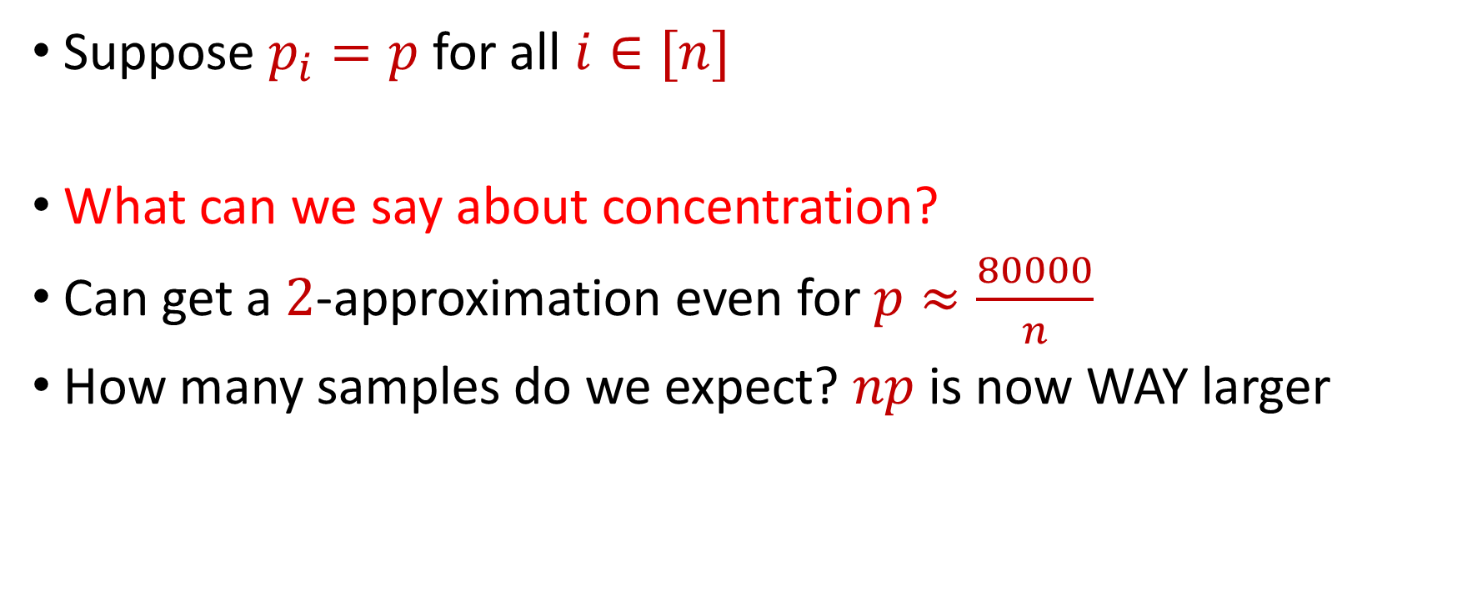
Coreset Construction and Uniform Sampling
Suppose $p_{i}=p$ for all $i∈[n]$
What can we say about concentration?
Can get a $2$-approximation even for $p≈\frac{80000}{n}$
How many samples do we expect? $np$ is now WAY larger

Slide 26
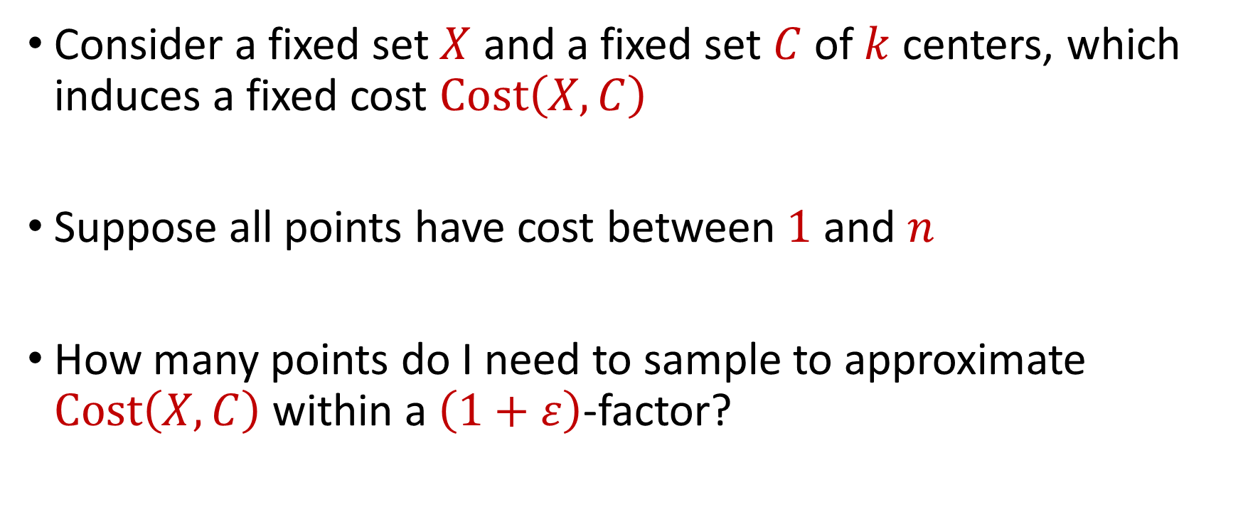
Coreset Construction and Uniform Sampling
Consider a fixed set $X$ and a fixed set $C$ of $k$ centers, which induces a fixed cost $Cost\left(X,C\right)$
Suppose all points have cost between $1$ and $n$
How many points do I need to sample to approximate $Cost\left(X,C\right)$ within a $\left(1+ε\right)$-factor?

Slide 27

Coreset Construction and Uniform Sampling
Bernstein’s inequality: Let $y_{1},…,y_{n}∈[−M,M]$ be independent random variables and let ${y=y}_{1}+…+y_{n}$ have mean $μ$ and variance $σ^{2}$. Then for any $t≥0$:
Set $M=\frac{n}{p}$ , $t=\frac{x}{2}$, and $σ^{2}≈\frac{n^{2}}{p}$. Then
$$Pr\left[\left|y−μ\right|≥t\right]≤2e^{−\frac{t^{2}}{2σ^{2}+\frac{4}{3}Mt}}$$
$$Pr\left[\left|y−μ\right|≥\frac{x}{2}\right]≤2exp\left(−\frac{{\left(x/2\right)}^{2}}{2\left(n^{2}/p\right)+(4/3)(nx/2p)}\right)$$

Slide 28
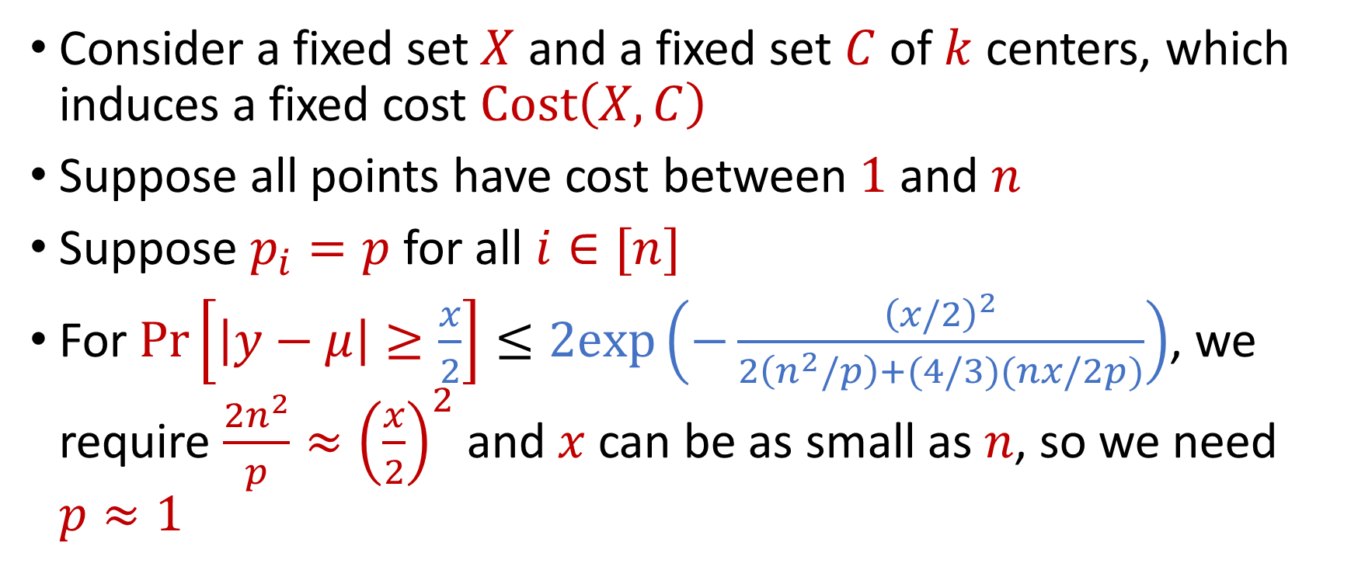
Uniform Sampling for Sum Estimation
Consider a fixed set $X$ and a fixed set $C$ of $k$ centers, which induces a fixed cost $Cost\left(X,C\right)$
Suppose all points have cost between $1$ and $n$
Suppose $p_{i}=p$ for all $i∈[n]$
For $Pr\left[\left|y−μ\right|≥\frac{x}{2}\right]≤2exp\left(−\frac{{\left(x/2\right)}^{2}}{2\left(n^{2}/p\right)+(4/3)(nx/2p)}\right)$, we require $\frac{2n^{2}}{p}≈{\left(\frac{x}{2}\right)}^{2}$ and $x$ can be as small as $n$, so we need $p≈1$

Slide 29
Coreset Construction and Sampling
Consider a fixed set $X$ and a fixed set $C$ of $k$ centers, which induces a fixed cost $Cost(X,C)$
Uniform sampling needs a lot of samples if there is a single point that greatly contributes to $Cost(X,C)$

Slide 30
Coreset Construction and Sampling
Fix: Importance sampling, sample each point $x∈X$ into $X′$ with probability proportional $Cost(x,C)$, i.e., $Cost(x,C)/Cost(X,C)$

Slide 31

Coreset Construction and Sampling
Fix: Importance sampling, sample each point $x∈X$ into $X′$ with probability proportional $Cost(x,C)$, i.e., $Cost(x,C)/Cost(X,C)$

Slide 32
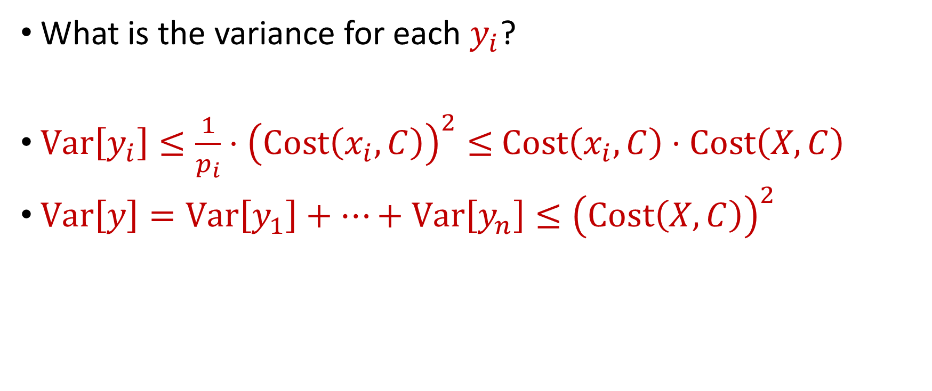
Importance Sampling for Coreset Construction
What is the variance for each $y_{i}$?
$Var\left[y_{i}\right]≤\frac{1}{p_{i}}⋅{\left(Cost\left(x_{i}, C\right)\right)}^{2}≤$ $Cost\left(x_{i}, C\right)⋅Cost\left(X, C\right)$
$Var\left[y\right]=Var\left[y_{1}\right]+…+Var\left[y_{n}\right]≤{\left(Cost\left(X, C\right)\right)}^{2}$

Slide 33
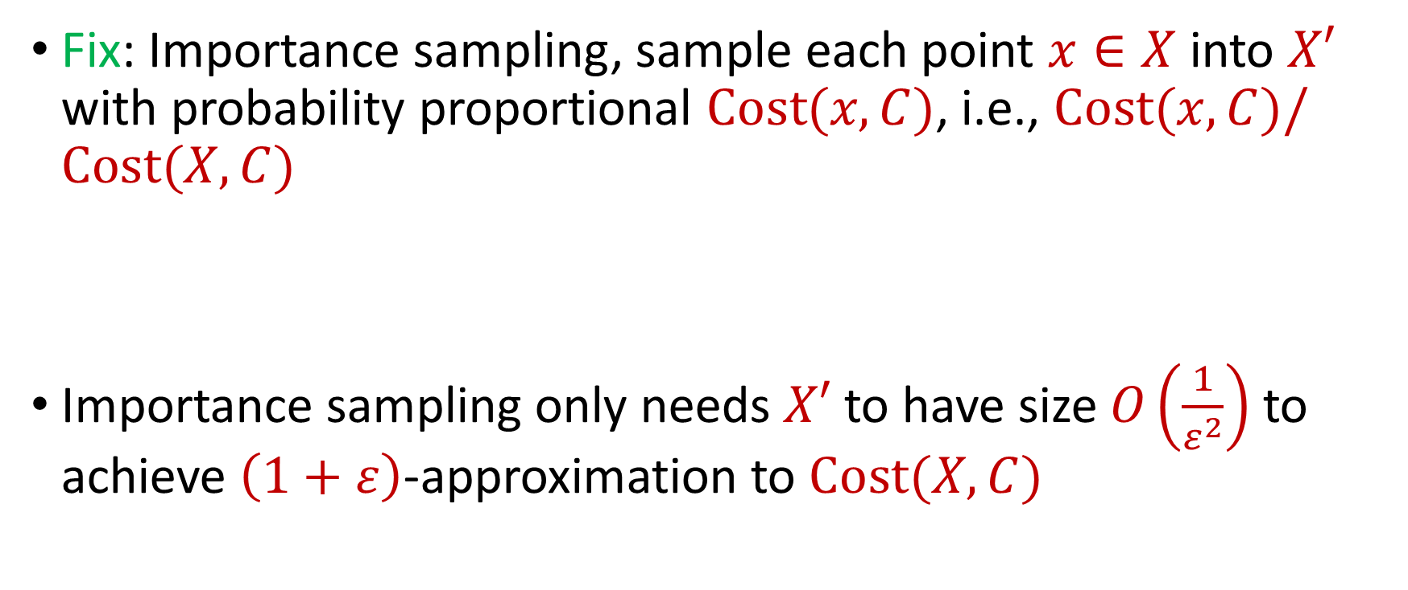
Coreset Construction and Sampling
Fix: Importance sampling, sample each point $x∈X$ into $X′$ with probability proportional $Cost(x,C)$, i.e., $Cost(x,C)/Cost(X,C)$
Importance sampling only needs $X′$ to have size $O\left(\frac{1}{ε^{2}}\right)$ to achieve $\left(1+ε\right)$-approximation to $Cost(X,C)$

Slide 34
Coreset Construction and Sampling
Importance sampling only needs $X′$ to have size $O\left(\frac{1}{ε^{2}}\right)$ to achieve $\left(1+ε\right)$-approximation to $Cost(X,C)$
What about a different choice $C$ of $k$ centers?

Slide 35
Coreset Construction and Sampling
Importance sampling only needs $X′$ to have size $O\left(\frac{1}{ε^{2}}\right)$ to achieve $\left(1+ε\right)$-approximation to $Cost(X,C)$
To handle all possible sets of $k$ centers:
Need to sample each point $x$ with probability $\max_{C}\frac{Cost\left(x,C\right)}{Cost\left(X,C\right)}$ instead of $\frac{Cost\left(x,C\right)}{Cost\left(X,C\right)}$
Need to union bound over a net of all possible sets of $k$ centers

Slide 36

Nets
A net $N$ is a set of sets $C$ of $k$ centers such that accuracy on $N$ implies accuracy everywhere

Slide 37
Coreset Construction and Sampling
Importance sampling only needs $X′$ to have size $O\left(\frac{1}{ε^{2}}\right)$ to achieve $\left(1+ε\right)$-approximation to $Cost(X,C)$
To handle all possible sets of $k$ centers:
Need to sample each point $x$ with probability $\max_{C}\frac{Cost\left(x,C\right)}{Cost\left(X,C\right)}$ instead of $\frac{Cost\left(x,C\right)}{Cost\left(X,C\right)}$
Need to union bound over a net of all possible sets of $k$ centers
Net with size ${\left(\frac{nΔ}{ε}\right)}^{O(kd)}$

Slide 38
Sensitivity Sampling
The quantity $s\left(x\right)=\max_{C}\frac{Cost\left(x,C\right)}{Cost\left(X,C\right)}$ is called the sensitivity of $x$ and intuitively measures how “important” the point $x$ is
The total sensitivity of $X$ is $\sum_{x∈X}{s(x)}$ and quantifies how many points will be sampled into $X′$ through importance/sensitivity sampling (before the union bound)

Slide 39

$$s\left(x_{t}\right)=\max_{C:\left|C\right|≤k}{\frac{Cost\left(x_{t},C\right)}{Cost\left(X,C\right)}}=\max_{C:\left|C\right|≤k}{\frac{Cost\left(x_{t},C\right)}{\sum_{i=1}^{n}{Cost\left(x_{i},C\right)}}}$$

Slide 40
$$s\left(x_{t}\right)=\max_{C:\left|C\right|≤k}{\frac{Cost\left(x_{t},C\right)}{Cost\left(X,C\right)}}=\max_{C:\left|C\right|≤k}{\frac{Cost\left(x_{t},C\right)}{\sum_{i=1}^{n}{Cost\left(x_{i},C\right)}}}$$
Point has sensitivity $1$

Slide 41
$$s\left(x_{t}\right)=\max_{C:\left|C\right|≤k}{\frac{Cost\left(x_{t},C\right)}{Cost\left(X,C\right)}}=\max_{C:\left|C\right|≤k}{\frac{Cost\left(x_{t},C\right)}{\sum_{i=1}^{n}{Cost\left(x_{i},C\right)}}}$$
Point has sensitivity $1$
Point has sensitivity $1$

Slide 42
$$s\left(x_{t}\right)=\max_{C:\left|C\right|≤k}{\frac{Cost\left(x_{t},C\right)}{Cost\left(X,C\right)}}=\max_{C:\left|C\right|≤k}{\frac{Cost\left(x_{t},C\right)}{\sum_{i=1}^{n}{Cost\left(x_{i},C\right)}}}$$
Point has sensitivity $1$
Point has sensitivity $1$
Point has sensitivity $1$

Slide 43
$$s\left(x_{t}\right)=\max_{C:\left|C\right|≤k}{\frac{Cost\left(x_{t},C\right)}{Cost\left(X,C\right)}}=\max_{C:\left|C\right|≤k}{\frac{Cost\left(x_{t},C\right)}{\sum_{i=1}^{n}{Cost\left(x_{i},C\right)}}}$$
Point has sensitivity $1$
Point has sensitivity $1$
Point has sensitivity $1$
Point has sensitivity $1$

Slide 44
$$s\left(x_{t}\right)=\max_{C:\left|C\right|≤k}{\frac{Cost\left(x_{t},C\right)}{Cost\left(X,C\right)}}=\max_{C:\left|C\right|≤k}{\frac{Cost\left(x_{t},C\right)}{\sum_{i=1}^{n}{Cost\left(x_{i},C\right)}}}$$
Point has sensitivity $1$
Point has sensitivity $1$
Point has sensitivity $1$
Point has sensitivity $1$
Point has sensitivity $1$

Slide 45
$$s\left(x_{t}\right)=\max_{C:\left|C\right|≤k}{\frac{Cost\left(x_{t},C\right)}{Cost\left(X,C\right)}}=\max_{C:\left|C\right|≤k}{\frac{Cost\left(x_{t},C\right)}{\sum_{i=1}^{n}{Cost\left(x_{i},C\right)}}}$$
Point has sensitivity $1$
Point has sensitivity $1$
Point has sensitivity $1$
Point has sensitivity $1$
Point has sensitivity $1$
Point has sensitivity $1$

Slide 46
$$s\left(x_{t}\right)=\max_{C:\left|C\right|≤k}{\frac{Cost\left(x_{t},C\right)}{Cost\left(X,C\right)}}=\max_{C:\left|C\right|≤k}{\frac{Cost\left(x_{t},C\right)}{\sum_{i=1}^{n}{Cost\left(x_{i},C\right)}}}$$
Point has sensitivity $1$
Point has sensitivity $1$
Point has sensitivity $1$
Point has sensitivity $1$
Point has sensitivity $1$
Point has sensitivity $1$
Point has sensitivity $1$

Slide 47
Sum of Online Sensitivity
Sum of online sensitivities can be at least $k$
How large can it be?

Slide 48
$$s\left(x_{t}\right)=\max_{C:\left|C\right|≤k}{\frac{Cost\left(x_{t},C\right)}{Cost\left(X,C\right)}}=\max_{C:\left|C\right|≤k}{\frac{Cost\left(x_{t},C\right)}{\sum_{i=1}^{n}{Cost\left(x_{i},C\right)}}}$$

Slide 49
$$s\left(x_{t}\right)=\max_{C:\left|C\right|≤k}{\frac{Cost\left(x_{t},C\right)}{Cost\left(X,C\right)}}=\max_{C:\left|C\right|≤k}{\frac{Cost\left(x_{t},C\right)}{\sum_{i=1}^{n}{Cost\left(x_{i},C\right)}}}$$

Slide 50
$$s\left(x_{t}\right)=\max_{C:\left|C\right|≤k}{\frac{Cost\left(x_{t},C\right)}{Cost\left(X,C\right)}}=\max_{C:\left|C\right|≤k}{\frac{Cost\left(x_{t},C\right)}{\sum_{i=1}^{n}{Cost\left(x_{i},C\right)}}}$$

Slide 51
$$s\left(x_{t}\right)=\max_{C:\left|C\right|≤k}{\frac{Cost\left(x_{t},C\right)}{Cost\left(X,C\right)}}=\max_{C:\left|C\right|≤k}{\frac{Cost\left(x_{t},C\right)}{\sum_{i=1}^{n}{Cost\left(x_{i},C\right)}}}$$

Slide 52
$$s\left(x_{t}\right)=\max_{C:\left|C\right|≤k}{\frac{Cost\left(x_{t},C\right)}{Cost\left(X,C\right)}}=\max_{C:\left|C\right|≤k}{\frac{Cost\left(x_{t},C\right)}{\sum_{i=1}^{n}{Cost\left(x_{i},C\right)}}}$$
Partition the sum of the sensitivities by each cluster

Slide 53
$$s\left(x_{t}\right)=\max_{C:\left|C\right|≤k}{\frac{Cost\left(x_{t},C\right)}{Cost\left(X,C\right)}}=\max_{C:\left|C\right|≤k}{\frac{Cost\left(x_{t},C\right)}{\sum_{i=1}^{n}{Cost\left(x_{i},C\right)}}}$$
Charge to $OPT$
Charge to $OPT$

Slide 54
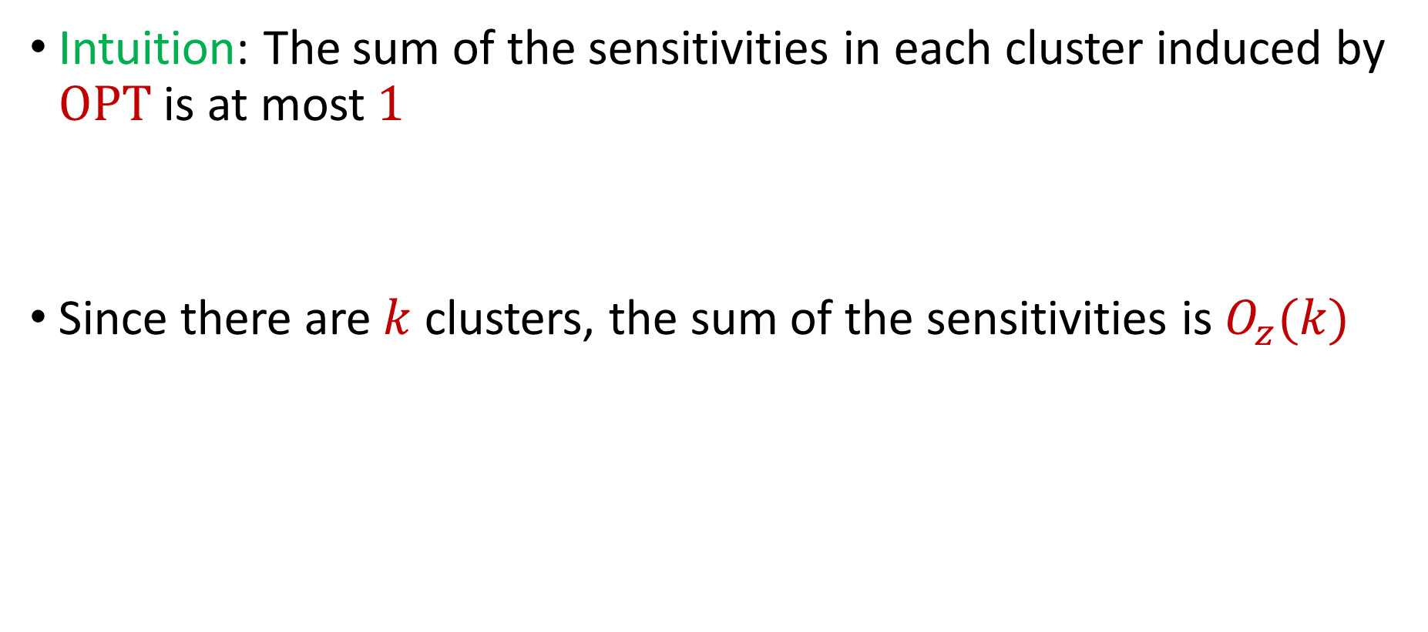
Sum of Online Sensitivity
Intuition: The sum of the sensitivities in each cluster induced by $OPT$ is at most $1$
Since there are $k$ clusters, the sum of the sensitivities is $O_{z}(k)$

Slide 55


census.gov:

Slide 56


Private Data Analysis
Sensitive dataset
Analyst
Analysis of medical datasets to predict possible issues
Pattern detection for social networks or epidemic spread
US Census information for apportionment

Slide 57

Anonymization
Sensitive dataset
Anonymized dataset
Analyst

Slide 58
Anonymizing Data
Age | Zip Code | Employer | Has Pet
56 | 77005 | Apple | Yes
32 | 77005 | Microsoft | No
71 | 77005 | Amazon | Yes
44 | 77005 | Petsmart | Yes
25 | 77005 | Netflix | No
61 | 77005 | Google | No

Slide 59
Anonymizing Data
Age | Zip Code | Employer | Has Pet
56 | 77005 | Apple | Yes
32 | 77005 | Microsoft | No
71 | 77005 | Amazon | Yes
44 | 77005 | Petsmart | Yes
25 | 77005 | Netflix | No
61 | 77005 | Google | No
Name | Age | Gender | Employer
Alice | 56 | Female | Apple
Bob | 32 | Male | Microsoft
Carol | 71 | Female | Amazon
Dale | 44 | Male | Petsmart
Erin | 25 | Female | Netflix
Fred | 61 | Male | Google

Slide 60
Reconstruction Attack
Name | Age | Zip Code | Gender | Employer | Has Pet
Alice | 56 | 77005 | Female | Apple | Yes
Bob | 32 | 77005 | Male | Microsoft | No
Carol | 71 | 77005 | Female | Amazon | Yes
Dale | 44 | 77005 | Male | Petsmart | Yes
Erin | 25 | 77005 | Female | Netflix | No
Fred | 61 | 77005 | Male | Google | No

Slide 61

Anonymizing Data

Slide 62
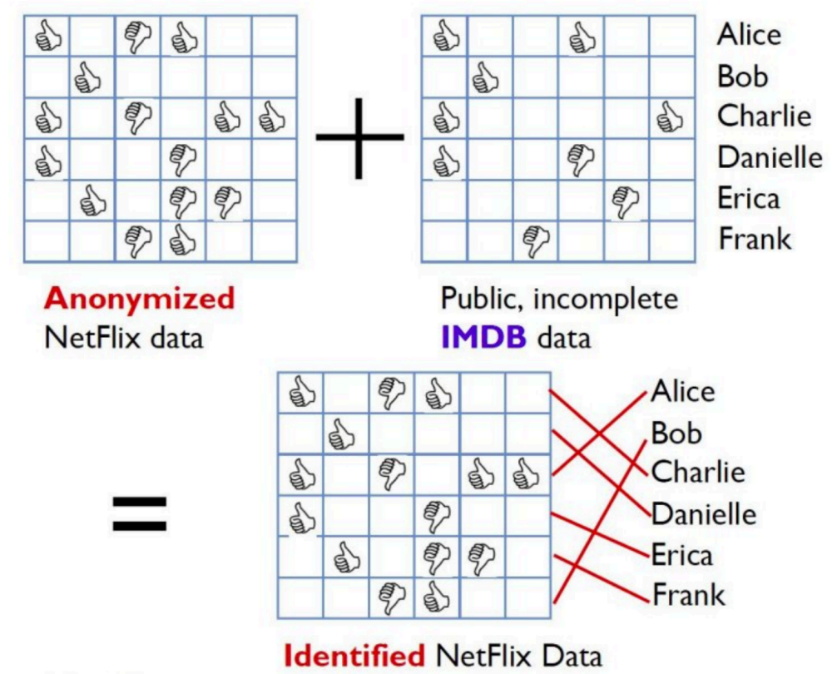
Image from Arvind Narayanan

Slide 63
Differencing Attacks
How many people in this classroom went to Kyle Field last weekend?
How many people in this classroom besides the instructor went to Kyle Field last weekend?

Slide 64
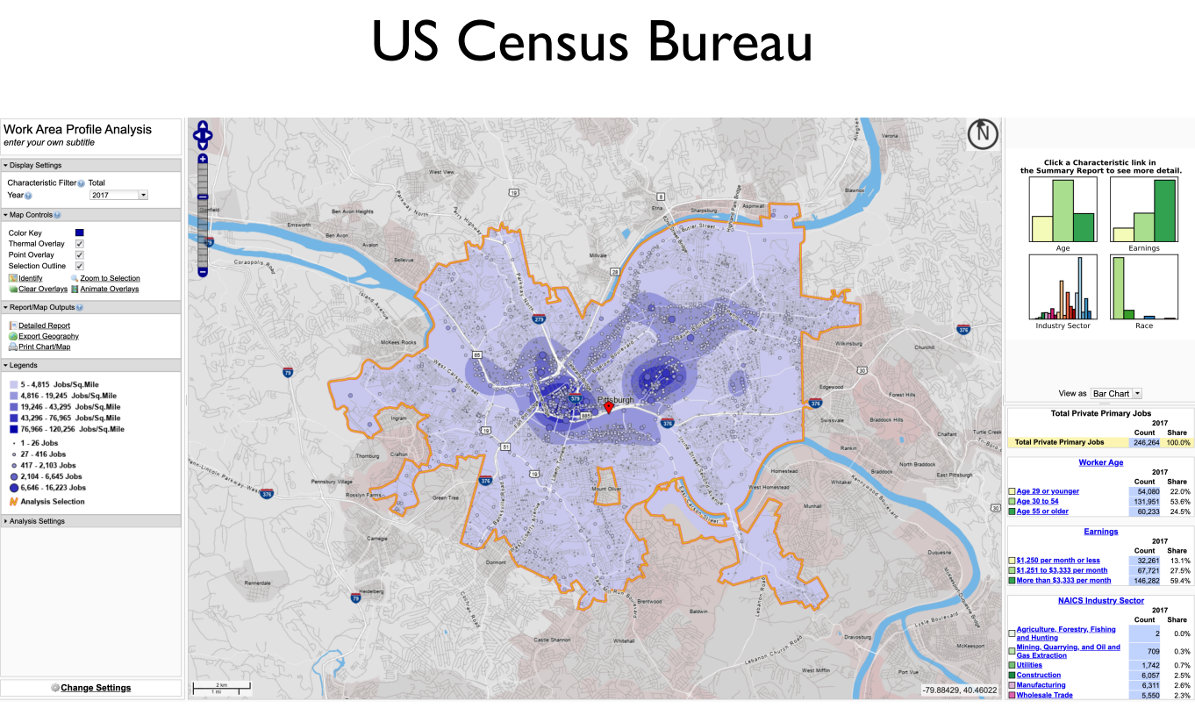
Slide from Steven Wu

Slide 65
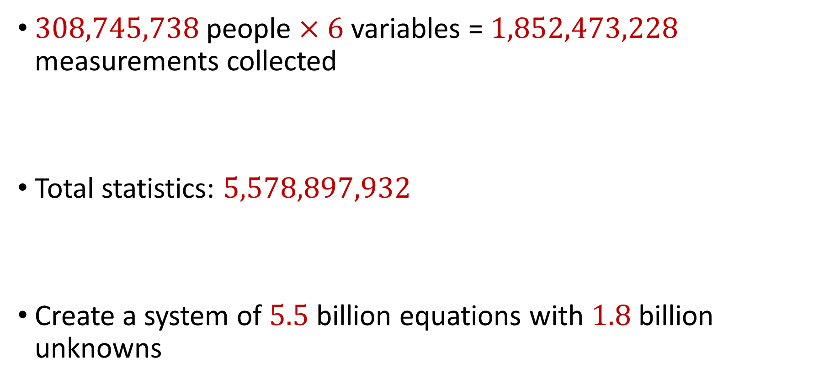
2010 US Census
$308,745,738$ people $×$ $6$ variables = $1,852,473,228$ measurements collected
Total statistics: $5,578,897,932$
Create a system of $5.5$ billion equations with $1.8$ billion unknowns

Slide 66
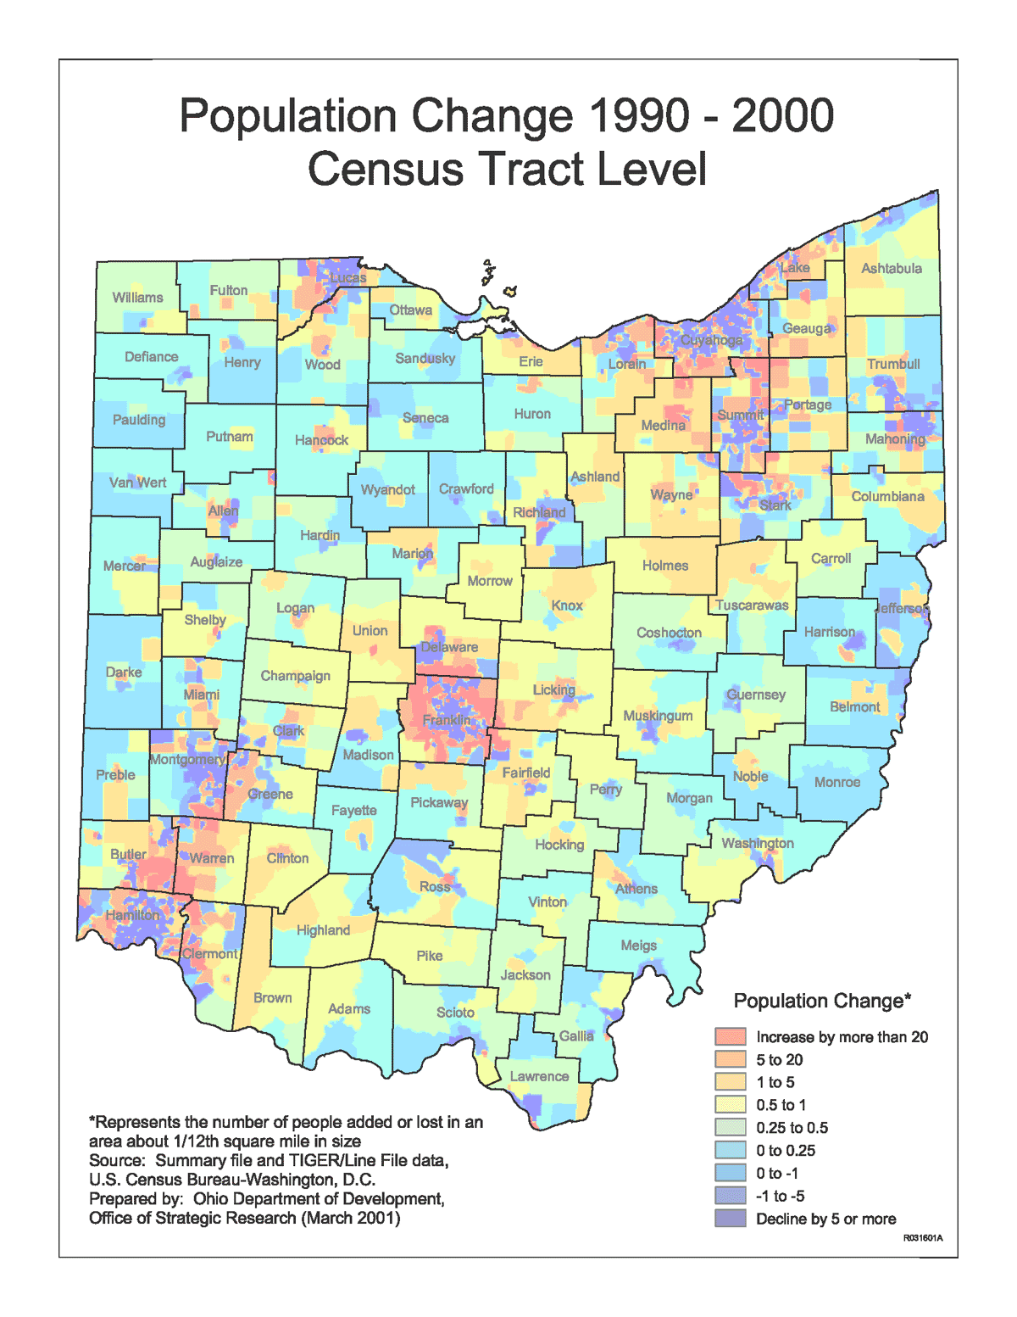
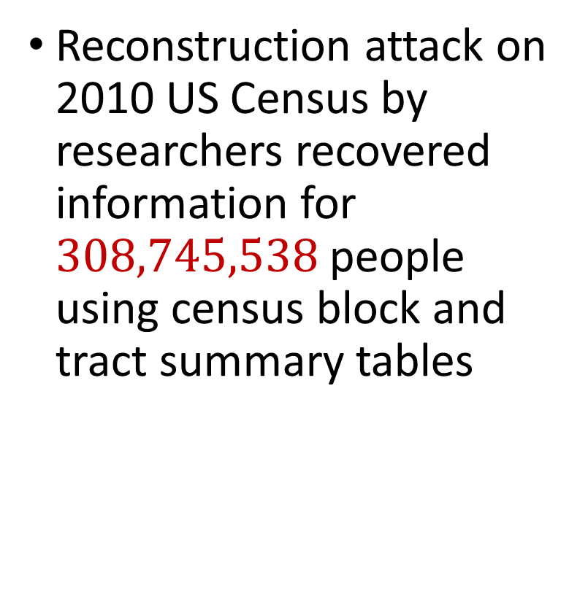
2010 US Census
Reconstruction attack on 2010 US Census by researchers recovered information for $308,745,538$ people using census block and tract summary tables

Slide 67
Summary
“Ad-hoc” privacy procedures like anonymization/deidentification often fails
Publishing too many queries on a sensitive database with too much accuracy can compromise the privacy of the database
Need a formal mathematical notion for measuring privacy

Slide 68

Possible Notion for Privacy #1
“The data analyst cannot learn anything about Alice”
Sensitive dataset
Analyst

Slide 69
Possible Notion for Privacy #1
“The data analyst cannot learn anything about Alice”
Most Aggies like Reveille
Alice is known to be an Aggie
Sensitive dataset
Analyst
Was Alice’s privacy violated?

Slide 70

Possible Notion for Privacy #1
“The data analyst cannot learn anything about Alice”
Most Aggies like Reveille
Bob participates in the survey
Sensitive dataset
Analyst
Even though Alice is not in the survey, it is still known that Alice is an Aggie

Slide 71
Possible Notion for Privacy #1
Suppose a survey is conducted on a sensitive dataset and concludes that “most Aggies like Reveille”
Alice is a known Aggie, and so a data analyst infers that Alice is more likely to be a dog owner and asks for higher apartment cleaning rates
Was Alice’s privacy violated by this study?

Slide 72
Possible Notion for Privacy #2
“A study is private…if the data analyst gains almost no additional information about Alice from the study than if the same study was performed without Alice’s data”

Slide 73

Possible Notion for Privacy #2
Stability: the data analyst reaches roughly similar conclusions if any individual data point is replaced by another data point of the population

Slide 74


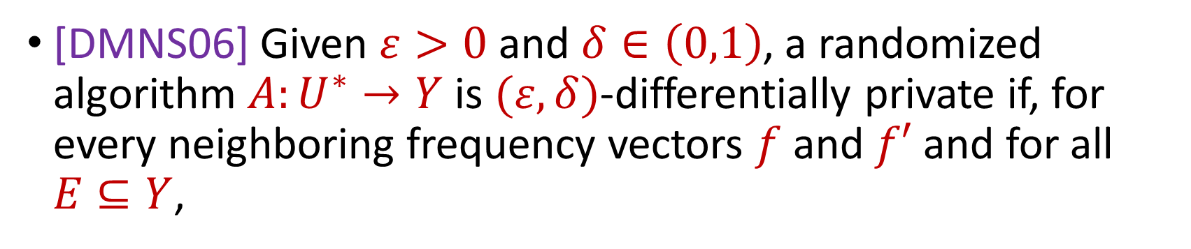

Differential Privacy
[DMNS06] Given $ε>0$and $δ∈\left(0,1\right)$, a randomized algorithm $A:U^{∗}→Y$ is $(ε,δ)$-differentially private if, for every neighboring frequency vectors $f$ and $f′$ and for all $E⊆Y$,
$$Pr\left[A\left(f\right)∈E\right]≤e^{ε}Pr\left[A\left(f^{′}\right)∈E\right]+δ$$
$$A\left( \right)≈A\left( \right)$$
Notes:
[DworkMcSherryNissimSmith06]

Slide 75
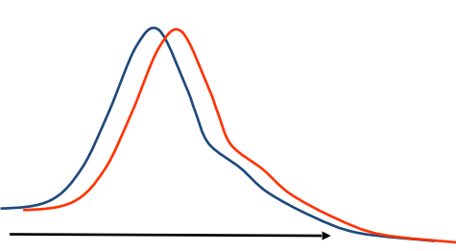
Differential Privacy
[DMNS06] Given $ε>0$and $δ∈\left(0,1\right)$, a randomized algorithm $A:U^{∗}→Y$ is $(ε,δ)$-differentially private if, for every neighboring frequency vectors $f$ and $f′$ and for all $E⊆Y$,
$$Pr\left[A\left(f\right)∈E\right]≤e^{ε}Pr\left[A\left(f^{′}\right)∈E\right]+δ$$
Sensitive dataset
Algorithm
Output distribution
Notes:
[DworkMcSherryNissimSmith06]

