Slide 1
CSCE 689: Special Topics on Algorithms for Big Data
September 27, 2023
Samson Zhou

Slide 2
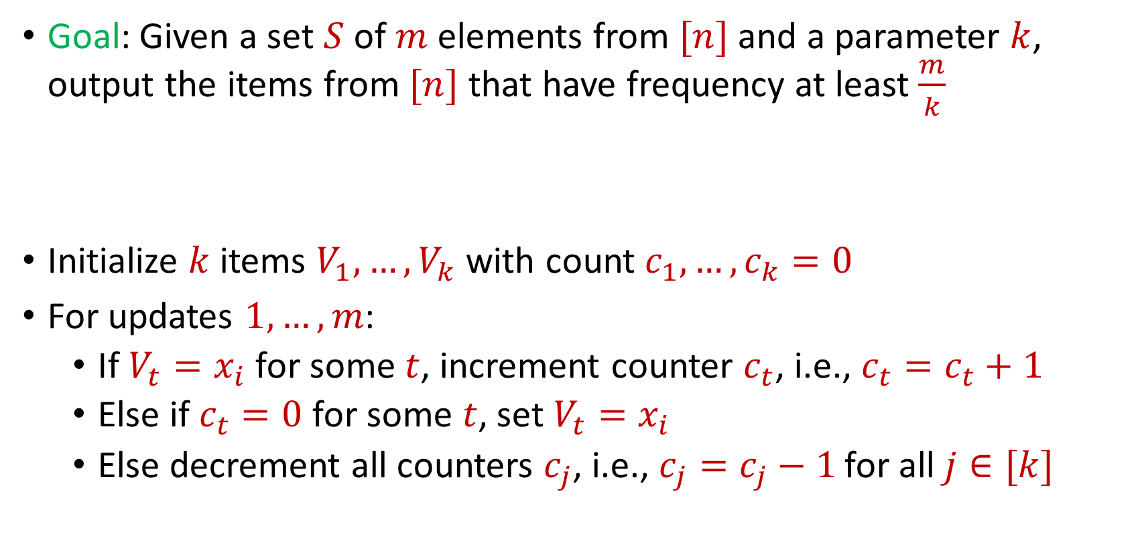
Previously: Misra Gries
Goal: Given a set $S$ of $m$ elements from $[n]$ and a parameter $k$, output the items from $[n]$ that have frequency at least $\frac{m}{k}$
Initialize $k$ items $V_{1},…,V_{k}$ with count $c_{1},…,c_{k}=0$
For updates $1,…,m$:
If $V_{t}=x_{i}$ for some $t$, increment counter $c_{t}$, i.e., $c_{t}=c_{t}+1$
Else if $c_{t}=0$ for some $t$, set $V_{t}=x_{i}$
Else decrement all counters $c_{j}$, i.e., $c_{j}=c_{j}−1$ for all $j∈[k]$

Slide 3
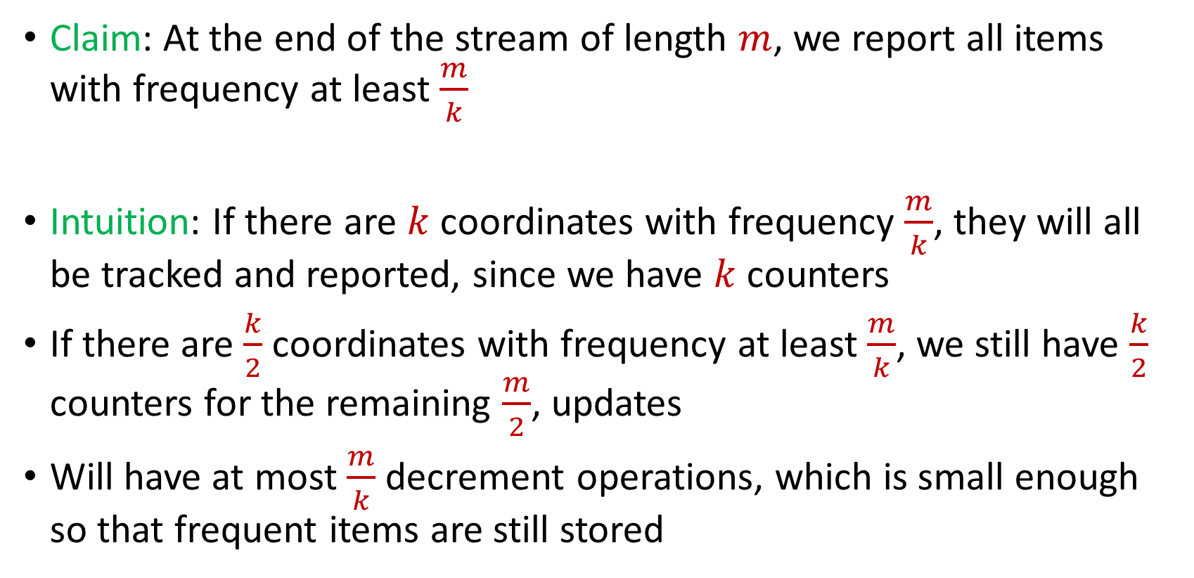
Misra Gries
Claim: At the end of the stream of length $m$, we report all items with frequency at least $\frac{m}{k}$
Intuition: If there are $k$ coordinates with frequency $\frac{m}{k}$, they will all be tracked and reported, since we have $k$counters
If there are $\frac{k}{2}$ coordinates with frequency at least $\frac{m}{k}$, we still have $\frac{k}{2}$ counters for the remaining $\frac{m}{2}$, updates
Will have at most $\frac{m}{k}$ decrement operations, which is small enough so that frequent items are still stored

Slide 4
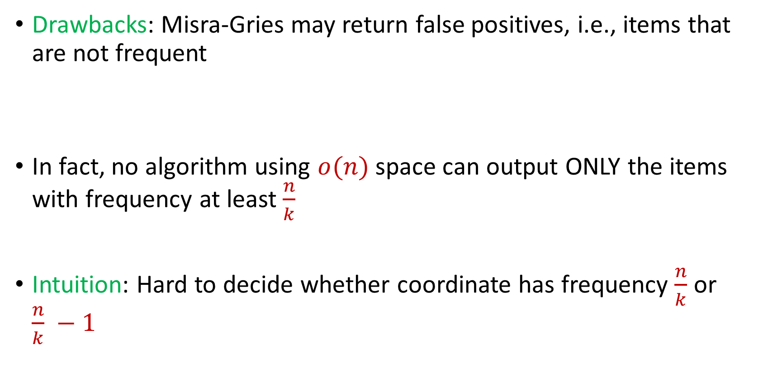
Misra Gries
Drawbacks: Misra-Gries may return false positives, i.e., items that are not frequent
In fact, no algorithm using $o(n)$ space can output ONLY the items with frequency at least $\frac{n}{k}$
Intuition: Hard to decide whether coordinate has frequency $\frac{n}{k}$ or $\frac{n}{k} −1$

Slide 5

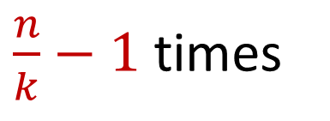
Misra Gries
Intuition: Hard to decide whether coordinate has frequency $\frac{n}{k}$ or $\frac{n}{k} −1$
$x_{1}=2$, $x_{2}=5$, $x_{3}=4$, $x_{4}=7$, $x_{5}=1$, $x_{6}=9$, …
$x_{n−\frac{n}{k}+1}=α$, $x_{n−\frac{n}{k}+2}=α$,…, $x_{n}=α$
$\frac{n}{k}−1$ times

Slide 6
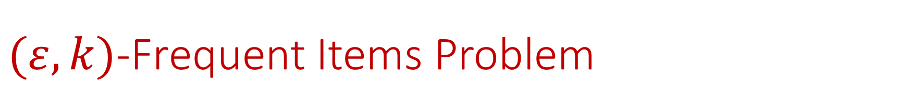

$(ε,k)$-Frequent Items Problem
Goal: Given a set $S$ of $m$ elements from $[n]$, an accuracy parameter $ε∈(0, 1)$, and a parameter $k$, output a list that includes:
The items from $[n]$ that have frequency at least $\frac{m}{k}$
No items with frequency less than $\left(1−ε\right)\frac{m}{k}$

Slide 7


Misra Gries for $(ε,k)$-Frequent Items Problem
Initialize $k$ items $V_{1},…,V_{k}$ with count $c_{1},…,c_{k}=0$
For updates $1,…,m$:
If $V_{t}=x_{i}$ for some $t$, increment counter $c_{t}$, i.e., $c_{t}=c_{t}+1$
Else if $c_{t}=0$ for some $t$, set $V_{t}=x_{i}$
Else decrement all counters $c_{j}$, i.e., $c_{j}=c_{j}−1$ for all $j∈[k]$

Slide 8
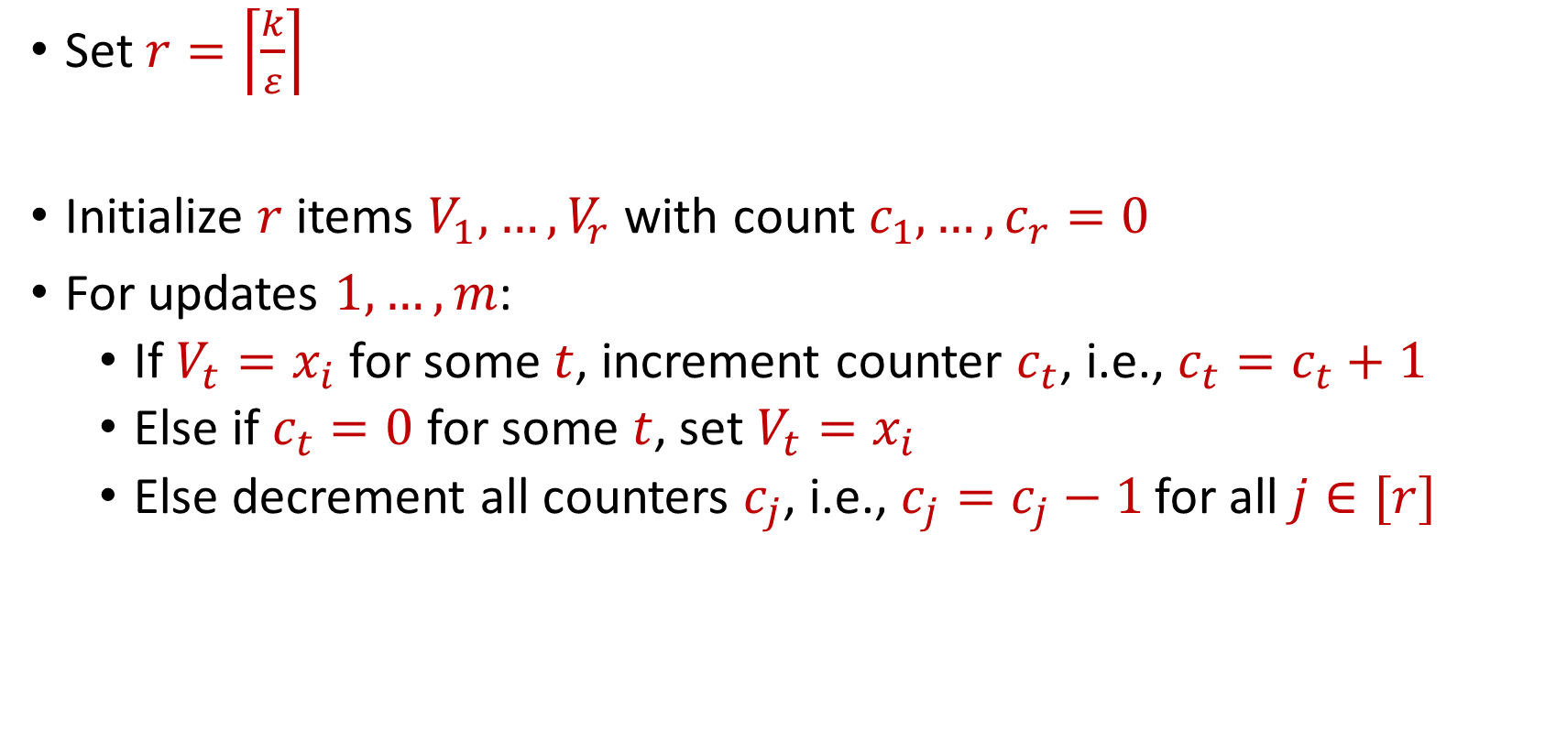
Misra Gries for $(ε,k)$-Frequent Items Problem
Set $r=\left\lceil \frac{k}{ε}\right\rceil$
Initialize $r$ items $V_{1},…,V_{r}$ with count $c_{1},…,c_{r}=0$
For updates $1,…,m$:
If $V_{t}=x_{i}$ for some $t$, increment counter $c_{t}$, i.e., $c_{t}=c_{t}+1$
Else if $c_{t}=0$ for some $t$, set $V_{t}=x_{i}$
Else decrement all counters $c_{j}$, i.e., $c_{j}=c_{j}−1$ for all $j∈[r]$

Slide 9


Misra Gries for $(ε,k)$-Frequent Items Problem
Claim: For all estimated frequencies $\hat{f_{i}}$ by Misra-Gries, we have
Intuition: Have a lot of counters, so relatively few decrements
$$f_{i}−\frac{εm}{k}≤\hat{f_{i}}≤f_{i}$$

Slide 10
$(ε,k)$-Frequent Items Problem
Goal: Given a set $S$ of $m$ elements from $[n]$, an accuracy parameter $ε∈(0, 1)$, and a parameter $k$, output a list that includes:
The items from $[n]$ that have frequency at least $\frac{m}{k}$
No items with frequency less than $\left(1−ε\right)\frac{m}{k}$

Slide 11
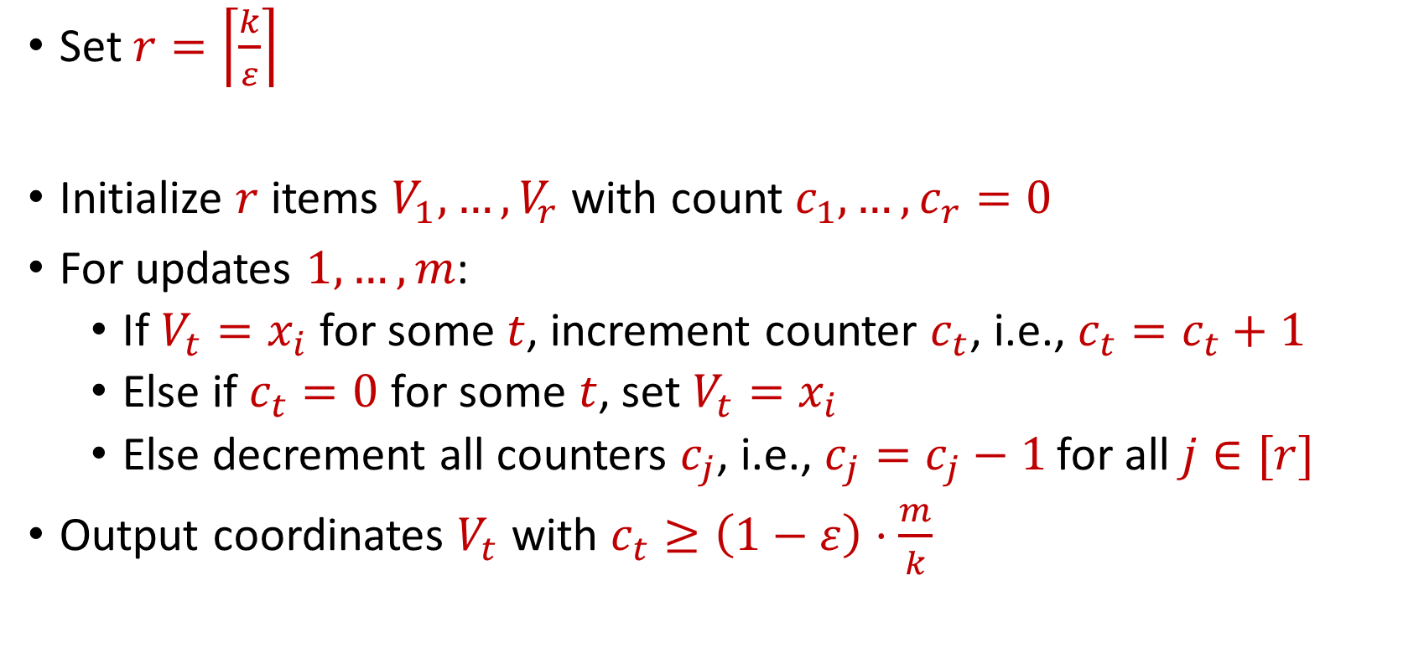
Misra Gries for $(ε,k)$-Frequent Items Problem
Set $r=\left\lceil \frac{k}{ε}\right\rceil$
Initialize $r$ items $V_{1},…,V_{r}$ with count $c_{1},…,c_{r}=0$
For updates $1,…,m$:
If $V_{t}=x_{i}$ for some $t$, increment counter $c_{t}$, i.e., $c_{t}=c_{t}+1$
Else if $c_{t}=0$ for some $t$, set $V_{t}=x_{i}$
Else decrement all counters $c_{j}$, i.e., $c_{j}=c_{j}−1$ for all $j∈[r]$
Output coordinates $V_{t}$ with $c_{t}≥\left(1−ε\right)⋅\frac{m}{k}$

Slide 12
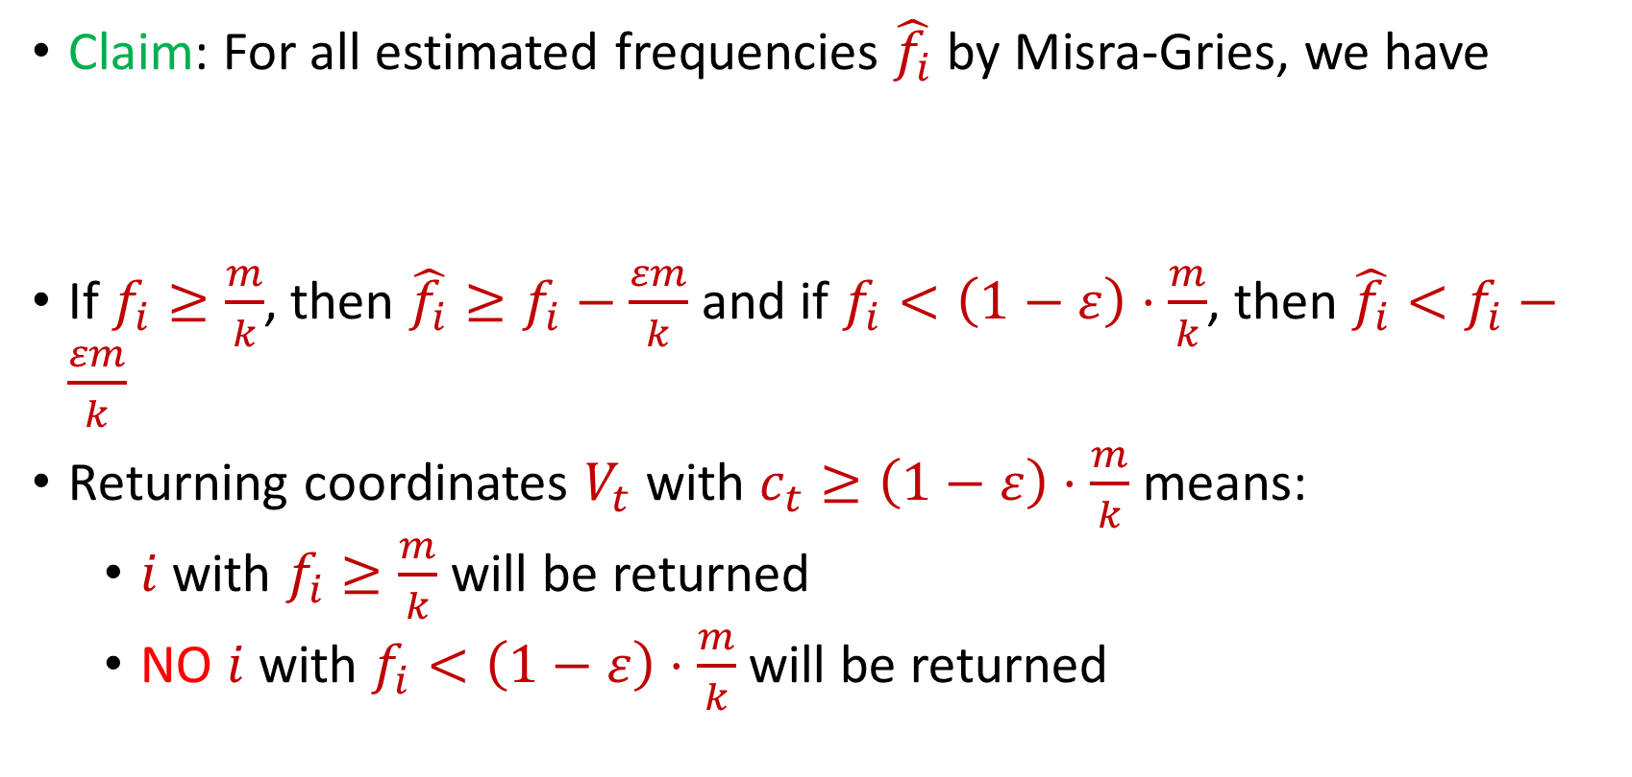
Misra Gries for $(ε,k)$-Frequent Items Problem
Claim: For all estimated frequencies $\hat{f_{i}}$ by Misra-Gries, we have
If $f_{i}≥\frac{m}{k}$, then ${\hat{f_{i}}≥f}_{i}−\frac{εm}{k}$ and if $f_{i}<\left(1−ε\right)⋅\frac{m}{k}$, then ${\hat{f_{i}}<f}_{i}−\frac{εm}{k}$
Returning coordinates $V_{t}$ with $c_{t}≥\left(1−ε\right)⋅\frac{m}{k}$ means:
$i$ with $f_{i}≥\frac{m}{k}$ will be returned
NO $i$ with $f_{i}<\left(1−ε\right)⋅\frac{m}{k}$will be returned
$$f_{i}−\frac{εm}{k}≤\hat{f_{i}}≤f_{i}$$

Slide 13
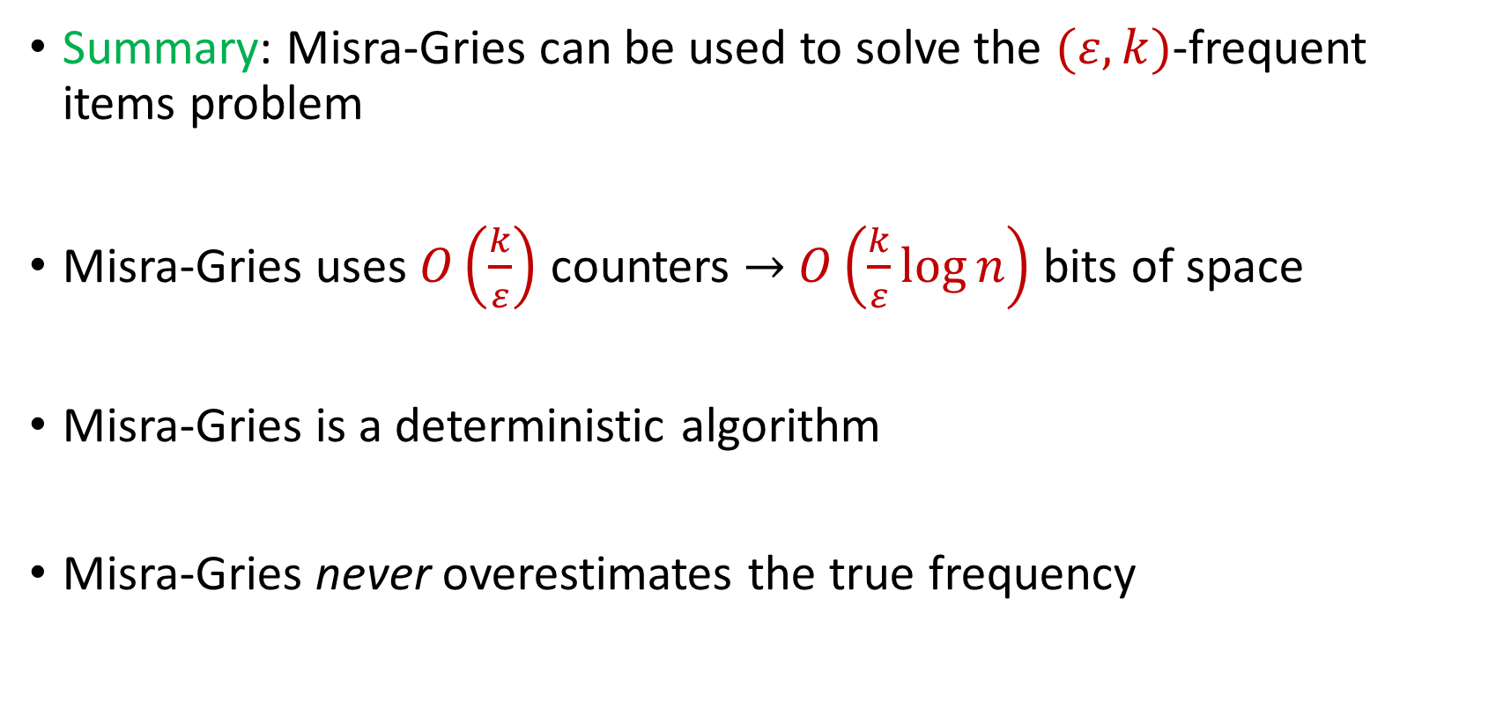
Misra Gries for $(ε,k)$-Frequent Items Problem
Summary: Misra-Gries can be used to solve the $(ε,k)$-frequent items problem
Misra-Gries uses $O\left(\frac{k}{ε}\right)$ counters $→$ $O\left(\frac{k}{ε}\log{n}\right)$ bits of space
Misra-Gries is a deterministic algorithm
Misra-Gries never overestimates the true frequency

Slide 14

Insertion-Deletion Streams
Stream of length $m=Θ\left(n\right)$
Universe of size $[n]$, underlying vector $f∈R^{n}$
Each update increases or decreases a coordinate in $f$
“Decrease $f_{6}$”
$f_{1}$ | $f_{2}$ | $f_{3}$ | $f_{4}$ | $f_{5}$ | $f_{6}$ | $f_{7}$
0 | 0 | 0 | 0 | 0 | 0 | 0
$f_{1}$ | $f_{2}$ | $f_{3}$ | $f_{4}$ | $f_{5}$ | $f_{6}$ | $f_{7}$
0 | 0 | 0 | 0 | 0 | -1 | 0

Slide 15
Insertion-Deletion Streams
Database Management: In database management, insertion-deletion streams are used to track changes made to the database over time
Transaction logs often utilize this concept to record insertions and deletions to ensure data integrity and support features like rollbacks and recovery

Slide 16




Insertion-Deletion Streams
Version Control Systems: Insertion-deletion streams track changes made to files, enabling users to see what has been added (inserted) or removed (deleted) in each version
Crucial for collaboration and managing software development projects, central to version control systems

Slide 17

Insertion-Deletion Streams
Traffic Flow and Transportation Systems: Insertion-deletion streams are used to analyze traffic patterns and changes in transportation systems
This helps in optimizing traffic flow, managing congestion, and improving transportation infrastructure

Slide 18

Frequent Items on Insertion-Deletion Streams
Misra-Gries on Insertion-Deletion Streams
“Increase $f_{1}$”
“Increase $f_{3}$”
“Increase $f_{2}$”
“Increase $f_{2}$”
“Decrease $f_{2}$”
“Decrease $f_{2}$”
“Decrease $f_{3}$”

Slide 19
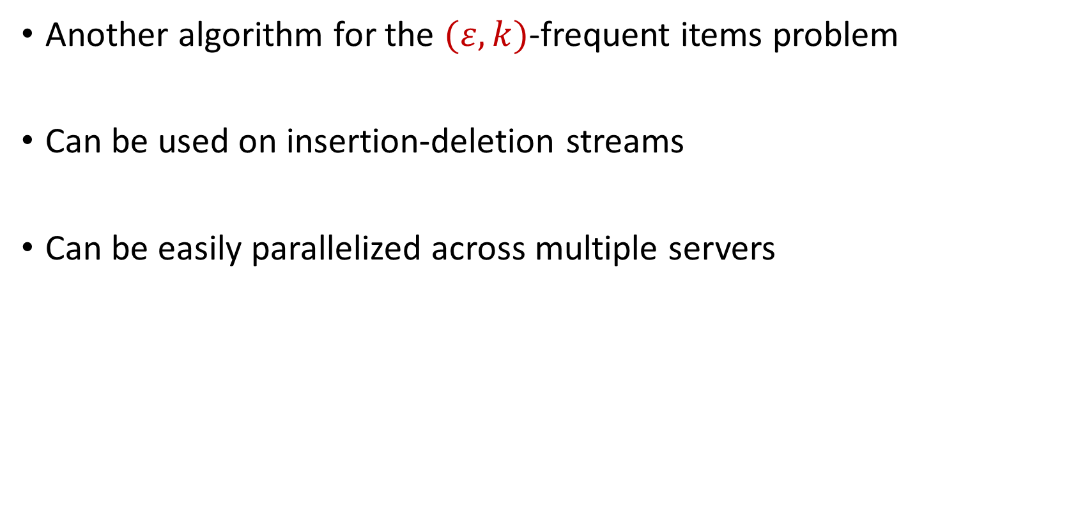
CountMin
Another algorithm for the $(ε,k)$-frequent items problem
Can be used on insertion-deletion streams
Can be easily parallelized across multiple servers

Slide 20
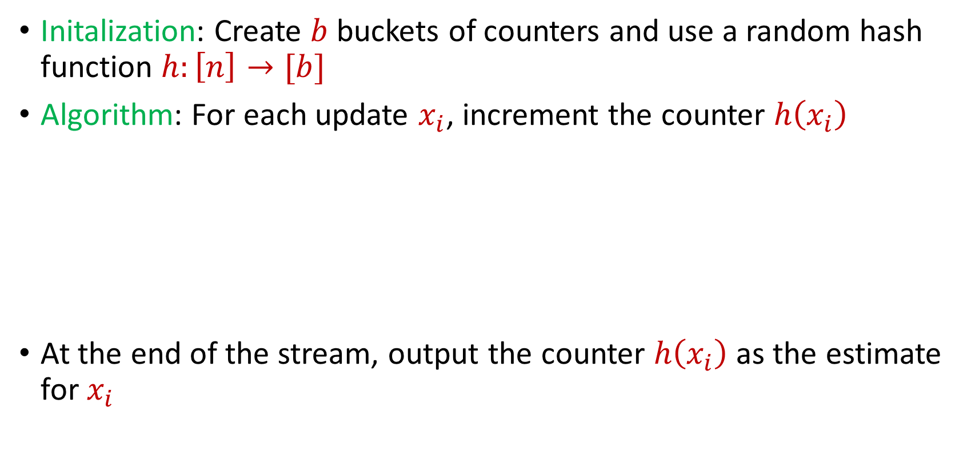
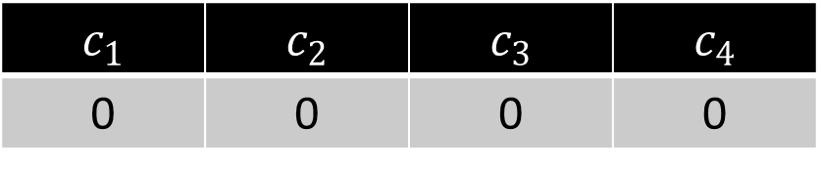
CountMin
Initalization: Create $b$ buckets of counters and use a random hash function $h:\left[n\right]→[b]$
Algorithm: For each update $x_{i}$, increment the counter $h\left(x_{i}\right)$
At the end of the stream, output the counter $h\left(x_{i}\right)$ as the estimate for $x_{i}$
$c_{1}$ | $c_{2}$ | $c_{3}$ | $c_{4}$
0 | 0 | 0 | 0

Slide 21
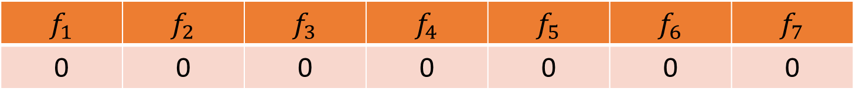


CountMin
$f_{1}$ | $f_{2}$ | $f_{3}$ | $f_{4}$ | $f_{5}$ | $f_{6}$ | $f_{7}$
0 | 0 | 0 | 0 | 0 | 0 | 0
$$1$$
$c_{1}$ | $c_{2}$ | $c_{3}$ | $c_{4}$
0 | 0 | 0 | 0

Slide 22
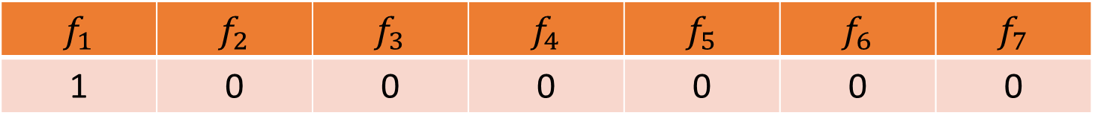

CountMin
$f_{1}$ | $f_{2}$ | $f_{3}$ | $f_{4}$ | $f_{5}$ | $f_{6}$ | $f_{7}$
1 | 0 | 0 | 0 | 0 | 0 | 0
$$1$$
$$h\left(x\right)=3x+2 (mod 4)$$
$c_{1}$ | $c_{2}$ | $c_{3}$ | $c_{4}$
0 | 0 | 0 | 0

Slide 23
CountMin
$f_{1}$ | $f_{2}$ | $f_{3}$ | $f_{4}$ | $f_{5}$ | $f_{6}$ | $f_{7}$
1 | 0 | 0 | 0 | 0 | 0 | 0
$$1$$
$$h\left(x\right)=3x+2 (mod 4)$$
$c_{1}$ | $c_{2}$ | $c_{3}$ | $c_{4}$
0 | 0 | 0 | 0

Slide 24
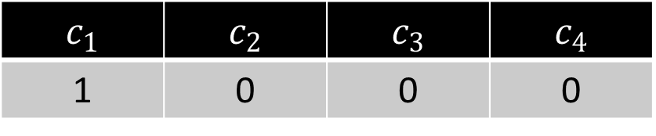
CountMin
$f_{1}$ | $f_{2}$ | $f_{3}$ | $f_{4}$ | $f_{5}$ | $f_{6}$ | $f_{7}$
1 | 0 | 0 | 0 | 0 | 0 | 0
$$1$$
$$h\left(x\right)=3x+2 (mod 4)$$
$c_{1}$ | $c_{2}$ | $c_{3}$ | $c_{4}$
1 | 0 | 0 | 0

Slide 25

CountMin
$f_{1}$ | $f_{2}$ | $f_{3}$ | $f_{4}$ | $f_{5}$ | $f_{6}$ | $f_{7}$
1 | 0 | 0 | 0 | 0 | 0 | 0
$$3$$
$$h\left(x\right)=3x+2 (mod 4)$$
$c_{1}$ | $c_{2}$ | $c_{3}$ | $c_{4}$
1 | 0 | 0 | 0

Slide 26
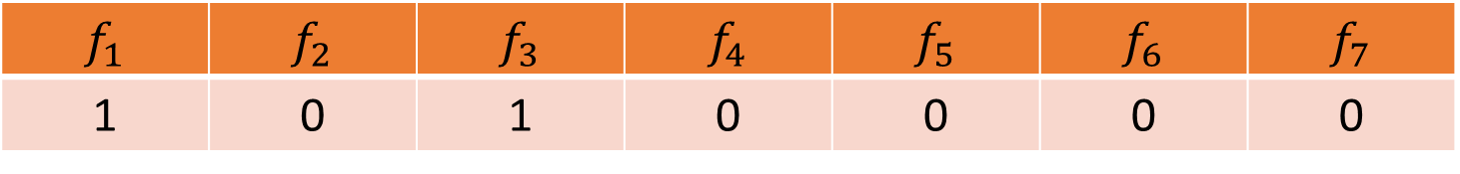
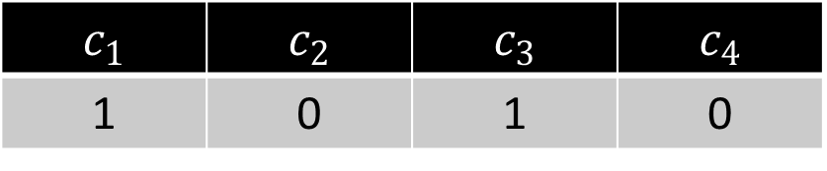
CountMin
$f_{1}$ | $f_{2}$ | $f_{3}$ | $f_{4}$ | $f_{5}$ | $f_{6}$ | $f_{7}$
1 | 0 | 1 | 0 | 0 | 0 | 0
$$3$$
$$h\left(x\right)=3x+2 (mod 4)$$
$c_{1}$ | $c_{2}$ | $c_{3}$ | $c_{4}$
1 | 0 | 1 | 0

Slide 27

CountMin
$f_{1}$ | $f_{2}$ | $f_{3}$ | $f_{4}$ | $f_{5}$ | $f_{6}$ | $f_{7}$
1 | 0 | 1 | 0 | 0 | 0 | 0
$$2$$
$$h\left(x\right)=3x+2 (mod 4)$$
$c_{1}$ | $c_{2}$ | $c_{3}$ | $c_{4}$
1 | 0 | 1 | 0

Slide 28
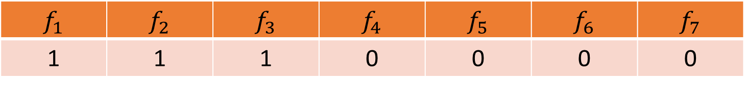
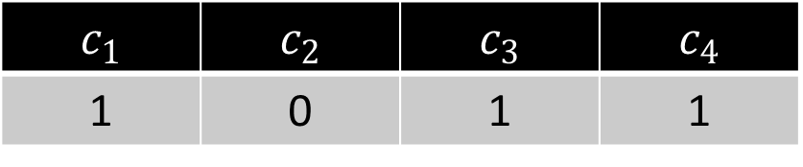
CountMin
$f_{1}$ | $f_{2}$ | $f_{3}$ | $f_{4}$ | $f_{5}$ | $f_{6}$ | $f_{7}$
1 | 1 | 1 | 0 | 0 | 0 | 0
$$2$$
$$h\left(x\right)=3x+2 (mod 4)$$
$c_{1}$ | $c_{2}$ | $c_{3}$ | $c_{4}$
1 | 0 | 1 | 1

Slide 29
CountMin
$f_{1}$ | $f_{2}$ | $f_{3}$ | $f_{4}$ | $f_{5}$ | $f_{6}$ | $f_{7}$
1 | 1 | 1 | 0 | 0 | 0 | 0
$$1$$
$$h\left(x\right)=3x+2 (mod 4)$$
$c_{1}$ | $c_{2}$ | $c_{3}$ | $c_{4}$
1 | 0 | 1 | 1

Slide 30
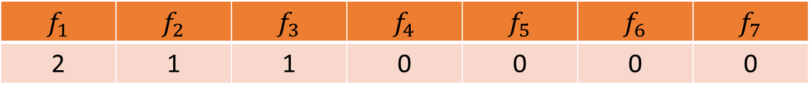
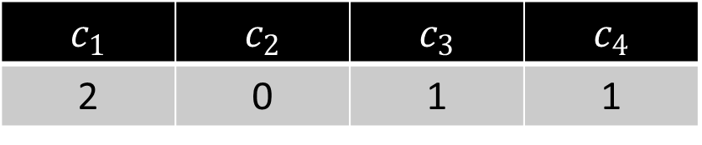
CountMin
$f_{1}$ | $f_{2}$ | $f_{3}$ | $f_{4}$ | $f_{5}$ | $f_{6}$ | $f_{7}$
2 | 1 | 1 | 0 | 0 | 0 | 0
$$1$$
$$h\left(x\right)=3x+2 (mod 4)$$
$c_{1}$ | $c_{2}$ | $c_{3}$ | $c_{4}$
2 | 0 | 1 | 1

Slide 31
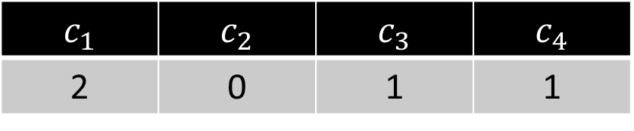

CountMin
$f_{1}$ | $f_{2}$ | $f_{3}$ | $f_{4}$ | $f_{5}$ | $f_{6}$ | $f_{7}$
2 | 1 | 1 | 0 | 0 | 0 | 0
$$5$$
$$h\left(x\right)=3x+2 (mod 4)$$
$c_{1}$ | $c_{2}$ | $c_{3}$ | $c_{4}$
2 | 0 | 1 | 1

Slide 32
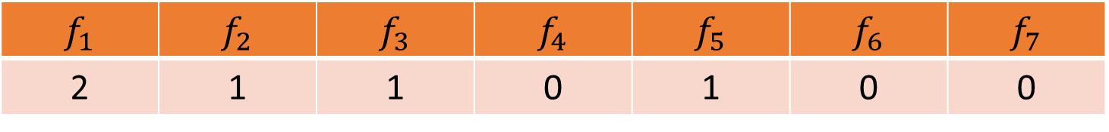
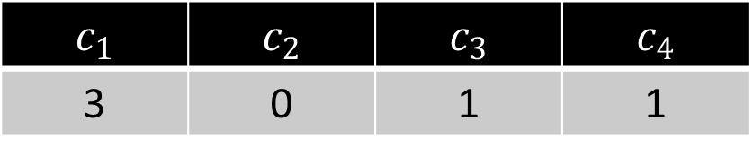
CountMin
$f_{1}$ | $f_{2}$ | $f_{3}$ | $f_{4}$ | $f_{5}$ | $f_{6}$ | $f_{7}$
2 | 1 | 1 | 0 | 1 | 0 | 0
$$5$$
$$h\left(x\right)=3x+2 (mod 4)$$
$c_{1}$ | $c_{2}$ | $c_{3}$ | $c_{4}$
3 | 0 | 1 | 1

Slide 33

CountMin
$f_{1}$ | $f_{2}$ | $f_{3}$ | $f_{4}$ | $f_{5}$ | $f_{6}$ | $f_{7}$
2 | 1 | 1 | 0 | 1 | 0 | 0
What is the estimation for $f_{4}$?
What about $f_{3}$?
What about $f_{5}$? What about $f_{1}$?
$$h\left(x\right)=3x+2 (mod 4)$$
$c_{1}$ | $c_{2}$ | $c_{3}$ | $c_{4}$
3 | 0 | 1 | 1

Slide 34
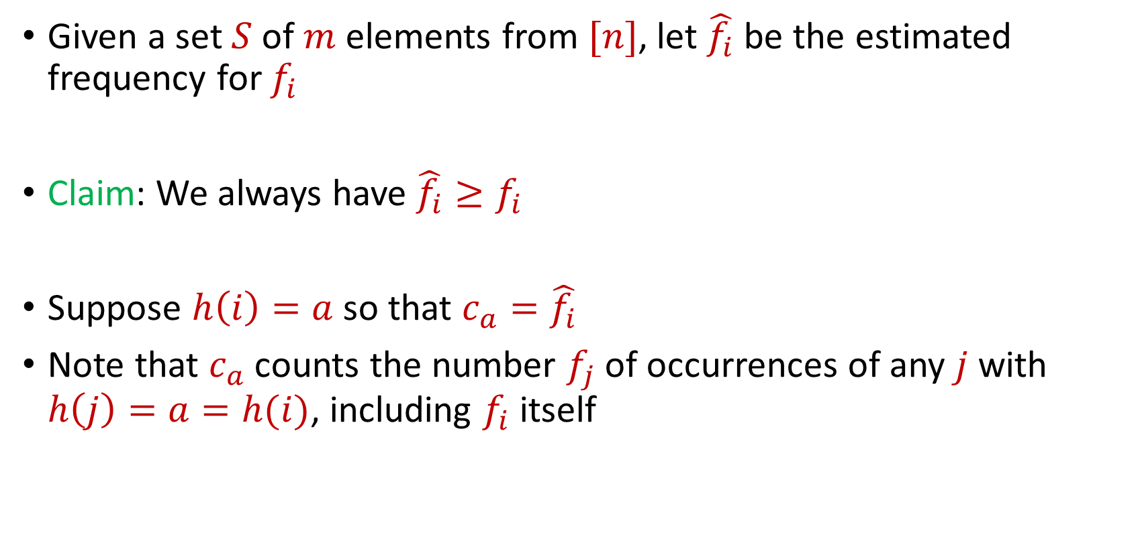
CountMin
Given a set $S$ of $m$ elements from $[n]$, let $\hat{f_{i}}$ be the estimated frequency for $f_{i}$
Claim: We always have $\hat{f_{i}}≥f_{i}$
Suppose $h\left(i\right)=a$ so that $c_{a}=\hat{f_{i}}$
Note that $c_{a}$counts the number $f_{j}$of occurrences of any $j$ with $h\left(j\right)=a=h(i)$, including $f_{i}$ itself

Slide 35
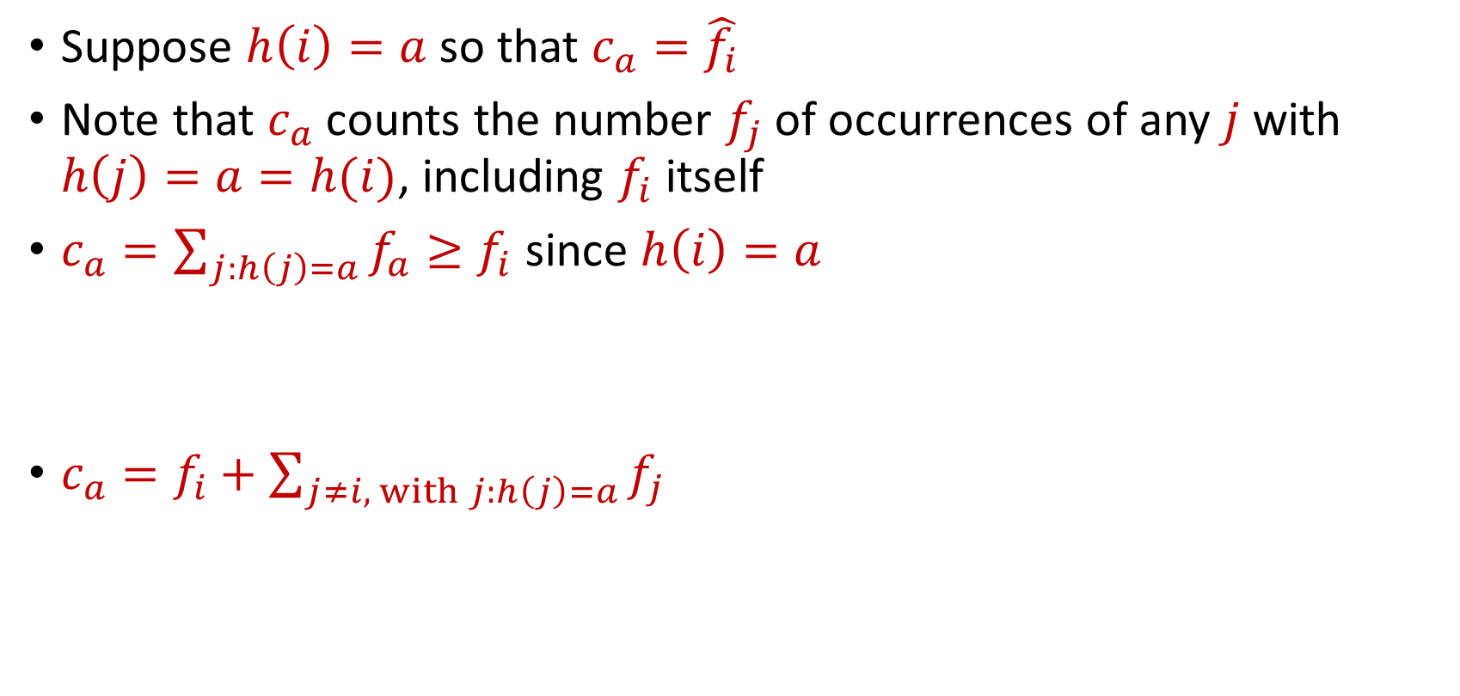
CountMin
Suppose $h\left(i\right)=a$ so that $c_{a}=\hat{f_{i}}$
Note that $c_{a}$counts the number $f_{j}$of occurrences of any $j$ with $h\left(j\right)=a=h(i)$, including $f_{i}$ itself
$c_{a}=\sum_{j:h\left(j\right)=a}{f_{a}}≥f_{i}$ since $h\left(i\right)=a$
$c_{a}=f_{i}+\sum_{j≠i, with j:h\left(j\right)=a}{f_{j}}$

Slide 36

CountMin Error Analysis
$c_{a}=f_{i}+\sum_{j≠i, with j:h\left(j\right)=a}{f_{j}}$
What is the expected error for $f_{i}$?

Slide 37

CountMin Error Analysis
$c_{a}=f_{i}+\sum_{j≠i, with j:h\left(j\right)=a}{f_{j}}$
What is the expected error for $f_{i}$?
$E\left[\left|\sum_{j≠i, with j:h\left(j\right)=a}{f_{j}}\right|\right]≤Σ_{j≠i}E\left[\left|f_{j}\right|⋅I_{h\left(j\right)=h(i)}\right]$

Slide 38
CountMin Error Analysis
$c_{a}=f_{i}+\sum_{j≠i, with j:h\left(j\right)=a}{f_{j}}$
What is the expected error for $f_{i}$?
$E\left[\left|\sum_{j≠i, with j:h\left(j\right)=a}{f_{j}}\right|\right]≤Σ_{j≠i}E\left[\left|f_{j}\right|⋅I_{h\left(j\right)=h(i)}\right]$
$$=Σ_{j≠i}E\left[I_{h\left(j\right)=h(i)}\right]⋅\left|f_{j}\right|$$

Slide 39
CountMin Error Analysis
$c_{a}=f_{i}+\sum_{j≠i, with j:h\left(j\right)=a}{f_{j}}$
What is the expected error for $f_{i}$?
$E\left[\left|\sum_{j≠i, with j:h\left(j\right)=a}{f_{j}}\right|\right]≤Σ_{j≠i}E\left[\left|f_{j}\right|⋅I_{h\left(j\right)=h(i)}\right]$
$$=Σ_{j≠i}E\left[I_{h\left(j\right)=h(i)}\right]⋅\left|f_{j}\right|$$
$$=Σ_{j≠i}Pr\left[h\left(j\right)=h(i)\right]⋅\left|f_{j}\right|$$

Slide 40

CountMin Error Analysis
$c_{a}=f_{i}+\sum_{j≠i, with j:h\left(j\right)=a}{f_{j}}$
What is the expected error for $f_{i}$?
$E\left[\left|\sum_{j≠i, with j:h\left(j\right)=a}{f_{j}}\right|\right]≤Σ_{j≠i}E\left[\left|f_{j}\right|⋅I_{h\left(j\right)=h(i)}\right]$
$$=Σ_{j≠i}E\left[I_{h\left(j\right)=h(i)}\right]⋅\left|f_{j}\right|$$
$$=Σ_{j≠i}Pr\left[h\left(j\right)=h(i)\right]⋅\left|f_{j}\right|$$
$$=Σ_{j≠i}\frac{1}{b}⋅\left|f_{j}\right|=\frac{{\left\|f\right\|}_{1}}{b}$$

Slide 41
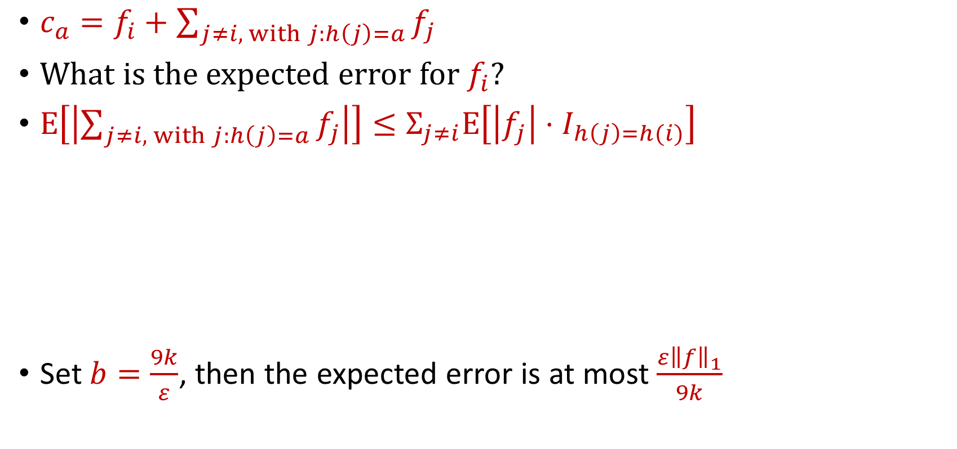

CountMin Error Analysis
$c_{a}=f_{i}+\sum_{j≠i, with j:h\left(j\right)=a}{f_{j}}$
What is the expected error for $f_{i}$?
$E\left[\left|\sum_{j≠i, with j:h\left(j\right)=a}{f_{j}}\right|\right]≤Σ_{j≠i}E\left[\left|f_{j}\right|⋅I_{h\left(j\right)=h(i)}\right]$
Set $b=\frac{9k}{ε}$, then the expected error is at most $\frac{ε{\left\|f\right\|}_{1}}{9k}$
$$=Σ_{j≠i}E\left[I_{h\left(j\right)=h(i)}\right]⋅\left|f_{j}\right|$$
$$=Σ_{j≠i}Pr\left[h\left(j\right)=h(i)\right]⋅\left|f_{j}\right|$$
$$=Σ_{j≠i}\frac{1}{b}⋅\left|f_{j}\right|=\frac{{\left\|f\right\|}_{1}}{b}$$

Slide 42
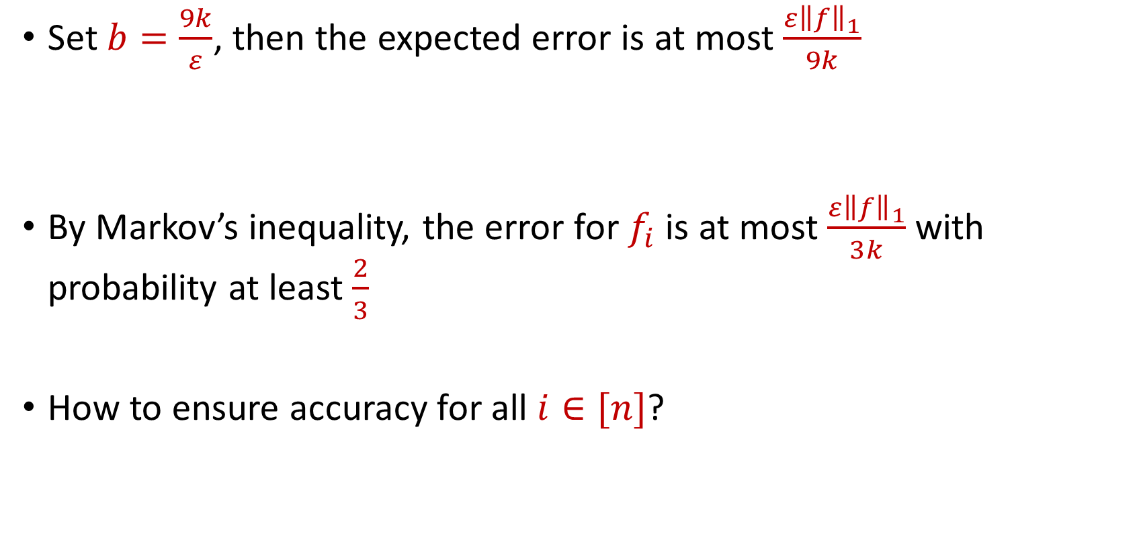
CountMin Error Analysis
Set $b=\frac{9k}{ε}$, then the expected error is at most $\frac{ε{\left\|f\right\|}_{1}}{9k}$
By Markov’s inequality, the error for $f_{i}$ is at most $\frac{ε{\left\|f\right\|}_{1}}{3k}$ with probability at least $\frac{2}{3}$
How to ensure accuracy for all $i∈[n]$?

Slide 43
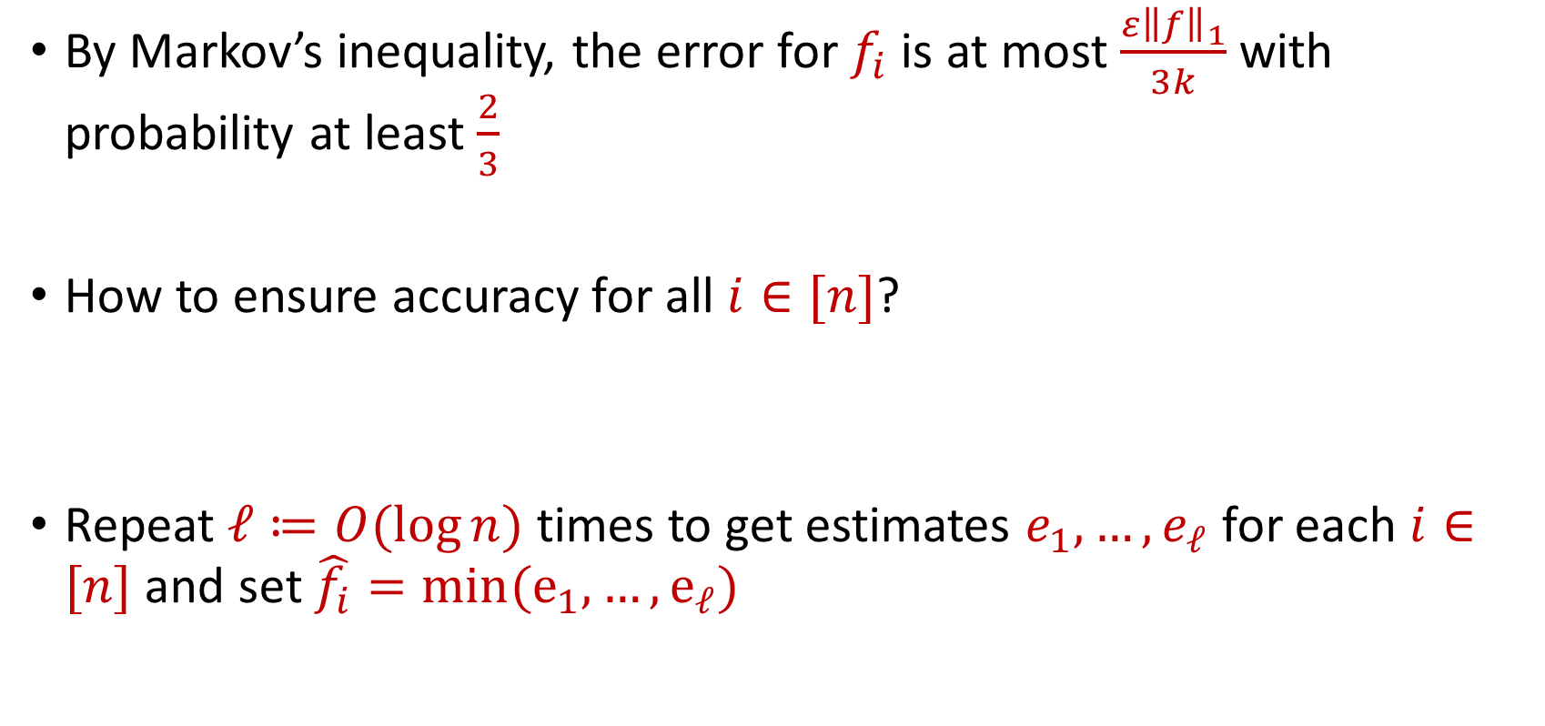
CountMin Error Analysis
By Markov’s inequality, the error for $f_{i}$ is at most $\frac{ε{\left\|f\right\|}_{1}}{3k}$ with probability at least $\frac{2}{3}$
How to ensure accuracy for all $i∈[n]$?
Repeat $ℓ≔O(\log{n)}$ times to get estimates $e_{1},…,e_{ℓ}$ for each $i∈[n]$ and set $\hat{f_{i}}=min(e_{1},…, e_{ℓ})$

