Slide 1

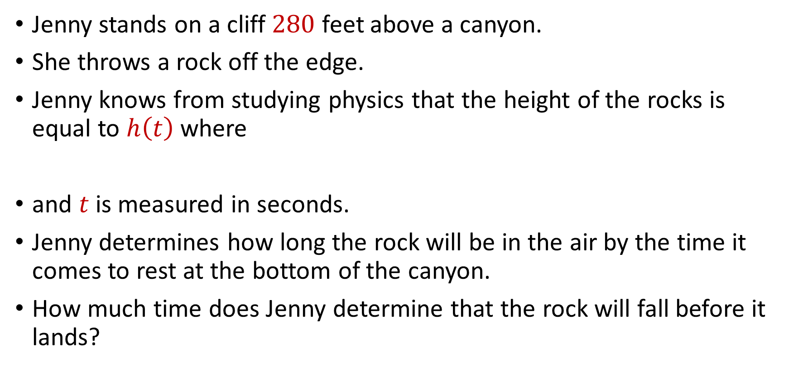
Quadratic Equations
Jenny stands on a cliff $280$ feet above a canyon.
She throws a rock off the edge.
Jenny knows from studying physics that the height of the rocks is equal to $h\left(t\right)$ where
and $t$ is measured in seconds.
Jenny determines how long the rock will be in the air by the time it comes to rest at the bottom of the canyon.
How much time does Jenny determine that the rock will fall before it lands?
$h\left(t\right)=280−5t−16t^{2}$

Slide 2

Quadratic Equations
Determine the unique pair of real numbers $(x,y)$ such that
$$\left(3x^{2}+4x+8\right)\left(2y^{2}+10y+20\right)=50$$

Slide 3


Quadratic Equations
Solve the following system of equations for real $\left(a,b,c\right)$.
$$a^{2}+10b=−34$$
$$b^{2}+4c=17$$
$$c^{2}+8a=−28$$

Slide 4


Special Algebraic Insights
If $xy=a$, $xz=b$, and $yz=c$, and none of these quantities is $0$, what is the value of
$x^{2}+y^{2}+z^{2}$?

Slide 5

Special Algebraic Insights
Solve for real values of $x$, $y$, and $z$, where
$$3x^{2}+y^{2}+z^{2}=2x(y+z)$$

Slide 6

Funky Numbers
Simplify
$$\sqrt{7+4\sqrt{3}}$$

Slide 7

Funky Numbers
Simplify
$$\sqrt{14+6\sqrt{5}}$$

Slide 8
Funky Numbers
Simplify
$$\sqrt{5+12i}$$

Slide 9
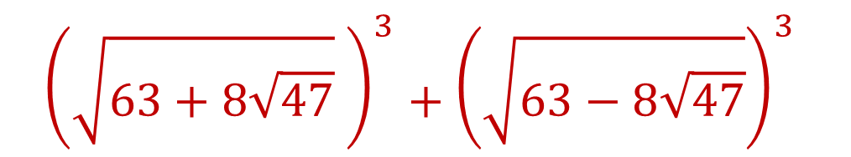
Funky Numbers
Find the value of
$${\left(\sqrt{63+8\sqrt{47}} \right)}^{3}+{\left(\sqrt{63−8\sqrt{47}}\right)}^{3}$$

Slide 10

Graphing Quadratics
What is the minimum value of
where $x$ can take on any real value?
$$f\left(x\right)=2x^{2}+12x+21$$

Slide 11
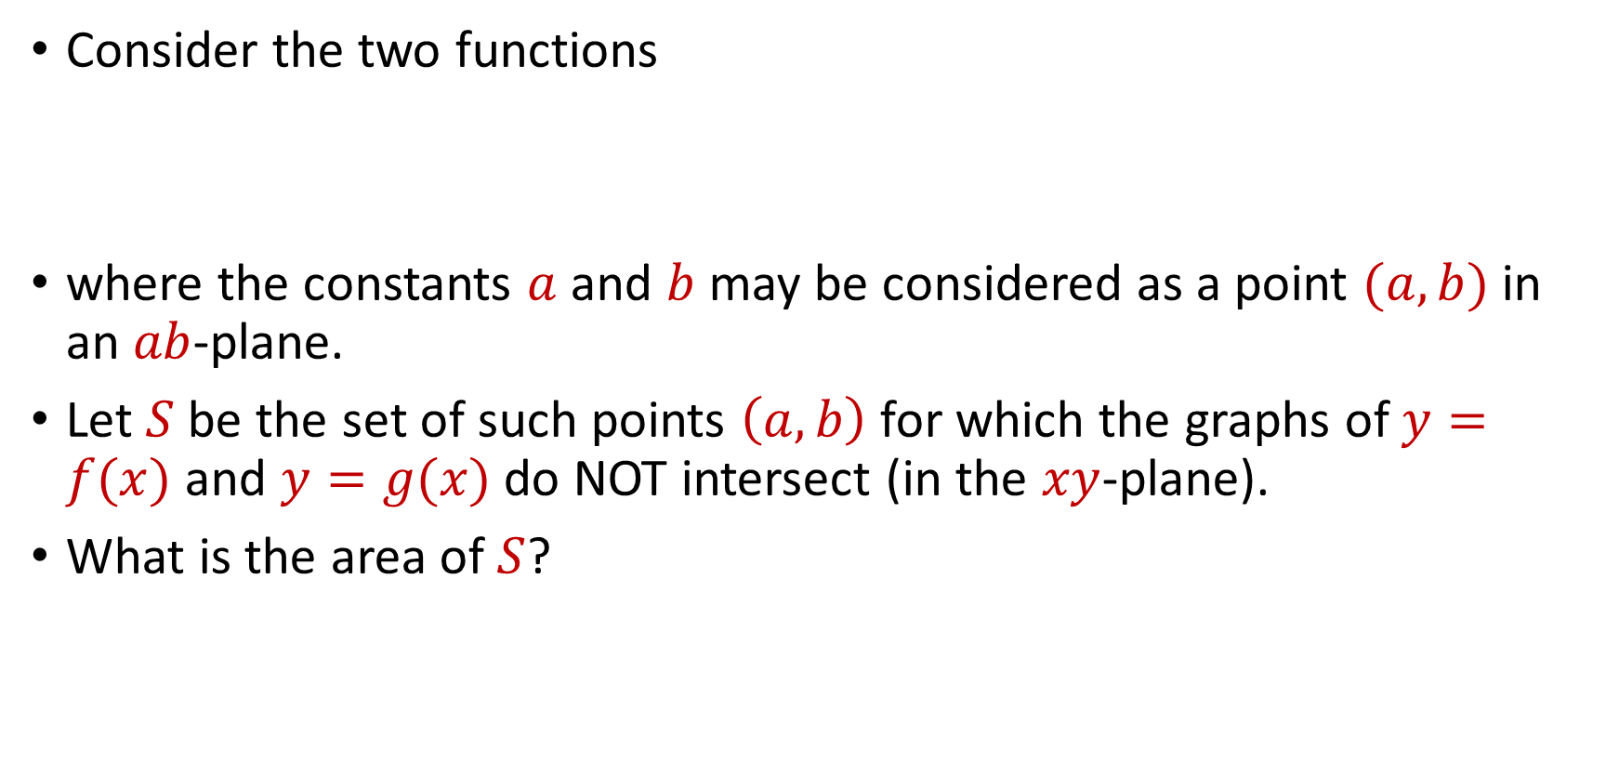
Graphing Quadratics
Consider the two functions
where the constants $a$ and $b$ may be considered as a point $(a,b)$ in an $ab$-plane.
Let $S$ be the set of such points $\left(a,b\right)$ for which the graphs of $y=f(x)$ and $y=g(x)$ do NOT intersect (in the $xy$-plane).
What is the area of $S$?
$f\left(x\right)=x^{2}+2bx+1$, $g\left(x\right)=2a(x+b)$,

Slide 12

Challenge Problems
Find all real values of $x$ such that
$$2^{2x}−2^{x+2}=32$$

Slide 13
Challenge Problems
Find all real values of $x$ such that
$$2^{2x}−2^{x+2}=32$$

