Slide 1
CSCE 689: Special Topics in Modern Algorithms for Data Science
Lecture 11
Samson Zhou

Slide 2
Presentation Schedule
September 25: Team DAP, Team Bokun, Team Jason
September 27: Galaxy AI, Team STMI
September 29: Jung, Anmol, Chunkai

Slide 3
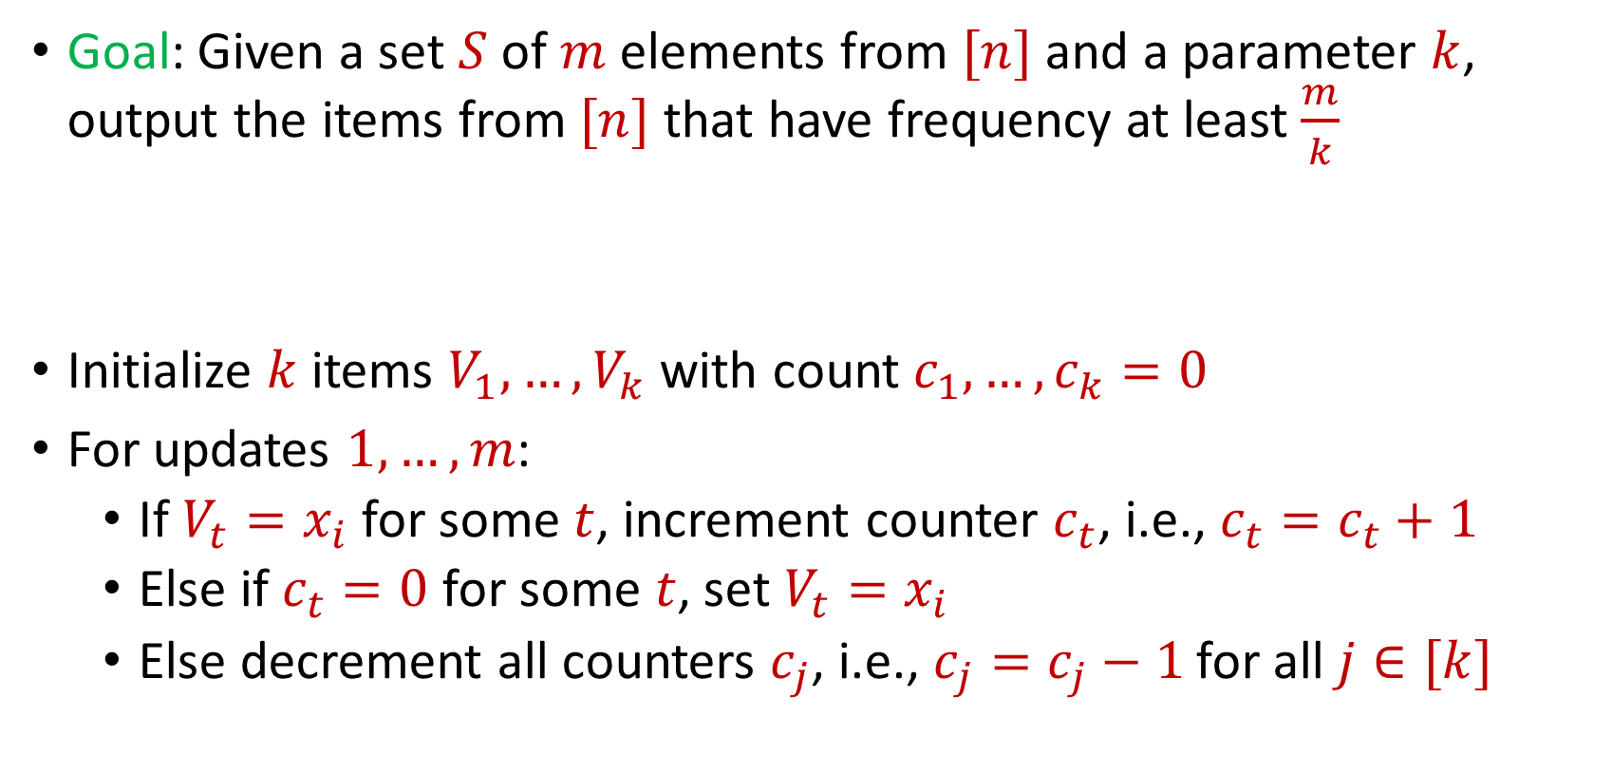
Last Time: Misra Gries
Goal: Given a set $S$ of $m$ elements from $[n]$ and a parameter $k$, output the items from $[n]$ that have frequency at least $\frac{m}{k}$
Initialize $k$ items $V_{1},…,V_{k}$ with count $c_{1},…,c_{k}=0$
For updates $1,…,m$:
If $V_{t}=x_{i}$ for some $t$, increment counter $c_{t}$, i.e., $c_{t}=c_{t}+1$
Else if $c_{t}=0$ for some $t$, set $V_{t}=x_{i}$
Else decrement all counters $c_{j}$, i.e., $c_{j}=c_{j}−1$ for all $j∈[k]$

Slide 4
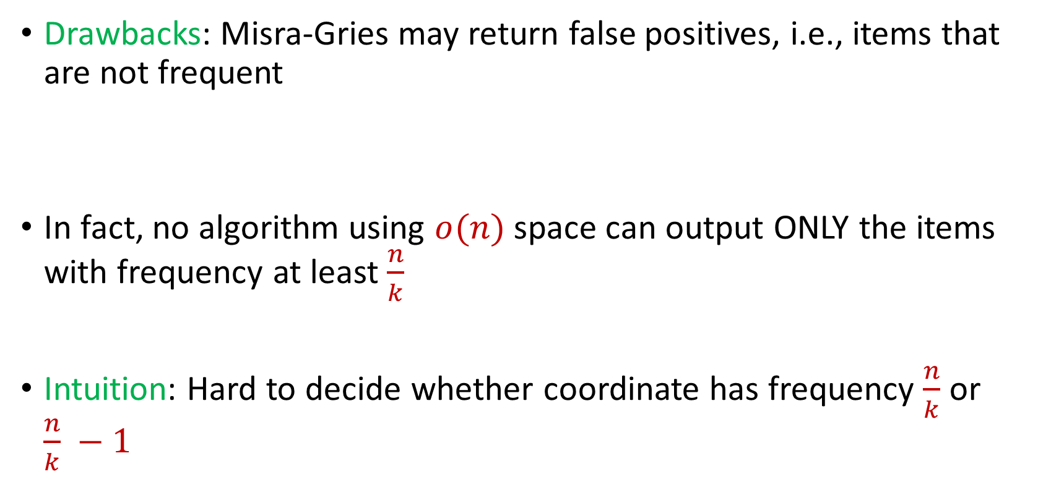
Last Time: Misra Gries
Drawbacks: Misra-Gries may return false positives, i.e., items that are not frequent
In fact, no algorithm using $o(n)$ space can output ONLY the items with frequency at least $\frac{n}{k}$
Intuition: Hard to decide whether coordinate has frequency $\frac{n}{k}$ or $\frac{n}{k} −1$

Slide 5


Last Time: $(ε,k)$-Frequent Items Problem
Goal: Given a set $S$ of $m$ elements from $[n]$, an accuracy parameter $ε∈(0, 1)$, and a parameter $k$, output a list that includes:
The items from $[n]$ that have frequency at least $\frac{m}{k}$
No items with frequency less than $\left(1−ε\right)\frac{m}{k}$

Slide 6

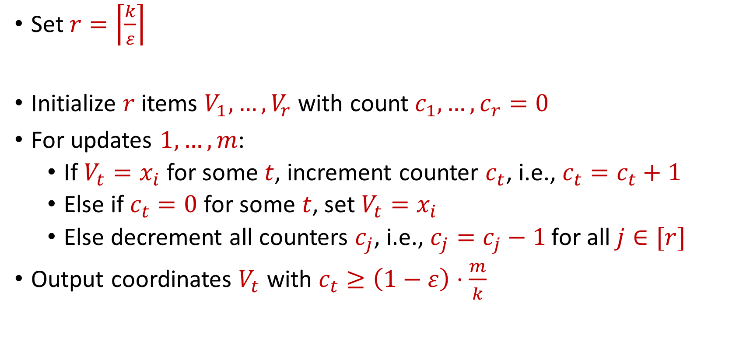
Last Time: Misra Gries for $(ε,k)$-Frequent Items Problem
Set $r=\left\lceil \frac{k}{ε}\right\rceil$
Initialize $r$ items $V_{1},…,V_{r}$ with count $c_{1},…,c_{r}=0$
For updates $1,…,m$:
If $V_{t}=x_{i}$ for some $t$, increment counter $c_{t}$, i.e., $c_{t}=c_{t}+1$
Else if $c_{t}=0$ for some $t$, set $V_{t}=x_{i}$
Else decrement all counters $c_{j}$, i.e., $c_{j}=c_{j}−1$ for all $j∈[r]$
Output coordinates $V_{t}$ with $c_{t}≥\left(1−ε\right)⋅\frac{m}{k}$

Slide 7

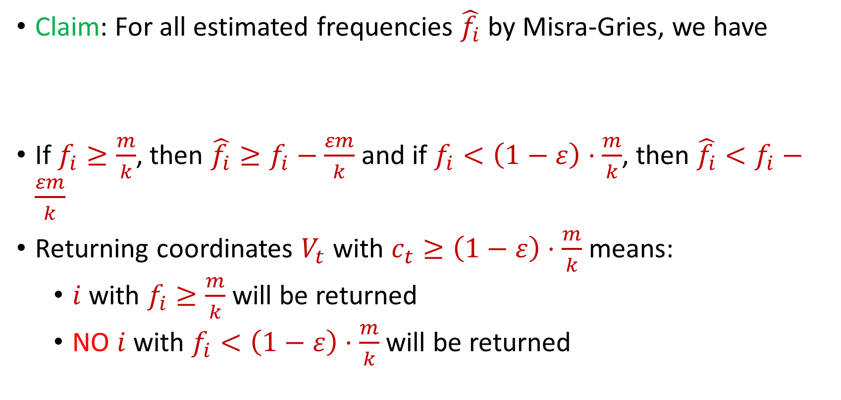
Last Time: Misra Gries for $(ε,k)$-Frequent Items Problem
Claim: For all estimated frequencies $\hat{f_{i}}$ by Misra-Gries, we have
If $f_{i}≥\frac{m}{k}$, then ${\hat{f_{i}}≥f}_{i}−\frac{εm}{k}$ and if $f_{i}<\left(1−ε\right)⋅\frac{m}{k}$, then ${\hat{f_{i}}<f}_{i}−\frac{εm}{k}$
Returning coordinates $V_{t}$ with $c_{t}≥\left(1−ε\right)⋅\frac{m}{k}$ means:
$i$ with $f_{i}≥\frac{m}{k}$ will be returned
NO $i$ with $f_{i}<\left(1−ε\right)⋅\frac{m}{k}$will be returned
$$f_{i}−\frac{εm}{k}≤\hat{f_{i}}≤f_{i}$$

Slide 8
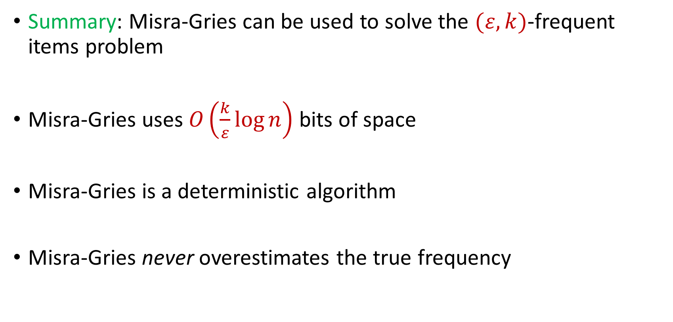
Last Time: Misra Gries for $(ε,k)$-Frequent Items Problem
Summary: Misra-Gries can be used to solve the $(ε,k)$-frequent items problem
Misra-Gries uses $O\left(\frac{k}{ε}\log{n}\right)$ bits of space
Misra-Gries is a deterministic algorithm
Misra-Gries never overestimates the true frequency

Slide 9

Insertion-Deletion Streams
Stream of length $m=Θ\left(n\right)$
Universe of size $[n]$, underlying vector $f∈R^{n}$
Each update increases or decreases a coordinate in $f$
“Decrease $f_{6}$”
$f_{1}$ | $f_{2}$ | $f_{3}$ | $f_{4}$ | $f_{5}$ | $f_{6}$ | $f_{7}$
0 | 0 | 0 | 0 | 0 | 0 | 0
$f_{1}$ | $f_{2}$ | $f_{3}$ | $f_{4}$ | $f_{5}$ | $f_{6}$ | $f_{7}$
0 | 0 | 0 | 0 | 0 | -1 | 0

Slide 10
Insertion-Deletion Streams
Database Management: In database management, insertion-deletion streams are used to track changes made to the database over time
Transaction logs often utilize this concept to record insertions and deletions to ensure data integrity and support features like rollbacks and recovery

Slide 11




Insertion-Deletion Streams
Version Control Systems: Insertion-deletion streams track changes made to files, enabling users to see what has been added (inserted) or removed (deleted) in each version
Crucial for collaboration and managing software development projects, central to version control systems

Slide 12

Insertion-Deletion Streams
Traffic Flow and Transportation Systems: Insertion-deletion streams are used to analyze traffic patterns and changes in transportation systems
This helps in optimizing traffic flow, managing congestion, and improving transportation infrastructure

Slide 13

Frequent Items on Insertion-Deletion Streams
Misra-Gries on Insertion-Deletion Streams
“Increase $f_{1}$”
“Increase $f_{3}$”
“Increase $f_{2}$”
“Increase $f_{2}$”
“Decrease $f_{2}$”
“Decrease $f_{2}$”
“Decrease $f_{3}$”

Slide 14
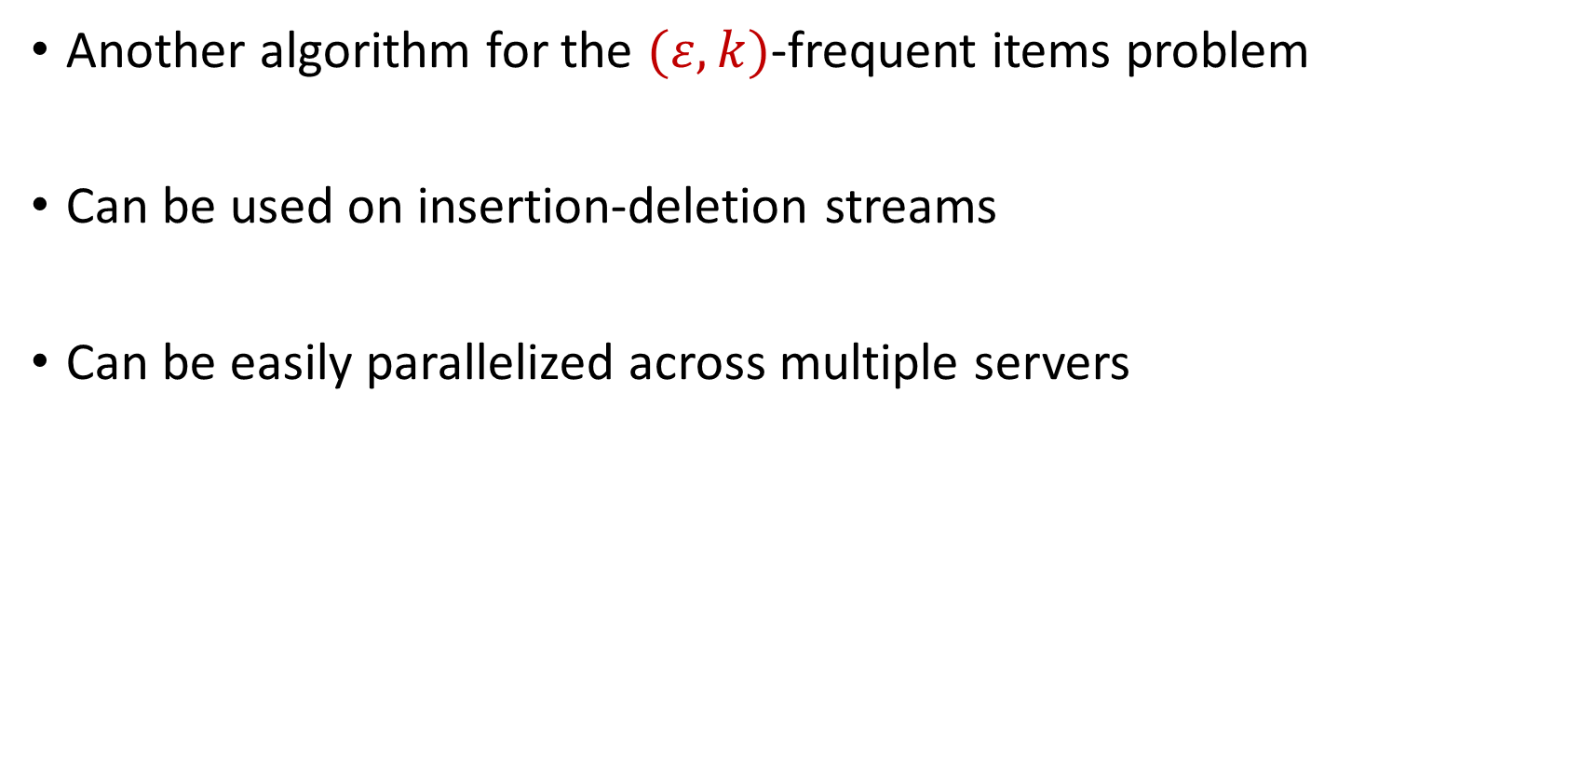
CountMin
Another algorithm for the $(ε,k)$-frequent items problem
Can be used on insertion-deletion streams
Can be easily parallelized across multiple servers

Slide 15
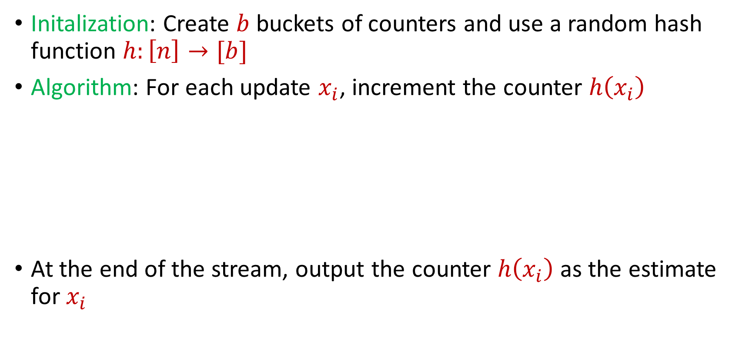
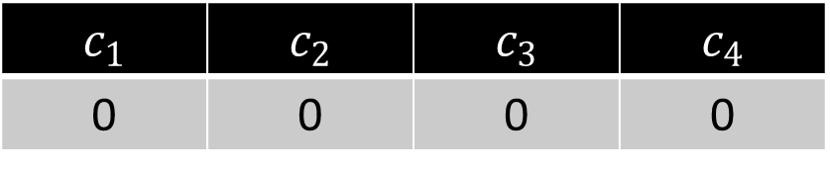
CountMin
Initalization: Create $b$ buckets of counters and use a random hash function $h:\left[n\right]→[b]$
Algorithm: For each update $x_{i}$, increment the counter $h\left(x_{i}\right)$
At the end of the stream, output the counter $h\left(x_{i}\right)$ as the estimate for $x_{i}$
$c_{1}$ | $c_{2}$ | $c_{3}$ | $c_{4}$
0 | 0 | 0 | 0

Slide 16
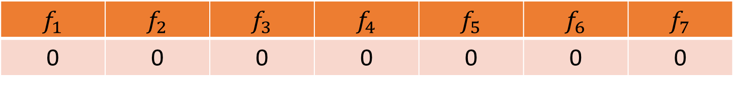


CountMin
$f_{1}$ | $f_{2}$ | $f_{3}$ | $f_{4}$ | $f_{5}$ | $f_{6}$ | $f_{7}$
0 | 0 | 0 | 0 | 0 | 0 | 0
$$1$$
$c_{1}$ | $c_{2}$ | $c_{3}$ | $c_{4}$
0 | 0 | 0 | 0

Slide 17
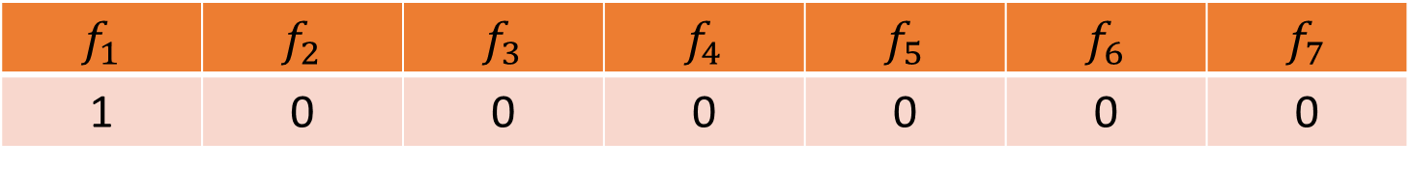

CountMin
$f_{1}$ | $f_{2}$ | $f_{3}$ | $f_{4}$ | $f_{5}$ | $f_{6}$ | $f_{7}$
1 | 0 | 0 | 0 | 0 | 0 | 0
$$1$$
$$h\left(x\right)=3x+2 (mod 4)$$
$c_{1}$ | $c_{2}$ | $c_{3}$ | $c_{4}$
0 | 0 | 0 | 0

Slide 18
CountMin
$f_{1}$ | $f_{2}$ | $f_{3}$ | $f_{4}$ | $f_{5}$ | $f_{6}$ | $f_{7}$
1 | 0 | 0 | 0 | 0 | 0 | 0
$$1$$
$$h\left(x\right)=3x+2 (mod 4)$$
$c_{1}$ | $c_{2}$ | $c_{3}$ | $c_{4}$
0 | 0 | 0 | 0

Slide 19
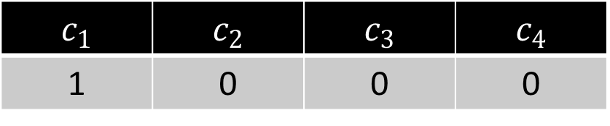
CountMin
$f_{1}$ | $f_{2}$ | $f_{3}$ | $f_{4}$ | $f_{5}$ | $f_{6}$ | $f_{7}$
1 | 0 | 0 | 0 | 0 | 0 | 0
$$1$$
$$h\left(x\right)=3x+2 (mod 4)$$
$c_{1}$ | $c_{2}$ | $c_{3}$ | $c_{4}$
1 | 0 | 0 | 0

Slide 20

CountMin
$f_{1}$ | $f_{2}$ | $f_{3}$ | $f_{4}$ | $f_{5}$ | $f_{6}$ | $f_{7}$
1 | 0 | 0 | 0 | 0 | 0 | 0
$$3$$
$$h\left(x\right)=3x+2 (mod 4)$$
$c_{1}$ | $c_{2}$ | $c_{3}$ | $c_{4}$
1 | 0 | 0 | 0

Slide 21
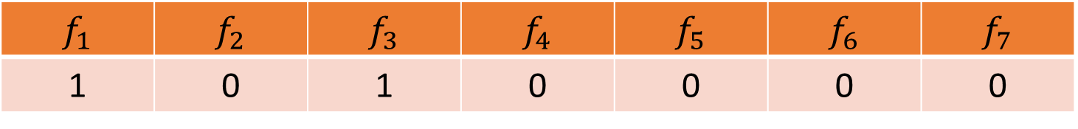
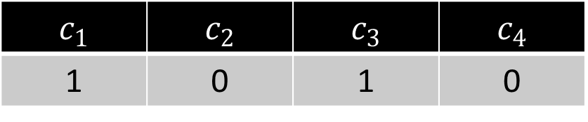
CountMin
$f_{1}$ | $f_{2}$ | $f_{3}$ | $f_{4}$ | $f_{5}$ | $f_{6}$ | $f_{7}$
1 | 0 | 1 | 0 | 0 | 0 | 0
$$3$$
$$h\left(x\right)=3x+2 (mod 4)$$
$c_{1}$ | $c_{2}$ | $c_{3}$ | $c_{4}$
1 | 0 | 1 | 0

Slide 22

CountMin
$f_{1}$ | $f_{2}$ | $f_{3}$ | $f_{4}$ | $f_{5}$ | $f_{6}$ | $f_{7}$
1 | 0 | 1 | 0 | 0 | 0 | 0
$$2$$
$$h\left(x\right)=3x+2 (mod 4)$$
$c_{1}$ | $c_{2}$ | $c_{3}$ | $c_{4}$
1 | 0 | 1 | 0

Slide 23
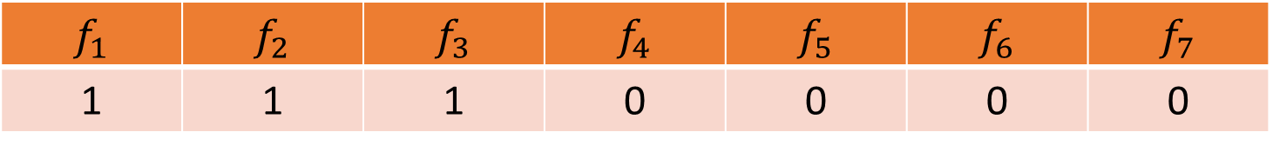
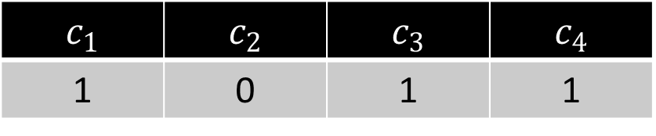
CountMin
$f_{1}$ | $f_{2}$ | $f_{3}$ | $f_{4}$ | $f_{5}$ | $f_{6}$ | $f_{7}$
1 | 1 | 1 | 0 | 0 | 0 | 0
$$2$$
$$h\left(x\right)=3x+2 (mod 4)$$
$c_{1}$ | $c_{2}$ | $c_{3}$ | $c_{4}$
1 | 0 | 1 | 1

Slide 24
CountMin
$f_{1}$ | $f_{2}$ | $f_{3}$ | $f_{4}$ | $f_{5}$ | $f_{6}$ | $f_{7}$
1 | 1 | 1 | 0 | 0 | 0 | 0
$$1$$
$$h\left(x\right)=3x+2 (mod 4)$$
$c_{1}$ | $c_{2}$ | $c_{3}$ | $c_{4}$
1 | 0 | 1 | 1

Slide 25
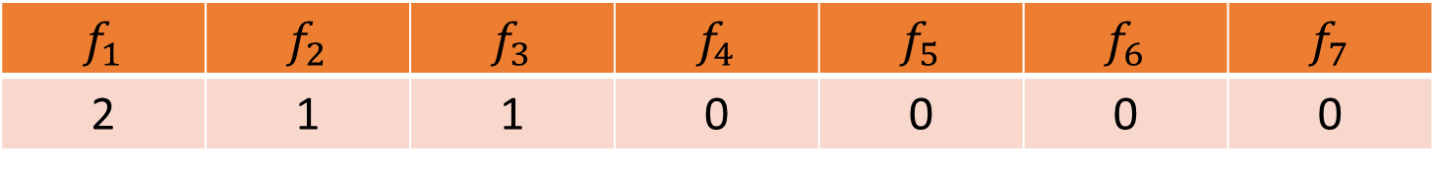
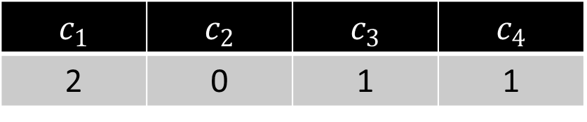
CountMin
$f_{1}$ | $f_{2}$ | $f_{3}$ | $f_{4}$ | $f_{5}$ | $f_{6}$ | $f_{7}$
2 | 1 | 1 | 0 | 0 | 0 | 0
$$1$$
$$h\left(x\right)=3x+2 (mod 4)$$
$c_{1}$ | $c_{2}$ | $c_{3}$ | $c_{4}$
2 | 0 | 1 | 1

Slide 26
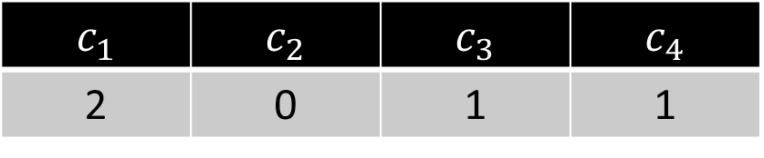

CountMin
$f_{1}$ | $f_{2}$ | $f_{3}$ | $f_{4}$ | $f_{5}$ | $f_{6}$ | $f_{7}$
2 | 1 | 1 | 0 | 0 | 0 | 0
$$5$$
$$h\left(x\right)=3x+2 (mod 4)$$
$c_{1}$ | $c_{2}$ | $c_{3}$ | $c_{4}$
2 | 0 | 1 | 1

Slide 27
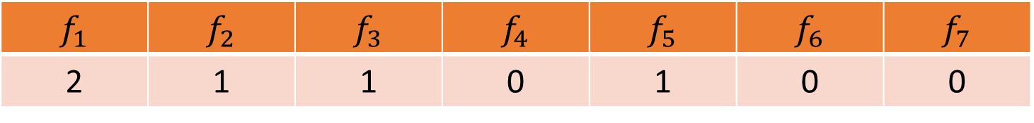
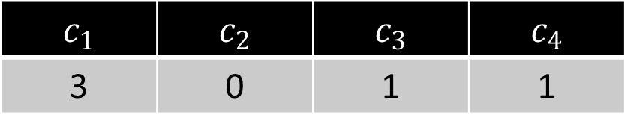
CountMin
$f_{1}$ | $f_{2}$ | $f_{3}$ | $f_{4}$ | $f_{5}$ | $f_{6}$ | $f_{7}$
2 | 1 | 1 | 0 | 1 | 0 | 0
$$5$$
$$h\left(x\right)=3x+2 (mod 4)$$
$c_{1}$ | $c_{2}$ | $c_{3}$ | $c_{4}$
3 | 0 | 1 | 1

Slide 28

CountMin
$f_{1}$ | $f_{2}$ | $f_{3}$ | $f_{4}$ | $f_{5}$ | $f_{6}$ | $f_{7}$
2 | 1 | 1 | 0 | 1 | 0 | 0
What is the estimation for $f_{4}$?
What about $f_{3}$?
What about $f_{5}$? What about $f_{1}$?
$$h\left(x\right)=3x+2 (mod 4)$$
$c_{1}$ | $c_{2}$ | $c_{3}$ | $c_{4}$
3 | 0 | 1 | 1

Slide 29
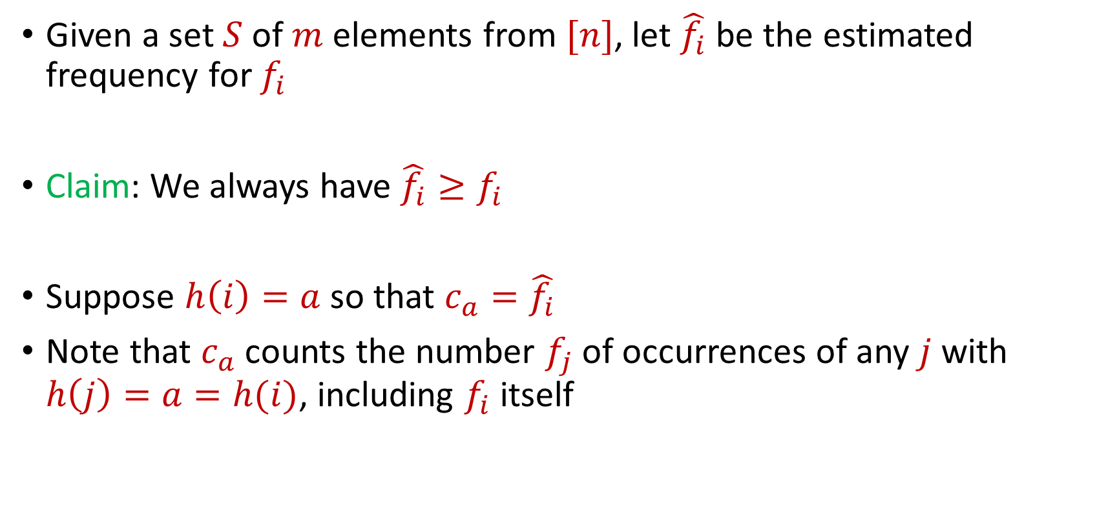
CountMin
Given a set $S$ of $m$ elements from $[n]$, let $\hat{f_{i}}$ be the estimated frequency for $f_{i}$
Claim: We always have $\hat{f_{i}}≥f_{i}$
Suppose $h\left(i\right)=a$ so that $c_{a}=\hat{f_{i}}$
Note that $c_{a}$counts the number $f_{j}$of occurrences of any $j$ with $h\left(j\right)=a=h(i)$, including $f_{i}$ itself

Slide 30
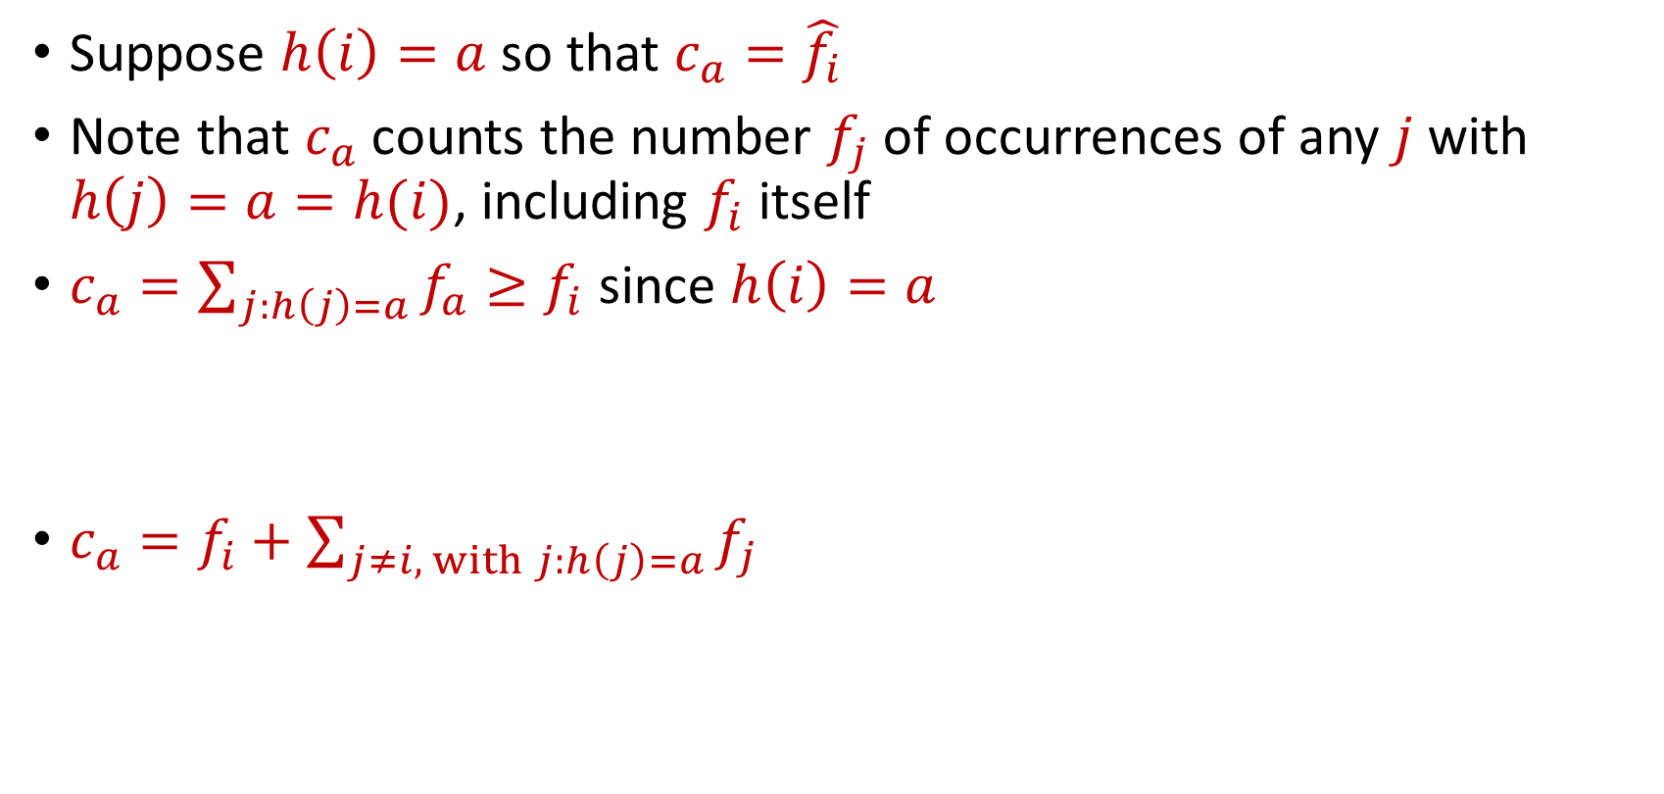
CountMin
Suppose $h\left(i\right)=a$ so that $c_{a}=\hat{f_{i}}$
Note that $c_{a}$counts the number $f_{j}$of occurrences of any $j$ with $h\left(j\right)=a=h(i)$, including $f_{i}$ itself
$c_{a}=\sum_{j:h\left(j\right)=a}{f_{a}}≥f_{i}$ since $h\left(i\right)=a$
$c_{a}=f_{i}+\sum_{j≠i, with j:h\left(j\right)=a}{f_{j}}$

Slide 31

CountMin Error Analysis
$c_{a}=f_{i}+\sum_{j≠i, with j:h\left(j\right)=a}{f_{j}}$
What is the expected error for $f_{i}$?

Slide 32

CountMin Error Analysis
$c_{a}=f_{i}+\sum_{j≠i, with j:h\left(j\right)=a}{f_{j}}$
What is the expected error for $f_{i}$?
$E\left[\left|\sum_{j≠i, with j:h\left(j\right)=a}{f_{j}}\right|\right]≤Σ_{j≠i}E\left[\left|f_{j}\right|⋅I_{h\left(j\right)=h(i)}\right]$

Slide 33
CountMin Error Analysis
$c_{a}=f_{i}+\sum_{j≠i, with j:h\left(j\right)=a}{f_{j}}$
What is the expected error for $f_{i}$?
$E\left[\left|\sum_{j≠i, with j:h\left(j\right)=a}{f_{j}}\right|\right]≤Σ_{j≠i}E\left[\left|f_{j}\right|⋅I_{h\left(j\right)=h(i)}\right]$
$$=Σ_{j≠i}E\left[I_{h\left(j\right)=h(i)}\right]⋅\left|f_{j}\right|$$

Slide 34
CountMin Error Analysis
$c_{a}=f_{i}+\sum_{j≠i, with j:h\left(j\right)=a}{f_{j}}$
What is the expected error for $f_{i}$?
$E\left[\left|\sum_{j≠i, with j:h\left(j\right)=a}{f_{j}}\right|\right]≤Σ_{j≠i}E\left[\left|f_{j}\right|⋅I_{h\left(j\right)=h(i)}\right]$
$$=Σ_{j≠i}E\left[I_{h\left(j\right)=h(i)}\right]⋅\left|f_{j}\right|$$
$$=Σ_{j≠i}Pr\left[h\left(j\right)=h(i)\right]⋅\left|f_{j}\right|$$

Slide 35

CountMin Error Analysis
$c_{a}=f_{i}+\sum_{j≠i, with j:h\left(j\right)=a}{f_{j}}$
What is the expected error for $f_{i}$?
$E\left[\left|\sum_{j≠i, with j:h\left(j\right)=a}{f_{j}}\right|\right]≤Σ_{j≠i}E\left[\left|f_{j}\right|⋅I_{h\left(j\right)=h(i)}\right]$
$$=Σ_{j≠i}E\left[I_{h\left(j\right)=h(i)}\right]⋅\left|f_{j}\right|$$
$$=Σ_{j≠i}Pr\left[h\left(j\right)=h(i)\right]⋅\left|f_{j}\right|$$
$$=Σ_{j≠i}\frac{1}{b}⋅\left|f_{j}\right|=\frac{{\left\|f\right\|}_{1}}{b}$$

Slide 36
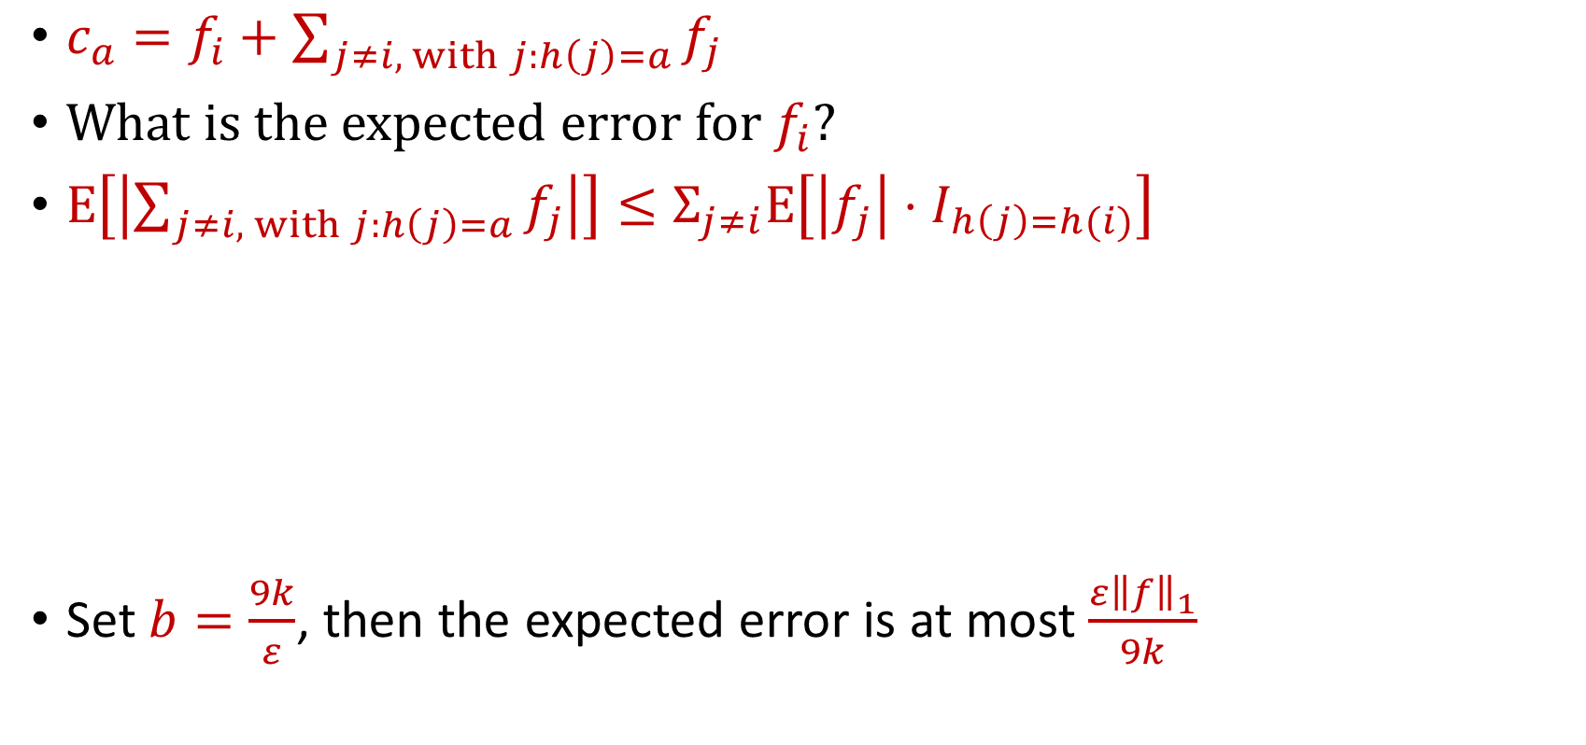

CountMin Error Analysis
$c_{a}=f_{i}+\sum_{j≠i, with j:h\left(j\right)=a}{f_{j}}$
What is the expected error for $f_{i}$?
$E\left[\left|\sum_{j≠i, with j:h\left(j\right)=a}{f_{j}}\right|\right]≤Σ_{j≠i}E\left[\left|f_{j}\right|⋅I_{h\left(j\right)=h(i)}\right]$
Set $b=\frac{9k}{ε}$, then the expected error is at most $\frac{ε{\left\|f\right\|}_{1}}{9k}$
$$=Σ_{j≠i}E\left[I_{h\left(j\right)=h(i)}\right]⋅\left|f_{j}\right|$$
$$=Σ_{j≠i}Pr\left[h\left(j\right)=h(i)\right]⋅\left|f_{j}\right|$$
$$=Σ_{j≠i}\frac{1}{b}⋅\left|f_{j}\right|=\frac{{\left\|f\right\|}_{1}}{b}$$

Slide 37
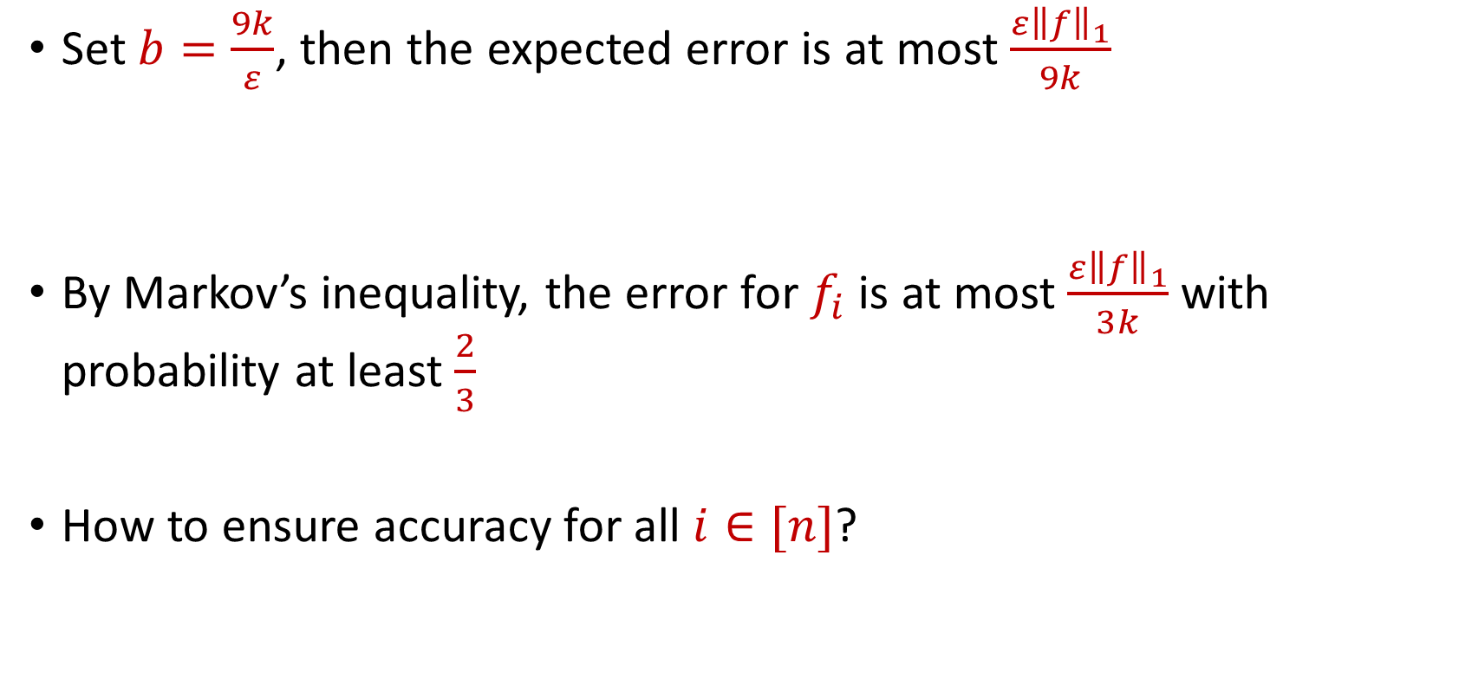
CountMin Error Analysis
Set $b=\frac{9k}{ε}$, then the expected error is at most $\frac{ε{\left\|f\right\|}_{1}}{9k}$
By Markov’s inequality, the error for $f_{i}$ is at most $\frac{ε{\left\|f\right\|}_{1}}{3k}$ with probability at least $\frac{2}{3}$
How to ensure accuracy for all $i∈[n]$?

Slide 38
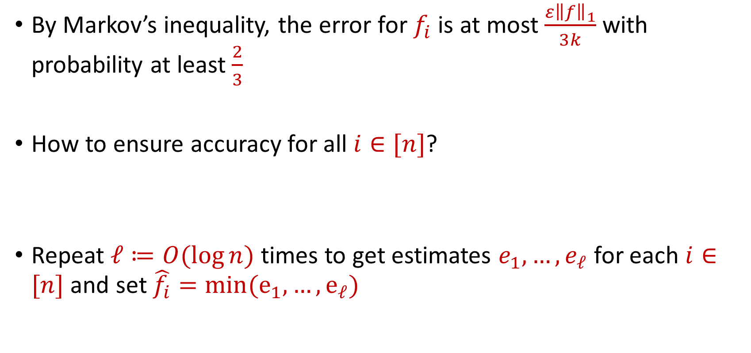
CountMin Error Analysis
By Markov’s inequality, the error for $f_{i}$ is at most $\frac{ε{\left\|f\right\|}_{1}}{3k}$ with probability at least $\frac{2}{3}$
How to ensure accuracy for all $i∈[n]$?
Repeat $ℓ≔O(\log{n)}$ times to get estimates $e_{1},…,e_{ℓ}$ for each $i∈[n]$ and set $\hat{f_{i}}=min(e_{1},…, e_{ℓ})$

