Slide 1
CSCE 689: Special Topics in Modern Algorithms for Data Science
Lecture 12
Samson Zhou

Slide 2


Last Time: $(ε,k)$-Frequent Items Problem
Goal: Given a set $S$ of $m$ elements from $[n]$, an accuracy parameter $ε∈(0, 1)$, and a parameter $k$, output a list that includes:
The items from $[n]$ that have frequency at least $\frac{m}{k}$
No items with frequency less than $\left(1−ε\right)\frac{m}{k}$

Slide 3
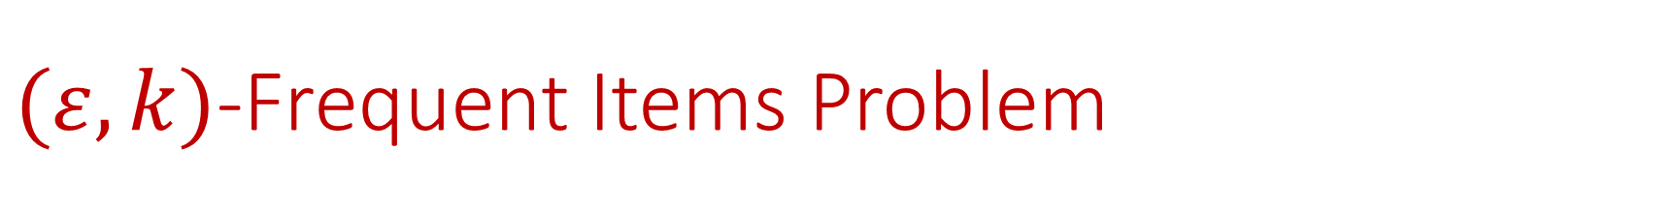
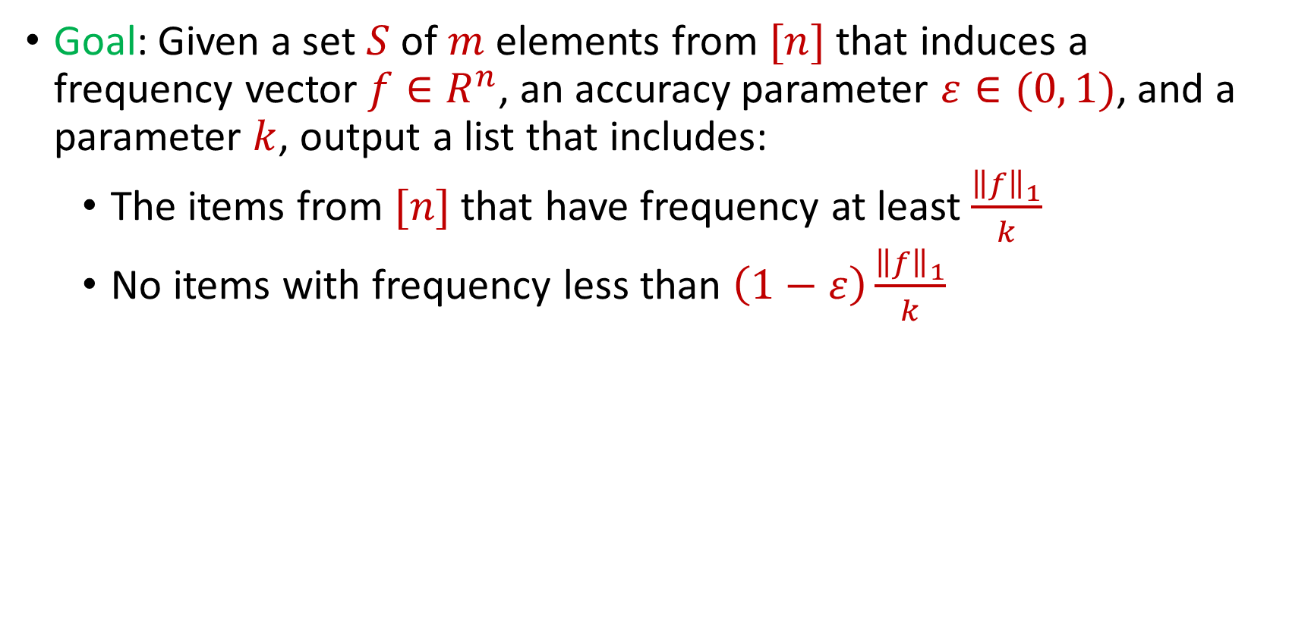
$(ε,k)$-Frequent Items Problem
Goal: Given a set $S$ of $m$ elements from $[n]$ that induces a frequency vector $f∈R^{n}$, an accuracy parameter $ε∈(0, 1)$, and a parameter $k$, output a list that includes:
The items from $[n]$ that have frequency at least $\frac{{\left\|f\right\|}_{1}}{k}$
No items with frequency less than $\left(1−ε\right)\frac{{\left\|f\right\|}_{1}}{k}$

Slide 4
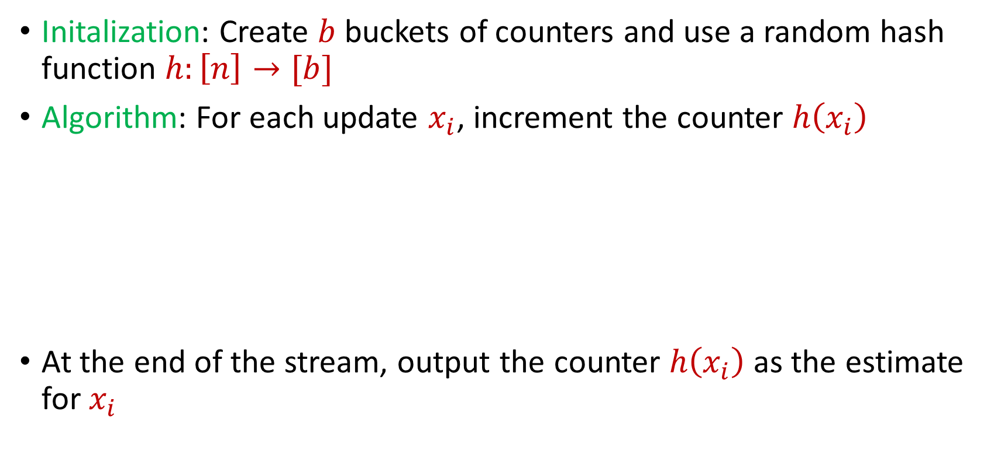
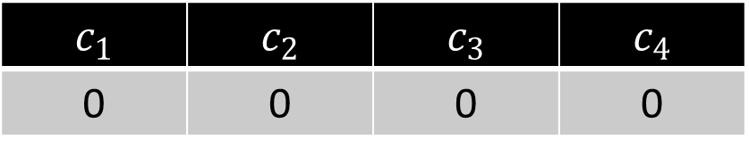
CountMin
Initalization: Create $b$ buckets of counters and use a random hash function $h:\left[n\right]→[b]$
Algorithm: For each update $x_{i}$, increment the counter $h\left(x_{i}\right)$
At the end of the stream, output the counter $h\left(x_{i}\right)$ as the estimate for $x_{i}$
$c_{1}$ | $c_{2}$ | $c_{3}$ | $c_{4}$
0 | 0 | 0 | 0

Slide 5


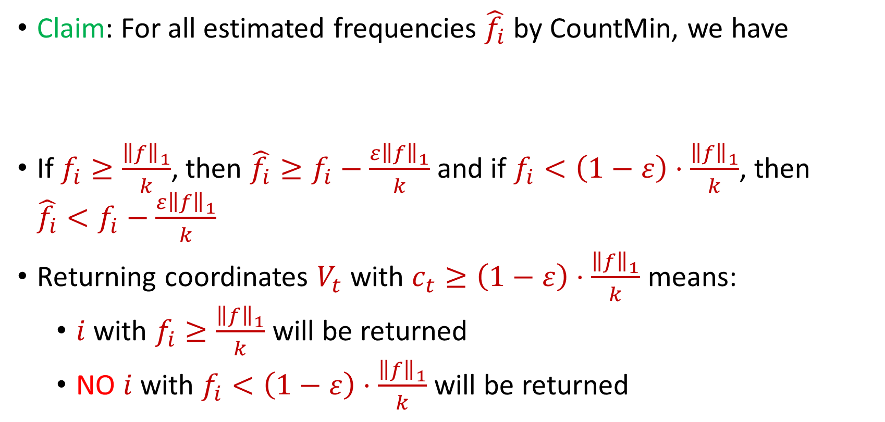
CountMin for $(ε,k)$-Frequent Items Problem
Claim: For all estimated frequencies $\hat{f_{i}}$ by CountMin, we have
If $f_{i}≥\frac{{\left\|f\right\|}_{1}}{k}$, then ${\hat{f_{i}}≥f}_{i}−\frac{ε{\left\|f\right\|}_{1}}{k}$ and if $f_{i}<\left(1−ε\right)⋅\frac{{\left\|f\right\|}_{1}}{k}$, then ${\hat{f_{i}}<f}_{i}−\frac{ε{\left\|f\right\|}_{1}}{k}$
Returning coordinates $V_{t}$ with $c_{t}≥\left(1−ε\right)⋅\frac{{\left\|f\right\|}_{1}}{k}$ means:
$i$ with $f_{i}≥\frac{{\left\|f\right\|}_{1}}{k}$ will be returned
NO $i$ with $f_{i}<\left(1−ε\right)⋅\frac{{\left\|f\right\|}_{1}}{k}$will be returned
$$f_{i}≤\hat{f_{i}}≤f_{i}+\frac{ε{\left\|f\right\|}_{1}}{k}$$

Slide 6
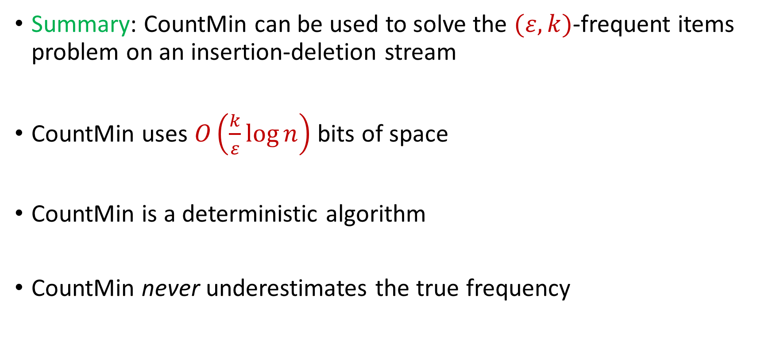
CountMin for $(ε,k)$-Frequent Items Problem
Summary: CountMin can be used to solve the $(ε,k)$-frequent items problem on an insertion-deletion stream
CountMin uses $O\left(\frac{k}{ε}\log{n}\right)$ bits of space
CountMin is a deterministic algorithm
CountMin never underestimates the true frequency

Slide 7
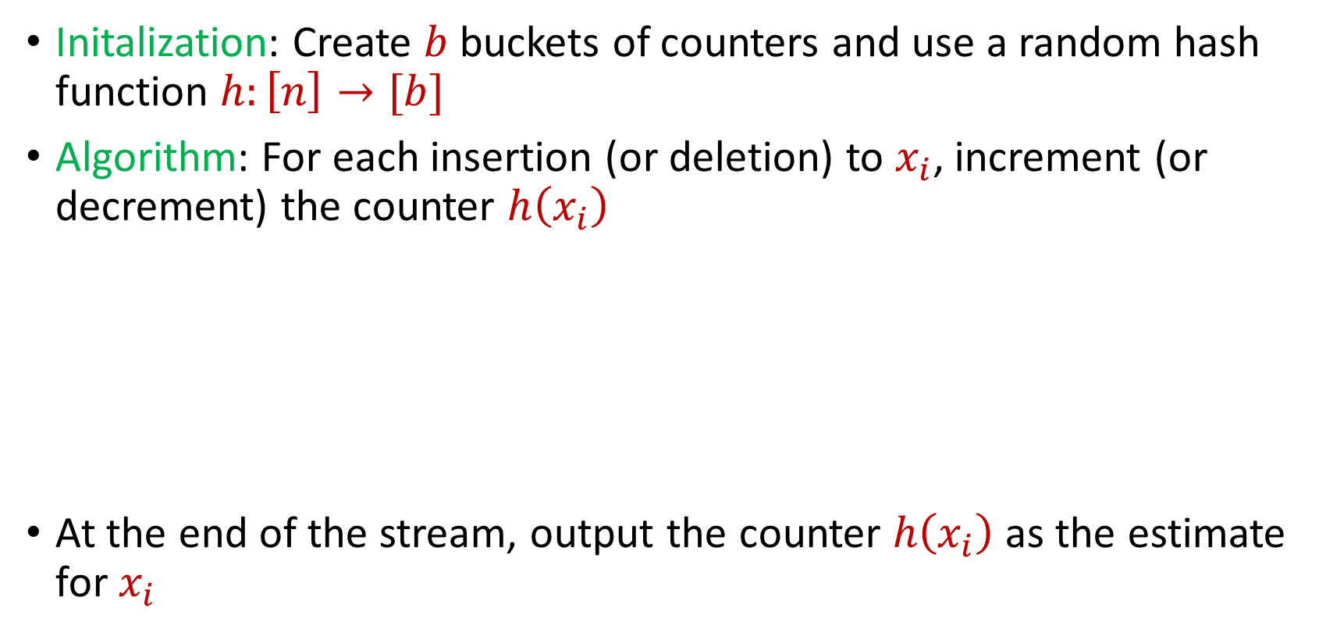
Revisiting CountMin
Initalization: Create $b$ buckets of counters and use a random hash function $h:\left[n\right]→[b]$
Algorithm: For each insertion (or deletion) to $x_{i}$, increment (or decrement) the counter $h\left(x_{i}\right)$
At the end of the stream, output the counter $h\left(x_{i}\right)$ as the estimate for $x_{i}$
$c_{1}$ | $c_{2}$ | $c_{3}$ | $c_{4}$
0 | 0 | 0 | 0

Slide 8
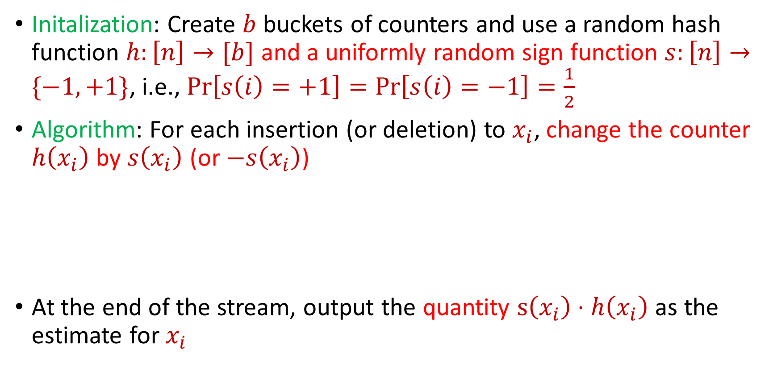
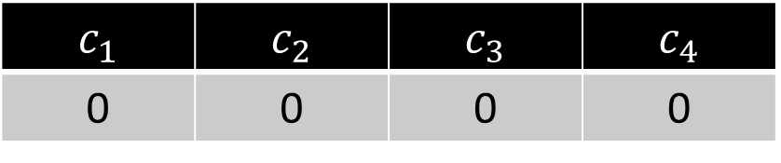
Revisiting CountMin
Initalization: Create $b$ buckets of counters and use a random hash function $h:\left[n\right]→[b]$ and a uniformly random sign function $s:\left[n\right]→\{−1,+1\}$, i.e., $Pr\left[s\left(i\right)=+1\right]=Pr\left[s\left(i\right)=−1\right]=\frac{1}{2}$
Algorithm: For each insertion (or deletion) to $x_{i}$, change the counter $h\left(x_{i}\right)$ by $s\left(x_{i}\right)$ (or $−s\left(x_{i}\right)$)
At the end of the stream, output the quantity $s\left(x_{i}\right)⋅h\left(x_{i}\right)$ as the estimate for $x_{i}$
$c_{1}$ | $c_{2}$ | $c_{3}$ | $c_{4}$
0 | 0 | 0 | 0

Slide 9
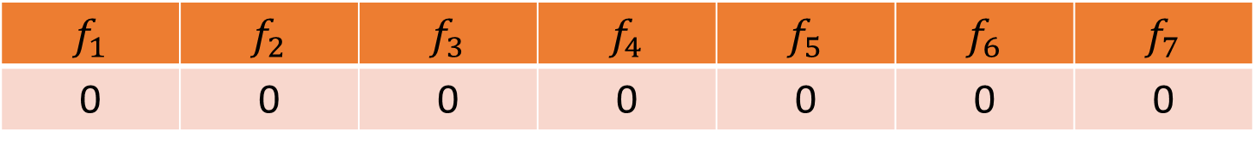


CountSketch
$f_{1}$ | $f_{2}$ | $f_{3}$ | $f_{4}$ | $f_{5}$ | $f_{6}$ | $f_{7}$
0 | 0 | 0 | 0 | 0 | 0 | 0
$$1$$
$c_{1}$ | $c_{2}$ | $c_{3}$ | $c_{4}$
0 | 0 | 0 | 0

Slide 10
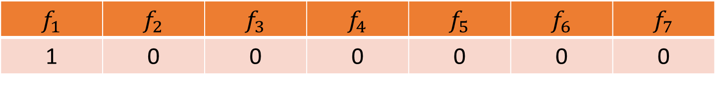
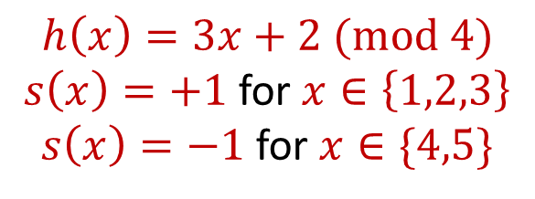
CountSketch
$f_{1}$ | $f_{2}$ | $f_{3}$ | $f_{4}$ | $f_{5}$ | $f_{6}$ | $f_{7}$
1 | 0 | 0 | 0 | 0 | 0 | 0
$$1$$
$$h\left(x\right)=3x+2 (mod 4)$$
$s\left(x\right)=+1$ for $x∈\left\{1,2,3\right\}$
$s\left(x\right)=−1$ for $x∈\{4,5\}$
$c_{1}$ | $c_{2}$ | $c_{3}$ | $c_{4}$
0 | 0 | 0 | 0

Slide 11
CountSketch
$f_{1}$ | $f_{2}$ | $f_{3}$ | $f_{4}$ | $f_{5}$ | $f_{6}$ | $f_{7}$
1 | 0 | 0 | 0 | 0 | 0 | 0
$$1$$
$$h\left(x\right)=3x+2 (mod 4)$$
$s\left(x\right)=+1$ for $x∈\left\{1,2,3\right\}$
$s\left(x\right)=−1$ for $x∈\{4,5\}$
$c_{1}$ | $c_{2}$ | $c_{3}$ | $c_{4}$
0 | 0 | 0 | 0

Slide 12
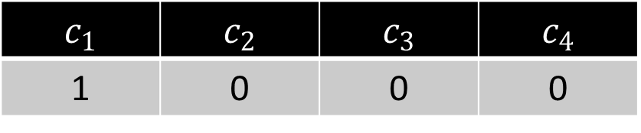
CountSketch
$f_{1}$ | $f_{2}$ | $f_{3}$ | $f_{4}$ | $f_{5}$ | $f_{6}$ | $f_{7}$
1 | 0 | 0 | 0 | 0 | 0 | 0
$$1$$
$$h\left(x\right)=3x+2 (mod 4)$$
$s\left(x\right)=+1$ for $x∈\left\{1,2,3\right\}$
$s\left(x\right)=−1$ for $x∈\{4,5\}$
$c_{1}$ | $c_{2}$ | $c_{3}$ | $c_{4}$
1 | 0 | 0 | 0

Slide 13

CountSketch
$f_{1}$ | $f_{2}$ | $f_{3}$ | $f_{4}$ | $f_{5}$ | $f_{6}$ | $f_{7}$
1 | 0 | 0 | 0 | 0 | 0 | 0
$$3$$
$$h\left(x\right)=3x+2 (mod 4)$$
$s\left(x\right)=+1$ for $x∈\left\{1,2,3\right\}$
$s\left(x\right)=−1$ for $x∈\{4,5\}$
$c_{1}$ | $c_{2}$ | $c_{3}$ | $c_{4}$
1 | 0 | 0 | 0

Slide 14
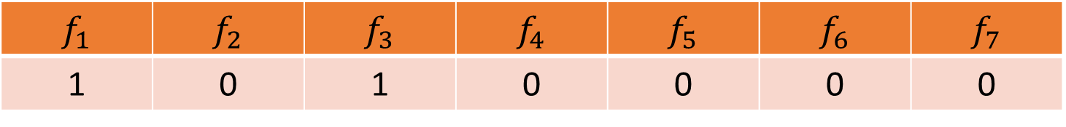
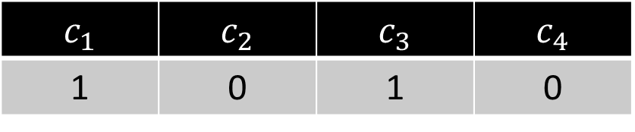
CountSketch
$f_{1}$ | $f_{2}$ | $f_{3}$ | $f_{4}$ | $f_{5}$ | $f_{6}$ | $f_{7}$
1 | 0 | 1 | 0 | 0 | 0 | 0
$$3$$
$$h\left(x\right)=3x+2 (mod 4)$$
$s\left(x\right)=+1$ for $x∈\left\{1,2,3\right\}$
$s\left(x\right)=−1$ for $x∈\{4,5\}$
$c_{1}$ | $c_{2}$ | $c_{3}$ | $c_{4}$
1 | 0 | 1 | 0

Slide 15

CountSketch
$f_{1}$ | $f_{2}$ | $f_{3}$ | $f_{4}$ | $f_{5}$ | $f_{6}$ | $f_{7}$
1 | 0 | 1 | 0 | 0 | 0 | 0
$$2$$
$$h\left(x\right)=3x+2 (mod 4)$$
$s\left(x\right)=+1$ for $x∈\left\{1,2,3\right\}$
$s\left(x\right)=−1$ for $x∈\{4,5\}$
$c_{1}$ | $c_{2}$ | $c_{3}$ | $c_{4}$
1 | 0 | 1 | 0

Slide 16
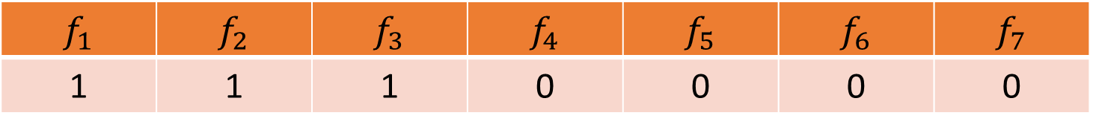
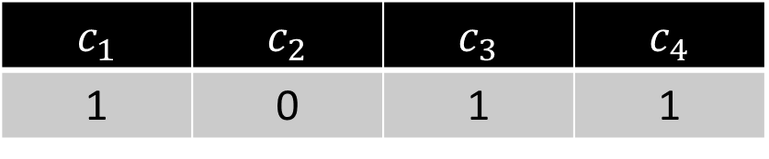
CountSketch
$f_{1}$ | $f_{2}$ | $f_{3}$ | $f_{4}$ | $f_{5}$ | $f_{6}$ | $f_{7}$
1 | 1 | 1 | 0 | 0 | 0 | 0
$$2$$
$$h\left(x\right)=3x+2 (mod 4)$$
$s\left(x\right)=+1$ for $x∈\left\{1,2,3\right\}$
$s\left(x\right)=−1$ for $x∈\{4,5\}$
$c_{1}$ | $c_{2}$ | $c_{3}$ | $c_{4}$
1 | 0 | 1 | 1

Slide 17
CountSketch
$f_{1}$ | $f_{2}$ | $f_{3}$ | $f_{4}$ | $f_{5}$ | $f_{6}$ | $f_{7}$
1 | 1 | 1 | 0 | 0 | 0 | 0
$$1$$
$$h\left(x\right)=3x+2 (mod 4)$$
$s\left(x\right)=+1$ for $x∈\left\{1,2,3\right\}$
$s\left(x\right)=−1$ for $x∈\{4,5\}$
$c_{1}$ | $c_{2}$ | $c_{3}$ | $c_{4}$
1 | 0 | 1 | 1

Slide 18
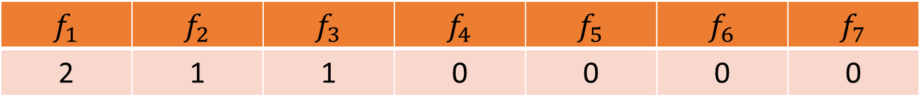
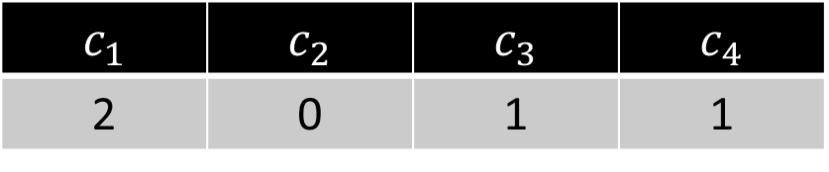
CountSketch
$f_{1}$ | $f_{2}$ | $f_{3}$ | $f_{4}$ | $f_{5}$ | $f_{6}$ | $f_{7}$
2 | 1 | 1 | 0 | 0 | 0 | 0
$$1$$
$$h\left(x\right)=3x+2 (mod 4)$$
$s\left(x\right)=+1$ for $x∈\left\{1,2,3\right\}$
$s\left(x\right)=−1$ for $x∈\{4,5\}$
$c_{1}$ | $c_{2}$ | $c_{3}$ | $c_{4}$
2 | 0 | 1 | 1

Slide 19

CountSketch
$f_{1}$ | $f_{2}$ | $f_{3}$ | $f_{4}$ | $f_{5}$ | $f_{6}$ | $f_{7}$
2 | 1 | 1 | 0 | 0 | 0 | 0
$$5$$
$$h\left(x\right)=3x+2 (mod 4)$$
$s\left(x\right)=+1$ for $x∈\left\{1,2,3\right\}$
$s\left(x\right)=−1$ for $x∈\{4,5\}$
$c_{1}$ | $c_{2}$ | $c_{3}$ | $c_{4}$
2 | 0 | 1 | 1

Slide 20
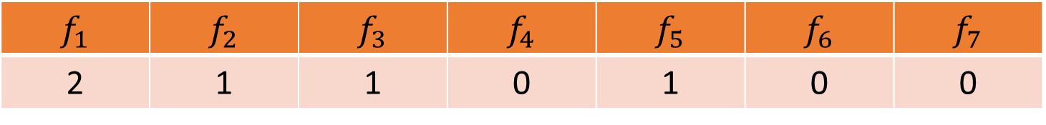
CountSketch
$f_{1}$ | $f_{2}$ | $f_{3}$ | $f_{4}$ | $f_{5}$ | $f_{6}$ | $f_{7}$
2 | 1 | 1 | 0 | 1 | 0 | 0
$$5$$
$$h\left(x\right)=3x+2 (mod 4)$$
$s\left(x\right)=+1$ for $x∈\left\{1,2,3\right\}$
$s\left(x\right)=−1$ for $x∈\{4,5\}$
$c_{1}$ | $c_{2}$ | $c_{3}$ | $c_{4}$
1 | 0 | 1 | 1

Slide 21
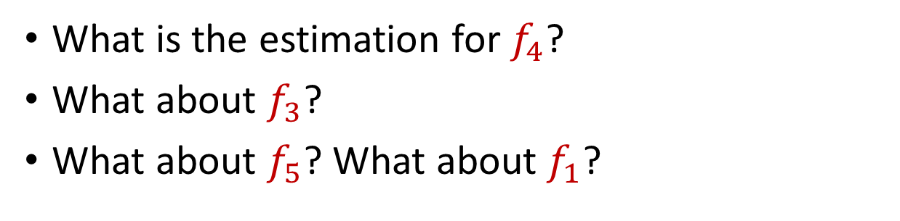
CountSketch
$f_{1}$ | $f_{2}$ | $f_{3}$ | $f_{4}$ | $f_{5}$ | $f_{6}$ | $f_{7}$
2 | 1 | 1 | 0 | 1 | 0 | 0
What is the estimation for $f_{4}$?
What about $f_{3}$?
What about $f_{5}$? What about $f_{1}$?
$$h\left(x\right)=3x+2 (mod 4)$$
$s\left(x\right)=+1$ for $x∈\left\{1,2,3\right\}$
$s\left(x\right)=−1$ for $x∈\{4,5\}$
$c_{1}$ | $c_{2}$ | $c_{3}$ | $c_{4}$
1 | 0 | 1 | 1

Slide 22
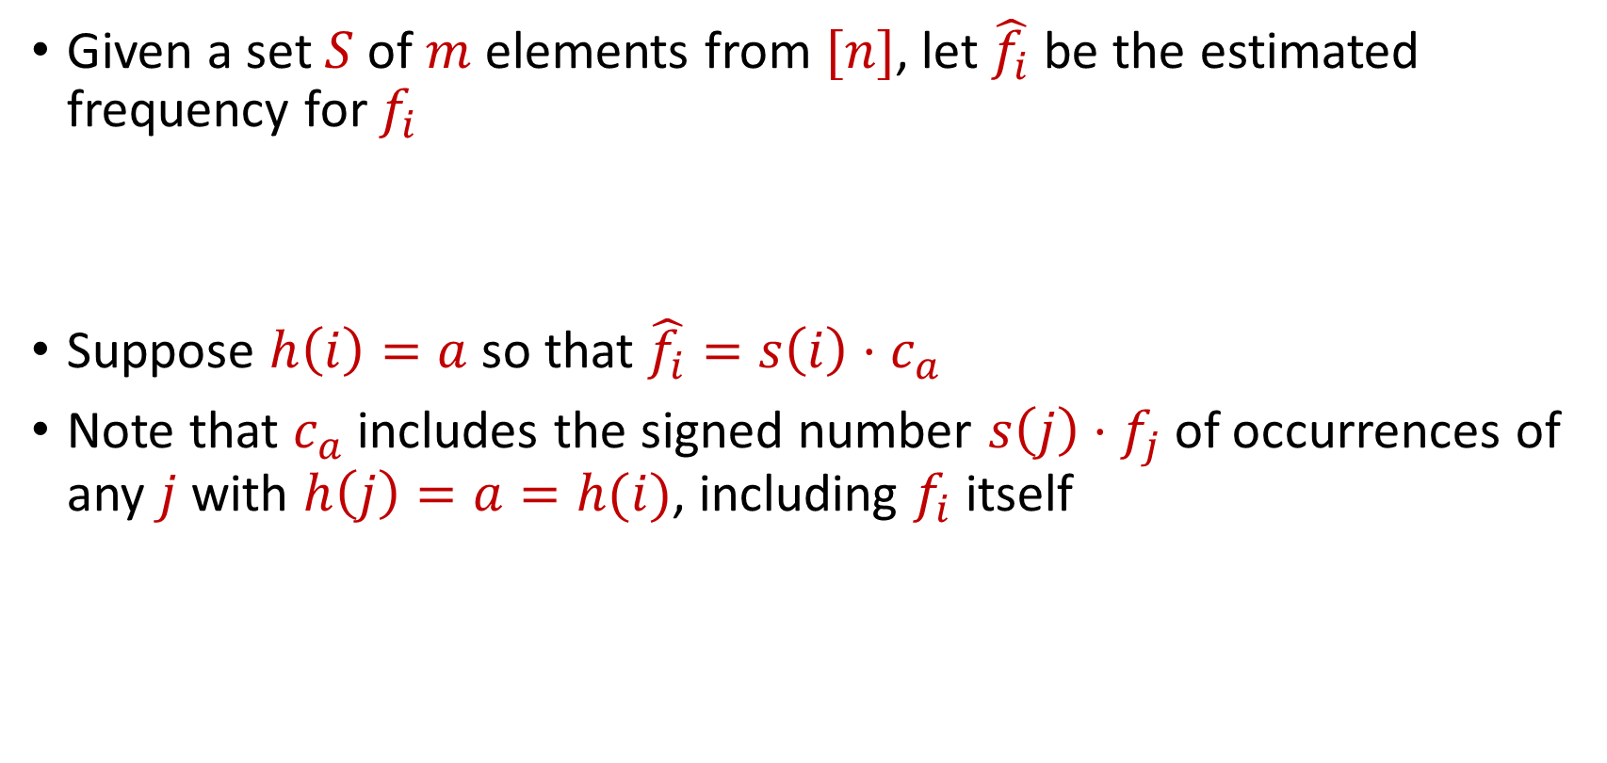
CountSketch
Given a set $S$ of $m$ elements from $[n]$, let $\hat{f_{i}}$ be the estimated frequency for $f_{i}$
Suppose $h\left(i\right)=a$ so that $\hat{f_{i}}=s\left(i\right)⋅c_{a}$
Note that $c_{a}$ includes the signed number $s\left(j\right)⋅f_{j}$of occurrences of any $j$ with $h\left(j\right)=a=h(i)$, including $f_{i}$ itself

Slide 23
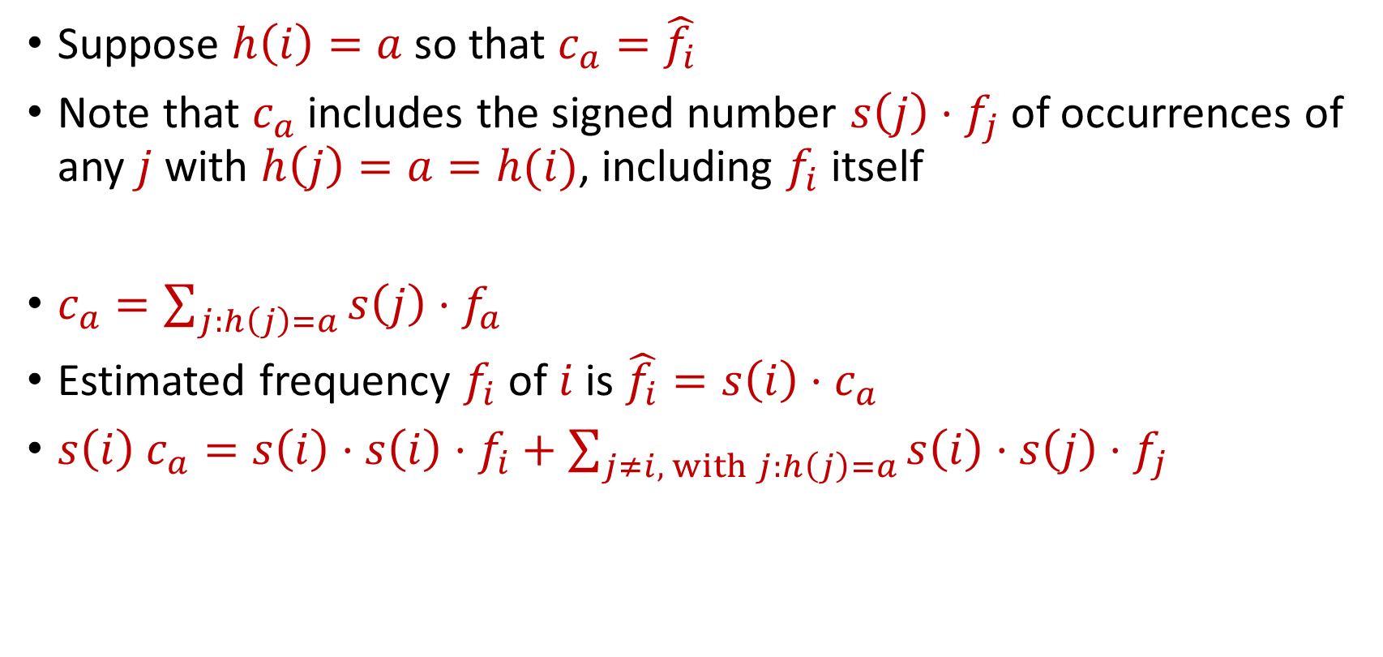
CountSketch
Suppose $h\left(i\right)=a$ so that $c_{a}=\hat{f_{i}}$
Note that $c_{a}$ includes the signed number $s\left(j\right)⋅f_{j}$of occurrences of any $j$ with $h\left(j\right)=a=h(i)$, including $f_{i}$ itself
$c_{a}=\sum_{j:h\left(j\right)=a}{s\left(j\right)⋅f_{a}}$
Estimated frequency $f_{i}$ of $i$ is $\hat{f_{i}}=s\left(i\right)⋅c_{a}$
$s\left(i\right) c_{a}=s\left(i\right)⋅s\left(i\right)⋅f_{i}+\sum_{j≠i, with j:h\left(j\right)=a}{s\left(i\right)⋅s\left(j\right)⋅f_{j}}$

Slide 24

CountSketch Error Analysis
$c_{a}=s\left(i\right)⋅s\left(i\right)⋅f_{i}+\sum_{j≠i, with j:h\left(j\right)=a}{s\left(i\right)⋅s\left(j\right)⋅f_{j}}$
Since $s\left(i\right)∈\{−1,+1\}$, we have $s\left(i\right)⋅s\left(i\right)=1$
What is the expected error for $f_{i}$?

Slide 25

CountSketch Error Analysis
$c_{a}=s\left(i\right)⋅s\left(i\right)⋅f_{i}+\sum_{j≠i, with j:h\left(j\right)=a}{s\left(i\right)⋅s\left(j\right)⋅f_{j}}$
What is the expectation of the error term for $f_{i}$?
$E\left[\sum_{j≠i, with j:h\left(j\right)=a}{{s\left(i\right)⋅s\left(j\right)⋅f}_{j}}\right]=Σ_{j≠i}E\left[{s\left(i\right)⋅s\left(j\right)⋅f}_{j}⋅I_{h\left(j\right)=h(i)}\right]$

Slide 26

CountSketch Error Analysis
$c_{a}=s\left(i\right)⋅s\left(i\right)⋅f_{i}+\sum_{j≠i, with j:h\left(j\right)=a}{s\left(i\right)⋅s\left(j\right)⋅f_{j}}$
What is the expectation of the error term for $f_{i}$?
$E\left[\sum_{j≠i, with j:h\left(j\right)=a}{{s\left(i\right)⋅s\left(j\right)⋅f}_{j}}\right]=0$

Slide 27

CountSketch Error Analysis
$c_{a}=s\left(i\right)⋅s\left(i\right)⋅f_{i}+\sum_{j≠i, with j:h\left(j\right)=a}{s\left(i\right)⋅s\left(j\right)⋅f_{j}}$
What is the expectation of the error term for $f_{i}$?
$E\left[\sum_{j≠i, with j:h\left(j\right)=a}{{s\left(i\right)⋅s\left(j\right)⋅f}_{j}}\right]=0$
What is the variance of the error term for $f_{i}$?

Slide 28

CountSketch Error Analysis
Variance is at most the 2nd moment of the error term
$E\left[{\left(\sum_{j≠i, with j:h\left(j\right)=a}{{s\left(i\right)⋅s\left(j\right)⋅f}_{j}}\right)}^{2}\right]$

Slide 29

CountSketch Error Analysis
Variance is at most the 2nd moment of the error term
$E\left[{\left(\sum_{j≠i, with j:h\left(j\right)=a}{{s\left(i\right)⋅s\left(j\right)⋅f}_{j}}\right)}^{2}\right]=Σ_{j≠i}E\left[{\left|f_{j}\right|}^{2}⋅I_{h\left(j\right)=h(i)}\right]$

Slide 30

CountSketch Error Analysis
Variance is at most the 2nd moment of the error term
$E\left[{\left(\sum_{j≠i, with j:h\left(j\right)=a}{{s\left(i\right)⋅s\left(j\right)⋅f}_{j}}\right)}^{2}\right]=Σ_{j≠i}E\left[{\left|f_{j}\right|}^{2}⋅I_{h\left(j\right)=h(i)}\right]$
$$=Σ_{j≠i}E\left[I_{h\left(j\right)=h(i)}\right]⋅{\left|f_{j}\right|}^{2}$$

Slide 31

CountSketch Error Analysis
Variance is at most the 2nd moment of the error term
$E\left[{\left(\sum_{j≠i, with j:h\left(j\right)=a}{{s\left(i\right)⋅s\left(j\right)⋅f}_{j}}\right)}^{2}\right]=Σ_{j≠i}E\left[{\left|f_{j}\right|}^{2}⋅I_{h\left(j\right)=h(i)}\right]$
$$=Σ_{j≠i}E\left[I_{h\left(j\right)=h(i)}\right]⋅{\left|f_{j}\right|}^{2}$$
$$=Σ_{j≠i}Pr\left[h\left(j\right)=h(i)\right]⋅{\left|f_{j}\right|}^{2}$$

Slide 32

CountSketch Error Analysis
Variance is at most the 2nd moment of the error term
$E\left[{\left(\sum_{j≠i, with j:h\left(j\right)=a}{{s\left(i\right)⋅s\left(j\right)⋅f}_{j}}\right)}^{2}\right]=Σ_{j≠i}E\left[{\left|f_{j}\right|}^{2}⋅I_{h\left(j\right)=h(i)}\right]$
$$=Σ_{j≠i}E\left[I_{h\left(j\right)=h(i)}\right]⋅{\left|f_{j}\right|}^{2}$$
$$=Σ_{j≠i}Pr\left[h\left(j\right)=h(i)\right]⋅{\left|f_{j}\right|}^{2}$$
$$=Σ_{j≠i}\frac{1}{b}⋅{\left|f_{j}\right|}^{2}=\frac{{\left\|f\right\|}_{2}^{2}}{b}$$

Slide 33
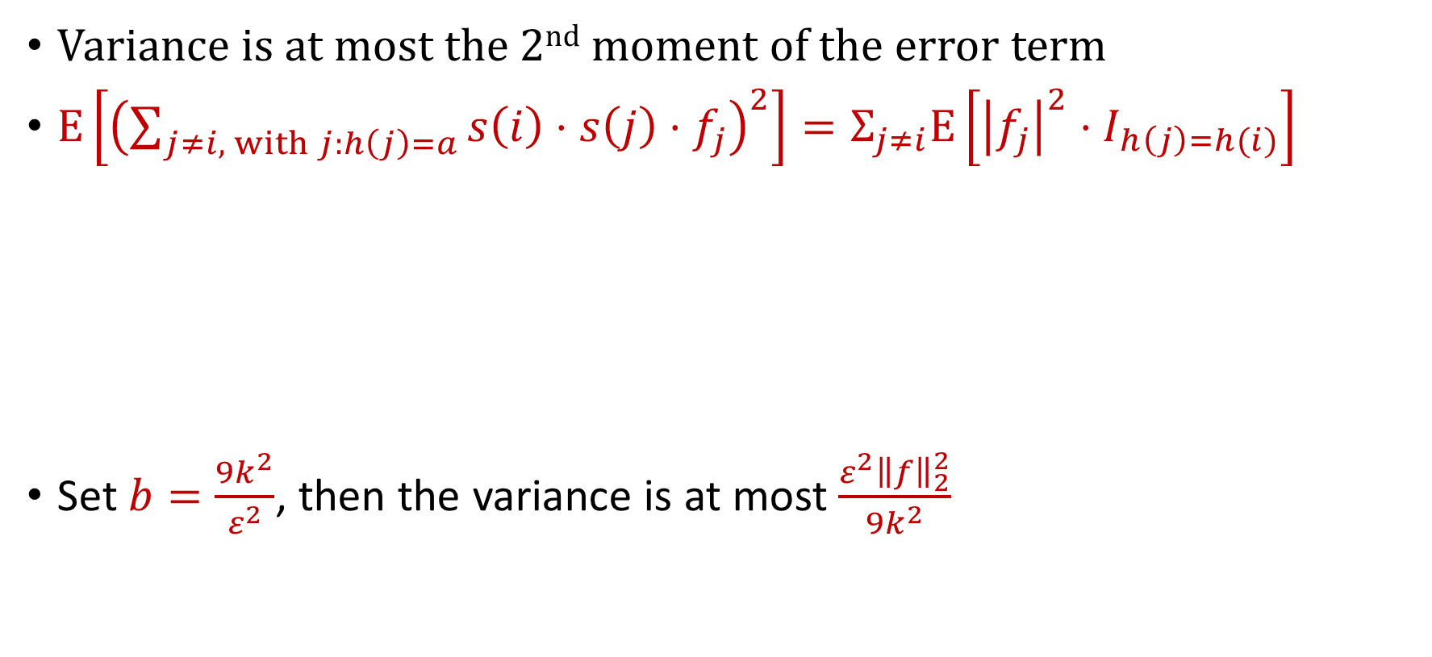
CountSketch Error Analysis
Variance is at most the 2nd moment of the error term
$E\left[{\left(\sum_{j≠i, with j:h\left(j\right)=a}{{s\left(i\right)⋅s\left(j\right)⋅f}_{j}}\right)}^{2}\right]=Σ_{j≠i}E\left[{\left|f_{j}\right|}^{2}⋅I_{h\left(j\right)=h(i)}\right]$
Set $b=\frac{9k^{2}}{ε^{2}}$, then the variance is at most $\frac{ε^{2}{\left\|f\right\|}_{2}^{2}}{9k^{2}}$
$$=Σ_{j≠i}E\left[I_{h\left(j\right)=h(i)}\right]⋅{\left|f_{j}\right|}^{2}$$
$$=Σ_{j≠i}Pr\left[h\left(j\right)=h(i)\right]⋅{\left|f_{j}\right|}^{2}$$
$$=Σ_{j≠i}\frac{1}{b}⋅{\left|f_{j}\right|}^{2}=\frac{{\left\|f\right\|}_{2}^{2}}{b}$$

Slide 34
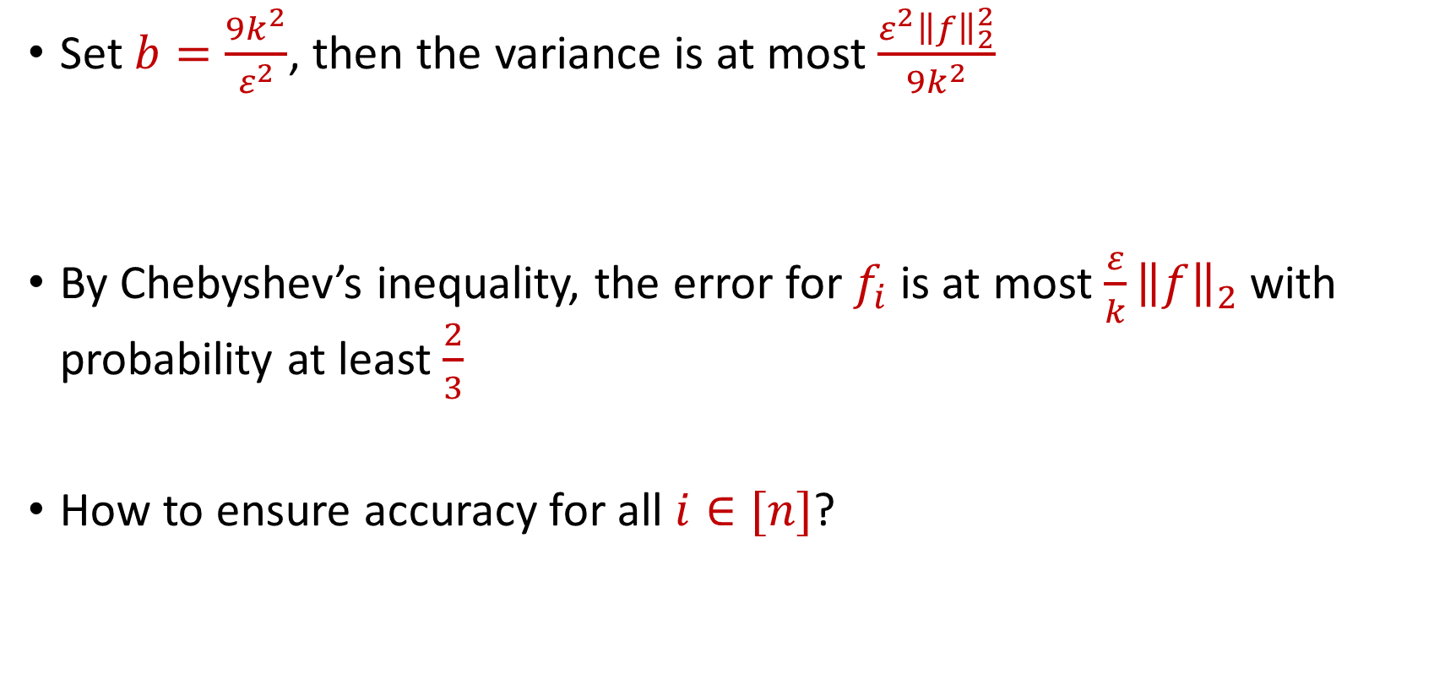
CountSketch Error Analysis
Set $b=\frac{9k^{2}}{ε^{2}}$, then the variance is at most $\frac{ε^{2}{\left\|f\right\|}_{2}^{2}}{9k^{2}}$
By Chebyshev’s inequality, the error for $f_{i}$ is at most $\frac{ε}{k}{\left\|f\right\|}_{2}$with probability at least $\frac{2}{3}$
How to ensure accuracy for all $i∈[n]$?

Slide 35
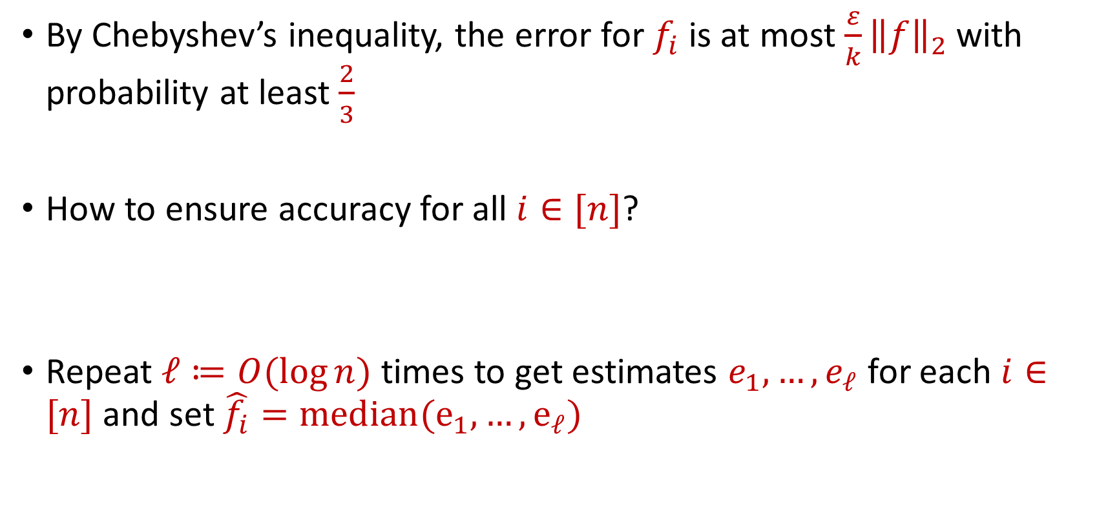
CountSketch Error Analysis
By Chebyshev’s inequality, the error for $f_{i}$ is at most $\frac{ε}{k}{\left\|f\right\|}_{2}$with probability at least $\frac{2}{3}$
How to ensure accuracy for all $i∈[n]$?
Repeat $ℓ≔O(\log{n)}$ times to get estimates $e_{1},…,e_{ℓ}$ for each $i∈[n]$ and set $\hat{f_{i}}=median(e_{1},…, e_{ℓ})$

Slide 36


CountSketch Error Analysis
Claim: For all estimated frequencies $\hat{f_{i}}$ by CountSketch, we have
$$f_{i}−\frac{ε{\left\|f\right\|}_{2}}{k}≤\hat{f_{i}}≤f_{i}+\frac{ε{\left\|f\right\|}_{2}}{k}$$

Slide 37

Sparse Recovery
Suppose we have an insertion-deletion stream of length $m=Θ\left(n\right)$ and at the end we are promised there are at most $k$ nonzero coordinates
Recover the $k$ nonzero coordinates and their frequencies

Slide 38
Applications of Sparse Recovery
Anomaly detection and network traffic analysis:
Noiseless sparse recovery can be used to identify anomalies or outliers in streaming data. By modeling normal behavior as a sparse signal, deviations from this model can be detected in real-time. This is valuable for cybersecurity, fraud detection, and monitoring network traffic for unusual patterns.
Noiseless sparse recovery can be applied to analyze network traffic in real-time, identifying patterns and trends, and helping in network management, intrusion detection, and quality of service (QoS) optimization

Slide 39
Applications of Sparse Recovery
Online Natural Language Processing (NLP): In real-time natural language processing tasks, noiseless sparse recovery can assist in extracting relevant features or patterns from streaming text data, making it useful for sentiment analysis, topic modeling, and summarization

Slide 40
Applications of Sparse Recovery
Real-time Compressive Imaging: Compressive imaging techniques can be applied to streaming video or image data. By capturing and processing fewer measurements, noiseless sparse recovery can provide real-time reconstruction of high-resolution images or videos.

Slide 41
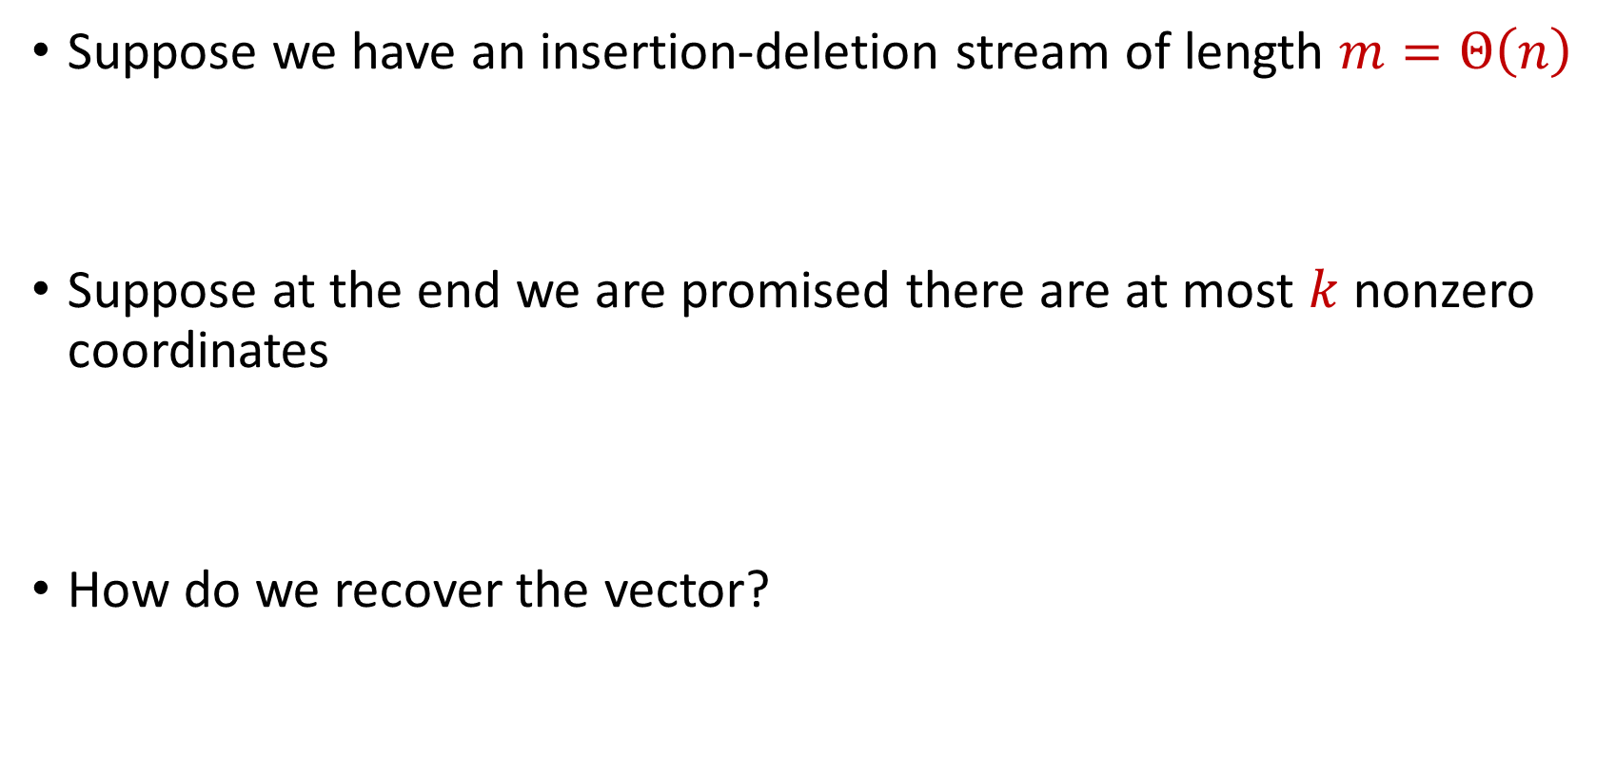
Sparse Recovery
Suppose we have an insertion-deletion stream of length $m=Θ\left(n\right)$
Suppose at the end we are promised there are at most $k$ nonzero coordinates
How do we recover the vector?

Slide 42

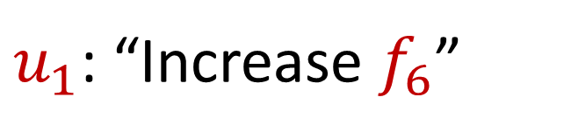
Sparse Recovery
Suppose at the end we are promised there are at most $k$ nonzero coordinates
Suppose $k=1$ and we are promised the coordinate has frequency $1$
$u_{1}$: “Increase $f_{6}$”

Slide 43
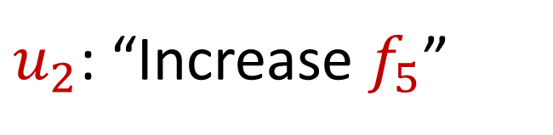
Sparse Recovery
Suppose at the end we are promised there are at most $k$ nonzero coordinates
Suppose $k=1$ and we are promised the coordinate has frequency $1$
$u_{2}$: “Increase $f_{5}$”

Slide 44
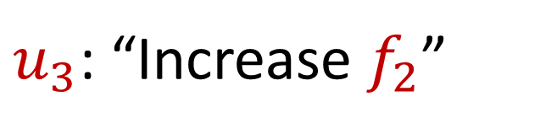
Sparse Recovery
Suppose at the end we are promised there are at most $k$ nonzero coordinates
Suppose $k=1$ and we are promised the coordinate has frequency $1$
$u_{3}$: “Increase $f_{2}$”

Slide 45
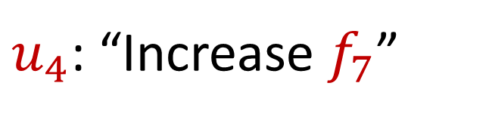
Sparse Recovery
Suppose at the end we are promised there are at most $k$ nonzero coordinates
Suppose $k=1$ and we are promised the coordinate has frequency $1$
$u_{4}$: “Increase $f_{7}$”

Slide 46
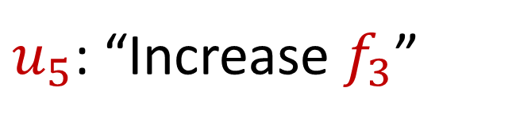
Sparse Recovery
Suppose at the end we are promised there are at most $k$ nonzero coordinates
Suppose $k=1$ and we are promised the coordinate has frequency $1$
$u_{5}$: “Increase $f_{3}$”

Slide 47
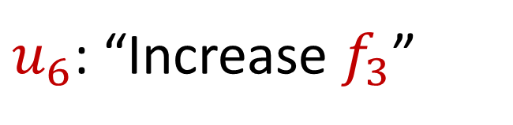
Sparse Recovery
Suppose at the end we are promised there are at most $k$ nonzero coordinates
Suppose $k=1$ and we are promised the coordinate has frequency $1$
$u_{6}$: “Increase $f_{3}$”

Slide 48
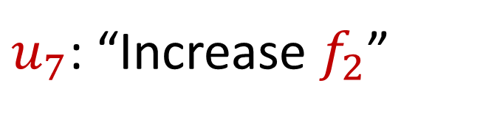
Sparse Recovery
Suppose at the end we are promised there are at most $k$ nonzero coordinates
Suppose $k=1$ and we are promised the coordinate has frequency $1$
$u_{7}$: “Increase $f_{2}$”

Slide 49
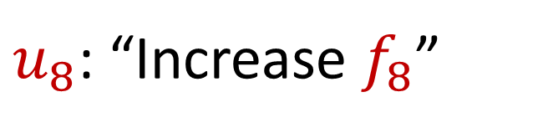
Sparse Recovery
Suppose at the end we are promised there are at most $k$ nonzero coordinates
Suppose $k=1$ and we are promised the coordinate has frequency $1$
$u_{8}$: “Increase $f_{8}$”

Slide 50
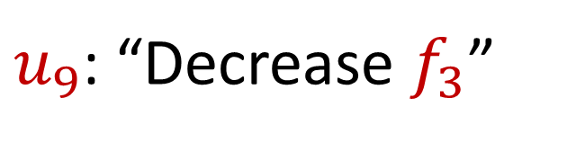
Sparse Recovery
Suppose at the end we are promised there are at most $k$ nonzero coordinates
Suppose $k=1$ and we are promised the coordinate has frequency $1$
$u_{9}$: “Decrease $f_{3}$”

Slide 51
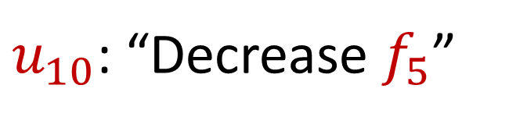
Sparse Recovery
Suppose at the end we are promised there are at most $k$ nonzero coordinates
Suppose $k=1$ and we are promised the coordinate has frequency $1$
$u_{10}$: “Decrease $f_{5}$”

Slide 52
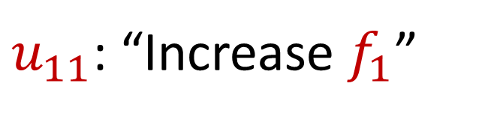
Sparse Recovery
Suppose at the end we are promised there are at most $k$ nonzero coordinates
Suppose $k=1$ and we are promised the coordinate has frequency $1$
$u_{11}$: “Increase $f_{1}$”

Slide 53
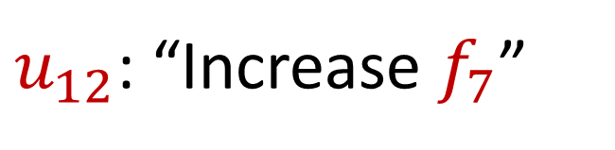
Sparse Recovery
Suppose at the end we are promised there are at most $k$ nonzero coordinates
Suppose $k=1$ and we are promised the coordinate has frequency $1$
$u_{12}$: “Increase $f_{7}$”

Slide 54
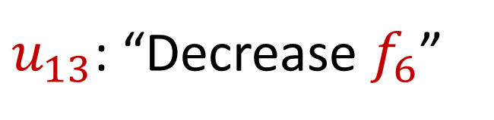
Sparse Recovery
Suppose at the end we are promised there are at most $k$ nonzero coordinates
Suppose $k=1$ and we are promised the coordinate has frequency $1$
$u_{13}$: “Decrease $f_{6}$”

Slide 55

Sparse Recovery
Suppose at the end we are promised there are at most $k$ nonzero coordinates
Suppose $k=1$ and we are promised the coordinate has frequency $1$
$u_{14}$: “Decrease $f_{8}$”

Slide 56

Sparse Recovery
Suppose at the end we are promised there are at most $k$ nonzero coordinates
Suppose $k=1$ and we are promised the coordinate has frequency $1$
$u_{15}$: “Decrease $f_{1}$”

Slide 57

Sparse Recovery
Suppose at the end we are promised there are at most $k$ nonzero coordinates
Suppose $k=1$ and we are promised the coordinate has frequency $1$
$u_{16}$: “Decrease $f_{7}$”

Slide 58

Sparse Recovery
Suppose at the end we are promised there are at most $k$ nonzero coordinates
Suppose $k=1$ and we are promised the coordinate has frequency $1$
$u_{17}$: “Decrease $f_{3}$”

Slide 59

Sparse Recovery
Suppose at the end we are promised there are at most $k$ nonzero coordinates
Suppose $k=1$ and we are promised the coordinate has frequency $1$
$u_{18}$: “Decrease $f_{2}$”

Slide 60

Sparse Recovery
Suppose at the end we are promised there are at most $k$ nonzero coordinates
Suppose $k=1$ and we are promised the coordinate has frequency $1$
$u_{19}$: “Decrease $f_{7}$”

Slide 61

Sparse Recovery
Suppose at the end we are promised there are at most $k$ nonzero coordinates
Suppose $k=1$ and we are promised the coordinate has frequency $1$
What is left?

Slide 62

Sparse Recovery
Suppose at the end we are promised there are at most $k$ nonzero coordinates
Suppose $k=1$ and we are promised the coordinate has frequency $1$
What is left?
$$f_{2}=1$$

Slide 63

Sparse Recovery
Suppose at the end we are promised there are at most $k$ nonzero coordinates
Suppose $k=1$ and we are promised the coordinate has frequency $1$
Algorithm: Keep running sum of all the coordinates

Slide 64

Sparse Recovery
Suppose at the end we are promised there are at most $k$ nonzero coordinates
Suppose $k=1$ and we are promised the coordinate has frequency $1$
Algorithm: Keep running sum of all the coordinates
Write each insertion to coordinate $c_{i}∈[n]$as $u_{i}←\left(s_{i}=1, c_{i}\right)$
Write each deletion to coordinate $c_{i}∈[n]$as $u_{i}←\left(s_{i}=−1, c_{i}\right)$

Slide 65

Sparse Recovery
Suppose $k=1$ and we are promised the coordinate $j$ has frequency $1$
Algorithm: Keep running sum of all the coordinates
Write each insertion to coordinate $c_{i}∈[n]$as $u_{i}←\left(s_{i}=1, c_{i}\right)$
Write each deletion to coordinate $c_{i}∈[n]$as $u_{i}←\left(s_{i}=−1, c_{i}\right)$
Running sum of coordinates $\sum_{i∈[m]}{s_{i}c_{i}}=j$

Slide 66

Sparse Recovery
Suppose at the end we are promised there are at most $k$ nonzero coordinates
Suppose $k=1$ and we are promised the coordinate $j$ has frequency $1$
Algorithm: Keep running sum of all the coordinates?

Slide 67

Sparse Recovery
Suppose at the end we are promised there are at most $k$ nonzero coordinates
Suppose $k=1$ and we are promised the coordinate $j$ has frequency $1$
Algorithm: Keep running sum of all the coordinates AND a different linear combination of all the coordinates

Slide 68

Sparse Recovery
Suppose at the end we are promised there are at most $k$ nonzero coordinates
Suppose $k=1$ and we are promised the coordinate $j$ has frequency $1$
Algorithm: Keep running sum of all the coordinates AND a different linear combination of all the coordinates
Keep $\sum_{i∈[m]}{s_{i}c_{i}}$ and $\sum_{i∈[m]}{s_{i}c_{i}^{2}}$

Slide 69

Sparse Recovery
Suppose at the end we are promised there are at most $k$ nonzero coordinates
Suppose $k=1$ and we are promised the coordinate $j$ has frequency $1$
$u_{1}$: “Increase $f_{6}$”

Slide 70
Sparse Recovery
Suppose at the end we are promised there are at most $k$ nonzero coordinates
Suppose $k=1$ and we are promised the coordinate $j$ has frequency $1$
$u_{2}$: “Increase $f_{5}$”

Slide 71
Sparse Recovery
Suppose at the end we are promised there are at most $k$ nonzero coordinates
Suppose $k=1$ and we are promised the coordinate $j$ has frequency $1$
$u_{3}$: “Increase $f_{2}$”

Slide 72
Sparse Recovery
Suppose at the end we are promised there are at most $k$ nonzero coordinates
Suppose $k=1$ and we are promised the coordinate $j$ has frequency $1$
$u_{4}$: “Increase $f_{7}$”

Slide 73
Sparse Recovery
Suppose at the end we are promised there are at most $k$ nonzero coordinates
Suppose $k=1$ and we are promised the coordinate $j$ has frequency $1$
$u_{5}$: “Increase $f_{3}$”

Slide 74
Sparse Recovery
Suppose at the end we are promised there are at most $k$ nonzero coordinates
Suppose $k=1$ and we are promised the coordinate $j$ has frequency $1$
$u_{6}$: “Increase $f_{3}$”

Slide 75
Sparse Recovery
Suppose at the end we are promised there are at most $k$ nonzero coordinates
Suppose $k=1$ and we are promised the coordinate $j$ has frequency $1$
$u_{7}$: “Increase $f_{2}$”

Slide 76
Sparse Recovery
Suppose at the end we are promised there are at most $k$ nonzero coordinates
Suppose $k=1$ and we are promised the coordinate $j$ has frequency $1$
$u_{8}$: “Increase $f_{8}$”

Slide 77
Sparse Recovery
Suppose at the end we are promised there are at most $k$ nonzero coordinates
Suppose $k=1$ and we are promised the coordinate $j$ has frequency $1$
$u_{9}$: “Decrease $f_{3}$”

Slide 78
Sparse Recovery
Suppose at the end we are promised there are at most $k$ nonzero coordinates
Suppose $k=1$ and we are promised the coordinate $j$ has frequency $1$
$u_{10}$: “Decrease $f_{5}$”

Slide 79
Sparse Recovery
Suppose at the end we are promised there are at most $k$ nonzero coordinates
Suppose $k=1$ and we are promised the coordinate $j$ has frequency $1$
$u_{11}$: “Increase $f_{1}$”

Slide 80
Sparse Recovery
Suppose at the end we are promised there are at most $k$ nonzero coordinates
Suppose $k=1$ and we are promised the coordinate $j$ has frequency $1$
$u_{12}$: “Increase $f_{7}$”

Slide 81
Sparse Recovery
Suppose at the end we are promised there are at most $k$ nonzero coordinates
Suppose $k=1$ and we are promised the coordinate $j$ has frequency $1$
$u_{13}$: “Decrease $f_{6}$”

Slide 82
Sparse Recovery
Suppose at the end we are promised there are at most $k$ nonzero coordinates
Suppose $k=1$ and we are promised the coordinate $j$ has frequency $1$
$u_{14}$: “Decrease $f_{8}$”

Slide 83
Sparse Recovery
Suppose at the end we are promised there are at most $k$ nonzero coordinates
Suppose $k=1$ and we are promised the coordinate $j$ has frequency $1$
$u_{15}$: “Decrease $f_{1}$”

Slide 84
Sparse Recovery
Suppose at the end we are promised there are at most $k$ nonzero coordinates
Suppose $k=1$ and we are promised the coordinate $j$ has frequency $1$
$u_{16}$: “Decrease $f_{7}$”

Slide 85
Sparse Recovery
Suppose at the end we are promised there are at most $k$ nonzero coordinates
Suppose $k=1$ and we are promised the coordinate $j$ has frequency $1$
$u_{17}$: “Decrease $f_{3}$”

Slide 86

Sparse Recovery
Suppose at the end we are promised there are at most $k$ nonzero coordinates
Suppose $k=1$ and we are promised the coordinate $j$ has frequency $1$
$u_{18}$: “Decrease $f_{7}$”

Slide 87

Sparse Recovery
Suppose at the end we are promised there are at most $k$ nonzero coordinates
Suppose $k=1$ and we are promised the coordinate $j$ has frequency $1$
What is the state of our algorithm?

Slide 88

Sparse Recovery
Suppose at the end we are promised there are at most $k$ nonzero coordinates
Suppose $k=1$ and we are promised the coordinate $j$ has frequency $1$
What is the state of our algorithm?
$\sum_{i∈[m]}{s_{i}c_{i}}=4$ and $\sum_{i∈[m]}{s_{i}c_{i}^{2}=8}$

Slide 89

Sparse Recovery
Suppose at the end we are promised there are at most $k$ nonzero coordinates
Suppose $k=1$ and we are promised the coordinate $j$ has frequency $1$
What is the state of our algorithm?
We know $\sum_{i∈[m]}{s_{i}c_{i}}=j⋅f_{j}$ and $\sum_{i∈[m]}{s_{i}c_{i}^{2}=j⋅f_{j}^{2}}$
$\sum_{i∈[m]}{s_{i}c_{i}}=4$ and $\sum_{i∈[m]}{s_{i}c_{i}^{2}=8}$

Slide 90

Sparse Recovery
Suppose at the end we are promised there are at most $k$ nonzero coordinates
Suppose $k=1$ and we are promised the coordinate $j$ has frequency $1$
What is the state of our algorithm?
We know $\sum_{i∈[m]}{s_{i}c_{i}}=j⋅f_{j}$ and $\sum_{i∈[m]}{s_{i}c_{i}^{2}=j⋅f_{j}^{2}}$
So $f_{j}=2$ and $j=2$
$\sum_{i∈[m]}{s_{i}c_{i}}=4$ and $\sum_{i∈[m]}{s_{i}c_{i}^{2}=8}$

Slide 91

Sparse Recovery
Suppose at the end we are promised there are at most $k$ nonzero coordinates
Suppose $k=1$ and we are promised the coordinate $j$ has frequency $1$
What is the state of our algorithm?
We know $\sum_{i∈[m]}{s_{i}c_{i}}=j⋅f_{j}$ and $\sum_{i∈[m]}{s_{i}c_{i}^{2}=j⋅f_{j}^{2}}$
So $f_{j}=2$ and $j=2$
$\sum_{i∈[m]}{s_{i}c_{i}}=4$ and $\sum_{i∈[m]}{s_{i}c_{i}^{2}=8}$
$f_{1}$ | $f_{2}$ | $f_{3}$ | $f_{4}$ | $f_{5}$ | $f_{6}$ | $f_{7}$
0 | 2 | 0 | 0 | 0 | 0 | 0

Slide 92

Sparse Recovery
Suppose at the end we are promised there are at most $k$ nonzero coordinates
Algorithm for $k=1$: Keep running sum of all the coordinates AND a different linear combination of all the coordinates

Slide 93

Sparse Recovery
Suppose at the end we are promised there are at most $k$ nonzero coordinates
Algorithm: Keep $2k$running sum of different linear combinations of all the coordinates
We have $2k$ equations and $2k$ unknown variables
Correctness can be shown from linear algebra

Slide 94

Sparse Recovery
Suppose at the end we are promised there are at most $k$ nonzero coordinates
Algorithm: Keep $2k$running sum of different linear combinations of all the coordinates
Space: $O(k)$ words of space

Slide 95


Heavy-Hitters (Frequent Items)
Given a set $S$ of $m$ elements from $[n]$, let $f_{i}$ be the frequency of element $i$. (How often it appears)
Let $L_{2}$ be the norm of the frequency vector:
Goal: Given a set $S$ of $m$ elements from $[n]$ and a threshold $ε$, output the elements $i$ such that $f_{i}>$ $ε L_{2}$...and no elements $j$ such that $f_{j}<$ $\frac{ε}{16} L_{2}$
Motivation: DDoS prevention, iceberg queries
$$L_{2}=\sqrt{f_{1}^{2}+f_{2}^{2}+…+f_{n}^{2}}$$

Slide 96



Frequency Moments ($L_{p}$ Norm)
Given a set $S$ of $m$ elements from $[n]$, let $f_{i}$ be the frequency of element $i$. (How often it appears)
Let $F_{p}$ be the frequency moment of the vector:
Goal: Given a set $S$ of $m$ elements from $[n]$ and an accuracy parameter $ε$, output a $(1+ε)$-approximation to $F_{p}$
Motivation: Entropy estimation, linear regression
$F_{p}=$ $f_{1}^{p}+f_{2}^{p}+…+f_{n}^{p}$

Slide 97


Distinct Elements ($F_{0}$ Estimation)
Given a set $S$ of $m$ elements from $[n]$, let $f_{i}$ be the frequency of element $i$. (How often it appears)
Let $F_{0}$ be the frequency moment of the vector:
Goal: Given a set $S$ of $m$ elements from $[n]$ and an accuracy parameter $ε$, output a $(1+ε)$-approximation to $F_{0}$
Motivation: Traffic monitoring
$F_{0}=$ $|\{i :f_{i}≠0\}|$

