Slide 1
CSCE 689: Special Topics in Modern Algorithms for Data Science
Lecture 6
Samson Zhou

Slide 2
Today
Today: Email me the members/group name
Monday: Labor Day, NO CLASS
Wednesday: Sign-up for meetings to discuss proposed projects

Slide 3


Recall: Moments
For $p>0$, the $p$-th moment of a random variable $X$ over $Ω$ is:
$$E\left[X^{p}\right]=\sum_{x∈Ω}{Pr\left[X=x\right]⋅x^{p}}$$

Slide 4

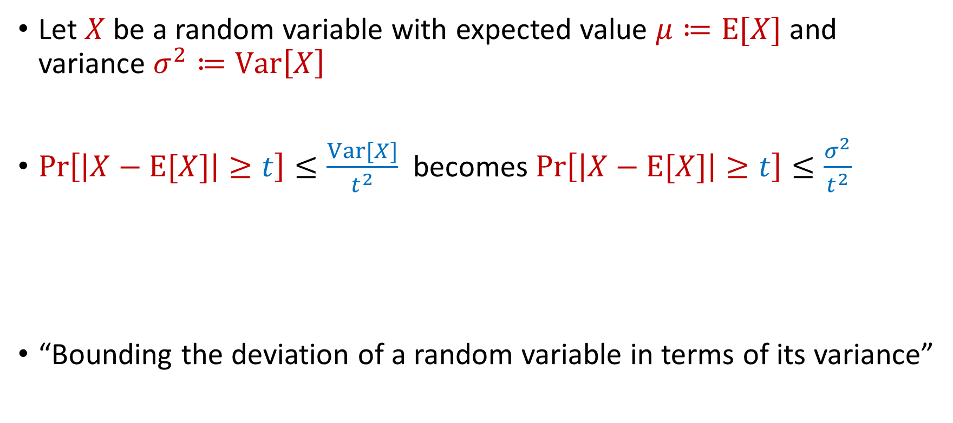
Last Time: Chebyshev’s Inequality
Let $X$ be a random variable with expected value $μ≔E[X]$ and variance $σ^{2}≔Var\left[X\right]$
$Pr\left[\left|X−E[X]\right|≥t\right]≤\frac{Var[X]}{t^{2}}$ becomes $Pr\left[\left|X−E[X]\right|≥t\right]≤\frac{σ^{2}}{t^{2}}$
“Bounding the deviation of a random variable in terms of its variance”
$$Pr\left[\left|X−μ\right|≥kσ\right]≤\frac{1}{k^{2}}$$

Slide 5
Last Time: Accuracy Boosting
Algorithmic consequence of Law of Large Numbers
To improve the accuracy of your algorithm, run it many times independently and take the average

Slide 6
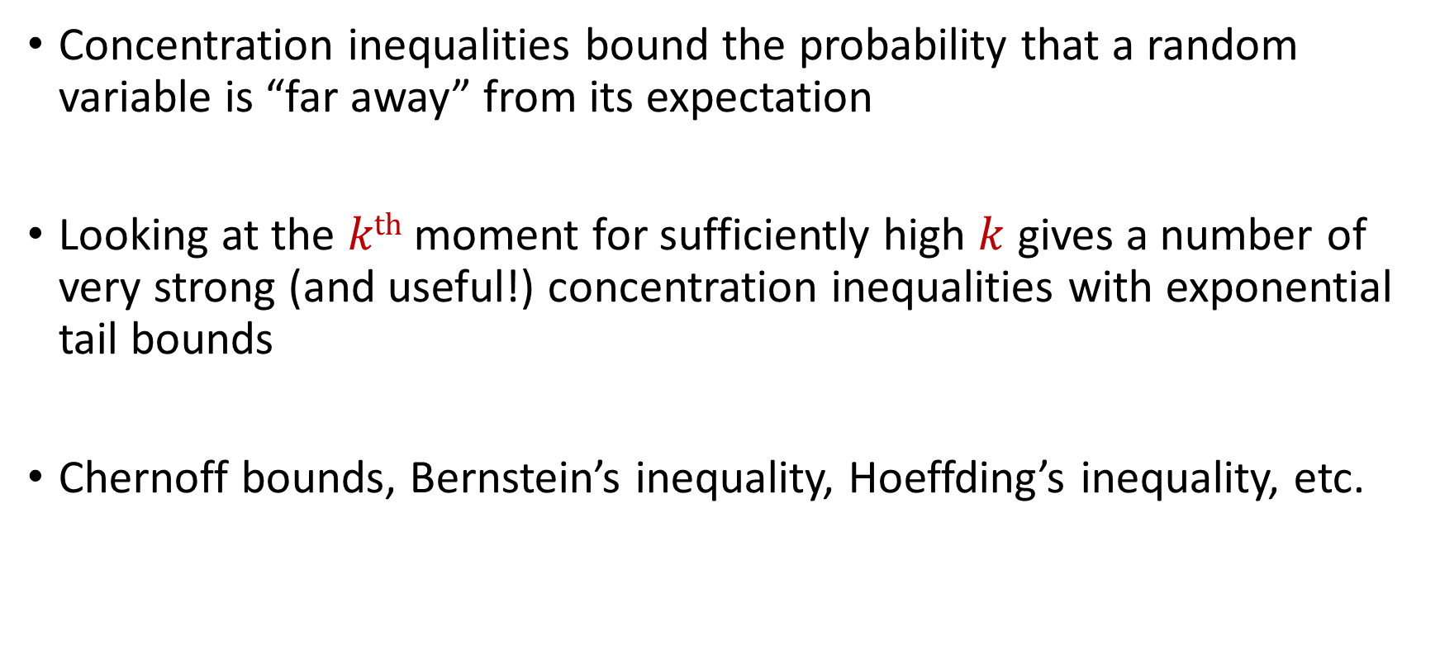
Recall: Concentration Inequalities
Concentration inequalities bound the probability that a random variable is “far away” from its expectation
Looking at the $kth$ moment for sufficiently high $k$ gives a number of very strong (and useful!) concentration inequalities with exponential tail bounds
Chernoff bounds, Bernstein’s inequality, Hoeffding’s inequality, etc.

Slide 7


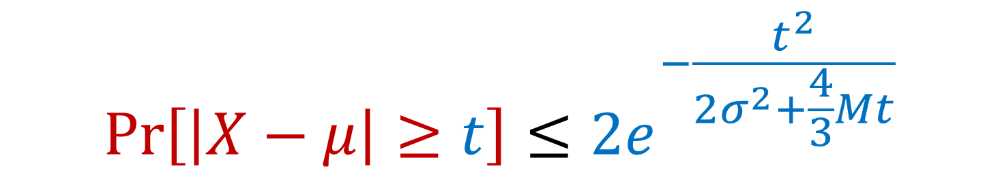
Last Time: Bernstein’s Inequality
Berstein’s inequality: Let $X_{1},…,X_{n}∈[−M,M]$ be independent random variables and let ${X=X}_{1}+…+X_{n}$ have mean $μ$ and variance $σ^{2}$. Then for any $t≥0$:
Example: Suppose $M=1$ and let $t=kσ$. Then
$$Pr\left[\left|X−μ\right|≥t\right]≤2e^{−\frac{t^{2}}{2σ^{2}+\frac{4}{3}Mt}}$$
$$Pr\left[\left|X−μ\right|≥kσ\right]≤2exp\left(−\frac{k^{2}}{4}\right)$$

Slide 8
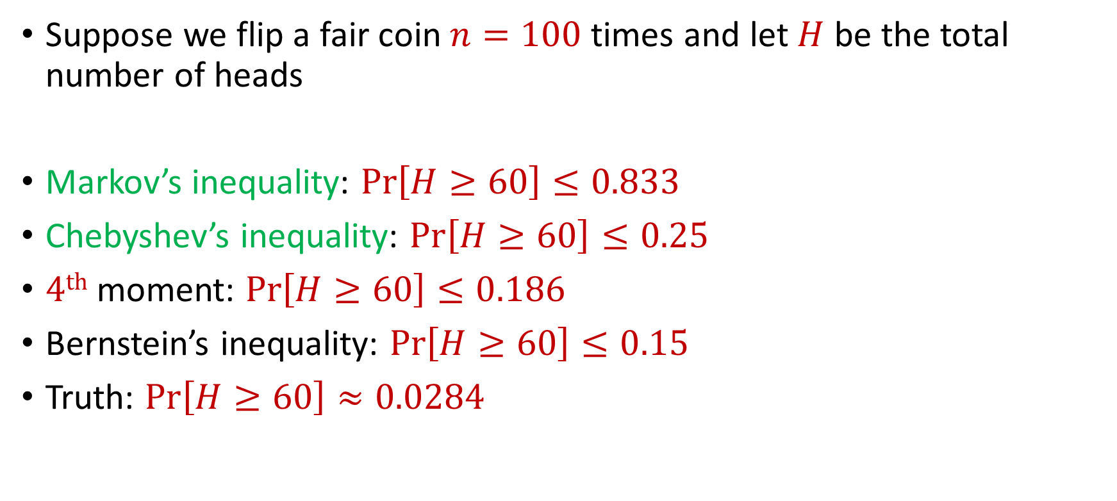
Bernstein’s Inequality
Suppose we flip a fair coin $n=100$ times and let $H$ be the total number of heads
Markov’s inequality: $Pr\left[H≥60\right]≤0.833$
Chebyshev’s inequality: $Pr\left[H≥60\right]≤0.25$
$4th$ moment: $Pr\left[H≥60\right]≤0.186$
Bernstein’s inequality: $Pr\left[H≥60\right]≤0.15$
Truth: $Pr\left[H≥60\right]≈0.0284$

Slide 9
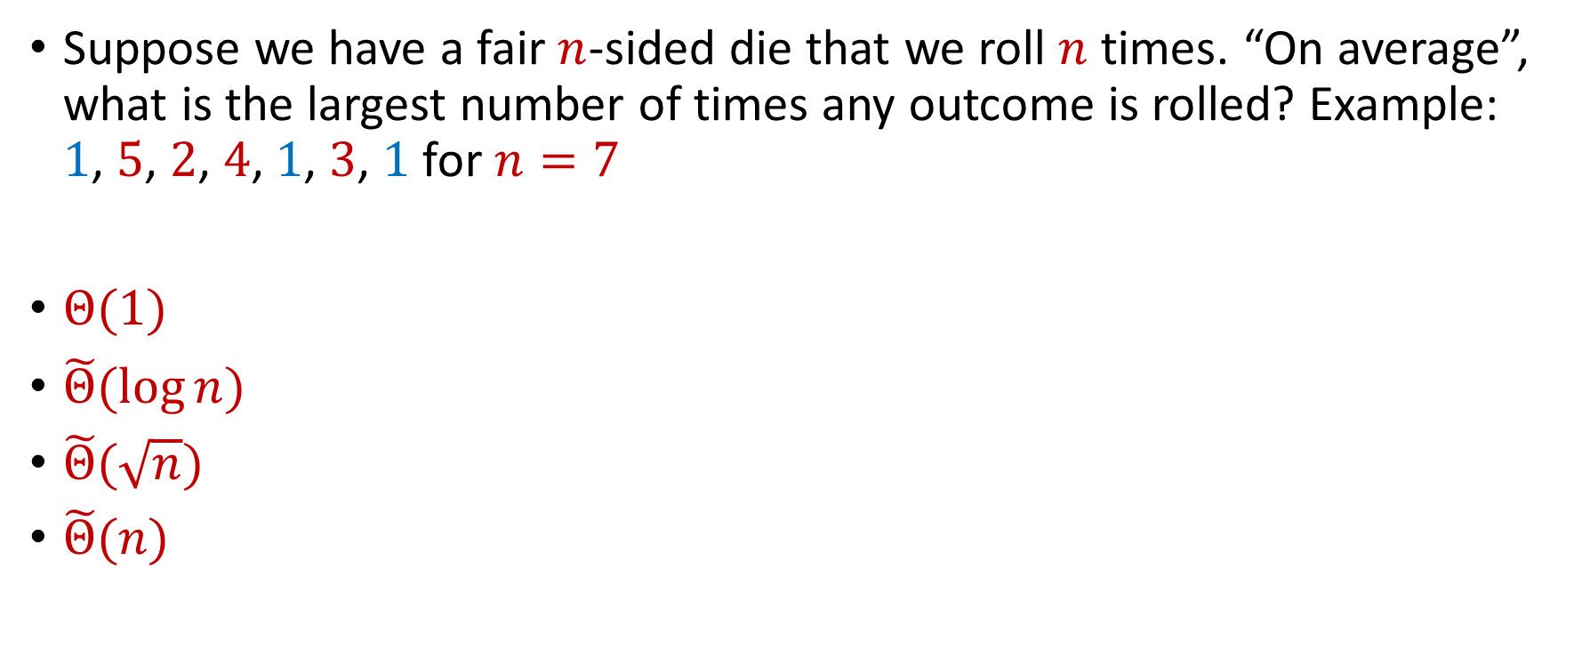
Trivia Question #3 (Max Load)
Suppose we have a fair $n$-sided die that we roll $n$ times. “On average”, what is the largest number of times any outcome is rolled? Example: $1$, $5$, $2$, $4$, $1$, $3$, $1$ for $n=7$
$Θ(1)$
$\tilde{Θ}(\log{n})$
$\tilde{Θ}(\sqrt{n})$
$\tilde{Θ}(n)$

Slide 10
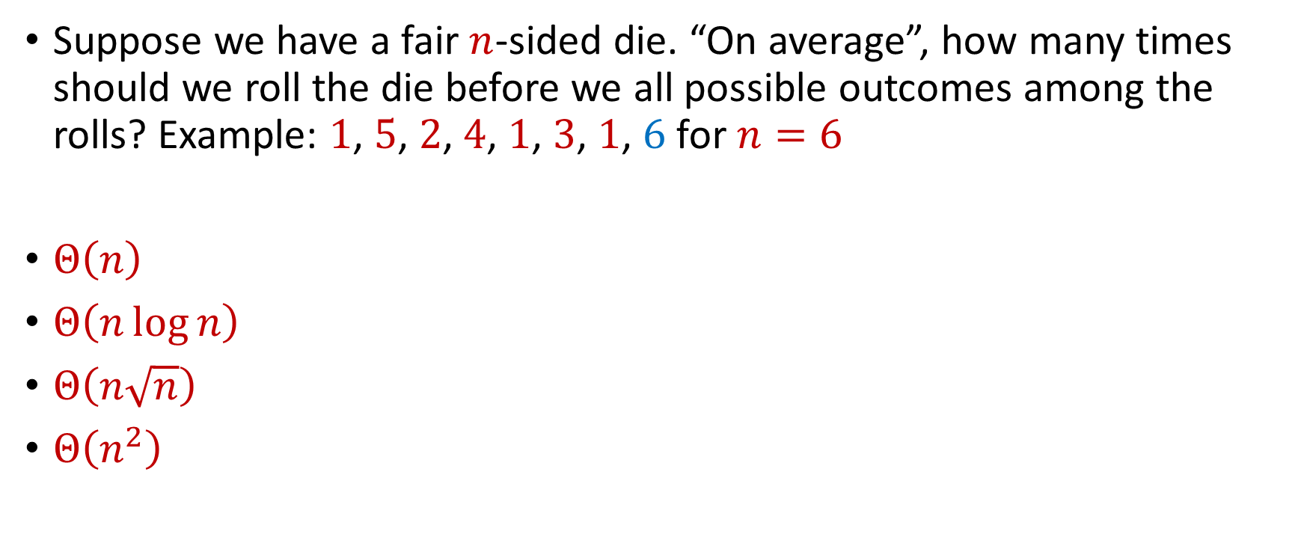
Trivia Question #4 (Coupon Collector)
Suppose we have a fair $n$-sided die. “On average”, how many times should we roll the die before we all possible outcomes among the rolls? Example: $1$, $5$, $2$, $4$, $1$, $3$, $1$, $6$ for $n=6$
$Θ\left(n\right)$
$Θ\left(n\log{n}\right)$
$Θ\left(n\sqrt{n}\right)$
$Θ\left(n^{2}\right)$

Slide 11


Chernoff Bounds
Useful variant of Bernstein’s inequality when the random variables are binary
Chernoff bounds: Let $X_{1},…,X_{n}∈\{0, 1\}$ be independent random variables and let ${X=X}_{1}+…+X_{n}$ have mean $μ$. Then for any $δ≥0$:
$$Pr\left[\left|X−μ\right|≥δμ\right]≤2\exp\left(−\frac{δ^{2}μ}{2+δ}\right)$$

Slide 12




Multiplicative Error Chernoff Bounds
Chernoff bounds: Let $X_{1},…,X_{n}∈\{0, 1\}$ be independent random variables and let ${X=X}_{1}+…+X_{n}$ have mean $μ$. For $δ∈\left(0,1\right)$:
$$Pr\left[X≥\left(1+δ\right)μ\right]≤2\exp\left(−\frac{δ^{2}μ}{2+δ}\right)$$
$$Pr\left[X≤\left(1−δ\right)μ\right]≤\exp\left(−\frac{δ^{2}μ}{2}\right)$$
$$Pr\left[\left|X−μ\right|≥δμ\right]≤2\exp\left(−\frac{δ^{2}μ}{3}\right)$$

Slide 13
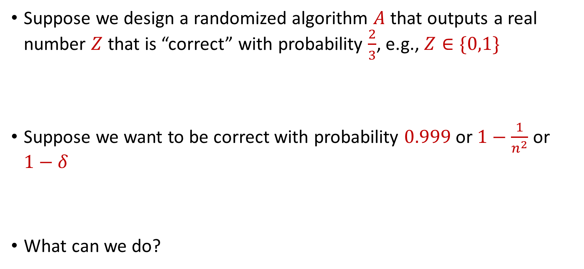
Use Case
Suppose we design a randomized algorithm $A$ that outputs a real number $Z$ that is “correct” with probability $\frac{2}{3}$, e.g., $Z∈\{0,1\}$
Suppose we want to be correct with probability $0.999$ or $1−\frac{1}{n^{2}}$ or $1−δ$
What can we do?

Slide 14

Success Boosting
Chernoff bounds: Run the algorithm $A$ a total of $O\left(\log{\frac{1}{δ}}\right)$ times and take the median. It will be correct with probability $1−δ$

Slide 15

Median-of-Means Framework
Suppose we design a randomized algorithm $A$ to estimate a hidden statistic $Z$ of a dataset and we know $0<Z≤1000$.
Suppose each time we use the algorithm $A$, it outputs a number $X$ such that $E\left[X\right]=Z$ and $Var\left[X\right]=100Z^{2}$
Suppose we want to estimate $Z$ to accuracy $ε$, with probability $1−δ$

Slide 16
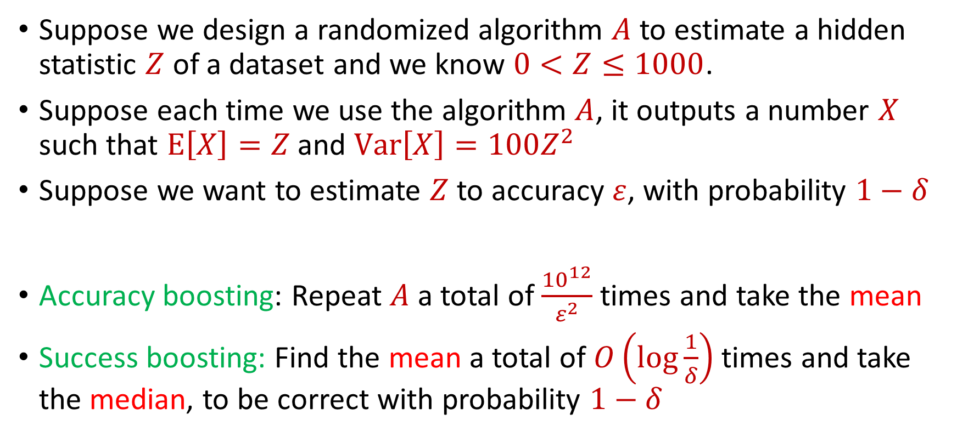
Median-of-Means Framework
Suppose we design a randomized algorithm $A$ to estimate a hidden statistic $Z$ of a dataset and we know $0<Z≤1000$.
Suppose each time we use the algorithm $A$, it outputs a number $X$ such that $E\left[X\right]=Z$ and $Var\left[X\right]=100Z^{2}$
Suppose we want to estimate $Z$ to accuracy $ε$, with probability $1−δ$
Accuracy boosting: Repeat $A$ a total of $\frac{{10}^{12}}{ε^{2}}$ times and take the mean
Success boosting: Find the mean a total of $O\left(\log{\frac{1}{δ}}\right)$ times and take the median, to be correct with probability $1−δ$

Slide 17
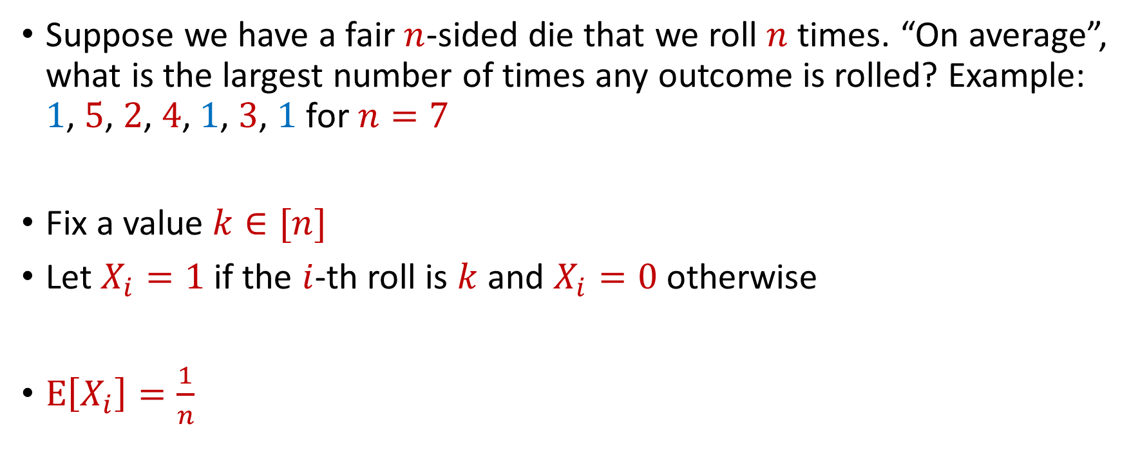
Max Load
Suppose we have a fair $n$-sided die that we roll $n$ times. “On average”, what is the largest number of times any outcome is rolled? Example: $1$, $5$, $2$, $4$, $1$, $3$, $1$ for $n=7$
Fix a value $k∈[n]$
Let $X_{i}=1$ if the $i$-th roll is $k$ and $X_{i}=0$ otherwise
$E\left[X_{i}\right]=\frac{1}{n}$

Slide 18


Max Load
The total number of rolls with value $k$ is $X=X_{1}+…+X_{n}$
$E\left[X\right]=1$
Recall Chernoff bounds:
$Pr\left[X≥3 log{n}\right]≤\frac{1}{n^{2}}$
$$Pr\left[X≥\left(1+δ\right)μ\right]≤2\exp\left(−\frac{δ^{2}μ}{2+δ}\right)$$

Slide 19
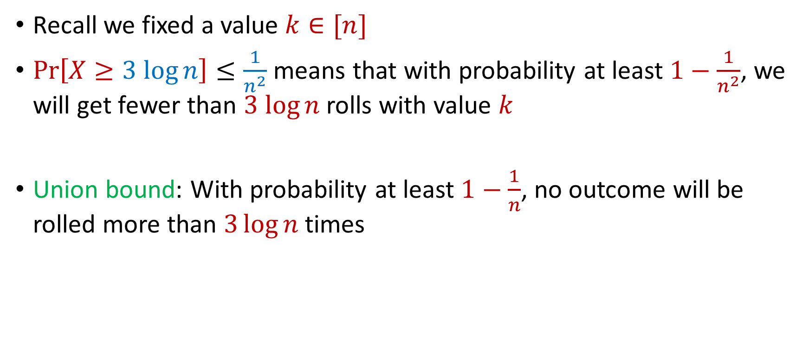
Max Load
Recall we fixed a value $k∈[n]$
$Pr\left[X≥3 log{n}\right]≤\frac{1}{n^{2}}$ means that with probability at least $1−\frac{1}{n^{2}}$, we will get fewer than $3 log{n}$ rolls with value $k$
Union bound: With probability at least $1−\frac{1}{n}$, no outcome will be rolled more than $3\log{n}$ times

Slide 20
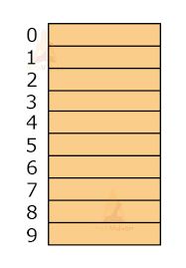

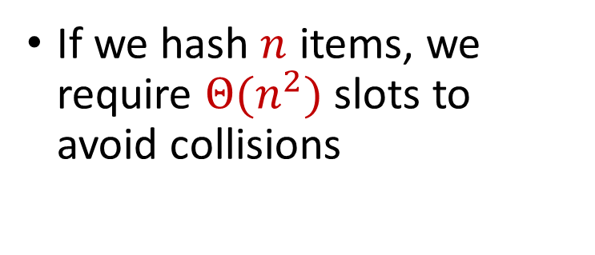
Hashing
Suppose we have a number of files, how do we consistently store them in memory?
$$h\left(x\right)$$
Wenjing Chen
If we hash $n$ items, we require $Θ(n^{2})$ slots to avoid collisions
Chunkai Fu
Ayesha Qamar
Shima Salehi
David Xiang
Shuo Xing

Slide 21

Dealing with Collisions
Suppose we store multiple items in the same location as a linked list
If the maximum number of collisions in a location is $c$, then could traverse a linked list of size $c$ for a query
Query runtime: $O(c)$
$$h(Matthew Chang)$$
$$Jung Seo$$
Matthew Chang

Slide 22
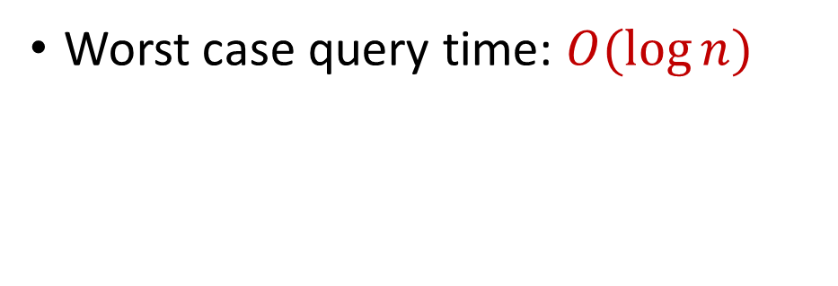
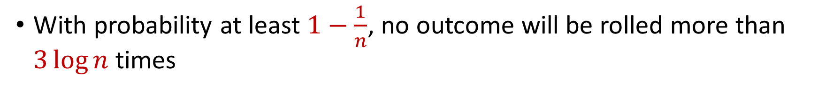

Collisions and Max Load
With probability at least $1−\frac{1}{n}$, no outcome will be rolled more than $3\log{n}$ times
Worst case query time: $O(\log{n})$
$$Jung Seo$$
Matthew Chang

Slide 23

Hashing
For $O(1)$ query time, use $Θ(n^{2})$ slots to avoid collisions
For $O(\log{n})$ query time, use $Θ(n)$ slots with linked lists
$$h\left(x\right)$$
Wenjing Chen
Chunkai Fu
Ayesha Qamar
Shima Salehi
David Xiang
Shuo Xing

Slide 24
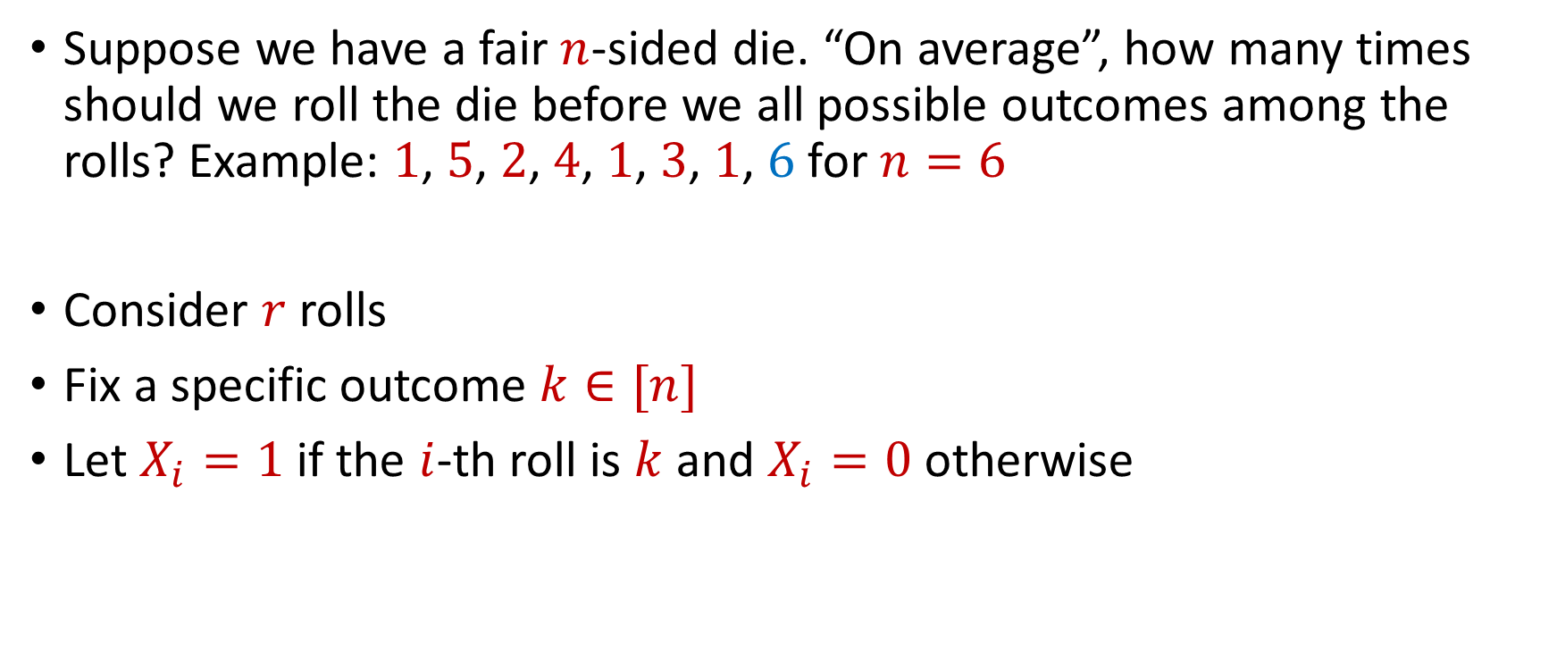
Coupon Collector
Suppose we have a fair $n$-sided die. “On average”, how many times should we roll the die before we all possible outcomes among the rolls? Example: $1$, $5$, $2$, $4$, $1$, $3$, $1$, $6$ for $n=6$
Consider $r$ rolls
Fix a specific outcome $k∈[n]$
Let $X_{i}=1$ if the $i$-th roll is $k$ and $X_{i}=0$ otherwise

Slide 25


Coupon Collector
The total number of rolls with value $k$ is $X=X_{1}+…+X_{r}$
$E\left[X\right]=\frac{r}{n}=6\log{n}$ for $r=6n\log{n}$
Recall Chernoff bounds:
$Pr\left[X≤\log{n}\right]≤\frac{1}{n^{2}}$
$$Pr\left[X≤\left(1−δ\right)μ\right]≤\exp\left(−\frac{δ^{2}μ}{2}\right)$$

Slide 26
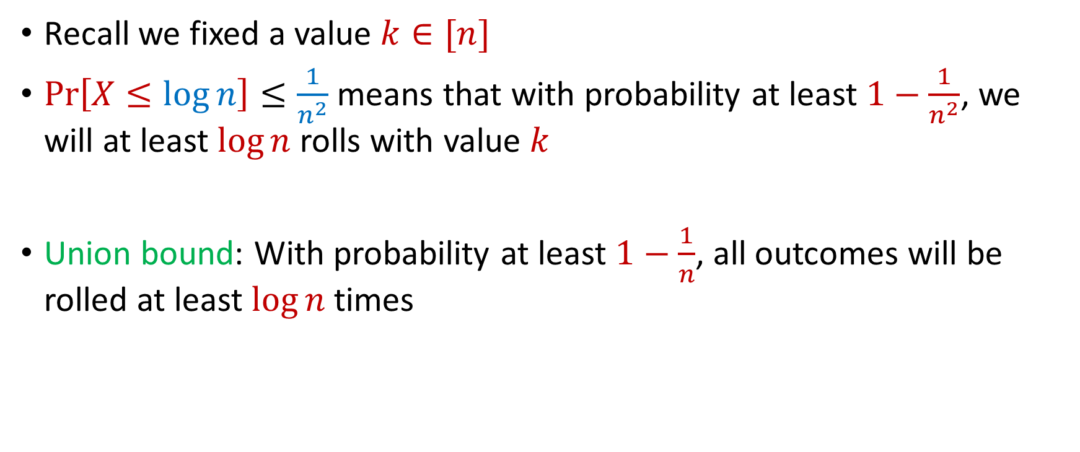
Coupon Collector
Recall we fixed a value $k∈[n]$
$Pr\left[X≤\log{n}\right]≤\frac{1}{n^{2}}$ means that with probability at least $1−\frac{1}{n^{2}}$, we will at least $\log{n}$ rolls with value $k$
Union bound: With probability at least $1−\frac{1}{n}$, all outcomes will be rolled at least $\log{n}$ times

Slide 27
CSCE 689: Special Topics in Modern Algorithms for Data Science
Lecture 7
Samson Zhou

Slide 28
Big Data
Not only many data points, but also many measurements per data point, i.e., very high dimensional data

Slide 29
Big Data
Not only many data points, but also many measurements per data point, i.e., very high dimensional data
Twitter has 450 million active monthly users (as of 2022), records (tens of) thousands of measurements per user: who they follow, who follows them, when they last visited the site, timestamps for specific interactions, how many tweets they have sent, the text of those tweets, etc...

Slide 30
Big Data
Not only many data points, but also many measurements per data point, i.e., very high dimensional data
A 3 minute Youtube clip with a resolution of 500 x 500 pixels at 15 frames/second with 3 color channels is a recording of 2 billion pixel values. Even a 500 x 500 pixel color image has 750, 000 pixel values

Slide 31
Big Data
Not only many data points, but also many measurements per data point, i.e., very high dimensional data
The human genome contains 3 billion+ base pairs. Genetic datasets often contain information on 100s of thousands+ mutations and genetic markers

Slide 32
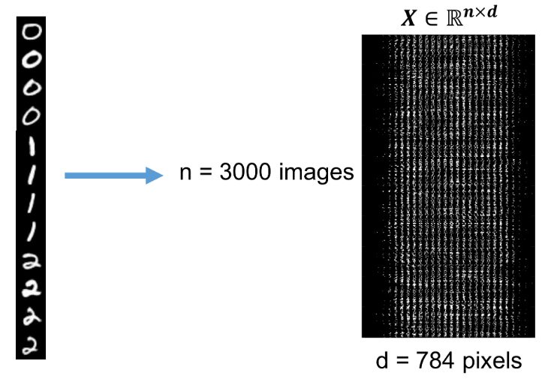
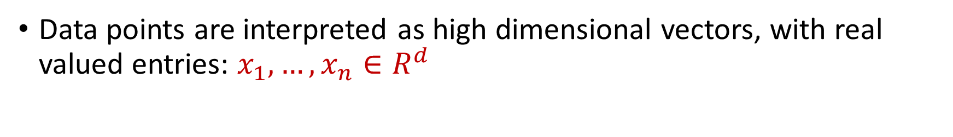

Visualizing Big Data
Data points are interpreted as high dimensional vectors, with real valued entries: $x_{1},…,x_{n}∈R^{d}$
Dataset is interpreted as a matrix: $X∈R^{n×d}$ with $k$-th row $x_{k}$

Slide 33







Dimensionality Reduction
Dimensionality Reduction: Transform the data points so that they have much smaller dimension
Transformation should still capture the key aspects of $x_{1},…,x_{n}$
$x_{1},…,x_{n}$ $∈R^{d}$
$y_{1},…,y_{n}$ $∈R^{m}$
for $m≪d$
$$x_{i}=(0, 1, 0, 0, 1, 0, 1, 1)$$
$$y_{i}=(−1, 2, 1)$$

Slide 34

Low Distortion Embedding
Given $x_{1},…,x_{n}$ $∈R^{d}$, a distance function $D$, and an accuracy parameter $ε>0$, a low-distortion embedding of $x_{1},…,x_{n}$ is a set of points $y_{1},…,y_{n}$, and a distance function $D′$ such that for all $i,j∈[n]$
$$\left(1−ε\right)D\left(x_{i},x_{j}\right)≤D^{′}\left(y_{i},y_{j}\right)≤\left(1+ε\right)D\left(x_{i}, x_{j}\right)$$

Slide 35
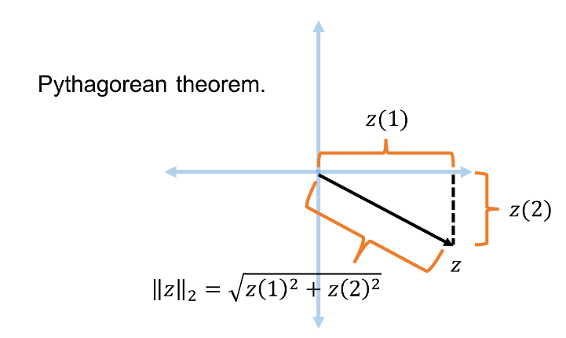


Euclidean Space
For $z$ $∈R^{d}$, the $ℓ_{2}$ norm of $z$ is denoted by ${\left\|z\right\|}_{2}$ and defined as:
$${\left\|z\right\|}_{2}=\sqrt{z_{1}^{2}+z_{2}^{2}+…+z_{d}^{2}}$$

Slide 36

Euclidean Space
For $z$ $∈R^{d}$, the $ℓ_{2}$ norm of $z$ is denoted by ${\left\|z\right\|}_{2}$ and defined as:
$${\left\|z\right\|}_{2}=\sqrt{z_{1}^{2}+z_{2}^{2}+…+z_{d}^{2}}$$
For $x,y$ $∈R^{d}$, the distance function $D$ is denoted by ${\left\|⋅\right\|}_{2}$ and defined as ${\left\|x−y\right\|}_{2}$

Slide 37
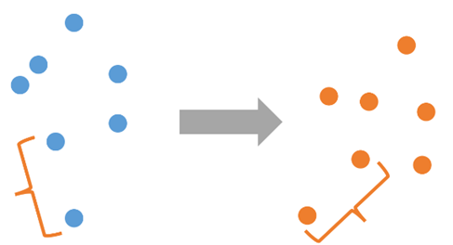

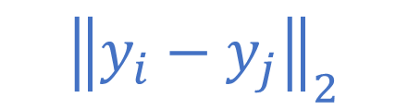
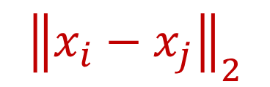
Low Distortion Embedding for Euclidean Space
Given $x_{1},…,x_{n}$ $∈R^{d}$ and an accuracy parameter $ε>0$, a low-distortion embedding of $x_{1},…,x_{n}$ is a set of points $y_{1},…,y_{n}$ such that for all $i,j∈[n]$
$$\left(1−ε\right){\left\|x_{i}−x_{j}\right\|}_{2}≤{\left\|y_{i}−y_{j}\right\|}_{2}≤\left(1+ε\right){\left\|x_{i}−x_{j}\right\|}_{2}$$
$${\left\|x_{i}−x_{j}\right\|}_{2}$$
$${\left\|y_{i}−y_{j}\right\|}_{2}$$

Slide 38
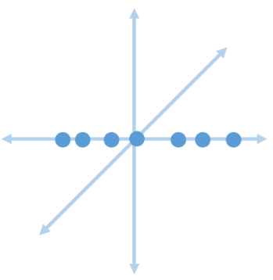
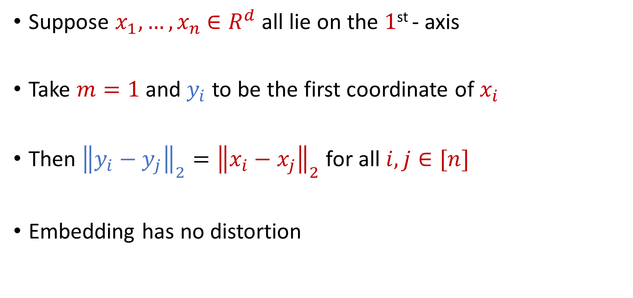
Examples: Embeddings for Euclidean Space
Suppose $x_{1},…,x_{n}$ $∈R^{d}$ all lie on the $1$^{st} - axis
Take $m=1$ and $y_{i}$ to be the first coordinate of $x_{i}$
Then ${\left\|y_{i}−y_{j}\right\|}_{2}={\left\|x_{i}−x_{j}\right\|}_{2}$ for all $i,j∈[n]$
Embedding has no distortion

Slide 39
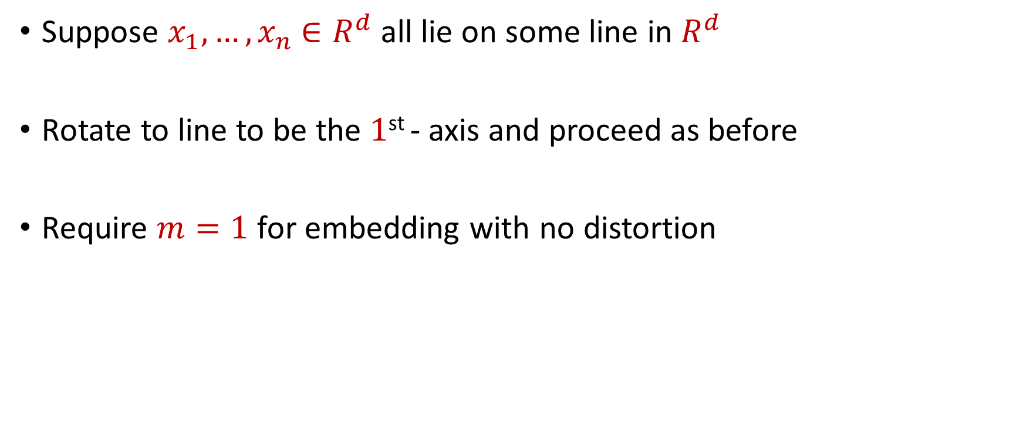
Examples: Embeddings for Euclidean Space
Suppose $x_{1},…,x_{n}$ $∈R^{d}$ all lie on some line in $R^{d}$
Rotate to line to be the $1$^{st} - axis and proceed as before
Require $m=1$ for embedding with no distortion

Slide 40
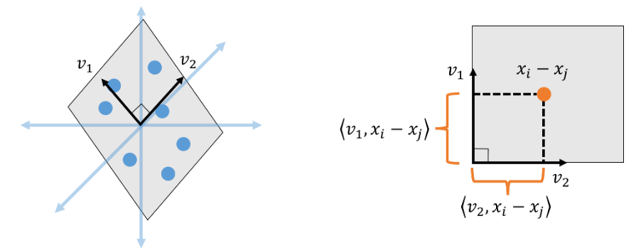
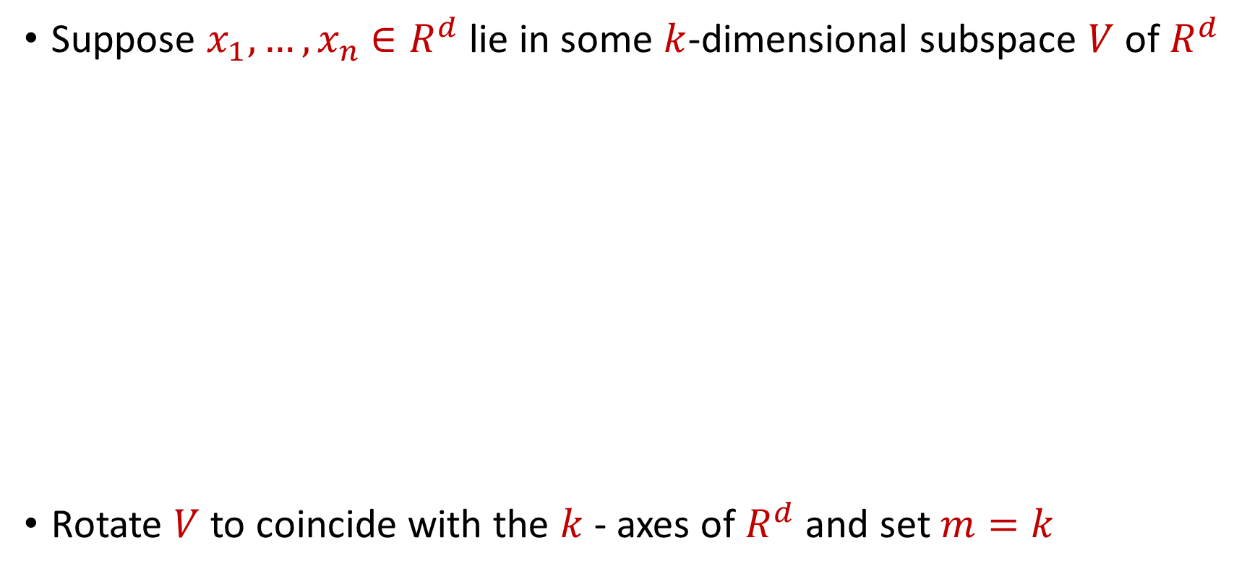
Examples: Embeddings for Euclidean Space
Suppose $x_{1},…,x_{n}$ $∈R^{d}$ lie in some $k$-dimensional subspace $V$ of $R^{d}$
Rotate $V$ to coincide with the $k$- axes of $R^{d}$ and set $m=k$

Slide 41

Embeddings for Euclidean Space
Given $x_{1},…,x_{n}$ $∈R^{d}$ that lie in general position, does there exist an embedding with no distortion?

Slide 42
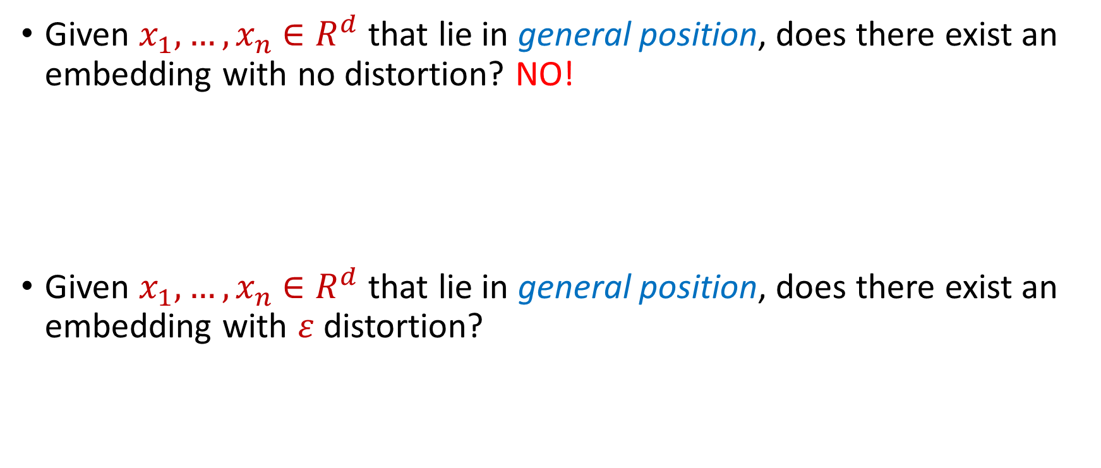
Embeddings for Euclidean Space
Given $x_{1},…,x_{n}$ $∈R^{d}$ that lie in general position, does there exist an embedding with no distortion? NO!
Given $x_{1},…,x_{n}$ $∈R^{d}$ that lie in general position, does there exist an embedding with $ε$ distortion?

Slide 43
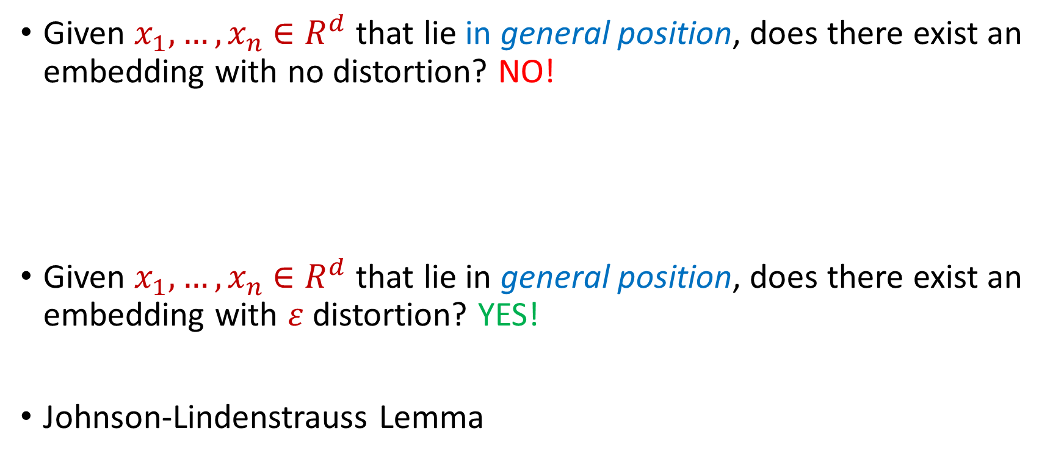
Embeddings for Euclidean Space
Given $x_{1},…,x_{n}$ $∈R^{d}$ that lie in general position, does there exist an embedding with no distortion? NO!
Given $x_{1},…,x_{n}$ $∈R^{d}$ that lie in general position, does there exist an embedding with $ε$ distortion? YES!
Johnson-Lindenstrauss Lemma

Slide 44

Johnson-Lindenstrauss Lemma
Johnson-Lindenstrauss Lemma: Given $x_{1},…,x_{n}$ $∈R^{d}$ and an accuracy parameter $ε>0$, there exists a linear map $Π:R^{d}→R^{m}$ with $m=\left(\frac{\log{n}}{ε^{2}}\right)$ so that if $y_{i}=Πx_{i}$, then for all $i,j∈[n]$:
$$\left(1−ε\right){\left\|x_{i}−x_{j}\right\|}_{2}≤{\left\|y_{i}−y_{j}\right\|}_{2}≤\left(1+ε\right){\left\|x_{i}−x_{j}\right\|}_{2}$$

Slide 45
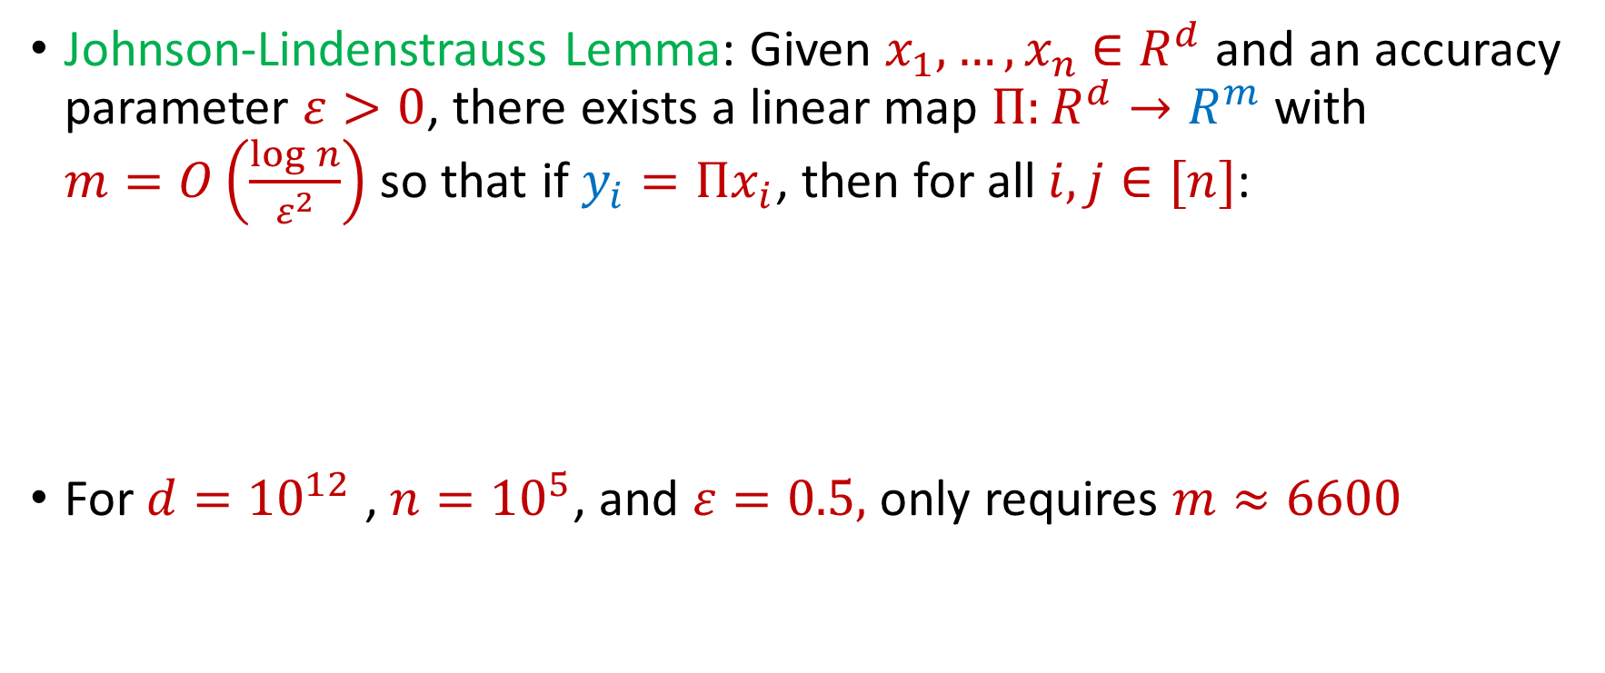
Johnson-Lindenstrauss Lemma
Johnson-Lindenstrauss Lemma: Given $x_{1},…,x_{n}$ $∈R^{d}$ and an accuracy parameter $ε>0$, there exists a linear map $Π:R^{d}→R^{m}$ with $m=O\left(\frac{\log{n}}{ε^{2}}\right)$ so that if $y_{i}=Πx_{i}$, then for all $i,j∈[n]$:
For $d={10}^{12}$ , $n={10}^{5}$, and $ε=0.5,$ only requires $m≈6600$
$$\left(1−ε\right){\left\|x_{i}−x_{j}\right\|}_{2}≤{\left\|y_{i}−y_{j}\right\|}_{2}≤\left(1+ε\right){\left\|x_{i}−x_{j}\right\|}_{2}$$

Slide 46
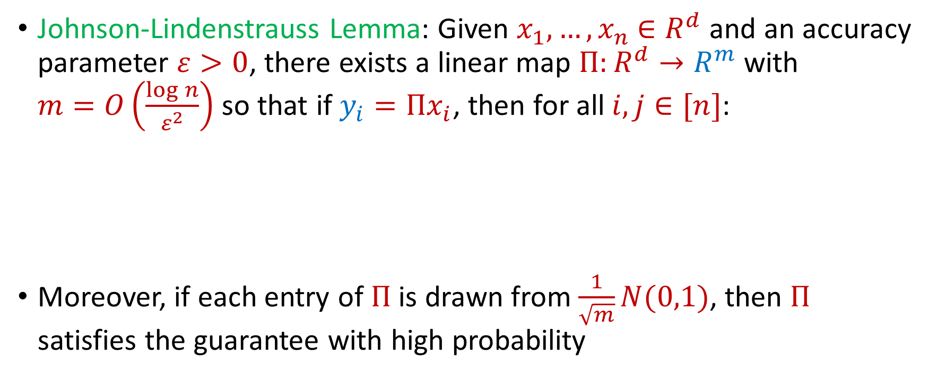
Johnson-Lindenstrauss Lemma
Johnson-Lindenstrauss Lemma: Given $x_{1},…,x_{n}$ $∈R^{d}$ and an accuracy parameter $ε>0$, there exists a linear map $Π:R^{d}→R^{m}$ with $m=O\left(\frac{\log{n}}{ε^{2}}\right)$ so that if $y_{i}=Πx_{i}$, then for all $i,j∈[n]$:
Moreover, if each entry of $Π$ is drawn from $\frac{1}{\sqrt{m}}N(0,1)$, then $Π$ satisfies the guarantee with high probability
$$\left(1−ε\right){\left\|x_{i}−x_{j}\right\|}_{2}≤{\left\|y_{i}−y_{j}\right\|}_{2}≤\left(1+ε\right){\left\|x_{i}−x_{j}\right\|}_{2}$$

Slide 47
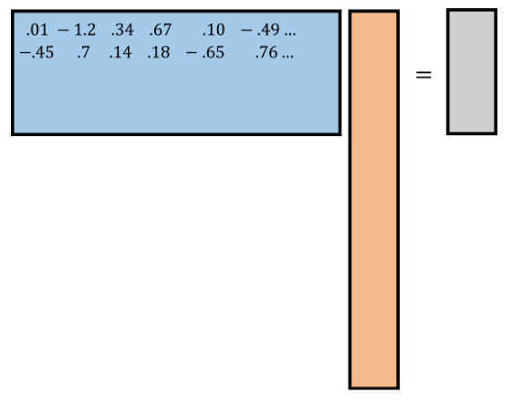
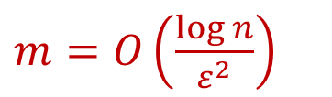







Johnson-Lindenstrauss Lemma
$$R^{m×d}$$
$$R^{d}$$
$$R^{m}$$
Given $x_{1},…,x_{n}$ $∈R^{d}$ and $Π∈R^{m×d}$ with $m=O\left(\frac{\log{n}}{ε^{2}}\right)$ and each entry drawn from $\frac{1}{\sqrt{m}}N\left(0,1\right)$ and setting $y_{i}=Πx_{i}$, then with high probability, for all $i,j∈[n]$:
$Π$ is called a random projection
$$y_{i}$$
$$Π$$
$m=O\left(\frac{\log{n}}{ε^{2}}\right)$
$$x_{i}$$
$$\left(1−ε\right){\left\|x_{i}−x_{j}\right\|}_{2}≤{\left\|y_{i}−y_{j}\right\|}_{2}≤\left(1+ε\right){\left\|x_{i}−x_{j}\right\|}_{2}$$

Slide 48

Johnson-Lindenstrauss Lemma
Johnson-Lindenstrauss Lemma: Given $x_{1},…,x_{n}$ $∈R^{d}$ and an accuracy parameter $ε>0$, there exists a linear map $Π:R^{d}→R^{m}$ with $m=O\left(\frac{\log{n}}{ε^{2}}\right)$ so that if $y_{i}=Πx_{i}$, then for all $i,j∈[n]$:
“Applying a simple random linear transformation to a set of points approximately preserves all pairwise distances”
$$\left(1−ε\right){\left\|x_{i}−x_{j}\right\|}_{2}≤{\left\|y_{i}−y_{j}\right\|}_{2}≤\left(1+ε\right){\left\|x_{i}−x_{j}\right\|}_{2}$$

